Slide 1
Shielding and Background
IKON4, February 2013
Nataliia Cherkashyna, ESS

Slide 2
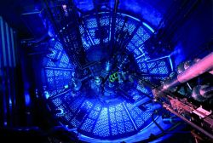
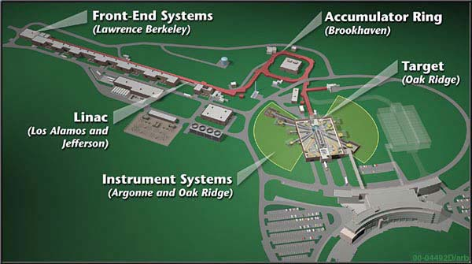
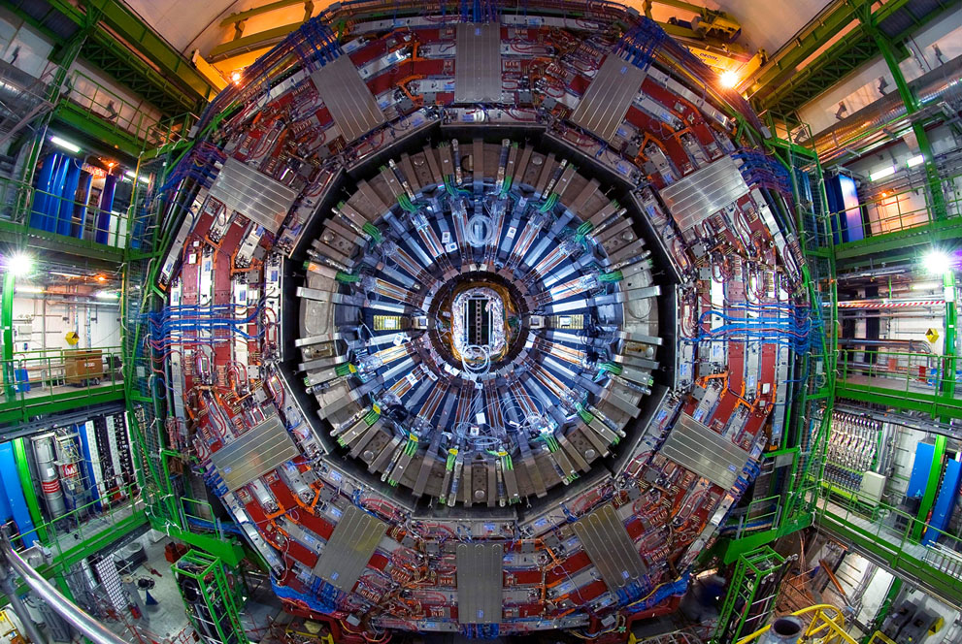
Shielding Requirements
 | Low Energy < 20 MeV | High Energy 20 MeV – 3 GeV
Biological Shielding | Known territory at reactors, low risk | Known territory at spallation sources, low risk
Background Shielding (in particular “Prompt pulse”) | Known territory at both research reactors and spallation sources, low risk | Existing designs at neutron facilities have proved insufficient at high energies, but potentially useful concepts exist in the physics community, e.g. CERN.

Slide 3
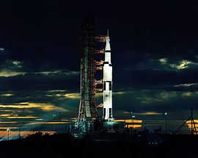
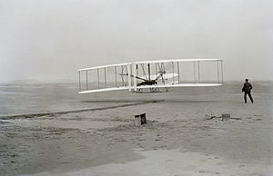
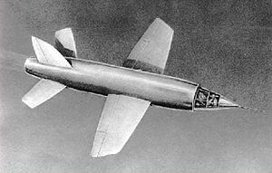
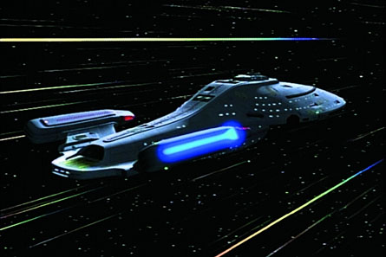
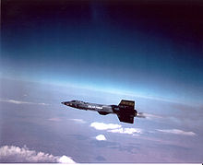
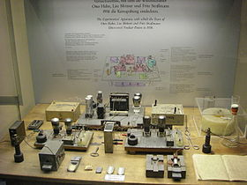
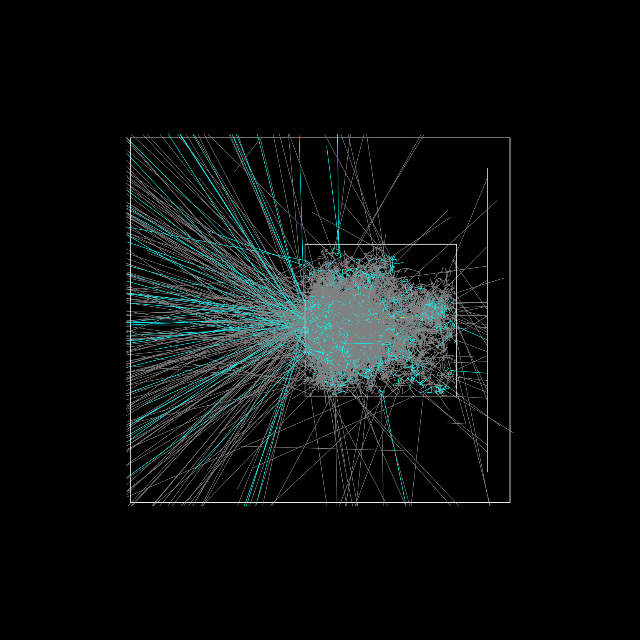
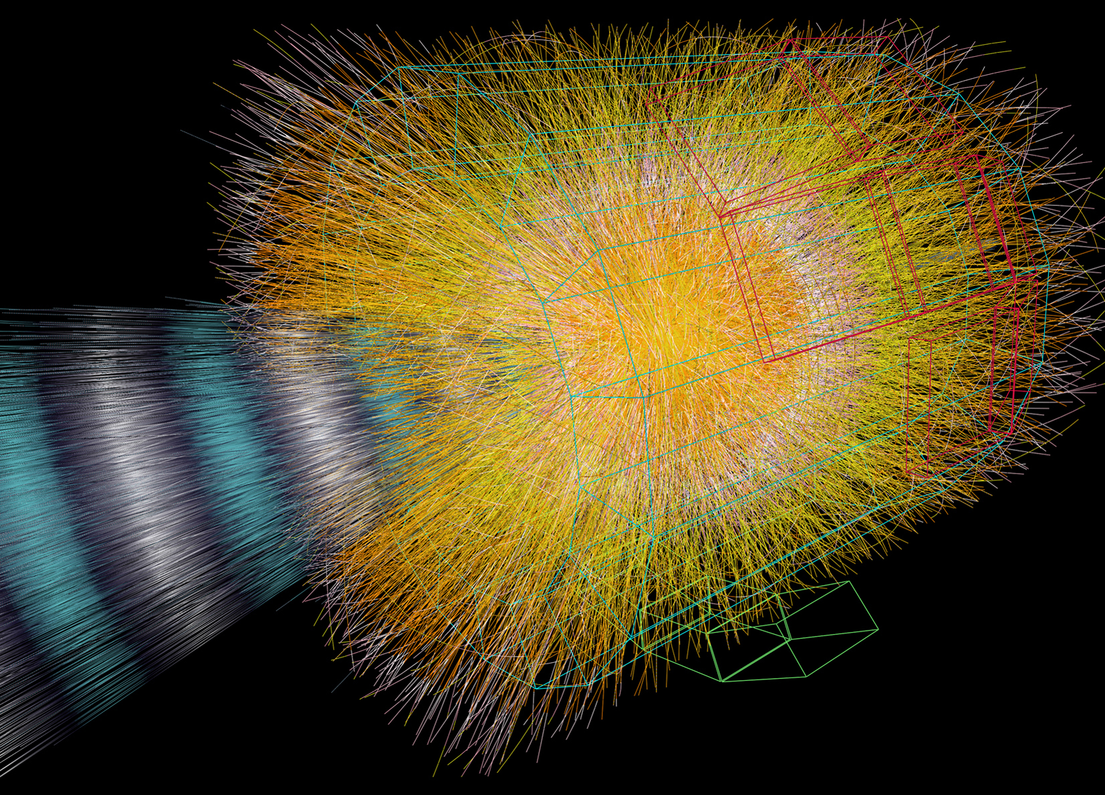
New Thinking Required
Sub-sonic
Supersonic
Space
Warp drive(!)
Fission (<20 MeV)
EM Showers Only
(<GeV)
Hadronic Showers
(>~GeV)
Probing Standard Model
(Tev)

Slide 4

Talk to People
Collaboration with SNS, PSI
Lots of discussions with many groups at ESS
ESS has hired some awesome people

Slide 5
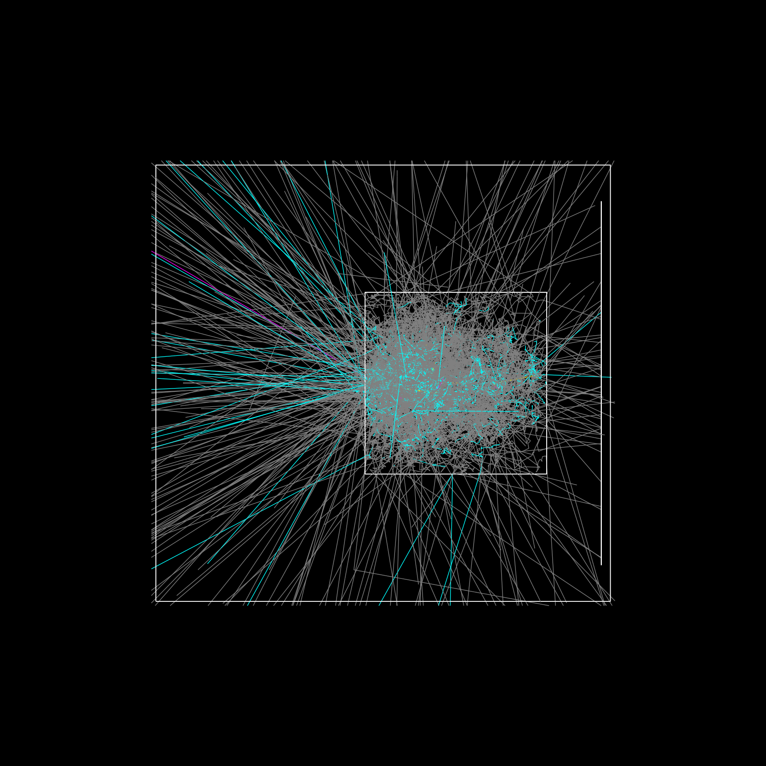
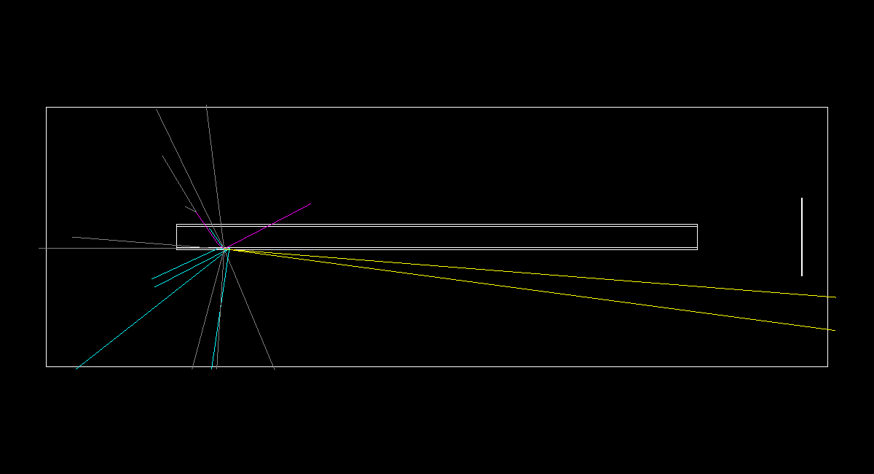
Root Cause of Prompt Pulse
1 m thick Steel Shielding

Slide 6
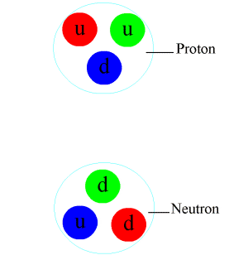
Strong Force

Slide 7
Particle shower
Hadronic
Electromagnetic
nucleons &
other quark-composite particles
Fundamental interactions involved:
strong nuclear
photons, electrons, positrons
Fundamental interactions involved:
electromagnetism

Slide 8
Particle shower
Proton:
Quarks:
=
u
d
Photon:
Neutron:
Gluons:
Charged particles:
=

Slide 9
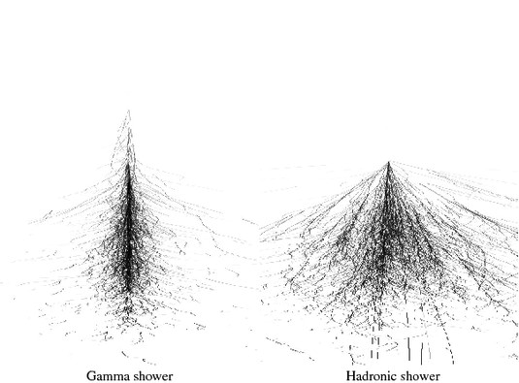
Electromagnetic vs. hadronic showers

Slide 10
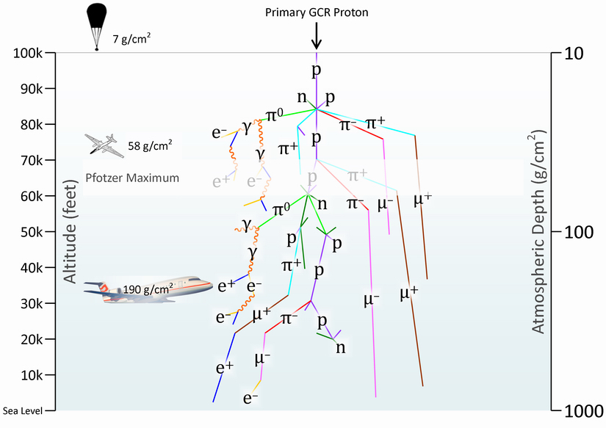
Electromagnetic vs. hadronic showers

Slide 11
General idea

Slide 12
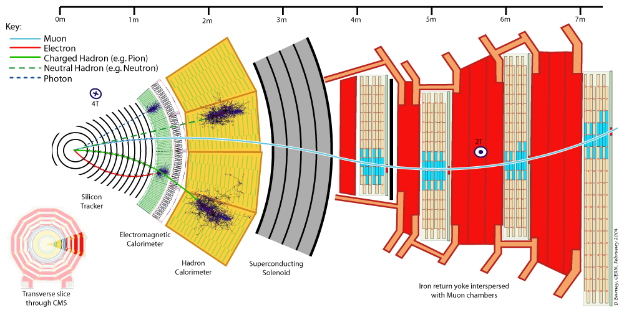
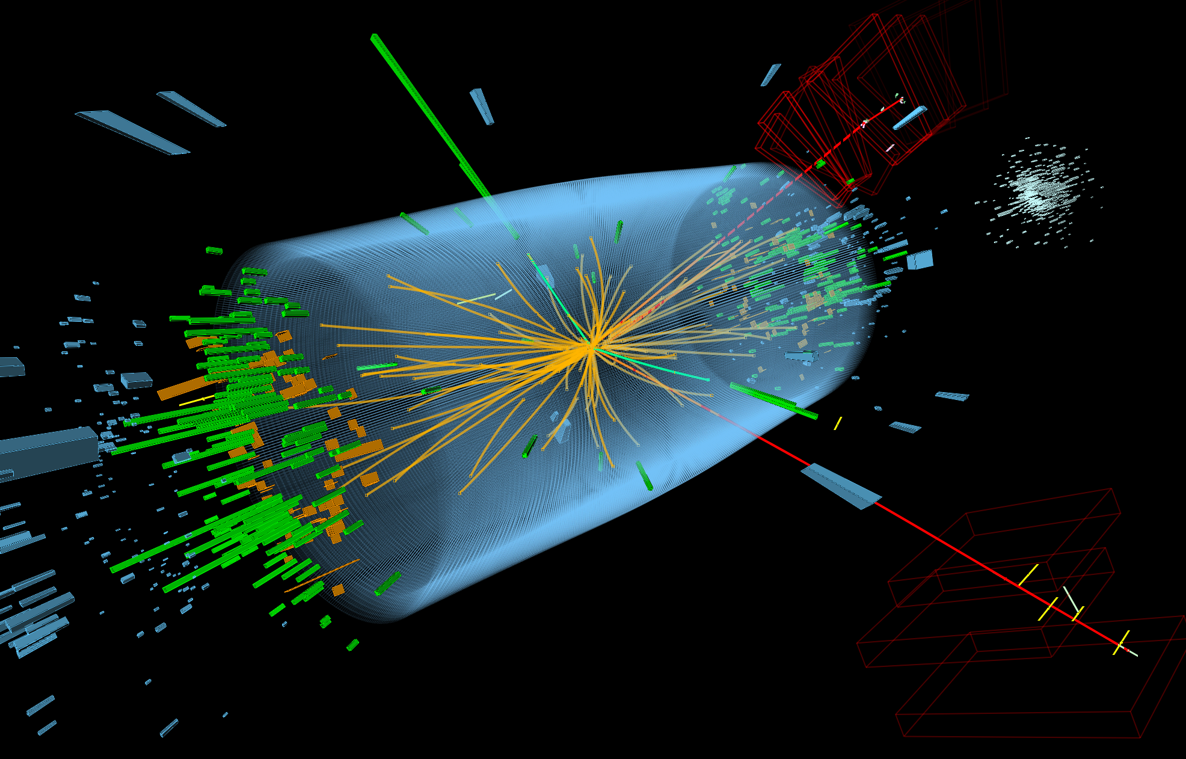
Don’t Panic!
CERN are dealing with TeV neutrons and protons, 1000s times more energetic than ESS!
Hadron calorimeters are only a few metres thick

Slide 13
Current Efforts
With PSI and SNS, we are designing new shielding for spallation sources
We are collaborating on measurements of energetic particle spectra to understand the processes that generate backgrounds
We are using detectors and methods that are used routinely at high energy labs
Much of this has not been done fully at neutron sources

Slide 14
General idea
GEANT4
10. 000 n →
2 GeV
Size:
2m x 2m x Z
Z:
from 0.2m to 3m

Slide 15

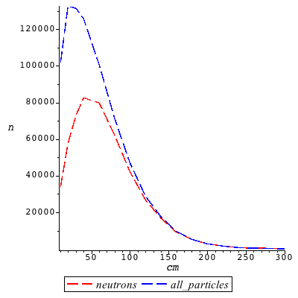
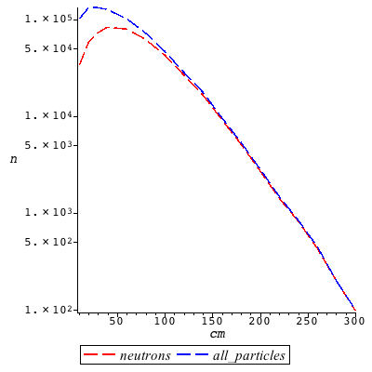
Iron
1m→
neutron, gamma, proton,
e+, pi-, e-, pi+, kaon0, mu-
2m→
neutron, gamma,
e-,proton
3m→
neutron, gamma

Slide 16
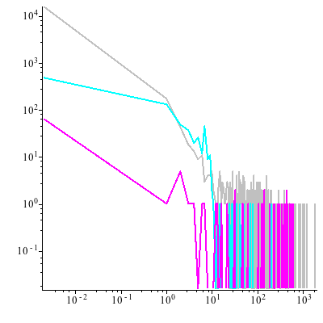
Iron, energy spectra, 140cm
Neutrons
Gammas
Charged particles

Slide 17
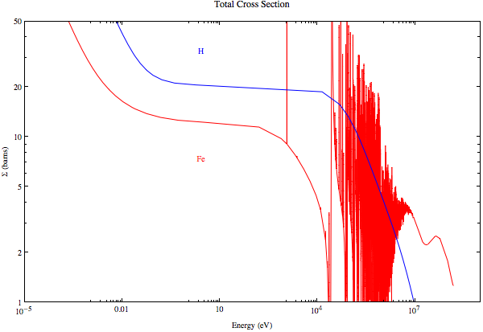
Energy Gaps

Slide 18
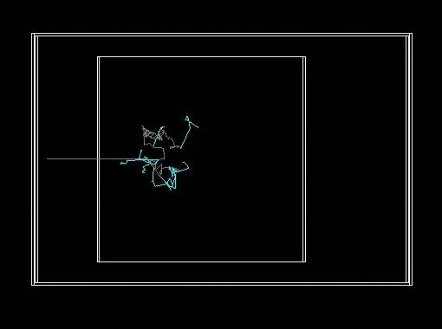
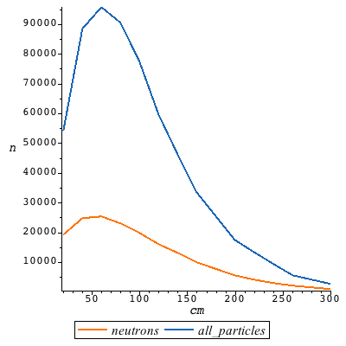
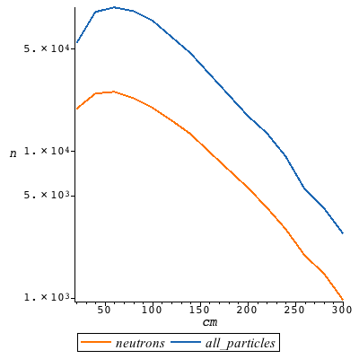
Concrete, 2.3 g/cm³
3m→
gamma, neutron, proton, e-, e+, pi-, pi+, mu-

Slide 19
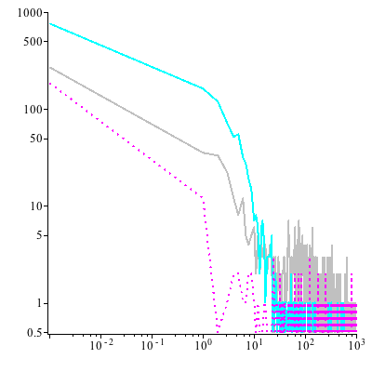
Concrete, energy spectra, 300cm
Neutrons
Gammas
Charged particles

Slide 20

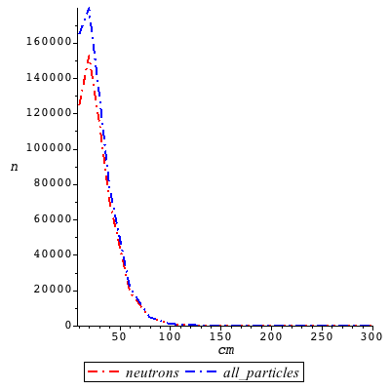
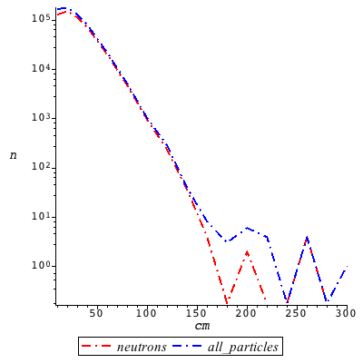
Tungsten
0.8m→
anti_nu_mu, neutron, nu_mu, nu_e, proton, gamma, pi-, e-, anti_nu_e, pi+

Slide 21

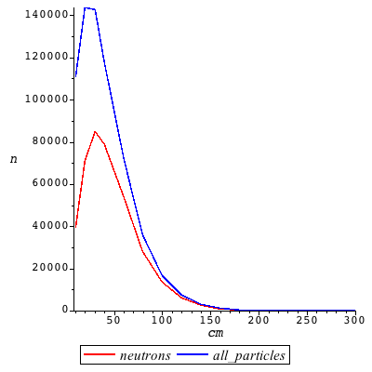
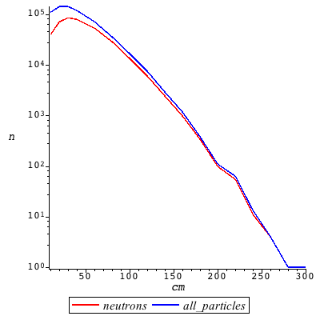
Copper
1m→
neutron, gamma, e-, proton, pi+, pi-, e+

Slide 22
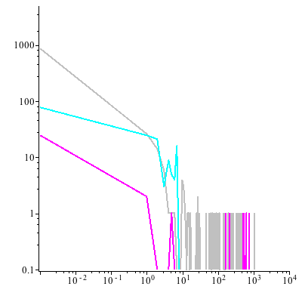
Copper, energy spectra, 160cm
Neutrons
Gammas
Charged particles

Slide 23
Energy Gaps

Slide 24
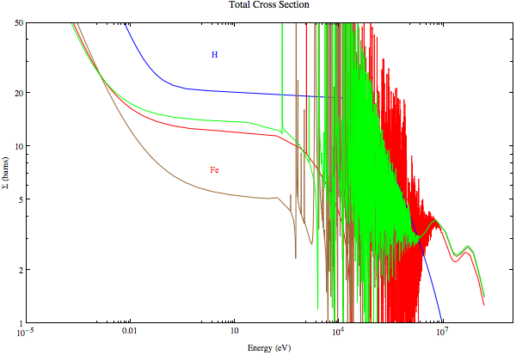
Plugged Energy Gaps

Slide 25
Comparison
Material & width | Neutrons survived | Particles survived
Fe, 3m | 98 (~1%) | 100
Cu, 3m | ~1 (0.01%) | ~1
W, 2.4m | ~0 | ~0
Al, 3m | 5644 (~56%) | 7624
C, 3m | 4186 (~42%) | 10011
Ni, 2.4m | ~1 (0.01%) | ~1
Concrete, 3m | 972 (~10%) | 2737
Graphite, 3m | 1853 (~18%) | 4187
Z₁, 4.4m 3m Fe + 1m Cu + 0.4m W | ~0 | ~0
Z₂, 3.5m 2.5 m Fe + 0.7 m Cu + 0.3m W | ~0 | ~0
Z₃, 3m 2m Fe + 0.7m Cu + 0.3m W | ~0 | 99
Z₄, 3m 2m C + 0.7m Cu + 0.3m W | 217 (~2%) | 511
Z₅, 4m 3m C + 0.7m Cu + 0.3m W | 22 (~0.2%) | 256
Z₆, 3m 1m Fe + 2m Concrete | 33 (0.33%) | 90

Slide 26
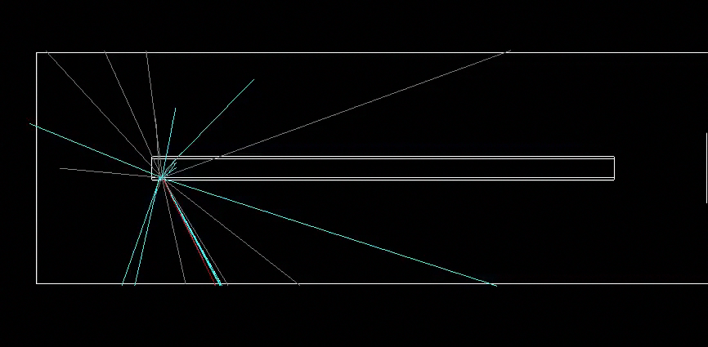
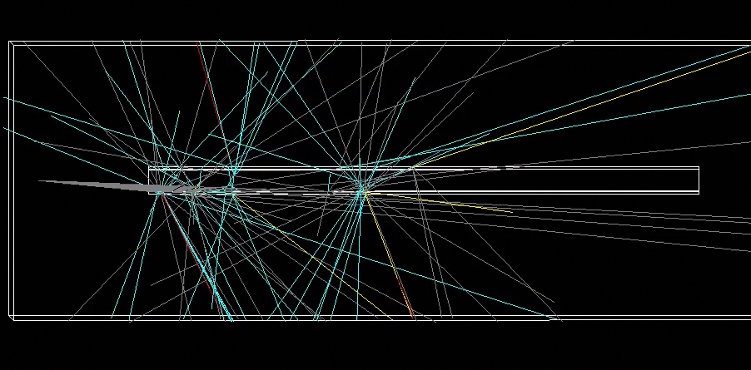
2.5 GeV neutrons
1 n
2m tube of iron
10 n
2m tube of iron

Slide 27
Preliminary conclusions
Steel and concrete are only part of the solution, not the whole solution
The ESS will use a range of materials in a laminate structure
These will include steel, copper, tungsten, polyethylene, lead, borated materials
Not ruling out depleted uranium
Six months from now we should have some nice models
One year from now expect significant progress in this subject from modelling and measurements

Slide 28
Acknowledgements
Uwe Filges (PSI)
Pascale Deen (ESS)
Robert Connatser (ESS)
Kalliopi Kanaki (ESS)
Richard Hall-Wilton (ESS)
Thomas Kittelmann (ESS)
Ken Herwig (SNS)
Barry Winn (SNS)
Georg Ehlers (SNS)
Geoffrey Greene (SNS)
Esben Klinkby (DTU Copenhagen)
Luca Zanini (ESS)
Konstantin Batkov (ESS)
Tom Shea (ESS)
Notes:
This just one part. Have to design the whole system. Big thanks to the postdocs in neutron technology group.
Big thanks to ESS management, SNS and PSI for supporting this project.

Slide 29
Thanks for your attention!

