Slide 1

DMSC-Detector Group Interface
DMSC-DG Meeting
9th May 2017
Steven Alcock (DG)

Slide 2
Agenda
Target Architecture Overview
Basic Networking (and the role of the FPGA)
Proposed Stack Implementation
The Merits of a Switch

Slide 3
Target Architecture
FPGA Master:
  Aggregates data from upstream detector hardware,
  Packetises data,
  Forwards to NIC in DMSC server.
Assume more than one Master, and more than one NIC.
Switch is optional!
FPGA Master 1
FPGA Master 2
Switch
Diagnostic Server
DMSC Server 1
DMSC Server 2
Notes:
Powerful FPGA Master concentrates all data from upstream detector hardware, and sends to a NIC in a server, possibly via a switch.
May use a single switch for multiple instruments, and may service multiple NICs.

Slide 4
Protocol Stack - Overview
Application Layer (Instrument Data)
Transport Layer (TCP/UDP)
Network Layer (IP)
Link Layer (Ethernet)
Physical Layer (Copper/Fibre)
Notes:
TCP/IP is the standard for Internet communications, and is a de-facto standard for similar networks.
Stack provides a useful service-based abstraction model for describing networks.
Some or all layers may be different depending on application.
In the case of TCP/IP, the technology is widely understood and available.

Slide 5
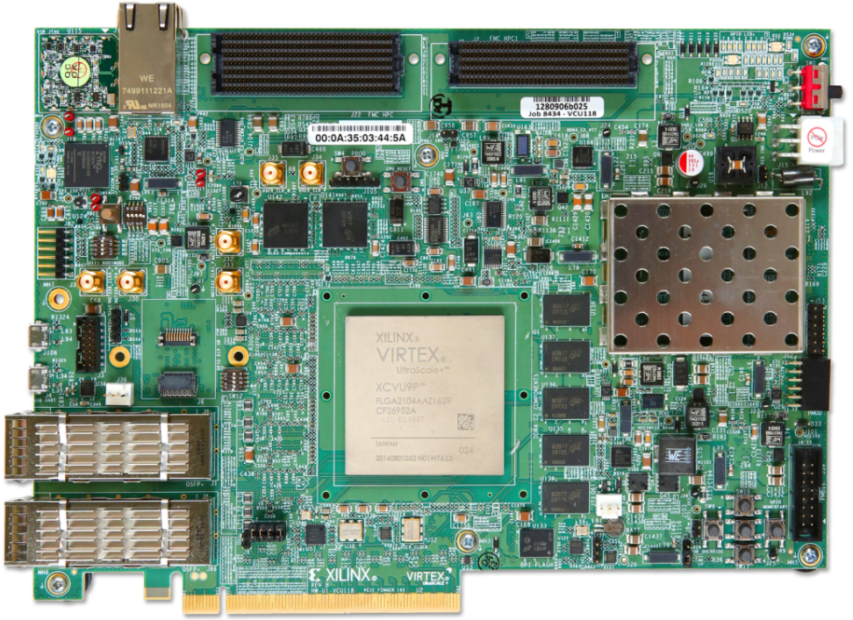
Protocol Stack – Physical Layer
Responsible for moving bits from source to destination.
Expect to use commercial fibre/copper cables
FPGA achieves mechanical connectivity via standard QSFP+ cages.
Common to have “hardened” silicon to handle remaining PHY
functionality (such as scrambling, coding, clock recovery and deskew).
Multi-Gigabit Transceivers deserialise signals and clock them into FPGA user-logic.
RJ45 (1000 BaseT)
QSFP+ (100 GbE)

Slide 6
Protocol Stack – Data Link Layer
Responsible for moving frames between devices on a common LAN.
MAC sublayer typically implemented in FPGA logic, BUT this is non-trivial for high data
rates (> 1 Gbps).
Standard practice to buy a “logic core”.
Latest VCU118 FPGA avoids this by including, for free, a hardened PHY/MAC core for
100 G applications.
Future-proofs design.
Notes:
100 G is cheaper (in terms of money) than eg 10 or 40 G, because the PHY/MAC functionality is included in the FPGA.

Slide 7
Protocol Stack – Network Layer
Responsible for moving packets across a network of separate LANs – implies routing.
Full implementation not well suited to FPGAs:
  Trivial to implement basic header functionality
  More difficult to implement associated functionality such as ARP, DHCP.
All our nodes are on the same LAN – no need for the IP layer?

Slide 8
Protocol Stack – Transport Layer
Responsible for reliably moving packets across a network of separate LANs.
TCP is not well suited to FPGAs:
  Stateful retransmission of packets requires potentially extensive buffering
  and control logic.
  For low rates, common practice to instantiate a hard or soft microprocessor,
  although commercial logic cores do exist.
Generally, UDP is used instead.
  Lightweight protocol that doesn’t gain us much?
Source Port | Destination Port | Length | Checksum

Slide 9
Protocol Stack - Conclusion
Run our own custom protocol over raw Ethernet at 100 G.
Application Layer (Custom Protocol)
Link Layer (100 G Ethernet)
Physical Layer (Fibre)

Slide 10
Frame Size
Lower protocol overhead and lots of spare bandwidth:
  Jumbo frames not essential for throughput.
Standard frames (marginally) reduce buffering requirements on FPGA:
  RAMs instantiated in 4500- or 2250-byte blocks
The figures below do NOT account for Instrument Protocol overhead, as this is to
be finalised. The actual efficiency, in terms of digitised samples, will be lower.
Frame Type | L1 Overhead | L2 Overhead | MTU | Total | Efficiency
Standard | 20 | 18 | 1500 | 1538 | 97.5%
Jumbo | 20 | 18 | 9000 | 9038 | 99.6%
Notes:
L1 Overhead: preamble (8 bytes), inter-packet gap (12 bytes)
L2 Overhead: 6-byte destination MAC address, 6-byte source MAC address, 2-byte EtherType, 4-byte CRC

Slide 11
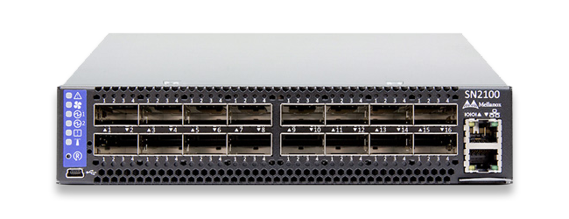
Optional Switch – MSN2100
Rate Conversion:
  100 G to 56/40/25/10 G
“Load Balancing”:
  Redistribute single input port across multiple output ports
Diagnostics:
  Duplicate input port on multiple output ports
Low Cost:
  About 5000 USD
Notes:
Good relationship with Mellanox due to prior projects at RAL and close proximity to Daresbury.
Testing is under way.

Slide 12
Questions
What EtherType should we use in the frame header?
Are there any compelling reasons to use IP/UDP?
Anything else?

