Slide 1
Data Acquisition and Monitoring for
Detector Development
Morten Jagd Christensen
www.europeanspallationsource.se
9 May 2017

Slide 2
Architecture

Slide 3
System overview
Two data streams per instrument
  Detector Data / EPICS Data
Event Formation processes Detector data
Events are streamed to Aggregator (kafka) for later filewriting to persistent storage

Slide 4
System overview

Slide 5
Event Formation Unit (EFU)
One EFU per detector panel
Direct fiber connection (10G)
EFU is pure multi core software processing (if possible)
Switched Ethernet on the output side

Slide 6
EFU Pipeline and Stages

Slide 7
EFU Pipeline and Stages
input
distributor
distribute data to multiple processing cores (load balancing)
validator
detect invalid data (crc errors, etc.)

Slide 8
EFU Pipeline and Stages
input
distributor
distribute data to multiple processing cores (load balancing)
validator
detect invalid data (crc errors, etc.)
processing
collection
pick up data until enough to process
rejection
reject data (noise, artifacts, simultaneous, ...)
clustering
determine a dataset suitable for event calculation
event calculation
generate <time, detector pixel id> tuple

Slide 9
EFU Pipeline and Stages
input
distributor
distribute data to multiple processing cores (load balancing)
validator
detect invalid data (crc errors, etc.)
processing
collection
pick up data until enough to process
rejection
reject data (noise, artifacts, simultaneous, ...)
clustering
determine a dataset suitable for event calculation
event calculation
generate <time, detector pixel id> tuple
output
serialization
convert data structures to buffers for transmission
sorting
sort data by time or pixel id
producer
transmit data to Kafka cluster

Slide 10
Pipeline SW Architecture
Prototype Pipeline Process v2
Ethernet RingBuffer <9000> (length)
Lockless FIFO <unsigned int, length>
Event RingBuffer <12> (length)
Lockless FIFO <unsigned int, length>
pthread
pthread
pthread
input
processing
output
UDP
TCP
input thread writes data to buffers by socket receive()
processing thread reads data from RingBuffer, writes (event) data to event RingBuffer
output thread reads (event) data from RingBuffer and appends to Kafka transmit buffer. Sends when full.
No dynamic allocation of memory, no mutexes, small data structures, minimal copying.

Slide 11
Application Interfaces

Slide 12
Processes, plugins and pipelines
EFU is a single Linux/Mac process with pthreads
Detectors are loadable modules
Contains the input, processing and output functions

Slide 13
EFU Connectivity
servers
user interaction
broker_ip:9092
Detector
Data
UDP
TCP
Kafka
Broker
input
processing
efu_ip:9000
output
Command
Client
TCP
efu server
TCP
Graphite
db
Grafana
Live
Metrics
efu_ip:8888
graphite_ip:2003
grafana_ip:3000
TCP
Greylog
file system
config .json
calibration
data
greylog_ip:12201

Slide 14
Gd-GEM VMM SRS Readout

Slide 15

Gd-GEM VMM SRS Readout
Analog/Electric
Domain
Digital HW Domain
Network Data Domain
Data Aggregation Domain
EFU
Events
Gd-GEM Detector
FE Hybr.
FEC
Input
Proc.
Output
Histograms (x,y)
Particle tracks (x,y)
File System Domain
Decoded data dump

Slide 16
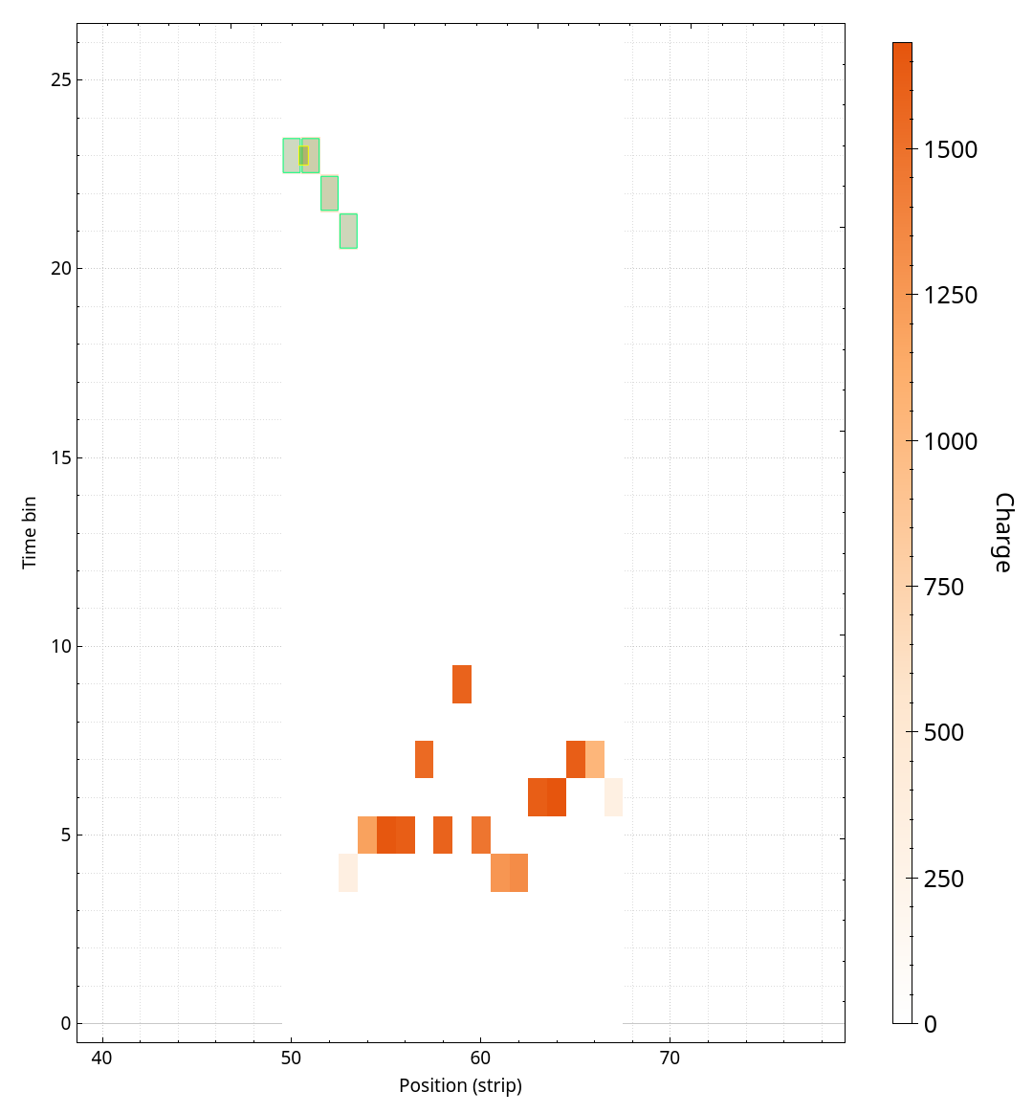
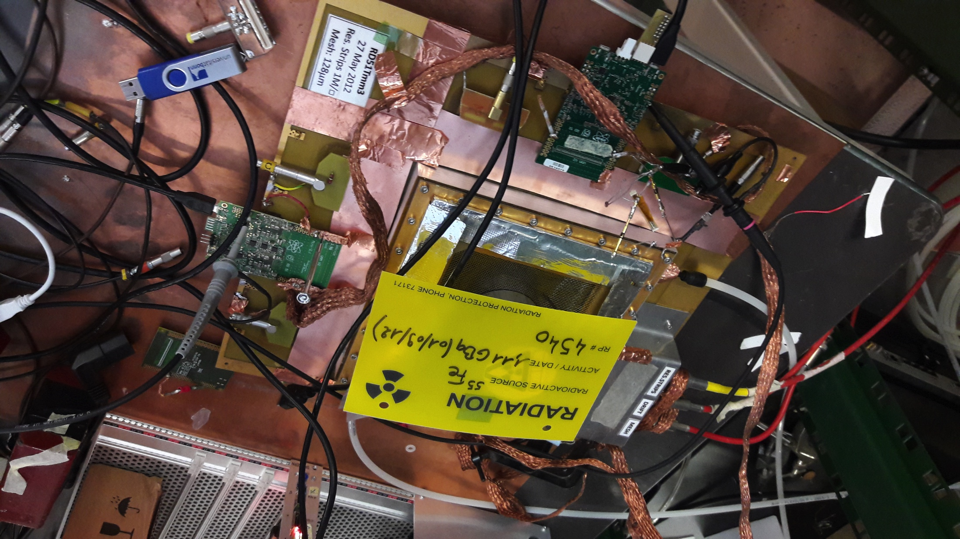


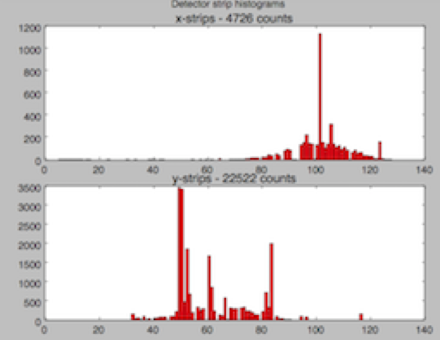
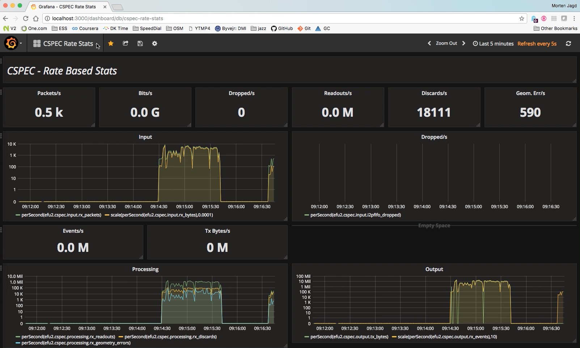
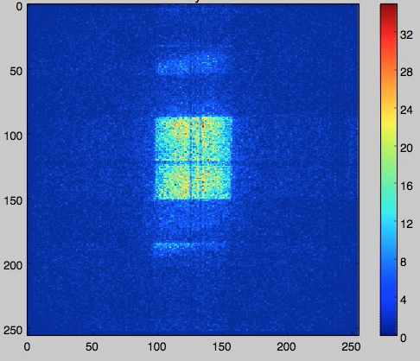
Live Data Monitoring
Detector
Live Monitor
Detector and readout
Event formation
Aggregation
RD-51 SRS
Gd-GEM
Application Monitoring

Slide 17
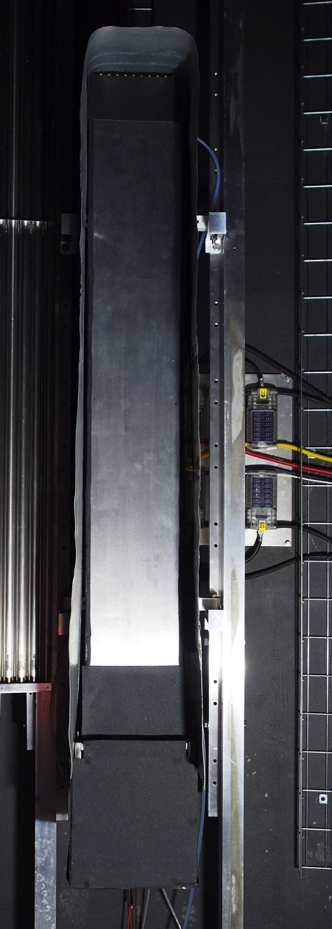
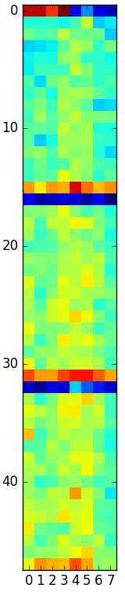
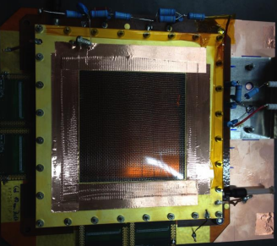
Delayed ‘Live’ Data Monitoring
Detector
Live Monitor
Detector and readout
Event formation
Aggregation
Multi Grid
~210.000 raw files
~500M Events
NFS Storage
Raw data streamer
Application Monitoring
Gd-GEM
HDF5 files

Slide 18
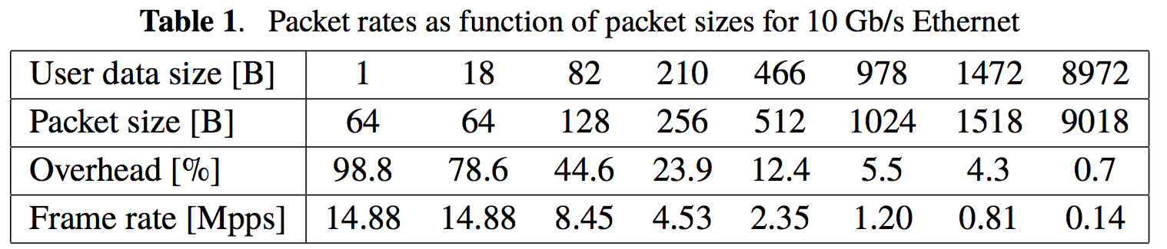
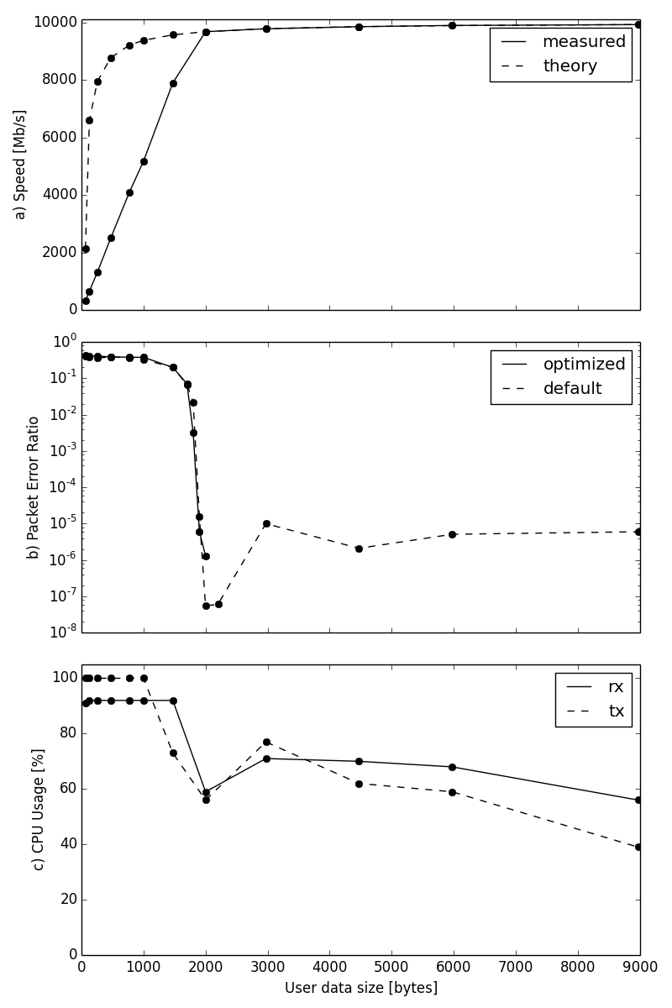
Packet sizes and data rates
78 M Evts/s
@ 128 bit

Slide 19
Wish list

Slide 20
Packet sizes
  Jumbo frames, pref. 9KB
No implicit data interpretation
  VMM id, FEC#, etc. should be in the packets
Data integrity
  sequence numbers
Efficient encoding
  (VMM2 horror story)
In-band control and config. protocol
  Time units for tdc values
  geometry remappings
  thresholds
  occational counters
Addressing flexibility
  Unicast, multicast
  sequential sender addresses (or ports) (within a range)

Slide 21
Summary

Slide 22
The End

