Slide 1
Event formation processing
(mostly NMX)
Martin Shetty
www.europeanspallationsource.se
9 May 2017

Slide 2
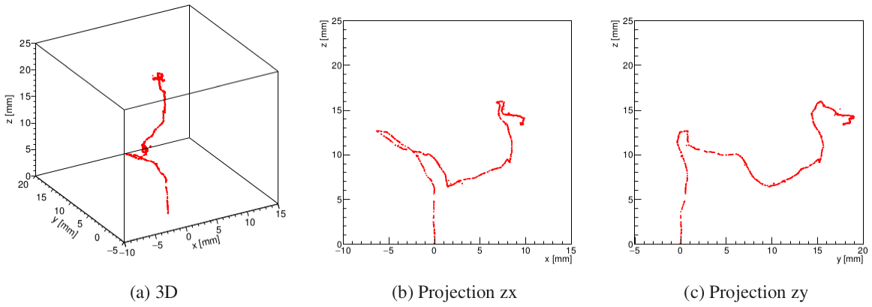
Worst case: NMX
Cluster and correlate
Analyze 3d track
Recognize bad events

Slide 3
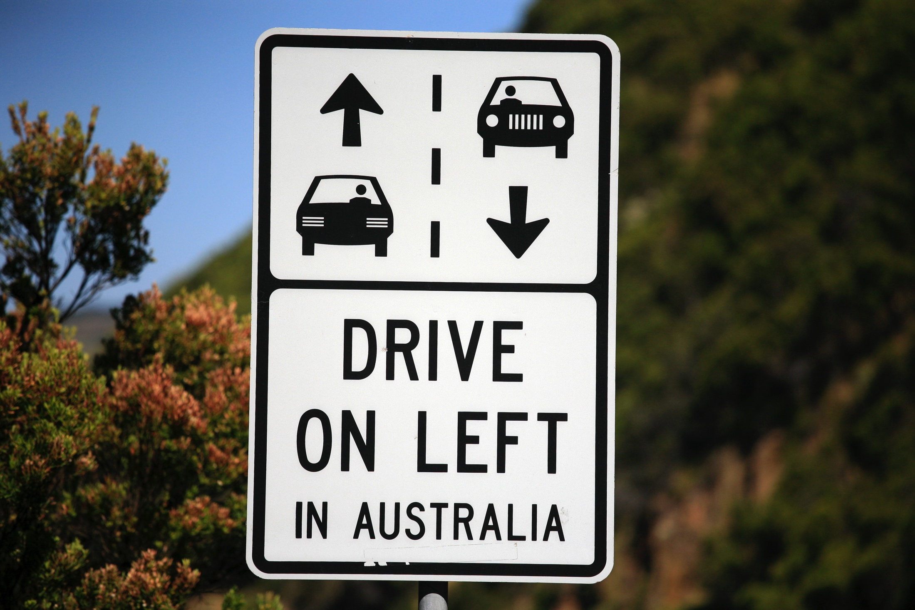

Slide 4
Track analysis
Find entry point (if possible)
Recognize bifurcation or curvature
Accept / reject?

Slide 5
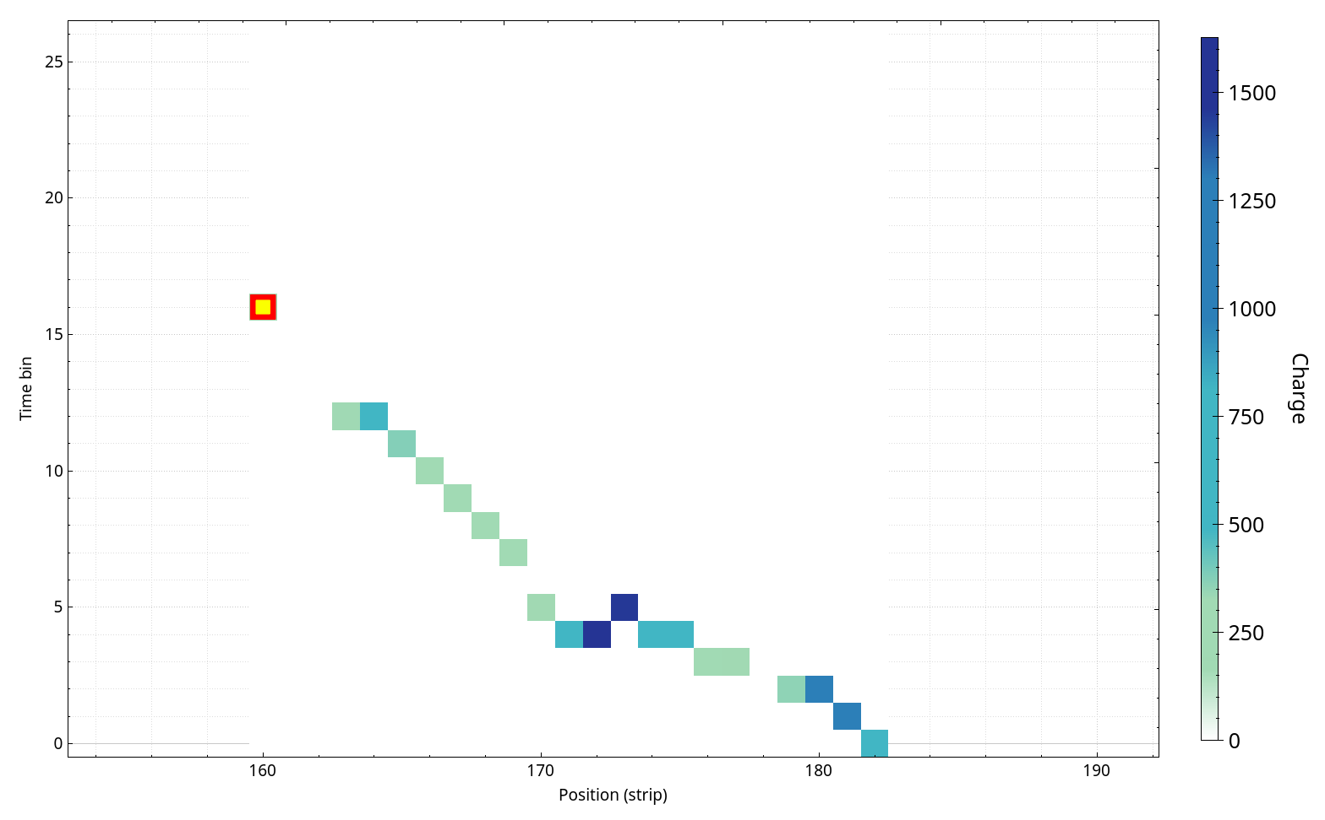
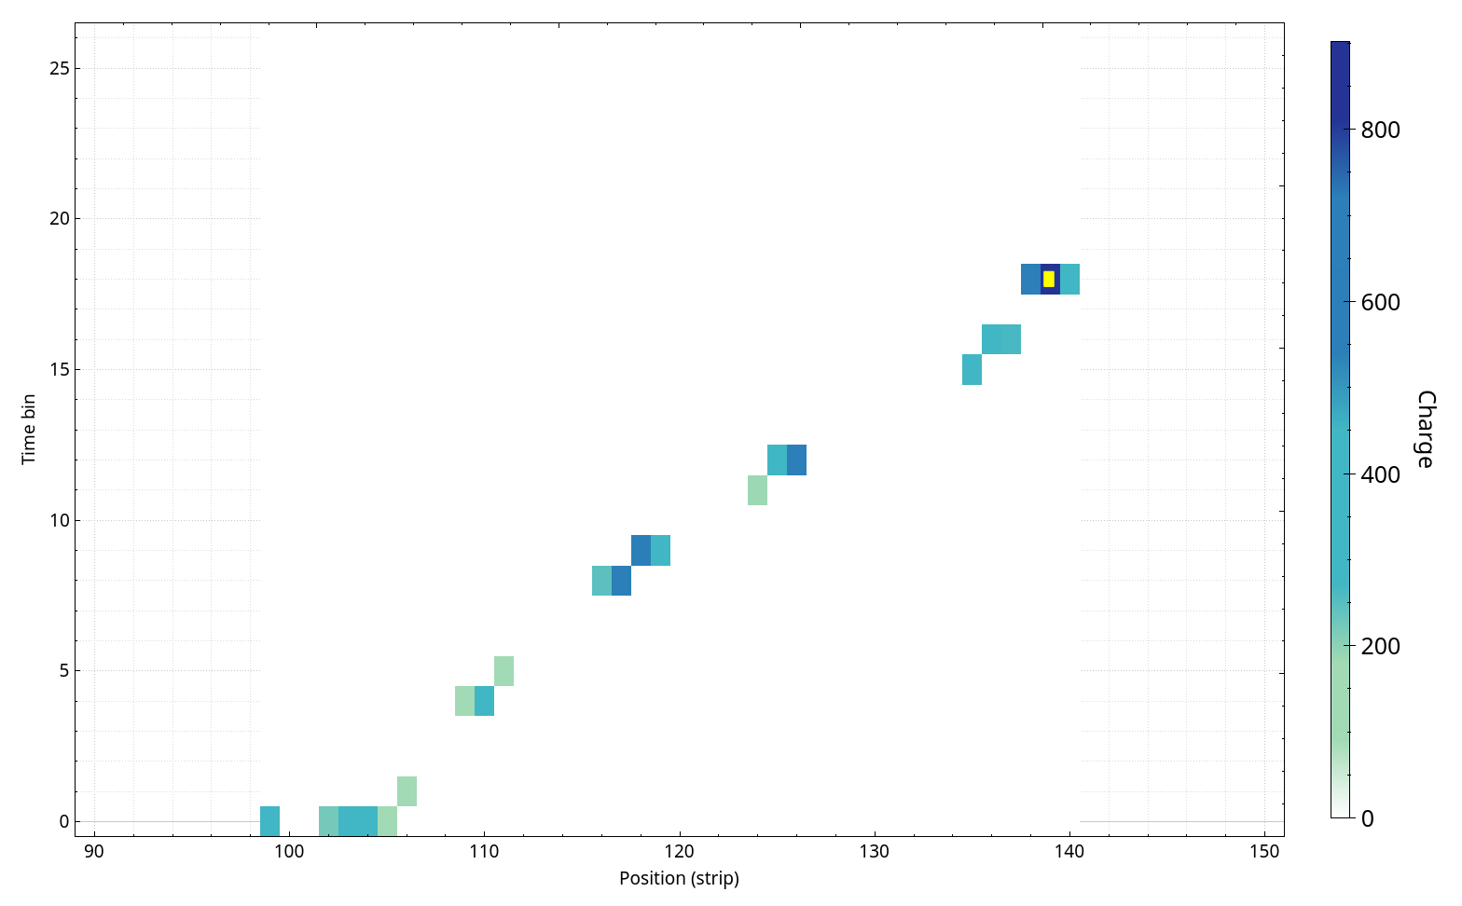
Track analysis
VMM data should be (something) like this
uTPC: find latest point
If more than one latest point:
  Average
  ADC-weighted average

Slide 6
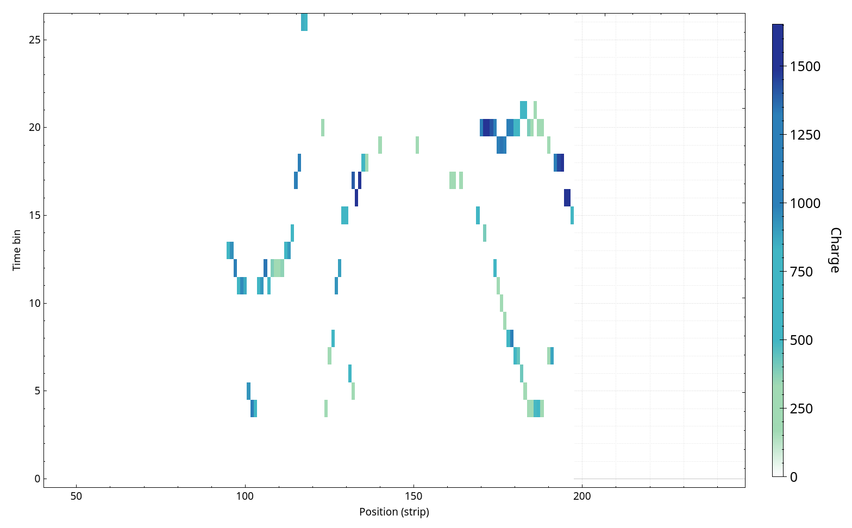
WTF?
Many defy discrete categorization
Indicators of misbehaviour:
  Twists and turns
  Discontinuous
  Ambiguity in later timepoints
  Mismatch in time of entry
  Energy?

Slide 7
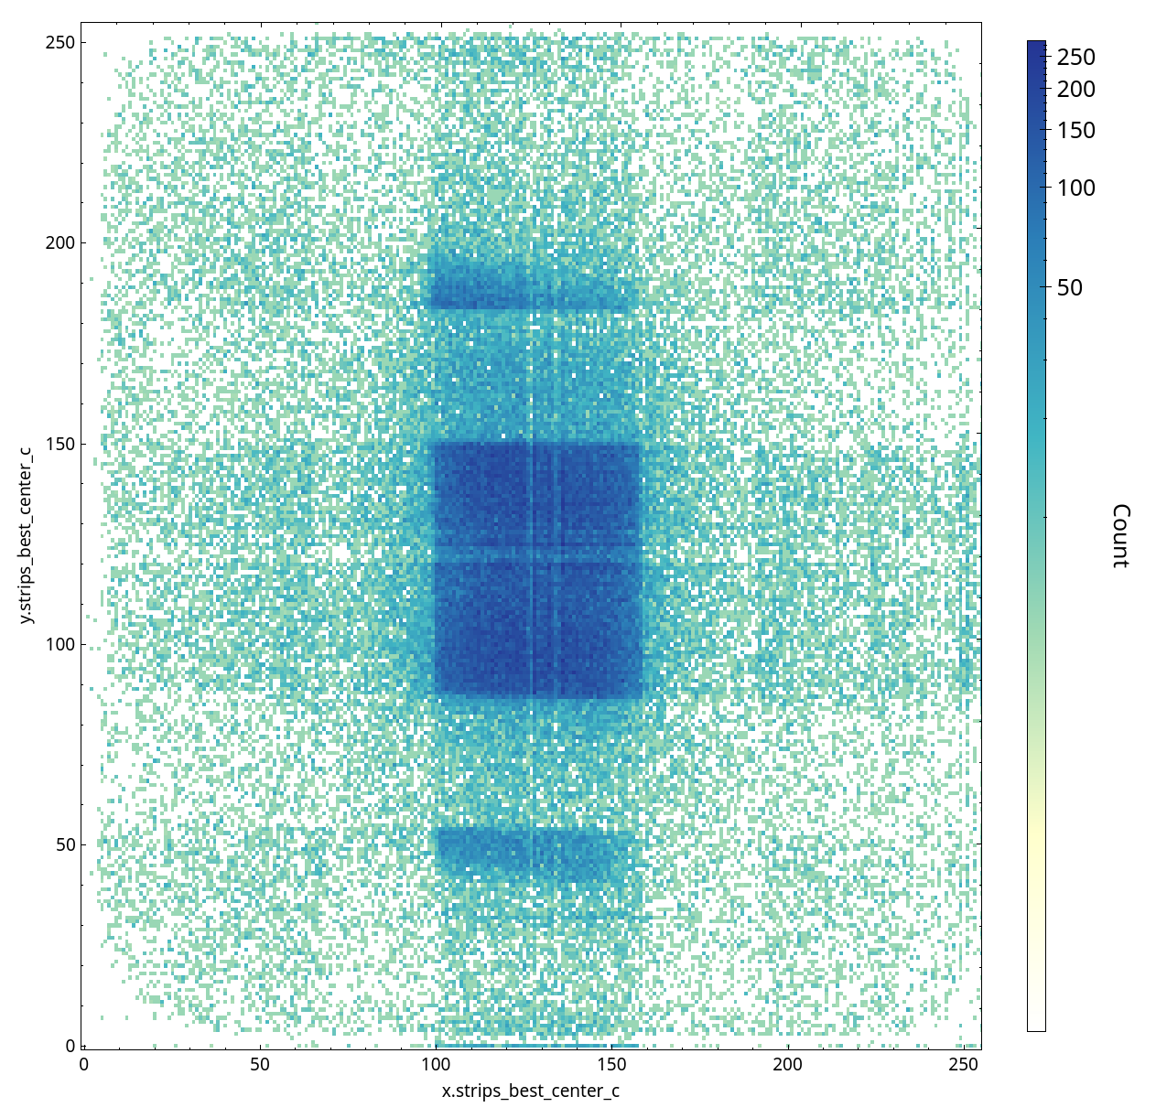
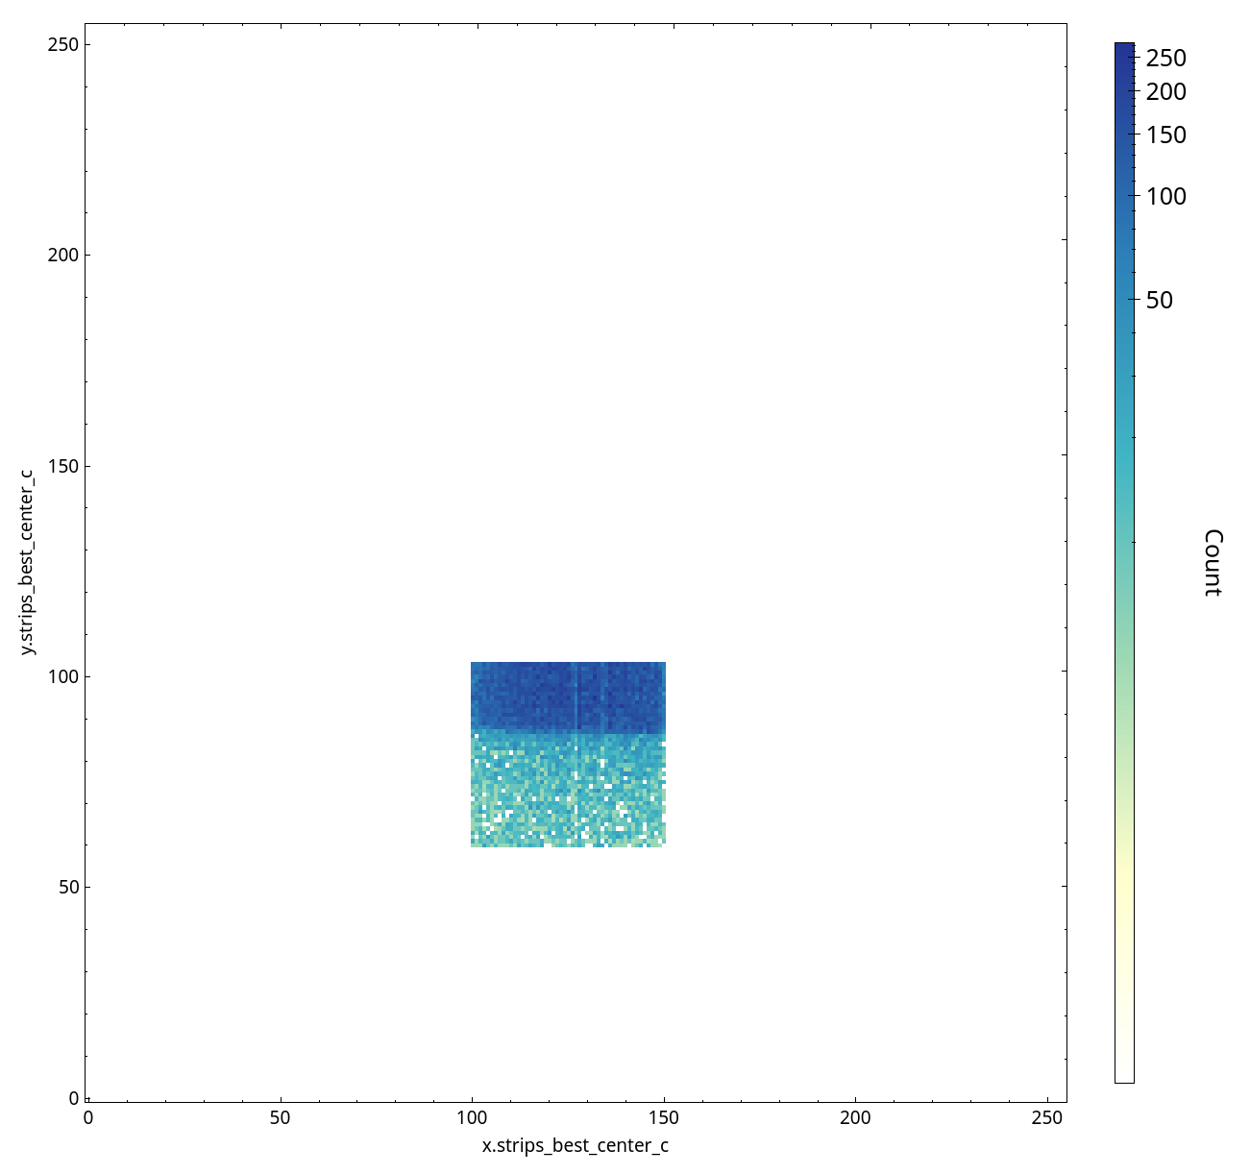
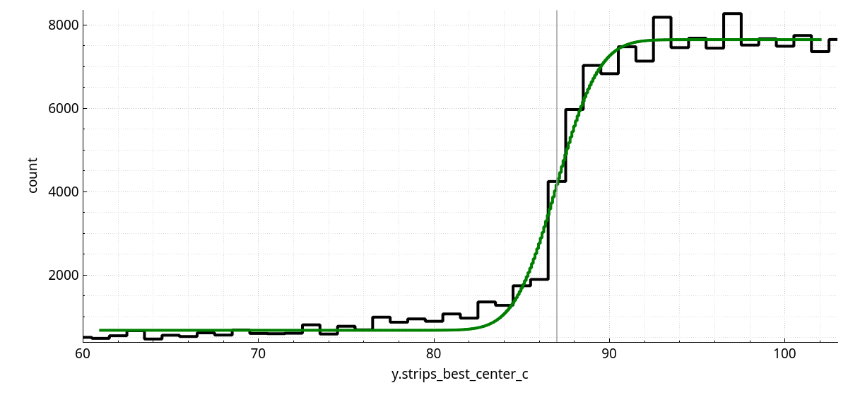
Filter evaluation
Find region with edge
Select to minimize noise
  (this is already filtering)
  (take note of total count)
Fit error function
Evaluate parameters:
  Y-offset -> background
  Amplitude -> signal
  Slope -> resolution
  SnR

Slide 8
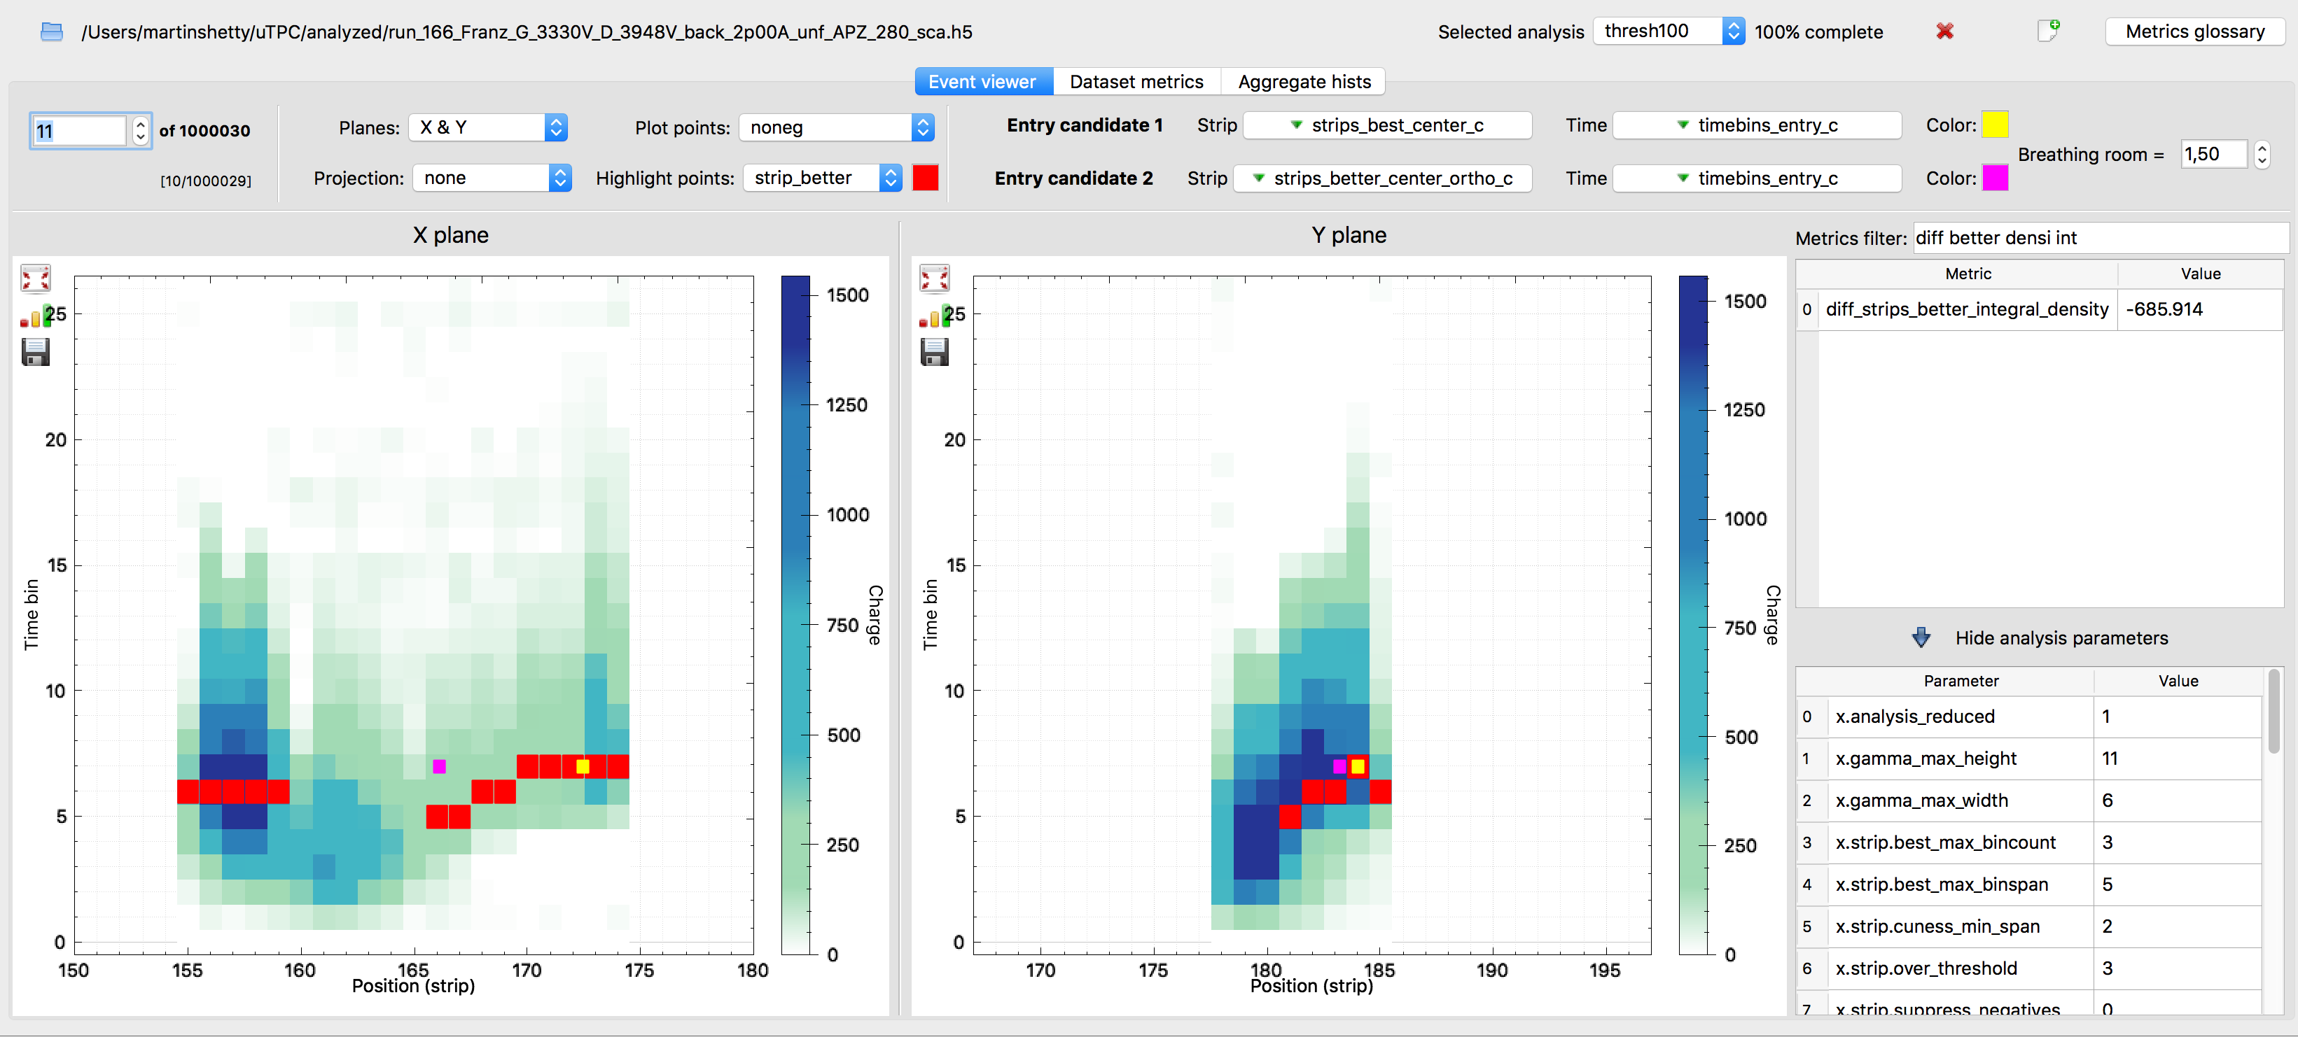
Software

Slide 9
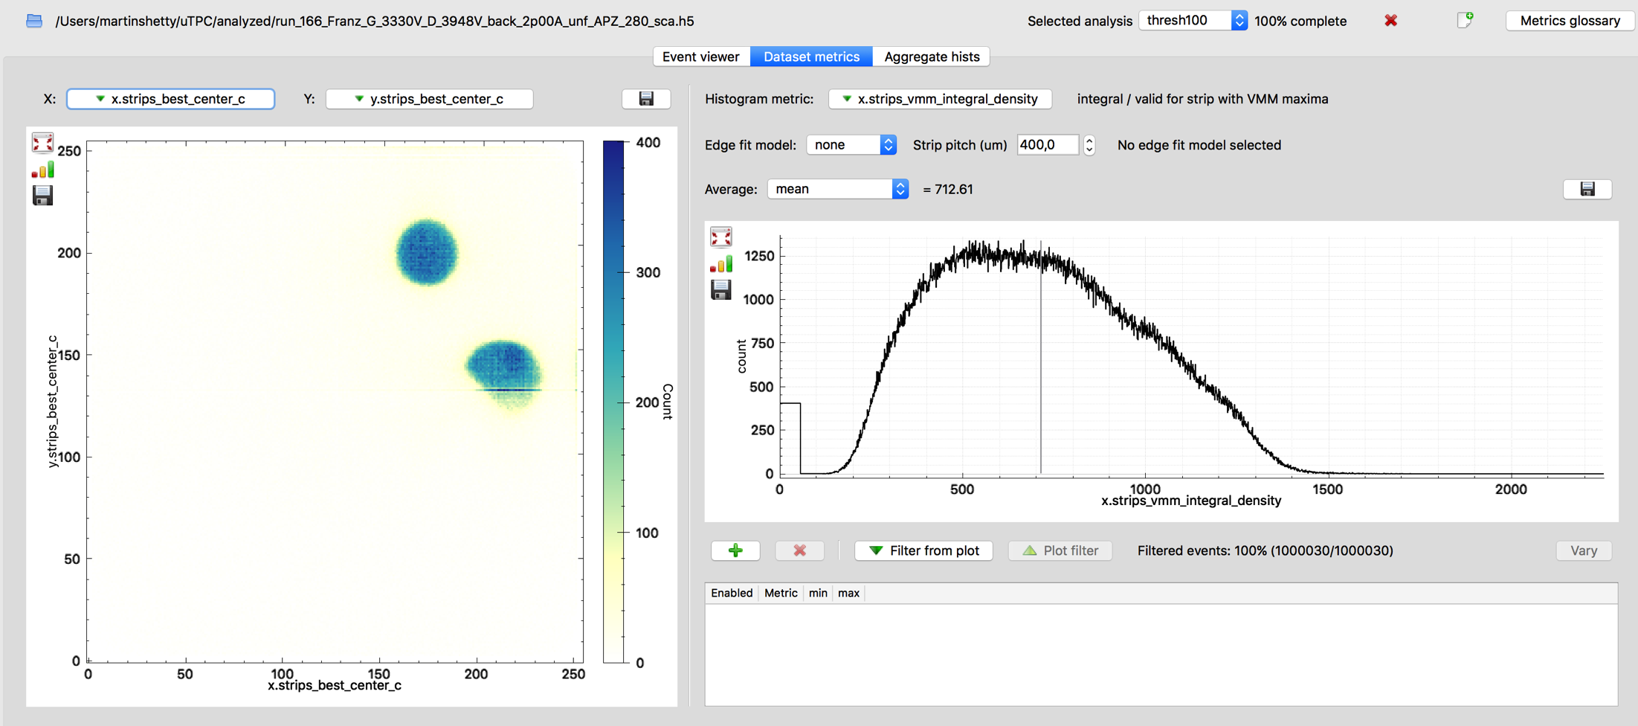
Software

Slide 10
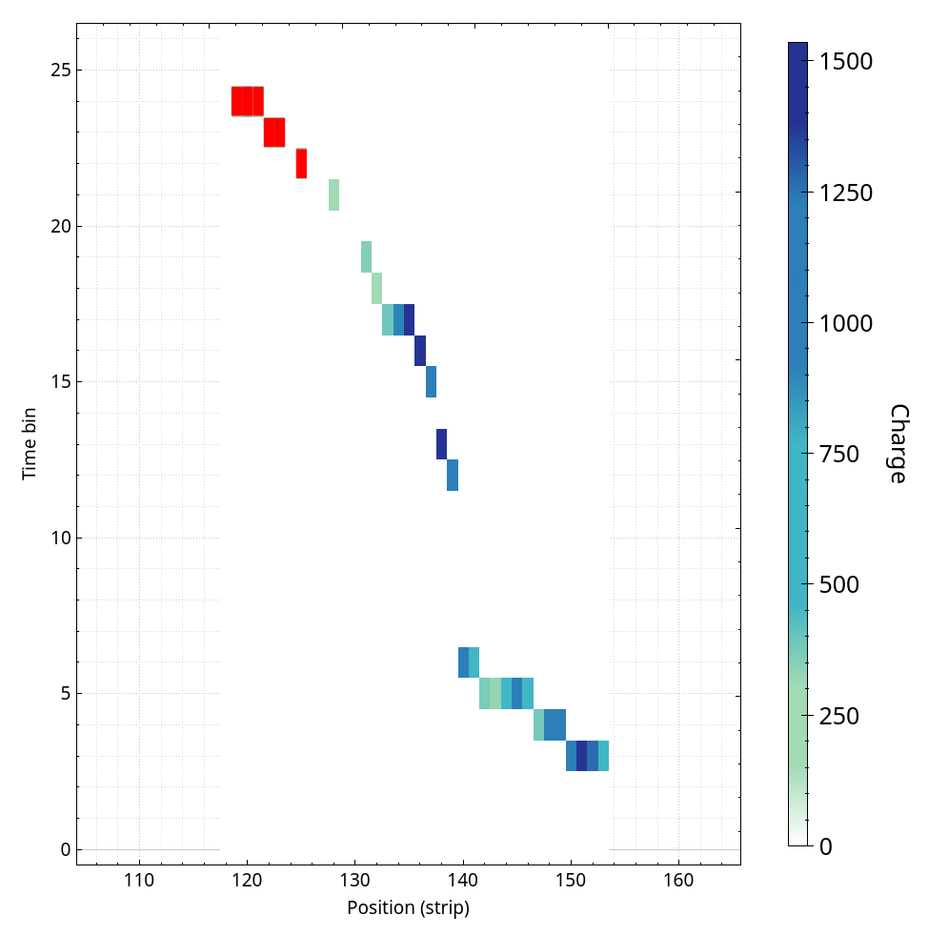
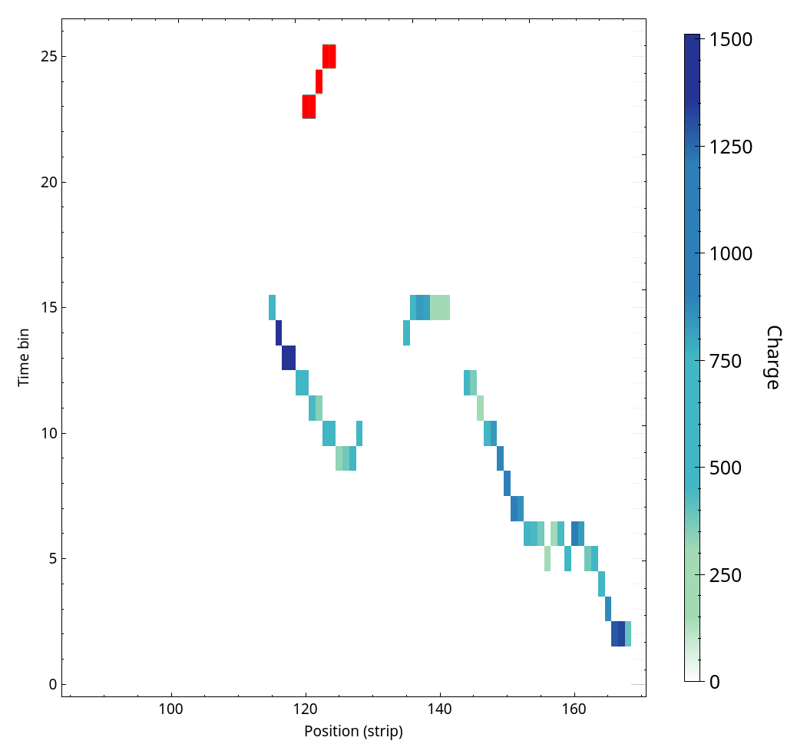
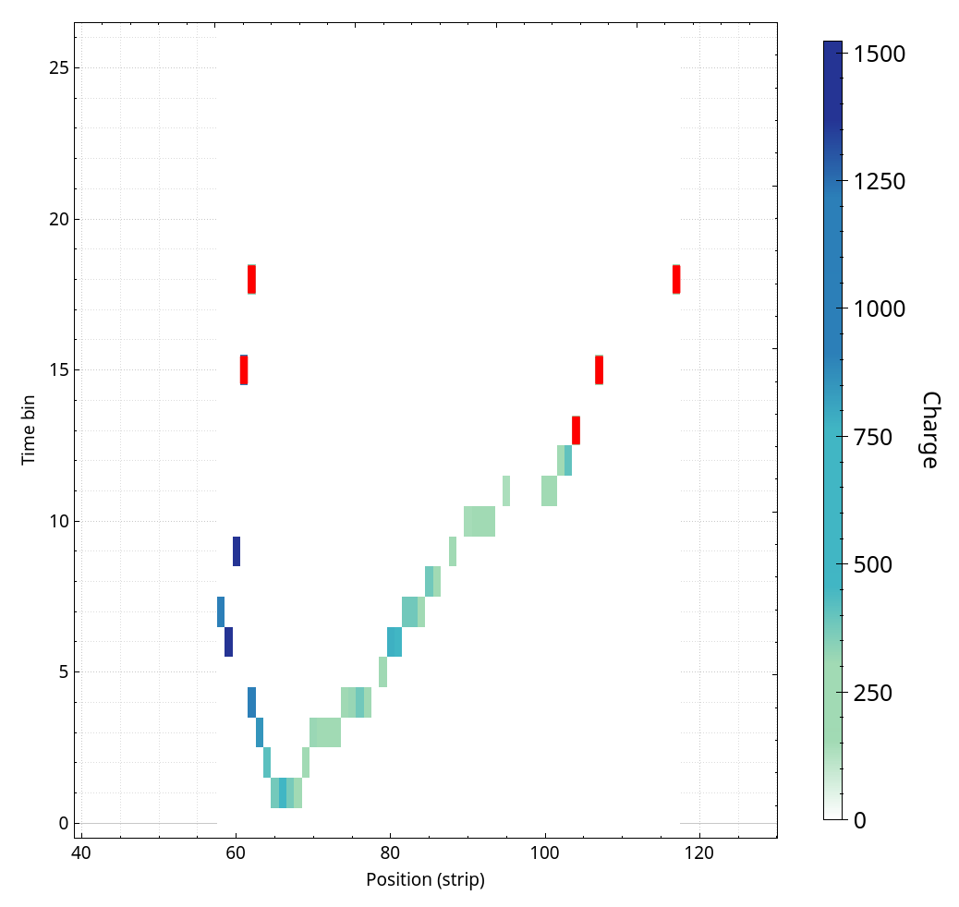
Later span
Definition: strip span of later points, “later” defined by thresholds
A reasonable measure of uncertainty
Always low for linear events
Can be curved, but ok if it happens away from conversion plane

Slide 11
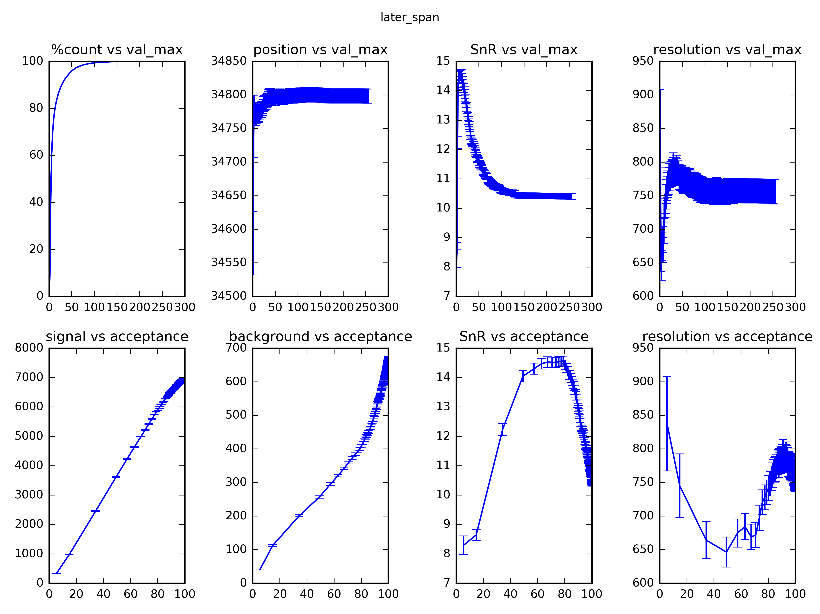
Later span
SnR peaks early (around 11)
Resolution dips early (6-10)
%count grows as expected
Can rescale by %count

Slide 12
Later span
Inflexions in signal and background curves explains SnR
Plateaus / valleys for optimal filters
Curves for comparing different filters

Slide 13
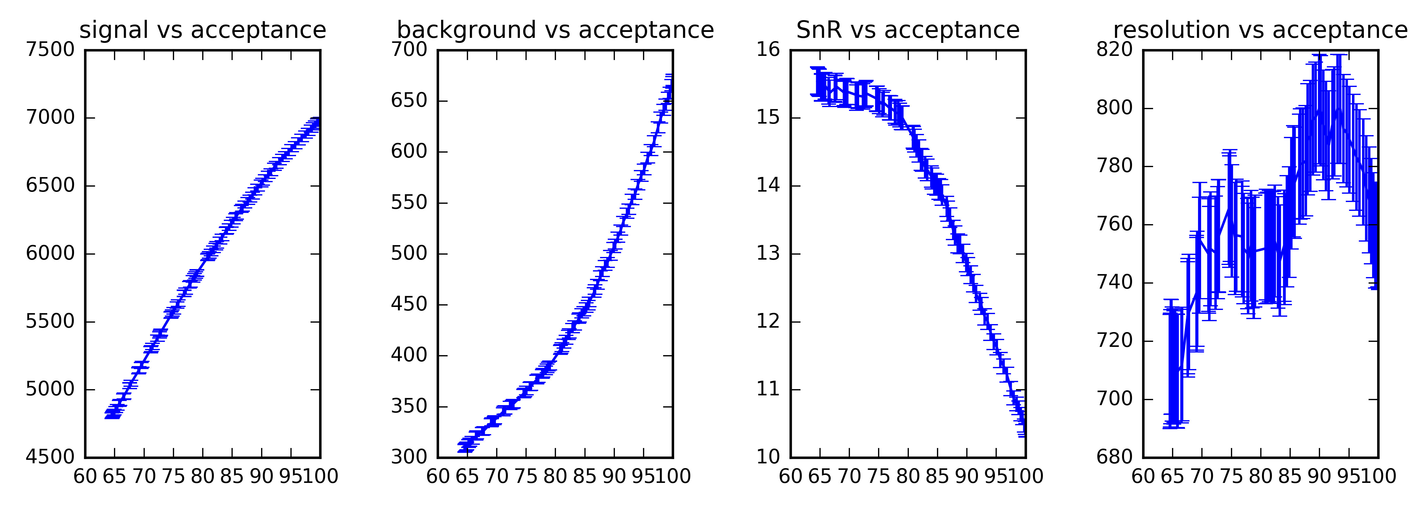
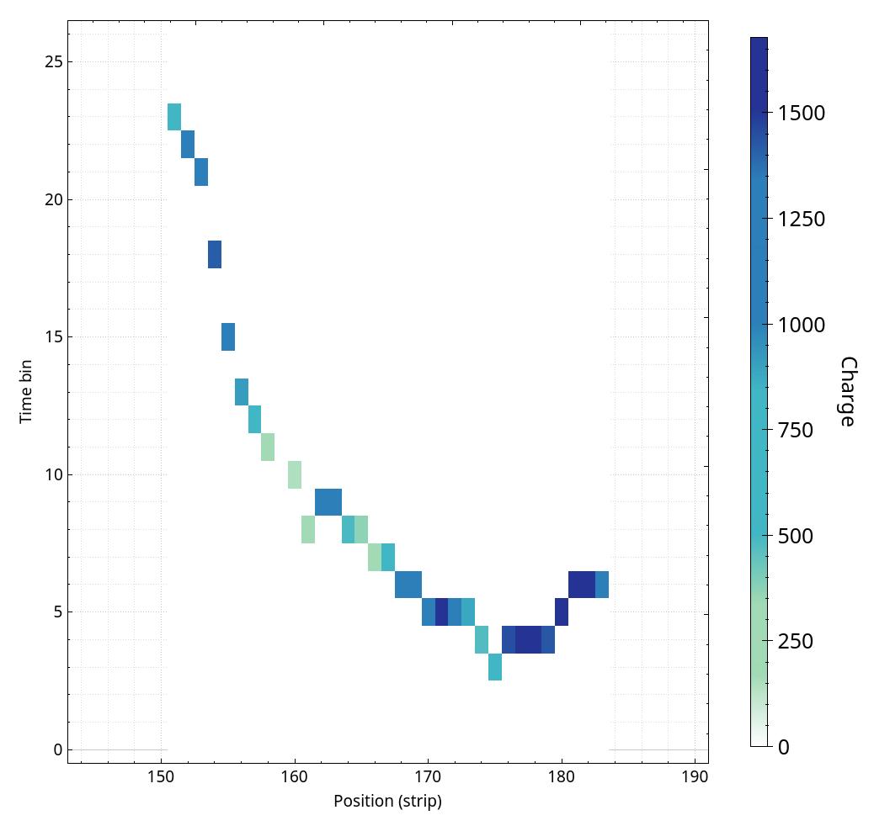
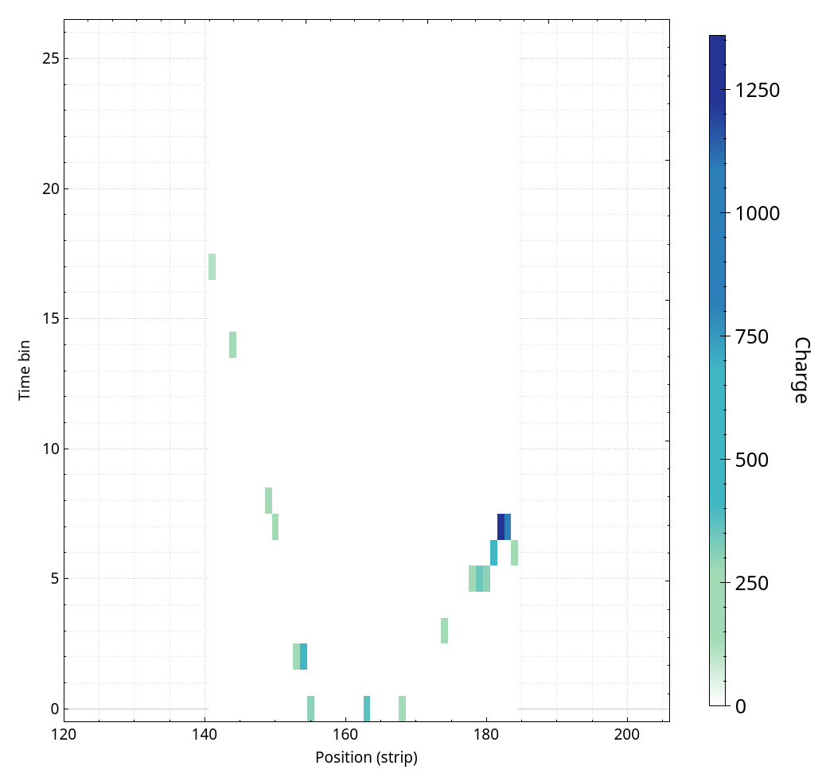
Density

Slide 14
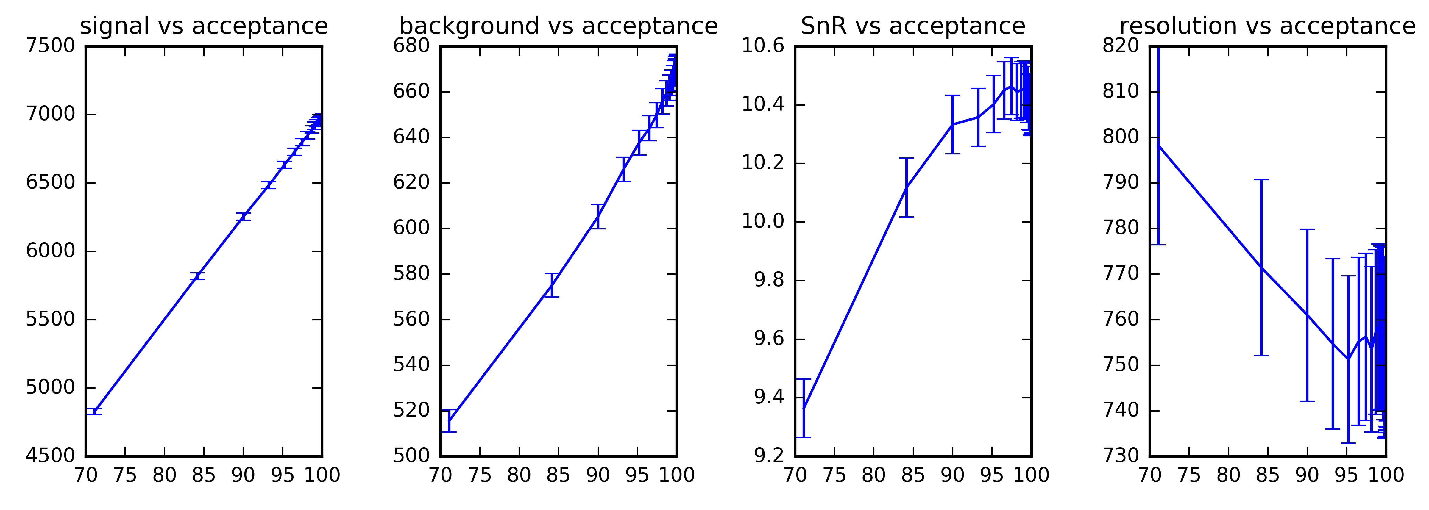
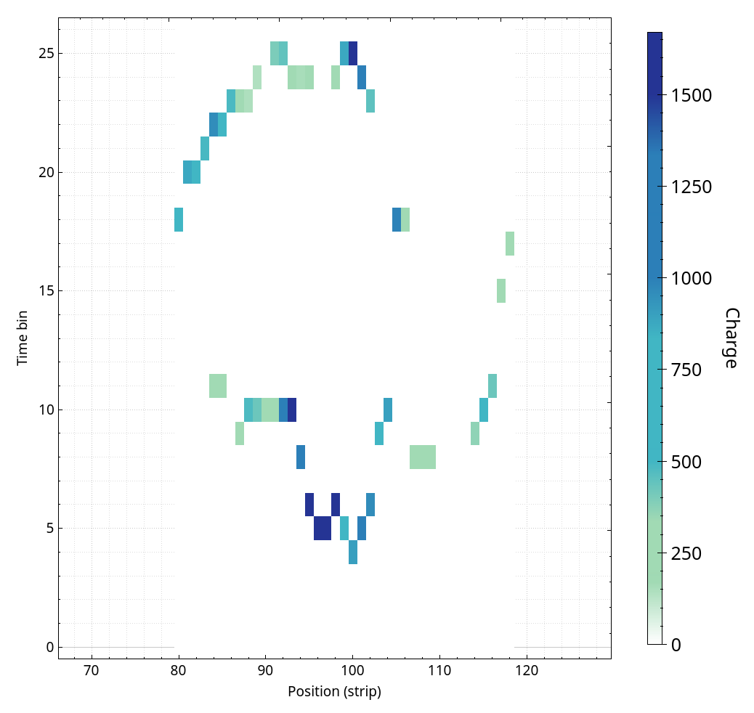
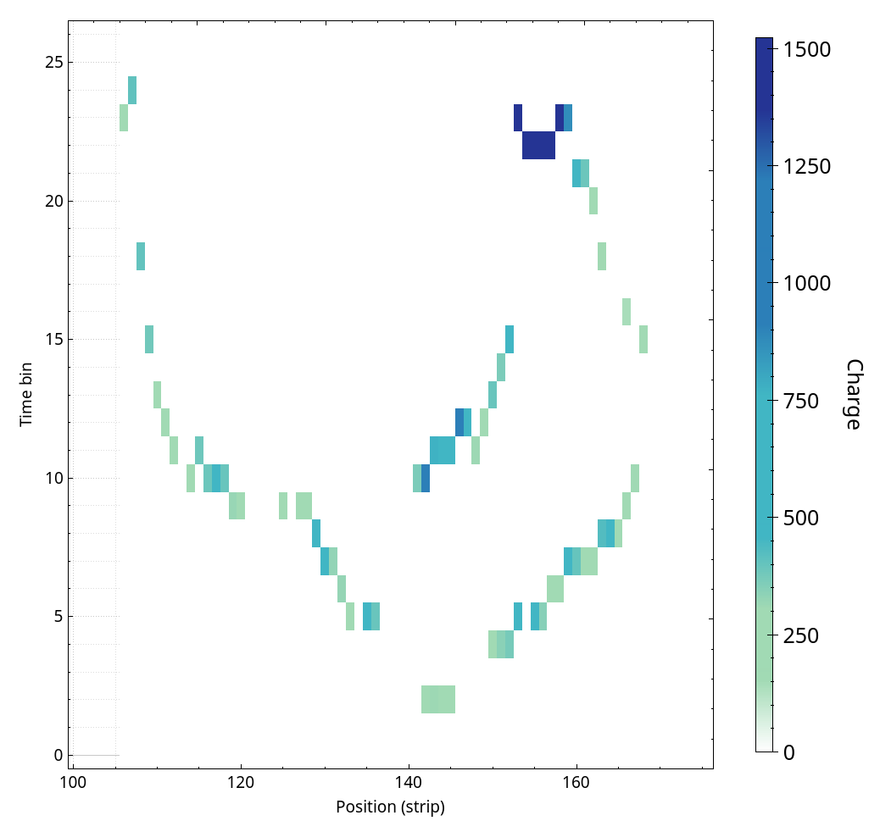
C-ness

Slide 15
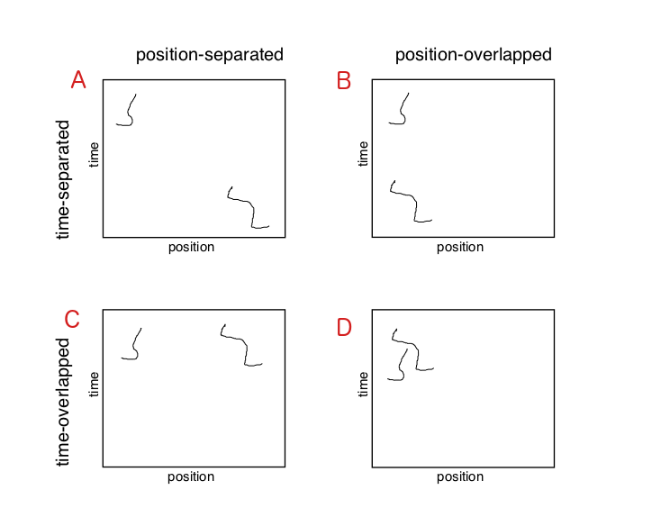
Clustering
Will never happen: AC, AD, BC, BD
Easy: AA, AB, BB
Hard: CC
Easy, at cost of uncertainty: CD
Indiscernible (efficiency loss): DD
Take-aways:
  Time is key
  Clusters must be defined

Slide 16
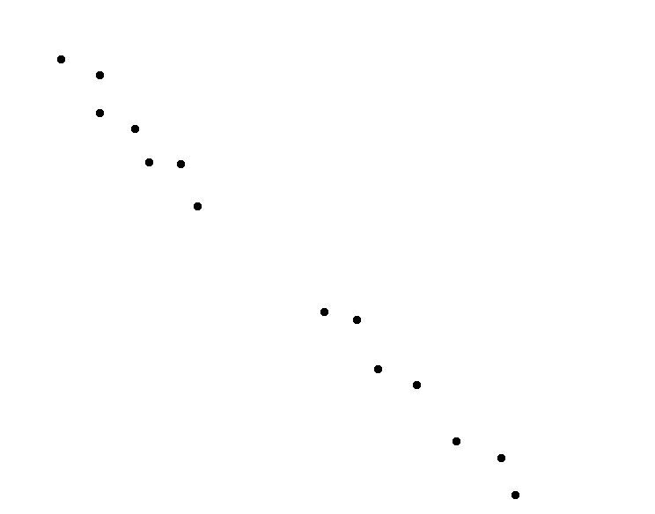
Clustering

Slide 17
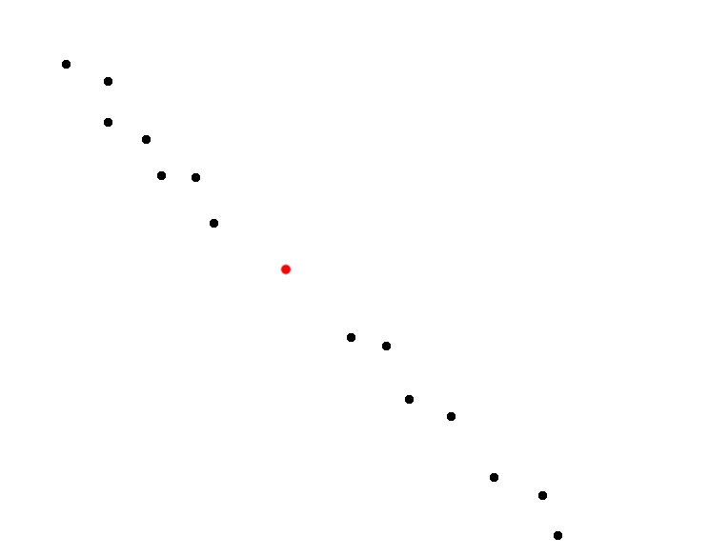
Clustering

Slide 18
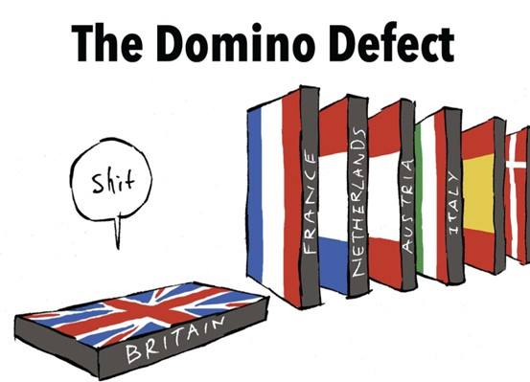
merci beaucoup ;)

