Slide 1


NSS
Instrument
Work Packages and XLPM
Rob Connatser

Slide 2
Accepted
instrument
Phase 1 – Preliminary Engineering
Design and Baseline
Decision
to move forward
Approved
Baseline
Design,
Cost
and Schedule
Phase 2 – Final Engineering
Design and Installation Plan
Engineering
Review
Safety Systems
Review
Phase 3 – Construction
and Installation
Readiness for
“Hot”
Commissioning
“Hot”
Commissioning
and Operations
Phase 4 – Beam Testing
and cold Commissioning
Notes:
Without transitions

Slide 3
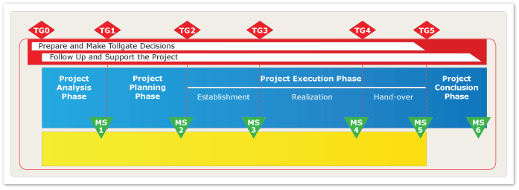
XLPM Project Timeline

Slide 4
Tollgate Zero
Tollgate 0 is an optional decision point in a project at which the decision to start the project analysis phase is made.
Proposal to analyze an instrument concept.

Slide 5
XLPM Project Timeline

Slide 6
Project Analysis Phase
In the project analysis phase, a business idea is assessed from a feasibility and commercial perspective. Stakeholders should be identified. Their expressed and unexpressed requirements and expectations on the potential project and its expected outcome should be collected and analyzed. The resources and the competence needed for the project should be identified.
In order to decide whether or not to make these resources available for the potential project, the project's alignment with the organization's business direction should be made clear.
The project analysis also includes the preparation of a budget and a time schedule for the project planning phase. This is a basis for the decision to start the project planning phase. The project analysis work should be documented and handed over to the project sponsor as one input for the Tollgate 1 decision.
i.e., a concept unit.

Slide 7
XLPM Project Timeline

Slide 8
Tollgate One
Business situation
Will the potential project and its expected outcome result in a profitable solution in agreement with the organization's business direction, strategies, customer expectations and demands, external regulations and market trends?
Project portfolio status
Will the expected benefit from the potential project and its expected outcome justify the effects from the project planning phase on resources for the total project portfolio?
Project status
Does the progress of the project analysis phase prove the potential project's ability to meet requirements on the project outcome and to do so on time and within cost limits?
Confidence and commitment
Do the parties involved in the project analysis phase, or involved in or affected by the potential project and its outcome, have confidence in the project and are they fully committed to it?
Decision to accept/deny an instrument proposal.

Slide 9
XLPM Project Timeline

Slide 10
Planning Phase
A team consisting of people from all the competence areas involved carries out the project planning work.
During the project planning the project scope is defined, the project goal is formulated, the project organization defined and risks and opportunities assessed. A quality plan for the project is defined to ensure that the project outcome and performance will be aligned with the quality demands expressed by the customer and the organization.
Project plans are prepared at a level detailed enough to establish realistic time and cost estimates for the project and ensure proper control over it. Internal and external resources needed in the project are identified and agreements for procurement made.
Phase 1: Preliminary Engineering and Design resulting in a set of baseline documents.

Slide 11
XLPM Project Timeline

Slide 12
Tollgate Two
The Tollgate 2 decision should be made when the project planning work and business situation give sufficient information for a decision to establish the project. If the decision is delayed, the information gained may not be relevant anymore. The risks involved in terms of money, resources and customer satisfaction will have to determine how detailed the project planning phase must be.
Will the expected benefit from the project and its outcome justify its effects on resources?
Decision to move forward

Slide 13
Project Execution Phase
Phase 2
Final Engineering Design
Phase 3
Construction and Installation
Phase 4
Beam Testing and Cold Commissioning
Engineering Review &
Re-baseline

Slide 14
Project Execution Phase
“Hot” Commissioning
Readiness for “Hot” Commissioning

Slide 15
Accepted
instrument
Phase 1 – Preliminary Engineering
Design and Baseline
Decision
to move forward
Tollgate 1
Planning Phase
Tollgate 2
Approved
Baseline
Design,
Cost
and Schedule
Phase 2 – Final Engineering
Design and Installation Plan
Engineering
Review
Project Execution: Establishment
Tollgate 3
Safety Systems
Review
Phase 3 – Construction
and Installation
Project Execution: Realization part 1
Readiness for
“Hot”
Commissioning
“Hot”
Commissioning
and Operations
Phase 4 – Beam Testing
and cold Commissioning
Project Execution: Realization part 2
Tollgate 4
Project Execution: Hand-Over
Notes:
Without transitions

Slide 16
Accepted
instrument
Phase 1 – Preliminary Engineering
Design and Baseline
Decision
to move forward
Tollgate 1
Planning Phase
Tollgate 2
Approved
Baseline
Design,
Cost
and Schedule
Phase 2 – Final Engineering
Design and Installation Plan
Engineering
Review
Project Execution: Establishment
Tollgate 3
Safety Systems
Review
Phase 3 – Construction
and Installation
Project Execution: Realization
Tollgate 4
Readiness for
“Hot”
Commissioning
“Hot”
Commissioning
and Operations
Phase 4 – Beam Testing
and cold Commissioning
Project Execution: Hand-Over
Tollgate 5
Notes:
Without transitions

Slide 17
SCALE

