Slide 1
Characterization of Thermal Neutron Beam Monitors
Fatima Issa
www.europeanspallationsource.se
21 March 2017

Slide 2
Outline
why Beam monitors?
Types and specifications of the used Beam monitors
results (efficiency, attenuation, gamma sensitivity,.. )
conclusion

Slide 3
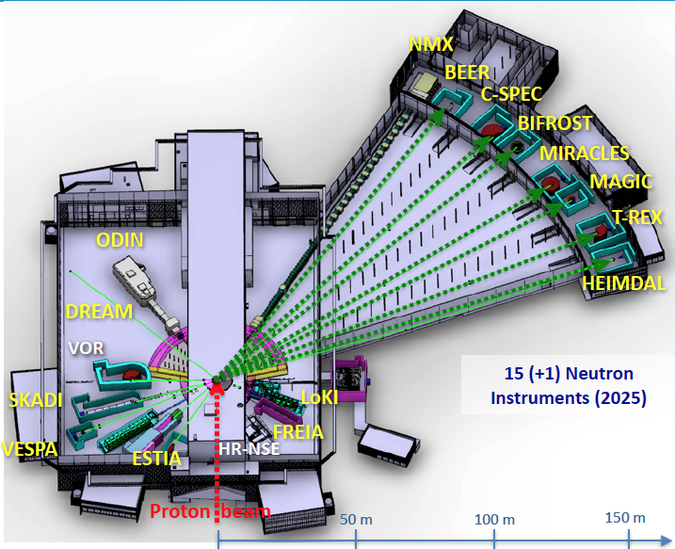
ESS instruments
Instrument Class | Instrument Sub-class
Large Scale Structures | Small Angle Scattering
 | Reflectometry
Diffraction | Powder Diffraction
 | Single crystal diffraction
Engineering | Strain scanning
 | Imaging and tomography
Spectroscopy | Direct Geometry
 | Indirect Geometry
At each instrument beam monitors will be used for diagnostics and for normalization

Slide 4
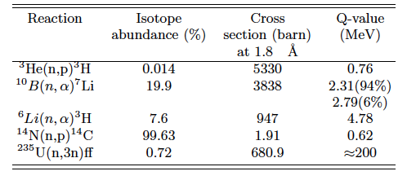
Beam Monitor
Nuclear reactions used for thermal neutron detection
Beam monitors are thermal neutron detectors with relatively low efficiency which varies from
10⁻⁶ to 10⁻² depending on the instrument requirements

Slide 5
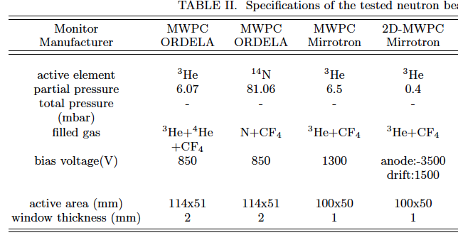
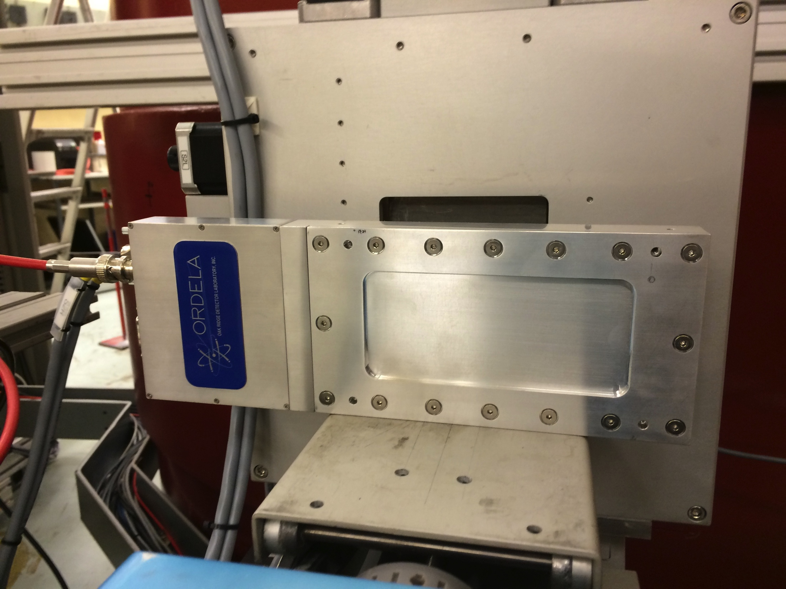
Types of Beam Monitor
Multi-wire proportional chamber (MWPC)
From Mirrotron
From ORDELA
MWPC Can be filled with either ³He or ¹⁴N gas

Slide 6
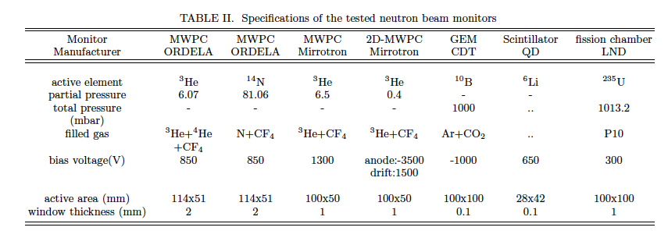
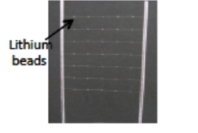
Types of Beam Monitor
Fission Chamber:
From LND
Inner wall coated with ²³⁵U
Counting gas P10
Scintillator
From Quantum detector

Slide 7
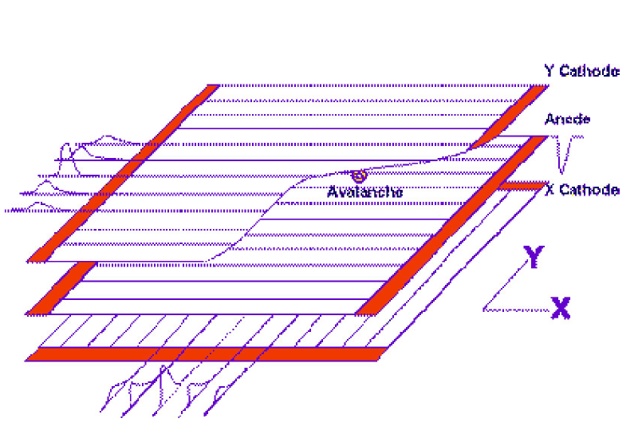
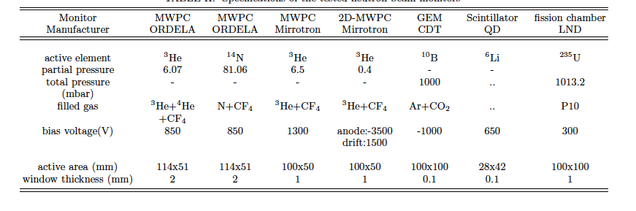
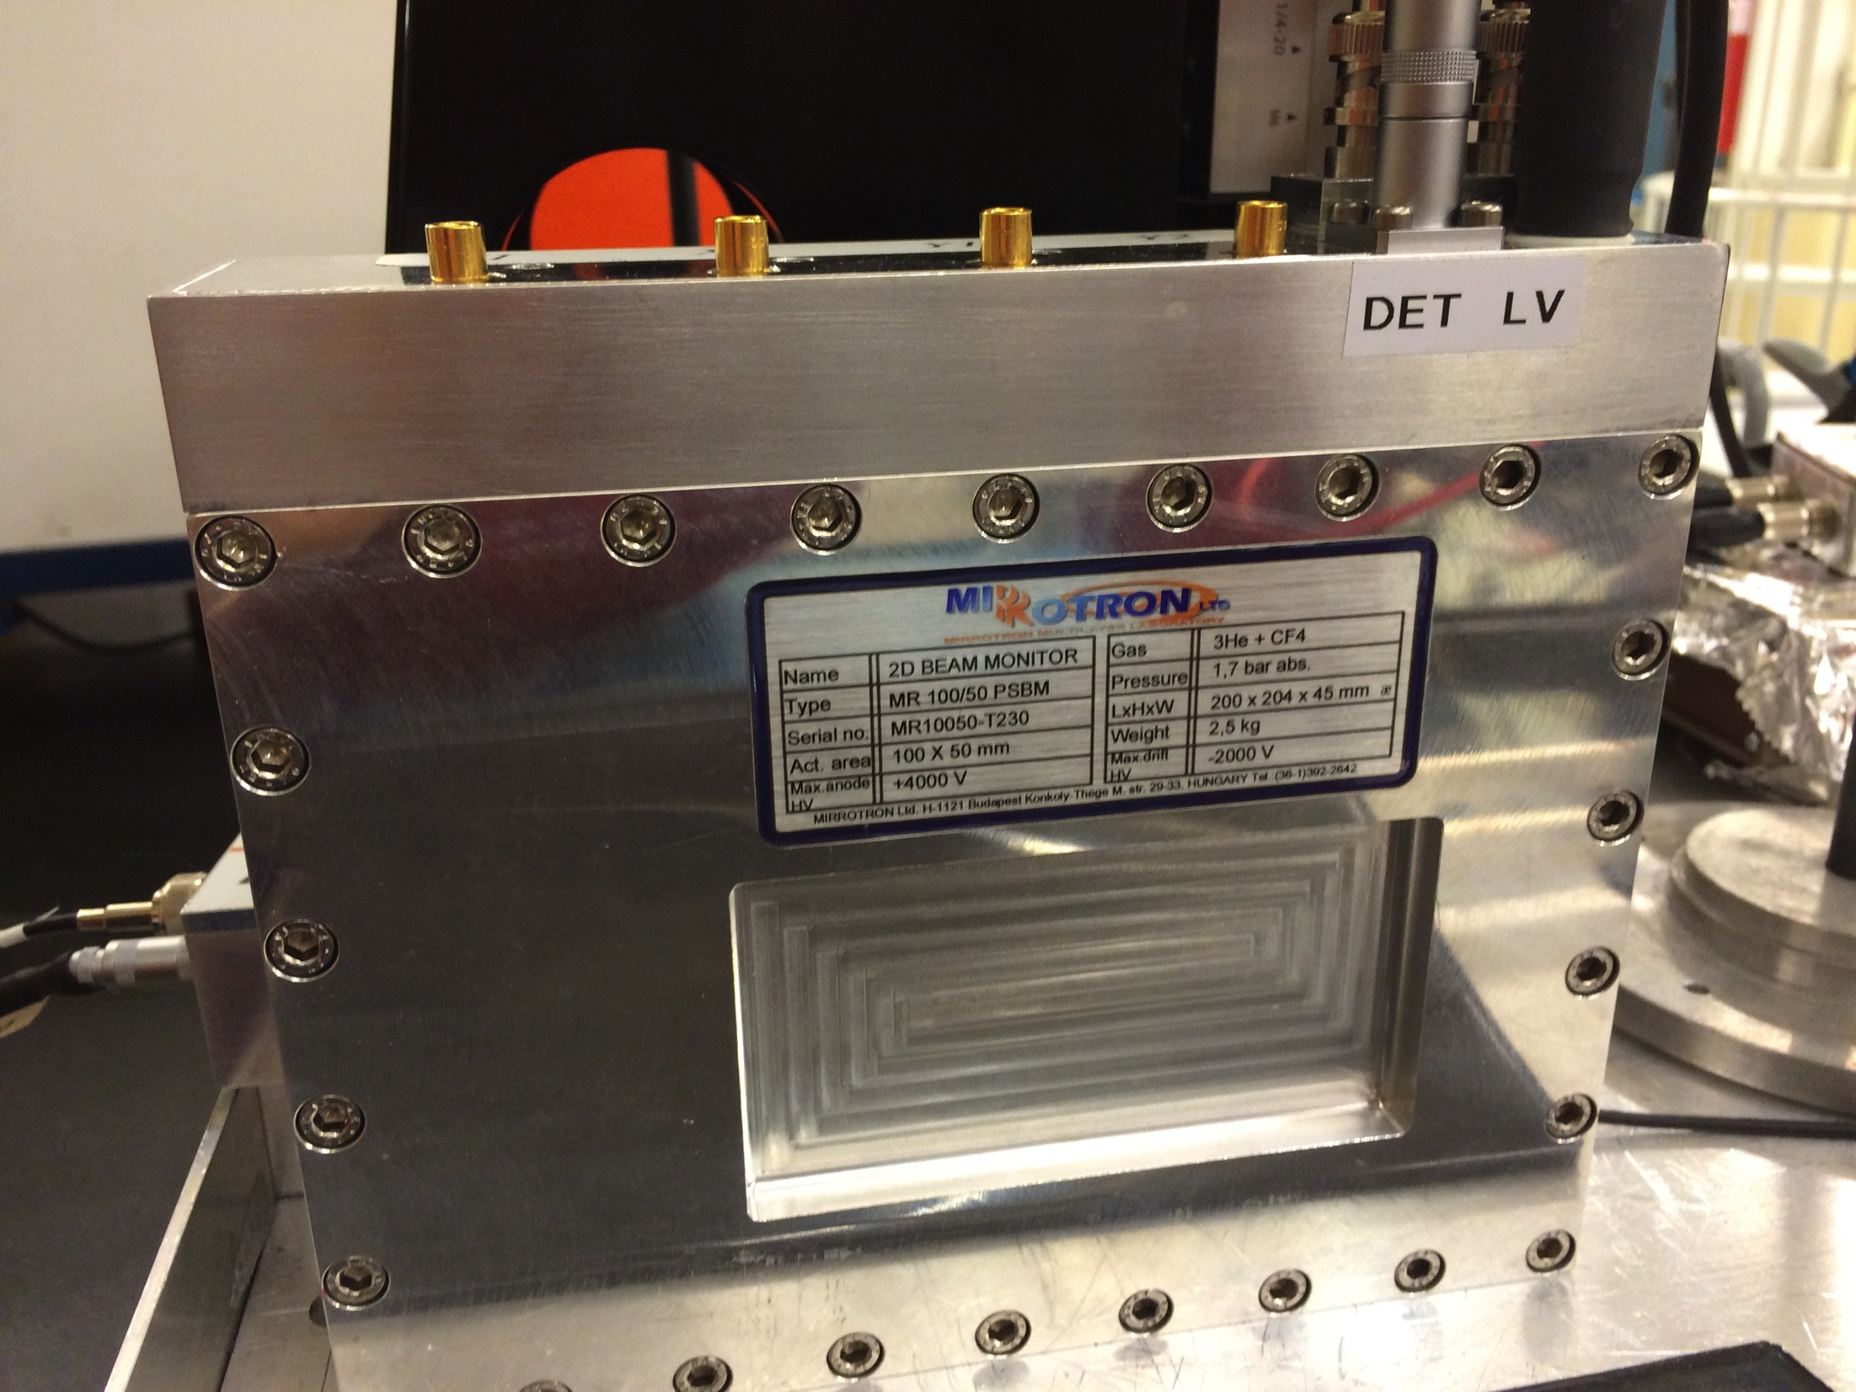
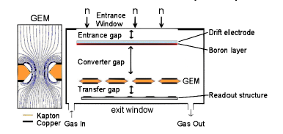
Types of Beam Monitor
Multi-wire proportional chamber (2D-MWPC)
From Mirrotron
Gas Electron Multiplier (2D-GEM)
From CDT
0.8 μm boron layer was selected for the sake of the measurement. Thinner layer will be selected for full implementation (50 -100 nm).

Slide 8
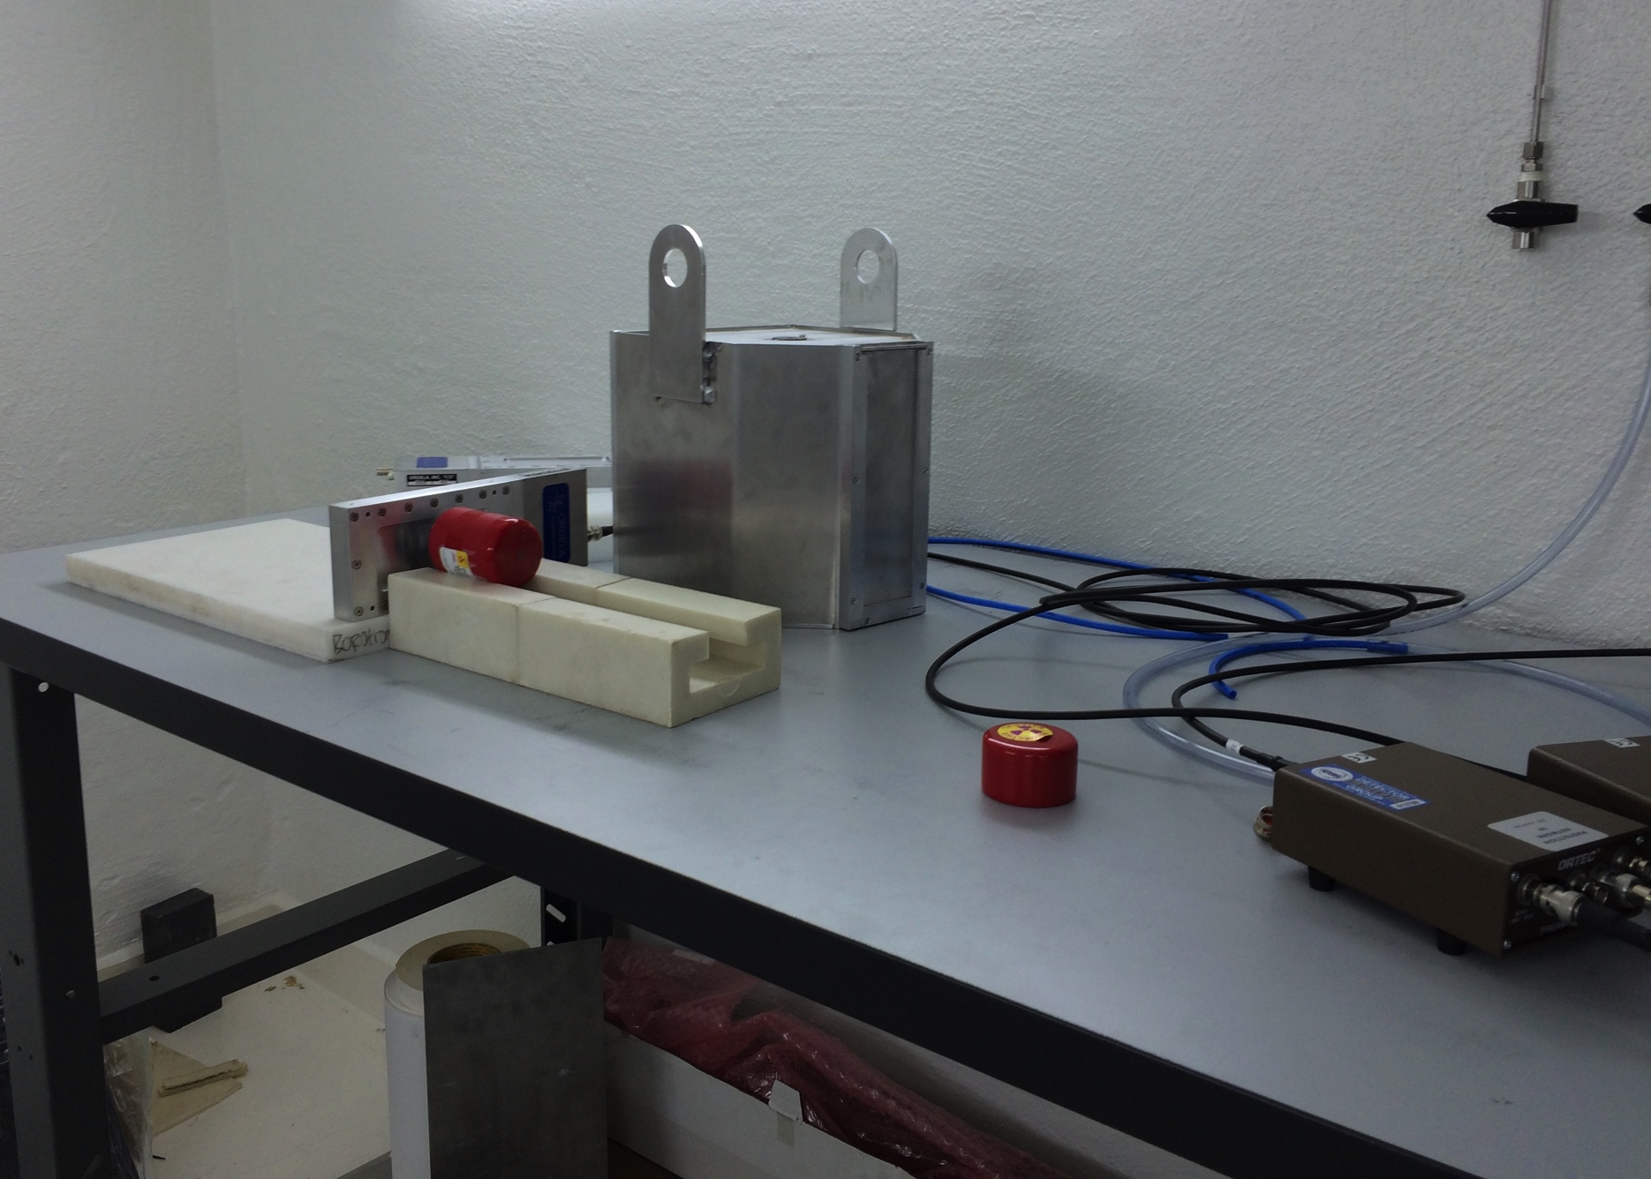
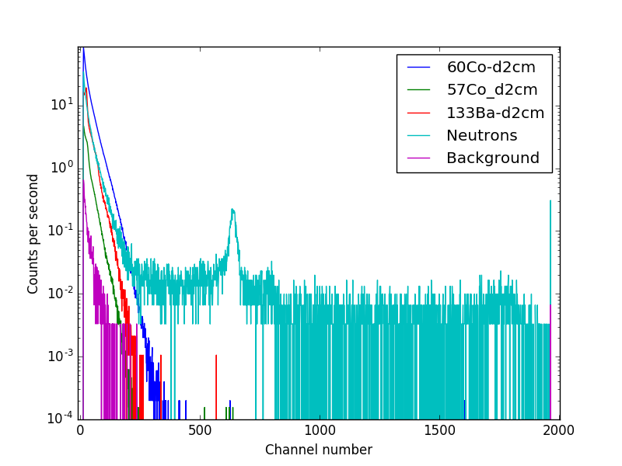

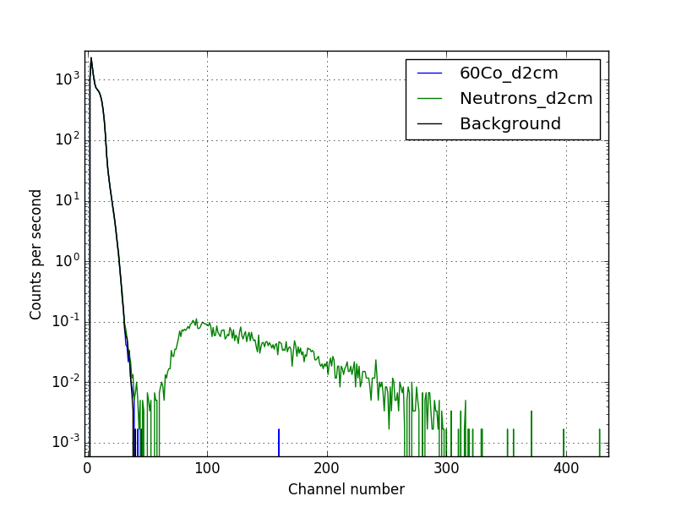
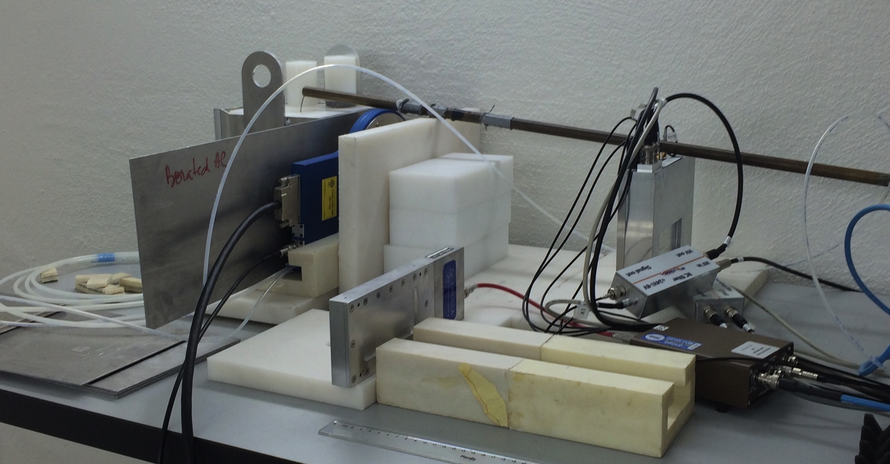
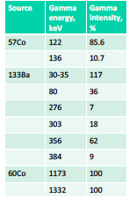
Beam Monitors-Gamma sensitivity measurement
MWPC from Mirrotron
Gamma source
source | Gamma energy KeV | Gamma intensity %
⁵⁷Co | 122 | 85.6
 | 136 | 10.7
¹³³Ba | 30-35 | 117
 | 80 | 36
 | 276 | 7
 | 303 | 18
 | 356 | 62
 | 384 | 9
⁶⁰Co | 1173 | 100
 | 1332 | 100
Beam monitor
neutron source
Fission chamber from LND
Beam monitor
Gamma sensitivity studied with three gamma sources with low, medium, and high energy

Slide 9
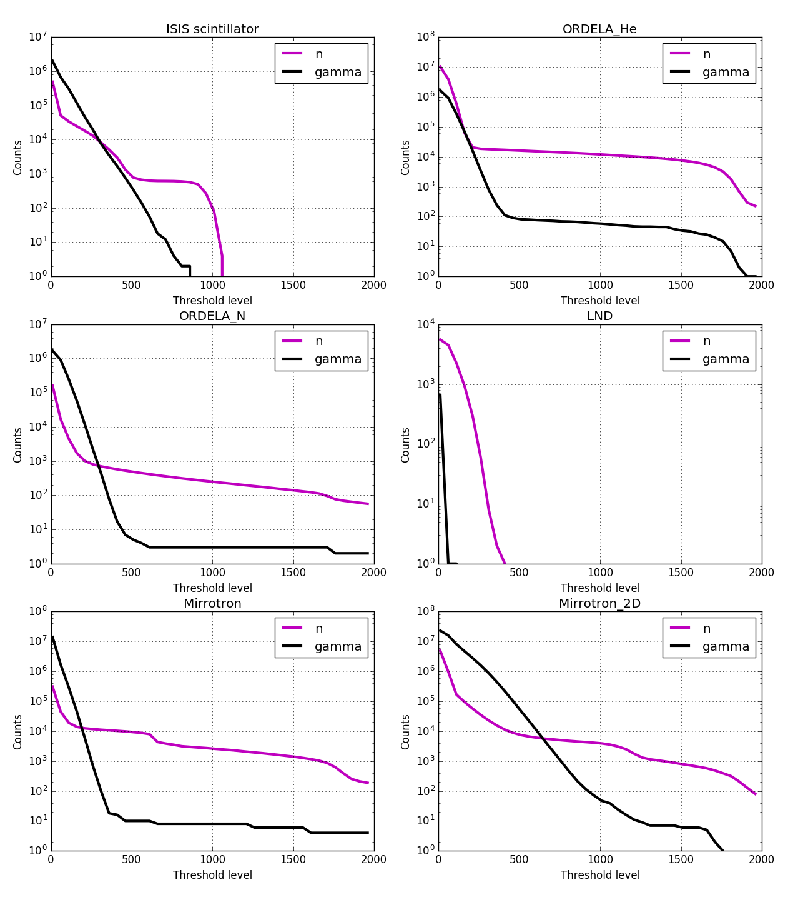
Beam Monitors-Gamma sensitivity measurement
Measuring time 10 min
Gamma source
source | Gamma energy KeV | Gamma intensity %
⁵⁷Co | 122 | 85.6
 | 136 | 10.7
¹³³Ba | 30-35 | 117
 | 80 | 36
 | 276 | 7
 | 303 | 18
 | 356 | 62
 | 384 | 9
⁶⁰Co | 1173 | 100
 | 1332 | 100
Beam monitor
neutron source
Beam monitor
Gamma sensitivity depends on the set threshold, fission chamber showed the lowest gamma sensitivity

Slide 10

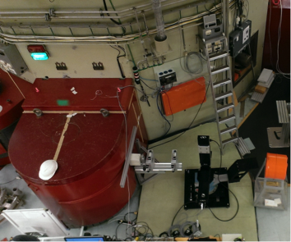
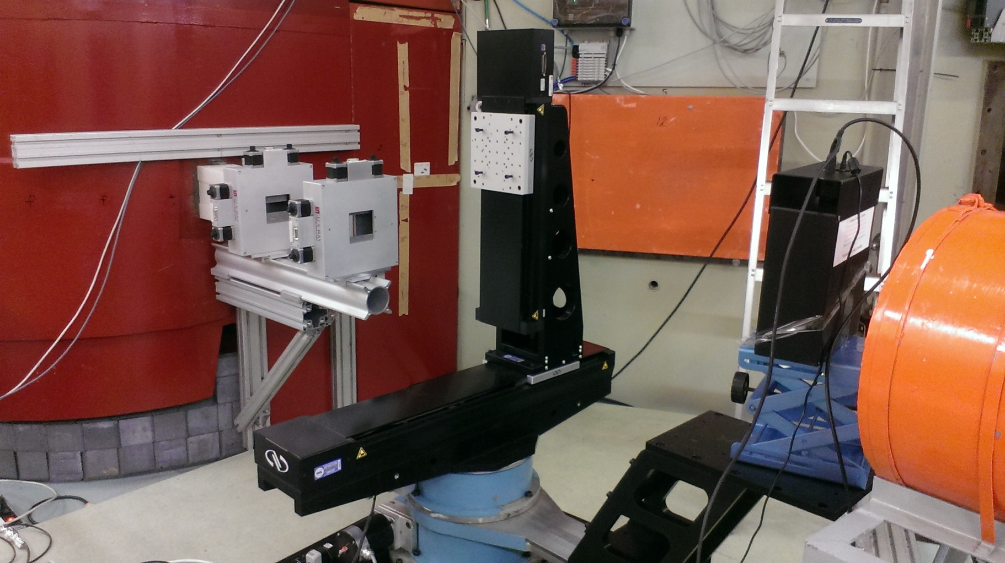
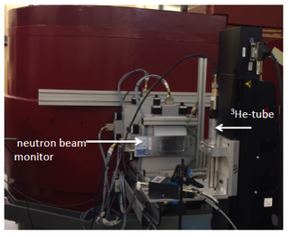
Beam Monitors- Neutron measurement at R2D2
Slit 1
Slit 2
Peak wavelength (Å)
400 2.00
911 0.878
711 1.12
511 1.54
822 0.943
311 2.41
933 0.804

Slide 11
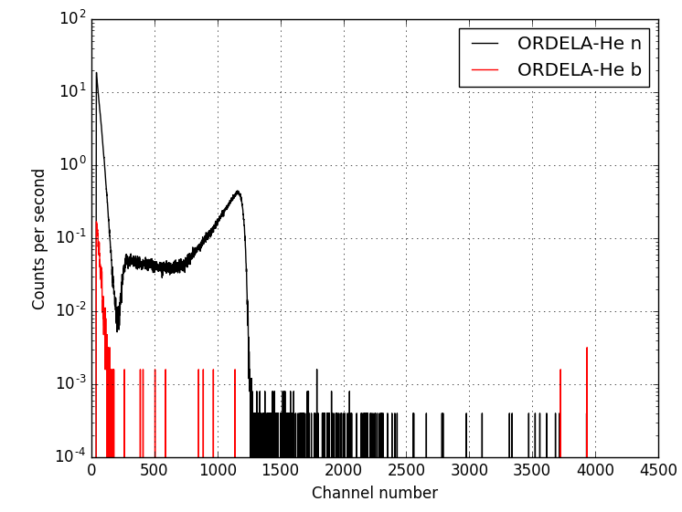
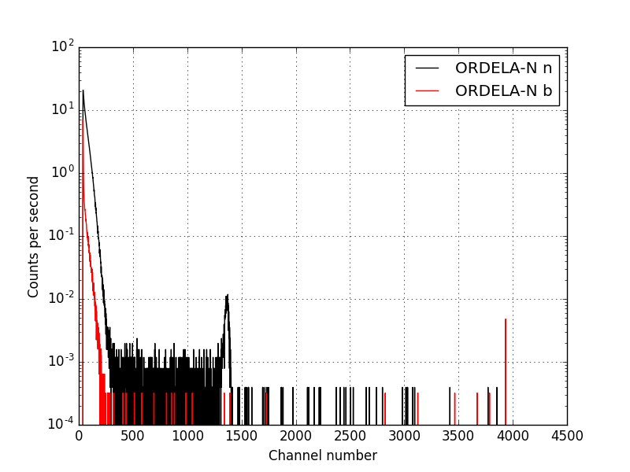
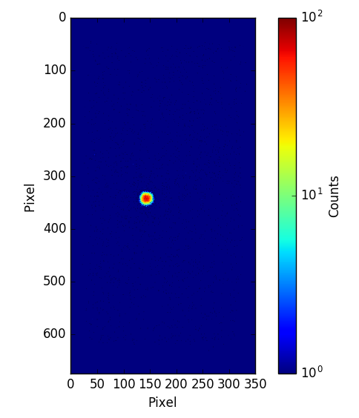
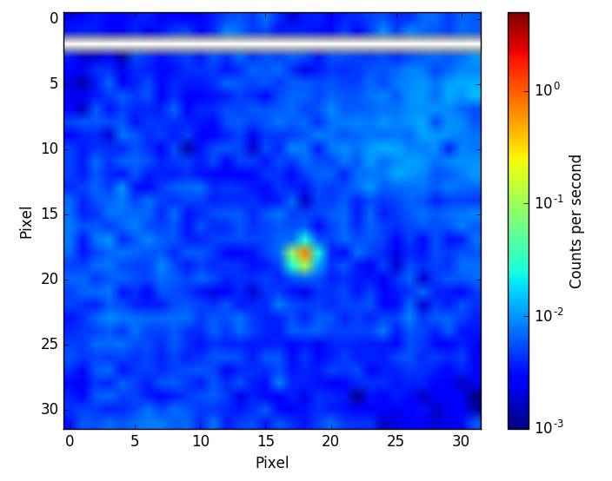
Beam Monitors- Neutron measurement
ORDELA-N
ORDELA-He
2D-GEM
2D-MWPC

Slide 12
Beam monitors-main results
 | MWPC | MWPC | MWPC BM-100X50 | 2D-MWPC | 2D-GEM | Scintillator | Fission chamber
supplier | ORDELA | ORDELA | Mirrotron | Mirrotron | CDT | Quantum detector | LND
Isotope used for neutron capture | ³He | ¹⁴N | ³He | ³He | ¹⁰B | ⁶Li | ²³⁵U
Gas pressure mbar | Partial pressure 6,0795 | Partial pressure 81,06 | Partial pressure 6,5 | Partial pressure 0.4 | Total pressure 100 | ------ | Total pressure 1013,2
Filled gas | ³He+⁴He +CF₄ | N+CF₄ | ³He+CF₄ | ³He+CF₄ | Ar/CO₂ | -------- | P10
Active Area (mm²) | 114 x 51 | 114 x 51 | 100 x 50 | 100 x 50 | Diameter 100 mm | 28 x 42 | Diameter 108.0 mm
Applied voltage (V) | 850 | 850 | 1300 | Anode at -3500V Drift at 1500V | -1000 | 650 | 300
Measured attenuation % | 4.5 | 4.4 | 2.5 | 7.3 | 10.6 | 0.4 | 3.8
Calculated attenuation % | 4.05 | 4.05 | 2.05 | 4.5 | 6.9 | 0.1 | 2.4
Measured Efficiency at 2.4Å | 1.2x10⁻³ | 2x10⁻⁵ | 1.1x10⁻³ | 1.5x10⁻⁴ | 3x10⁻² | 5x10⁻³ | 10⁻⁴
More characterization → monitors will be customized to match ESS requirements for each instruments

Slide 13
Conclusions
Different types of beam monitors (MWPC, 2D-GEM, scintillator, fission chamber) from different supplier have been tested
Efficiency, attenuation and gamma sensitivity were studied
Relatively high attenuation factor → mainly contributed to the window thickness
more characterization is planned (sensitivity to fast neutrons, ageing, linearity, )
monitors will be customized to match ESS requirements for each instruments

Slide 14


Horizon 2020 grant agreement 676548
Thank you

