Slide 1




New Simulation Tools and Reproduction of CNCS results using Geant4
676548
E. Dian,
K. Kanaki, X. X. Cai, R. Hall-Wilton, A. Khaplanov, T. Kittelmann
dian.eszter@energia.mta.hu
HAS Centre for Energy Research
European Spallation Source ESS ERIC
28 March 2017, ICANS XXII, Oxford

Slide 2
Outline
The ESS detector challenge
  All instruments in different design phases
  Diverse set of requirements
  Challenge: new detectors with several different designs
Powerful simulation tools
Application in detector design:
  Background study for MultiGrid detector
I’m an
end-user!
Notes:
ESS
Instruments in different design phases
Challenge: new detectors
Challenging environment around instruments
Prototyping and existing tech was enough so far -> strong and appropriate sim. Tool needed
General description of coding framework (Before unavailable extensions to unify all packages of this field -> see jamboree. Nice plot from TK!
Openly available , well documented and USEFUL tools, continuous development, use it, it’s not only for dets!)
NXSG4 - MG
Ncrystal - ?? Ask XX
(MCPL?) –LOKI?/SKADI
Application in detector development,
detector background (Motivation from det/inst design point of view, example given from bg pov
Gamma bg, NA -> ref to MCNP paper
Scat. n bg -> MG@CNCS (+ MG@IN6 ?)
Detector effect vs instrument effect

Slide 3
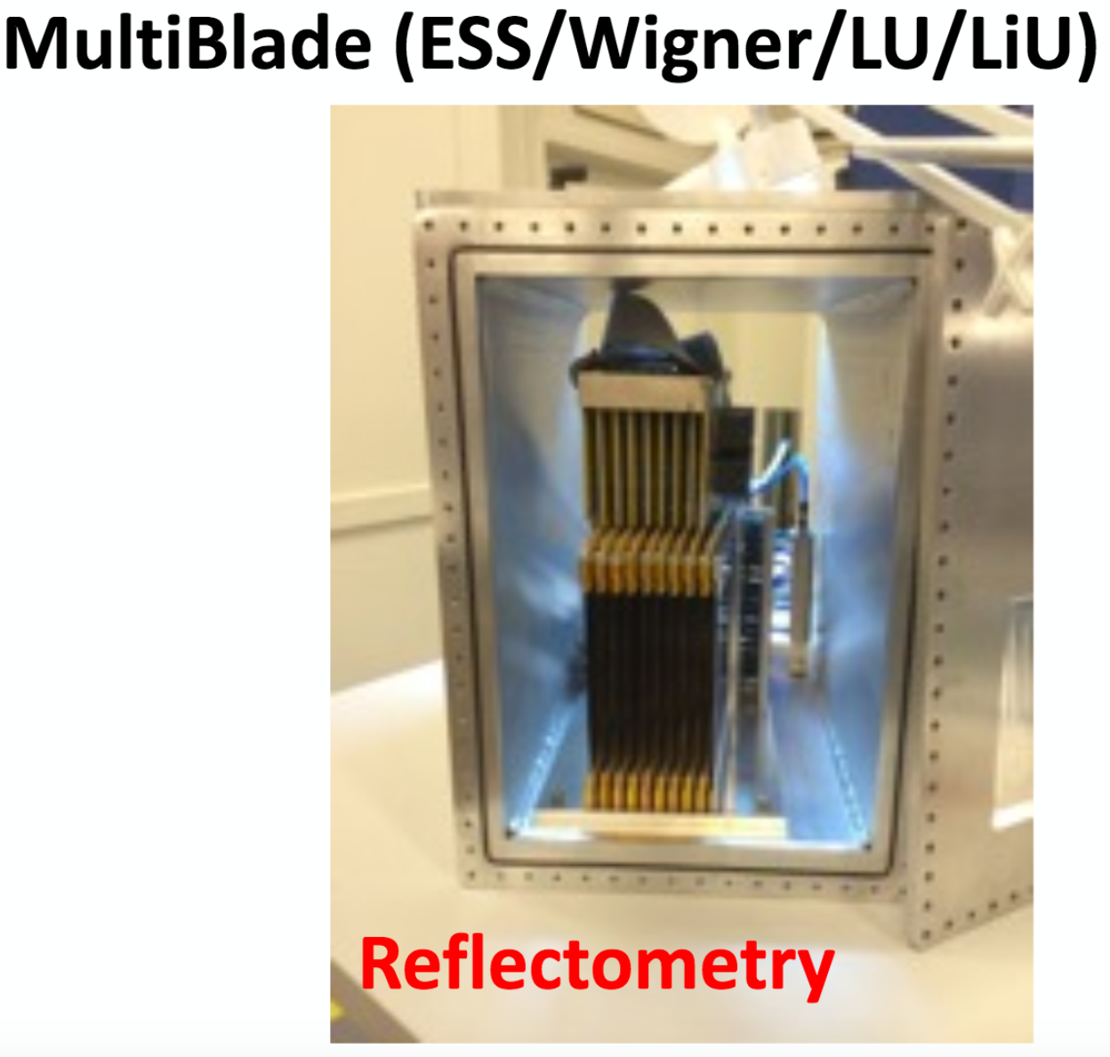
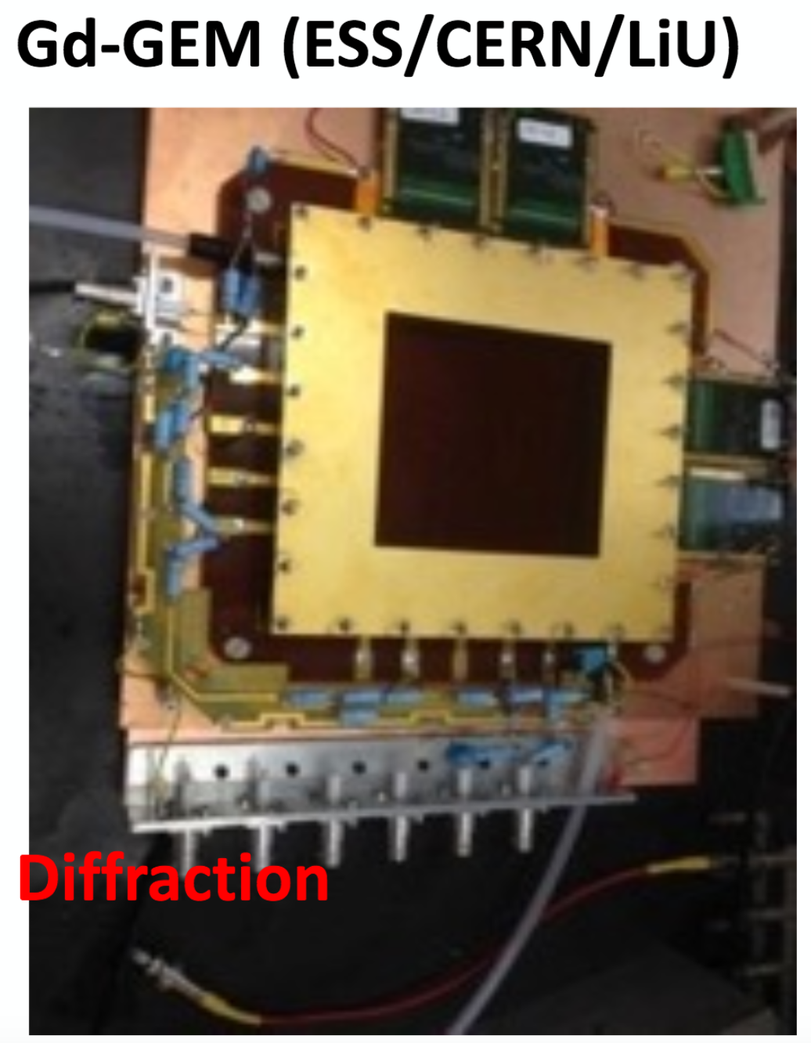

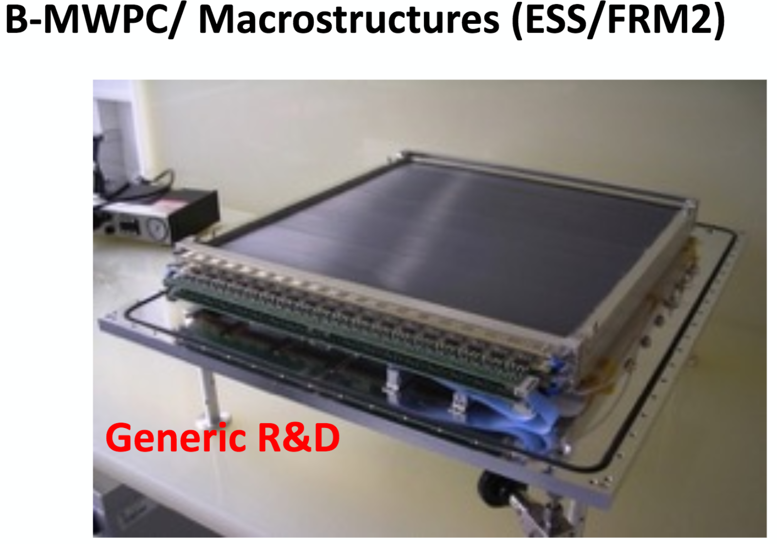
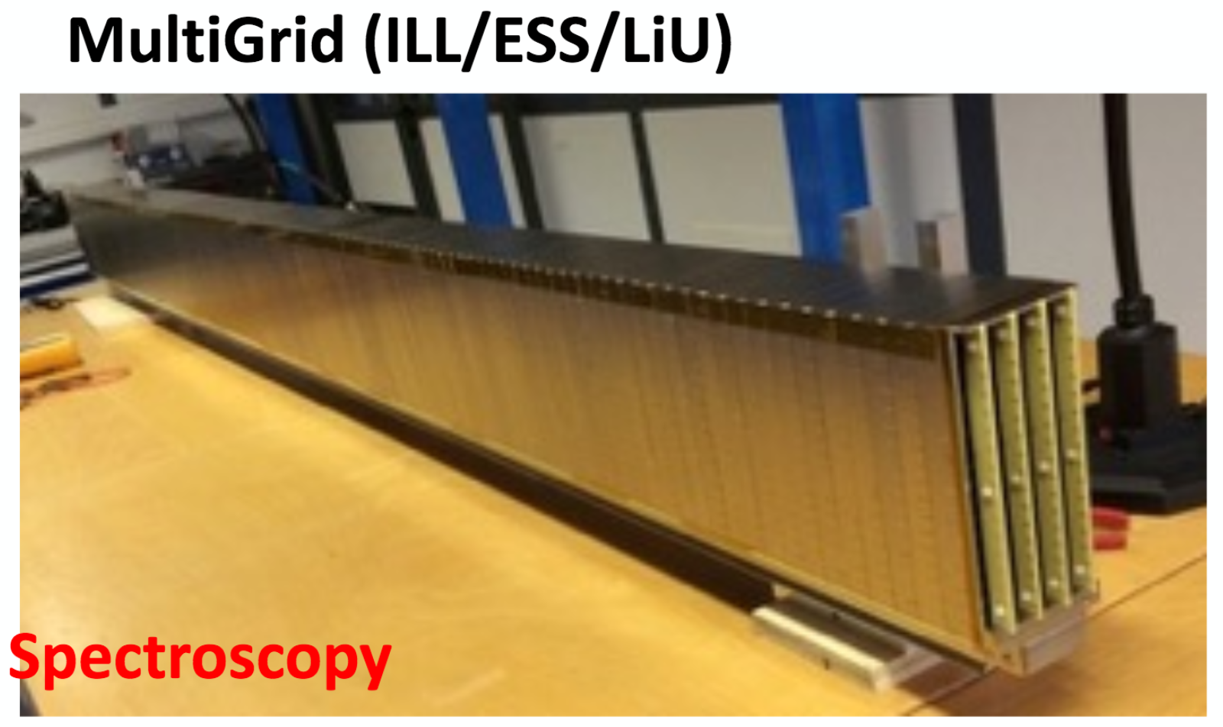
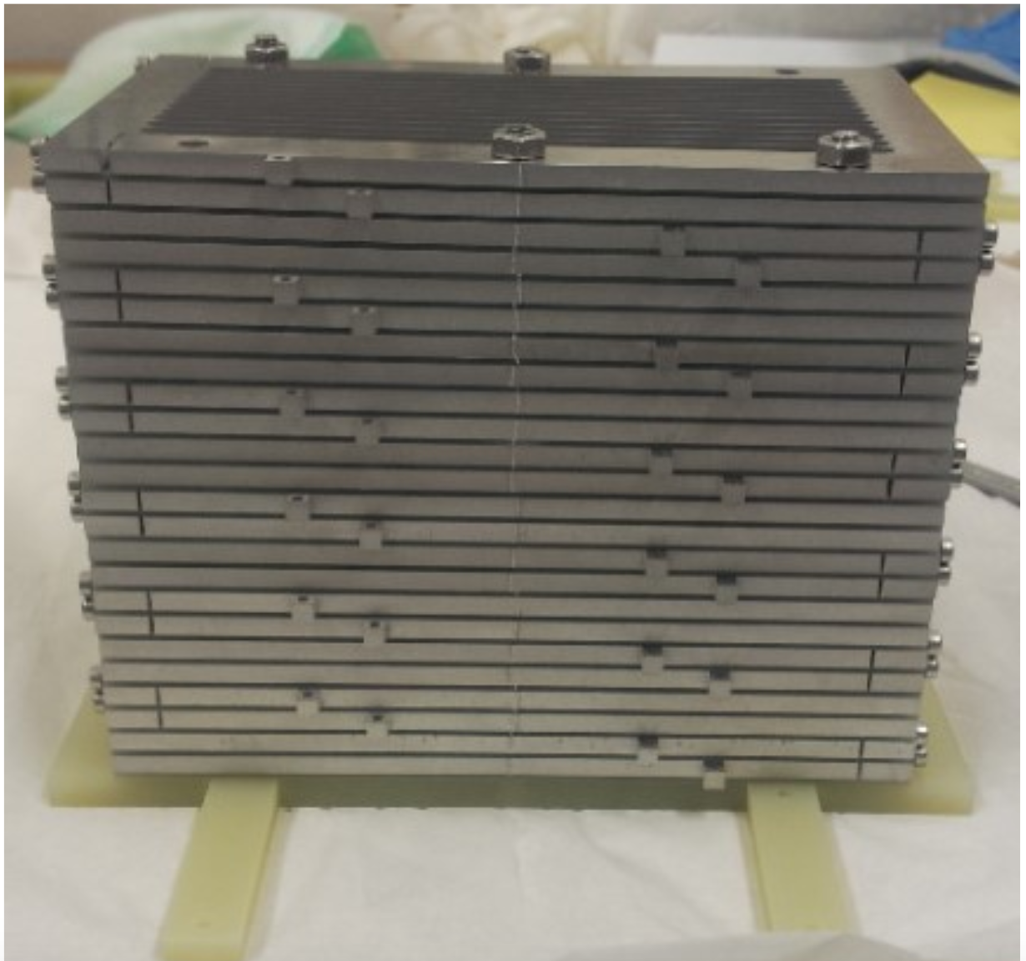
The ESS detector challenge
Various detectors for various instruments at ESS
All with different designs, all have to be optimised for respective instrument requirements
Good measurement
=>high signal-to-background
ESS: increased flux
Low level background
=> need to understand
Effective and universal
simulation tool
Molecular crystallography
BandGEM (Milan/CNR/INFN/CERN/ESS)
SANS
Notes:
ESS
Several detectors for various instruments, different phases of development (get nice plot from IKON12!)
Conclusion:
We cannot manage without very effective tools
Core of all measurement is the SBR. ESS increases flux, so increases Signal. Now we have to build detectors with low Bg.
(keep in mind:
@CF it’s easy and fast to build up and modify geometries,
analyse and plot data,
move from one code to the other
safe, handles well the big amount of data)

Slide 4
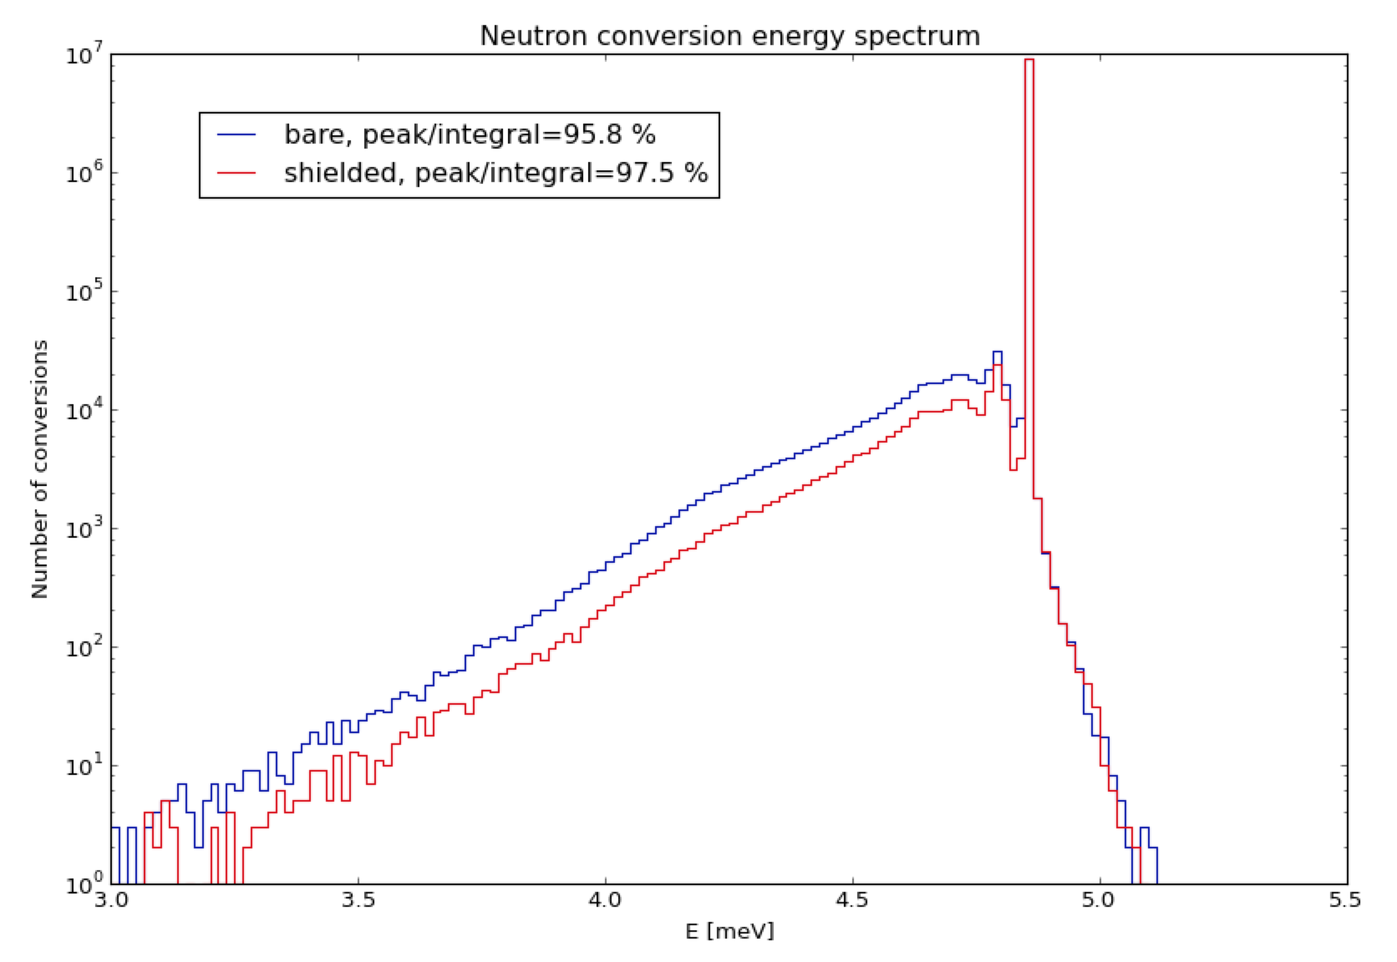
The ESS detector challenge
Various detectors for various instruments at ESS
All with different designs, all have to be optimised for respective instrument requirements
Good measurement
=>high signal-to-background
ESS: increased flux
Low level background
=> need to understand
e.g. MultiGrid for inelastic instrument
Background suppression
Effective and universal
simulation tool
Using scientific quantities for optimisation
Notes:
ESS
Several detectors for various instruments, different phases of development (get nice plot from IKON12!)
Conclusion:
We cannot manage without very effective tools
Core of all measurement is the SBR. ESS increases flux, so increases Signal. Now we have to build detectors with low Bg.
(keep in mind:
@CF it’s easy and fast to build up and modify geometries,
analyse and plot data,
move from one code to the other
safe, handles well the big amount of data)

Slide 5








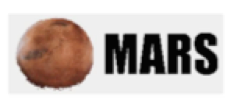
The detector simulation challenge
inspiration
Several already existing simulation codes
New or improved features needed:
  Physics
    Coherent scattering
    Inelastic scattering
    Single- and polycrystals…
  And more
    Communication
    Visualisation
    Ready-to use…
Notes:
Point out: What is geant4?

Slide 6
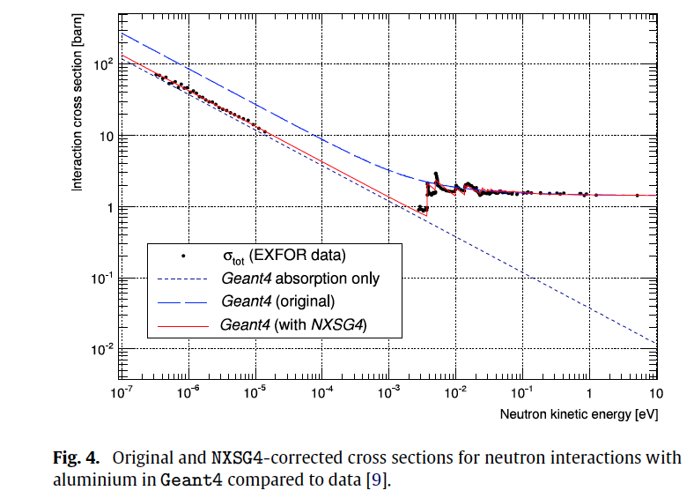
NXSG4 extension
[Thomas Kittelmann, Mirko Boin]
nxs library
  Low-energy neutron scattering
  Polycrystalline materials
    Coherent and
    Incoherent neutron scattering
http://cern.ch/nxsg4/
  examples, license details
  instructions for installation and usage
  usage of the code (including nxs and SgInfo) is free for non-commercial purposes
NXSG4 makes nxs library
available as Geant4 extension
doi:10.1016/j.cpc.2014.11.009
Notes:
Point out: What is geant4?

Slide 7
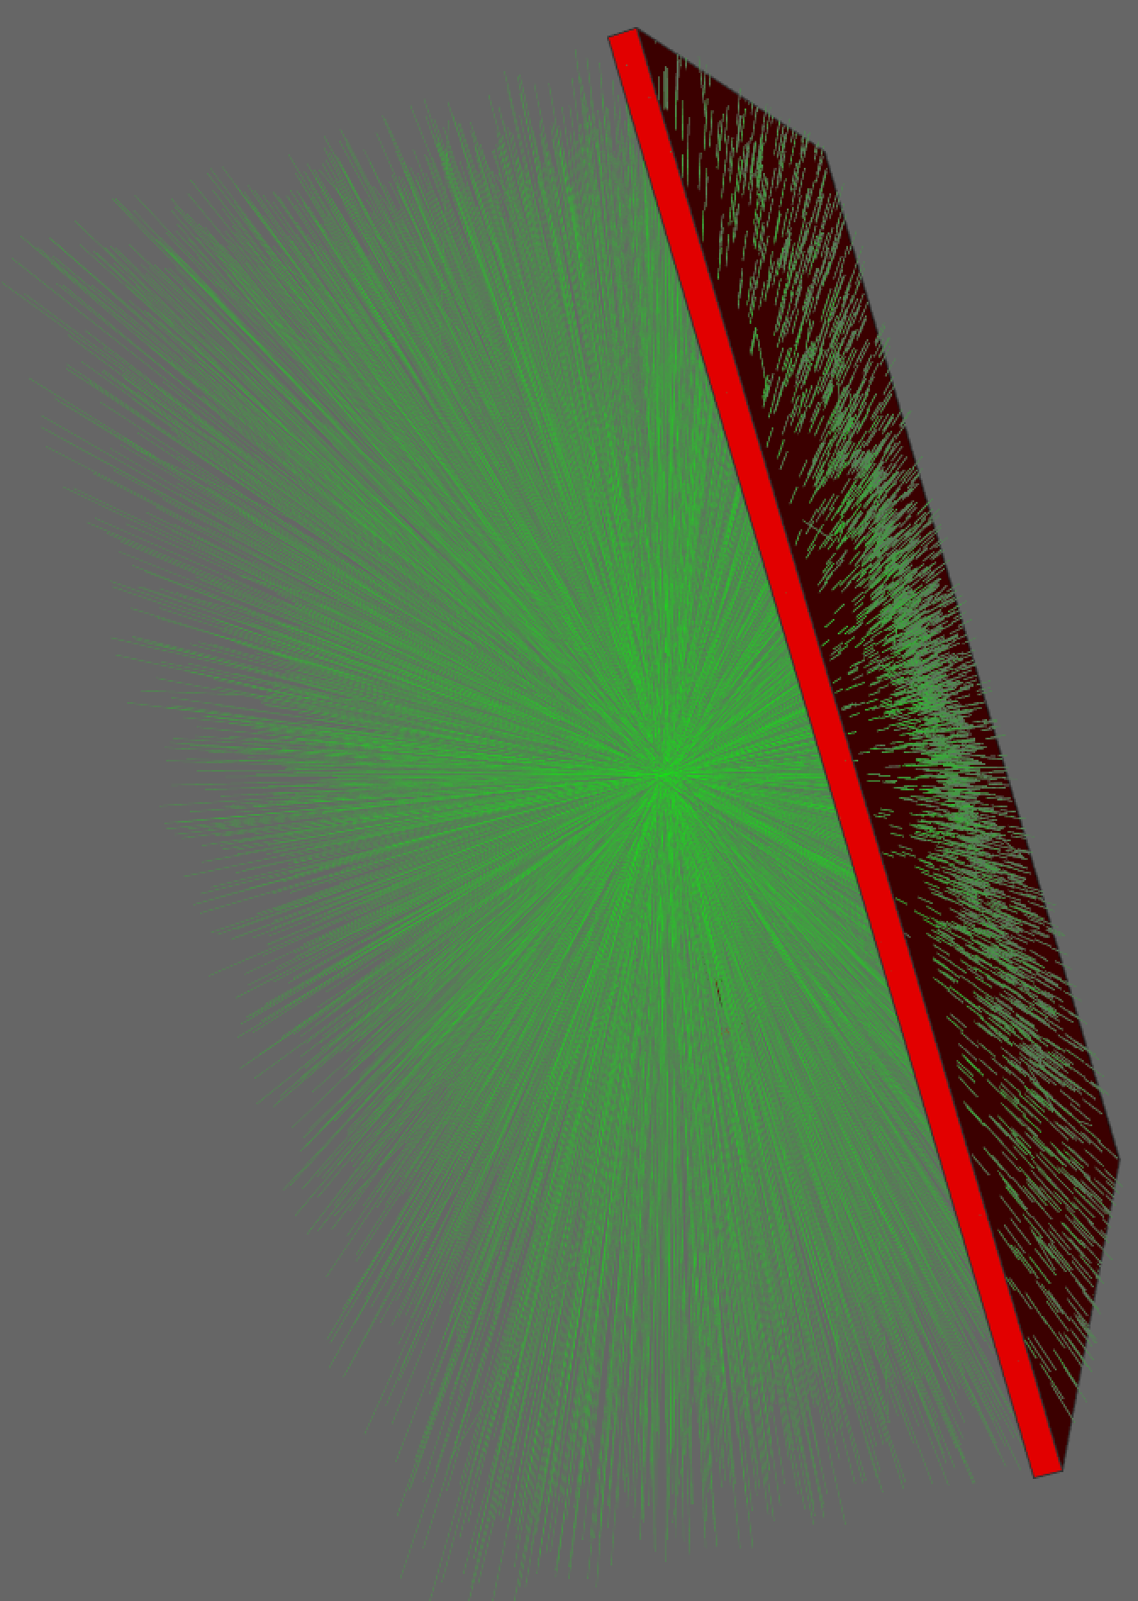
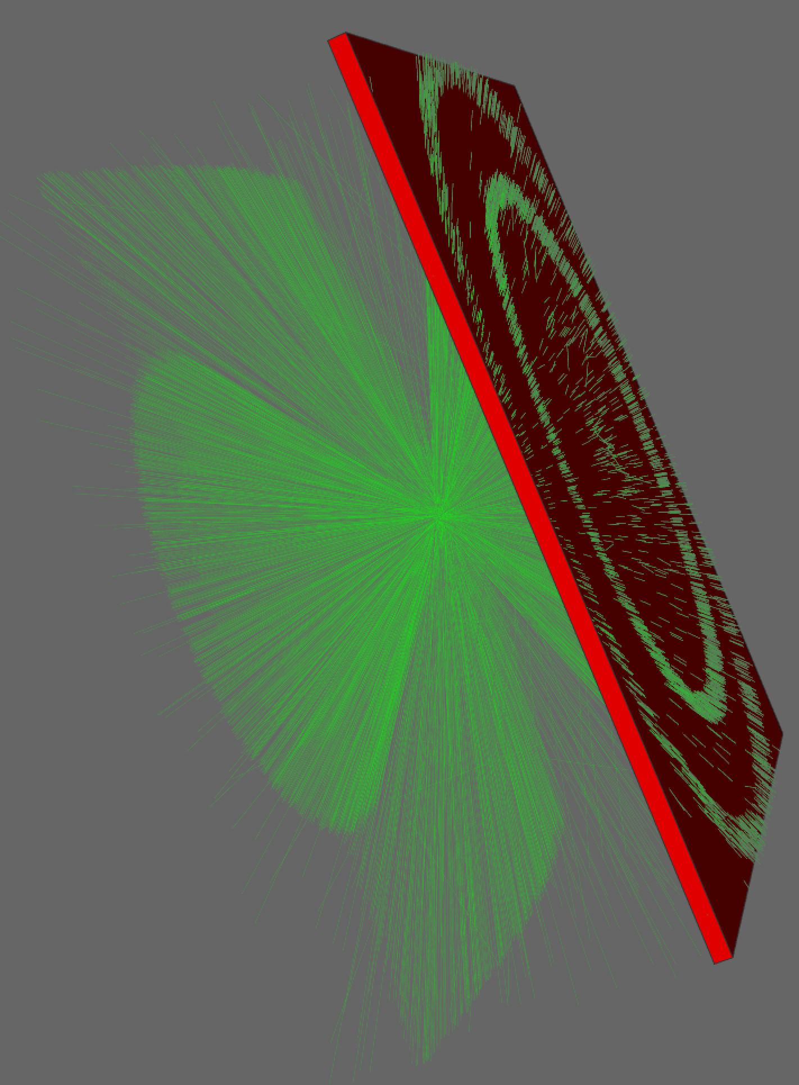
NXSG4 extension
[Thomas Kittelmann, Mirko Boin]
Geant4 simulation
Free-gas model Geant4 aluminum
NXSG4
aluminum
n
n

Slide 8
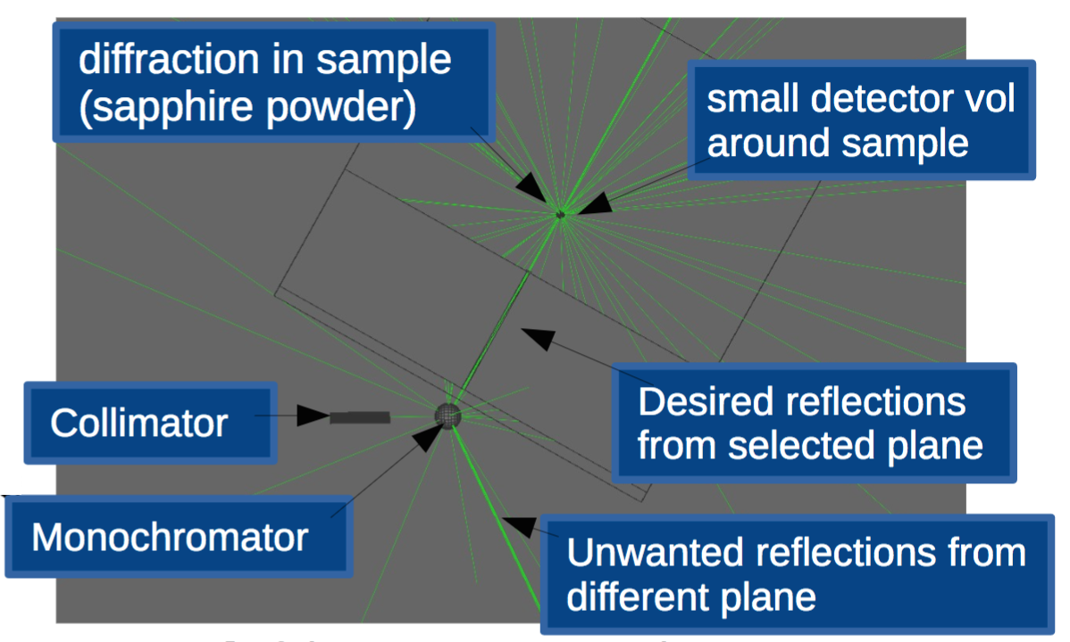
NCrystal
[Xiao Xiao Cai, Thomas Kittelmann]
NCrystal
  Neutron scattering on
  single- and polycrystalline materials
  detailed Bragg diffraction
  first principle inelastic model
C++
open source
See Xiao Xiao Cai’s talk
Friday 09:55 (Neutronics 2)
monochromators, analysers, filters, powder samples
full-instrument simulation
Standalone NCrystal tool coming soon
Notes:
Coming soon as a standalone tool (right now it’s only available @ CF)
Consistent treatment of low energy neutrons and other particles within one code
Coherent scattering
Bragg diffraction
Inelastic scattering (it was future plan in Sept, ask XX)
Scattering on single- and poly-crystals

Slide 9
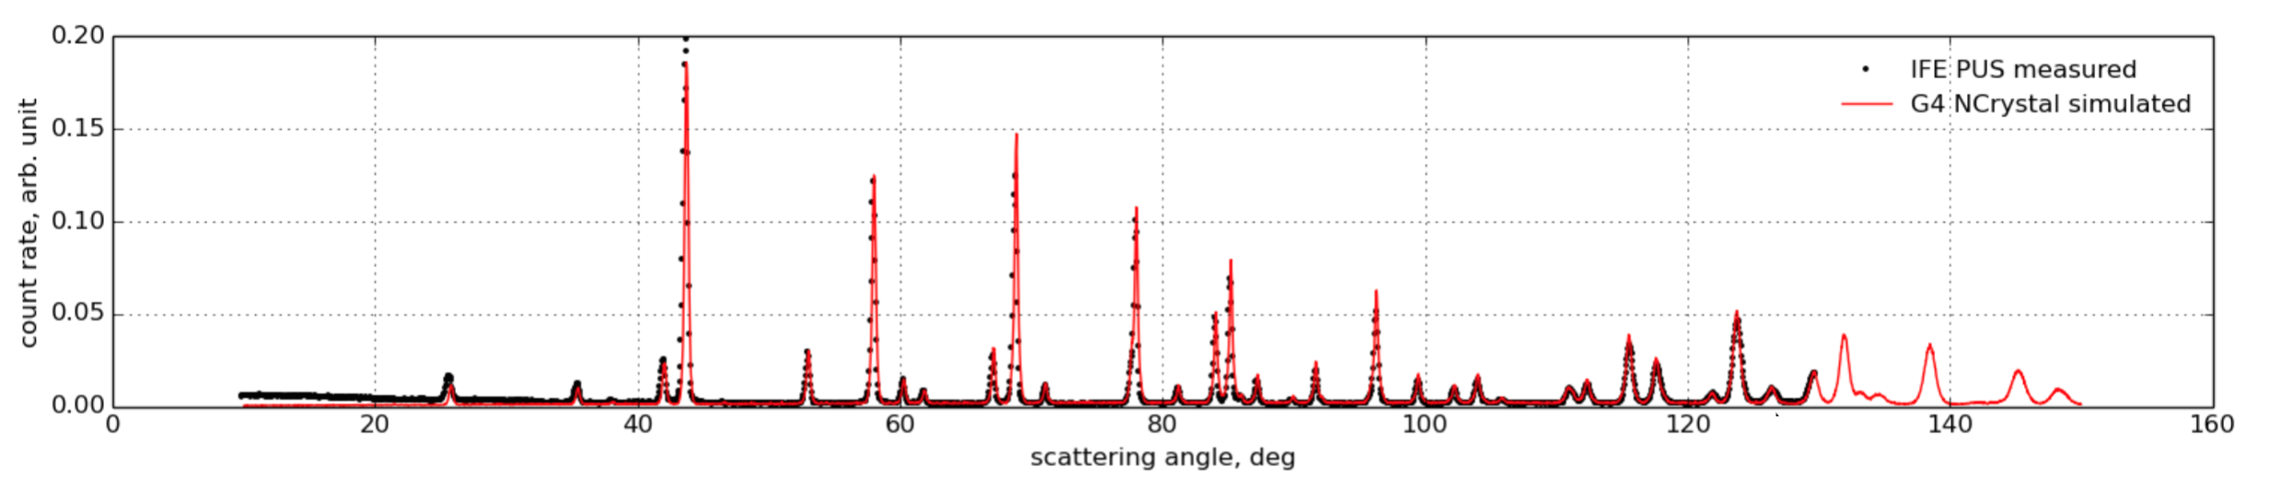
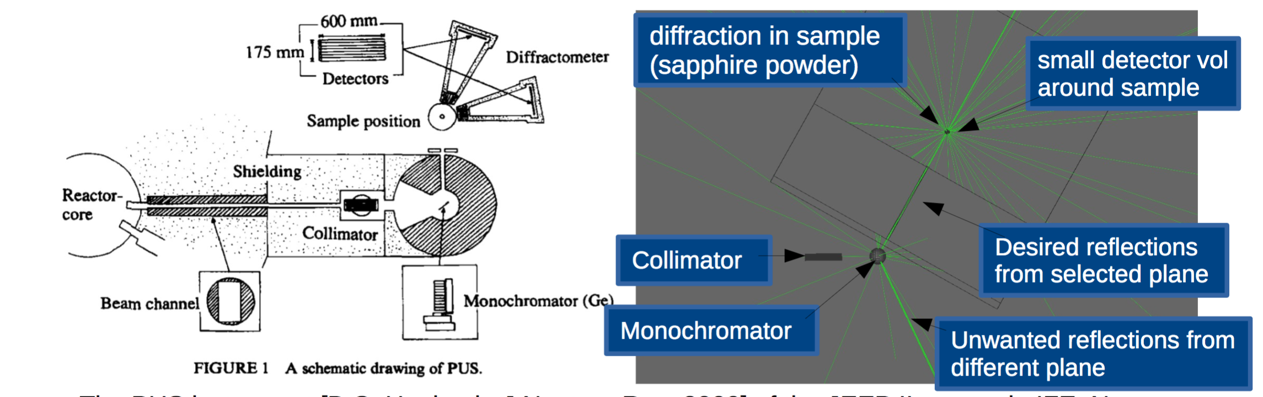
NCrystal
[Xiao Xiao Cai, Thomas Kittelmann]
Geant4 simulation
Powder Diffractometer PUS at IFE, Norway
Standalone NCrystal tool coming soon
Notes:
Coming soon as a standalone tool (right now it’s only available @ CF)
Consistent treatment of low energy neutrons and other particles within one code
Coherent scattering
Bragg diffraction
Inelastic scattering (it was future plan in Sept, ask XX)
Scattering on single- and poly-crystals

Slide 10
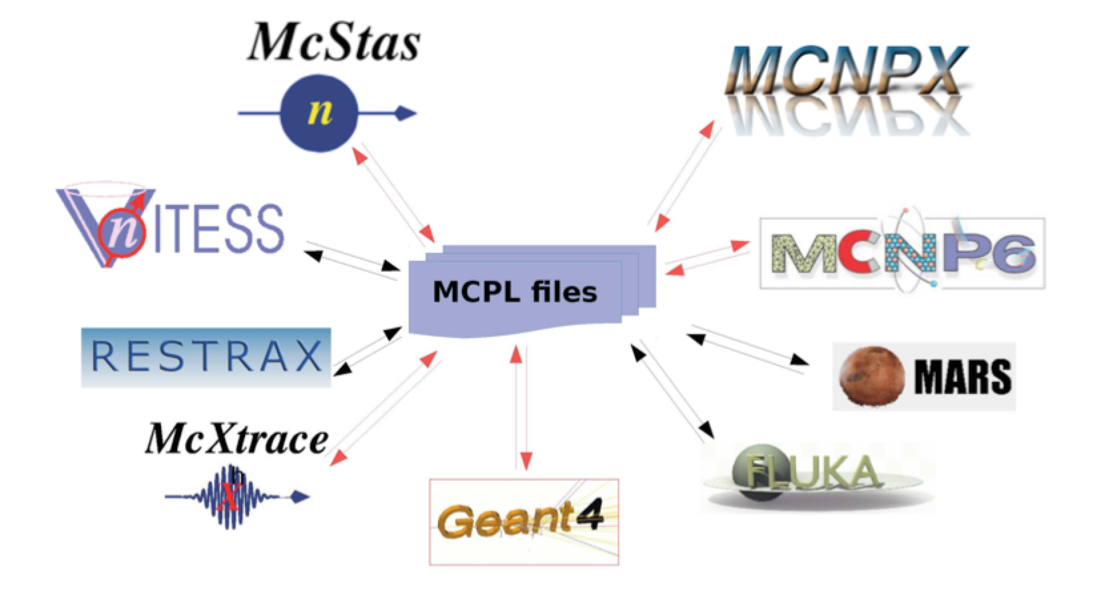
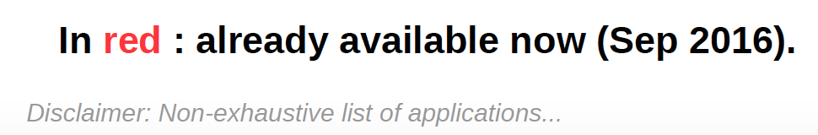
MCPL-Monte Carlo Particle List
[Thomas Kittelmann, Esben Klinkby, Erik B. Knudsen, Peter Willendrup]
Contact:
mcpl-developers@cern.ch
Monte Carlo Particle List
  https://mctools.github.io/mcpl/
  Interchange particles with all their properties between MC packages
  flexible yet efficient storage of particle-state information
arxiv:1609.02792
Best code for
best application
http://sine2020.eu/news-and-media/mcpl-a-new-format-that-simplifies-data-interchange-between-applications.html

Slide 11
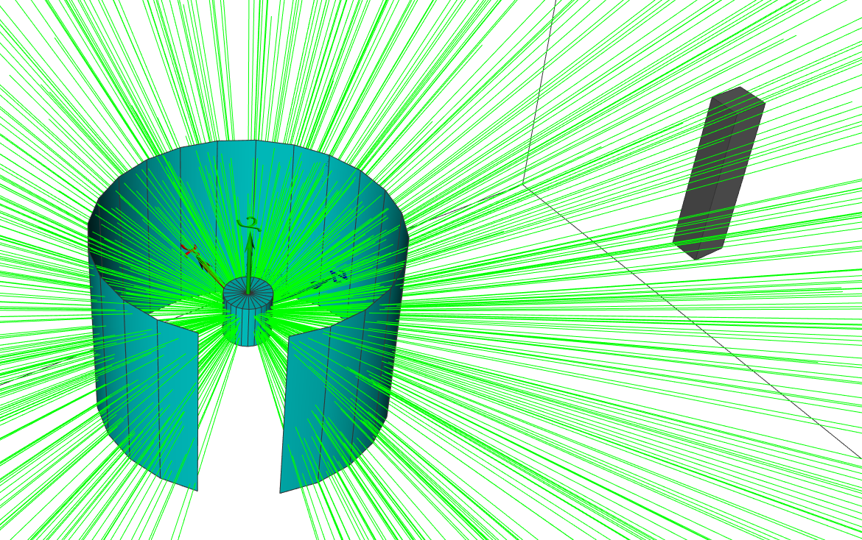
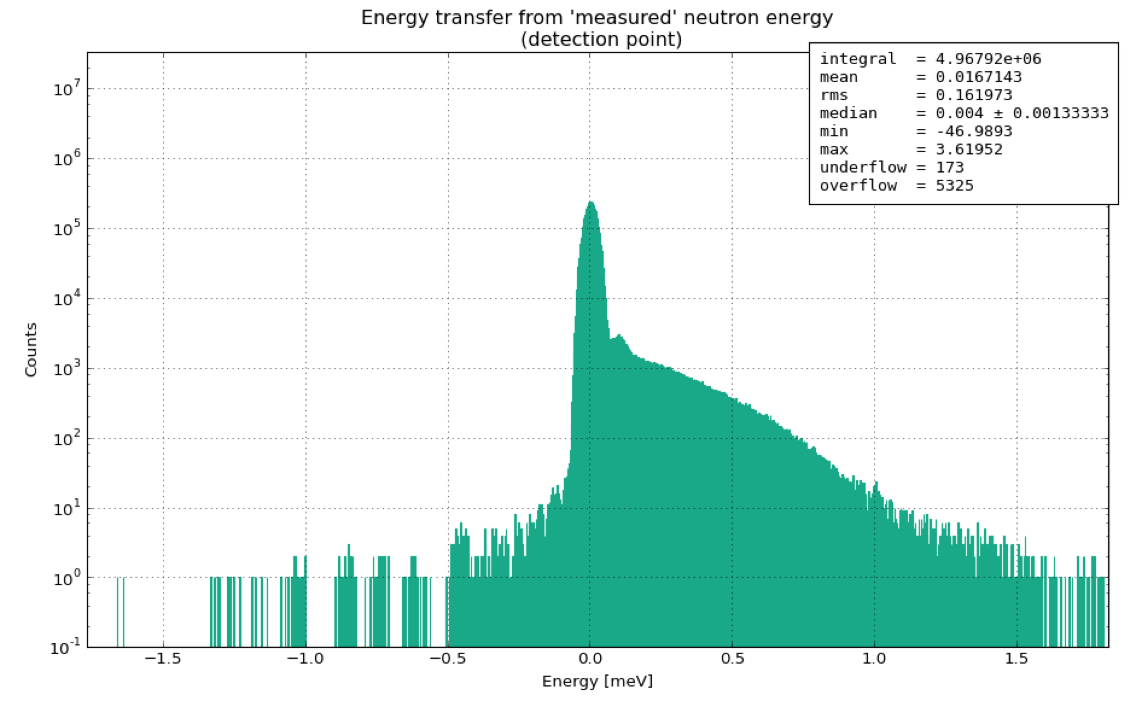
ESS Coding Framework
[Thomas Kittelmann, Xiao Xiao Cai, Kalliopi Kanaki]
Contact:
Thomas Kittelmann: thomas.kittelmann@esss.se
Xiao Xiao Cai: xcai@dtu.dk
Kalliopi Kanaki: kalliopi.kanaki@esss.se
Geant4 simulation framework
  Developed by ESS Detector Group
  Used by other groups in ESS e.g.
  Accelerator Group, Shielding and Optics Group
Contains all afore mentioned tools:
  Integrated
  Transparent for end-user
  Out-of-the-box usage
And more:
  Effective build system
  Python interface
  Easy-to-handle histograms for analysis
  3D visualisation
  Griff: an effective binary format for results
  Powerful parameter scan without recompilation
  Intuitive
  User friendly
I’m a happy end-user!
Available, just send a mail ☺
  Fast to develop new simulations
Notes:
Contains all above mentioned tools are integrated, transparent for end-user in ready-to-use (out-of-the-box ?) form and more
G4!
Build system
Python interface
Histograms
3Dviewer
Griff
scalable
Fast, safe and user friendly
Used by other groups in ESS e.g. Accelerator Group, Shielding and Optics Group

Slide 12
ESS Coding Framework
[Thomas Kittelmann, Xiao Xiao Cai, Kalliopi Kanaki]
Contact:
Thomas Kittelmann: thomas.kittelmann@esss.se
Xiao Xiao Cai: xcai@dtu.dk
Kalliopi Kanaki: kalliopi.kanaki@esss.se
Geant4 simulation framework
  Developed by ESS Detector Group
  Used by other groups in ESS e.g.
  Accelerator Group, Shielding and Optics Group
Contains all afore mentioned tools:
  Integrated
  Transparent for end-user
  Out-of-the-box usage
And more:
  Effective build system
  Python interface
  Easy-to-handle histograms for analysis
  3D visualisation
  Griff: an effective binary format for results
  Powerful parameter scan without recompilation
  Intuitive
  User friendly
I’m a happy end-user!
Available, just send a mail ☺
  Fast to develop new simulations
Now let’s use it!
Notes:
Contains all above mentioned tools are integrated, transparent for end-user in ready-to-use (out-of-the-box ?) form and more
G4!
Build system
Python interface
Histograms
3Dviewer
Griff
scalable
Fast, safe and user friendly
Used by other groups in ESS e.g. Accelerator Group, Shielding and Optics Group

Slide 13

Detector background study with Monte Carlo codes
Sources of neutron detector background
  Neutron induced gamma background (MCNP6)
    Prompt gamma radiation from neutron capture
    Decay gammas from neutron activation
  Scattered neutrons (Geant4)
    Elastic, inelastic
    Coherent, incoherent
General neutron activation study prepared with MCNP6 for ESS operation conditions
- Ar/CO₂ counting gas
- Aluminum-frame
E. Dian et al.
arXiv:1701.08117
submitted to ARI
⁴¹Ar activity saturates at 128 mBq/cm³ low
Negligible signal from self-activation
Great impact of Coding Framework!
Notes:
General neutron activation study already prepared for B4C-based neutron detectors -> ref arXiv:1701.08117
If it weren’t negligible, we could use it as an input to G4 ☺
Run until sample, MCPL-> uniq tool to optimise det with realistic (meas or sim) data

Slide 14
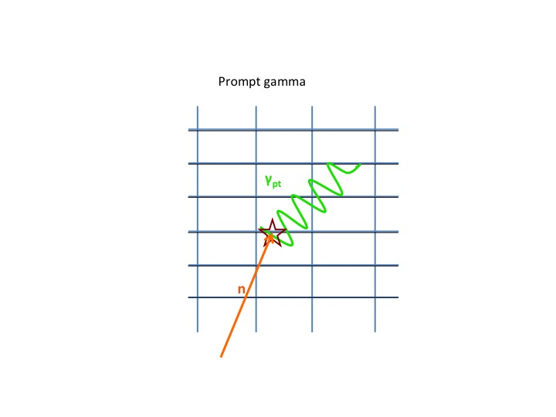
Detector background study with Monte Carlo codes
Sources of neutron detector background
  Neutron induced gamma background (MCNP6)
    Prompt gamma radiation from neutron capture
    Decay gammas from neutron activation
  Scattered neutrons (Geant4)
    Elastic, inelastic
    Coherent, incoherent
General neutron activation study prepared with MCNP6 for ESS operation conditions
- Ar/CO₂ counting gas
- Aluminum-frame
E. Dian et al.
arXiv:1701.08117
submitted to ARI
⁴¹Ar activity saturates at 128 mBq/cm³ low
Negligible signal from self-activation
Great impact of Coding Framework!
Notes:
General neutron activation study already prepared for B4C-based neutron detectors -> ref arXiv:1701.08117
If it weren’t negligible, we could use it as an input to G4 ☺
Run until sample, MCPL-> uniq tool to optimise det with realistic (meas or sim) data

Slide 15
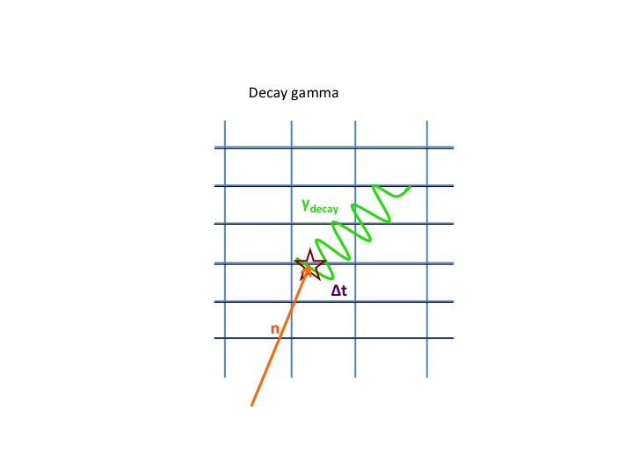
Detector background study with Monte Carlo codes
Sources of neutron detector background
  Neutron induced gamma background (MCNP6)
    Prompt gamma radiation from neutron capture
    Decay gammas from neutron activation
  Scattered neutrons (Geant4)
    Elastic, inelastic
    Coherent, incoherent
General neutron activation study prepared with MCNP6 for ESS operation conditions
- Ar/CO₂ counting gas
- Aluminum-frame
E. Dian et al.
arXiv:1701.08117
submitted to ARI
⁴¹Ar activity saturates at 128 mBq/cm³ low
Negligible signal from self-activation
Great impact of Coding Framework!
Notes:
General neutron activation study already prepared for B4C-based neutron detectors -> ref arXiv:1701.08117
If it weren’t negligible, we could use it as an input to G4 ☺
Run until sample, MCPL-> uniq tool to optimise det with realistic (meas or sim) data

Slide 16
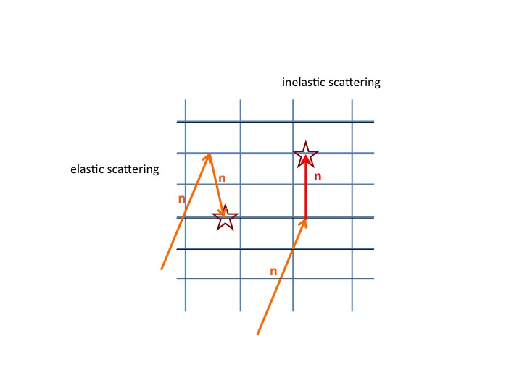
Detector background study with Monte Carlo codes
Sources of neutron detector background
  Neutron induced gamma background (MCNP6)
    Prompt gamma radiation from neutron capture
    Decay gammas from neutron activation
  Scattered neutrons (Geant4)
    Elastic, inelastic
    Coherent, incoherent
General neutron activation study prepared with MCNP6 for ESS operation conditions
- Ar/CO₂ counting gas
- Aluminum-frame
E. Dian et al.
arXiv:1701.08117
submitted to ARI
⁴¹Ar activity saturates at 128 mBq/cm³ low
Negligible signal from self-activation
Great impact of Coding Framework!
Notes:
General neutron activation study already prepared for B4C-based neutron detectors -> ref arXiv:1701.08117
If it weren’t negligible, we could use it as an input to G4 ☺
Run until sample, MCPL-> uniq tool to optimise det with realistic (meas or sim) data

Slide 17
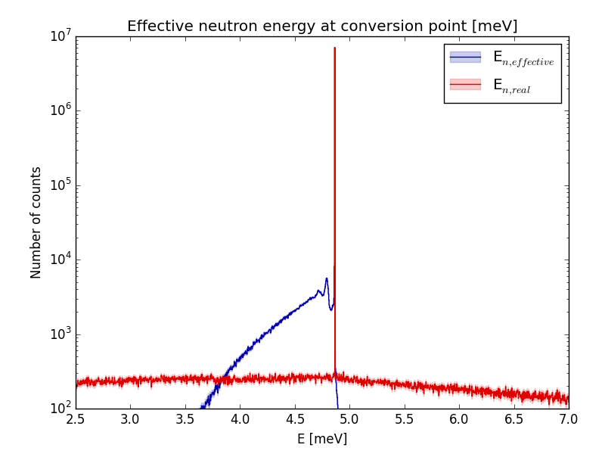
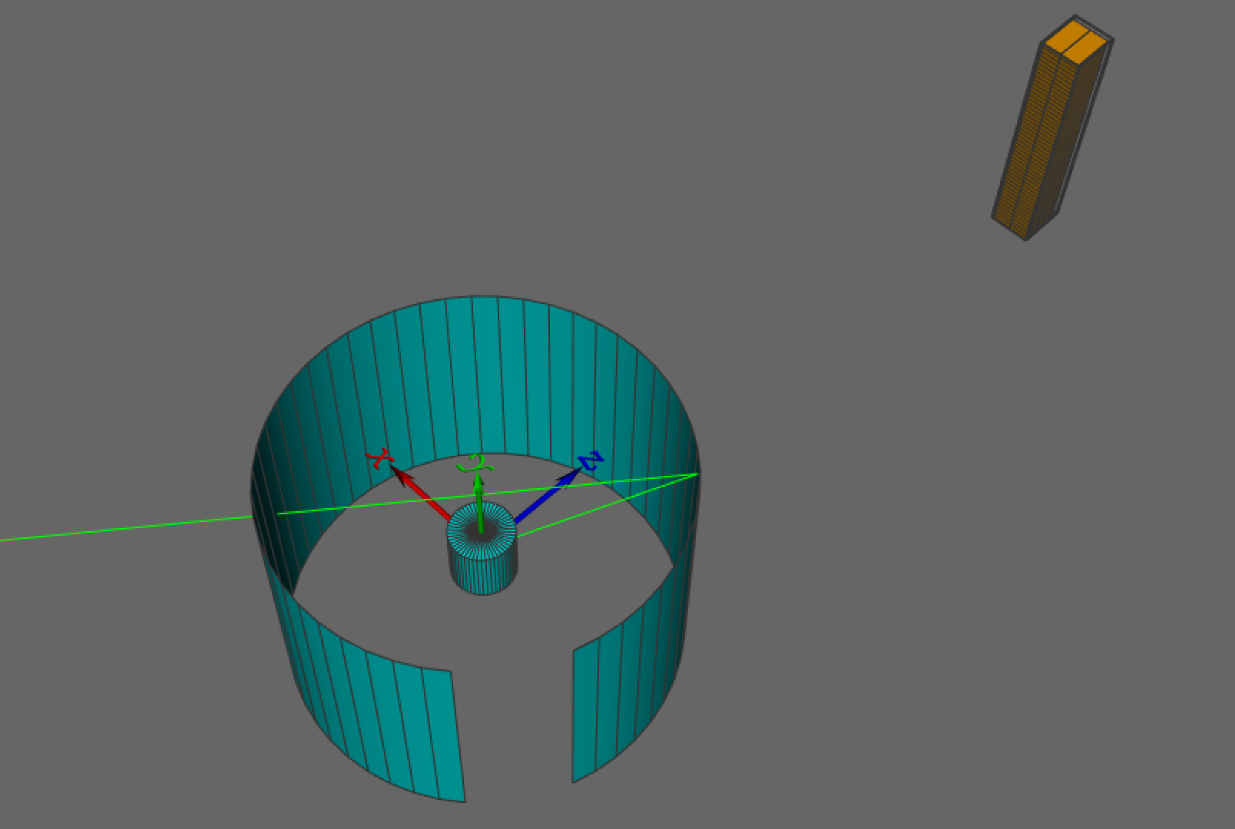
Scattered neutron background – power of simulation
Follow the history of neutrons
Study and distinguish background effects
Guidelines for detector design
Realistic simulation
Scattered neutron
Scattered neutron
Detector
Real and measurable neutron energy at conversion point
Sample environment
Geant4 simulation

Slide 18
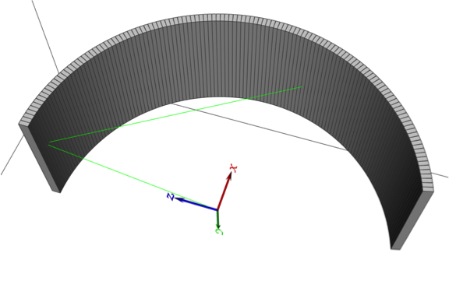
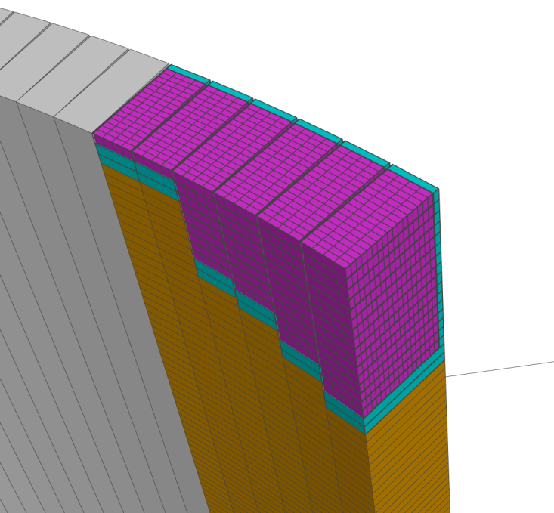
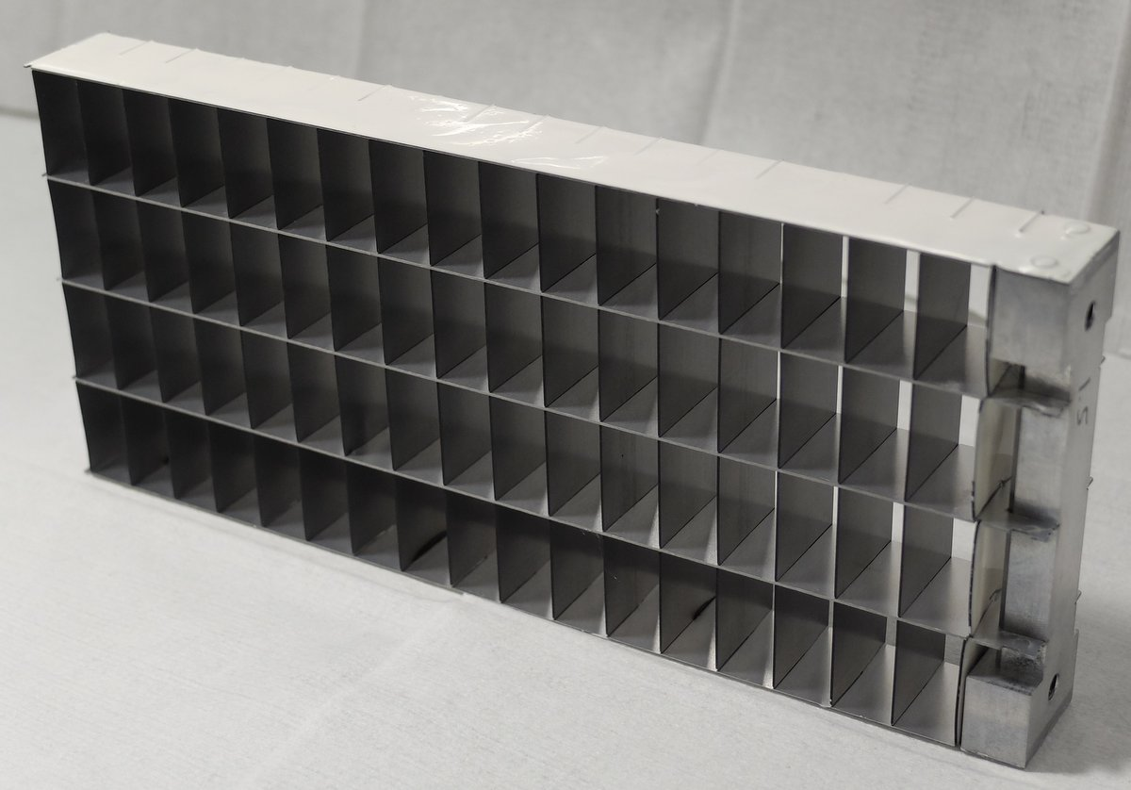
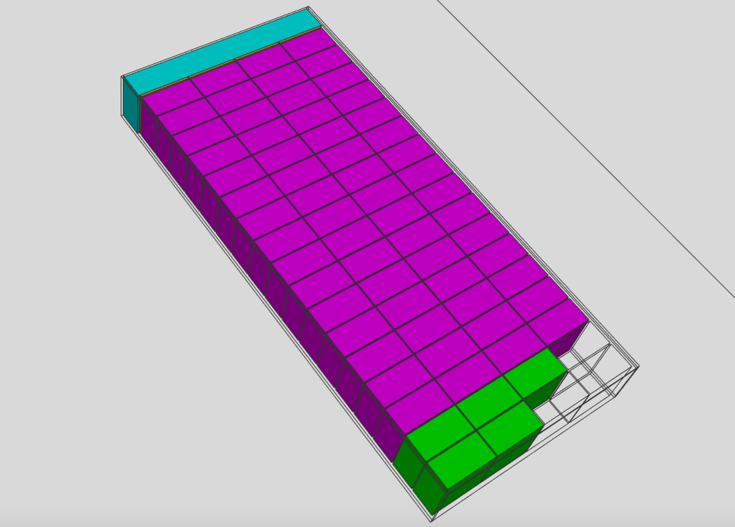
Large area detector for chopper spectroscopy - MultiGrid
Geant4 simulation
Bla
Large area MultiGrid detector chosen as example
Chopper spectroscopy:
  Low background is essential
A. Khaplanov et al.
http://dx.doi.org/10.1016/j.nima.2012.12.021
Notes:
Point out: Visualisation!

Slide 19

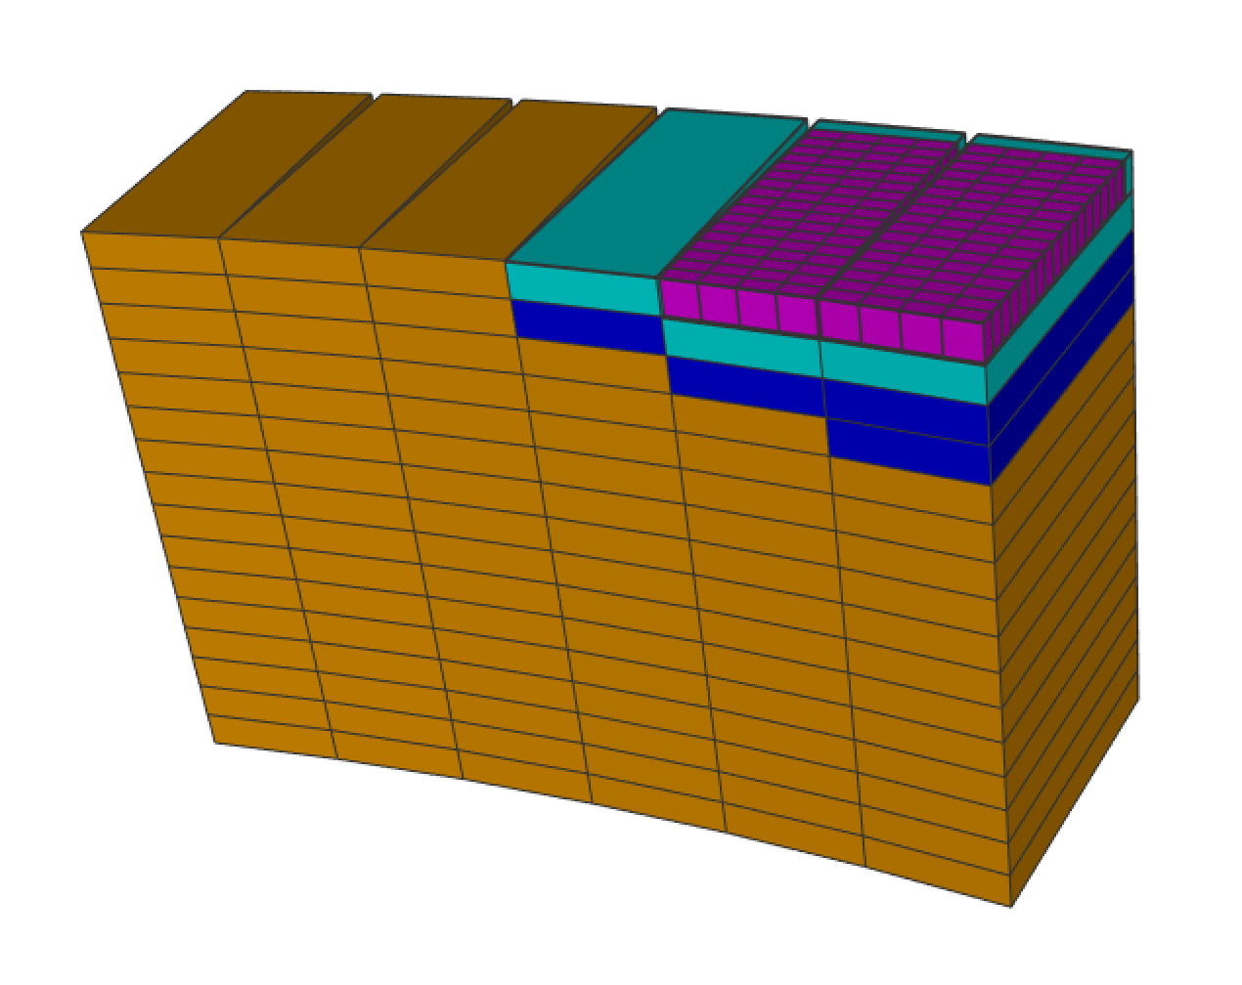
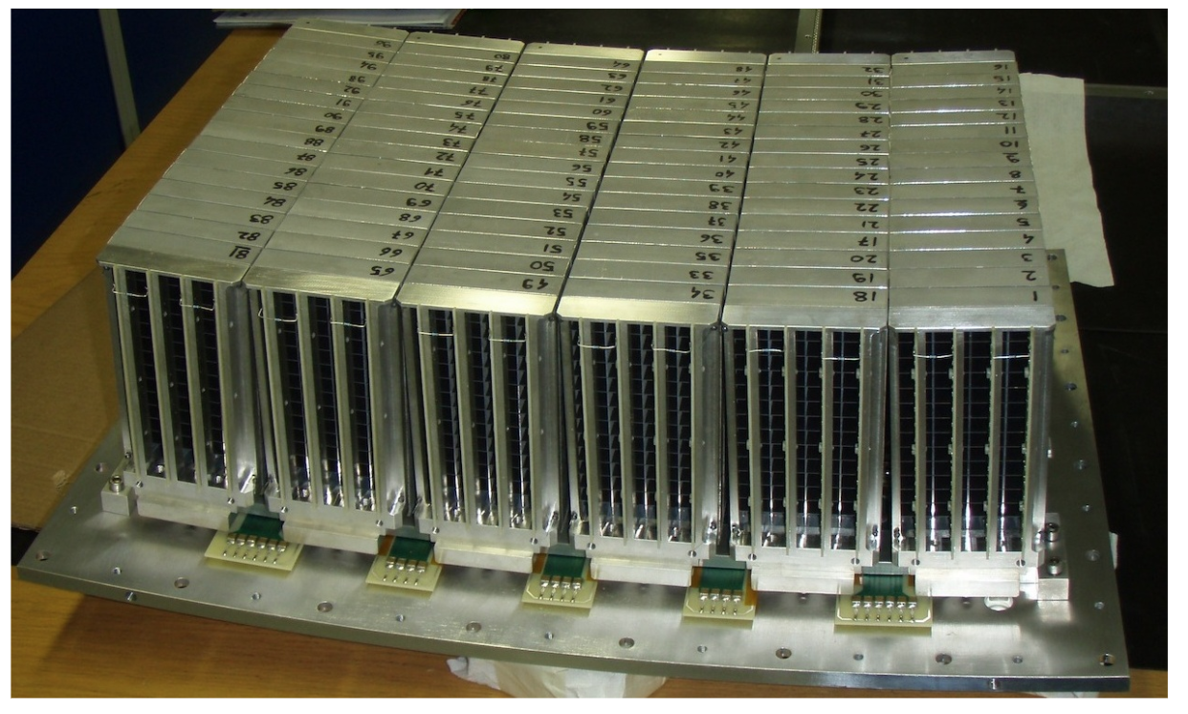
MultiGrid detector test at ILL
In-beam test of the Boron-10 Multi-Grid neutron detector at the IN6 time-of-flight spectrometer at the ILL
A. Khaplanov et al.
http://iopscience.iop.org/article/10.1088/1742-6596/528/1/012040/pdf
Validation
No shielding on the rear wall of grids

Slide 20
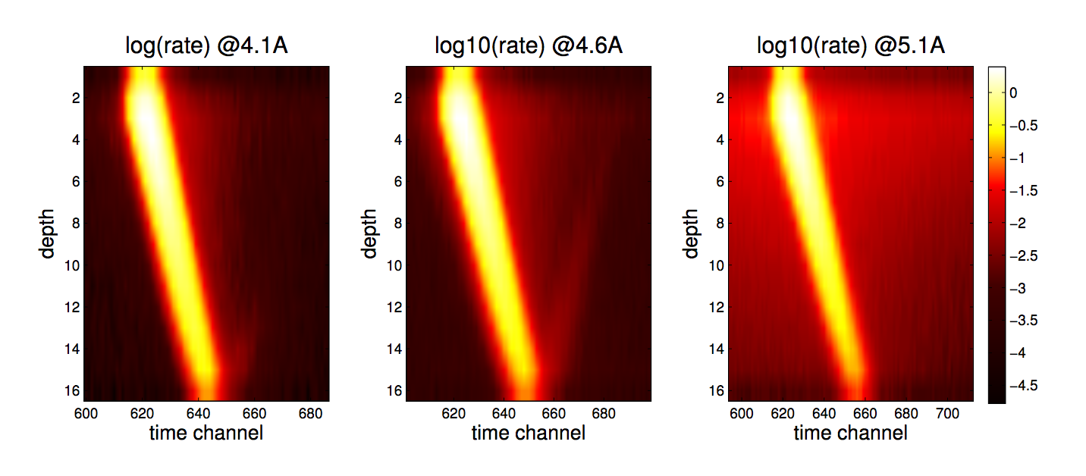
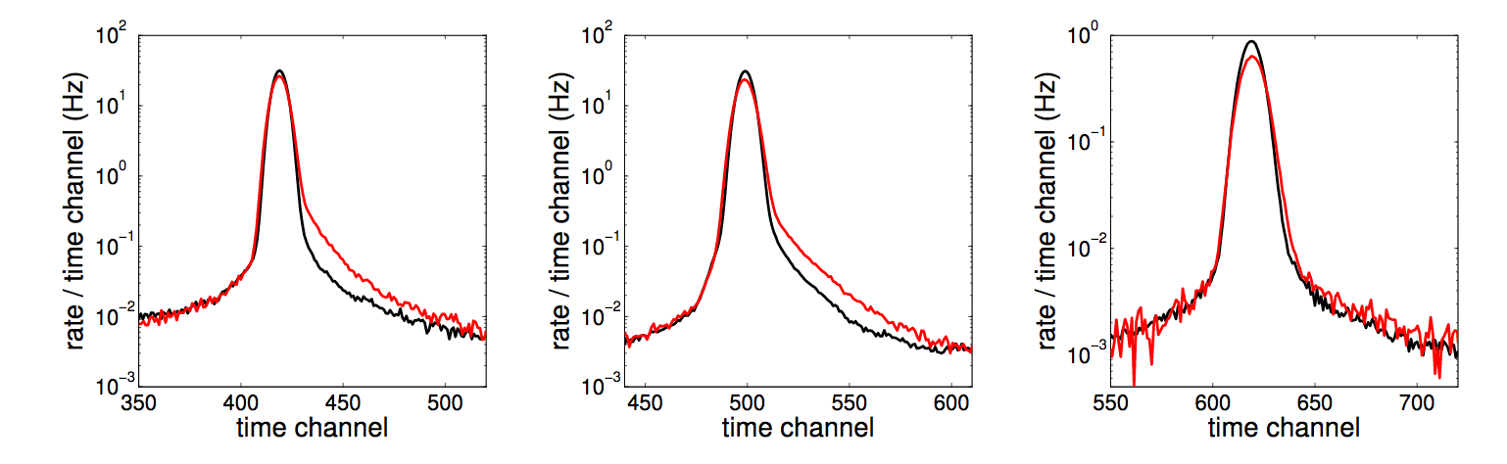
MultiGrid detector test at ILL
Measured data (ToF, depth of detection)
Validation

Slide 21
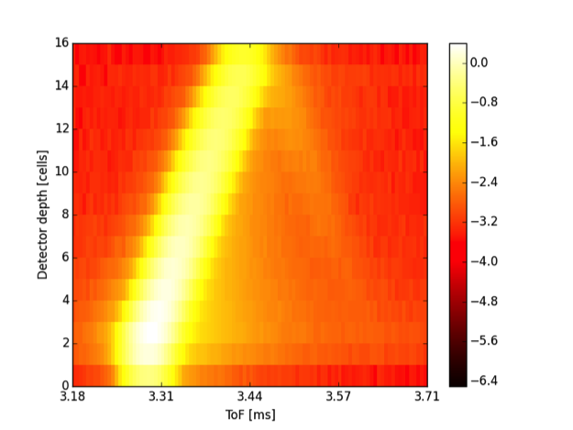
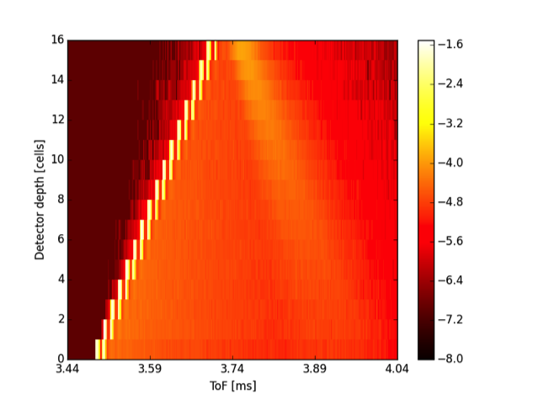
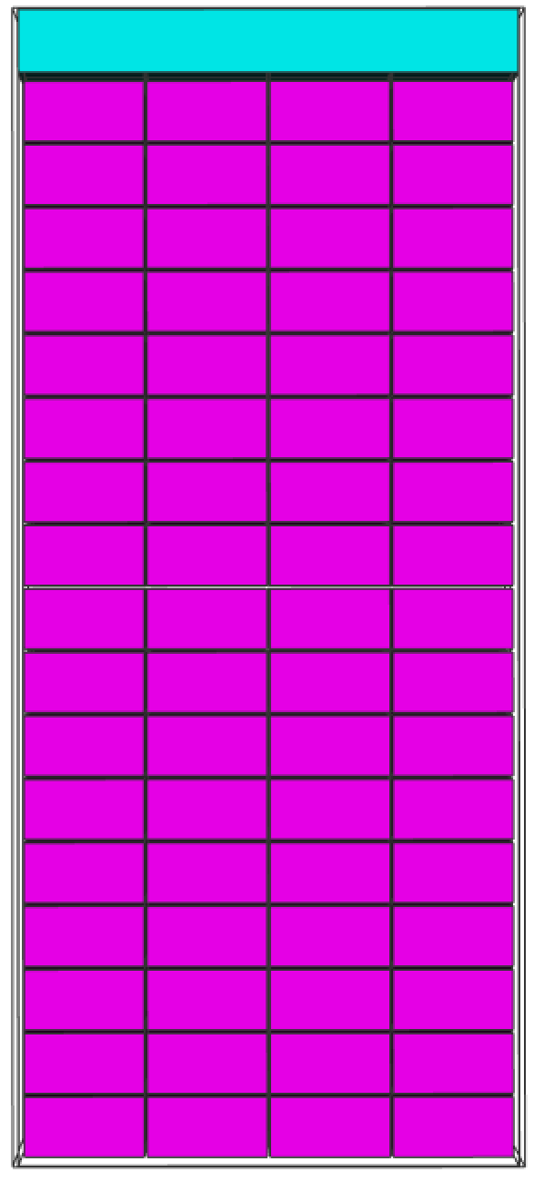
MultiGrid detector test at ILL
Measured and simulated ToF-depth of detection
Geant4 simulation
Backscatter from the unshielded rear wall of the detector at 4.6 Å
Validation
measured
simulated
Depth in detector [cells]
Depth in detector [cells]
ToF
Measured ToF-depth characteristic and backscatter phenomena reproduced with simulation at 4.1 and 4.6 Å

Slide 22
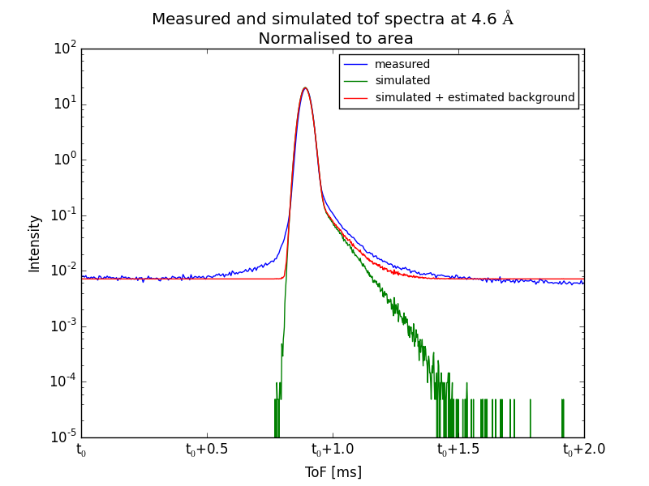
MultiGrid detector test at ILL
Measured and simulated ToF spectra
Geant4 simulation
Validation
Estimated flat alpha-background added (red),
unique for this prototype
Measured
ToF-spectrum reproduced with simulation at 4.1 and 4.6 Å

Slide 23
MultiGrid detector test at CNCS, SNS
Geant4 simulation
Sample environment
Detector
3.3 m
Isotropic scattering
particles simulated from sample
Notes:
Origin of particles…

Slide 24
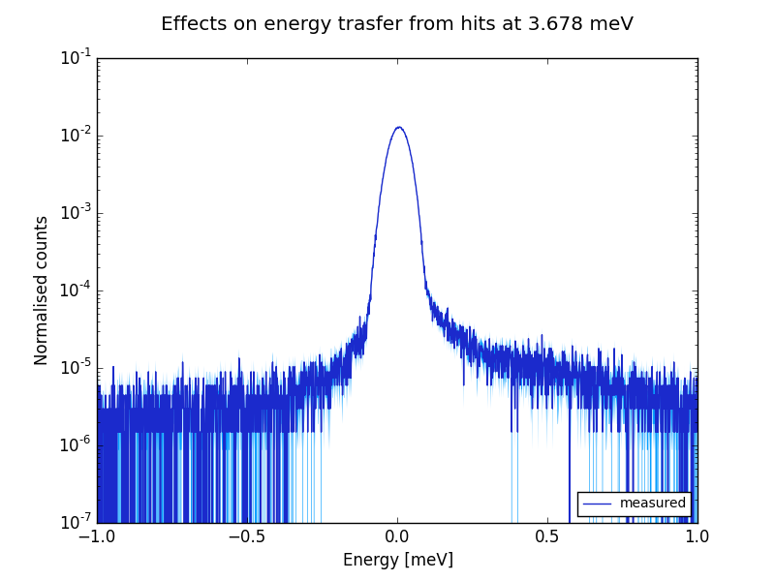
MultiGrid detector test at CNCS, SNS
[Anton Khaplanov]
Derived energy transfer at 3.678 meV from measurement
See Anton Khaplanov’s talk Today 12:10 (Detectors 1)
Chopper spectroscopy
Measured quantities:
  ToF
  detection-coordinates
Energy transfer:
E_{trf} = E_{initial} – E_{final}
E_{trf} = E_{initial} - E_{final}
Counts
Anton Khaplanov et al.:
Multi-Grid Detector for Neutron Spectroscopy: Results Obtained on Time-of-Flight Spectrometer CNCS
Submitted to JINST arXiv:1703.03626

Slide 25
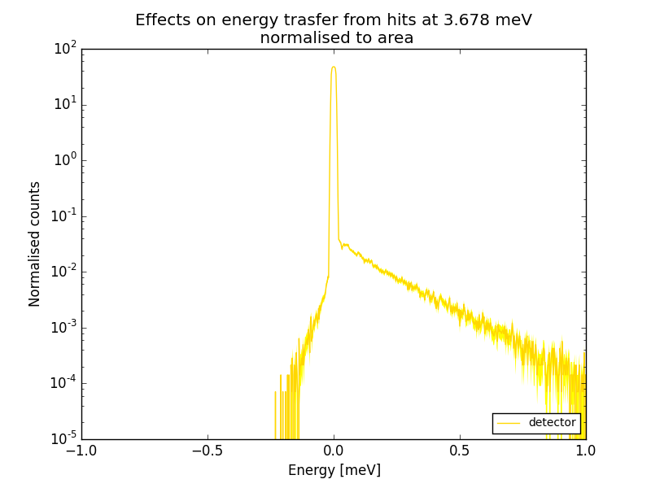
MultiGrid detector test at CNCS, SNS
Geant4 simulation
Elastic peak
E_{trf} = E_{initial} - E_{final}
Scattered neutron background from detector

Slide 26
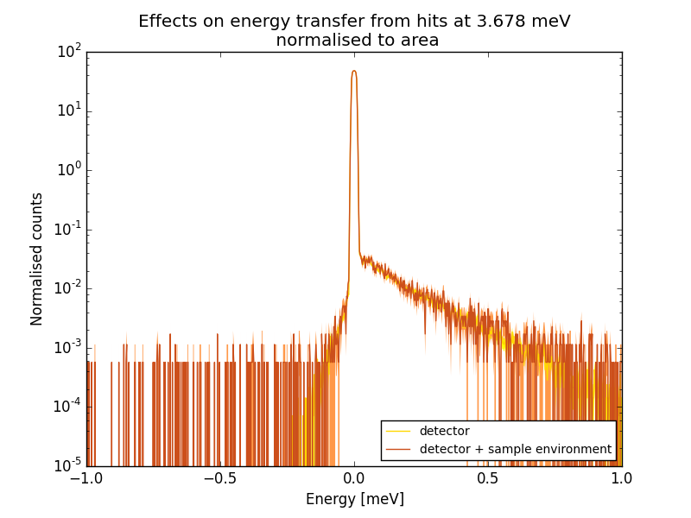
MultiGrid detector test at CNCS, SNS
Geant4 simulation
Elastic peak
E_{trf} = E_{initial} - E_{final}
Scattered neutron background
from sample environment
Scattered neutron background from detector

Slide 27
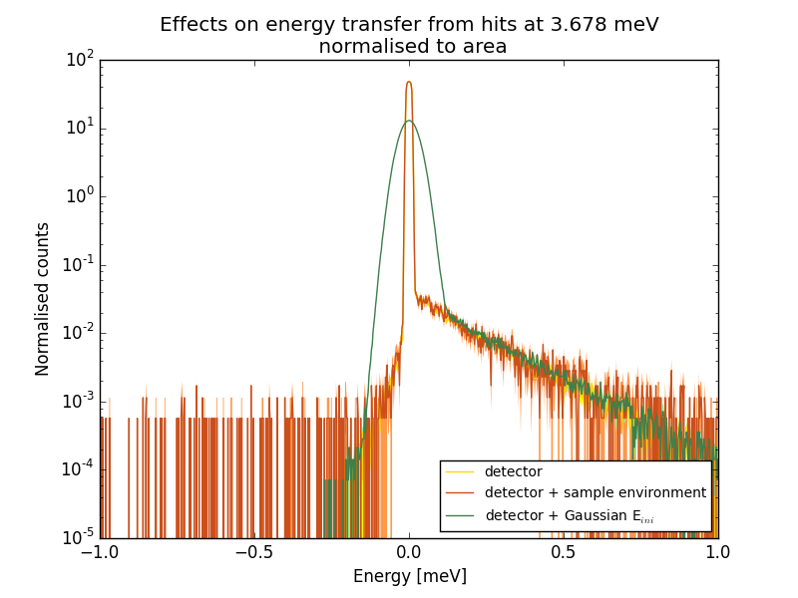
MultiGrid detector test at CNCS, SNS
Geant4 simulation
Elastic peak
E_{trf} = E_{initial} - E_{final}
Scattered neutron background
from sample environment
Scattered neutron background from detector

Slide 28
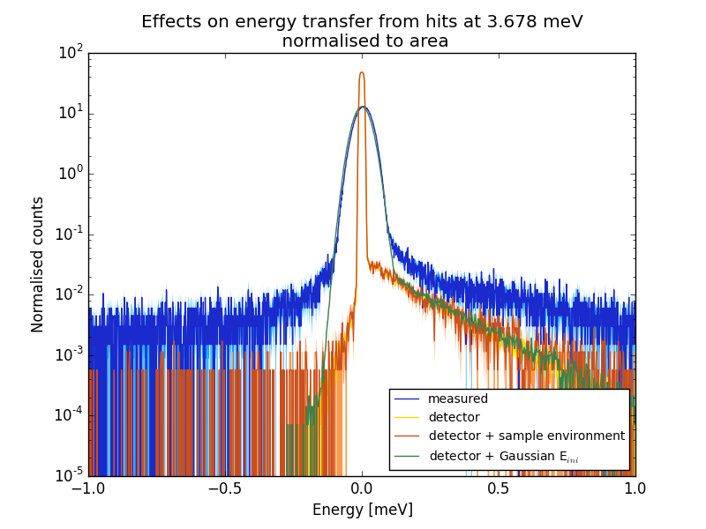
MultiGrid detector test at CNCS, SNS
Geant4 simulation
Elastic peak
E_{trf} = E_{initial} - E_{final}
Scattered neutron background
from sample environment
Scattered neutron background from detector

Slide 29
MultiGrid detector test at CNCS, SNS
Validation
Elastic peak
Distinguish different sources of background
Detailed analysis and quantification of background effects
E_{trf} = E_{initial} - E_{final}
Scattered neutron background
from detector
Scattered neutron background
from sample environment
Energy transfer reproduced with simulation at 3.678 meV

Slide 30
Summary
Great progress in neutron scattering simulation
  Improved modeling for neutron scattering on crystalline material (NXSG4, NCrystal)
  Effective particle interchange (MCPL)
    Easy to combine MC codes
  ESS Coding Framework, where all tools are combined
  Full-scale instrument simulation can be done with a single application
Realistic MultiGrid model built
  reproduced measured results from
  IN6 and CNCS experiments
Ready to use for optimisation
A powerful neutron simulation toolkit developed
Instruments with better
signal-to-background ratio by design

Slide 31

Summary
Great progress in neutron scattering simulation
  Improved modeling for neutron scattering on crystalline material (NXSG4, NCrystal)
  Effective particle interchange (MCPL)
    Easy to combine MC codes
  ESS Coding Framework, where all tools are combined
  Full-scale instrument simulation can be done with a single application
Realistic MultiGrid model built
  reproduced measured results from
  IN6 and CNCS experiments
Ready to use for optimisation
A powerful neutron simulation toolkit developed
Instruments with better
signal-to-background ratio by design
Use the Force, Luke!

Slide 32

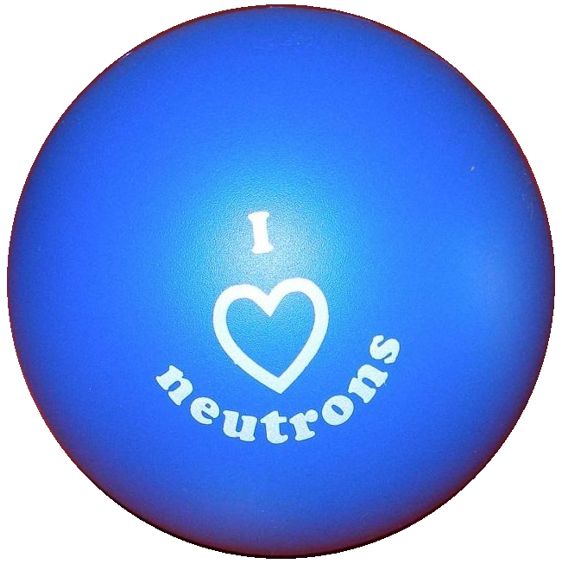
676548
Thank you for your attention!
Thanks to the collaborators for all the prepared tools and materials,
and for making my life easier!
28 March 2017, ICANS XXII, Oxford

Slide 33
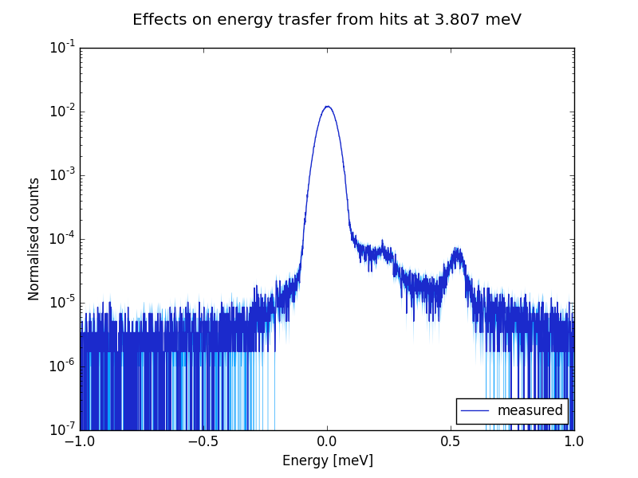
MultiGrid detector test at CNCS
[Anton Khaplanov]
Derived energy transfer at 3.807 meV from measurement
See Anton Khaplanov’s talk Today 12:10 (Detectors 1)
Chopper spectroscopy
Measured quantities:
  ToF
  detection-coordinates
Energy transfer:
E_{trf} = E_{initial} – E_{final}
E_{trf} = E_{initial} - E_{final}
Counts
Anton Khaplanov et al.:
Multi-Grid Detector for Neutron Spectroscopy: Results Obtained on Time-of-Flight Spectrometer CNCS
Submitted to JINST arXiv:1703.03626

Slide 34
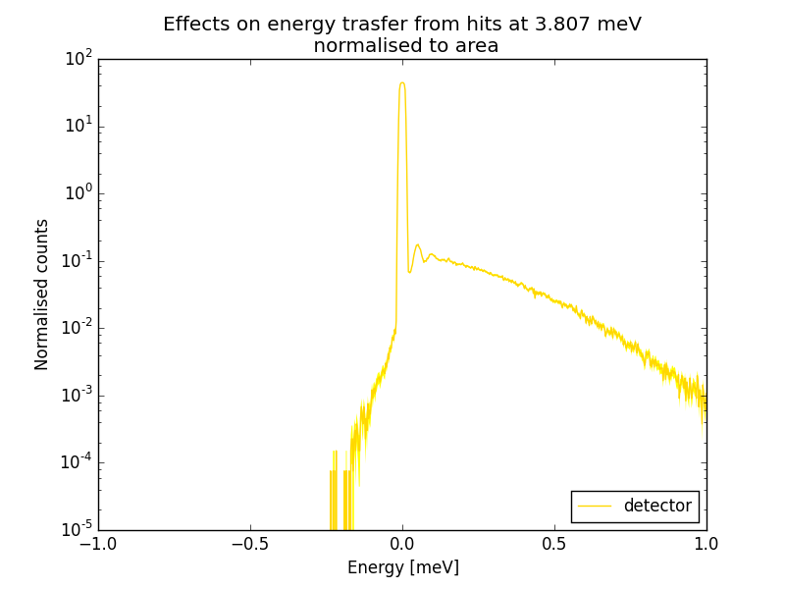
MultiGrid detector test at CNCS
Elastic peak
E_{trf} = E_{initial} - E_{final}
Scattered neutron background from detector

Slide 35
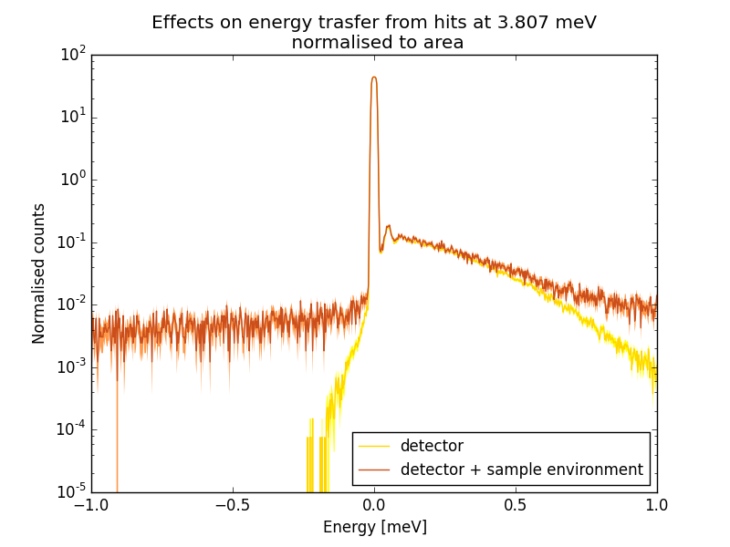
MultiGrid detector test at CNCS
Elastic peak
E_{trf} = E_{initial} - E_{final}
Scattered neutron background
from sample environment
Scattered neutron background
from detector

Slide 36
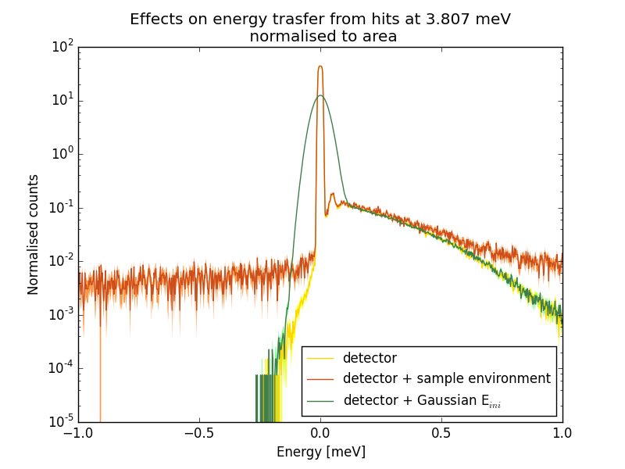
MultiGrid detector test at CNCS
Elastic peak
E_{trf} = E_{initial} - E_{final}
Scattered neutron background
from sample environment
Scattered neutron background
from detector

Slide 37
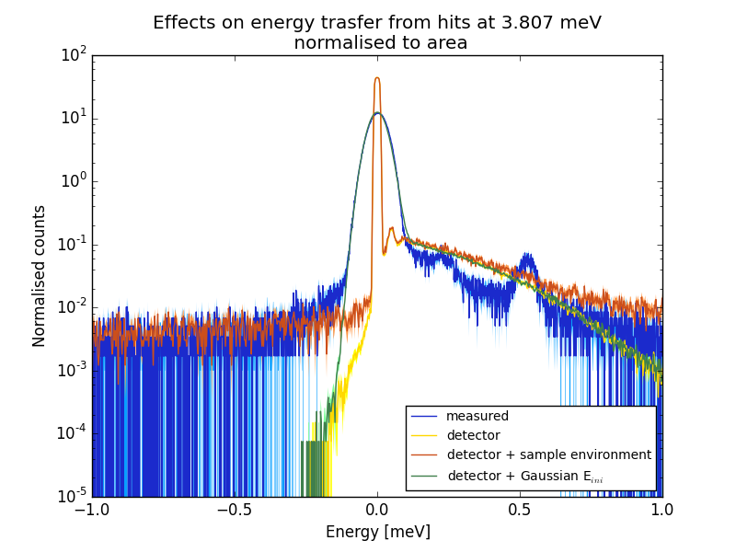
MultiGrid detector test at CNCS
Elastic peak
E_{trf} = E_{initial} - E_{final}
Scattered neutron background
from sample environment
Scattered neutron background
from detector

Slide 38
MultiGrid detector test at CNCS
Validation
Elastic peak
Distinguish different sources of background
Detailed analysis and quantification of background effects
E_{trf} = E_{initial} - E_{final}
Scattered neutron background
from detector
Scattered neutron background
from sample environment
Energy transfer reproduced with simulation at 3.807 meV

