Slide 1





Neutron Detection in a High Rate Environment, with Reflectometry at ESS as an example
Francesco Piscitelli
on behalf of
the ESS / Wigner / Lund University / Linköping University collaboration
ICANS XXII
2017/03/27
Wigner Research Institute
Linköping University
Building research infrastructure and synergies for highest scientific impact on ESS
Horizon 2020 grant agreement 676548

Slide 2

4 cm
Counting rate definitions

Slide 3

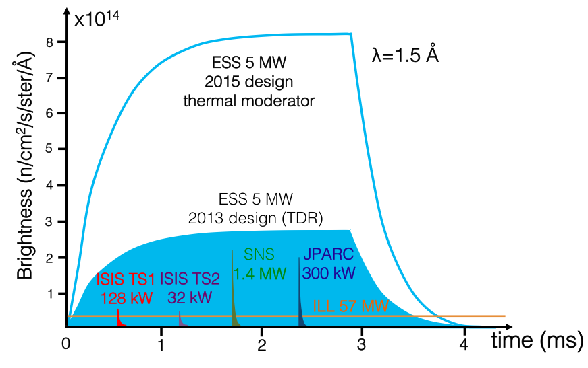
4 cm
Counting rate definitions

Slide 4
4 cm
Counting rate definitions
intensity
time
Source

Slide 5
4 cm
Counting rate definitions
detector area
intensity
time
Source
Flux at detector

Slide 6

4 cm
Counting rate definitions
detector area
neutron delivery system
sample
intensity
time
Source
Beam transportation
Flux at sample
Flux at detector
Wavelengths spread in time, intensities are chopped and shaped
Each instrument is different!

Slide 7
4 cm
Counting rate definitions
detector area
neutron delivery system
sample
intensity
time
Source
Beam transportation
Flux at sample
Flux at detector
Wavelengths spread in time, intensities are chopped and shaped
Each instrument is different!

Slide 8
Counting rate definitions
 | Global over whole detector area | Local per cm², mm² or pixel
Time-averaged
per s
Instantaneous
per s
*I. Stefanescu et al. ,“Neutron detectors for the ESS diffractometers,” Journal of Instrumentation , vol. 12, no. 01, p. P01019, 2017.

Slide 9
Counting rate definitions
 | Global over whole detector area | Local per cm², mm² or pixel
intensity
intensity
Time-averaged
per s
time
time
intensity
intensity
Instantaneous
per s
time
time
*I. Stefanescu et al. ,“Neutron detectors for the ESS diffractometers,” Journal of Instrumentation , vol. 12, no. 01, p. P01019, 2017.

Slide 10
Counting rate definitions
 | Global over whole detector area | Local per cm², mm² or pixel
intensity
intensity
Time-averaged
per s
time
time
At peak is the worst condition, i.e. highest
intensity
intensity
Instantaneous
per s
time
time
*I. Stefanescu et al. ,“Neutron detectors for the ESS diffractometers,” Journal of Instrumentation , vol. 12, no. 01, p. P01019, 2017.

Slide 11
Counting rate definitions
 | Global over whole detector area | Local per cm², mm² or pixel
detector area
intensity
intensity
Time-averaged
per s
time
time
Total number of neutrons per second on whole detector area
Relevant for bandwidth in DAQ and storage
At peak is the worst condition, i.e. highest
intensity
intensity
Instantaneous
per s
time
time
*I. Stefanescu et al. ,“Neutron detectors for the ESS diffractometers,” Journal of Instrumentation , vol. 12, no. 01, p. P01019, 2017.

Slide 12
Counting rate definitions
 | Global over whole detector area | Local per cm², mm² or pixel
detector area
detector area
intensity
intensity
Time-averaged
per s
time
time
Total number of neutrons per second on whole detector area
Total number of neutrons per second on a pixel or unit area
Relevant for bandwidth in DAQ and storage
At peak is the worst condition, i.e. highest
intensity
intensity
Instantaneous
per s
time
time
*I. Stefanescu et al. ,“Neutron detectors for the ESS diffractometers,” Journal of Instrumentation , vol. 12, no. 01, p. P01019, 2017.

Slide 13
Counting rate definitions
 | Global over whole detector area | Local per cm², mm² or pixel
detector area
detector area
intensity
intensity
Time-averaged
per s
time
time
Total number of neutrons per second on whole detector area
Total number of neutrons per second on a pixel or unit area
Relevant for bandwidth in DAQ and storage
At peak is the worst condition, i.e. highest
detector area
detector area
intensity
intensity
Instantaneous
per s
time
time
Highest instantaneous number of neutrons per second on whole detector area
Highest instantaneous number of neutrons per second in the brightest pixel or unit area
Relevant for detector technology choice
*I. Stefanescu et al. ,“Neutron detectors for the ESS diffractometers,” Journal of Instrumentation , vol. 12, no. 01, p. P01019, 2017.

Slide 14
Counting rate definitions
 | Global over whole detector area | Local per cm², mm² or pixel
detector area
detector area
intensity
intensity
Time-averaged
per s
time
time
Data storage
Total number of neutrons per second on whole detector area
Total number of neutrons per second on a pixel or unit area
Relevant for bandwidth in DAQ and storage
At peak is the worst condition, i.e. highest
detector area
detector area
intensity
intensity
Instantaneous
per s
time
time
SANS
Highest instantaneous number of neutrons per second on whole detector area
Reflectometry
Highest instantaneous number of neutrons per second in the brightest pixel or unit area
Relevant for detector technology choice
*I. Stefanescu et al. ,“Neutron detectors for the ESS diffractometers,” Journal of Instrumentation , vol. 12, no. 01, p. P01019, 2017.

Slide 15
Detector requirements in terms of instantaneous counting rate capability
detector area
intensity
time
Highest instantaneous number of neutrons per second in the brightest pixel or unit area

Slide 16
Detector requirements in terms of instantaneous counting rate capability
Rate requirements
factor by which requirements
exceed state-of-the-art
Direct Spectroscopy
Indirect Spectroscopy
Diffraction
SANS
Imaging
Reflectometry
Instantaneous
Rate Capability (log)
1 10 100 1000
1 = state-of-the-art
detector area
intensity
time
Highest instantaneous number of neutrons per second in the brightest pixel or unit area

Slide 17
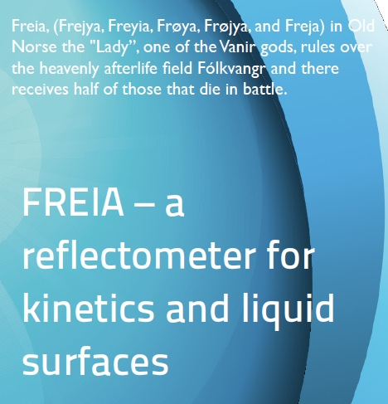
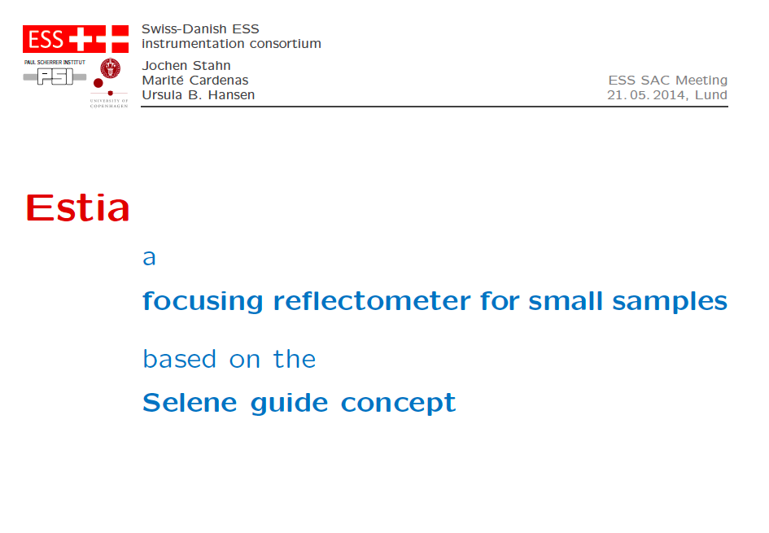
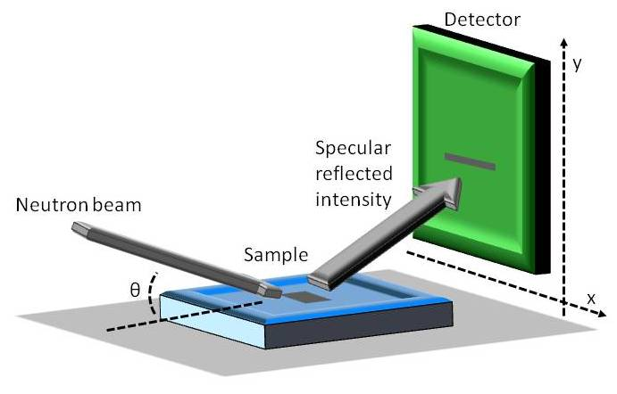
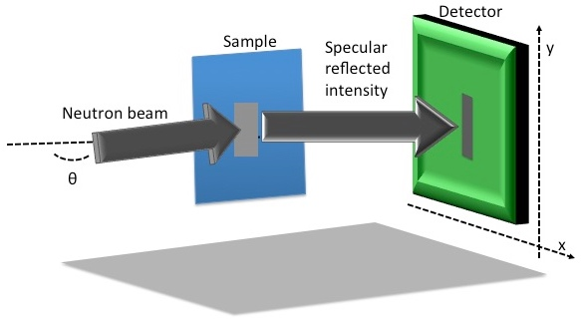
Reflectometry at ESS: FREIA and ESTIA
Horizontal Reflectometer
Vertical Reflectometer

Slide 18
Reflectometry
Reflectometry is a technique to study
SURFACES AND INTERFACES

Slide 19

Reflectometry
Reflectometry is a technique to study
SURFACES AND INTERFACES
Specular reflection
I₀ incoming intensity
I_{R} s. refl. intensity
θ
θ
detector
sample

Slide 20
Reflectometry
Reflectometry is a technique to study
SURFACES AND INTERFACES
To measure the reflected neutrons
as a function of q
Specular reflection
q
I₀ incoming intensity
q =(4π/λ) sin(θ)
I_{R} s. refl. intensity
θ
θ
Neutron wavelength
Incidence angle
detector
sample

Slide 21
Reflectometry
y
Specular reflection
I₀ incoming intensity
localized
specular
reflected
intensity
(2mm x 40mm)
I_{R} s. refl. intensity
θ
θ
detector
sample
detector
x

Slide 22
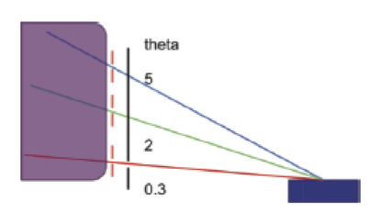
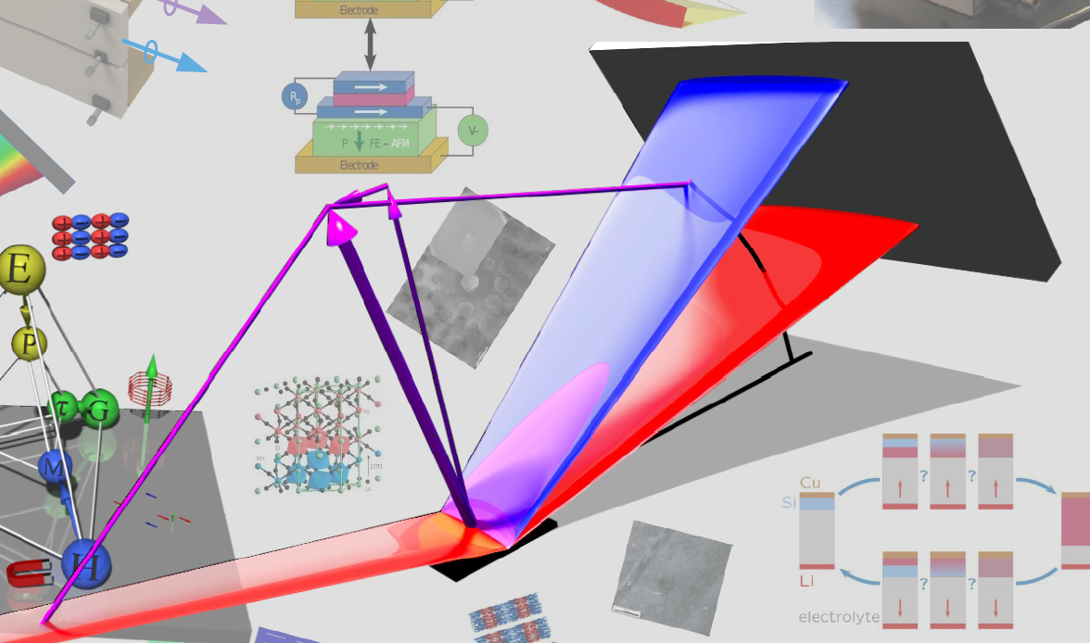
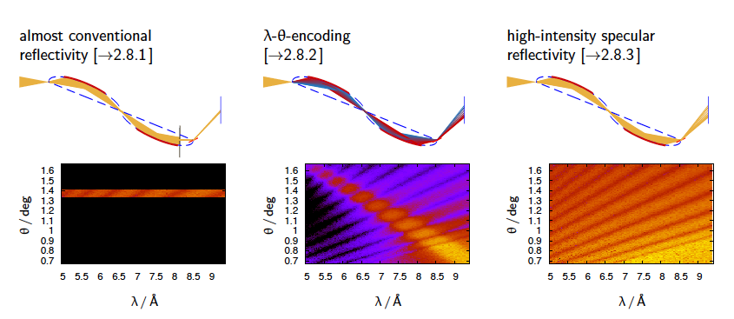
Reflectometry
FREIA measures 3 angles at once:
sample
ESTIA can work in 3 different modes:
y
Specular reflection
I₀ incoming intensity
localized
specular
reflected
intensity
(2mm x 40mm)
I_{R} s. refl. intensity
θ
θ
detector
sample
detector
x

Slide 23
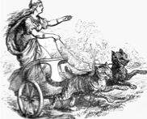
Reflectometry at ESS: FREIA

Slide 24

Reflectometry at ESS: FREIA
detector area
neutron delivery system
sample
intensity
time
Source
Beam transportation
Flux at sample
Flux at detector

Slide 25
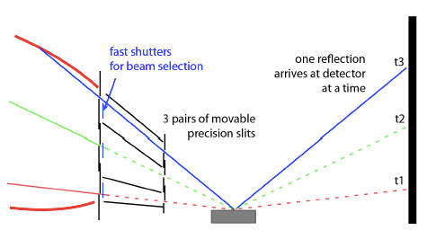
Reflectometry at ESS: FREIA
q =(4π/λ) sin(θ)
3 ranges in q measured at once without moving the sample
sample
detector area
neutron delivery system
sample
intensity
time
Source
Beam transportation
Flux at sample
Flux at detector

Slide 26
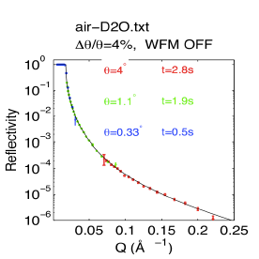
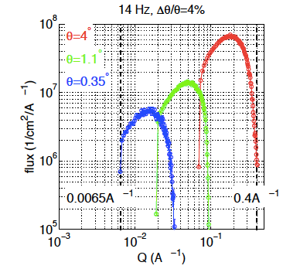
Reflectometry at ESS: FREIA
q =(4π/λ) sin(θ)
Incoming Flux at sample
sample
detector area
neutron delivery system
sample
intensity
time
Source
Beam transportation
Flux at sample
Flux at detector

Slide 27
Reflectometry at ESS: FREIA
q =(4π/λ) sin(θ)
Incoming Flux at sample
sample
10⁶
R=10⁰
10⁷
R<10⁻¹
R<10⁻⁴
10⁸ n/s/cm²
(at peak)
10⁸
10⁴
3 angles
10⁷
10⁵
detector
10⁶
10⁶
sample

Slide 28
Reflectometry at ESS: FREIA
q =(4π/λ) sin(θ)
Incoming Flux at sample
sample
10⁶
R=10⁰
10⁷
R<10⁻¹
R<10⁻⁴
10⁸ n/s/cm²
(at peak)
+ divergence
+ footprint on detector
to get the rate per mm²
10⁸
10⁴
3 angles
10⁷
10⁵
detector
10⁶
10⁶
sample

Slide 29
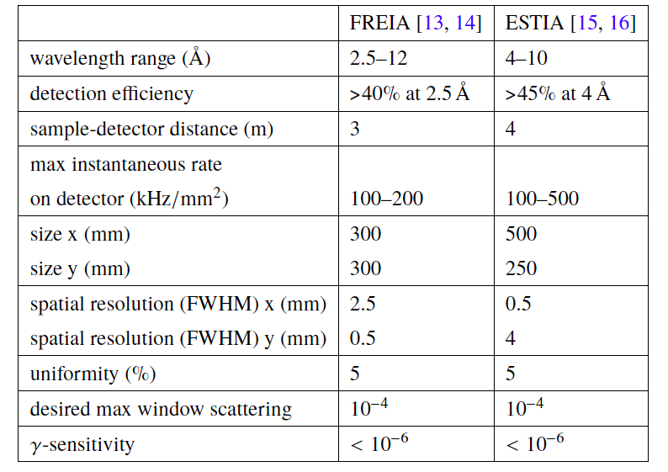
Detector requirements for Reflectometry at ESS

Slide 30
Detector requirements for Reflectometry at ESS
10-100 times
state-of-the-art detectors
3 times
state-of-the-art detectors

Slide 31
4 cm
What can we do to meet the requirments?

Slide 32
Neutron detector schematic
converter
¹⁰B, ³He, ⁶Li, …
charged particles
electric signals
electronics and
DAQ
neutron
detection

Slide 33
Neutron detector schematic
converter
¹⁰B, ³He, ⁶Li, …
charged particles
electric signals
electronics and
DAQ
neutron
detection
… rate limitation mainly comes from here!
Not really important which converter you use but how you optimize the detection process

Slide 34
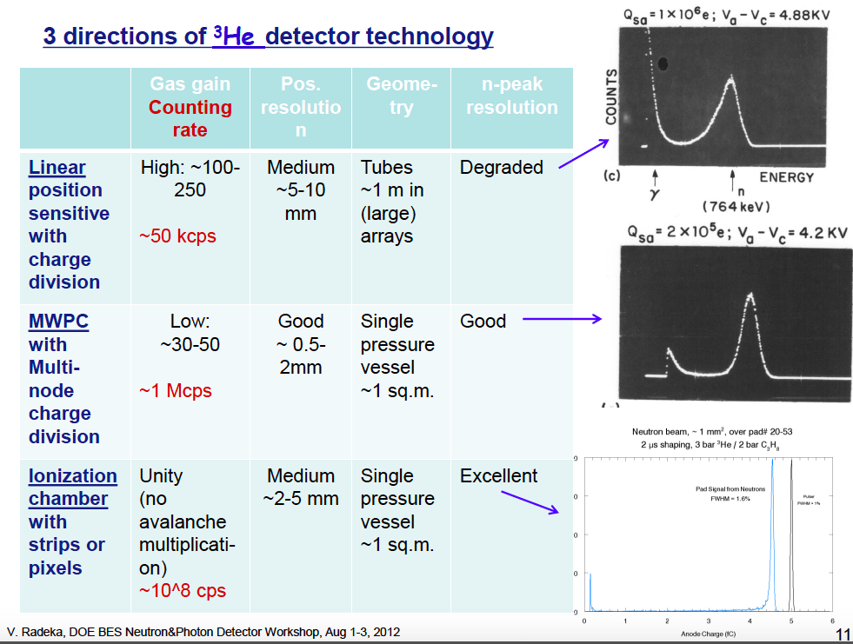
Neutron detector schematic
converter
¹⁰B, ³He, ⁶Li, …
charged particles
electric signals
electronics and
DAQ
neutron
detection
… rate limitation mainly comes from here!
Not really important which converter you use but how you optimize the detection process
gain ~ charge to evacuate
rate capability

Slide 35
¹⁰B-layer-based detectors
¹⁰B₄C layer
substrate
1. Multi-layer
Publications about the Multi-Grid:
J. Birch et al., 10B4C Multi-Grid as an alternative to 3He for large area neutorn detectors, IEEE TNS, vol. 60, no. 2, 2013.
J. Birch et al., In-beam test of the Boron-10 Multi-Grid
neutron detector at the IN6 time-of-flight spectrometer
at the ILL, JoP, vol. 528, 012040, 2014.
A. Khaplanov et al., Multi-Grid Detector for Neutron Spectroscopy: Results Obtained on Time-of-Flight Spectrometer CNCS, arXiv: 1703.03626, 2017
(submitted to JINST)
gas
volume
neutron
2. Grazing angle (<10˚)
Publications about the Multi-Blade:
F. Piscitelli et al., Study of a high spatial resolution
10B-based thermal neutron detector for application
in neutron reflectometry: the Multi-Blade prototype,
JINST vol. 9, P03007, 2014
F. Piscitelli et al., The Multi-Blade Boron-10-based
Neutron Detector for high intensity Neutron Reflectometry at ESS, JINST vol.12, P03013, 2017.
gas
volume
¹⁰B₄C layer
substrate
neutron

Slide 36
Readout options for gaseous detectors
converter
¹⁰B, ³He, ⁶Li, …
charged particles
electric signals
electronics and
DAQ
neutron
detection
MWPC
GEM
Micromegas
Microstrips

Slide 37
Readout options for gaseous detectors
converter
¹⁰B, ³He, ⁶Li, …
charged particles
electric signals
electronics and
DAQ
neutron
detection
MWPC
GEM
Micromegas
Microstrips
Counting rate capability limited mainly by space charge effect and double hit time resolution

Slide 38
Readout options for gaseous detectors
MWPC
GEM
Micromegas
Microstrips
A. Ravazzani et al. , “Characterisation of proportional counters,” Radiation Measurements , vol. 41, no. 5, pp. 582 – 593, 2006.
A. Andronic et al. , “A comprehensive study of rate capability in multi-wire proportional chambers,” Journal of Instrumentation , vol. 4, no. 10, p. P10014, 2009.
H. Sipilä and V. Vanha-Honko, “The counting rate dependent gain shift and the space charge in proportional counters,” Nuclear Instruments and Methods , vol. 153, no. 2, pp. 461 – 464, 1978.
E. Mathieson, “Dependence of gain on count rate, due to space charge, in coaxial and multiwire proportional chambers,” Nuclear Instruments and Methods in Physics Research Section A: Accelerators, Spectrometers, Detectors and Associated Equipment , vol. 249, no. 2,
pp. 413 – 420, 1986.
E. Mathieson and G. Smith, “Gain reduction due to space charge in a multiwire proportional chamber irradiated by a uniform beam of rectangular section,” Nuclear Instruments and Methods in Physics Research Section A: Accelerators, Spectrometers, Detectors and Associated Equipment , vol. 316, no. 2, pp. 246 – 251, 1992.
Y. Ivaniouchenkov et al. , “Breakdown limit studies in high-rate gaseous detectors,” Nuclear Instruments and Methods in Physics Research Section A: Accelerators, Spectrometers, Detectors and Associated Equipment , vol. 422, no. 1–3, pp. 300 – 304, 1999.
S. Koperny and T. Z. Kowalski, “11th topical seminar on innovative particle and radiation detectors (IPRD08) performance of proportional counters under high count rate, high gas gain and at high working gas pressure,” Nuclear Physics B - Proceedings Supplements , vol. 197, no. 1, pp. 370 – 373, 2009.
P. Fonte, “Which gaseous detector is the best at high rates?,” SLAC-JOURNAL-ICFA-16-2 .
E. P. Cippo et al. , “A GEM-based thermal neutron detector for high counting rate
applications,” Journal of Instrumentation , vol. 10, no. 10, p. P10003, 2015.

Slide 39
Readout options for gaseous detectors
MWPC
GEM
Micromegas
Microstrips
A. Ravazzani et al. , “Characterisation of proportional counters,” Radiation Measurements , vol. 41, no. 5, pp. 582 – 593, 2006.
A. Andronic et al. , “A comprehensive study of rate capability in multi-wire proportional chambers,” Journal of Instrumentation , vol. 4, no. 10, p. P10014, 2009.
H. Sipilä and V. Vanha-Honko, “The counting rate dependent gain shift and the space charge in proportional counters,” Nuclear Instruments and Methods , vol. 153, no. 2, pp. 461 – 464, 1978.
E. Mathieson, “Dependence of gain on count rate, due to space charge, in coaxial and multiwire proportional chambers,” Nuclear Instruments and Methods in Physics Research Section A: Accelerators, Spectrometers, Detectors and Associated Equipment , vol. 249, no. 2,
pp. 413 – 420, 1986.
E. Mathieson and G. Smith, “Gain reduction due to space charge in a multiwire proportional chamber irradiated by a uniform beam of rectangular section,” Nuclear Instruments and Methods in Physics Research Section A: Accelerators, Spectrometers, Detectors and Associated Equipment , vol. 316, no. 2, pp. 246 – 251, 1992.
Y. Ivaniouchenkov et al. , “Breakdown limit studies in high-rate gaseous detectors,” Nuclear Instruments and Methods in Physics Research Section A: Accelerators, Spectrometers, Detectors and Associated Equipment , vol. 422, no. 1–3, pp. 300 – 304, 1999.
S. Koperny and T. Z. Kowalski, “11th topical seminar on innovative particle and radiation detectors (IPRD08) performance of proportional counters under high count rate, high gas gain and at high working gas pressure,” Nuclear Physics B - Proceedings Supplements , vol. 197, no. 1, pp. 370 – 373, 2009.
P. Fonte, “Which gaseous detector is the best at high rates?,” SLAC-JOURNAL-ICFA-16-2 .
E. P. Cippo et al. , “A GEM-based thermal neutron detector for high counting rate
applications,” Journal of Instrumentation , vol. 10, no. 10, p. P10003, 2015.
Most of them studied with
X-rays but not with neutrons

Slide 40
Readout options for gaseous detectors
MWPC
GEM
Micromegas
(MM)
Microstrips (MSGC)
Rate performance
Gain
(or total charge in the detector)
Ideal case
Rate

Slide 41
Readout options for gaseous detectors
MWPC
GEM
Micromegas
(MM)
Microstrips (MSGC)
Rate performance
Gain
(or total charge in the detector)
Ideal case
reality
Gain drops
Rate

Slide 42
Readout options for gaseous detectors
MWPC
GEM
Micromegas
(MM)
Microstrips (MSGC)
Rate performance
Gain
(or total charge in the detector)
Ideal case
Higher gain
Lower gain
Rate

Slide 43
Readout options for gaseous detectors
MWPC
GEM
Micromegas
(MM)
Microstrips (MSGC)
Rate performance
rate capability
Gain
(or total charge in the detector)
Ideal case
Higher gain
Lower gain
Rate
gain ~ charge to evacuate

Slide 44
Readout options for gaseous detectors
MWPC
GEM
Micromegas
(MM)
Microstrips (MSGC)
Final charge =
0.15pC
X-ray
6 keV
< 0.05 fC
(in Ar/CO₂)
G = 3000
G = 30000
1.5pC

Slide 45
Readout options for gaseous detectors
MWPC
GEM
Micromegas
(MM)
Microstrips (MSGC)
Final charge =
0.15pC
X-ray
6 keV
< 0.05 fC
(in Ar/CO₂)
G = 3000
G = 30000
converter3He
1.5pC
neutron
proton + t
770 keV
< 3 fC
G = 500

Slide 46
Readout options for gaseous detectors
MWPC
GEM
Micromegas
(MM)
Microstrips (MSGC)
Final charge =
0.15pC
X-ray
6 keV
< 0.05 fC
(in Ar/CO₂)
G = 3000
G = 30000
converter3He
1.5pC
neutron
proton + t
770 keV
< 3 fC
G = 500
Does not depend on the 3He but to the usually employed charge division readout that needs charge to get the position resolution

Slide 47
Readout options for gaseous detectors
MWPC
GEM
Micromegas
(MM)
Microstrips (MSGC)
converter
10B
neutron
alpha
1470 keV
< 10 fC
G = 15
Final charge =
0.15pC
X-ray
6 keV
< 0.05 fC
(in Ar/CO₂)
G = 3000
G = 30000
converter3He
1.5pC
neutron
proton + t
770 keV
< 3 fC
G = 500
Does not depend on the 3He but to the usually employed charge division readout that needs charge to get the position resolution

Slide 48
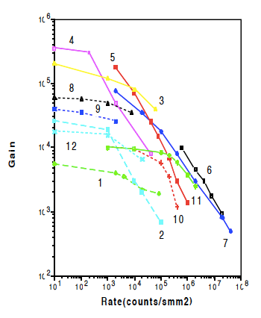
Readout options for gaseous detectors
MWPC
GEM
Micromegas
(MM)
Microstrips (MSGC)
converter
10B
neutron
alpha
1470 keV
< 10 fC
G = 15
Final charge =
0.15pC
X-ray
6 keV
< 0.05 fC
(in Ar/CO₂)
G = 3000
G = 30000
converter3He
1.5pC
studied with X-rays
proton + t
770 keV
neutron
< 3 fC
G = 500
G
MM
Does not depend on the 3He but to the usually employed charge division readout that needs charge to get the position resolution
MSGC
MWPC

Slide 49
Readout options for gaseous detectors
MWPC
GEM
Micromegas
(MM)
Microstrips (MSGC)
converter
10B
neutron
alpha
1470 keV
< 10 fC
G = 15
Final charge =
0.15pC
X-ray
6 keV
< 0.05 fC
(in Ar/CO₂)
G = 3000
G = 30000
converter3He
1.5pC
studied with X-rays
proton + t
770 keV
GEM
< 3 fC
G = 500
neutron
equivalent neutron
charge event
for 3He readout
G
MM
Does not depend on the 3He but to the usually employed charge division readout that needs charge to get the position resolution
MSGC
equivalent neutron
charge event
for 10B readout
MWPC

Slide 50
Readout options for gaseous detectors
MWPC
GEM
Micromegas
(MM)
Microstrips (MSGC)
converter
10B
neutron
alpha
1470 keV
< 10 fC
G = 15
Final charge =
0.15pC
X-ray
6 keV
< 0.05 fC
(in Ar/CO₂)
G = 3000
G = 30000
converter3He
1.5pC
studied with X-rays
proton + t
770 keV
GEM
< 3 fC
G = 500
neutron
equivalent neutron
charge event
for 3He readout
G
MM
Does not depend on the 3He but to the usually employed charge division readout that needs charge to get the position resolution
MSGC
equivalent neutron
charge event
for 10B readout
MWPC
MWPC can reach >10⁴ Hz/mm²

Slide 51
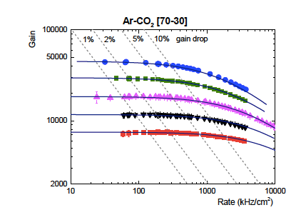
Readout options for gaseous detectors: MWPC
MWPC
converter
10B
neutron
alpha
1470 keV
< 10 fC
G = 15
Final charge =
0.15pC
X-ray
6 keV
< 0.05 fC
(in Ar/CO₂)
G = 3000
G = 30000
converter3He
1.5pC
neutron
proton + t
770 keV
< 3 fC
G = 500
G
equivalent neutron
charge event
for 3He readout
equivalent neutron
charge event
for 10B readout
100 1000 10000 100000
Rate (Hz/mm²)

Slide 52
Readout options for gaseous detectors: MWPC
MWPC
converter
10B
neutron
alpha
1470 keV
< 10 fC
G = 15
Final charge =
0.15pC
X-ray
6 keV
< 0.05 fC
(in Ar/CO₂)
G = 3000
G = 30000
converter3He
1.5pC
neutron
proton + t
770 keV
< 3 fC
G = 500
G
rate capability
equivalent neutron
charge event
for 3He readout
gain ~ charge to evacuate
equivalent neutron
charge event
for 10B readout
100 1000 10000 100000
Rate (Hz/mm²)

Slide 53
The Multi-Blade project
F. Piscitelli et al., The Multi-Blade Boron-10-based Neutron Detector for high intensity Neutron Reflectometry at ESS, JINST 12 (3) P03013 (2017).

Slide 54

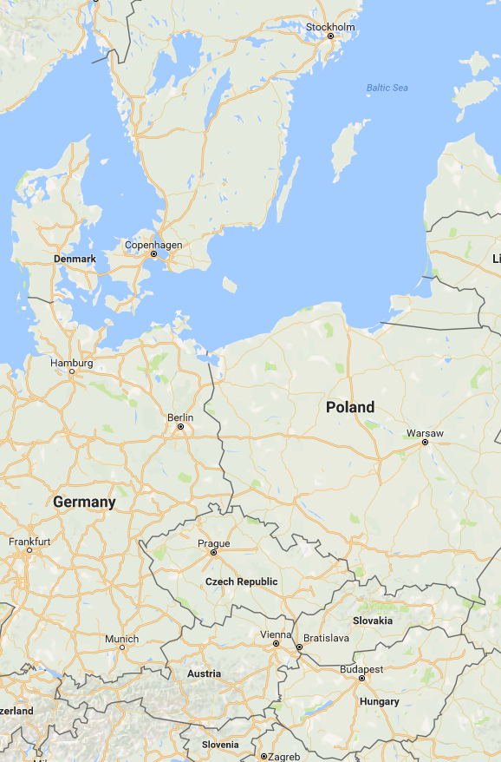
The Multi-Blade project
Linköping
Lund
Wigner Research Institute
Linköping University
3 years
The key objective of WP4 is the technological
evolution of neutron detectors in terms of
resolution, intensity and dimensions.
Budapest
Task 4.2 Neutron Detectors – The Intensity Frontier

Slide 55
The Multi-Blade project
Efficiency
5 degrees
Efficiency 45% at 2.5Å
A single Boron layer inclined at 5 degrees
substrate
¹⁰B₄C
neutrons
θ
θ = 5 degrees

Slide 56
The Multi-Blade project
MWPC
neutrons
wires X
Multi-Blade
sample
substrate
¹⁰B₄C
neutrons
strips Y
θ
θ = 5 degrees

Slide 57
The Multi-Blade project
Why the counting rate capability is improved?
The intensity is spread over a wider surface (5 degrees ~ factor x10)
    Thin gap MWPC (4mm)
      Low gas gain operation G~20
(max 0.2pC avalanches)
MWPC
neutrons
wires X
Multi-Blade
sample
substrate
¹⁰B₄C
neutrons
strips Y
θ
θ = 5 degrees

Slide 58
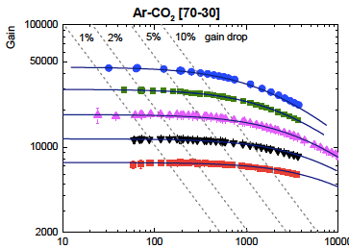
The Multi-Blade project
Why the counting rate capability is improved?
The intensity is spread over a wider surface (5 degrees ~ factor x10)
    Thin gap MWPC (4mm)
      Low gas gain operation G~20
(max 0.2pC avalanches)
ESS requirement
wires X
100 1000 10000 100000
substrate
rate
Rate (Hz/mm²)
¹⁰B₄C
neutrons
strips Y
θ
θ = 5 degrees

Slide 59
The Multi-Blade project
Why the counting rate capability is improved?
The intensity is spread over a wider surface (5 degrees ~ factor x10)
    Thin gap MWPC (4mm)
      Low gas gain operation G~20
(max 0.2pC avalanches)
ESS requirement
equivalent neutron
charge event
for 10B readout
wires X
100 1000 10000 100000
substrate
rate
Rate (Hz/mm²)
¹⁰B₄C
neutrons
strips Y
rate capability
θ
gain ~ charge to evacuate
θ = 5 degrees

Slide 60
The Multi-Blade project
Why the counting rate capability is improved?
The intensity is spread over a wider surface (5 degrees ~ factor x10)
    Thin gap MWPC (4mm)
      Low gas gain operation G~20
(max 0.2pC avalanches)
ESS requirement
equivalent neutron
charge event
for 10B readout
wires X
100 1000 10000 100000
substrate
rate
Rate (Hz/mm²)
¹⁰B₄C
neutrons
strips Y
rate capability
θ
gain ~ charge to evacuate
θ = 5 degrees

Slide 61
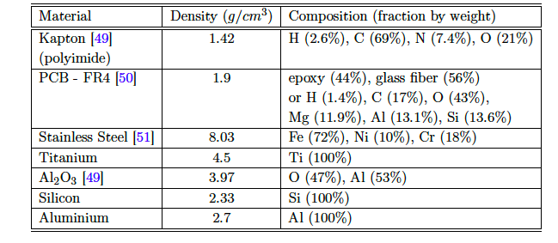
Materials evaluation
Old Design
cassette
neutrons
substrate
¹⁰B₄C
NO MPGD
Inclination makes a factor 10 thicker layers!
Reduce the scattering

Slide 62
Materials evaluation
30um kapton is 300um at 5deg
Old Design
MWPC
cassette
neutrons
strips Y
substrate
¹⁰B₄C
wires X
Inclination makes a factor 10 thicker layers!
Reduce the scattering

Slide 63
Materials evaluation
Old Design New Design
MWPC
MWPC
cassette
cassette
neutrons
neutrons
θ
substrate
θ = 5 degrees
wires X
¹⁰B₄C
substrate
strips Y
strips Y
¹⁰B₄C
wires X
Reduce the scattering

Slide 64
Materials evaluation
Old Design New Design
MWPC
MWPC
cassette
cassette
neutrons
X
neutrons
θ
substrate
θ = 5 degrees
wires X
¹⁰B₄C
substrate
strips Y
strips Y
¹⁰B₄C
wires X
99% absorption with 7μm
2.5Å
Reduce the scattering

Slide 65
The Multi-Blade project
MWPC
neutrons
wires X
Multi-Blade
sample
substrate
¹⁰B₄C
neutrons
strips Y
θ
θ = 5 degrees

Slide 66
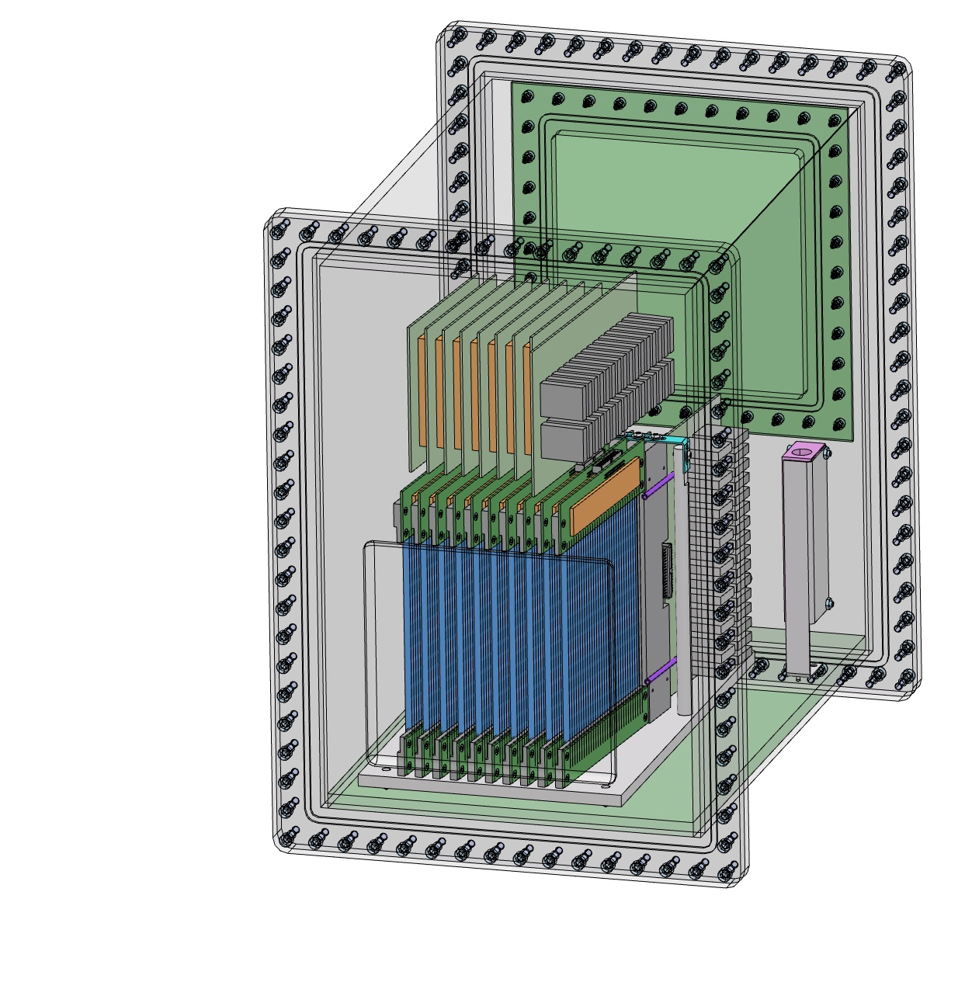
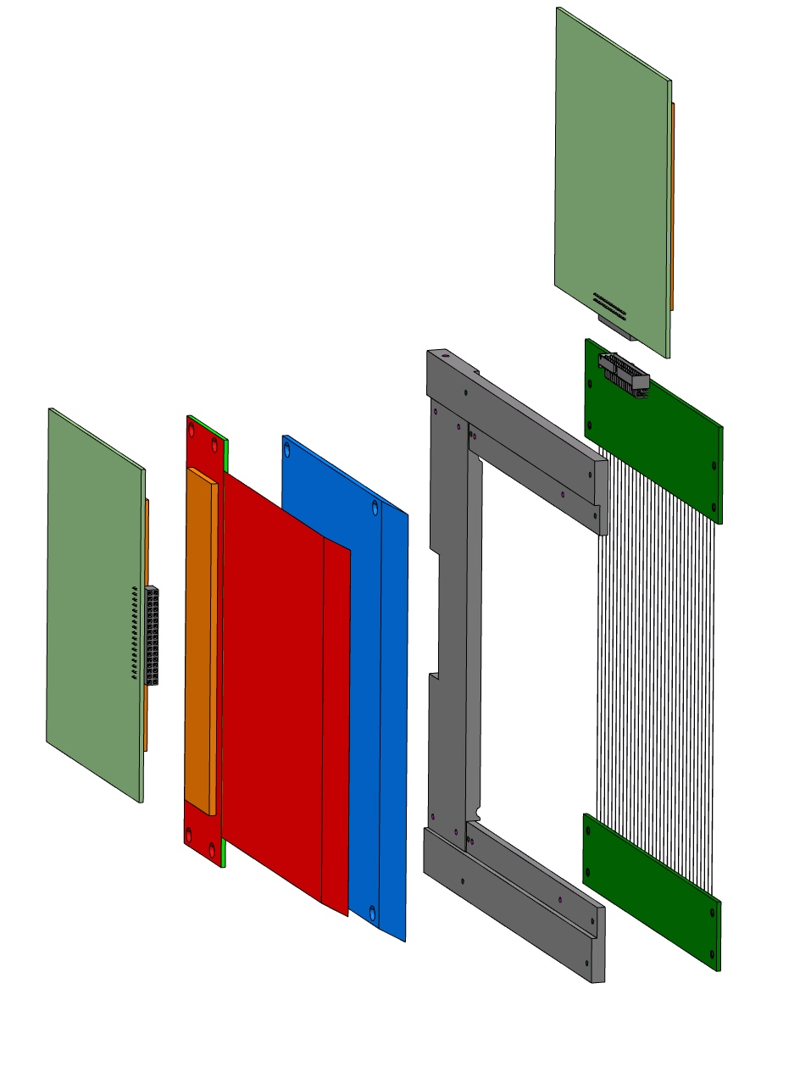
Mechanical design
100x140mm² active area demonstrator
amplifier board
¹⁰B₄C substrate
amplifier board
cathode strips
holding frame
anode wires
neutrons

Slide 67
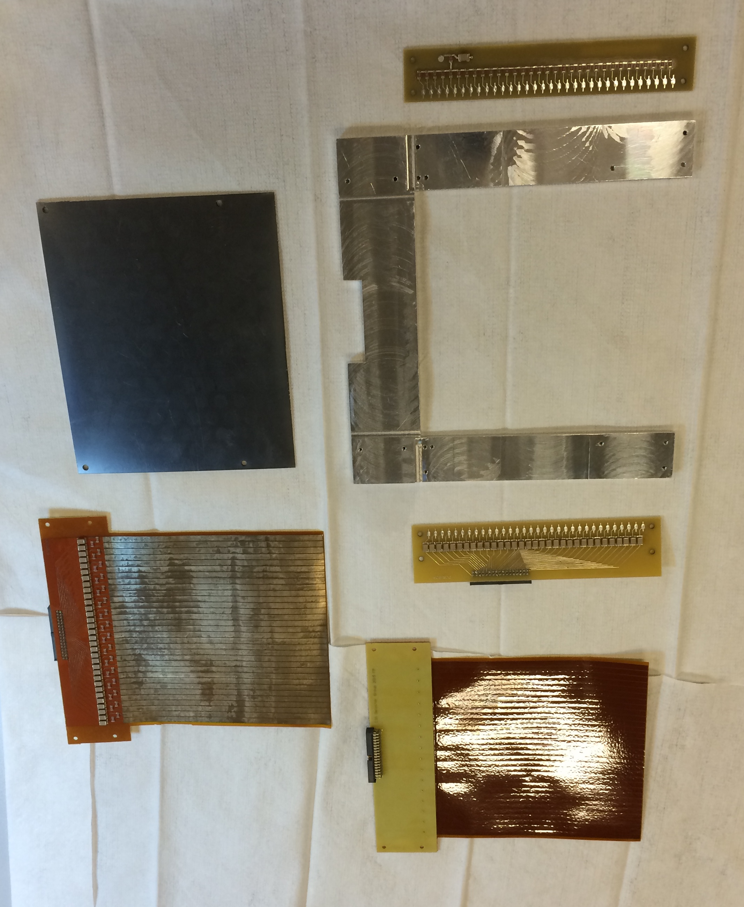
The Multi-Blade detector
amplifier board
¹⁰B₄C substrate
holding frame
¹⁰B₄C substrate
amplifier board
cathode strips
cathode strips
holding frame
anode wires
cathode strips

Slide 68
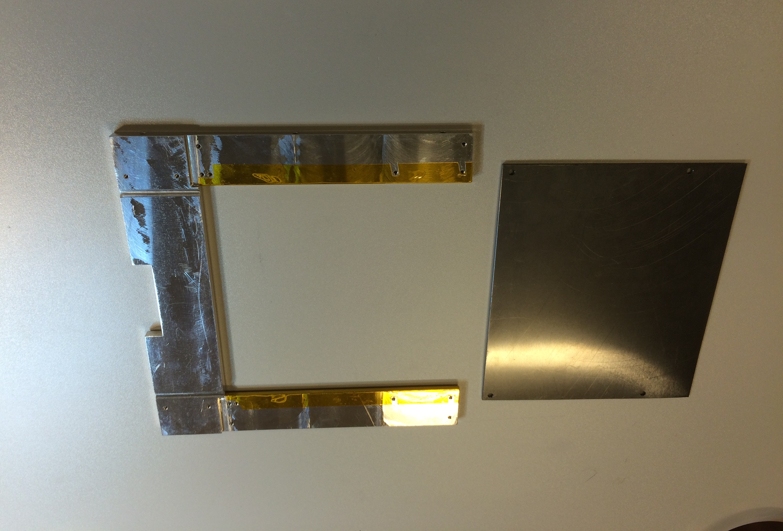
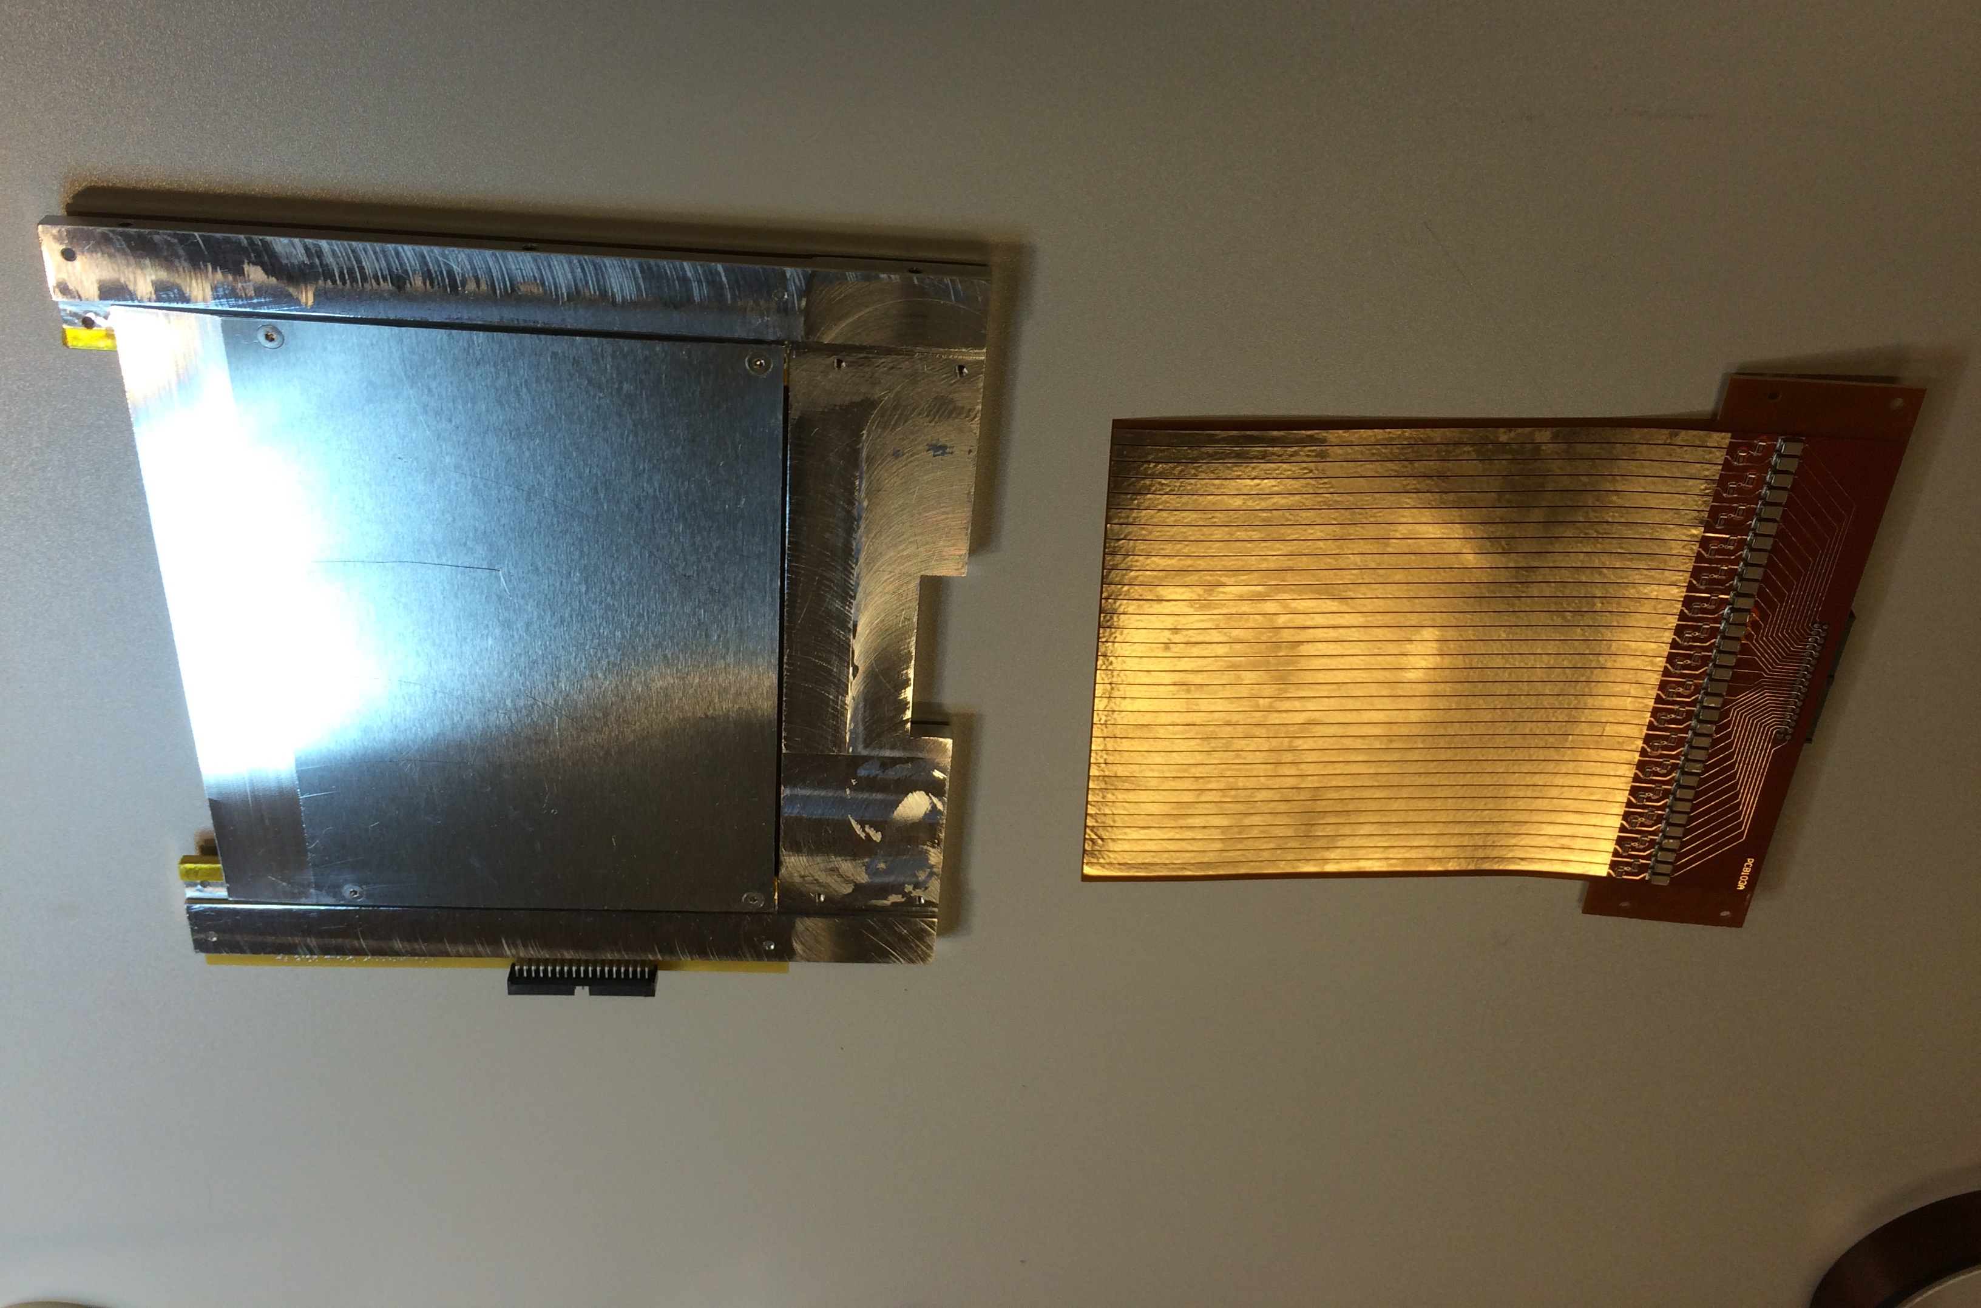
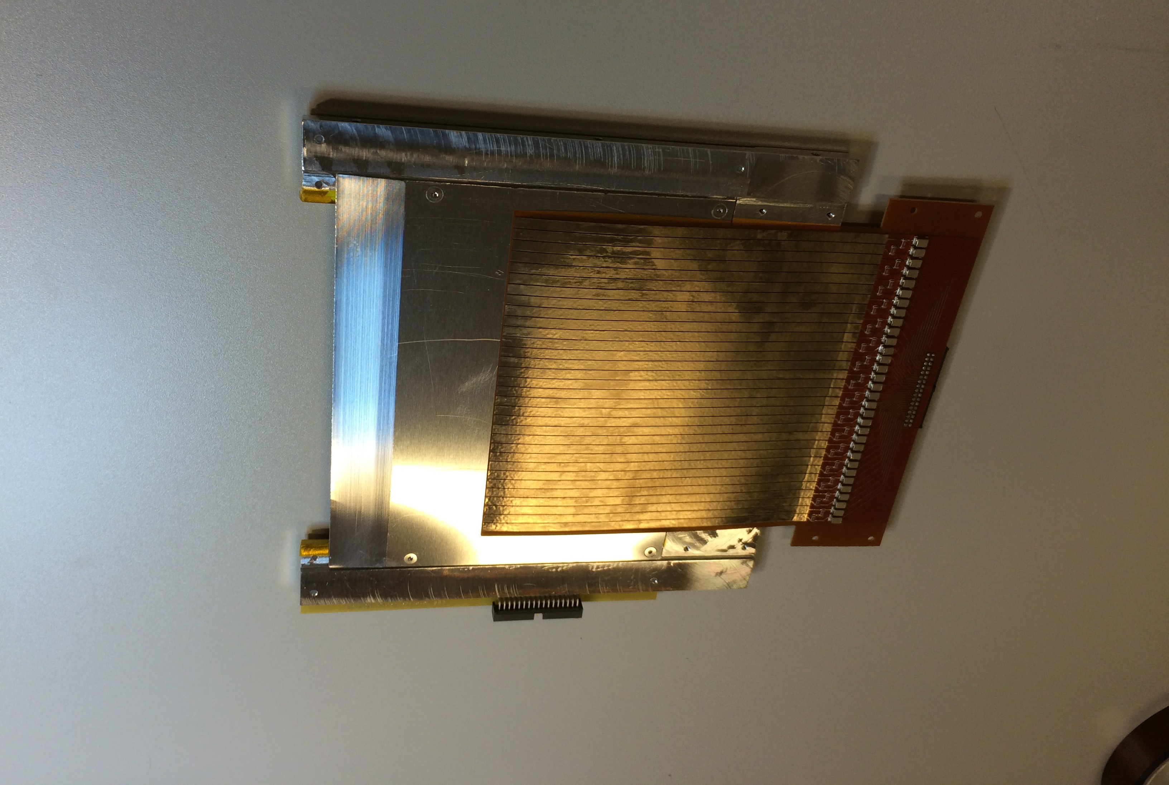
The Multi-Blade detector
¹⁰B₄C substrate
holding frame
cathode strips
cathode strips

Slide 69
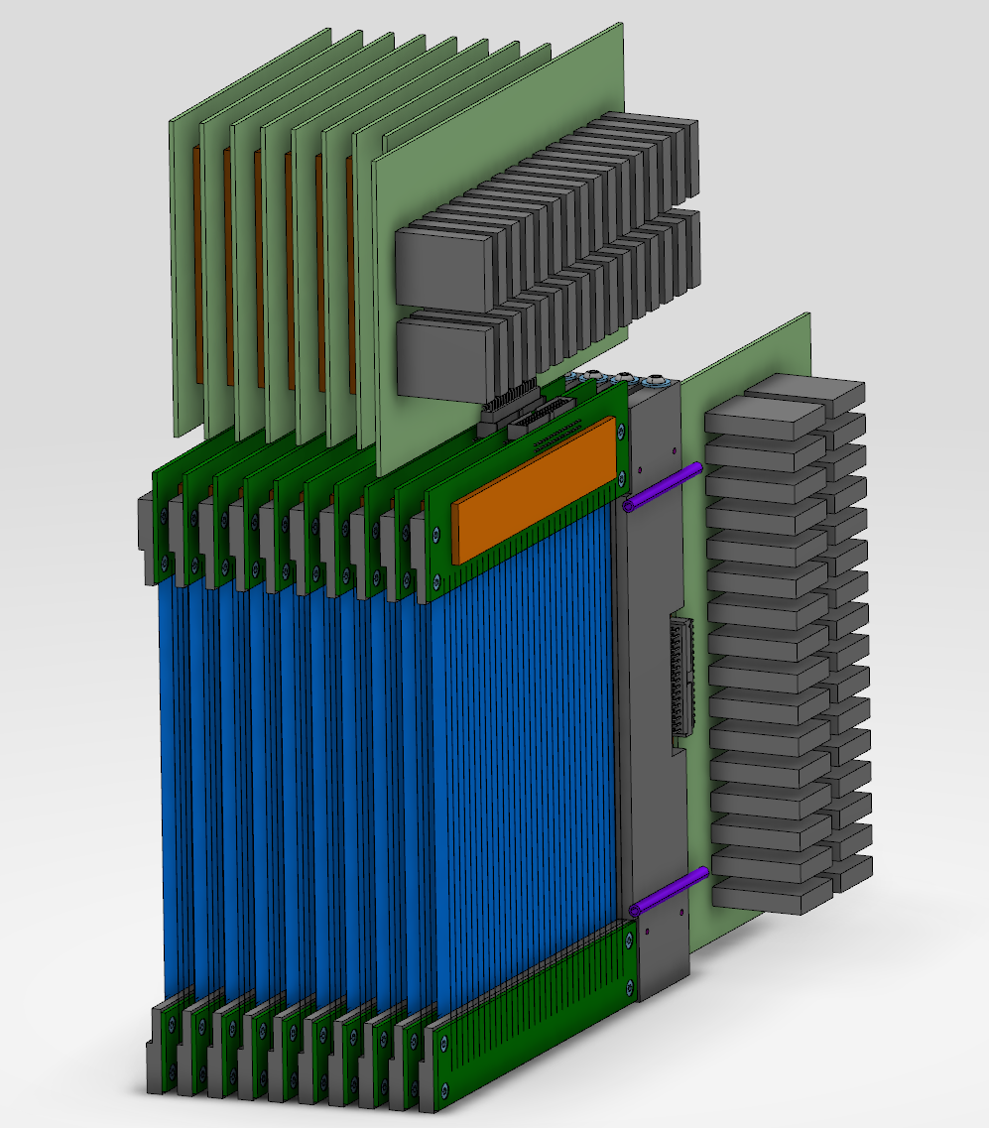
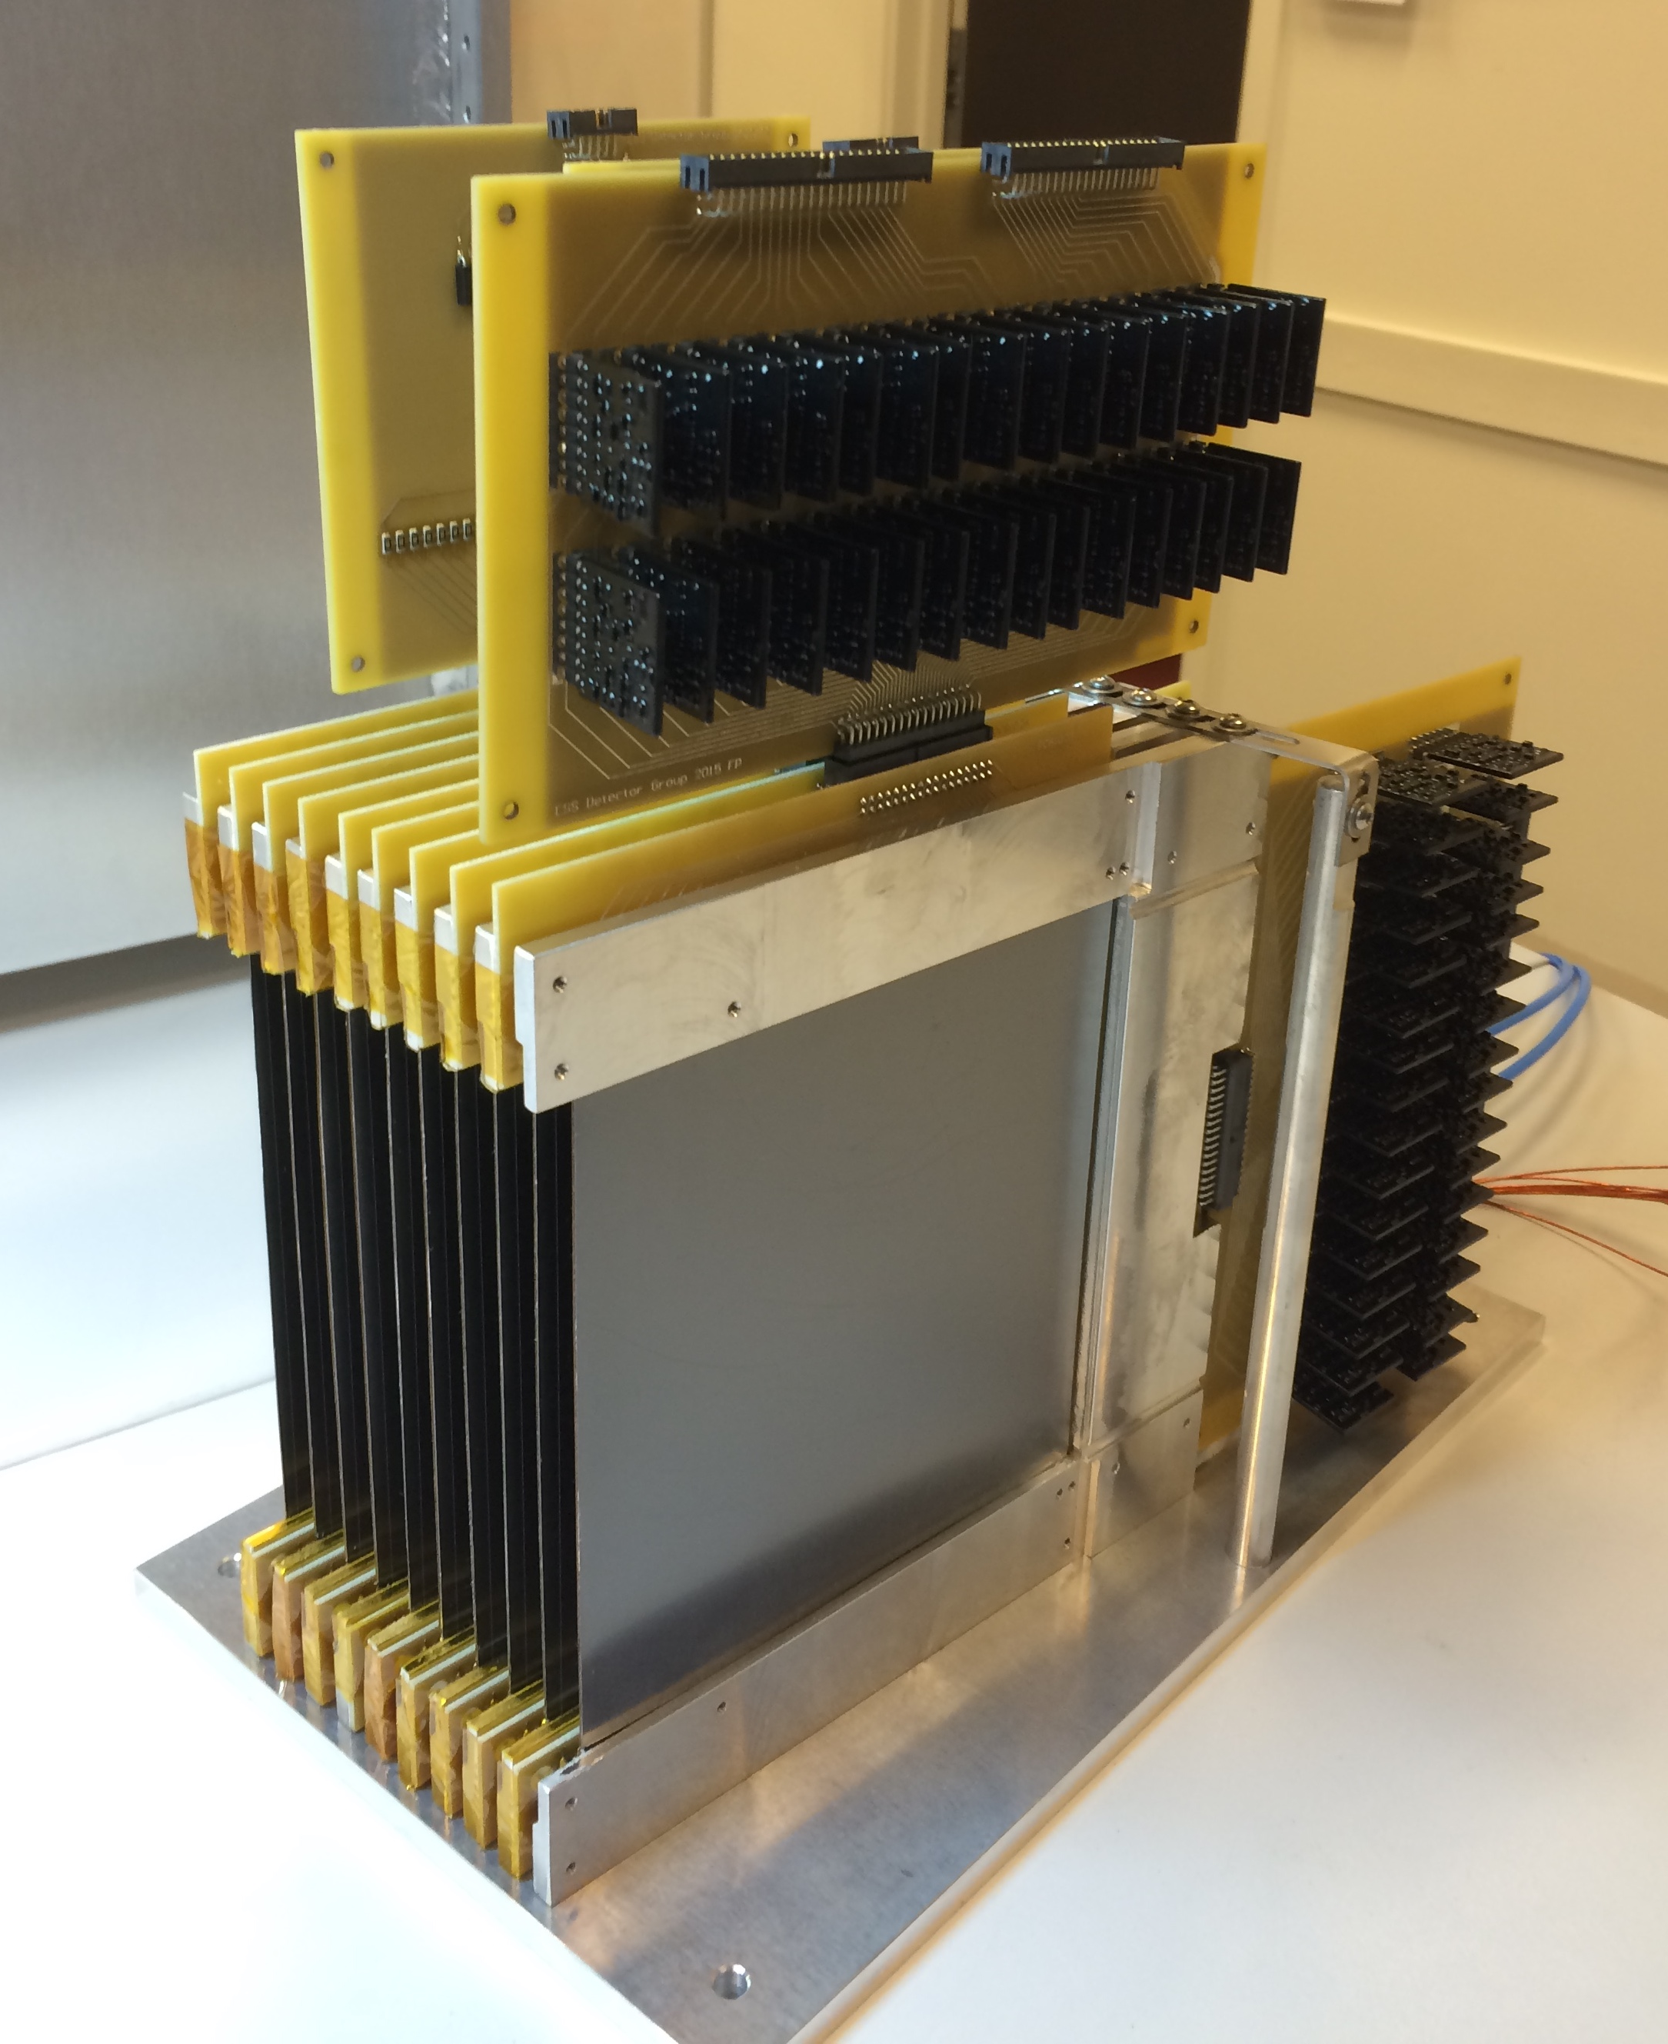
The Multi-Blade detector

Slide 70
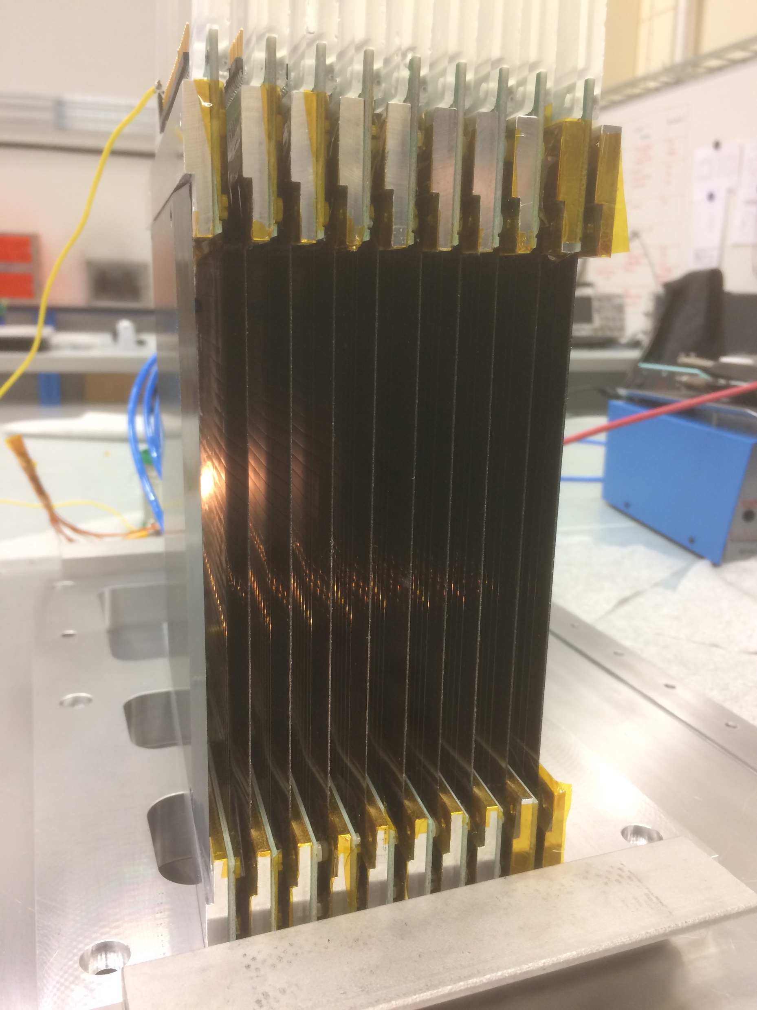
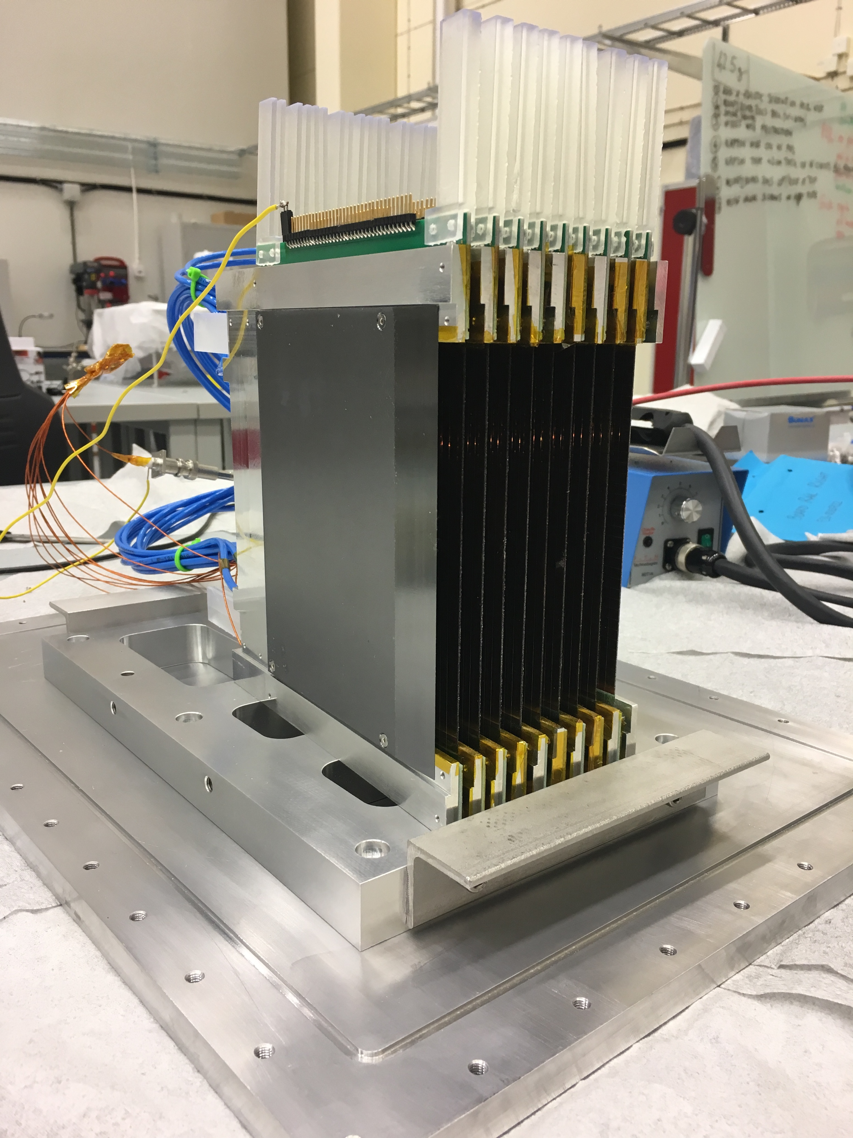
The Multi-Blade detector
140mm
100mm
neutrons
neutrons
Multi-Blade

Slide 71
Results
F. Piscitelli et al., The Multi-Blade Boron-10-based Neutron Detector for high intensity Neutron Reflectometry at ESS, JINST 12 (3) P03013 (2017).

Slide 72
Efficiency
*F. Piscitelli and P. van Esch,
Analytical modeling of thin film neutron converters and its application to thermal neutron gas detectors
J. Instrum. 8, P04020 (2013)
arXiv:1302.3153
Calculated*
measured
64% @ 5.1Å
58% @ 4.2Å
45% @ 2.5Å
F. Piscitelli et al., The Multi-Blade Boron-10-based Neutron Detector for high intensity Neutron Reflectometry at ESS, JINST 12 (3) P03013 (2017).

Slide 73
PHS and Gain
*F. Piscitelli and P. van Esch,
Analytical modeling of thin film neutron converters and its application to thermal neutron gas detectors
J. Instrum. 8, P04020 (2013)
arXiv:1302.3153
Measured @ 4.1Å 5 degrees
calculated*
measured
Gas Gain ~ 20 (max 0.2pC avalanche charge)
(contributes to improve the counting rate capability)
F. Piscitelli et al., The Multi-Blade Boron-10-based Neutron Detector for high intensity Neutron Reflectometry at ESS, JINST 12 (3) P03013 (2017).

Slide 74
PHS and Gain
*F. Piscitelli and P. van Esch,
Analytical modeling of thin film neutron converters and its application to thermal neutron gas detectors
J. Instrum. 8, P04020 (2013)
arXiv:1302.3153
ESS requirement
Measured @ 4.1Å 5 degrees
calculated*
measured
equivalent neutron
charge event
for 10B readout
100 1000 10000 100000
Rate (Hz/mm²)
Gas Gain ~ 20 (max 0.2pC avalanche charge)
(contributes to improve the counting rate capability)
>10⁵ Hz/mm² is achievable
F. Piscitelli et al., The Multi-Blade Boron-10-based Neutron Detector for high intensity Neutron Reflectometry at ESS, JINST 12 (3) P03013 (2017).

Slide 75
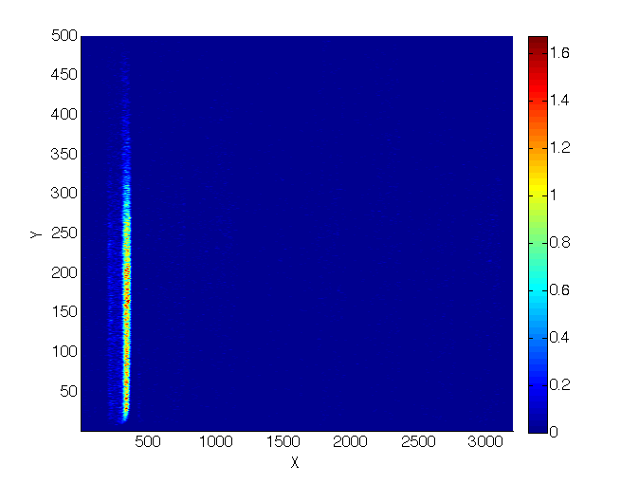
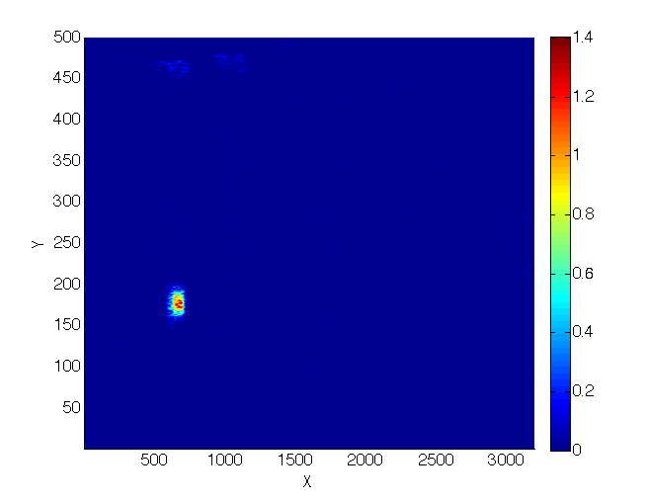
Counting rate capability
17kHz/ch
Rate per channel
Slit
Rate per mm²
1.6kHz/mm²
Spot
No saturation observed!
F. Piscitelli et al., The Multi-Blade Boron-10-based Neutron Detector for high intensity Neutron Reflectometry at ESS, JINST 12 (3) P03013 (2017).

Slide 76
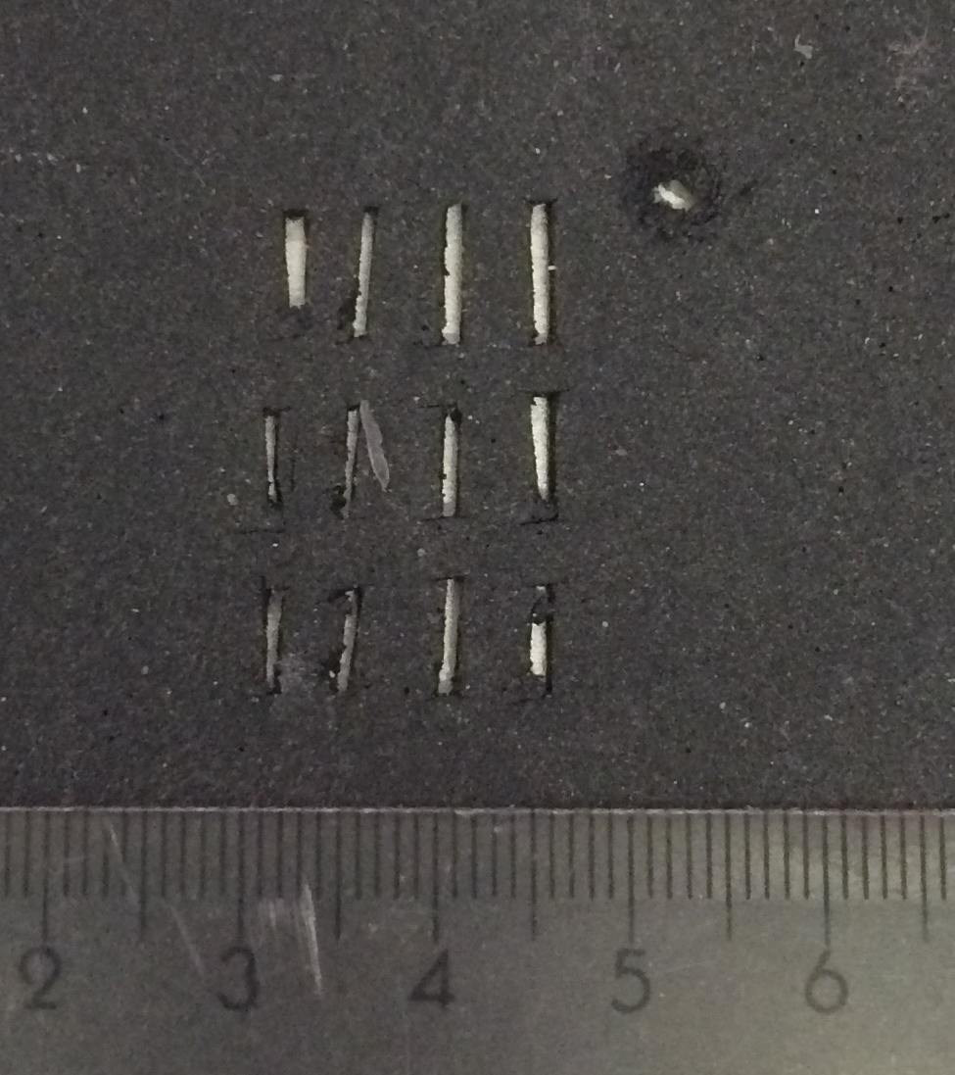
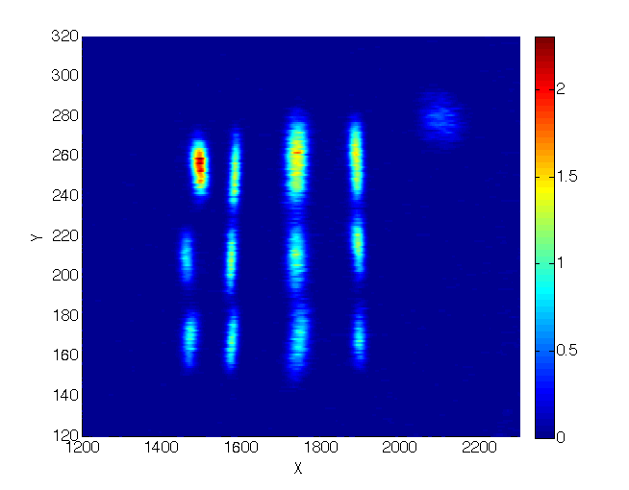
Images
Spatial Resolution FWHM ~ 0.5mm
14mm
14mm
24mm
Spatial Resolution FWHM ~ 2.5mm
24mm
Mask
Raw image from the detector
F. Piscitelli et al., The Multi-Blade Boron-10-based Neutron Detector for high intensity Neutron Reflectometry at ESS, JINST 12 (3) P03013 (2017).

Slide 77
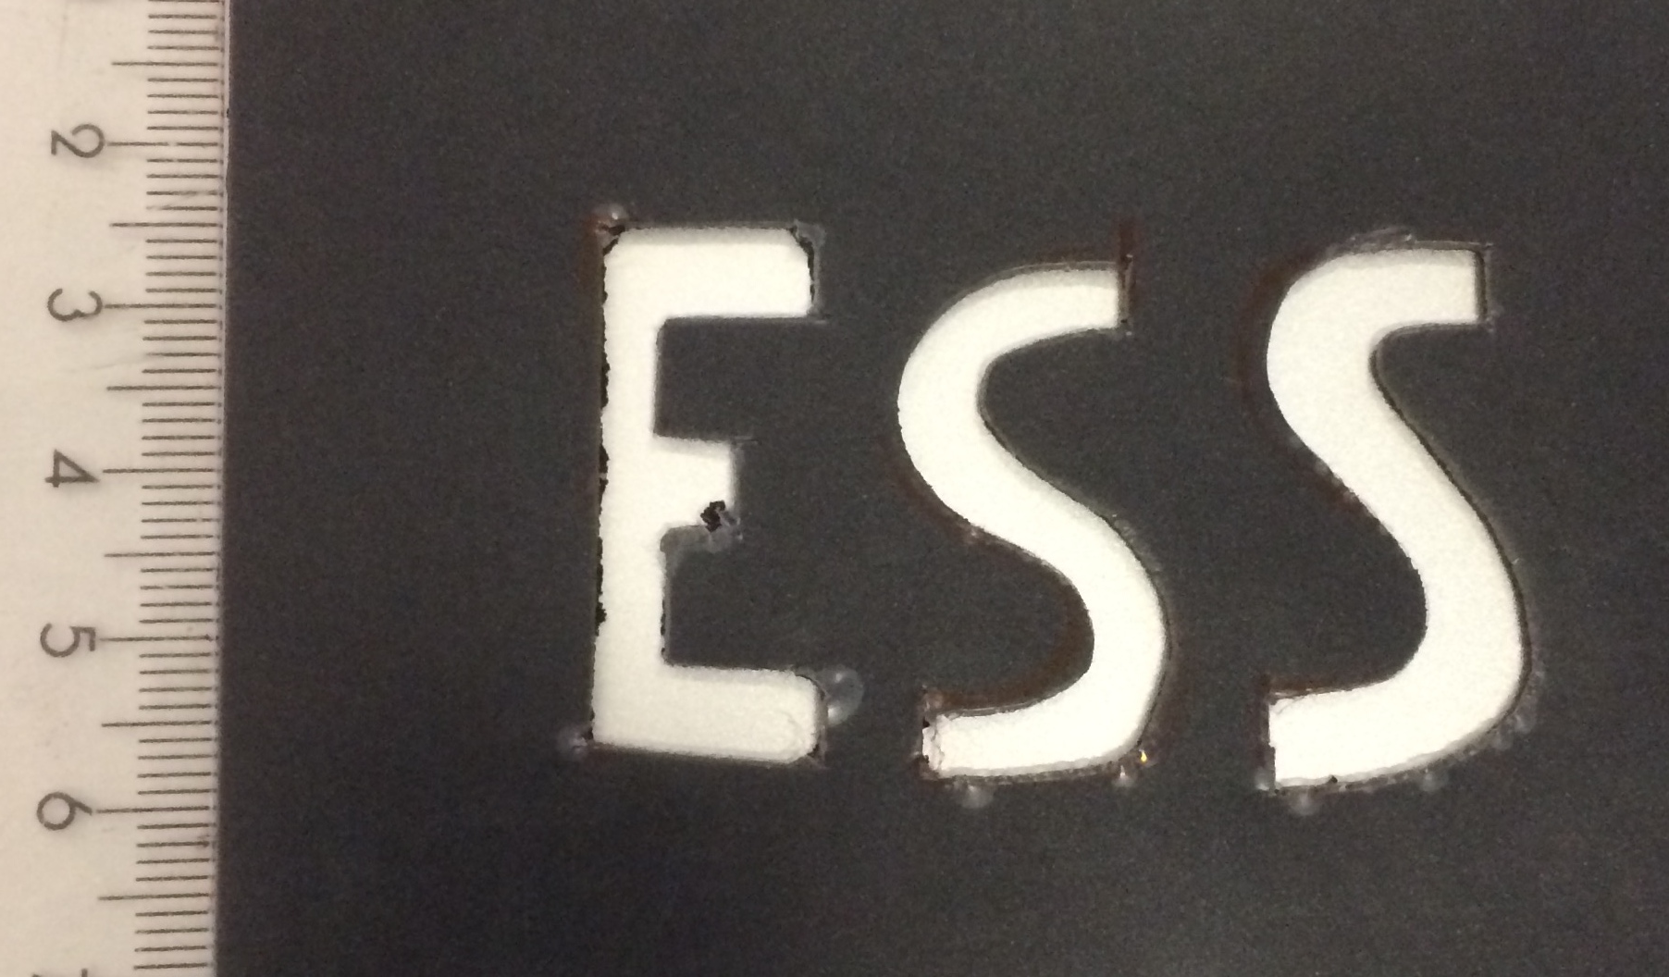
Images
60mm
60mm
35mm
35mm
Mask
Raw image from the detector (log scale)
F. Piscitelli et al., The Multi-Blade Boron-10-based Neutron Detector for high intensity Neutron Reflectometry at ESS, JINST 12 (3) P03013 (2017).

Slide 78
Summary

Slide 79
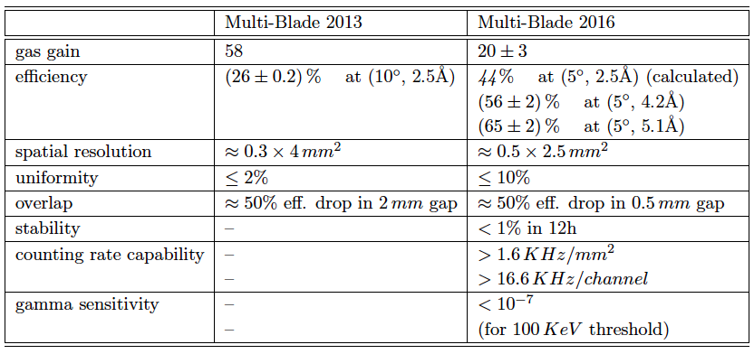
Summary

Slide 80
Summary

Slide 81
Summary
Matching ESS requirements
Focus on next steps

Slide 82
Summary
x3 better than
state-of-the-art
Matching ESS requirements
x10 better than
state-of-the-art

Slide 83
Summary
x3 better than
state-of-the-art
Matching ESS requirements
x10 better than
state-of-the-art
A new detector is going to be tested this year on a Reflectometer

Slide 84
Wigner Research Institute
Linköping University
Thank you.
Building research infrastructure and synergies for highest scientific impact on ESS
Horizon 2020 grant agreement 676548

Slide 85
Backup slides

Slide 86
References:
I. Stefanescu et al. ,“Neutron detectors for the ESS diffractometers,” Journal of Instrumentation , vol. 12, no. 01, p. P01019, 2017.
O. Kirstein et al. , “Neutron position sensitive detectors for the ESS,” arXiv:1411.6194 ,vol. Proceedings of the 23rd International Workshop on Vertex
Detectors, 15-19 September 2014, Macha Lake, The Czech Republic, no. PoS(Vertex2014)029, 2014.
H. Wacklin. FREIA: Reflectometer concept for fast kinetics at ESS - ESS instrument proposal –
https://europeanspallationsource.se/sites/default/files/freia_proposal.pdf, 2014.
J. Stah, U. Filges and T. Panzner, “Focusing specular neutron reflectometry for small samples,” Eur. Phys. J. Appl. Phys. , vol. 58, no. 1, p. 11001, 2012.
A. Ravazzani et al. , “Characterisation of proportional counters,” Radiation Measurements , vol. 41, no. 5, pp. 582 – 593, 2006.
B. Guerard, R. Hall-Wilton, and F. Murtas, “Prospects in MPGDs development for neutron detection,” 2014 - arXiv:1410.0107.
C. Höglund et al. , “B4C thin films for neutron detection,” Journal of Applied Physics ,vol. 111, no. 10, 2012.
A. Andronic et al. , “A comprehensive study of rate capability in multi-wire proportional chambers,” Journal of Instrumentation , vol. 4, no. 10, p. P10014, 2009.
H. Sipilä and V. Vanha-Honko, “The counting rate dependent gain shift and the space charge
in proportional counters,” Nuclear Instruments and Methods , vol. 153, no. 2, pp. 461 – 464,
1978.
E. Mathieson, “Dependence of gain on count rate, due to space charge, in coaxial and multiwire proportional chambers,” Nuclear Instruments and Methods in Physics Research
Section A: Accelerators, Spectrometers, Detectors and Associated Equipment , vol. 249, no. 2, pp. 413 – 420, 1986.
E. Mathieson and G. Smith, “Gain reduction due to space charge in a multiwire proportional chamber irradiated by a uniform beam of rectangular section,” Nuclear Instruments
And Methods in Physics Research Section A: Accelerators, Spectrometers, Detectors and Associated Equipment , vol. 316, no. 2, pp. 246 – 251, 1992.
Y. Ivaniouchenkov et al. , “Breakdown limit studies in high-rate gaseous detectors,” Nuclear Instruments and Methods in Physics Research Section A: Accelerators,
Spectrometers, Detectors and Associated Equipment , vol. 422, no. 1–3, pp. 300 – 304, 1999.
S. Koperny and T. Z. Kowalski, “11th topical seminar on innovative particle and radiation detectors (IPRD08) performance of proportional counters under high count rate,
high gas gain and at high working gas pressure,” Nuclear Physics B - Proceedings Supplements , vol. 197, no. 1, pp. 370 – 373, 2009.
P. Fonte, “Which gaseous detector is the best at high rates?,” SLAC-JOURNAL-ICFA-16-2 .
M. Titov, “Perspectives of micro-pattern gaseous detector technolologies for future physics projects,” 2013 - arXiv:1308.3047.
E. P. Cippo et al. , “A GEM-based thermal neutron detector for high counting rate applications,” Journal of Instrumentation , vol. 10, no. 10, p. P10003, 2015.

Slide 87
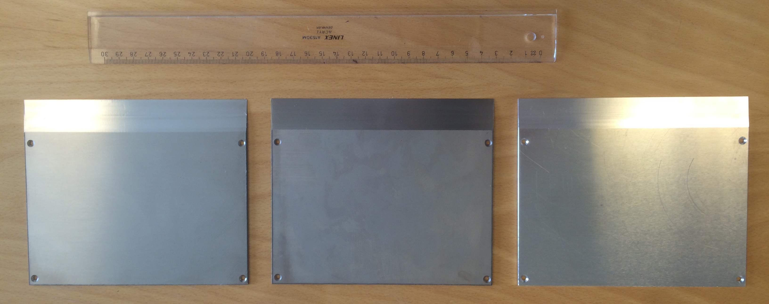
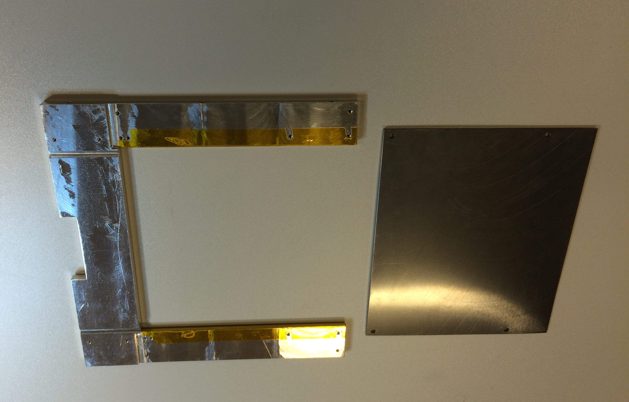
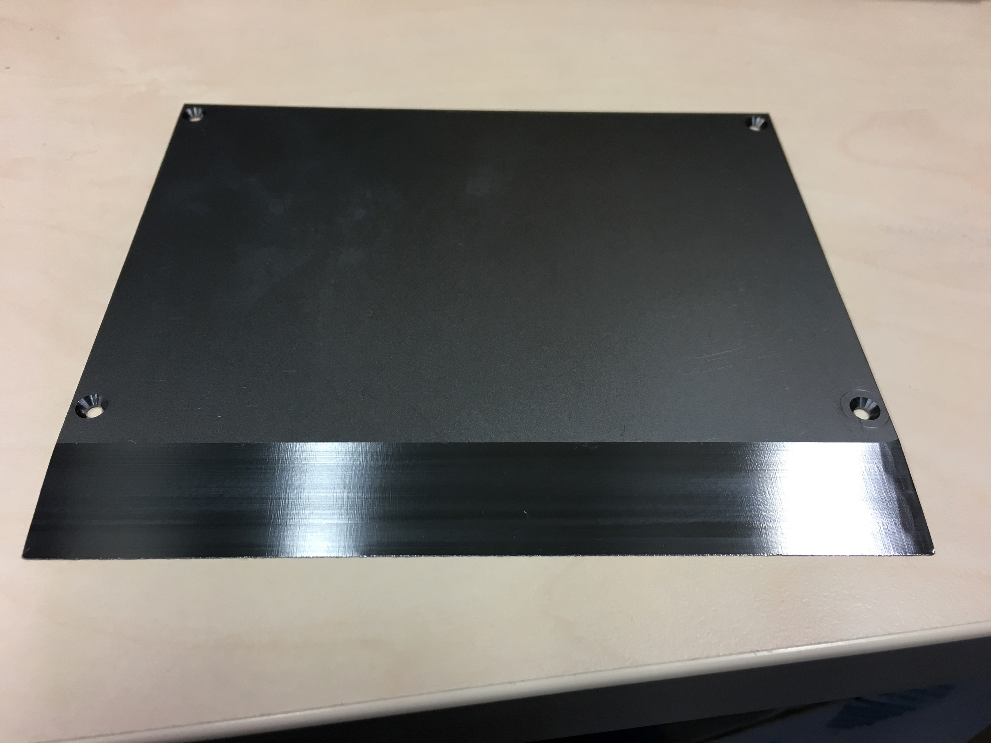
MB-16
Planarity is an issue on large surfaces on Al
Al Ti SS
Ti

Slide 88
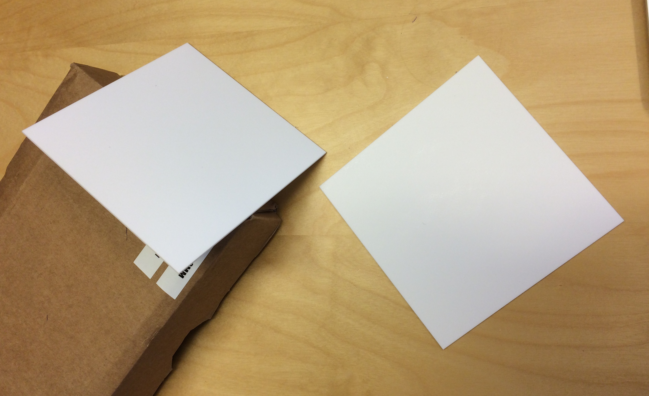
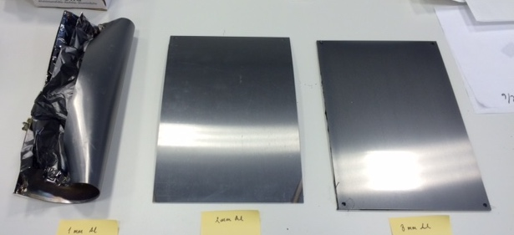
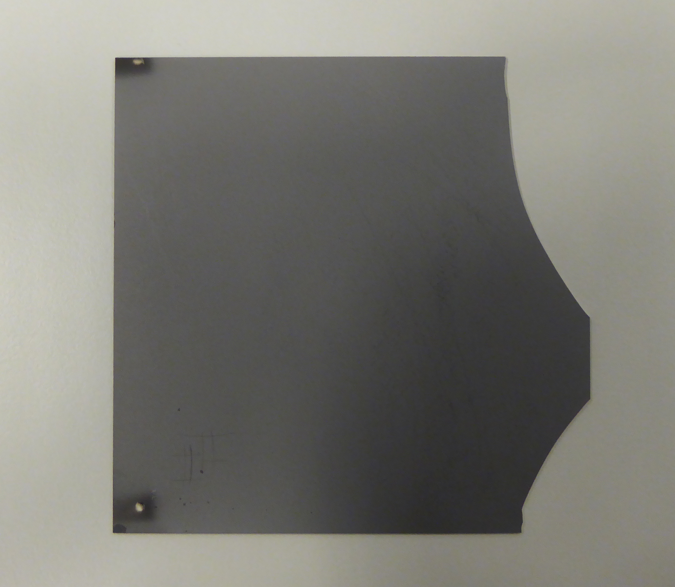
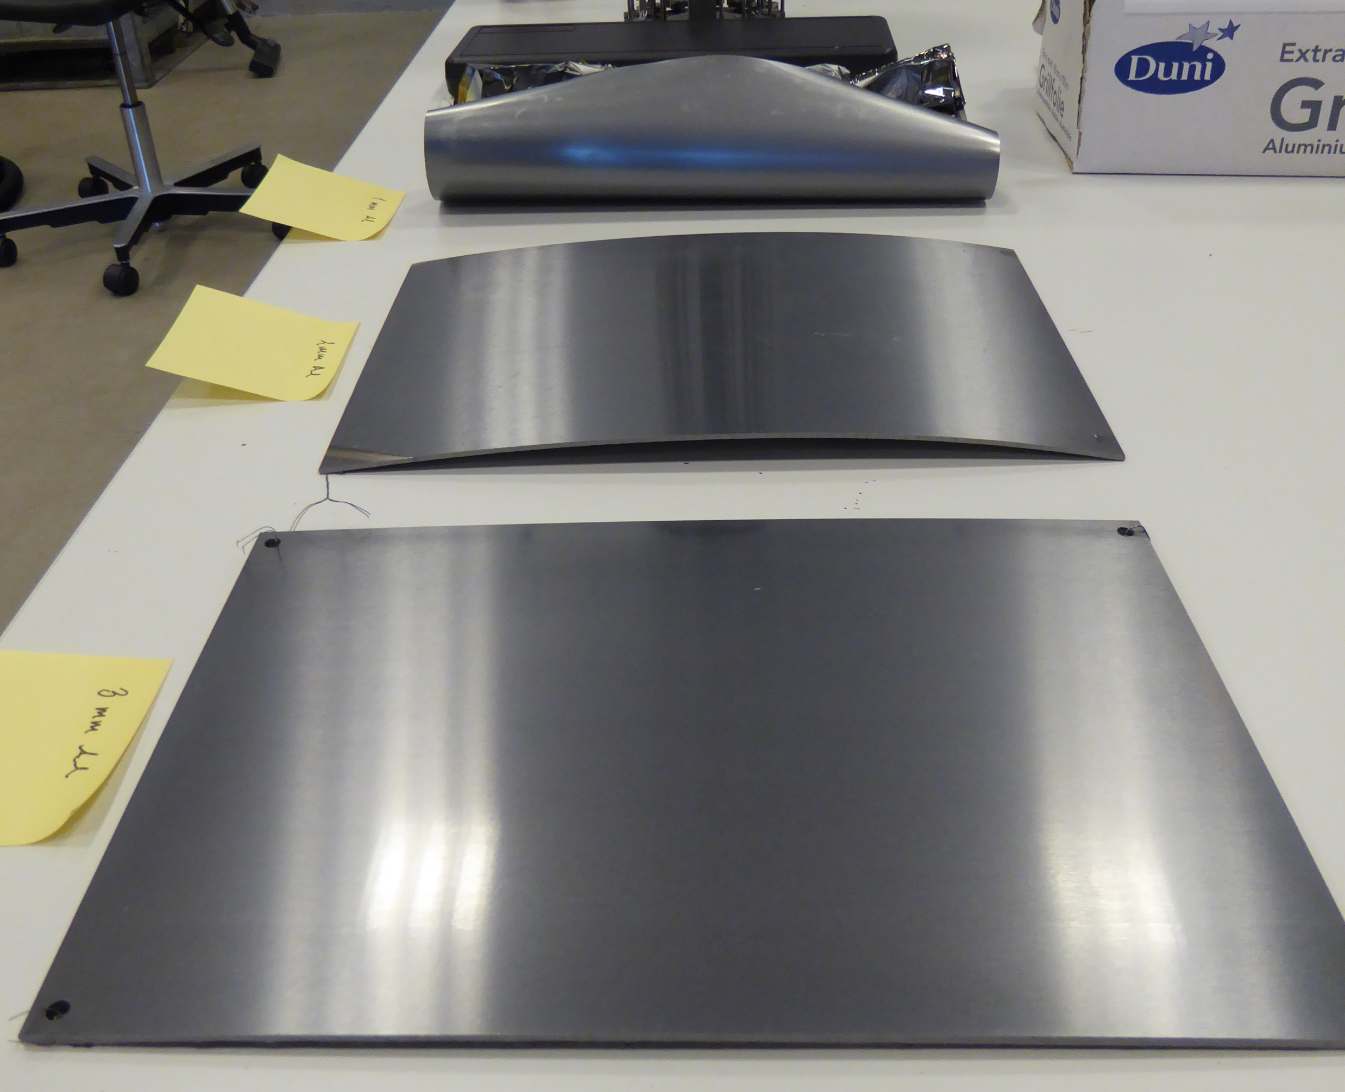
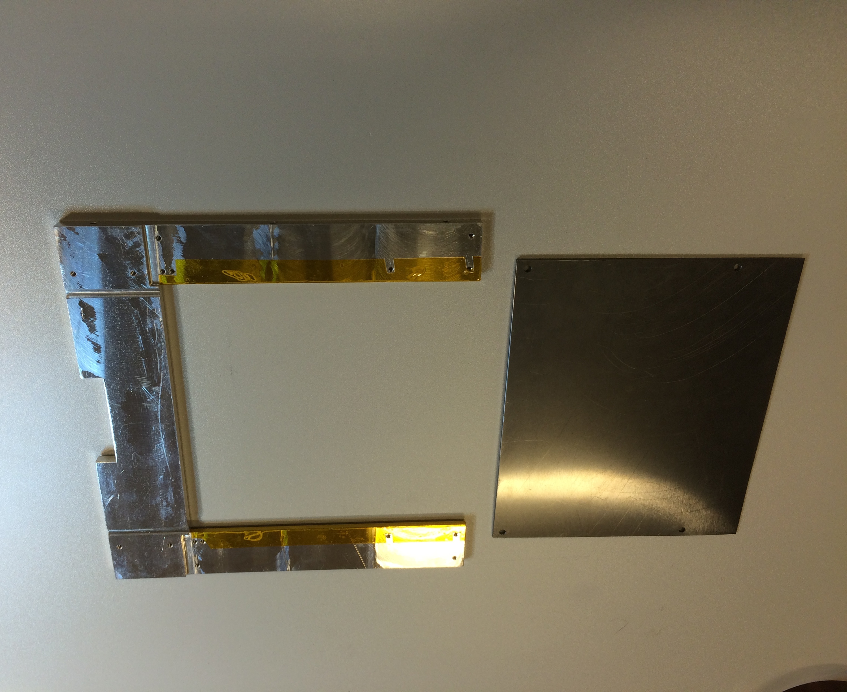
Materials evaluation
1mm
2mm
Planarity is an issue on large surfaces
¹⁰B₄C
~7 μm single-side
100x100mm²
Si
Al₂O₃ substrate
1mm 2mm 3mm
¹⁰B₄C good adhesion
¹⁰B₄C
Al substrate
Al₂O₃

