Slide 1
Analysis software for reflectometry (system requirements and schedule)
Thomas Holm Rod
Group Leader Data Analysis and Modelling
www.europeanspallationsource.se
21 March 2017

Slide 2
Data Analysis and Modeling Scope
Last step in data processing chain that enable users to get value (publications) out of their reduced data ( I(q,ω) / I(hkl) / corrected images )
Scope in construction has been limited to:
Basic (model fitting) data analysis software for the 15 ESS instruments incl. resolution convolution
User-friendly, sustainable, maintainable, reliable, easily installable, and extensible software
Enable users to harness the full potential of ESS
Live-analysis for at least high-throughput techniques.
Remote access to data analysis
Not in scope of construction budget
Co-analysis (e.g. diffraction + SANS)
Analysis beyond basic analysis (e.g. integration of MD simulations).
Mobile/tablet user interfaces
Many users also expect support for analysis beyond what’s currently in the scope!
2

Slide 3
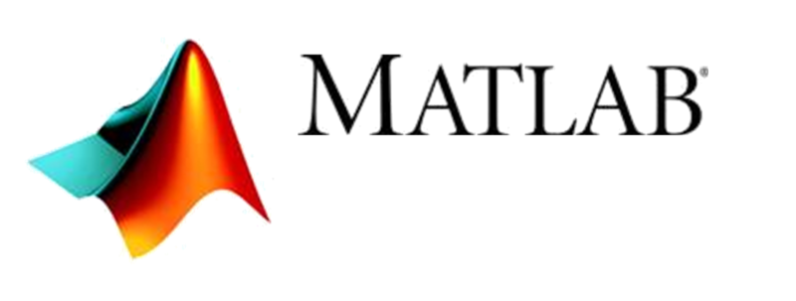
The user community is diverse – even for each instrument
Non-expert and occasional user (few days/year)
Experienced (daily) or geeky user
Graphical User Interface
Command Line Interface
Notes:
Management and coordination is important

Slide 4
Required for world class user programme
Maintainable, sustainable, reliable, and extensible software that we can build on in operation
Enable users to take full advantage of ESS features
Real-time analysis, parametric analysis
Improve & debug existing developments based on user feedback
Silver plated solutions
E.g. automation, support full spectrum of users, single-pulse
More advanced features
Construction
Hot Commissioning
Operation
Notes:
From TDR

Slide 5
What do we mean by sustainable software (system requirements)
ESS should be able to takeover the software and maintain, sustain and (rapidly) extend the software.
Modularized
Python scripting interface & GUI
Facilitates 3rd party contributions
Fully open source and free
Preferably Python/C++/Qt
Adequate quality assurance
Adequately documented
No single point of failure
Is a widely used reflectometry code (preferably the standard)
Supported by other facilities and attractive for an in kind partner
(WP10)
SANS
Reflectometry
Imaging
(QENS)
Some codes: | RasCal | GenX | MotoFit | BornAgain

Slide 6
SINE2020
Six facilities have agreed to promote and support one specific analysis framework for each of the techniques: SANS, reflectometry, imaging, QENS, and muon spectroscopy
FZJ/MLZ in charge of reflectometry (ESS in charge of SANS)
User involvement through workshops:
Workshop II, April 24th & 25th 2017 at ILL for early adopters / expert users
Session for reflectometry organized by BornAgain team
RasCal and GenX developers will participate.
MotoFit developer will provide input.
Workshop III, Spring 2018 at MLZ for ‘non-expert’ users.
Notes:
Results when leaving results

Slide 7
High-level schedule
User programmme
MS: Intuitive analysis software
2023
Commissioning
(Cold + Hot)
Make it work & debug!
Respond quickly to user requests
Improve user experience (automation) based on real data and user feedback
>2020
MS: Solid base for ongoing developments
Construction/pre-operation phase
2016
Status: ~15 programs in various conditions

Slide 8
Time line for sub-class with two instruments
Make it work & debug!
Improve user experience (automation) based on real data & user feedback
2016 | 2017 | 2018 | 2019 | 2020 |  | 2021 |  | 2022 |  | 2023
 |  |  |  |  |  | I.T. |  | I.T.
Instr #1
Instr #2
MS: Solid base for ongoing development;
Sustainable, maintainable, reliable, modularized and extensible program(s)
Scripting interface & GUI
Framework for live analysis
Analysis for ESS specific features
Features needed for Hot Commissioning
MS: Intuitive analysis software;
User-friendly
Automation
Functional live analysis
Scripting interface & GUI

Slide 9
QUESTIONS

