Slide 1
ESS – NID & DMSC workshop on
software requirements for diffraction instruments
10:00 Werner Schweika - Welcome / Introduction / Program
10:20 Jon Taylor - DMSC overview Expectations
10:45 Instrument control
Robin Woracek Experiences from V20 - ESS test beamline
(Michael Wedel)
Marina Ganeva (Georg Brandl) - NICOS
11:20 Data acquisition / storage / reduction &visualization
Mikhail Feygenson - Handling excessive data rates
Xavier Fabreges - Experience from TOPAZ@SNS and extrapolation to MAGIC 12:00 Lunch 12:30 Data reduction & visualization
Jochen Fenske - BEER diffraction data
Marina Ganeva Mantid at MLZ for powder and single crystal diffraction 13:15 Data analysis software for powder & single crystal
Thomas Holm Rod
Mikhail Feygenson - DREAM software requirements
Mogens Christensen - HEIMDAL software needs
Andreas Houben - multi-dim Rietveld at POWTEX
14:45 Coffee & cake
15:15 Jonathan Fisher - nsxtool: Data Analysis for Crystal Diffraction
Andrew Sazonov - Polarised neutron diffraction data analysis software
16:02 end
April 7th ESS NID-DMSC Copenhagen
Software requirements for diffraction instruments
Werner Schweika

Slide 2
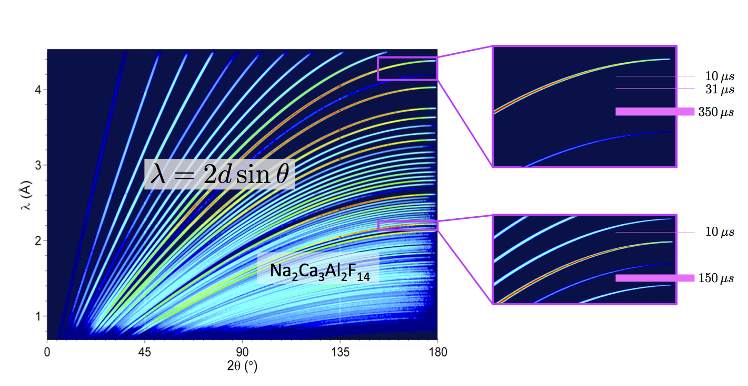
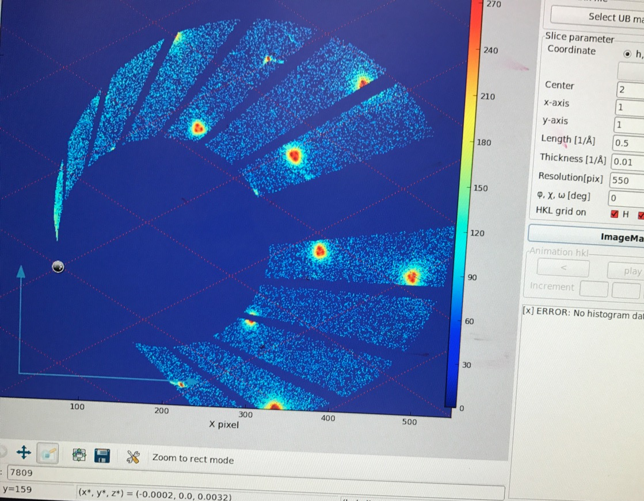
Commons for diffraction instruments DREAM, HEIMDAL, MAGIC, BEER
Timeline: 2021 hot commissioning 2023 user operation
Control: Python script, include SE Gui one computer- one-window-one-click-only
Detector: B10-inclined geometry CDT & DENEX
readout electronics in accordance with ESS requirements (early procurement)
volume detector ∼10⁶ voxels with TOF-spectra ≳ 10³ channels
data/count rates ∼0.1 Gbit/s (typical) to ≲ 5 Gbit/s (peak) 64bit/event
Acquisition
Storage
Visualization
resolution varies
ragged workspace?
4 dimensions 2 dimensions
life-display
2D Rietveld
Reduction
Laue
1D-hkl lists
Single crystal
Texture
integrate: time
detector depth
powder
integrate: phi
detector depth
1D list
&
Profile PV
Refinement
3D nice
2D-cuts I(Q)
TASK: define core & instrument specifics requirements
April 7th ESS NID-DMSC Copenhagen
Software requirements for diffraction instruments
Werner Schweika

Slide 3
April 7th ESS NID-DMSC Copenhagen

