Slide 1
HEIMDAL software needs
Mogens Christensen (AU/DK), Jürg Schefer (PSI/CH)
www.europeanspallationsource.se
17-04-04

Slide 2
Software needs
HEIMDAL Overview
Azimuthal integration
Time
Instrument layout
Timeline

Slide 3
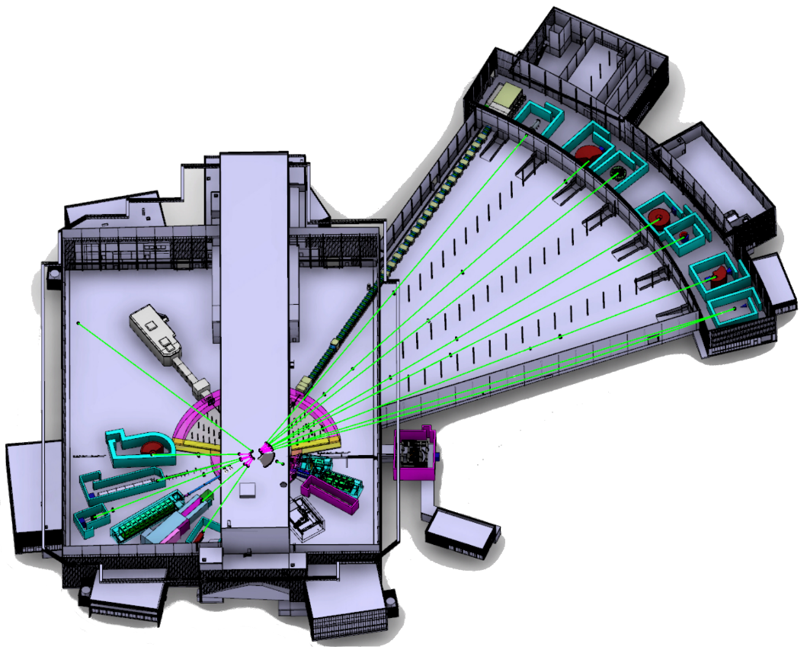
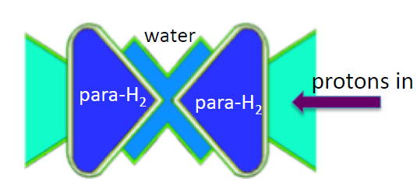
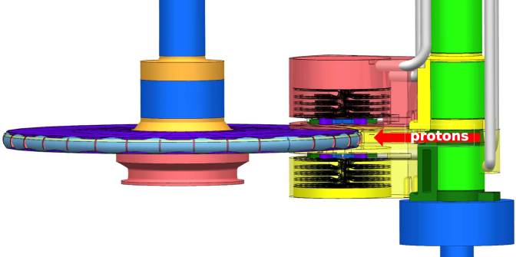
Instrument layout
Experimental hall E01
Beam port W8
Neighbour: T-Rex
HEIMDAL

Slide 4
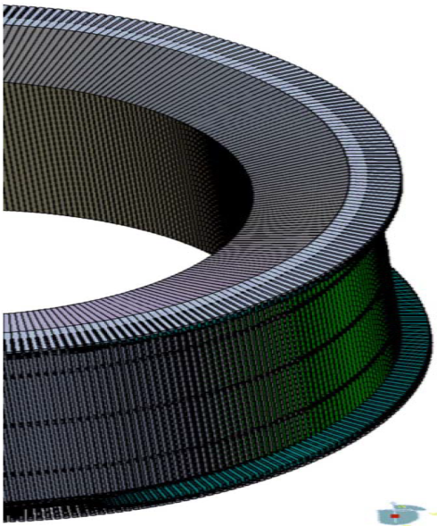
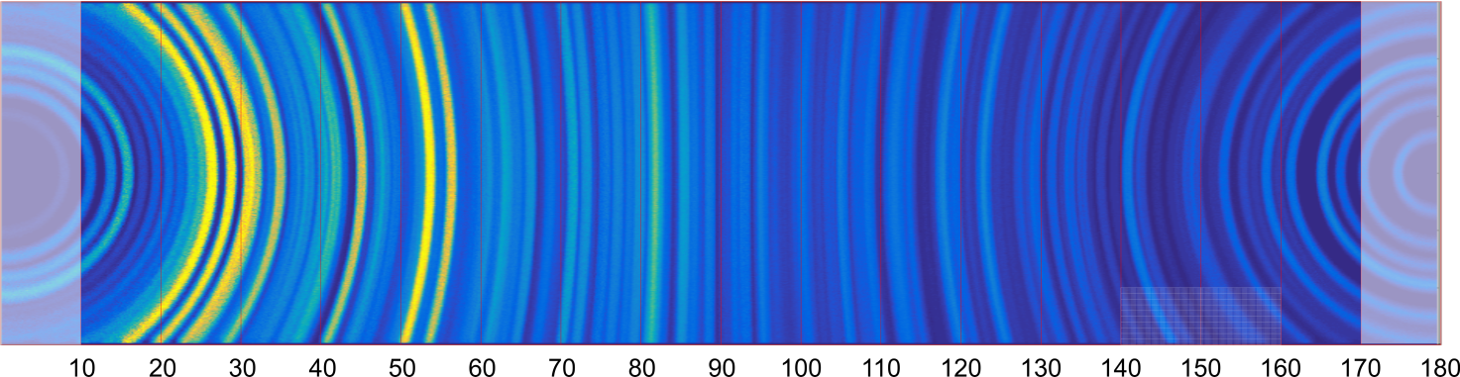
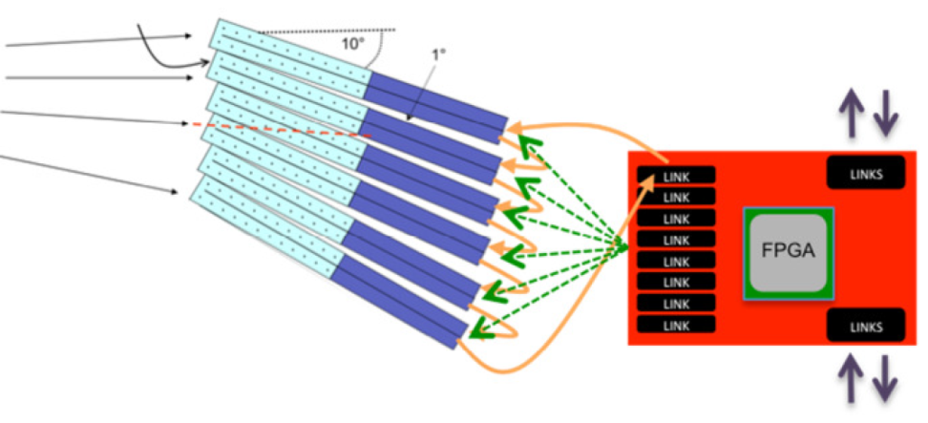
Detectors
Data format – one time frame
Azimutal integration
Equal 2θ – integrated into same time bin
Pulse normalization
Detector normalization
Noise correction, etc..
Removal of suprions/masking

Slide 5
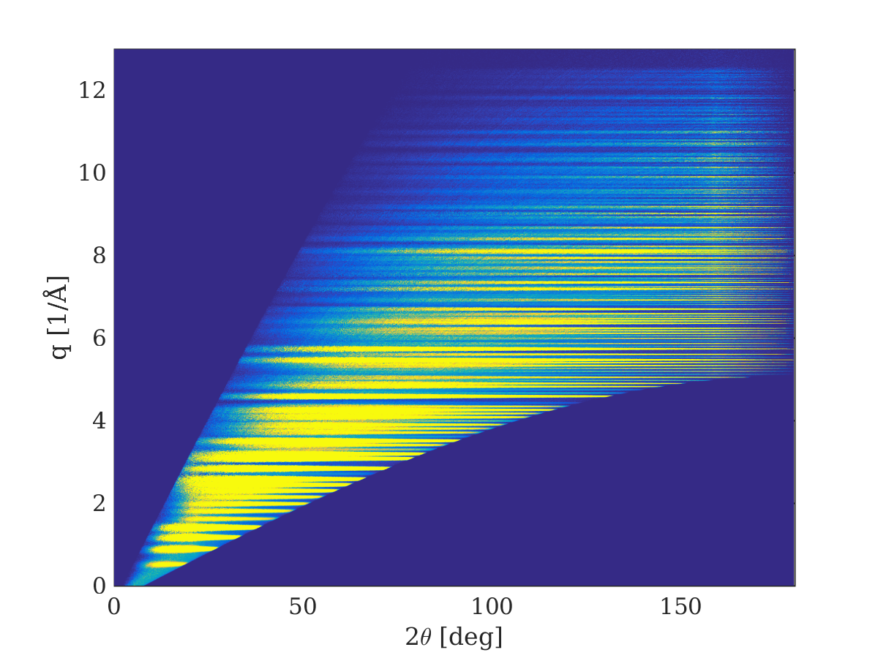
Time variation
Data format
t = bin1
t = bin2
t = bin3
t = binX
Azimuthal integration:
Conversion to q and 2θ
Rietveld refinemtns in 2D

Slide 6
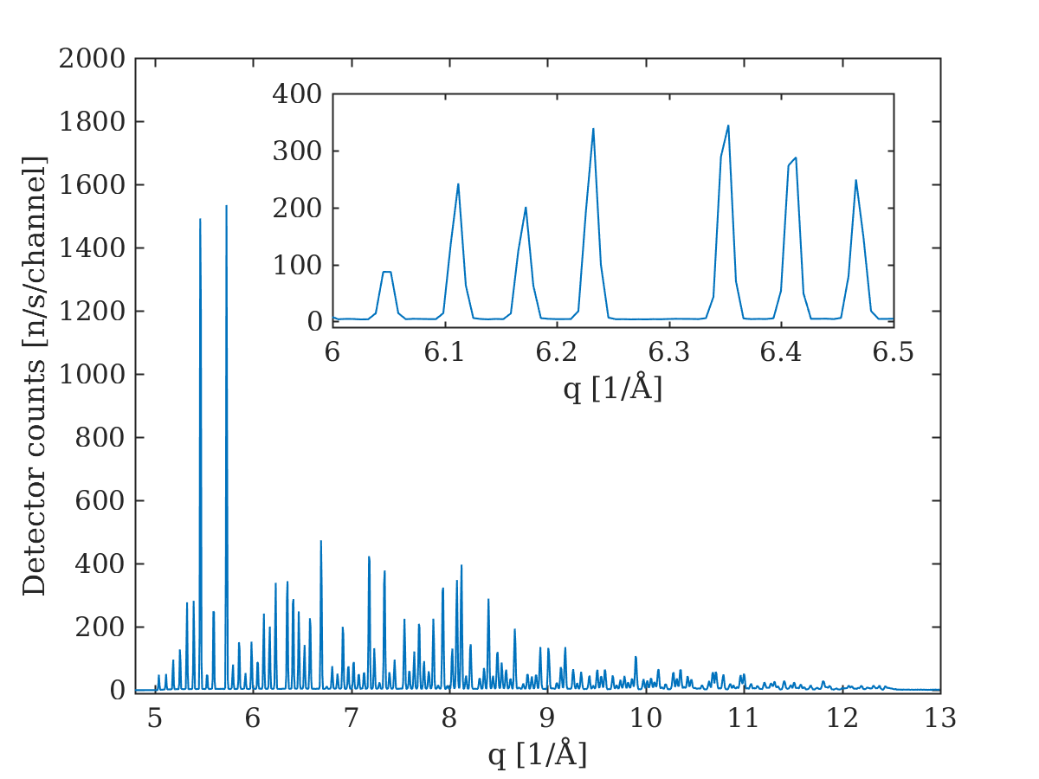
Rietveld refinements in 2D
Rietveld refinements in 2D:
- Binning in 2θ to improve statistics
- Plotting in 1D for model evaluation
- Quick fitting

Slide 7
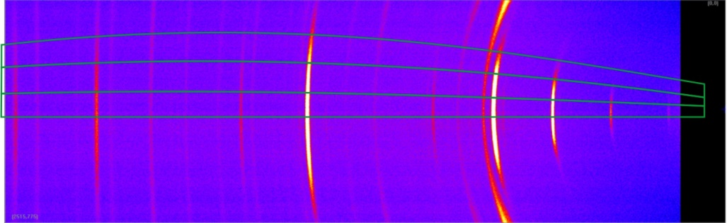
‘3D’ Analysis of texture:
Partial intergration of Debye Scherrer cones
Including sample orientation in 2D refinements => quasi 3D refinements

Slide 8

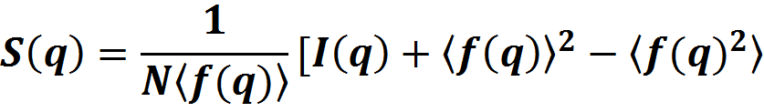
Total scattering
Convert data from
Reciprocal q-space to G(r) in direct space
Corrected for scattering from the capillary → I_{coh}(q)

Slide 9
Nice to have
Co-treatment of data (PXRD, SANS, RAMAN, MÖSSBAUER etc):
Estimation of sufficient statistics:
Intelligent data collection:
Diffraction tomography
Bragg edge imaging (will be discussed in the imaging software group):
3D grain mapping:

Slide 10
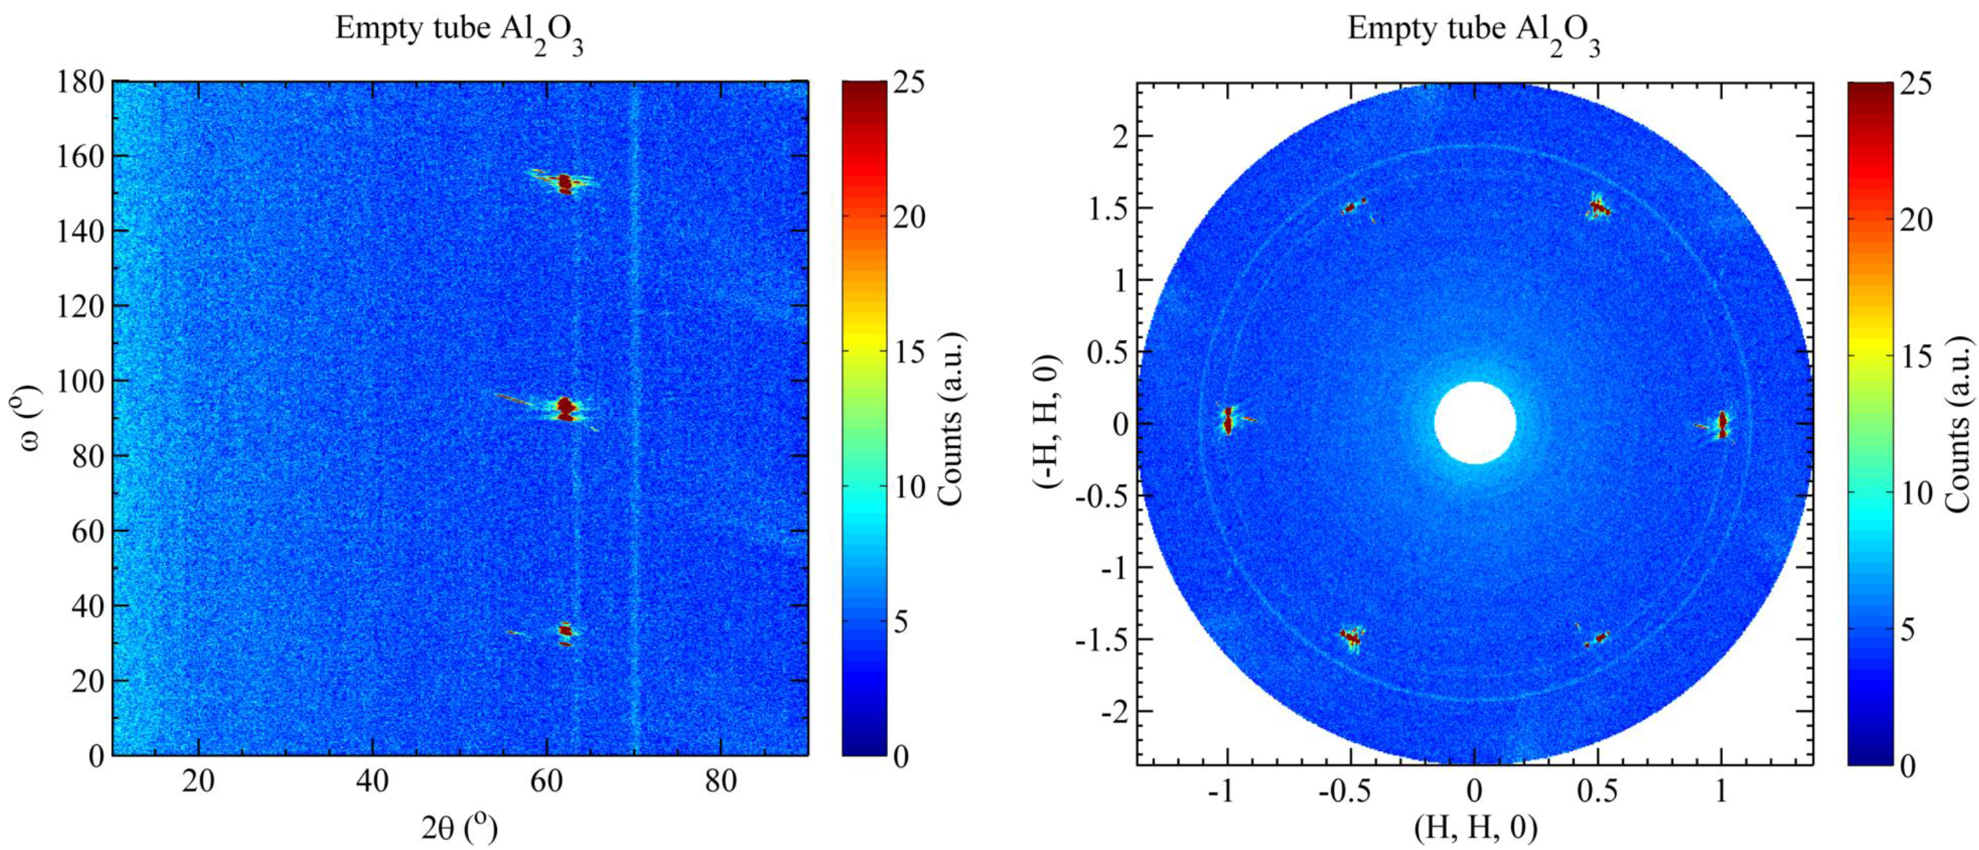
Removal of single crystal spots / masking

