Slide 1
BEER – Diffraction Data

Slide 2
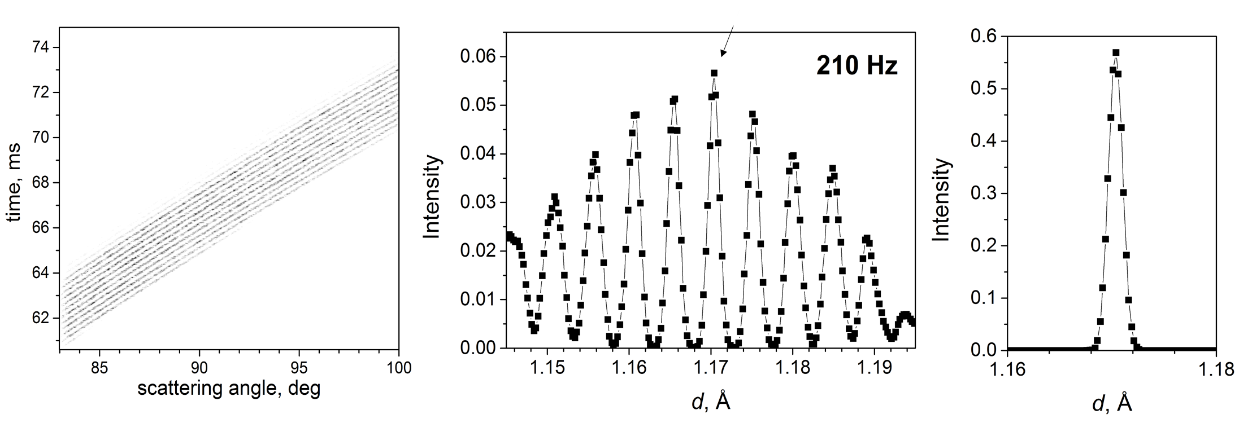
Data reduction
Modulation technique:
Single Bragg reflection is observed as multiple lines according to the M_{d} factor
M_{d} in general has no integer value
Reduction to 1D pattern based on exact knowledge of the chopper state
No overlap – only for high symmetry materials
Mostly used for strain scanning

Slide 3
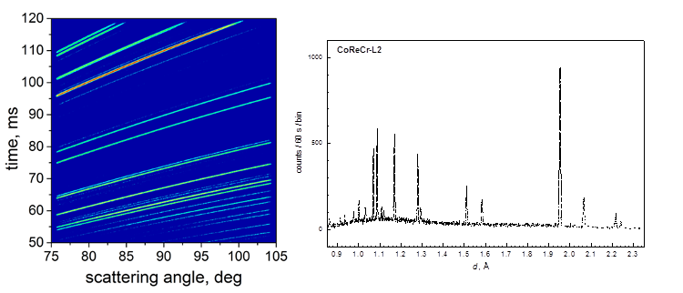
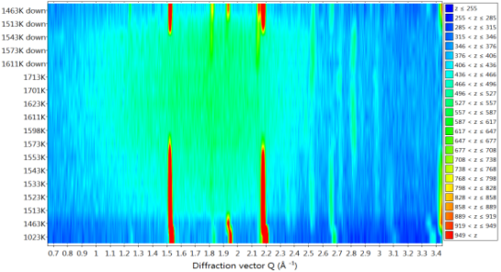
Data reduction
Mode diffraction:
2D patterns TOF vs. angle, several detectors
Reduction to 1D pattern – for plotting against SE status
2D pattern fitting will be advantage (example Mantid – POLDI)
Problematic intensity calibration over detector area for pattern fitting
Fast data reduction and simple analysis for active SE feedback (no full pattern fit)

Slide 4
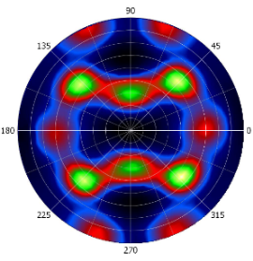
Data reduction
Mode Texture:
link between detection time and position of sample
link between velocity of sample rotation and detection
time in case of continuos rotation of sample → information
about sample geometry important
data reduction by software like Steca from MLZ and MAUD

Slide 5
Software in general
Simulation Software:
Virtual experiments for instrument set-up (resolution/intensity modes)
Simulation of modulation mode, e.g. for low and high symmetric materials
Instrument control software:
Control of Sample Environment
Time stamping and control of Sample Environment off beam for long term
experiments (stand alone mode)
Sample Environment driven experiment control
Include Pre-scans of sample geometry for strain scanning (e.g. SScanSS at EnginX)
Experiment movement than in sample coordination system
Control by graphical user interface (GUI) and command line (CL)
Data live visualisation

