Slide 1
Critical design review #1 for medium beta cavity cryomodules
3-4 APRIL 2017
-
SAFETY AND RAMI INPUTS
-
Franck Peauger
OLIVIER KUSTER (INSTALLATION AND SAFETY MANAGER)

Slide 2
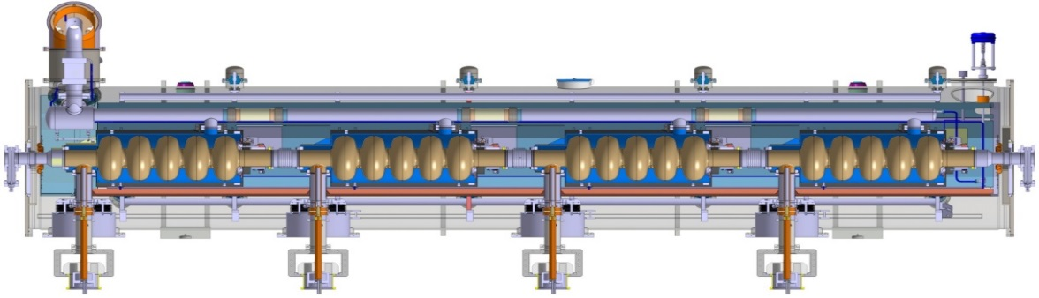
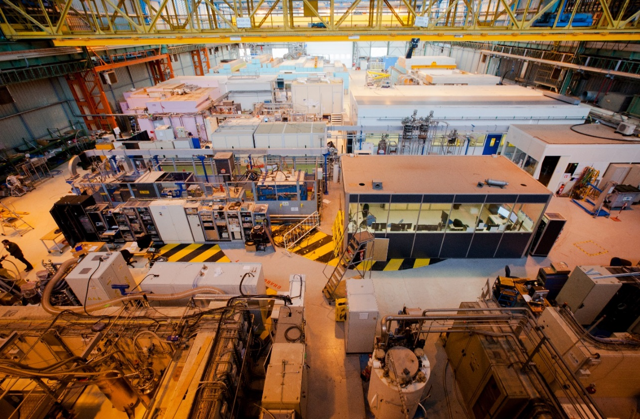
SAFETY FOR THE ESS CRYOMODULE

Slide 3
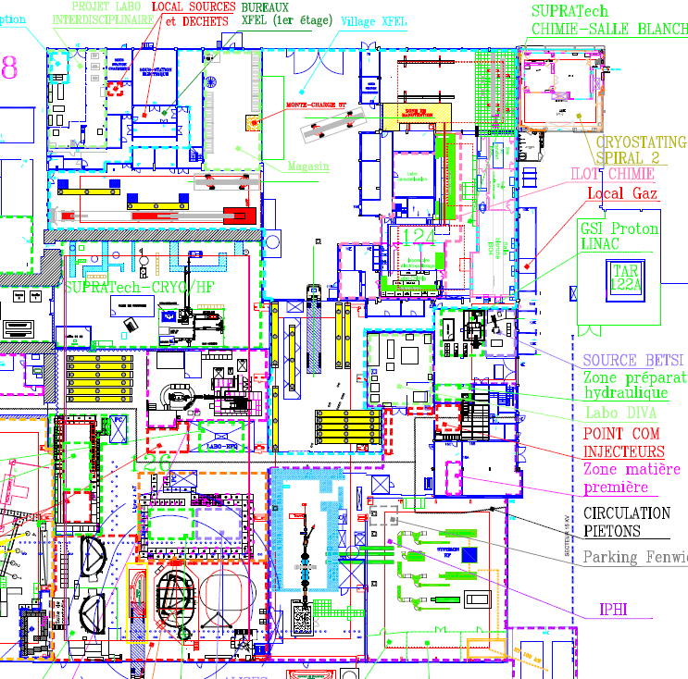
ESS tests areas
CV2 : Cryo & RF tests for cavities
Chemicals treatments for cavities
BOTH: reception, control, storage, assembly area
Cleanroom : couplers & cavity string assembly
CV2
Barge RF
RF conditionning for couplers
Both
ESS/SARAF bunker : RF conditionning & tests for CM
N

Slide 4
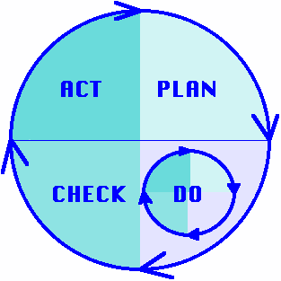
Safety Risks analysis
« Prototype phase »
  Safety studies of existing experimental stations
  ESS safety study for the CEA Saclay Safety Local Commission
  (CLS) authorization (April-May 2017)
  Radiation protection study
  Equipment under pressure study (PED)
  Prevention plans, fire permits, etc. for work sites to fit out ESS areas
« Industrial phase »
  Safety & environmental requirements for ESSI specifications
  ESSI safety study for the CEA Saclay Safety Local Commission (CLS) authorization
  Prevention plan with the chosen industrial partner for the assembly production

Slide 5

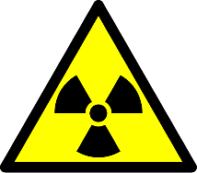

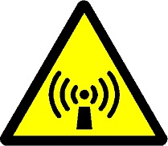
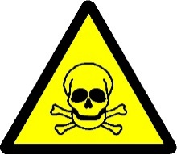
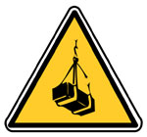
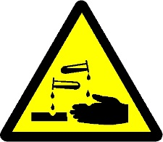
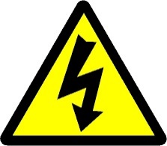

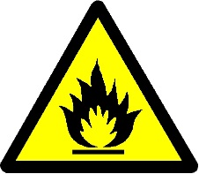



MAIN Hazards for ESS tests in saclay
Risk of anoxia
Cryogenic hazard
Chemical hazards
Noise
Ergonomics
Ionizing radiations
Non ionizing radiations (RF)
Handlings
Electrical hazard
Fire
Interferences

Slide 6
Safety management & exploitation
Works, logistics, environment, health and safety team
2 Team leaders on each experimental station
General safety rules, procedures, safety instructions
Twice-monthly meetings to manage exploitation and prevent interferences
Quaterly meetings for land use of Synergium infrastructure
Prior authorization sheet to begin a test
Safety inspections & safety drills
Periodical and regulatory controls of equipments
Safety training plan, medical supervision, personal protective equipments

Slide 7
Ionizing Radiation protection for CM Tests (1/2)
Radiation calculations and simulations
15 MeV (uprating)
Beam toward the North
Usual concrete (uprating)
Cartography in hourly dose rate (H*(10)) for an electrons flow at 0,1 nA (adapted for a 4% pulsed cycle)
>> Exposure level outside bunker compatible with public people

Slide 8
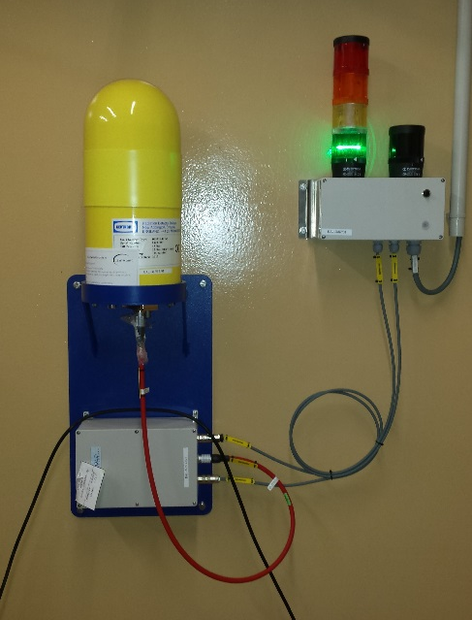
Ionizing Radiation protection for CM Tests (2/2)
Radiation protections : concrete bunker with roof
Homogeneity control of the bunker with an Xray generator
Plugging of leaks with Lead (bricks, leaves, balls)
Safety chain
RF shutdown beyond public level outside
Controls of the chain by radiation protection team
Monitoring of radiations levels :
  > Gamma rays measurer (hourly dose rates)
  > Neutrons measurer (hourly dose rates)
  > Cartographies around the bunker by radiation protection team
  > Dosemeter films around the bunker
Radiation prevention plan (DIMR), procedures, signs, restricted access area
Authorized staff, safety trainings
Ionizing chamber
150 nSv/h-0,15 Sv/h
OK for Pulsed cycle

Slide 9
RAMI
RAMI = Reliability, Availability, Maintainability and Inspectability
Objective:
  reduce the risk level of a main function breakdown
  decrease the time to repair
WHAT can go wrong, WHERE and WHEN
Strategy:
  spare components
  back-up systems
  Maintenance
  component standardization
  systems design optimization

Slide 10
What can go wrong
Very preliminary analysis
 | WHAT | PROBLEM | WHERE
1 | Cavity | failure
2 | Stepper motor | failure | Tuning system
3 | Piezo actuator | break | Tuning system
4 | Cryogenic circuit | Flange leak | Gasket connections
5 | Elastomer gasket | degradation | Vacuum vessel
6 | Internal RF cable | degradation | From cavity pick-up port to vacuum vessel port
7 | Helium valves | failure | Top of the vacuum vessel extremities
8 | Vacuum gate valves | failure | vacuum vessel extremities
9 | Ceramic | break | Power coupler or pick-ups

Slide 11
Thank you
Commissariat à l’énergie atomique et aux énergies alternatives
Centre de Saclay | 91191 Gif-sur-Yvette Cedex
T. +33 (0)1 69 08 76 11 | F. +33 (0)1 69 08 30 24
Etablissement public à caractère industriel et commercial | RCS Paris B 775 685 019

