Slide 1
Critical design review #1 for medium beta cavity cryomodules
3-4 APRIL 2017
-
PLANNING TOOLS
-
XAVIer hanus

Slide 2
OVERVIEW
MS-PROJECTS
M-ECCTD
CEA.LEV.0: ESSI /DEV. PLAN, ROADMAP
  Large grain size ≥ 1 month
  Combined tasks & plan reviews
  Address to ESS & partners >> STRATEGY
CEA.LEV.I : WP /PROJECT LEADING
  Grain size = 1 month – 1 week
  More decomposition
  Address to WP leaders >> PROJ. MANAGEMENT
CEA.LEV.II : WP, LEADERS / DETAILED
  Grain size = 1 week – days
  Individual tasks vs. mat./hum. resources
  Loaded with resources for identified sequences when shared
  Updated ~weekly
  Address to project leaders & lab managers >> ORGANIZATION & OPERATIONAL MANAGEMENT
CEA.LEV.0 – M-ECCTD
CEA.LEV.I → CEA.LEV.II
CEA.LEV.II – M-ECCTD full
CEA.LEV.II – M-ECCTD CAV
Tracking Action List_M-ECCTD_IRFU_2016.04.15.xls
M-SERIE
CEA.LEV.0 – ESSI_CM-DEV-PLAN:
CEA.LEV.I – ESSI-CRYOMODULE:
  Market survey & delivery oriented
  Holds points for contract follow-up
  Delivery lots for each market

Slide 3
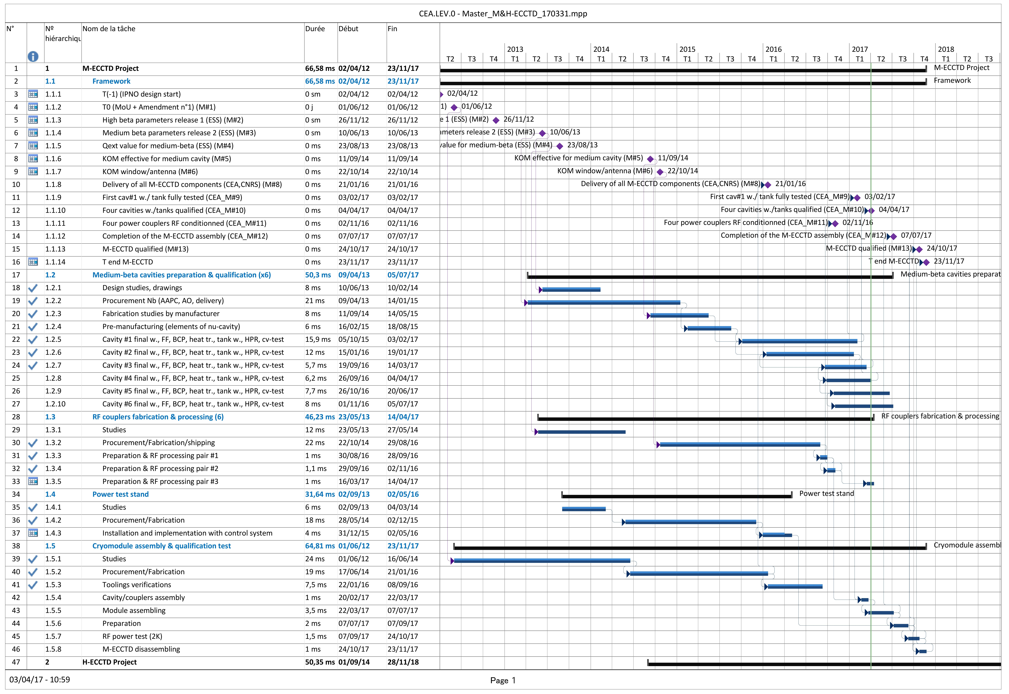
CEA.LEV.0 – MASTER M-ECCTD

Slide 4
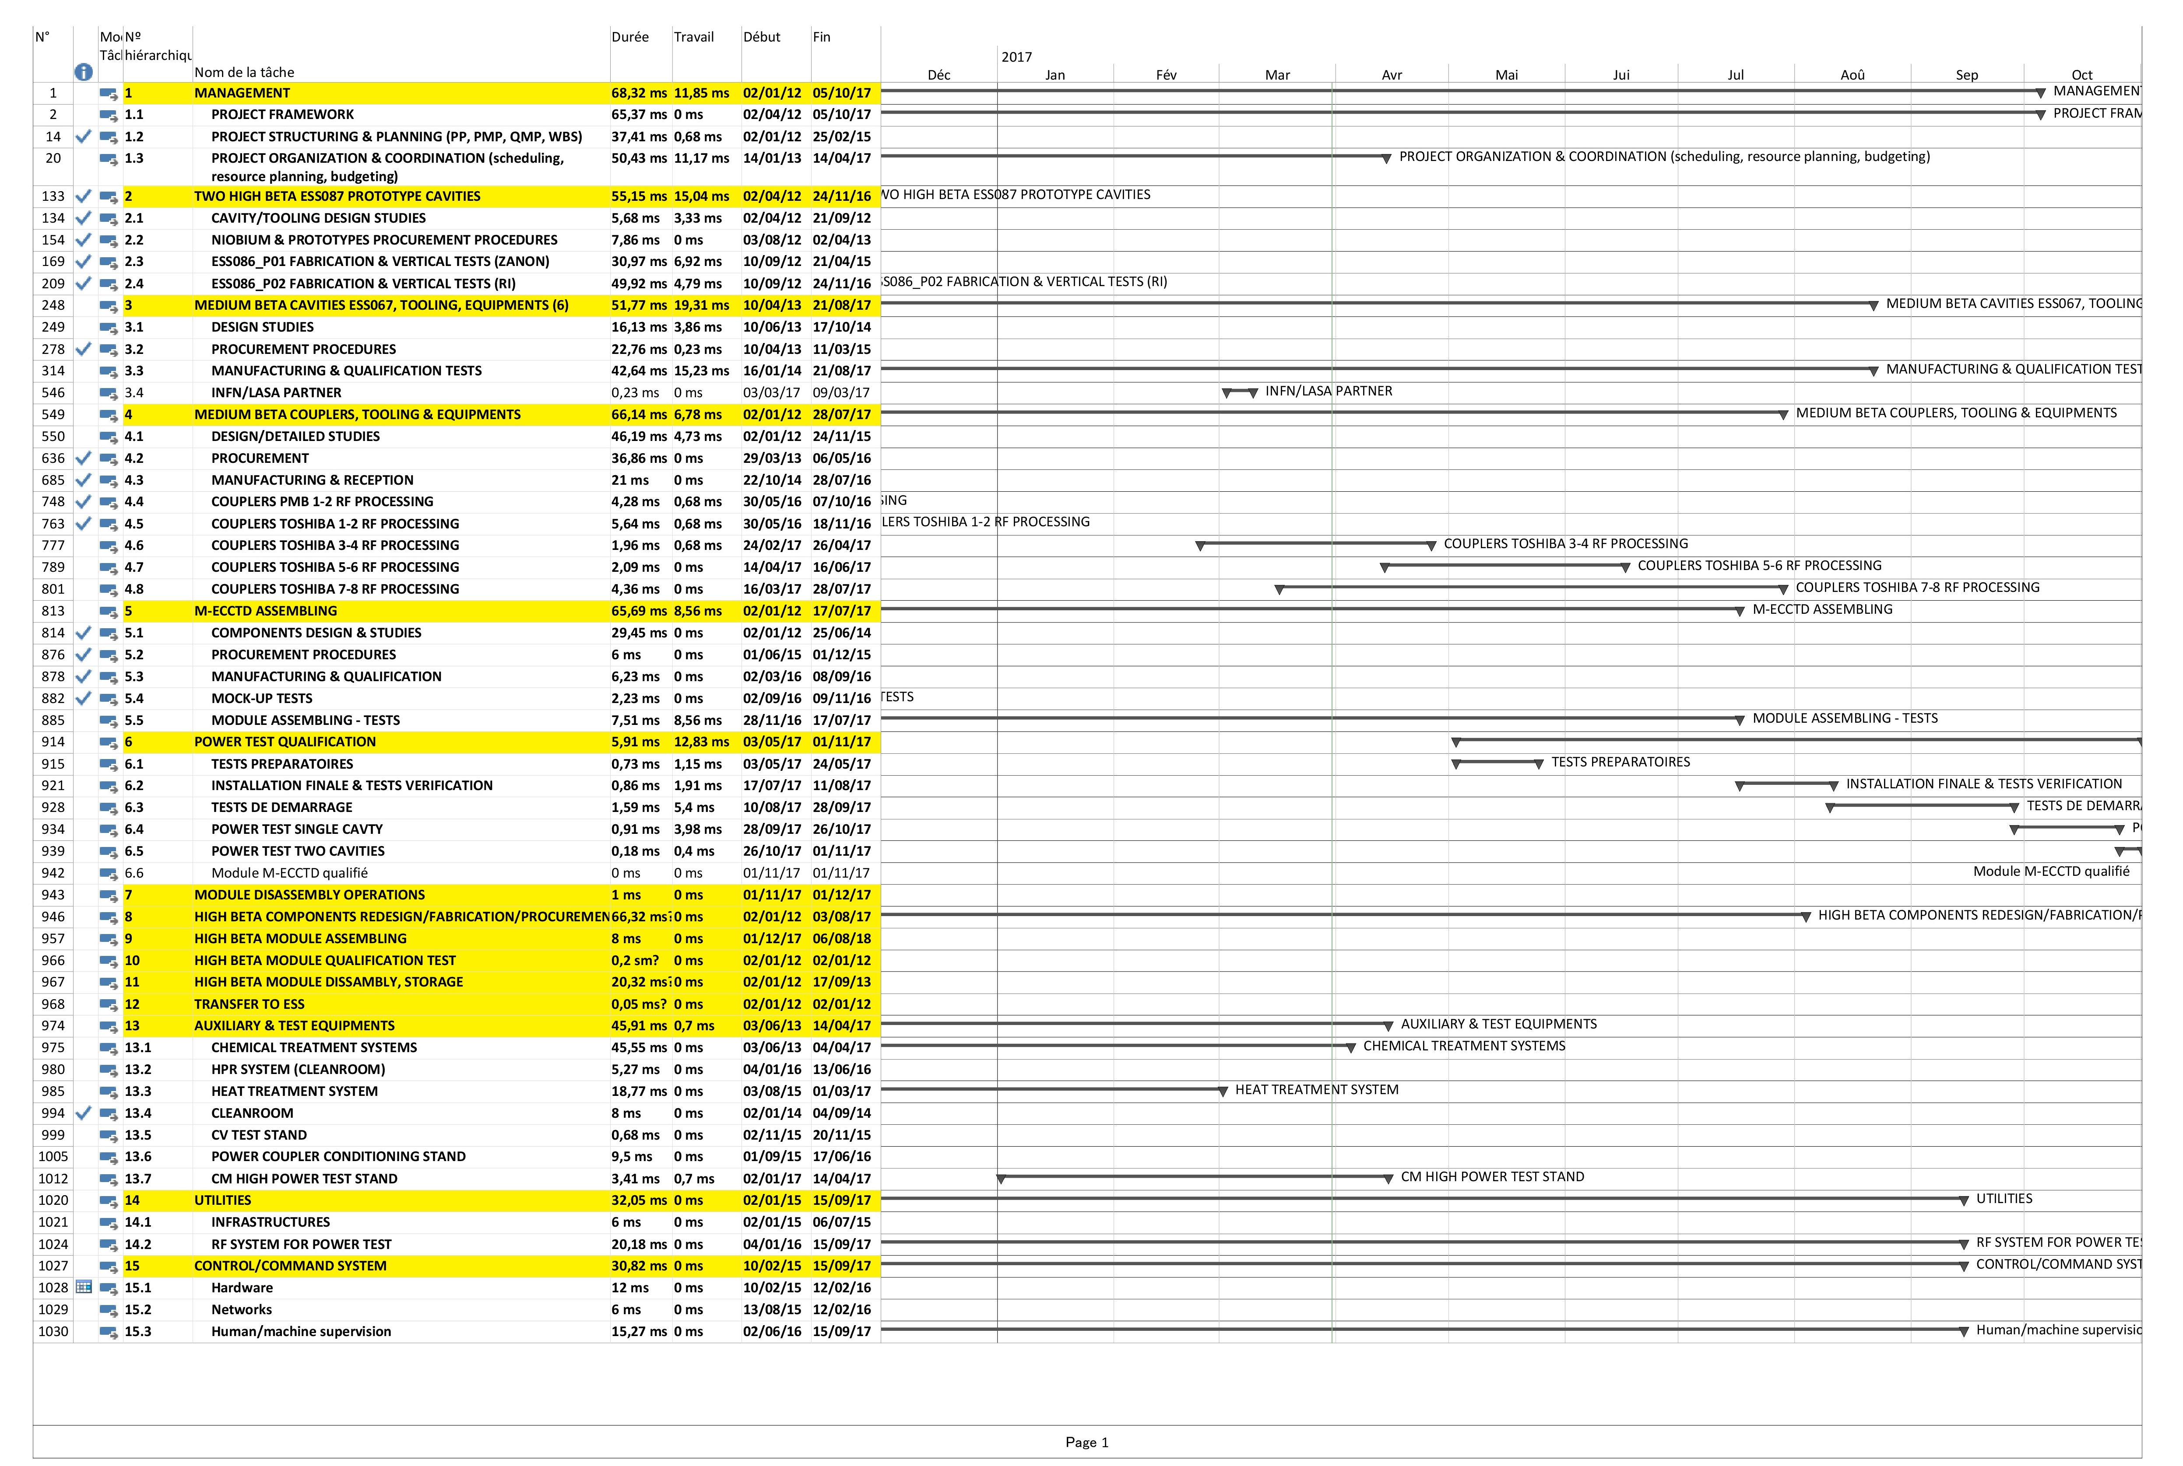
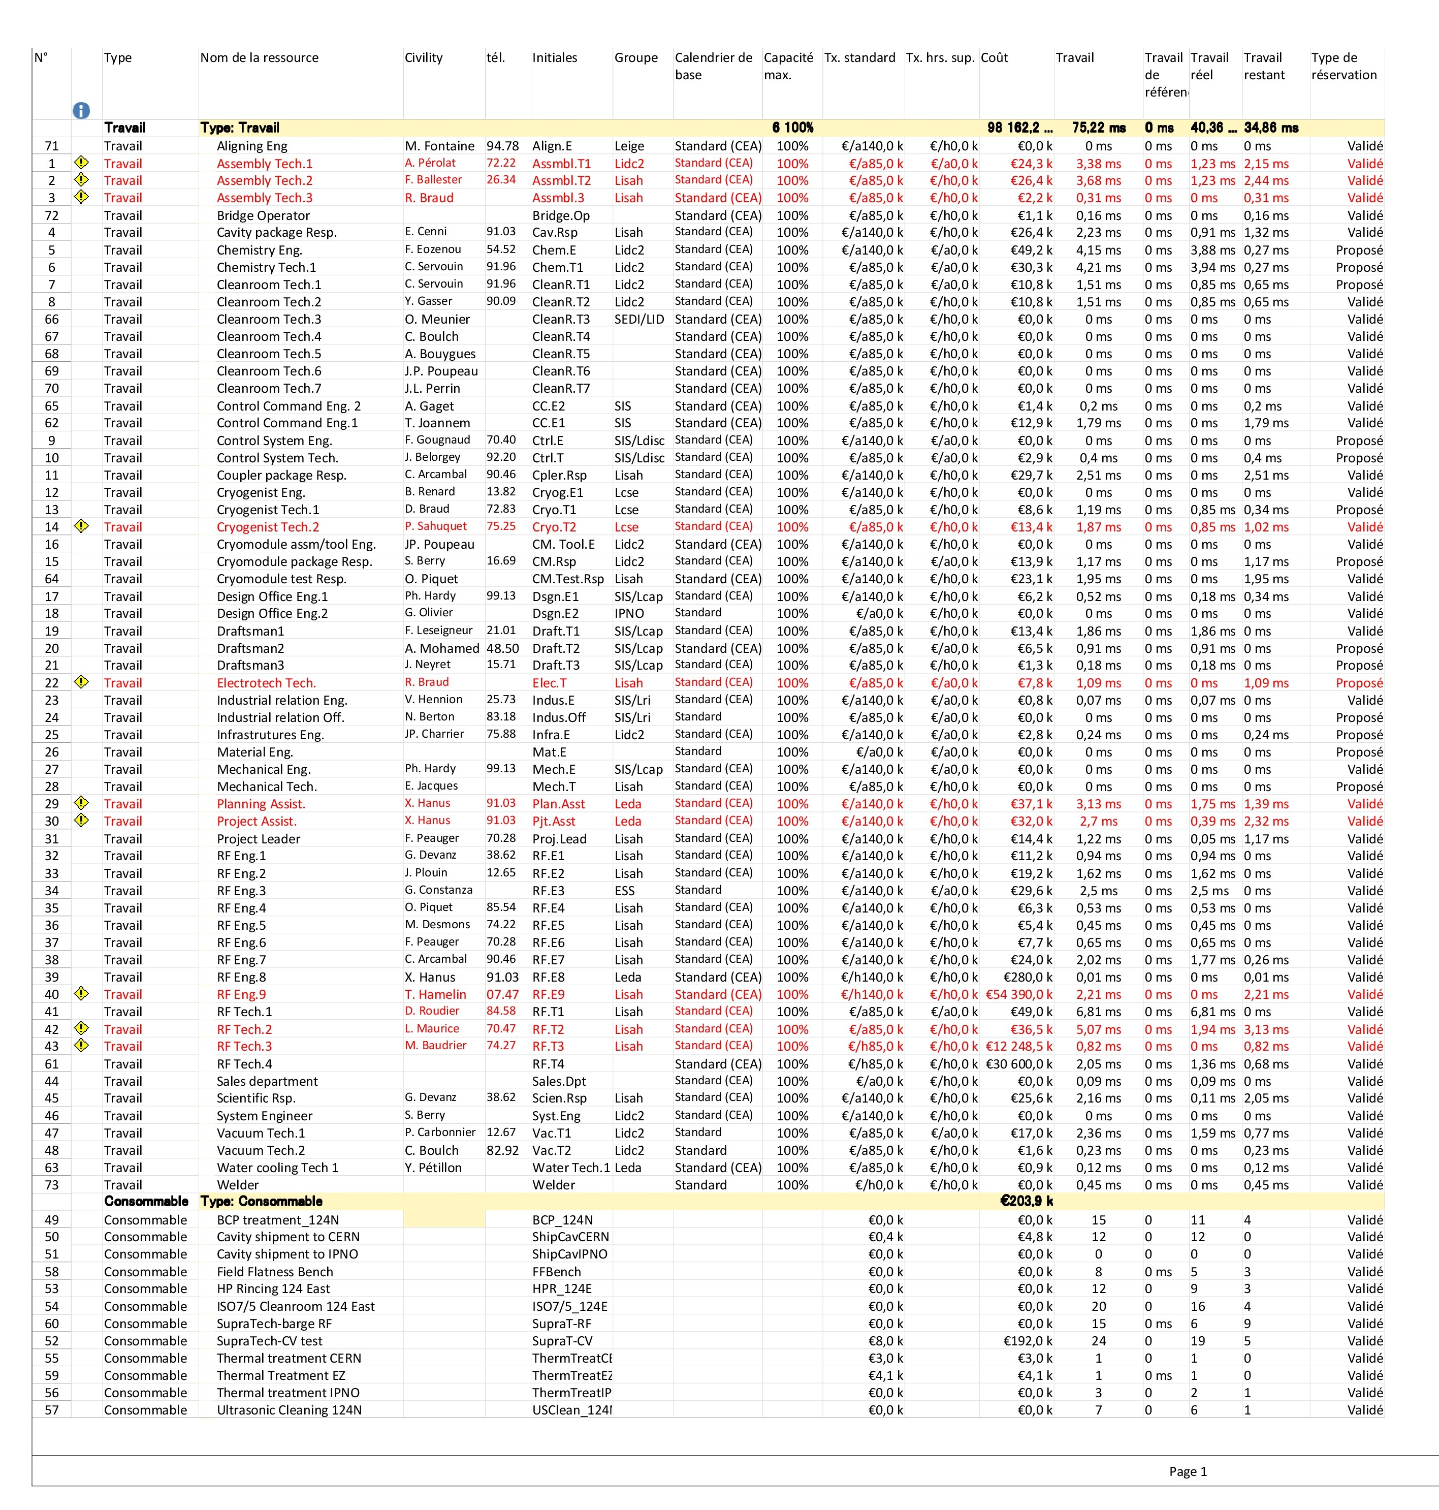
CEA.LEV.II – M-ECCTD full (plan & rh)

Slide 5
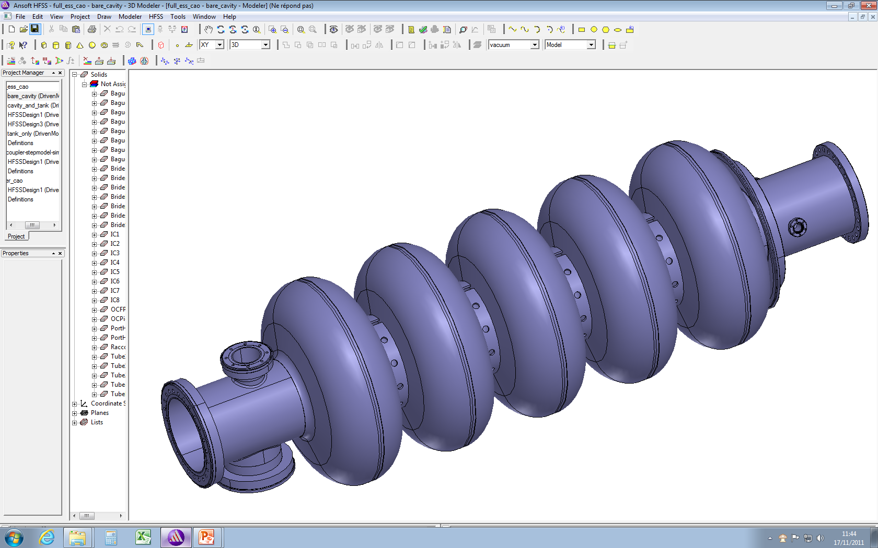
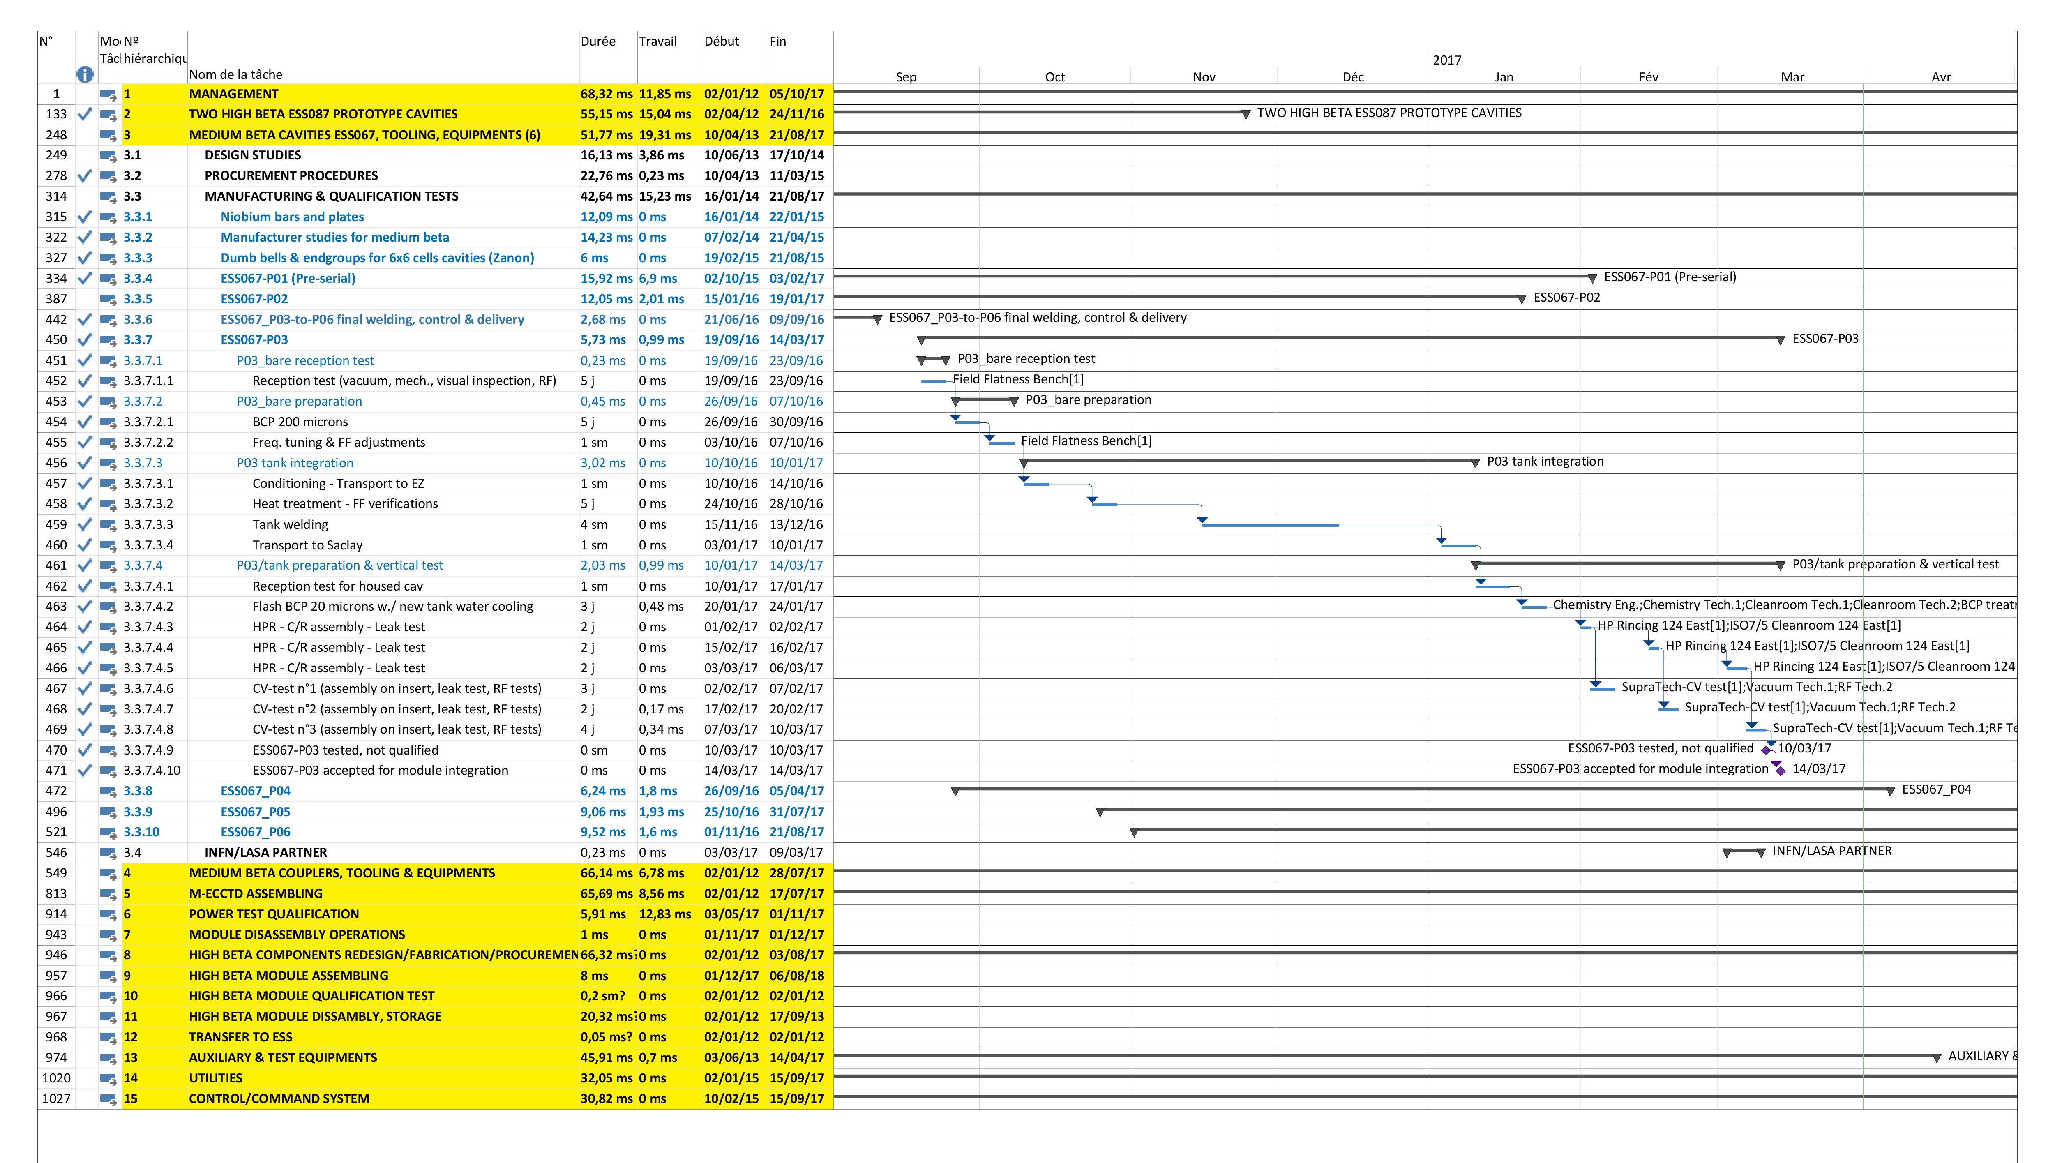
CEA.LEV.II – M-ECCTD full (cavity P03)

Slide 6
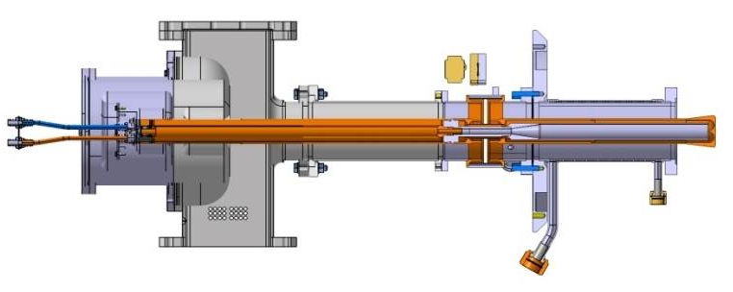
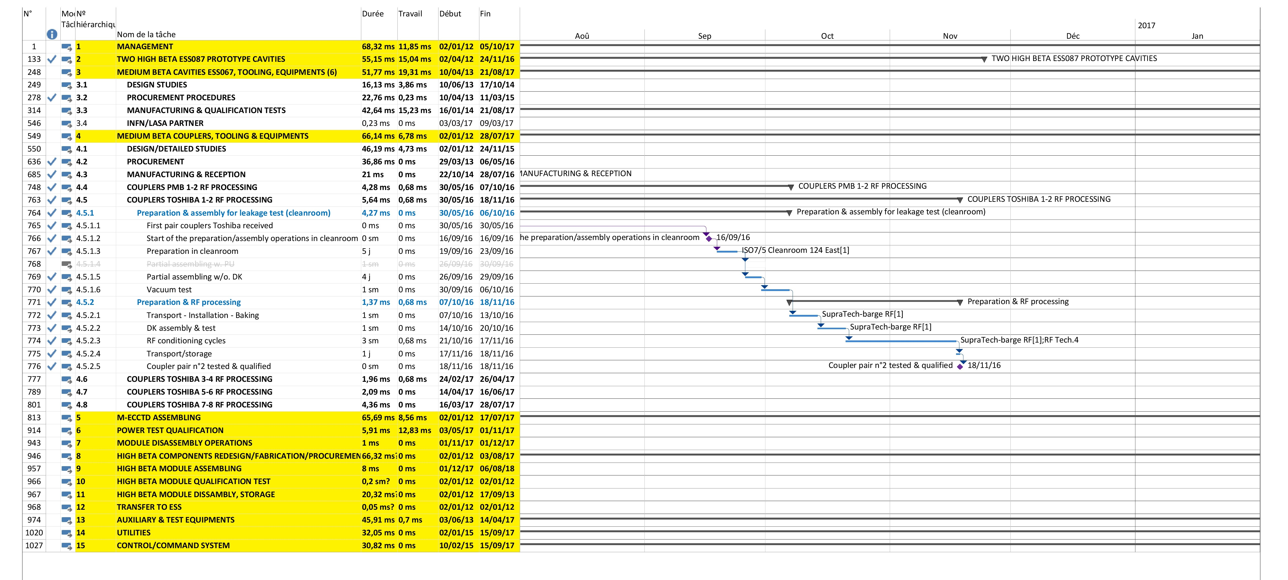
CEA.LEV.II – M-ECCTD full (TOSHiba #1-2)

Slide 7
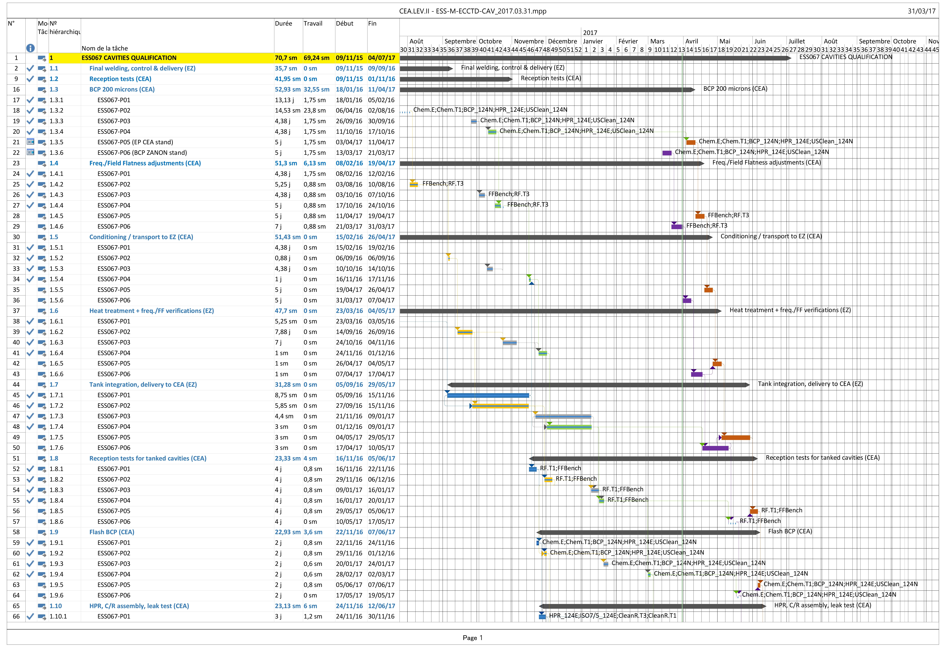
CEA.LEV.II – M-ECCTD CAVITY

Slide 8
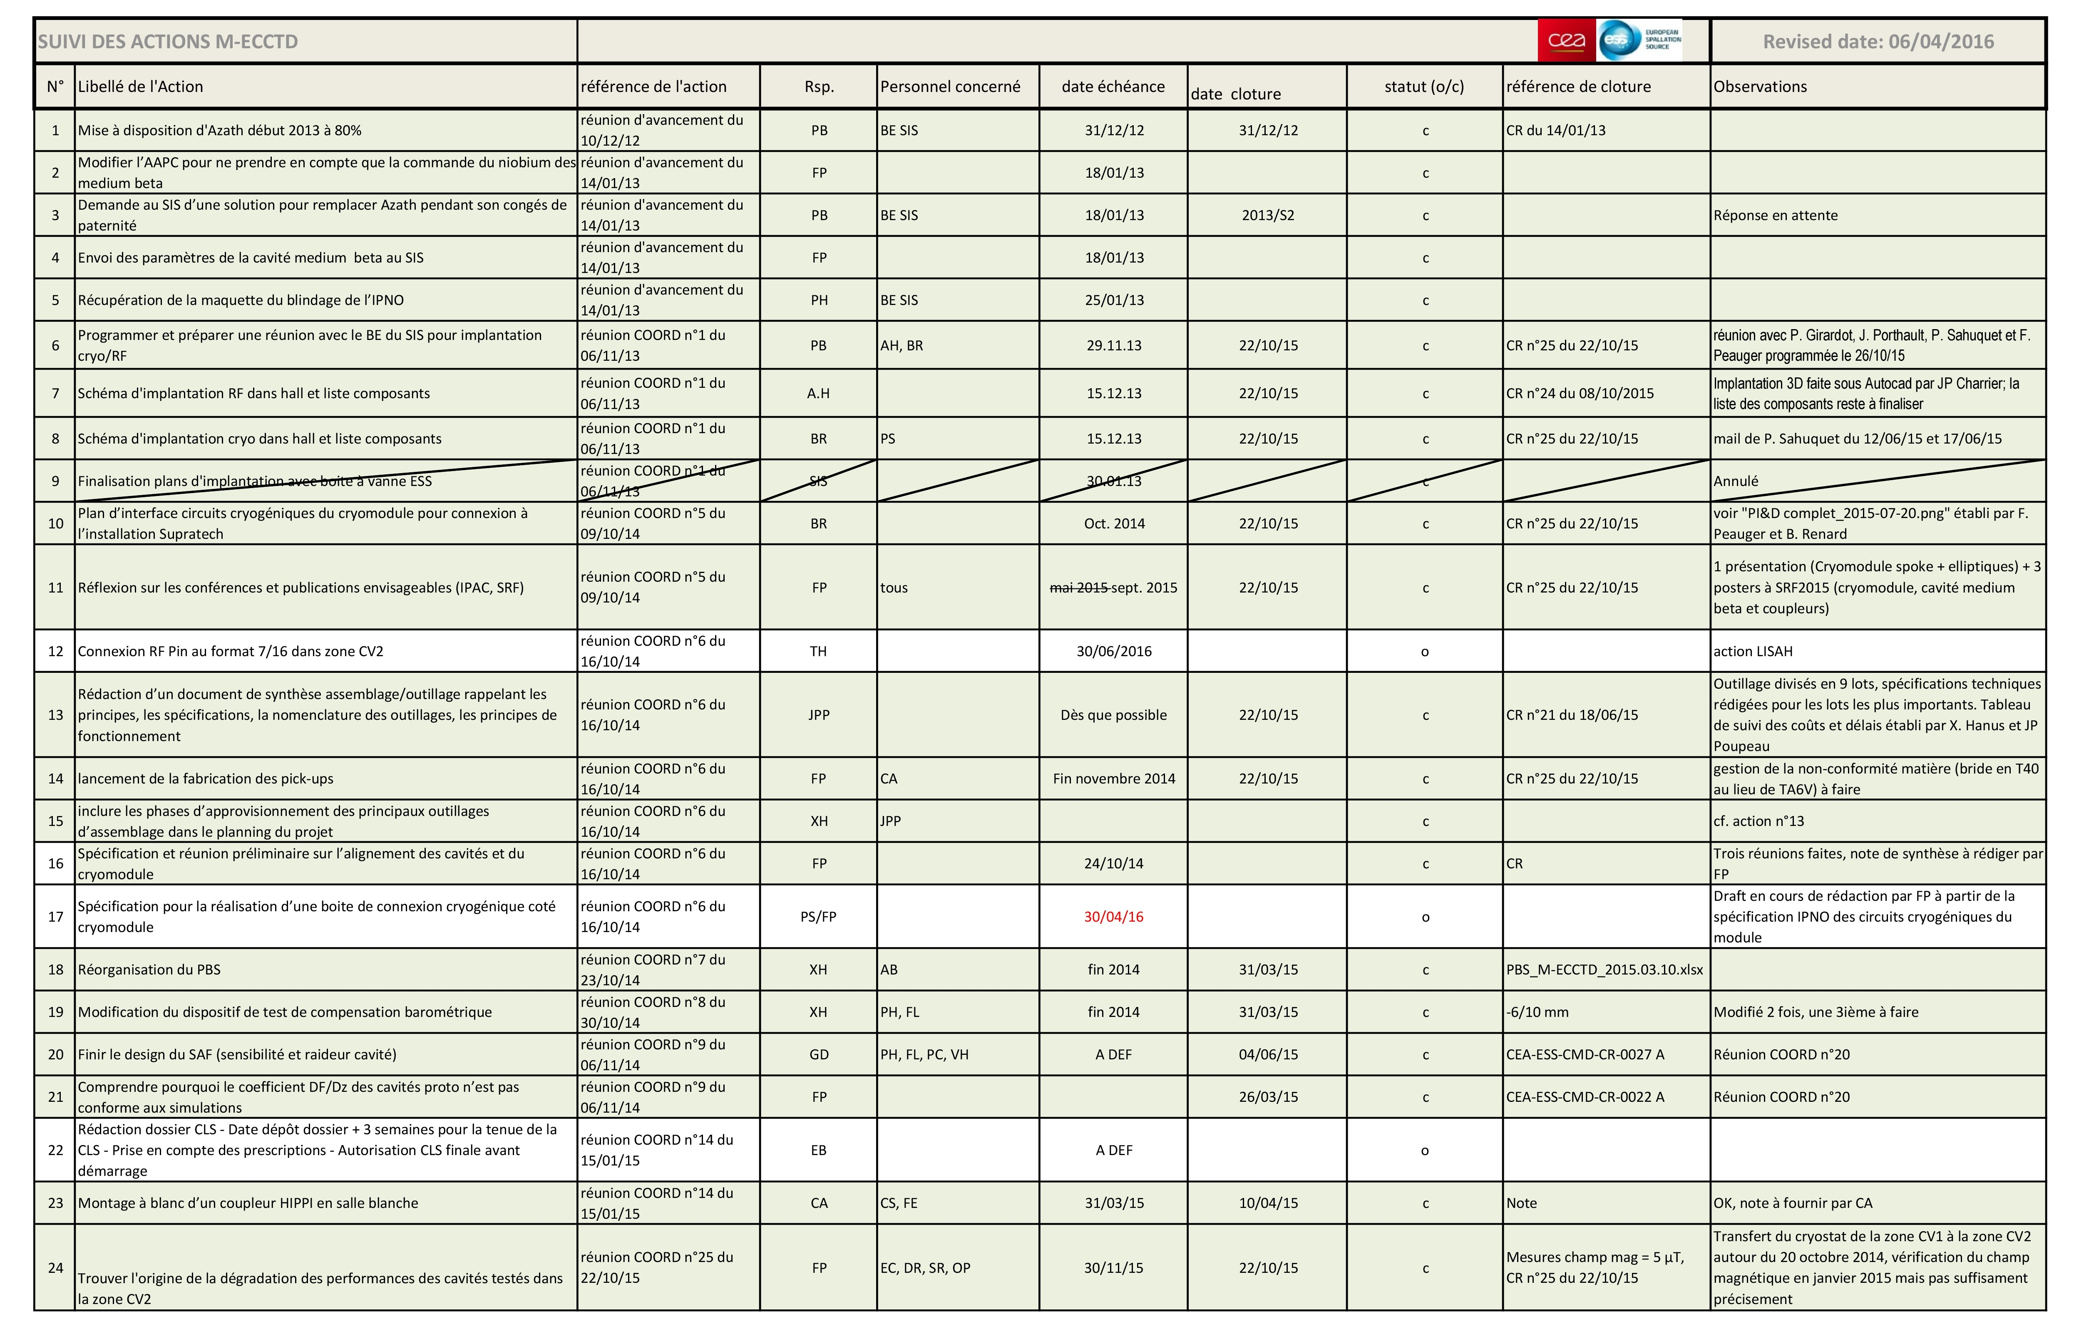
Tracking Action list
Tracking Action List_M-ECCTD_IRFU_2016.04.15.xls

Slide 9
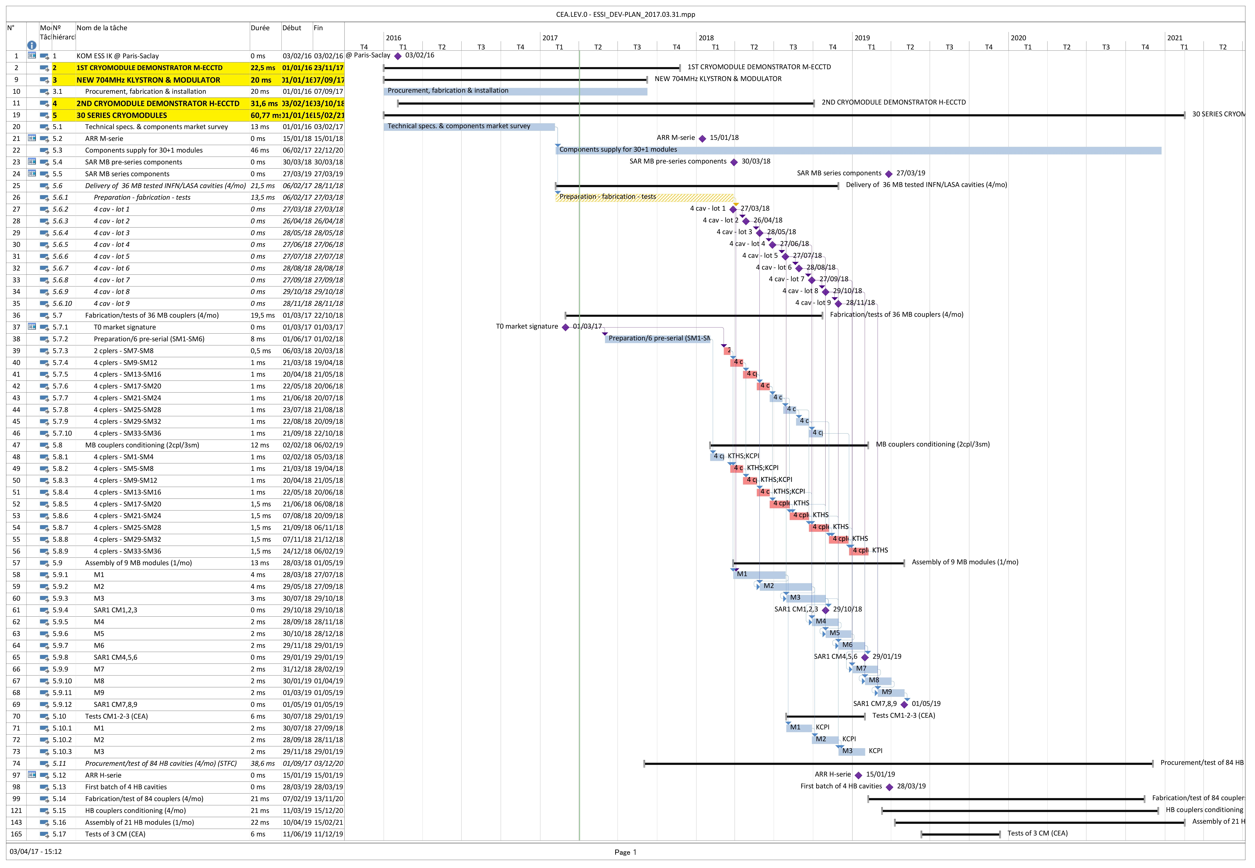
CEA.LEV.0 – CM DEVELOPMENT PLAN (1)

Slide 10
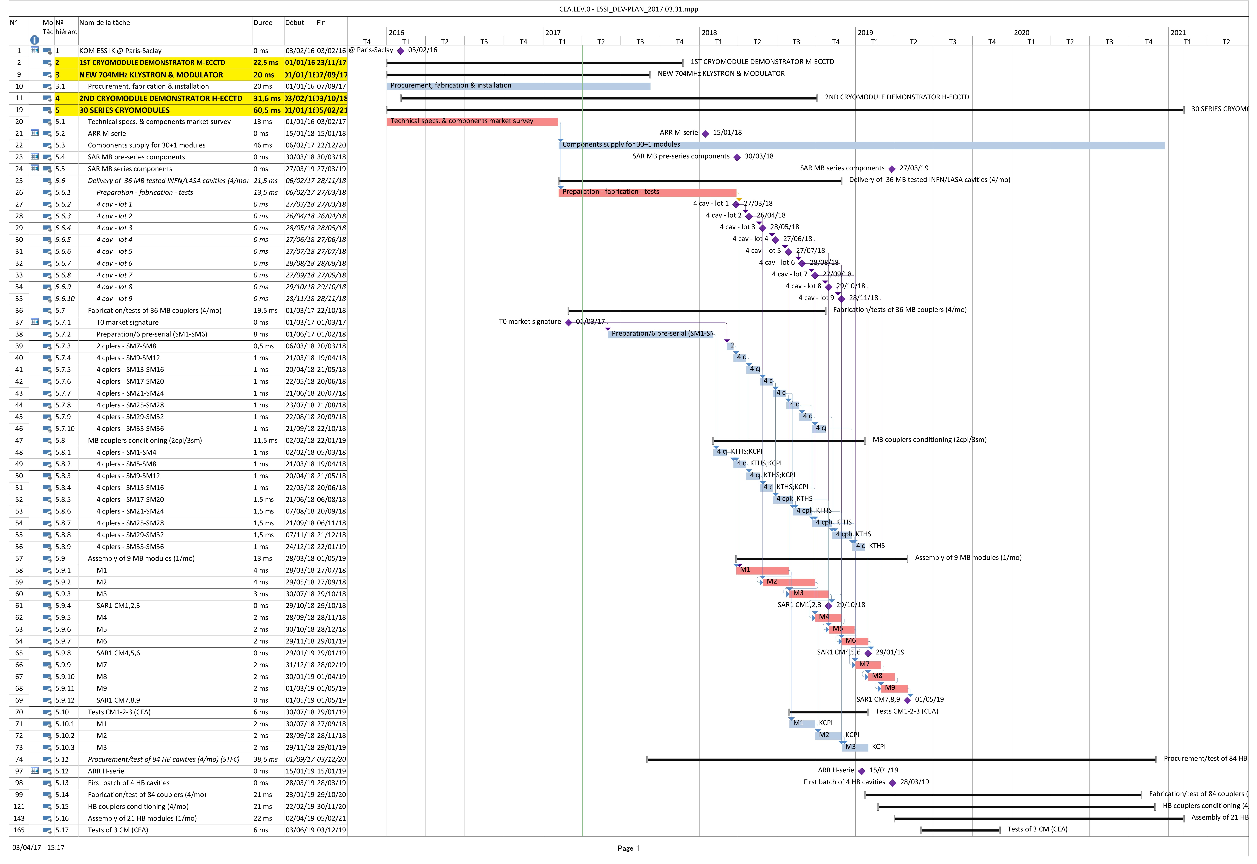
CEA.LEV.0 – CM DEVELOPMENT PLAN (2)

Slide 11
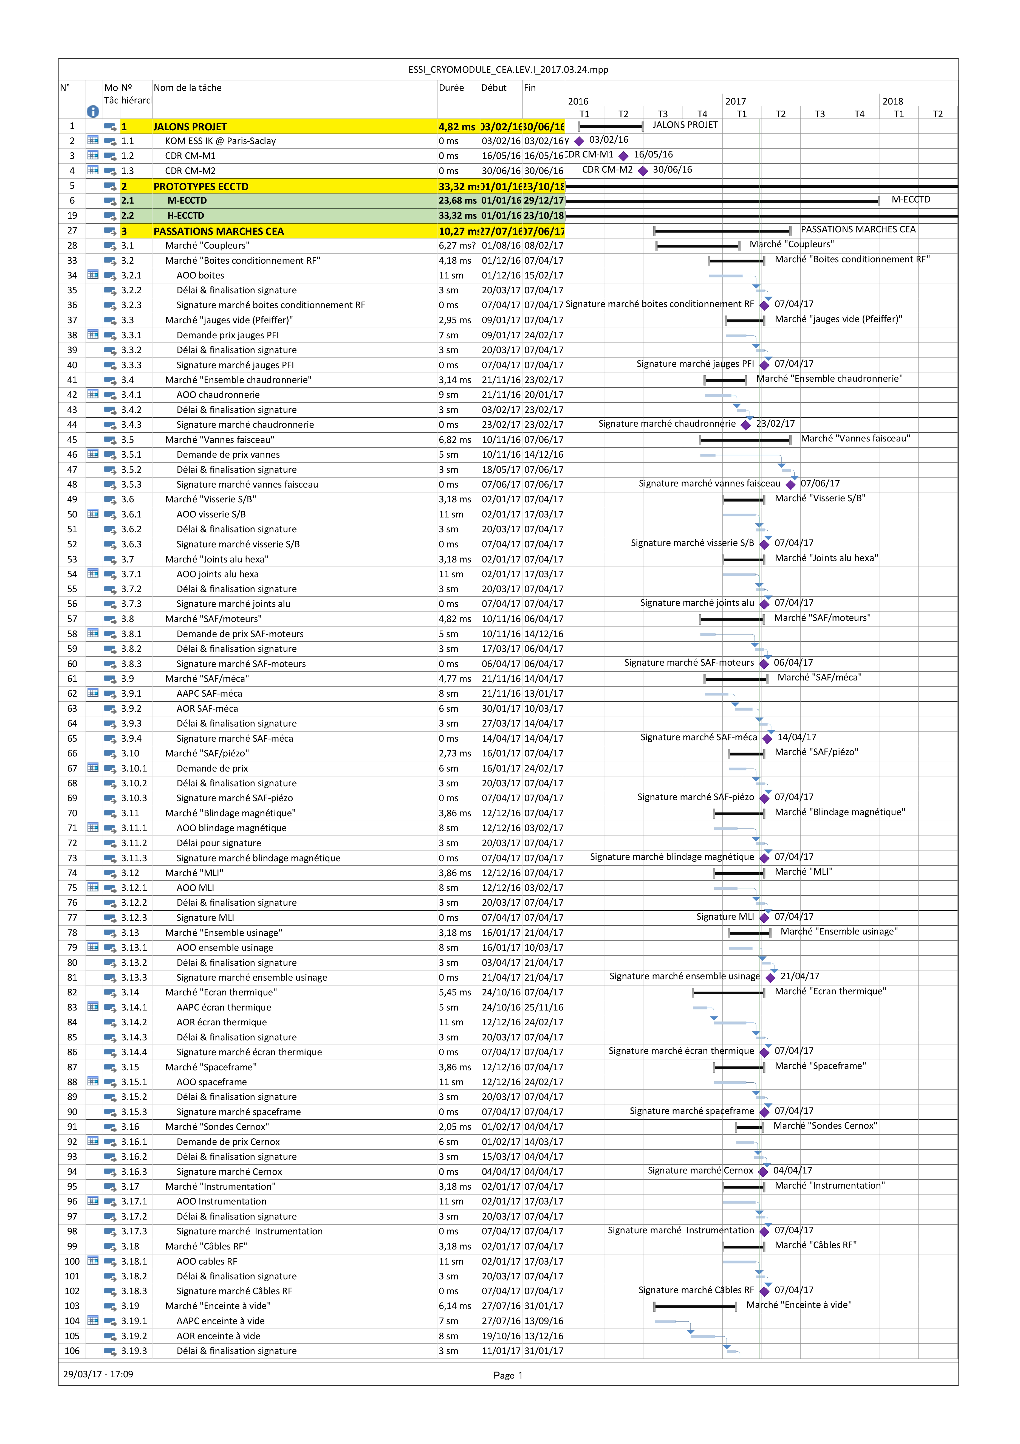
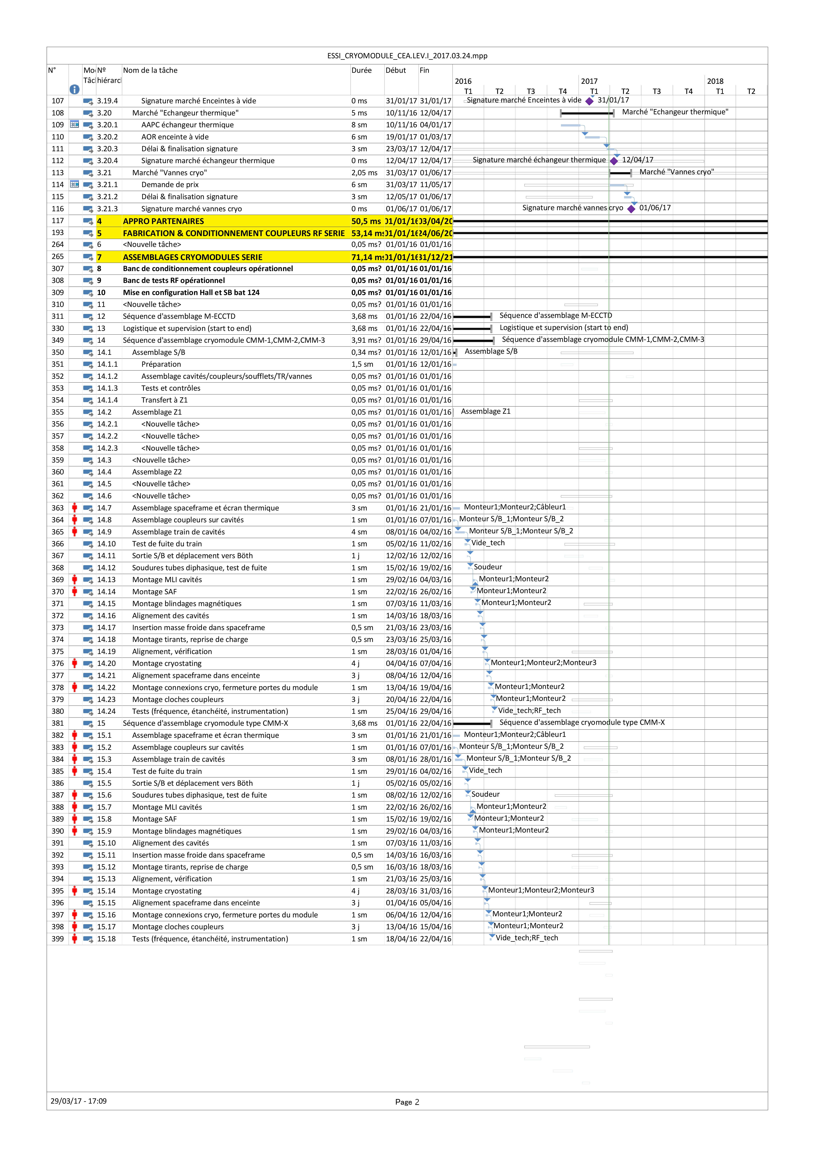
CEA.LEV.I – ESSI_CRYOMODULE (1)

Slide 12
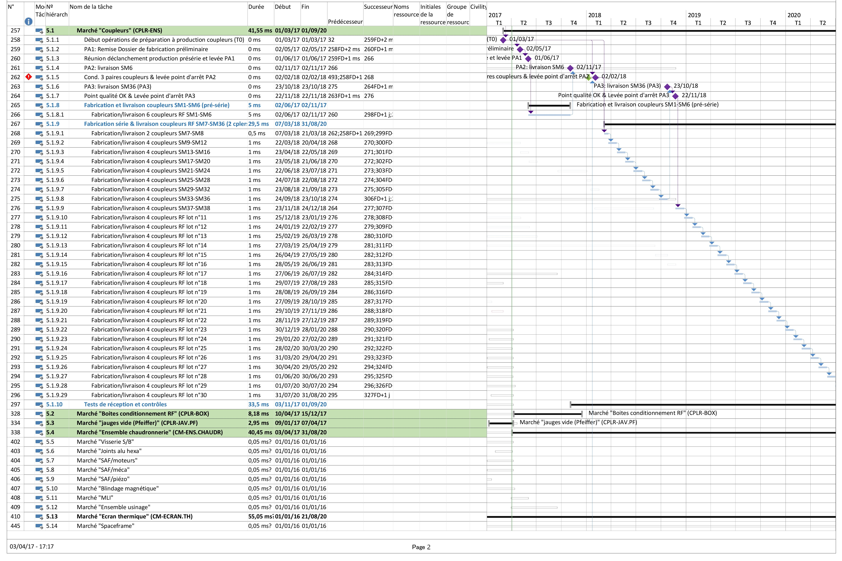
CEA.LEV.I – ESSI_CRYOMODULE (2)

Slide 13
conclusion
Planification tools are available and regularly updated, with reactivity.
For series, the work is still in progress (hold points for each market).
The 3 levels planifications are adapted to each level of decision and organization of the project:
  ESSI (strategy),
  the WP leaders (project management),
  the products leaders (organization & operational management).
These CEA plannings are built in agreement with the ESS requirements and hopefully in agreement with the partners time schedules.
Some topics need to be clarified to respect the goals (interfaces, …)

Slide 14
Thank you
Commissariat à l’énergie atomique et aux énergies alternatives
Centre de Saclay | 91191 Gif-sur-Yvette Cedex
T. +33 (0)1 69 08 76 11 | F. +33 (0)1 69 08 30 24
Etablissement public à caractère industriel et commercial | RCS Paris B 775 685 019

