Slide 1







Licensing requirements for Cryomodules
Christine Darve
Critical Design Review – Medium-beta Cryomodules
CEA Saclay
April 3-4, 2017

Slide 2
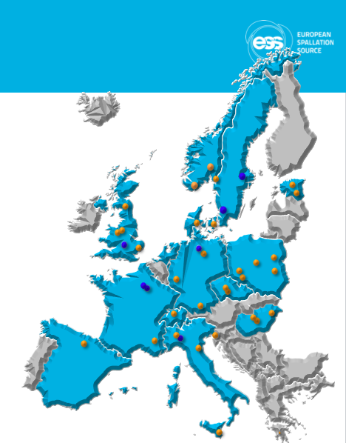
Outline
NC FE
Spoke
M-β
H-β
352.21 MHz
704.42 MHz
2.4 m
4.6 m
3.8 m
39 m
56 m
77 m
179 m
Target
Source
LEBT
RFQ
MEBT
DTL
Spokes
Medium β
High β
HEBT & Contingency
75 keV
3.6 MeV
90 MeV
216 MeV
571 MeV
2000 MeV
Identify the Licensing Requirements and Needs applicable to the Cryomodules
Guiding principles
Assess Licensing requirements

Slide 3
Identify the Licensing Requirements applicable to the Cryomodules
➔ Input to Vincent Hennion’s talk: “ CRYOMODULE LICENSING PLAN ”
Goal: Comply with ESS Norms and Standards - EU Directives or EU regulations, EU requirements, such as safety, health and environmental protection. ESS-0001515
Examples:
AFS 2005:1-3: Swedish Safety Standard for vacuum and pressure vessels
Pressure Equipment Directive: 2014/68/UE (97/23/CE)
Materials choice:
  Radiation hardness
  Halogen free
Design → Apply to every step of the cryomodule life-cycle:
Life-cycle - Unit |  | Life-cycle - Assembly
Fabrication |  | Tunnel installation
Testing |  | Commissioning
Transportation |  | Operation

Slide 4
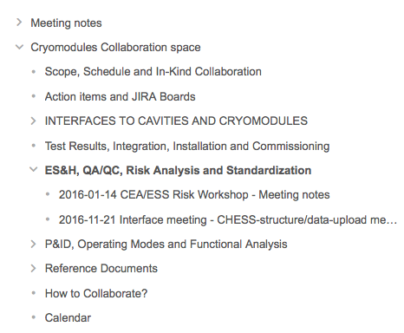
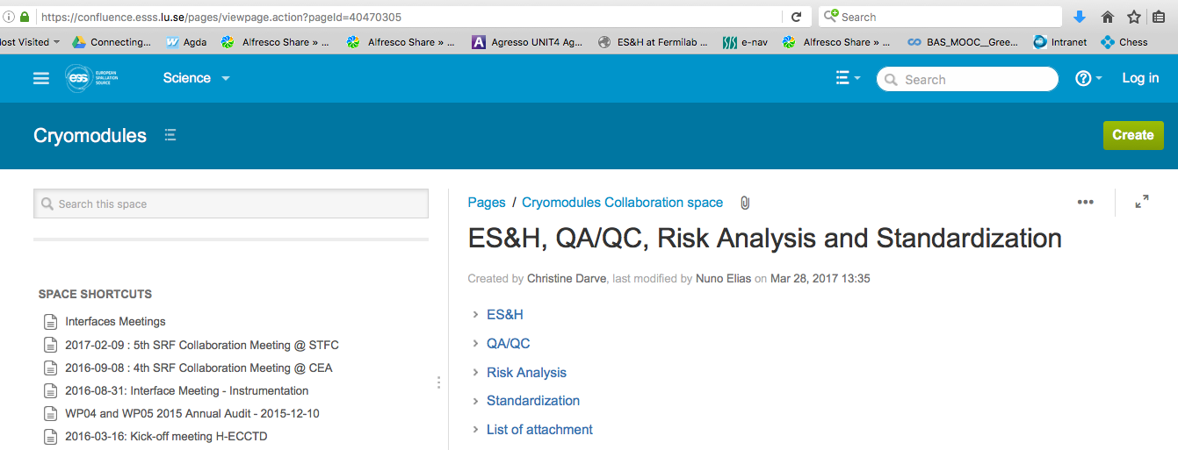
Licensing Topics
Pressure Equipment Directive
  Tuv Nord Pre study: ESS-0033356_V4
Ionization radiation
  Radiation Map: ESS-0060208.2

Slide 5
Outline
NC FE
Spoke
M-β
H-β
352.21 MHz
704.42 MHz
2.4 m
4.6 m
3.8 m
39 m
56 m
77 m
179 m
Target
Source
LEBT
RFQ
MEBT
DTL
Spokes
Medium β
High β
HEBT & Contingency
75 keV
3.6 MeV
90 MeV
216 MeV
571 MeV
2000 MeV
Identify the Licensing Requirements and Needs applicable to the Cryomodules
Guiding principles
Assess Licensing requirements

Slide 6
WP04/05 guiding principles:
From Design to Operation
Limit change requests:
  Fabrication: In-Kind via industry
  ESS interfaces at assembly
Sounds Engineering Practice:
  Declaration of Conformity
  At least:
  ESS pressure tested
  suggested
  Data package and
  Technical files
Product
Identify Relevant EC Directives e.g.
2006/42/EG
2006/95/EG
2004/108/EG
Identify and apply applicable standards
Compile Technical file
Description, Technical reports, Test reports, Construction plans, Circuit diagrams, Part lists etc.
Issue
User manual
in English
Notes:
, ALARA ?

Slide 7
Vs. IK data package
ESS Quality Division:
Do we want to be compliant with applicable laws?
  National and European legislation, standards and directives ➔ Requirements
Do we want to have a facility that we can up-date and repair with high availability?
  Drawings, material certificates, test/inspection reports etc. ➔ Technical file
Do we want to have a safe, satisfying and high quality user program?
  Safety/risk assessment ➔ Safety file
    AIK $5.1: “ 4.2.1. Stage 1: Detailed design phase
Stage 1 of the contribution is the detailed design and engineering phase that prepares for and precedes potential procurement of the facility element. Within Stage 1 the design is detailed and verified by way of analysis and/or test down to the lowest level selected by the Partner. This includes but is not necessarily limited to:
Provide input to the project quality plan [PQP].
Design and development including a complete set of drawings and specifications of the H-ECCTD as well as the design report containing all the studies and definition of interfaces.
Establish a complete set of specifications for the H-ECCTD cavity and component procurement.
Develop a complete test plan.
Establish the assembly procedures for the H-ECCTD.
Stage 1 starts upon completion of a successful kick-off meeting and ends with the successful completion of the Stage 1 design review, CDR. For this H-ECCTD project, the acceptance by ESS of the stage 1 data package detailed in paragraph 4.4.1 of this schedule will be equivalent to the successful completion of this CDR.”

Slide 8
Outline
NC FE
Spoke
M-β
H-β
352.21 MHz
704.42 MHz
2.4 m
4.6 m
3.8 m
39 m
56 m
77 m
179 m
Target
Source
LEBT
RFQ
MEBT
DTL
Spokes
Medium β
High β
HEBT & Contingency
75 keV
3.6 MeV
90 MeV
216 MeV
571 MeV
2000 MeV
Identify the Licensing Requirements and Needs applicable to the Cryomodules
Guiding principles
Assess Licensing requirements

Slide 9
Technology Demonstrator to verify the requirements: ECCTD
  Validate the In-Kind process: e.g. AIK #5.1, incl. licensing
  Verify fabrication procedures: e.g. procurement, fabrication process
  Verify assembly procedures: e.g. cleaning, tooling, procedures, QA;
  The mechanical design performance: e.g. MAWP, stability, alignment;
  The RF design performance:
  e.g. characterize the cavity RF signature; validate RF results obtained in vertical cryostat;
  The thermal design performance:
  eg. cool-down rate, operating conditions; heat loads; cooling scheme efficiency;
  The vacuum design performance: e.g. leak tightness, bake-out; possible NEG
  The safe operation of the cryomodules:
  e.g. process variables, control loops, operating modes, relieving system and interlock;
  Training: e.g. to assemble, to operate.

Slide 10
ESS Licensing applicable to Cryomodules
  Study: ESS-0033356_V4: B. Hoff; Tuv Nord - 07/10/2015
  Workshops and Safety Reviews: e.g. 15/01/2015; 10/02/2016; 09/06/2016
Courses PED by Experts: 24/11-11/12/2015
Weekly meetings to cope with specific issues
Risk assessments
Traceability:
  Collaboration Space – communication and work in progress
  CHESS – official site
  Conference papers, technical Notes, etc
  Meeting minutes
  CEA Technical Notes, design proprieties and operating procedures
  → Input to LASA, STFC, and ESS to complete interface requirements
Notes:
CEA/demonstrator, and design is upstream of all fabrication process, so crucial role

Slide 11
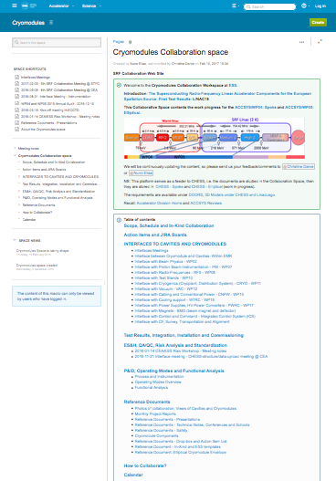
Coordination Team !
Web Platform: Cryomodules Collaboration space to gather all documents for the SRF Collaboration
➔ https://confluence.esss.lu.se/display/CRYOM
Weekly video-conferences:
  Interface Uppsala – Mondays
  Interface Saclay – Tuesdays
  Interface IPNO – Wednesdays (bi)
  Interface SRF Collaboration – Fridays
  Overall Schedules – Fridays (bi)
Every 3 months: SRF Collaboration Meetings (@CEA, LASA, STFC)
Web access for interface meetings and Minutes
People @ ESS: Christine Darve, Nuno Elias, Fredrick Hankansson, Cecilia Maiano, Felix Schlander
➔ to coordinate daily activities with all In-Kind partners and ESS other Work Packages
Notes:
Daily phone calls

Slide 12

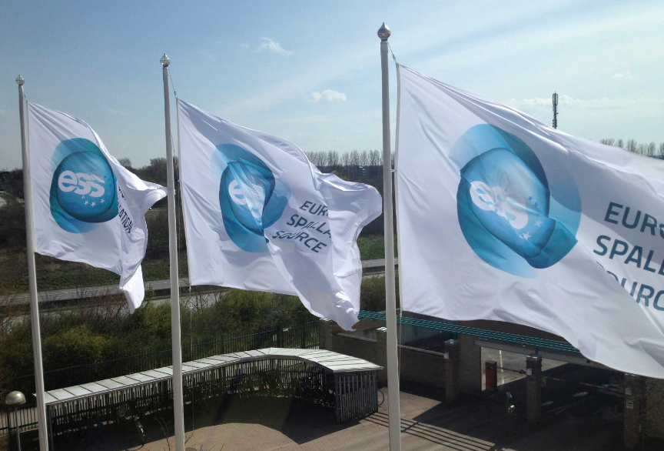



Thank you for your attention!
Licensing is a critical Requirements between ESS and its partners !
Clear communication and guiding/coordination is mandatory.
Many lessons learned from Technology Demonstrator results !
The Devil is in the details and in the Interfaces !
Build further capacity in industrialization process
Acknowledgment and thanks to the excellent progress of the
ESS SRF teams

Slide 13
Extra slides

Slide 14
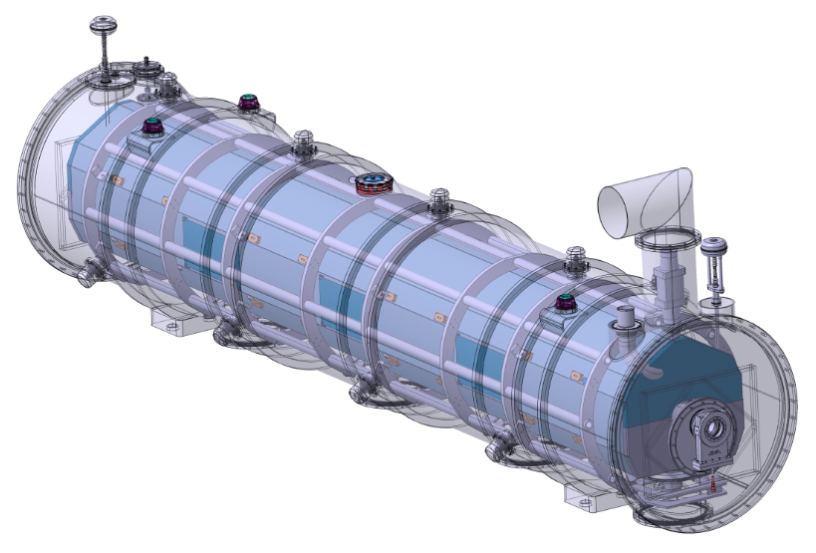
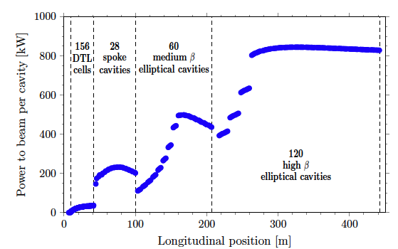
Cryomodule Interfaces
Most AD internal Work Packages (beam optics, RF, cryo, vacuum, test stands, electrical, cooling, installation)
External WPs cryomodule, cavity and designers and potential In-Kind collaborators
Control command (Control Box, PLC, LLRF, MPS, EPICS)
Data-logging ICS teams
ESS ES&H
Conventional Facility
ESS system engineer, QA
Survey experts
Transport
Cryogenic distridution
Cryogenic distribution
Control system
Beam Diagnostic
Beam Optics
Previous Linac version for comparison ➔
Beam Vacuum
Radio-Frequency

