Slide 1
Progress and status on Ess medium beta prototype cavities
E. Cenni on behalf of cavities work unit
CEA Saclay/ESS ECCTD WU Cavités| Enrico Cenni

Slide 2
OUTLINE
Manufacturing and preparation
  Shape control
  RF measure
  Heat treatment
  BCP
Latest results
  Surface resistance
  Q-E curves
  X-ray measures
  LFD
  Tuning sensitivity
  100K parking
  Magnetic shielding
Cavities status
Lessons learned
Summary and outlook

Slide 3
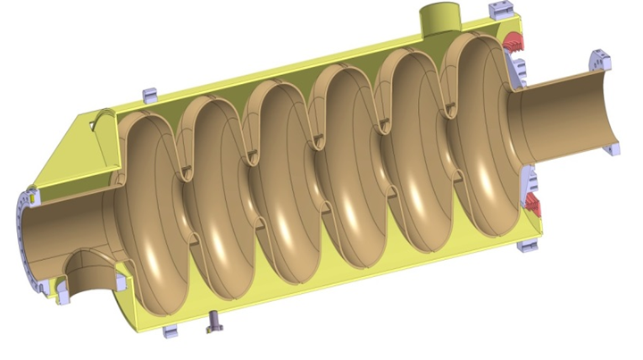



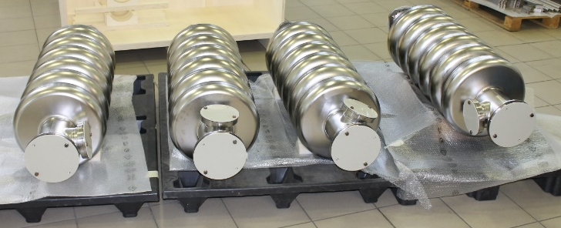
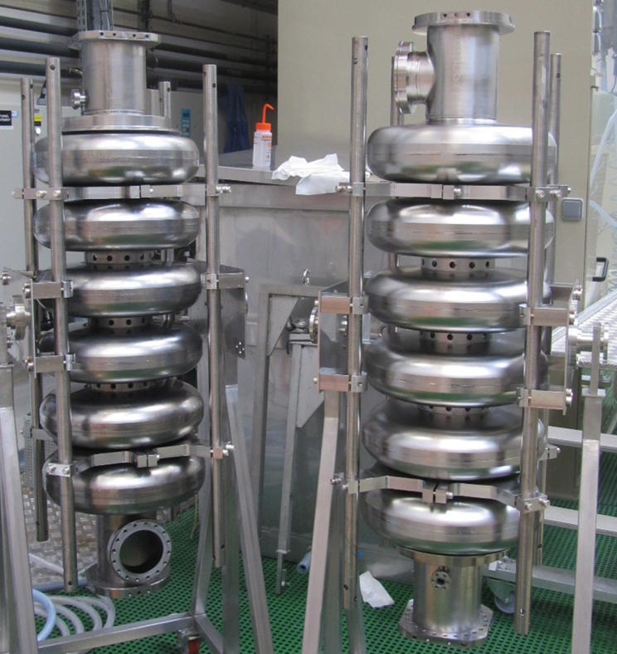

Medium beta prototypes at cea
DESIGN
DESIGN
MANUFACTURING
MANUFACTURING and PREPARATION
PREPARATION
M-ECCTD will be equipped with 3 cavities from CEA and 1 cavity from INFN-LASA
This talk will be about the work done in CEA concerning medium beta prototypes

Slide 4
Manufacturing

Slide 5
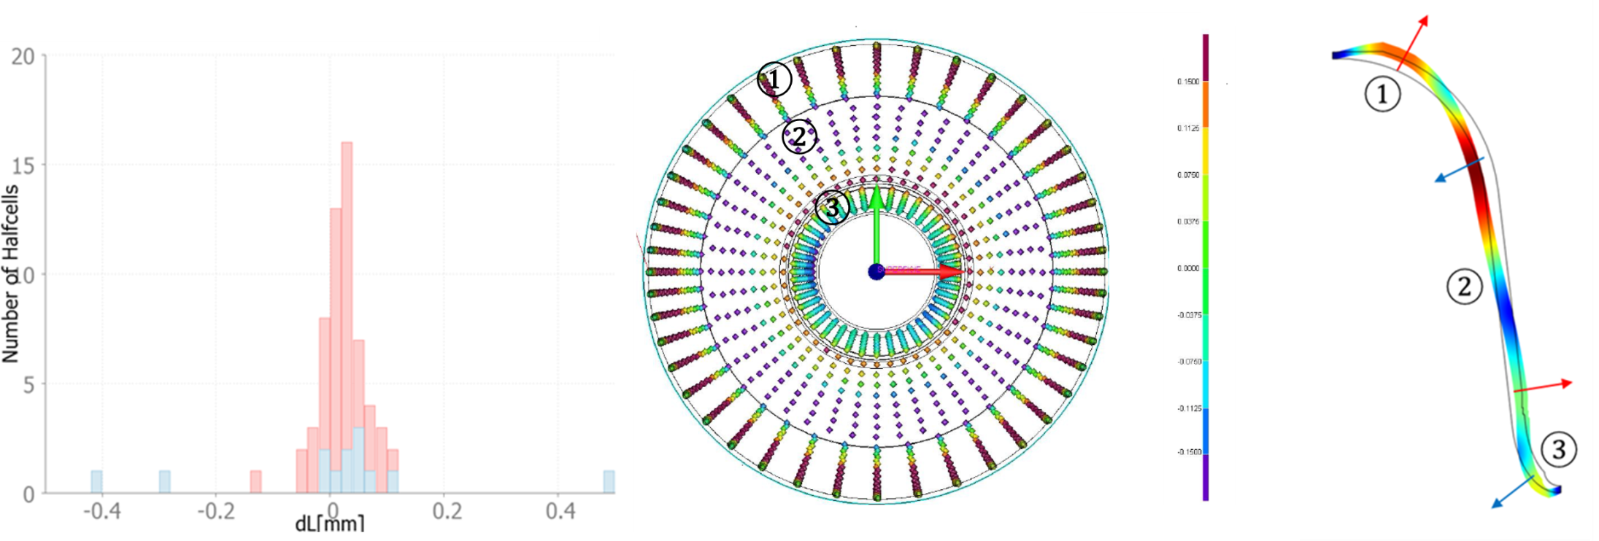
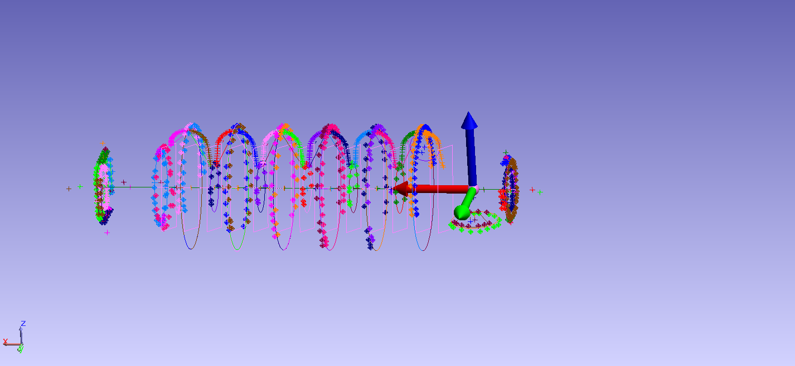
Shape control
Length difference between simulated and measured values on central group (red) and end group (blue) halfcells, each bin has 0.02mm width.
3D CMM result on a central half cell, red +0.15mm, purple -0.15mm (shape tolerance 0.3).
Scheme of average deformation observed on central half cell not in scale.
Laser tracking 3D measure performed at CEA

Slide 6
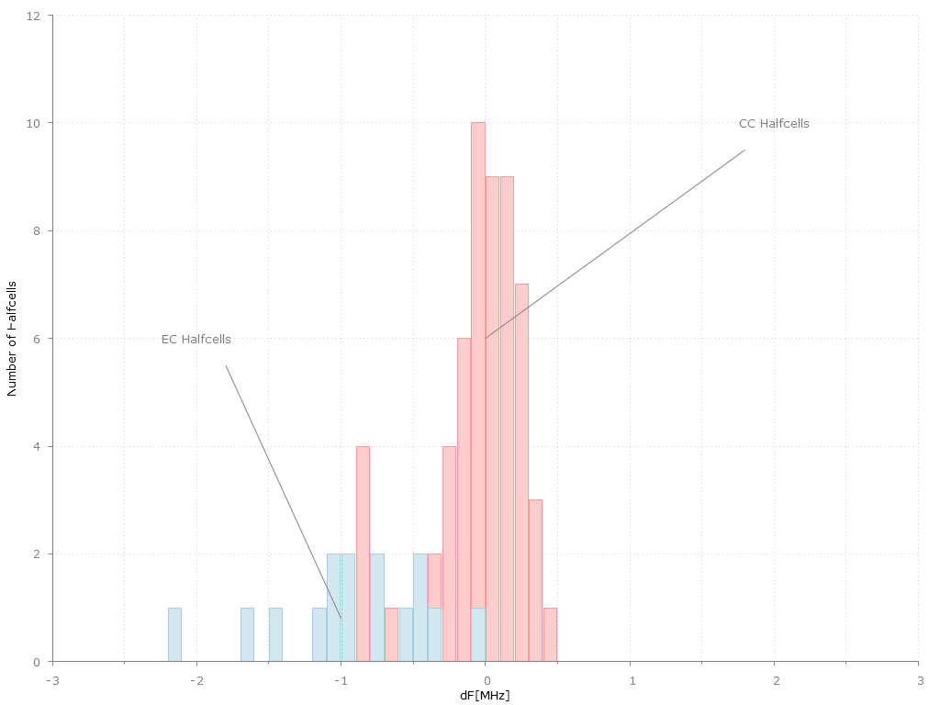
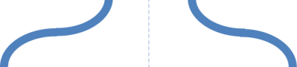
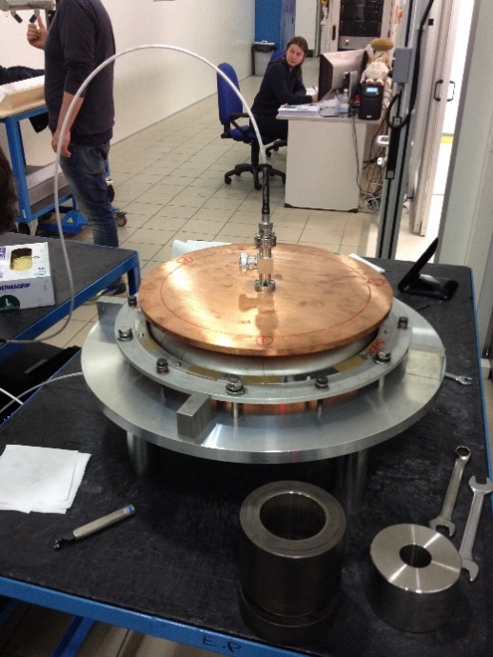
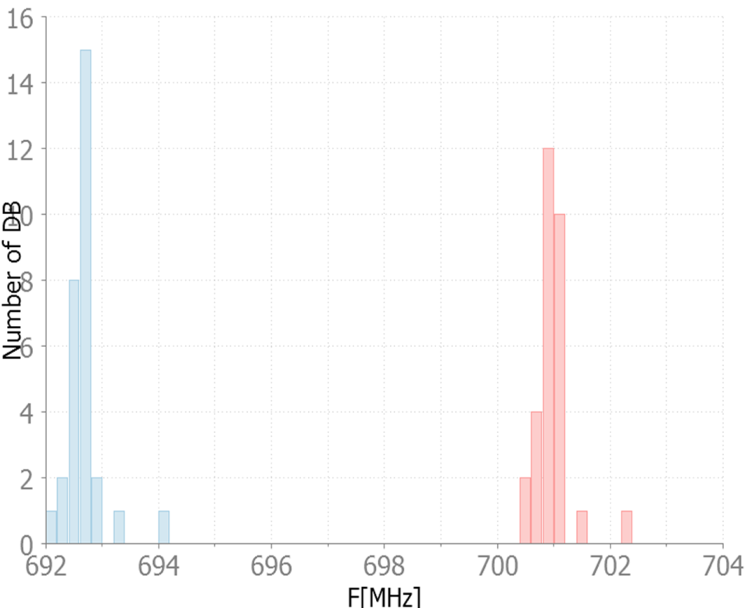
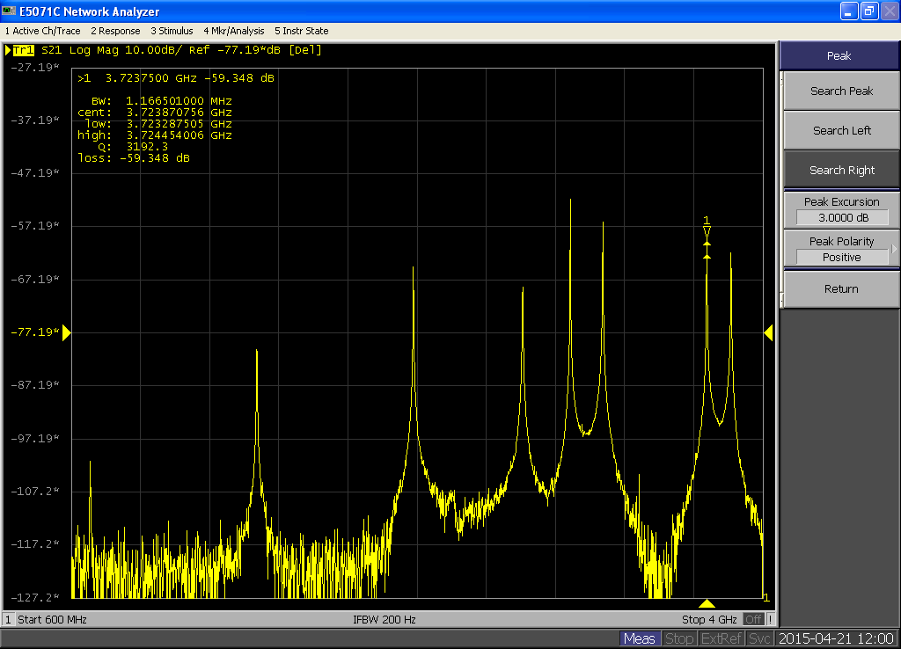
RF measures
RF connector
Antenna
Half cells
Upper plate (iris side)
Lower plate (equator) side)
0.5MHz
Dumbbells
0.5MHz

Slide 7
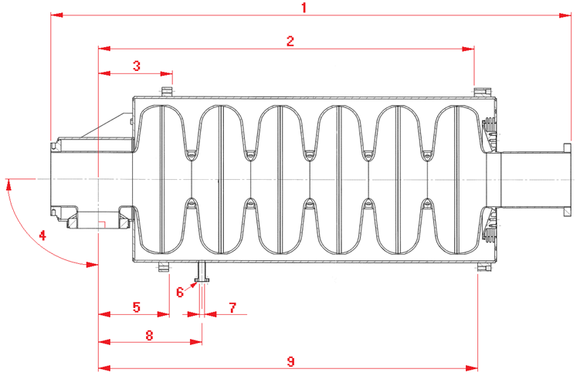
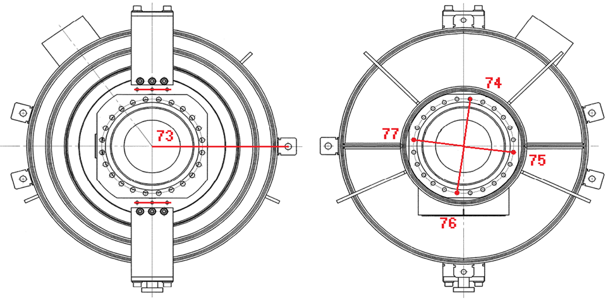
Manufacturing (medium beta)
We have created a dimension control plan on each subparts
300 points on each halfcells and dumbbells by means of CMM
On the integrated cavity we put about 80 dimensional controls (this will be optimized after string assembly feedback)
Some number related to the first 4 integrated cavities:
Maximum displacement between beam flanges 1mm (average is 0.6mm)
Maximum angular displacement 0.5° (average is 0.2°)

Slide 8
Measures and results

Slide 9
First results
Process | Rs @2K [nΩ]
BCP (~200µm) | ~200
Heat treatment+HPR | ~20
BCP(~20µm)+HPR | ~10

Slide 10
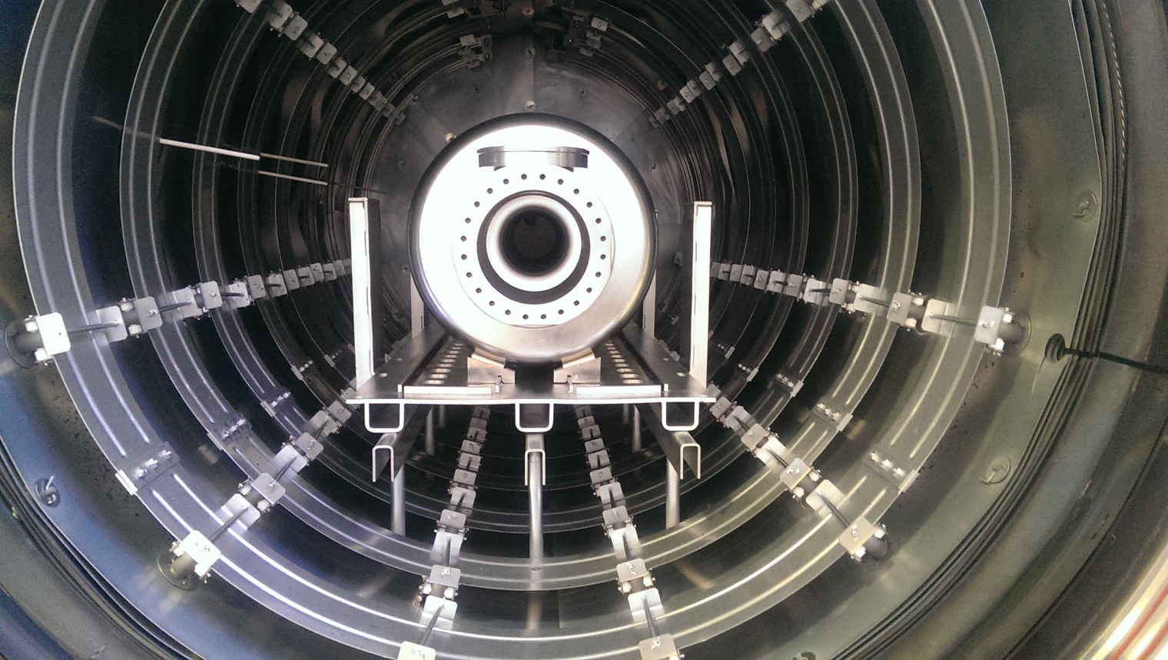
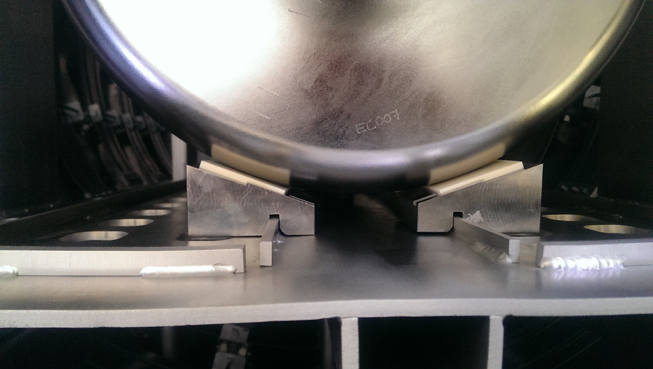
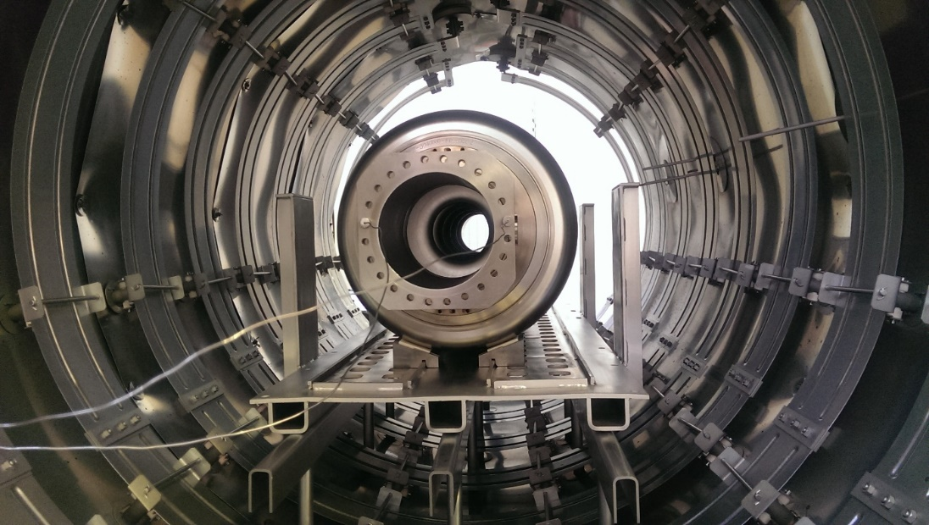
Zanon
First shield and heating system made with Molybdenum.
Same oven used for XFEL and LCLS2

Slide 11
Heat treatment
Zanon

Slide 12
RGA
Zanon

Slide 13
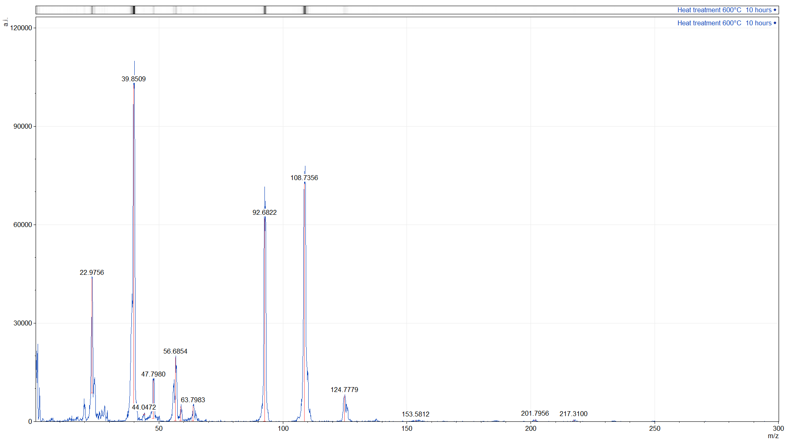
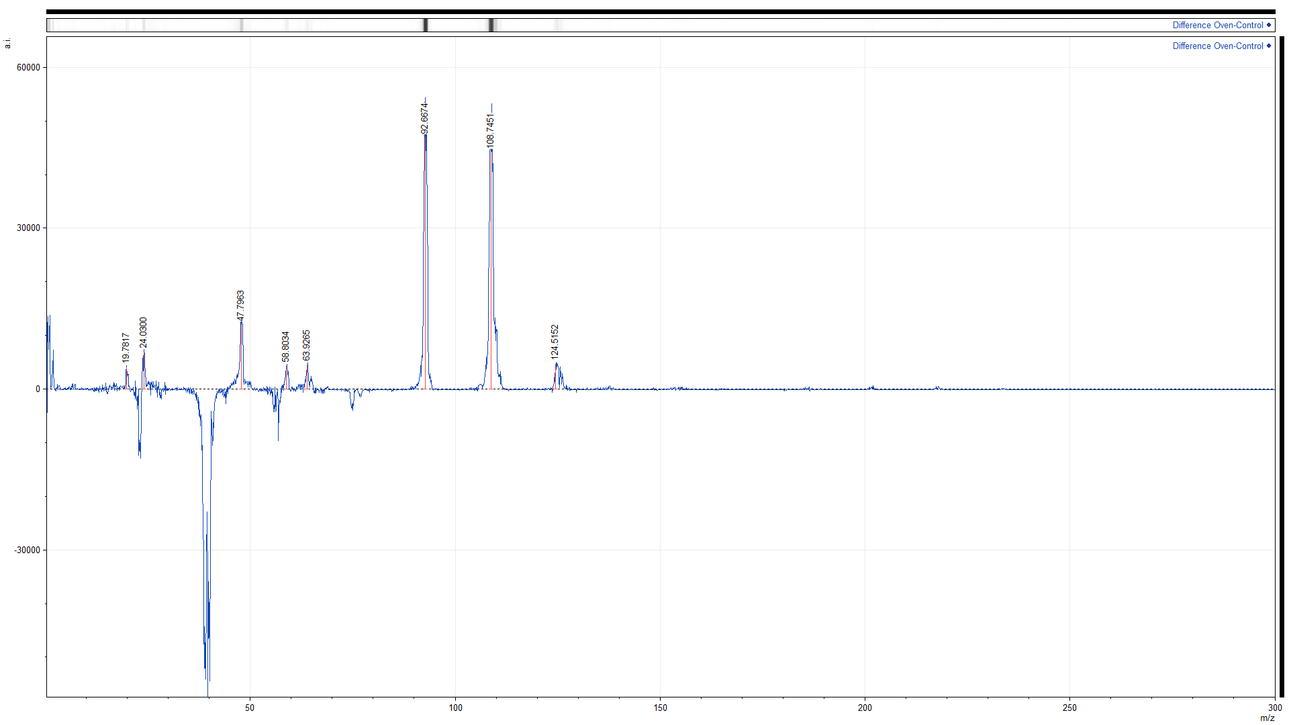
SIMS analysis (Argon beam)
IPNO
Ar+
NbO+
Nb+
Na+
Ar++
Ca++
Ti+
Fe+
FeH+
TiO+
NbO₂+

Slide 14
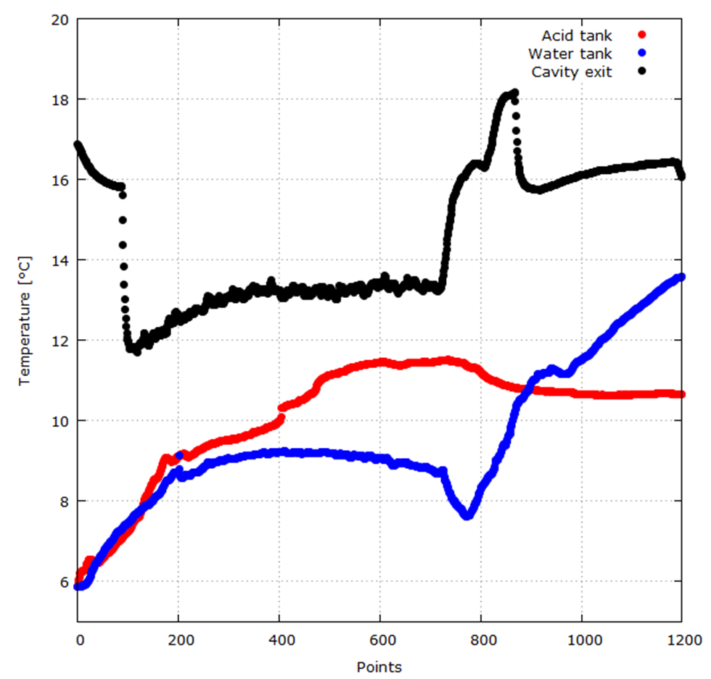
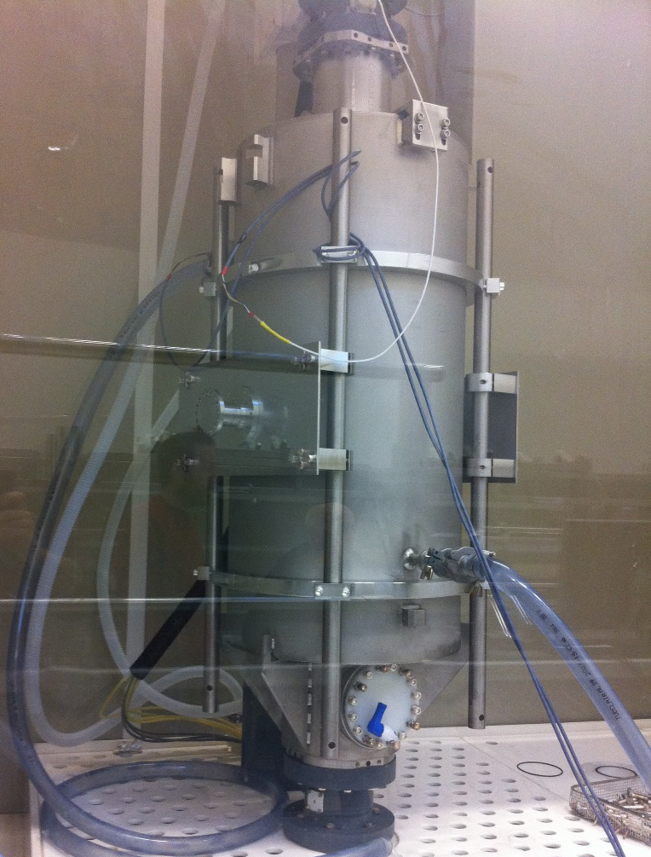
Bcp with helium tank and water cooling
X. Hanus
C. Servouin
F. Eozenou
Y. Boudigou,
G. Monnereau
Acid fill up the cavity
Cavity full of water
BCP finished
Cavity empty
We are able to limit the temperature increase during BCP.
Acid enter the cavity

Slide 15

Latest results (RS)
D. Roudier
L. Maurice
We are able to obtain good surface resistance on all cavities.
BCP process has been strongly improved
Fitted with
$$R_{S}=\frac{A}{T}×e^{−\frac{∆}{T}}+R_{0}$$
 | P01 | P02 | P03 | P04
R₀ [nΩ] | 3.1 | 6 | 6 | 7.1
Δ [K] | 18.58 | 19.01 | 19.27 | 19.29
Eg [meV] | 1.6 | 1.64 | 1.66 | 1.66
Q₀(2K) at low field is ≥ 1.9x10¹⁰ for all cavities

Slide 16
Latest results (Q-E)
D. Roudier
L. Maurice

Slide 17
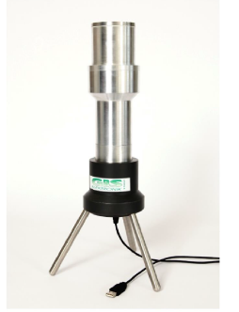
X-rays
MP barrier
We plan to implement systematic x-ray spectra recording on vertical cryostat and cryomodule with a similar system used at DESY
Na(Tl) scintillator

Slide 18
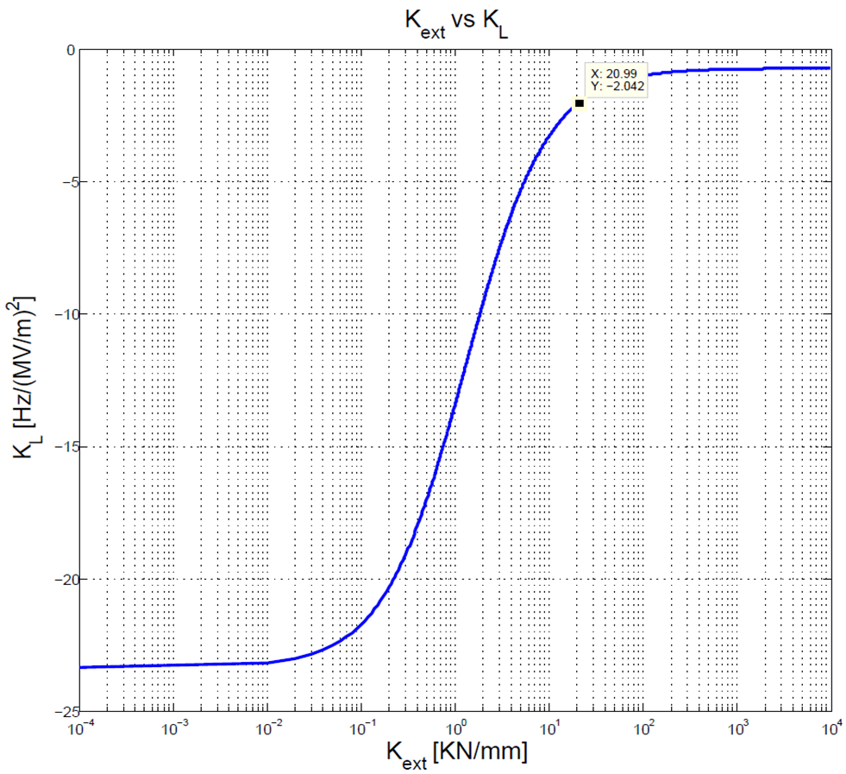

Lorentz force detuning
D. Roudier
L. Maurice
The measure is consistent with calculation
More details on G. Devanz talk

Slide 19
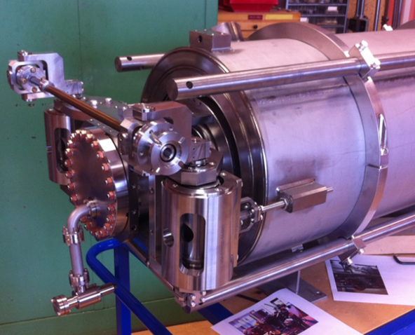
Tuning sensitivity
D. Roudier
E. Jacques
Passband mode frequencies in vacuum while moving the tuner
Blue 10 turns pull (~1mm)
Orange 0 turn (blocked before pumping)
Tuning sensitivity:
Pulling
Releasing
No backlash
Computation predict 211kHz/mm measured value is between 210-212 kHz/mm

Slide 20
100K effect
D. Roudier
L. Maurice
P. Sahuquet
The heat treatment proved to be effective against Q-disease

Slide 21
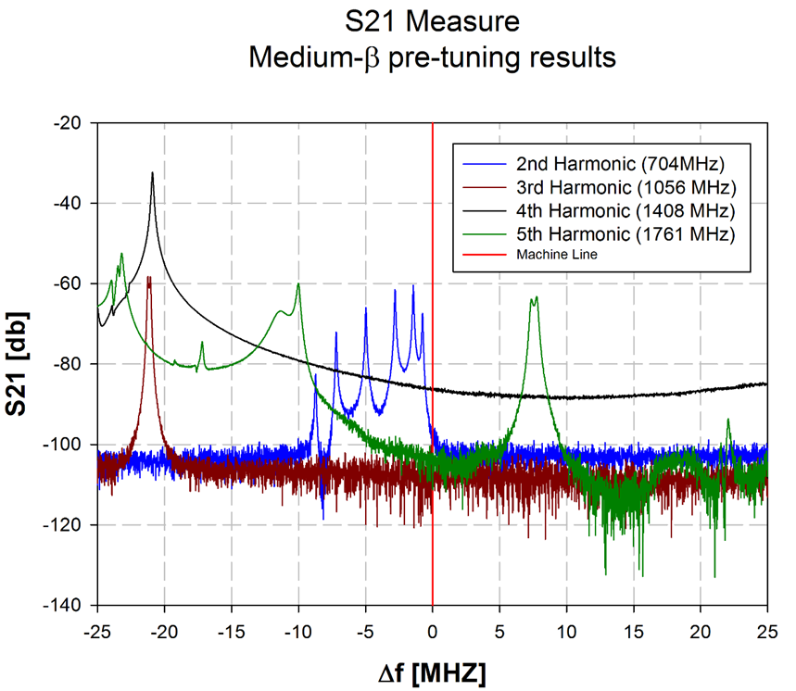
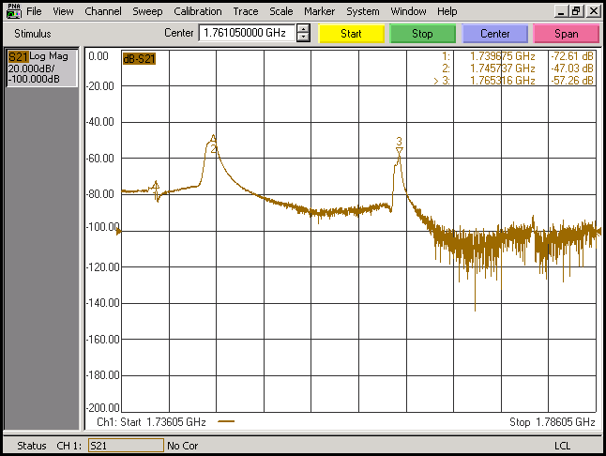
FF and HOMs
D. Roudier
Cavity Field flatness are consistently brought to 95%, heat treatment and tank integration can change the field flatness about 1-2% depending on the accumulated stress on the cavity.
HOMs are monitored during manufacturing and they are away from machine lines as designed (typically more than 20MHz)
TE modes
TM mode
Note: each BCP moves the dangerous TM mode more away from machine line

Slide 22
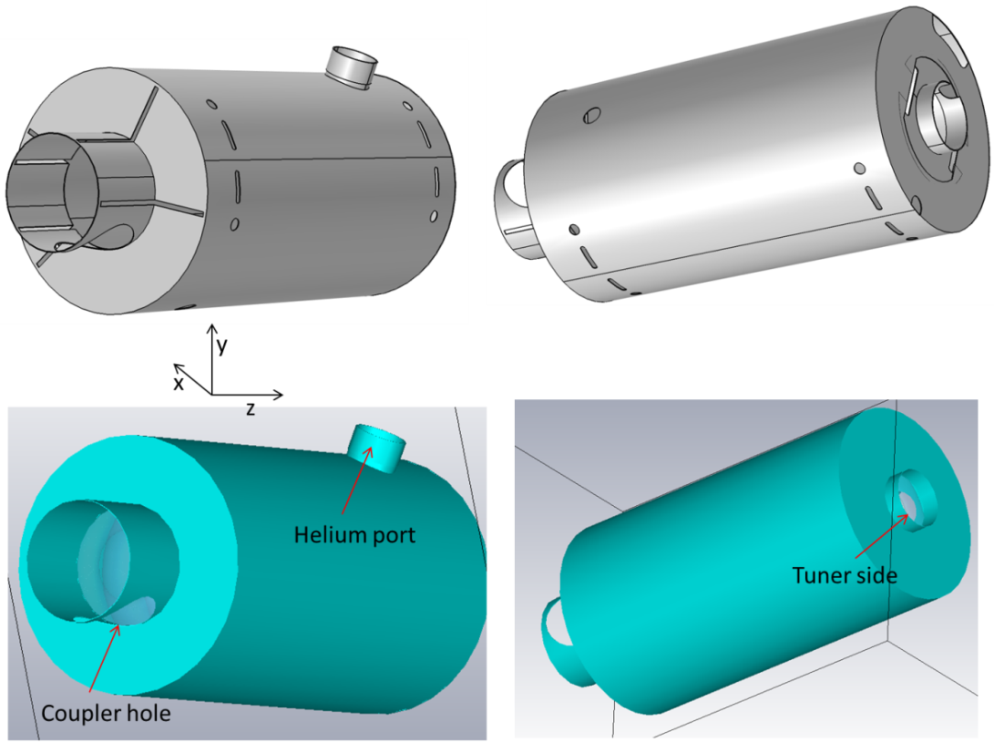
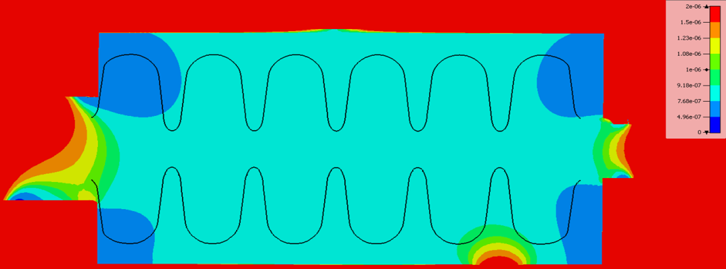
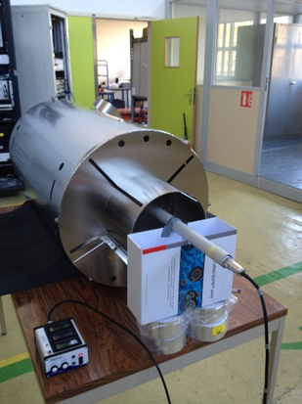
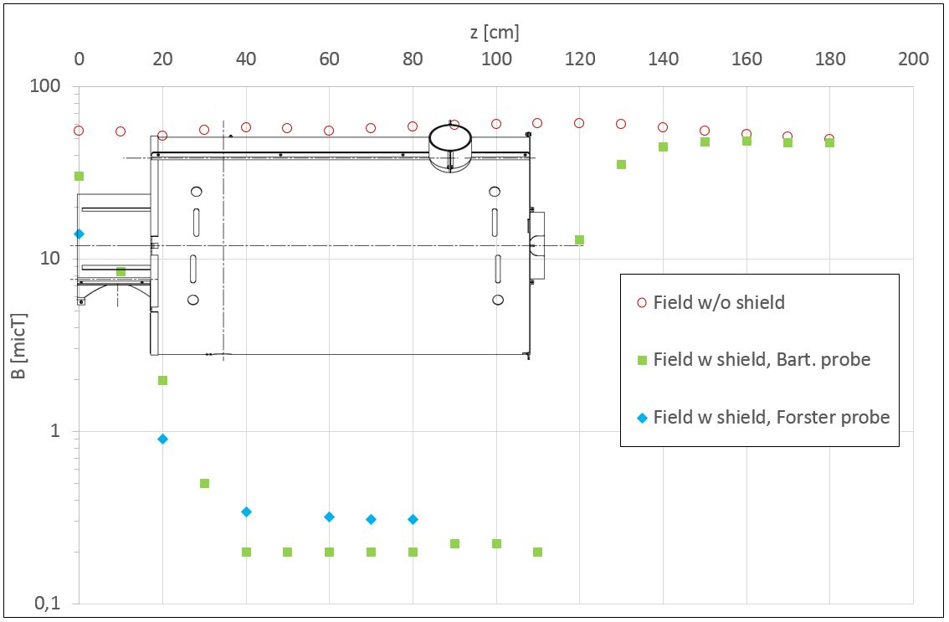
Magnetic shielding design
J. Plouin
Requirements: maximal field around cavity < 2 μT
Tesla
1 µT
Field is lower than 1 μT inside the shield, and mainly around 0,5 μT
We are confident for a value <2 μT at cold temperature

Slide 23
Cavities status
Cavities | Status | Details
MP01 | Assembled on the string
MP02 | Assembled on the string
MP03 | Assembled on the string
MP04 | Vertical test
MP05 | Ready to test BCP with different setup | Will be sent to Zanon for integration
MP06 | 200µm BCP performed at Zanon | Will be soon tested in the vertical cryostat

Slide 24
Lessons learned
Manufacturing process looks to be reproducible and reliable (learning curve shall be took into account), still there is space for improvement
BCP temperature shall be monitored, water cooling proof to be effective with integrated cavity (recently we were able to obtain very low Rs)
Frequency change rate with BCP is about 2.9kHz/µm and the average etching rate is about 1µm/min with 1:1:2.4 mix (FNP), in good agreement with simulation
Heat treatment at 600°C for 10 hours works fine (no Q-disease has been observed)

Slide 25
Summary and outlook
We have successfully manufactured 6 medium cavities, 4 of them are now equipped with helium tank.
Three cavities have been successfully assembled with power couplers, they are assembled on the string.
For P01 and P02 Q-E curves are above specifications even with field emission. We are improving HPR procedure in order to avoid future issues.
P03 has not reached ESS specification but is field emission free (need further investigation)
We keep working on the remaining prototypes in order to have the best recipe for cavity series and H-ECCTD

Slide 26
SUMMARY table
Area | Detail | Future action
Design and manufacturing | Dimensional controls and interfaces
 | Lorentz force detuning
 | Tuning sensitivity
 | HOMs
Preparation and testing | Rs
 | Q0 (2K low field)
 | Q-slope | Vertical tests and BCPs
 | Q-disease “vaccination”
 | Etching sensitivity
 | Field emission | HPR improvement and monitoring
 | Magnetic shielding (RT)
We keep working on the remaining prototypes in order to have the best recipe for cavity series and H-ECCTD

Slide 27
THANK YOU FOR YOUR ATTENTION
Thanks to: D. Roudier, L. Maurice, X. Hanus, F. Peauger, P. Bosland, C. Madec, F. Eozenou, C. Servouin, Y. Boudigou, G. Monnereau, E. Jacques, G. Devanz .

