Slide 1
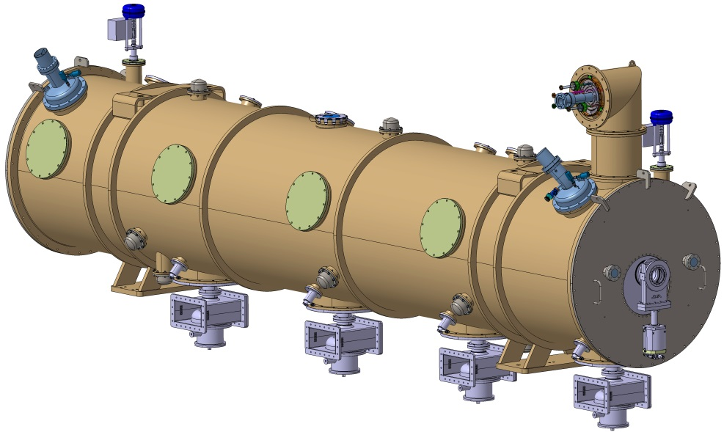
ESS elliptical cryomodule
ESS CRYOMODULE FOR ELLIPTICAL CAVITIES
CRITICAL DESIGN REVIEW
SACLAY April 3th, 2017
Unité mixte de recherche
CNRS-IN2P3
Université Paris-Sud 11
91406 Orsay cedex
Tél. : +33 1 69 15 73 40
Fax : +33 1 69 15 64 70
http://ipnweb.in2p3.fr

Slide 2
ESS elliptical cryomodule
SUMMARY
Overview
Medium & High beta
Bellows & transitions
Cavity string supporting system
Coupler bell
Spaceframe
Thermal screen
Vacuum vessel
Transportation
Heat balance
Jumper connections
Instrumentation

Slide 3
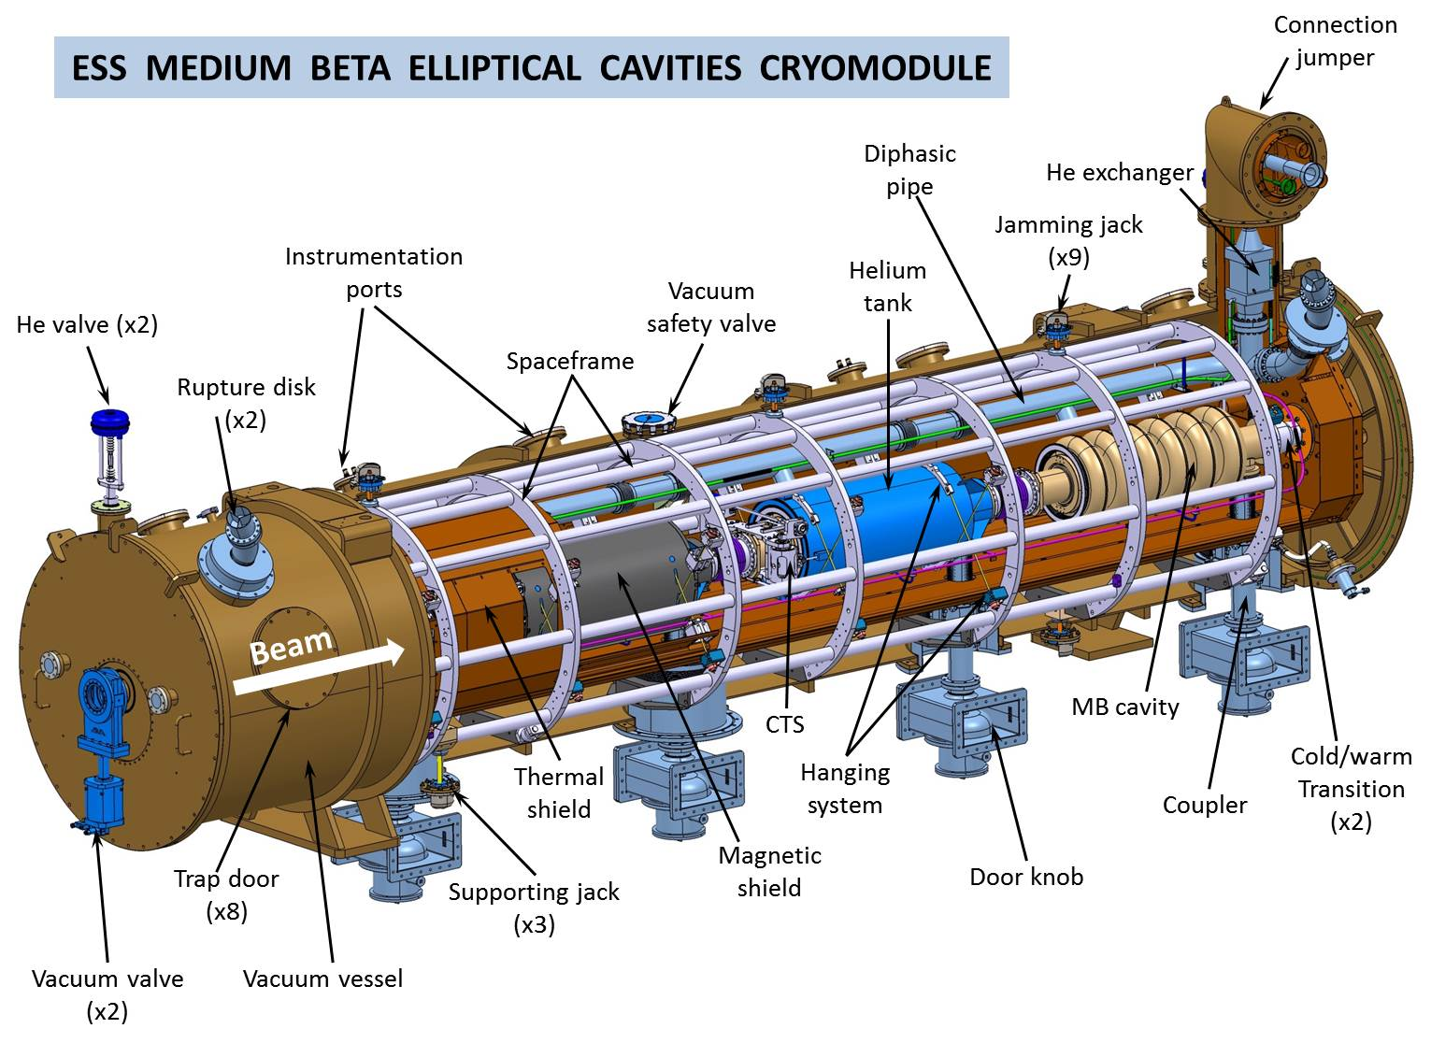
ESS elliptical cryomodule

Slide 4
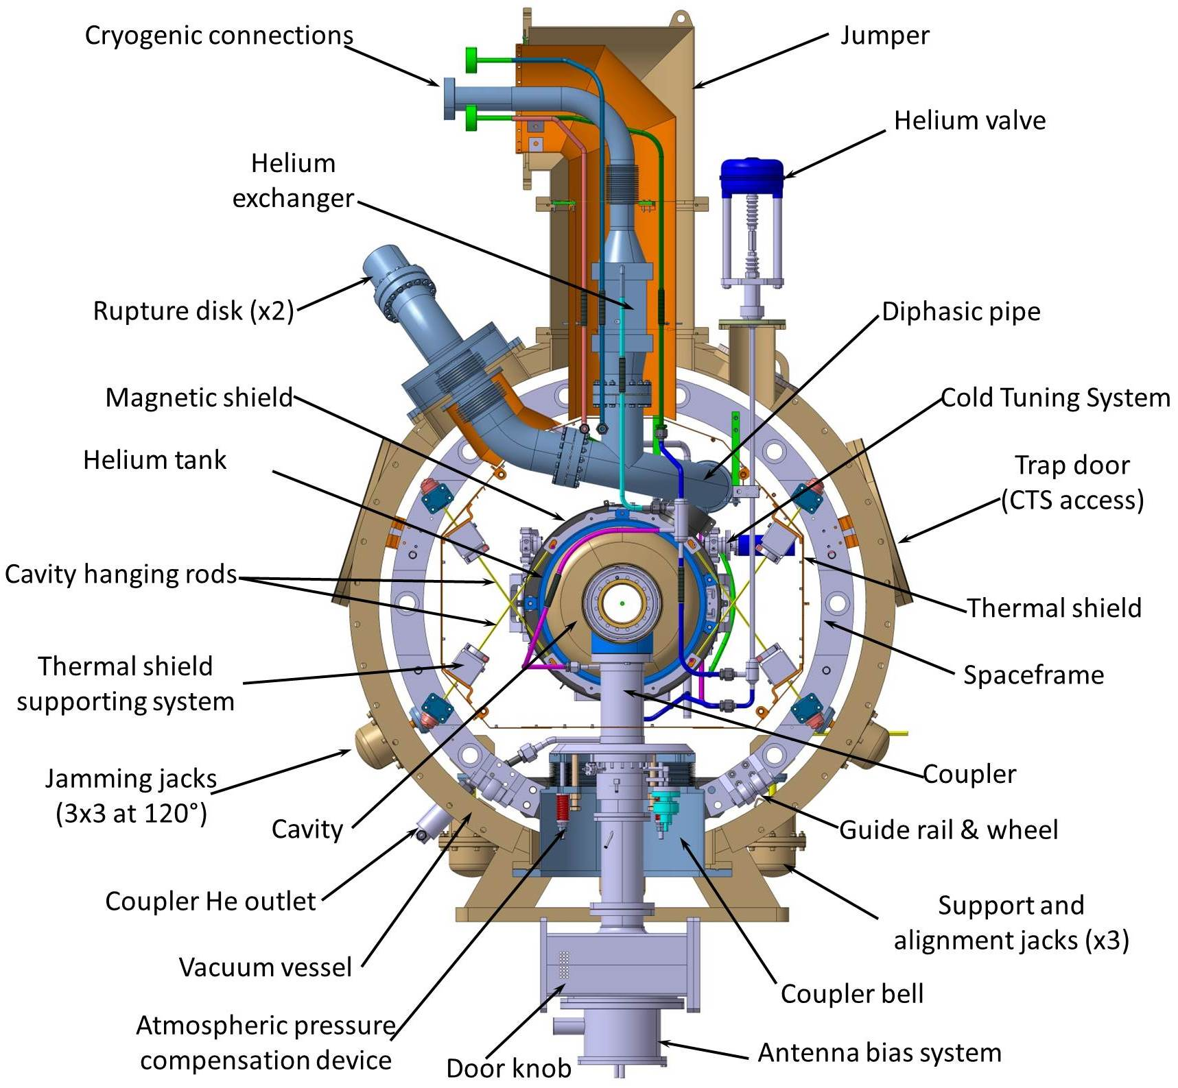
ESS elliptical cryomodule

Slide 5
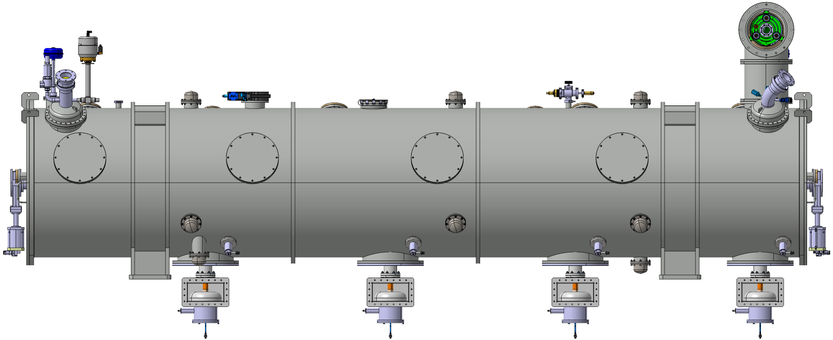
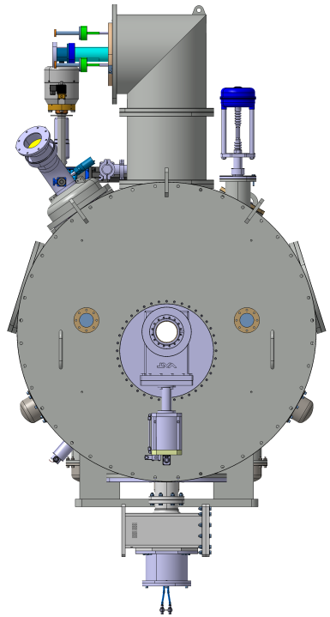
Main characteristics
Weight: 6 tons
1245
2969,5
2745
Ø1216
1500
1500
1500
1500
506,3
GROUND
4300
1156,3
6587,6 (valve flange to valve flange)
For more information, see interface drawings:
24G9914 Tunnel version
24G9916 Test stand version
24G9919 Transportation version

Slide 6
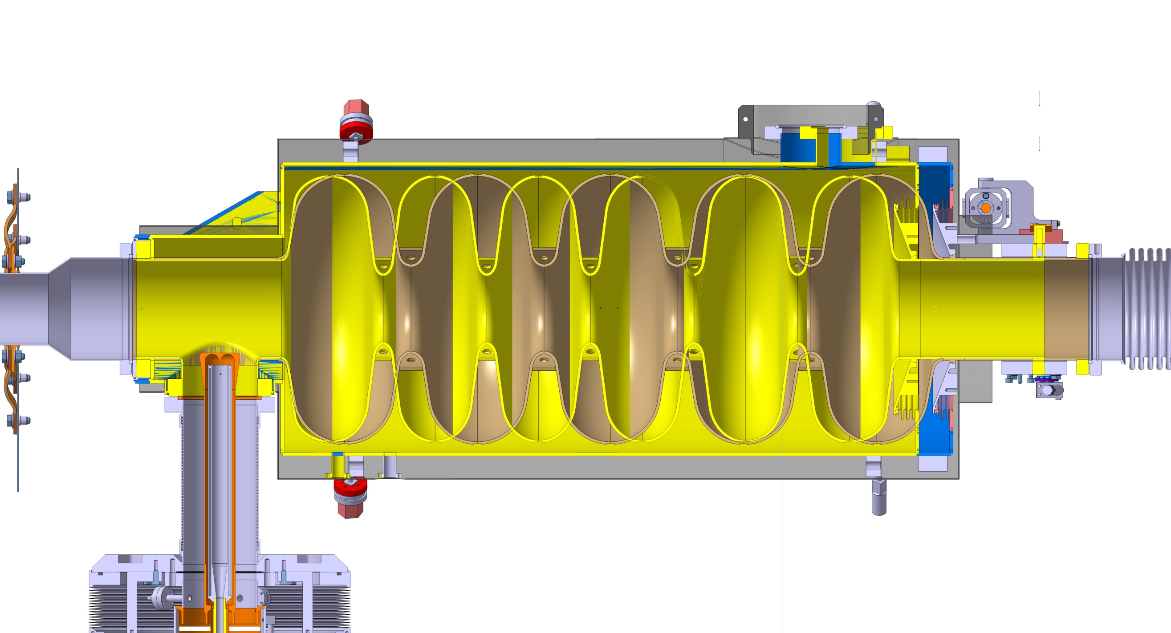
High and medium beta standardization
57,5 mm
High beta (0,86):
5 cells
Length 1316,91mm
Medium beta (0,67):
6 cells
Length 1259,40mm

Slide 7
High and medium beta standardization
1316,91 (HB) / 1259,4 (MB)
900
Blocks for half ring fasteners
794
Position of the nozzle
Main identical dimensions
Main differences
188
20
Identical sub-assemblies:
Vacuum vessel
Spaceframe
Thermal shield
Cryogenics circuits
Ø418
Same mechanical interfaces in the tunnel
Position of the nozzle
180
120,3 (HB)
115,3 (MB)
250
Specific components:
Inter cavities bellows
Cold/warm transitions
908
1500 between couplers

Slide 8
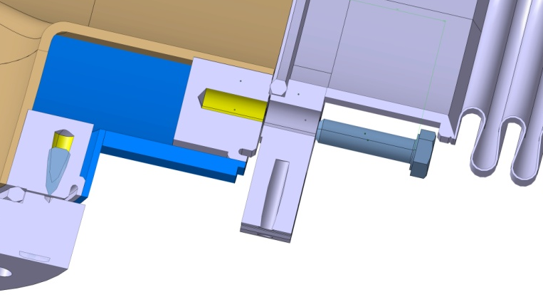
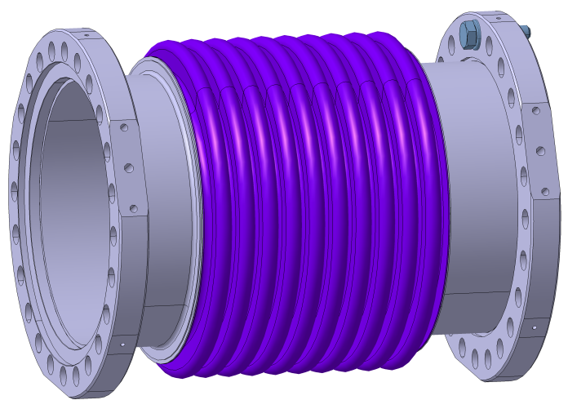
Inter-cavities bellows
Manufacturer WITZENMANN/HYDRA
Internal diameter 135mm
External diameter 174mm
Corrugation length 13mm
Thickness 2x0.3mm
Axial stroke per corrugation +/- 3mm max.
Axial stiffness per corrugation 210N/mm
Radial stroke per corrugation +/-0.08mm max.
Radial stiffness per corrugation 44500N/mm
HIGH BETA
Number of corrugations: 6
Overall length 183mm (at rest)
Axial stroke for 6 corrugations +/-18mm
Axial stiffness for 6 corrugations 35N/mm
Radial stroke for 6 corrugations +/-0.48mm
Radial stiffness for 6 corrugations 7417N/mm
MEDIUM BETA
Number of corrugations: 10
Overall length 240,5mm
Axial stroke for 10 corrugations +/- 30mm
Axial stiffness for 10 corrugations 21N/mm
Radial stroke for 10 corrugations +/-0.80mm
Radial stiffness for 10 corrugations 4450N/mm
Hexagonal aluminium seals for bellows and transitions
(XFEL Type)

Slide 9
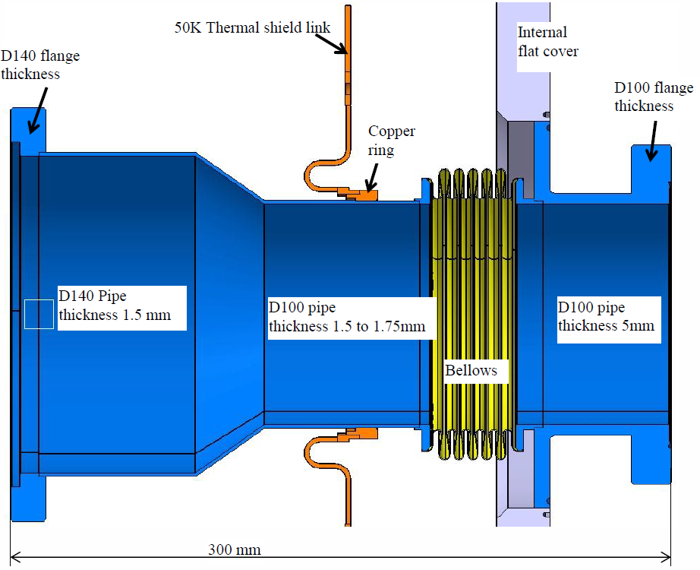
Cold / warm transitions
Located at each extremity of the cryomodules
BELLOWS
Metal: stainless steel
Type: corrugated bellows
Internal diameter: 105mm
External diameter: 132mm
Thickness: 0.3mm
Corrugation length: 6.3mm
Number of corrugations: 5
Axial spring rate per corrugation: 240N/mm
Axial spring rate for 5 corrugations: 48N/mm
External vacuum valve
Air
2 identical transitions for high beta
2 different for medium beta
Weight: 5.8 Kg without the flat cover and the vacuum valve
25.5 Kg with the flat cover and without the vacuum valve
49 Kg with the flat cover and the vacuum valve
Specific supporting tools

Slide 10
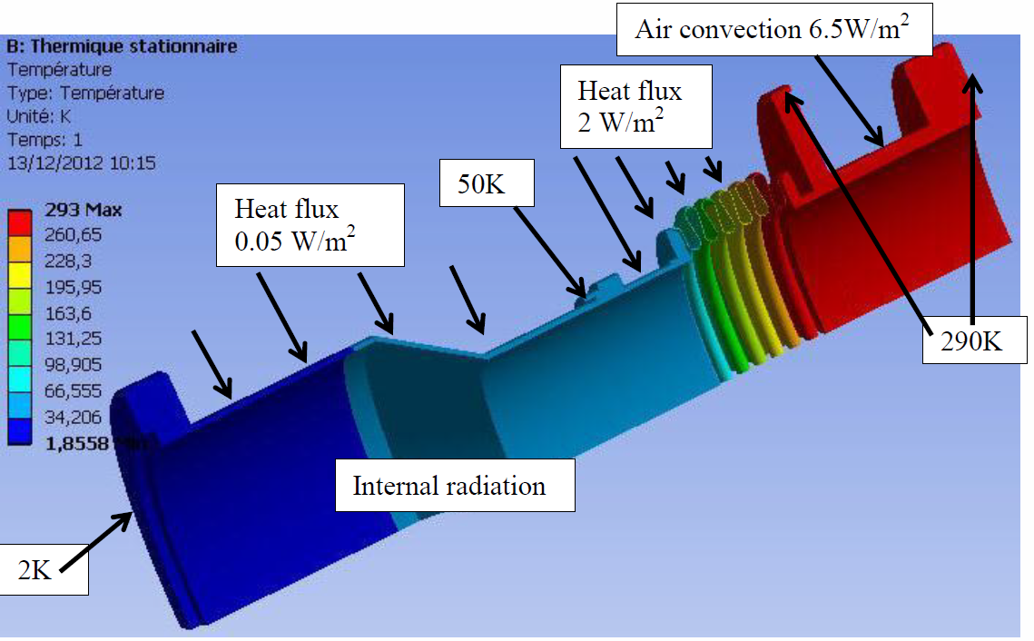
Cold / warm transitions
THERMAL BEHAVIOUR
NEITHER ICING
NOR CONDENSATION OUTSIDE
Heat transfer on the 2K circuit: 0.91W
Heat transfer on the 50K circuit: 1.40W
External radiation replaced by heat flux
For more information, see technical note:
"HB Cryomodule – Cold/warm transition"
(IPN/EDMS-I032756)

Slide 11
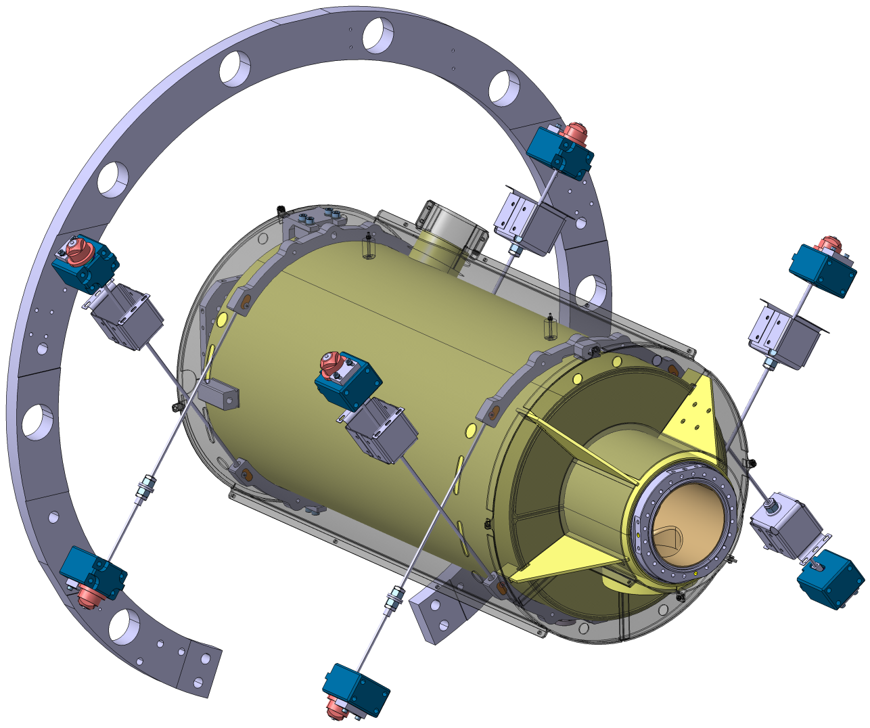
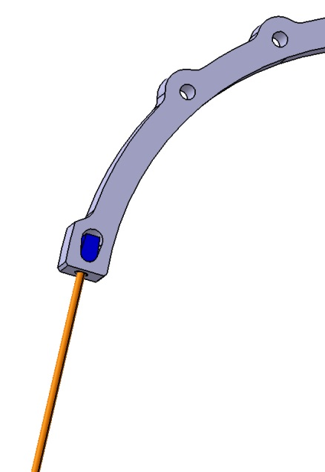
Cavity string supporting system
Hanging of the cross rods
on 2 titanium half rings fastened (on their middle only) to the helium tank on one side
On the spaceframe on the other side
Spaceframe ring
Helium tank
Magnetic
shield
Fastening of the thermal shield
(& thermalization)
Half ring
(titanium)
Rods
Clevis pin
(rotating joint)
Supporting rod
(TA6V, Diam. 6mm)
The rods are composed of 2 sections. The first is assembled on the cavity string alone, the second after insertion in the spaceframe while the hanging of the thermal shield
Half rings linked to the tank (under the magnetic shield)

Slide 12
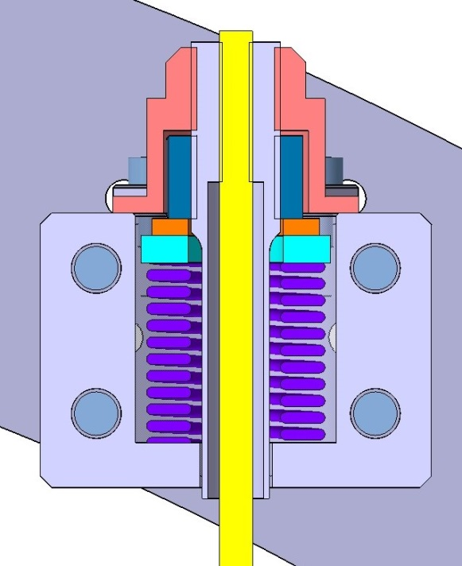
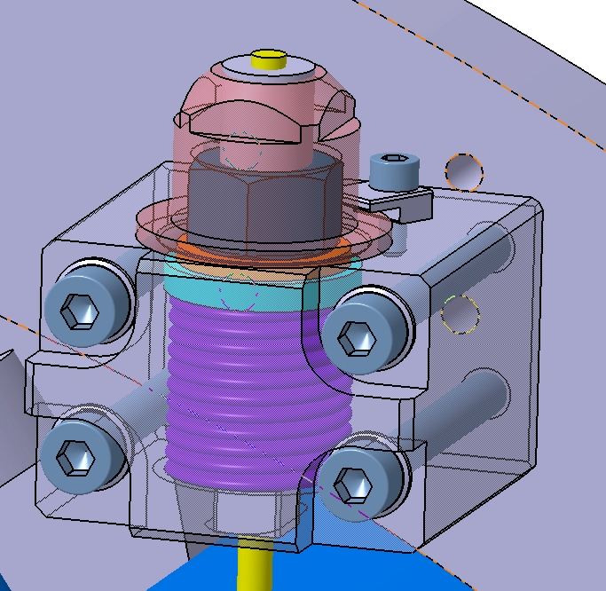
Cavity string supporting system
Blocking nut
M6 thread
Pre-stress nut
M16 thread
Spaceframe ring
Intermediate screw blocked in rotation
Spring
LOCKING DEVICE ON THE SPACEFRAME
Rod
- Heavy load spring D16x32 H38mm, stiffness 518N/mm
- Stroke under 3000N pre-stress: 5,8mm
- Locking of the rods after pre-stress
- Rod length 490mm, diameter 6mm, material TA6V

Slide 13
Cavity string supporting system
MECHANICAL STRESS FIGURES
Stress in the rod core (M6 thread, Ø4.77mm, 17.9mm²) due to the 3000N pre stress: 168MPa
Stress in the upper rod core due to the weight (900N per rod): 51MPa
Stress in the rod core due to the thermal shrinkage: 250MPa (equiv. force 4443N)
Total stress in the rod core: 469MPa (Tensile yield strength 825MPa to 1040MPa)
Maximum force in one upper rod: 8343N
Maximum vertical acceleration during transportation: 5g (given to inter-cavity bellows maximum transverse displacement)
Characteristics | TA6V
Density | 4.43
Young modulus (GPa) | 110 (293K)
Poisson’s ratio | 0.33
Yield strength (MPa) | 825 (290K)
Heat conductivity 4-50K (W/m.K) | 0.233-2.411
Heat conductivity 50-300K (W/m.K) | 2.411-7.555
Thermal shrinkage 4-293K | 0.0017
Traction test performed at more than 1 ton
For more information, see technical note:
"Cavity string supporting system"
(IPN/EDMS-I036271)

Slide 14
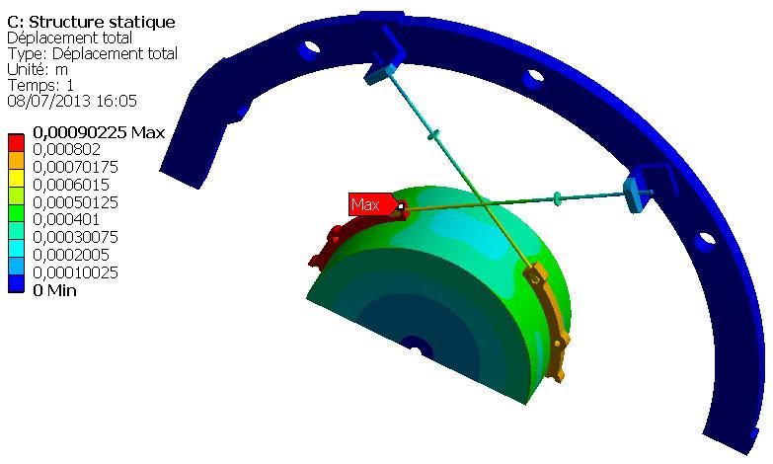
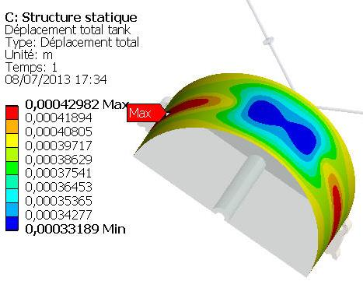
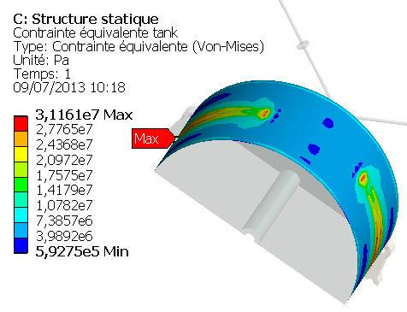
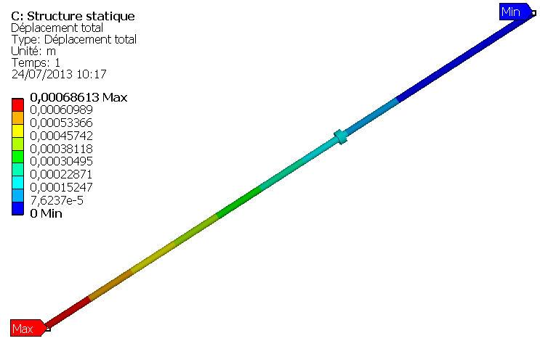
Cavity string supporting system
Spaceframe
Displacement
Rods
Half rings
Helium tank
Titanium half rings
3000N pre-stress
After cool down
Locked point on the spaceframe
Titanium tank alone
SIMPLIFIED
MODEL
Stress
Rod displacement
Max 31MPa

Slide 15
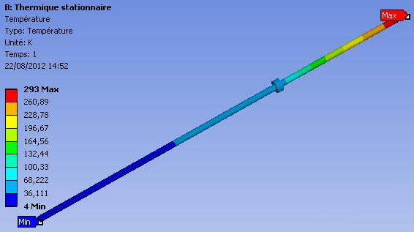
Cavity string supporting system
HEAT LOSSES
Material | G10 (Normal dir.) |  | Nitronic 50 (SS304) |  | TA6V
Diameter (mm) | 6 | 7 | 6 | 7 | 3 | 4 | 5 | 6
Section (mm²) | 28.27 | 38.48 | 28.27 | 38.48 | 7.07 | 12.57 | 19.63 | 28.27
Loss 4-50K (260mm) (W) | 0.00078 | 0.0011 | 0.01354 | 0.01846 | 0.0016 | 0.0028 | 0.004 | 0.00629
Loss for 32 rods (W) | 0.025 | 0.034 | 0.433 | 0.591 | 0.050 | 0.089 | 0.139 | 0.201
Loss 50-293K (140mm) (W) | 0.01423 | 0.0194 | 0.39596 | 0.5385 | 0.0453 | 0.0805 | 0.1257 | 0.18086
Loss for 32 rods (W) | 0.455 | 0.619 | 12.671 | 17.232 | 1.450 | 2.576 | 4.022 | 5.788
Calculation by Ansys®
Length 490mm
50K thermalization at 300mm
SOLUTION ADOPTED

Slide 16
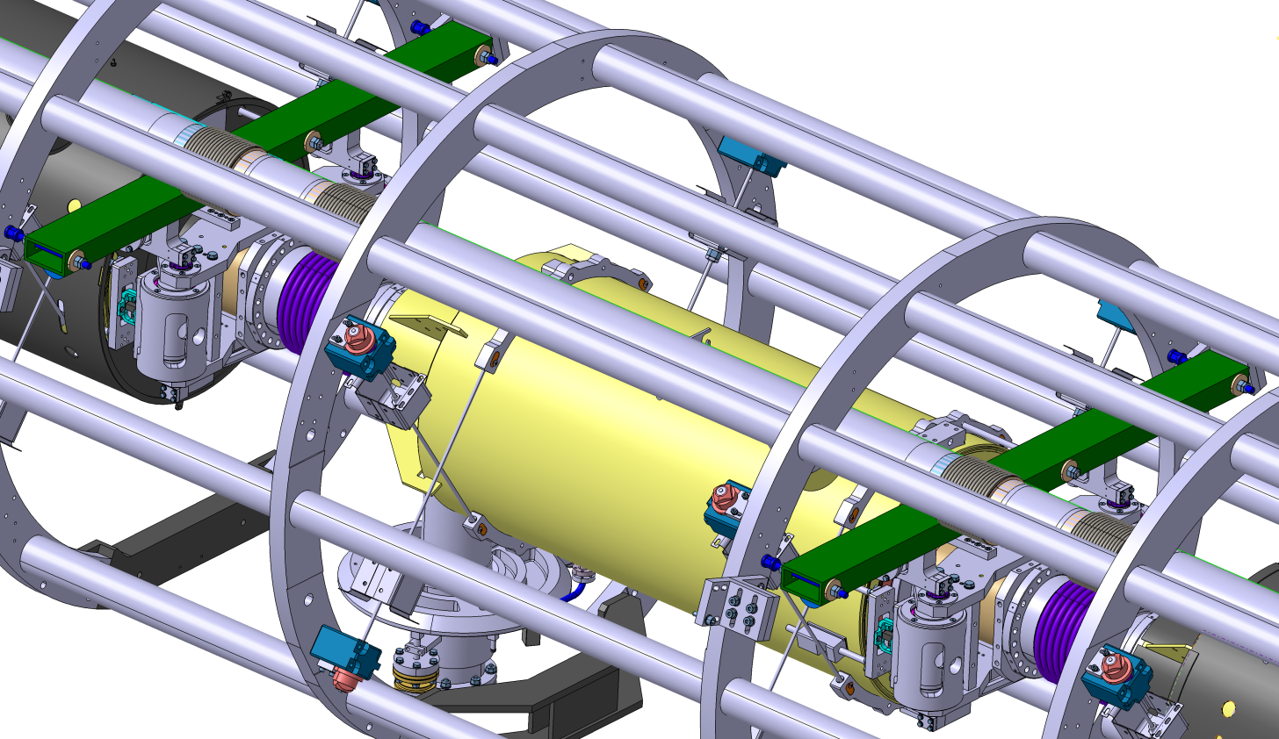
Axial positioning
Adjustment at 290K of the axial position of the cavities by rods fixed at different spaceframe rings(removed after jamming of the couplers on the vacuum vessel)
Locking by threaded rod
The rods are located between the tank and the magnetic shield
No permanent axial rods
Jamming on the coupler flange (see next slide)
Transverse bar
All the tooling is temporary and is removed for operation after axial jamming of the cavity string (see following slide)
This tooling is carried out again for transportation (g-load compensation)

Slide 17
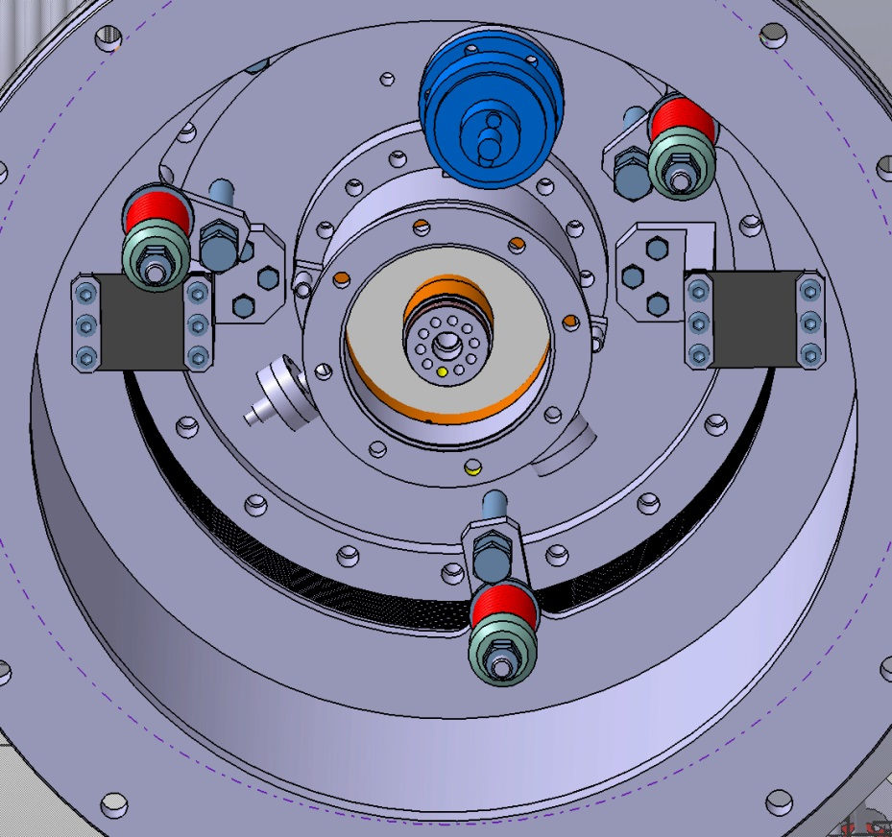
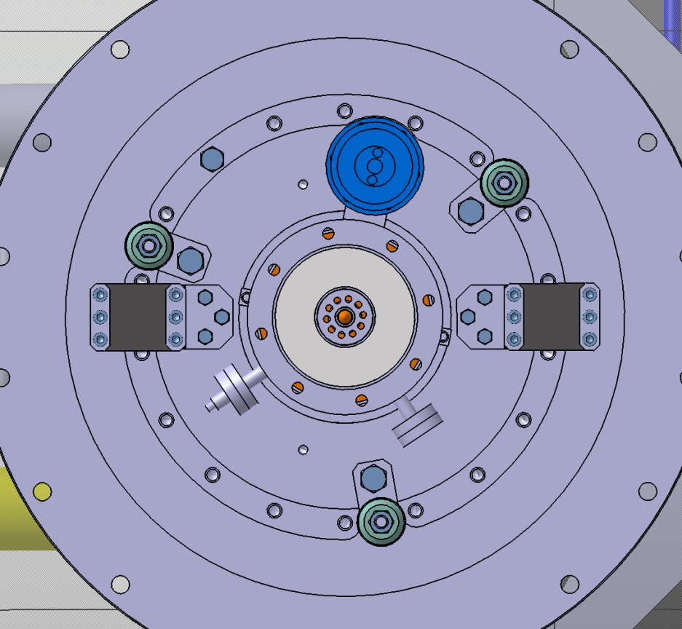
Axial blocking
Atmospheric pressure compensation
(see relevant slides)
Coupler flange
Coupler
Thin plate
(thickness 0,75mm)
Bellows
"Bell" for vessel/coupler connection

Slide 18
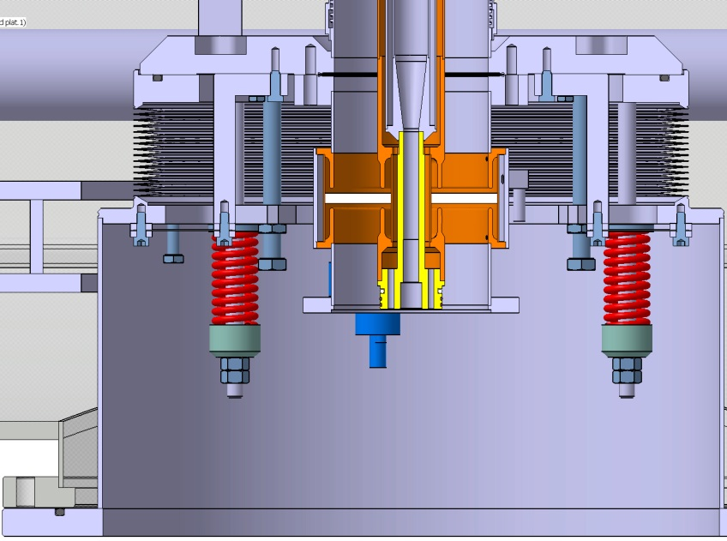
Atmospheric pressure compensation
The aim of the device is to limit the load on the cavity flange while pumping and cooling (1 ton if nothing done)
A pre-stress is performed by means of 3 heavy load springs (3 x 172N/mm). A stop rod device (x3) avoids any force on the coupler flange during this operation.
The vacuum pressure is applied to the bellows flange (Dext 360mm)
Due to the cooling, the thermal shrinkage of the coupler (0,5mm) induces both the lifting of the lower parts of the RF line (coaxial line and door-knob) and a compression of the springs
Coupler
Flange
Vacuum effect
9985N
Bellows
Spring effect
9177N
Doorknob weight 550N
Thermal shrinkage
258N
Flange locked to the vessel
Effort on the flange (N) | 0 (stop rod) | 808 (Push) | 0
Stop rods
Springs

Slide 19
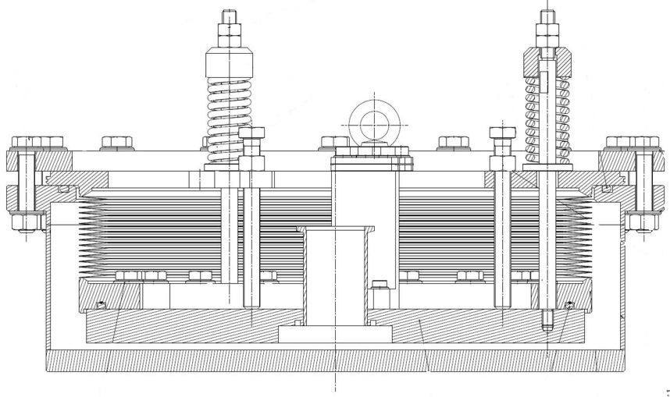
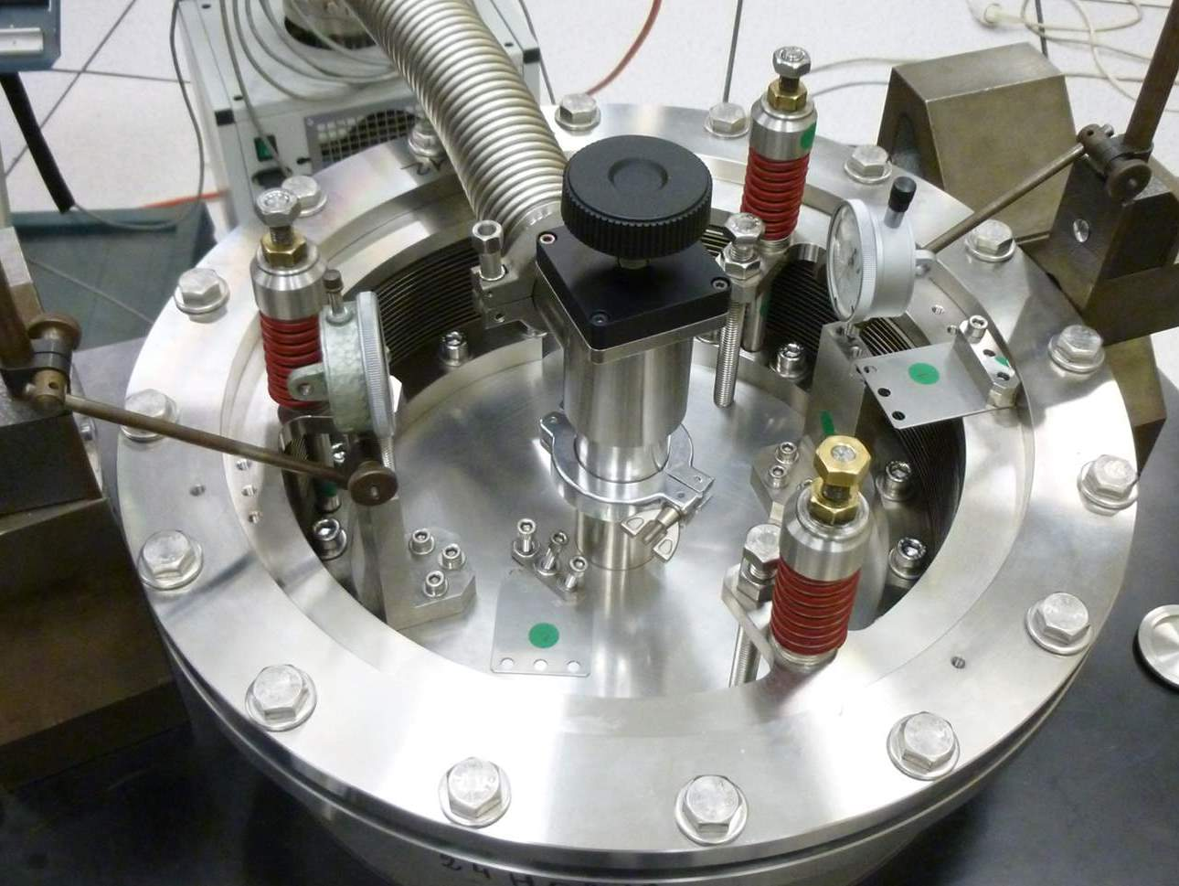
Atmospheric pressure compensation
Test equipment to validate the atmospheric pressure compensation device (CEA)

Slide 20
Atmospheric pressure compensation
PRE-STRESS OPERATION
The stress value is applied with accuracy by means of a hydraulic jack. Each spring remains in position between 2 flanges and is released after assembly .

Slide 21
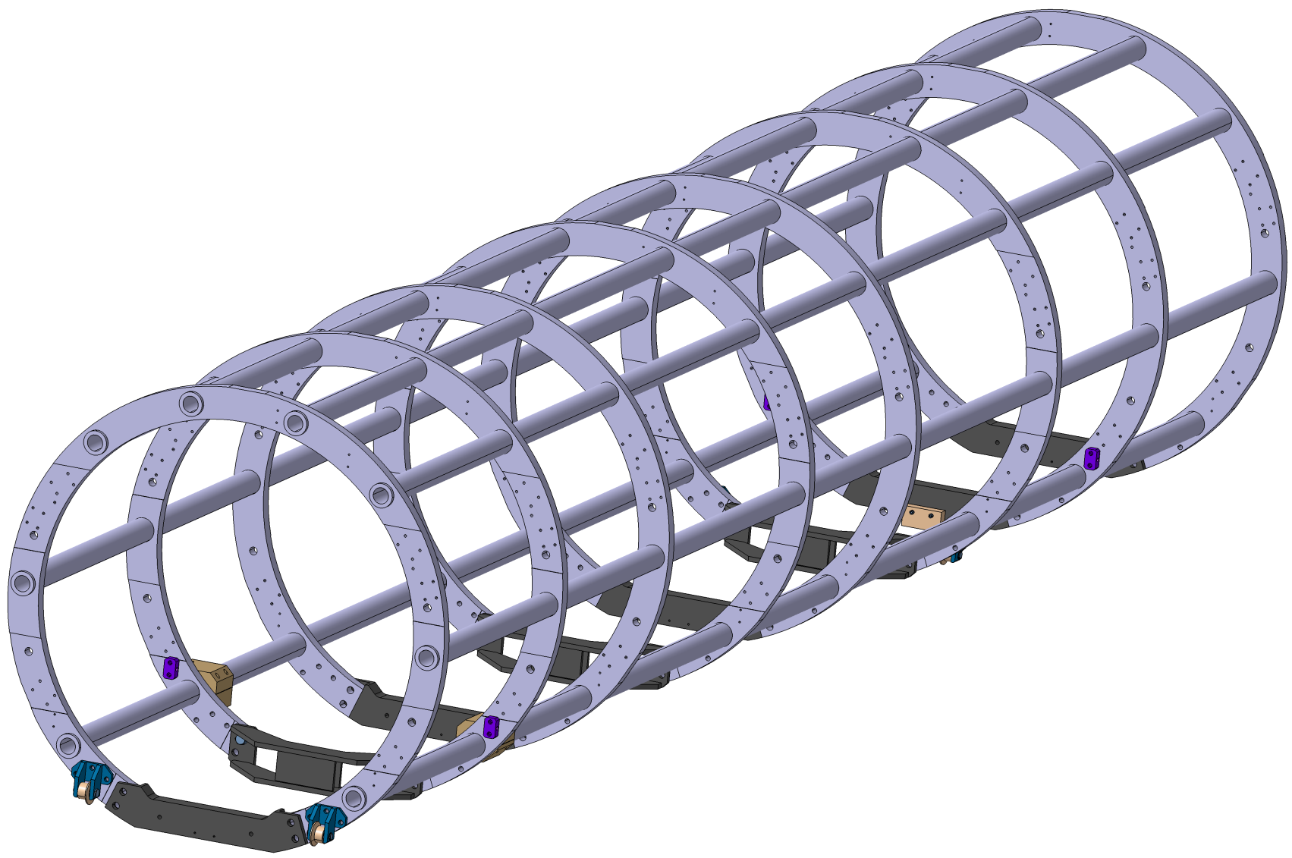
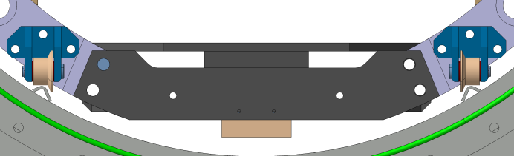
spaceframe
Hanging of the cavities
Hanging of the thermal shield
Positioned inside the vacuum vessel
Rings (Alu.6082 T651)
(thickness 30mm)
Remains at ambient temperature
8 Pipes D40x60
(Alu. 6060T6)
Rolling inside the vacuum vessel on 2 rails
Rollers
(2nd level)
Closing parts
(stainless steel)
Positioning & resting blocks
Rollers
(1st level)
For more information, see technical note:
"ESS Cryomodule - Spaceframe"
(IPN/EDMS-I046559)

Slide 22
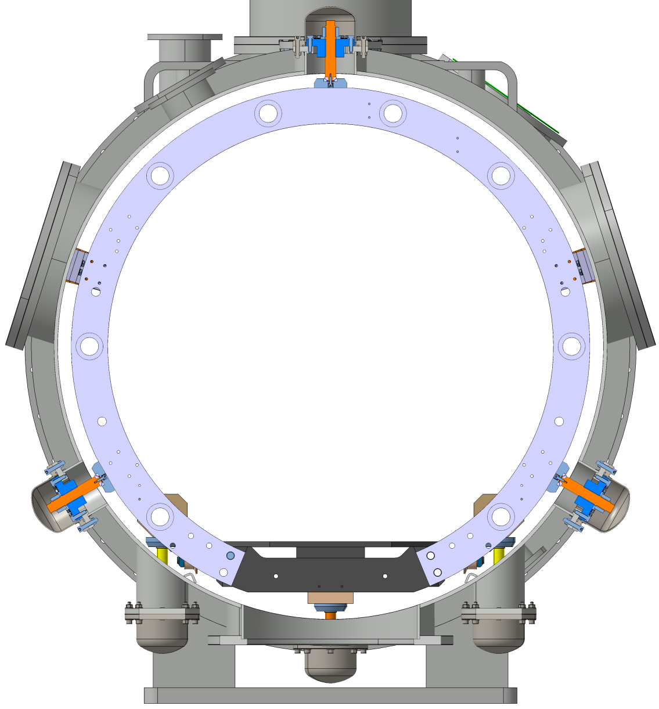
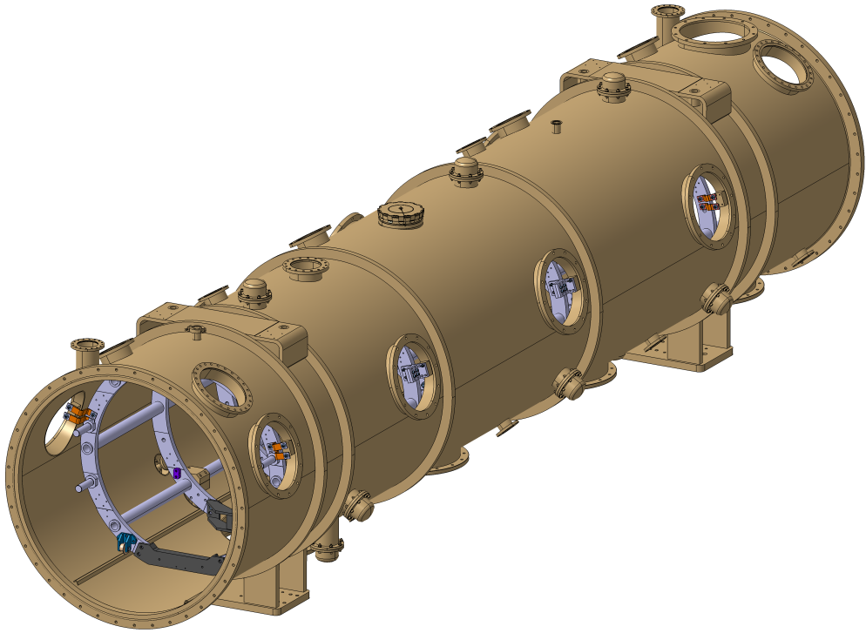
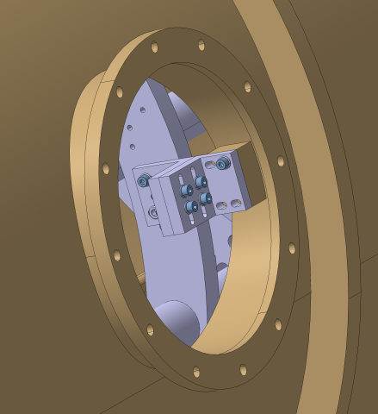
Spaceframe locking
Transverse blocking:
3 jacks at 120°
On 3 sections
Axial locking at the trap doors levels (2x2)
The spaceframe is directly fastened to the vacuum vessel by a set of brackets
Positioning:
3 vertical jacks

Slide 23
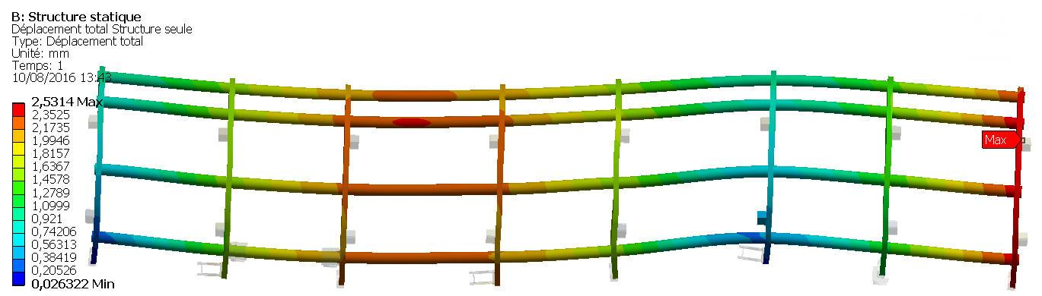
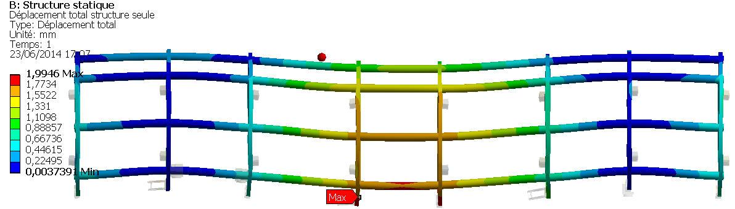
Spaceframe mechanical behaviour
During insertion in the vacuum vessel (on rollers)
Stress max. 38MPa
Rollers
Calculations performed with full load:
Weight, pre-stress & cooling down (rods).
During the positioning
& in operation (on supports)
Stress max. 38MPa
Supports
Minimum yield strength R_{p0,2} for aluminium 6060T6 or 6082T6: 240MPa
Total Displ. (mm) | Structure Displ. (mm) | Blocks Displ. (cavity string fastening) (mm) | Max stress (Mpa)
2,06 | 1,99 (Z:-1,96 to +0,42) | 0,07 à 1,76 (Z: -1,67 to +0,17) | 38

Slide 24
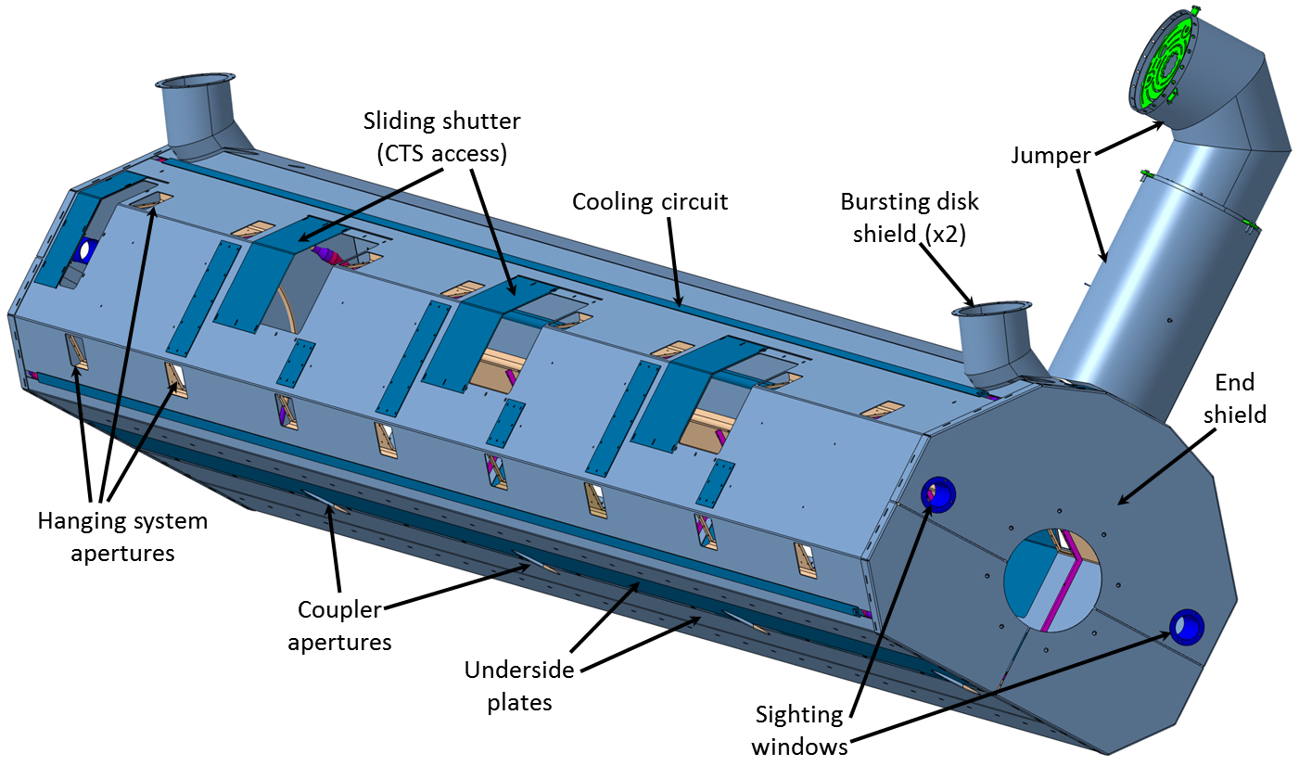
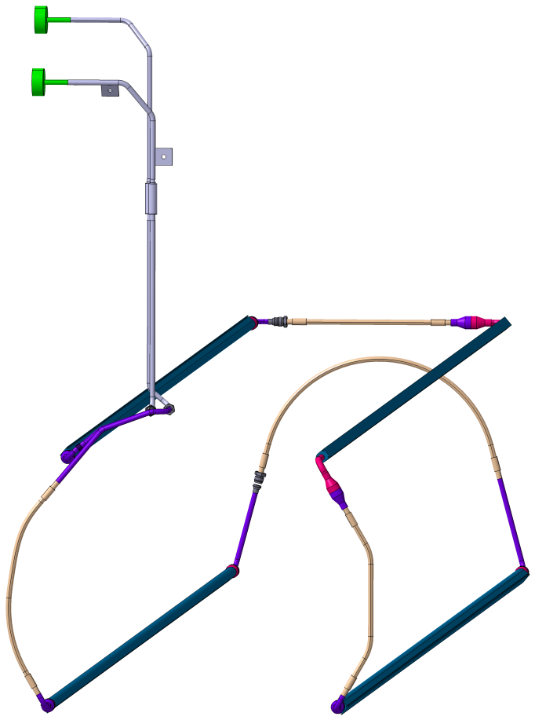
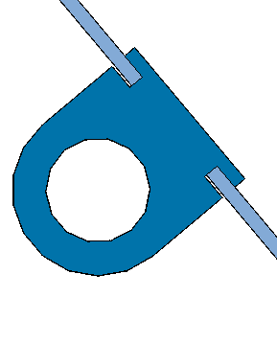
Thermal shield
Made of aluminium
Thickness 2mm
Several plates
2 closing plates at each extremity
Cooling circuit connections: weld or VCR
Cooling circuit
Extruded aluminium pipe
stainless Steel/alu. transition at each extremity
Weld seams

Slide 25
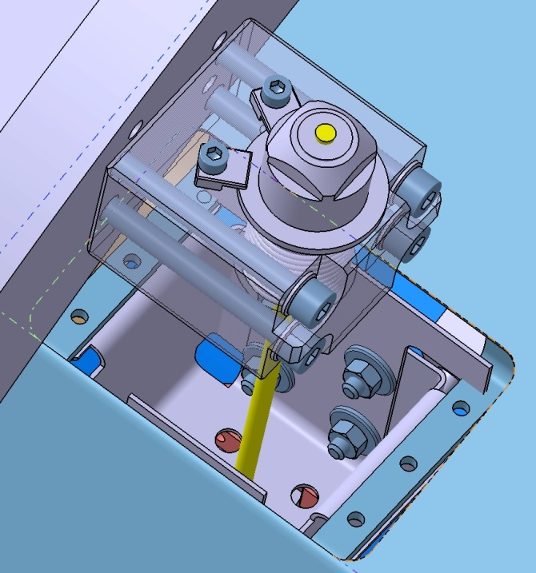
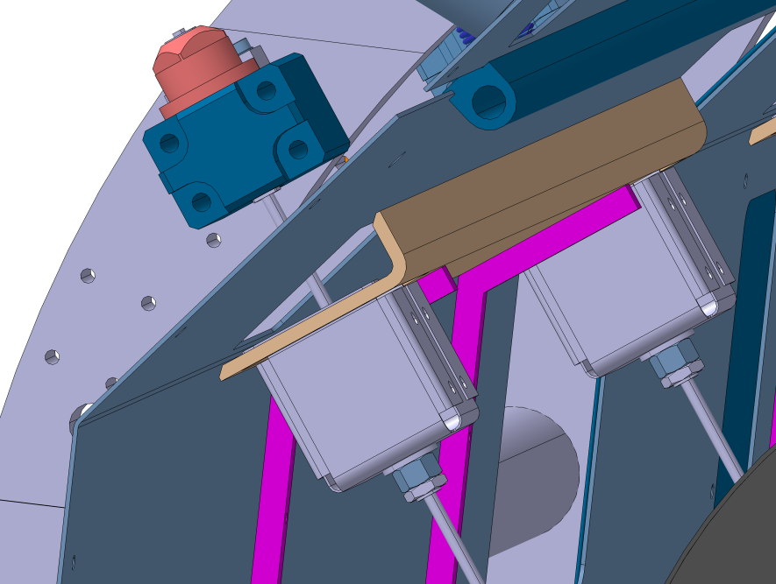
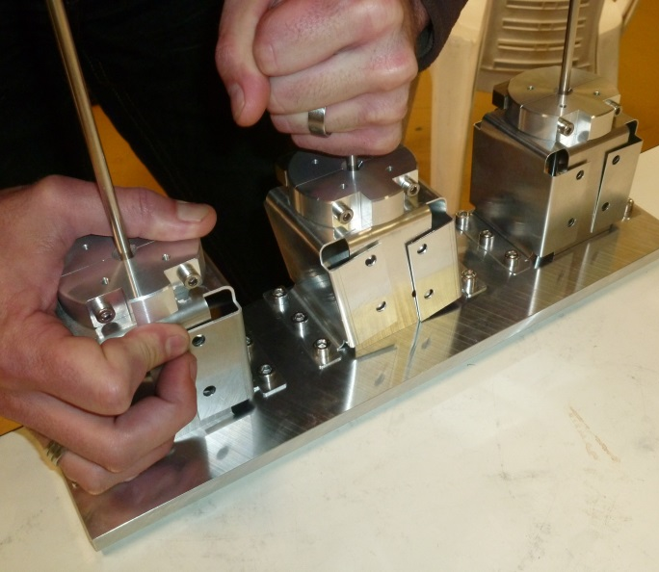
Thermal shield hanging & thermalization
Thermal shield
Supporting rods
The boxes are blocked only at the fixed point at mid of the thermal shield
Locking screws
& thermalization
Elastic boxes
Maximum thermal shrinkage to be compensated: 12,9mm
FOLDED BOXES ENSURE THE AXIAL MOVING AND THE THERMALIZATION OF THE THERMAL SHIELD.
THEY PERMIT ONLY LOW DISPLACEMENTS ON OTHER DIRECTIONS
3 prototypes have been made (thickness 0,5 , 1 et 1,5mm)

Slide 26
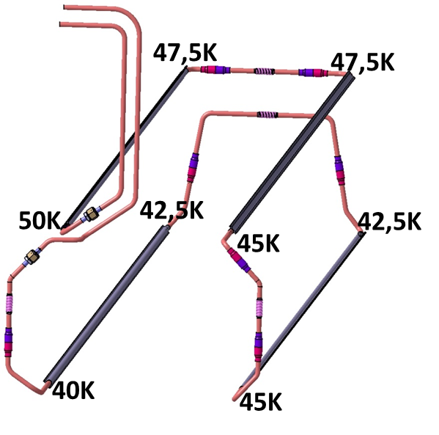
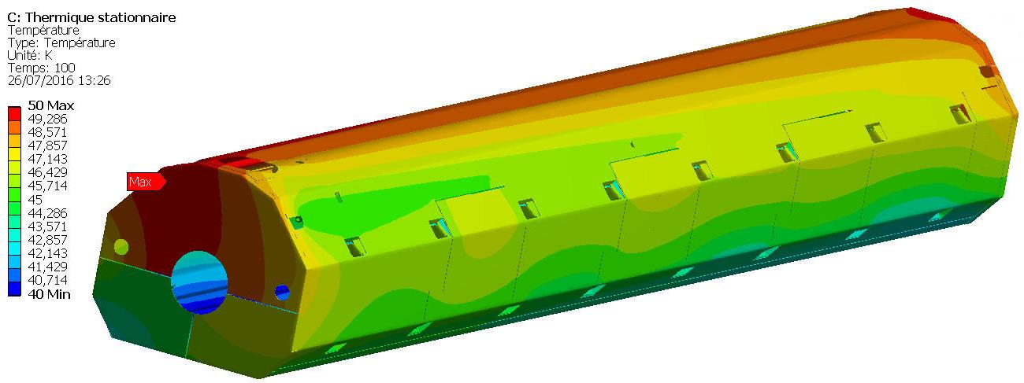
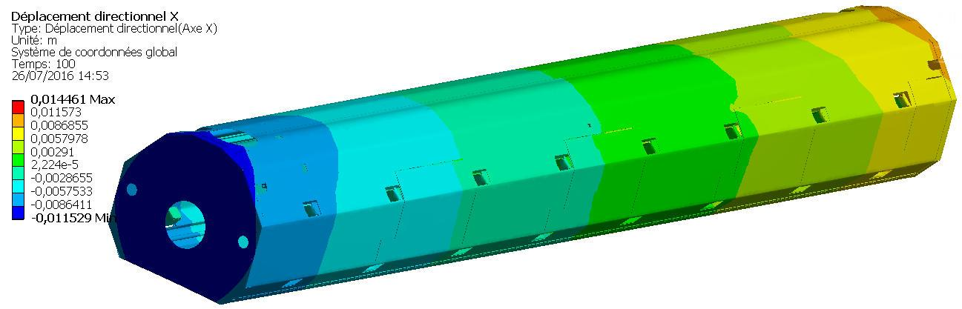
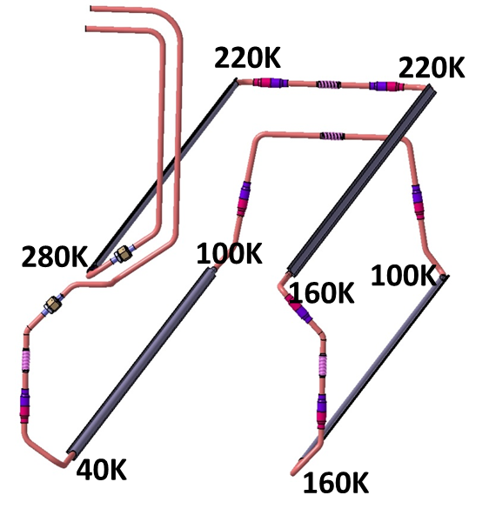
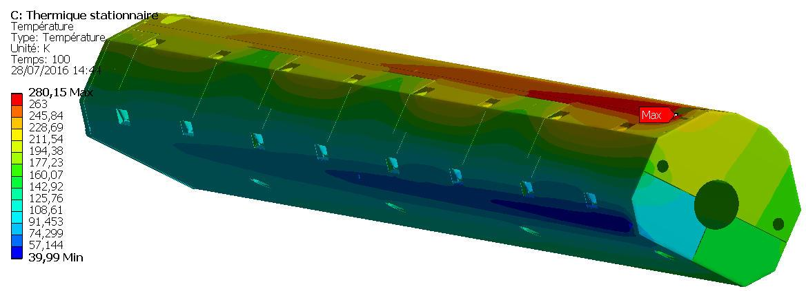
Thermal shield thermal aspects
In operation
Temperature map
Constant temperature gradient along 4 sections
Fixed point
Thermal shrinkage
Cooling down
Temperature map

Slide 27
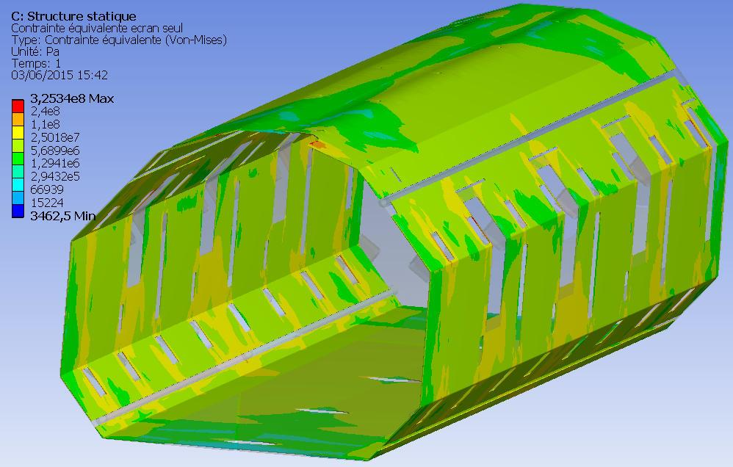
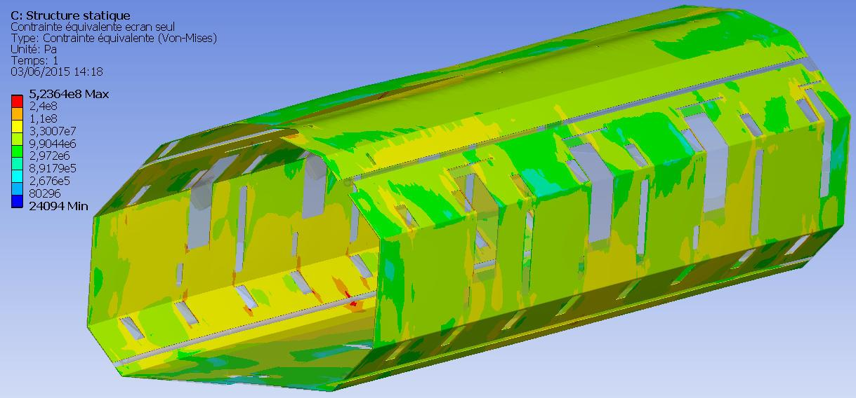
Thermal shield thermal aspects - stress
For more information, see technical note:
"ESS Cryomodule – Thermal shield"
(IPN/EDMS-I04659)
Aluminium 6082T6:
Yield strength 260MPa at ambient temperature
Yielding is limited at very local surfaces
In operation
As the shield length is divided in several sections for manufacturing constraints (4 for M-ECCTD), the stress is relieved with regard to the calculations
Cooling down

Slide 28
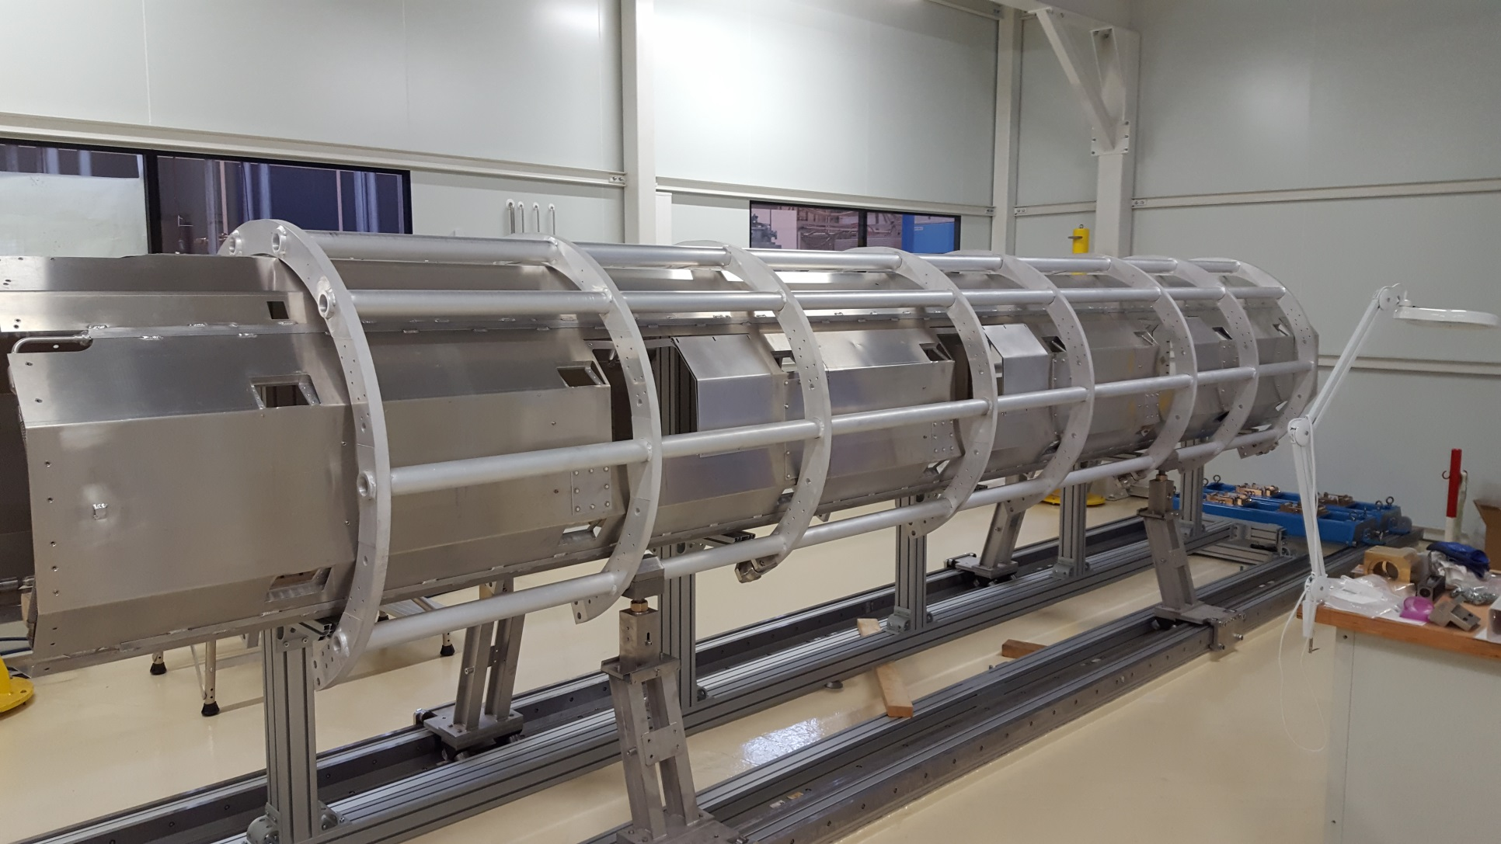
Spaceframe & thermal shield
M-ECCTD first assembly

Slide 29
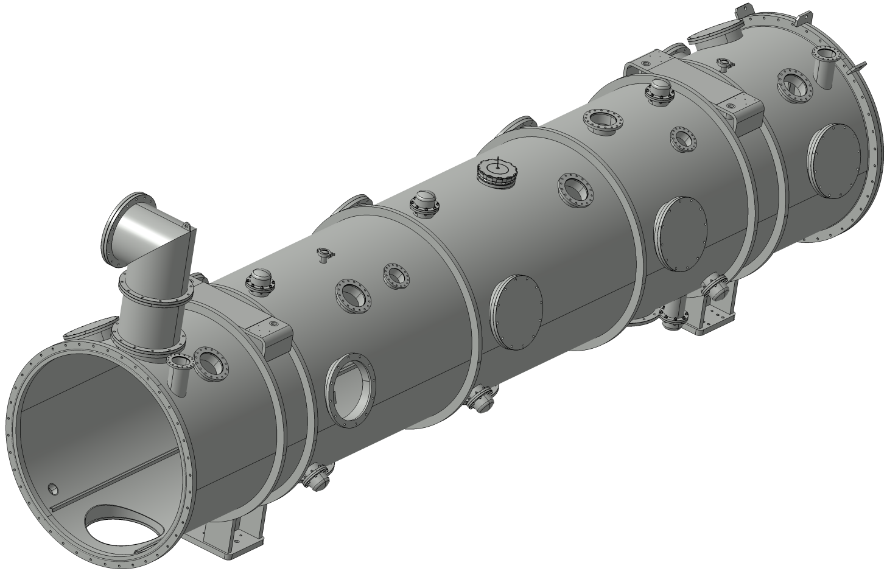
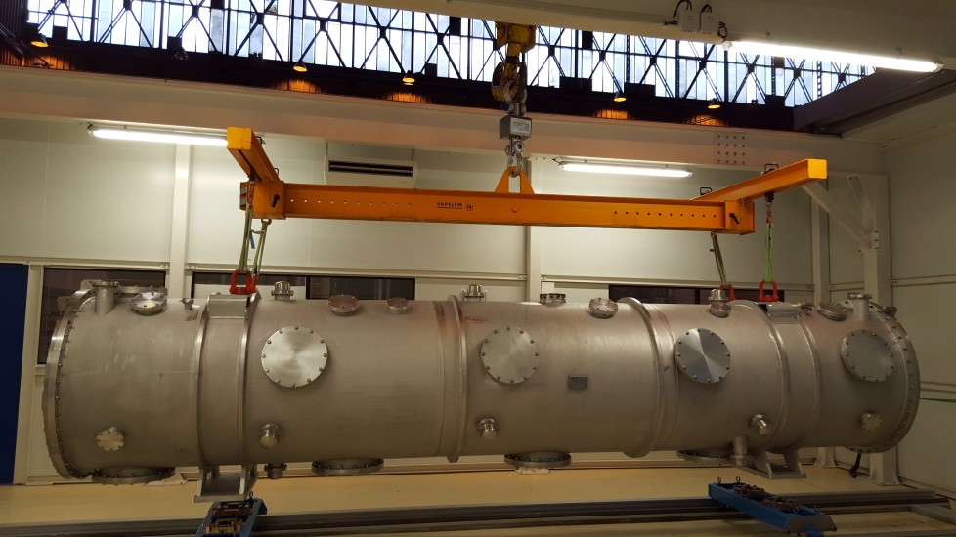
Vacuum vessel
Optical alignment
Length: 6285mm
Internal diameter: 1200mm
Thickness: 8 mm
Weight: 3,8 tons
2 supports
Spaceframe jacks adjustment
Trap doors for CTS access (motor removing)
Stiffeners
Supports
Rail for spaceframe guiding
2 flat covers at each extremity
For more information, see technical note:
"Vacuum vessel – EN13445 Compliance"
(IPN/ATRIUM-46561)

Slide 30
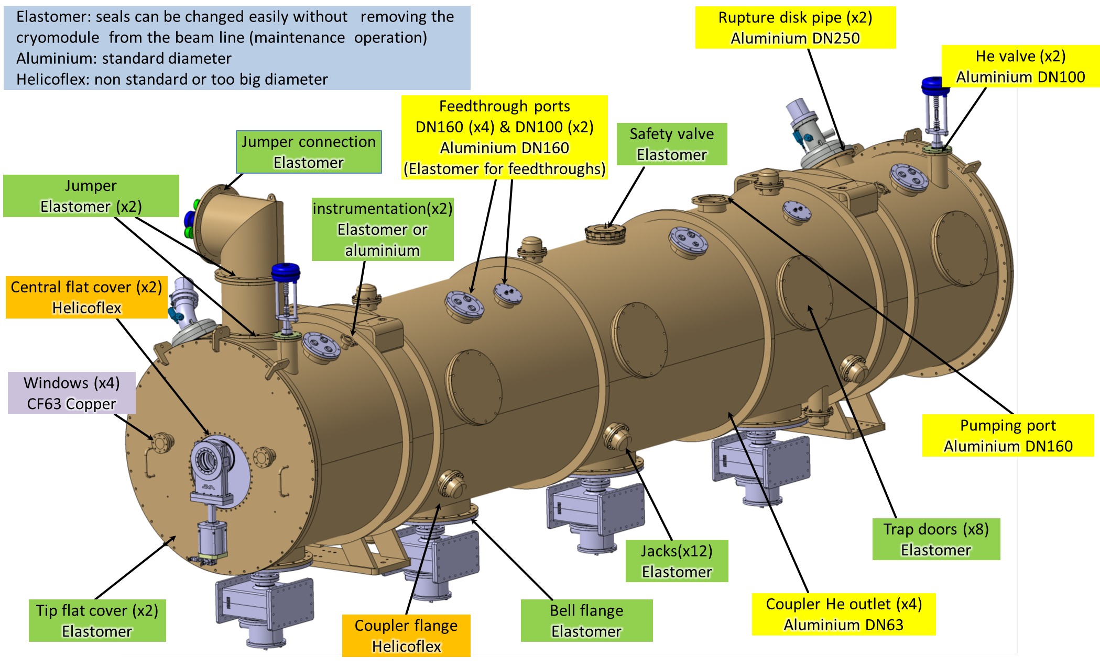
Vacuum sealing

Slide 31
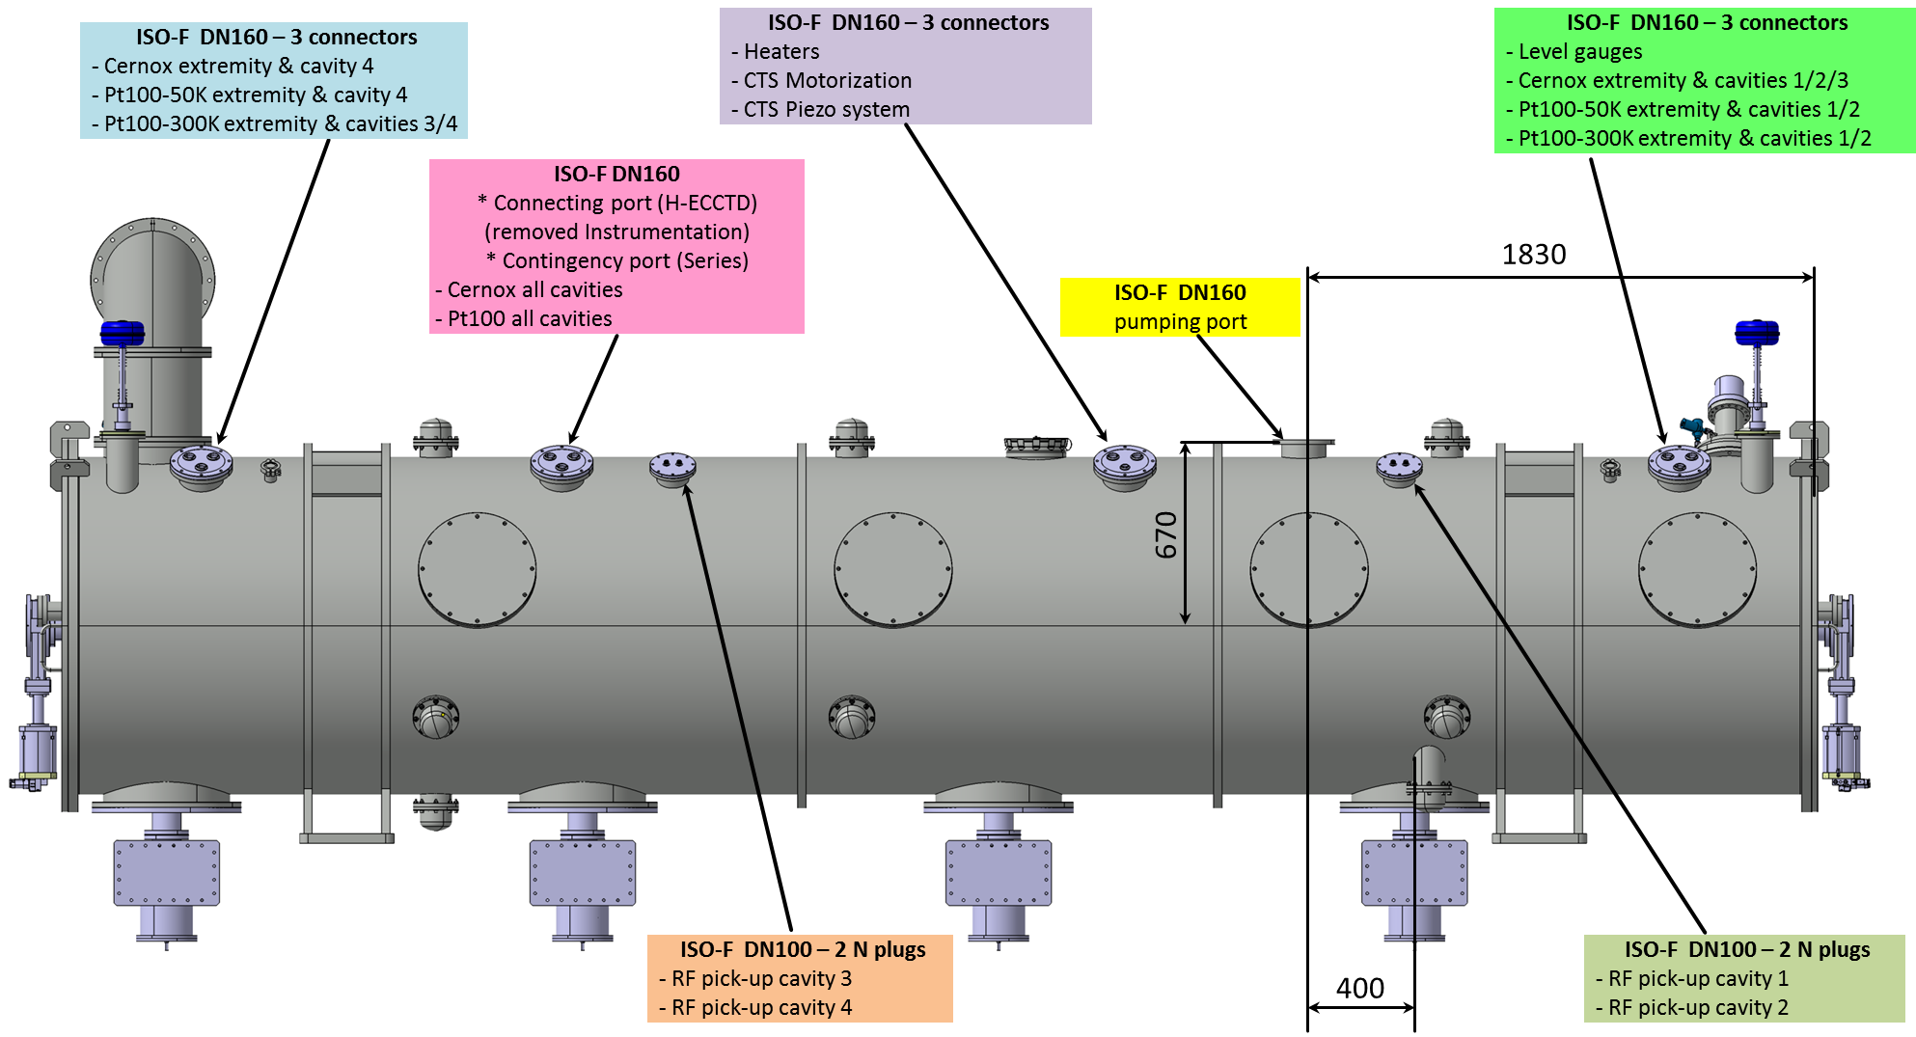

Pumping & connecting ports
Feedtroughs
LEMO Type HGP (vacuumtight)

Slide 32


Transportation additional links
Fastening of the jumper cryogenic pipes
To be removed:
Door knobs
Actuators
Others
Fastening of each cavity
(see previous slide)
A transportation test Saclay/Lund is foreseen in 2017 for the M-ECCTD
Fastening of the spaceframe on the vacuum vessel
(see previous slide)
Specified accelerations during
transportation (CEA) :
Axial (X): 2,5g
Transverse (Y): 2,5g
Vertical (Z): 2,5g
Fastening of the thermal shield
(2x4 positions)

Slide 33

transportation
For more information, see technical note:
"Cryomodule ESS – Analyse mécanique"
Modal analysis
Main modes | Frequency (Hz) | % load X | % Load Y | % Load Z
7 | 19,5 |  | 21,5
10 | 21,4 |  | 42
25 | 37,3 |  |  | 24,4
29 | 41,2 |  |  | 5,8
36 | 45 | 11,8
These values are high enough to avoid any activation during transportation
(>16Hz)

Slide 34



transportation
"Static" acceleration
Accelerations :
Axial (X): 5g
Transverse (Y): 1,5g
Vertical (Z): 3g
Von-Mises stress
 | X (axial) (Mpa) | Y (trans) (Mpa) | X (vert) (Mpa) | R_{p02} at 300K (Mpa)
Vacuum vessel | 44,9 | 41,3 | 45,7 | 210 (SS)
Thermal shield | 43,6 | 12,3 | 30,2 | 240 (Alu)
Space-frame | 35,8 | 24,9 | 48,6 | 240 (Alu)
Cryo. lines | 33,3 | 6,8 | 20,8 | 210 (SS)
Support. rods | 138 | 157 | 238 | 825 (TA6V)

Slide 35
Heat balance
For more information,
see technical note:
"ESS Cryomodule –
Global heat balance"
(IPN/EDMS-I036405)

Slide 36





Diphasic pipe
& jumper connection
JUMPER CONNECTION
Avoid any additional constraint other than the weight at the jumper VLP line connection in order to limit:
The stress at the connection between the diphasic pipe and the helium tank
The displacement of the first cavity
Additional flexible hoses in the jumper (vertical section on the valve box side)???
To be defined
Stress
Displacement

Slide 37
M-ecctd instrumentation
Instrumentation | Brand / Reference | Series. Comments & issues
Temperature gauge <10K | Cernox / CX-1050 | Concerns about resin radiation behaviour
Temp. gauge Pt100 >40K | Pyro-Controle
Pressure transmitters | MKS / 722B | Remote sensor (radiations)?
Level gauges | Cryomagnetics (L 623mm)
Rupture disk | Witzenmann / DN100
Safety valve 0,64bar (SV90) | Herose / 6850 | To be welded. Difficulties do find on the market
Controlled valve 0,5bar (CV91) | To be defined
Regulated valve (CV01, CV02) | Weka
Flexible heaters | Omega / KHLV
Heaters (cartridge, EH11/21/31/41) | Vulcanic / Vulstar 1004
Connectors | LEMO / HGP
Beam vacuum valves (CV80/81) | VAT / 48240 (DN100)
Insulation vacuum valve (CV71) | VAT / 10844 (DN160)
He purge valve (HV90) | VAT / 28424 DN16 + adapt.
Vacuum Pirani gauge | Pfeiffer / TPR018
Vacuum Penning gauge | Pfeiffer / IKR-070

Slide 38
ESS elliptical cryomodule
Fruitful collaboration between IPNO and CEA
Design performed in continuous collaboration
Cooperation to carry on for M-ECCTD assembly, H-ECCTD and series (Technical support and mechanical files follow-up)
As a whole, the supply of M-ECCTD components and sub-assemblies has gone well.
Some remaining design topics still to fix:
Helium collecting line
Jumper connection
Instrumentation

Slide 39
ESS elliptical cryomodule
Thank you for your attention

