Slide 1
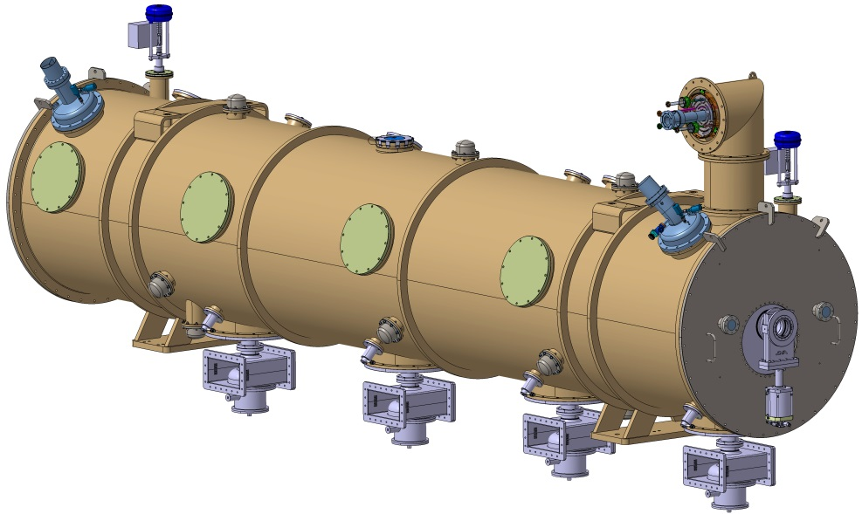
ESS elliptical cryomodule
ESS CRYOMODULE FOR ELLIPTICAL CAVITIES
Cryogenic architecture
Saclay April 3-4, 2017
Unité mixte de recherche
CNRS-IN2P3
Université Paris-Sud 11
91406 Orsay cedex
Tél. : +33 1 69 15 73 40
Fax : +33 1 69 15 64 70
http://ipnweb.in2p3.fr

Slide 2
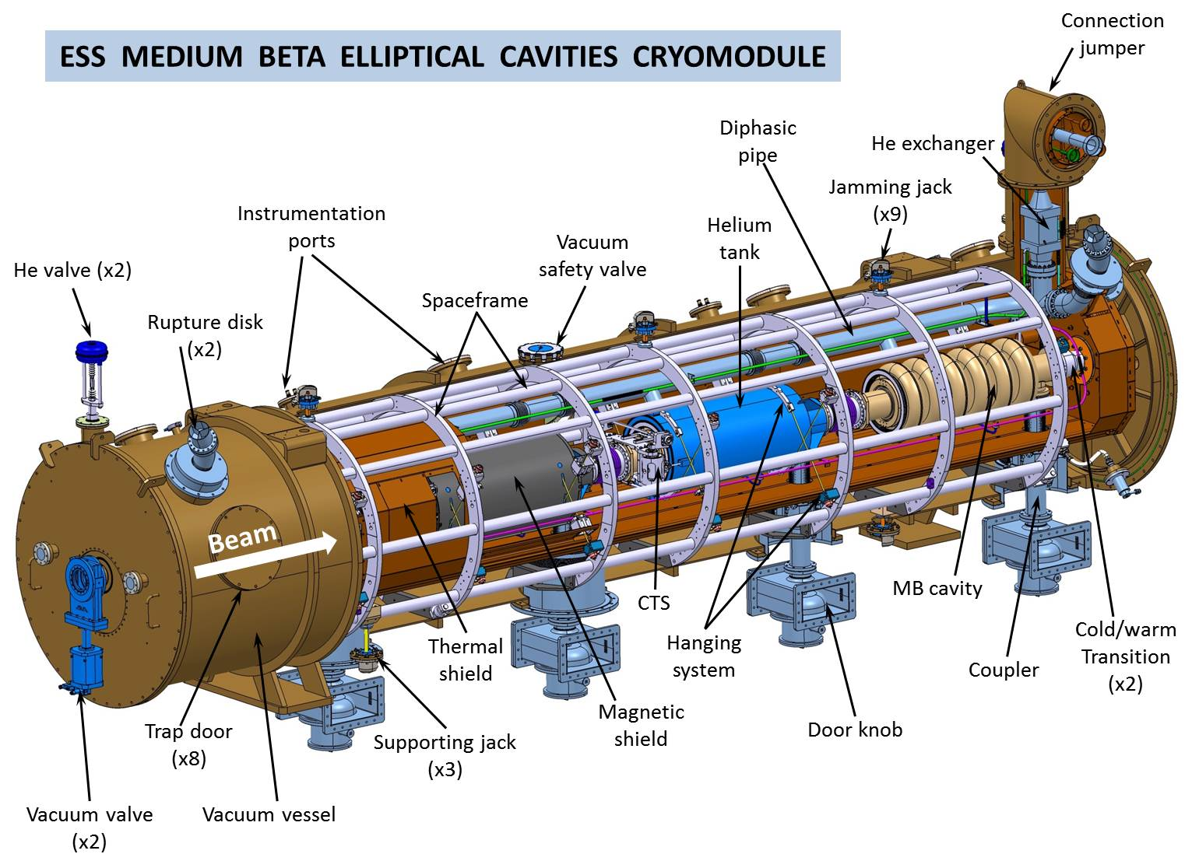
ESS elliptical cryomodule

Slide 3
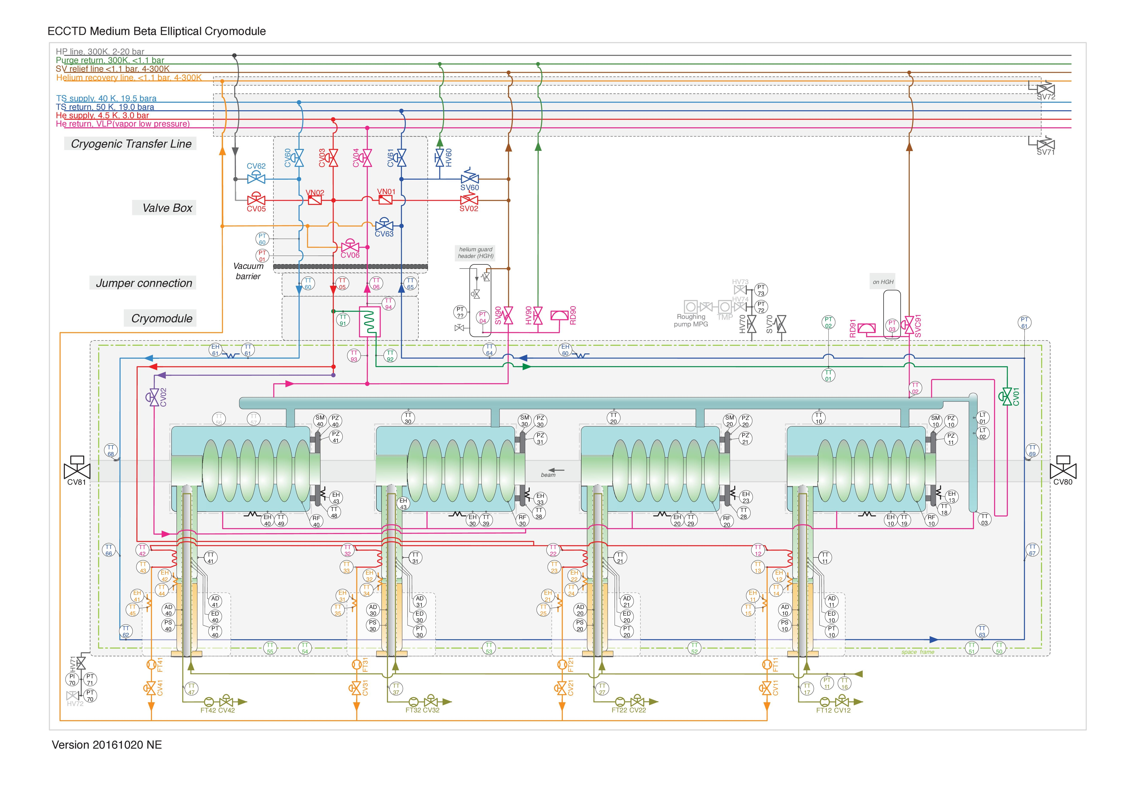
ESS elliptical cryomodule

Slide 4
ESS elliptical cryomodule

Slide 5

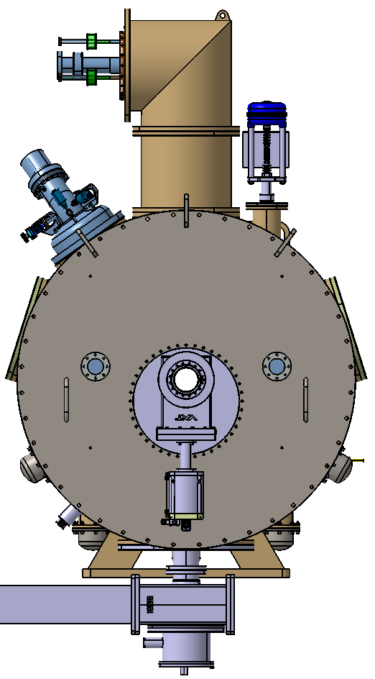
Cryogenic interfaces
Rupture disk
& safety valve
CV01
Jumper
connections
Vacuum safety valve
CV02
Rupture disk
& purge valve
He coupler outlet (x4)

Slide 6
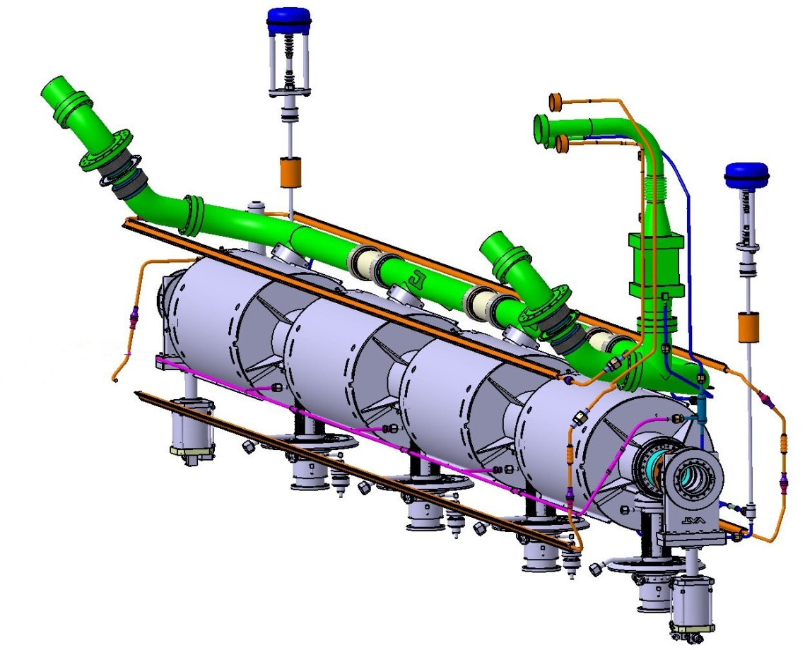
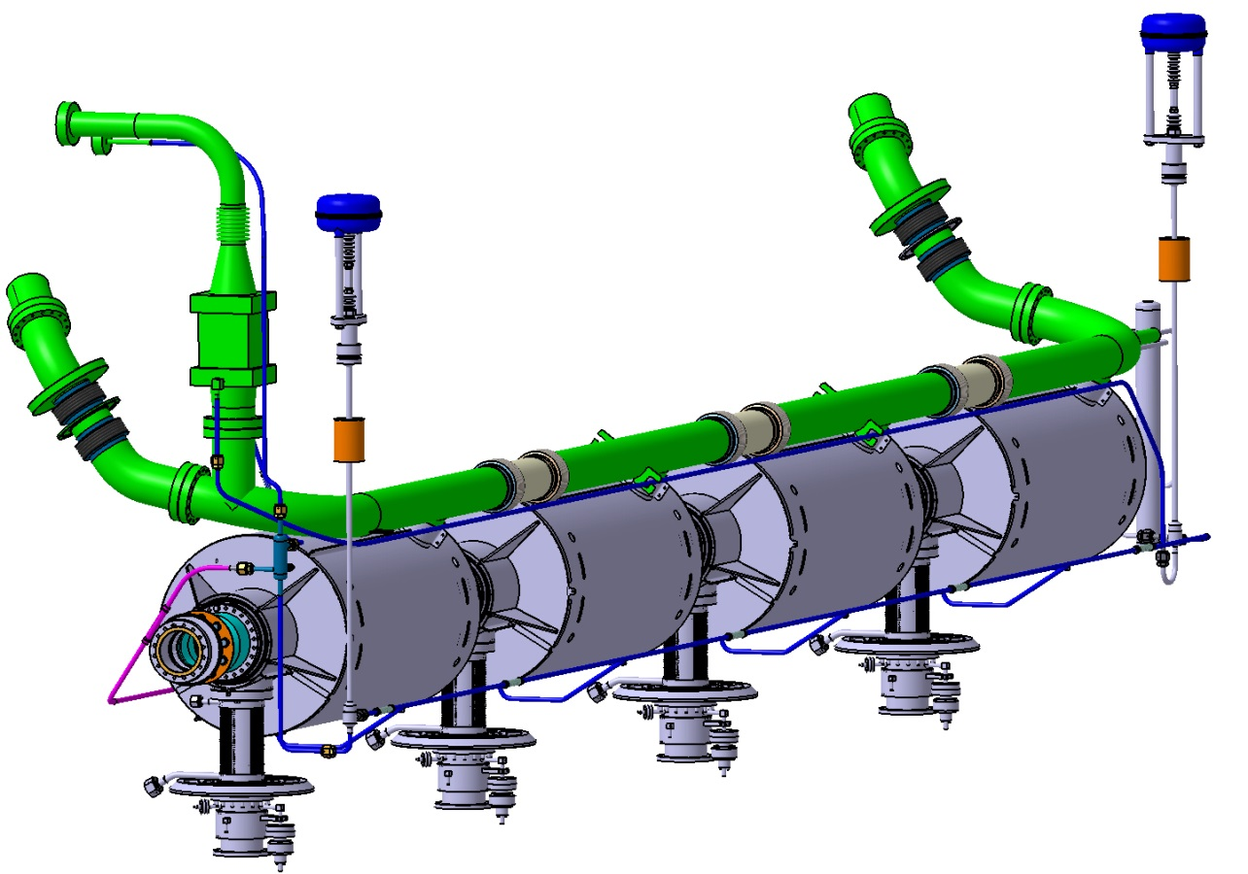
Cryogenic DISTRIBUTION
Rupture disk
& safety valve
Jumper VLP circuit
Helium subcooling heat Exchanger
JT valve
CV01
Rupture disk
& purge valve + pressure gauges
Cooling down valve (CV02)
Diphasic pipe
(27l)
Helium tank (48l)
Coupler circuit
Thermal shield circuit
Filling line
Cooling down circuit

Slide 7
Cryogenic DISTRIBUTION
Circuit | Temperature (K) | Pressure (bara) | Control valve | Safety device
Thermal shield filling | 40 - 50 | 19 - 19.5 | CV60 (Valve Box) | SV60 (24 barg)
Thermal shield He return | 40 - 50 | 19 - 19.5 | CV61 (Valve Box)
Helium inlet | 5.2 tbc | 3 | CV03 (Valve Box) | SV02 (3 barg)
Couplers | 5.2 tbc | 3
Cooling down | 4.5 | 0.029 - 1,43 | CV02 | RD90/RD91 (0.99 barg) CV91 (1.5 bara) SV90 (0.64 barg)
JT Filling | 2 - 4.5 | 0.029 - 1.43 | CV01
Low pressure GHe return | 2 | 0.029 - 1.43 | CV04 (Valve Box)
Vacuum | 300 K | 0 - 1 |  | SV70 (0.02 barg)

Slide 8
COOling down
Cold mass cool down phase
Mass of helium needed:
During this phase, the cryogenic equipments are cooled by use the enthalpy of the helium at 5.2 K tbc, 3 bara which is provided by the cryogenic plant.
The mass of cold helium required to cool the cold mass from 300 K to 4.5 K are:
Matériaux | Masse (kg) | kg SHe / kg matériau | SHe (kg)
Nb | 230 | 0.08 | 18.4
NbTi | 20 | 0.13 | 2.6
Ti | 160 | 0.13 | 20.8
Stainless Steel | 220 | 0.11 | 24.2
μmetal | 100 | 0.10 | 10.0
Total | 730 |  | 76.0

Slide 9
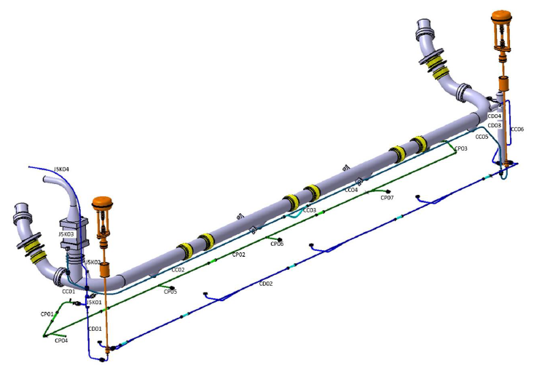
Cooling down
Mass flow rate: a cool-down time of 8 hours is reasonable, the minimum mass flow rate to cool the cold mass of 730 kg (76 kg of SHe) is 2.7 g/s
A design mass flow rate of 6 g/s is chosen:
to compensate the non perfect heat transfers,
to increase the mass flow rate close to 100 K.
New design design with Ø5 mm cavities inlet
- applied to the quarter of the flow
- helps equal flow repartition
- adds starting delay
- <20 mbar additional
pressure drop once cold

Slide 10
Cooling down
Thermal shield cool down phase
Mass of helium needed
The mass of cold helium required to cool the thermal shield from 300 K to 40 K are :
Matériaux | Masse (kg) | kg SHe / kg matériaux | SHe (kg)
Al | 120 | 0.33 | 39.6
Stainless Steel | 20 | 0.19 | 3.8
Total | 140 |  | 43.4
Mass flow rate: a cool-down time of 4 hours is reasonable, the minimum mass flow rate to cool the thermal shield of 140 kg (43.4 kg of SHe) is 3 g/s
A design mass flow rate of 6 g/s is chosen to compensate the non perfect heat transfers.

Slide 11
Heat loads
Static heat loads
Estimated heat loads are:
 | 2 K Heat load (W) | Thermal shield heat loads (W)
Conduction through cold to warm transitions | 2 | 3
Conduction through supporting | 0.65 | 6,2
Conduction of safety organs pipes | 0.38 | 4,1
Radiation (10 layers and 30 layers MLI) | 0.7 | 31.5
Couplers conduction (with cooling flow) | 4
Couplers radiation | 2,8
Instrumentation | 2,7 | 1,5
Total static heat loads | 13,3 | 46
If the power couplers are not gas cooled, conduction heat load rises from 1 to 15 W for each power coupler

Slide 12
Heat loads
Summary of heat loads
 | Heat load (W) | Temperature (K) | Pressure (bar) | Mass flow (g/s)
Thermal shield | 46 | 40 - 50 | 19.5 - 19 | 0.85
Couplers |  | 5 - 280 | 3 | 4 x 0.023
2 K static | 13,3 | 2.0 | 0.031 | 0.6
2 K dynamic | 23.3 | 2.0 | 0.031 | 1.1
2 K dynamic + static | 37 | 2.0 | 0.031 | 1.7
(High beta CM) | 41 | 2.0 | 0.031 | 1.8
The static + dynamic heat loads define the helium nominal mass flow rate in normal operation
15% additional mass flow rate are needed for 2 K heat loads due to liquefaction ratio after the JT valve

Slide 13
Cryogenic DISTRIBUTION
Size of the control valves
Flow coefficient kv is determined taking in account the flow conditions (inlet and outlet pressure, temperature, …) and it allows to reach and regulate the mass flow rate defined for the cool-down or/and for the normal operation.
 | Name | m_{mini} (g/s) | m_{Maxi} (g/s) | P_{up} (bara) | P_{down} (bara) | DN | PN | Kv max
JT valve | CV01 | 0.4 - 2.7 | 4.5 tbc | 2.5 tbc | 0.03 | 6 | 10 | 0.2
He cool down | CV02 | 0.5 - 2 | 6 | 3 | 1.4 | 6 | 10 | 0.8
Saclay test |  |  |  | 1.2 | 1.15 |  |  | 5
Thermal shield (ESS) | CV60 | 0.85 | 6 | 19.5 | 19 | 6 | 25 | 0.2
An additional CV02 valve seat is required for cooling in the Saclay test facility
Rad-hard material:
Valves seats in vespel, PEEK or equivalent
Metallic or EPDM joints, stainless steel tubing
Rad-hard positioner SIEMENS Sipart PS2 6DR5910-0NG00-0AA0
Remote electronic control SIEMENS Sipart PS2 A5E0025050x provided by ESS

Slide 14
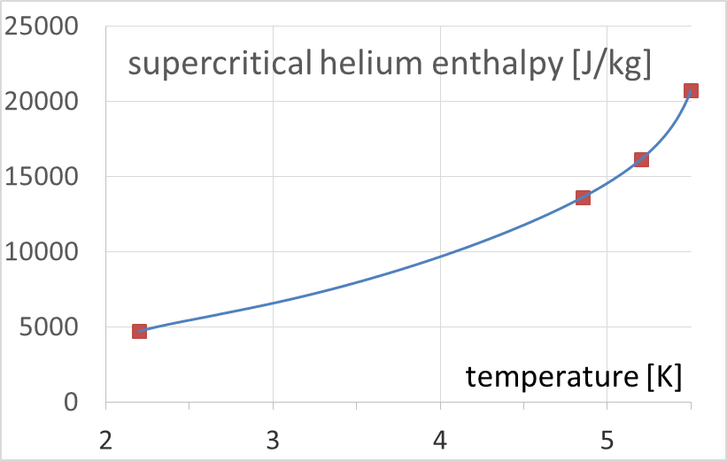
Cryogenic DISTRIBUTION
Subcooling heat exchanger
To improve the efficiency of the isenthalpic expansion produced by the JT valve, a heat exchanger is used to subcool at 2.2 K the helium supplied by the cryoplant (3 bara and 4.85 K expected, guaranteed <5.5 K by requirement 2170).
CM heat load margin
Mass flow rate (g/s) | 2 | 3.2 | 4.5
W (4.85 K) | 17.8 | 28.5 | 40.1
W (5.2 K) | 22.9 | 36.6 | 51.4
W (5.5 K) | 32.0 | 51.3 | 72.1
CDS heat load margin

Slide 15
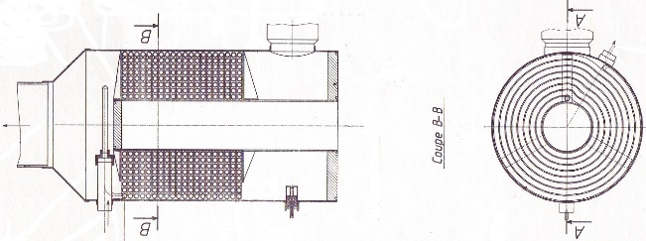
Cryogenic DISTRIBUTION
Subcooling heat exchanger
Heat exchanger prototype caracteristics
Main constraint: the pressure drop in the low pressure branch must be <1 mbar.
 | HP branch | LP branch
m_{mini} (g/s) | 0.5
m_{maxi} (g/s) | 4.5 tbc
T_{inlet} (K) | 5.2 tbc | 1,9 - 2
T_{outlet} (K) | 2.2 | -
P_{inlet} (bara) | 3
P_{outlet} (mbara) |  | 29 - 30
ΔP_{maxi} (mbar) | 1000 | 1
The heat exchanger is placed in the jumper
The volume and mass should be minimised to ease assembly, possibly by using Hampson HX geometry

Slide 16
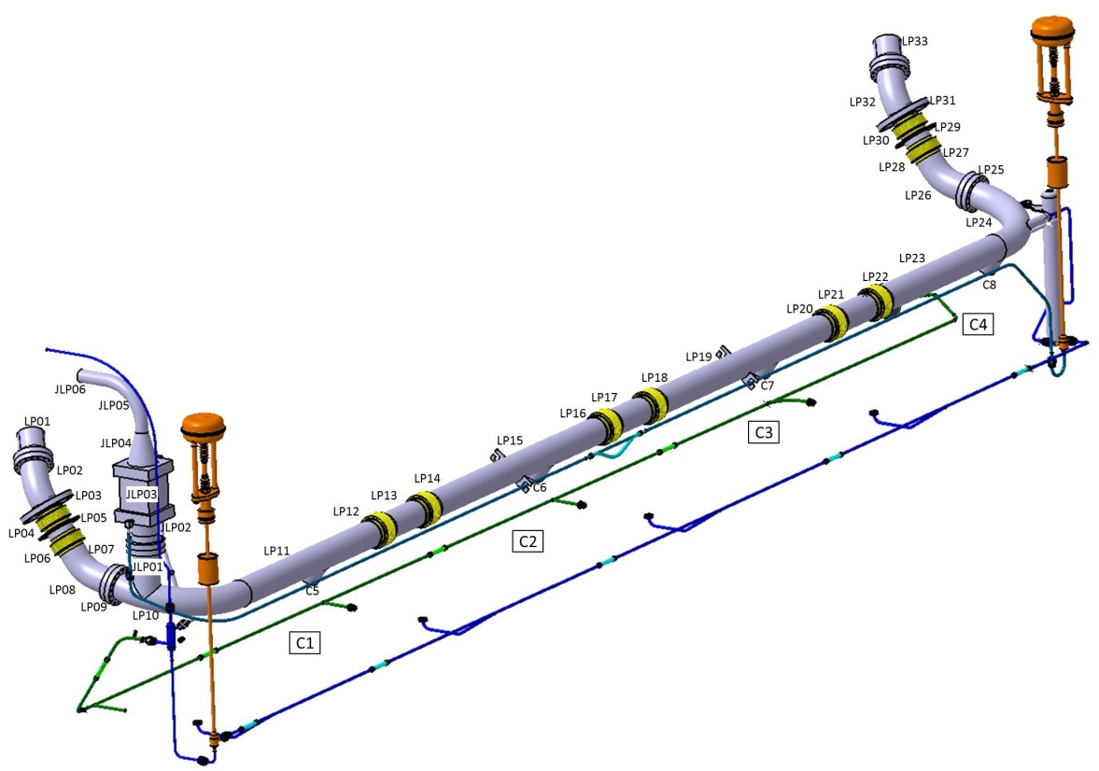
Pressure equipment directive
Breakdown of each circuit in elementary sections to check the product PS x V or PS x D and the compliance to the Pressure Equipment Directive.
Each section is considered as a separate vessel or a separate pipe.
article 4.3, fluid group 2
⇒PS x V < 50 bar.l
⇒ D > 32 mm & PS x D < 1000 bar.mm
  Manufacturing strategy:
    All components of the cryomodule must be in the category defined by the article 4, paragraph 3 of the PED 2014/68

Slide 17
Pressure equipment directive
Vessel
PS = 1.04 barg
1.04
48
Aim:
remain in 4.3 category
of PED/2014/68
Volume of the largest circuit vessel: the cavity helium tank

Slide 18
SAFETY STRATEGY FOR THE LOW PRESSURE CIRCUITS
  Operating constraints:
    maximal allowable pressure of cavities is 2.04 bars,
    pressure required by the cryogenic plant is 1.43 bar,
    1.43 bar is close of the opening pressure of the safety valves, the pressure margin between the operating pressure and safety device is low.
    burst disks are connected to a helium collector line (p_{line}>p_{atmospheric})
  Safety strategy:
    Two burst disks (RD90 – RD91) designed for accidental scenarios,
    safety valve (SV90) designed for abnormal operation and to avoid the bursting of RD90 or RD91,
    control valve (CV90) designed to limit the pressure at a level lower than the opening pressure of SV90.

Slide 19
Safety devices operating range
ABSOLUTE PRESSURE
GAUGE PRESSURE
P_{max} = 2.14 bar
Maximum pressure = 1.1 PS = 1.14 barg
2.04 bar
PS = MAWP = 1.04 barg
Rupture disk outlet
to the atmosphere
at 1 bara
Bursting area of the rupture disk
Bursting pressure = 0.99 barg ±0.05bar
1.94 bar
0.94 barg
Pressure margin ~ 0.2 bar
1.74 bar
Max. pressure when the relief valve is open: 1.1 x 0.67 ~ 0.74 barg
Opening area
of the
relief valve
1.05 P_{set} ~ 0.67 barg
Safety valve outlet
to SV relief line
at 1 bara
Set pressure = 0.64 barg ± 5%
0.95 P_{set} ~ 0.61 barg
1.55 bar
Min. pressure to allow the closing of the relief valve:
0.9 x 0.61 ~ 0.55 barg
1.5 bar
PLC Control valve ~ 0.5 barg
1.43 bar
Min./Max. operating pressure of the cryogenic plant:
~ 0.43 barg
Operating pressure area
30 mbar
Pressure operation at 2K

Slide 20
Safety devices operating range
ABSOLUTE PRESSURE
GAUGE PRESSURE
P_{max} = 2.14 bar
Maximum pressure = 1.1 PS = 1.14 barg
2.04 bar
PS = MAWP = 1.04 barg
Rupture disk outlet
to the atmosphere
at 1 bara
Bursting area of the rupture disk
Bursting pressure = 0.99 barg ±0.05bar
1.94 bar
0.94 barg
Pressure margin ~ 0.1 bar
1.84 bar
Max. pressure when the relief valve is open: 1.1 x 0.67 ~ 0.74 barg (% outlet circuit)
Opening area
of the
relief valve
1.05 P_{set} ~ 0.67 barg (% outlet circuit)
Safety valve outlet
to SV relief line
at 1.1 bara
Set pressure = 0.64 barg ± 5% (% outlet circuit)
0.95 P_{set} ~ 0.61 barg (% outlet circuit)
1.65 bar
Min. pressure to allow the closing of the relief valve:
0.9 x 0.61 ~ 0.55 barg (% outlet circuit)
1.5 bar
PLC Control valve ~ 0.5 barg
1.43 bar
Min./Max. operating pressure of the cryogenic plant:
~ 0.43 barg
Operating pressure area
30 mbar
Pressure operation at 2K

Slide 21
Thermal shield: Safety devices
Minimum flow section (mm²) | Set pressure (barg)
34 | 24
  Most critical scenario: loss of insulation vacuum
    air condensates on the thermal shield surface covered with 30 layers MLI
    considered heat power density : 1.5 kW/m²
    thermal shield (~24 m²): 36 kW
    helium mass flow : 0.1 kg/s (25 bara, 66 K)
Diameter of relief valve SV60 : 10 mm

Slide 22
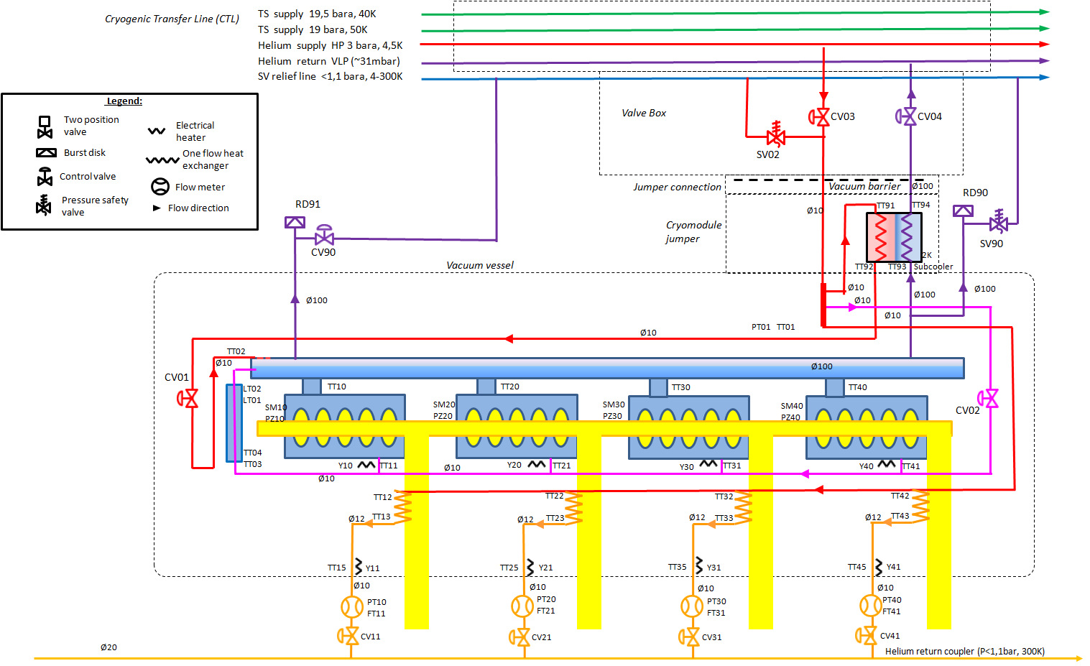
COOL DOWN AND COUPLER CIRCUITS: Safety devices
  A relief valve SV90 associated with a control valve CV90 (1.5 bara)
Minimum flow section (mm²) | Set pressure (barg)
340 | 0.64
  Most critical scenario: valves malfunction
    HP He supply: 3 bara, 5.2 K tbc
    Valves CV01, CV02, CV03 fully opened (at kv max)
    Valve CV04 closed
    helium mass flow : 0.104 kg/s (1.74 bara, 4.85 K)
Diameter of relief valve SV90 : 25 mm
kv of CV 90 : 9

Slide 23
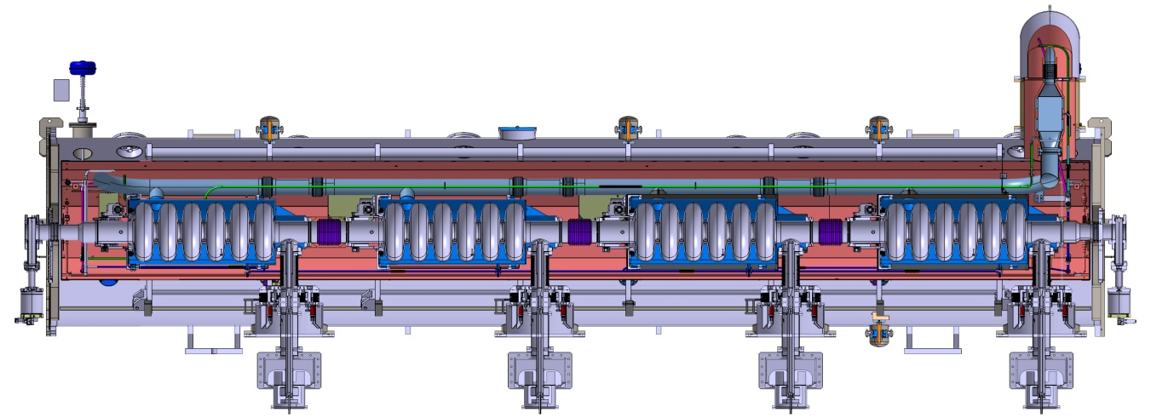
VACUUM VESSEL: Safety devices
Minimum flow section (mm²) | Set pressure (barg)
11200 | 0.02
  Most critical scenario: Rupture of 2 K phase separator
    liquid helium fills the vacuum vessel
    helium passes through the holes of the thermal shield
    liquid helium mass : 30 kg
    Volume of vessel : 6.3 m³
    helium mass flow : 4.1 kg/s (1.04 bara, 4.76 K)
Diameter of relief plate SV70 : 200 mm

Slide 24
2 K vessel: Safety devices
Failure scenarios
scenarios | Circuit | Area (m²) | heat flux (kW/m²) | Heat load (kW) | Mass flow (kg/s)
Failure of the insulation vacuum | Helium vessel | 4 x 1.53 | 6.2 (10 MLI layers) | 38 | 2
Failure of the beam vacuum | Cavity | 4 x 1.81 | 38 (air on cavity wall) | 275 | 14.5
Failure of insulation and beam vacuum | Vessel + cavity |  |  | 312 | 16.4
7.25 kg/s per bursting disk
Most critical
reference for the sizing of the safety devices
Not credible
Minimum rupture disk diameter: 88 mm
Maximum He volume to be evacuated: 220 l
(21.5 kg at 2 K, diphasic pipe half filled)
The maximum helium mass flow rate is defined for a maximum helium collector pressure < 1.9 bara

Slide 25
SUMMARY 1/2
  The cryogenic study is achieved.
  Pressure safety rules are met
  Safety organs are dimensioned.
  - 2 burst discs protect the He vessels
  - The outlet of the burst disks is connected to a helium collector.
  - The pressure margin between the burst disks and safety valves is low (100 to 200 mbar).
Name | Minimum flow section (mm²) | Practical diameter (mm) | Set pressure (barg)
SV60 | 34 | 10 | 24
SV02 | 34 | 10 | 3
SV90 | 340 | 25 | 0.64
CV90 | kv > 9 | 25 | 1.5 bara
RD90 - RD91 | 5300 | 100 | 0.99
SV70 | 11200 | 200 | 0.02
  Heat loads are detailed
  - Manufacturing recommendations are given to meet design heat loads
  Operation scenarios have been checked

Slide 26
SUMMARY 2/2
  Pressure drop and flow distribution is calculated
  Control valves are dimensioned
 | Name | m_{mini} (g/s) | m_{Maxi} (g/s) | P_{up} (bara) | P_{down} (bara) | DN | PN | kv
JT valve | CV01 | 2.3 | 4.5 | 3 | 0.03 | 6 | 10 | 0.2
He cool down | CV02 | 2.7 | 6 | 3 | 1.4 | 6 | 10 | 0.8
He main supply | CV03 | 2.7 | 6 | 3 | 1.4 | 10 | 25 | 2.8
GHe return | CV04 | 2.7 | 6 | 3 | 1.4 | 50 | 25 | 71
Thermal Shield | CV60 | 1.4 | 6 | 19.5 | 19 | 6 | 25 | 0.8
Installed inside the cryomodule
Installed inside the valve box
  - JT and cooling valve are inside the CM, other cryogenic valves in the valve box,
  - All valve are closed as default position except for CV04 and CV61 return valves.
  The subcooling heat exchanger is located inside the jumper and dimensioned for ~50 W. Design pair of mass flow rate and temperature margin should be approved by ESS.

Slide 27
ESS elliptical cryomodule
Thank you for your attention

