Slide 1
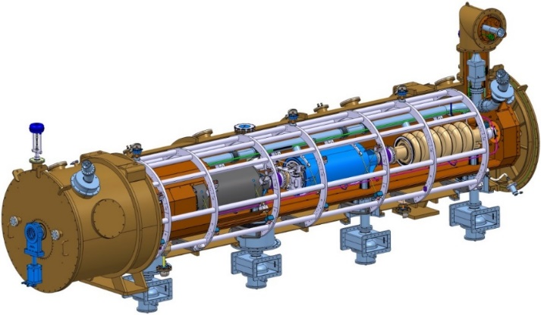
Quality assurance and Quality control organisation
Cryomodule CDR 1 | Anaïs Bruniquel & Christelle Cloué
Cryomodules WP

Slide 2
CONTENT
Quality Assurance
  Quality organisation P.04
  Document management P.05
  Non Conformity management P.10
Quality Control
  PBS management P.13
  Quality requirements during manufacturing phase P.14
  Quality control steps – acceptance levels P.15

Slide 3
quality ASSURANCE
- document management
ESS-I project (at CEA) from CEA to ESS
- non-conformity management

Slide 4




Quality Assurance - 1/7
Quality organisation
ESS-I project
PMO
System Engineering & Configuration Management Oficer
Vincent Hennion
Product Assurance Officer (PAO)
Christelle Cloué
ESS-I
Diagnostics
WP
ESS-I
Control system
WP
ESS-I
RFQ
WP
ESS-I
Cryomodules
WP
Quality engineer
Quality engineer
Apply QA/QC organisation in the WP
Define QA/QC specifications for cryomodules
Louise Napoly
Anaïs Bruniquel
Notes:
There is a product Assurance officer who defines the quality assurance and quality control organisation for the ESS-I project (all deliverables of the ESS-I project).
In the cryomodules Worpackage, the quality engineers apply this organisation and define QA/QC specifications for the cryomodules (components manufacturing).
NB : (dire qu’il y a un travail d’échanges entre tous ces acteurs pour harmoniser les pratiques et valoriser le retour d’experiences).

Slide 5
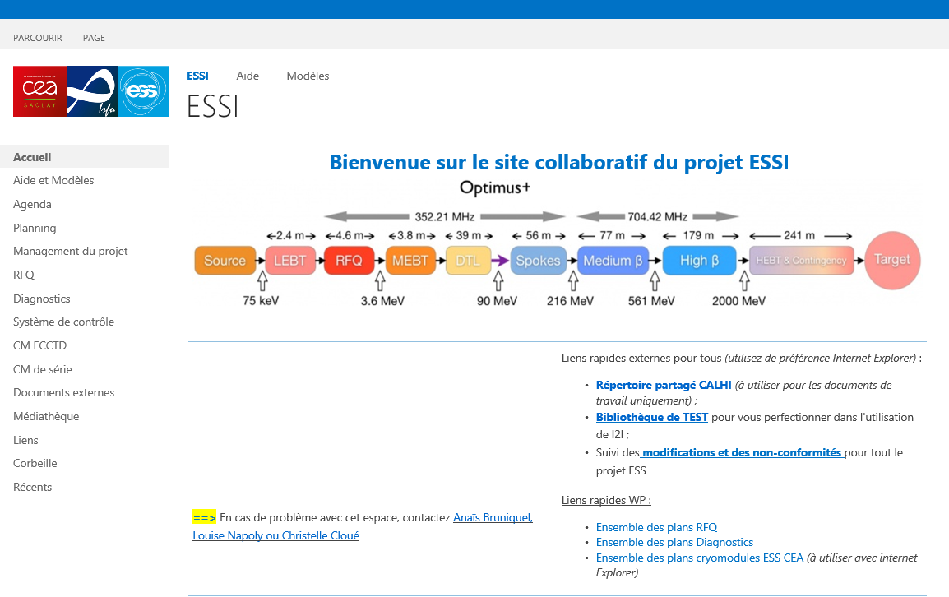


Quality assurance - 2/7 documentation at cea
Document management system : i2i
  I2I system is used to identify, store and classify all the document of the ESSI project and ESSI WPs:
      Project documents,
      Design documents,
      Manufacturing documents,
      Test and assembly results.
  I2I system is for internal use of CEA only
  ➔ The tool is in french.
Identification
  Identification of CEA document (excluded the CAD drawings);
  Chronological number attributed by i2i system.
CEA Workpackage
(CMD / CMS)
Issuer
Project
Type of doc.
Chronological number
Edition
(1.0, 2.0, …)
CMD : prototype cryomodule
CMS : serial cryomodule
Notes:
For managing documents, we use a tool which permit to identify, store and classify all the document of the project such as : project documents, design documents, manufacturing documents, tests and assembly results.

Slide 6
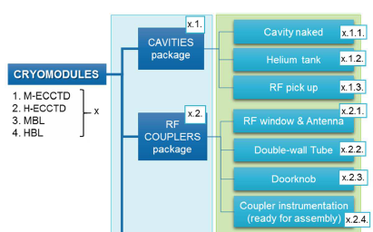
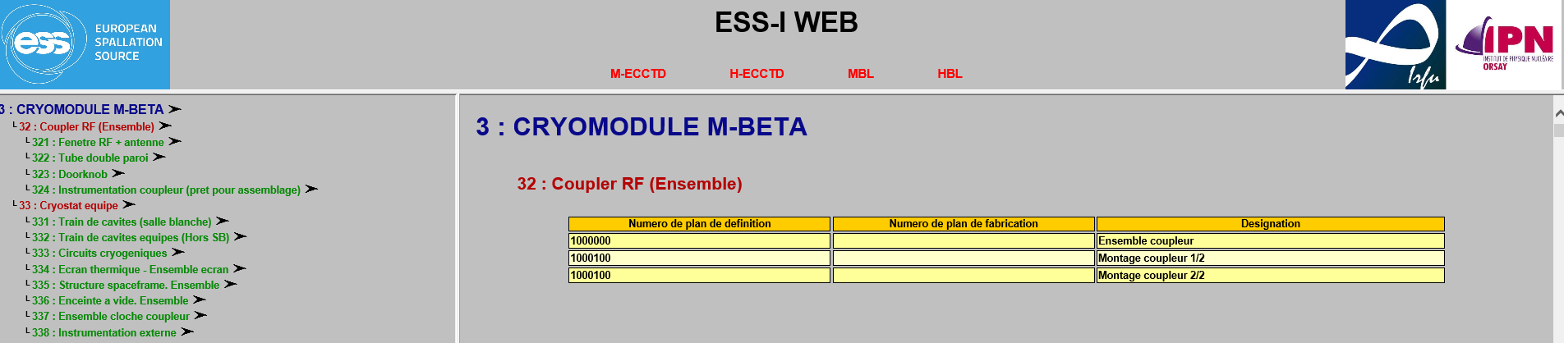
Quality assurance - 3/7 documentation at cea
CAD drawings
  CEA and IPNO CAD drawings are compiled in a CEA web application;
  This software is organized according to the PBS (product breakdown structure) for each cryomodule type;
  The latest version of the CAD drawings is available in this software.
  System integration of the CATIA mock-up from CEA and from IPNO merged
Notes:
The CAD drawings come from 2 instituts. So in order to have a global vision of the design of each cryomodule, we developpe a web application based on the PBS. The lastest version …

Slide 7
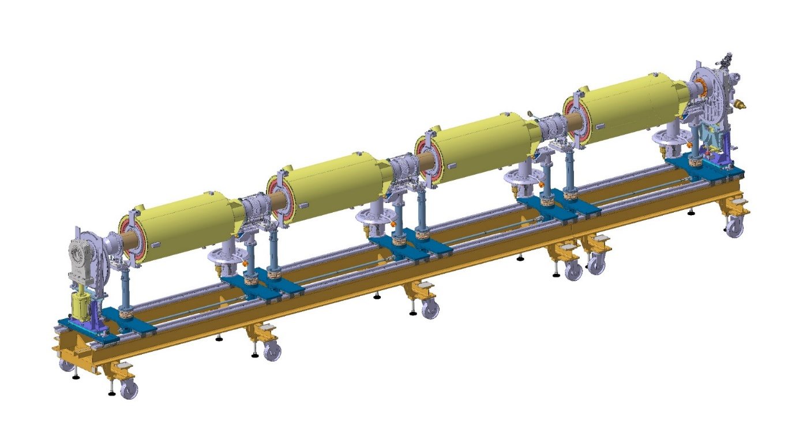
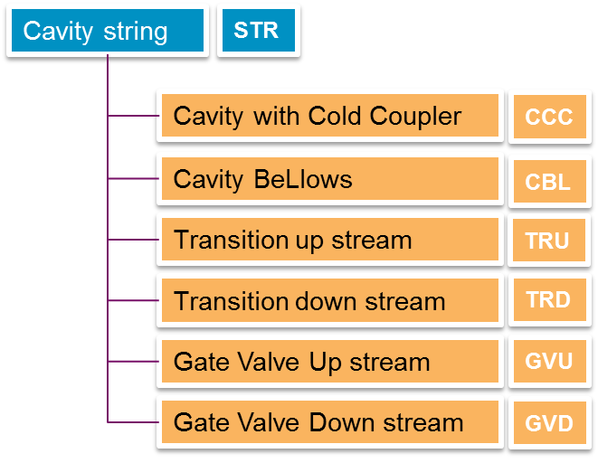
Quality assurance - 4/7 documentation from cea to ESS
Classification of the document in CHESS system
  Definition of a documentation organisation as a tree, during the cryomodules assembly process.
Notes:
For the documents delivered to ESS, a documentation structure is defined to classify documents in CHESS system. This structure is based on the cryomodule assembly process. At the end of the workstation, you have a new assembly and a set of documents associated to this assembly.

Slide 8
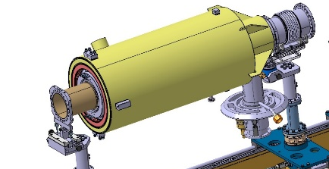
Quality assurance - 5/7 documentation from CEA to ESS
Naming convention of ESS
  Name of files to be recorded in
  CHESS System
Title
Date
 |  |  | - |  |  |  | - |  |  |  | - |  |  |  | - |  | _
Cryomodule type
(MBL or HBL)
Component or assembly
Document type
Serial number
(of the component or the assembly)
Components examples
CAV: cavity
COU: coupler
SPF: spaceframe
Examples
TRP: Verification/test report
TRA: Traveler
CFG: configuration report
Assembly corresponds to the output element of a workstation
Assembly examples
CCC: Cavity with Cold Coupler
SPA: spaceframe assembly (thermal shield with spaceframe)
Assembly report of the coupler-cavity assembly # 3
MBL-CCC-003-TRP-Assembly_170213
Notes:
With this documentation structure, there is a naming convention about the file exchanged between CEA and ESS. So, the naming of the file includes « Cryomodule type », « component or assembly » concerned, it serial number, « the document type », a title and the date of the operation.
For example, you can see an assembly report for the coupler / cavity number 3

Slide 9
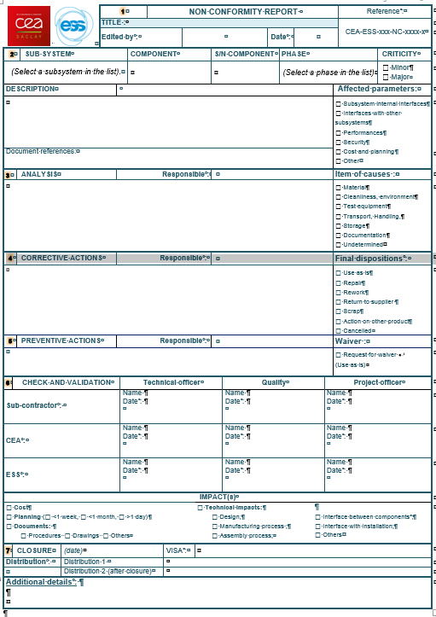
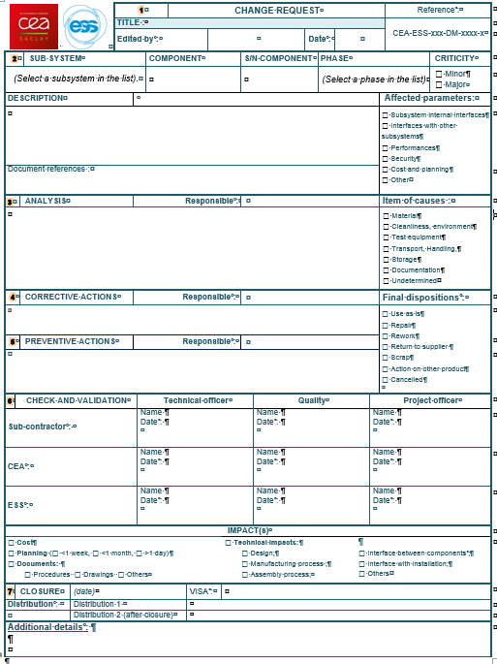
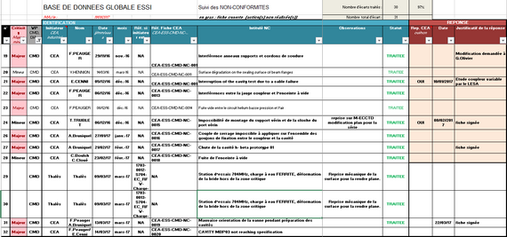
QUALITY assurance - 6/7
Non-conformity & change request
Method & tool
  Procedure of non-conformity management ➔ CEA-ESS-PJT-AQ-0004;
  Forms : Non-conformity (NC) report and Change request (CR);
  Spreadsheet to follow NC and change requests
  from CEA or from suppliers.
Notes:
When there is a deviation from the requirements, we apply a procedure of … and use two types of forms. A spreadsheet enable the follow up on all deviation however from CEA or suppliers

Slide 10
QUALITY assurance - 7/7
Non-conformity & change request
Detect and record the deviation
L2 : NCR or CR that will affect interfaces, safety, lifetime, performances, functional requirements with an impact at ESS level.
After corrective actions, the item is compliant to all specified requirements.
Actions implemented after the CEA approval.
L3 : NCR or CR that will affect interfaces, safety, lifetime, performances, functional requirements with an impact at ESS level.
Actions implemented after the ESS approval.
L1 : NCR or CR that will affect internal interfaces, performances and functional requirements without impact at the ESS level.
(CEA responsibility)
Deviation classification
L1
Not L1
but L2 or L3
List of level 2 NCR/CR sent to ESS every two months
CEA PMO & WP
Define a process to manage deviations between CEA and ESS
Analyse the root causes
and the consequences
Propose corrective and preventive actions
CEA WP
Impact at higher level
Analyse the root causes and the consequences / Validate the corrective and preventive actions
L2
L3
ESS - CEA
Analyse the root causes and the consequences / Validate the corrective and preventive actions
Implement the actions
Check the actions
Close the report
Notes:
The procedure of non-conformity and change request classifies the deviation in 3 levels. The first and second level are defined as minor deviations. The third level corresponds to the major deviation.
According to these levels, the way in the procedure is not the same.
The first level corresponds to a deviation that will affect interfaces, performances and functional requirements WITHOUT impact at the ESS Level. For this L1, for example a screw with dimensions which is not allowed the assembly. The way is like this. The corrective action could be changing the screw type.
The second level corresponds to a deviation that will affect interfaces, safety, etc. WITH an impact at the ESS level but after implementation of corrective action, the deviation is compliant. For example, a motor of tuning system isn’t operating and after the switch of a new motor, the system is ok and compliant with the functional requirements. So, the way for this level is like this.
The third and final level corresponds to the deviation that will affect the same thing that the second level but there is a necessity to have the ESS approval to implement actions. It could be a coupler according to the ESS specifications. So, the way to process these deviations is like this.

Slide 11
Quality control
(component manufacturing phase)
- PBS management
- quality requirements during manufacturing
- Quality control steps : Acceptance levels by cea

Slide 12
Quality control - 1/3
PBS – product Breakdown Structure
to specify the drawing reference and version applied during the manufacturing phase (for each cryomodule type).
= Reference configuration
« Product Breakdown Structure table »
to identify the deliverables of each market / each contract with manufacturer
to identify components according to the ESS-I and ESS naming convention
A PBS table review is organized on a monthly basis.
Notes:
To have a baseline as an input for the different operations (such as the component manufacturing), we use a PBS table. PBS for Product breakdown structure. It is used to… to…. And to ….
A PBS table review is organized on a monthly basis.

Slide 13
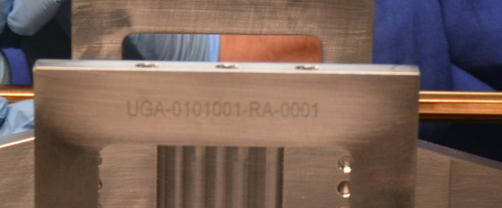

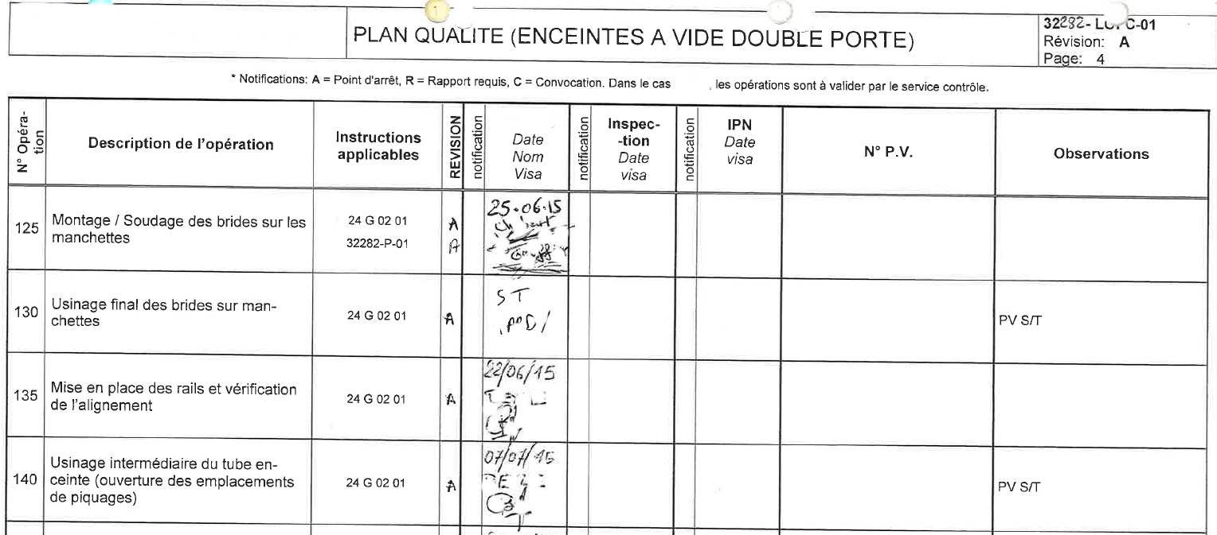
Quality control - 2/3
Quality requirements
Quality requirements for the component manufacturing :
  Identification and labelling of
  each component which is under the
  responsability of CEA;
  Application of ISO 9001;
  Manufacturing quality plan;
  Application of manufacturing and materials
  standards
U
G
A
0
1
0
1
0
0
1
R
A
0
0
0
1
Purchaser
Supplier
Drawing reference
Deliverable
Edition
Serial number
The quality requirements are included in the technical specifications
A tuning system for M-ECCTD
Notes:
During the manufacturing phase, we specify quality requirements such as Identification,… application of ISO … and the ….
All these requirements are included in the technical specifications.

Slide 14
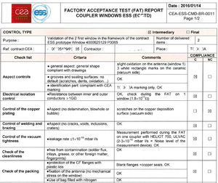
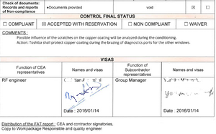
Quality control - 3/3
Acceptance levels
Quality control during manufacturing phase
Controls
& Tests
Factory acceptance test
Site acceptance test
Manufacturing operation
Ready for assembly
(After ESS Acceptance – System Acceptance Review)
Responsibility
manufacturer
manufacturer & CEA
CEA
According to the CEA technical specifications and the validation of the quality plan of the manufacturer
Visual inspection
Leak test
Dimensional control
Documentation check
Etc.
Visual inspection
Leak test
Dimensional control
Etc.
Control types
Manufacturer folder (tests & controls reports, etc.)
Factory acceptance test report
Site acceptance test report
Traceability of controls and acceptance
Manufacturer
Manufacturer
CEA
Manufacturer
CEA
Notes:
To ensure that the manufactured product is compliant, there are at least 3 acceptance levels. The first corresponds to the controls and tests realised by the manufacturer and according to the technical specifications form CEA. These controls results are formalised in different reports.
At the end of the manufacturing, when the component is ready to deliver to Saclay, the manufacturer and the CEA organise a Factory acceptance test which includes different tests such as visual inspection, documentation check. A report of this factory formalises the results or the acceptance by CEA to deliver the component to Saclay.
When the component is received at CEA Saclay, there is a reception control called Site acceptance test. There is a report about this, too.
Then, after ESS Acceptance, the component is ready for assembly. It is necessary to define this acceptance system.

Slide 15
QA – QC - Summary
NC/CR
Industry
Requirements (CEA&ESS)
CEA
Manufacturing, tests and controls
Component production data // Manufacturing folder
Tests, component preparation, assembly, shipment
Documents for component acceptance
Documents for cryomodule acceptance
To manage and ensure the compliance with the requirements
Requirements
(ESS)
NC/CR
Quality assurance & Quality control
ESS
CHESS
DOORS
Notes:
If we represent the global system to deliver the cryomodules, you can see the different entities implicated in this system and the different flows (information, materials…).
The quality assurance and quality control is defined to manage and ensure the compliance with the requirements : the ESS requirements and CEA requirements during the differents steps before the cryomodules delivery.
The quality team contributes to the activities management at CEA Saclay and participates regularly in the technical operations : with for example, the worksite meeting on Mondays and the industrial visits for the FAT.

Slide 16
Thank you for your attention

Slide 17
DSM
Irfu
Commissariat à l’énergie atomique et aux énergies alternatives
Centre de Saclay | 91191 Gif-sur-Yvette Cedex
T. +33 (0)1 69 08 xx xx | F. +33 (0)1 69 08 99 89
  Etablissement public à caractère industriel et commercial | RCS Paris B 775 685 019

Slide 18


Quality Assurance - / documentation at cea
How to manage the documentation
ESS-I documents
Managed in CEA Data Management System (i2i)
Manufacturing documents (from manufacturers)
CAD drawings from CEA and IPNO mechanical design offices
Document delivered to ESS
Managed with an internal web application (from CEA)
Managed with CHESS

Slide 19
Classification of the NCR / Cr
L1 : NCR or CR that will affect internal interfaces, performances and functional requirements without an impact at the ESS level.
Actions implemented after the CEA approval.
L2 : NCR or CR that will affect interfaces, safety, lifetime, performances, functional requirements with an impact at ESS level.
After corrective actions, the item is compliant to all specified requirements.
Actions implemented after the CEA approval.
List of level 2 NCR/CR sent to ESS every two months
L3 : NCR or CR that will affect interfaces, safety, lifetime, performances, functional requirements with an impact at ESS level.
Actions implemented after the ESS approval.
Define a process to manage deviations between CEA and ESS

