Slide 1
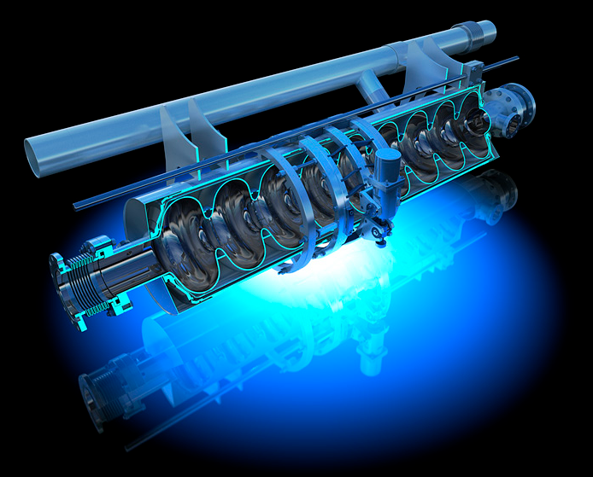
R&D for Thermal Mapping with Transition Edge Sensors for SRF cavity testing
Hernán Furci,
Giovanna Vandoni, Torsten Koettig
Tobias Stegmaier, Zsolt Ferenc Kovacs
SLHIPP-7 – 8th-9th June 2017

Slide 2
Thermal Mapping with TES: the team
Giovanna Vandoni
BE-RF
Hernán Furci
BE-RF-SRF
Tobias Stegmaier
Senior Scientist
Senior Fellow
Thermal Mapping R&D projects responsible
Cryolab R&D Coordinator
Senior Cryogenics Scientist
TE-CRG-CI
Torsten Koettig
BE-RF-SRF
Technical Student
Zsolt Kovàcs
BE-RF-SRF
Technical Student
Finished his bachelor in Material Science with thesis in development of TES films
Masters thesis on Cryogenic experimental techniques for SRF
SRF activities coordinator
Mentors
Project started in March 2016

Slide 3
Context: SRF cavities and testing

Slide 4
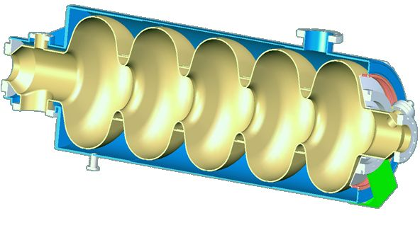
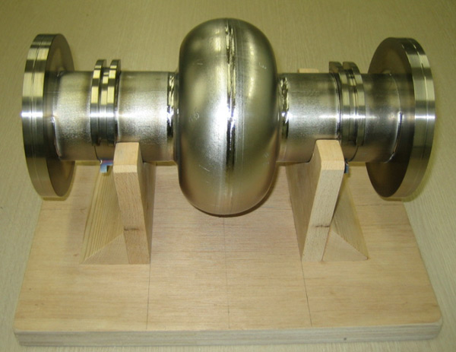
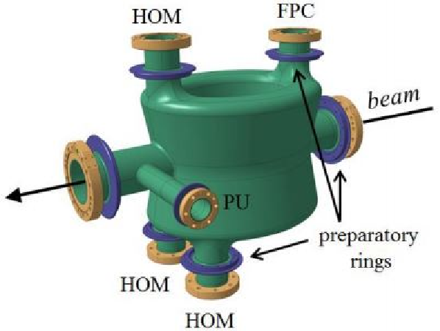
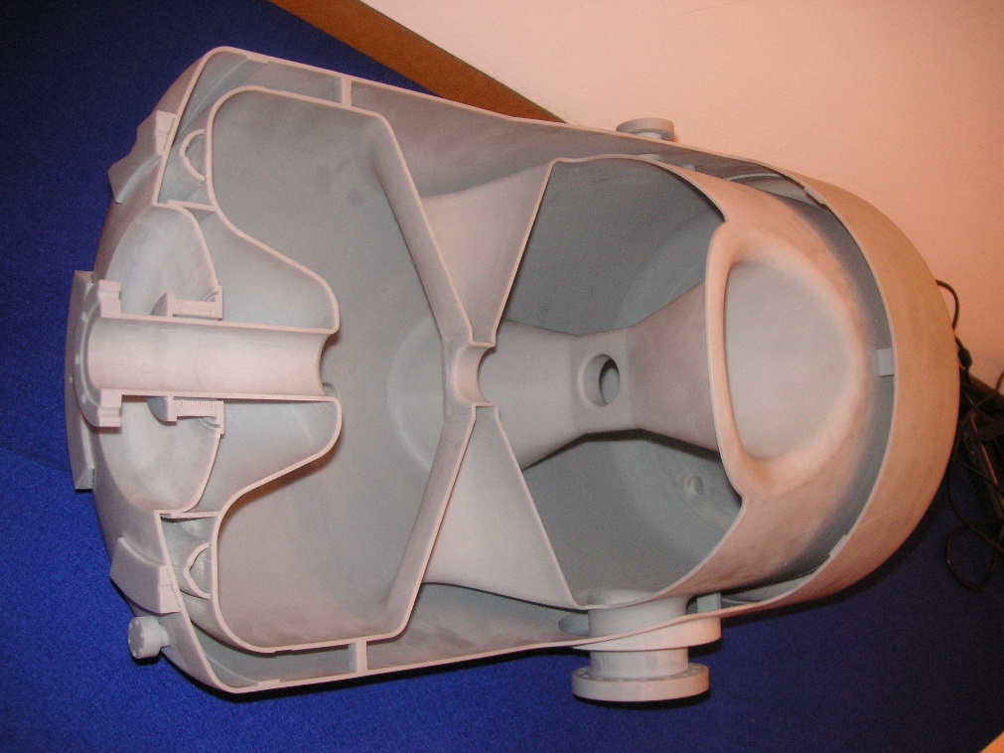
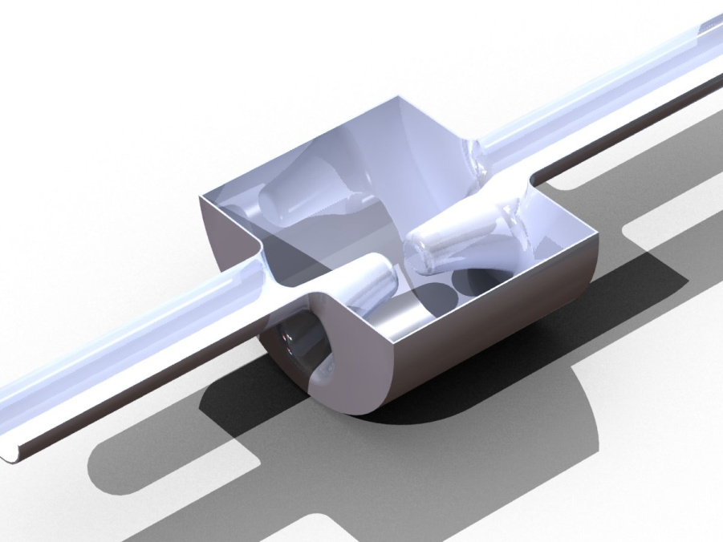
Cavities can have diverse and complex geometry

Slide 5
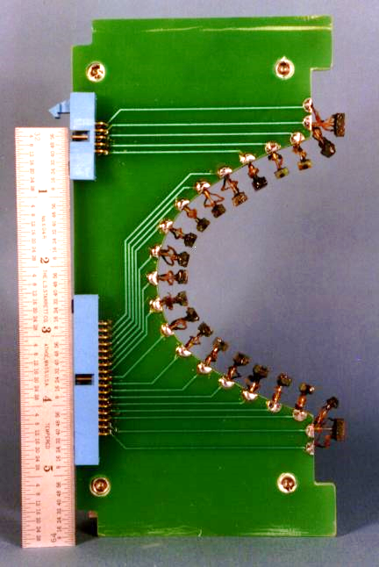
What is SRF Thermal Mapping?
Future accelerators
QUENCH: limits performance
Where did the quench start?
What kind of defect induced the quench?
Contact thermometry
Placing temperature sensors on the cavity walls
Requires individual preparation of each cavity
Non- contact thermometry
Allows systematic and fast testing of diverse cavities
Technique based on superfluid helium second sound
Need of testing superconducting cavities of variable size and geometry.
Localized? Magnetic?
Can the problem be corrected?

Slide 6
Non-contact thermal mapping
(for He-II cooled cavities)
One of He-II many outstanding properties is second sound: temperature-entropy wave
This wave is originated by a transient heat flux on a wall in contact with the fluid.
A quenching surface produces second sound!!!
Measuring the difference in time of flight to many sensors, the origin of the wave can be trilaterated (GPS-like).

Slide 7
Second Sound in He-II
and its detection

Slide 8
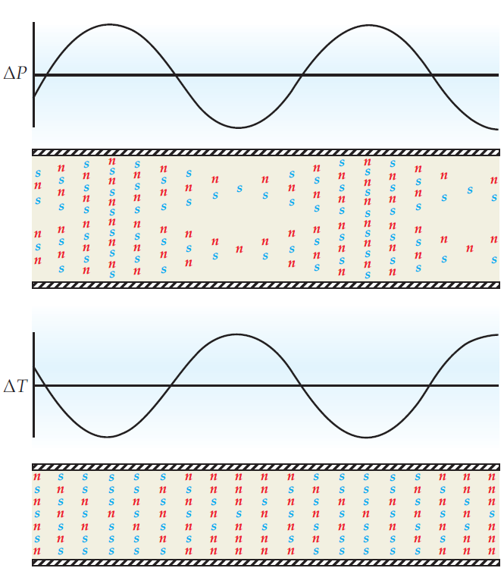
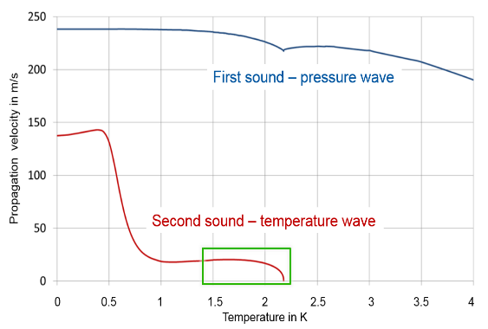

He-II and second sound physics
He-II
He-I
Excited mechanically
Excited by heat on a wall
n: normal component particles
s: superfluid component particles

Slide 9
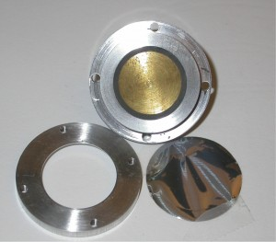
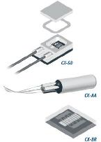
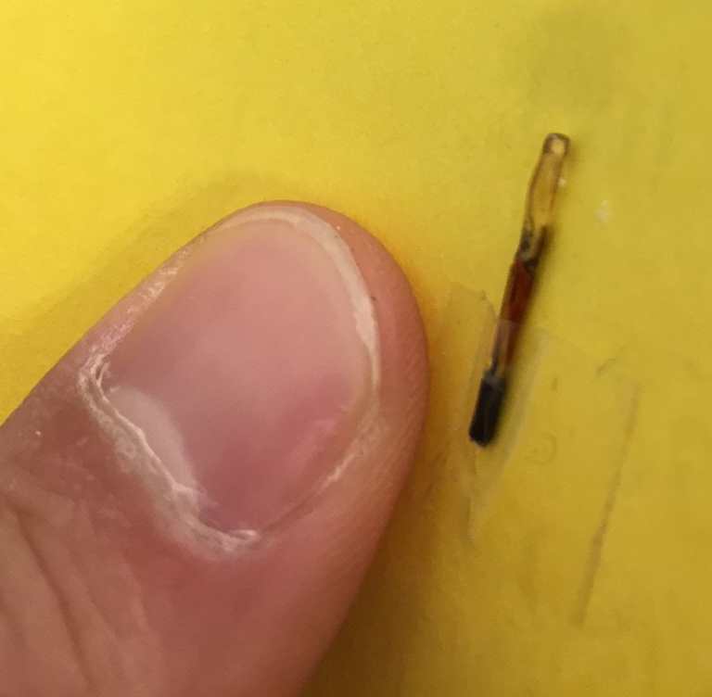
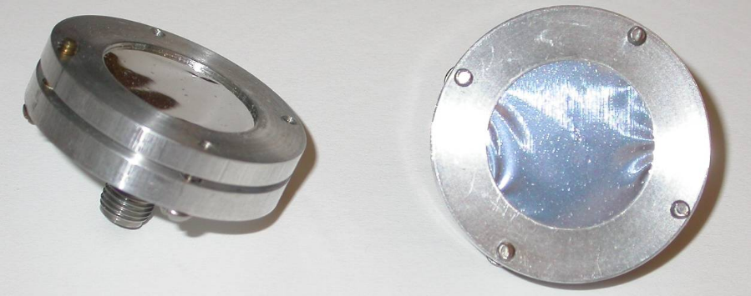
Second sound detection
Thermometry
Measurement of the temperature variation with fast response, highly sensitive thermometers
Commercial sensors like Cernox bare chip sensors
Oscillating SuperLeak Transducers (OST)
Sensing of the relative movement of the two components
Superfluid leak
Transition edge sensors

Slide 10
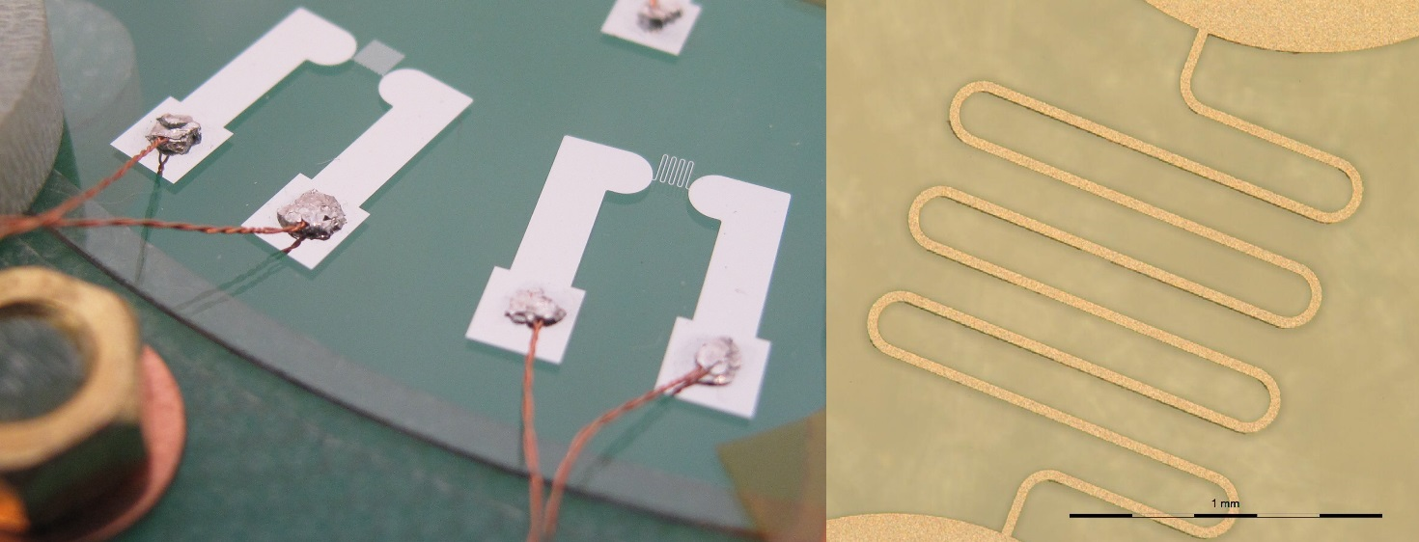
Transition Edge Sensors
Bolometers: tiny temperature variations (≈1 mK)
Based on the (gradual) SC to NC transition of an alloy
Only sensitive in the transition range
Transition range ‘tuned’ with a bias current
R
Fixed current
curves
SC-region
NC-region
Transition Edge
T
I
Transition edge
*TES developed by us at CERN
T

Slide 11
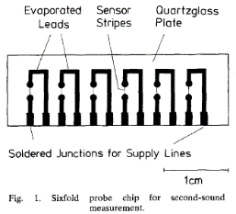
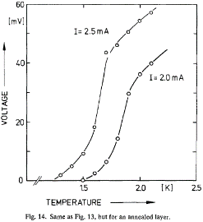
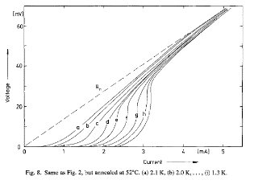
TES literature survey
Developed and studied in the 70’s and 80’s, especially for space applications
For second sound detection, Au-Sn thin film alloys are a proven material.
Produced by metal evaporation with mask of 20 nm Au - 100 nm Sn on quartzglass.

Slide 12
Advantages of TES to OST
Electronics
Simpler: 4-wire measurement is enough
Space resolution
One can fabricate them practically as small as desired
Thermometry
They could provide information on the quench heat flux
Signal
Not polluted with the mechanical oscillations of the membrane
Reproducibility
Can all the parameters involved in the fabrication process be controlled?

Slide 13
Project Objectives
Establish an in-house production method of TES at CERN → appropriation of the technology
Produce prototypes of TES
Cryogenic testing of TES at the Cryolab
Deliver a TES sensing device
Design a large scale TES thermal mapping system
Validate TES thermal mapping on an SRF quenching system
Characterisation of the SC transitions
Second sound detection by TES

Slide 14
Fabricating TES in Au-Sn

Slide 15
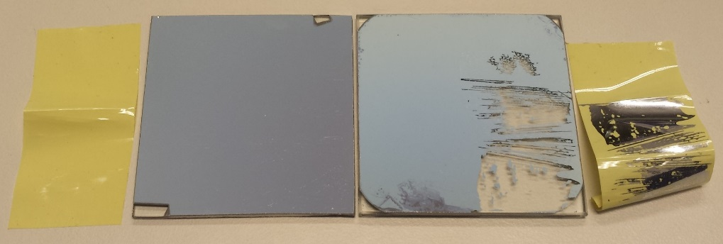
Fabrication process
Not available commercially – In-house development
Need of an easy-going process to fabricate the TES
We used a clean room platform at CMi/EPFL
* Thanks to T. Schneider (CERN/EP/DT) ☺
Drawing of the sensors
Sensor array on standard wafer (10 cm diameter)
Process flow
Automatized photolithography
Cabling
Soldering with Indium
Twisted 4-wires, by hand and without heat
On any CAD program
leads and strips of the same material
* Thanks to A. Mapelli (CERN/EP/DT) ☺

Slide 16
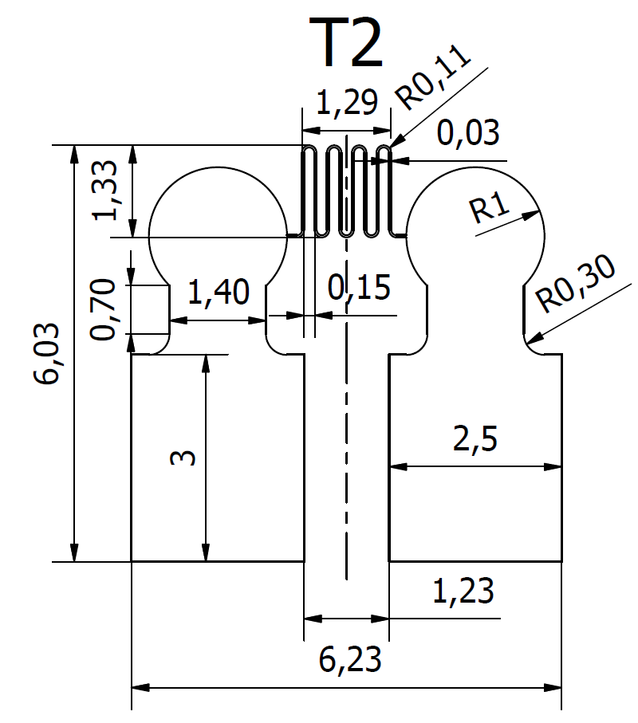
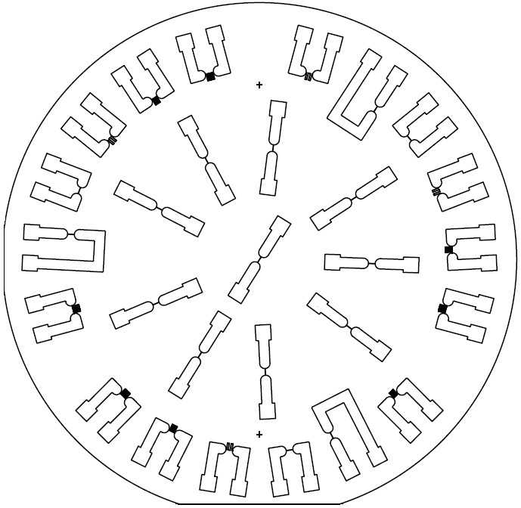
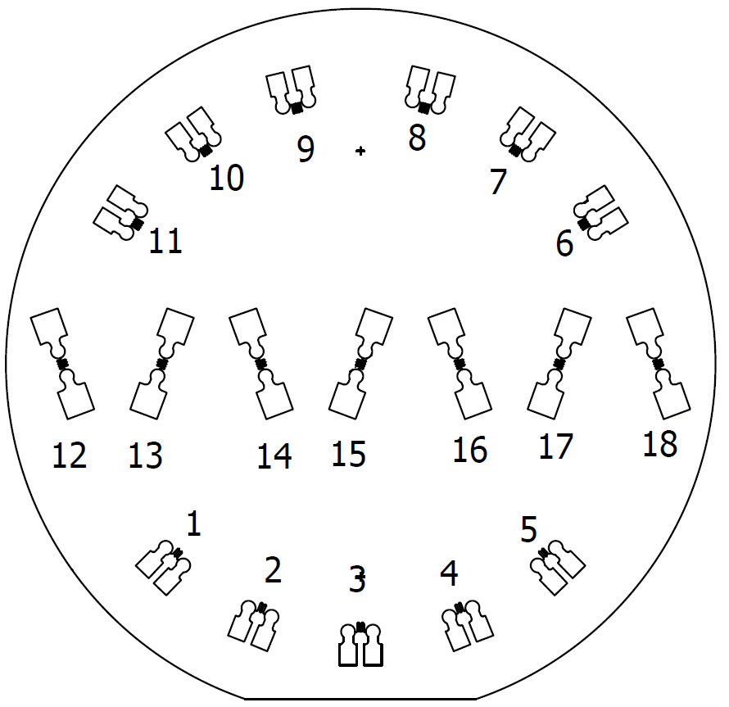
Wafer designs (2016)
Strips
30 μm wide
Variable length
Oriented for cabling
Big enough for cabling
Meandering design
Leads
Sensing area $≈1 mm^{2}$
Sensing area ≈1 𝑚𝑚^2

Slide 17
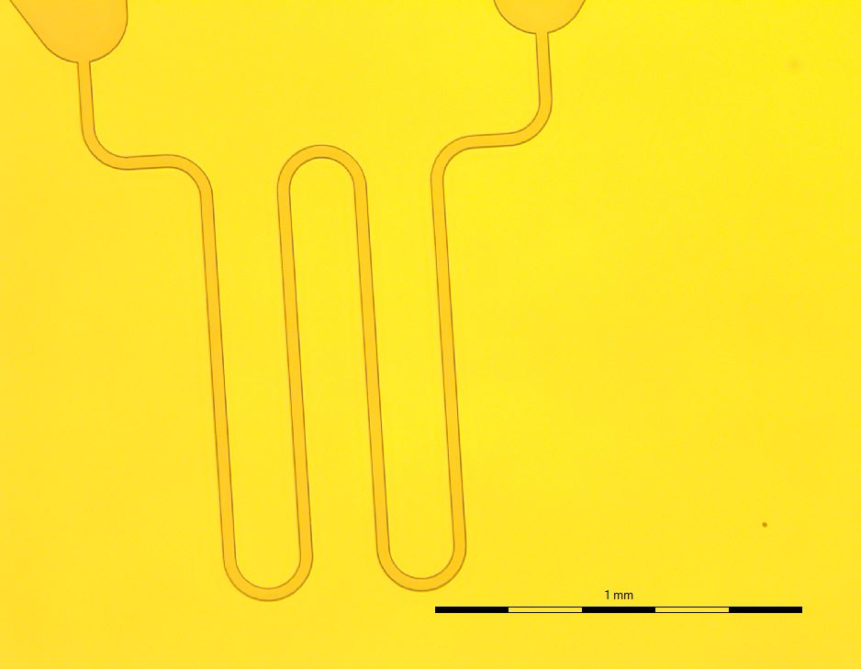
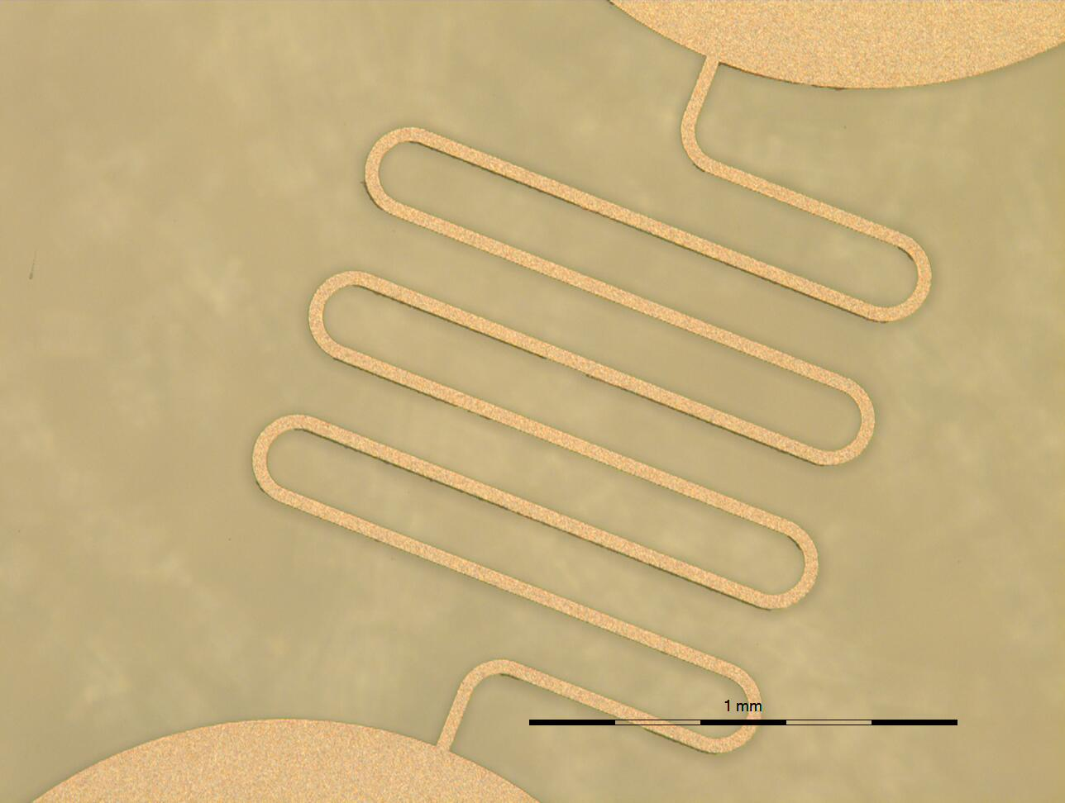
Photolithography results
After metallization and lift-off
After laser writing and development
1mm
1mm

Slide 18
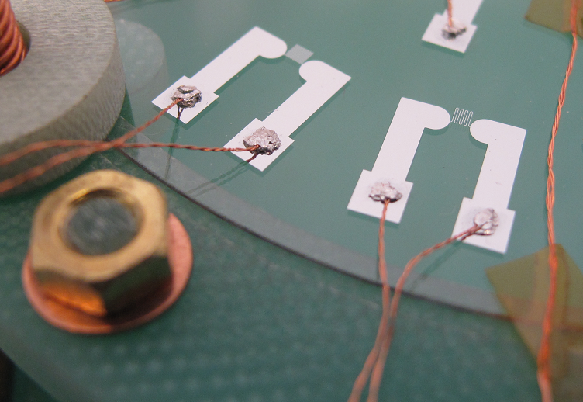

Cabling – $In$ cold soldering
Indium base
Cable immersion
Indium cover
NO single contact point was lost during cooldown
The force of one point is enough to lift the whole wafer

Slide 19
Cryogenic testing

Slide 20
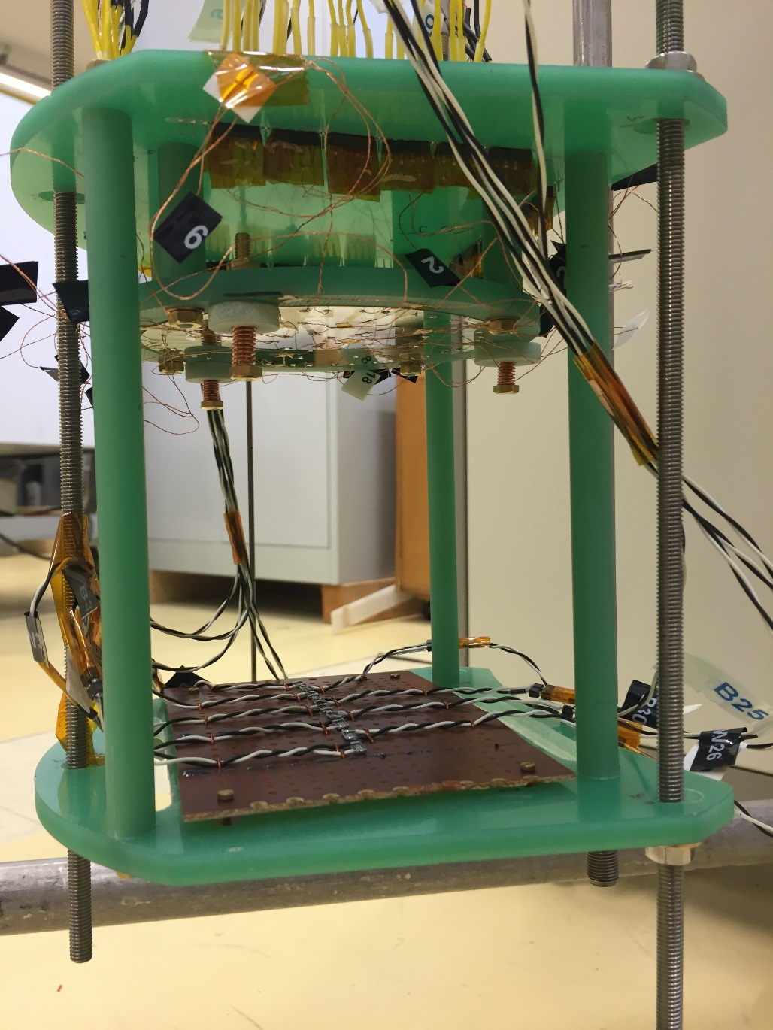
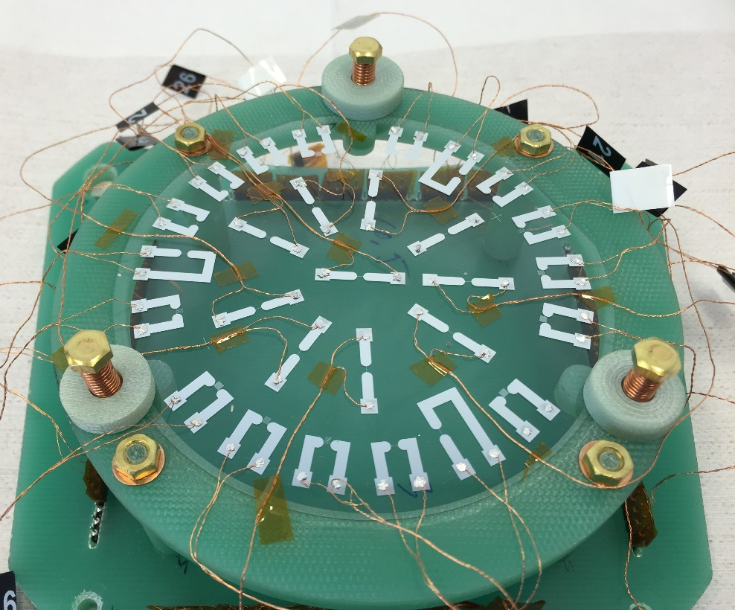
Testing of TES at the Cryolab
Pump
P
Vapor
P < 5000 Pa
Liquid, Saturated He-II
Wafer with TES’s
Heaters →
2nd sound pulses
* Thanks to A. Vacca and J-L. Carpano (Cryolab) ☺

Slide 21
TES Characterization
(20 nm Au – 100 nm Sn)
R vs. T and I.
Pressure steps: 450 to 5000 Pa (1.5 to 2.17 K)
Current sweeps: 0 to 3 mA
Sensitivity Optimization
Max. dV/dT vs. I (at a given bath temperature)
1.55 K
1.95 K

Slide 22
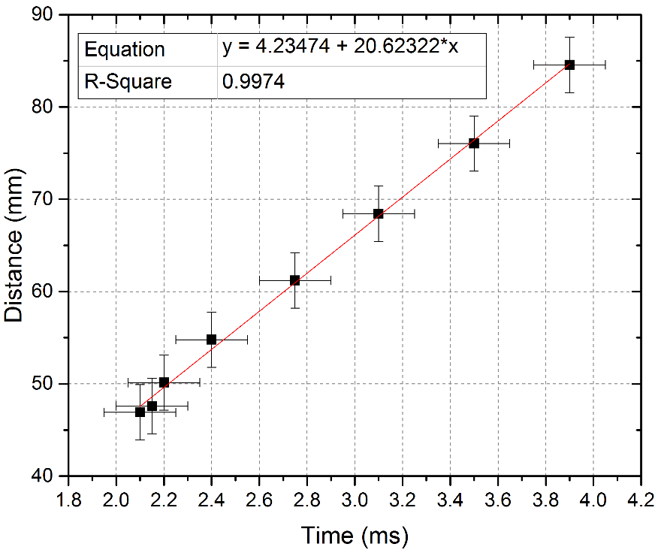
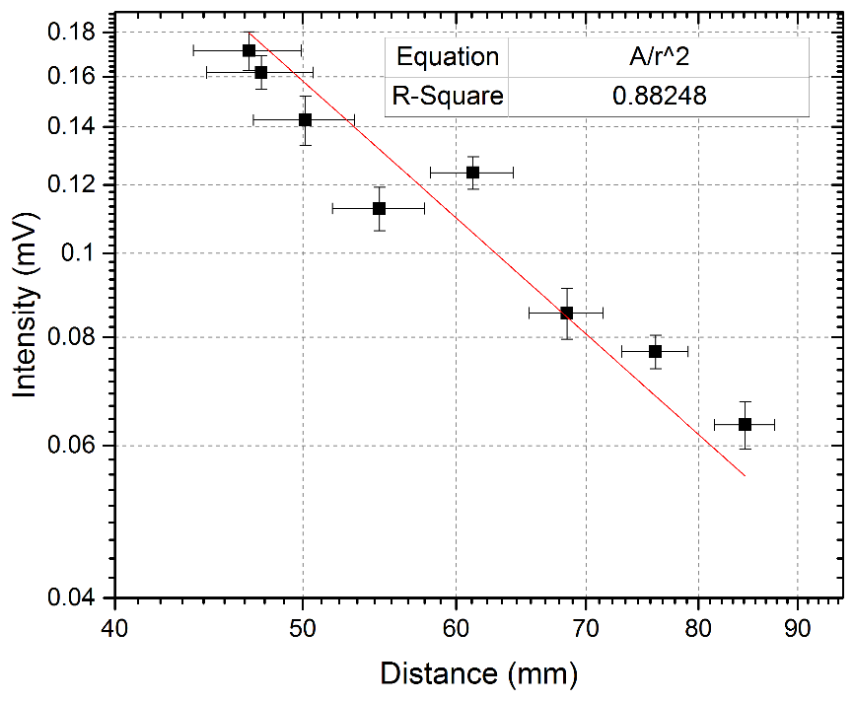

Second sound measurements with TES
$$T=1.6 K$$
$$I=0.9 mA$$
Pulses by resistive heaters
Different distances
Sensors biased at constant current
270 μV 2nd S. signal
50 μV p2p
noise
Heating power
The second sound signal is clearly identified

Slide 23
Further studies on TES thin film
Variation of composition and its impact of TES quality.
Study of other material combination (Cu-Sn)
Reproducibility
Effect of adhesion-improving pre-layer on the TES performance.

Slide 24
Towards a
Thermal Mapping Instrument

Slide 25
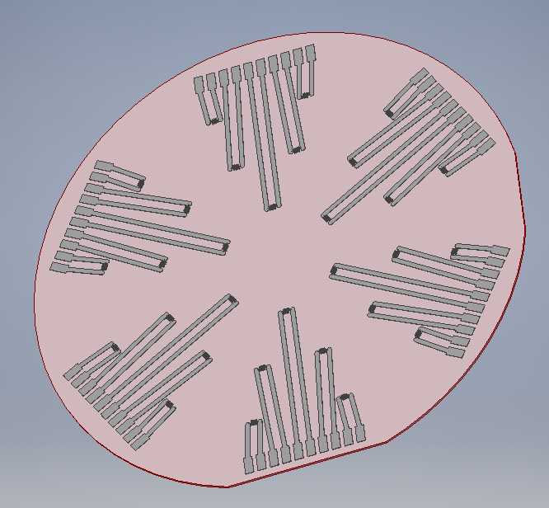
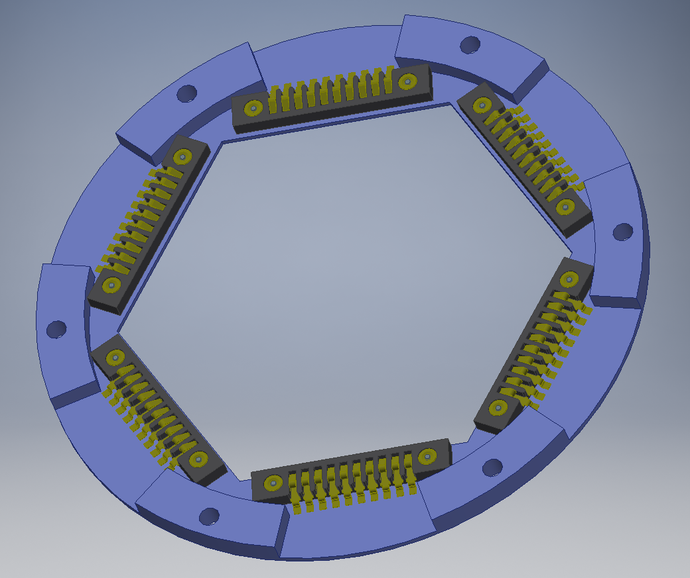
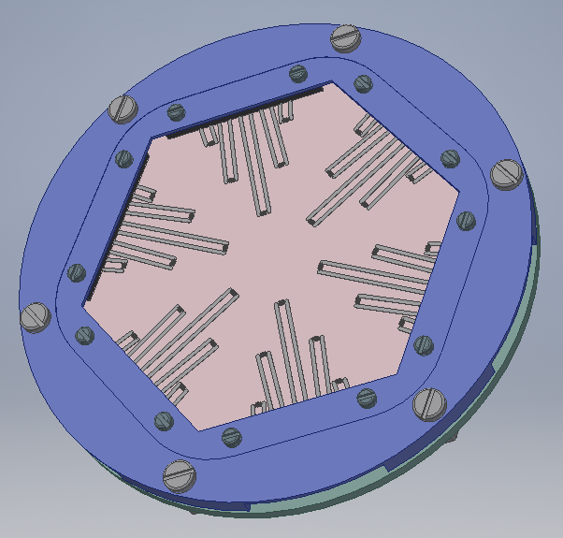
TES camera array
A compact multi-sensor device of sufficient size to do thermal mapping with.
A network of independent sensors is proposed.
The robustness is provided by a G10 frame. The connection is simplified with spring connectors. The fragility of the film needs to be dealt with, specially at electrodes.

Slide 26
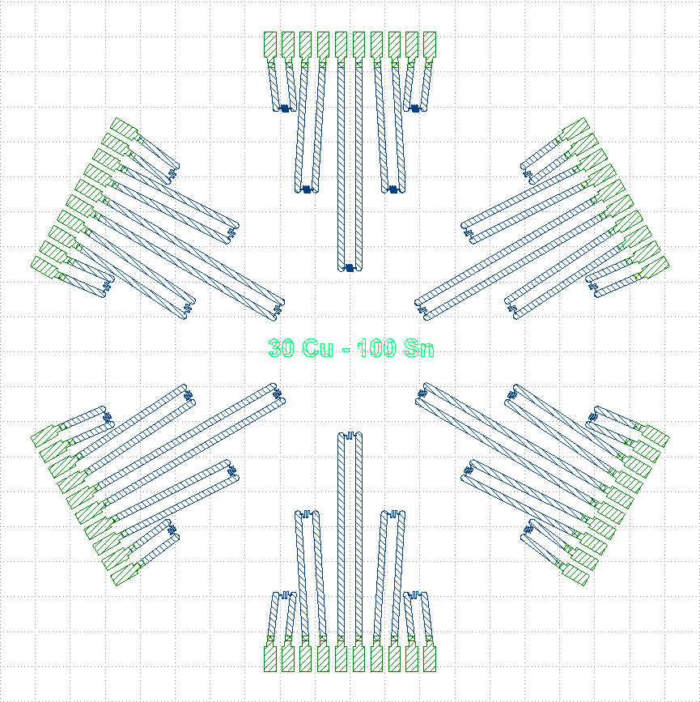
TES camera array: electrodes
More resistant electrodes can be obtained with a thin film of Ti and Au: we tested 20 nm – 80 nm thickness.* The adhesion is more than sufficient.
Two photolithography processes: one for electrodes; one for sensors.
Micrometric alignment performed for the second laser writing process.
Photolithography Electrodes
PR Coating
Writing
Developing
Thin Film (Ti-Au)
Lift-off
Oxygen plasma cleaning
Photolithography Sensors
PR Coating
Writing (with micrometric alignment)
Developing
Thin Film (Au-Sn or Cu-Sn)
Lift-off
To eliminate eventual remaining solvent and PR impurities
Low intensity, not to damage the thin film
Electrodes
Superimposition zone
*Thanks to G. Rosaz (CERN/TE/VSC) for the advice! ☺
SC film

Slide 27
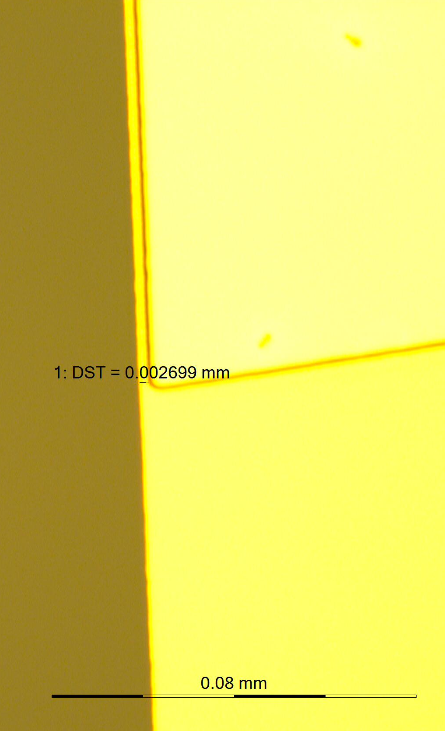
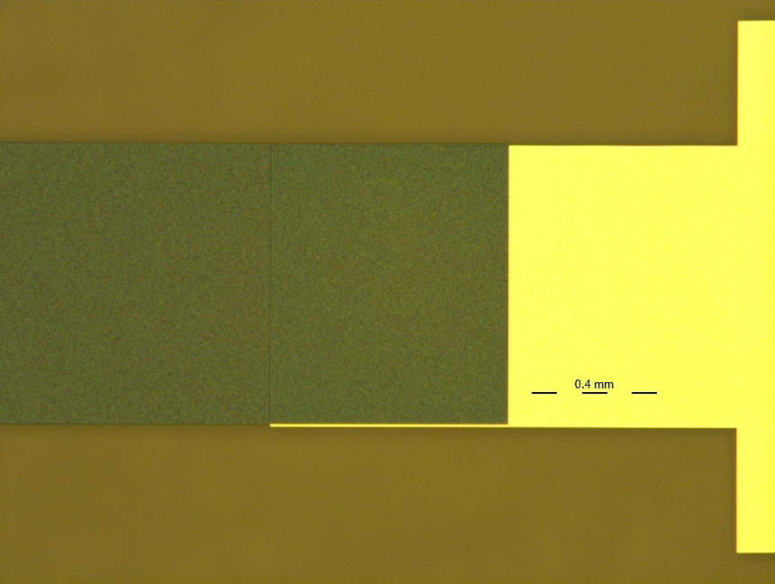
TES camera array: electrodes
More resistant electrodes can be obtained with a thin film of Ti and Au: we tested 20 nm – 100 nm thickness.* The adhesion is more than sufficient.
Two photolithography processes: one for electrodes; one for sensors.
Micrometric alignment performed for the second laser writing process.
Electrodes
Superimposition zone
SC film
Electrode
SC film
0.4 mm
*Thanks to G. Rosaz (CERN/TE/VSC) for the advice! ☺

Slide 28
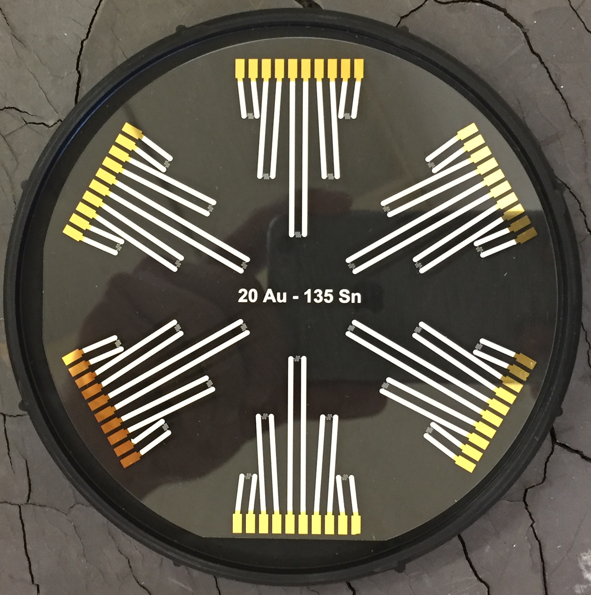
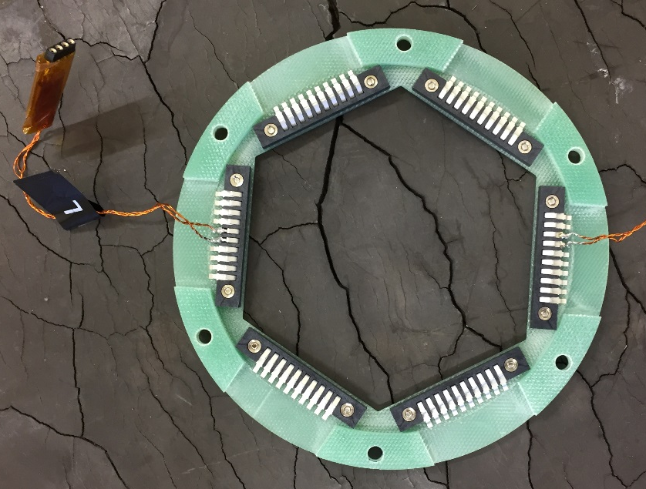
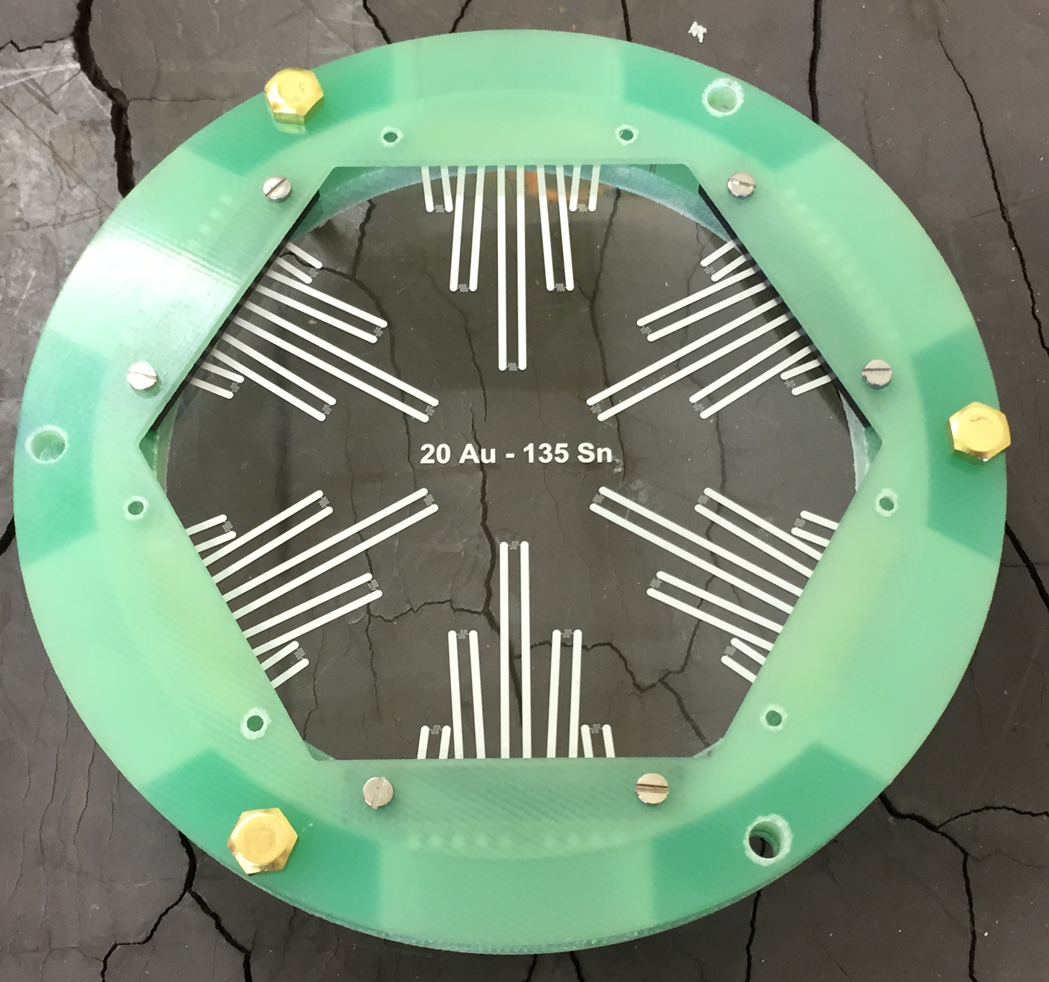
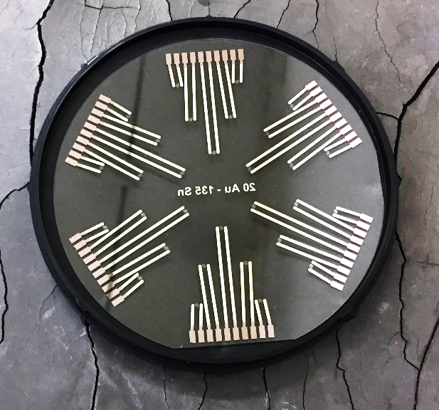
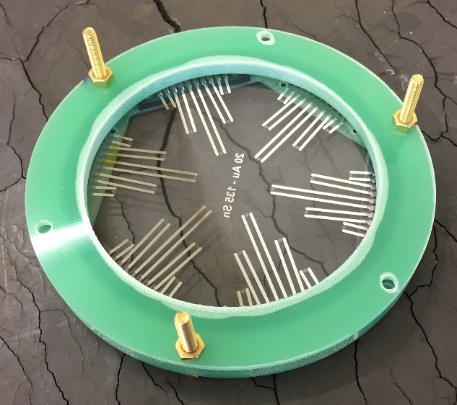
TES camera array: prototype

Slide 29
Conclusions on TES advances
TES as second sound detectors have been produced with Au-Sn thin films
An equivalent device built using Cernox bare chip sensors would be 30 times more expensive (not to mention cumbersome).
A robust camera-like device has been designed and fabricated
The sensors were tested and satisfyingly detect second sound waves
Effects of composition, process flow parameters and adhesive layers have been studied

Slide 30
What is next?

Slide 31
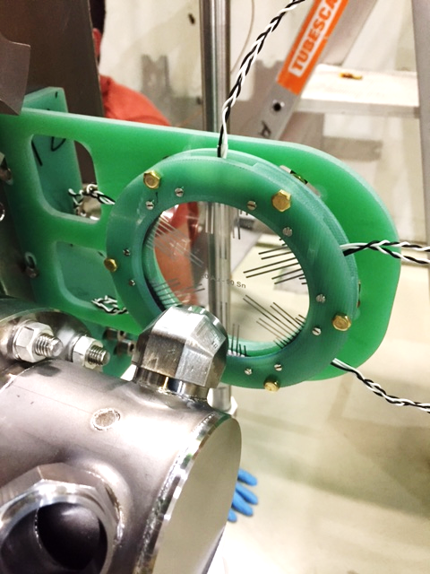
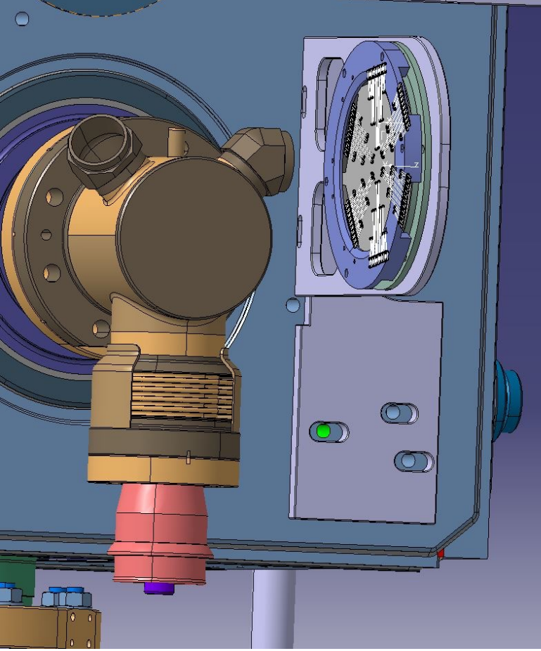
TES CRAB Cavities HOM - quench test
Current SM-18 test is dressed CRAB cavity with HOM couplers
Test are taking place right now and are done with OST’s simultaneously
Opportunity to start commissioning TES as a quench localisation system at SM18

Slide 32
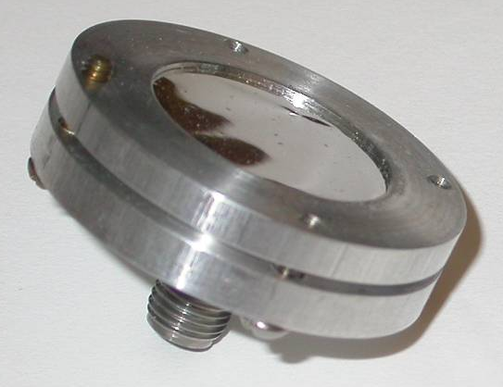
Comparative study TES-OST
Fully characterise the two types of sensors
Appreciate differences in…
Angular response
Effect of distance from the source
Time response features
in a common set-up
in the same conditions
Response to source intensity
Assess the advantages and drawbacks of each of them

Slide 33
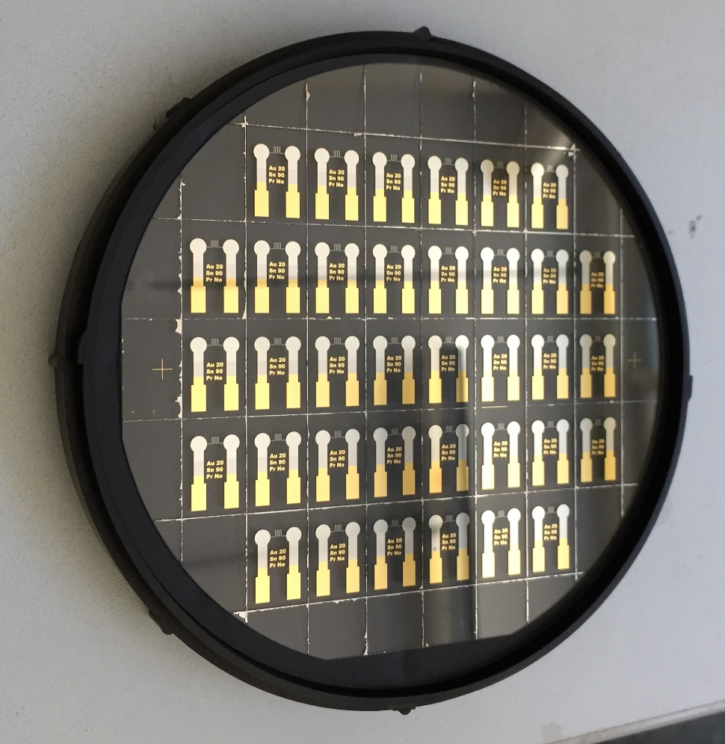
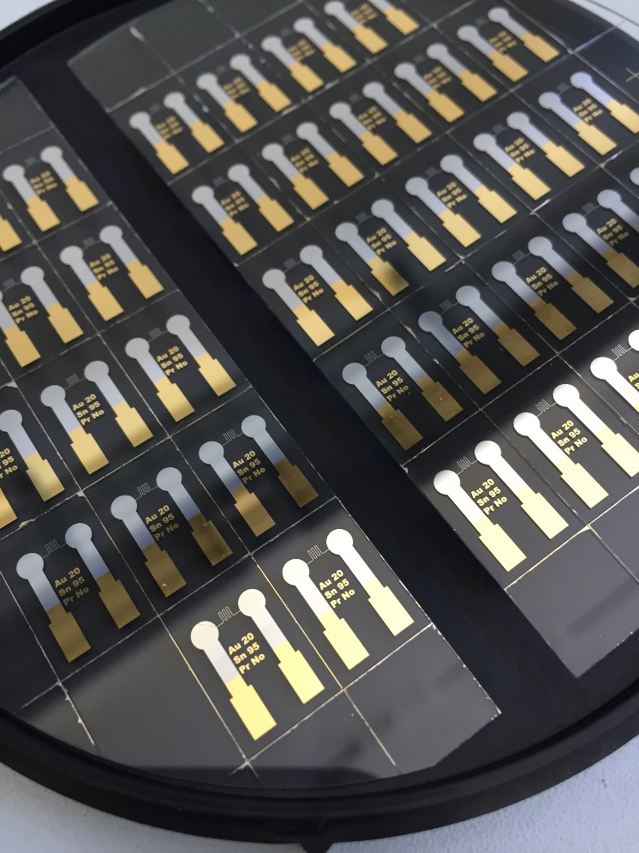
Stand-alone TES chips
Wafers have already been produced to test the method
Pre-diced thickness: 270 µm (removed 230 µm)
Thicker coating
Laser more intense
Careful manipulation
The results is satisfying
Good geometrical quality
Easy to separate
Not yet tested
Supports will be produced soon

Slide 34
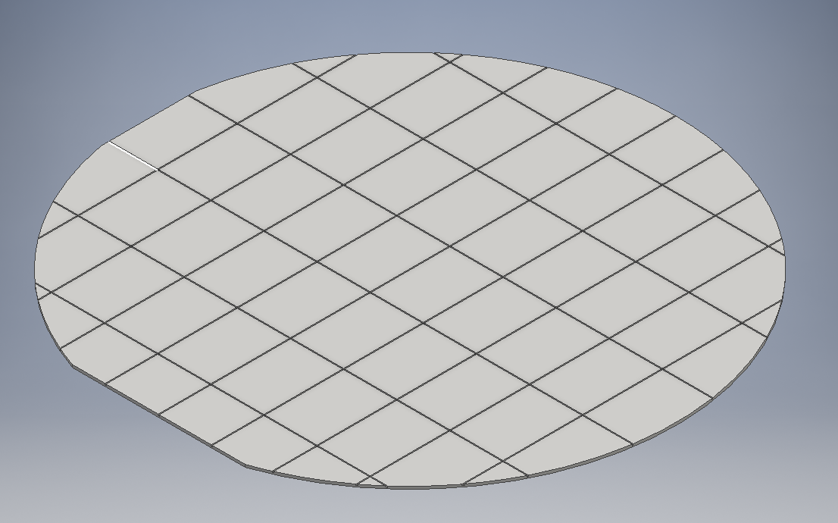
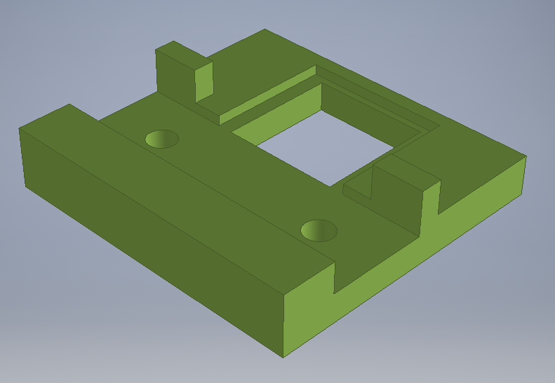
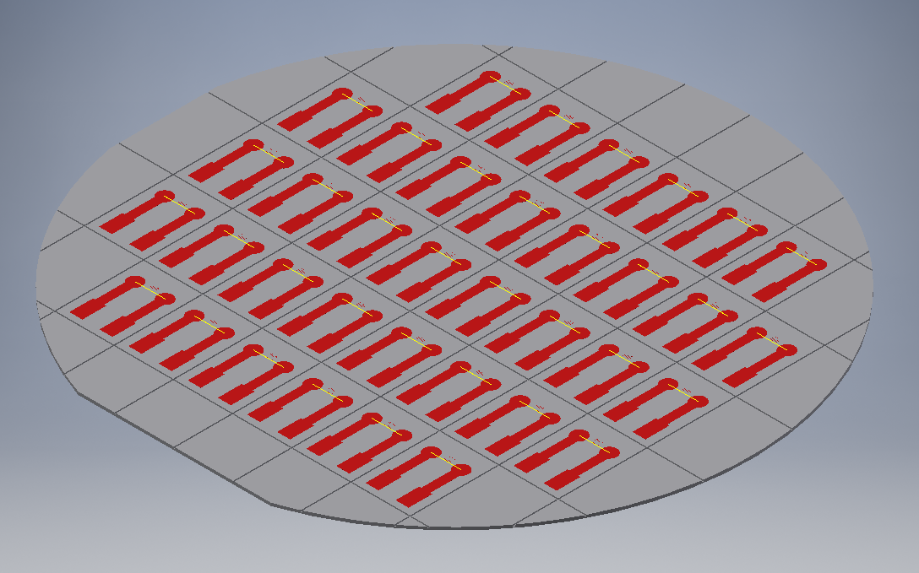
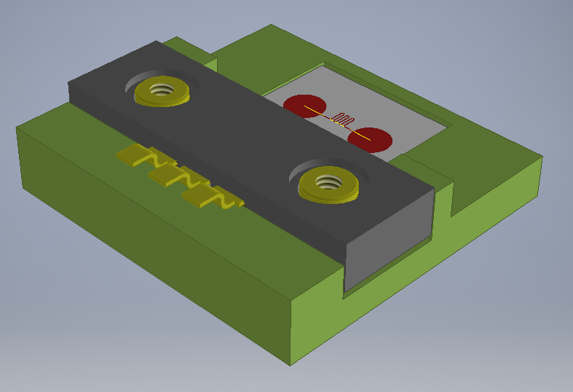
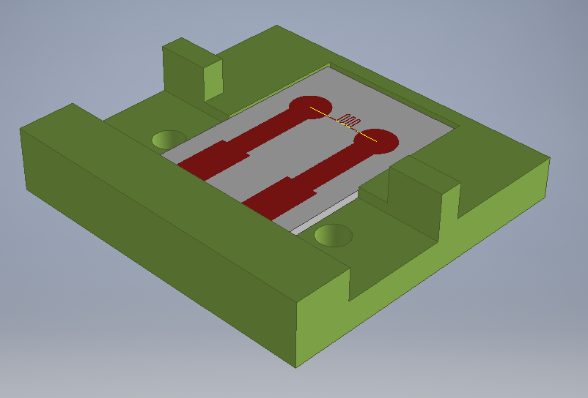
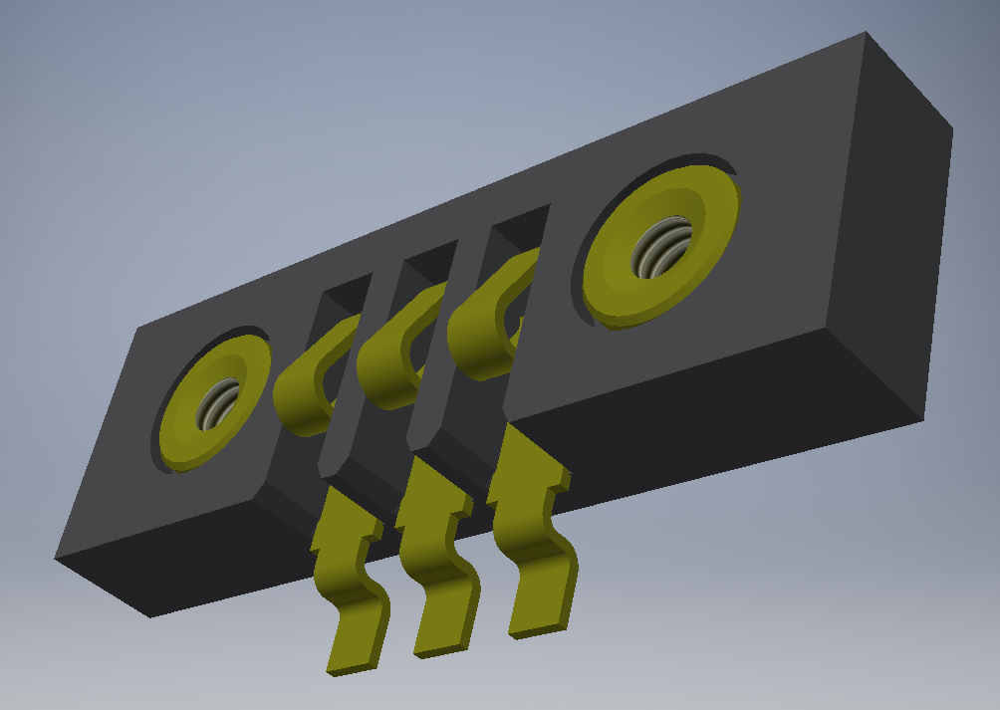


Stand-alone TES chips
Pre-machined wafer

Slide 35


TES RF-quench test
Test the TES as a quench localisation system with a simple geometry cavity
Induce quench at known location with a small magnet, a heater, an intentional surface defect, or simply a bad-performing cavity
CRAB cavity testing program may be an opportunity

Slide 36
Last but not least…

Slide 37
Acknowledgments
Cryolab
Technicians
Collaboration
Infrastructure
Helium
Th. Schneider, M. van Stenis, G. Rosaz
Thin films
consulting
A. Mapelli (CERN/EP),
J. Dorsaz and G. Corradini (EPFL)
Microfabrication
consulting
CMi EPFL
A. Lunt, F. Leaux
(EN-MME-MM)
Microscopic analysis
Thin films
tests
SEM, SESI, ESB, EDX, FIB, etc.

Slide 38





Thank you for your attention!!!
?
?
?

