Slide 1
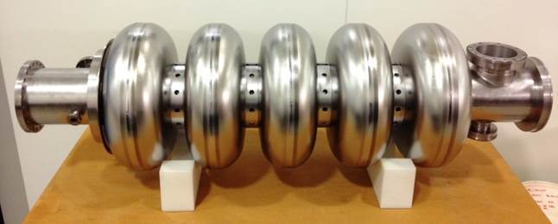
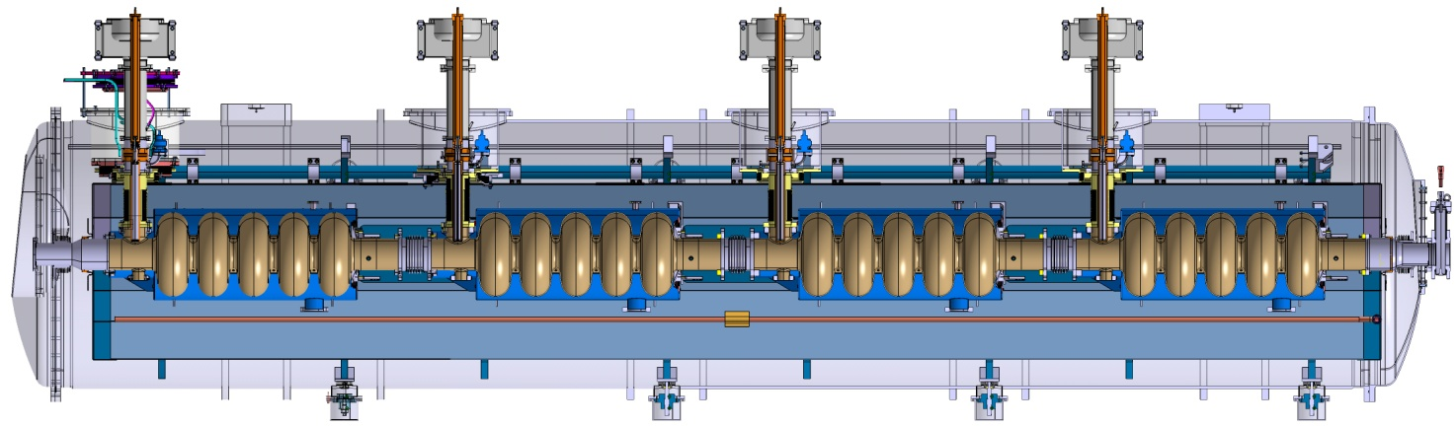
High-Beta cavity STATUS at DAREsbury laboratory
A Wheelhouse on behalf of the STFC team
ASTeC, STFC Daresbury Laboratory
SLHiPP
8th - 9th June 2017

Slide 2
Outline
High-β Cavity Programme
  ESS Requirements & Program
  Project Scope
  Project Schedule
Infrastructure Preparations
Cavity Qualification Preparation
  Procurement
  QA
Future Plans
Summary

Slide 3
High-β Cavity Programme

Slide 4
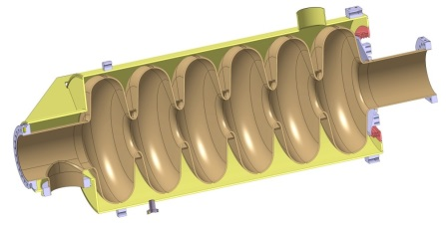
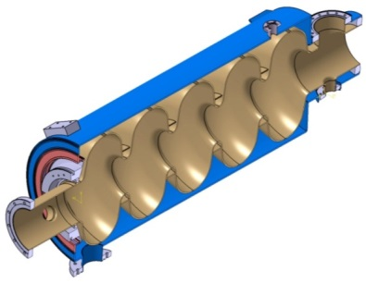
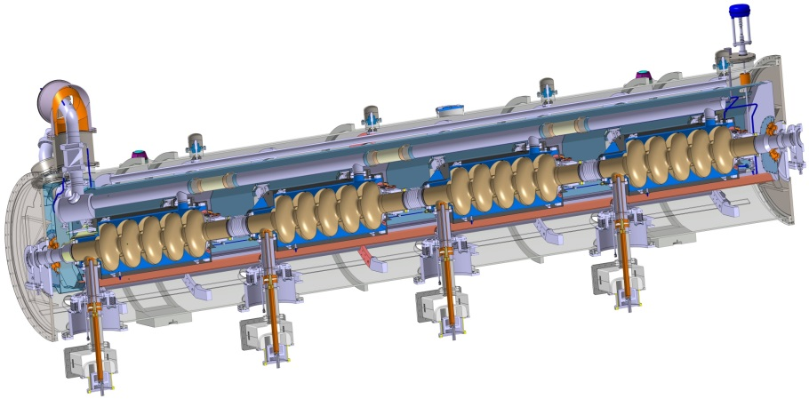
ESS Program
STFC
WP5
5 cells high beta (0.86) cavity
6-cells medium beta (0.67) cavity
Cavities without HOM coupler
INFN
Production of 36 dressed medium-β cavities
STFC
Production of 84 (+ 4 spares) dressed high-β cavities
CEA Saclay
Design of medium and high-β cavities
Design of cryomodules
Prototypes
Cryomodule integration
Programme is part of the UK IKC to ESS

Slide 5
ESS Requirements
WP5
5 cells high beta (0.86) cavity
6-cells medium beta (0.67) cavity
Cavities without HOM coupler
 | Medium-β | High-β
Geometrical β | 0.67 | 0.86
Frequency (MHz) | 704.42
No. of Cryomodules | 9 | 21
Cavities /Cryomodule | 4 | 4
No. of Cavities | 36 | 84
Cryomodule length (m) | 6.584
Nominal Accelerating gradient (MV/m) | 16.7 | 19.9
Nominal Accelerating Voltage (MV) | 14.3 | 18.2
Q₀ at nominal gradient | > 5 x 10⁹
Similar to CEBAF/SNS cryomodule concept with 4 cavities per cryomodule
Common cryomodule design for medium and high beta cavities

Slide 6
Scope
STFC In-Kind Contribution:
Niobium procurement
Manage Eddy Current Scanning (DESY)
Validation of treatment processes (esp. BCP) in industry using ‘pre-series’ cavities
Cavity fabrication of 84 high beta cavities in industry
2K RF qualification of cavities to 22.9MV/m, Q₀ ≥ 5 x 10⁹
Transport to Saclay

Slide 7
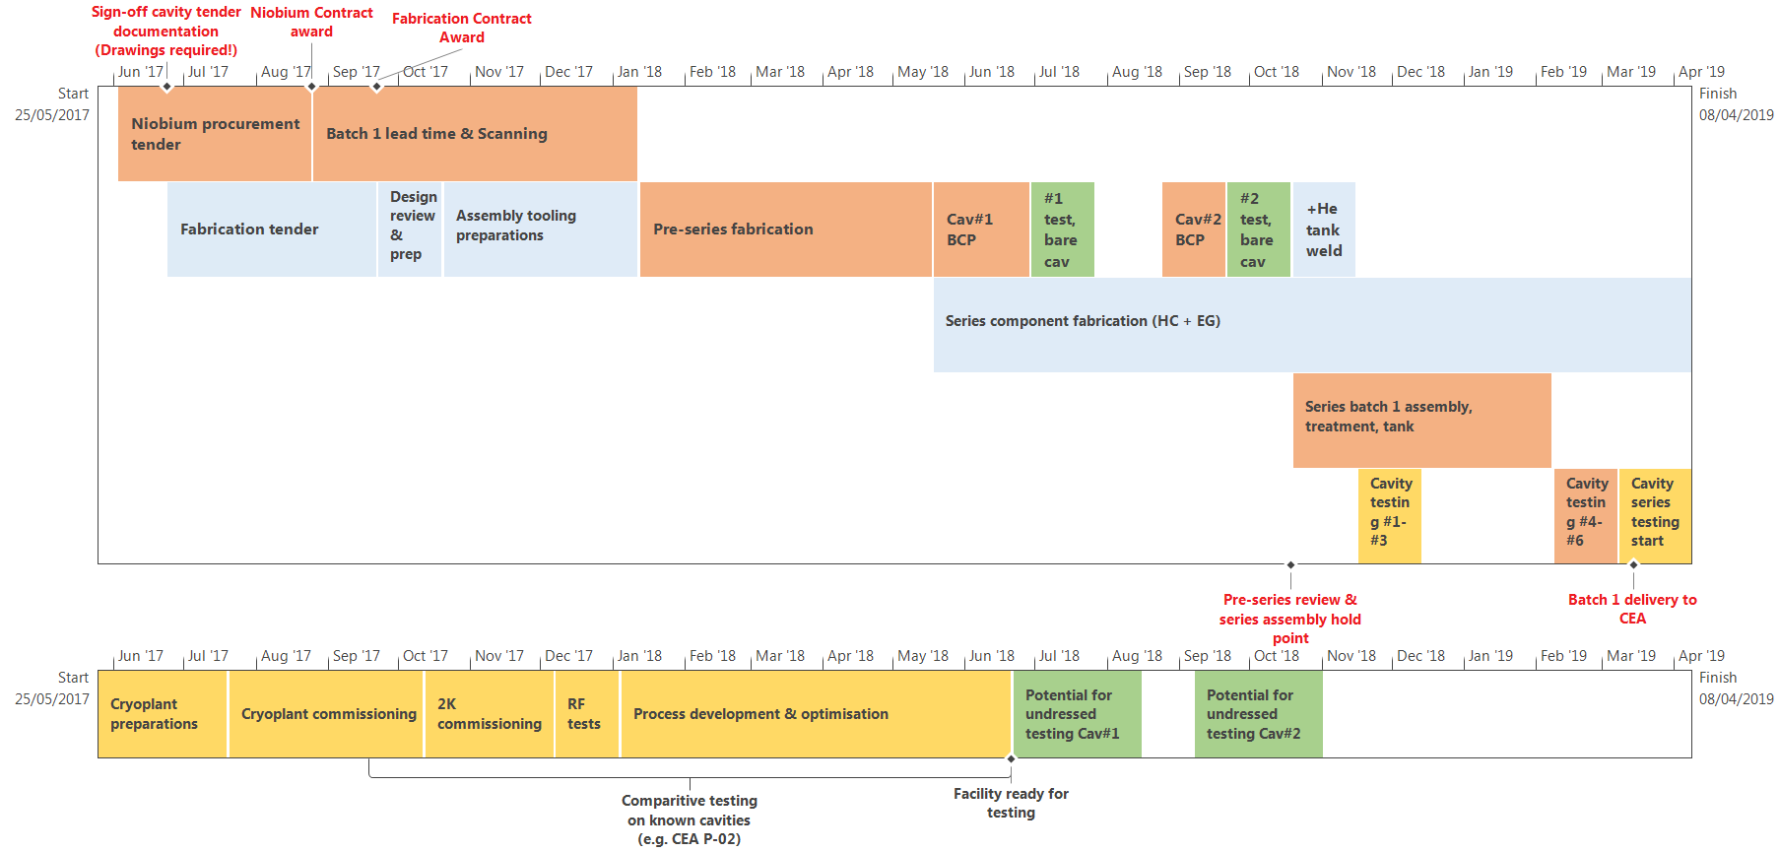
High-β Cavity Schedule
KEY
Critical path
STFC or industry
STFC task
Industry task
STFC or external

Slide 8
High-β Cavity Schedule
Critical Path:
Nb tender process & Nb lead time
Pre-series fabrication & test
Series final assembly
Qualification testing
KEY
Critical path
STFC or industry
STFC task
Industry task
STFC or external

Slide 9
High-β Cavity Schedule
Near-critical path (limited float):
Fabrication tender
Tooling & preparations
KEY
Critical path
STFC or industry
STFC task
Industry task
STFC or external

Slide 10
High-β Cavity Schedule
VTF Preparations & Plans
Final deliveries due mid summer
Assembly & commissioning of subsystems independently
Integration & controls development in parallel (not shown)
2K commissioning with known cavities to compare measurements
KEY
Critical path
STFC or industry
STFC task
Industry task
STFC or external

Slide 11
High-β Cavity Schedule
Hold point:
Trimming & welding of HC for series cavities only after successful pre-series tests
KEY
Critical path
STFC or industry
STFC task
Industry task
STFC or external

Slide 12
Infrastructure Preparations

Slide 13
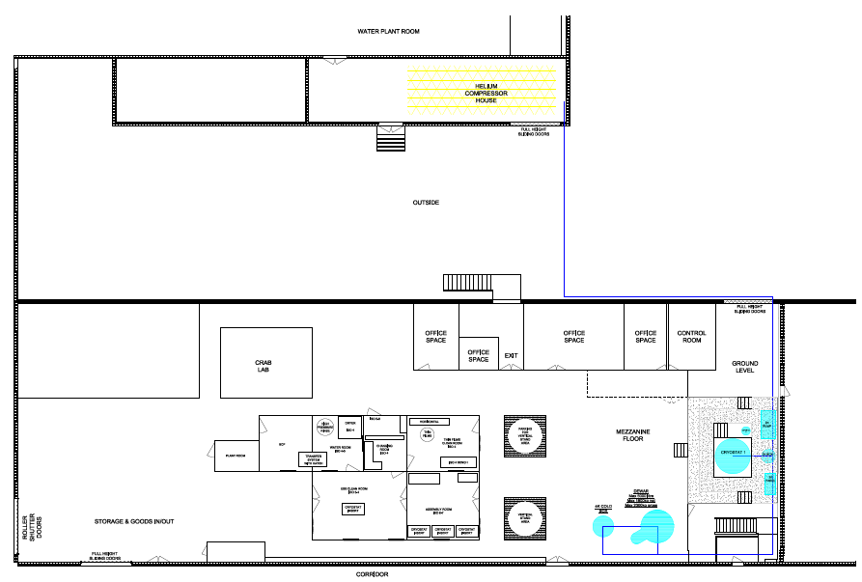
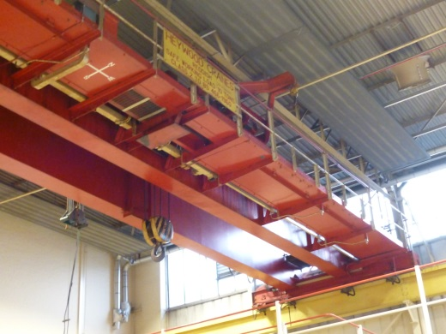
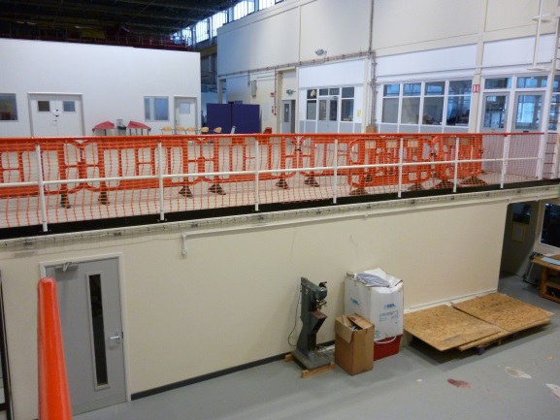
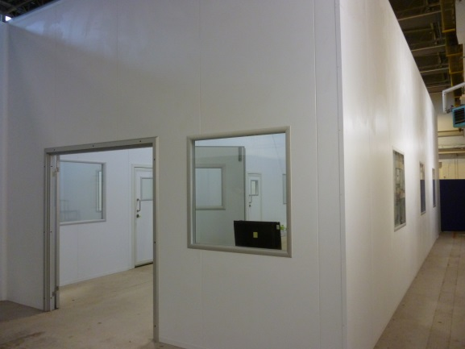

SRF Hall
He Compressor House
Full crane coverage
Offices upstairs
Cavity Goods-In & Out downstairs
Thin Film Lab
Crab
Lab
20m
VTF
Cleanroom
Cryo-plant
55m

Slide 14
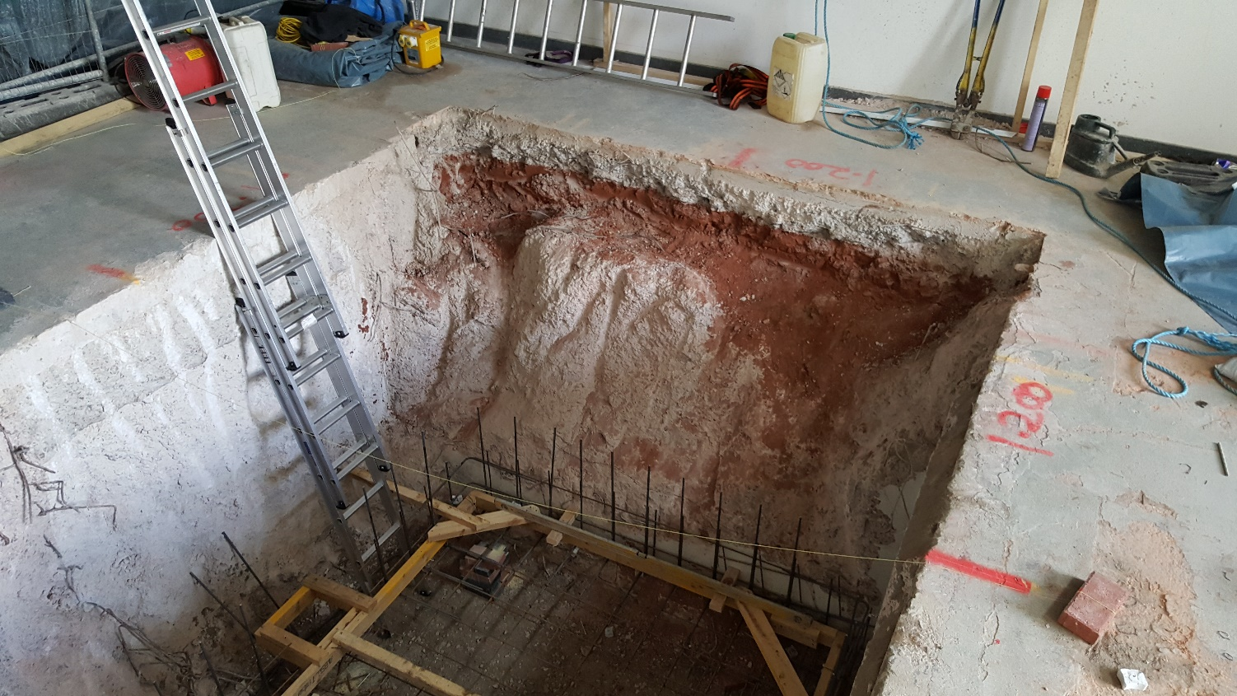
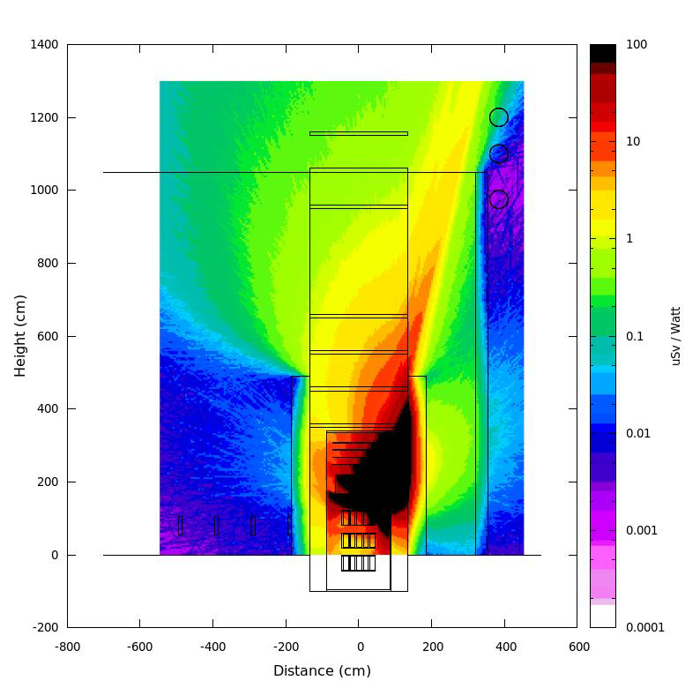
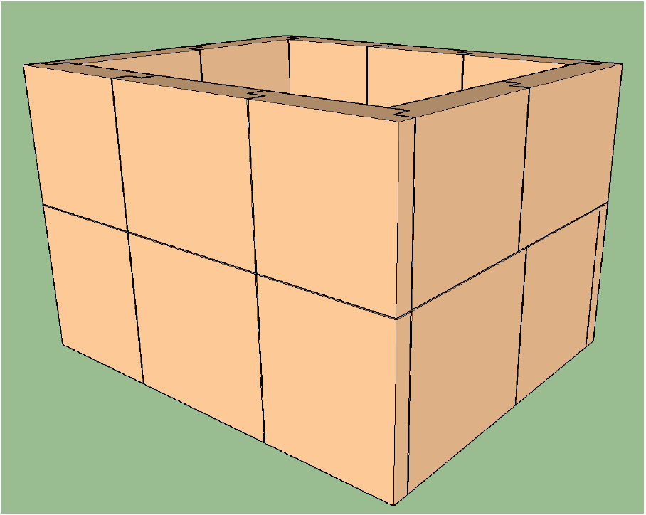
Shielding
Detailed assessment performed by Nuclear Technology
Bunker excavation completed ~2.0m
Concept block shielding design completed
  Concrete thickness is defined – 1.85 m
  Final shielding design progressing with suppliers; iterating for installation crane requirements
  Includes radiation detectors inside the bunker for each cavity
  Being reviewed in 2 weeks time

Slide 15
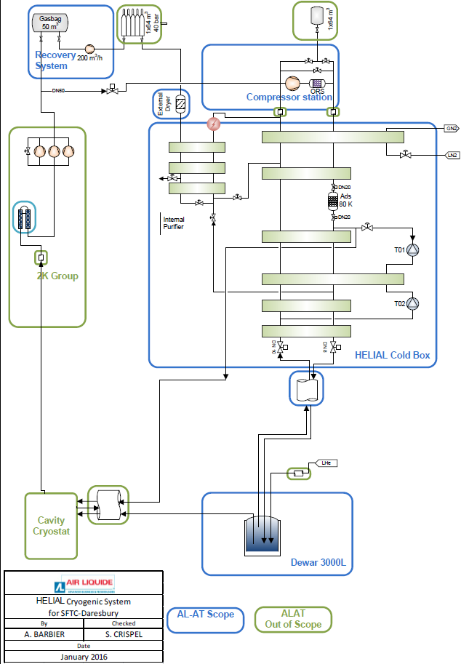
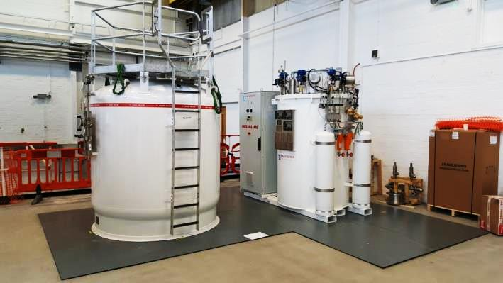
Cryogenic Plant
Air Liquide Advance Technologies have provided (Feb 2017) :
  He Liquefier (100 l/h)
  3000 l LHe Dewar
  Helium Recovery System (10g/s)
Installation is on-going
Commissioning of system due to commence end of June 2017
  Produce liquid He (4K)
PFD & Process description
Cold Box
Dewar

Slide 16
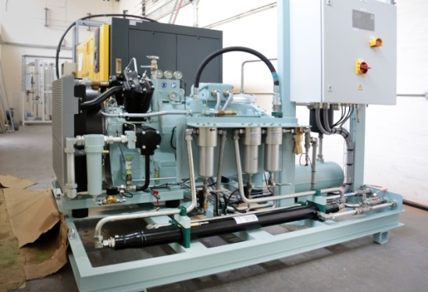
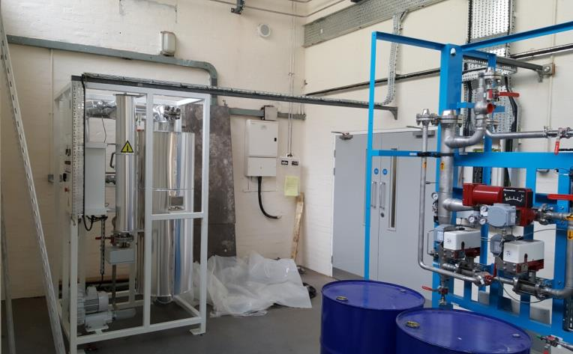
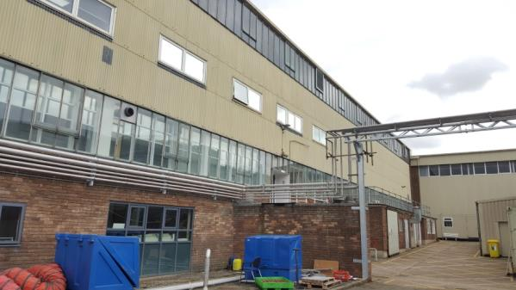
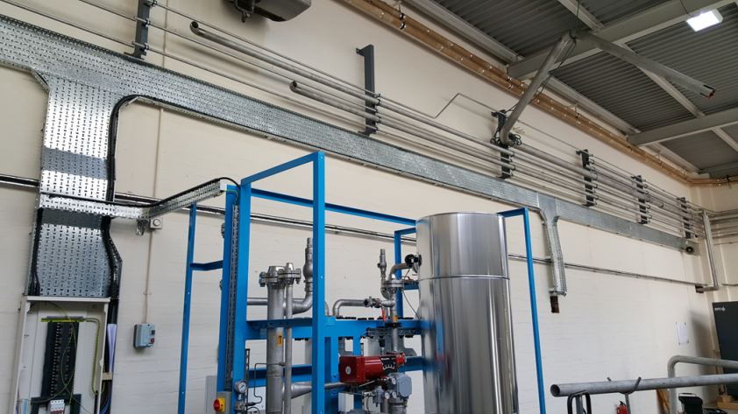
Cryogenic Plant
Air Purification Dryer
Cycle and Recovery Compressors
Majority of the pipework is in place (except final connections)
Electrical distribution on-going
Frame work for gas bag recovery system is due in June
PLC program for 2K pumps is being developed
Oil Recovery System

Slide 17
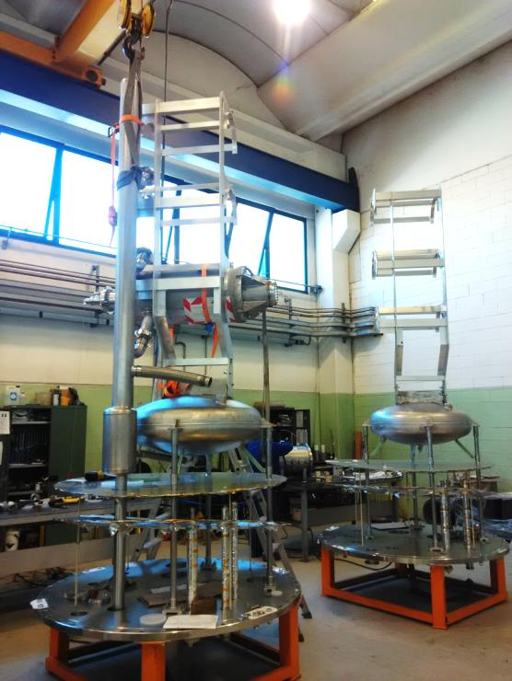
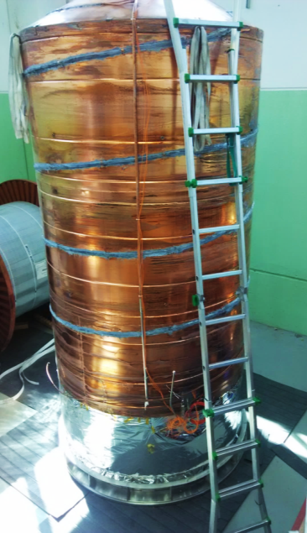
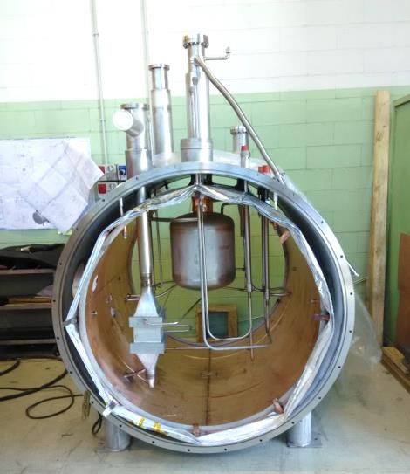
Cryostat
Cavities to be tested horizontally
Crystat is being produced by Criotec
Cryostat ahead of schedule
  Delivery June
Magnetic shielding is being provided by MSL Magnetic Shield Ltd and has been completed
  Test fitting successfully undertaken at Criotec
  Delivery to Daresbury is being arranged
  Installation scheduled - June / July
Cavity support inserts
(inverted for assembly purposes!)
Cryostat pressure vessel & thermal shielding
2K Box

Slide 18
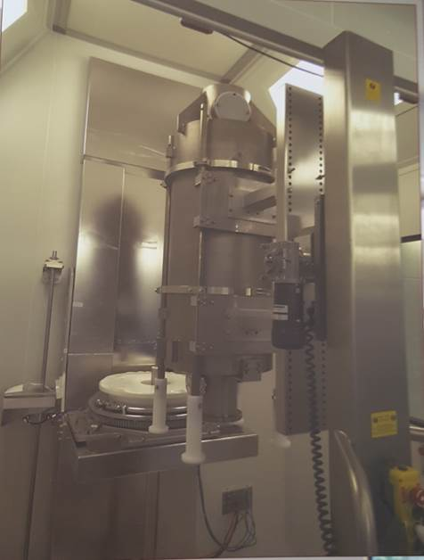
Cleanroom
Cleanroom
  The cleanroom design has been surveyed by an external cleanroom specialist and reviewed by external experts to ensure the correct standards are met for the re-work of the high-β cavities.
  Outline procedures for the cavity workflow and personnel are complete.
  A zoned area for the disassembly + assembly of the cavity has been incorporated into the design to ensure ISO 4 standards are maintained – for QA/QC.
  Order to be raised in August
HPR System
  Specification for the HPR facility has been completed and reviewed by external experts.
  Design based on the HPR system at CEA Saclay
  Tender has been run and an order placed with Acmel
  Acceptance test to be performed with a Perspex cavity
CEA HPR System

Slide 19
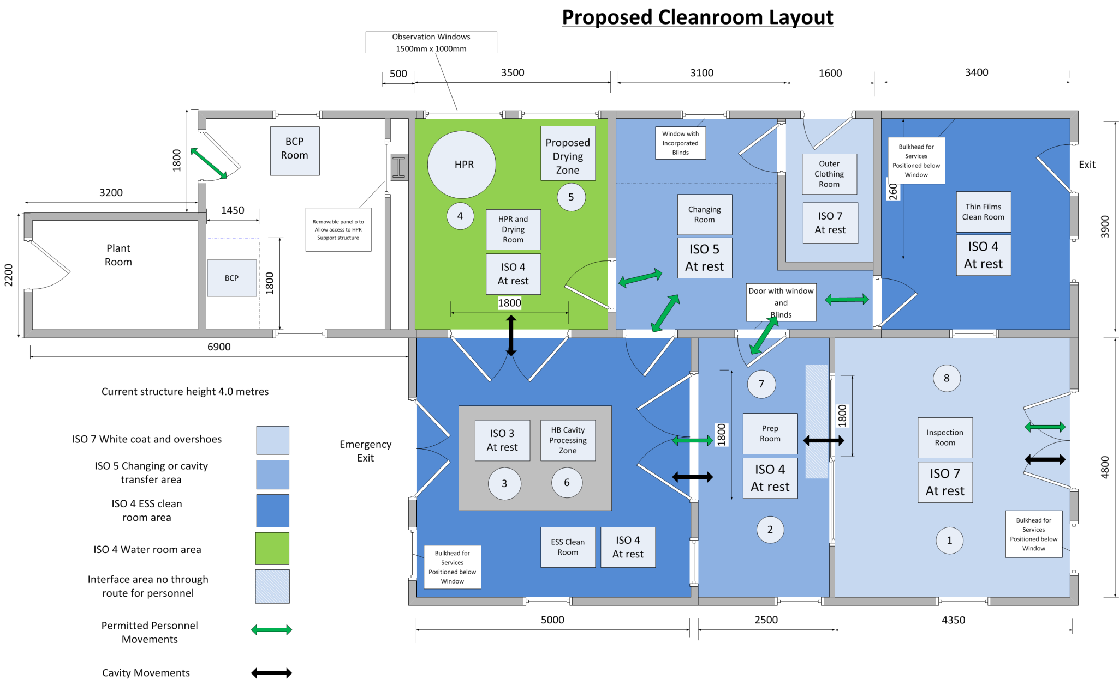
Cleanroom
ISO 4 areas: Assembly room & HPR
ISO 5 areas: Changing room & Preparation room
ISO 7 area: Inspection room

Slide 20
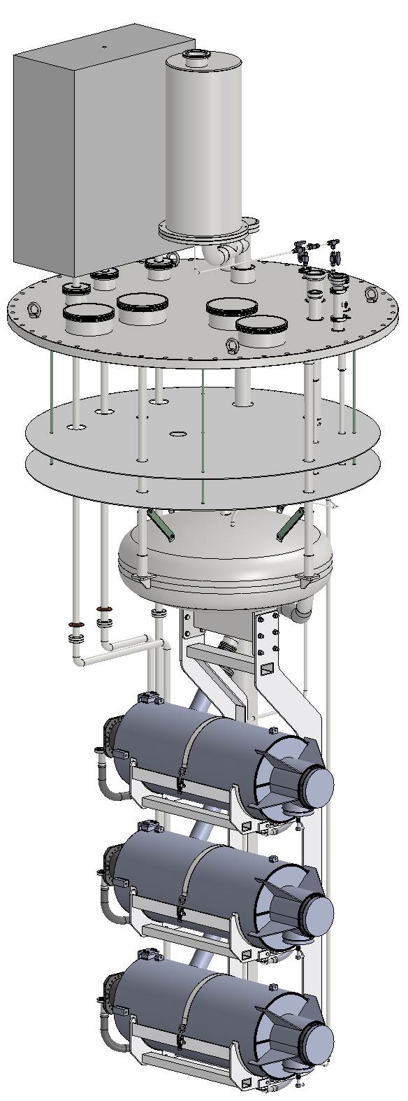
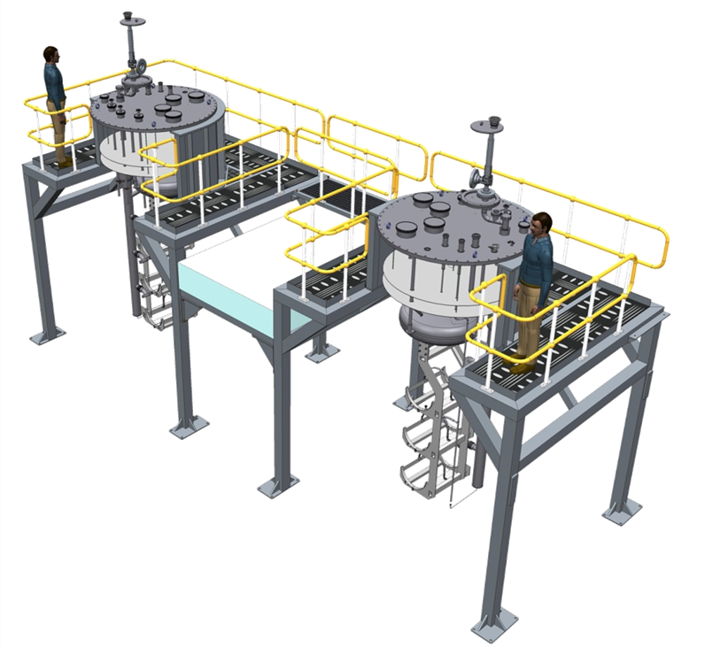
Cryostat Insert Stand
Requirements:
Structure to hold 2 Cryostat inserts 1500kg, laden ~1800kg (each)
Personnel access for vacuum and electrical connections to be made on top of the cryostat.
Access for cavity lifters to load and Unload cavities between the structure support legs.
Framework to support a cleanroom solution.
Access from the ground floor or office platform including escape route.

Slide 21
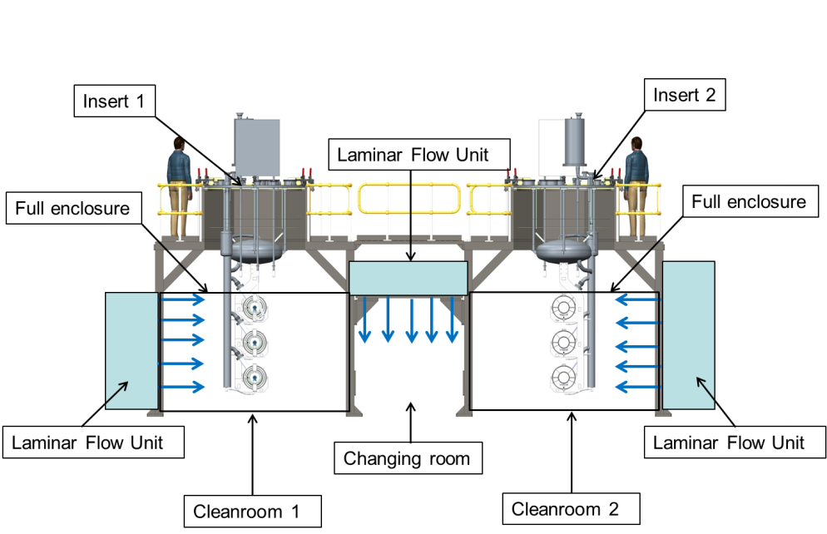
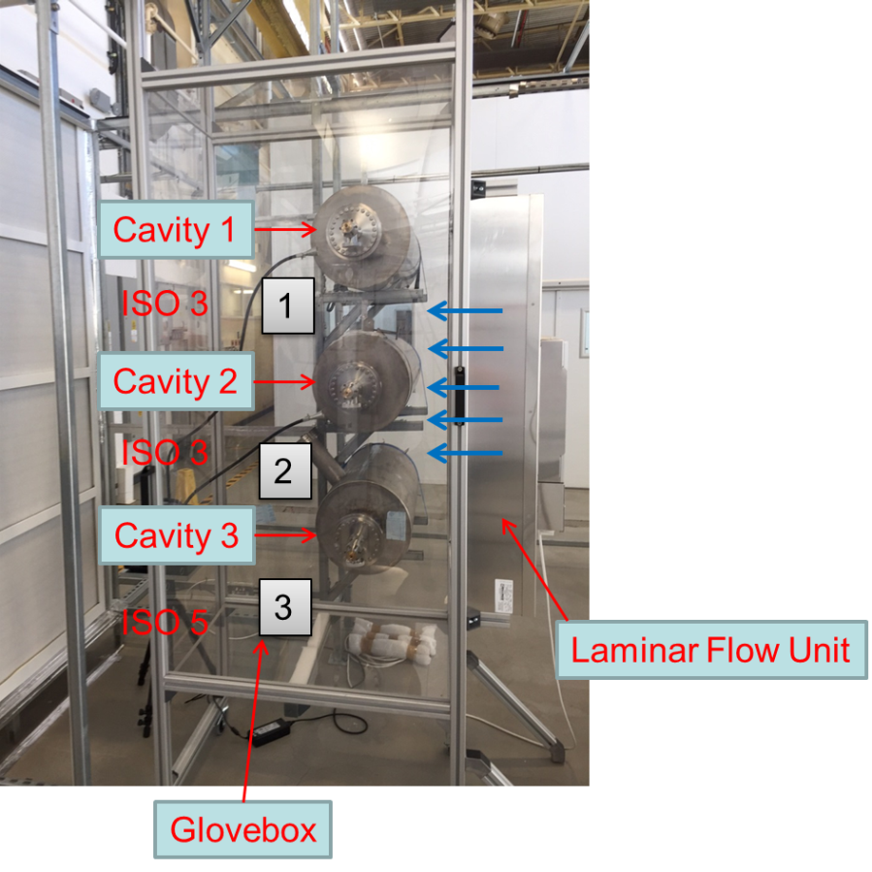
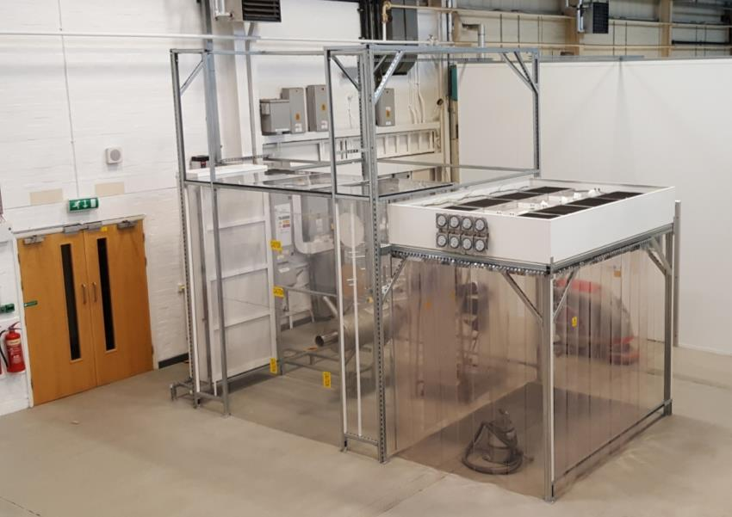
Modular Cleanroom Progress
Modular cleanroom testing has been completed
  Two configurations reviewed
    Full cleanroom
    Large glovebox
  Glovebox design is the preferred solution
Modular cleanroom & cavity support stand
  Design being finalised
  Contract for manufacture is imminent
  Target for fabrication and installation to be completed by the end of June
Mock-up
for testing & training

Slide 22
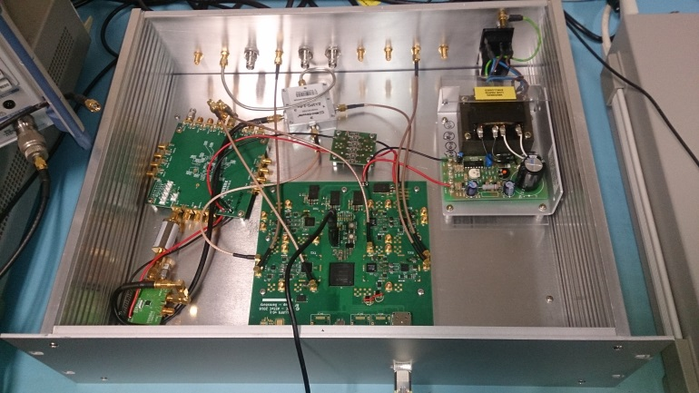
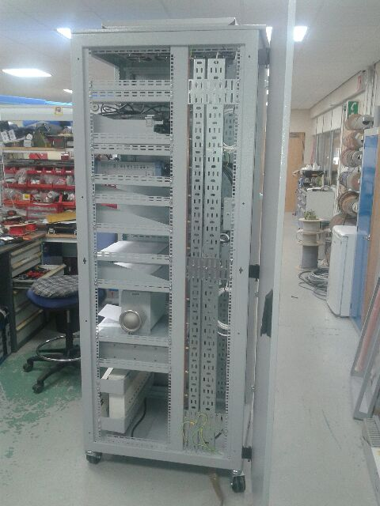
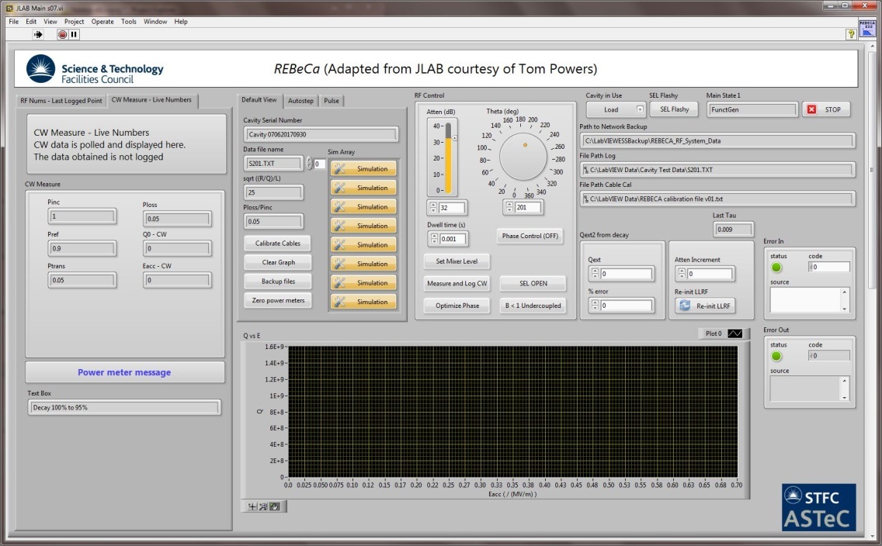
RF System
Rack design reviewed and finalised drawings completed
All parts have been delivered; rack build to be completed by the end of June
LLRF control system being developed
  Labview control system based on JLabs system developed by Tom Powers
  FPGA system being developed in-house;
    Self-excited loop algorithm has been implemented and tested
    IOC software development is on-going
Cold system testing to be performed using a Nb coaxial resonator (Q~1x10⁷) and cryo-cooler - planned for June/July
First cold tests using a cryostat targeted for Nov 2017
FPGA Development Rack
Labview Control System
RF Rack

Slide 23
Cavity Qualification Preparation

Slide 24
Procurement
Major procurements are on-going
  Niobium
  Cavity fabrication
Niobium – Initial tender unsuccessful
  4 bids received; none compliant
  Technical, commercial, schedule and selection issues
  Market survey repeated and specification has been revised
  Tender to be re-launched soon
  Eddy current scanning of the sheets is to be performed at DESY
Cavity Fabrication
  Specification on-going (90% complete)
  Market survey performed
  Planned pre-series cavity production
  ‘Final’ design and drawings awaited from ESS/CEA; existing drawings to be used on tender
  Design issues
    Flange on diphasic line
    Helium inlet (bimetallic transition)

Slide 25
QA: Cavity Fabrication
Niobium Acceptance
Detailed STFC scheme in development
Aligning with known systems
  XFEL, LASA, industrial experience
Incorporate prototype learning
Incorporate any requirements specific to ESS Cryomodule design
Will include all required control measurements
  RF frequency, FF, HOM spectra
  Mechanical dims, CMM etc
  Visual inspections, ultrasound
  Treatment parameters
  Mass measurements
Acceptance level 1
A.L. 2
Acceptance Level 3

Slide 26
Future Plans & Summary

Slide 27
Future Plans
Re-launch Nb tender
Launch cavity fabrication tender
Progress infrastructure installation and commissioning
  Cryoplant commissioning
  Cryostat delivery – July 2017
  RF system commissioning – Dec 2017
  HPR system delivery – Jan 2018
  Cleanroom delivery – Jan 2018

Slide 28
Summary
Infrastructure development progressing well with much progress made over the last year - Need to ensure the schedule is maintained
Nb procurement is on the critical path – Tender to be re-launched.
Cavity fabrication tender to follow shortly after Nb tender
Schedule for the high-β elliptical cavities is tight wrt the ESS programme
Programme needs continued strong coordination between ESS, STFC, CEA & INFN to ensure requirements and timescales are maintained

Slide 29
Any Questions

Slide 30
Additional Slides

Slide 31
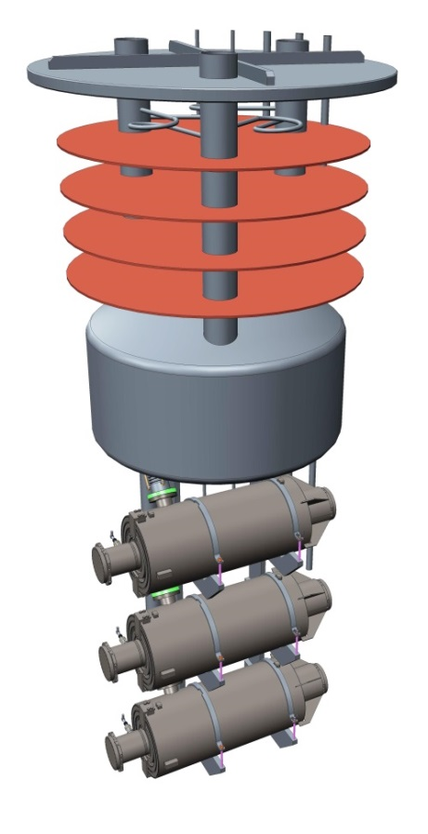
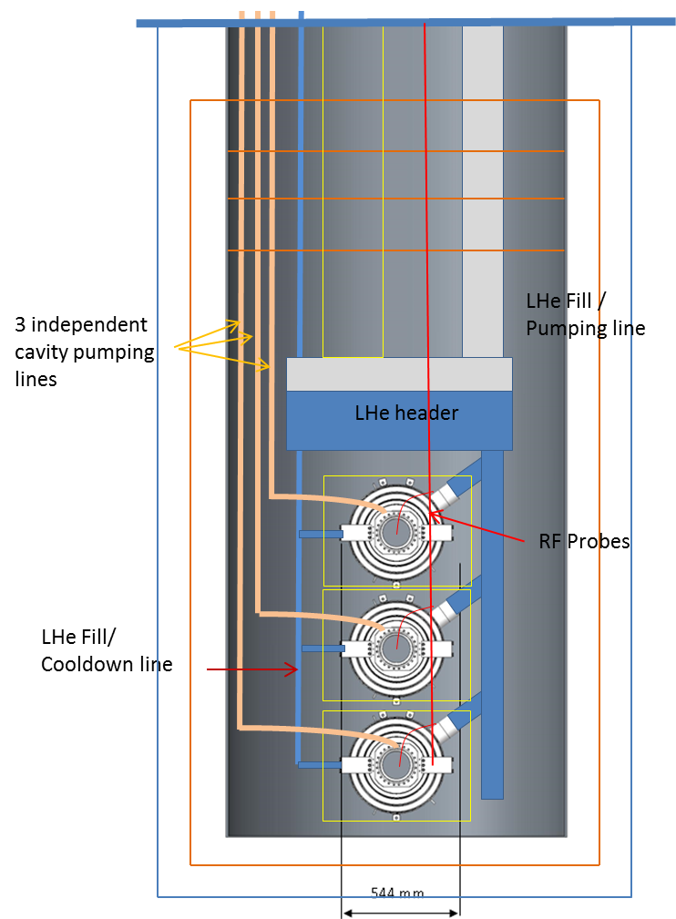
Horizontal Tests in a Cryostat
Aim to test 3 cavities horizontal in the cryostat
  Diameter sufficient to test 3 vertically if required
Helium vessel will be used to cool the cavities:
  Reduced LHe requirements  75% saving on LHe and gas storage
  Automatic leak checks on He vessel
  Higher confidence in performance
  Quicker cool-down/warm up periods
Cryostat order placed with Criotec
Schedule discussions held
Kick-off meeting 1st June 2016
  Requirements to be fully defined and agreed
Delivery May 2017 (Improvement from the original date of July 2017)
Cryostat Proposed Design

Slide 32

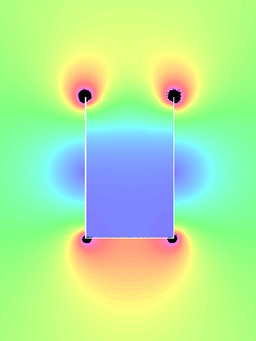
Magnetic Shielding of the Cryostat
  Target field at the cavities is 1µT
  Background field measurements performed
  Defined magnetic shield needed to be capable dealing with fields of:-
    100 µT vertically
    50 µT horizontally
  Full size model of shield constructed in OPERA – 2D with background fields and accurate mu-metal BH curve
  Defines a mu-shield thickness of 1.5 mm
  For the lid a cylinder designed with a coil around the inside the top to provide active shielding allows suitable compensation of field at current densities in the region of 0.4 – 0.45 A/mm² for heights below 1.8 m

Slide 33
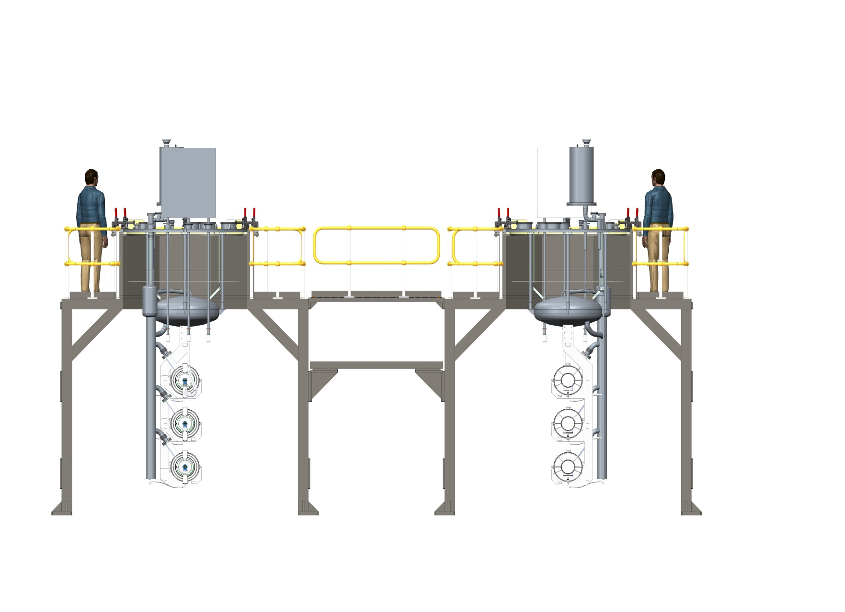
Modular Cleanroom Progress
Insert 1
Insert 2
Laminar Flow Unit
Full enclosure
Full enclosure
Laminar Flow Unit
Laminar Flow Unit
Changing room
Cleanroom 1
Cleanroom 2

Slide 34
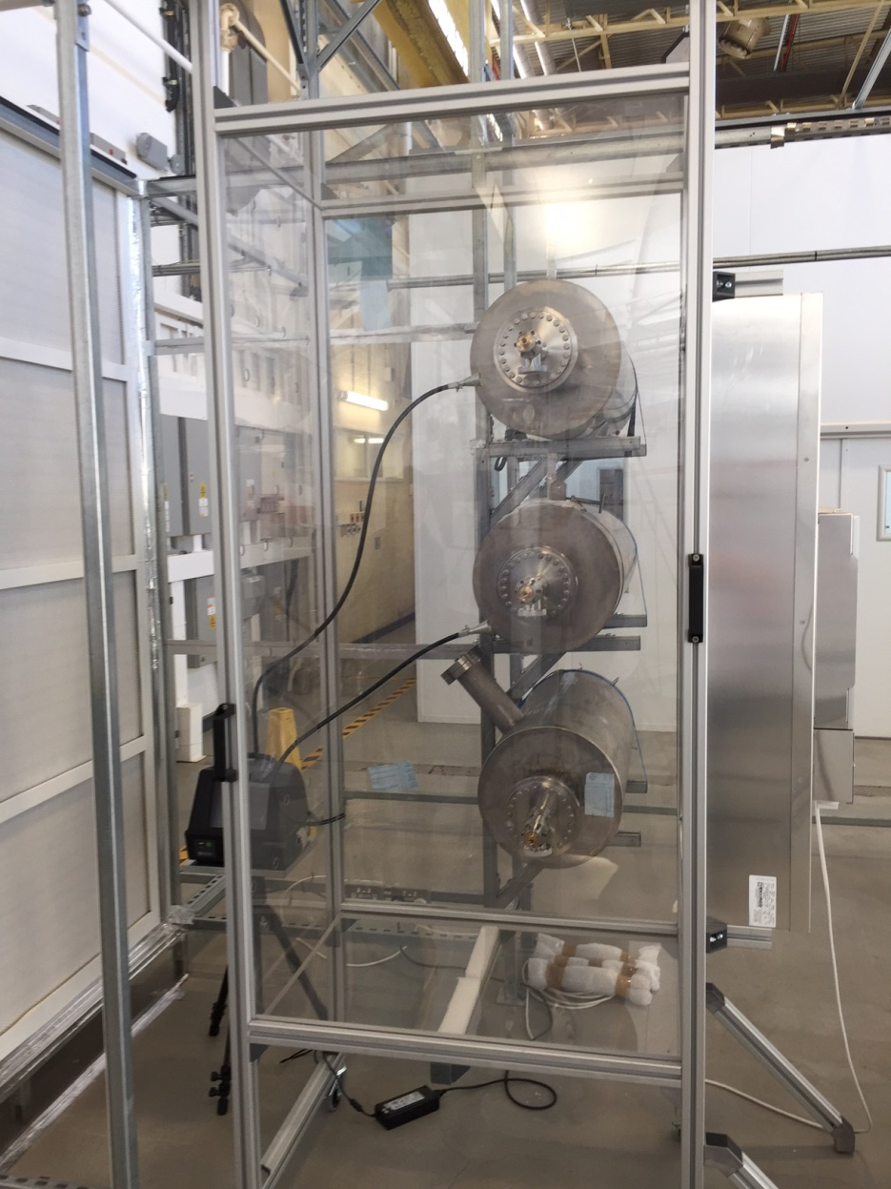
Glovebox Solution
The Glovebox solution has been
designed to:
Reduce the size of the cleanroom.
Speed up the process, minimising
cleaning of the cavity and
infrastructure – reduced manpower.
Eliminate the changing area and
full gowning procedures.
User friendly solution for enclosure/
isolation of the cavities.
Reduce overall costs.
Fixed particle counter monitoring for
each cavity – quality control.
Cavity 1
ISO 3
1
Cavity 2
ISO 3
2
Cavity 3
ISO 5
3
Laminar Flow Unit
Best result: ISO 3 at rest
Glovebox

