Slide 1
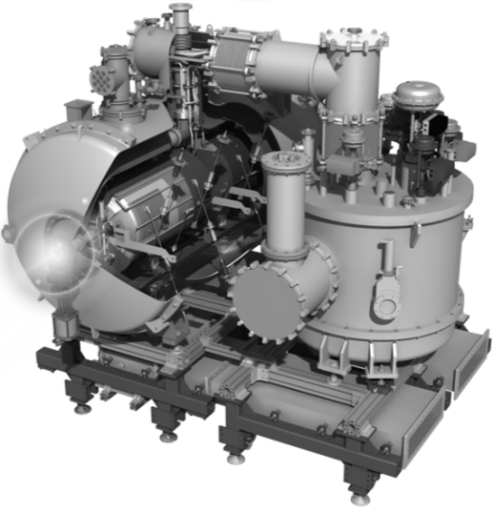
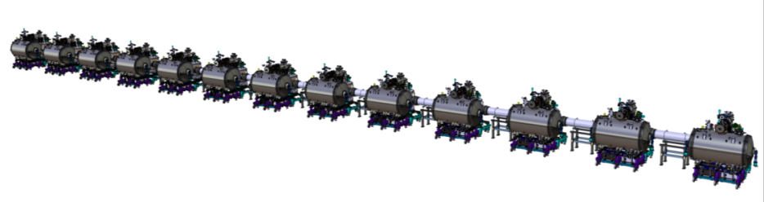
Cryogenic tests of the ESS Spoke prototype cryomodule and it's valve box
7th Open Collaboration Meeting on Superconducting Linacs for High Power Proton Beams (SLHiPP-7)
8-9 June 2017
P. DUTHIL (CNRS-IN2P3 IPN Orsay / Division Accélérateurs)
on behalf of the IPNO team, ESS and Uppsala university colleagues

Slide 2
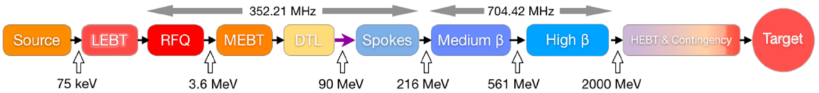

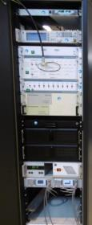

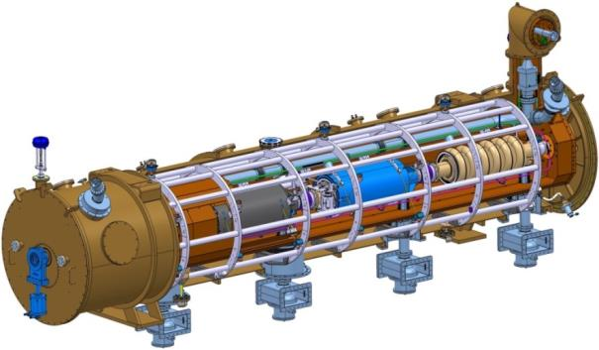
ESS MACHINE
The European Spallation Source (ESS) LINAC
CNRS CONTRIBUTION (CNRS/IN2P3/IPNO)
P
SRF LINAC: ~312 m
Moderated neutrons To experiments lines
LENGTH:
    SRF cavity cooling: 2 K in saturated He II bath (⇒ simple techno.+ few energy stored + pressure control)
    Elliptical section (~256 m):
    design of the 30 cryomodules
    (collaboration with )
    Design, construction and installation of the Spoke section (~56 m) except warm Spoke units (focusing and diagnostics)
    Design, construction and installation of the cryogenic C&C system of theLINAC

Slide 3
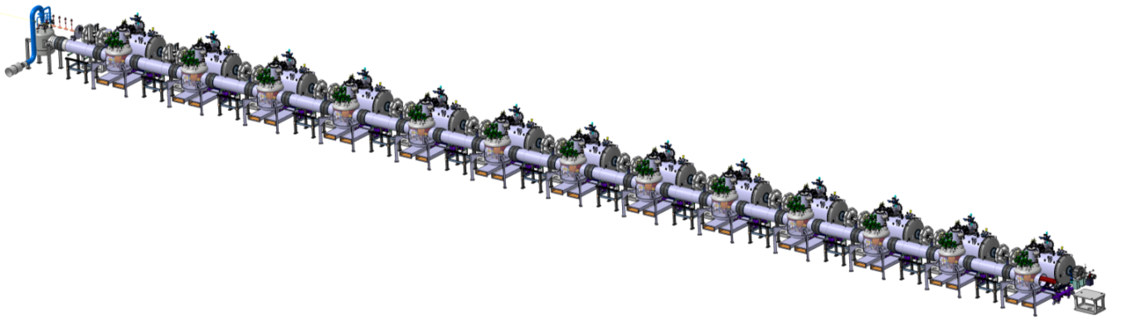
The ESS Spoke section
Spoke section overview
  13 Spoke cryomodules (SPK-CM)
  Cryogenic Distribution System for Spoke linac (CDS-SL)
    main four-channels cryoline (headers)
    13 valve boxes (VB): one for each Spoke cryomodule
    1 end box: to return excess flow to the cryogenic plant (ACCP)
    13 branch cryolines (cryogenic jumpers): connection from SPK-VB to each SPK-CM
Spoke cryomodule
End box →
Beam direction
Valve box
Headers
To the ACCP*→
* See J. WEISEND II’s talk

Slide 4
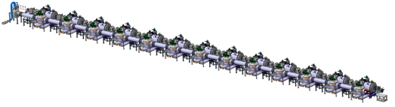
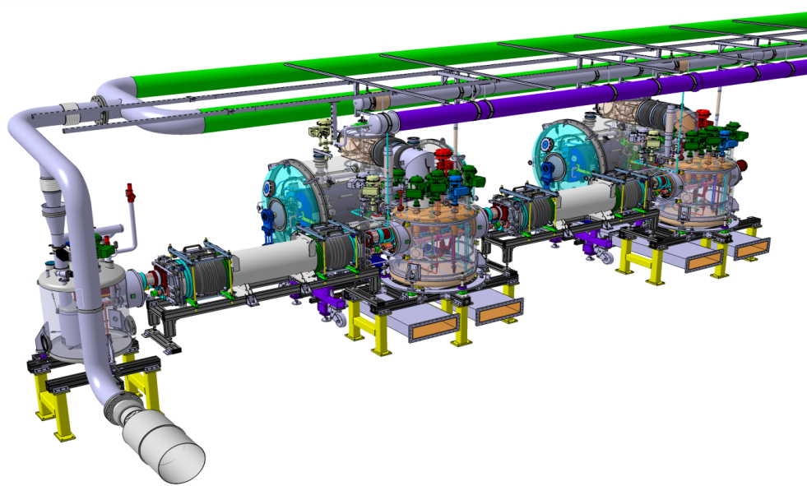
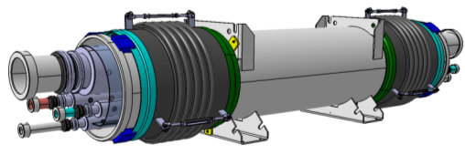
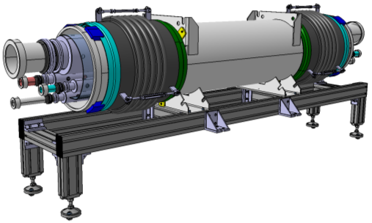
The ESS Spoke section
Spoke section overview
  Cryogenic Distribution System for Spoke linac (CDS-SL)
Auxiliary lines
Valve box
Headers
Vent line
End Box
    main four-channels cryoline (headers unit)

Slide 5
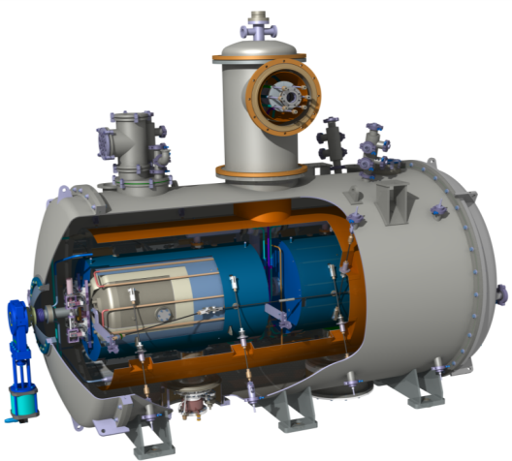
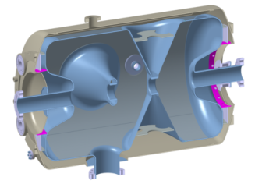
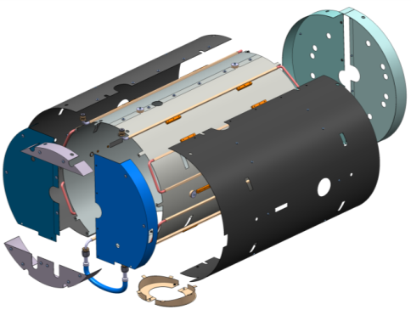
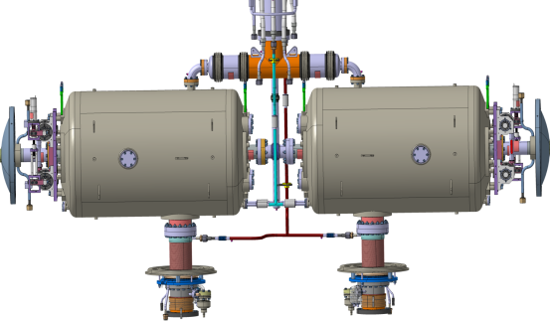
The ESS Spoke section
Spoke section overview
  The ESS Spoke cryomodule
Cryodistribution
Interface to VB
2x Double Spoke Cavity
Frequency [MHz] | 352.21
Beta_optimum | 0.50
Operating gradient [MV/m] | 9.0
2x
See D. Longuevergne’s talk
∅~1,3 m
2x Magnetic shield
Cryophy® | Double layer
Working temperature | Cooled down before cavity transition by use of a dedicated cryocircuit
2,86 m
Cooling circuit
Internal shield
Tuner side ends
External shield
Cavity bellow side ends
Shield support
Coupler shield

Slide 6
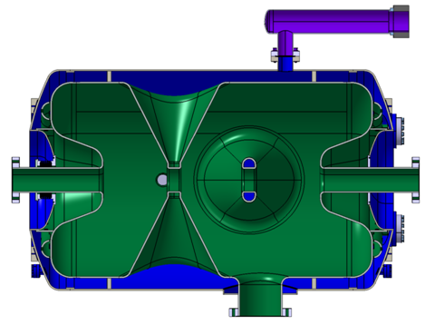
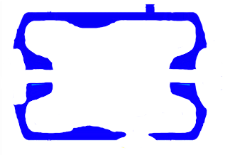
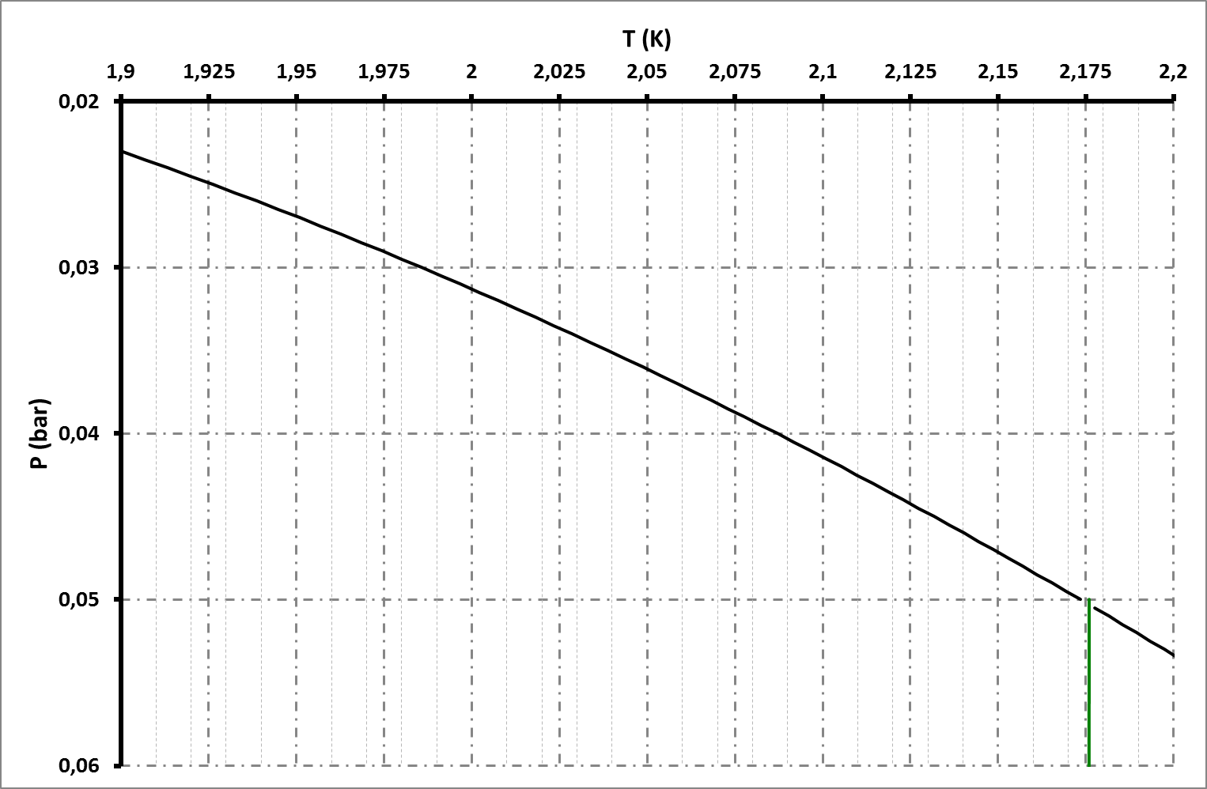
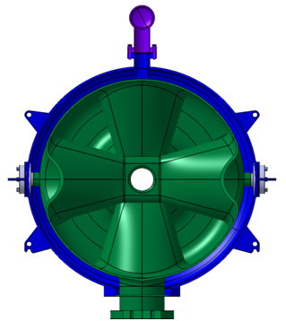
The ESS Spoke section
Operating SRF Spoke cavities (nominal operations)
609 mm
Bi-phase pipe: liquid/vapour interface
150 mm
488 mm
VAPOUR
Subcooled liquid
Bi-phase pipe
Top of the cavity
Bottom of the cavity
Thermal Margin
Point λ
SUPERFLUID
LIQUID
(He II)
Ligne λ
Bath pressure

Slide 7

The ESS Spoke section
The ESS Spoke cryomodule
Cryomodule heat load budget
  2 double Spoke cavities @ 2 K (sat. HeII)
    RF 2 x 2.5 W (requirement)
  Beam loss: 1.5 W (ESS requirement)
  2 RF power couplers:
    Heat intercept within the coupler double wall: SHe (3 bara; 5-300 K)
    liquefaction power ~ 2x 0.40 g/s (RF OFF)
    + 2x 6 mg/s (RF ON)
    2 x 1,75 W @ 2 K (heat rad + diffusion)
  Rest of static heat loads @ 2 K: ~ 6,5 W
  ⇒ total static heat loads of ~ 10 W
  NB: dynamic heat loads ~ 2/3x static heat loads
Instrumentation (measurement of T,
P, cryo levels)
Cavities Supporting system
2 spoke cavities
2 Cold to warm transitions
2 RF power couplers

Slide 8
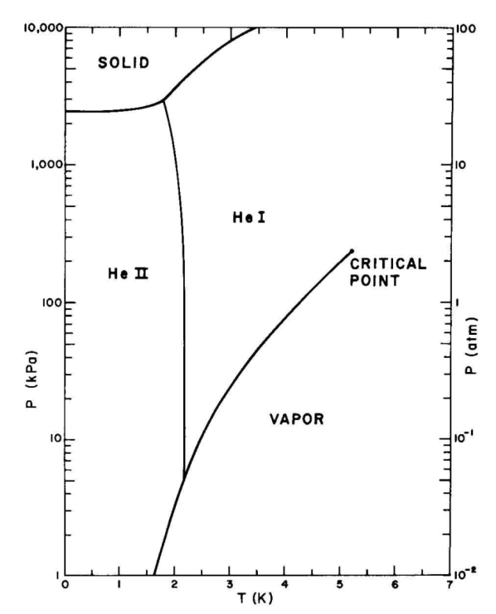
The ESS Spoke section
Operating SRF Spoke cavities (nominal operations)
⁴He phase diagram
Pump
(to decrease pressure)
Superfluid Helium
1 bar
Saturated vapour
Saturated Helium I
Saturated liquid
Saturated Helium II

Slide 9
The ESS Spoke section
Operating SRF Spoke cavities (nominal operations)
⁴He phase diagram
Pump
(to decrease pressure)
PressurizedHelium I
Superfluid Helium
1 bar
Saturated vapour
Saturated Helium I
Saturated liquid
Saturated Helium II

Slide 10

The ESS Spoke section
Operating SRF Spoke cavities (nominal operations)
⁴He phase diagram
Pump
(to decrease pressure)
PressurizedHelium I
Superfluid Helium
1 bar
Saturated vapour
Saturated Helium I
Maintain the LHe level
Saturated liquid
Saturated Helium II
Heat loads

Slide 11
The ESS Spoke section
Operating SRF Spoke cavities (nominal operations)
⁴He phase diagram
Pump
(to decrease pressure)
Heat
Heat exhanger
(subcooler)
PressurizedHelium I
Superfluid Helium
Cooling at P=cst
Pressure drop
(JT expansion)
Valve
1 bar
Saturated vapour
Saturated Helium I
Maintain the LHe level
Expansion (pressure drop) at h=cst
Saturated liquid
Saturated Helium II
Heat loads

Slide 12
The ESS Spoke section
Operating SRF Spoke cavities (nominal operations)
⁴He phase diagram
Pump
Heat
Heat exhanger
(subcooler)
PressurizedHelium I
T_{HEX_HP_outlet}
Superfluid Helium
Cooling at P=cst
Valve
1 bar
Saturated vapour
Saturated Helium I
Expansion (pressure drop) at h=cst
Saturated liquid
Production of a mix of liquid + vapour
To be noted: the lowest is the T_{HEX_HP_outlet} :
the larger is the ratio liquid/vapour
⇒ lot of usefull liquid produced versus "lost" vapour
⇒ JT expansion is efficient
Saturated Helium II

Slide 13
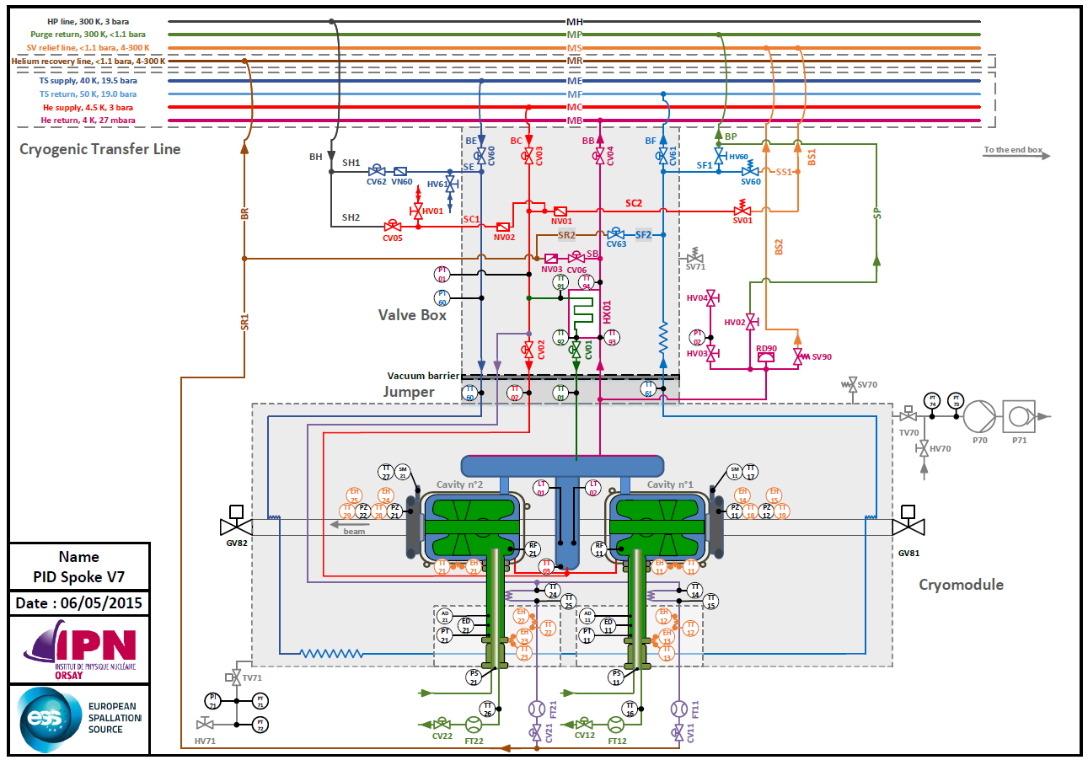
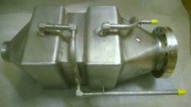
The ESS Spoke section
Flow scheme (PID): machine version
ESS cryoplant supplies:
He: 3 bara; 4.5 K
(and He: ~20 bara; ~40 K)
CDS-SL Key features:
All cryovalves are in the valve box
(none in the cryomodule)
He II locally produced in the valve box by:
- isobaric cooling (subcooler 2,5 g/s)
- JT expansion
RF coupler heat intercept:
SHe (ACCP supplies 3 bara; 5-300 K)
⇒ liquefaction power ∼ 26 x 50 mg/s

Slide 14
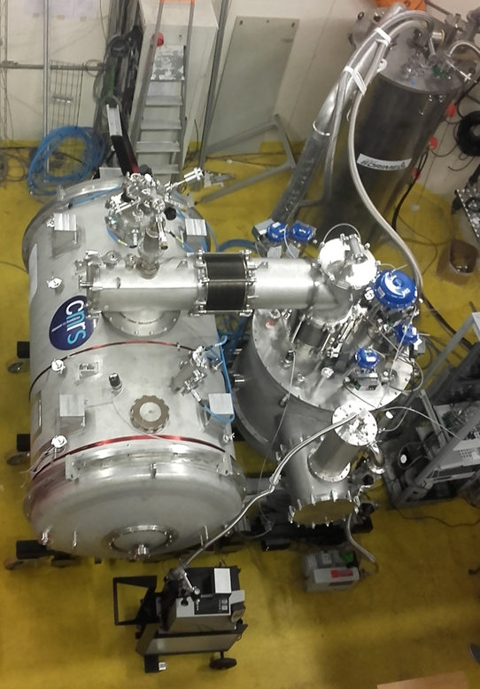
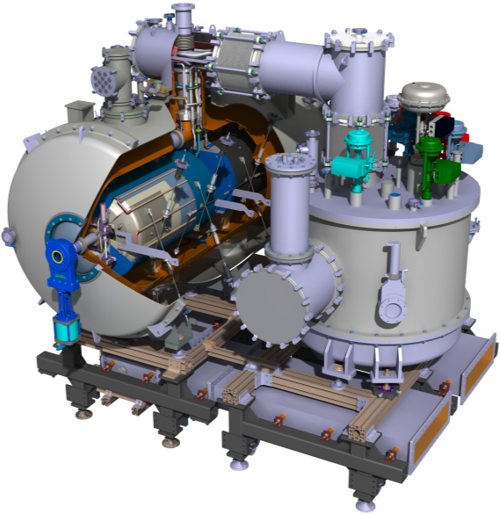
Prototyping the Spoke section
Prototypes: 1 SPK-CM + 1 SPK-VB
CRYOGENIC JUMPERS
PROTORYPE SPOKE CRYOMODULE
PROTOTYPE /TEST VALVE BOX

Slide 15

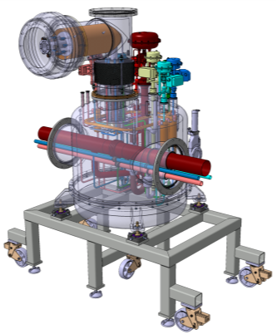

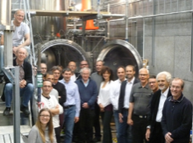
Prototyping the Spoke section
Prototype Cryomodule
and test
ESS Series cryomodules
Prototype Valve box
IPNO
Uppsala univ.
@ Uppsala Univ. (UU)
  A prototype and test valve box:
    Prototype valve box ⇒ to validate the valve box concepts
    ⇒ to validate the prototype Spoke cryomodule
    Test valve box ⇒ to validate 13 series Spoke cryomodules
    ⇒ Compromise between an optimized test stand and a demonstrator (cryoprocess, assembly)
  A versatile (flexible) valve box
    Tests at IPNOrsay (FRANCE)
    Tests at Uppsala University (SWEDEN)
    ⇒ To manage different cryogenic infrastructures

Slide 16
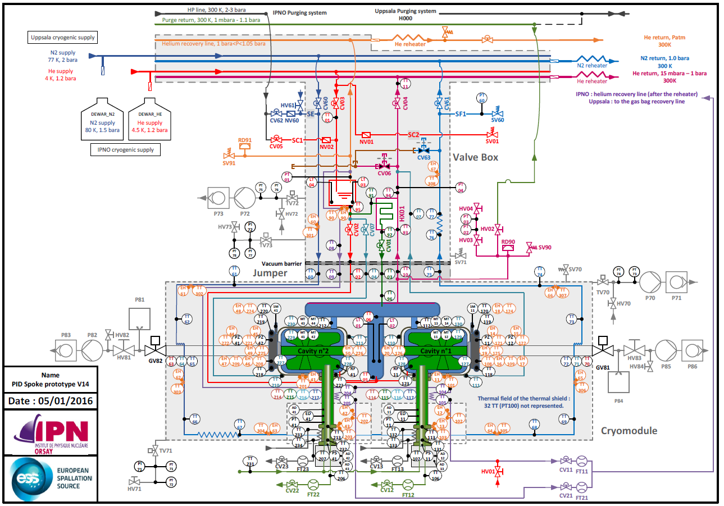
Prototyping the Spoke section
Protype and test valve box
  Flow scheme (PID): prototype version
Main differences wrt the machine configuration:
Instrumentation (T° sensors: 60 CX + 110 PT100; 69 heaters, etc)

Slide 17
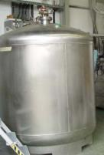
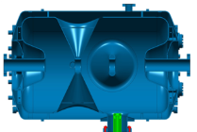
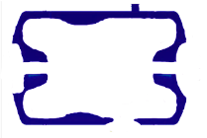

Prototyping the Spoke section
Protype and test valve box
  Operating prototype SRF Spoke cavities
T_{sat,} P_{sat}
~P_{sat}, T_{sat}
Main differences wrt the machine configuration:
Cryodfluids supplies:
  - Thermal shield: saturated LN₂ supply (no low T° pressurized He)
  Saturated LHe supply (not pressurized)
  . vapour produced ⇨ phase separator in the VB
  . T_{sat} and P_{sat} are dependant variables: when P_{sat} is decreased, T_{sat} is also decreased
  to obtain good JT efficiency we need to decrease T_{HEX_HP_outlet} ⇨ and to decrease T_{sat} and P_{sat}
  - heat intercept along the RF double wall coupler is done by use of cold saturated vapours instead of SHe* ⇒ very low ΔP is allowed along the whole cooling circuit
~T_{sat}
Pump
Heat
Heat exhanger
(subcooler)
T_{HEX_HP_outlet}
Valve
Ratio of Liq/Vap production depends on JT expansion efficiency
~P_{atm}
ΔP=P_{sat}-P_{atm}~100 mbar
*Tests of coupler cooling with She are performed in HNOOS at UU, see H. Li’s talk
Mass flow regulation

Slide 18
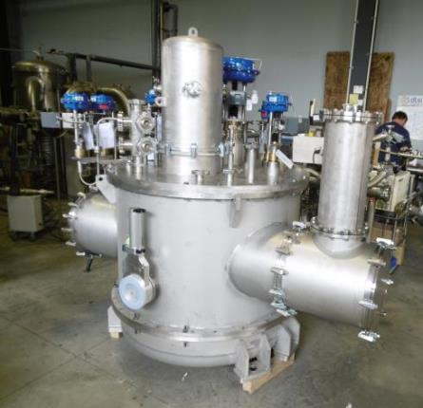
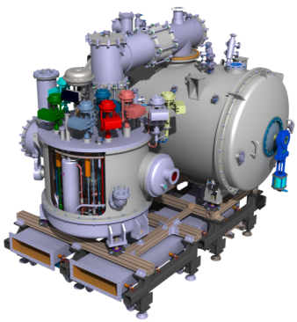
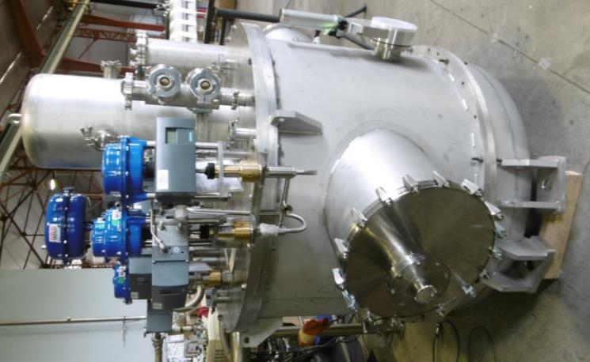
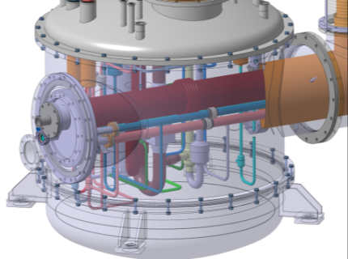
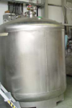
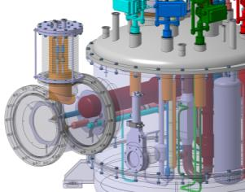
Protype and test valve box
  Overview
Phase separator
Liquid inlets
Dewars
Vapours exhaust
Or
Uppsala cryogenic infras
Horizontal headers integrated to explore future series VB assembly

Slide 19
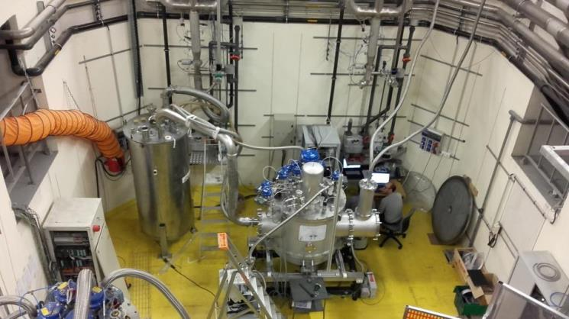
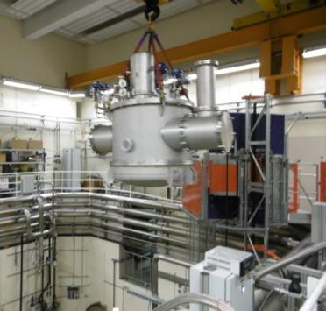
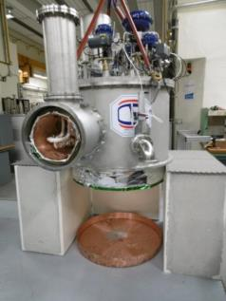
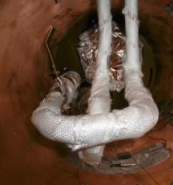
Testing the prototypes
Valve Box
Delivered in Sept. 2016 (delay ~ 9 months)
Installed in Supratech platform (IPNO) Oct. 2016
1st cool-down and operation at 4 K in Oct. 2016
some minor problems detected but tests were OK:
no thermoacoustic activities,
C&C (diagnostics and LHe regulations OK)
no leak…
Valve box was disassembled at IPNO and the minor problems corrected with the manufactrer (Oct. 2016)

Slide 20
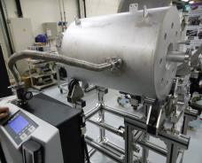
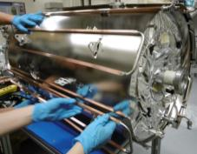
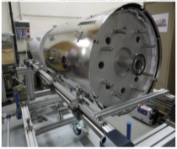
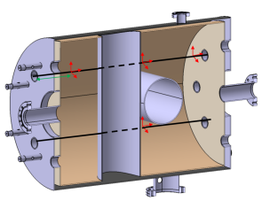
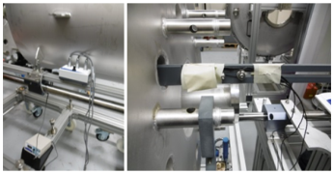
Testing the prototypes
Tank
Crymodule + Valve box test
  2 mock-up cavities instead of 2 db Spoke cavities
  Context: UU test plan and ESS (aggressive) schedule
  Goals:
    Assembly/mechanics: test the cryostating tooling
    Cryogenics:
      Cryo Tests: cool-down, He II production , C&C (regulations…)
      Cryo measurements (heat loads, liquids consumption…)
      ⇒ Same LHe tank volume: 52 L
      ⇒ “Similar” geometry
      masses 2x 95 kg 304L instead of 2x (75 kg Nb + 40 kg Ti)
      ⇒ 5% additional He consumption during cool-down
    RF package related activities:
      Measurement of the magnetic field inside the mock-up cavities
      at room and cryo T° to evaluate the shielding properties
      real magnetic shields (double layer) was set on
      12x single axis fluxgate magnetometers
      (several locations within the 2 mock-up cavities
      and tri-axial functions)
AISI 304 - 3mm
Mock-up cavity
AISI 304 - 3mm

Slide 21
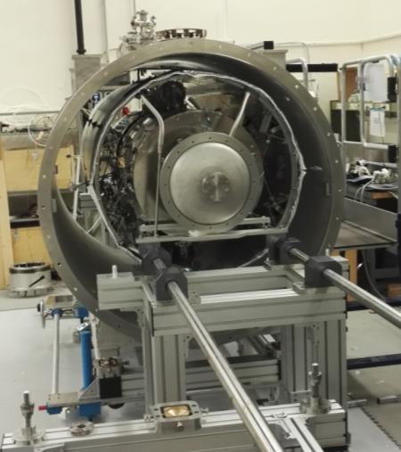
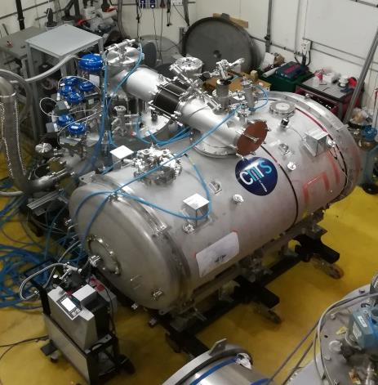
Testing the prototypes
Crymodule test
  Assembly of the cryomodule was done at the end of October 2016
  Cryogenic jumpers delivered in
  November 2016
  All the set-up installed in the experimental
  test area in November 2016

Slide 22
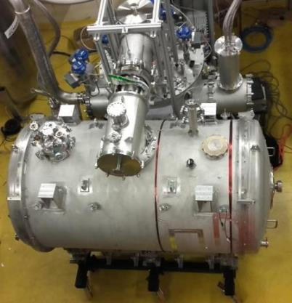
Prototyping the Spoke section
Cryogenic jumpers
  Connection of the cryomodule to the valve box was performed and…
  troubles began !
From end of Nov. 2016 to April 2017: solving problems and creating new problems to be solved !
Main technical cause: the cryogenic jumpers
- delivered bellows (inside the jumpers and covered by MLI) were not corresponding to the design drawings
- cryogenic jumpers pressure test tools were not well sized
plastic deformation of bellows during pressure test (but no leak)
bellows damaged when cryogenic circuit were vacuum pumped
Leaks occured:
on the cryomodule side of the cryogenic jumper first
then on the valve box side…
NB: context of the ESS schedule
⇒ Everything was done (and tried) to perform a cryo test ASAP

Slide 23
Prototyping the Spoke section
Consequences
  Connection of the cryomodule to the valve box and…
  troubles began !
Technical point of view:
VB jumper was repaired by the manufacturer
Meantime, some components of the CM jumper were changed and repaired at IPNO
(with on-stock or used components)
- VLP branch line was modified (DN40 inside a DN100 !)
- Exhaust burst disk line modifed: DN100 ⇒ DN40 (use of mock-up cavities so beam
vacuum loss incident is not considered)
Project point of view:
Diagnostics difficult to evaluate (e.g. information from/to the manufacturer)
Fast decision to take wrt to the schedule context
  seemingly good decisions can have unexpected (bad) consequences
e.g.: trying to repair the CM within the experimental area to save time
without the cryostating tooling + with cryogenic bellows not correctly designed/manufactured
⇒ damaged the magnetic shield cooling circuit because of guided bellows…

Slide 24
Prototyping the Spoke section
Cryogenic tests
  Experimental configuration
    - March 2017: cryomodule and valve box connected
    Configuration "not optimal" (the worst possible configuration for cryogenics?) as:
      . 3/4 of the 2 magnetic shields not cooled
      . pumping line (VLP) modified inducing additional heat load ⇒ + 0,3 W @ 2 K
      . 1 power coupler double-wall installed but not cooled (low pressure drop mass flow meter not procured) ⇒ + 18 W @ 2 K
      to be added to the 9.5 W of static heat loading the 2 K bath.
      ⇒ 1,35 g/s of LHe needed at 2 K with a JT efficiency of 90%
    - Availability of liquid helium limited due to the stand-by of helium liquefying operations (periodic control of the helium liquefier)
    - But 4 K and 2 K cryogenic tests were performed with the Spoke cryomodule and test valve box

Slide 25
Prototyping the Spoke section
Cryogenic tests
  Some results
    - Cool down (CM + VB):
      . Time measurement:
      3.5 h from LN2 supply to LHe supply
      4 h from LHe supply to LHe level regulation into the mock-up cavities
      . Consumption:
      ~375 LHe for cool down of the valve box and the cryomodule
      ⇒ averaged mass flow rate: 3.25 g/s over the 4 hours cool down
    - 4 K operation (CM + VB):
      . Stand-by 4 K mode was operated succesfully: pressures and liquid levels regulations of the cryomodule and valve box phase separators were operating normally.
    - 2 K operation (CM + VB):
      . 2 K mode was operated during 20 min;
      . during that time, a level of 20 cm of LHeII was regulated in the mock-up cavities
      (the cavities were not filled up because: this was a first test, LHe availability was limited due to the liquefier stand-by, burst disk was reduced from DN100 to DN 40
      . a mass flow rate of 1.55 g/s was measured at 1.95 K (vs 1.35 g/s estimated ⇒ extra 15%)
      ⇒ origin of the additional 0.2 g/s? ⇒ JT expansion not so efficient (warm magnetic shield, top of the cavities and bi-phase not filled with He)? Probably but not confirmed (lack of diagnostic).

Slide 26
Conclusion
Testing the prototype Spoke cryomodule and testvalve box
  1st 4 K and 2K modes operations
    Cool-down OK
    Mechanics OK for the valve box and the cryomodule; not for the jumpers
    C&C OK
    Some encouraging results
    Some minor modifications to do and done
  Cryomodule disassembled for repairs and new test configuration
  Magnetic shield cooling circuit already repaired
Foreseen Plan
  Cryogenic jumper of the cryomodule entirely repaired (and modified)
    To be delivered by the manufacturer on Monday June 12th + IPNO integration
  Re-assembly of the Spoke cryomodule with:
      1 mock-up cavity equipped with
      .double wall coupler (to be cooled)
      . magnetic shield and fluxgate magnetometers
      1 double Spoke cavity equipped with
      . RF antennas
      . Spoke cold tuning system (see N. Gandolfo’s talk)
  New (cryo) tests planned to start from end of June

Slide 27
Thank you for your attention
CSP12
28 Novembre 2014

