Slide 1
Status of ESS
Mats Lindroos
Head of Accelerator
Adjungated Professor at Lund University, Physics department
and the ESS Accelerator Collaboration
www.europeanspallationsource.se
June 2017

Slide 2
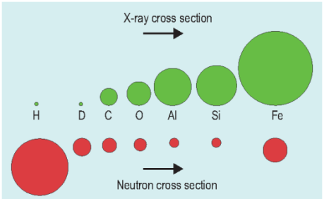
Neutrons & x-rays: similar methods, sensitive to different elements.

Slide 3

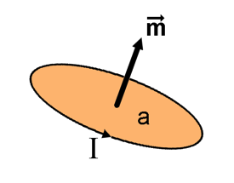
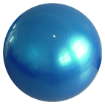

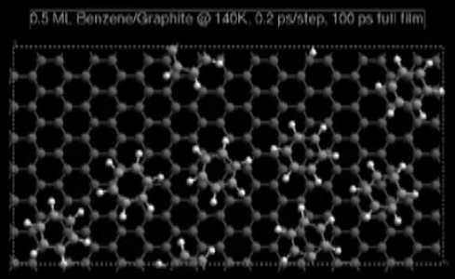
Neutrons are beautiful!
Wave
Magnetic moment
Particle
Neutral
Diffractometers - Measure structures
– Where atoms and molecules are
Spectrometers - Measure dynamics
– What atoms and molecules do

Slide 4
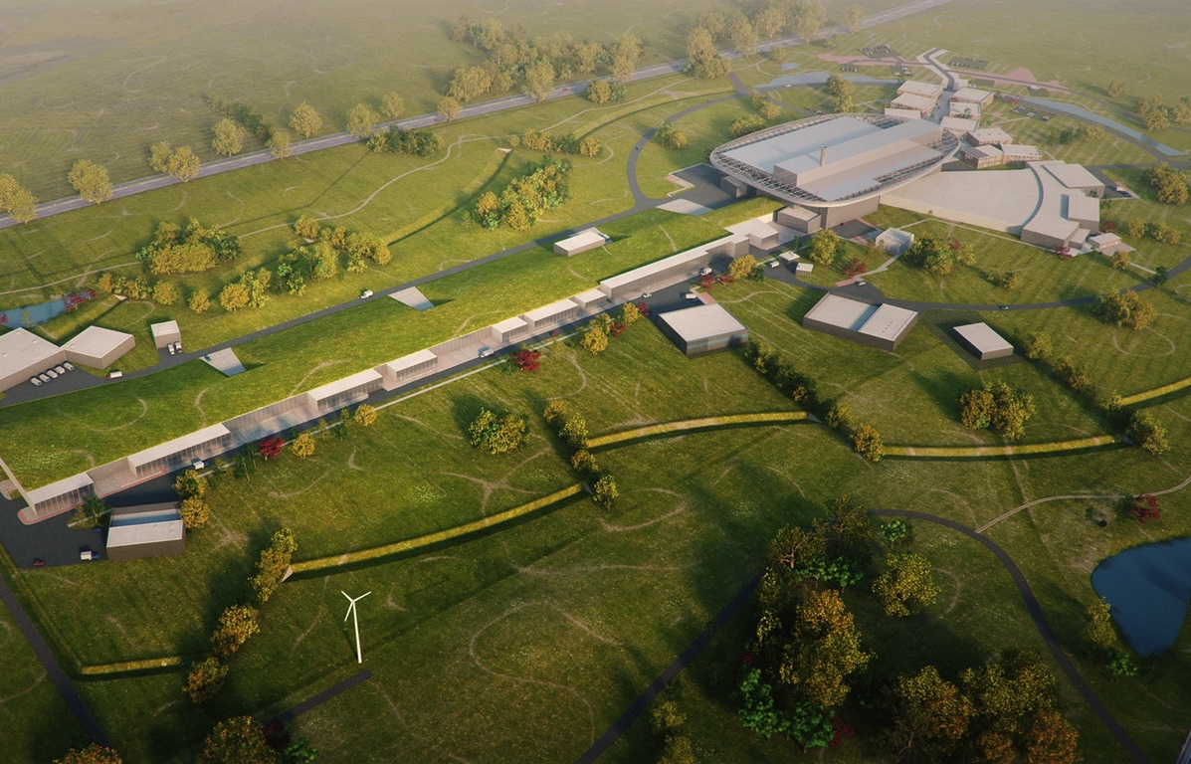
ESS design
High Power
Linear Accelerator:
Energy: 2 GeV
Rep. Rate: 14 Hz
Current: 62.5 mA
Target Station:
He-gas cooled rotating
W-target (5MW average
power)
42 beam ports
16 Instruments in Construction budget
Committed to deliver 22 instruments by 2028
Peak flux ~30-100 brighter than the ILL
Ion Source
Total cost: 1843 MEuros ₂₀₁₃

Slide 5
Neutron facilities
Reactor sources
Accelerator-driven sources
ESS
Effective thermal neutron flux n/cm²-s
J-PARC
NIST
ILL
LANSCE
ISIS
FRM-II
SNS
CSNS
Year
Notes:
CP-1 Chicago USA
CP-2 Chicago USA
X-10: Oak Ridge, USA
NRX: Chalk River, USA
MTR: Idaho, USA
LVR: Rez, Czech Republic
HIFAR: Sydney Australia
NRU: Chalk River, USA
HOR Delft Netherlands
SAFARI-1 Pretoria South Africa
HFBR: Brookhaven, USA
HFIR: ORNL, Oak Ridge, USA
NIST: National Inst. for Stds and Tech. Gaithersburg, USA
ILL: Grenoble, France
JEEP II Kjeller Norway
MARIA Swierk Poland
ORPHEE LLB Saclay France
Dhruva: Mumbai, India
RSG: serpong, Indonesia
SINQ: PSI, Switzerland
JRR-3: Tokai, Japan
ES-Salam Algiers Algeria
HANARO: Daejon KAERI, South Chorea
ETERR-2 Cairo Egypt
FRM-II: Munich, Germany
OPAL: Sydney, Australia
CARR: Beijing China
PIK: Gatchina, Russia
ZING-P Argonne USA
WNR Los Alamos USA
KENS Tsukuba Japan
IPNS Argonne USA
IBR-II Dubna Russia
LANSCE Los Alamos USA
ISIS Oxfordshire UK
SNS Oak Ridge USA
JPARC Tokai Japan
CSNS Beijing China
ESS Lund Sweden
More reactor sources exist across the world….

Slide 6
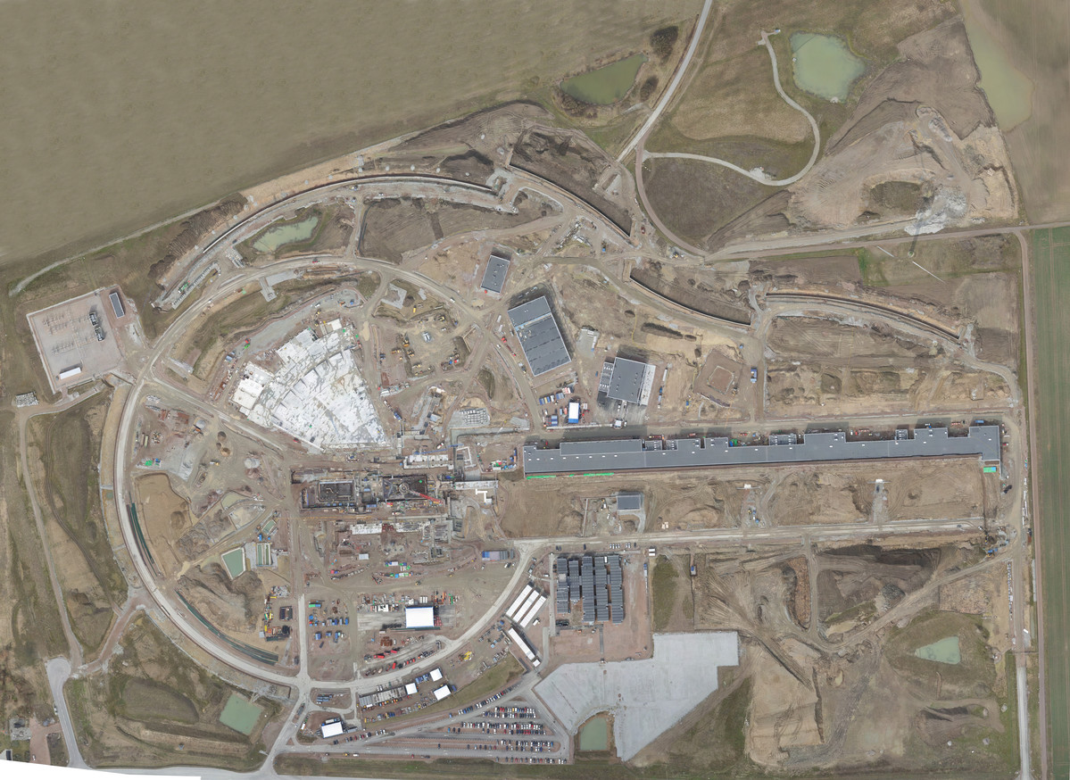

Distribution
Substation
Primary
Substation
Central Utility
Building
Exp. Hall
E01
Cryo Compressor
Building
Klystron Gallery
Front End
Building
Active
Cells
Target
Monolith
High Energy
Loading Bay
April 2017

Slide 7
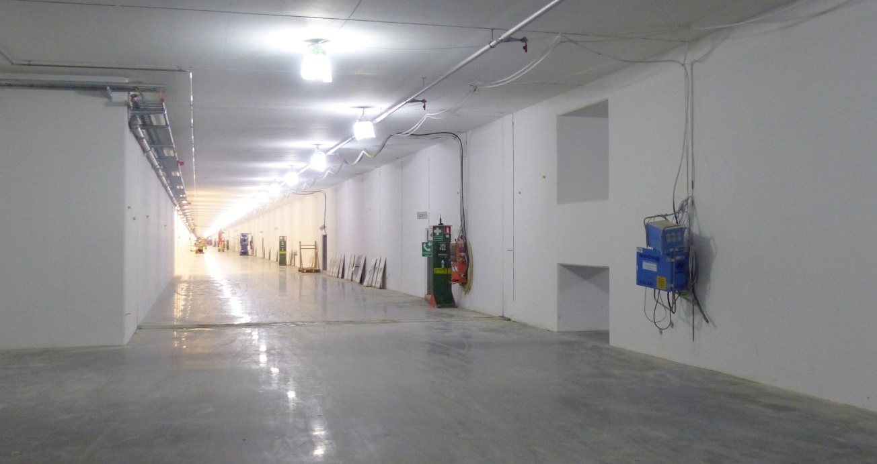
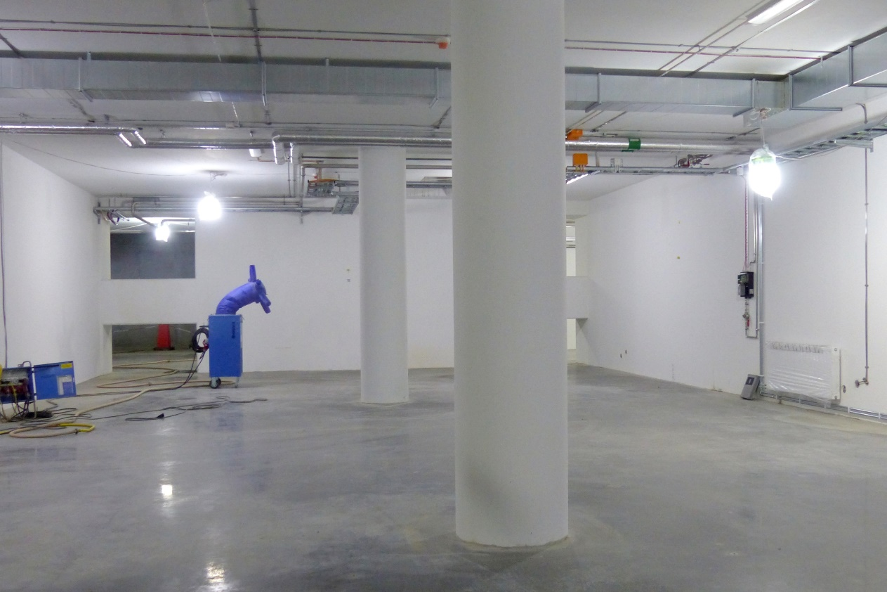
Linac tunnel
Tunnel, view from HEBT
Front End Building

Slide 8
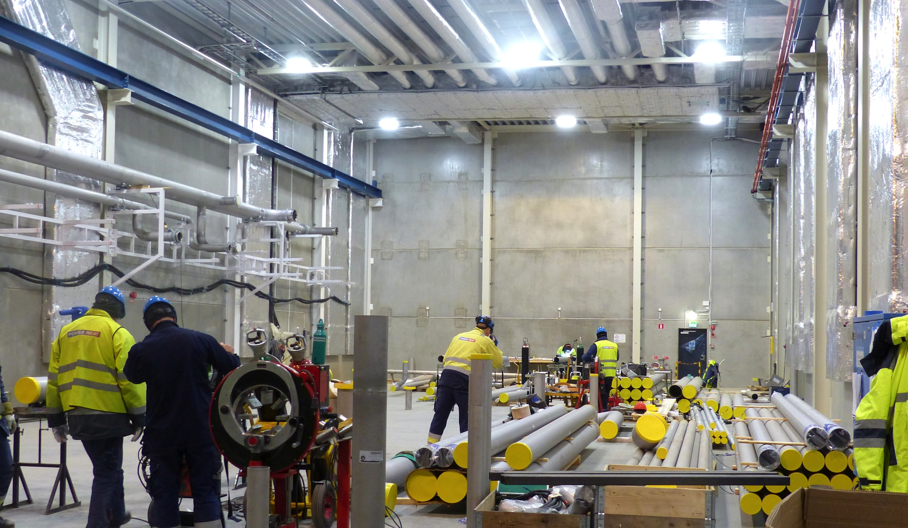
Cryo Compressor Building

Slide 9
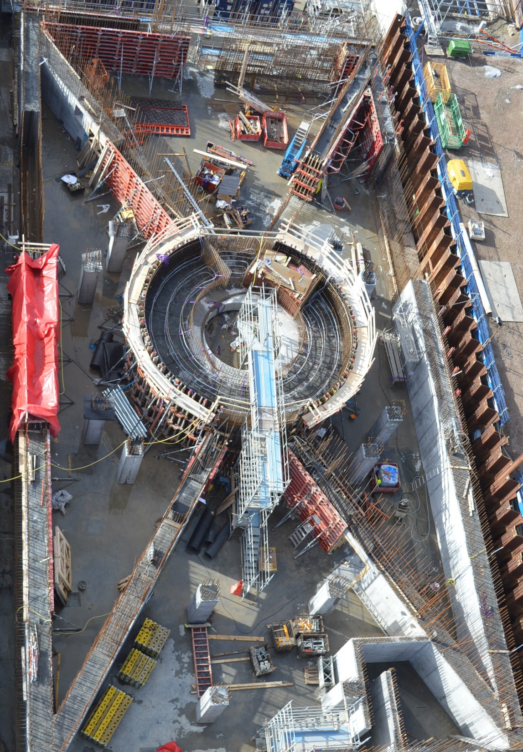
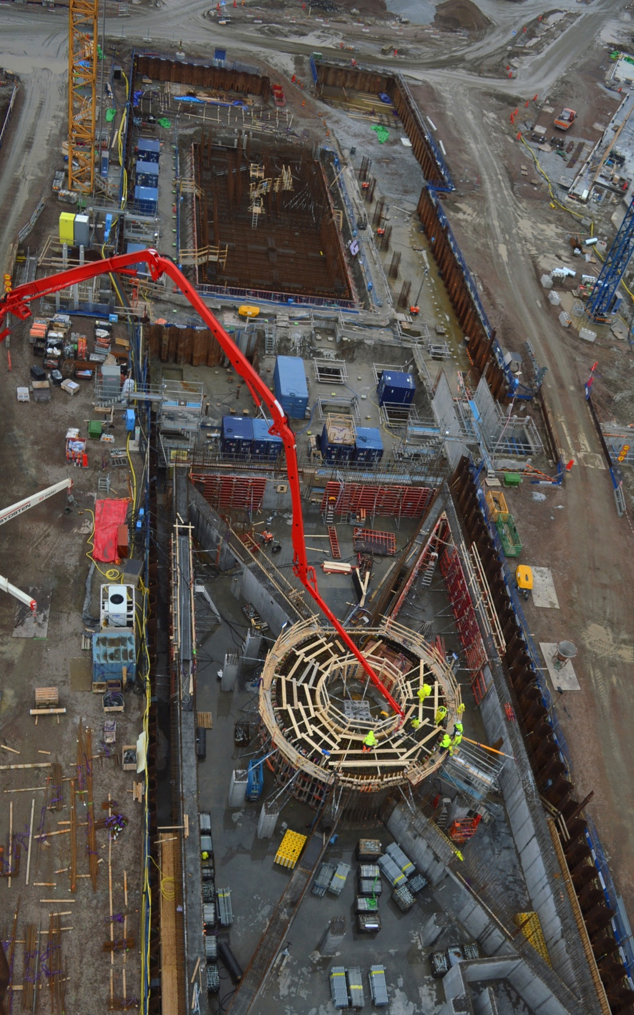
Target
Monolith & Active Cells

Slide 10
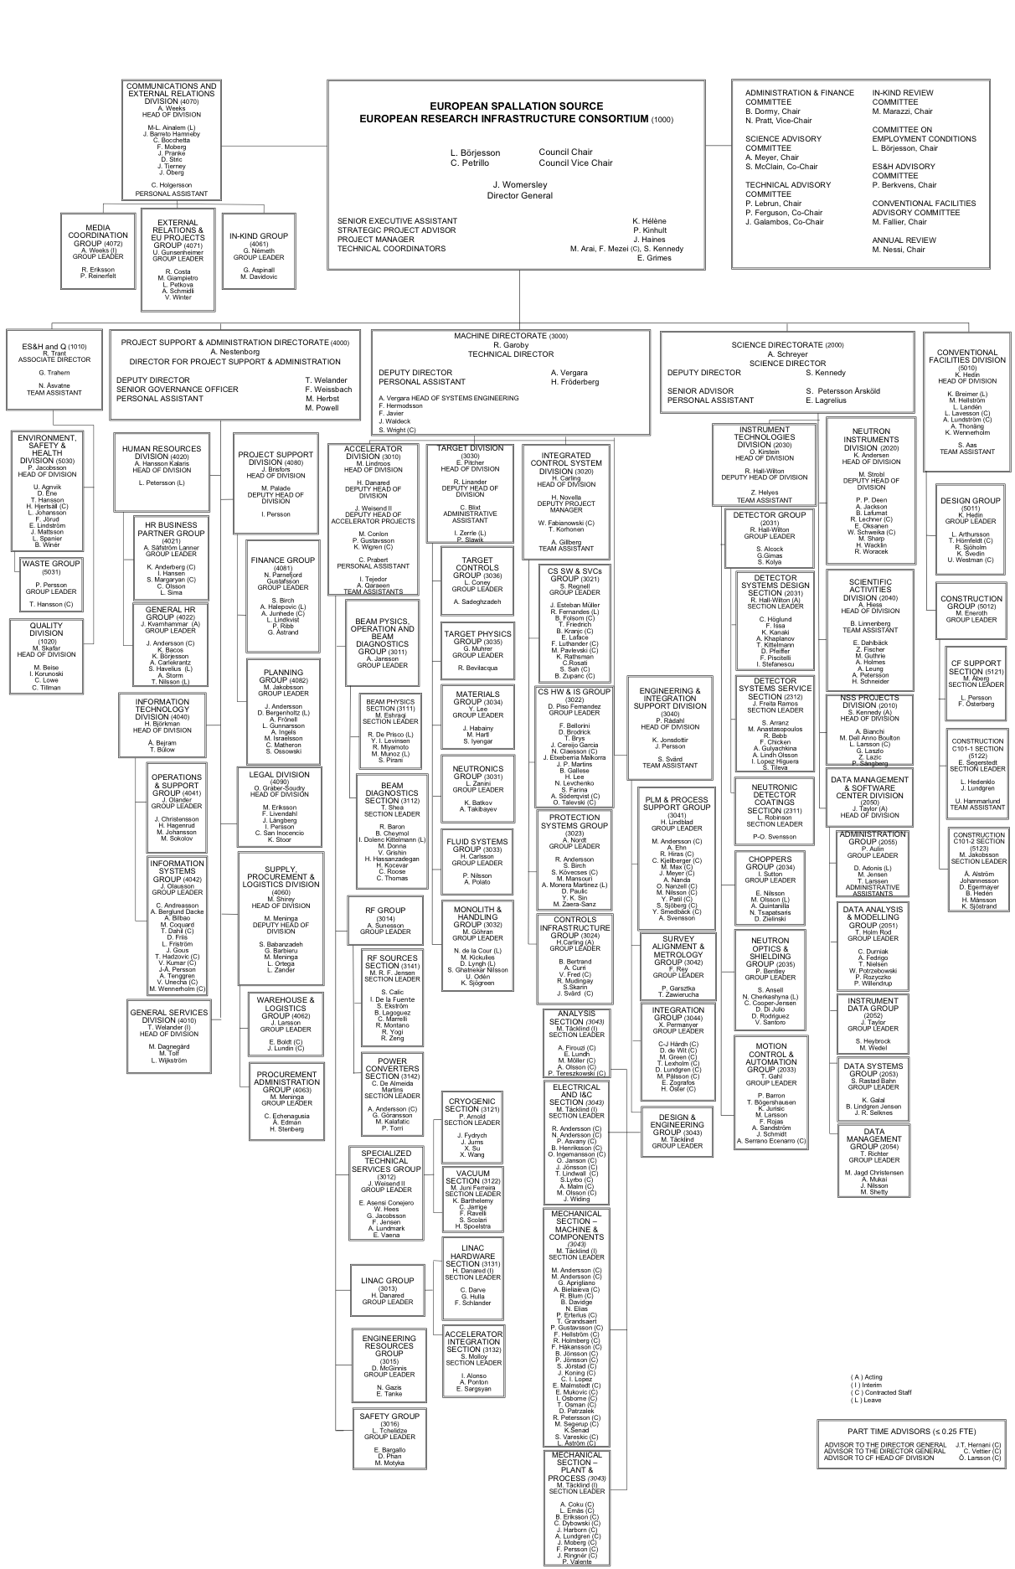


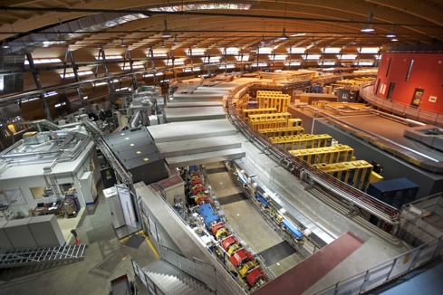
Organisation and People
401
Employees
48
Nationalities
> 45
Collaborating Institutions

Slide 11
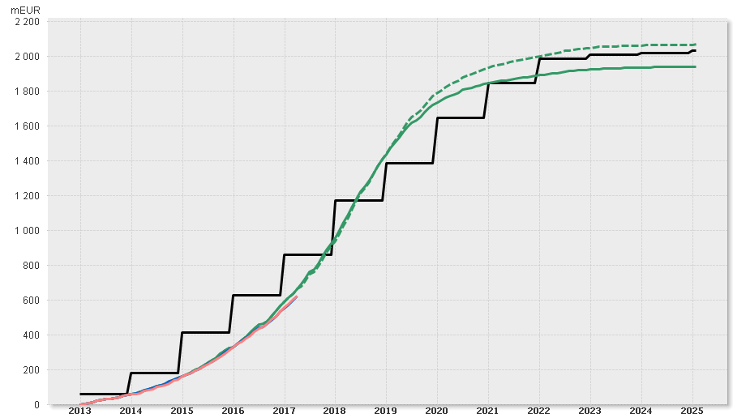

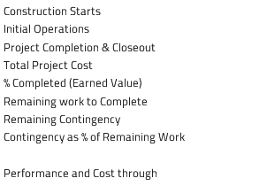

Construction funding & budget profile
M€
⧫ Start of user programme
⧫ First installations
(of Machine Systems)
Machine Ready for Beam on Target
Total Funding (Cumulative)
Total Baseline Budget incl. Contingency (Cumulative)
Total Baseline Budget excl. Contingency (Cumulative)
⧫ Construction
Starts
Total Earned Value (Cumulative)
Total Actual Cost (Cumulative)

Slide 12
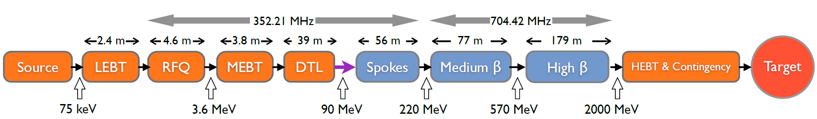
ESS linac
  Average beam power of 5 MW
  Peak beam power of 125 MW
  Acceleration to 2 GeV
  Peak proton beam current of 62.5 mA
  Pulse length of 2.86 ms at a rate of 14 Hz (4% duty factor)
96% of acceleration will be provided by superconducting cavities supplied by 150 high power RF sources (one per cavity):
  80% of the RF power sources delivering over 1.1 MW of peak RF power
  The RF system is the cost driver for the ESS accelerator.
    Low losses
    Minimimum energy use & energy recovery
    Flexibility for
    mitigation or upgrade

Slide 13



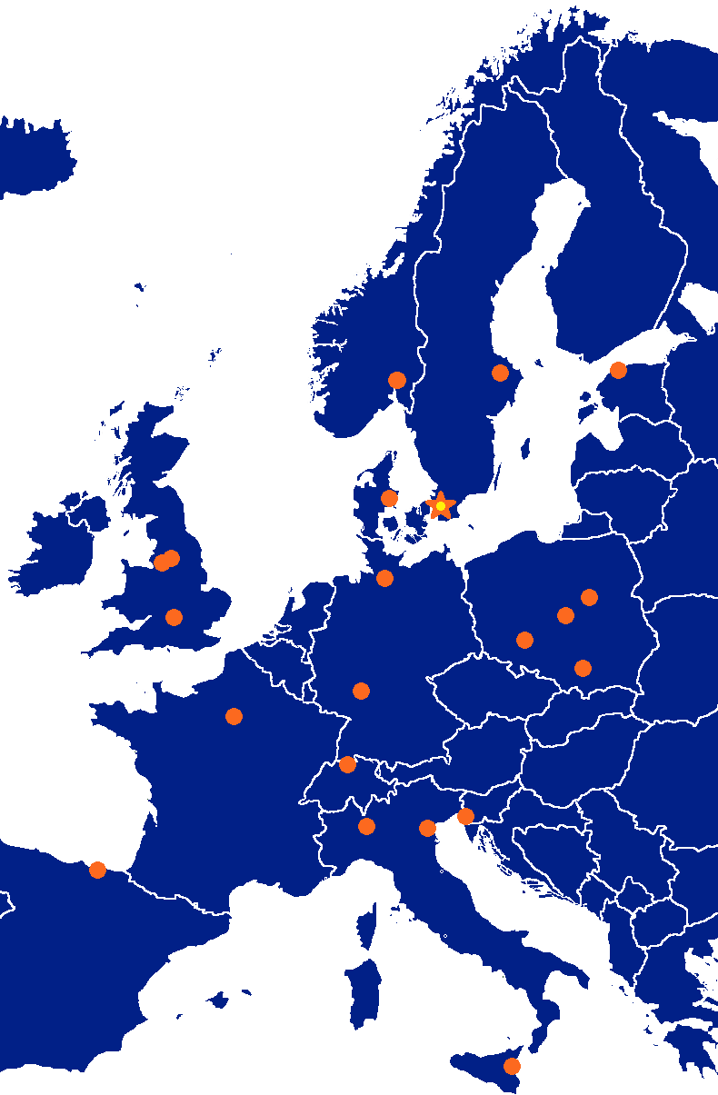



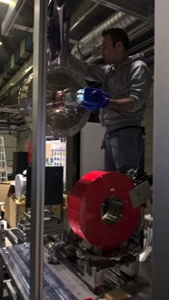




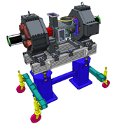


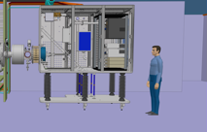



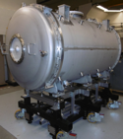
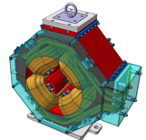

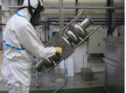

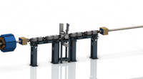




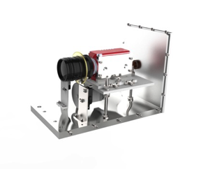
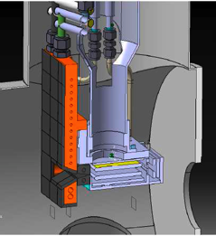
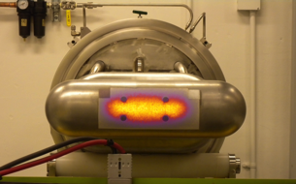

Accelerator components benefit from expert competencies all across Europe
352.21 MHz
704.42 MHz
2.4 m
4.6 m
3.8 m
39 m
56 m
77 m
179 m
Target
Source
LEBT
RFQ
MEBT
DTL
Spokes
Medium β
High β
HEBT & Contingency
75 keV
3.6 MeV
90 MeV
216 MeV
571 MeV
2000 MeV

Slide 14

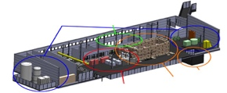



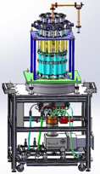
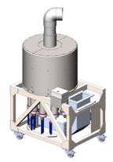



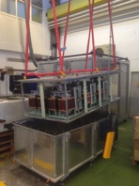
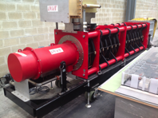
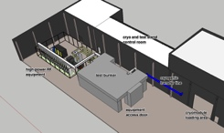
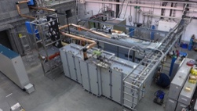
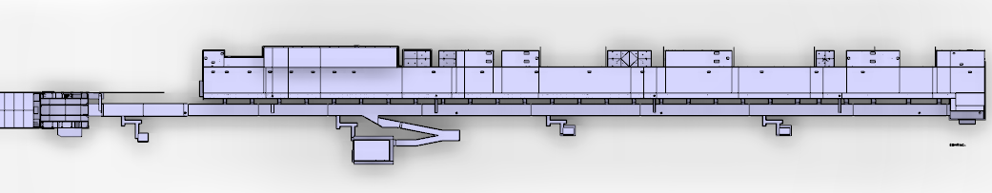









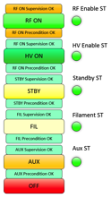


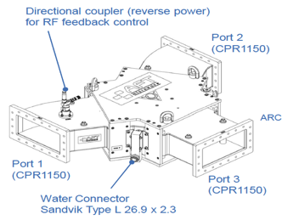
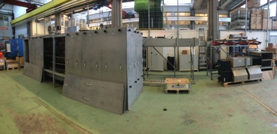
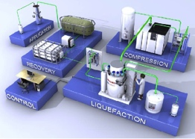

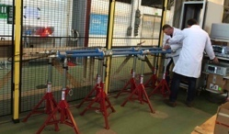

Accelerator components benefit from expert competencies all across Europe
Concept, courtesy of GRE (UK)

Slide 15
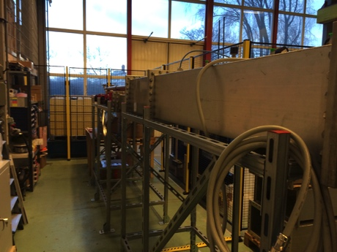
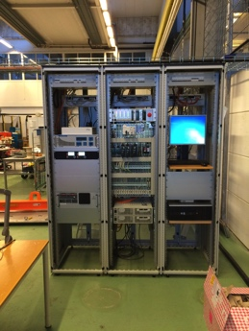
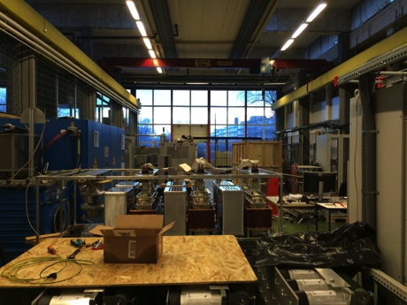
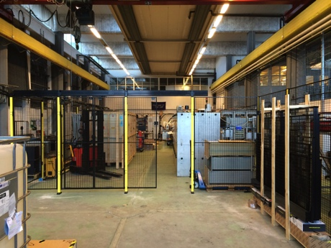
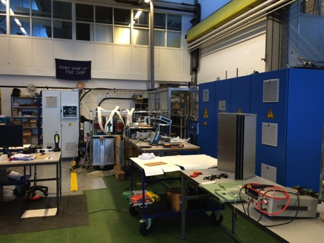
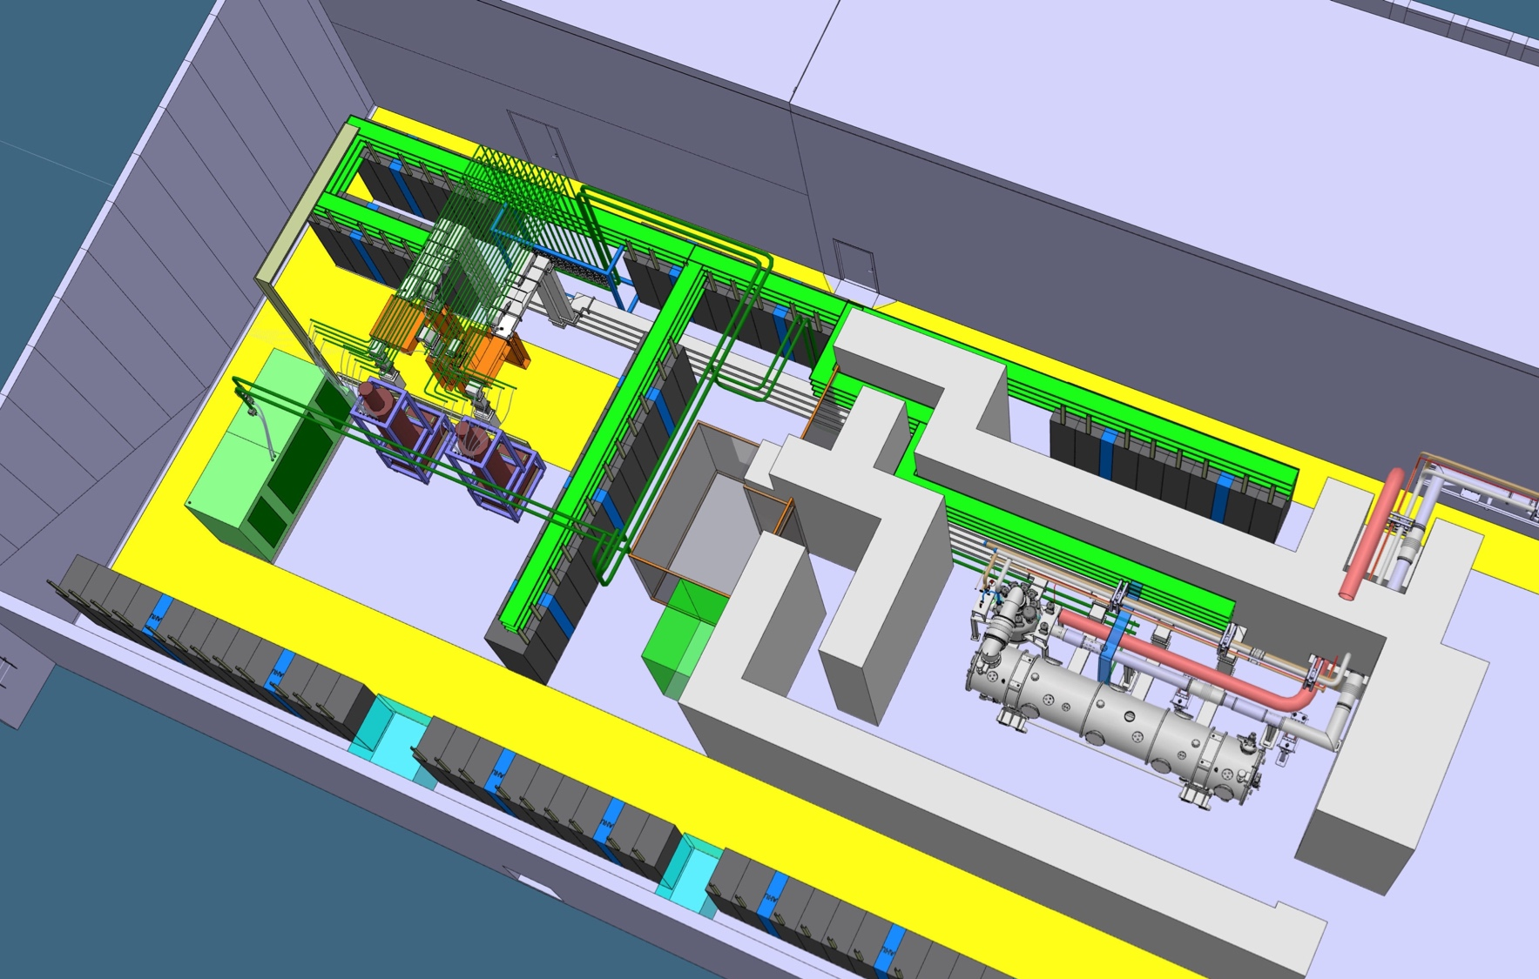
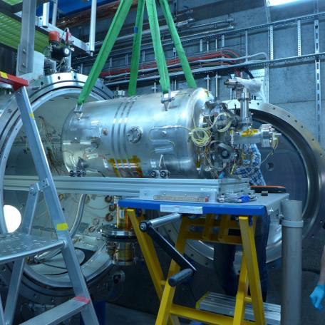
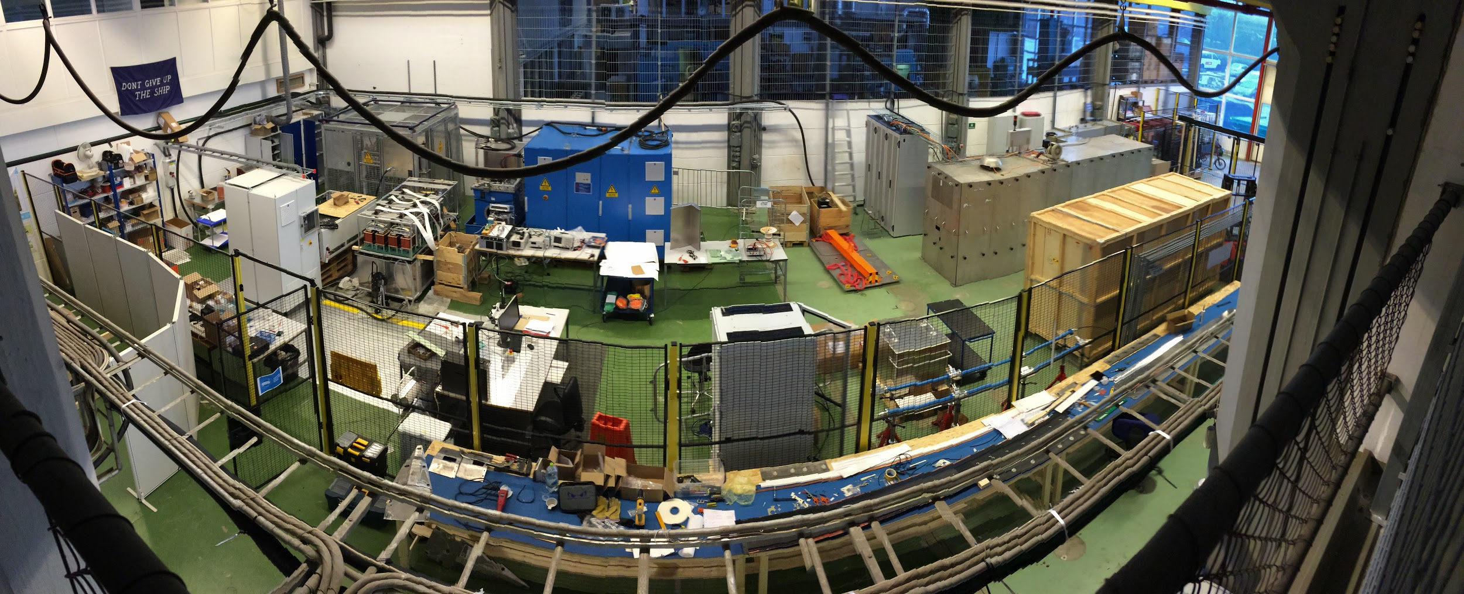
Test Stands 1, 2 in Lund and FREIA in Uppsala – Hands-on work has begun!

Slide 16
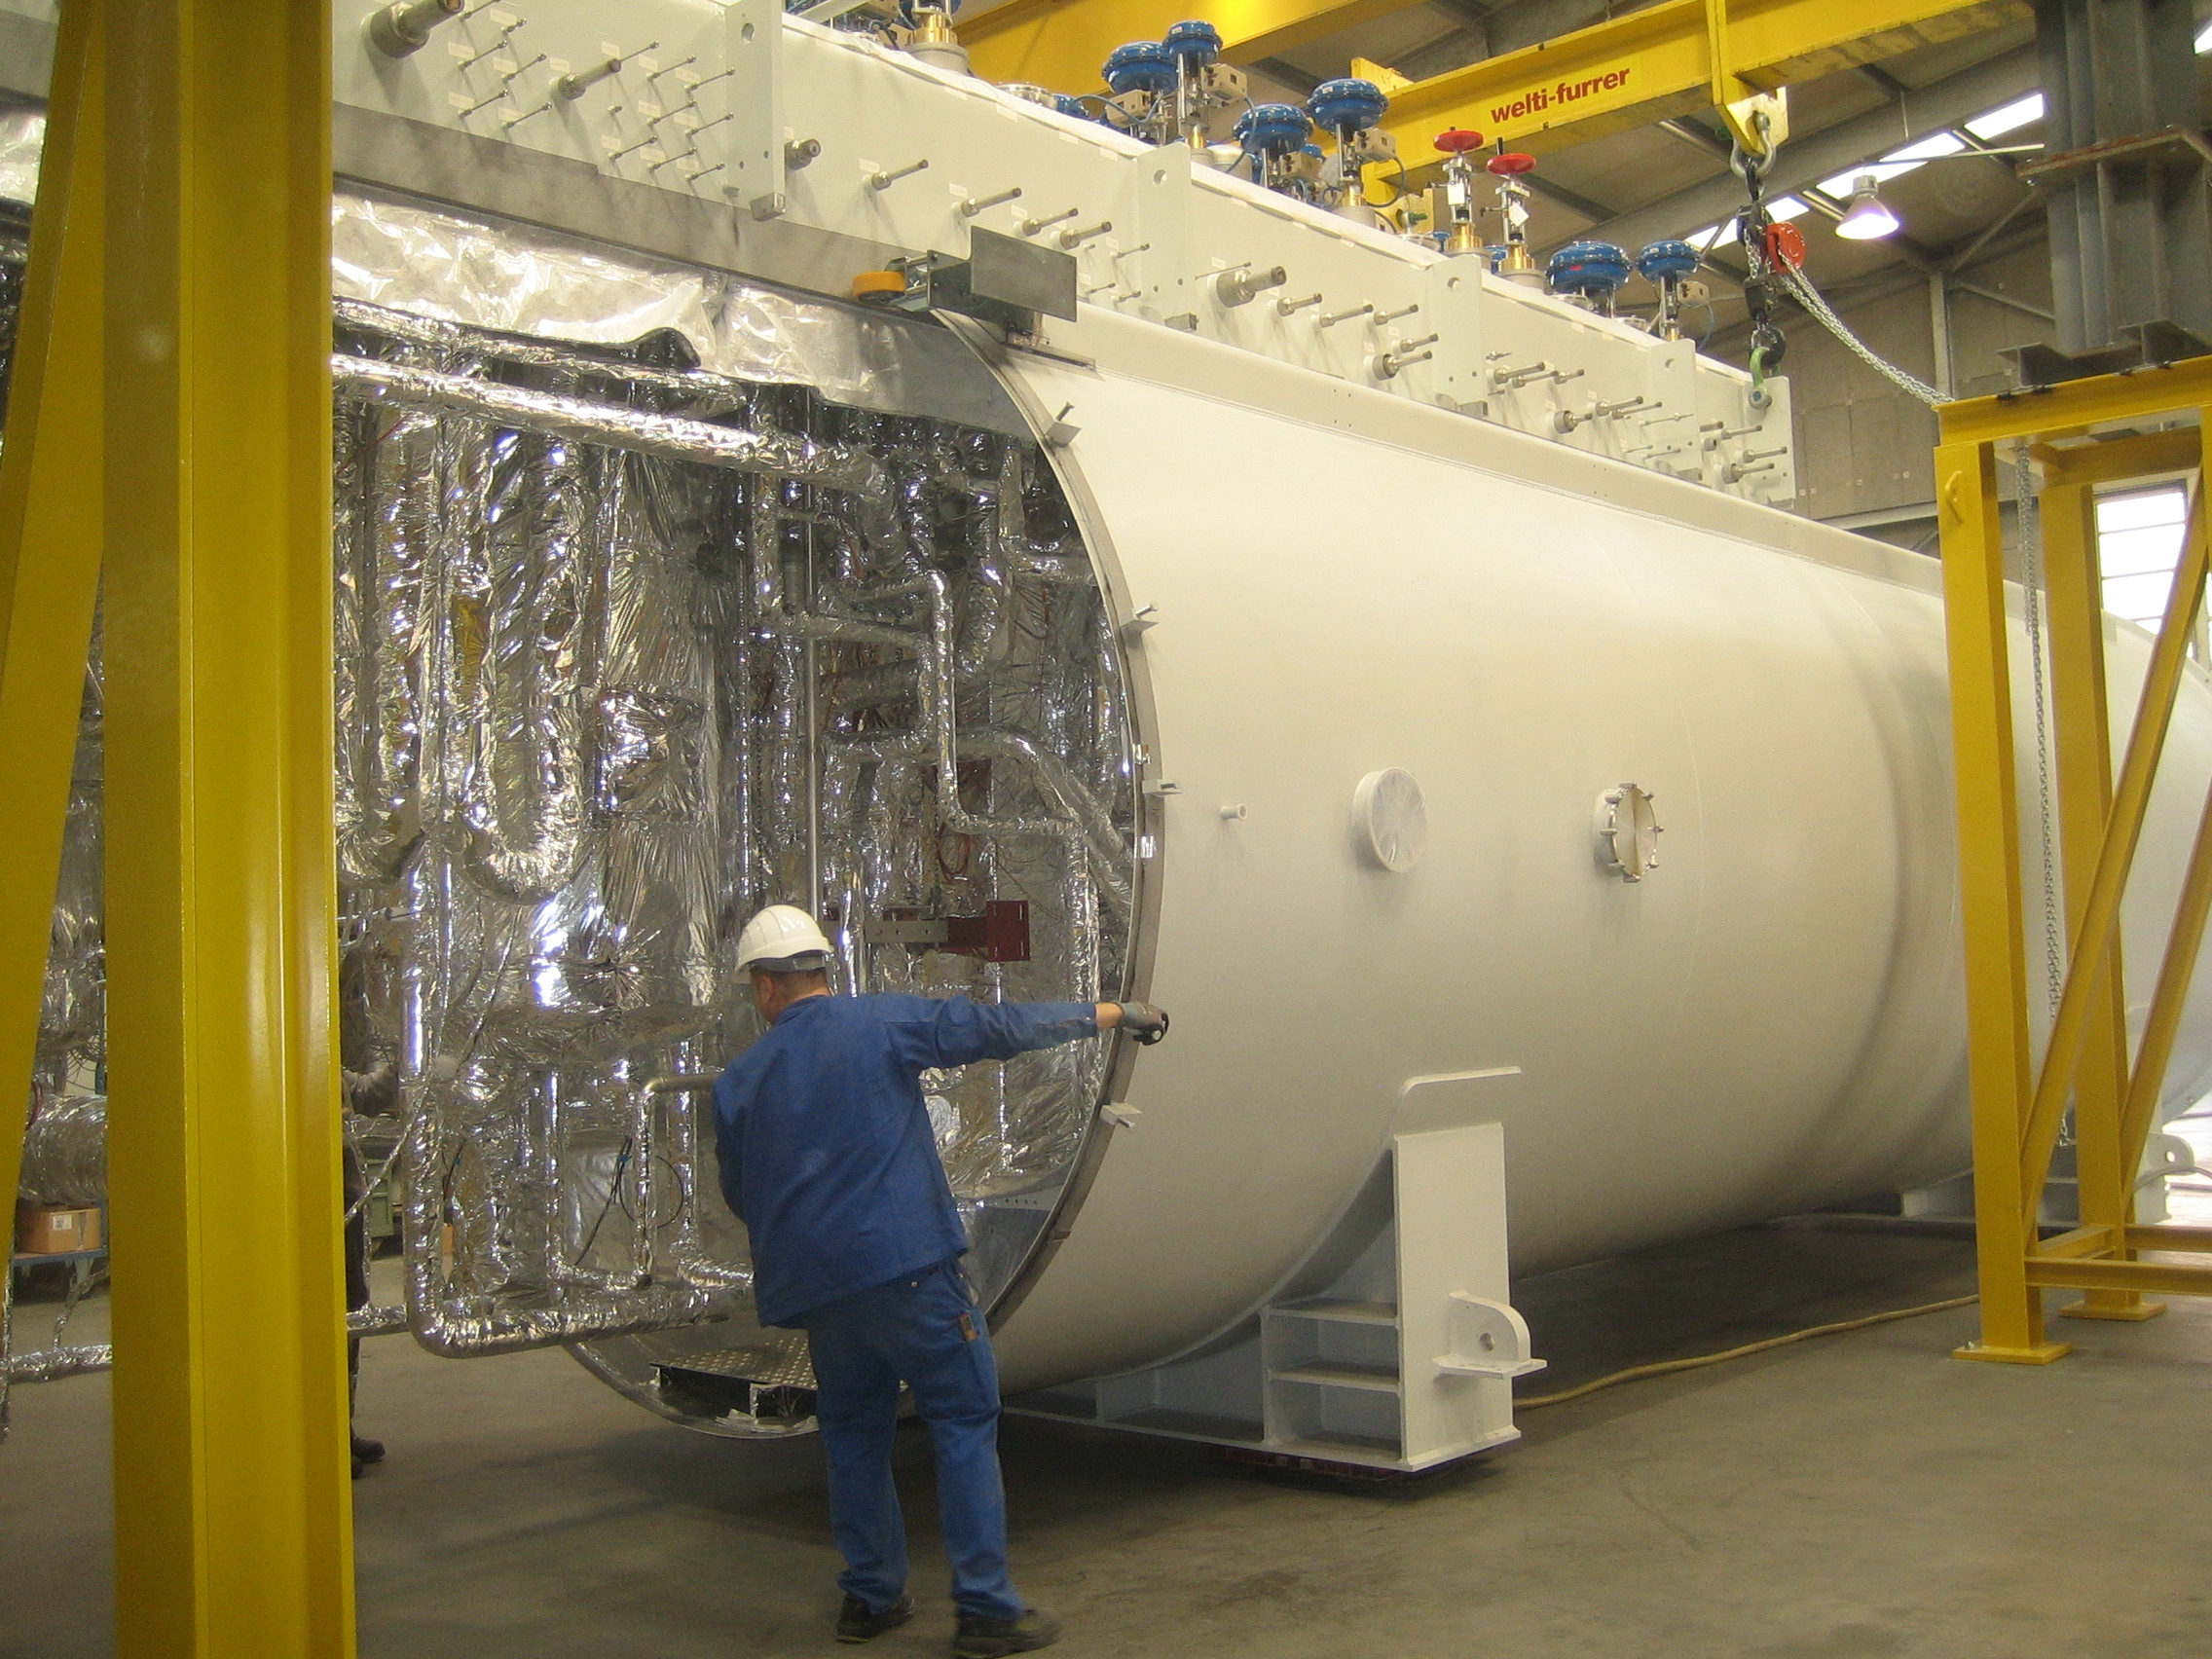
Accelerator cryoplant being completed

Slide 17

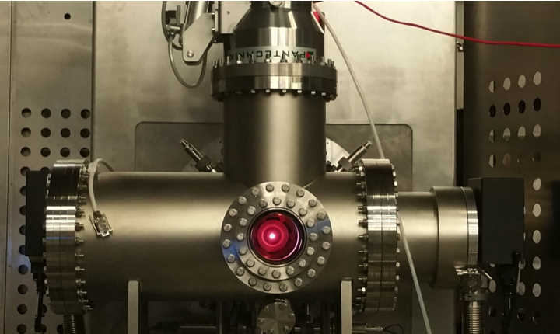

Ion source in Catania at nominal parameters

Slide 18



Beam Instrumentation Commissioning in Catania – Emittance Measurement
Emittance Measurement Unit installed in Catania
Evolution of the beam emittance along the pulse (values every 5 μs)
In-kind from CEA Saclay
Commissioned in January 2017
Beam transverse emittance reconstruction after data post processing

Slide 19




MEBT design and fabrication are in progress
Strip Line Chopper Tests Complete
Buncher Cavity Production
and Heat Treatment
THPIK082 Quadrupole Magnet Design for the ESS MEBT
(D. Fernandez-Canoto – ESS Bilbao)

Slide 20




DTL recent achievements
5 tanks
DTL design work at ESS and in Legnaro, 3.6 ->90 MeV.
[Picture from CERN Linac4]
Tank 4: forged 304 L stainless steel
Drift tube
prototypes

Slide 21



Spoke Cavities design & prototype performances
Spoke cavity prototype test results (Jan15 – Feb16):
Excellent performances, well within specifications (both on Eacc & Qo)
Pcav<0.5W
Chemical etching
Cryomodule with 2 cavities
Ultra pure water
high pressure rinsing
THOBB3 ESS SRF Linear Accelerator Components Preliminary Results and Integration (C. Darve (ESS)
MOPVA090 ESS Superconducting RF Collaboration (C. Darve – ESS)

Slide 22




Elliptical Cavities Highlights
Soft Multipacting barrier
The INFN LASA cavity was successfully tested @ 2 K, exceeding the ESS specifications.
Power Rise @ 2 K
A soft MP barrier was easily conditioned.
This barrier matches with simulations.
100 W CW cryo power,
i.e. 16.7 MV/m @ Q₀ 5 10⁹
HOM near 5th machine line
f = 1741.8 MHz (> 19 MHz from machine line)
Δf < 1 MHz from simulations (f =1742.4 MHz).

Slide 23






Cleanroom, RF Station, Assembly hall, Test Stand are ready in Saclay
First Medium β String in CEA Saclay Cleanroom
RF station: Power-coupler conditioning
    Re-use the current infrastructure of XFEL
Notes:
Assembly room in Saclay
Uses the current infrastructure of XFEL
Benefits from the experience of the XFEL cryomodule assembly (ALSYOM)

Slide 24


SML modulator topology successfully demonstrated on 120 kVA prototype
Integrated oil spill bin
All in one frame with permanently mounted wheels for easy transportation
Order of 3 units for NC linac by ESS-Bilbao
On-going ESS tender for 9 units for MB linac
Total footprint: 3.8m x 1.4m
(planned was 5.5m x 1.6m, i.e. 40% less);
Total weight: < 4 tons (without oil);
Total volume of oil: ~ 2200 litters;

Slide 25






Klystrons and MB-IOT prototypes
L3 IOT
Thales/CPI IOT
Height: 3.8 m 4.5 m 3.5 m
THPIK084 Results from the
704 MHz Klystron and
Multi-Beam IOT Prototypes
For the European Spallation
Source (M. Jensen – ESS)
Klystron Prototypes (resp. CPI, Thales and Toshiba)

Slide 26



Beam raster scanning on target
Raster system sweeping beam in 2D pattern @ target
8 colinear magnets, individually powered
Crosshatch pattern (f_{x}/f_{y}, ϕ_{xy}, a_{x}, a_{y}) within 2.86 ms pulse
5:4 pattern

Slide 27
Accelerator schedule
2016
2017
2018
2019
2020
2021
2022
NCFE
RFI ISRC & LEBT
RFI
MEBT
START RFQ MACHINING
RFI
RFQ
RFI
DTL5
SC LINAC
2 GeV
READY
SPOKE CM
TESTING STARTS
Spoke & Elliptical
cavities and cryomodules
SPOKE & MB CM
PRODUCTION
LAUNCHED
MB CM
TESTING STARTS
1-11 HB CM INSTALLED
12-21 HB CM INSTALLED
SC LINAC
570 MeV
READY
TOSHIBA/CPI/THALES KLYSTRON
PROTOTYPE DELIVERED
TECHNICAL STOP
TECHNICAL STOP
RF
CPI/THALES AND L3 IOT
PROTOTYPES DELIVERED
DECISION IOT OR
KLYSTRON FOR HB LINAC
RF SYSTEM
FOR MB
READY
CDS INSTALLATION
STARTS
Cryogenics
ACCELERATOR
CRYOPLANT
COMM./READY
CDS COMMISSIONED
BEAM COMM. COMPLETED FOR NCFE but DTL5
Commissioning
START RFQ COMMISIONING
BEAM COMM. COMPLETED FOR ISRC-> MEBT
FIRST PROTONS ON TARGET
2 GeV PROTONS AVAILABLE
1370 MeV PROTONS
AVAILABLE

Slide 28



EV Graph
(* No InKind included)
Current Status
Cost Variance has by end of Apr remained at -2.1 M€ ( same as in Mar).
Main negative contributors to the CV are: Power converters, Beam Diagnostics, Beam Delivery and Cooling Support
Schedule variance has slipped to -24.2 M€ dominated by delays at IK partners
Main negative contributors to the SV are: Vacuum, Power Converters, Cooling Support, NCFE, RF Systems, Spoke Cavities & Cryomodules and Beam Diagnostics.

Slide 29
Accelerator Division (AD)
– Site Organization
BAS-U framework
ESS management
Accelerator Installation
Manager
Nick Gazis
AD and ESS central Installation Services
(ISC workgroup, etc.)
RATS AreaSuper
hiring process
Inst-Test-Commis. Plan
(MS Project)
Eugene Tanke
QA/QC
Kent Wigren
Mechanical
Mechanical
Mechanical
Safety Team
Duy Phan
Area Supervisors
and ES&H
Area Supervisor Tunnel (G01) &
FEB (levels 090 & 100)
Dennis de Wit
Area Supervisor Gallery (G02 incl.Test Stand 2)
Marcus Green
Electrical
Utilities
Electrical
Utilities
Area Supervisor Cryobuildings (G04)
Ila Sjoholm
Electrical
Utilities
RF
other..
Indeed everyone is responsible for safety
el
System Leader 1
util
other..
mech
System Leader 2
AREAS
Other..
other
Task masters (Installation Support Team)
System Leader 3, 4..

Slide 30
Installation, Testing and Commissioning
The ESS Accelerator sub-project today has access to the cryo-buildings, test stand area and tunnel
Blue lining and drilling is now starting in the tunnel for the NCFE
Stub installation (RF transfer from gallery to tunnel) has proven very challenging but we are now starting a test installation and we are maintaining the installation schedule
We are seeing delays from several IK partners for the equipment “Ready For Installation” dates
  Technical delays of up to 3 month
  Administrative delays of 6-9 months
We are working on a new ITC schedule which resources will permit us to install efficiently the equipment as we receive it with the ambition of running parts of the linac in 2019
Note that it is crucial that delays in some areas isn’t used as an excuse to be late in other areas
We urge IK partners to let us know about possible delays or deviations for deliveries as early as possible so that we can work with them to mitigate the effects.

Slide 31
Conclusions
Thanks to all ESS Accelerator IK partners for all the hard work to set-up contracts, get work started and for maintaining the high tempo required by the Project schedule
Collaboration has enabled ESS to get construction under way at a green field site while building up an organization for installing, commissioning and operating the facility
Working together we can do what might seem as impossible

Slide 32


Many thanks to all my colleagues in the ESS accelerator collaboration
Thank you for listening!
Thanks to all my colleagues at ESS!
Together we are building ESS

Slide 33


Slide 34
ESS: The worlds first long pulse source
8
x10¹⁴
ESS 5 MW
2015 design
7
λ = 1.5 Å
Possibilities of pulse shaping
6
5
Brightness (n/cm²/s/sr/Å)
4
ESS 5 MW
2012 design (TDR)
3
SNS
1-2 MW
JPARC
0.3-1 MW
2
UK TS2
32 kW
1
UK TS1
128 kW
ILL 57 MW
0
time (ms)
1
2
3
4

Slide 35



Neutron Imaging - Examples

Slide 36


Några visioner för neutronanläggningar och synkrotronljusanläggningar
Higher (Room?) Temperature Super Conductors
Hydrogen storage substrate
Efficient membrane for fuel cells
Flexible and highly efficient solar cells
Understanding liquid membranes
Nano scaled structures for controlled drug release
Self healing materials – smart materials
Spintronics - Spin-state as a storage of data (10²³ gain in capacity)
CO₂ sequestration
Neutron electric dipole moment
Neutron oscillations
And much more…

