Slide 1
7th open collaboration meeting on Superconducting Linac for High Power Proton beams
Guillaume OLRY

Slide 2
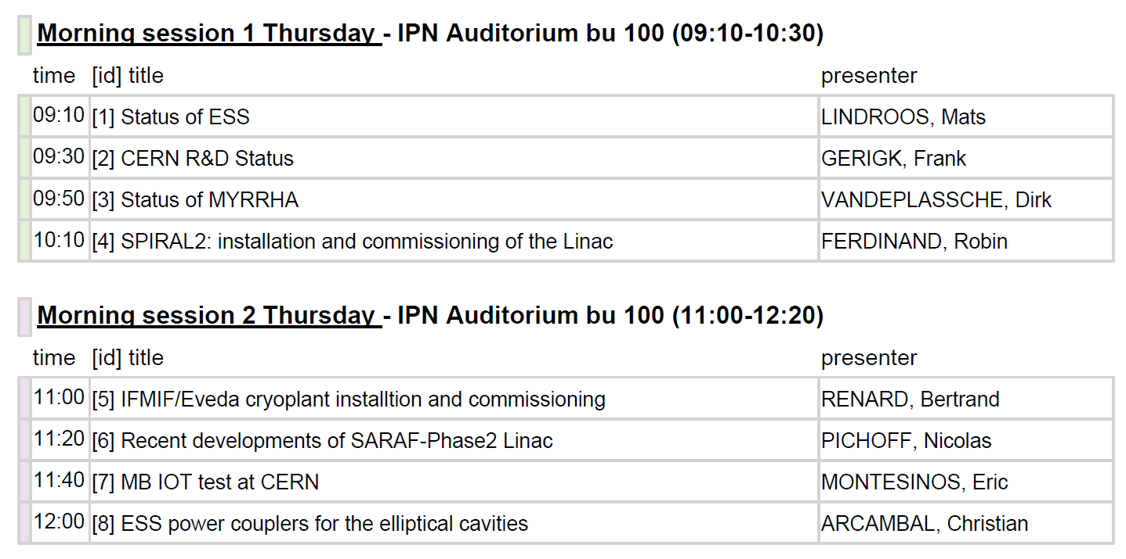
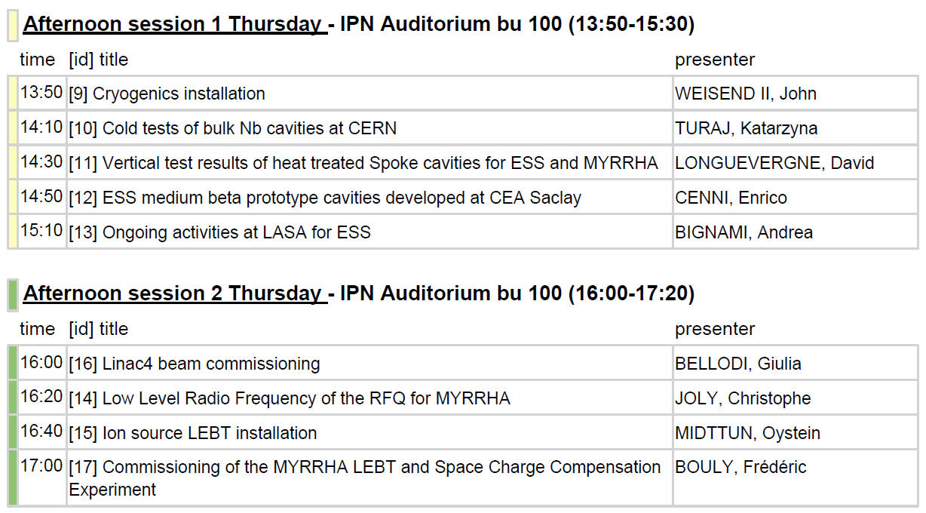
AGENDA
26 talks : please keep well within your speaking time!
THURSDAY
FRIDAY
Visit of the SUPRATECH platform on Friday morning (9h – 10h30)

Slide 3
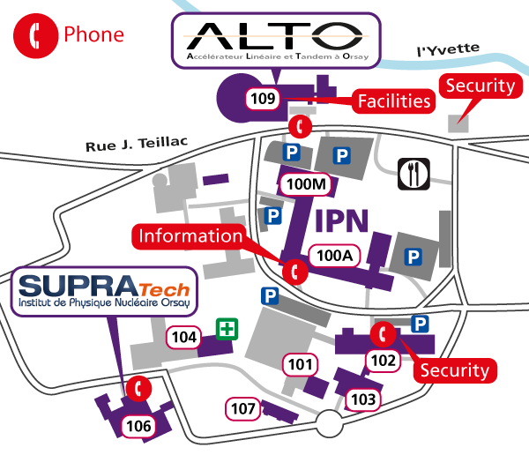
VISIT OF SUPRATECH
Meeting point: in front of building 106 at 9h (or between 8h45 and 9h at the Auditorium is you want to leave your luggage before the visit)
auditorium
From RER train station “Orsay-Ville”

Slide 4
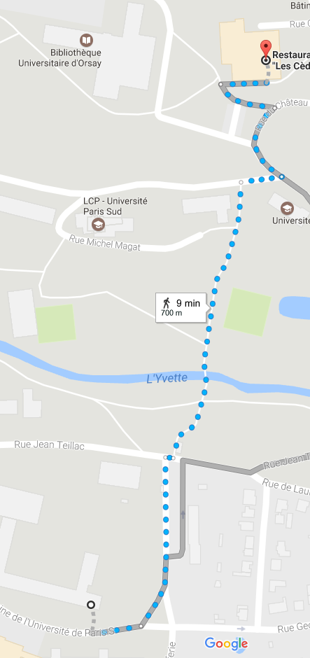
LUNCH TIME
Building 406, CROUS Restaurant des Cèdres (~700m, 10min)
restaurant
auditorium

Slide 5
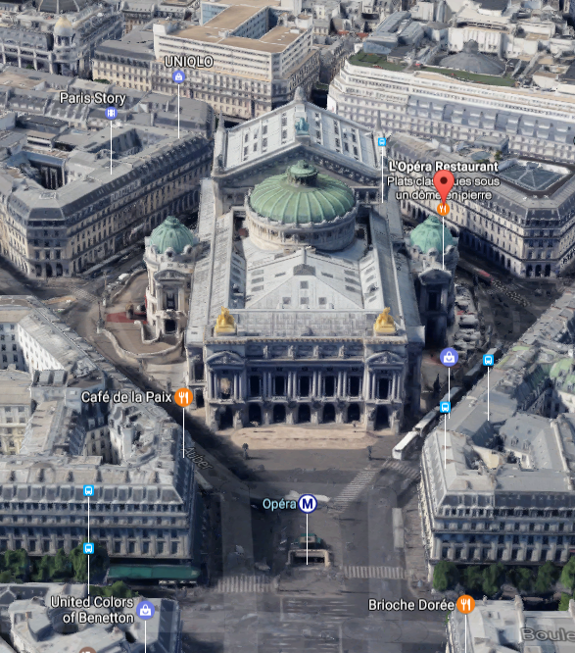
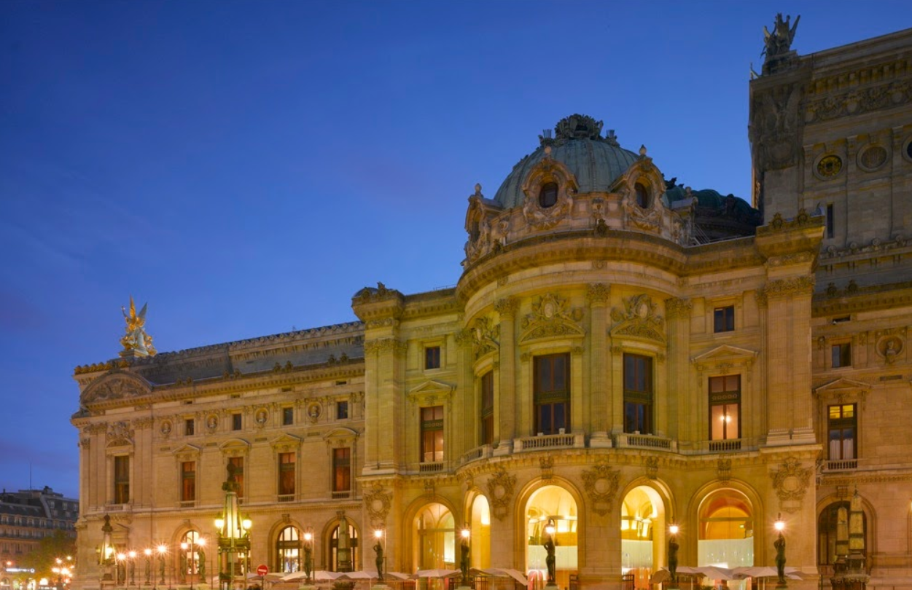
DINNER THIS EVENING
L’Opéra restaurant (on the right side of the Opéra Garnier, Place Jacques Rouché, 75009 Paris)
7:30 p.m.

