Slide 1



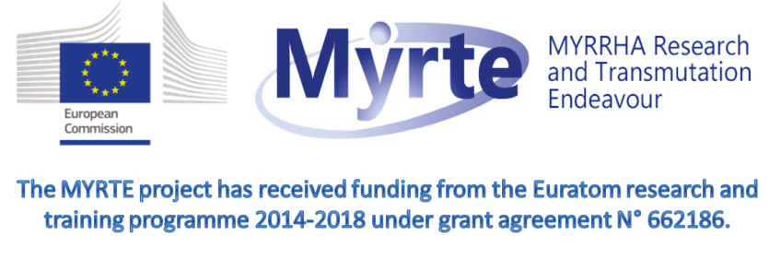


Vertical test results of heat treated Spoke cavities for ESS and MYRRHA
7th Open Collaboration Meeting on Superconducting Linacs for High Power Proton Beams
D. Longuevergne
On behalf of IPNO team
SLHIPP7 – June 2017 - Orsay

Slide 2
OUTLINE
SPOKE resonators and baseline performances
  DSR for ESS
  SSR for MYRRHA
Hydrogen degassing at 650°C
  Why is it required for 352 MHz cavities
  The furnace : performances and validation
  Standard procedure for ESS
  DSR Results
R&D for MYRRHA : MYRTE program
  No post-etching procedure
  Sample study
  SSR results

Slide 3
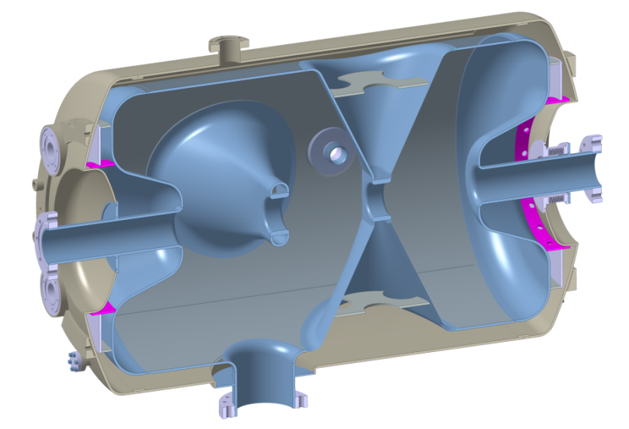
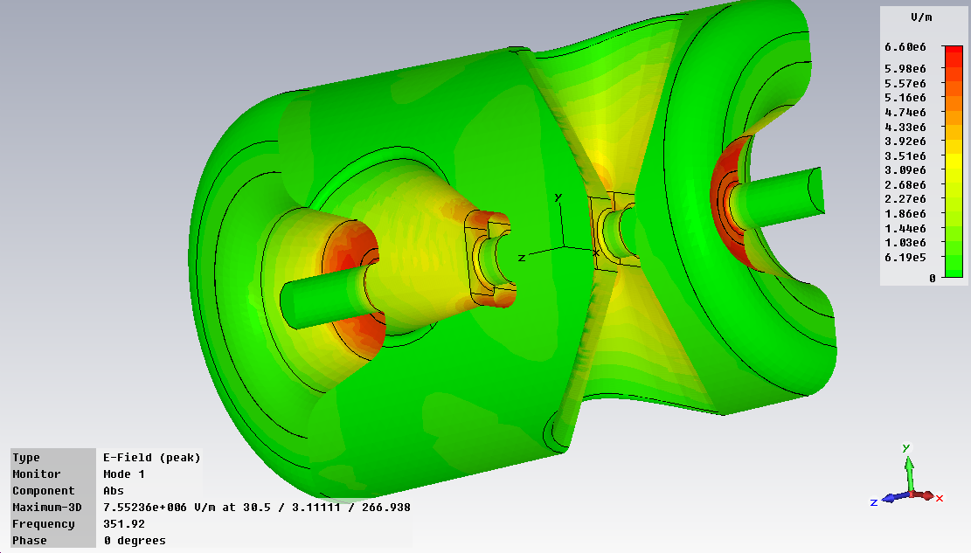
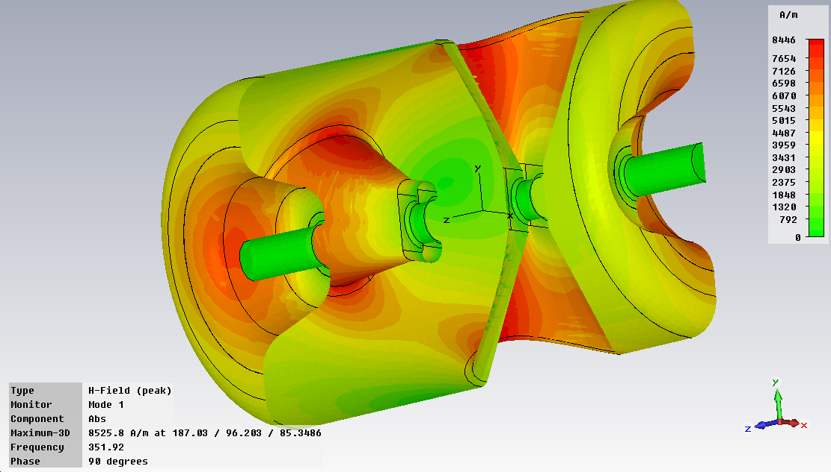
Spoke Resonator and baseline performance
DSR for ESS
Designed at IPNO
2 prototypes fabricated by E. Z. Zanon Spa. 1fabricated by SDMS
Received early 2015
Helium tank in titanium
Material : Bulk Niobium
β = 0.5
F₀ = 352 MHz
T : 2K
Eacc : 9 MV/m
Bpk/Eacc = 6.9 mT/MV/m
Epk/Eacc = 4.3
r/Q = 426
G = 130
4 HPR Ports
Pick-up Port
E field
Bellows
H field
Coupler port

Slide 4
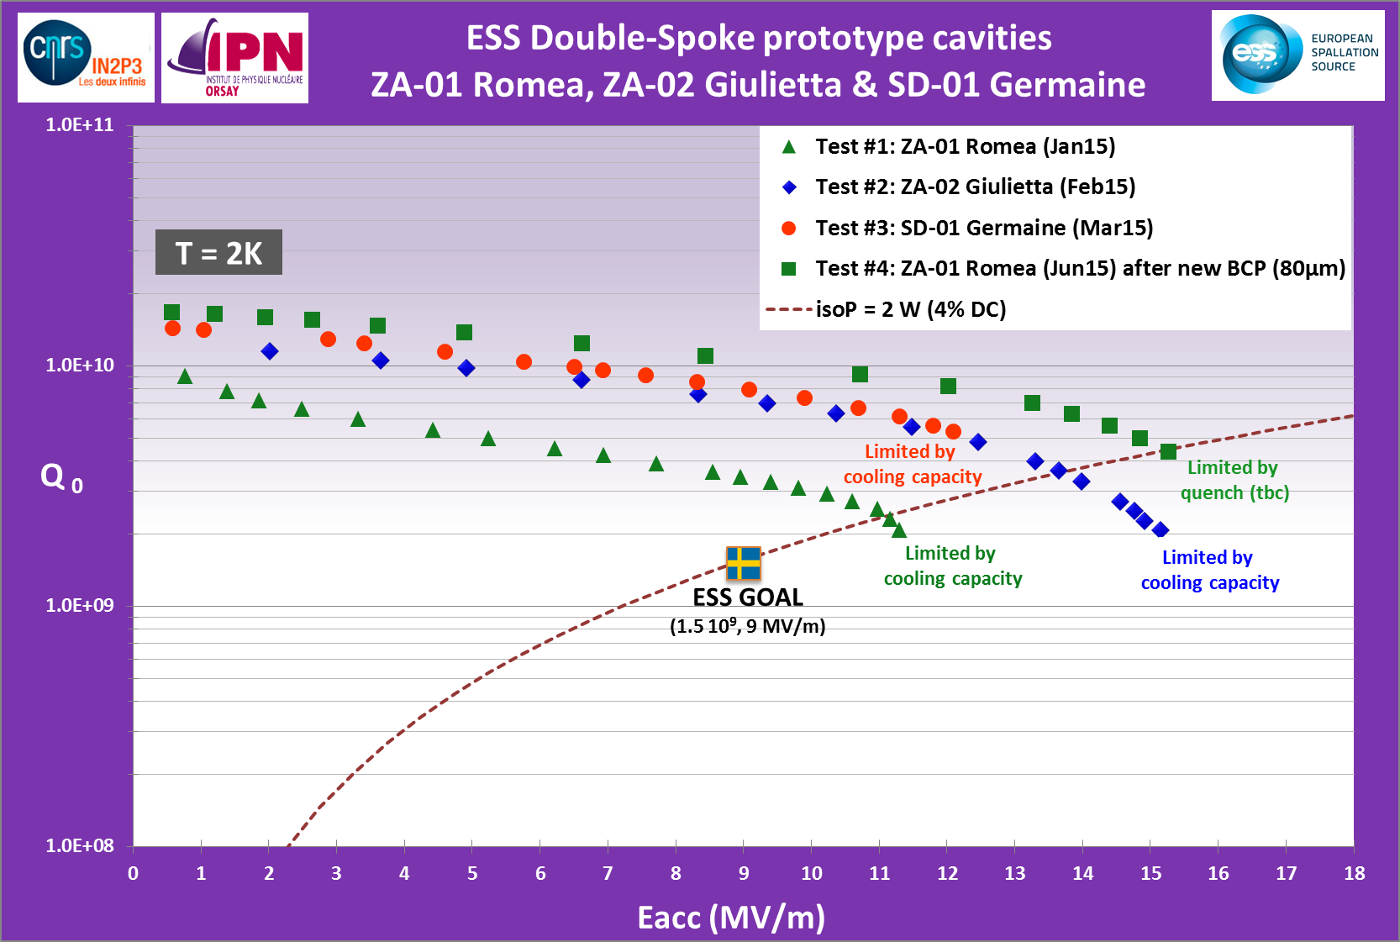
Spoke Resonator and baseline performance
DSR for ESS

Slide 5
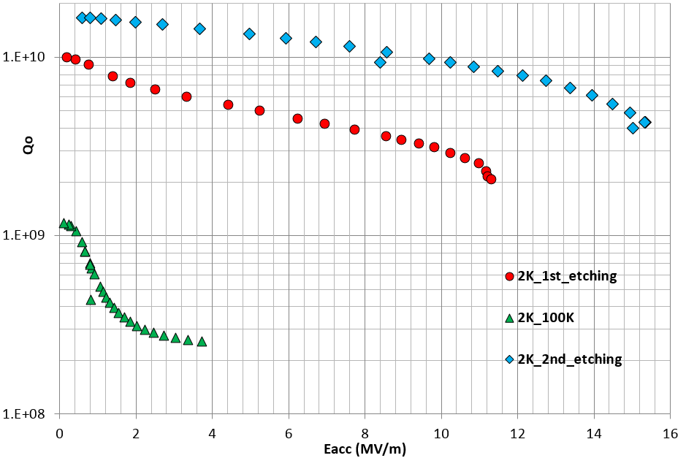

Spoke Resonator and baseline performance
DSR for ESS
Romea Prototype
6 hours between 80-100K

Slide 6
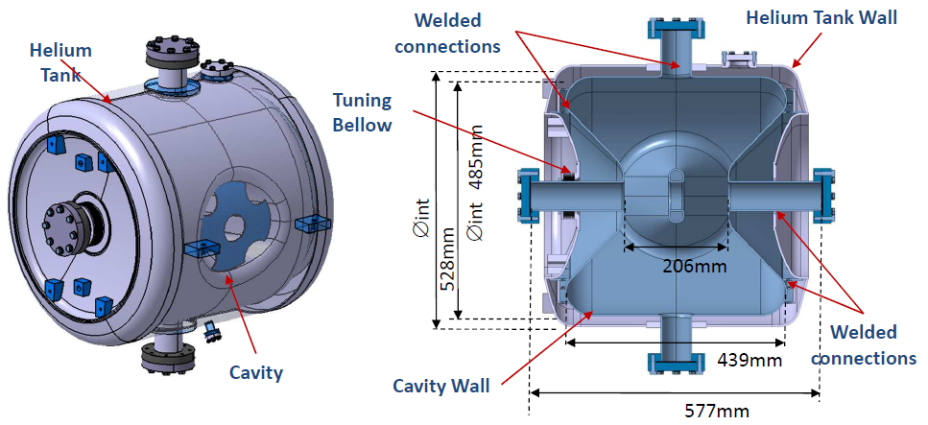
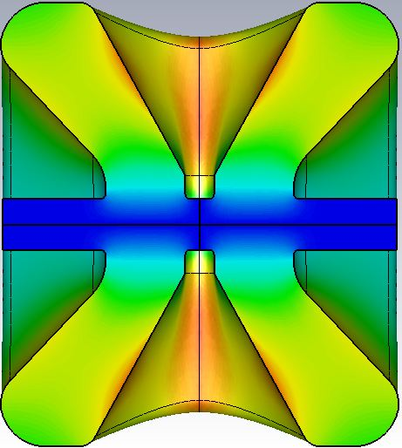
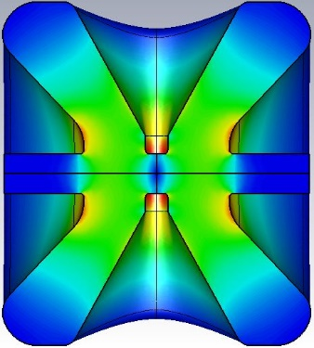
Spoke Resonator and baseline performance
SSR for MYRRHA
Material : Bulk Niobium
β = 0.37
F₀ = 352 MHz
T : 2K
Eacc : 6.4 MV/m
Bpk/Eacc = 7.3 mT/MV/m
Epk/Eacc = 4.3
r/Q = 217
G = 109
Designed at IPNO
2 prototypes fabricated by E. Z. Zanon Spa
Received in december 2015
Helium tank in titanium

Slide 7
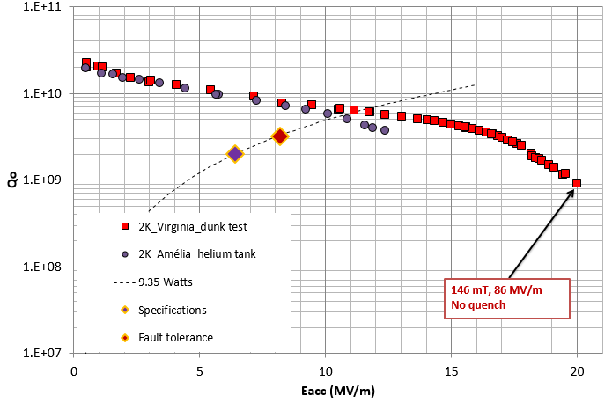
Spoke Resonator and baseline performance
SSR for MYRRHA

Slide 8
OUTLINE
SPOKE resonators and baseline performances
  DSR for ESS
  SSR for MYRRHA
Hydrogen degassing at 650°C
  Why is it required for 352 MHz cavities
  The furnace : performances and validation
  Standard procedure for ESS
  DSR Results
R&D for MYRRHA : MYRTE program
  No post-etching procedure
  Sample study
  SSR results

Slide 9
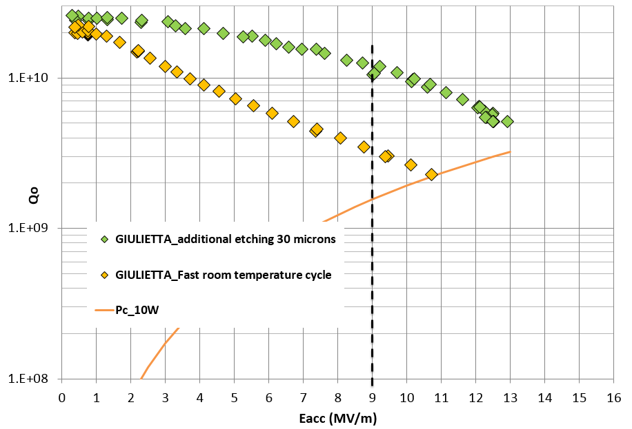
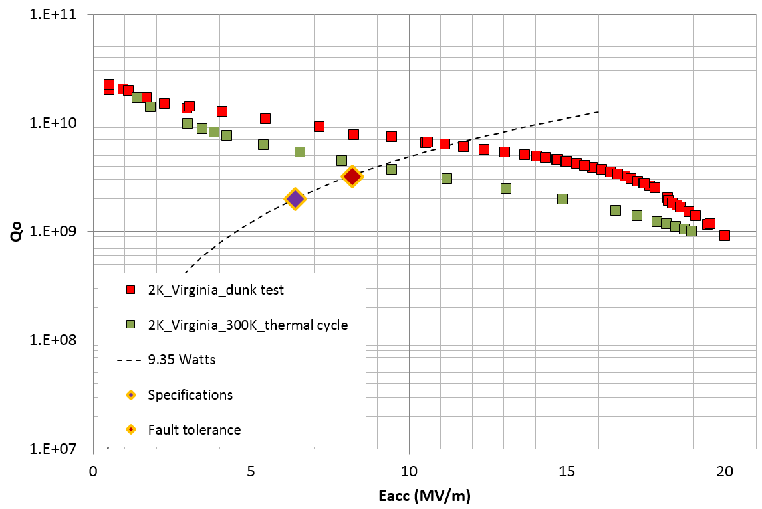
Hydrogen degassing at 650°C
Why is it required for 352 MHz ?
Cavity results (ESS and MYRRHA) show that a simple thermal cycle to 300K is enough to cause irreversible degradation of Qo
WHY NEVER OBSERVED ON SPIRAL2 QWR at 88 MHz or ISAC2 QWR at 141 MHz ??

Slide 10
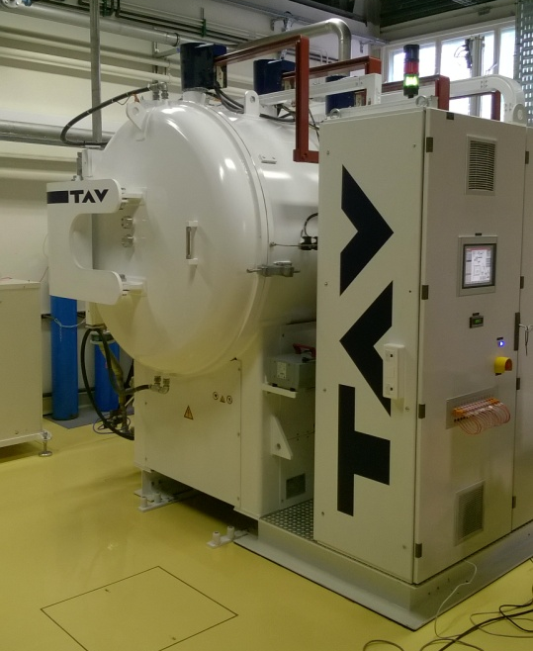
Hydrogen degassing at 650°C
The furnace at IPNO
Fabricated by TAV Vacuum Furnaces Spa
Commissioned in 2016
Max diameter : 700 mm
Max Length : 1600 mm
Temperature up to 1300°C (1°C – 10 °C per minutes). Homogeneity : +/- 5°C
Vacuum : 5E-7 – 1E-6 mbar
Cryogenic pump (roots + screw pumps)
Checks done :
  Pollution of Niobium samples after degassing at 650°C during 10h (RRR, SIMS, TE011 RF disk)
  Degassing of single cell elliptical cavity at 650°C duting 10h
  RGA measurement in helium tank at 150°C to check quality of ultrasonic cleaning (detection of organic compounds after fabrication)

Slide 11
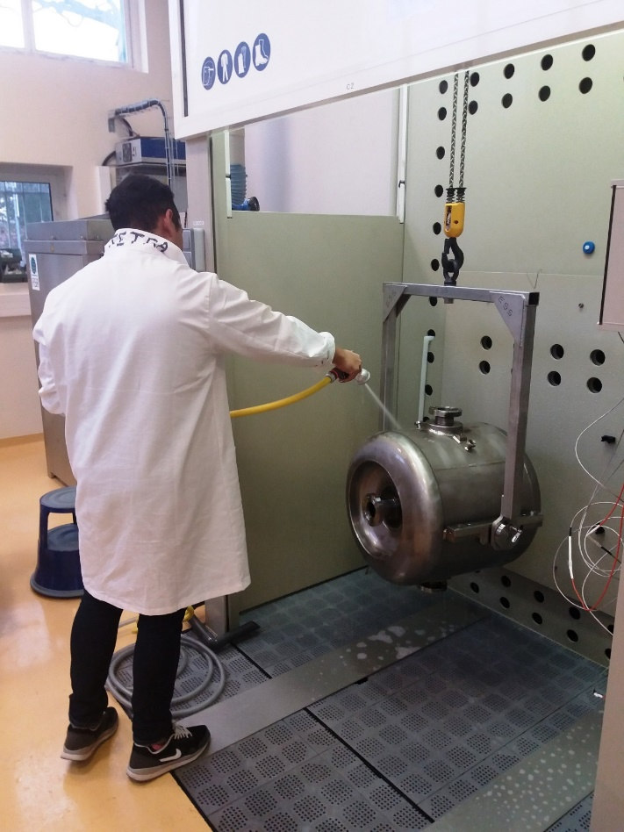
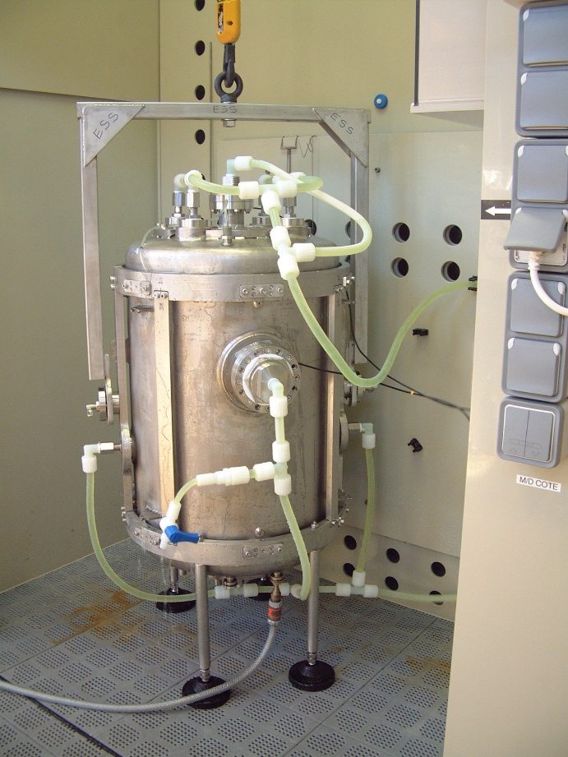
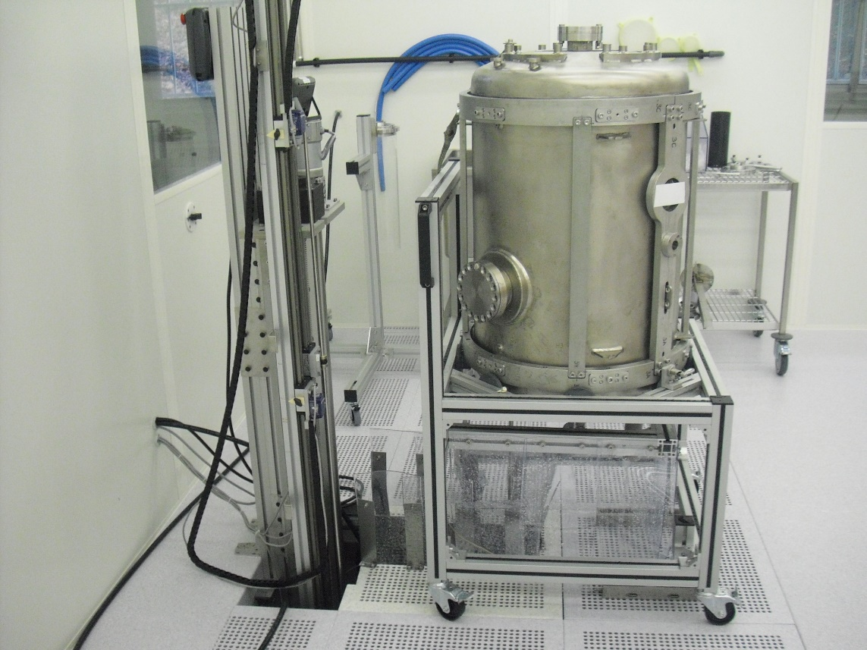
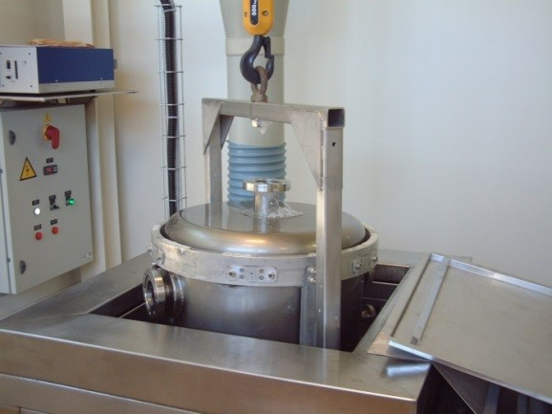
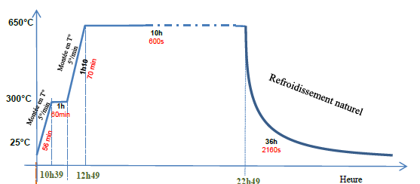
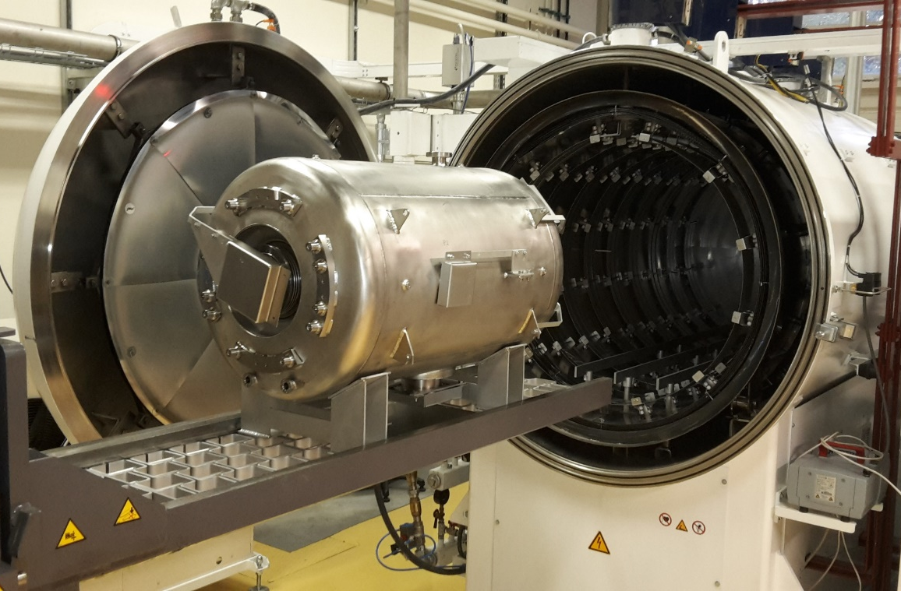
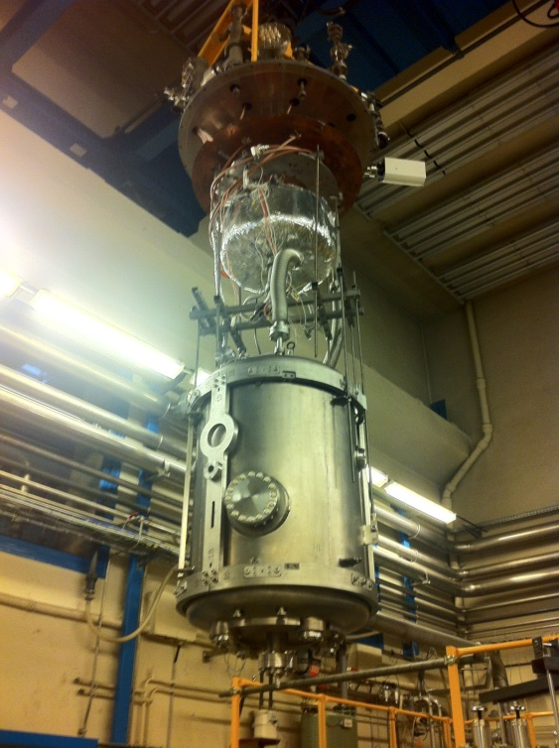
Hydrogen degassing at 650°C
Standard procedure for ESS
Degassing with the helium tank makes the procedure quite complex
US Bath + detergent (cavity + tank)
Deionized water rinsing (cavity + tank)
BCP (cavity)
HPR (cavity)
Drying in clean room
(cavity + tank)
Assembly
+ VT test
Furnace
Drying in clean room
(cavity + tank)
HPR
(cavity)
BCP (cavity)

Slide 12
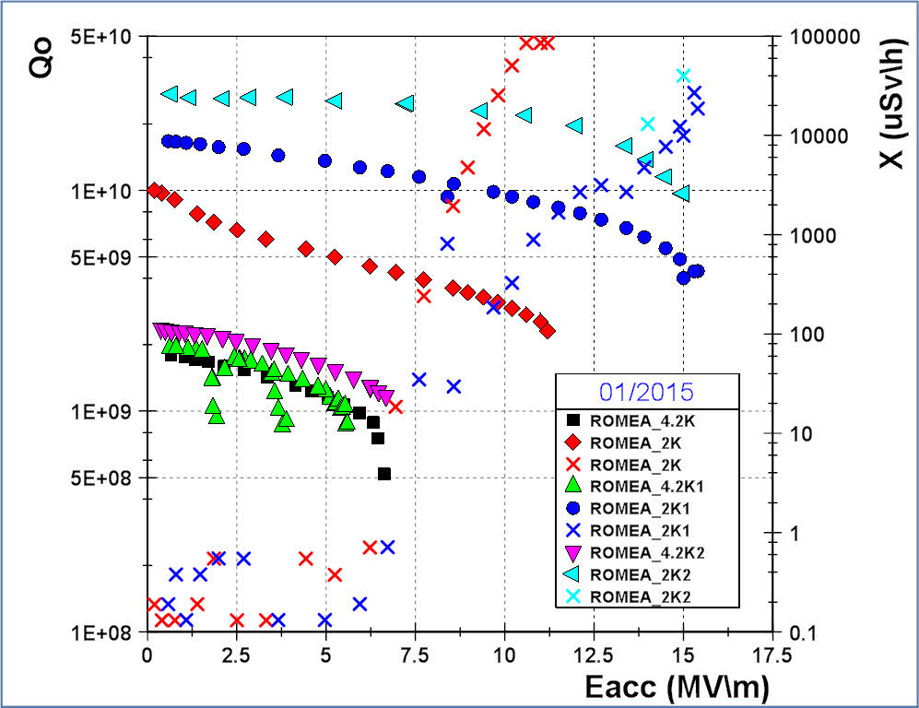
Hydrogen degassing at 650°C
DSR Results
Improvements done after additional etching and 650°C heat treatment
Residual resistance decreasing
6nΩ → 3.5nΩ
After degassing at 650°C 10h
Baseline additional cold BCP
Baseline warm BCP
BCS resistance decreasing (4.2K)
64nΩ → 51nΩ

Slide 13
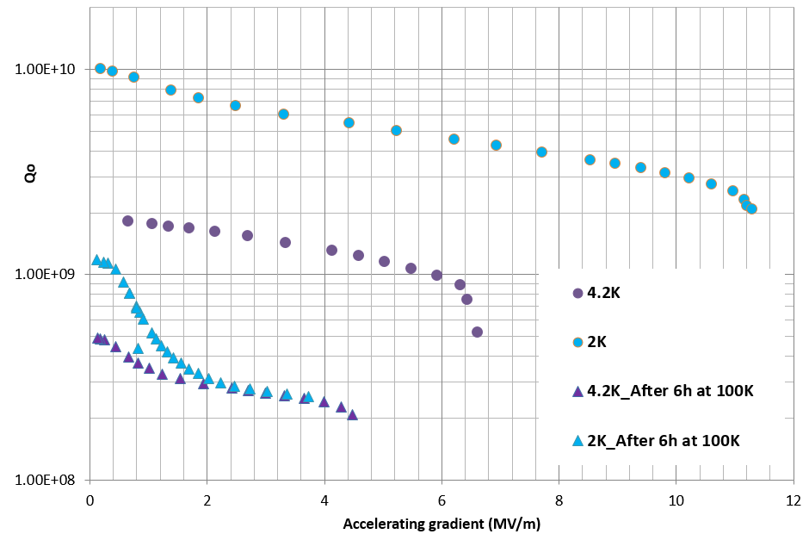
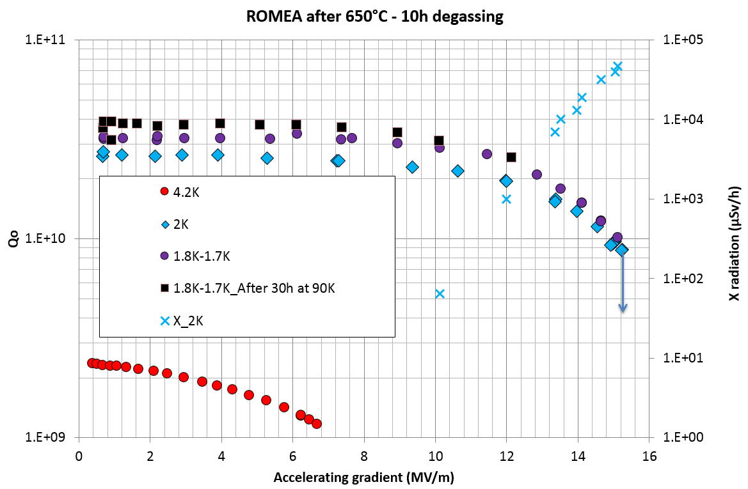
Hydrogen degassing at 650°C
DSR Results
Q-disease check
Cavity not degassed

Slide 14
OUTLINE
SPOKE resonators and baseline performances
  DSR for ESS
  SSR for MYRRHA
Hydrogen degassing at 650°C
  Why is it required for 352 MHz cavities
  The furnace : performances and validation
  Standard procedure for ESS
  DSR Results
R&D for MYRRHA : MYRTE program
  No post-etching procedure
  Sample study
  SSR results

Slide 15
R&D for MYRRHA : MYRTE program
No post-etching procedure
Hydrogen degassing at 650°C during 10h is a good recipe
Usually a chemical etching is required after heat treatment to remove any deposition
Removing this etching could simplify a lot the preparation process… so let’s try!
But this lead to be even more cautious
  Furnace has to be clean and dedicated to cavities
  Not only RF side of cavity but also helium tank has to be very clean
  RF side of cavity has to be shielded from outside : Niobium covers installed on each port of cavity.

Slide 16
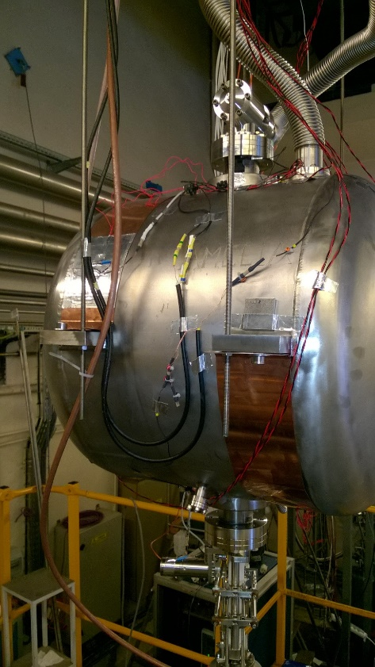
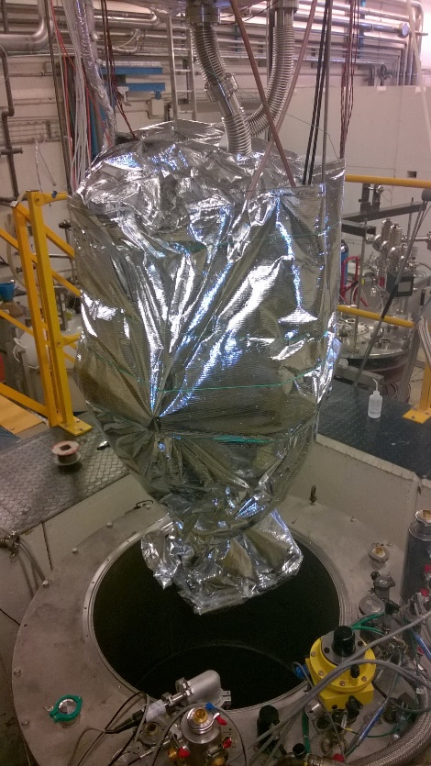

R&D for MYRRHA : MYRTE program
No post-etching procedure
Degassing with the helium tank makes the procedure quite complex
US Bath + detergent (cavity + tank)
Deionized water rinsing (cavity + tank)
BCP (cavity)
HPR (cavity)
Drying in clean room
(cavity + tank)
Assembly
+ VT test
Furnace
Drying in clean room
(cavity + tank)
HPR
(cavity)
BCP (cavity)

Slide 17
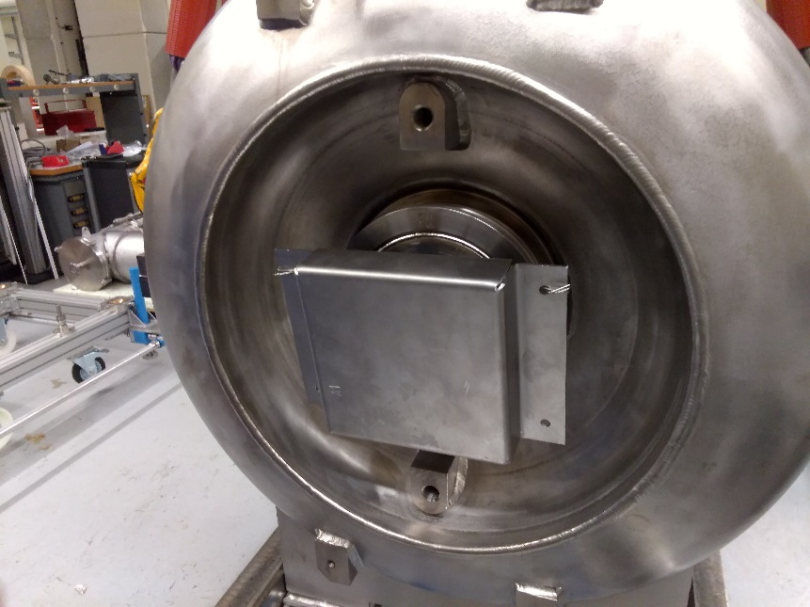
R&D for MYRRHA : MYRTE program
No post-etching procedure

Slide 18
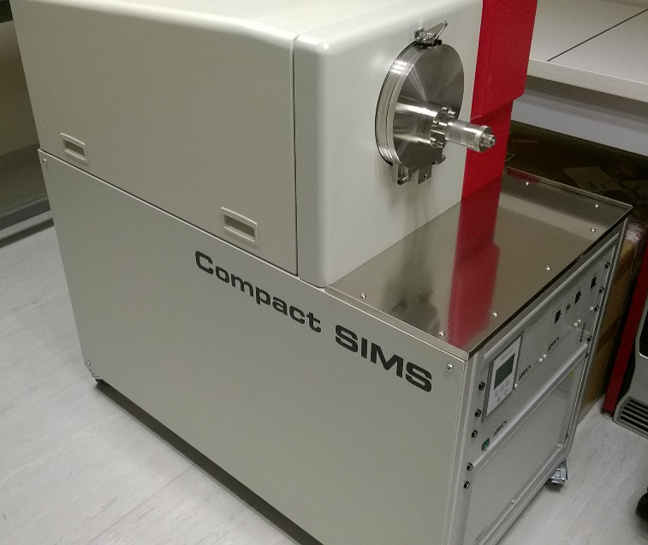
R&D for MYRRHA : MYRTE program
Sample study
Niobium samples have been installed in cavity
SIMS (Secondary Ion Mass Spectrometer) analysis to know what is on the surface after heat treatment
  Compact SIMS from Hiden Analytical

Slide 19
R&D for MYRRHA : MYRTE program
Sample study
A cavity not shielded during heat treatment :

Slide 20
R&D for MYRRHA : MYRTE program
Sample study
A cavity shielded during heat treatment :
A bit of Iron because of stainless steel wire

Slide 21
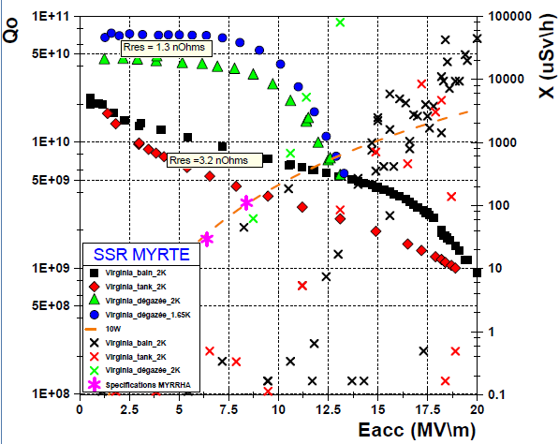
R&D for MYRRHA : MYRTE program
SSR results
1.65K
2K
2K
After degassing at 650°C 10h (no post-BCP)
2K
Baseline after 300K thermal cycle
Baseline warm BCP

Slide 22
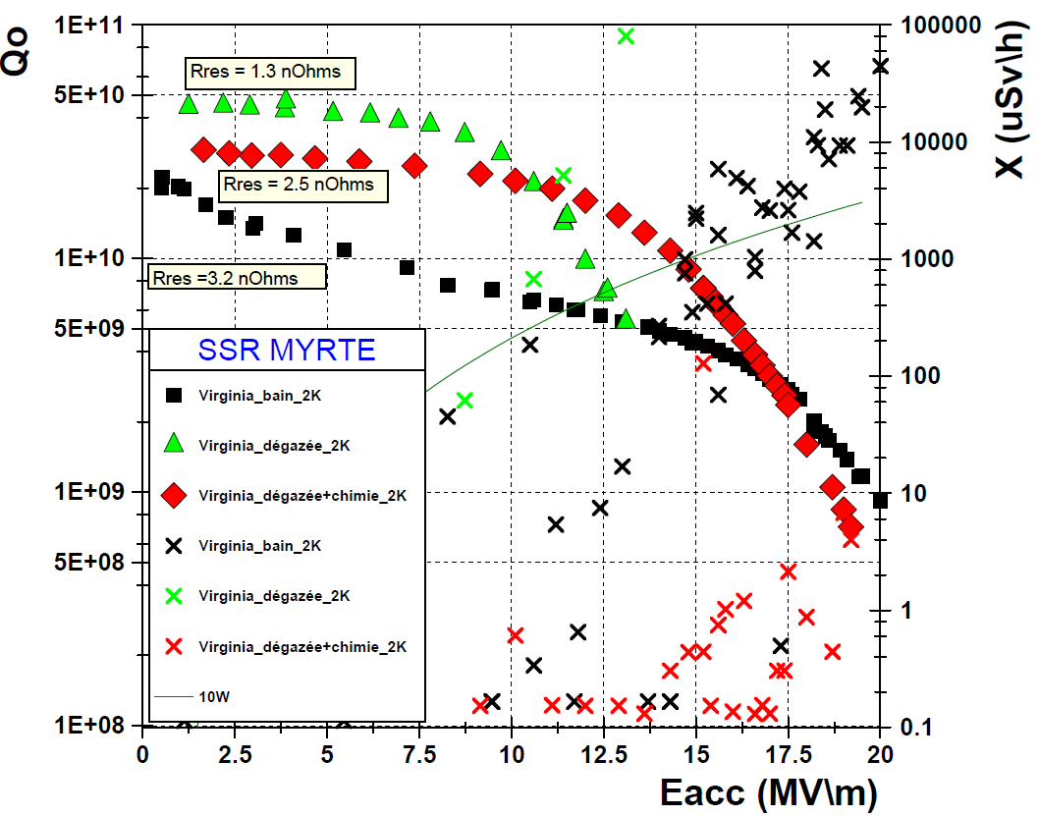
R&D for MYRRHA : MYRTE program
SSR results
2K
2K
2K
After degassing at 650°C 10h
+ 4 um BCP
After degassing at 650°C 10h (no post-BCP)
Baseline warm BCP

Slide 23
R&D for MYRRHA : MYRTE program
SSR results
Very good improvement of Qo after heat treatment!
  Residual resistance is improved (3.2 nΩ →1.3 nΩ)
  The low field Q-slope disapeared with/without post-BCP
  The high field Q-slope is revealed after BCP
Very strong X-rays emission after heat treatment
  Coming from surface pollution not removed by HPR (metallic deposition?)
  Unfortunate bad HPR ?
Sample study revealed Fe on surface
  Layer too thin to degrade surface resistance. Invisible to RF field.
  But can significantly increase the Secondary Emission Yield of the surface ?

Slide 24
CONCLUSIONS
CONCLUSIONS
  Vacuum furnace fully operational : First test → First success!
  FOR ESS :
    Both cavities are way above specifications
    >2E10 @9 MV/m (spec : 1.5E9)
    Heat treatment at 650°C during 10h is a success :
      The cleaning procedure is well defined with the titanium tank
      Removes Q-disease
      Decreases surface resistance
      Reduces Q-slope
  FOR MYRRHA :
    R&D to simplify procedure : remove post-BCP and optimize Qo
    BCP post-treatment is apparently not required :
      Diffusion of impurities is limited to few nanometers
      More precautions to limit presence of metallic pollution that could cause severe multipacting and field emission
    120°C UHV baking will be tested soon to confirm the reduction of high field Q-slope

Slide 25
  THANKS FOR YOUR ATTENTION

Slide 26
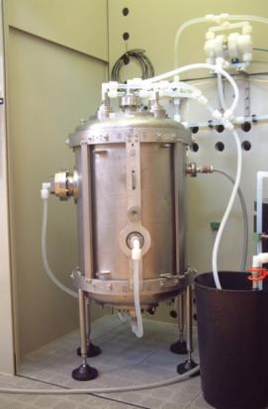
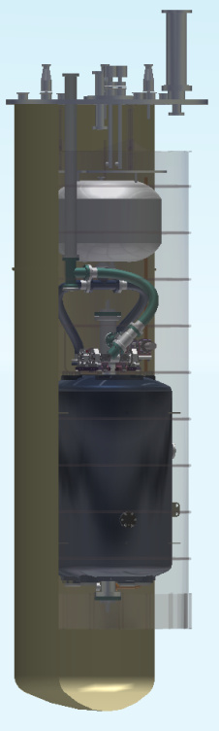
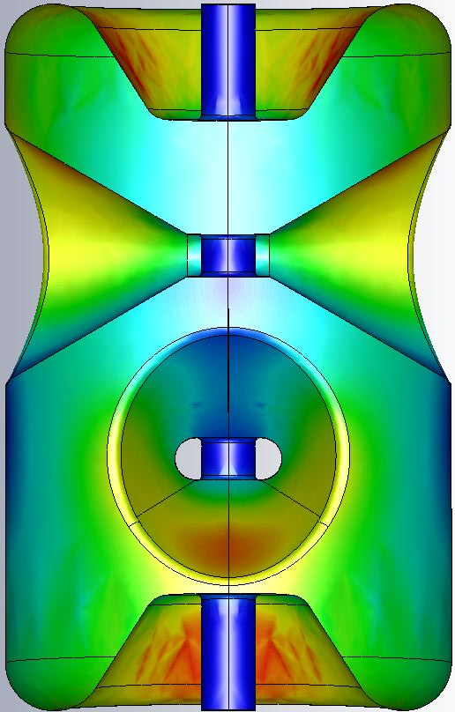
Spoke Resonator and baseline performance
DSR for ESS
Cavity preparation
  Ultra-sonic degreasing
  Etching of 200 µm (goal)
    Phase 1: Horizontal, 120 minutes
    Phase 2: Horizontal (180° rotation), 120 minutes
    Phase 3: Vertical, 240 minutes
    2 barrels to limit acid temperature < 18°C
    Cold water in helium tank
  HPR : 12h
    6 ports (2 beam tubes, 4 HPR ports)
    24h drying
Vertical test done « in vertical ».
  Cooling is not optimal : gas pocket

Slide 27

Spoke Resonator and baseline performance
SSR for MYRRHA
Cavity preparation
  Ultra-sonic degreasing
  Etching of 200 µm (goal) (~ 0.4 µm/min)
    Phase 1: Horizontal, 200 minutes
    Phase 2: Horizontal (180° rotation), 100 minutes
    Phase 3: Same position but fresh acid, 100 minutes
    2 barrels to limit acid temperature < 18°C
    Cold water in helium tank
  HPR :
    4 ports (2 beam tubes, 2 coupler ports)
    48h drying
Vertical test done « in horizontal ».
  Amélia : tested with helium tank
  Virginia : cavity fully immersed in helium
  (dunk test)

Slide 28
Values of R_{BCS}
R_{BCS} (nΩ) | 4.2K | 2K | 1.5K
1300 MHz | 600 | 15 | 1.2
700 MHz | 174 | 4.3 | 0.35
352 MHz | 44 | 1 | 9E-2
88 MHz | 3 | 7E-2 | 6E-3

Slide 29
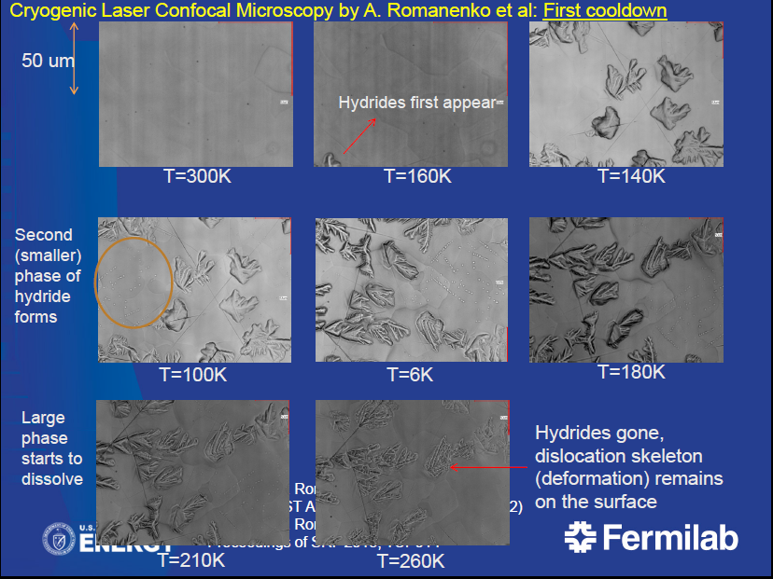
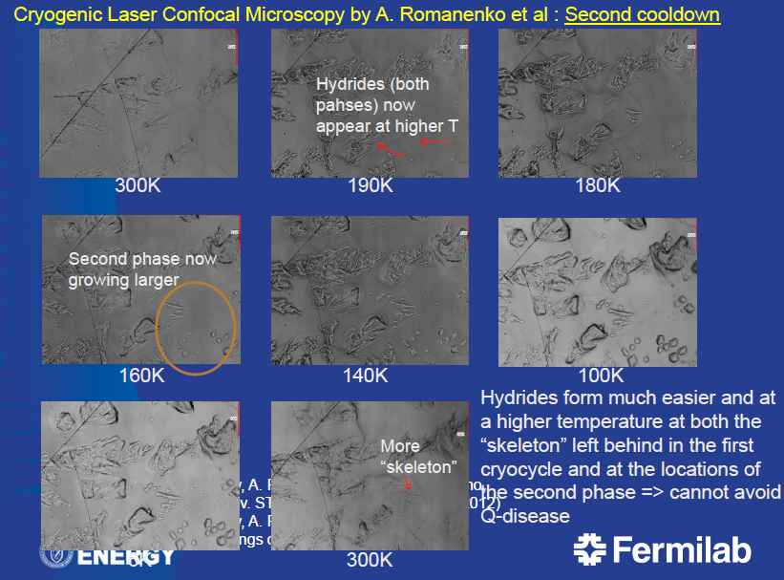
Q-disease
Original Qo-curve of an afflicted cavity cannot be recovered by thermally cycling it to room temperature
See article of Anna Grassellino
Advances in SRF Material Science aimed at High Q cavities
SRF Development Department, TD Fermilab
NA-PAC 2013
Pasadena, California

