Slide 1
Progress and status on Ess medium beta prototype cavities at cea
E. Cenni on behalf of cavities work unit
7th SLHiPP meeting Orsay 2017
CEA Saclay/ESS ECCTD WU Cavités| Enrico Cenni

Slide 2
OUTLINE
Manufacturing and preparation
  Shape control
  RF measure
  Heat treatment
  Final BCP
Latest results
  Surface resistance
  Q-E curves
  X-ray measures
  100K parking
  LFD
  Tuning sensitivity
  Magnetic shielding
Cavities status
Lessons learned
Summary and outlook

Slide 3
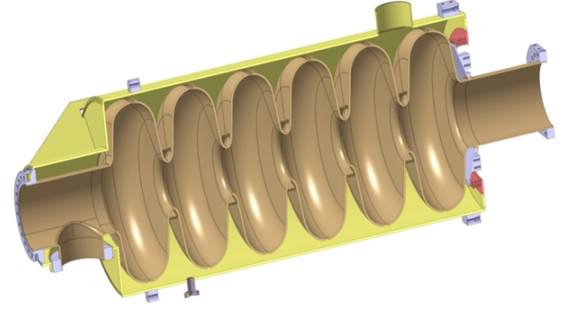


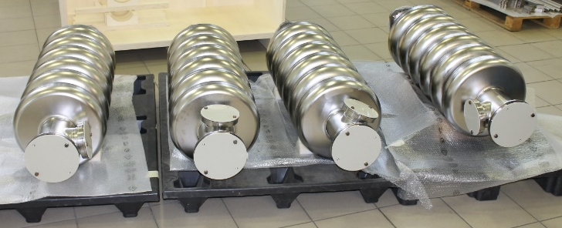
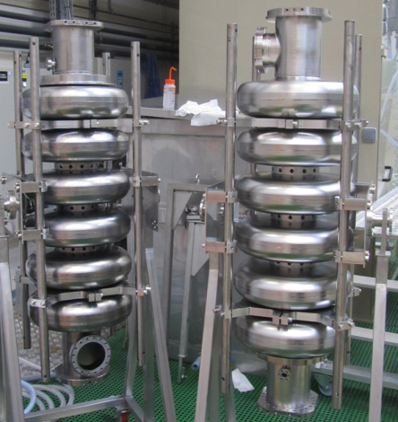

Medium beta prototypes at cea
DESIGN
MANUFACTURING
PREPARATION AND TEST
M-ECCTD will be equipped with 3 cavities from CEA and 1 cavity from INFN-LASA
This talk will be about the work done in CEA concerning medium beta prototypes

Slide 4
Manufacturing

Slide 5
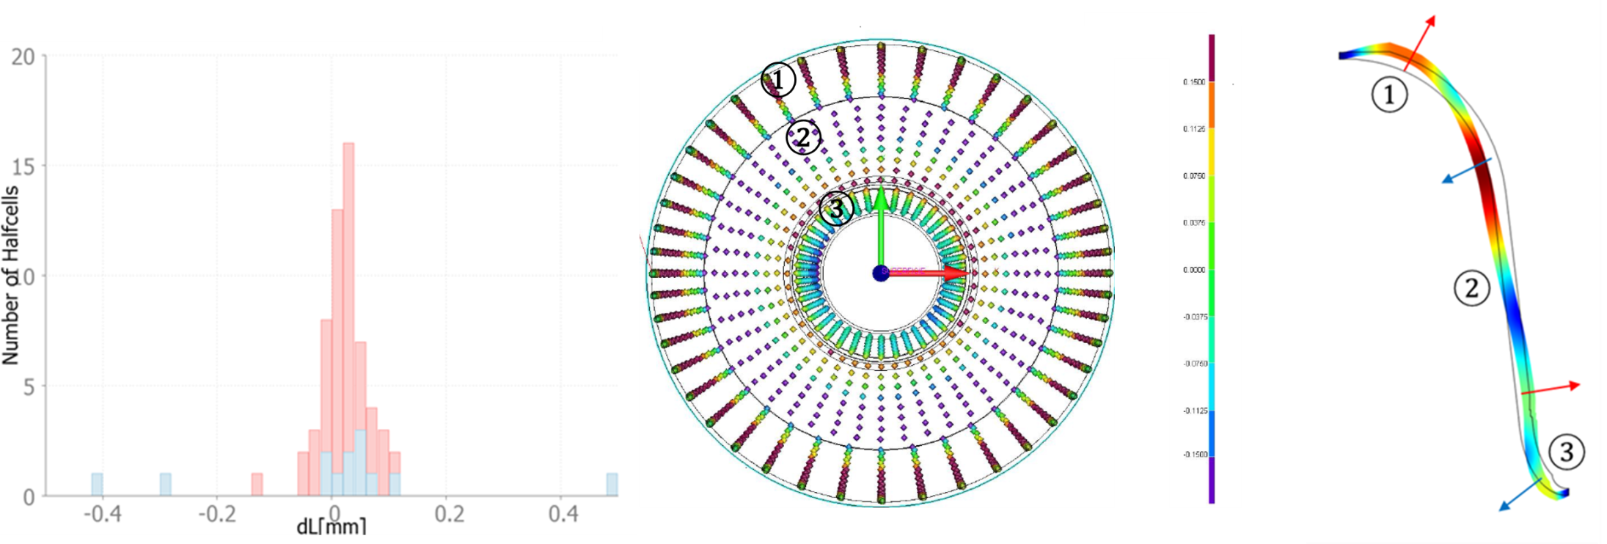
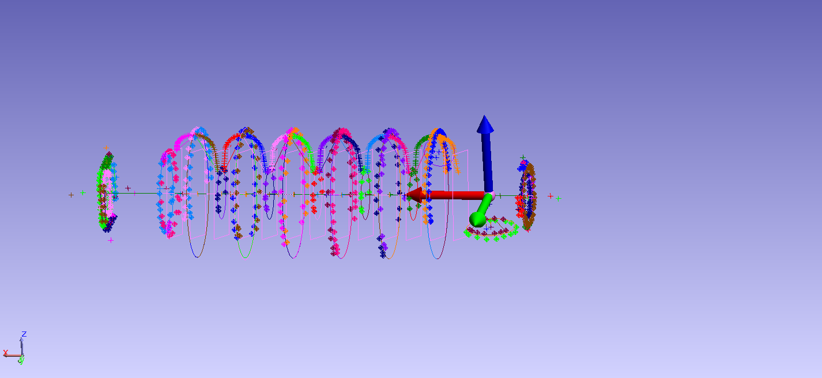
Manufacturing (Shape control)
Length difference between ideal and measured values on central group (red) and end group (blue) halfcells, each bin has 0.02mm width.
3D CMM result on a central half cell, red +0.15mm, purple -0.15mm (shape tolerance 0.3).
Sketch of average deformation observed on central half cell not in scale.
Laser tracking 3D measure performed at CEA

Slide 6
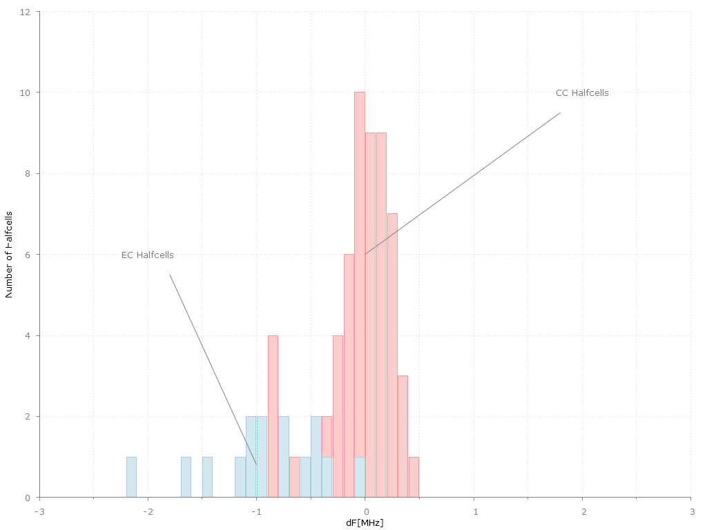
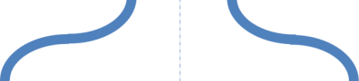
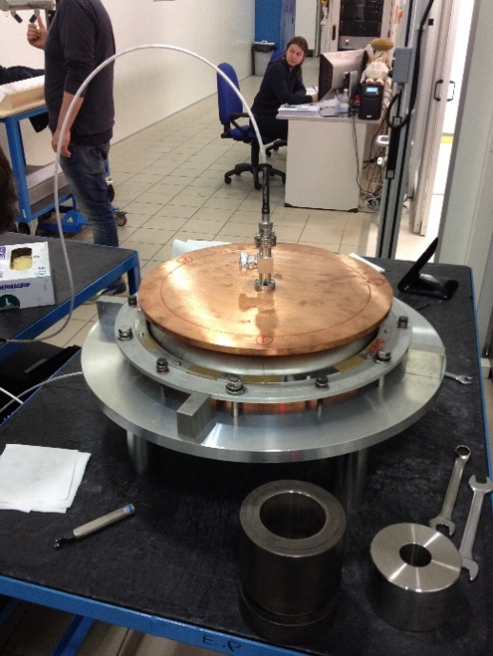
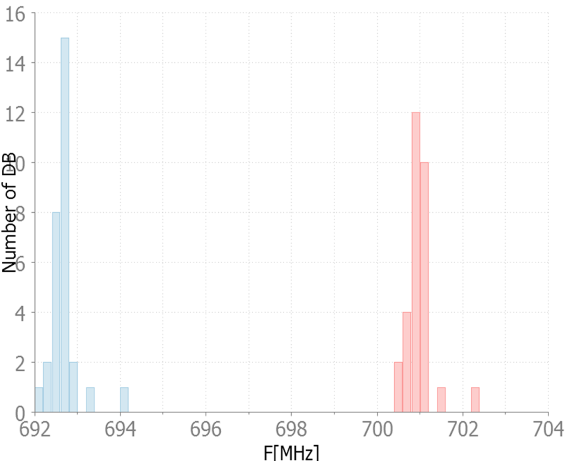
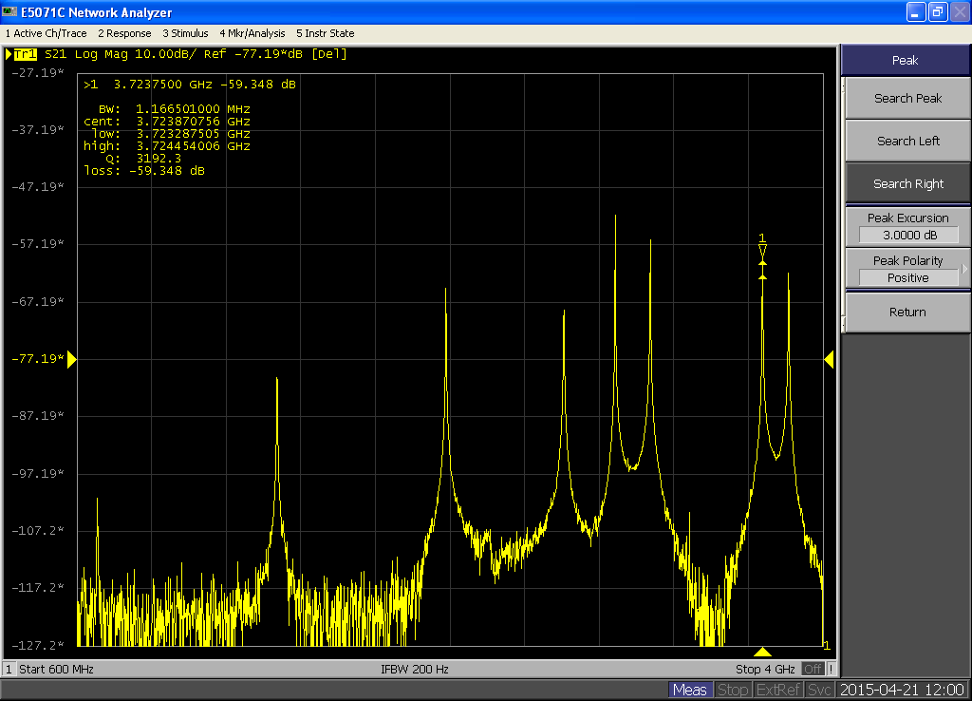
Manufacturing (RF measures)
RF connector
Antenna
Half cells
Upper plate (iris side)
Lower plate (equator) side)
0.5MHz
Dumbbells
0.5MHz

Slide 7
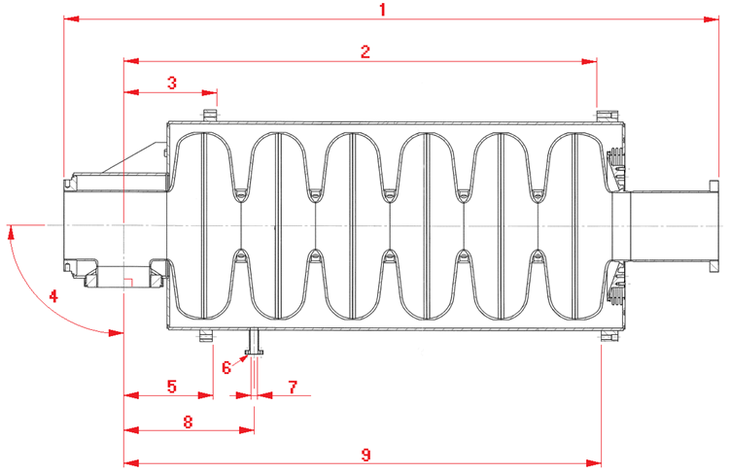
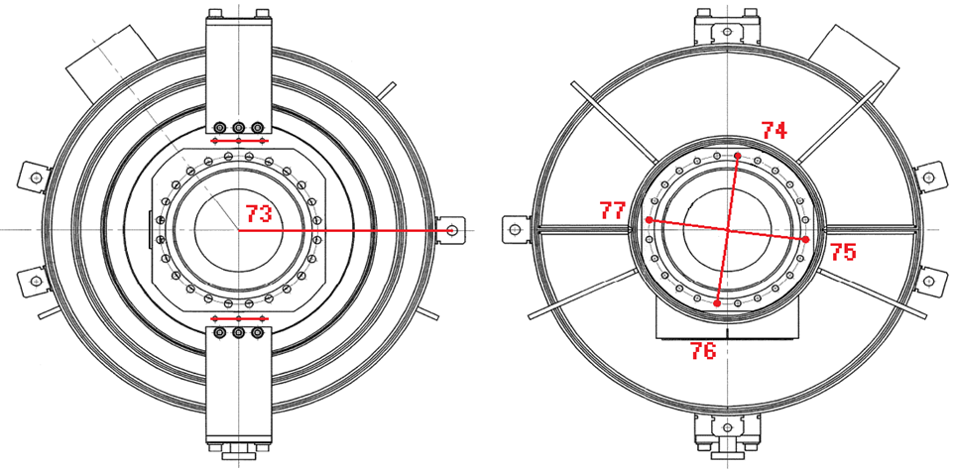
Manufacturing (integrated cavity)
We have created a dimension control plan on each subparts
300 points on each halfcells and dumbbells by means of CMM
On the integrated cavity we put about 80 dimensional controls (this will be optimized after string assembly feedback)
Some number related to the first 4 integrated cavities:
Maximum displacement between beam flanges 1mm (average is 0.6mm)
Maximum angular displacement 0.5° (average is 0.2°)

Slide 8
Measures and results

Slide 9
First results
Process | Rs @2K [nΩ]
BCP (~200µm) | ~200
Heat treatment+HPR | ~20
BCP(~20µm)+HPR | ~10

Slide 10
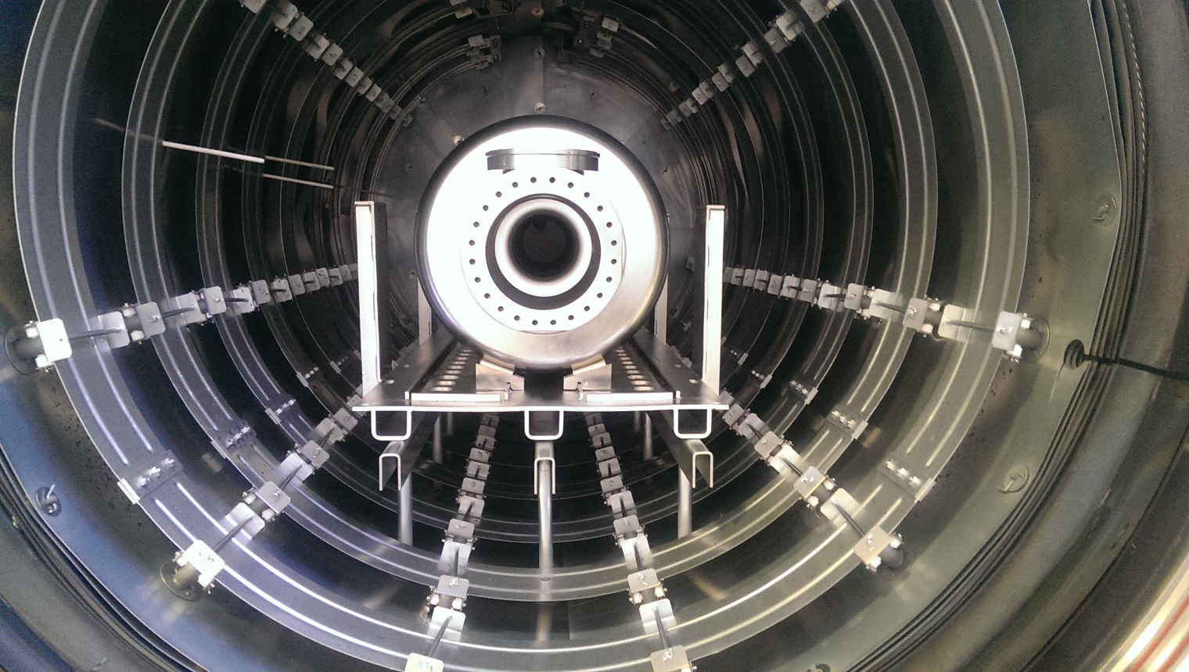
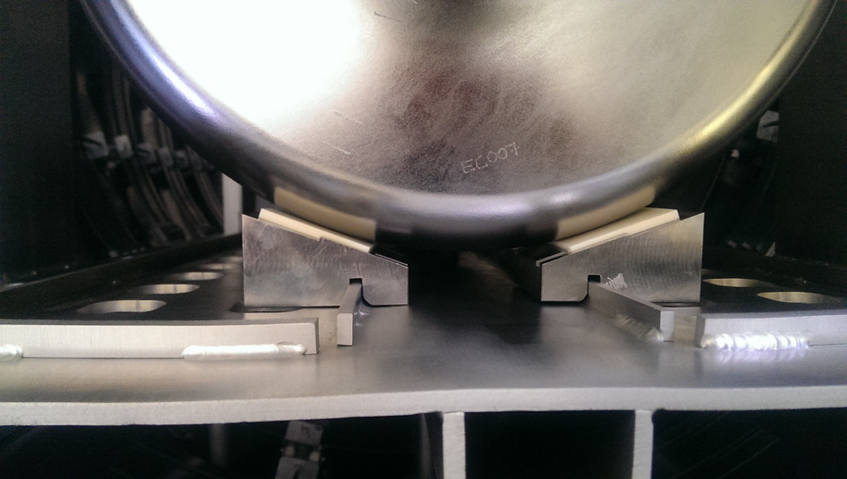
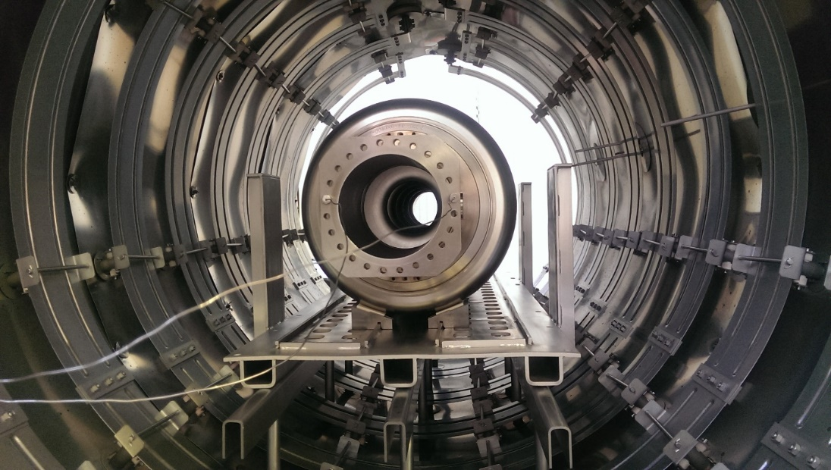
Zanon
First shield and heating system made with Molybdenum.
Same oven used for XFEL and LCLS2

Slide 11
Heat treatment
Zanon

Slide 12
RGA
Zanon

Slide 13
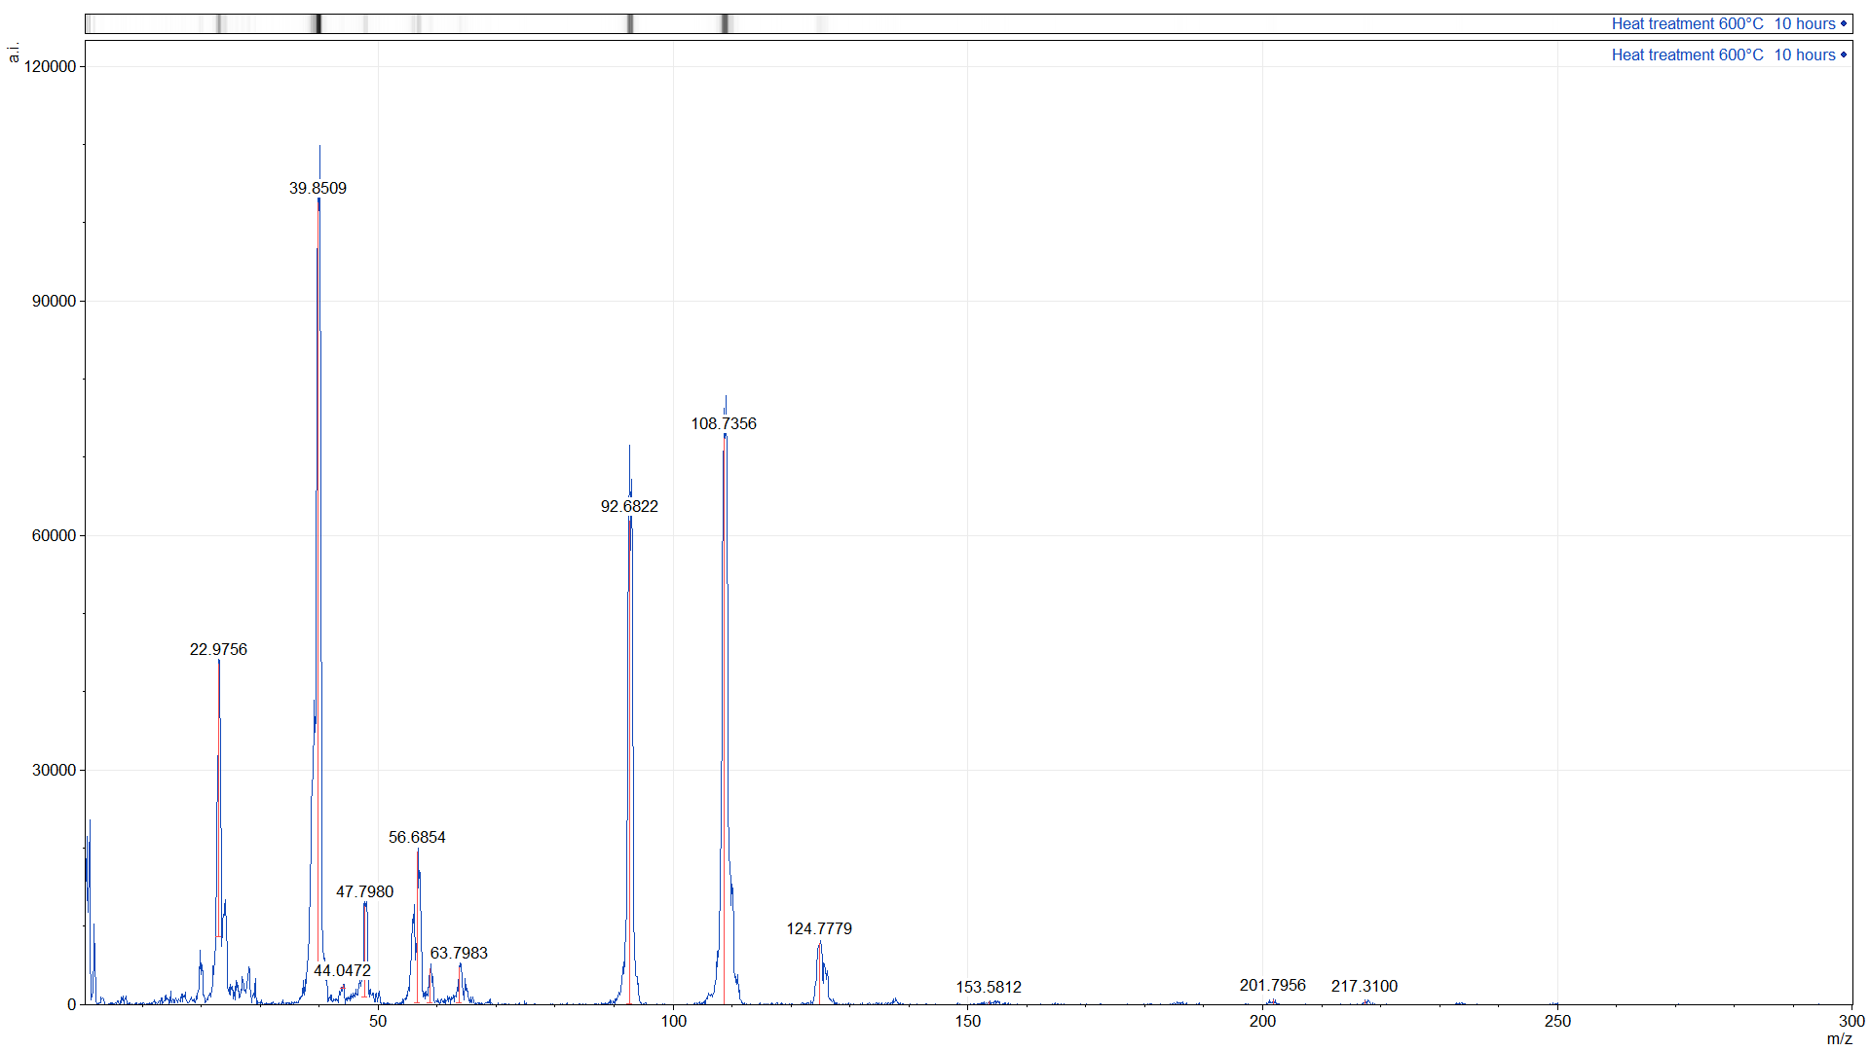
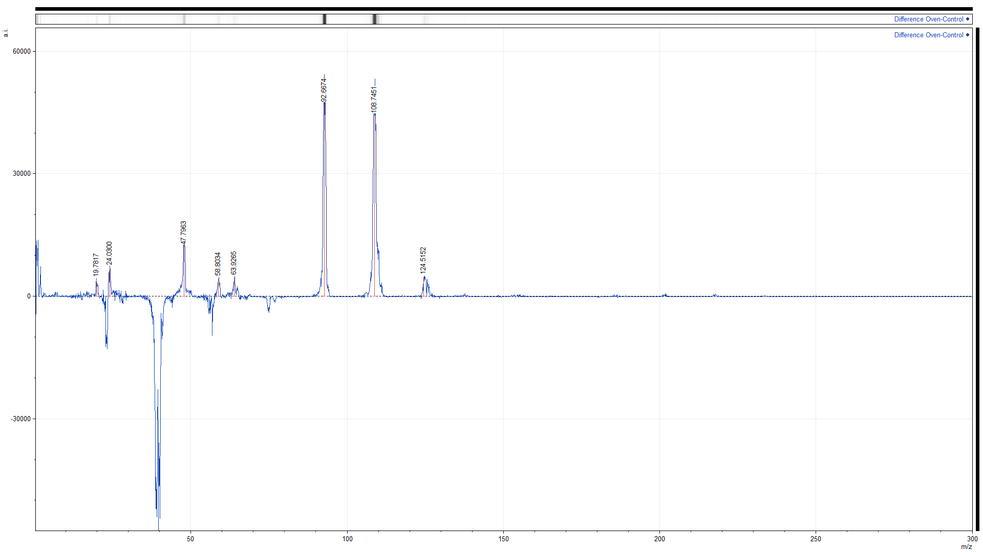
SIMS analysis (Argon beam)
D. LONGUEVERGNE
IPNO
Ar+
NbO+
Nb+
Na+
Ar++
Ca++
Ti+
Fe+
FeH+
TiO+
NbO₂+

Slide 14
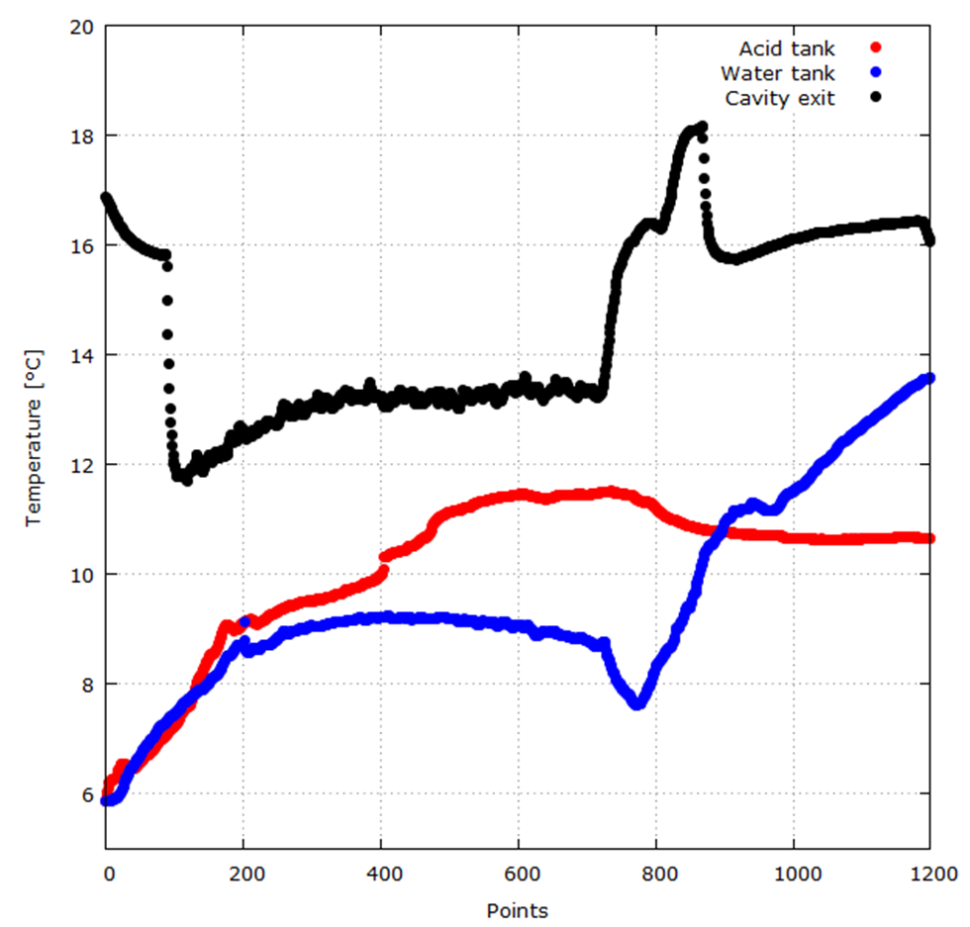
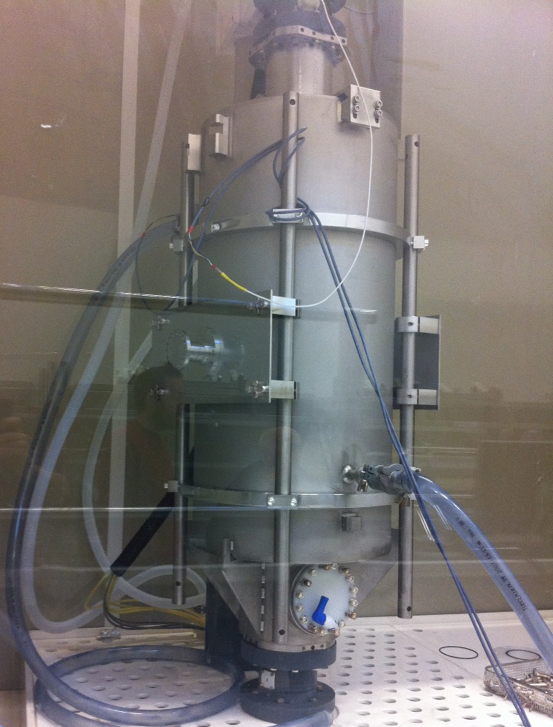
Bcp with helium tank and water cooling
X. Hanus
C. Servouin
F. Eozenou
Y. Boudigou,
G. Monnereau
Acid fill up the cavity
Cavity full of water
BCP finished
Cavity empty
We are able to limit the temperature increase during BCP.
Acid enter the cavity

Slide 15

Latest results (RS)
D. Roudier
L. Maurice
We were able to obtain good surface resistance on all cavities.
BCP process has been strongly improved
Data fitted with
$$R_{S}=\frac{A}{T}×e^{−\frac{∆}{T}}+R_{0}$$
Cavity serial number | Residual resistance (R₀ ) [nΩ] | Q0 at 1MV/m @2K
MP01 | 3.14 | 3.2x10¹⁰
MP02 | 6.09 | 2.2x10¹⁰
MP03 | 6.06 | 2.1x10¹⁰
MP04 | 7.09 | 1.9x10¹⁰
MP04 (b) | 4.85 | 2.5x10¹⁰
Q₀(2K) at low field is ≥ 1.9x10¹⁰ for all cavities

Slide 16
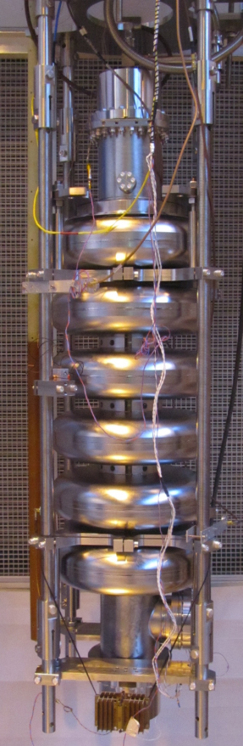
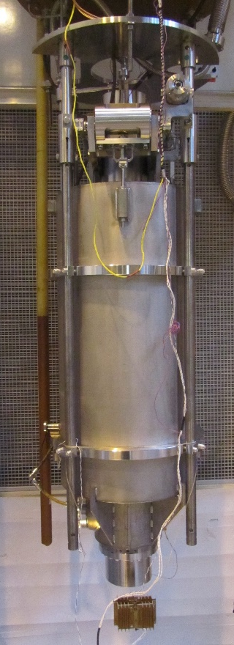
Latest results (Q-E)
D. Roudier
L. Maurice

Slide 17
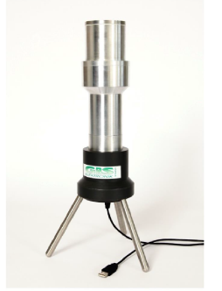
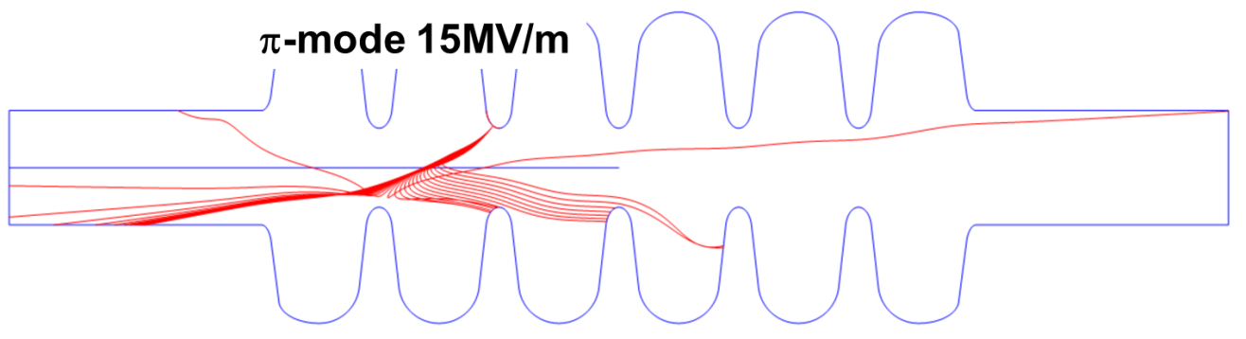
X-rays (Field emission)
D. Roudier
L. Maurice
MP barrier
NaI(Tl) scintillator
We plan to implement systematic x-ray spectra recording on vertical cryostat and cryomodule.
Cavity serial number | X-ray dose rate at ~15MV/m (π-mode) [mSv/h]
MP01 | 2.8
MP02 | 18.6
MP03 | 0.0002 (background)
MP04 | 0.1
MP04 (b) | 0.022

Slide 18
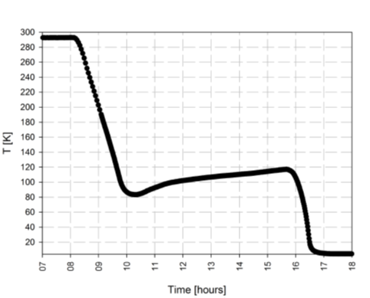
100K effect
D. Roudier
L. Maurice
P. Sahuquet
The heat treatment proved to be effective against Q-disease
“100K Parking”

Slide 19
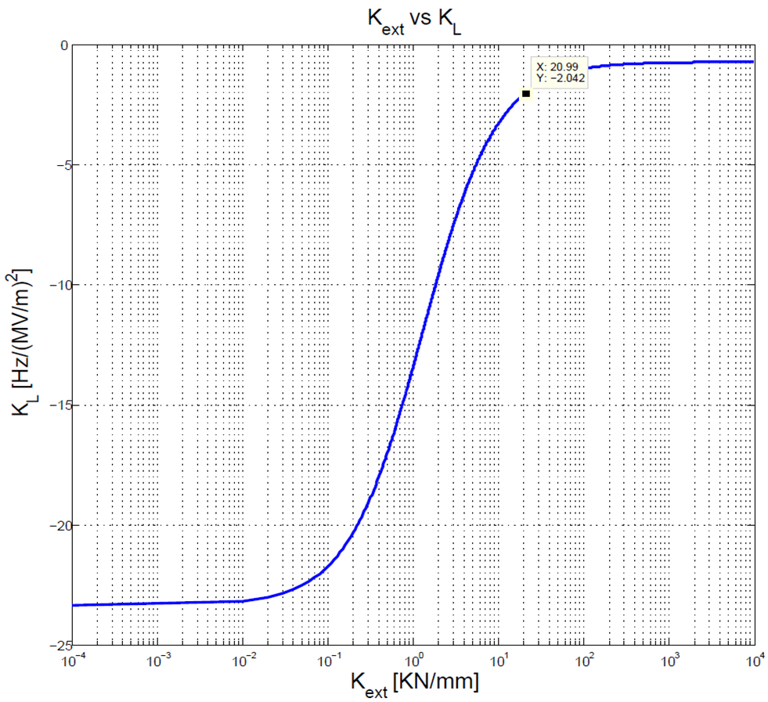

Lorentz force detuning
D. Roudier
L. Maurice
G. Devanz
The measure is consistent with calculation

Slide 20
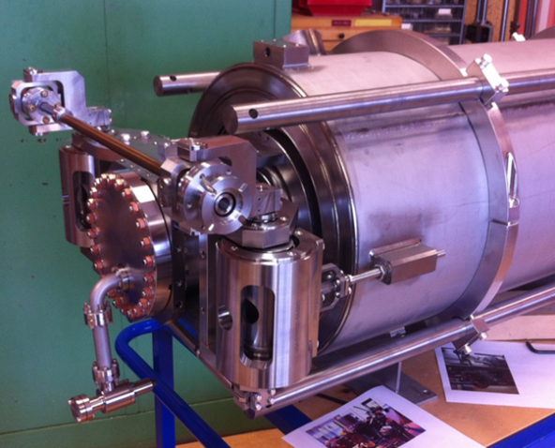
Tuning sensitivity
D. Roudier
E. Jacques
Passband mode frequencies in vacuum while moving the tuner
Blue 10 turns pull (~1mm)
Orange 0 turn (blocked before pumping)
Tuning sensitivity:
Pulling
Releasing
No backlash
Computation predict 211kHz/mm measured value is between 210-212 kHz/mm

Slide 21
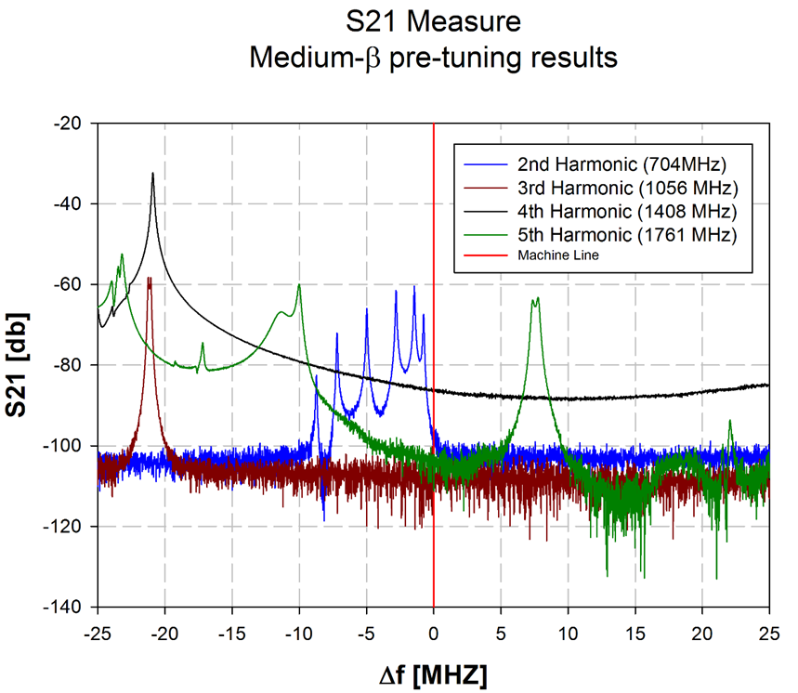
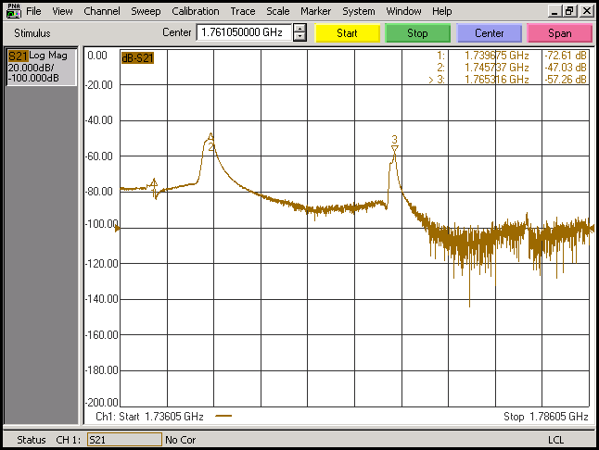
FF and HOMs
D. Roudier
Cavity Field flatness are consistently brought to 95%, heat treatment and tank integration can change the field flatness about 1-2% depending on the accumulated stress on the cavity.
HOMs are monitored during manufacturing and they are away from machine lines as designed (typically more than 20MHz)
TE modes
TM mode
Note: each BCP moves the dangerous TM mode more away from machine line

Slide 22
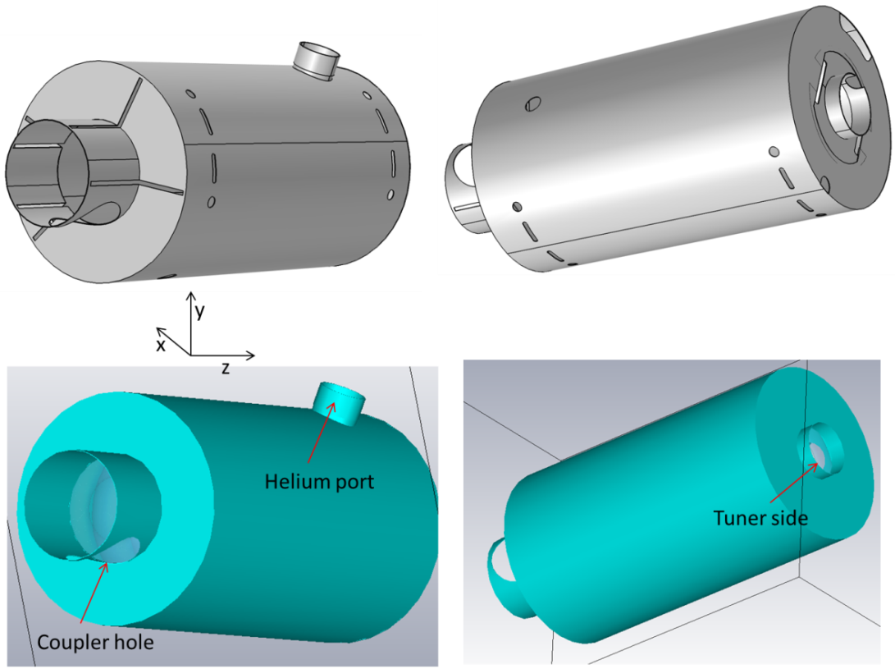
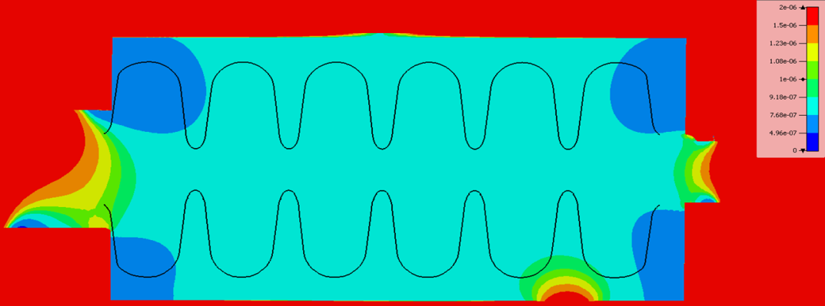
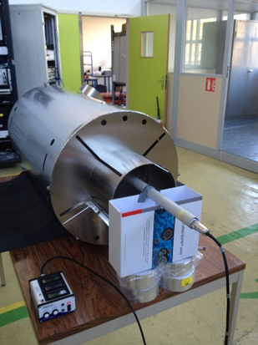
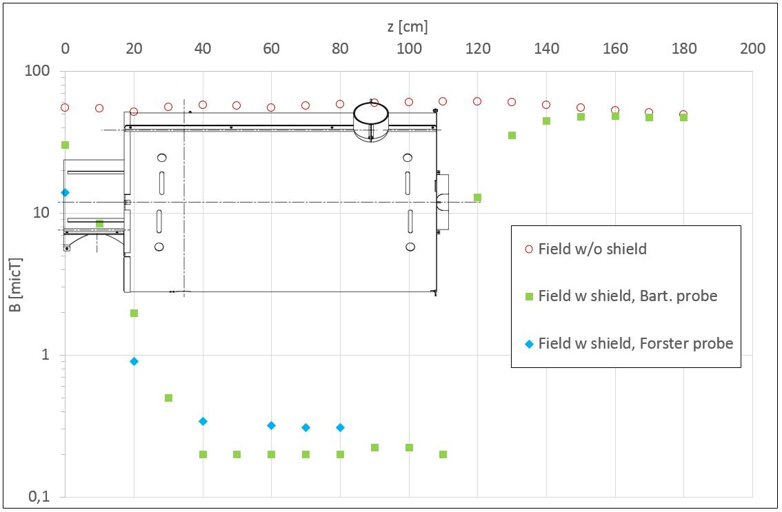
Magnetic shielding design
J. Plouin
Requirements: maximal field around cavity < 2 μT
Tesla
1 µT
Field is lower than 1 μT inside the shield, and mainly around 0,5 μT
We are confident for a value <2 μT at cold temperature

Slide 23
Cavities status
Cavities | Status | Details
MP01 | Assembled on the string
MP02 | Assembled on the string
MP03 | Assembled on the string
MP04 | Equipped with tank | R&D
MP05 | Naked | R&D
MP06 | Naked 200µm BCP performed at Zanon | R&D

Slide 24
Lessons learned and outlook
Manufacturing process looks to be reproducible and reliable (learning curve shall be took into account), still there is space for improvement
BCP temperature shall be monitored, water cooling proof to be effective with integrated cavity (recently we were able to obtain very low Rs)
Frequency change rate with BCP is about 2.9kHz/µm and the average etching rate is about 1µm/min with 1:1:2.4 mix (FNP), in good agreement with simulation
Heat treatment at 600°C for 10 hours works fine (no Q-disease has been observed)

Slide 25
Summary and outlook
We have successfully manufactured 6 medium cavities, 4 of them are now equipped with helium tank.
Three cavities have been successfully assembled with power couplers, they are assembled on the string.
For P01 and P02 Q-E curves are above specifications even with field emission.
P03 has not reached ESS specification but is field emission.
P04 also shows field emission, we are currently working on HPR and clean room operation.
We keep working on the remaining prototypes in order to have the best recipe for cavity series and High beta cryomodule demonstrator

Slide 26
THANK YOU FOR YOUR ATTENTION
Thanks to: D. Roudier, L. Maurice, X. Hanus, F. Peauger, P. Bosland, C. Madec, F. Eozenou, C. Servouin, Y. Boudigou, G. Monnereau, E. Jacques, J-P. Charrier, P. Sahuquet, P.Carbonnier, J. Pluoin, G. Devanz.

Slide 27
BACK UP SLIDES
Commissariat à l’énergie atomique et aux énergies alternatives
Centre de Saclay | 91191 Gif-sur-Yvette Cedex
T. +33 (0)1 69 08 xx xx | F. +33 (0)1 69 08 99 89
  Etablissement public à caractère industriel et commercial | RCS Paris B 775 685 019

Slide 29
SUMMARY table
Area | Detail | Future action
Design and manufacturing | Dimensional controls
 | Lorentz force detuning
 | Tuning sensitivity
 | HOMs
Preparation and testing | Rs
 | Q0 (2K low field)
 | Q-slope | Vertical tests and BCPs
 | Q-disease “vaccination”
 | Etching sensitivity
 | Field emission | HPR improvement and monitoring
 | Magnetic shielding (RT)
We keep working on the remaining prototypes in order to have the best recipe for cavity series and H-ECCTD

Slide 31
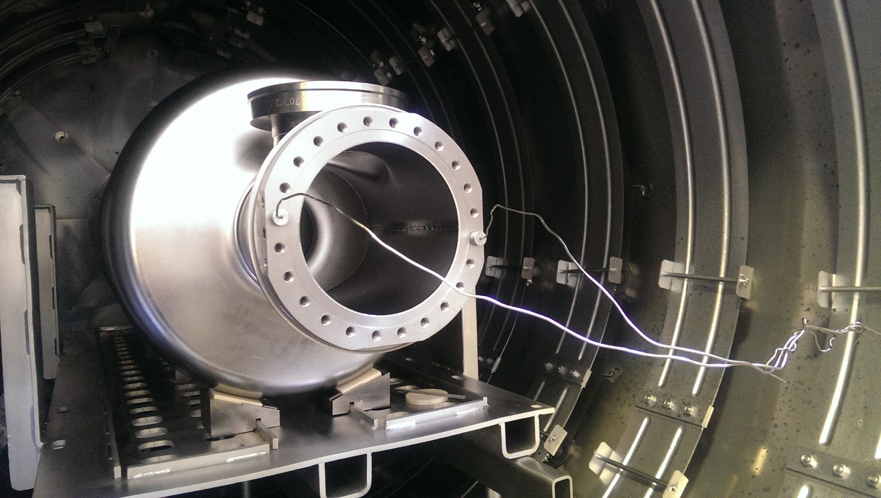
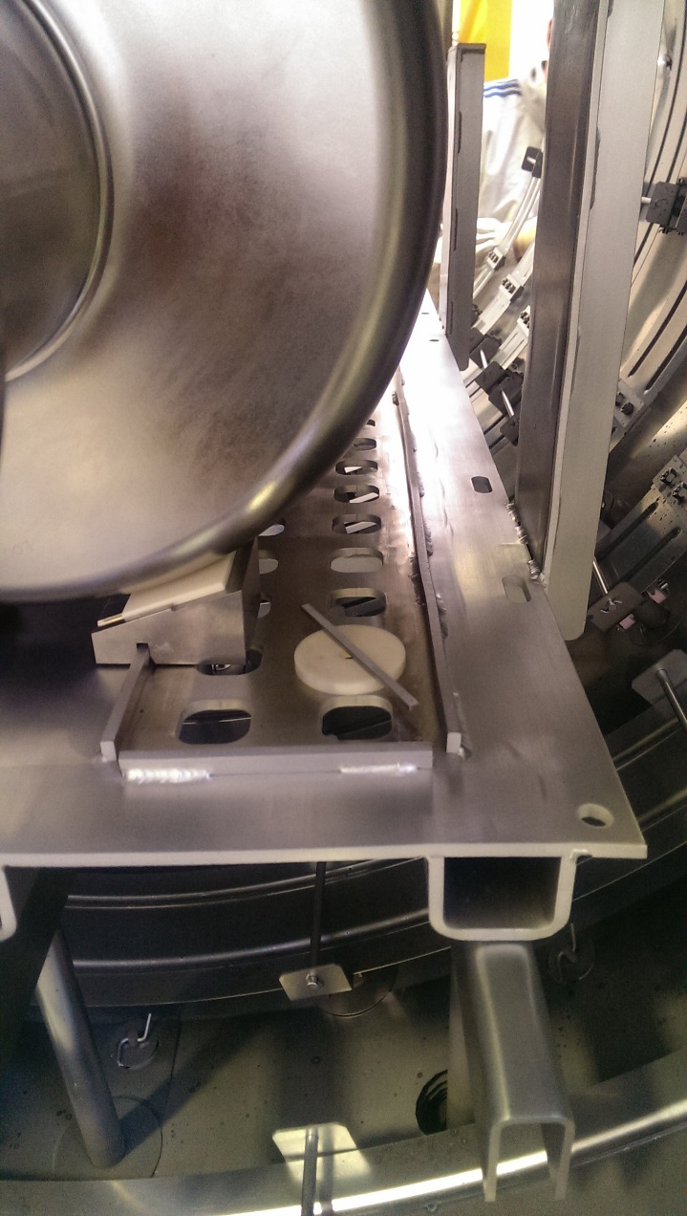
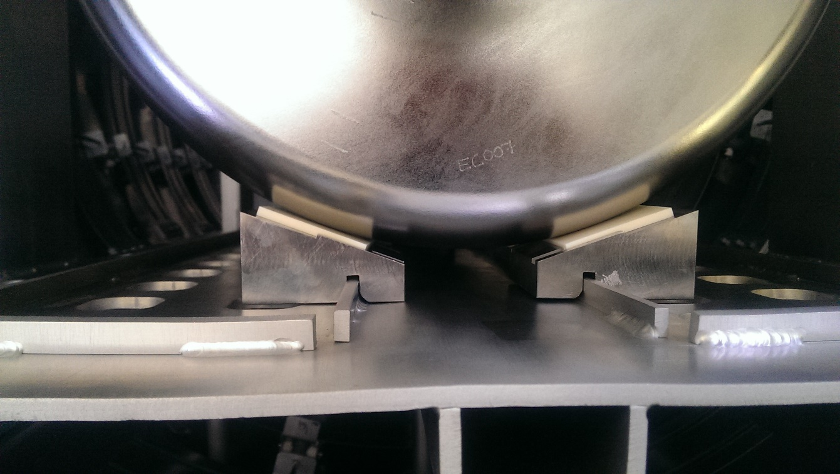

Slide 32
X-rays
MP barrier
Cavity serial number | X-ray dose rate at ~15MV/m (π-mode) [mSv/h]
MP01 | 2.8
MP02 | 18.6
MP03 | 0.0002 (background)
MP04 | 0.1
MP04 (b) | 0.022
We plan to implement systematic x-ray spectra recording on vertical cryostat and cryomodule.
NaI(Tl) scintillator

Slide 33
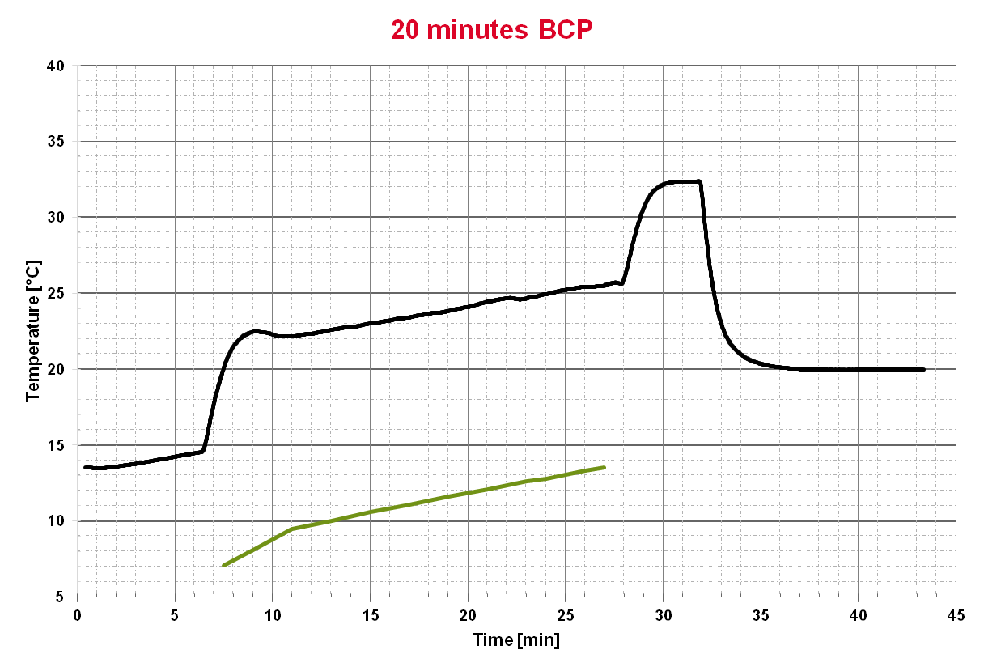
temperature curve features
(naked cavity) no exterior cooling
X. Hanus
C. Servouin
BCP reaction produces about 2kW, we are able to remove only 1kW in the acid tank.
Water rinsing
~ 2 °C/min
Acid touch the cavity surface
~0.2 °C/min
Acid flow stop and pumped out
~0.2 °C/min
Acid tank temperature

Slide 34
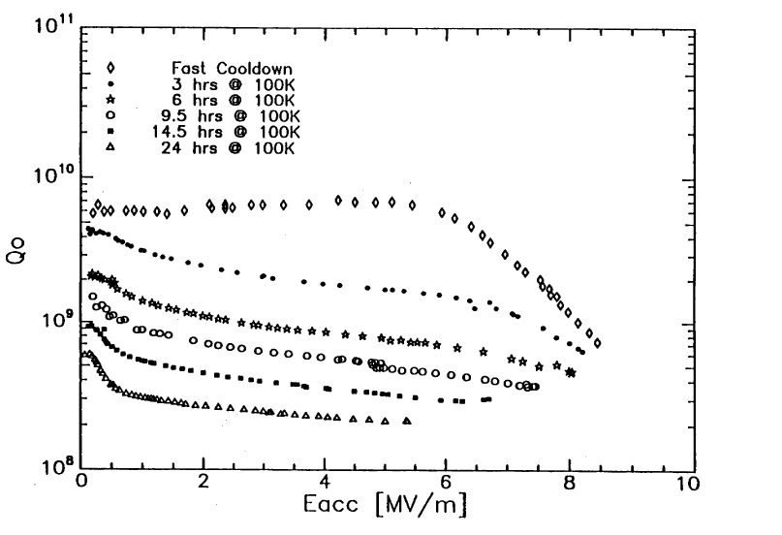
Q-disease
  Still present after warm up
  No difference with faster cooling rate
Hydrogen diffusion during BCP?
  Need to optimize the BCP process for the pre-series
J. Halbritter, P. Kneisel, K. Saito. SRF93.

Slide 35
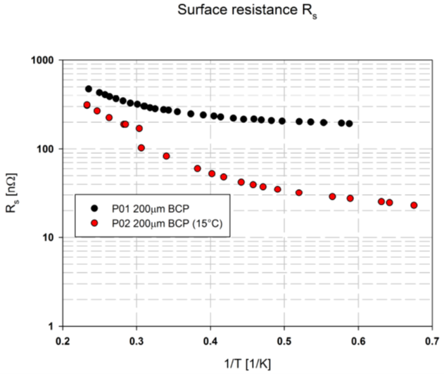
P01-P02 comparison
All BCP on P02 were done with acid temperature less than 15°C in the tank

Slide 36
Medium beta Cavity parameters
LFD [Hz/(MV/m)^2] | Zanon | IDEAL*
Fixed ends | -0.7796 | -0.735
Free ends | -21.98 | -23.35
Stiffness [kN/mm] | Zanon | IDEAL*
 | 1.362 | 1.286
Tuning sensitivity [kHz/mm] | Zanon | IDEAL*
 | 211.26 | 214.83
Pressure sensitivity [Hz/mbar] | Zanon | IDEAL* (1 mbar applied)
FIXED ENDS | 18.01 | 23.08
FREE ENDS | -417.35 | -364.94

Slide 37


Medium beta prototypes at cea
DESIGN
DESIGN
MANUFACTURING
MANUFACTURING and PREPARATION
PREPARATION
M-ECCTD will be equipped with 3 cavities from CEA and 1 cavity from INFN-LASA
This talk will be about the work done in CEA concerning medium beta prototypes

Slide 38
Frequencies (simulation)
Calculation agrees well with measurements
Tuner system is very close to fix ends condition

Slide 39
One cell temperature distribution
X. Hanus
ΔT≈15°C
5
4
3
1
2
ΔT≈10°C
Acid Flow

Slide 40
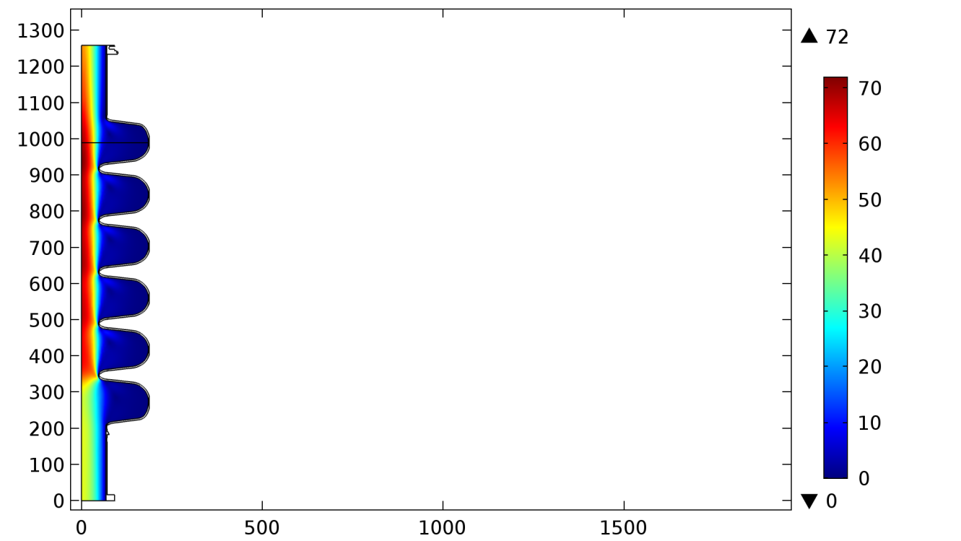
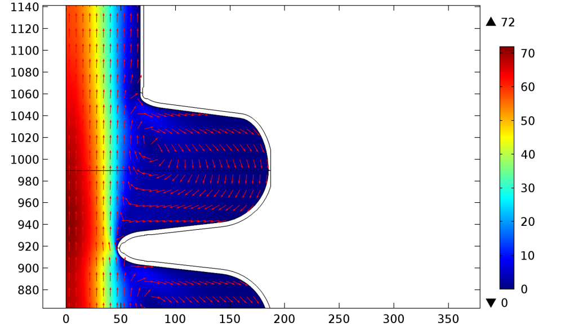
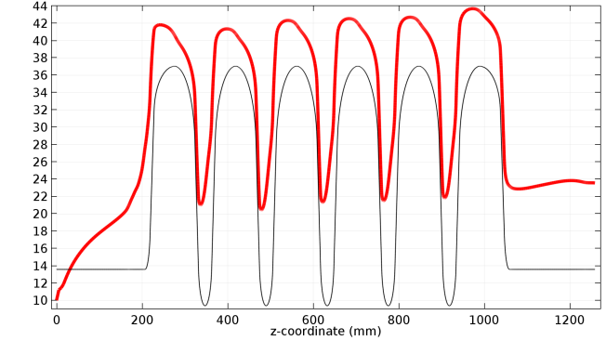
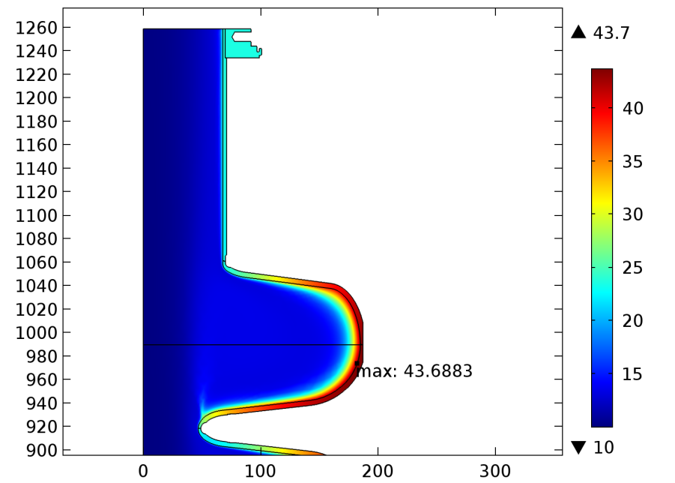
Fluid dynamics Simulation results
Inflow 20 l/min
Acid speed and velocity [mm/s]
Temperature [°C]
Acid speed [mm/s]

Slide 41
Where we started

Slide 43

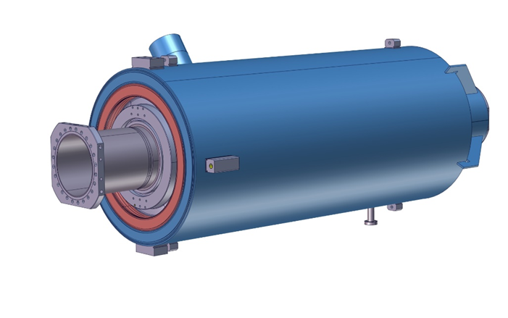
Cavities details
 | Medium |  | High
Geometrical beta - β_{geom} | 0.67 |  | 0.86
Frequency [MHz] | 704.42
Number of cells | 6 |  | 5
Operating temperature [K] | 2
Maximum surface field in operation [MV/m] | 40 |  | 44
Nominal Accelerating gradient E_{acc} [MV/m] | 16.7 |  | 19.9
Accelerating length L_{acc} = (n_{cell}.β_{geom}.λ/2) [m] | 0.855 |  | 0.915
Nominal Accelerating Voltage V_{acc} = (E_{acc} x L_{acc}) [MV] | 14.3 |  | 18.2
Theoretical R_{BCS} (1) at operating temperature [nΩ] | 3.2
G [Ω] | 196.6 | 241
Q₀ at operating temperature for R_{BCS} | 6.14x10¹⁰ | 7.53x10¹⁰
Q₀ at nominal gradient | > 5 x10⁹
Cavity dynamic RF heat load [W] | 4,9 |  | 6,5
Q_{ext} | 7.5x10⁵ |  | 7.6x10⁵
Iris diameter [mm] | 94 |  | 120
Beam tube diameter [mm] | 136 |  | 140
Cell to cell coupling κ [%] | 1.22 |  | 1.8
π and 5π/6 or 4π/5 mode separation [MHz] | 0.54 |  | 1.2
E_{pk}/E_{acc} at β_{opt} | 2.36 |  | 2.2
B_{pk}/E_{acc} [mT/(MV/m)] at β_{opt} | 4.79 |  | 4.3
Maximum r/Q [Ω] at β_{opt} | 394 |  | 477
r/Q [Ω] at β_{geom} | 367 |  | 435
Optimum beta β_{opt} | 0.705 |  | 0.92
Stored energy [J] at nominal E_{acc} and β_{opt} | 117.3 |  | 156.9
RF Power P_{fwd} [kW] with power coupler at Q_{ext} and β_{geom} (2) | 185 |  | 250

