Slide 1
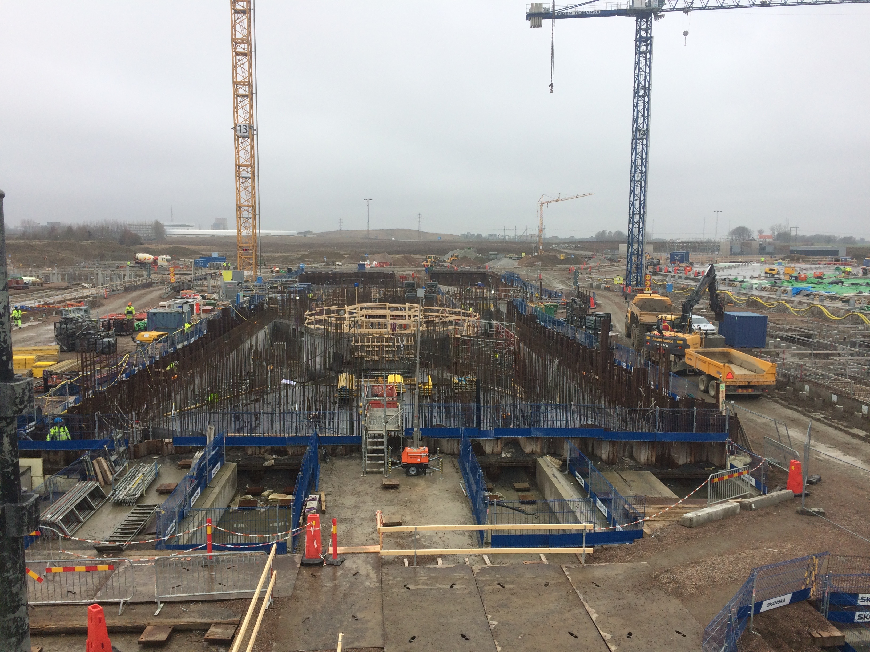

Ion source and LEBT installation at ESS
Øystein Midttun – University of Bergen
Ion source and LEBT system leader
www.europeanspallationsource.se
SLHiPP-7 – 8 June 2017

Slide 2
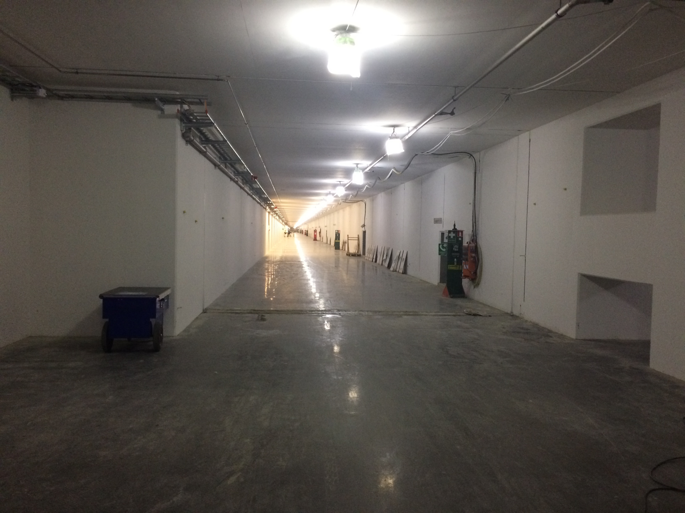
ESS accelerator tunnel – March 2017

Slide 3
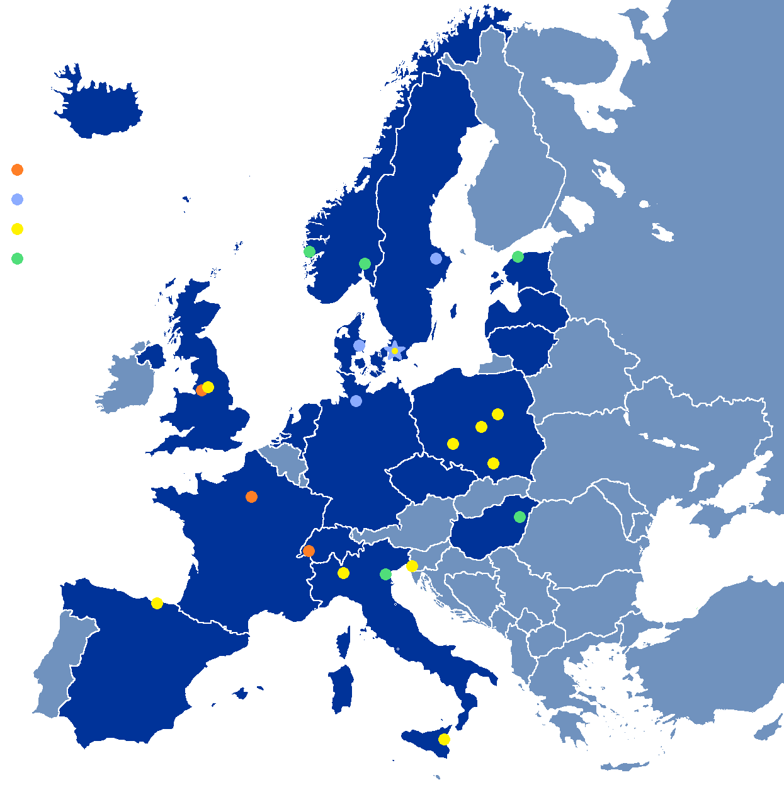


The ion source and LEBT is made though a partnership between INFN-LNS, ESS, and CEA
Vacuum
Controls
Beam diagnostic
Controls
Beam diagnostic
WP leader
Overall design
Construction
Commissioning
Installation

Slide 4
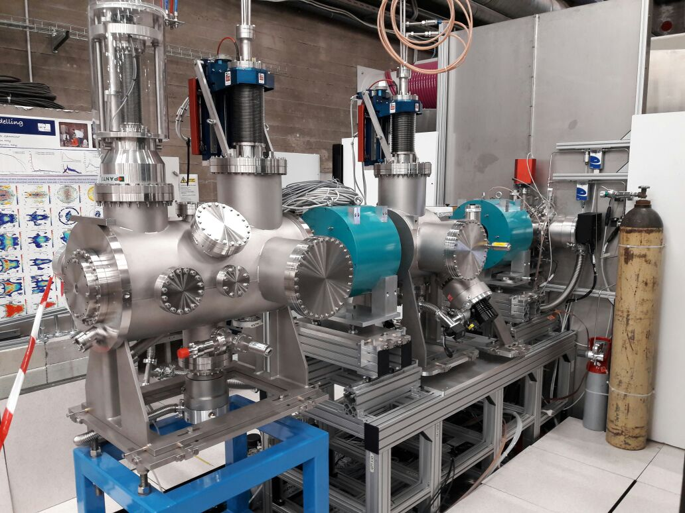
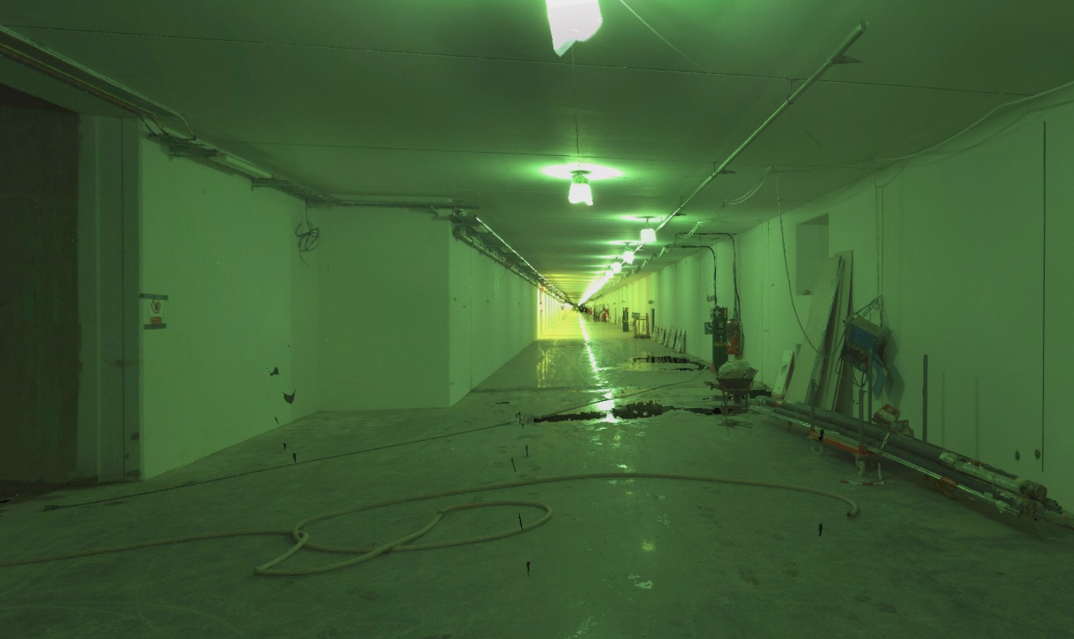
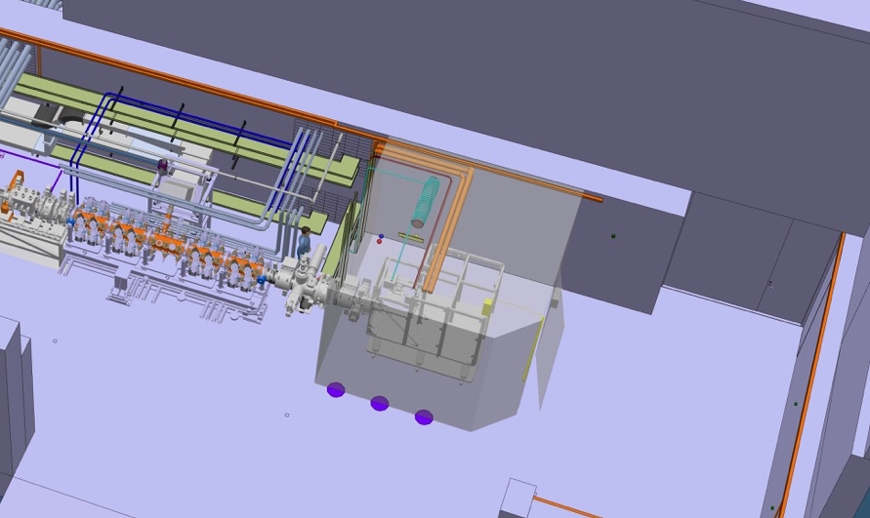
This presentation describes what we will install, where and when, and how we are preparing
Ion source and LEBT
Accelerator tunnel
How are we preparing?

Slide 5
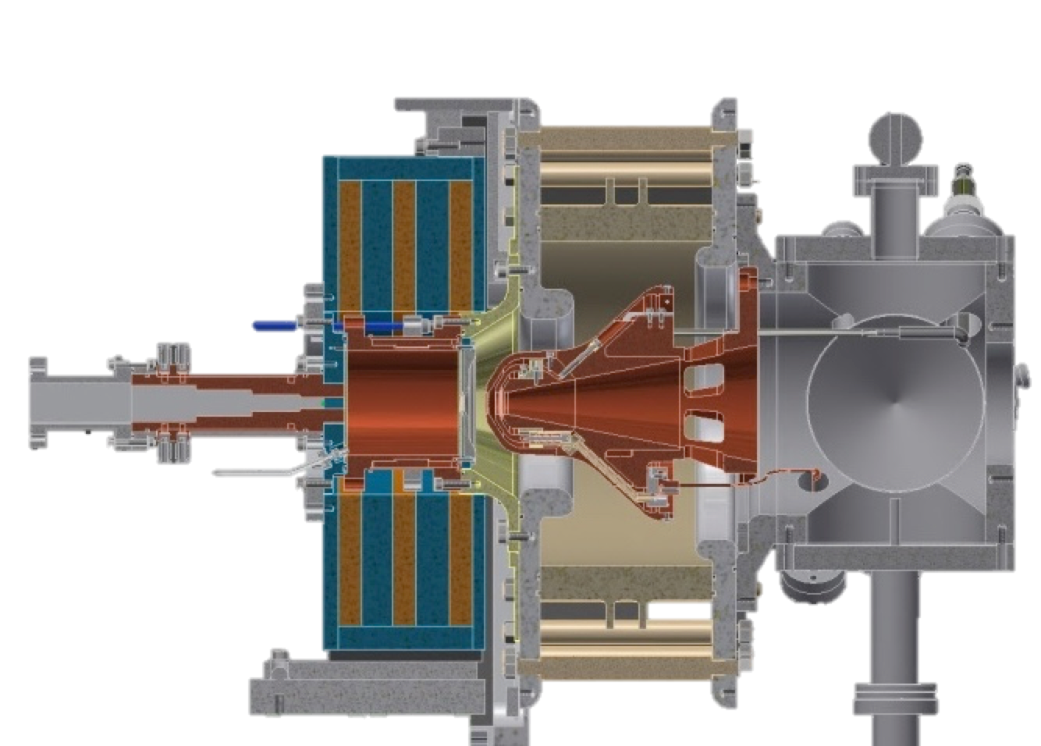
The ESS proton source is a microwave discharge ion source
High voltage insulator
Extraction electrodes
Plasma chamber
Waveguide
Pumping ports
Gas injection
Solenoid magnets
50 cm

Slide 6
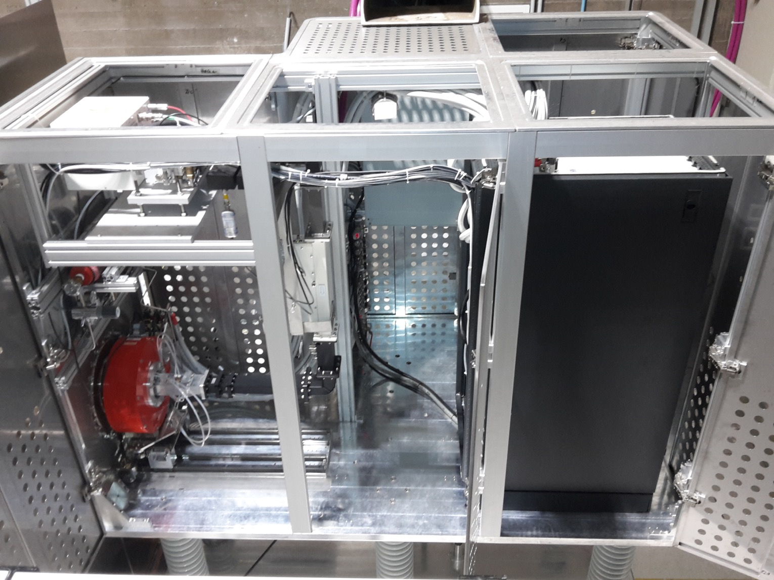
The plasma generator sits inside a 75 kV high voltage platform

Slide 7
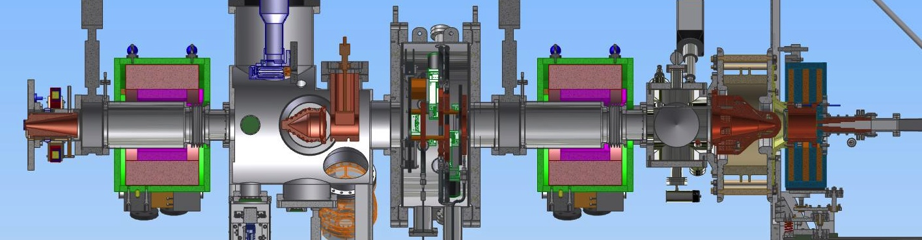
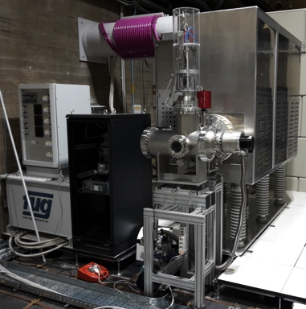
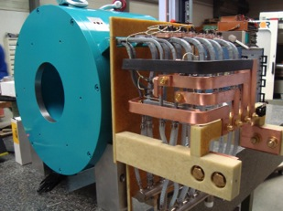
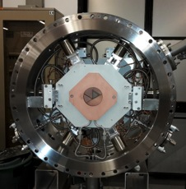
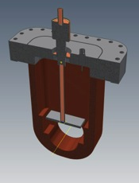
The Low Energy Beam Transport (LEBT) matches the beam to the RFQ input
Proton source
– creates the beam
Solenoid
– focuses the beam
Iris
– controls the current
Chopper and collimator
– controls the pulse length

Slide 8
LEBT as installed in Catania – June 2017

Slide 9
The ion source and LEBT will be the first accelerator components installed in the tunnel
Ion source and LEBT
Accelerator tunnel
How are we preparing?

Slide 10
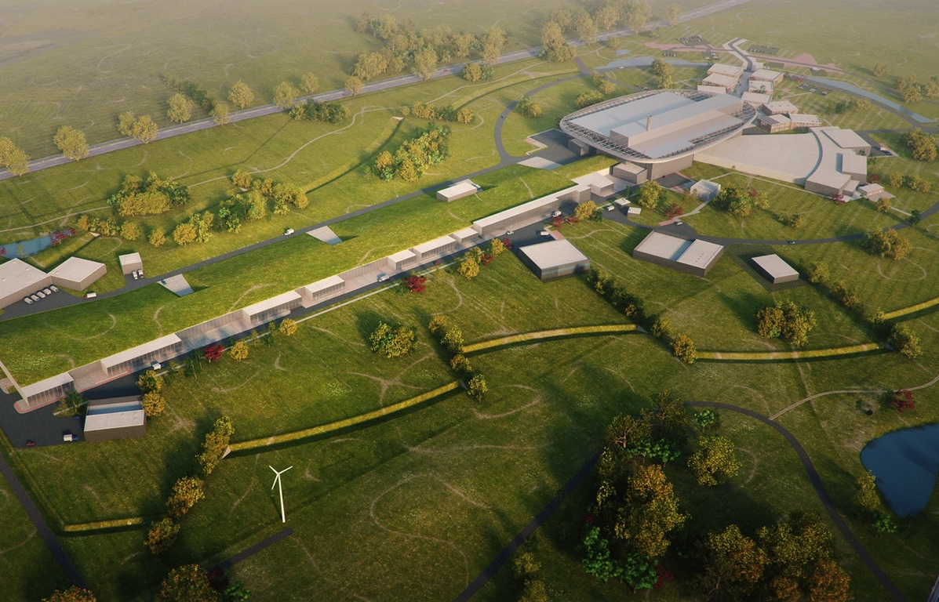
The location of the ion source is in the accelerator tunnel furthest from the target
Target Station
Ion Source and LEBT

Slide 11
The ESS Survey Alignment Metrology Group provides Truview to visualize the installation environment: https://truview.esss.lu.se/

Slide 12
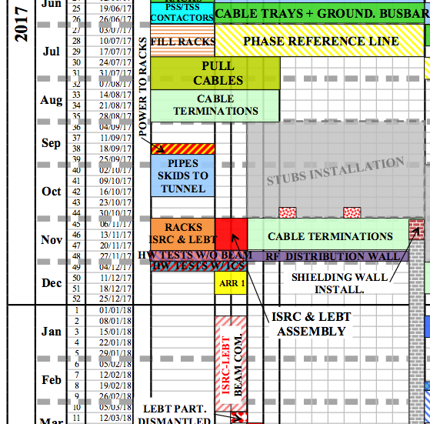
The ion source and LEBT will be installed in November 2017
3 weeks
for installation, and
9 weeks
for commissioning
is (very) short
In addition comes:
Installation readiness review
Accelerator readiness review
Installation
(INFN-LNS)
Commissioning
INFN-LNS will bring a team of 5-6 persons (technicians + coordinators) for the installation

Slide 13
Good preparation at the ESS site is needed for making the installation according to the schedule
Ion source and LEBT
Accelerator tunnel
How are we preparing?

Slide 14
ESS Accelerator Division’s site organization for the installation
Accelerator Installation
Manager
Nick Gazis
AD and ESS central Installation Services
(ISC workgroup, etc.)
RATS AreaSuper
hiring process
Inst-Test-Commis. Plan
underway in P6
QA/QC
Kent Wigren
Mechanical
Mechanical
Mechanical
Safety Team
Duy Phan
Area Supervisors
Skanska and ES&H
Area Supervisor Tunnel (G01) &
FEB (levels 090 & 100)
Dennis de Wit
Area Supervisor Gallery (G02 incl.Test Stand 2)
Marcus Green
Electrical
Utilities
Electrical
Utilities
Area Supervisor Cryobuildings (G04)
Ila Sjoholm
Electrical
Utilities
RF
other..
el
Indeed everyone is responsible for safety
System Leader 1
util
other..
mech
System Leader 2
AREAS
Other..
Task masters (Installation Support Team)
other
System Leader 3, 4..

Slide 15
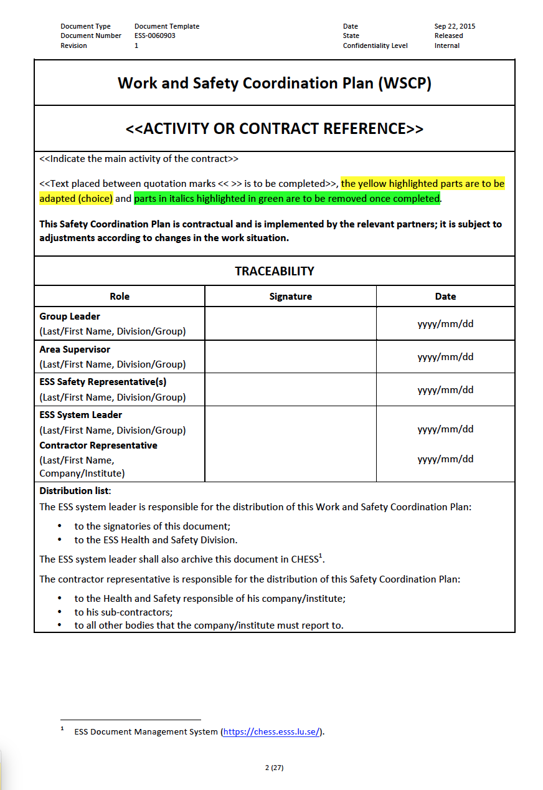

The Work and Safety Coordination Plan lists the preparatory measures prior to the installation
Part 1: Work Coordination Plan
GENERAL INFORMATION
Working hours
Duration of the activity
Contact persons
Contractor information
Regulatory framework & applicable documentation
PREPATORY MEASURES
Pre-work visits
Organizational measures (e.g. storage, waste management, equipment/machines, etc.)
Provision of services by ESS (e.g. electricity, water, staff, equipment/machines, safety measures, hot desks, toilets, changing rooms, etc.)
Provisions of safety measures by ESS (e.g. lock-out/tag-out, signage, etc.)
Description of the work to be done and/or systems to be installed
ESS-0085649
Courtesy of: D. Phan, ESS AD Safety Group

Slide 16
The WSCP lists associated hazards and safety control measures foreseen
Part 2: Safety Coordination Plan
HAZARD IDENTIFICATION AND CONTROL MEASURES
Area Hazard Analysis (AHA)
Job Hazard Analysis (JHA)
Parallel works
Control documents (e.g. fire permit, work authorization, lock-out/tag-out permit, permit for the use of lifting equipment, etc.)
INFORMATION AND TRAINING
List of mandatory safety trainings and awareness (see Skanska matrix)
Minimum number of first aiders required (1 per working team)
Site map
Reporting in case of an incident
Accident/incident reporting form
ESS-0085649
Courtesy of: D. Phan, ESS AD Safety Group

Slide 17

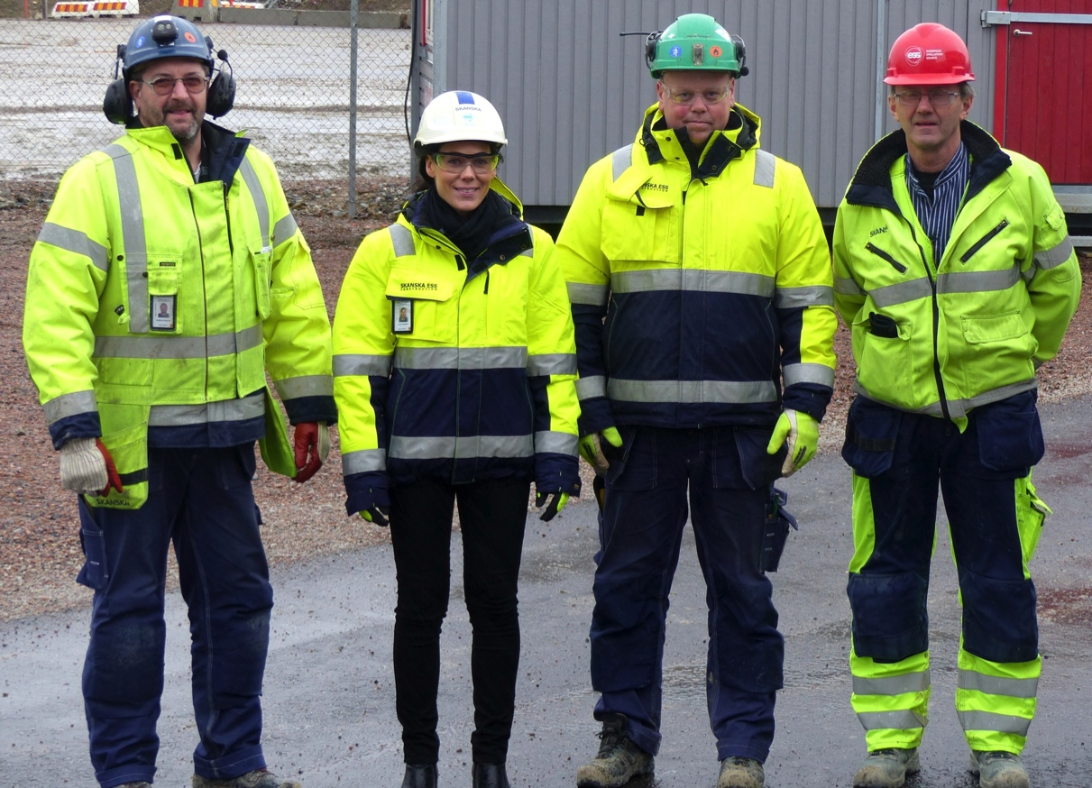
The ESS site follows rules of a construction site
Welcome to a Safe workplace!
Register before entering site
Wear helmet
Wear safety goggles
Wear gloves
Wear safety boots
Wear high visibility clothing
ID 06 visible
Unauthorized may not enter
Do not forget long trousers
Notes:
Compulsory

Slide 18
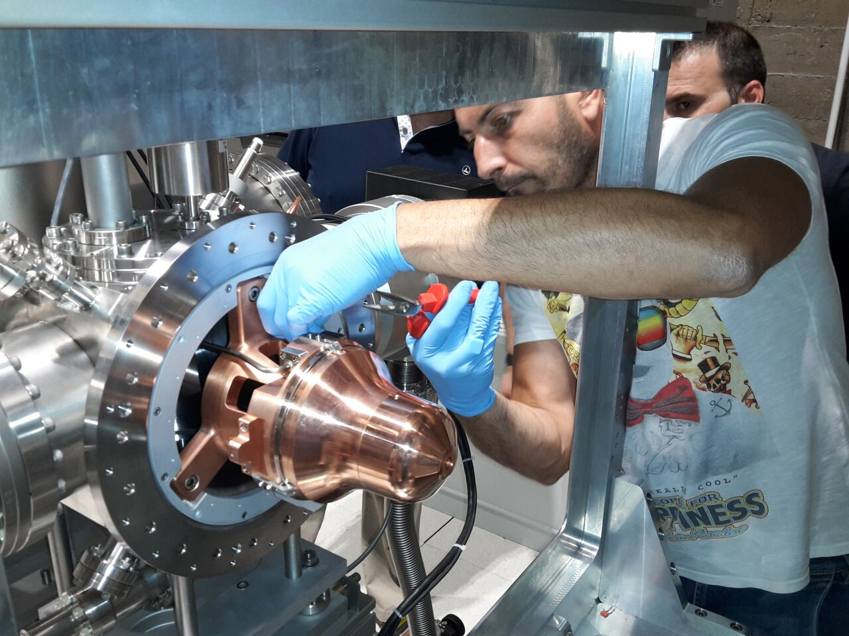
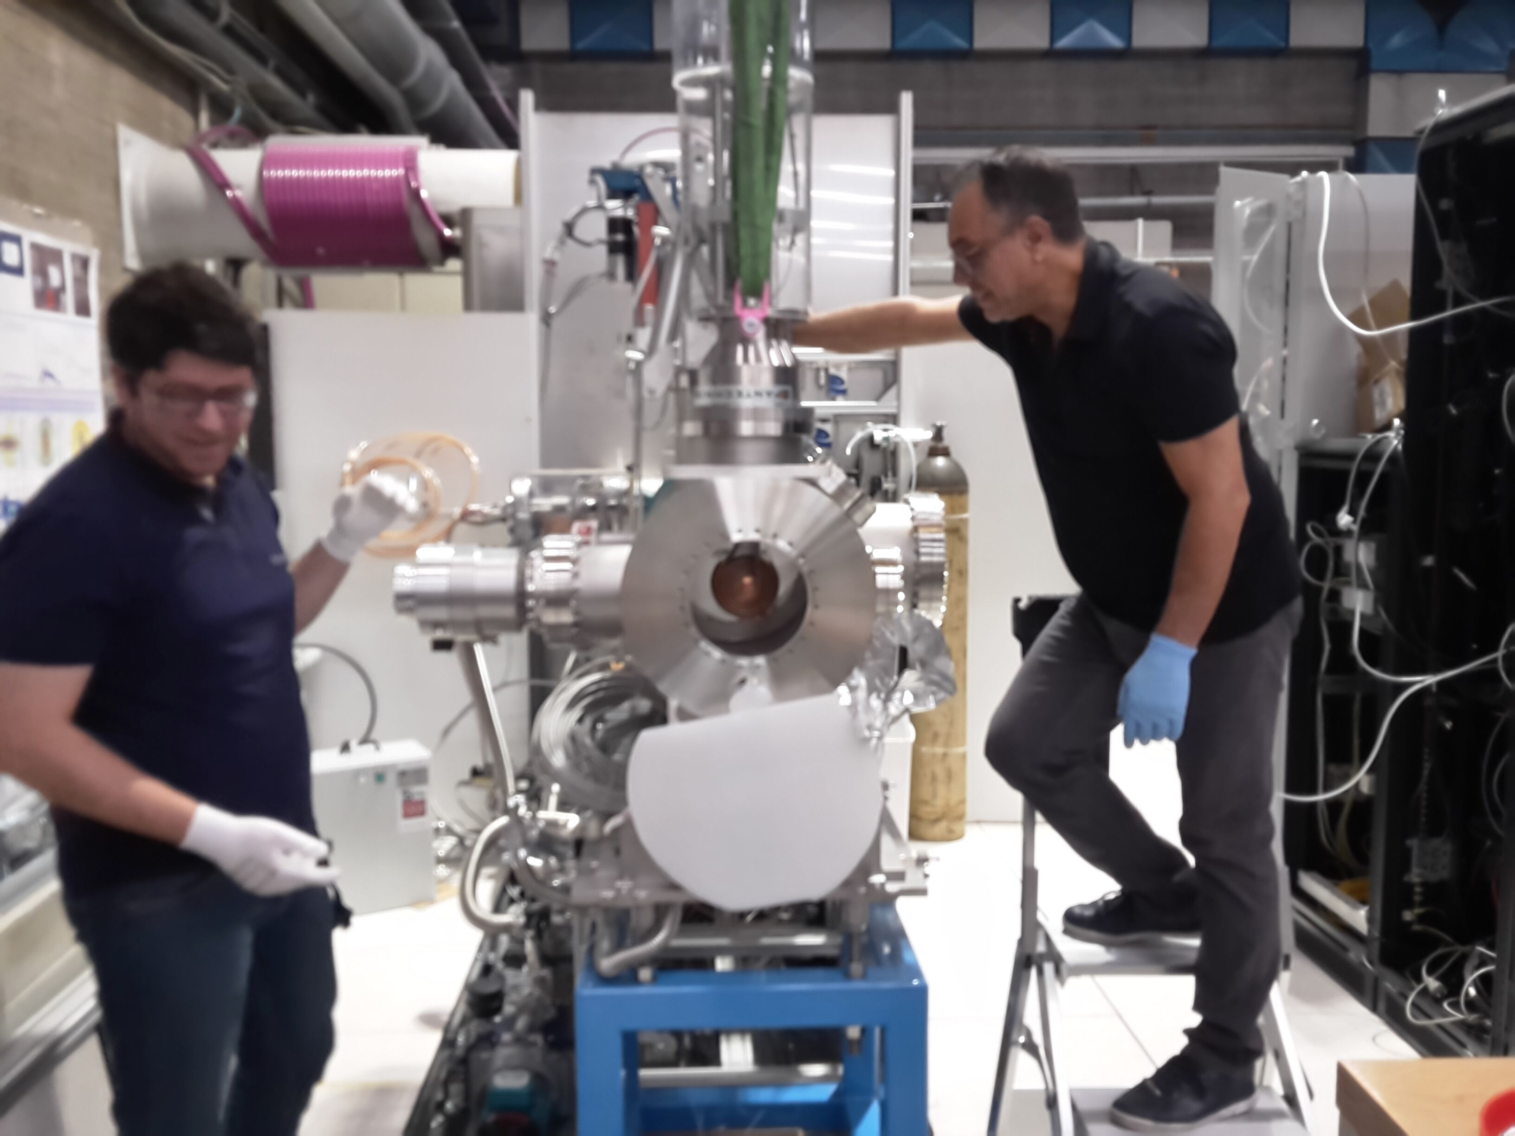
This may conflict with the standards of installation of equipment in a laboratory
Keep the environment clean
No dust around vacuum installations
No drilling of holes etc.
Wear plastic gloves
Protective equipment is not very practical for all tasks
Images from the installation at INFN-LNS

Slide 19
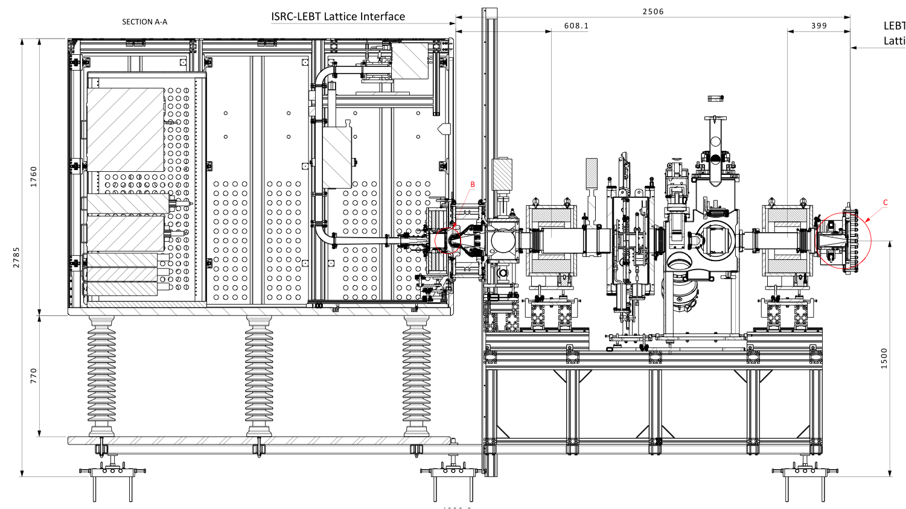
Example of challenge: tunnel roof height is 3.5 meters, and there is no crane installed
~ 2000 kg
~ 2000 kg

Slide 20
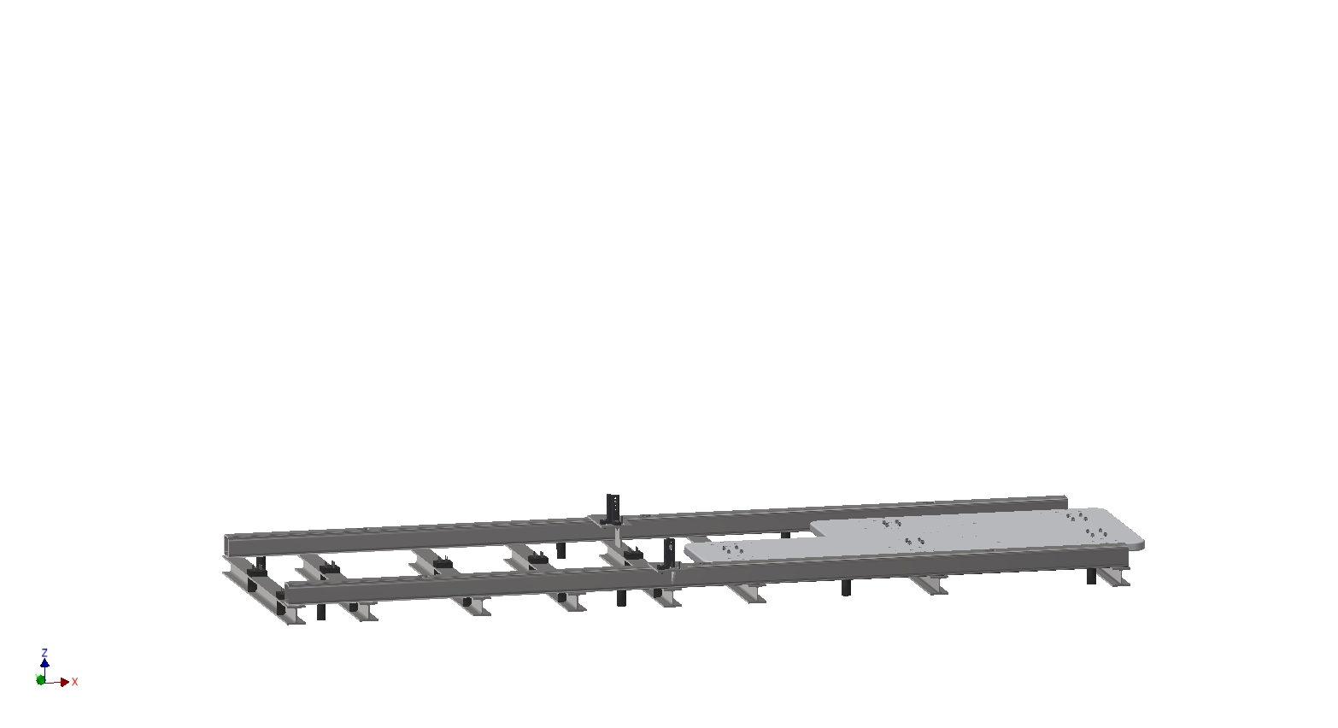
Below the drop hatch: Install the ion source and LEBT on a support frame

Slide 21
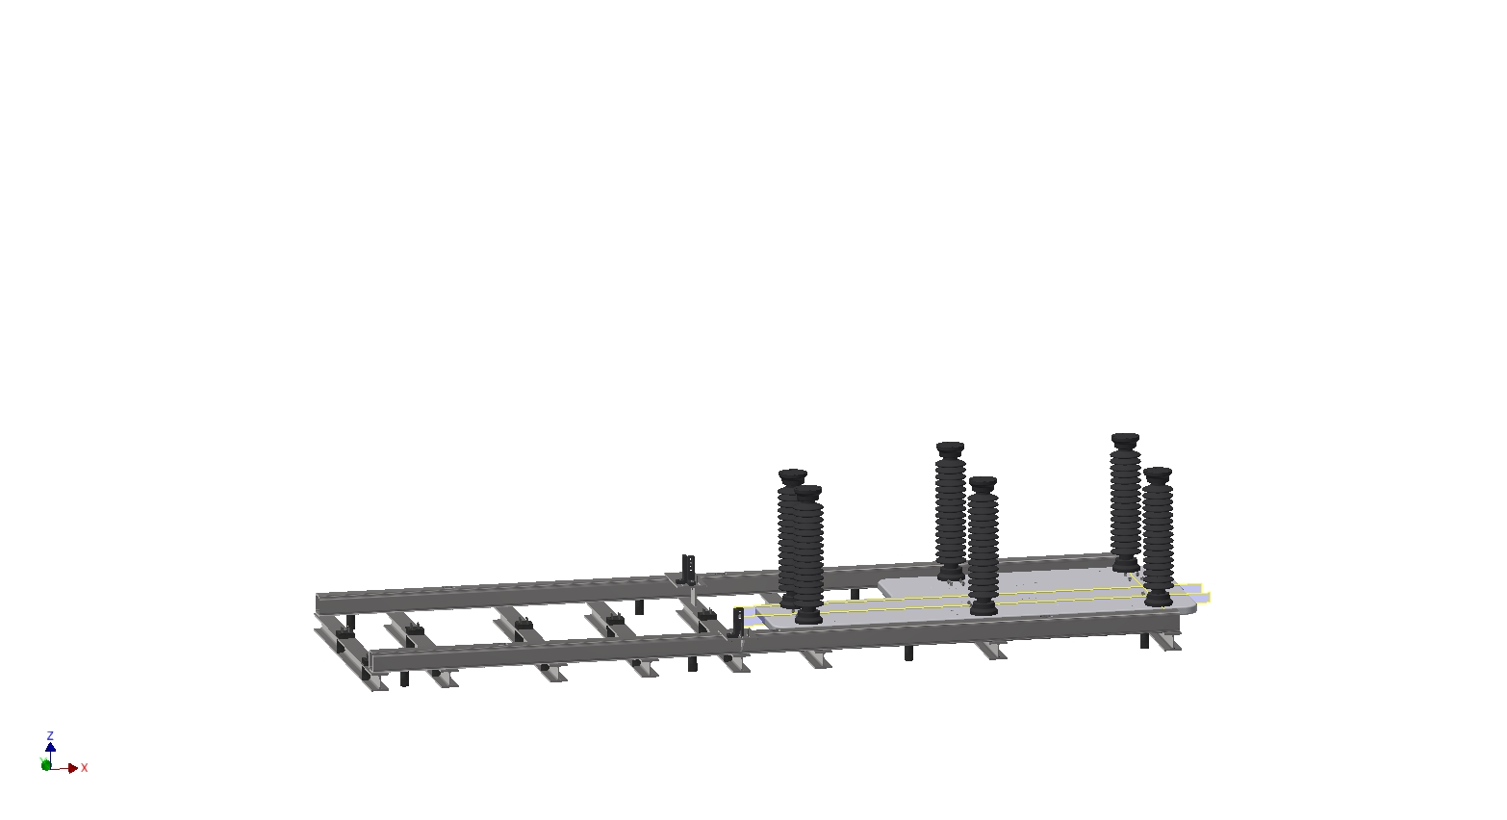
Below the drop hatch:
Mount the ceramic insulators

Slide 22
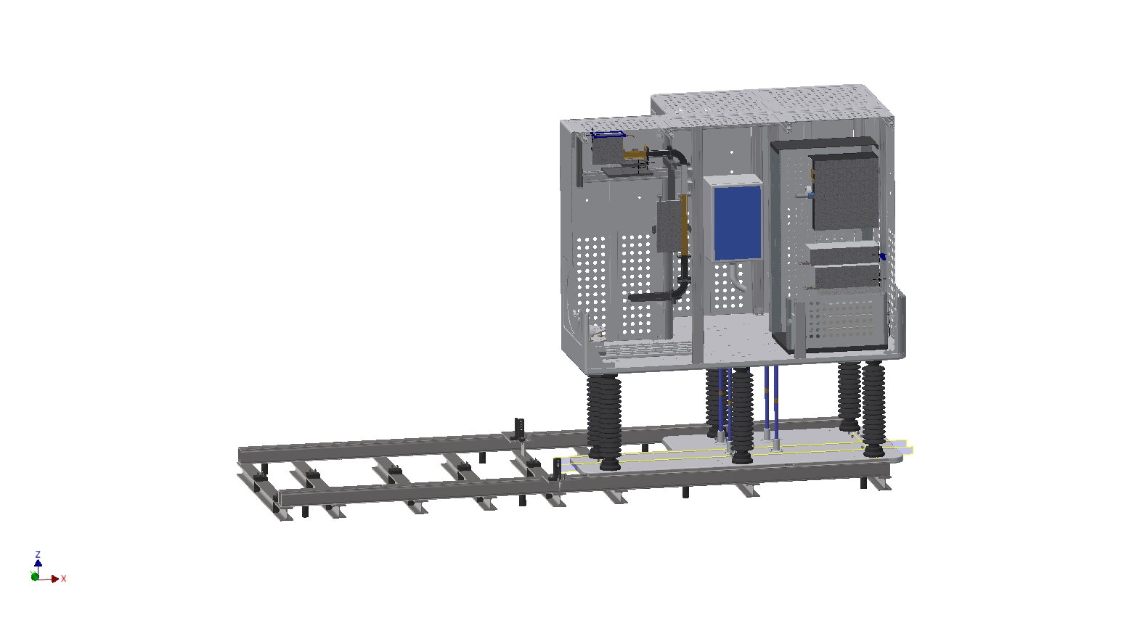
Wit the drop hatch crane: Lower the high voltage platform onto the insulators

Slide 23
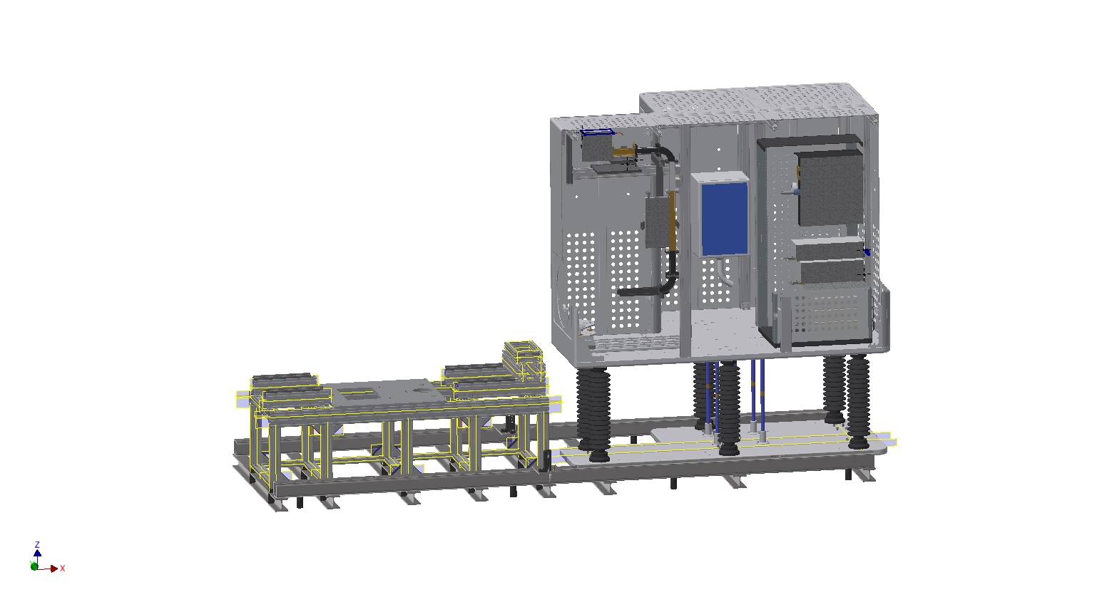
Below the drop hatch: Mount the LEBT support on the support frame

Slide 24
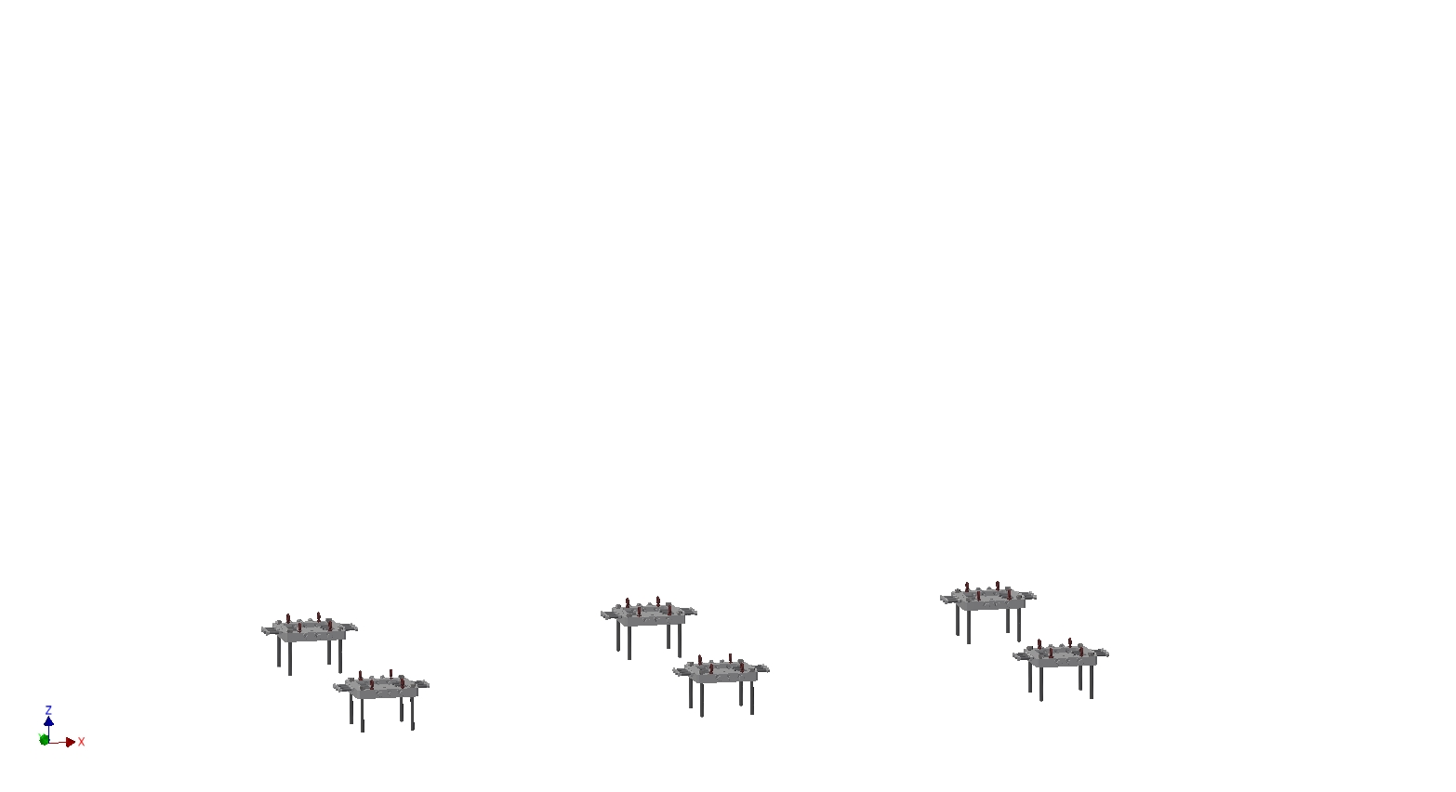
Inside the tunnel on the beam axis:
Install the feet for the support frame

Slide 25
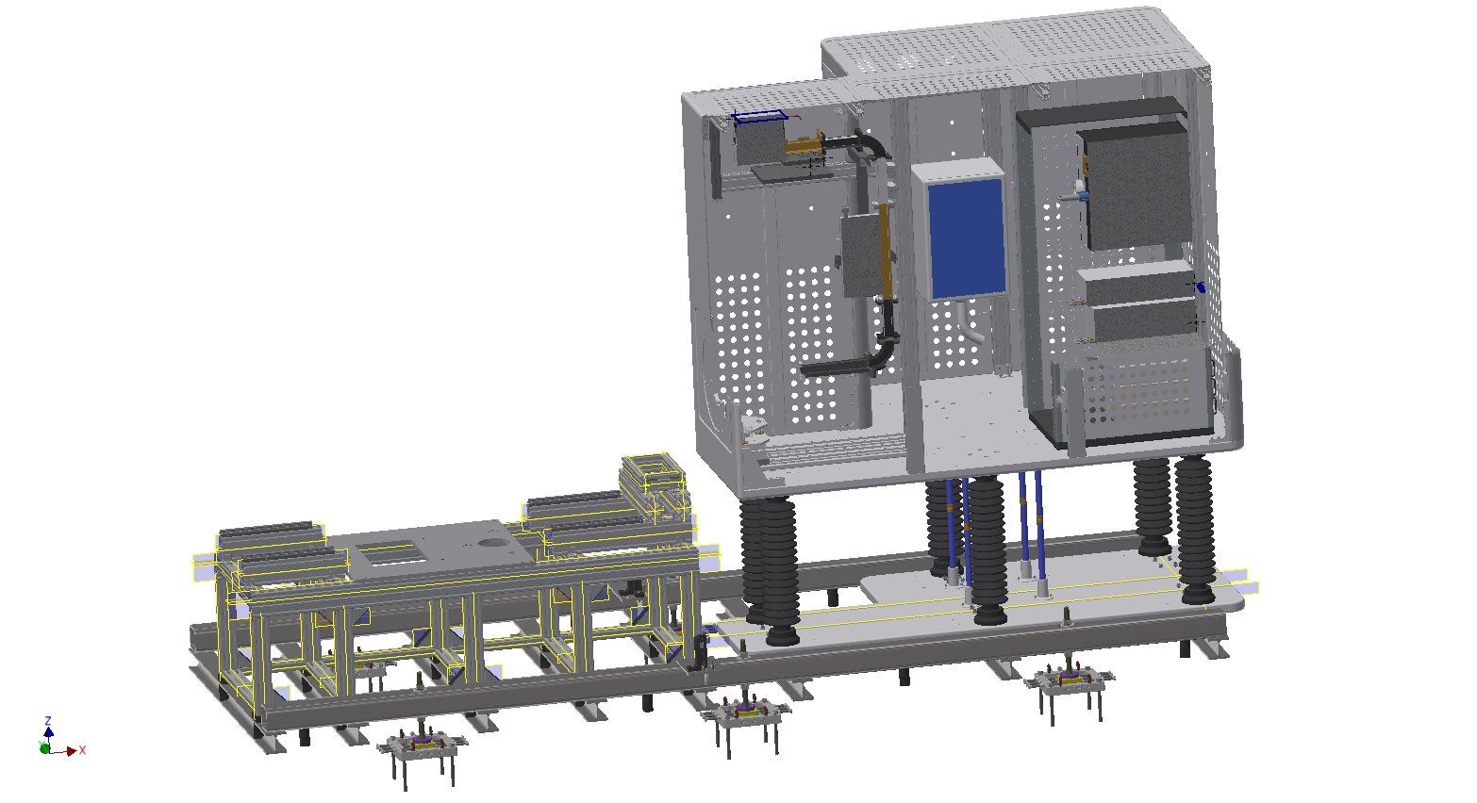
Bring the assembly on the feet using wheels (not represented), and align

Slide 26
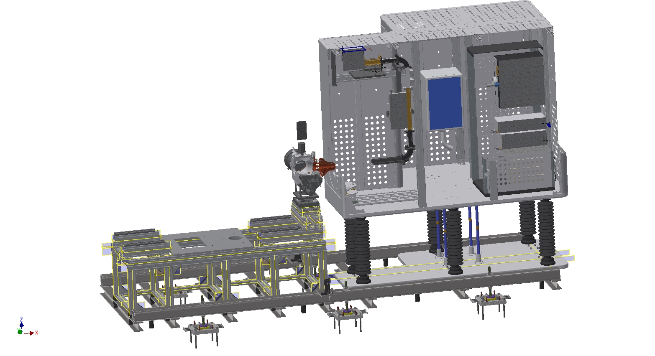
Install the 1st LEBT component with the extraction column, and align

Slide 27
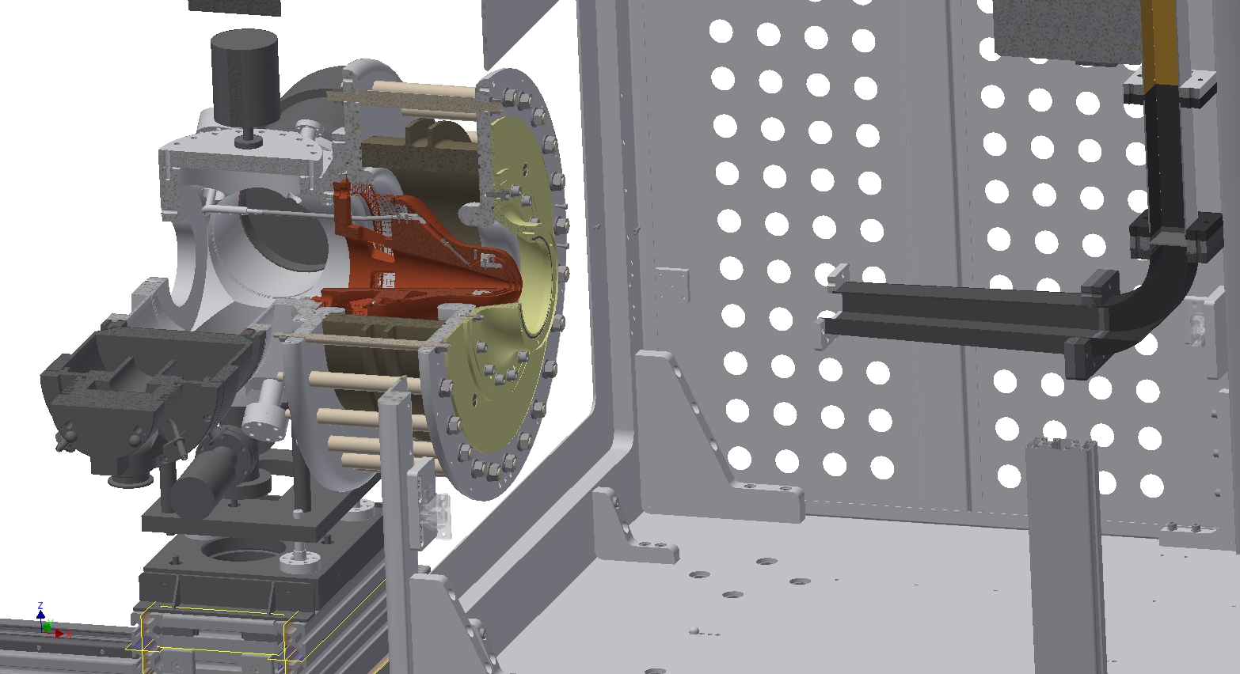
Mount the extraction column with the high voltage insulator

Slide 28
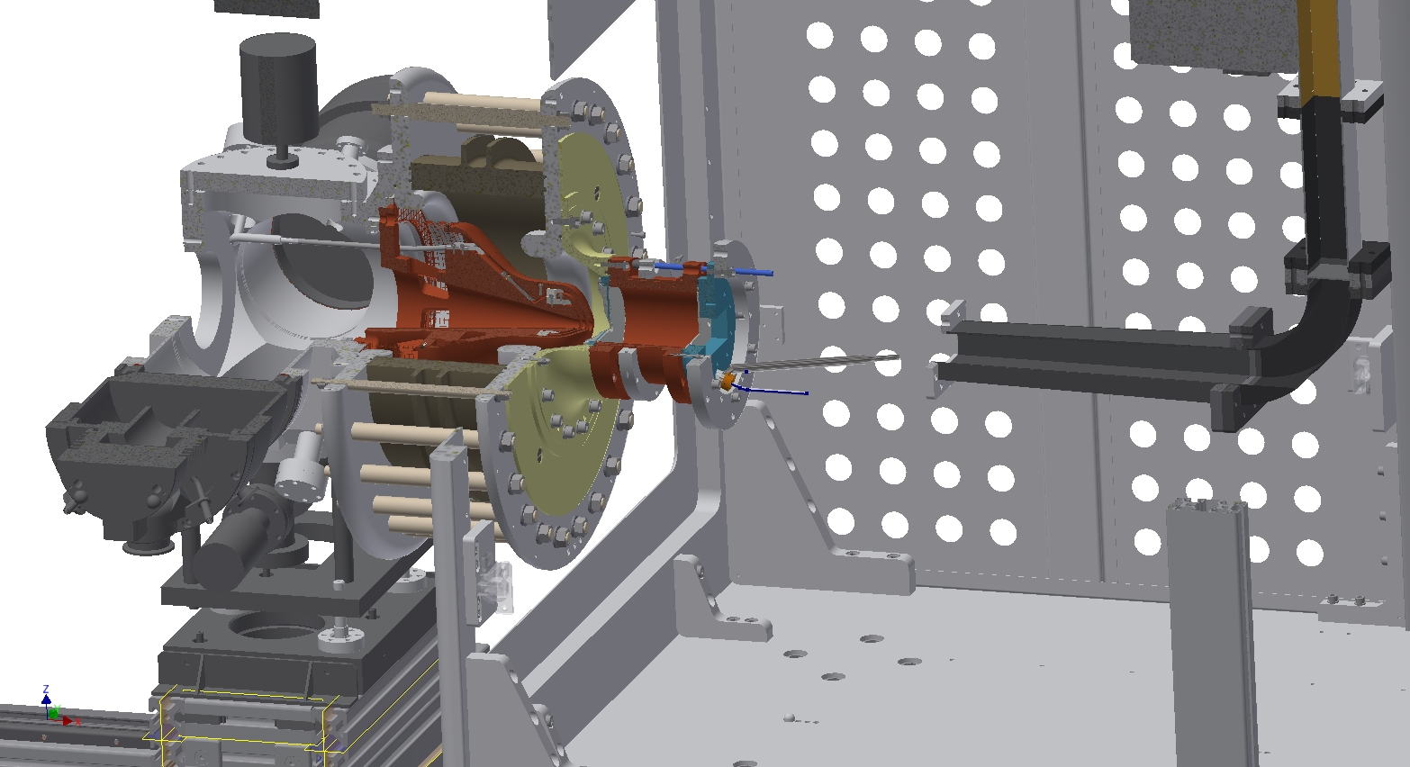
Attach the plasma chamber, and verify the alignment

Slide 29
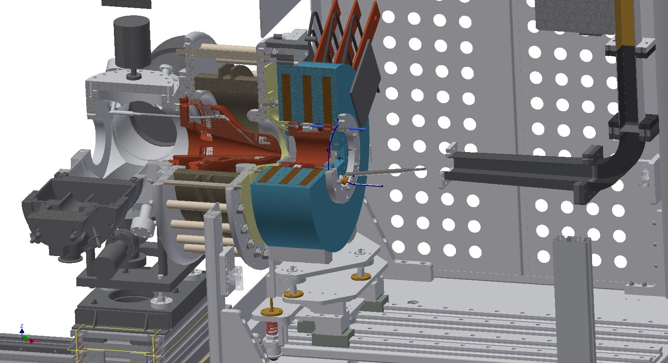
Install the coils on the support, and slide the assembly in place

Slide 30
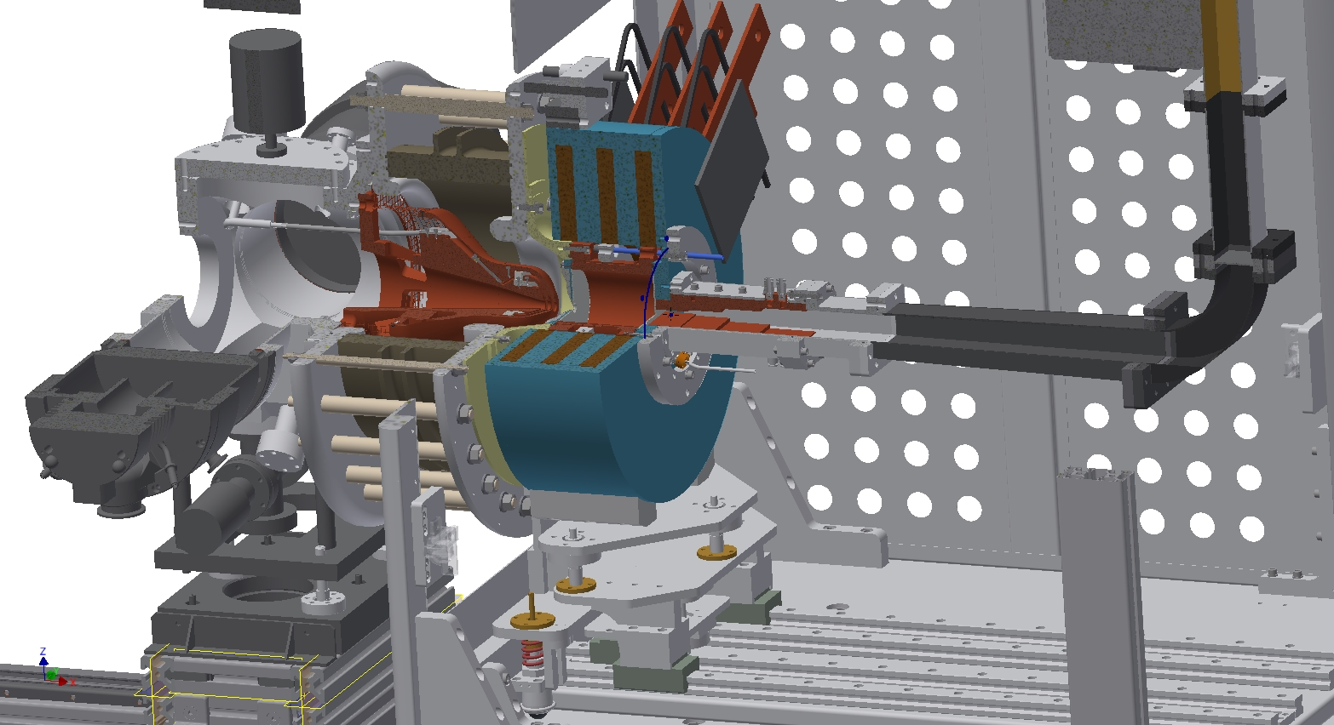
Install the wave guide from the magnetron to the plasma chamber

Slide 31
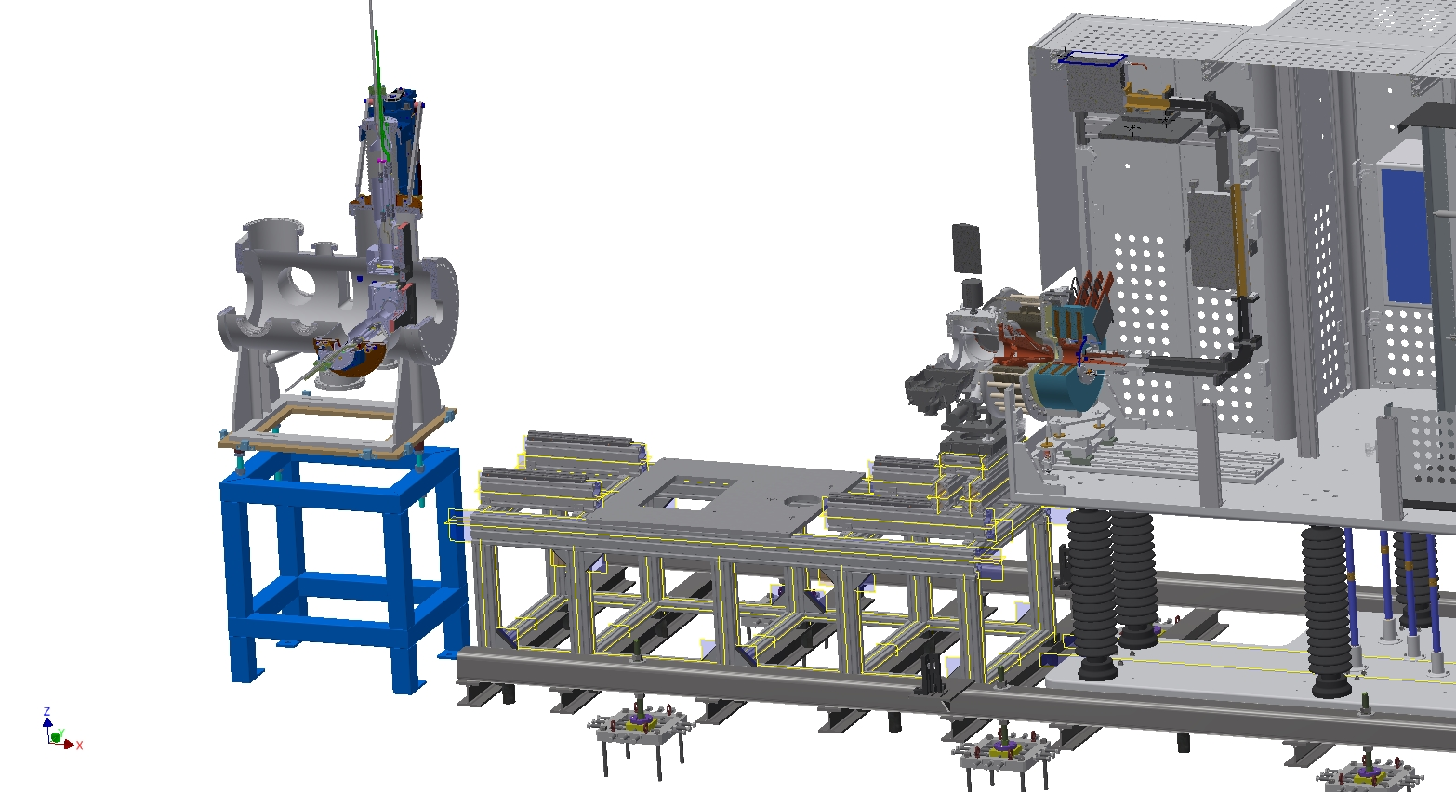
Install and align the commissioning tank that will be used to characterize the beam at the RFQ entrance

Slide 32
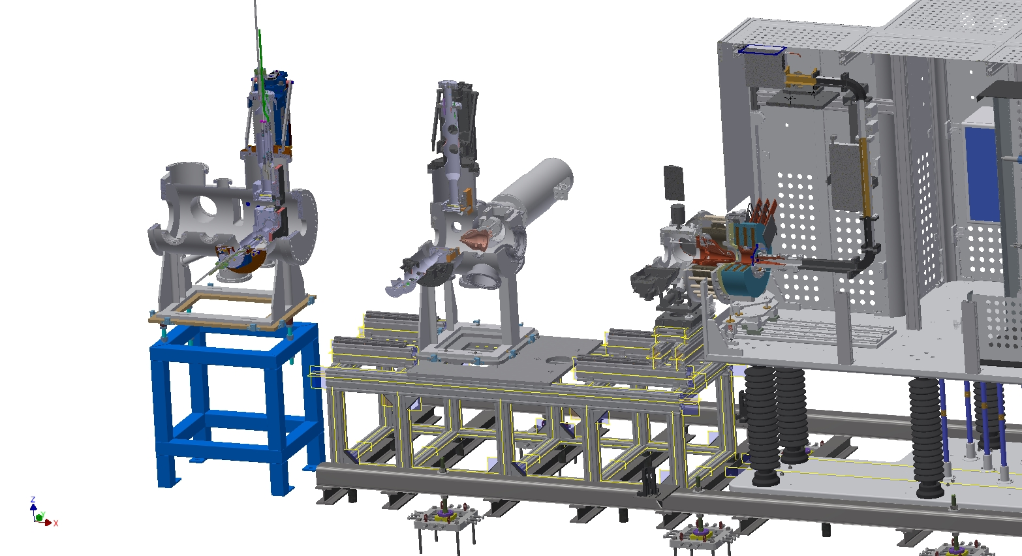
Install and align the permanent tank with instruments in place (because of the tunnel height)

Slide 33
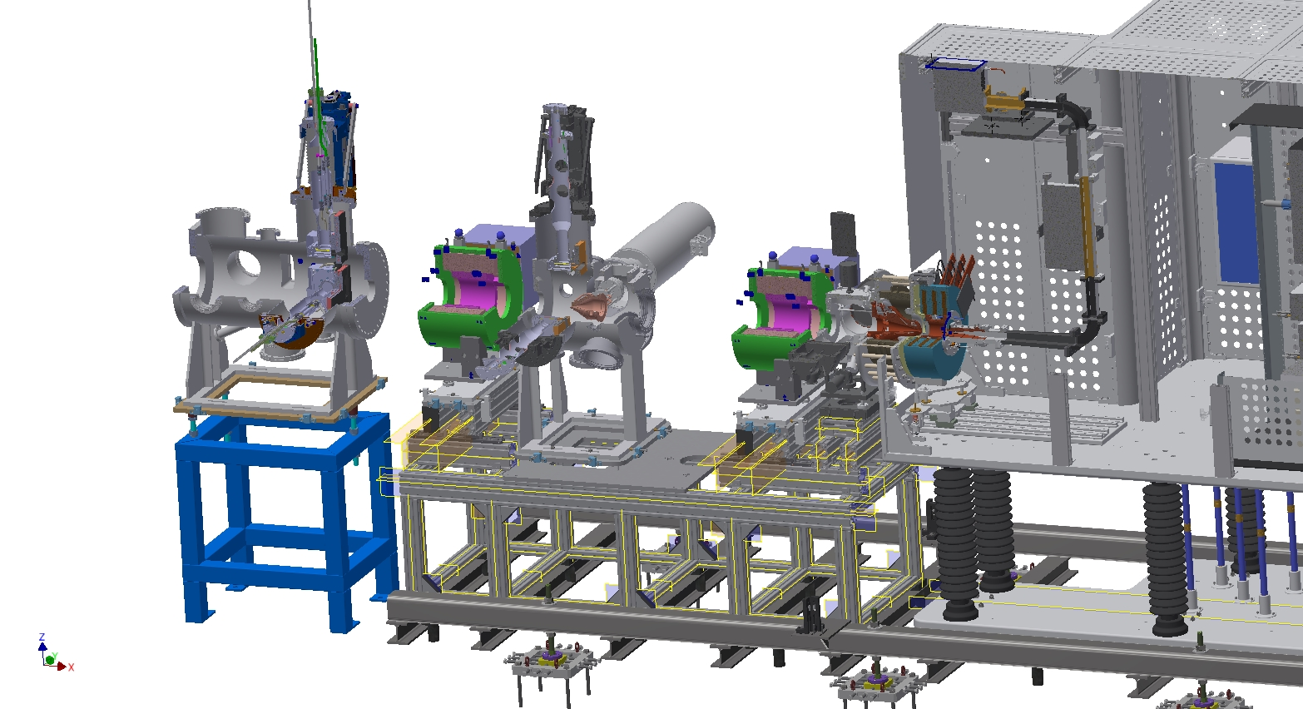
Install and align the LEBT solenoids

Slide 34
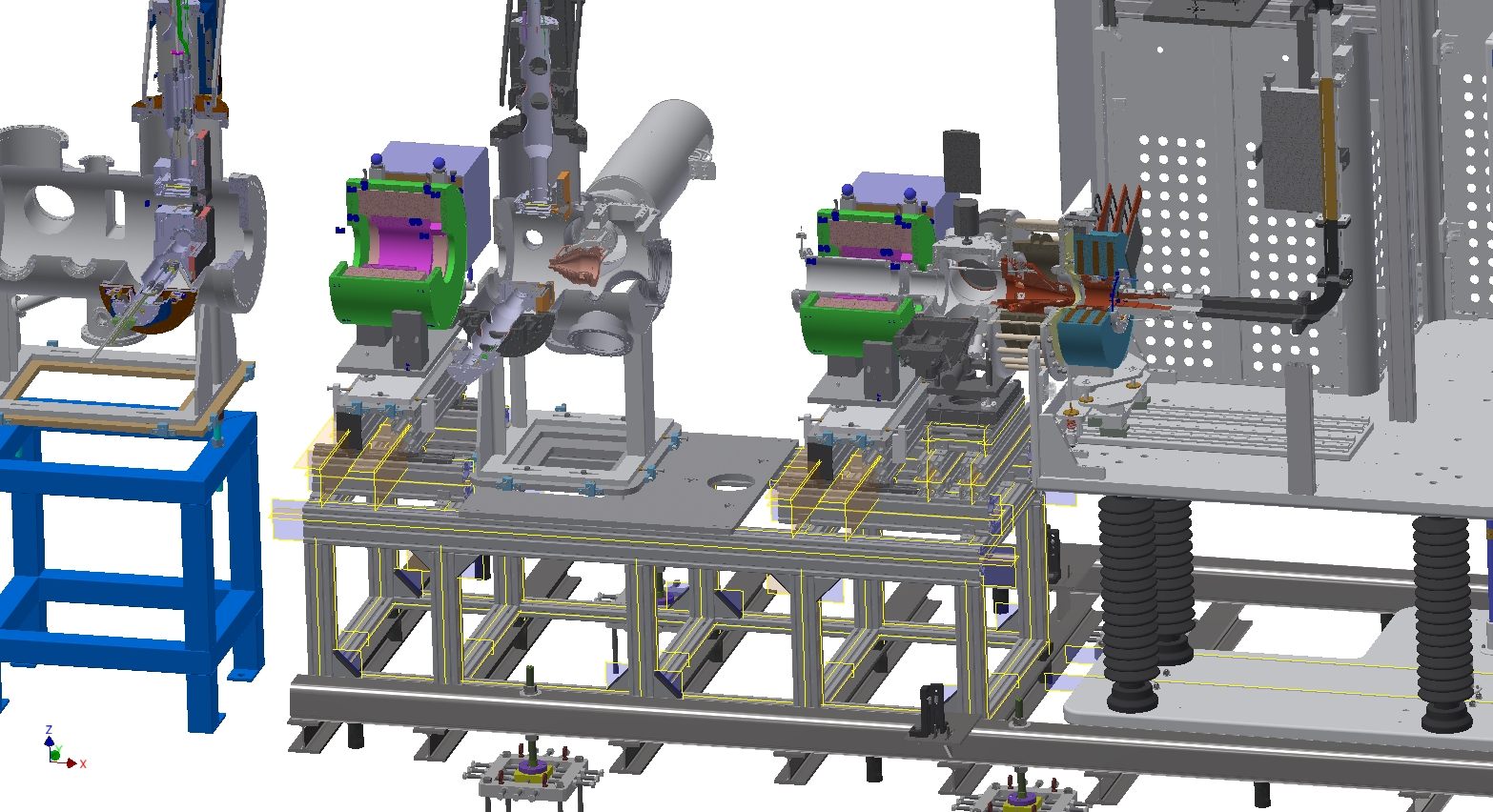
Install the beam pipe inside the 1st solenoid

Slide 35
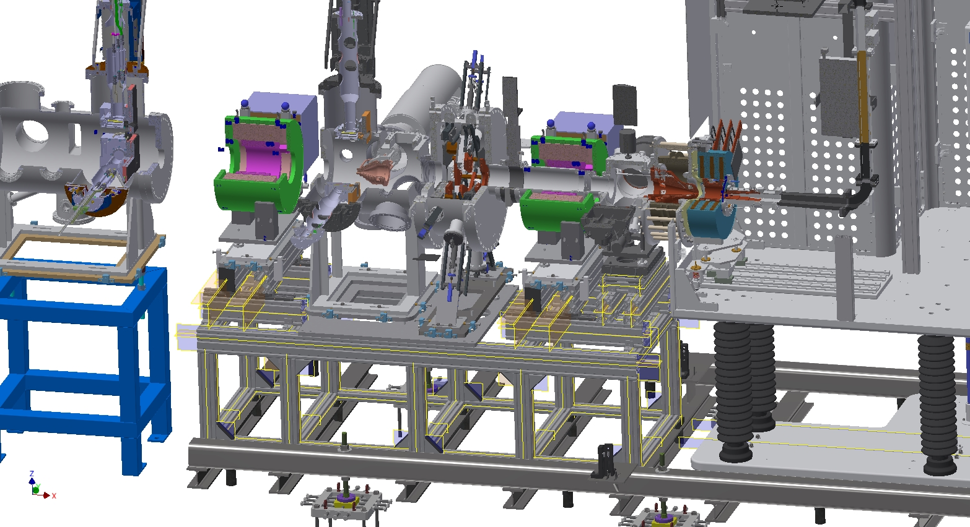
Install and align the iris

Slide 36
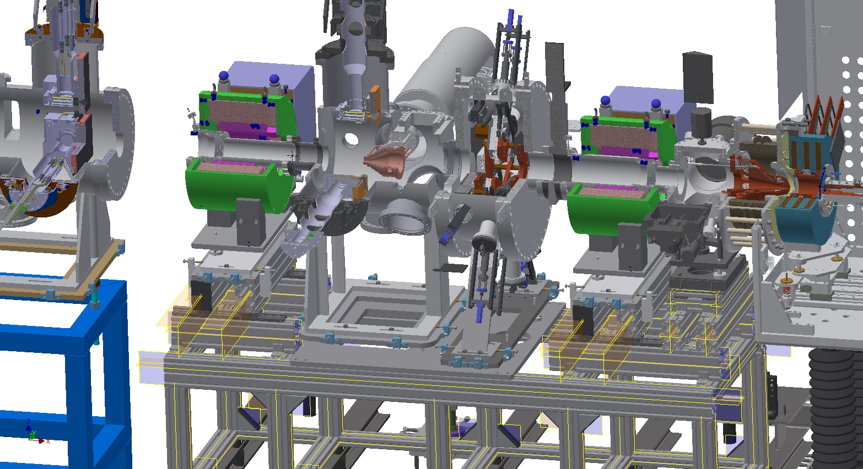
Install the beam pipe inside the 2nd solenoid

Slide 37
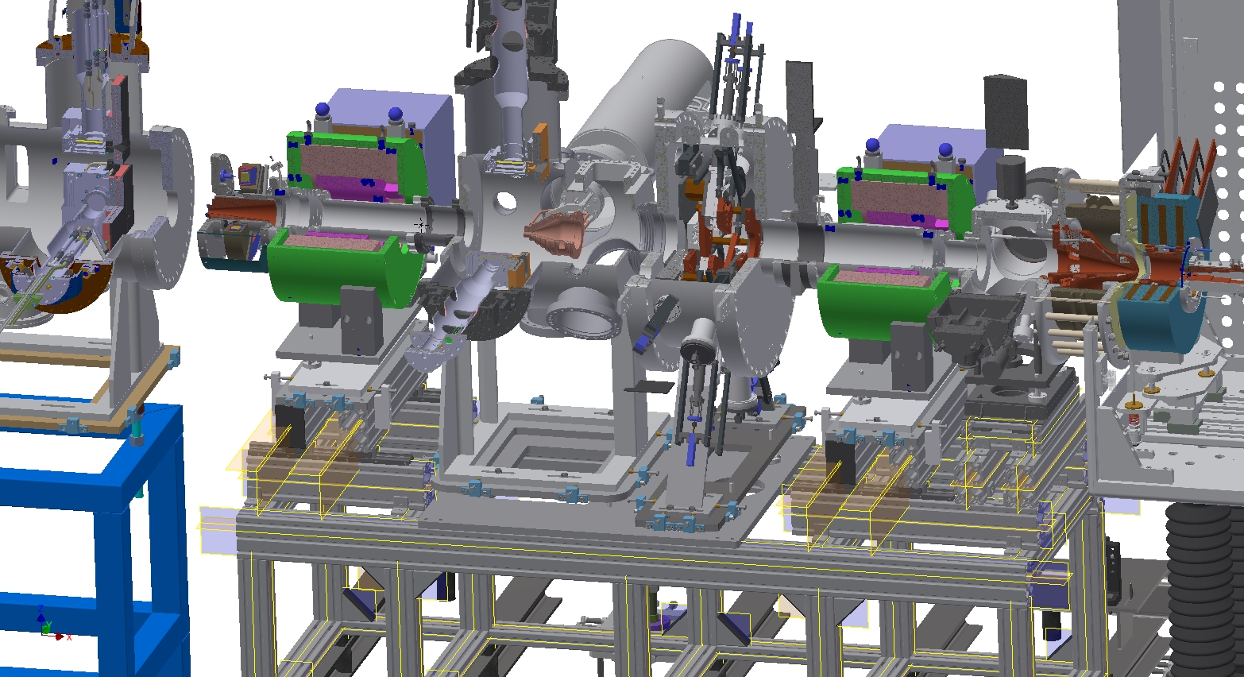
Install the collimator between the 2nd solenoid and the commissioning tank

Slide 38
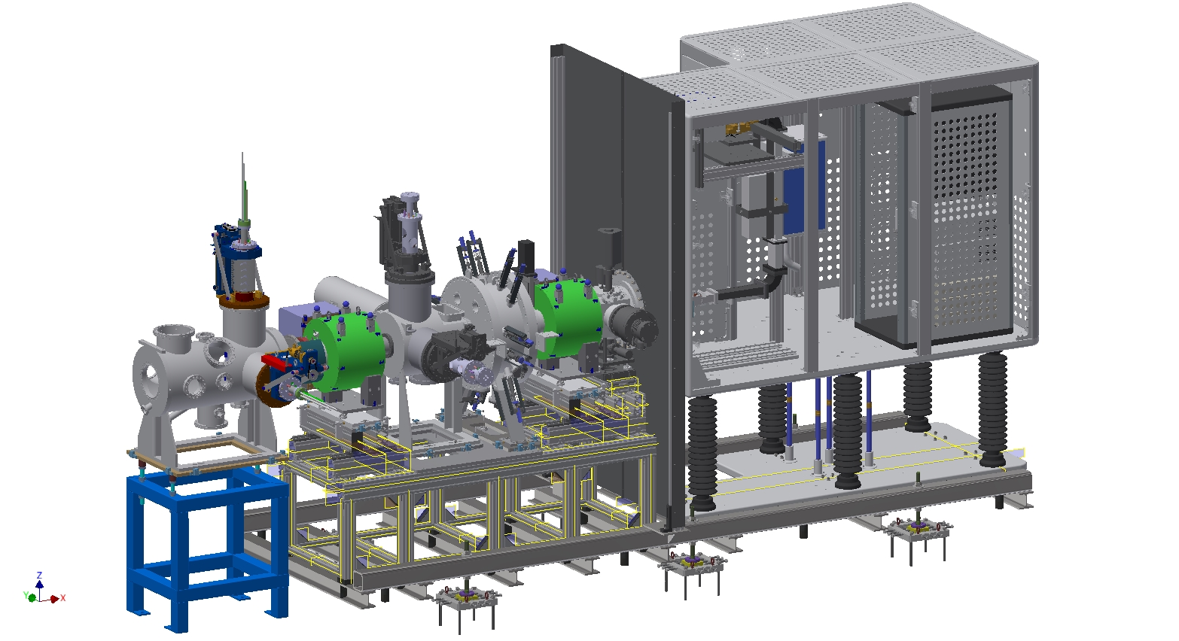
Install the ground shielding plate

Slide 39
The work finishes by installing and connecting ancillary equipment (not exhaustive list)
Cooling water
Fiber optics
HV power
Controls power
Vacuum
High voltage
protection cage
Diagnostics
H₂ gas delivery
Ground connections
Cables, power, water cooling, compressed air, drilled holes, etc. needs to be in place before the installation starts!

Slide 40
We are preparing for the installation of the ion source and LEBT in November 2017
The ion source and LEBT
are already installed
In Catania, and will be commissioned before shipment to Lund
A team from INFN-LNS will make the installation at ESS
We will together use the experience from Catania for planning the installation activities at ESS

