Slide 1
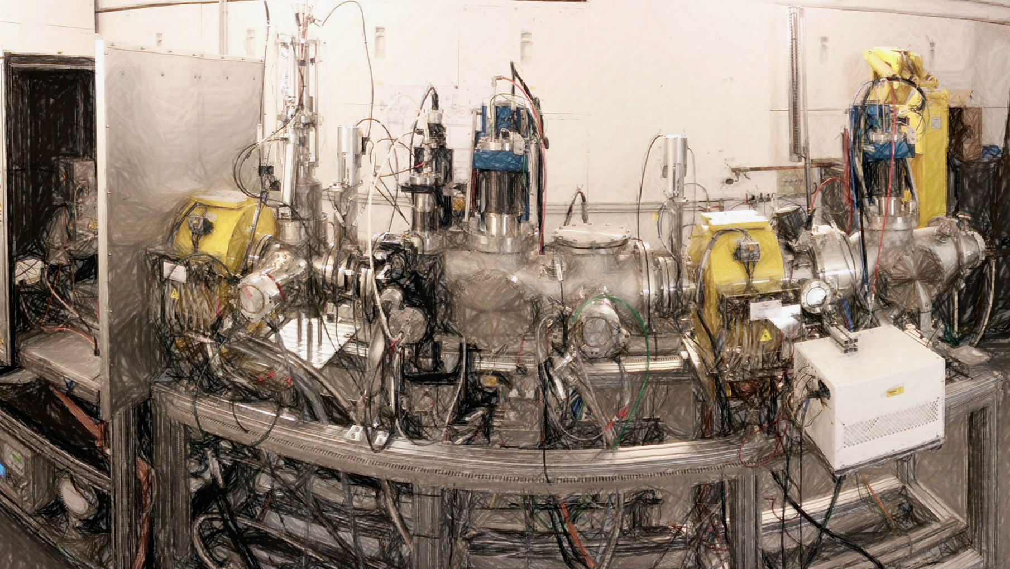
The MYRRHA LEBT Commissioning & Space Charge Compensation Experiments
F. Bouly, D. Bondoux (LPSC\IN2P3\CNRS)
Jorik Belmans, Dirk Vandeplassche (SCKCEN)
Nicolas Chauvin, Frédéric Gérardin (CEA)
SLHiPP - 7 Thursday, June 8, 2017
Orsay, France

Slide 2
MYRRHA Linac
Courtesy of J.- L. Biarrotte
Courtesy of H. Podlech

Slide 3
LEBT Functions
 The Low Energy Beam Transfer line (LEBT) is the first 3 meters of the MYRRHA accelerator
Ensure the ‘safe’ beam transport from the source to the RFQ :
➢ Minimise the beam losses → Increased Reliability
 Condition the beam for the RFQ
➢ Required parameters at the RFQ entrance : ε_{RMS.norm.proton} ≤ 0.2 π.mm.mrad
β =0.04 mm/π.mrad & α = 0.88
‘Clean’ the proton beam from other species (H₂⁺,H₃⁺)
➢ The Ion source produces protons but also H₂⁺,H₃⁺ (ionisation of H₂ gas)
 Give/Create the temporal beam time structure (‘holes’ / pseudo-pulsed beam / power mitigation)
40 ms
38 ms
Proposed MYRRHA beam time structure for operation: -> long blue pulses are sent to the reactor (mean power is adjusting with pulse length) -> short red ones are sent to ISOL experiment

Slide 4
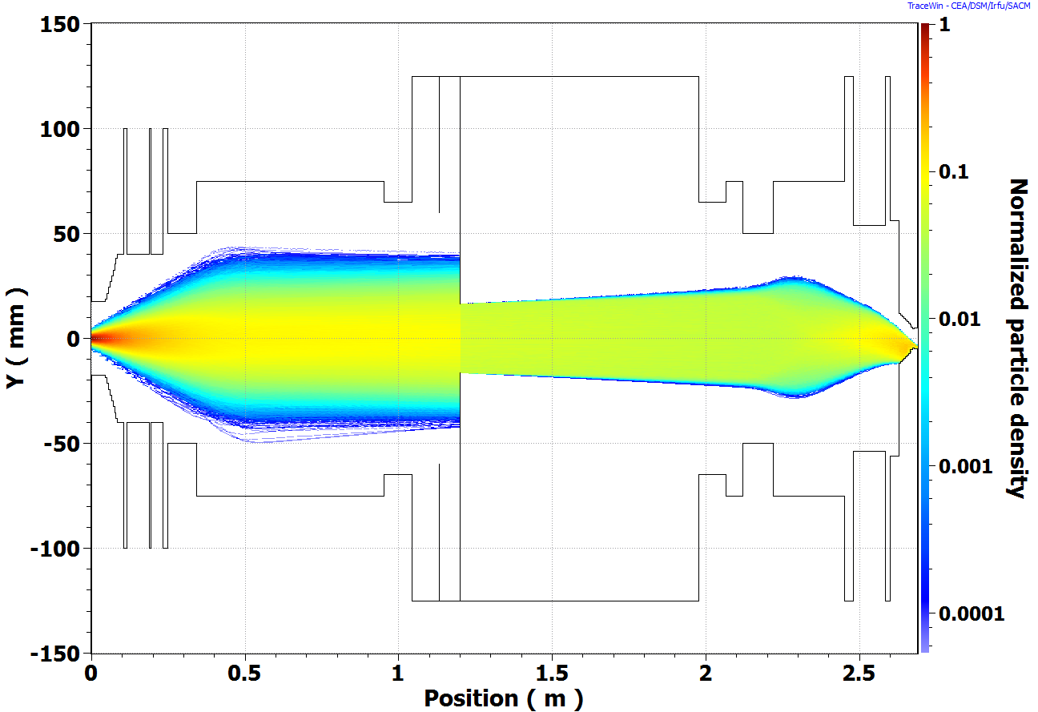
MYRRHA LEBT Design and Construction
● Design, Construction & Commissioning funded by EU projects (MAX - FP7, MARISA - FP7, MYRTE) and SCK-CEN
● Collaboration :
➢ LPSC (CNRS) : solenoid design, collimation , vacuum chamber, experimental area, part of the control system,… ➢ SCK-CEN : Chopper + collimation cone, … ➢ Cosylab (+ADEX) : Specific control system developments
➢ Compact design : ~ 3 meters long with two solenoids
 No ‘clean’ ions separation to ensure a direct proton current monitoring
 A minimum of elements/magnet to tune (Reliability )
 Simple design (Reliability)
 Minimise the number of electrostatic elements (Reliability)
 Shorter Space Charge Compensation transients than in a longer version

Slide 5
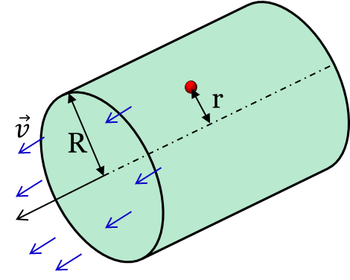
Beam dynamics : Space Charge & Compensation
● Defocusing effect : Coulomb repulsion of charged particles inside the beam
● 2 contributions (Lorentz):  Electrostatic : repelling Force
→ Magnetic : attractive Force (charged particles in movement )
Radial force seen by one particle of a continuous (DC) cylindrical and homogenous beam
$$F_{r}=\frac{\left(1−{βL}^{2}\right)}{βL}\frac{qI}{2π{ ε}_{0 }c} . \frac{r}{R2} (r<R)$$
β_{L} : reduced speed
$ε_{0 }$: vacuum permittivity
q : charge
$I$ : beam current
● Complex phenomena, difficult to model, depends on many parameters : influence of the vacuum chamber walls, beam transverse and longitudinal distribution, different species/ions, residual gas interaction, etc.
Courtesy of N. Chauvin
● A solution to compensate the beam diverging effect in the LEBT :
→ Use the Ionisation of the residual gas in the vacuum chamber.

Slide 6
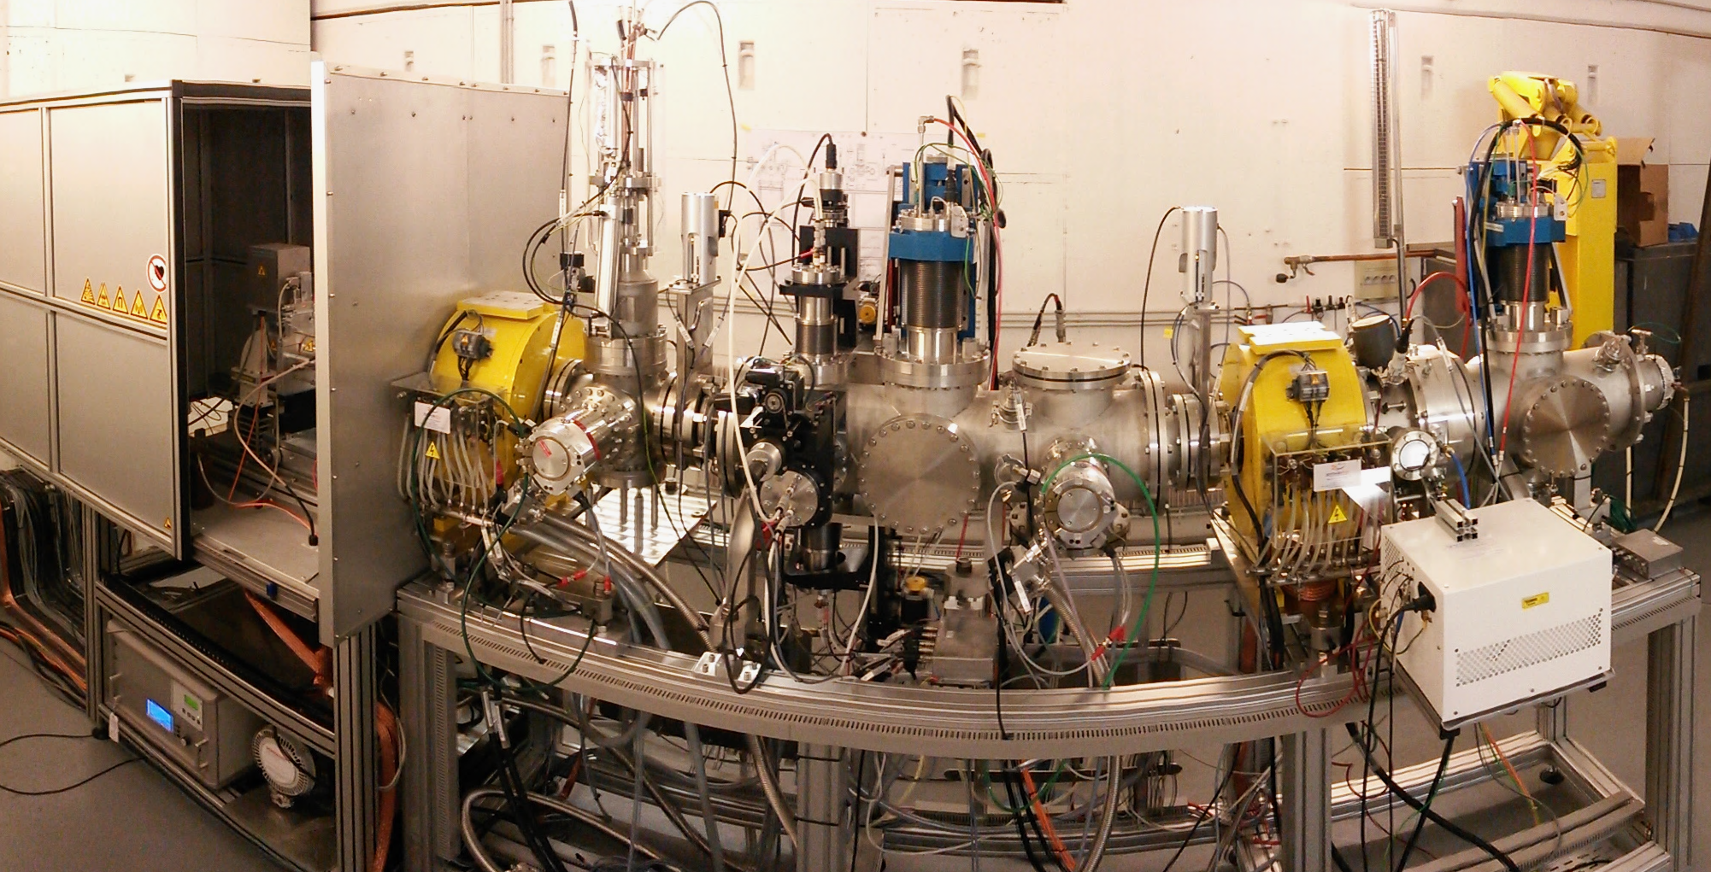
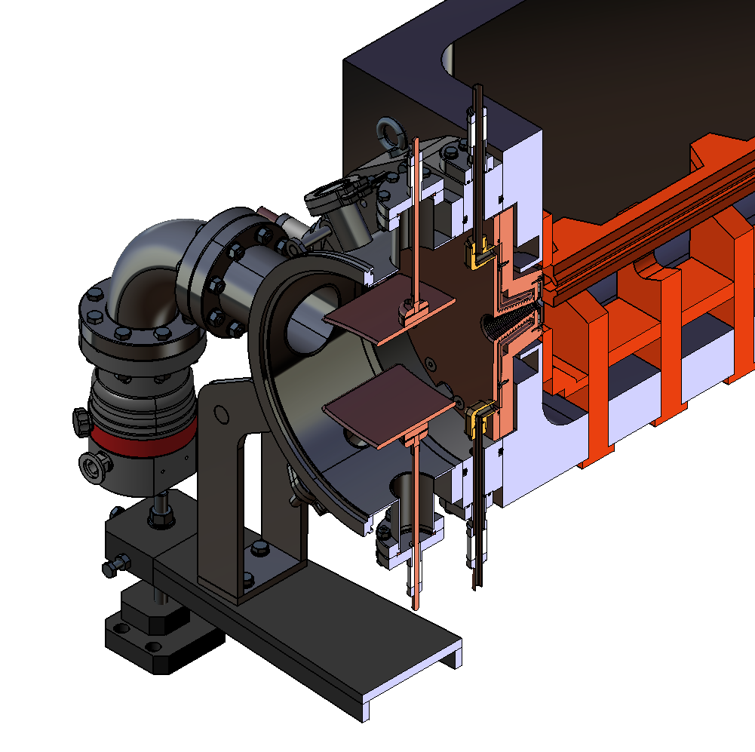
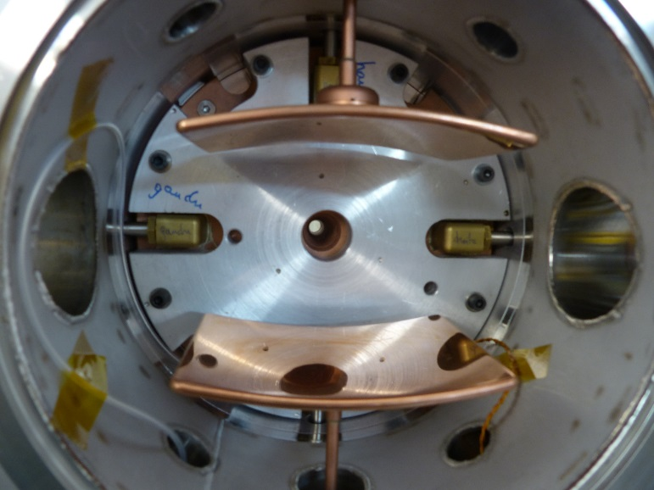
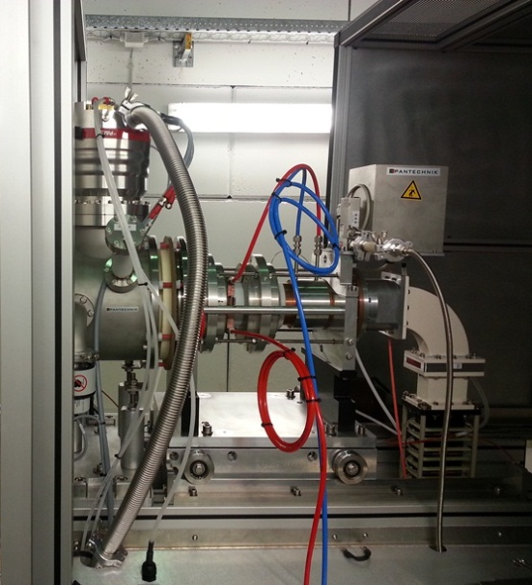
The LEBT installed at LPSC Grenoble
Allison Scanners
Solenoid 1
+ Steerers
Chopper
Solenoid 2
+ Steerers
ECR ion source
Chopper
Collimators & Allison scanner
Collimation cone
+ ACCT
Faraday Cup
Collimation system
Faraday Cup
ECR Source M-1000

Slide 7
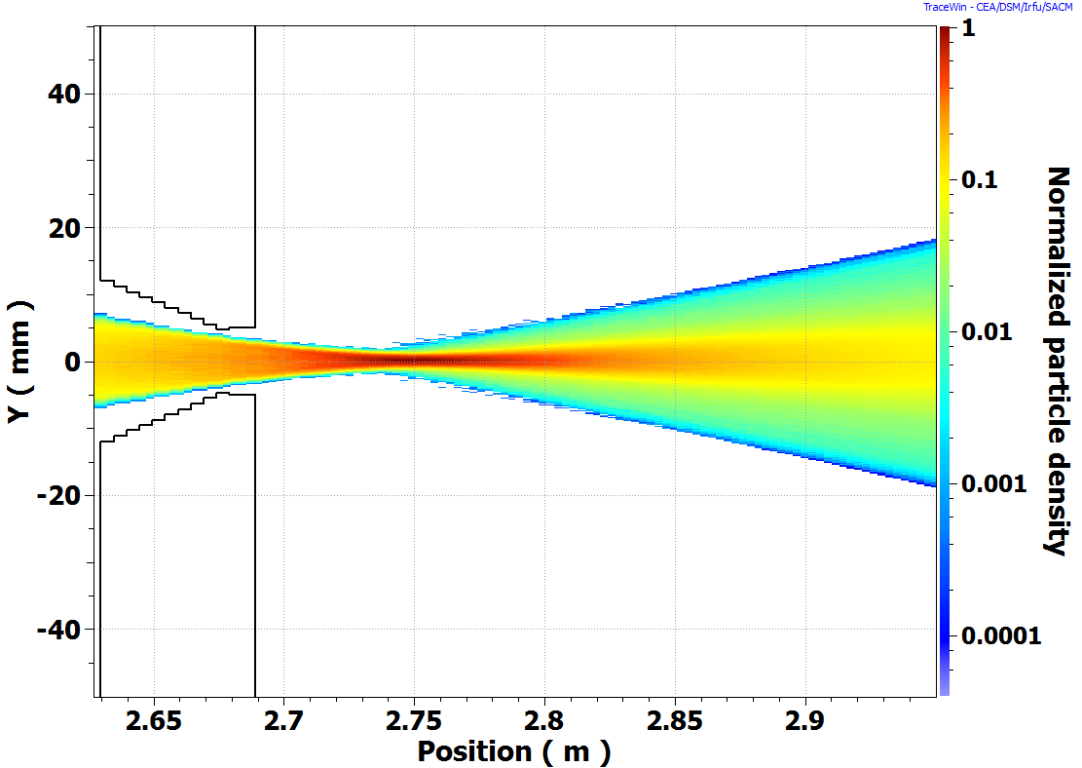
LEBT tuning
● Goal : tune the solenoids & steerers settings to optimise the transmission through the LEBT and to match the beam into the RFQ
● Solenoid scan on the beam transmission
➢I_{source} set at 9 mA, difficult to control below this value (dropout in an other plasma mode)
➢ Beam current & Twiss parameters measured 26.2 cm after the hole of the collimation cone (FC + Allisson scanner)
➢ Estimation of the beam parameters to be expected at the Emittance-meter location with TraceWin (SCC comp. : ~ 85% , ε_{RMS.norm.proton} = 0.1 mm.mrad)
Measurement
Allison-Scanner
RFQ injection
(LEBT output)
Requirement at RFQ input
-> β =0.04 mm/mrad & α = 0.88
Estimation : 262.5 mm after the RFQ injection hole
-> β ~ 2.9 mm/π.mrad & α ~ -12.5
262.5 mm

Slide 8
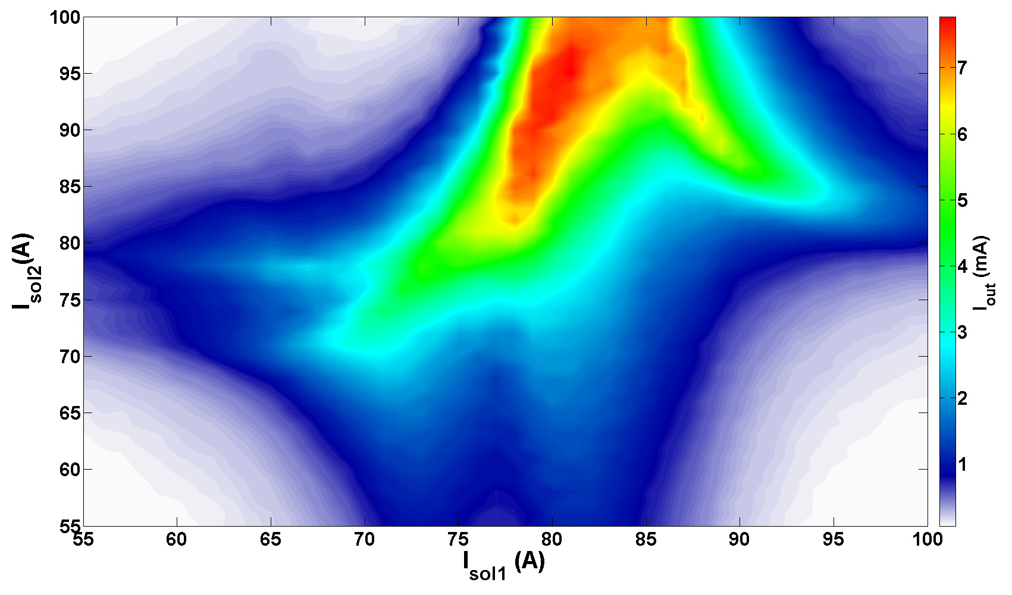
First Transmission map
● Beam current transmitted through the LEBT as function of the solenoid focusing (current in the coils)
● I_{source} = 9 mA
● No collimation in the middle of the LEBT
● No steerer tuning
● P = 1.1 10⁻⁵ mbar
Design goal
Need to adjust the central position of the beam with the steerers
Need collimation to adjust beam current

Slide 9
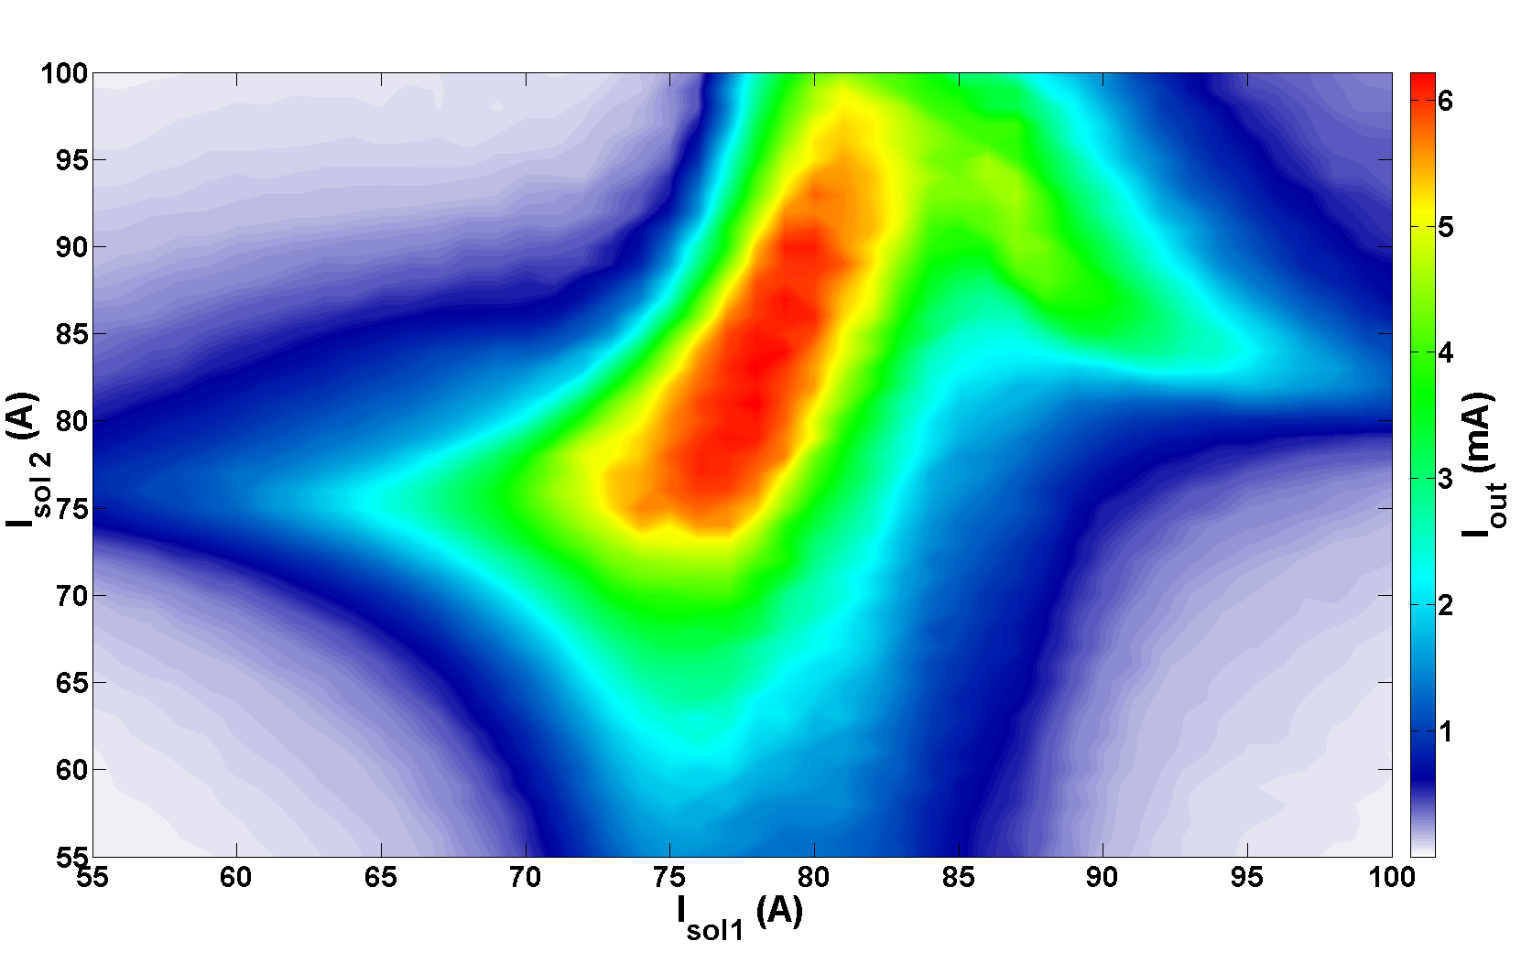
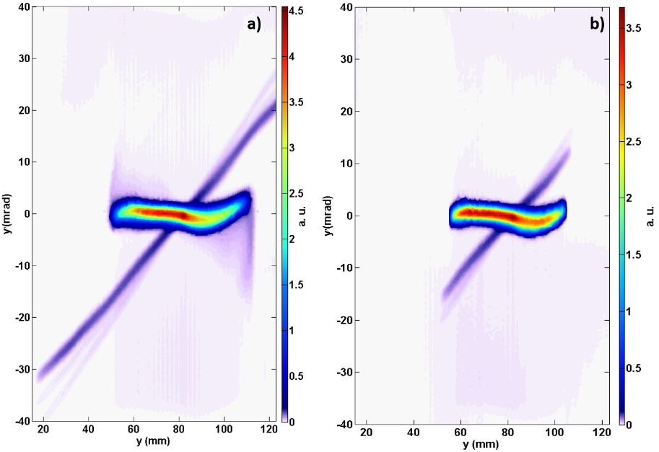
Transmission map : Tuned LEBT
● I_{source} = 9 mA
● P = 7 10⁻⁶ mbar
● Collimator aperture : 48 mm
● Steerers settings inside solenoid 2 :
➢ I_{steererH} = 0.5 A
➢ I_{steererV} = -2 A
No collimation
With collimation

Slide 10
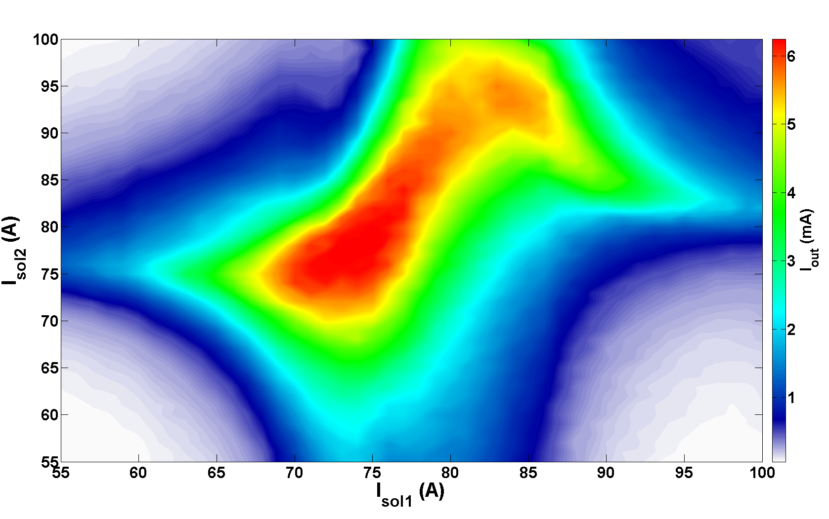
Transmission map : Tuned LEBT + Kr injection
● I_{source} = 9 mA
● P = 2.4 10⁻⁵ mbar (Kr injection)
● Collimator aperture : 48 mm
● Steerers settings inside solenoid 2 :
➢ I_{steererH} = 0.5 A
➢ I_{steererV} = -2 A
Gas injection (pressure, type) has an effect on the transmission in steady state and therefore on the space charge neutralisation
Already observed on several experiements :
_ R. Hollinger et. al. , “High current proton beam investigation at the SILHI-LEBT at CEA Saclay ”, TU3001, Proceedings of LINAC2006 , Knoxville, Tennessee, USA,2006
_ D. Winklehner, D. Leitner, "A space charge compensation model for positive DC ion beams." Journal of Instrumentation 10.10 (2015): T10006.
_ R. Ferdinand et al. , “Space-charge neutralization measurement of a 75 keV, 130 mA hydrogen-ion beam”, Proceedings of PAC’97, Vancouver, B.C., Canada,1997

Slide 11
Space charge compensation
● Evolution of the Emittance in the middle of the LEBT as function of the gas pressure
➢ the focusing strength of the solenoid is kept constant (I_{sol}=69A)
➢ Argon or Krypton gas injected
➢ The beam current is kept constant at the emittance measurement location : I_{proton} ≈ 8.5 mA
Ar injection - Horiz. Plane
Kr injection - Vert. Plane
~1.5 m from the source extraction hole
● In steady state we observed that the emittance decreases while residual gas pressure is increased

Slide 12
Space charge compensation
P = 9.2 10⁻⁶ mbar
Ar injection - Horiz. Plane
Kr injection - Vert. Plane
P =5.4 10⁻⁵ mbar
● For a given focusing strength of the solenoid :
→ the beam divergence is changing with the gas pressure

Slide 13
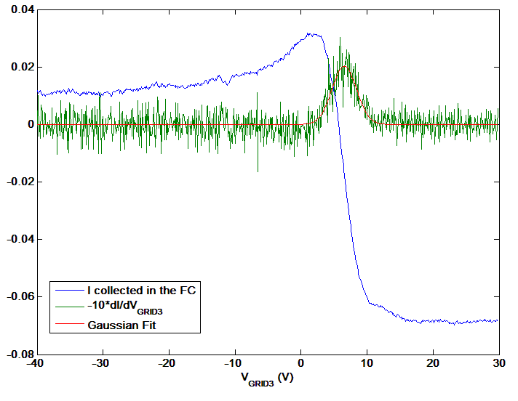
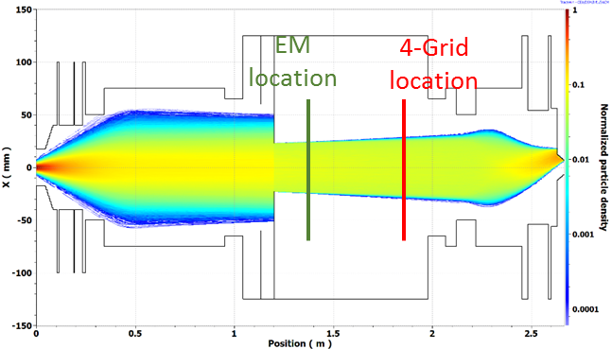
Space charge compensation degree
● Measurement of the space charge neutralisation degree with Kr injection:
$$\text{η}=1−\frac{φ_{c}}{φ_{0}}$$
● Careful – several assumptions :
➢ 4-grid analyser (low and noisy signal)
➢ Beam distribution assumed Gaussian
$$φ(0)= \frac{I}{4πε_{0} βc\left(1−e^{{−r_{b}^{2}}/{{2.σ}_{b}^{2}}}\right)} \left[−\frac{\ln\left({2.σ}_{b}^{2}\right)}{2} −\frac{1}{2}\ln\left(\frac{r_{b}^{2}}{{2.σ}_{b}^{2}}\right)+\frac{1}{2} \sum_{k=1}^{+∞}{\frac{{\left(−1\right)}^{k+1} {{(−r}_{b}^{2}}/{{2.σ}_{b}^{2})} }{k.k!}}+\left(1−e^{{−r_{b}^{2}}/{{2.σ}_{b}^{2}}}\right). ln\left(\frac{r_{vac.chamb}}{r_{b}}\right)+ln⁡(r_{b})\right]$$
➢ Beam radius calculated from emittance measurements

Slide 14
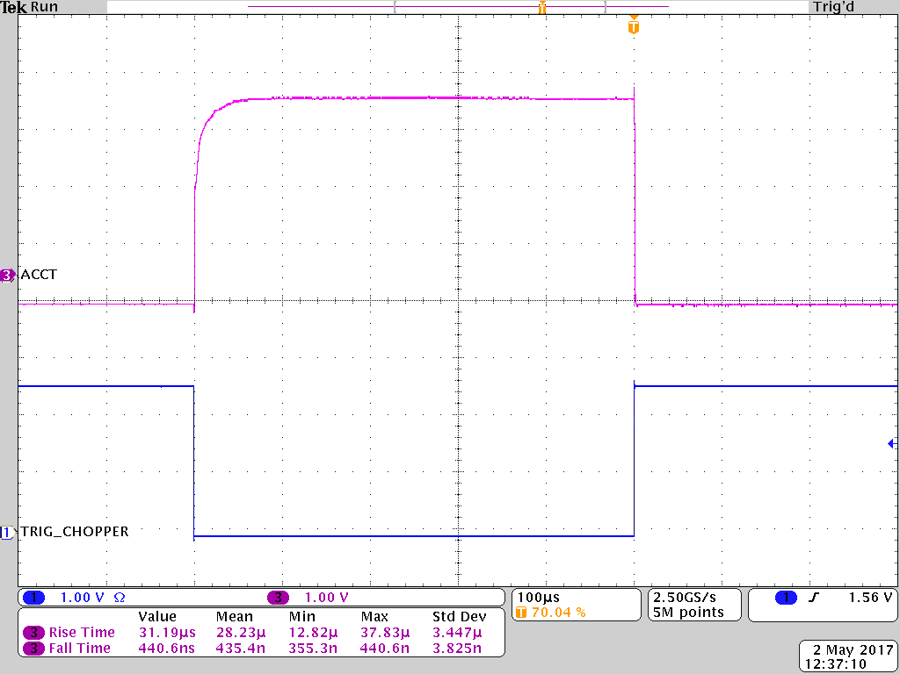
Chopper & SCC Transients
● Space charge compensation time measured as function of the pressure (Kr injection)
Beam current measured with the ACCT in the final collimation cone
τ_{95% :} time to reach 95 % of the maximum value
Chopper rise time : ~400 ns
95%
500 µs macro-pulse

Slide 15
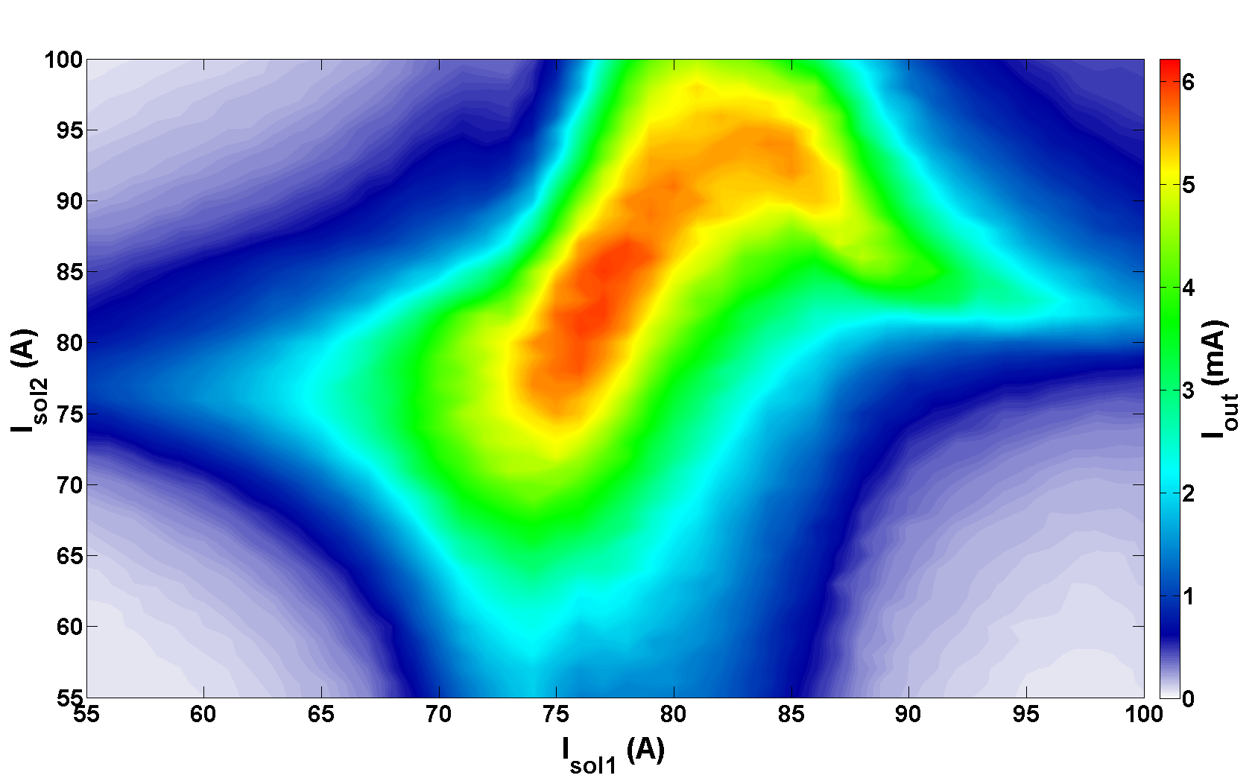
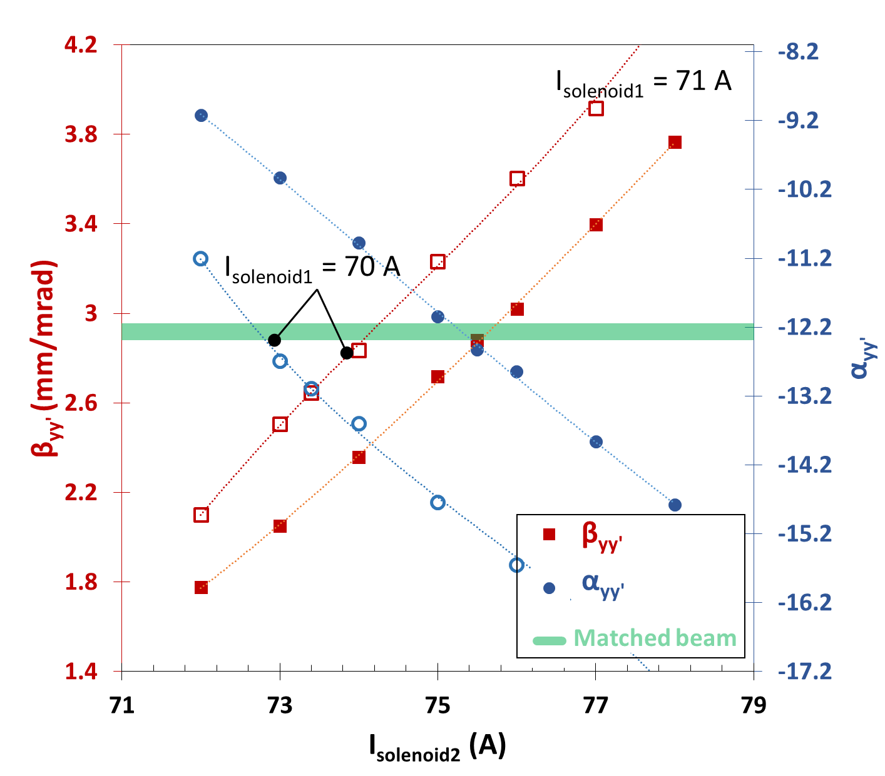
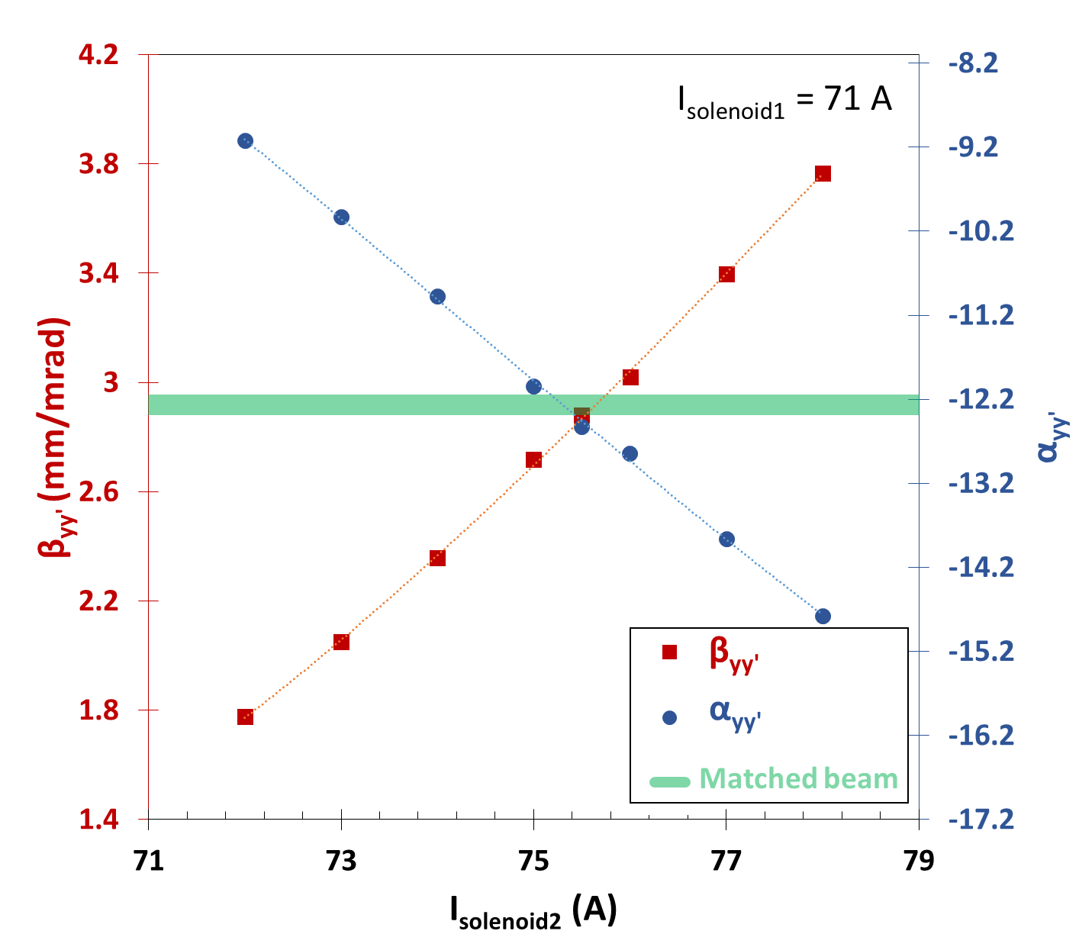
LEBT final tuning
● I_{source} = 9 mA
● P = 2.4 10⁻⁵ mbar (Kr injection)
● Collimator aperture : 37 mm
➢ I_{out} = 4.5 mA
● Steerers settings inside solenoid 2 :
➢ I_{steererH} = 0.5 A
➢ I_{steererV} = -2 A
ε_{YY’} _{rms. norm.proton} = 0.08 π.mm.mrad

Slide 16
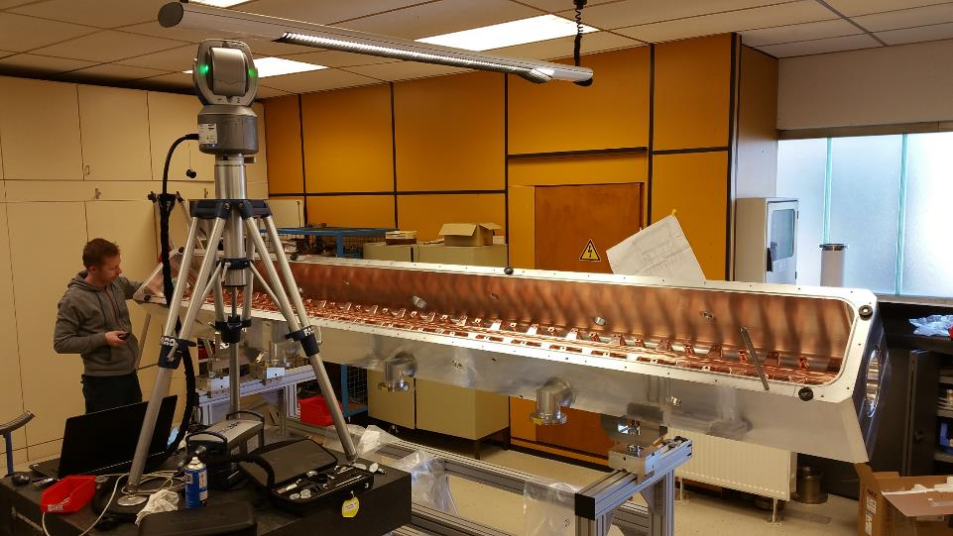
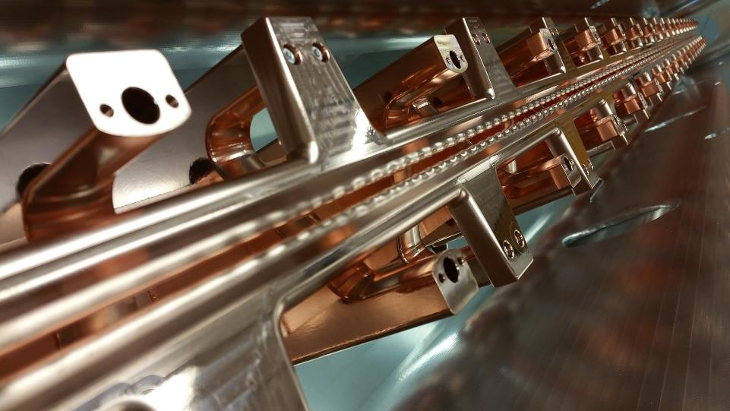
CONCLUSIONS & Future work
● The MYRRHA LEBT is fully commissioned
➢ Effect of gas on space charge compensation experimentally measured
➢ Tuned to provide the right beam parameters (Twiss, emittance) at RFQ input
● Analysis of experimental data for SCC studies in progress
➢ Model development With WARP for a better understanding of the Physical process of SCC in the LEBT
- As studied for example on LINAC4 C. A. Valerio-Lizarraga et al., Phy.Rev. ST Accelerator & beams, 2015
- Assess the effect of Emittance-meter on measurement accuracy
- Phd thesis of Frédéric Gérardin at CEA Saclay
➢ To anticipate on the future re-tuning & operation
Courtesy of F. Gérardin
● Next step : LEBT will be moved to Louvain-la-Neuve for RFQ and injector commissioning (2018)
Courtesy of A. Bechtold

Slide 17
Thank you to
Julien ANGOT, Dominique BONDOUX , Maud BAYLAC, Jorik BELMANS , Jean-Luc BIARROTTE , Thierry CABANEL, Mohammed CHALA, Nicolas CHAUVIN, Victor AMOR DURAN, Wouter DE COCK, Jean-Marie DE CONTO, Pierre DE LAMBERTERIE, Rémi FAURE, Dominique FOMBARON, Christian FOUREL, Emmanuel FROIDEFOND, Frédéric GERARDIN, Julien GIRAUD, Miguel DE LA IGLESIA, Calogero GERACI, Yólanda GÓMEZ-MARTÍNEZ, Étienne LABUSSIERE, Jean-Claude MALACOUR , Jan MALEC, Isaías MARTÍN-HOYO, Luis MEDEIROS ROMÃO, Myriam MIGLIORE, Robert MODIC, Luc PERROT, Solenne REY, Sébastien ROUDIER, Roberto SALEMME, Thomas THUILLIER, Didier URIOT, Aljaz VRH, Dirk VANDEPLASSCHE, Olivier ZIMMERMANN
Thank You for your Attention

