Slide 1
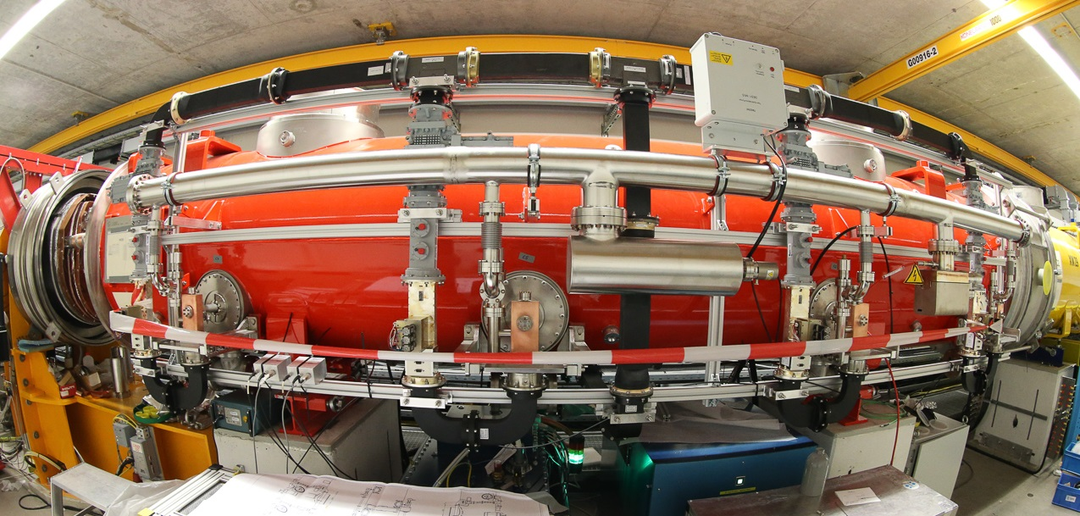
3.9GHz Module Commissioning for XFEL
Cecilia Maiano SLHiPP June 8-9 2017

Slide 2
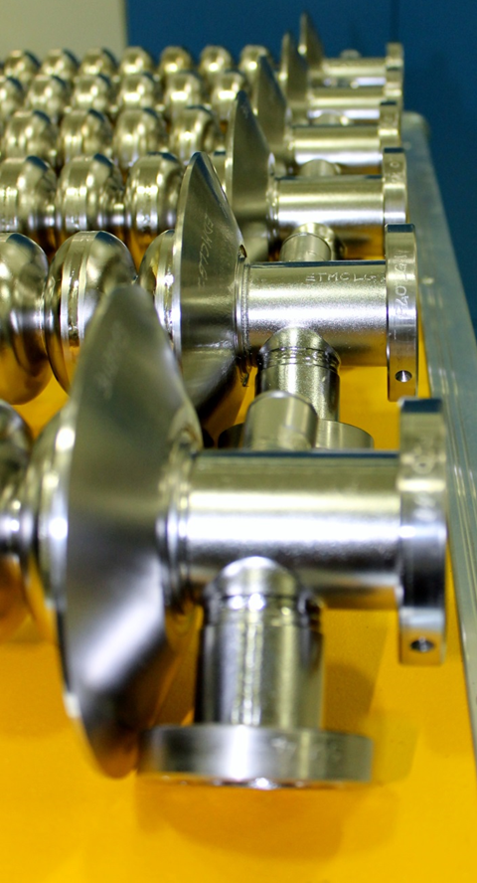
Outline
XFEL in a nutshell
Why do we a third harmonic system?
What is in there?
Technical Commissioning
Performance of AH1
Injector Run (130 MeV): Dec 15-Jul 16
XFEL Commissioning: Jan 17-ongoing

Slide 3
XFEL in a nutshell
1.3 GHz SRF linac with 17.5 GeV,5 kA bunches for an FEL operating in the 1-0.5 Å regime
27000 e- bunches/s (0.6ms flattop @ 10Hz, 2700 b/pulse)
1 klystron driving 4 8-cavity modules in vector sum mode
Beam quality (emittance at high currents) is the key
Three bunch compression stages at 130 MV, 600 MeV, 2.4 GeV to raise the bunch current

Slide 4
Why a third harmonic system
We need to manipulate the longitudinal phase space before the bunch compression stages in order to get a proper current profile along the bunch for the FEL lasing
Remove the RF curvature from the 1.3 GHz module caused by the long bunch length at the injector
Compensate wake fields in the main linac, BC non linear optics, space charge effects…
Control energy chirp, curvature, skewness in the longitudinal phase space for optimization of the bunch compression stages
Superposition of a harmonic field and proper setting of its amplitude and phase enables this manipulation

Slide 5
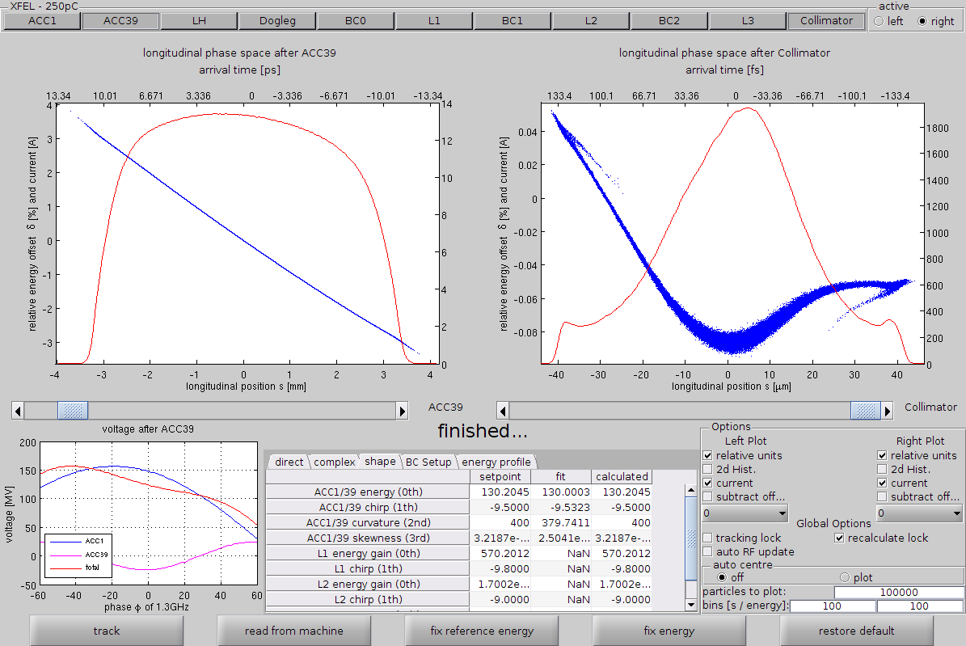
RF parameters for optimal BC
Beam dynamic tools for setting parameters (by BD experts)
Control Room tool
Beam Phase space at FEL
Beam Phase space after 3H module
Superposition of 1.3 GHz RF with a ~180∘
3.9 GHz RF to manipulate beam distribution

Slide 6
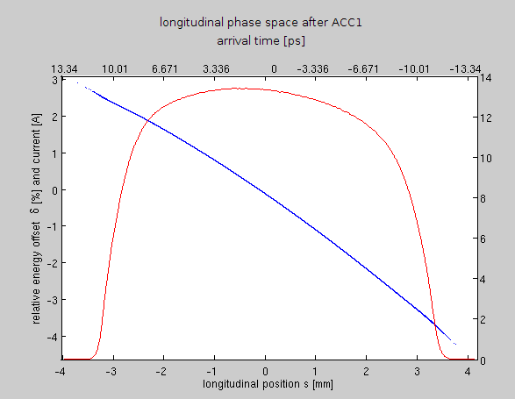
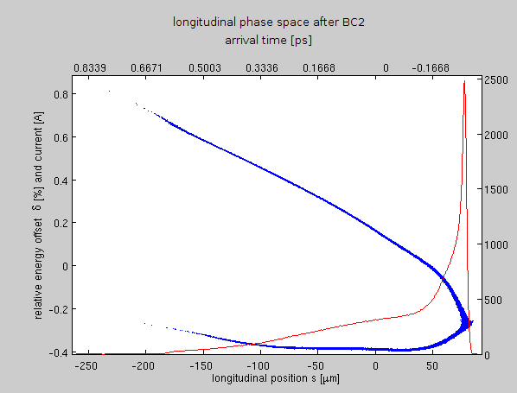
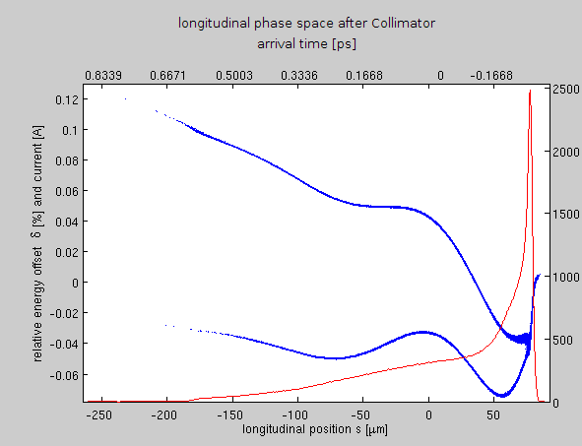
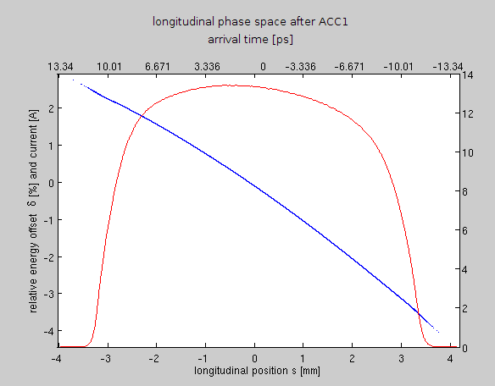
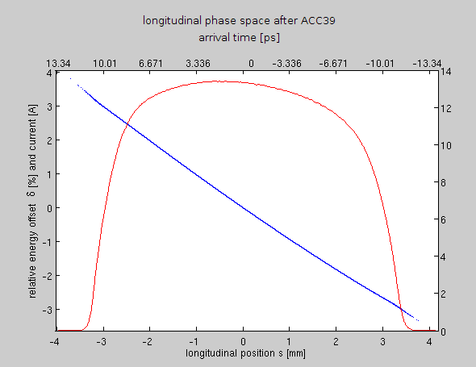
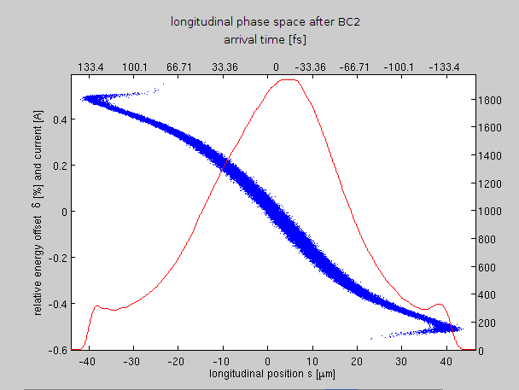
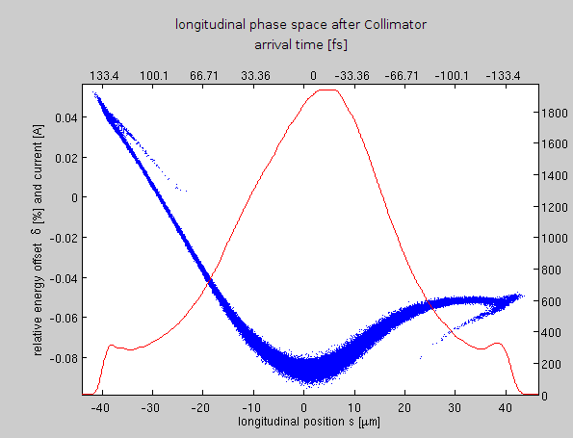
Phase space manipulation in a glance
Using only A1 to chirp the beam
(no AH1)
At final compression stage current spike
Large current spike but low charge for FEL!
Longitudinal phase space
Current along bunch
👎🏻
chirp+curvature!
With third harmonic manipulation
After A1 (150 MeV)
After AH1 (130 MeV)
After BC2 (2.4 GeV)
After L3+CL (17.5 GeV)
👍🏻
Off crest operation creates chirp+curvature
AH1 removes curvature and prepares for BC
At final compression stage good current profile
Beam flattened for good FEL emission

Slide 7
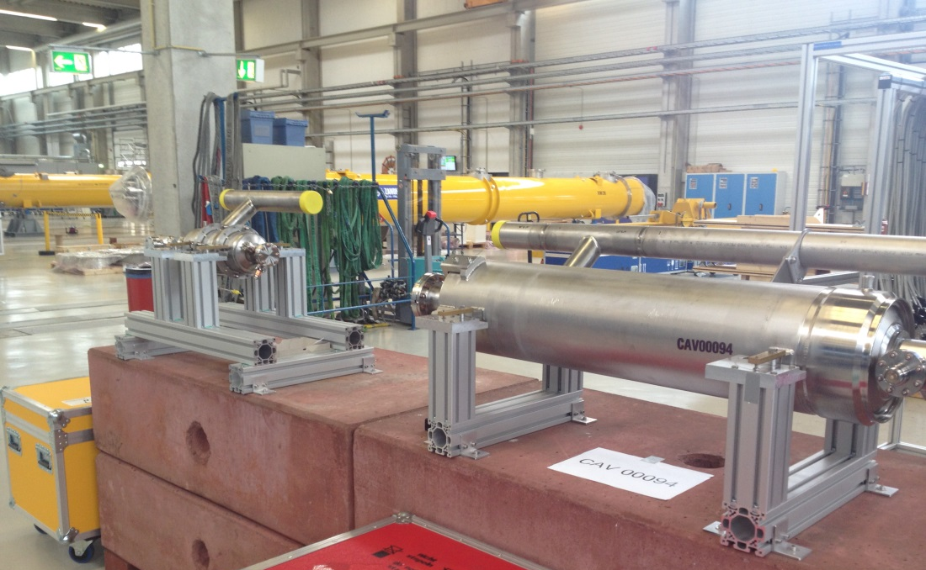
What is in the AH1 module?
The third harmonic system (AH1) is functionally like a standard main XFEL module, but contains 8 cavities at 3.9 GHz (3 times the frequency, therefore 1/3 of the size)
IN-KIND Contribution to XFEL by INFN (50%: Cavities and module) and DESY (50%: Couplers, RF and infrastructure)
Joint: installation, technical commissioning and initial operation

Slide 8
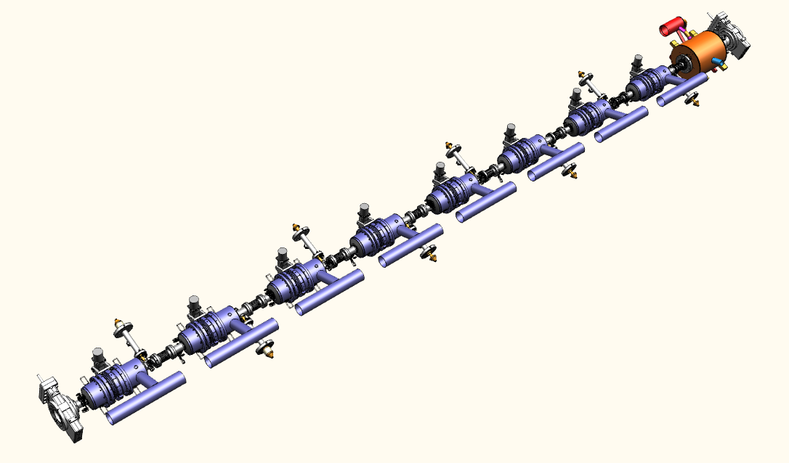
Inner module components
Same as ML modules, different order
1 reentrant cavity BPM
1 quadrupole at beginning of cavity string
8 cavities (3.9 GHz)
So, similar procedures for operation
Beam
Injector Overview Display
A1
AH1

Slide 9
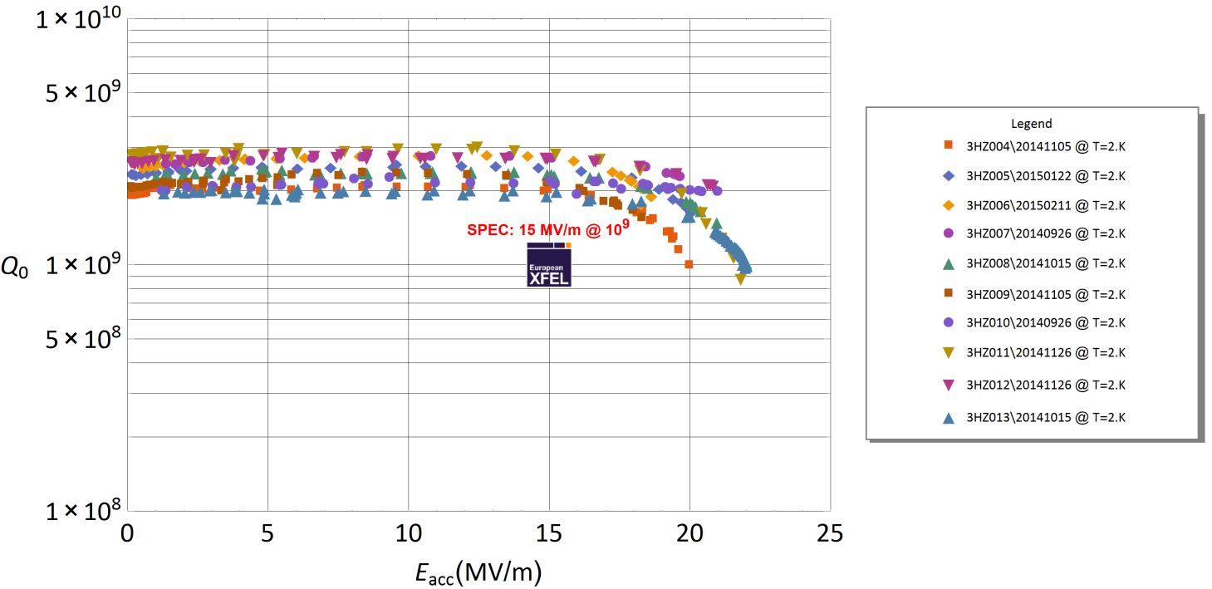
Cavity vertical tests at INFN/LASA
AH1 cavities: First vertical test 26-Sep-14 and last 11-Feb-2015
PERFORMANCE GOAL (SPEC): 15*0.346*8 ~ 42 MV
Beam Dynamic Requirements (worst case scenario ) < 30 MV

Slide 10
Major AH1 Assembly Milestones
July 3 2015
September 23 2015

Slide 11
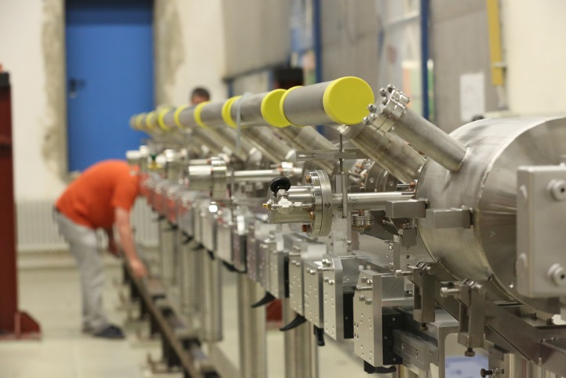
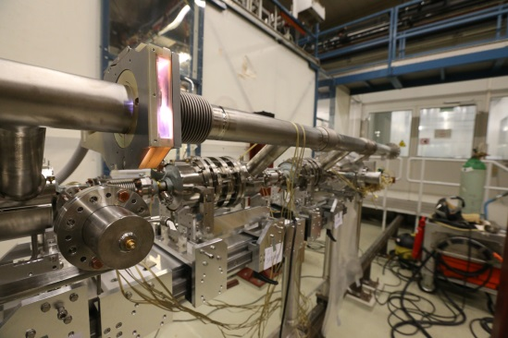
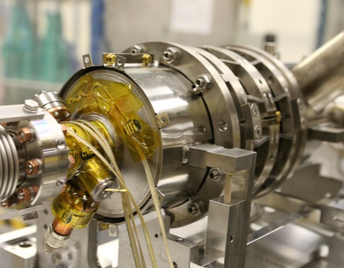
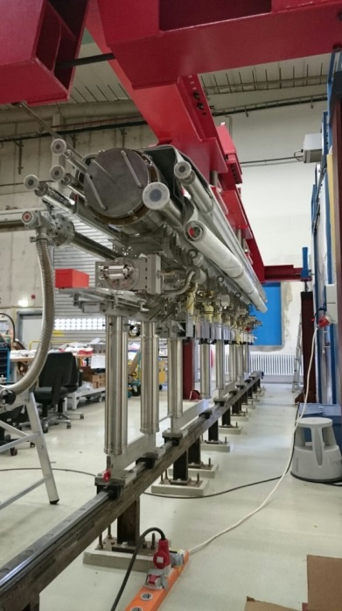
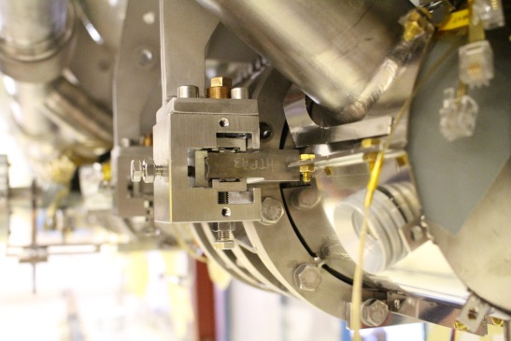
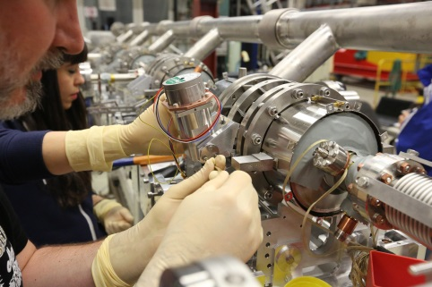
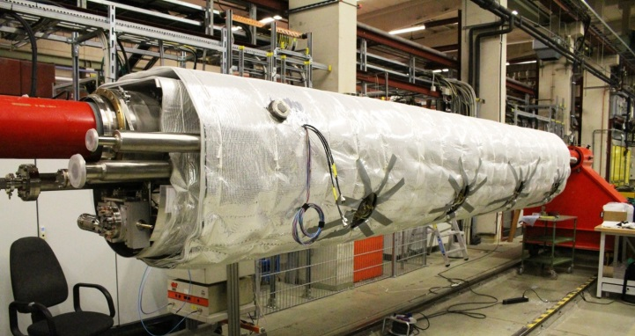
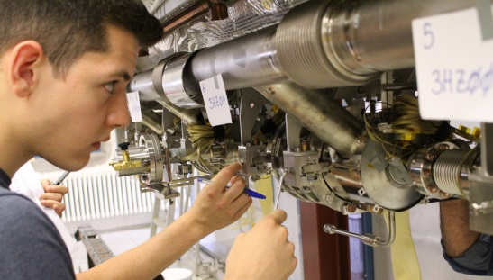
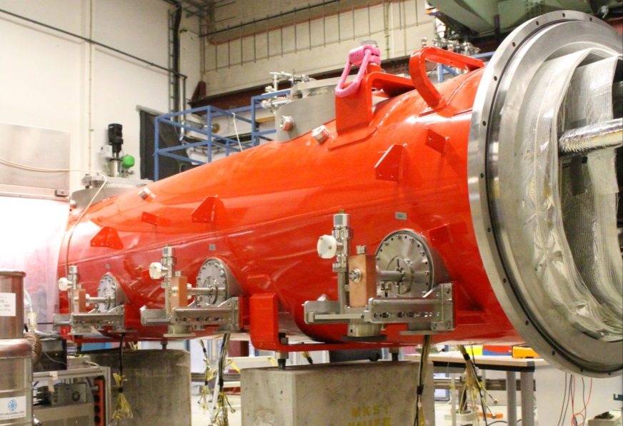
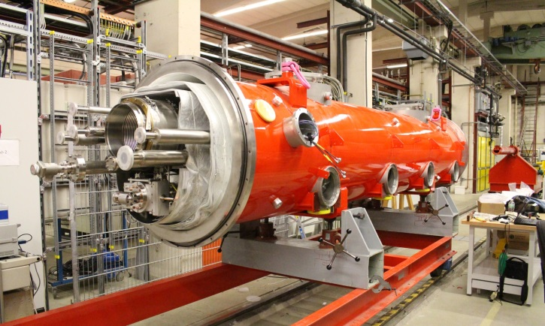
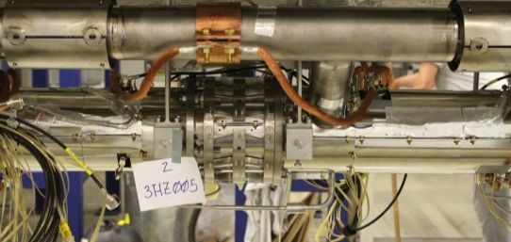
The assembly in Halle III (14 weeks)

Slide 12
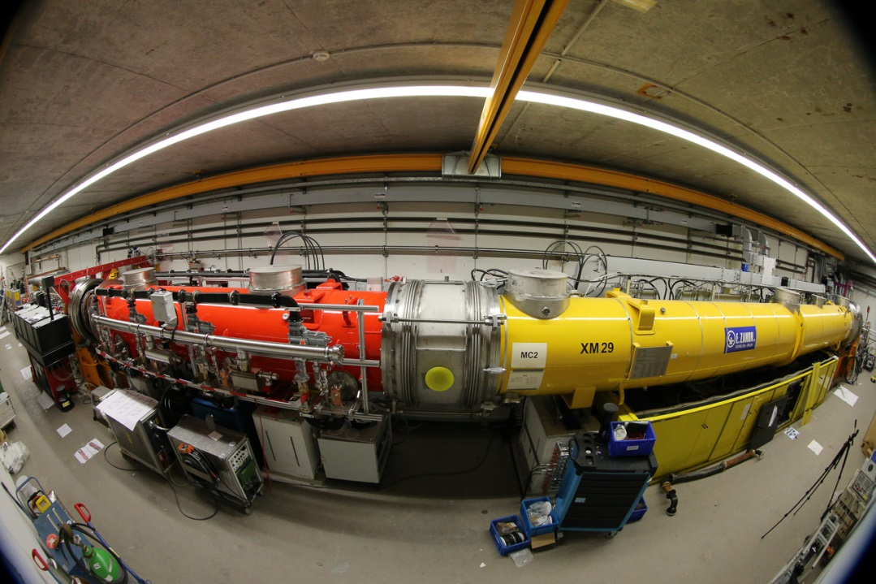
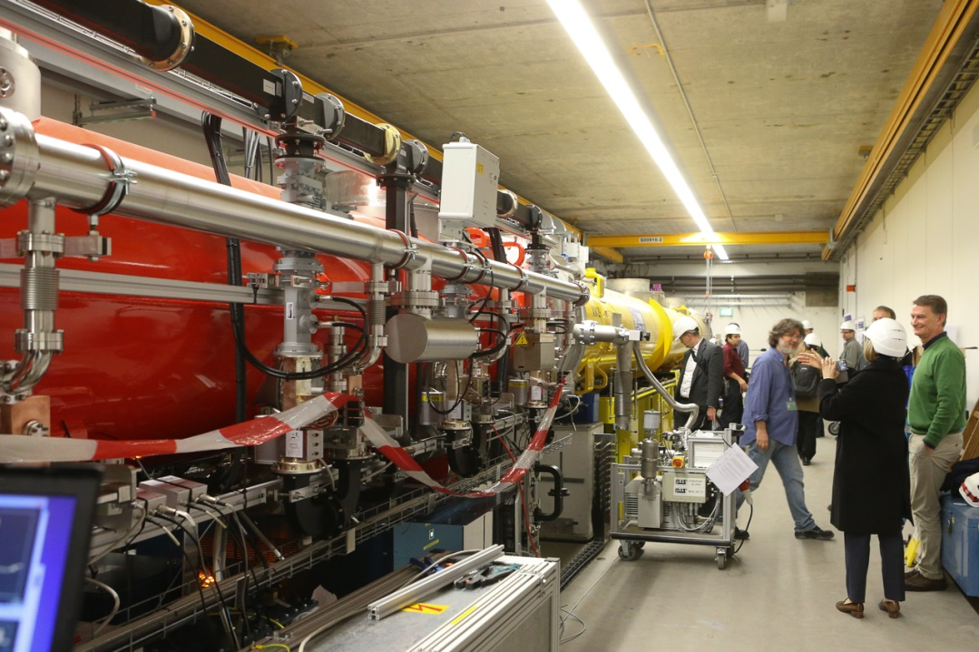
Final Preparation stages in tunnel
November 11 2015
Assembly WG distribution
Injector String Integration
Dec 10: Start cooldown
Dec 15, Cryo OK- cavity pre-tuning
Dec 16, calibration: AH1 Ready

Slide 13
RF Commissioning in Tunnel
Infrastructure aspects, workload of AMTF and schedule delays (arrival of 3.9 components) made it impossible to test the module before tunnel installation
Tunnel installation without cryogenic and RF testing
Tunnel is not the most favorable environment for precise RF measurements activities
Few RF power meters with respect to AMTF, though a few not initially foreseen were implemented by MHF-sl (e.g. HOM power readings, not present in the main linac)
The positive aspect is that all subcomponents were in their final configuration and driven by the XFEL control system
Smooth transition from characterization to operation

Slide 14
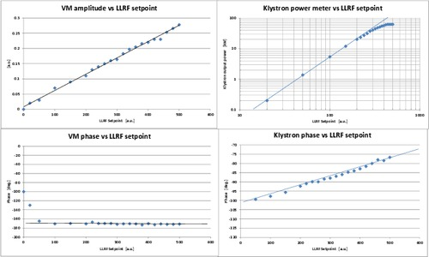
Present RF Distribution layout
Pre Amp
KLY
Output of LLRF VM
PMeter (Cal)
Cavity 1
Cavity 3
Cavity 5
Cavity 7
Check of the WG distribution flatness performed only at few W level after assembly
Cavity 2
Cavity 4
Vector operation of 8 cavities with one pulsed
Klystron (Max. power 80 kW, 1.3 ms@ 10 Hz)
Cavity 6
Cavity 8
Courtesy of R. Jonas, MIN, DESY
Only to LLRF

Slide 15
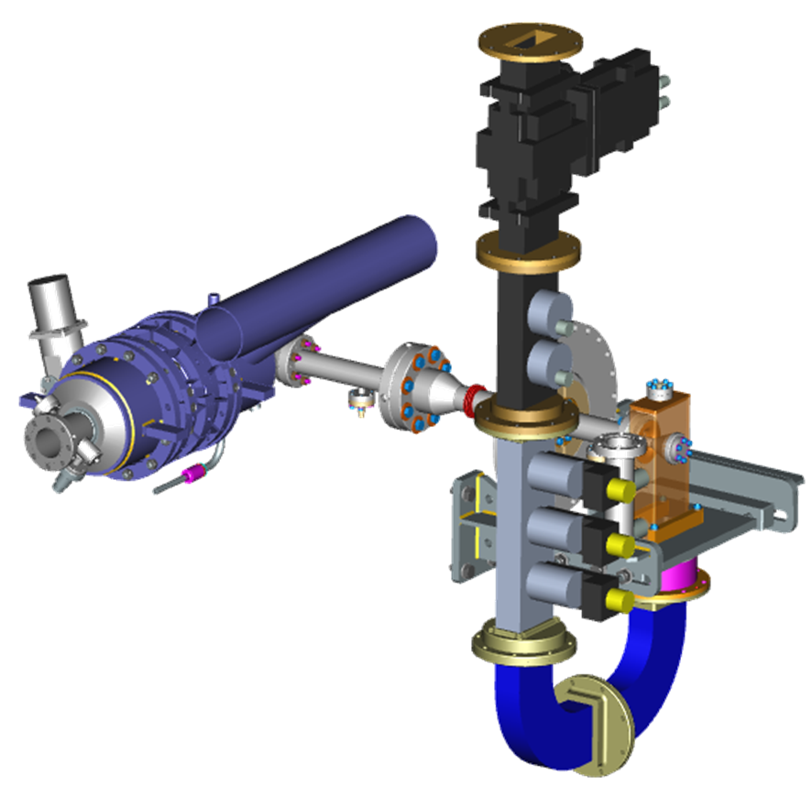
Cavity Phasing and QL adjustment
WG distribution uses 3dB splitters to provide RF power to cavities from a single Klystron
No phase shifters
Flexible waveguide sections
Assembled in tunnel
no measurements at relevant Kly power
Fixed coupler design
The systems relies on 3-stub tuners to achieve the desired QL adjustment and cavity phasing
Directional Coupler
3-stub tuner

Slide 16
Main technical commissioning checklist
Cavity performances, up to quench limit - done
Phase alignment and QL tuning - done
Beam-based calibrations - done
HOM thermal stability studies - done
Cryogenic performance assessment - done
Preserving (and improving) beam quality - done
Characterization of the RF power distribution – skipped (for schedule reason)

Slide 17
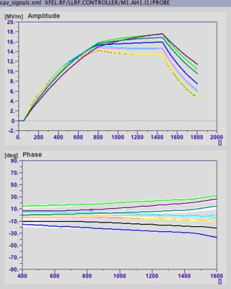
First operation at nominal gradient on Day 1
18 December 2015
Operation with no beam
First rough calibration (LLRF)
Assume P_{cav}=P_{kly}/10
Nominal pulse structure
Fill: 750 us/FlatTop: 650 us
Gradient well above nominal
40 MV of VS voltage
First quench > 45 MV
Cavity phasing missing and QL values not yet tuned
LLRF in FB mode
Arbitrary calibration/need beam

Slide 18
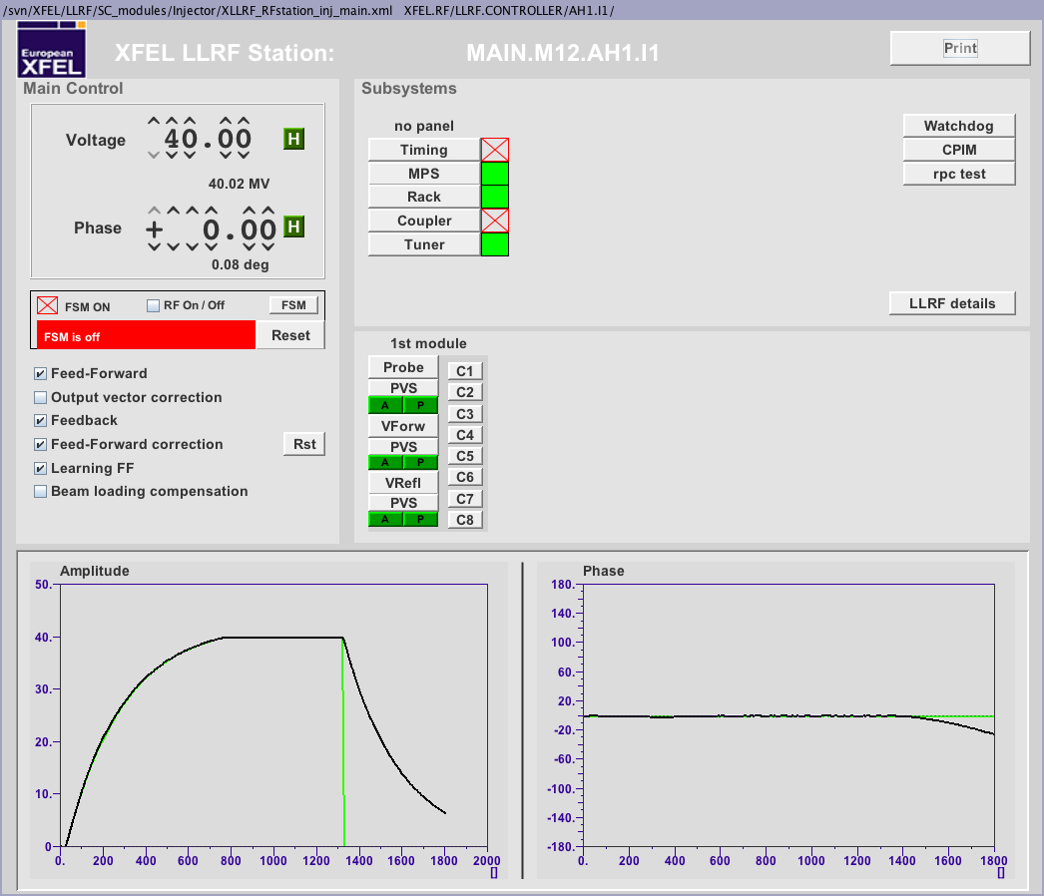
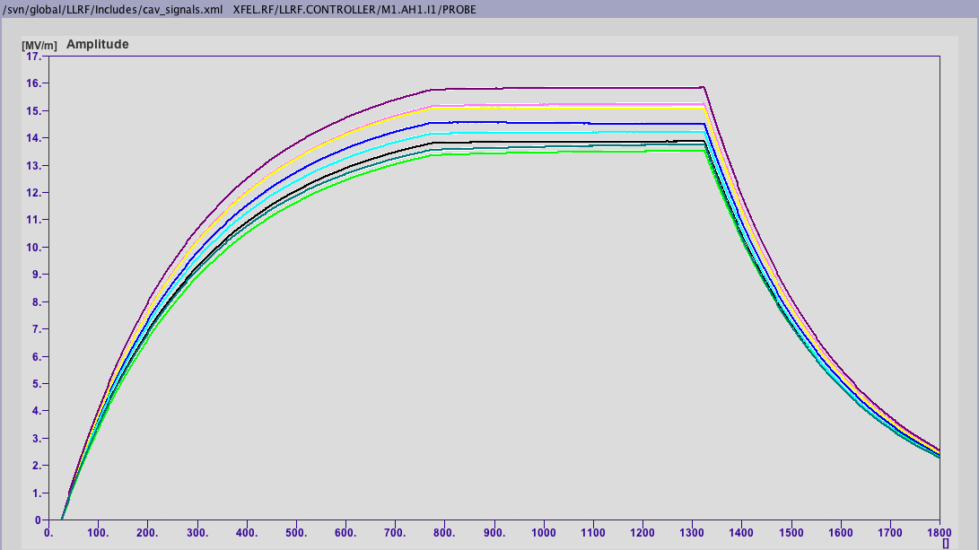
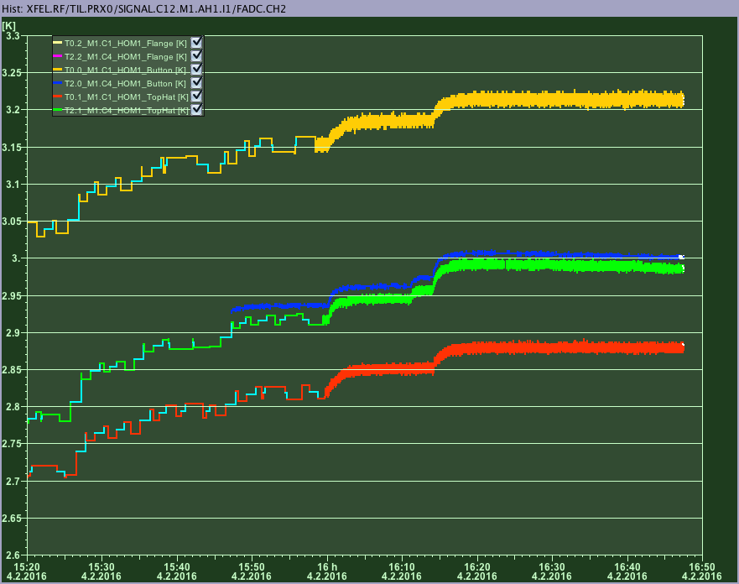
Achieved performances during Injector Run
>40 MV have been achieved during technical commissioning phase
First quench on C7 above 45 MV module setpoint
Individual cavity gradients
Module LLRF panels are the same as for ML
Thermally stable at 40 MV

Slide 19
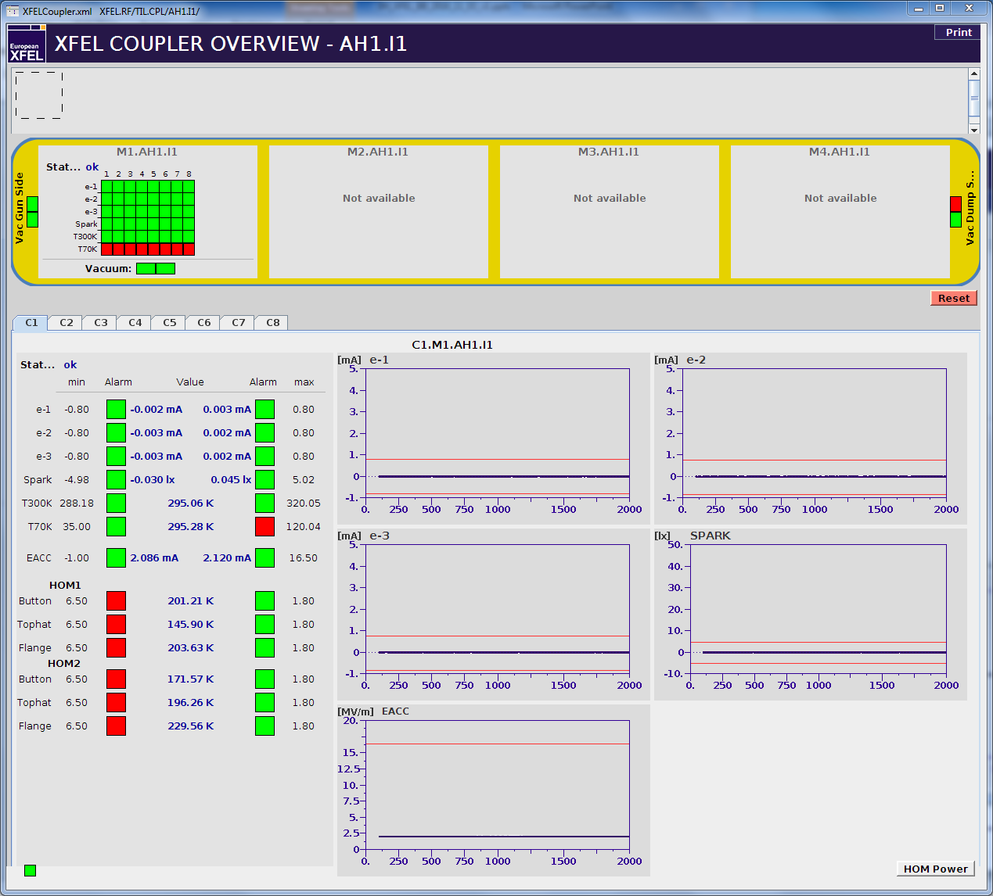
Technical interlocks
Several interlocks guarantee the cavities and couplers integrity, some are the same of those in the ML modules, some are particular to AH1
Coupler (same as 1.3 GHz)
e-pickups (3x)
Spark detector
Window temperatures (70K/300K)
Cavity (additional)
3 T sensors on each HOM coupler
Gradient interlock RF diode
+Cryo OK signal
Also, HOM power diagnostics

Slide 20
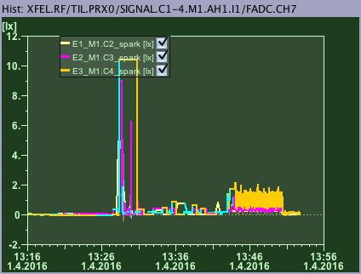
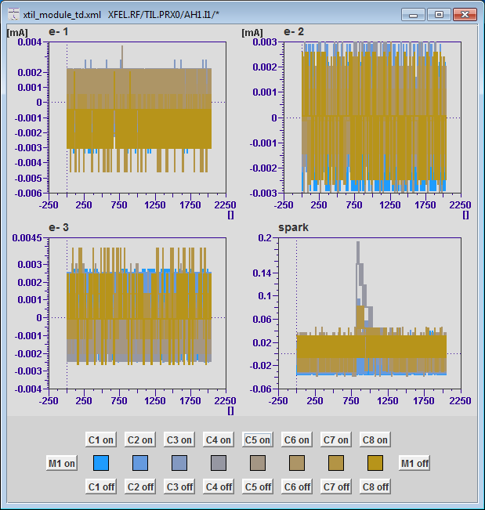
Coupler interlocks
Power level is low (roughly 10 kW range for SP 20 MV)
No events during warm power ramp up
No events at cold power ramp up
Few interlocks events (e.g. sparks) or activities in the signals were beam-related (opening 35 mm vs 76 mm in 1.3 GHz)
A look in the Time Domain signals from the technical interlock expert panel can help to spot if it is a beam effect
Cold quads at max setting by error, all AH1 spark detectors fired up

Slide 21
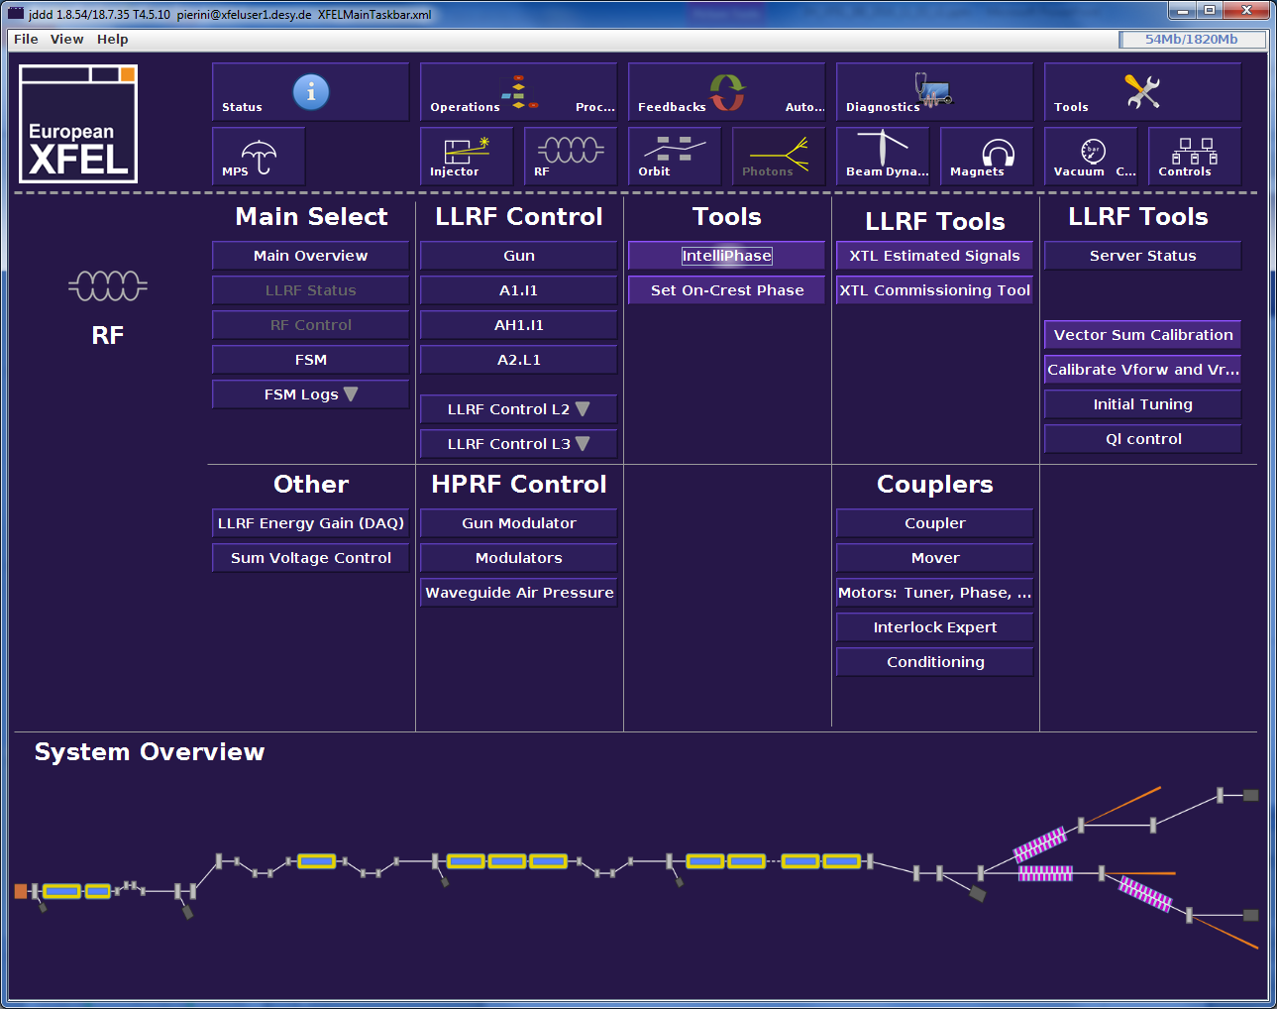
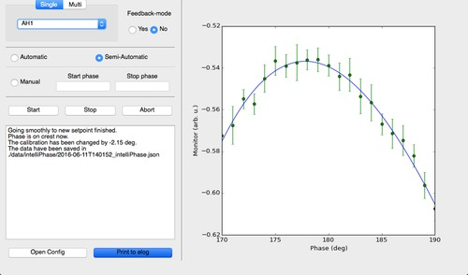
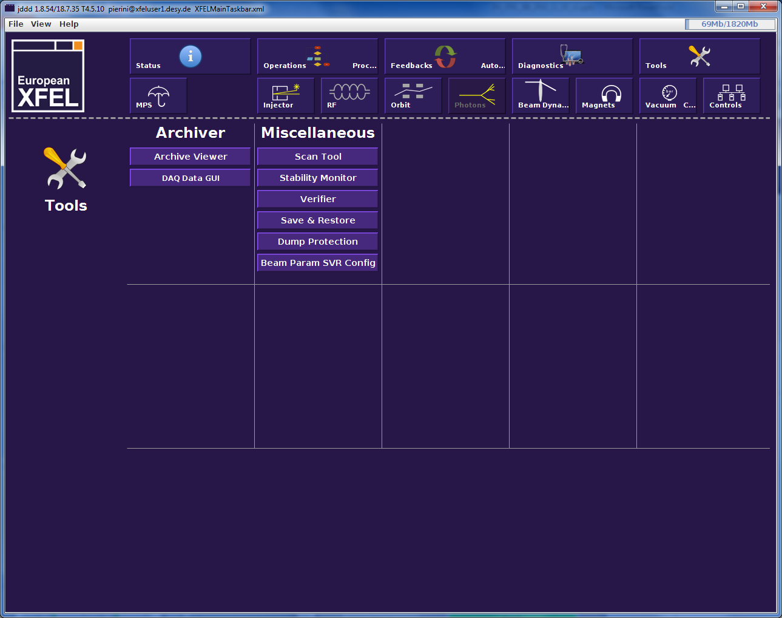
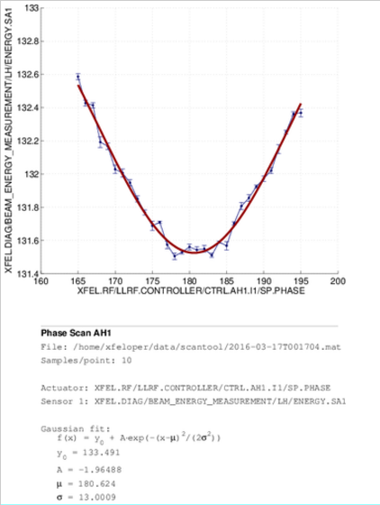
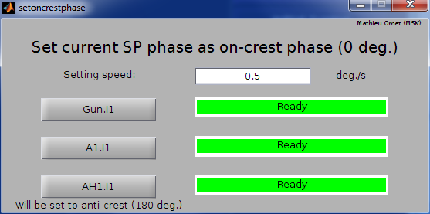
Cavity Phase tools
3
Scan, move and set
1
2

Slide 22
Initial QL values (nominal 3.2E6)
Cumulative effect of antenna / cavity tolerances & FF
Spread in the QL values (all stubs out), factor of 2
TUNING

Slide 23
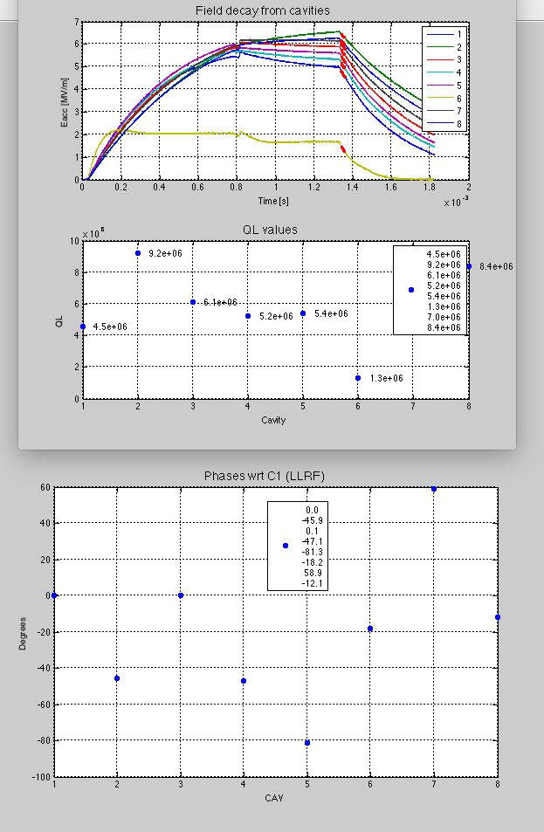
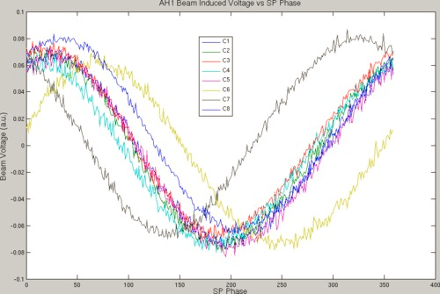
Beam Based calibration: Cavity Phases
January 2016, on beam
Beam transients
Phase Calibrations
Preliminary to :
Phase Tuning
QL tuning
Large initial cavity phase spread
WG assembled in tunnel, no cal.
Cavity transient, QL determination and phase calibration
Beam induced cavity gradient changes
Tune with
3-stub tuners
WG Spacers
160°
After operation of a few stub tuners

Slide 24
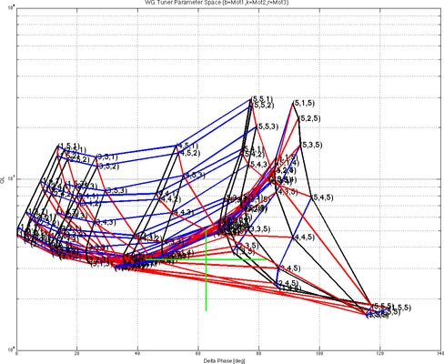
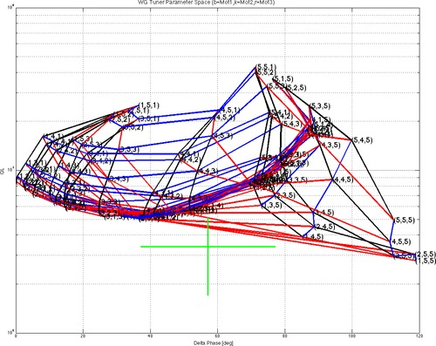
QL tuning & Phase alignment
1 February 2016, AH1 moved 1 ms after the beam
Allow injector commissioning while aligning cavity phases
Individual maps of all 3-stub tuner positions
QL-Phase region
Case of design in range of tuner
QL-Phase region
Case of design outside range of tuner
WG spacers installed on 3 cavities

Slide 25
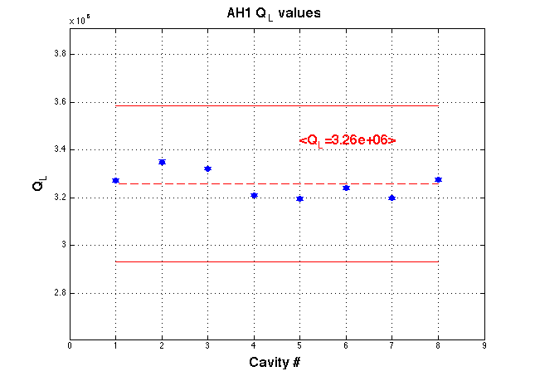
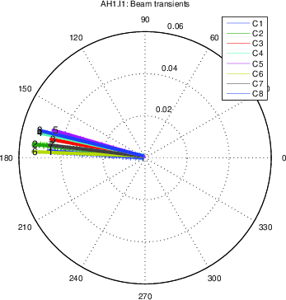
Started regular operation in injector
10 February 2016
QL aligned well within the 10% requirement
Phases within 15°
16 February 2016
Back on beam
Moved to -180°(wrt on-crest), calibration with beam energy

Slide 26
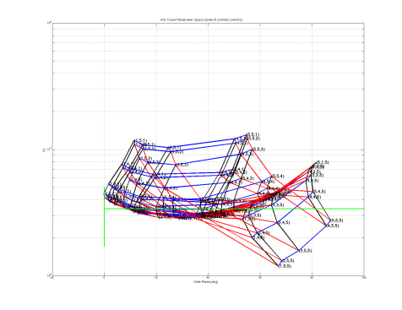
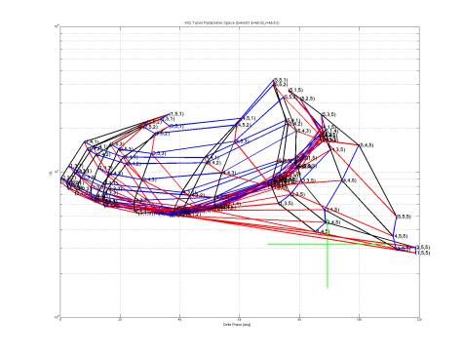
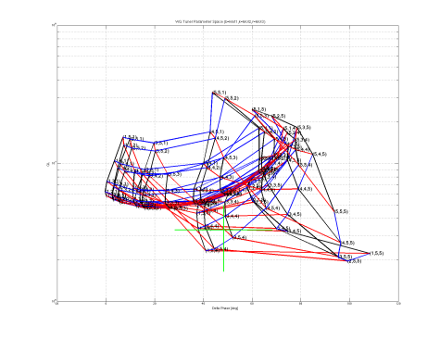
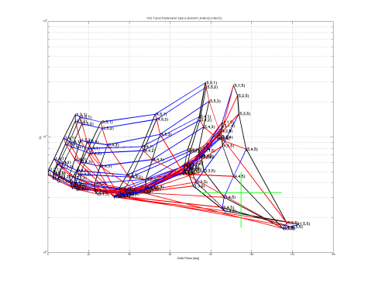
Max QL obtainable in present module
By mapping all tuners we were able to reach high QL values with the present antenna design
Easy without phase constraints (single 1:1 powering)
Cav | 1 | 2 | 3 | 4 | 5 | 6 | 7 | 8
Max QL | ~ 1E7 | ~ 4E7 | ~ 3E7 | ~ 3E7 | ~ 4E7 | ~ 1E7 | ~ 3E7 | ~ 4E7
Already close to values for CW operation (future upgrades)

Slide 27
Quench Gradients (VT vs Module)
Pure RF measurements in tunnel initially did not correlate too well with VT quench gradients
Little accuracy and knowledge of WG distribution details
Cav | Tunnel |  | VT
 | Max E_{acc} (RF measurements) 26.01_a | Max E_{acc} (Beam calibration) 16.06_n | Max E_{acc}
C1 | ~18 MV/m | ~21 MV/m | 21.0 MV/m
C2 | ~18 MV/m | ~20 MV/m | 20.0 MV/m
C3 | ~19 MV/m | ~21 MV/m | 20.8 MV/m
C4 | ~17 MV/m | ~20 MV/m | 22.0 MV/m
C5 | ~18 MV/m | ~21 MV/m | 21.0 MV/m
C6 | ~18 MV/m | ~20 MV/m | 19.6 MV/m
C7 | ~18 MV/m | ~20 MV/m | 20.0 MV/m
C8 | ~17 MV/m | ~20 MV/m | 21.8 MV/m
However, after beam calibration procedures a much better agreement (within 10%) was obtained
Gradient interlock RF diodes are set approximately 1 MV below these levels
(should not intervene up to the 30 MV SP)

Slide 28
Beam Based Calibration of Module voltage
RF calibration did not give sufficient consistency in A1/AH1 correlation. BB calibration using dispersion in spectrometer.
A1/AH1 need to be in good relative calibration to control the bunch shape with Sum Voltage Control
Improved consistency in VT/XTIN quench fields
Important to check after rf calibrations are done

Slide 29
RF Curvature linearization by AH1
X (i.e. E)
Beam image on screen in the spectrometer beamline
← AH1 off
AH1 on →
Y
X (i.e. E)
Beam image on screen in the spectrometer beamline, switching on the Transverse Deflecting Structure (TDS)
← AH1 off
AH1 on →
Vector Sum Control of the sum RF field of the two modules allows to set the beam shape parameters (e.g. chirp, curvature, skewness) for proper matching to the downstream compression stages
Y (i.e. t or s along bunch)

Slide 30
Summary
RF commissioning and operation of the 3.9 GHz module in the tunnel was a great success
Achieved performances above nominal during the early injector commissioning stages in December 2015, with the AH1 pulse shifted in time from the beam
Module in regular operation with beam since January 2016 in the Injector run and ready for operation at the start of the XFEL commissioning phase in January 2017
First XFEL lasing at 9 Å on May 4th 2017 (2 Å reached at end of May): final confirmation of proper third harmonic system performance (and of course of many other important systems…)

Slide 31
Thanks!
WP46: 3.9 GHz System
Acknowledgements
INFN
M.Bertucci, M. Bonezzi, A.Bosotti, JF.Chen, M.Chiodini, M.Fusetti, P.Michelato, L.Monaco, M.Moretti, C.Pagani, R.Paparella, D. Sertore
DESY
Too many people from MIN, MKS 1, MKS 3, MHF-SL, MPL, MSK, etc. And especially the whole BKR team
FNAL
Elvin Harms and the ACC39 team
Most photos courtesy of D. Nölle/Ettore Zanon S.p.A.

