Slide 1

Test Stand Installation:
Cryomodule test stand at ESS site
7th Open Collaboration Meeting on Superconducting Linacs for High Power Proton Beams (SLHiPP-7)
Emilio Asensi, Test Stand Engineer
www.europeanspallationsource.se
2017-06-09

Slide 2
Contents
Test Stands at ESS
Cryomodule test stand (TS2)
  Organisation
  Schedule
  RP Bunker
  RF Equipment
  Cryogenic Distribution System
  Electricity and Water
  Cryomodule installation and handling
Summary

Slide 3

WP10 – Test Stands
The ACCSYS work package 10 covers the test stands for main accelerator components in Uppsala and in Lund.
Test Stand 1 concerns the main RF equipment prototype soak tests (Uppsala).
Test Stand 2 (TS2) concerns the Site Acceptance Tests (SAT) of the series production cryomodules (elliptical cavities).
Uppsala test stand FREIA tests the spoke cavities and the spoke cavity cryomodule series SAT.
Other ESS Test Stands
RF Lab Lund concerns the testing of a new design modulator prototype (LTH).
Test Stand 3 concerns the SAT of the modulator series.
Testing at TS2 includes:
  Reception & preparation
  Couplers (re)conditioning
  Cool down
  RF tests up to full power
  Heat load tests
  Warm up & prepping for installation

Slide 4












Collaboration
ESS ACCSYS-WP
ESS Divisions
In-Kind Institutes
Industrial partners

Slide 5
Schedule
Installation in 2017 with first tests of medium beta cryomodules in 2018,
high beta cryomodules to be tested starting middle 2019.
 | 2017 |  |  |  |  |  |  |  |  |  |  |  | 2018
 | 1 | 2 | 3 | 4 | 5 | 6 | 7 | 8 | 9 | 10 | 11 | 12 | 1 | 2 | 3 | 4 | 5 | 6 | 7 | 8 | 9 | 10 | 11 | 12
Partial access
Full access
Utilities available
RF inst. and comm.
Cabling inst.
Controls comm.
Bunker inst.
TL and Cryo inst.
PSS inst. and comm.
MB-ECCTD CM
MB-Series CM
IFJ PAN: Preparations
 | 2018
 | 1 | 2 | 3 | 4 | 5 | 6 | 7 | 8 | 9 | 10 | 11 | 12
MB-ECCTD installation
MB-ECCTD commissioning
MB-ECCTD testing
MB CM 1 installation
MB CM 1 testing and SERIES
IFJ PAN: commissioning
IFJ PAN: phase 1 starts (testing medium beta CMs)

Slide 6
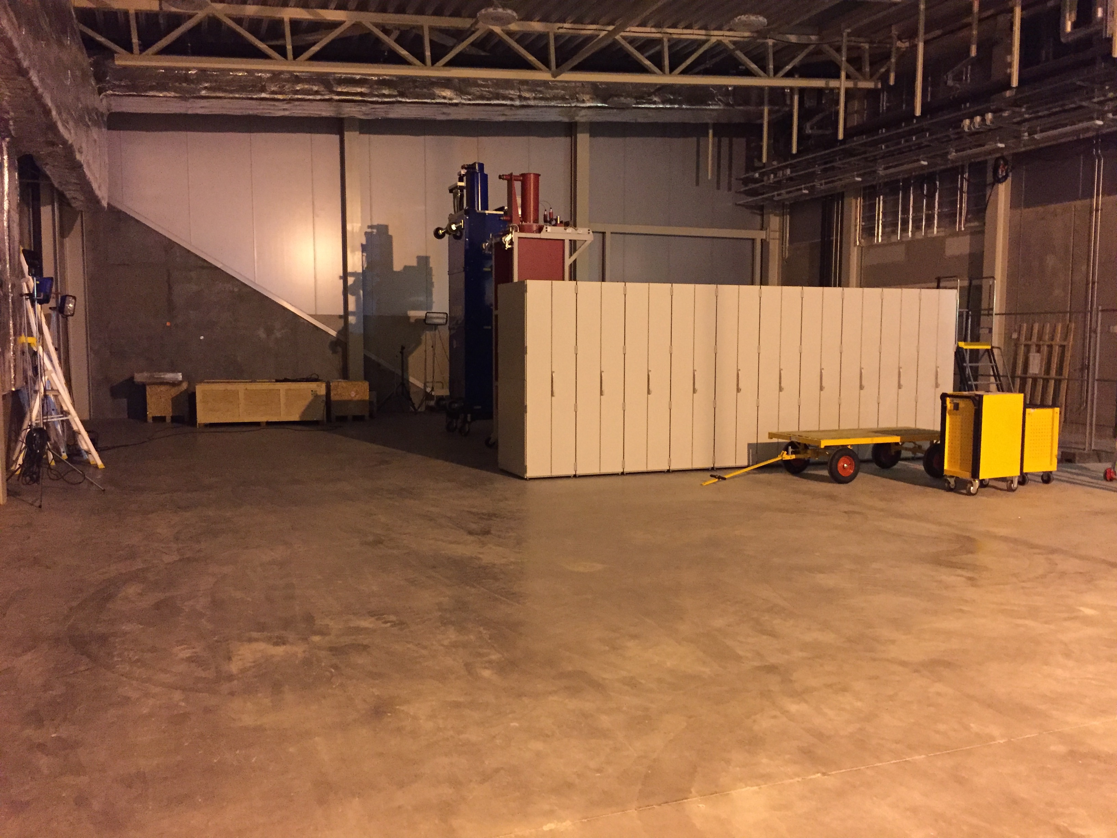
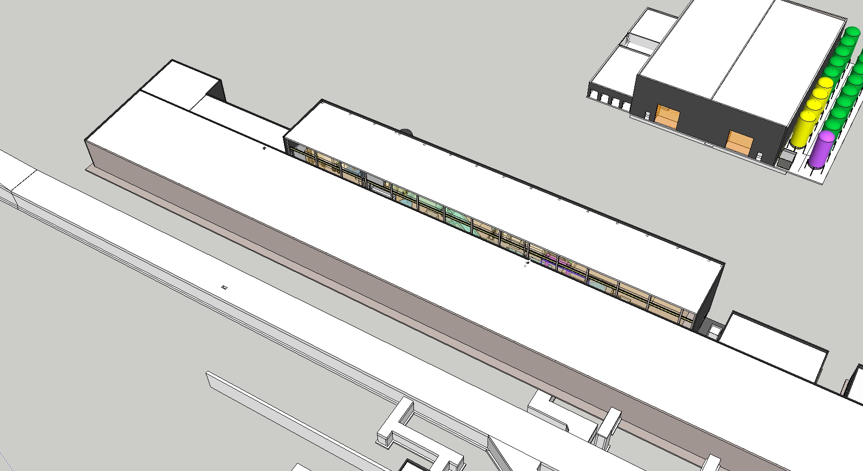
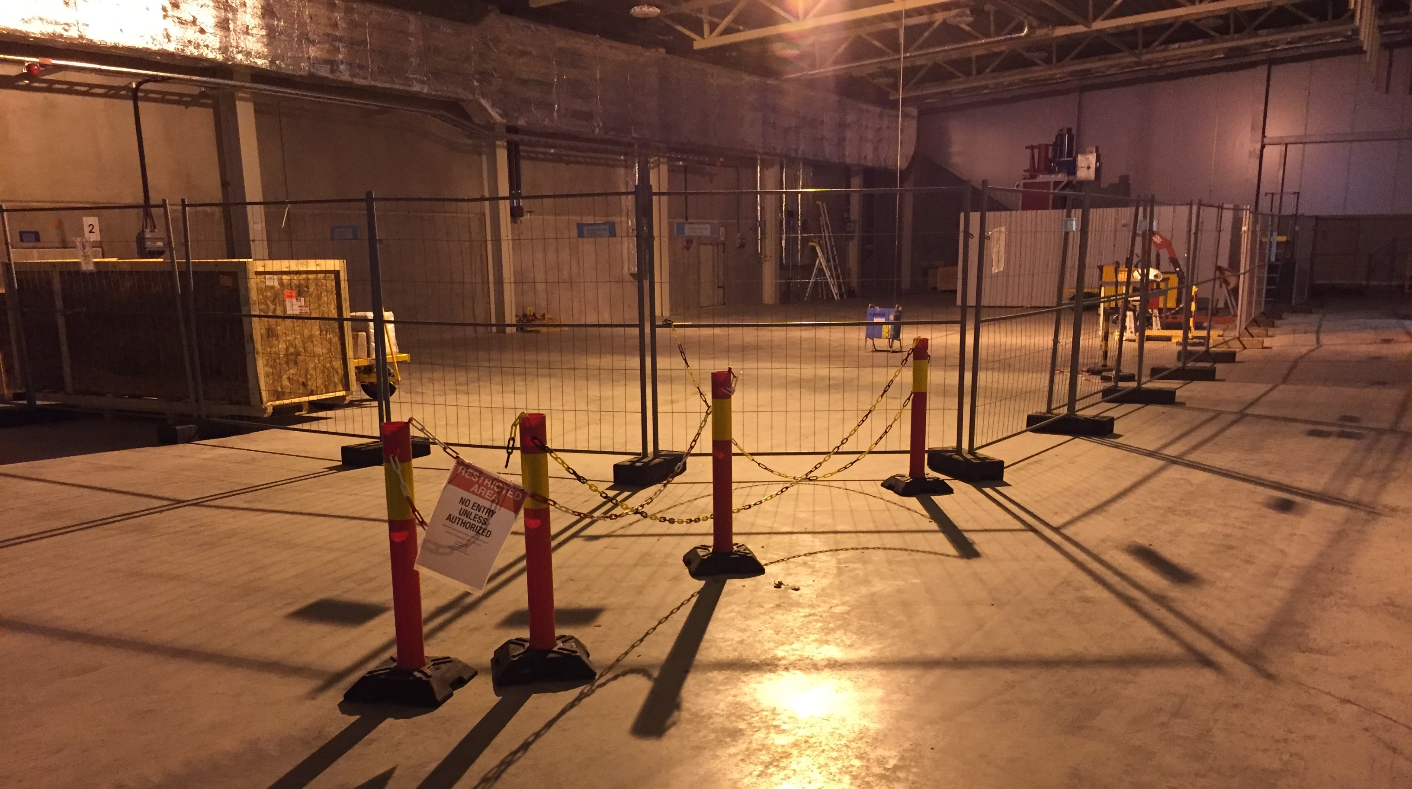
Test Stand 2
Test Stand 2 occupies 45 m in the high energy end of the klystron gallery, in the Gallery Technical Area (cont. space).
W. Hees

Slide 7
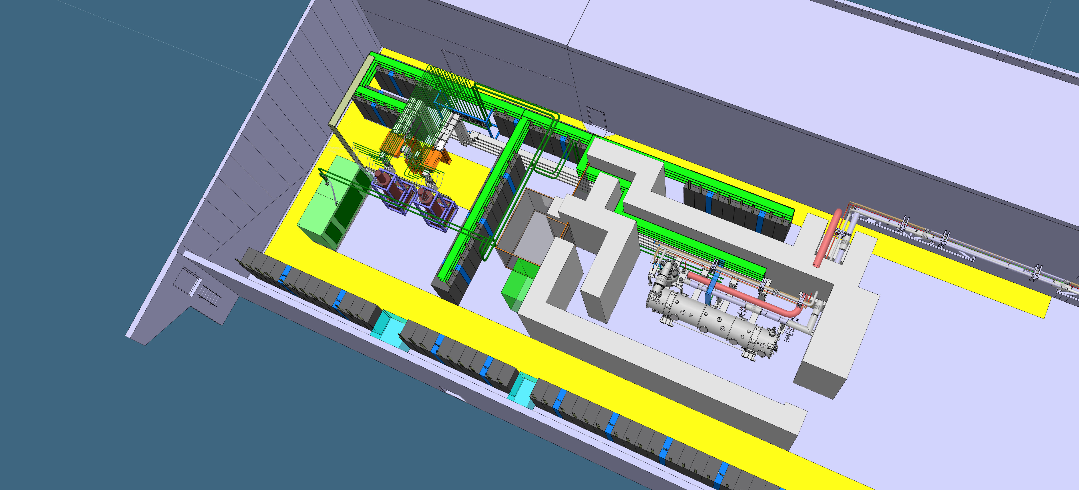
Layout
It consists of a bunker, a preparation area, an area for RF equipment and a control room.
Cryogenics and
Test Stand Control room
High power RF
equipment
Cryo Transfer Line
Test bunker
Preparation
Area

Slide 8
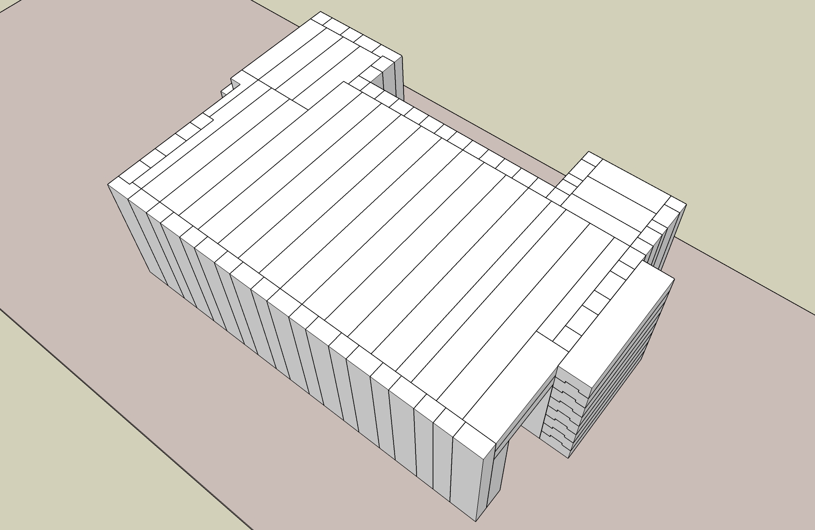
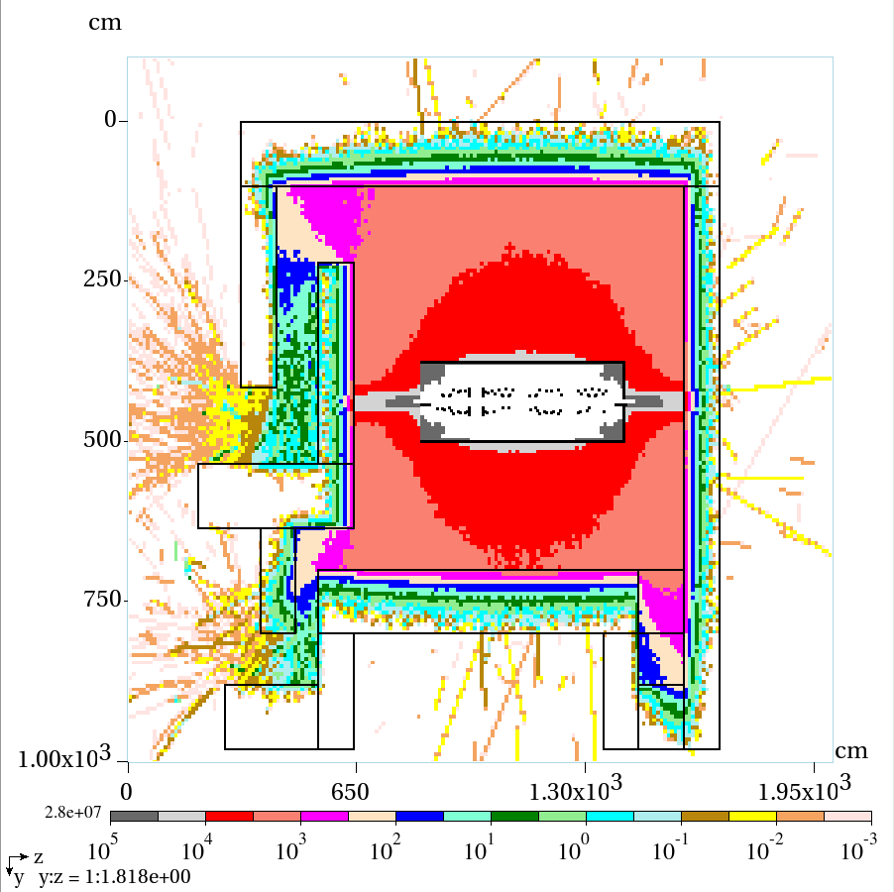
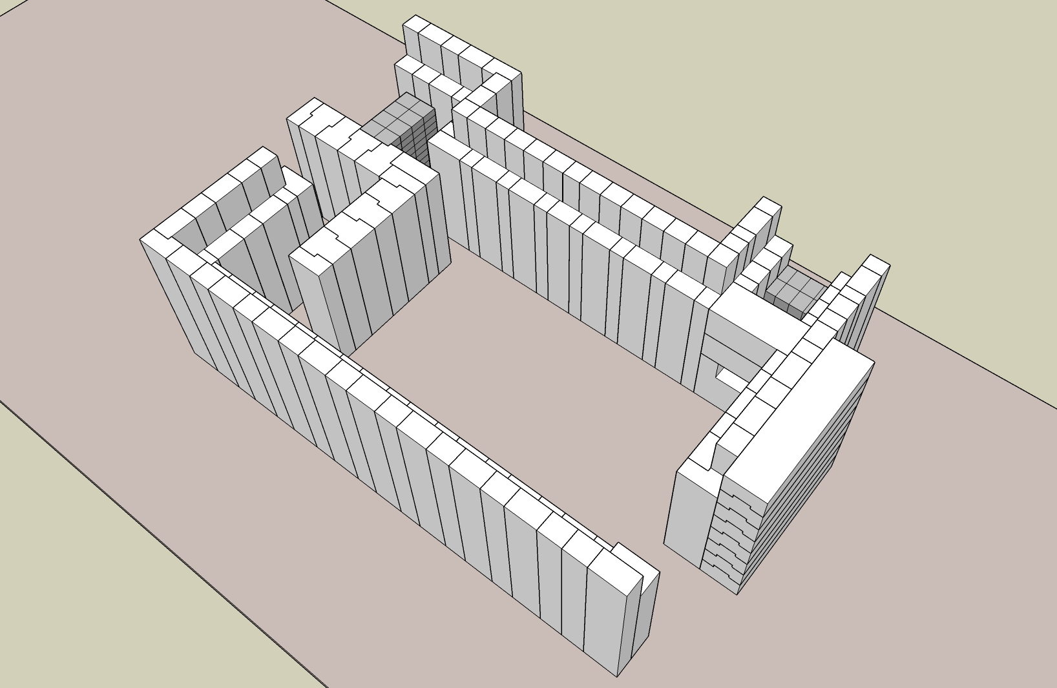
RP Bunker
The main function of the bunker is to protect the surrounding area from x-rays produced during the cryomodule tests. It consists of 1200 t of heavy, magnetite loaded concrete, arranged to form 1 m thick walls all around the cryomodule.
Total dose rate mSv/h
10 μSv/h
L. Tchelidze & M. Jarosz

Slide 9
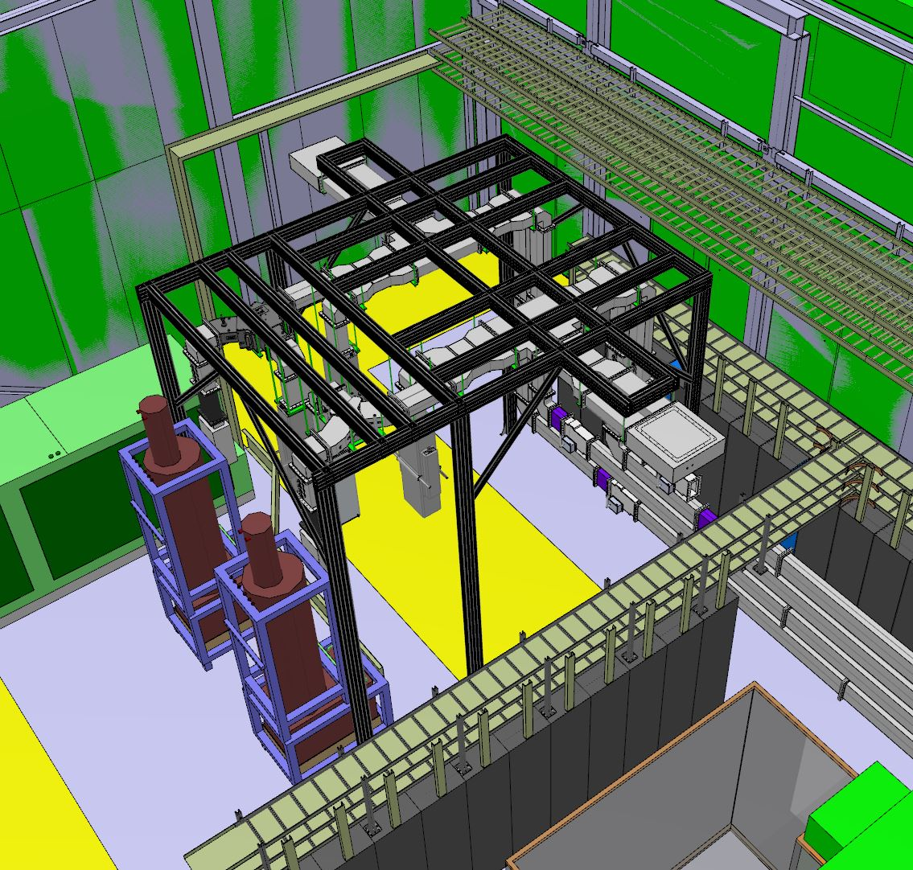
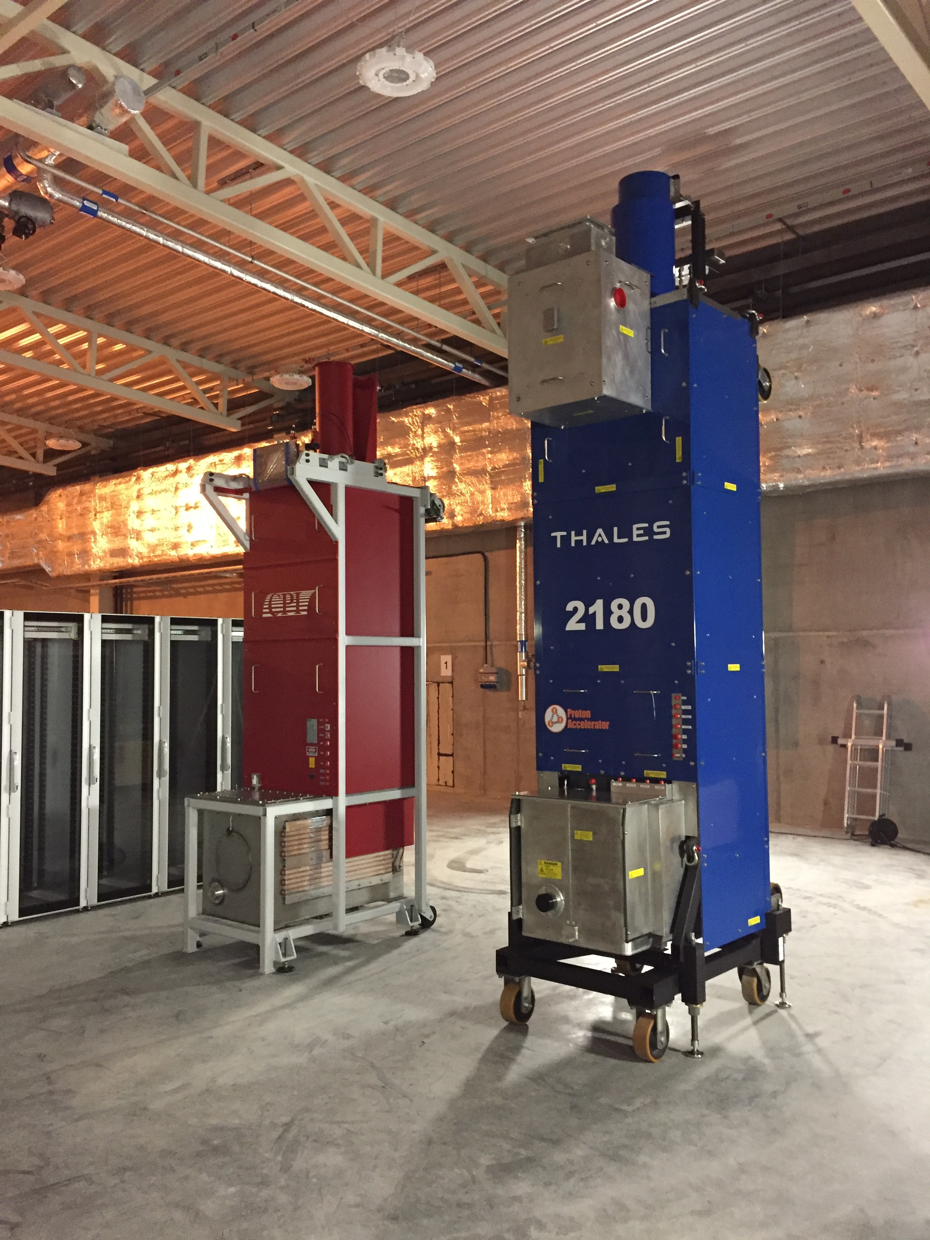
RF Systems

Slide 10
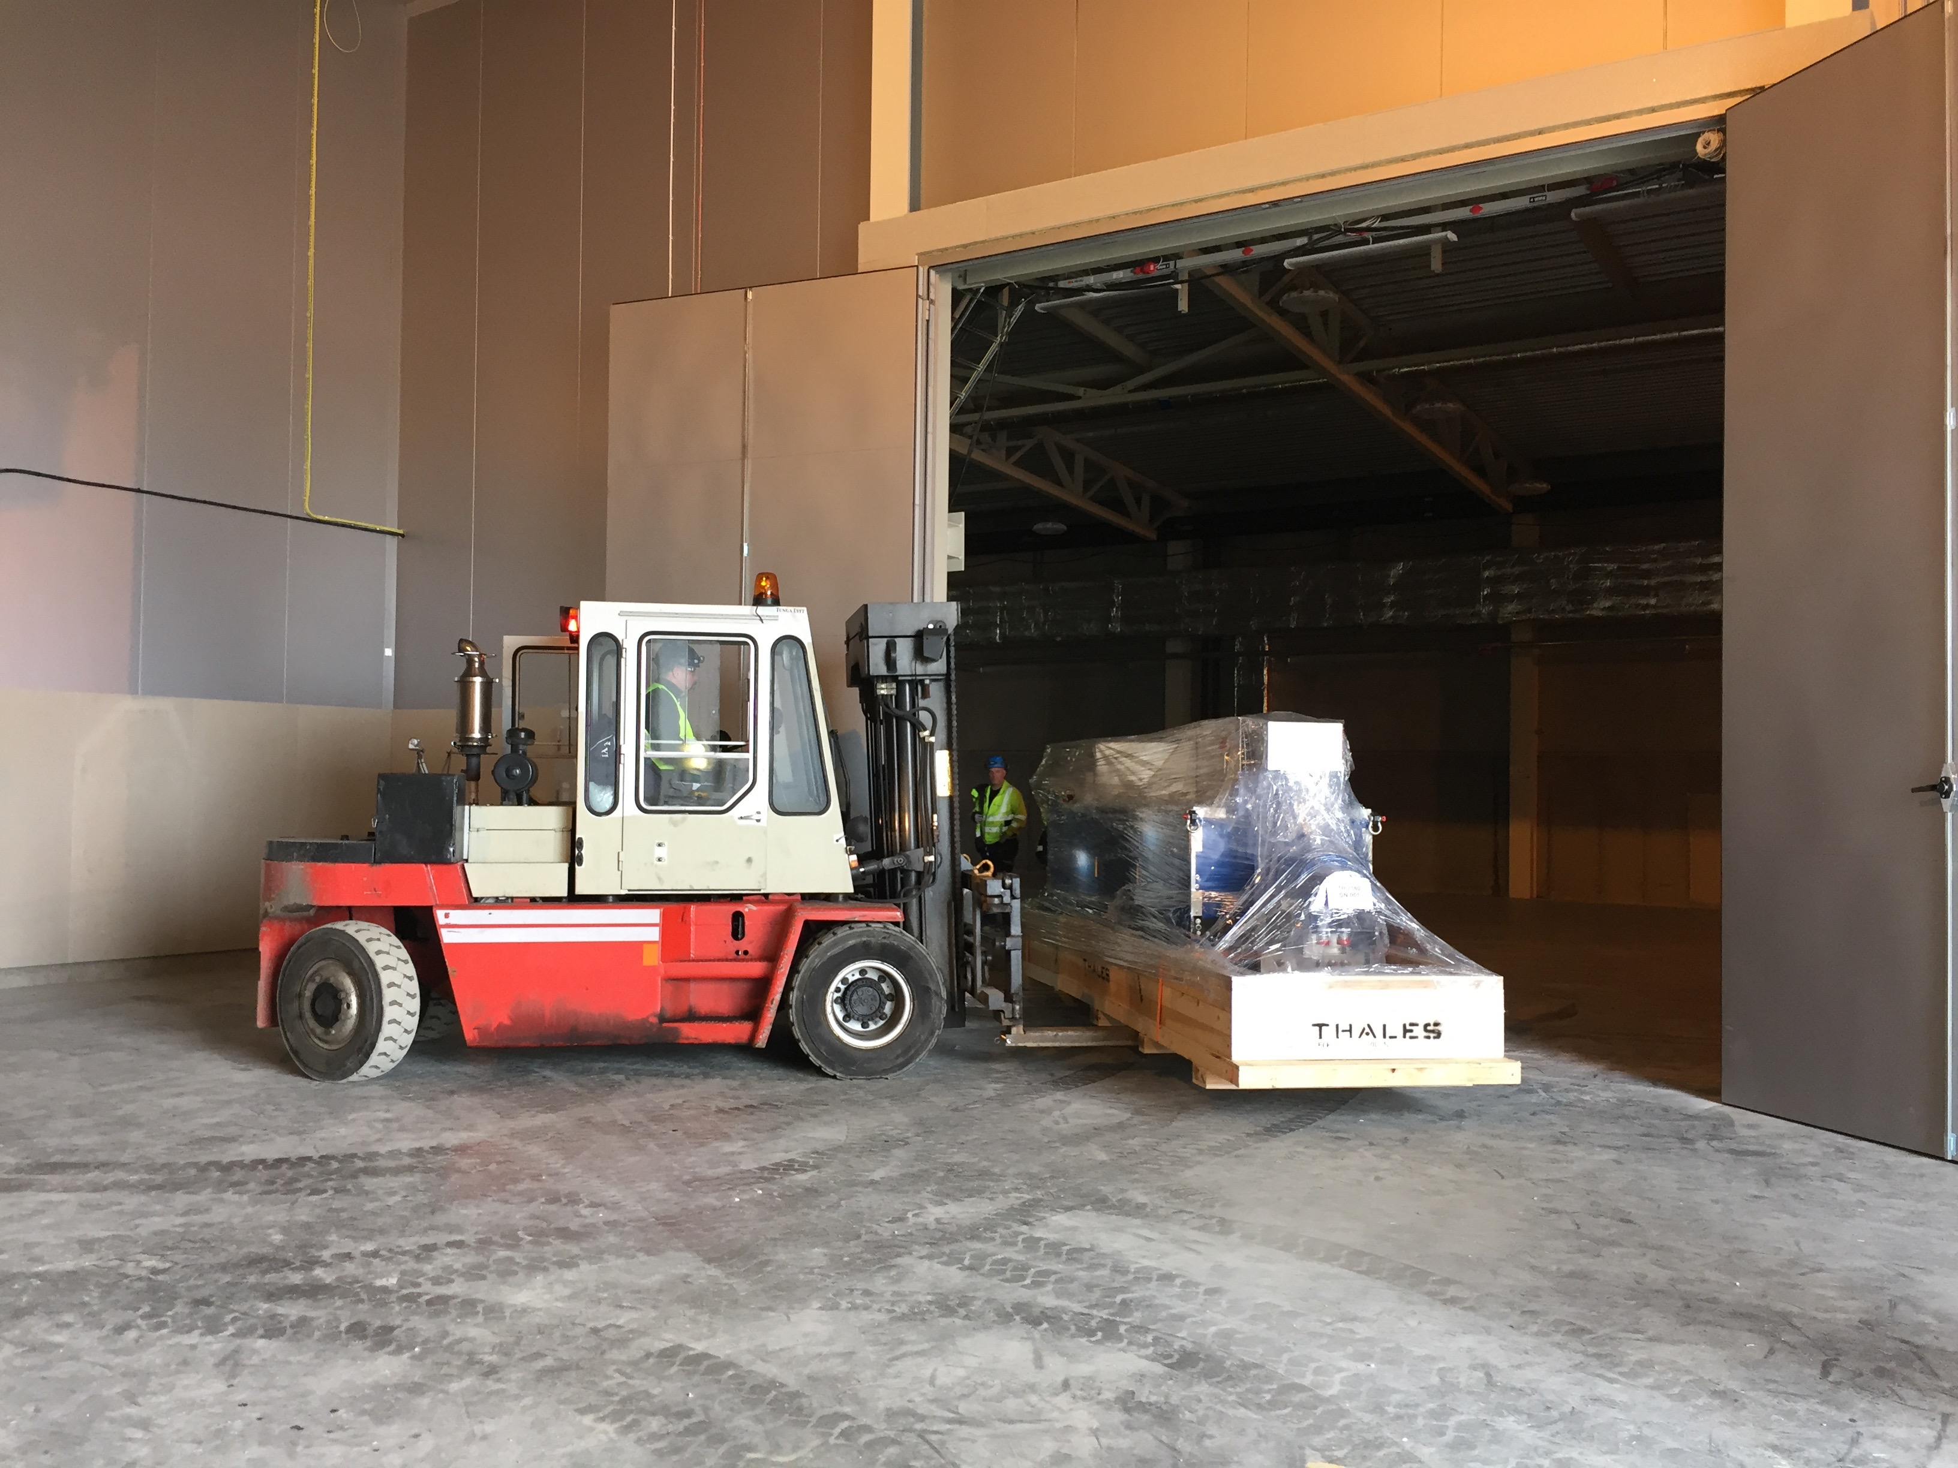
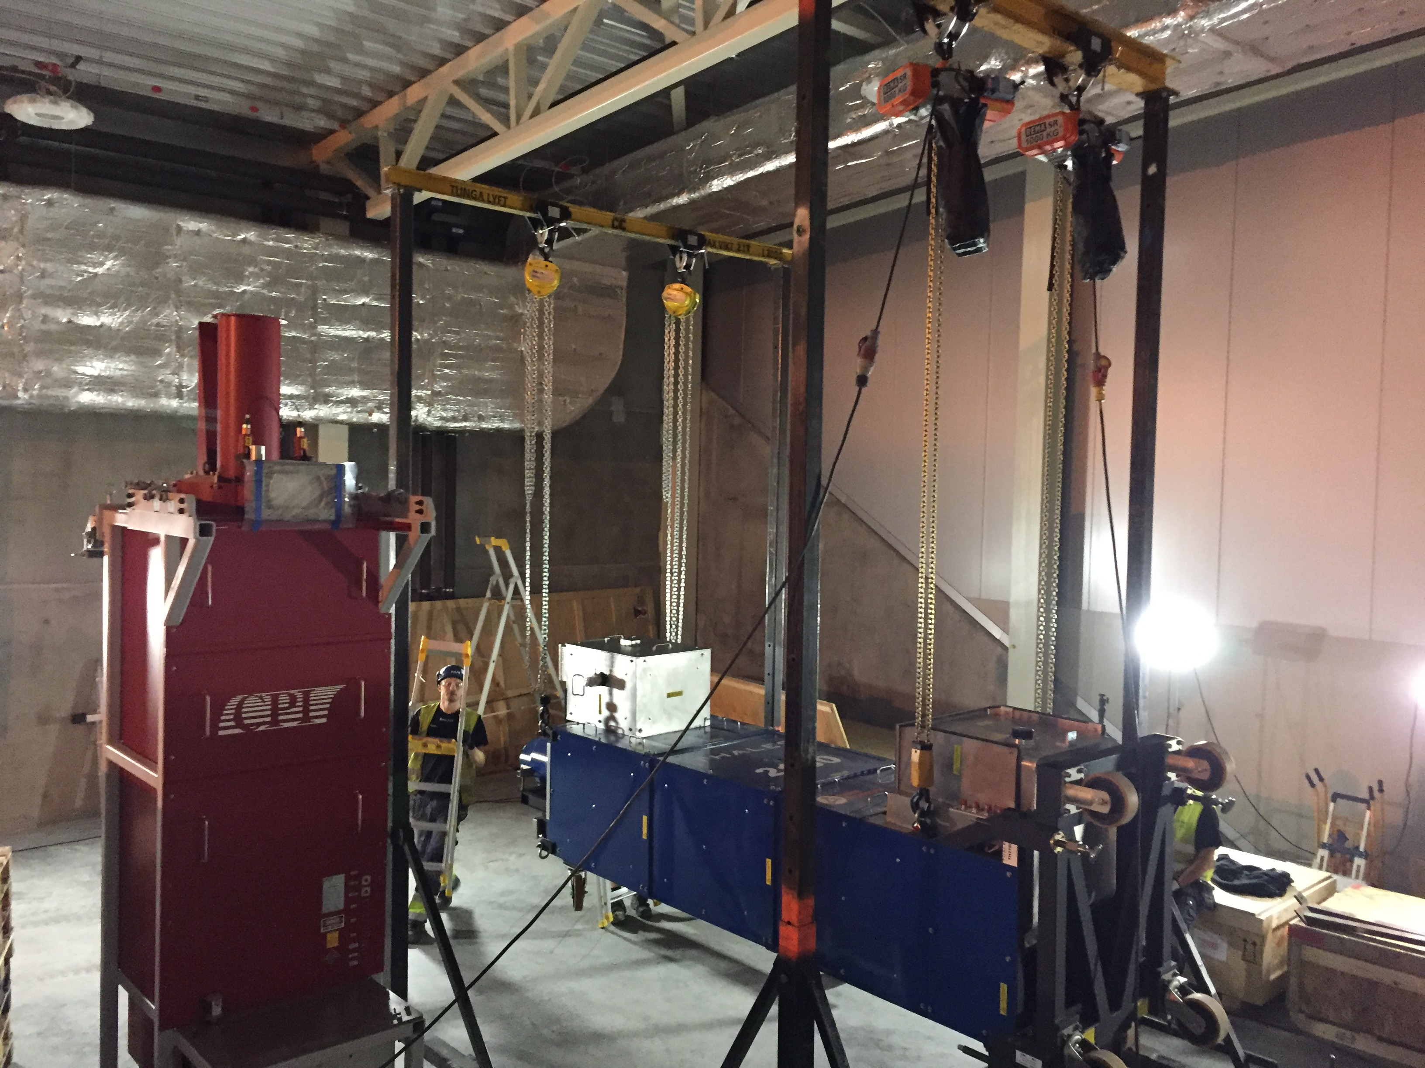
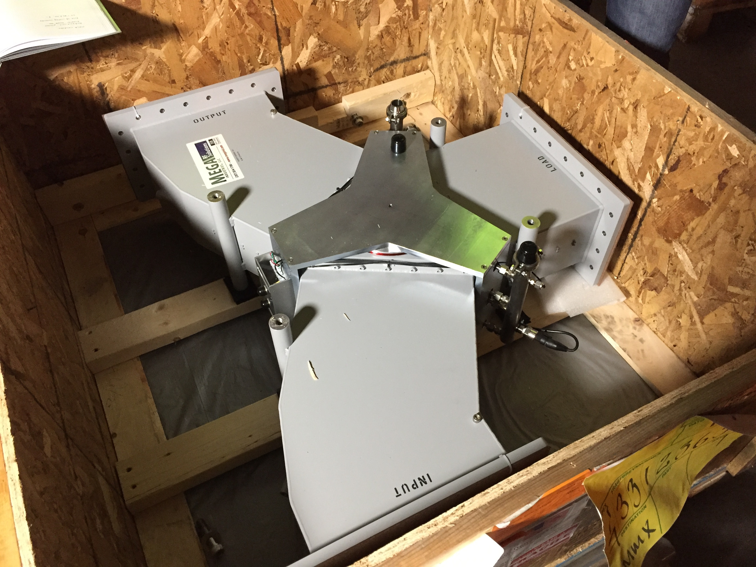
RF Systems
Two 1.5 MW, 704 MHz pulsed power klystrons are already installed in TS2, one coming from Thales and the other from CPI.
RFDS equipment like waveguides and circulators have also been delivered and are waiting to be installed.

Slide 11
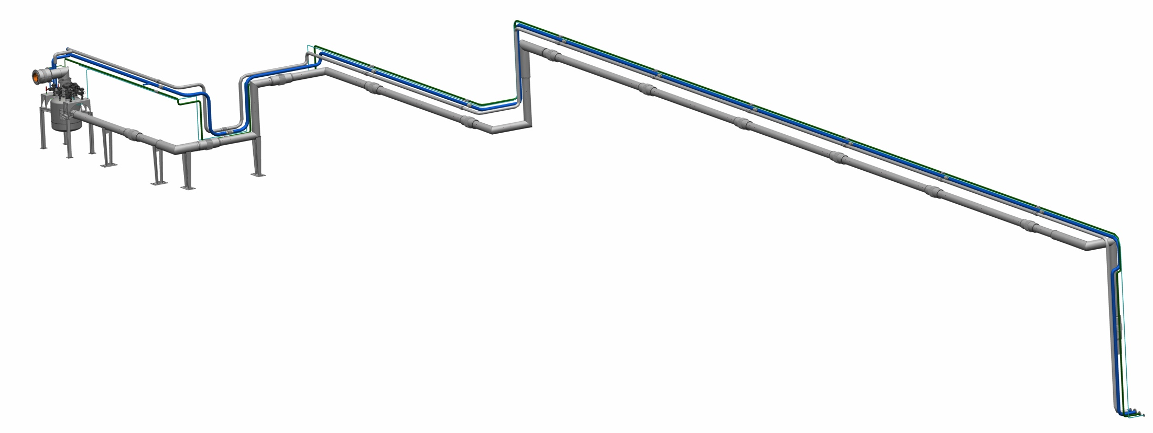
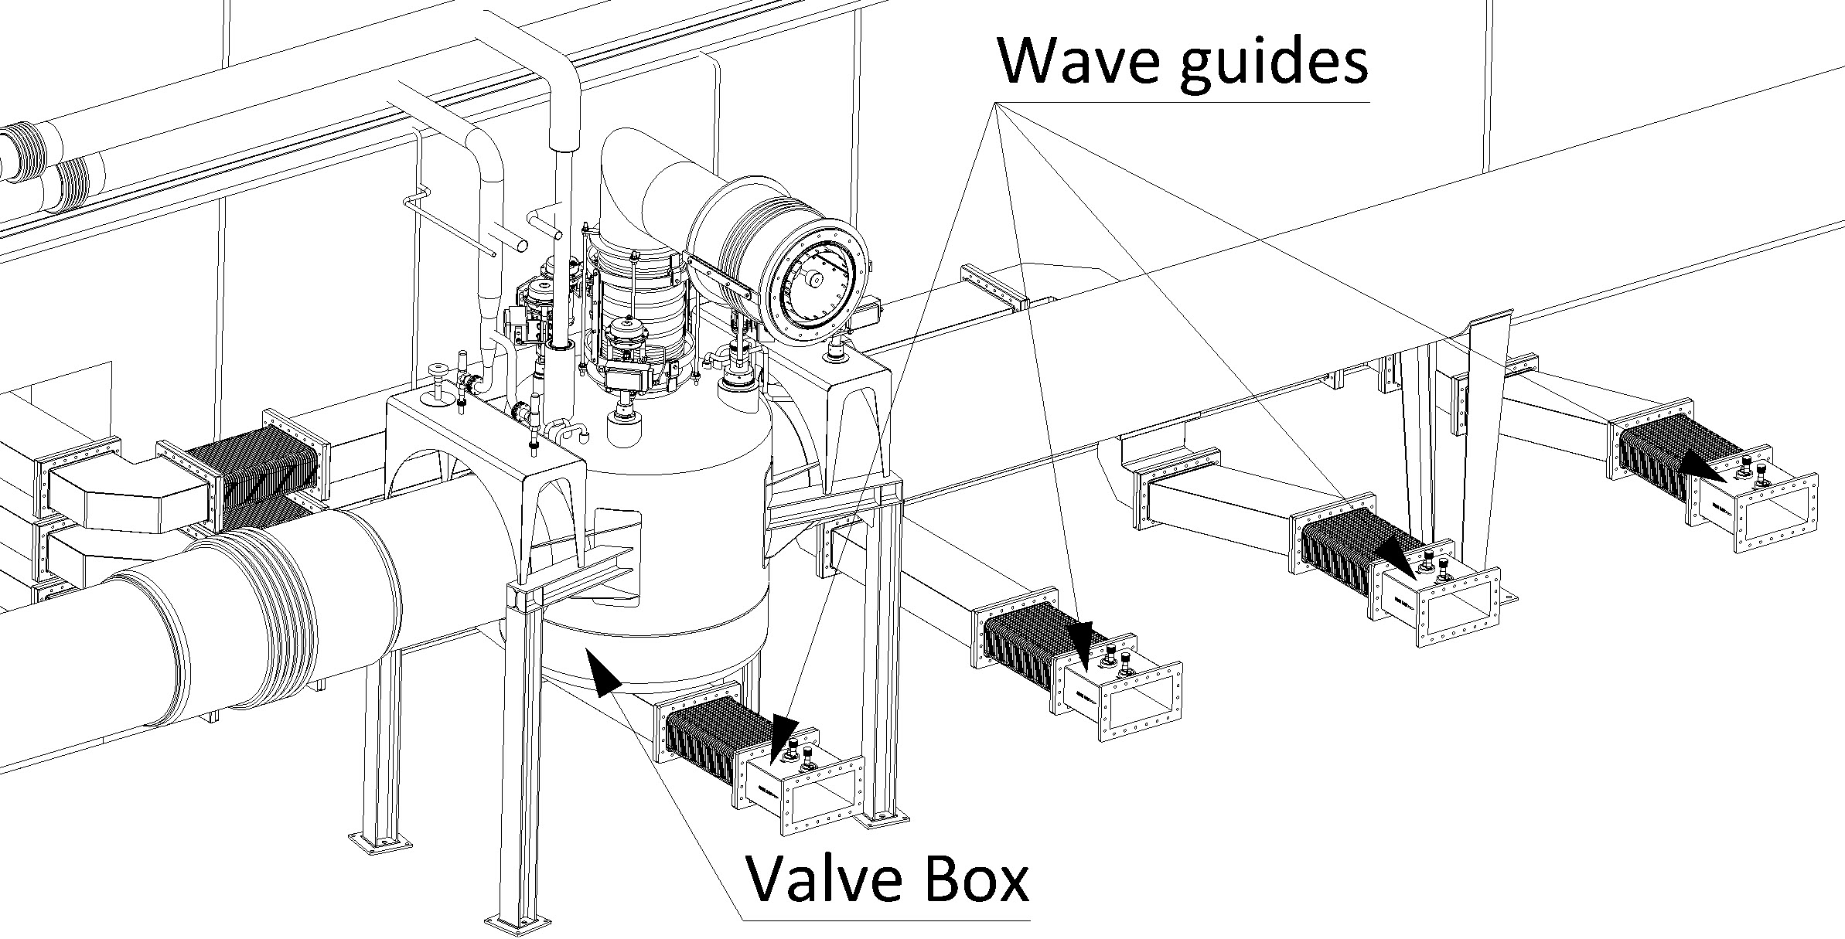
Cryogenic Distribution System
Interface to cryomodule
3
2
Interface
to TICP
1
1. Test Stand Valve Box
2. CTL housing 4 cold process lines
  Helium supply line
  VLP line
  TS supply line
  TS return line
3. Auxiliary process lines
  HP line
  Purge return line
  Helium recovery line
  SV relief line
J. Fydrych

Slide 12
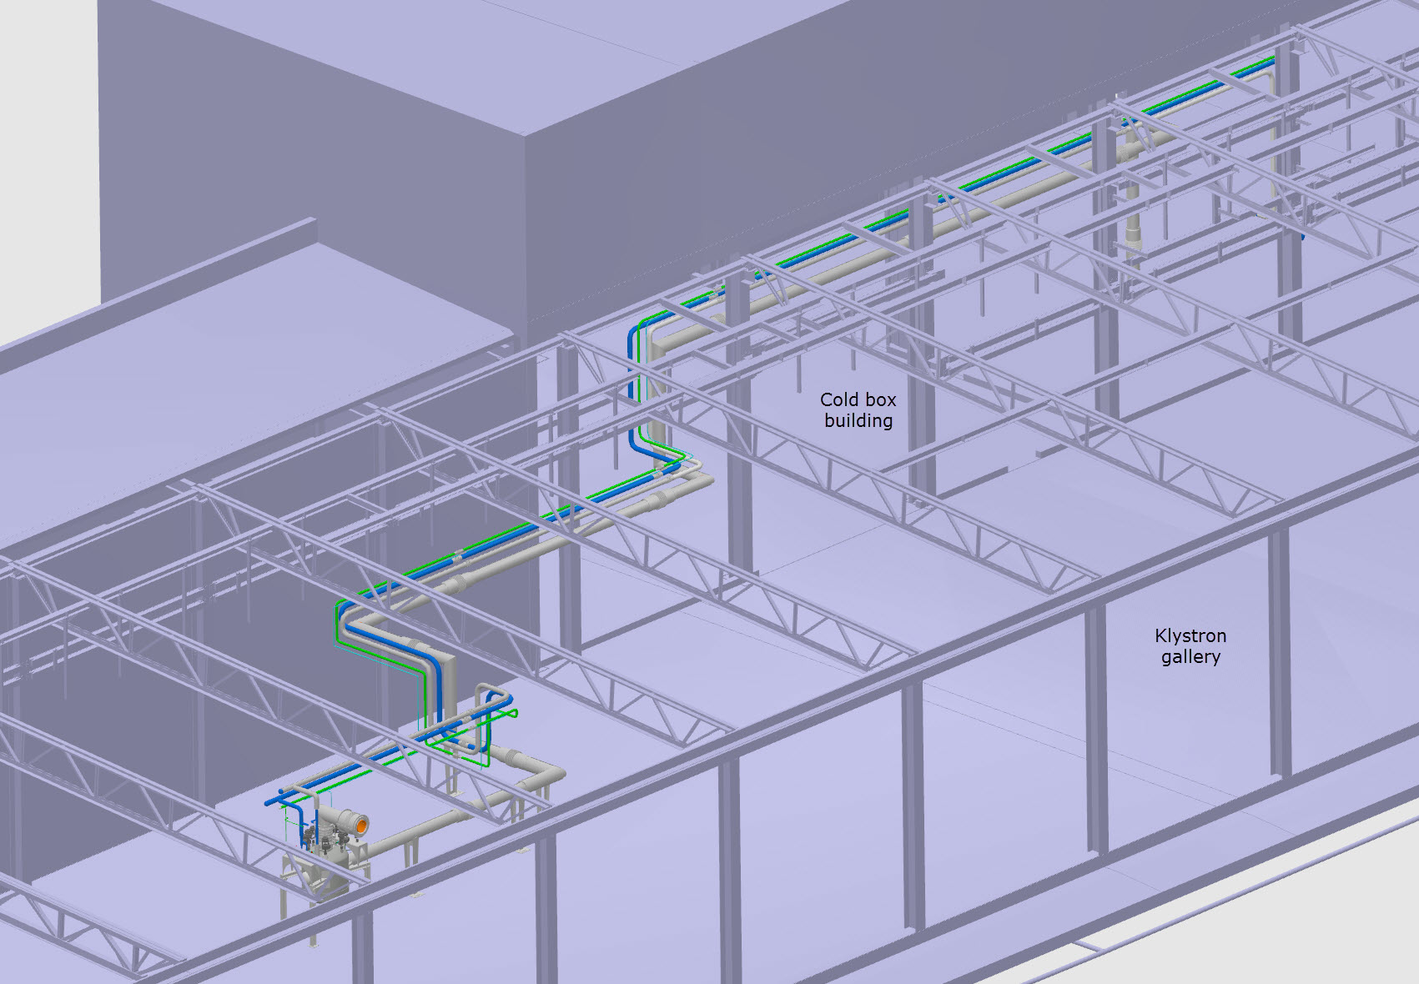
Cryogenic Distribution System
J. Fydrych

Slide 13
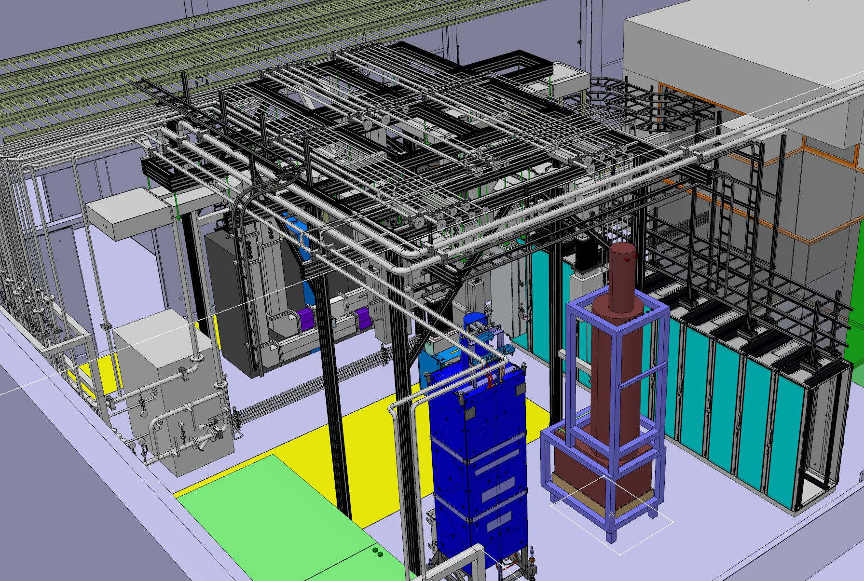
Cooling Water
Cooling water at 25’C is provided for one 330 kVA modulator and two RF stations, also for the RF couplers of the CM.
TS2 includes a separate water skid to prevent propagation in case of irradiated water.
The cooling system will run at low pressure due to the allowable pressure of the RF couplers.

Slide 14
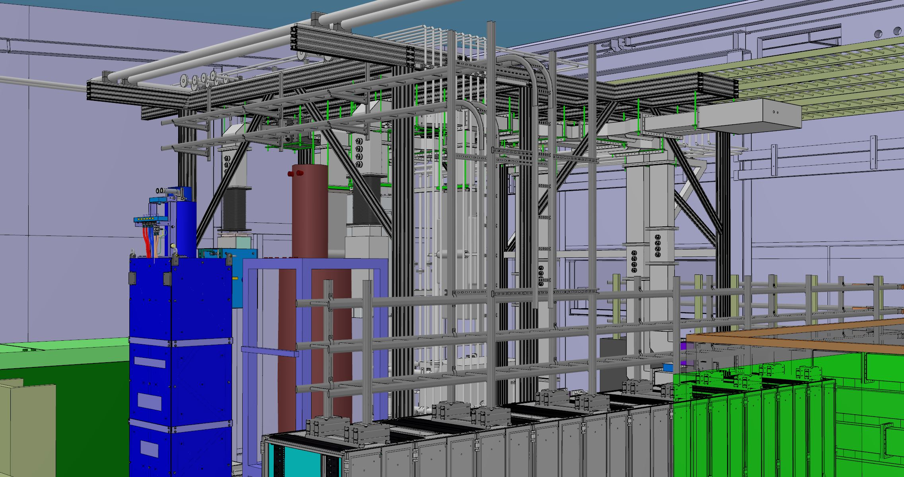
Electricity
TS2 includes 24 electrical racks for multiple uses, including:
RF data acquisition systems
Vacuum and Cryogenics instrumentation
Machine protection
Safety systems
Expansion modules
Cable trays and ladders are placed on top of the electrical racks and through the waveguides and water support to accommodate the power cables from the substation and the data cables from the cryomodule and installation instrumentation.

Slide 15
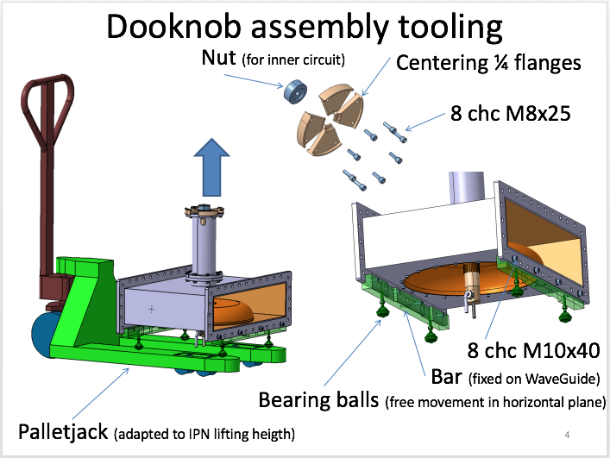
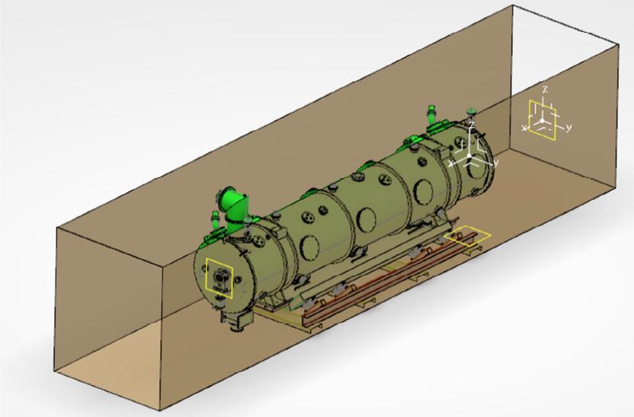
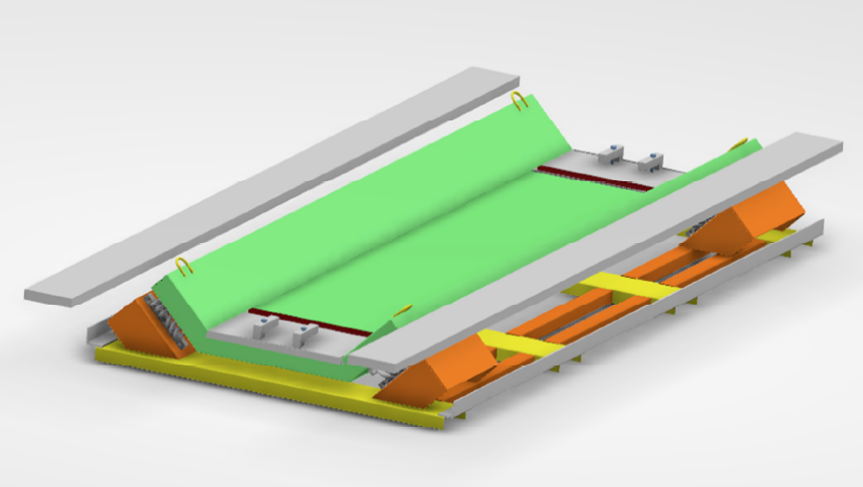
Cryomodule
Installation and Handling
Cryomodule transport trolley
Courtesy of IPNO and FREIA
Truck transport frame
F. Schlander

Slide 16
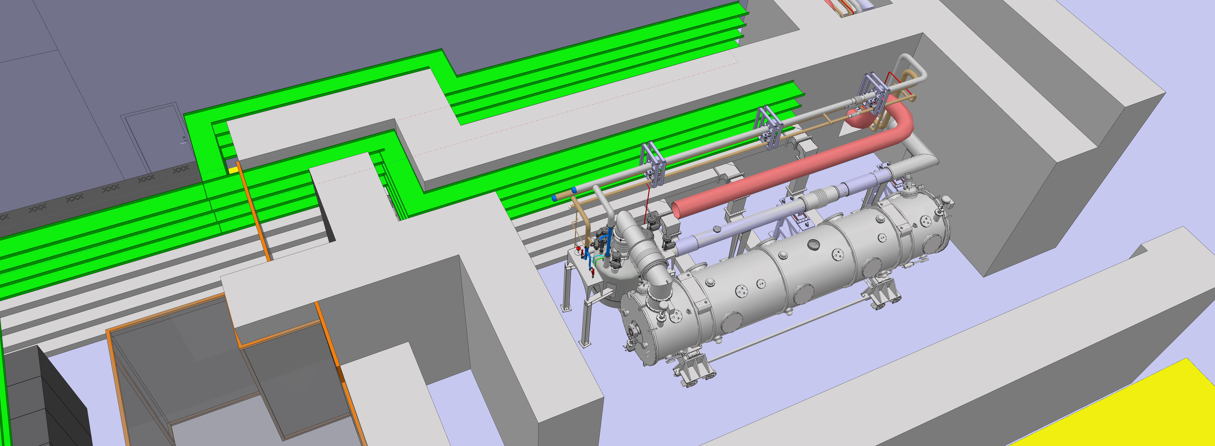
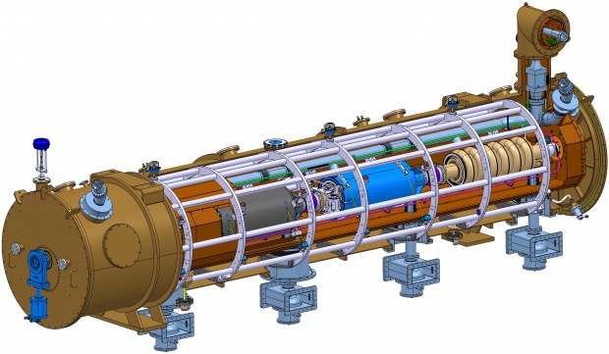
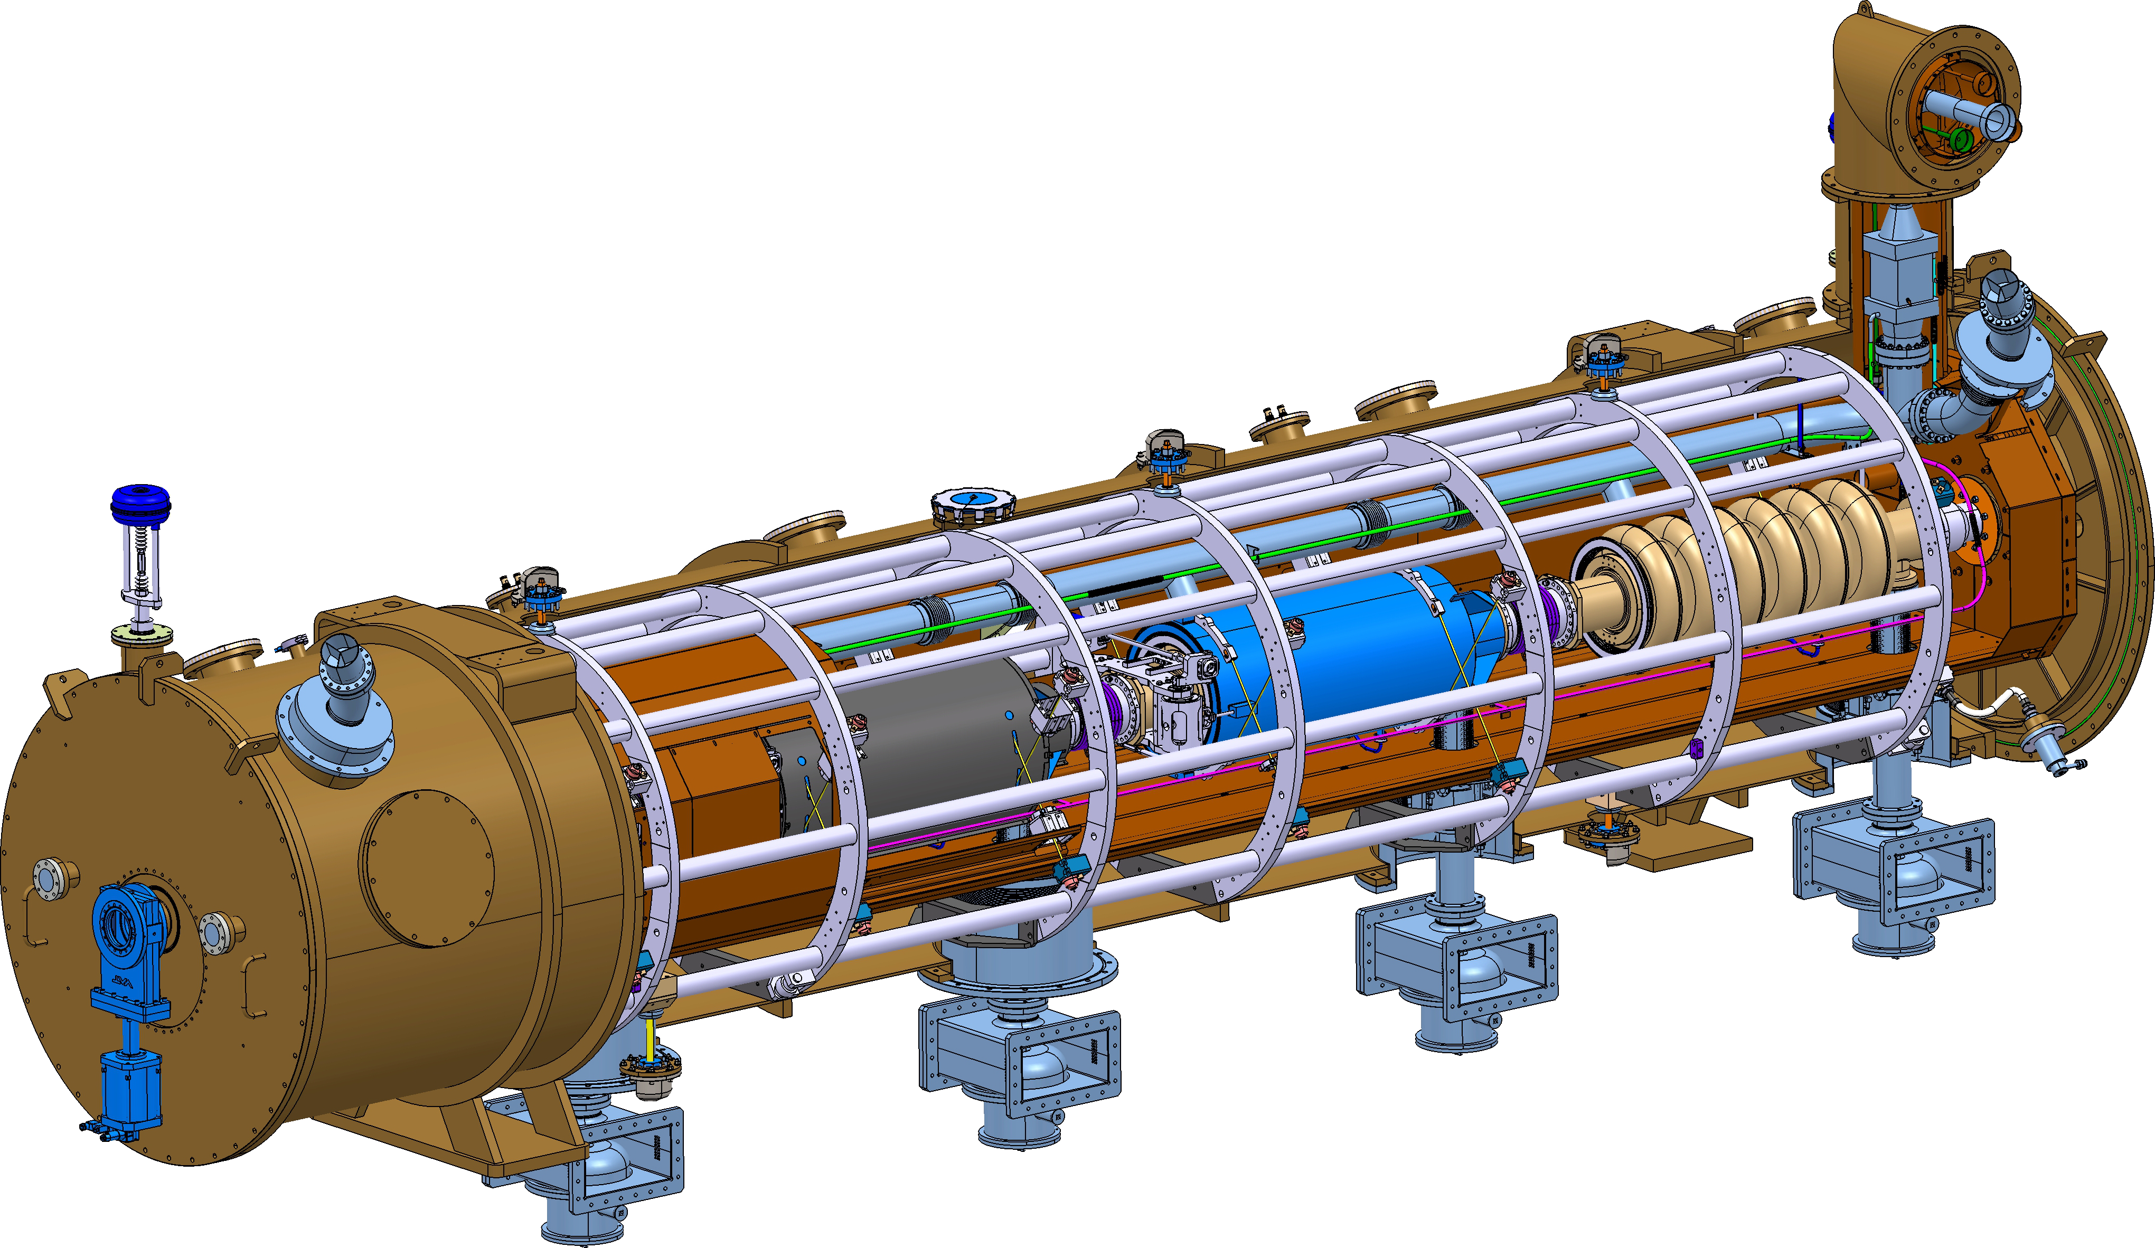



Summary: Cryomodule workflow
Saclay
Lund

Slide 17
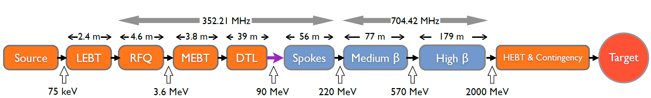
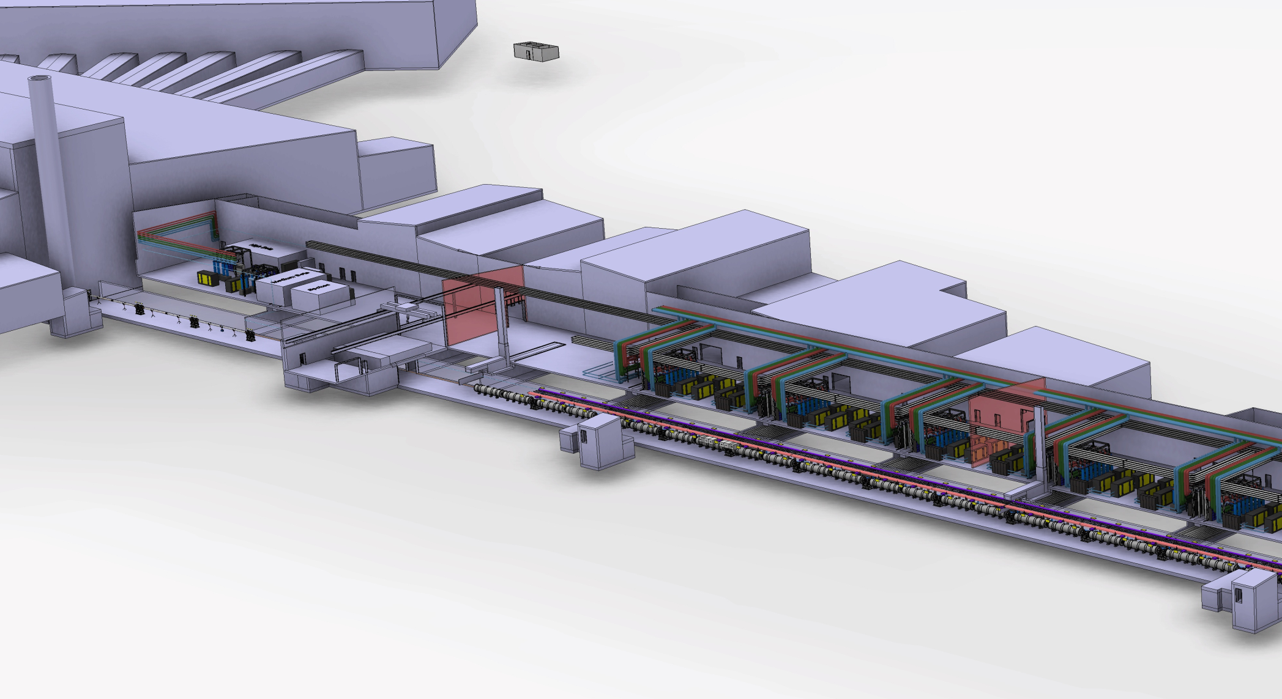

Summary: Cryomodule workflow
Klystron gallery
 | MEDIUM-β | HIGH-β
β | 0.67 | 0.86
# CM | 9 | 21
Cav. /CM | 4 | 4
# Cav. | 36 | 84
CM L [m] | 6.584 | 6.584
Sector L [m] | 77 | 179
Proton Beam
Elliptical cavities Cryomodules
Medium-β and high-β
P.Bosland, C.Darve

Slide 18
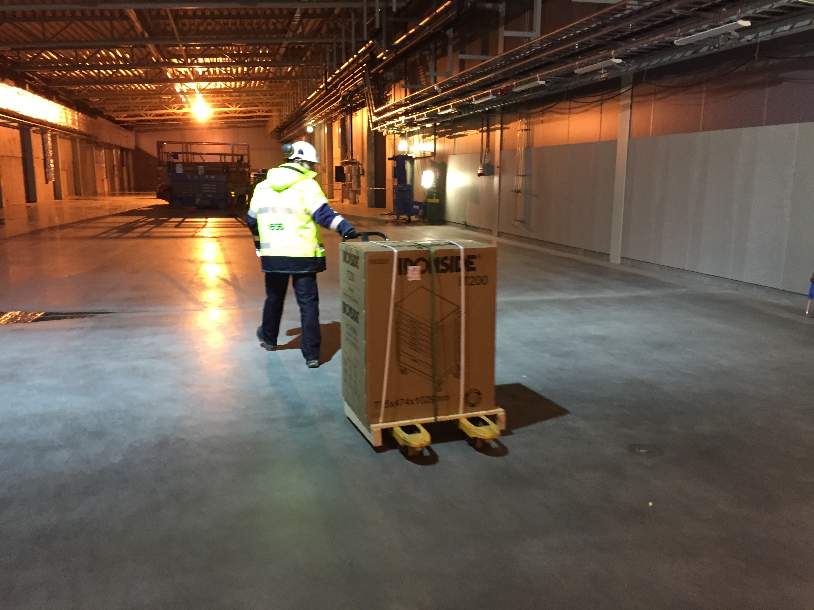
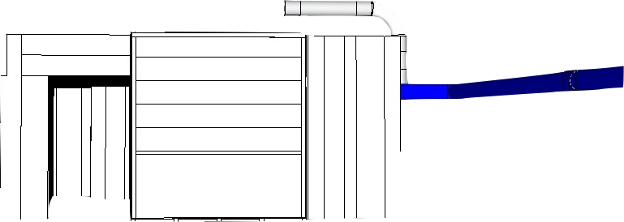
Thank you!

Slide 20
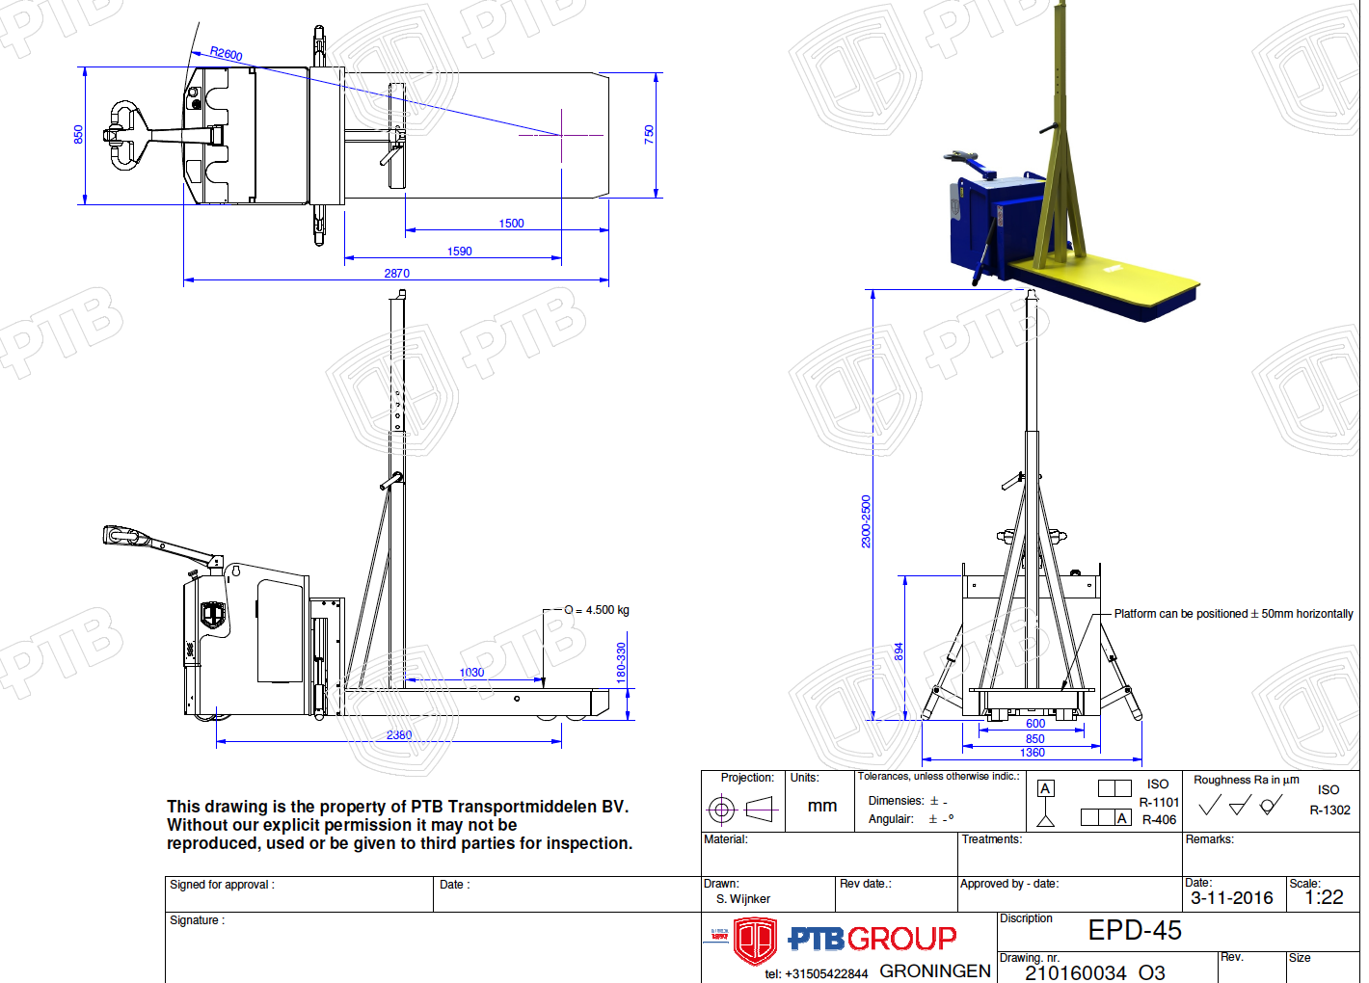
Installation and Handling
RF Systems
Klystron and equipment Delivery Access:
Two 5x5 m doors in cold box building with overhead crane
3x5 m door between Klystron assembly area and RF gallery
Order placed for dedicated truck for safe maneuvering, aligning and height adjustment.
Delivery expected in June 2017
M. Jensen

Slide 21
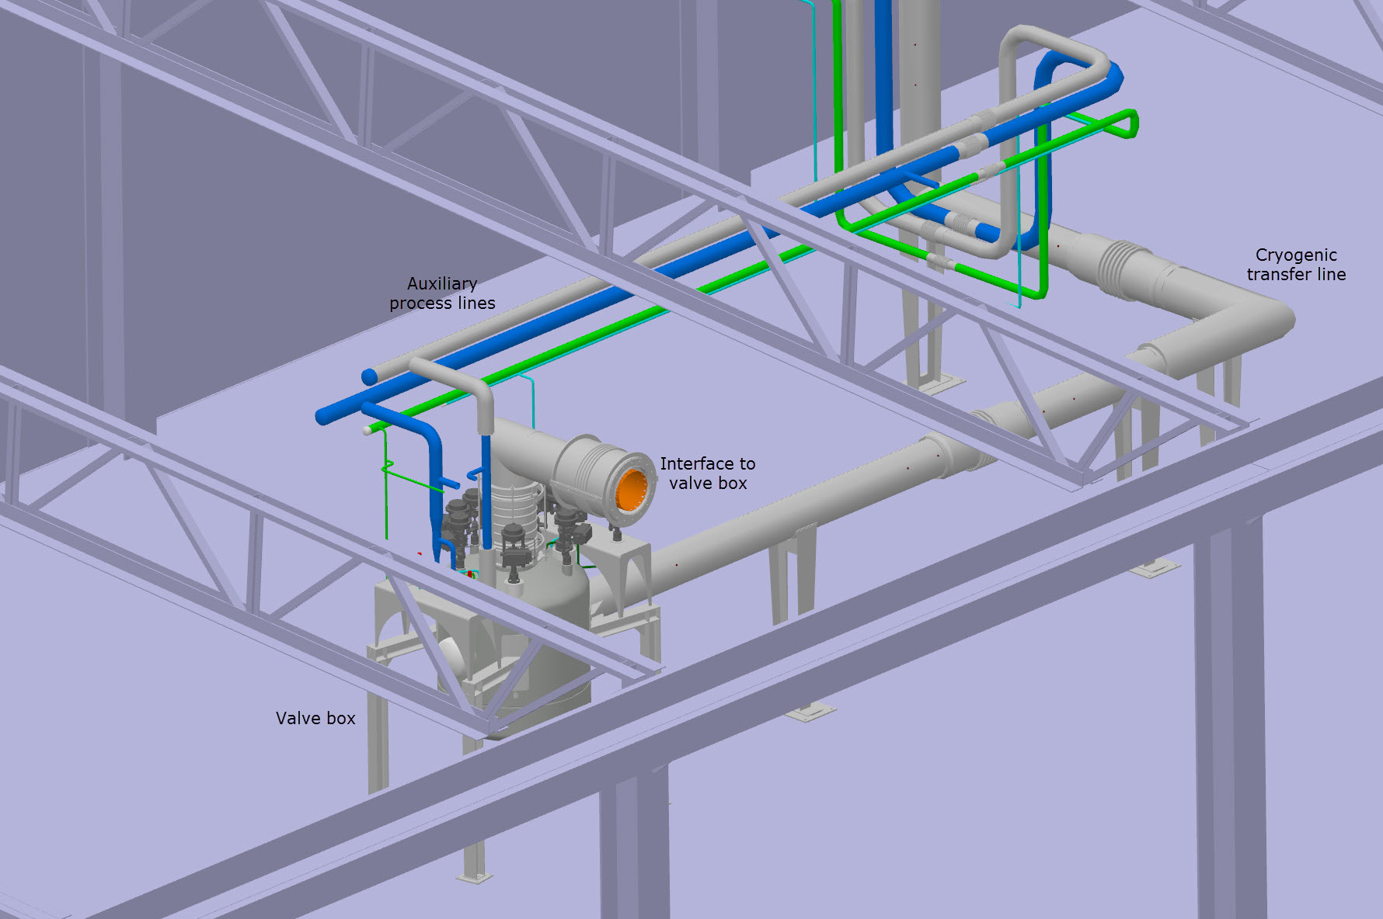
Cryogenic Distribution System
J. Fydrych

Slide 22
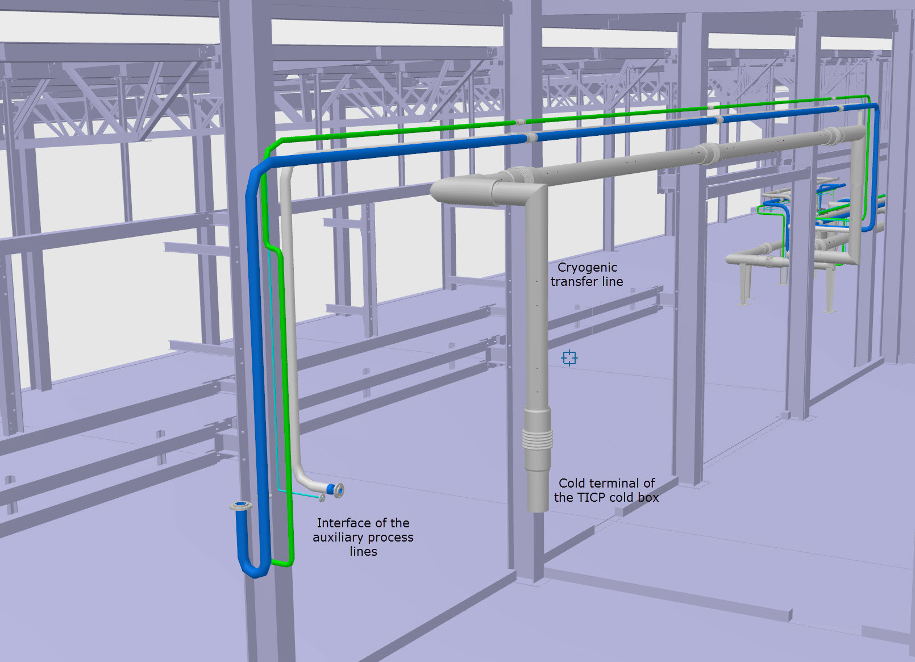
Cryogenic Distribution System
J. Fydrych

Slide 23
Test Plans overview
Testing of CMs includes a number of preparatory steps, the testing itself and a number of post-processing steps. This list of tasks is preliminary and will be expanded:
Reception:
  Inspection for damage, obvious manufacturing errors and completeness of delivery
Preparation for test bench:
  Preparation for installation on test bench, including adjustments as well as mounting and dismounting of parts (door knobs, beam vacuum pumps, insulation vacuum pump)
Installation on test bench:
  Moving into the bunker
  Alignment of the cryo jumper connection
  Connection of flanges
  Waveguide connections, cabling connections, coupler cooling connections
Initial testing:
  Diagnostic test, showing status of insulation vacuum, leak tightness of helium circuits, integrity of electrical circuits, proper functioning of instrumentation
Warm RF tests:
  Fundamental mode spectra measurements
  Cable calibration
Warm coupler conditioning:
  Monitoring and pumping of the beam vacuum
  Coupler conditioning, using ramped RF power
Cool down:
  System checking to assure it is purged and clean
  Cool down following a predetermined ramp
  Maintain cold He flow to assure operating temperature of cavities
Cold LP cavity tests:
  piezo capacitance measurement (before and during cooldown)
  microphonics measurement
  piezo scans (cavity detuning transfer function)
  4π/5 and 3π/5 mode identification
  cavity tuner motor characterization
  cavity loaded Q motor characterization
  Lorentz force detuning compensation
  closed-loop nominal gradient operation
Cold HP RF tests:
  loaded Q measurements and adjustment
  cavity gradient calibration
  cavity gradient performance measurement
Heat load measurements:
  Measuring heat loads at different operating conditions
Warm up:
  Warm up
Disconnection:
  Opening cryo connections
  Disconnecting waveguides, cabling, coupler cooling, vacuum pump
  Extraction from the bunker
Preparation for tunnel
  Preparing for transport to tunnel and installation.

