Slide 1
KINEMATIC MOUNTING SYSTEM
Borja Perez Villaluenga
www.europeanspallationsource.se
25 April, 2017

Slide 2
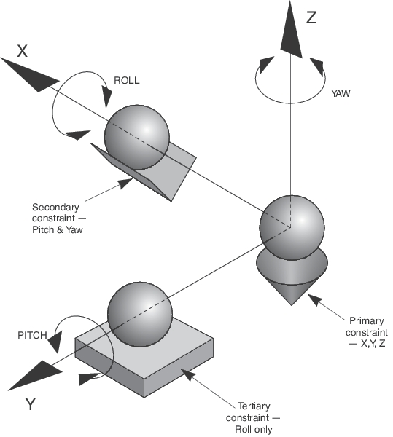
CONCEPT
Three legs/mounts:
Cone, groove and flat
Three balls, that fixed into the legs and maintain always the same position.
Constraints
Best system for repeatibility.

Slide 3
POSITIONING LEVELS
In our case there will be 3 different alignment levels.
Level 1:
Standard Euro pallet size 1200x800, for heavy equipment. Less precision required.(mm)
Level 2:
- Aprox. 500x500 round stage, valid for the most of the equipment within a good precision (hundreds microns)
Level 3:
- For small size and high precision equipment (50 microns)

Slide 4
What do we need?
WHAT DO WE NEED?
Placing the sample in the correct position
Inside equipment, Vacuum tank (sometimes no visuality).
Align it in reference to the beam line
Posibility of movement in case of desalignment
Good repeatibility
Fast install and uninstall

Slide 5
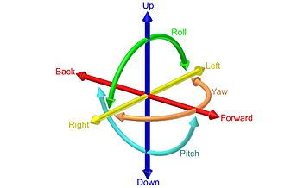
How can we do that?
Adjust all the grades of freedom.
Very precise alignment system with cameras
Clamping system
Easy accesibility and intuitive functionality
Creating standards.

Slide 6
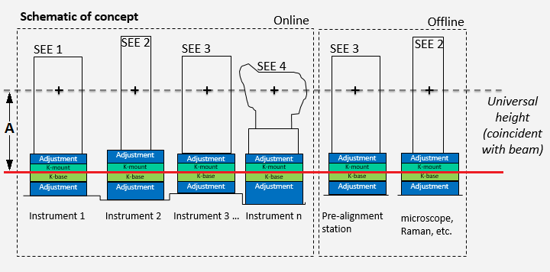
FIRST STANDARD
Each instrument its own coordinate system.
Beam line in known position in reference to that coordinate system
Create a reference line in a determinate standard distance (A=1.5 m) from the beam line.

Slide 7
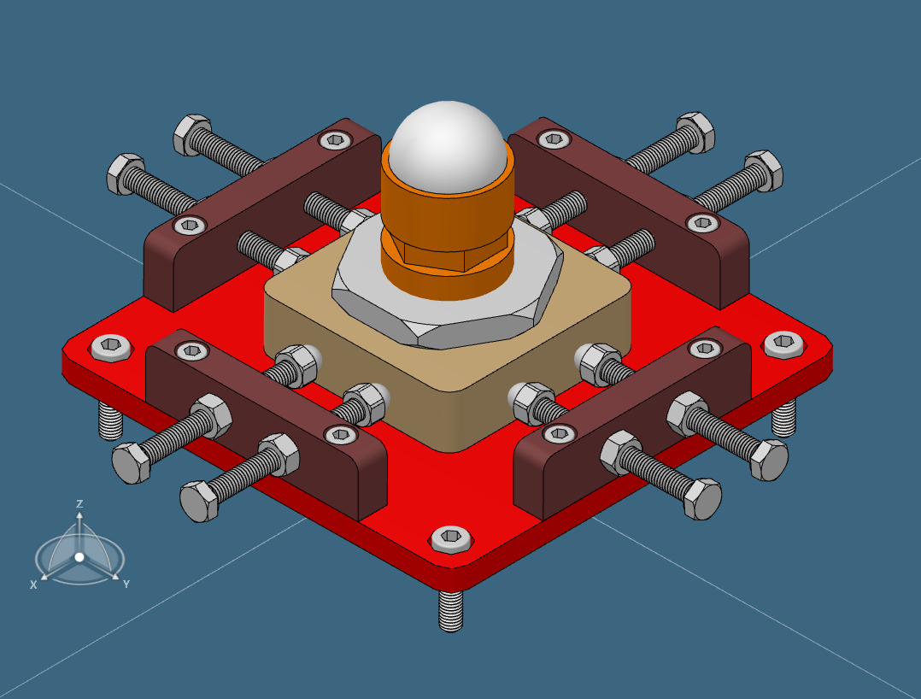
Base K-Mount
Parts:
(RED) Base plate, fixed
(BROWN) Pushing ears, fixed
(YELLOW) Resting block, move allowed in X and Y axis. Gravity mantains it positioned
(ORANGE) Z adjustment shaft, move allowed in X, Y and Z axis. Screwed to the block.
(WHITE) AISI52100 ball, G28/G40. Load capacity 1Tn.
Dimensions:
188 x 188 x 87 (mm)
Material:
Stainless Steel 316

Slide 8
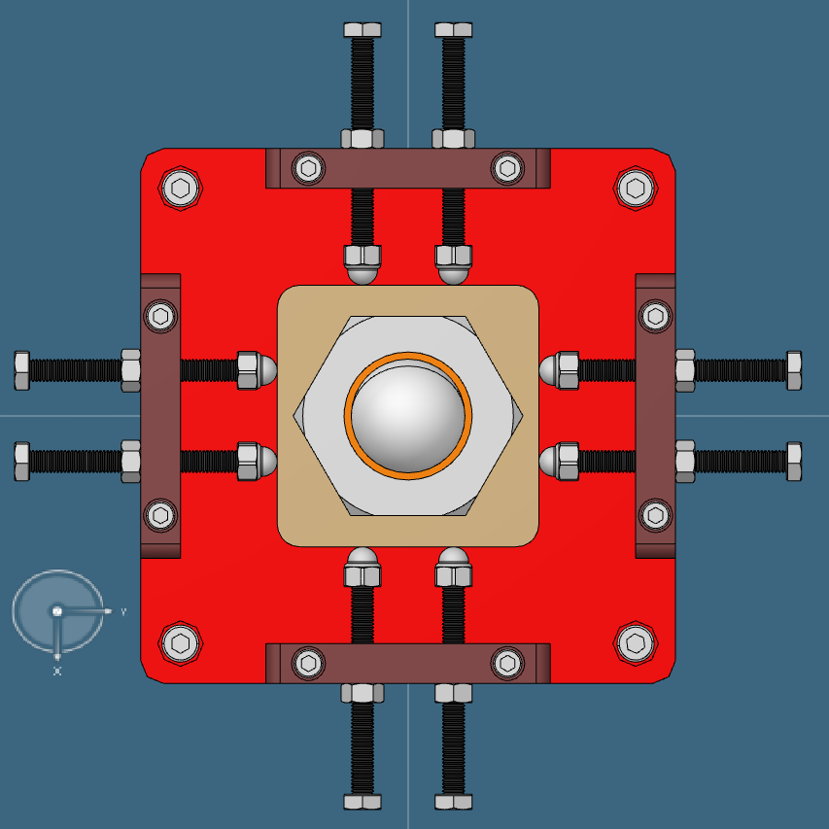
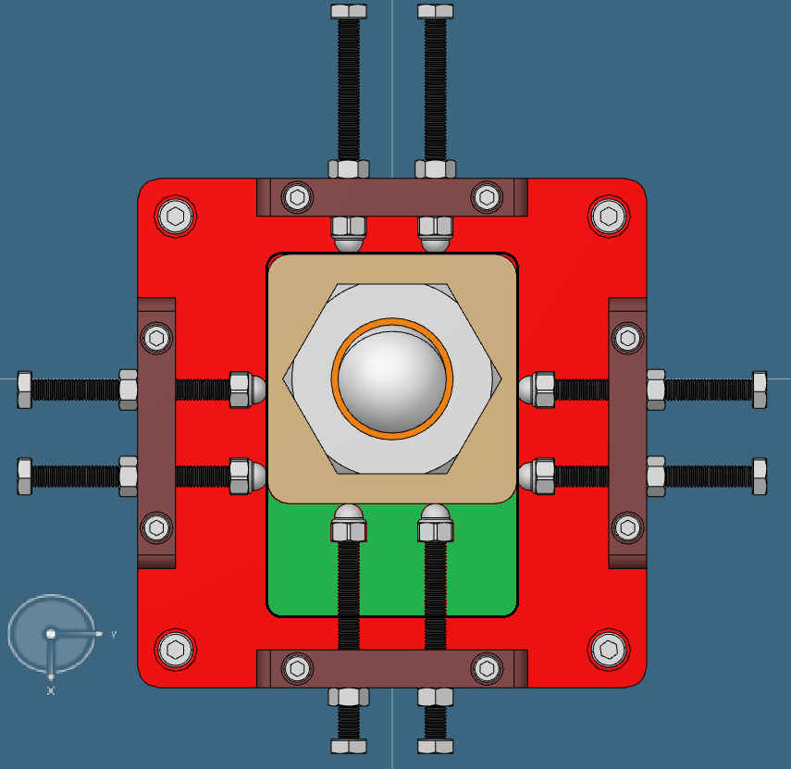
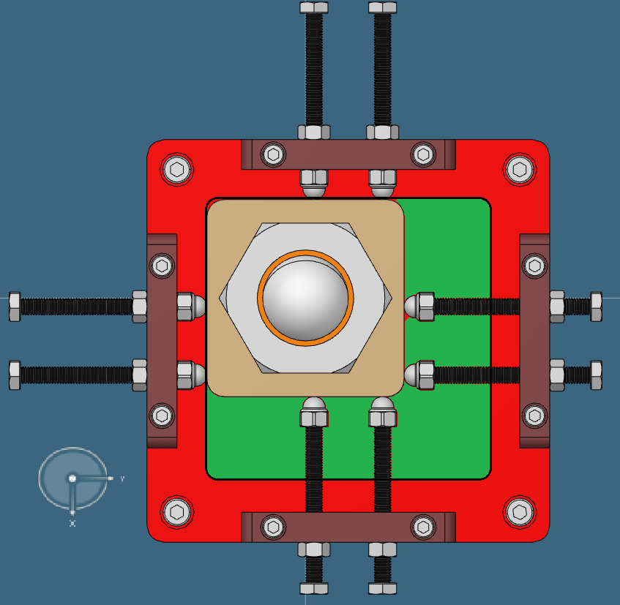
Base K-Mount
Resting standard position
Tolerances in X and Y axis equal plus minus 20 mm
Movement in X axis.
X= -20 mm
Movement in X and Y axis.
X= -20 mm
Y= -20 mm
Most critical position

Slide 9
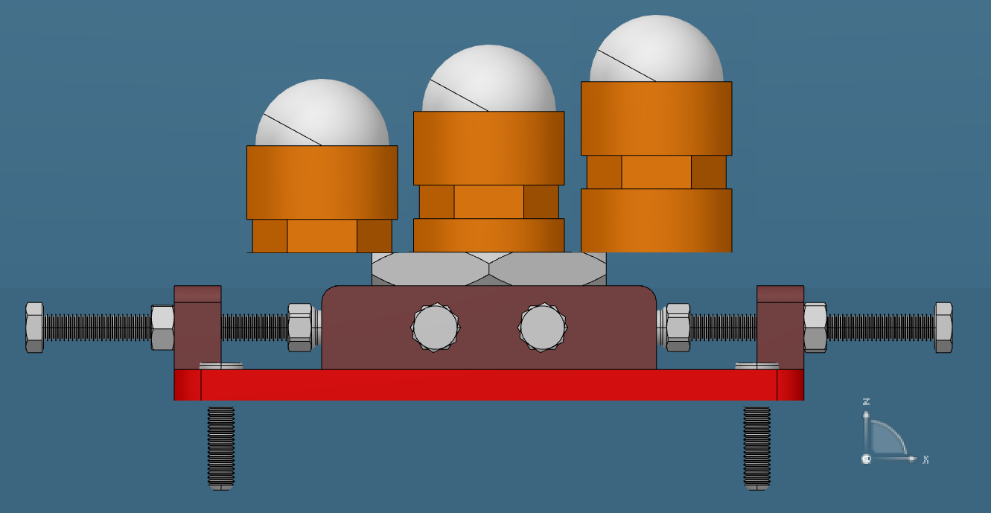
Base K-Mount
For the height adjustment, special designed shafts (orange part).
Tolerance plus/minus 10 mm

Slide 10
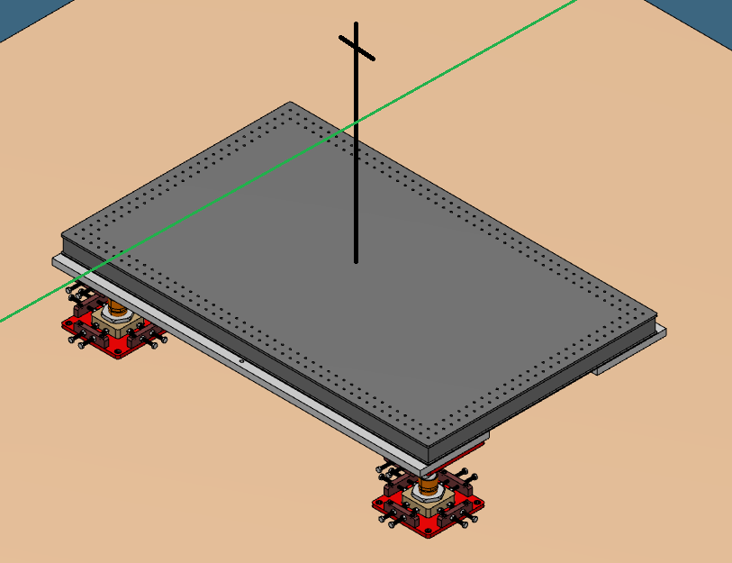
Base K-Mount Standard reference
First level in the floor.
Maintain the balls distance
Align them in reference to the previous mentioned reference line.
For doing so, standard block or bread board with a target(cross) on its top.
Once the position is defined, never move. Idea 1 per cicle.

Slide 11
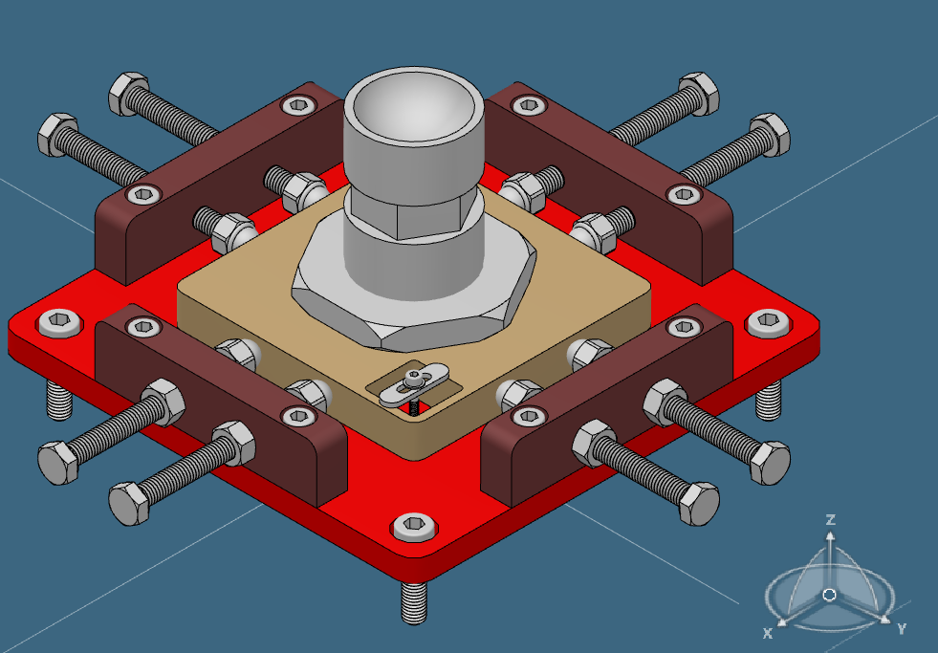
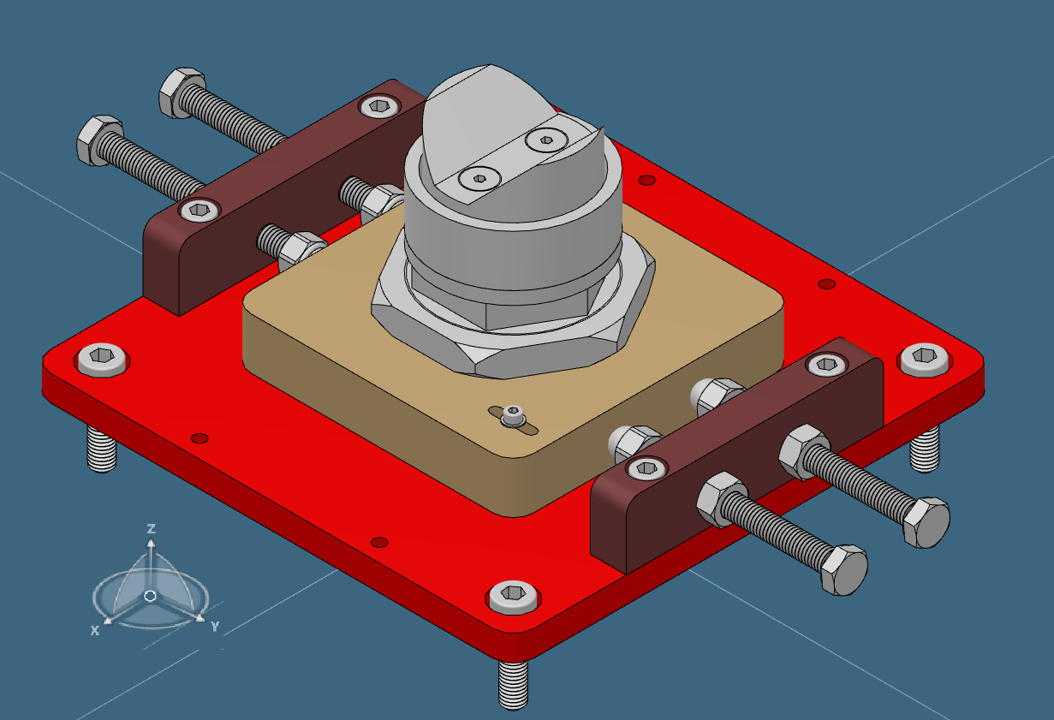
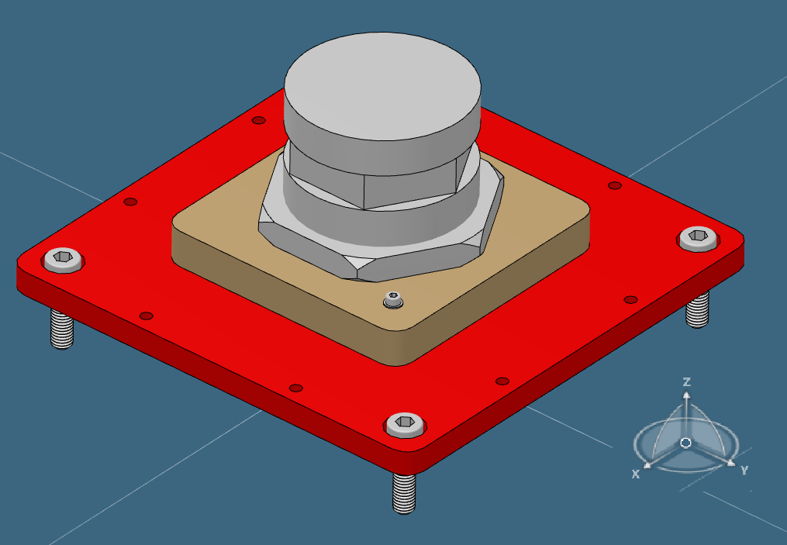
Top K-Mount
Same principle as the Base K-Mount with one difference.
Work position is Opposite.
Resting block need a clamping system.
Special block for each Top K-Mount.
CONE
GROOVE
FLAT

Slide 12
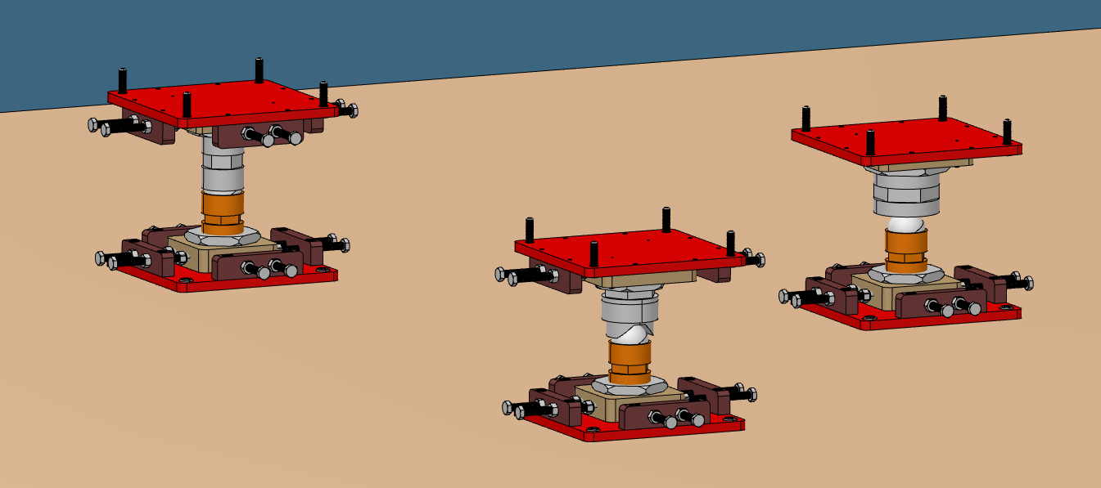
Top K-Mount
Each SEE will be different, so another alignment is needed in all the axis

Slide 13
Flat
Dimension:
188 x 188 x 80 mm
FLAT
CONE
GROOVE

Slide 14
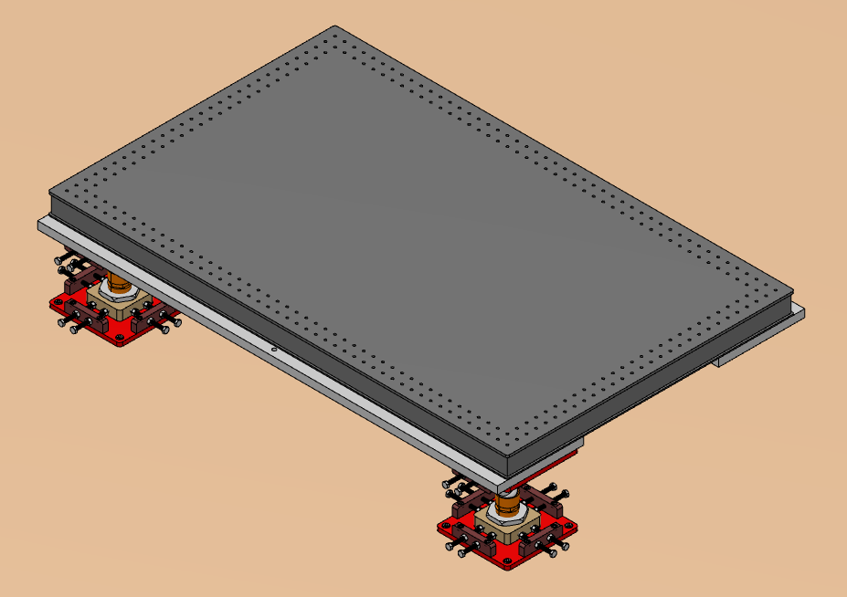
FIRST LEVEL SET UP
Dimension:
1200 x 800 x 262 mm
B = 187 mm
C = 262 mm
D = 107 mm

