Slide 1
SKADI TG2
Science Case and Overview
March 10th 2017 | Sebastian Jaksch, Sylvain Désert, Romuald Hanslik
Notes:
----- Meeting Notes (28.02.17 13:13) -----
Welcome
First Presentation of TG2 for SKADI
Science Case, Top Level Requirements, Cursory Overview
Construction Schedule and Risk Analysis

Slide 2
Outline
Organization
Science Case
Design Goals and Requirements
Technical Overview
Description of Single Components
Integration with ESTIA
Schedule
Risk Analysis and Mitigation
Answers to Reviewer Questions

Slide 3
Coordination and Responsibilities for SKADI
Team FZ-Juelich
Cooperation Leader and project responsible Sebastian Jaksch (JCNS)
Senior Advisor Henrich Frielinghaus (JCNS)
Lead Engineer for Mechanics Romuald Hanslik (ZEA-1)
Designer Achim Gussen (ZEA-1), Herbert Feilbach (JCNS)
Lead Engineers for Electronics Harald Kleines, Frank Suxdorf (JCNS)
Lead Engineers for SONDE Ralf Engels(ZEA-2), Günter Kemmerling(JCNS)
Team LLB
Responsible Scientist Jacques Jestin
Lead Engineer for Mechanics Sylvain Desert
Designer P. Lavie, P. Permingeat
Senior Advisor Annie Brûlet
Lead Engineer for SONDE Sylvain Desert

Slide 4
SKADI Work Packages
FZJ and LLB contribute equally to the work and budget for SKADI
Single work packages are assigned to either FZJ or LLB
Major work packages for FZJ:
Beam extraction
Heavy shutter
Polarizer
Chopper
Sample position system with shielding
Major work packages for LLB:
Collimation with VSANS-Option
Detector tank with detector rail system
Shielding
Beam monitors

Slide 5
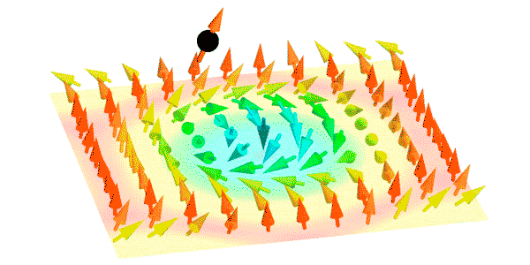
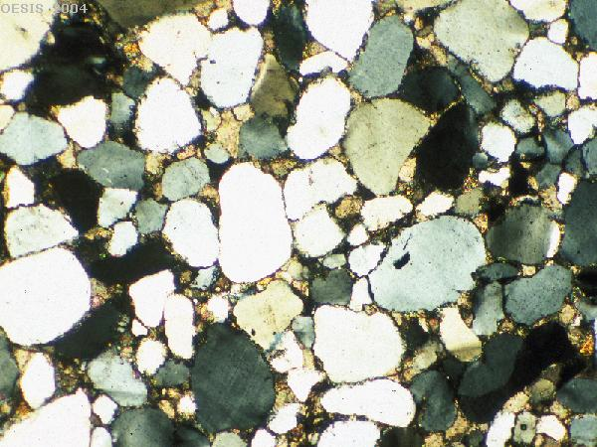
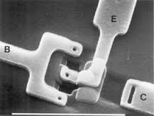
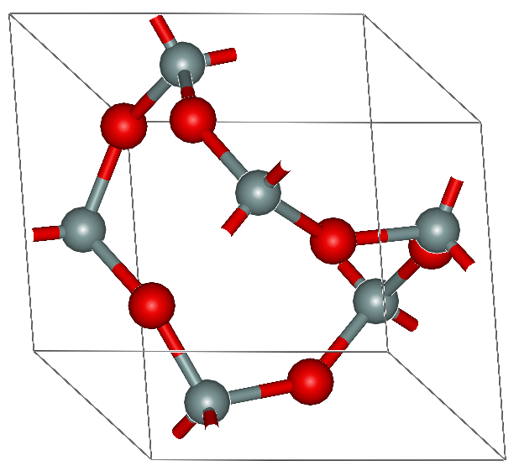
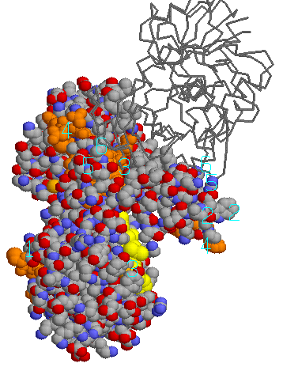
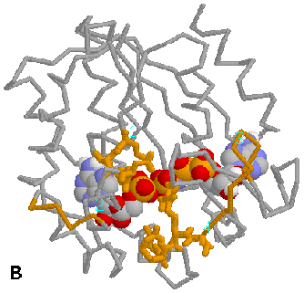
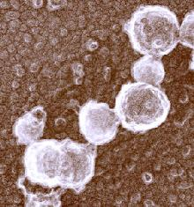
Magnetic Systems
Geological Studies
Electronics
Polymers
Food Science
Proteins
Viruses and Cells
1Å
10Å
100Å
1000Å
1µ m
10µ m
Q
1Å⁻¹
0.1Å⁻¹
0.01Å⁻¹
0.001Å⁻¹
10⁻⁴Å⁻¹
10⁻⁵Å⁻¹
SANS
VSANS
SKADI

Slide 6
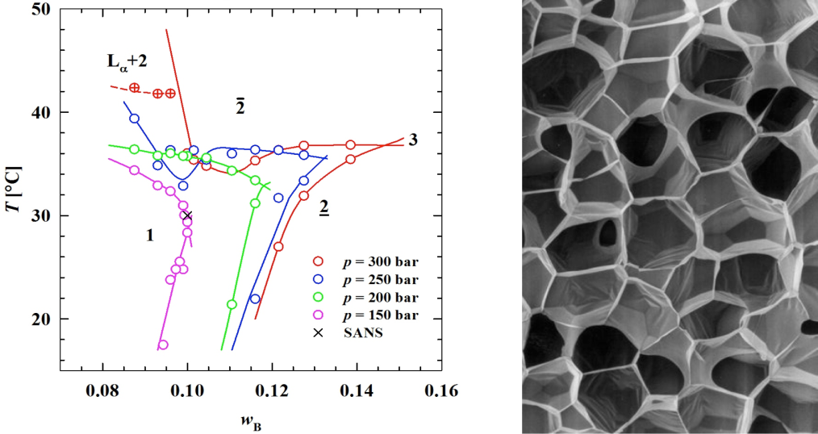
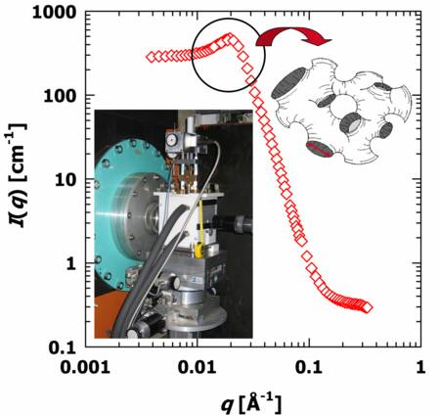
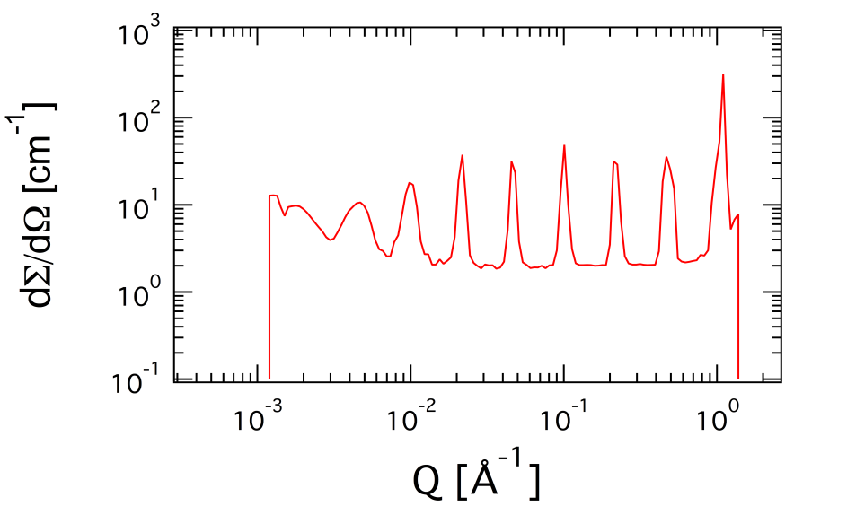
Science Case Example 1: Fast Kinetics
Release pressure from
super-critical CO₂ microemulsions
(Sottmann, Klemmer, Strey: U Köln)
Notes:
Mention also crowded systems

Slide 7
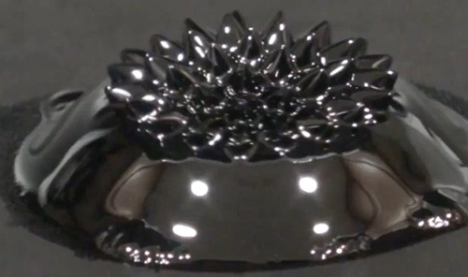
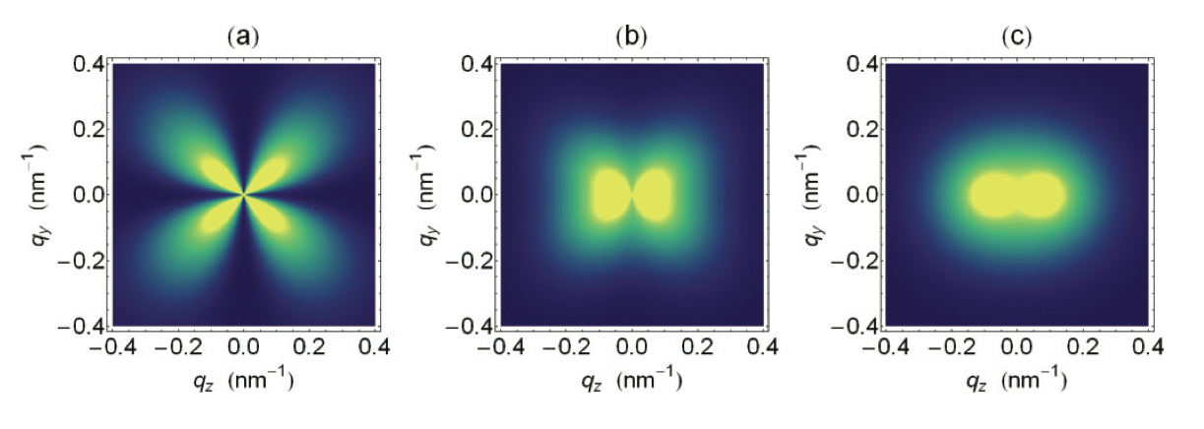
Science Case Example 2: Polarization (Full Scope)
Ferrofluid
(mechanic absorbers)
(EMF absorbers)
(switches)
Magnetic Nanoparticles @ 2T
H_{p}/ΔM = 0.2
H_{p}/ΔM = 1.6
H_{p}/ΔM = 8
Dirk Honecker and Andreas Michels PHYSICAL REVIEW B 87, 224426 (2013)

Slide 8
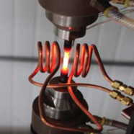
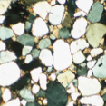
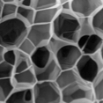
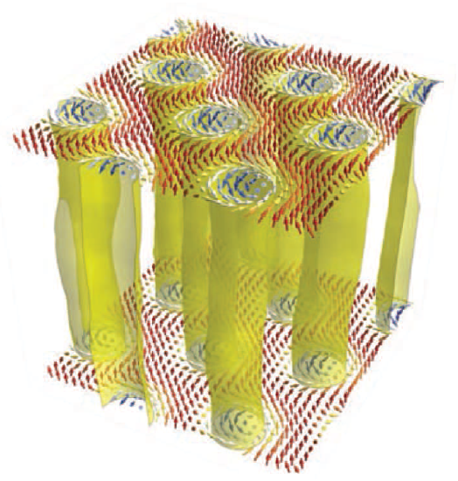
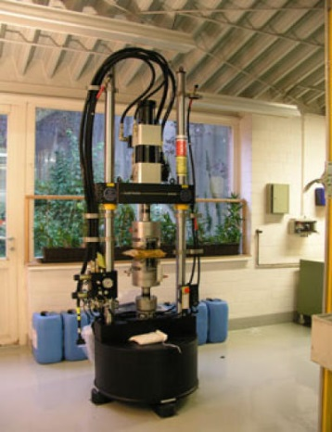
Science Case → Design Goals
Flexibility (sample area is approx. 3x3 m², and versatile collimation) for custom sample environments
Very small Q by focusing optics, for accessing length scales in the µm range
High dynamic Q-range covering three orders of magnitude simultaneously
Polarization for magnetic samples
High time-resolution together with Q-range will allow for the in-situ investigation of fast, non-reversible processes in a single measurement

Slide 9
SKADI: Project Scope & Upgrade
Project Scope
1 m² of active detector area, arranged at several positions in a balanced way contributed by SoNDe H2020 project
Adapted width of the footprint
Polarized neutron scattering, but no polarization analysis
2m inner diameter of detector tank
Moveabale detectors, including necessary motion control
Four single disk choppers
Cold Commissioning
Prepared for easy upgrade to Full Scope
Upgrade to Full Scope
Full detector coverage of 2 m²
Polarization analysis
Set of specialized sample environments

Slide 10
SKADI High Level Scientific Requirements
SKADI shall allow data collection over a Q-range of 1×10⁻⁴ Å⁻¹ < Q < 1 Å⁻¹ with a dynamic range of Q_{max}/Q_{min} = 1000
SKADI shall allow time resolved studies with a single shot time resolution below 200 ms
SKADI shall allow to match the size of the neutron beam to the size of the sample up to 30x30 mm²
SKADI shall provide polarized neutron beam with a relative polarization of >0.95
SKADI shall provide a Q resolution of dQ/Q < 15% between Q=1×10⁻³ Å⁻¹ and Q_{max}
SKADI shall allow for custom sample environments of volumes up to at least 1.5×1.5×2 m³ with masses up to 2000 kg
SKADI should be optimized to a signal to noise ratio (as defined in NOSG ESS-0039408, Appendix 3) better than 10⁻⁴

Slide 11
Scope, Science Case & Requirements
Science Case | Requirement
Micrometer Structures (Food Science, Electronics) | Q_{min} = 1×10⁻⁴ Å⁻¹
Å Structures ((semi) Crystalline Polymers, membranes) | Q_{max} = 1 Å⁻¹
Multi Scale Structures (Geological Studies, nanocomposites) | Q_{max}/Q_{min} = 1000
Fast Dynamics (Nanofoams, synthesis) | Time resolution below 200 ms
Magnetic samples (Ferrofluids), Low Concentration Solutions (Proteins) | Polarization > 0.95
Complex Structures (Proteins, magnetic samples, large aggregates and dimensionality) | dQ/Q < 15%
Low Contrast Samples (High-H Proteins) | S/N better than 10⁻⁴
Samples under Extreme Conditions (Large Stress/Strain rigs) | Custom Sample Environment 1.5×1.5×2 m³, 2t

Slide 12
Performance Considerations @ Project Scope
Consider Polymerizing Nanofoam Measurement at D22 and SKADI
Flux
Comparable flux at sample position at 2 MW
Time required for D22: 15 min measurement at 8 m (sample 1), 12 min detector movement, 30 min measurement at 20 m (sample 2)
57 min (1 h)
Time required for SKADI (at the same flux as D22) at one single detector setting covering an identical Q-space:
25 min
At a higher resolution (SKADI 3-6 mm, D22 8 mm detector pixel size)
Same sample for complete Q-range

Slide 13
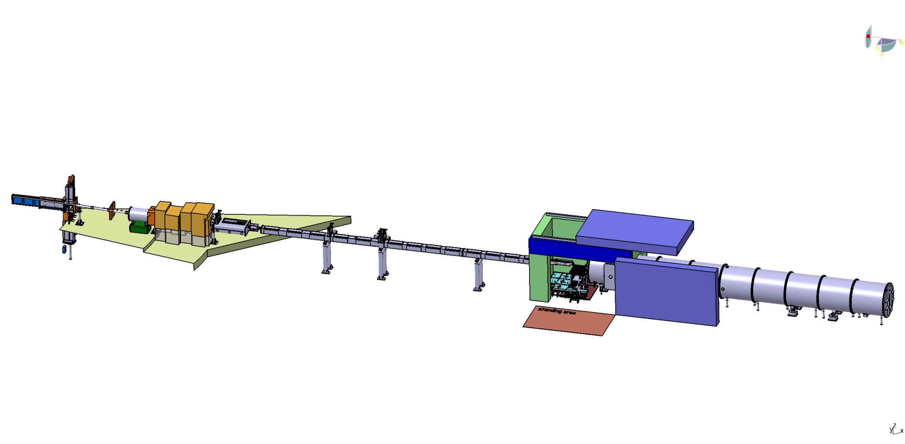
Technical Overview
20+20 m Instrument
S-Bender, twice out of line of sight
4 Choppers for High-Flux, pulse skipping or high resolution mode
Flexible sample area with kinematic mounting
1m² active detector area on two movable and one fixed detector position

Slide 14
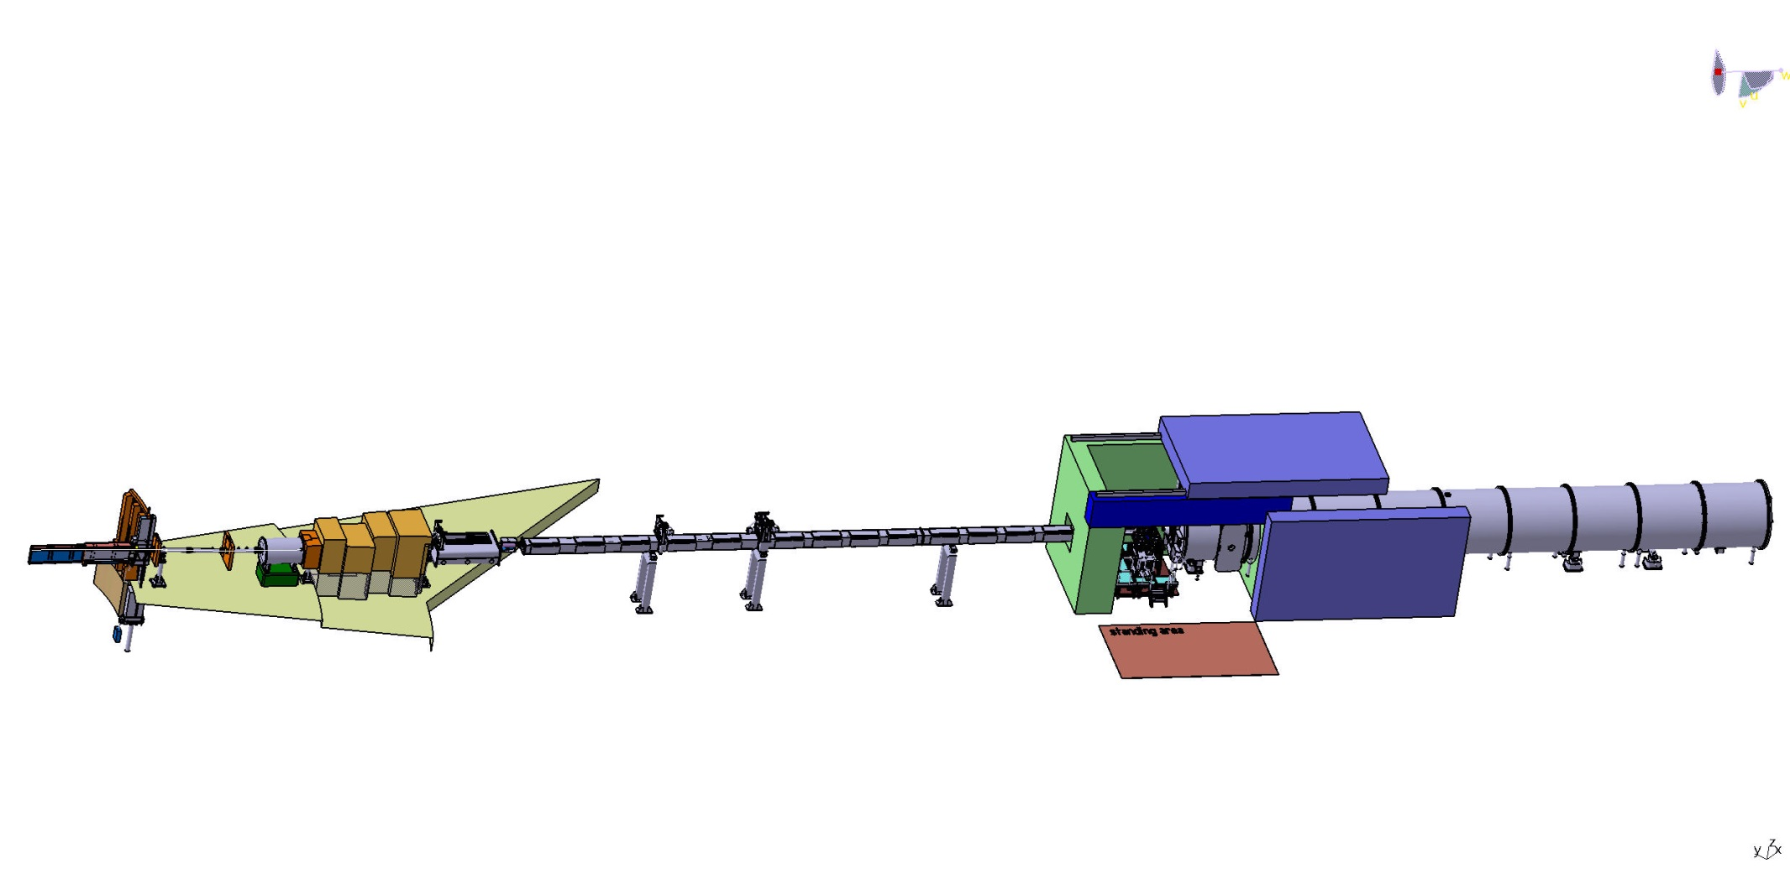
SKADI layout
Neutron
Extraction
Choppers
Sample Area
Detectortube
Bunker
Heavy shutter
Polarizer, Spin Flipper
Collimation

Slide 15
SKADI dimensions
Chopper No.4
26.6m
Chopper No. 1
15.5 m
Chopper No.3
26.3m
Chopper No.2
22.85m
Sample Area
38.5 m
Total Length
59.4 m
Heavy shutter
9.7m
Start collimation
18.5 m
All dimensions from the monolith center
Neutron Beam height in the neutron building hall 1897mm

Slide 16
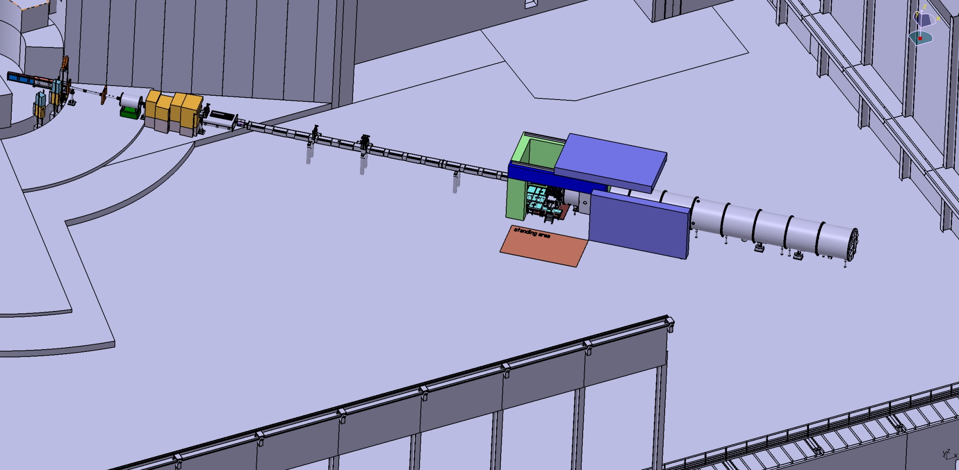
SKADI dimensions
(without Shielding)
59.4 m
6.4 m
ESS Target Building Layout ESS-0017891

Slide 17
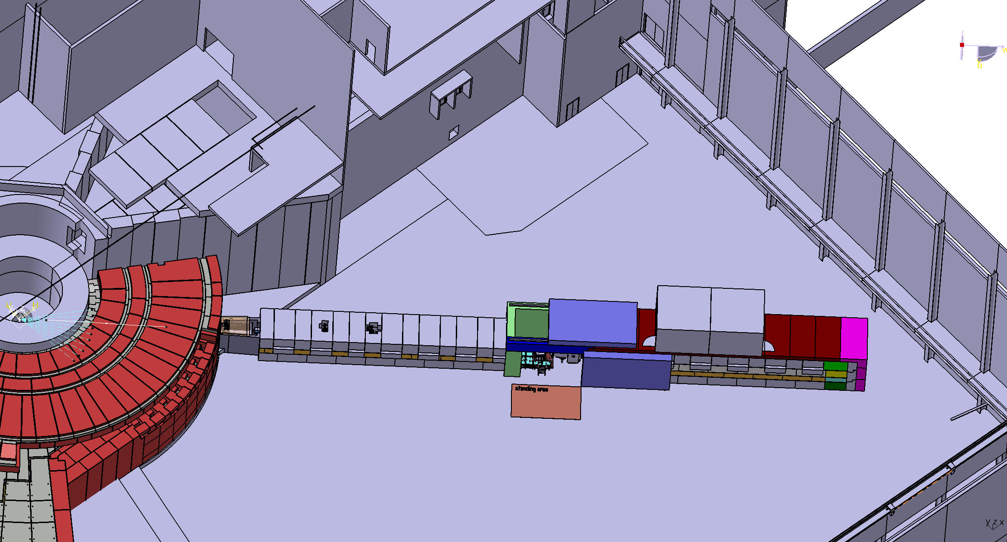
SKADI dimensions
(with Shielding)
62.6 m
2.7 m
ESS Target Building Layout ESS-0017891

Slide 18
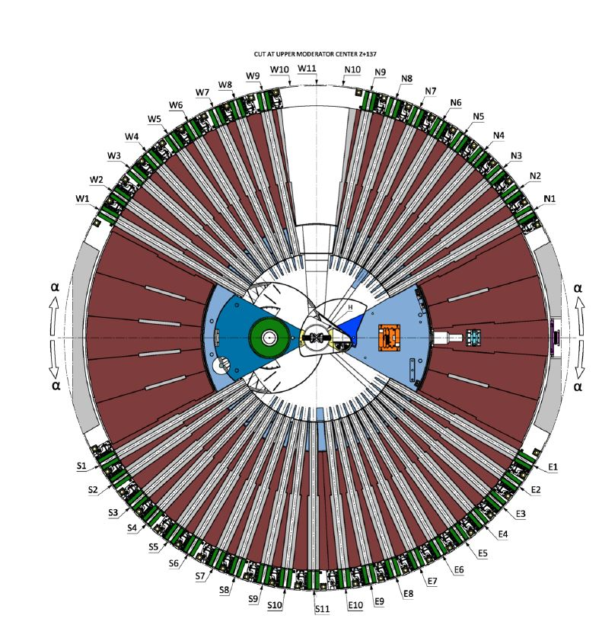
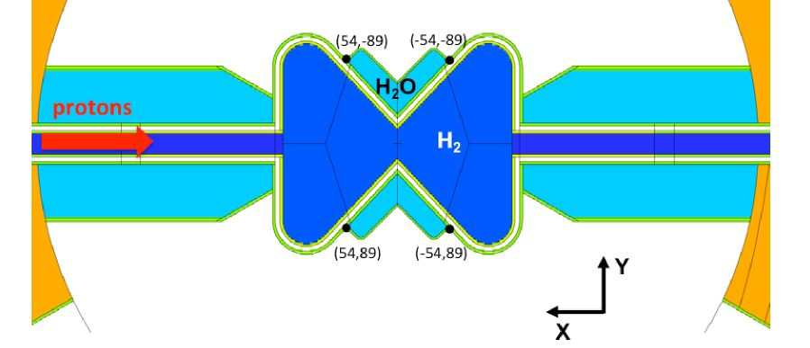
SKADI Beam Path
ESS - 0068256 23.09.2016
Beam extraction with respect to top moderator coordinates
X = 54mm
Y = -89mm
Z = 137mm
Z Rot = -42°
SKADI – E3-Port
SKADI – E3-Port

Slide 19
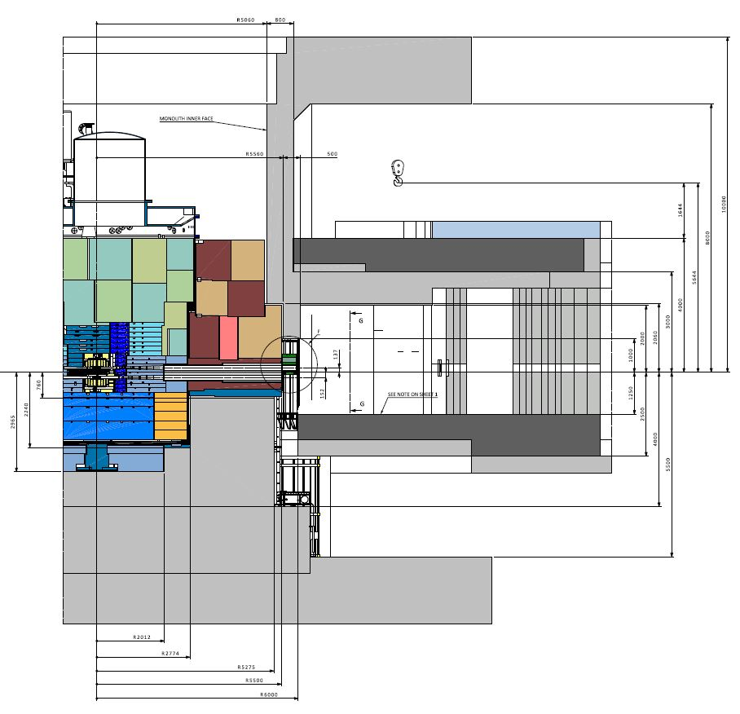
SKADI Beam path
Drawing Chess No. ESS0043981 11.12.2015
1387 mm
1897 mm
Height of the beam in the bunker (upper moderator) 1387mm
Height of the beam behind the bunker and S-Bender 1897 mm
Offset 240.2 mm
Twice out of line of sight

Slide 20
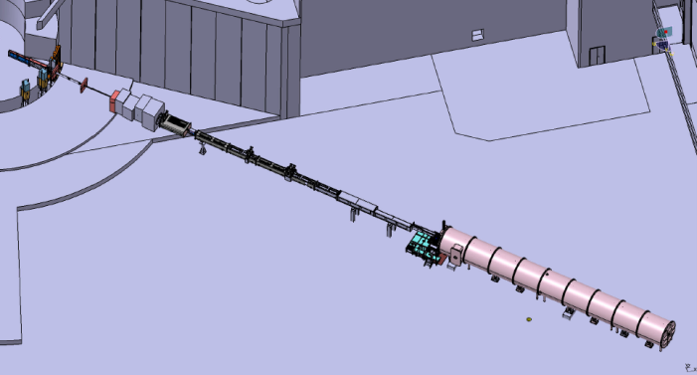
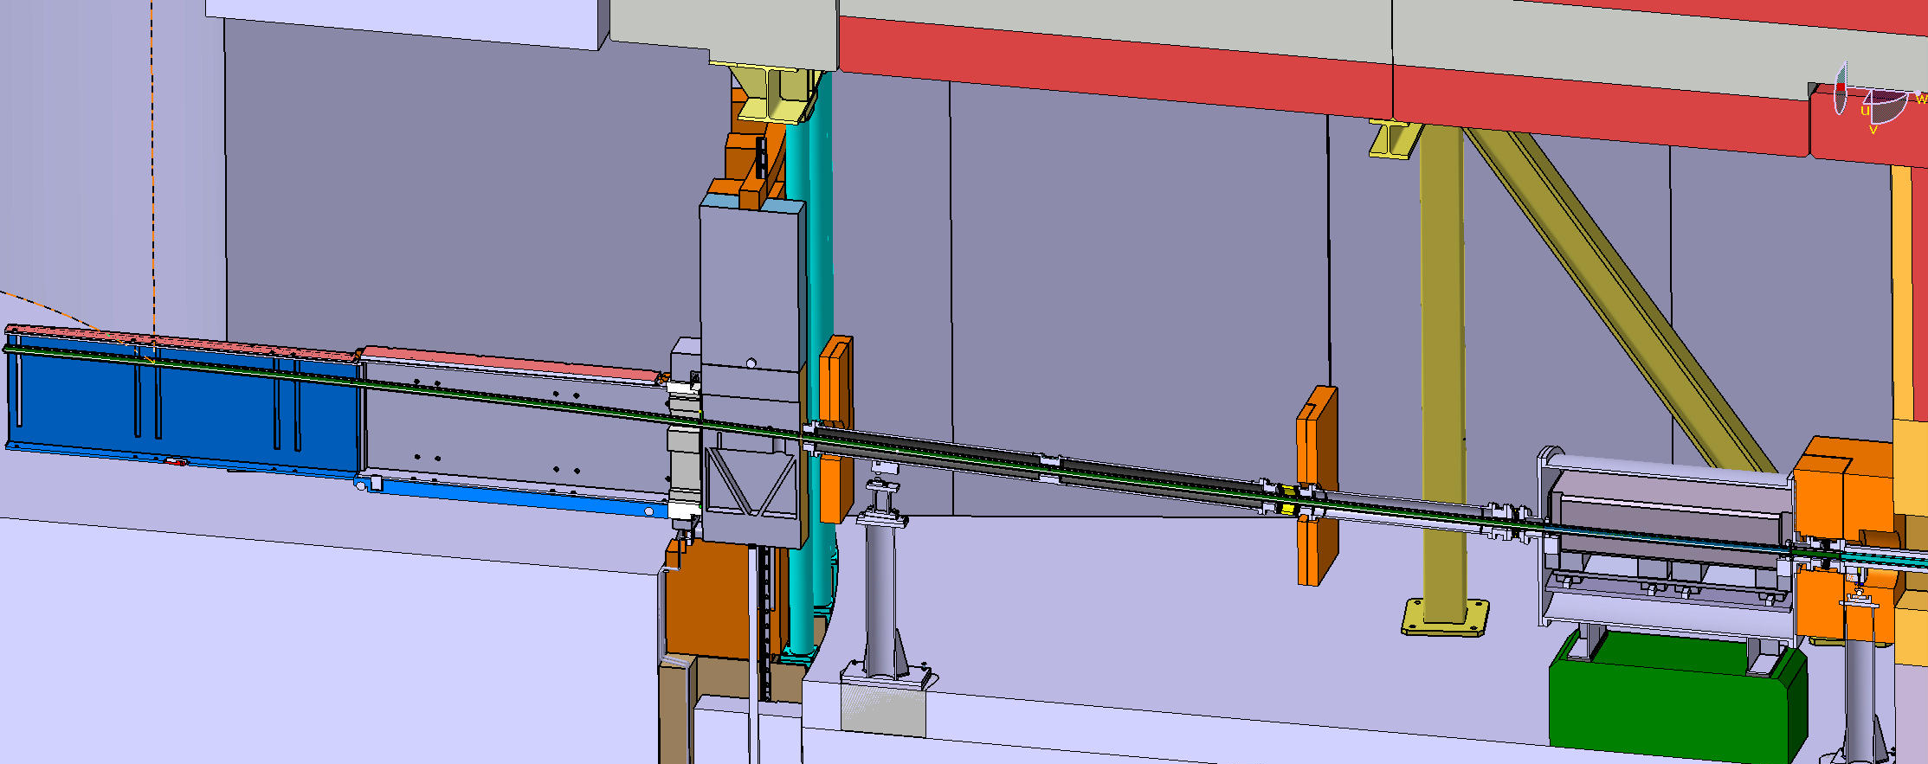
Bender
Vacuum Window
8980 mm
Bender offset 240.2 mm
Bender integrated in the neutron extraction components
S-Bender, twice out of line of sight
Vertical curved metallic neutron guide (Radius ca. 84m, offset 240,2mm, length 8,98m)
Cross section of neutron guide 30x30 mm²
Vacuum vessel in the bunker inside (vacuum level 10⁻² -10⁻³mbar)
NEW shutter, different from submitted documentation, after floor load change

Slide 21
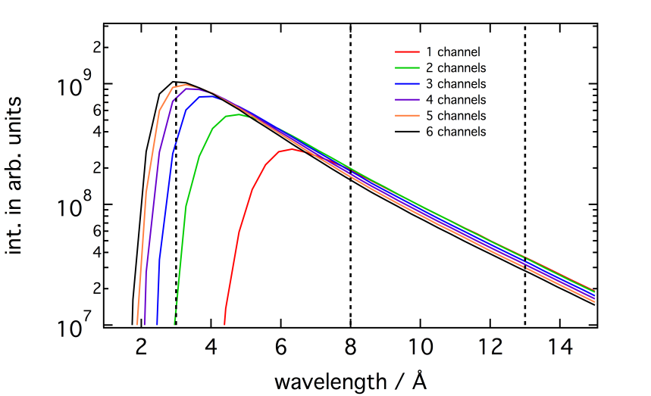
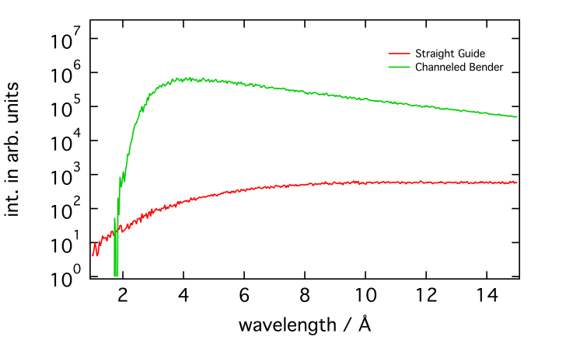
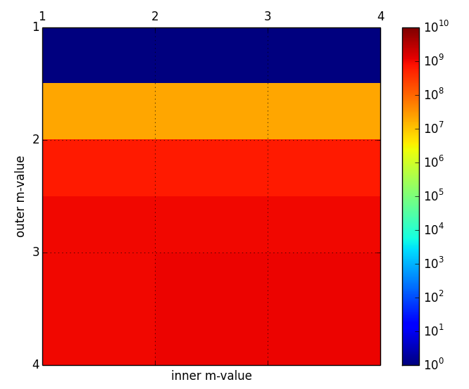
Bender
int. in arb. units
int. in arb. units
wavelength / Å
1
2
3
4
wavelength / Å
1
2
m-value outside
3
4
m-value inside
Five horizontal channels
Optimized for λ_{min}=3 Å (no gain by increasing the number of channels beyond 5)
m=3 for all surfaces
Huge gain compared to straight guide, optimal brilliance transfer
Optimal design with choppers outside the bunker

Slide 22
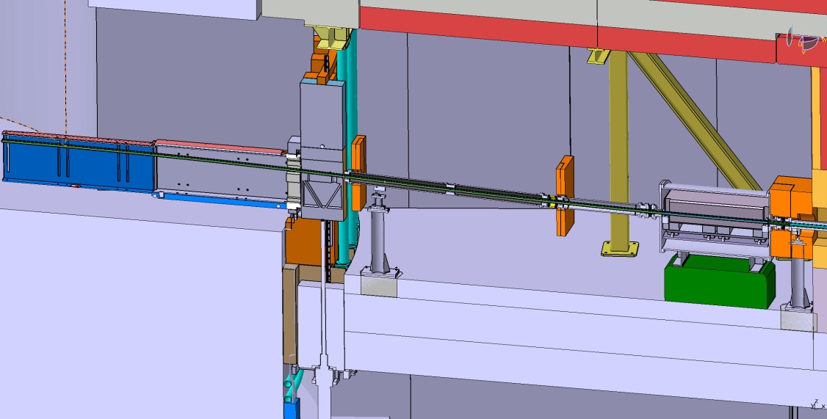
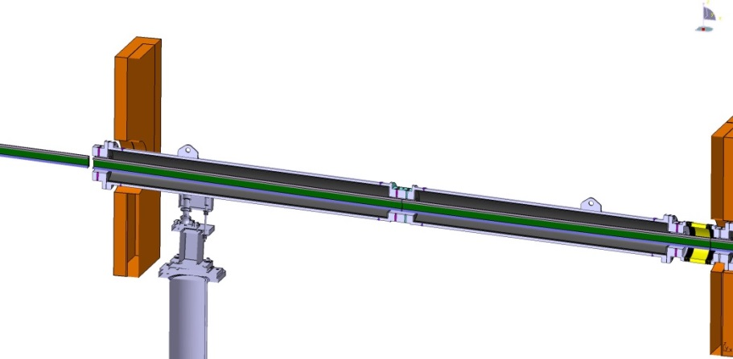
Bender and shielding
Copper collars
Vacuum housing lined with 5mm boron
No biological shielding inside the bunker
Three copper collars with accumulated thickness of 70 cm to prevent stray neutrons from propagating parallel along the beamline
Boron carbide lining to prevent activation of air in the bunker

Slide 23
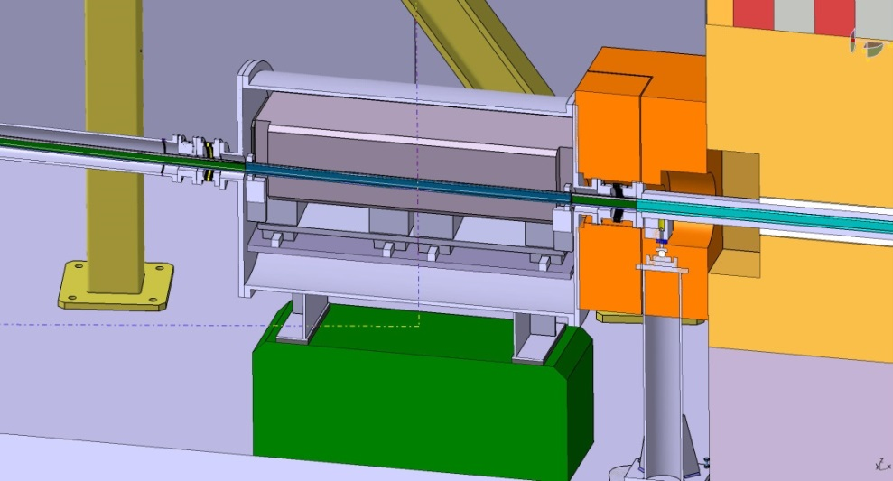
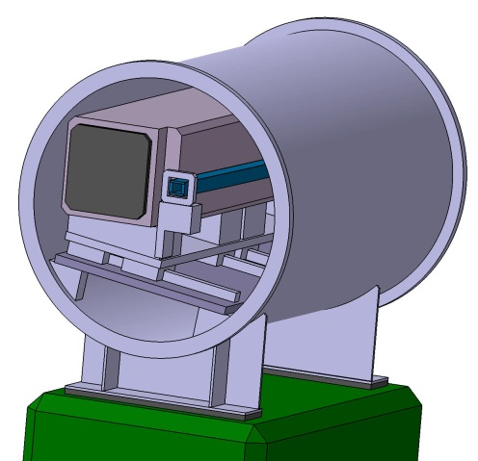
Heavy/Instrument shutter
1440 mm
300x300 mm²
Ø830 mm
Shutter inside the bunker
The last piece of bender integrated into the heavy shutter
Preliminary design
Pneumatic cylinders are proposed as the drive
NEW shutter, different from submitted documentation, after floor load change
Ø1500

Slide 24
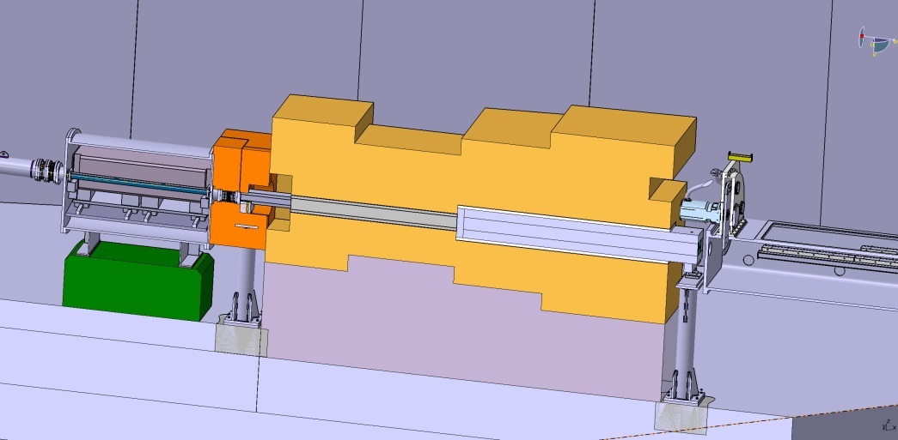
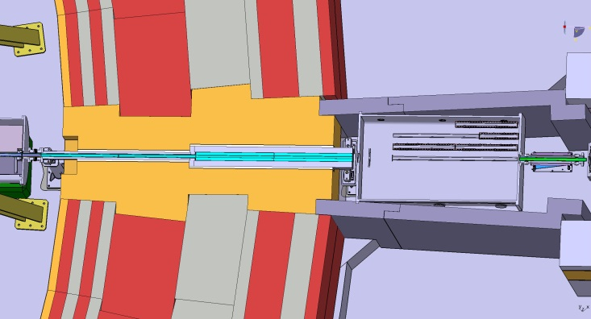
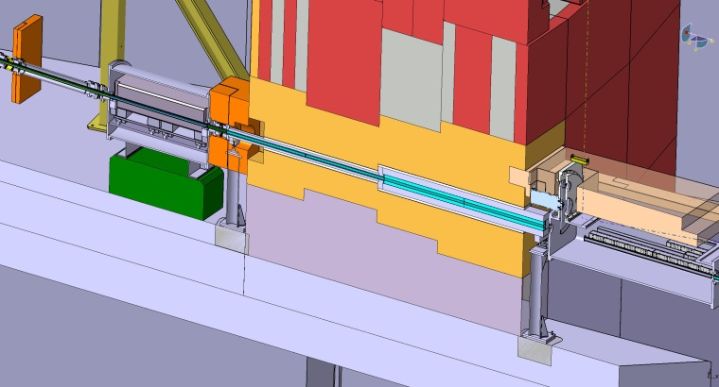
Feed through bunker wall
Feed through bunker wall following ESS design standards
Neutron housing adjustment from outside the wall
Interface between the copper collar and the bunker wall as well as between the bunker wall and optical cave shielding with chicane
No open streaming path
First shielding after bunker wall steel walls

Slide 25
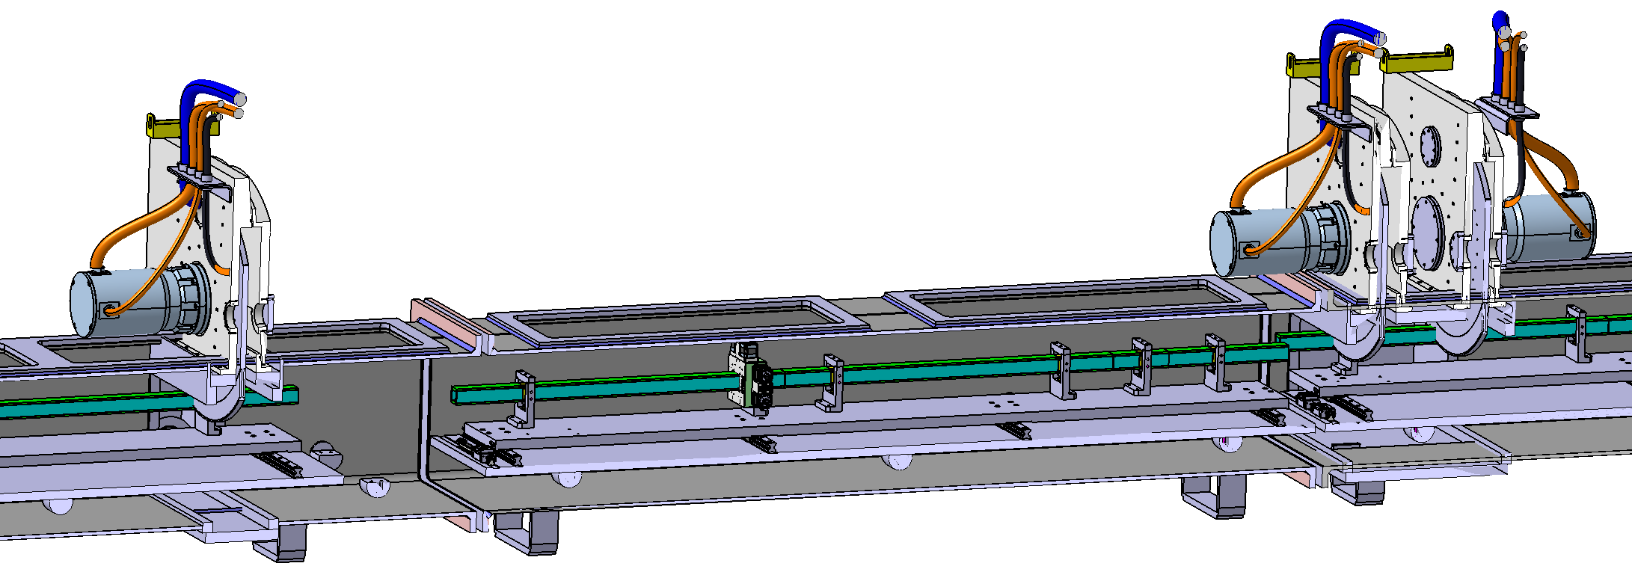
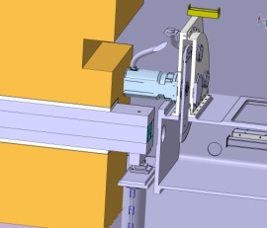
Chopper Systems
S. Jaksch, NIMA 835 61-65 (2016)
Two Choppers 14 Hz for standard modes (Frame overlap, Higher-order suppression)
Two Nx14Hz (210 Hz) for high resolution modes (High-Res1 and HiRes2) with single rotating disk each.
All Choppers outside bunker: Avoid cutting S-Bender for optimal flux
Chopper housing vacuum level 10⁻² -10⁻³ mbar
Shared shielding with collimation, NO additional chopper pit necessary
Chopper housing designed by FZJ, based on models in operation
Chopper No.1
Frame overlap, 14Hz
Chopper No.2
Higher Order suppression, 14Hz
Chopper No.3
High Res 1,Nx14Hz
Chopper No.4
High Res 2,Nx14Hz
Spindles – SKF spindles with a magnetic bearing
Disks Ø600 mm-Alumold AM 1-500 alloy, coated with a boron carbide powder and resin mixture to allow for the absorption of the neutrons

Slide 26
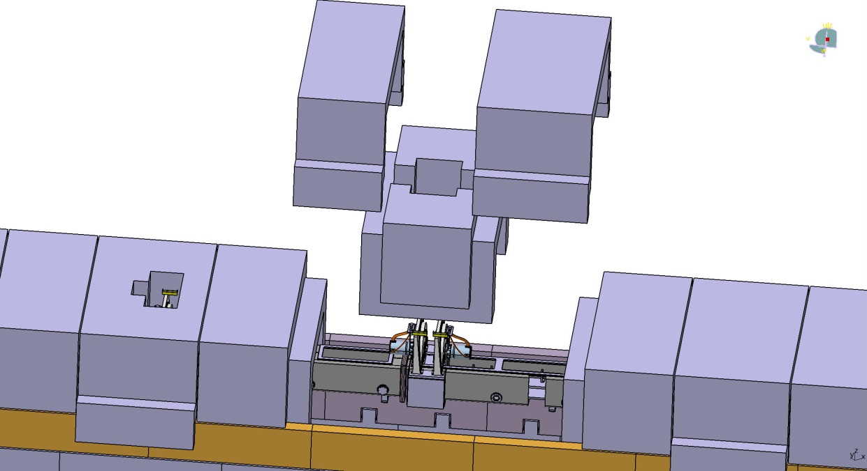
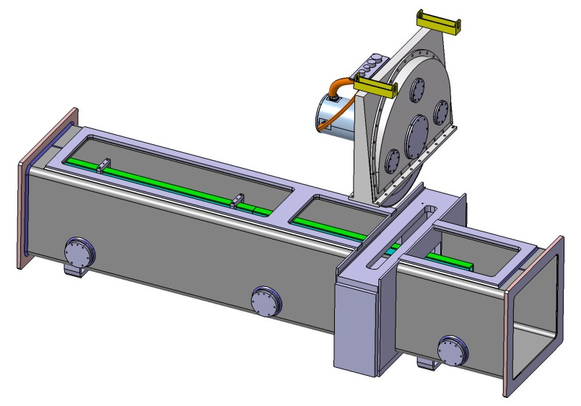
Chopper – Housing and maintenance access
All choppers located inside the optical cave shielding.
Optical cave shielding openend by crane
The chopper housing itself supports remote opening with the appropriate tools as well as craning out

Slide 27
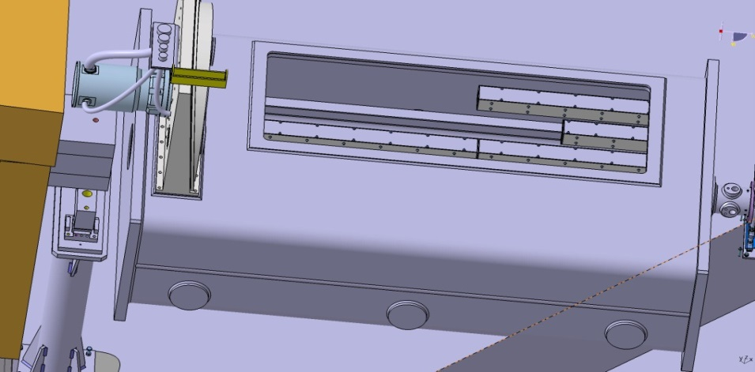
Polarizer
Horizontal changer in vacuum vessel for four positions (neutron guide, low wavelength band, high wavelength band, provisioning):
1x Neutron guide 1600mm length
1x Polarizer 1600mm length (two polarizers a 800mm)
1x NG+Polarizer 1200mm lengthNG+400mm length Polarizer
1x additional position for future upgrades
Shares collimation vacuum, necessary vacuum level 10⁻² -10⁻³mbar
Adjustment: horizontal remotely in the beam, xy manually
Accuracy of the alignment shall be 0.1 mm in all directions
1600 mm
Vacuum Window
Common vacuum until sample position

Slide 28
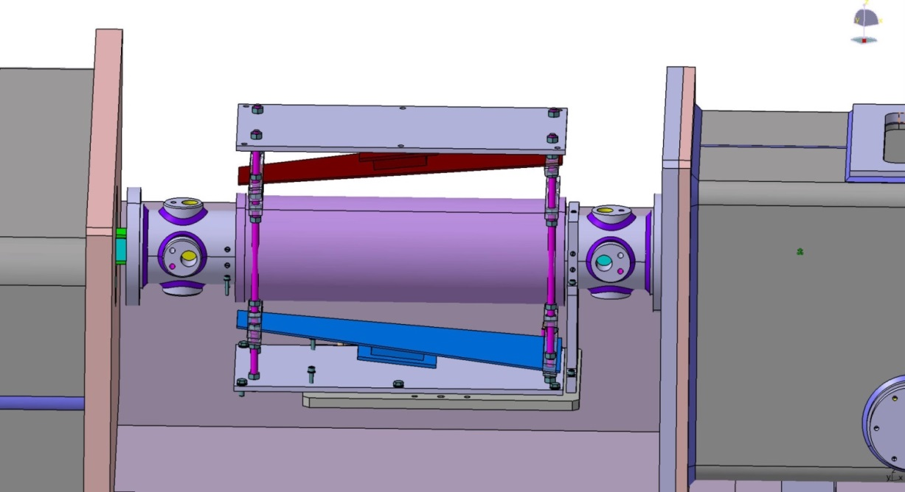
Spin Flipper
With RF-Coils and RF-Generator to operate between 2 Å and 13.5 Å
Positioned directly after the Polarizer
Without vacuum vessel
Alignment shall only be possible off-line
Accuracy of the alignment shall be 0.1 mm in all directions
Neutron guide is positioned and adjusted inside the SF
SF is connected to the polarizer housing and to the collimation vacuum tight (without window)

Slide 29
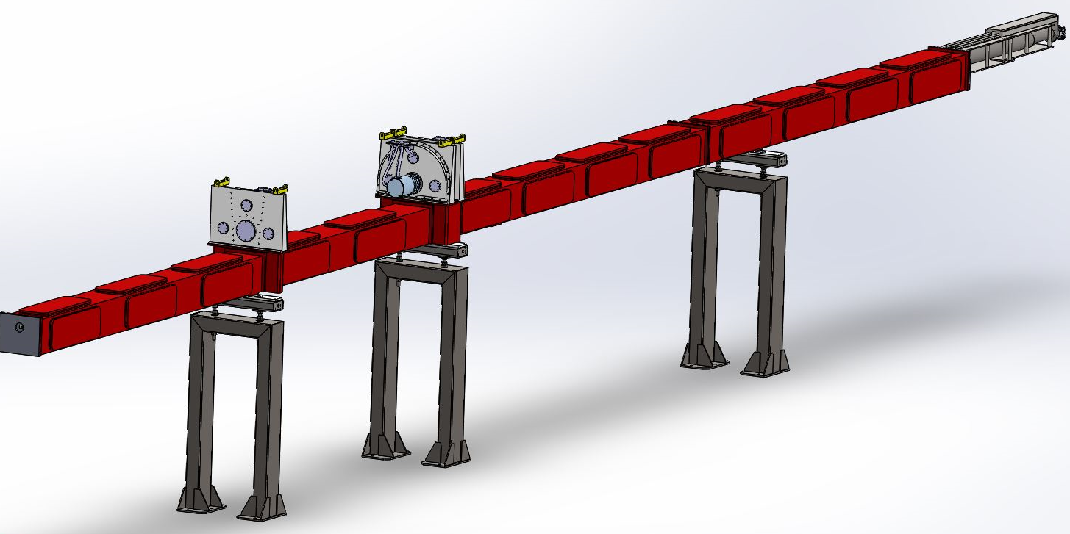
Collimator
20 m long under vacuum
3 configurations: 8, 14 and 20 m
Guide field
VSANS option
Extension nose: 1m -0/+1m
Chopper interfaces follow the ESS design standard

Slide 30
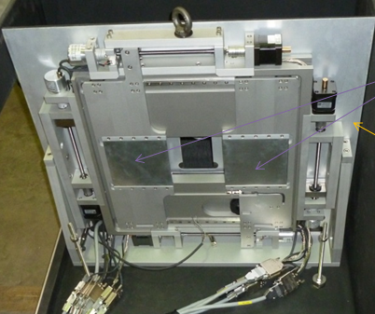
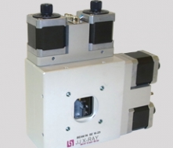
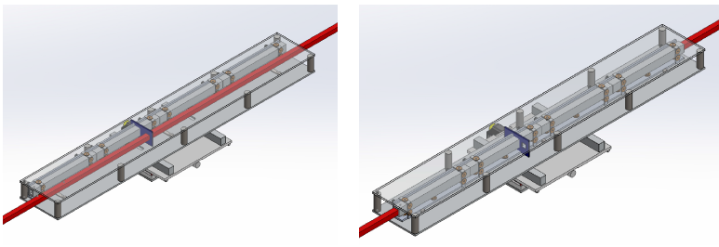
Collimator
4 independent blinds
Movable neutron guide segments (2 x 6 m)
Intermediate absorbers

Slide 31
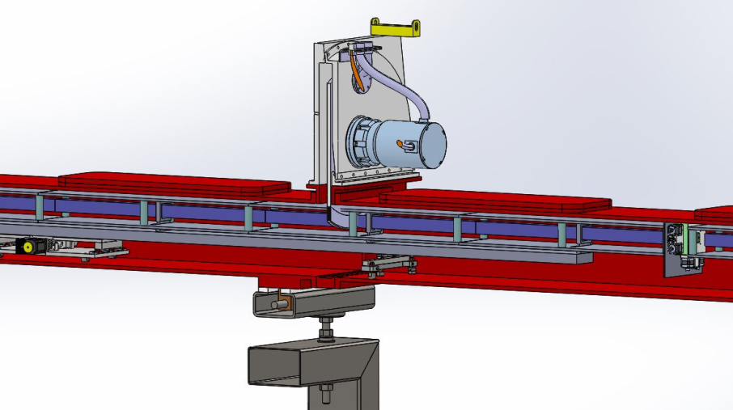
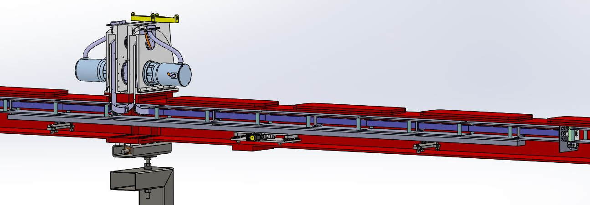
Collimator
Chopper integration

Slide 32
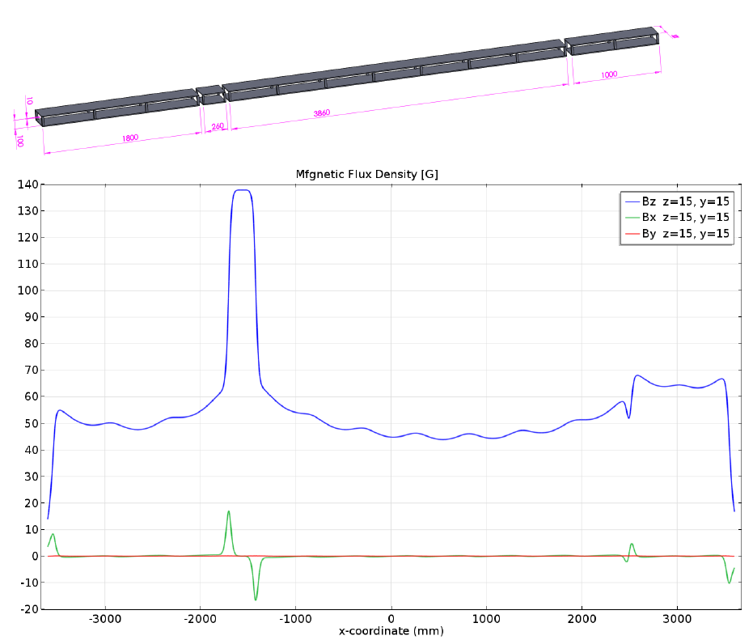
Collimator
Guide field, min. 45 G
1000 mm
3860 mm
1800 mm
Columns of magnets
Soft iron, 10 mm thickness
260 mm
magnetic flux density / G
z direction
x direction
y direction
100
50
0
-3000
-2000
-1000
0
1000
2000
3000
x coordinate / mm

Slide 33
Collimator
Telescopic nose: 1 +1/-0 m
Independent telescopic guide field
Last slit system

Slide 34
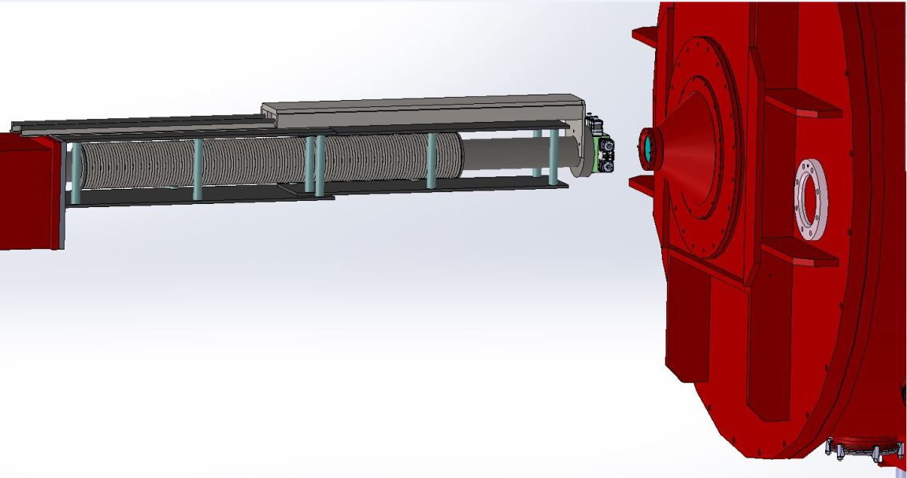
Collimator
Small sample environment
Large sample environment

Slide 35
Collimator - VSANS
Avoiding four decades of intensity loss in pinhole setup at low Q
Multi-beam / multi-slits (X50)
→ No crosstalk
Guide
Sample
Detector

Slide 36
Collimator - VSANS
Number of
channels
Channel size
L/m
L/m
→ 2 m: 5 elements of 40 cm
Notes:
Please make axis with proper units (min. Font 14 pt)

Slide 37
Sample exposure system
SKADI sample area: Sample environment, the last components of the collimation, first components of the detector tank
Guide field preserved when extending the vacuum nose
Several vacuum noses for detector tube available

Slide 38
Sample area
hollow floor removable
Media readily accessible below false floor
Door minimum 2,0x2,0 m²
Door and roof panel motorized
Door also allows access to detector tube
Hollow floor on wheels in order to be readily removable

Slide 39
Sample cave
3000 mm
4900 mm
1897 mm
Cross-section 3,0x3,0 m² at a height of 1.9 m below and 3.0 m above the neutron beam
Concrete shielding (walls and roof) for sample cave consist of 60 cm thick walls, total weight ca. 161 t
Additional steel shielding consist of 5 cm thick walls, weight ca. 36 t
Floor space for shielding 12,2 m²
Floor loading 16,5t/m², footprint will be increased to meet new floor load requirement

Slide 40
Quick mounting sample environment
Mountings points with adjustable bolts embedded in concrete floor
Hardened receptacles will be included into the pallet
Sample mounted on a pallet with mounting mechanism
The same mounting mechanism for sample preparation area and for sample area
The sample environment can then be aligned to a sufficient precision (0.1 mm) along any axis and then be transferred to the sample area
Transfer between the preparation and the sample area by pallet jack or crane
Concept: H. Feilbach, M. Pohl PGI/JCNS, S. Jaksch JCNS

Slide 41
Sample preparation area
Location for preparation area

Slide 42
Detector
20 m vessel under vacuum
Three detectors for simultaneous data acquisition

Slide 43
Detector
2 moving detectors
1m² – pixel 6 mm
400 modules / detector
1 fixed detector @20 m
20x20 cm² – pixel 3 mm
neutrons

Slide 44
Detector Settings

Slide 45
Detector Visibility
All drawings to scale:
8 m Collimation
14 m Collimation
20 m Collimation
All detectors are fully illuminated under all conditions
For finite thicknesses of detector (up to 0.4 m) locations have to flexible by about 1 m
Sample
Position
1.6 m
8.0 m
20 m
2.8 m
14 m
20 m
4.0 m
18.5 m
20 m

Slide 46
Beam Validation
Monitor for beam diagnostics and normalization
Very high transmission
ToF capability
→ Full time on-line
One after the bender
One movable (share VSANS translation)

Slide 47
SoNDe Overview
High-flux capability, capable of handling the peak-flux of up-to-date spallation sources (gain factor of 20 over current detectors)
High-resolution of 3 mm by single-pixel technique, below by interpolation
High detection efficiency of 80 % or more
Strategic independence from ³He
Time-of-flight (TOF) capability, necessary to exploit maximum flux, with a time resolution in the µs regime
Modularity, improving maintenance characteristics of today’s neutron detectors
LLB
FZ Jülich
IDEAS
ESS / Lund U
Supported by the European Union within the H2020 framework programme

Slide 48
SoNDe Detector
Linear well up to 250 kHz on 5x5 cm² module (8x8 pixels)
Single pixel linearity up to 125 kHz
100 MHz on full 1x1 m²
at 20% dead time 20 MHz counting
May still be improved, single pixels are better
5.4E13 Neutrons over 10 days, module still operational
Corresponds to 10 years lifetime at ESS

Slide 49
SoNDe Status
2x2 demonstrators ready
Module completely hidden behind MaPMT
Improved countrate
Full communication via ethernet
Better suppression of crosstalk due to improved scintillator design

Slide 50
Protections + Infrastructure
5 mm B₄C / 60 cm concrete / 5-10 cm steel

Slide 51
Protections + Infrastructure

Slide 52
Overlay with ESTIA

Slide 53
SKADI Schedule with Milestones
Early Procurement
Bender
Shutter
Inserts (Bunker, Monolith)
Some Chopper Components

Slide 54
Risks
Three risk categories considered:
Technical
Schedule
Budget
Severity Assessment of individual risk:
Severity = Probability (1...5)×Impact(1...5)
1..4 Low severity
5...7 Medium severity
8...15 High severity
Technical Risks
Risk | Probability | Impact | Severity | Mitigation
SoNDe project does not deliver a detector meeting specifications | 1 | 5 | 5 | Follow up with the SoNDe project, ³He solution as a backup
Supplier of a neutron guides fails to deliver | 1 | 5 | 5 | Switch supplier
Chopper delivery failure | 1 | 5 | 5 | Switch supplier
Insufficient Shielding | 2 | 3 | 6 | Modify Shielding
Neutron Optics not meeting specification | 1 | 3 | 3 | Improve adjustment, accept reduction in performance
Misalignment due to building movement | 2 | 3 | 6 | Re-align components

Slide 55
Risks
Budget Risks
Risk | Probability | Impact | Severity | Mitigation
Detector costs exceed budget | 2 | 4 | 8 | Reduce active area, use contingency
Shielding costs exceed budget | 1 | 4 | 4 | Use contingency
General cost underestimate | 2 | 4 | 8 | Balance value/performance
Increase of personnel costs due to longer project runtime /delays | 3 | 3 | 9 | Use contingency
Schedule Risks
Risk | Probability | Impact | Severity | Mitigation
Access to CF within the ESS not possible when needed | 2 | 3 | 6 | Close communication with ESS, rescheduling
Infrastructure not yet ready | 2 | 4 | 8
Delay in delivery of components | 2 | 3 | 6 | Reorder installation of components, early start of procurement
Supporting laboratories not ready at startup | 4 | 1 | 4 | Temporary use of sample preparation area with reduced capabilities
In-Bunker components cannot be installed in time | 3 | 3 | 9 | Close communication with ESS, rescheduling

Slide 56
Risk Monitoring and Mitigation
Potential risk
Monitor
Report
Adapt/mitigate

Slide 57
Take home
SKADI will be world leading from day 1
SKADI design based on outstanding science case
SKADI is ready to be a day one instrument
SKADI has the potential to be an essential part of the overall ESS early success strategy
Upgradeability to full scope is maintained
Detector will be delivered by the SoNDe project
Early Procurement is necessary for some components to meet overall ESS schedule
Based on the experience and support by LLB and FZJ the team is confident to meet the upcoming challenges

Slide 58
Thanks to ....
Henrich Frielinghaus
Jacques Jestin
JCNS and LLB Technical Groups
ESS Technical Groups
... , and you for your kind attention.

Slide 59
SKADI TG2
Answers to Questions
March 10th 2017 | Sebastian Jaksch

Slide 60
Detector Arrangement
8-18.5 m
20 m
1.6-4 m
1 m² of active area in a balanced distribution
Two movable, one fixed position
Three settings according to three collimation settings (middle detector at collimations distance, rear detector available for high resolution)

Slide 61
Detector Visibility
All drawings to scale:
8 m Collimation
14 m Collimation
20 m Collimation
All detectors are fully illuminated under all conditions
For finite thicknesses of detector (up to 0.4 m) locations have to flexible by about 1 m
Sample
Position
1.6 m
8.0 m
20 m
2.8 m
14 m
20 m
4.0 m
18.5 m
20 m

Slide 62
Q-Coverage
Lowest Q only depends on collimation/sample aperture setting and wavelength:
Collimation Setting | λ_{max} = 8 Å | λ_{max} = 13 Å
8 m | 3x10⁻³ Å⁻¹ | 1.8x10⁻³ Å⁻¹
14 m | 1.6x10⁻³ Å⁻¹ | 1x10⁻³ Å⁻¹
20 m | 1.1x10⁻³ Å⁻¹ | 7.2x10⁻⁴ Å⁻¹
Using maximum divergence for θ_{min}
Collimation Setting | λ_{min} = 3 Å | λ_{min} = 8 Å
8 m | 1.3 Å⁻¹ | 0.5 Å⁻¹
14 m | 0.75 Å⁻¹ | 0.28 Å⁻¹
20 m | 0.5 Å⁻¹ | 0.19 Å⁻¹

Slide 63
Q-Overlap
For λ = 3 ... 8 Å
Collimation Setting | Det 1 Q_{min} | Det2 Q_{max} | Det2 Q_{min} | Det3 Q_{max}
8 m | 0.1 Å⁻¹ | 0.26 Å⁻¹ | 0.019 Å⁻¹ | 0.02 Å⁻¹
14 m | 0.06 Å⁻¹ | 0.15 Å⁻¹ | 0.01 Å⁻¹ | 0.02 Å⁻¹
20 m | 0.04 Å⁻¹ | 0.11 Å⁻¹ | 8x10⁻³ Å⁻¹ | 0.02 Å⁻¹

Slide 64
Chopper Frame Overlap
λ = 21.25 Å
This setting will be used only at 20 m collimation:
max. divergence 0.75 mrad
max. upward distance without gravity 0.015 m
Neutron is falling out of the collimation
Only use of 20 m collimation setting foreseen (only sensible for low Q)

Slide 65
Comments on Chopper Setup
Out of bunker placement beneficial
No additional shielding costs by placing them outside the bunker
Collimation is already nearly as wide as a chopper
Considerable loss of flux when placed into bunker (S-Bender interrupted)
2% just by displacement (0.1 mm) per chopper → 4%
Additional loss due to non-zero divergence
→ Estimated 5-10% loss in flux
Better maintainability outside the bunker
Integration with ESTIA ongoing, sufficient space available (1.6 m in wedge at first chopper position)
HiRes Setup
Disks are tested for 200 Hz
Any multiple of 14 Hz acceptable for HiRes mode
Stroboscopic mode for free

Slide 66
High Res Choppers
Simulated
Calculated (acc. to Glinka et al.)
Improvement of Resolution (improvement dQQ of 20 % at Q = 2x10⁻³ Å)
Improvement of S/N
Simulated with identical amount of neutrons
Science Case: Low Q phenomena (magnetics, large scale structures, clustering/aggregates), Cubic phase silica particles (W.Briscoe et.al.)

Slide 67
Signal to Noise
From NOSG Handbook ESS-0039408:
“The signal to noise ratio for reflectometry translates into the dynamic range of a
Q-dependent intensity measurement of a standard sample, such as NiC. In other words,
if the reflectometer background level was 10⁻⁷, then with a relative intensity of 1 at the
smallest Q values, the specular reflectivity would be measurable down to 10⁻⁷ before
the data reaches a Q-independent background, or the standard deviation of the data
points equals the counts.”
For SANS this is done with scattering from dispersed spheres.

Slide 68
Collimator VSANS
Latex 1µm diameter
Slit
1
Pinhole
IIntentsy in arb.units
0.001
10⁻⁴
10⁻³
10⁻²
Q /Å⁻¹

Slide 69
Collimator VSANS
1000
IIntentsy in arb.units
1
10⁻³
10⁻²
Q /Å⁻¹

Slide 70
Sample cave door
10 m³ : 4.5 x 3.5 x 0.6
22 T balanced on 6 supports
Profile inside floor
Design compatible with trolleys

Slide 71
Short Questions
Why does the collimation stop already at 8 m?
Rarely used
Can be upgraded easily
There are no requirements on avoiding windows materials, which caused small-angle scattering.
Only Si, Sapphire and Al considered

