Slide 1
DMSC, Software for the ESS instrument suite.
Jonathan Taylor
SAC 17 18th-19th May

Slide 2
Prologue
SAC 15 report
Please clarify:
  DMSC / Instrument project integration
  Specific software requirements
  Data storage integration (and DAQ)

Slide 3
Outline
Introduction to DMSC scope and vision
Status and progress in key areas
Instrument software projects
Initial operations and science delivery

Slide 4
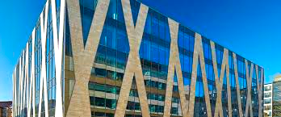
Data Management and Software Centre
Provide world leading scientific software and scientific computing support
for neutron scattering at ESS
Scientific Software development.
Experiment control
Data acquisition system
Data reduction, analysis & modelling
Data centre operations.
Dual location - Lund & Copenhagen
Data management and curation
User programme support
Data scientists
User office software
Remote access to data and software tools
Stream
events
&
meta data
Visualise
data
Analyse
data
Experiment
control
Live reduction

Slide 5
DMSC Organisation construction phase
DMSC
Data Systems
& Technologies
6FTE
DAQ & Data
Management
13FTE
Instrument Data
8FTE
Data Analysis
& Modeling
11FTE
Project admin
3FTE
Copenhagen Data Centre
DMSC servers in Lund
Clusters, Workstations
Disks, Parallel File System,
Database Servers
Networks (incl. Lund – CPH)
Data transfer, Back-up & Archive
External facing Servers
User Program Software –
Proposal & Scheduling Systems
Detector readout
Data Acquisition
File writers (NeXus)
Data curation
Instrument Control User
Interfaces
Live Visualization
Data reduction (MANTID)
Analysis codes MCSTAS support + dev.
Project support
Budget & schedule
Meeting organisation
Construction budget 20mio euro
+ SINE2020 (40pm) Brightness (23py)

Slide 6


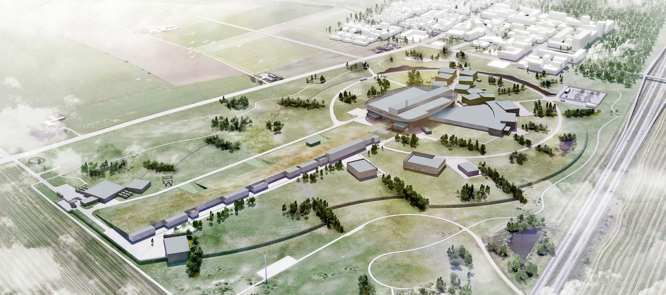
Challenges

Slide 7

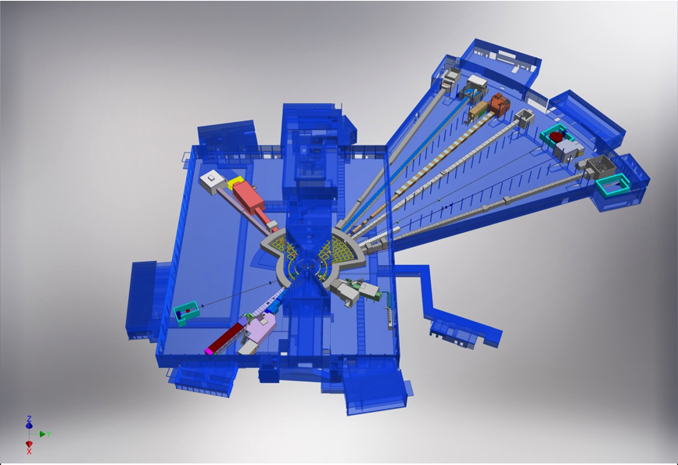

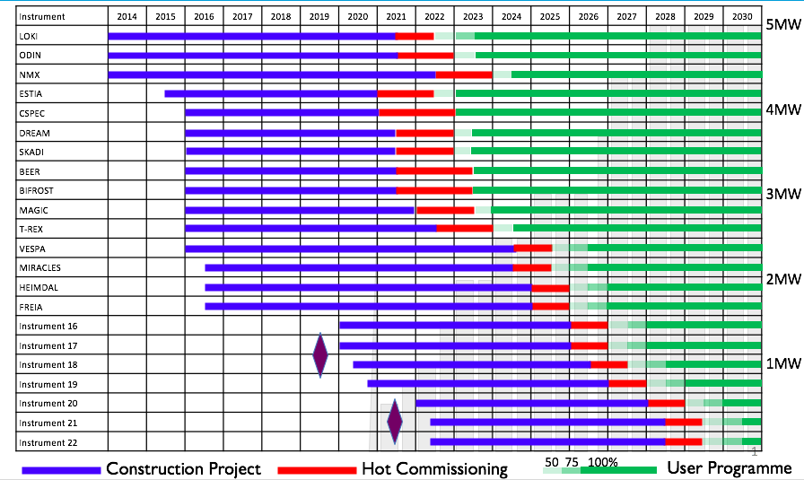
Challenges
Scientific computing for this
To this schedule

Slide 8

Scientific computing challenges at ESS
High event rate >10^7
Complex detector geometry
Software DAQ solution

Slide 9
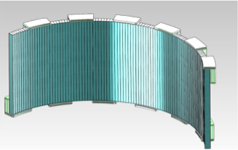
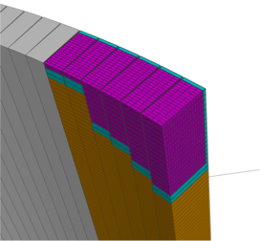
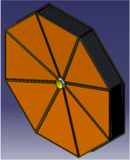
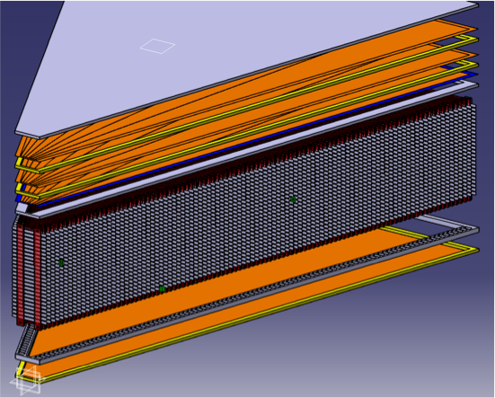
The detector geometry challenge
3 key issues
  Shape
  Position
  Number
10B Detectors are not geometrically simple to describe
Channel count is increased to deal with the rate
Each instrument is different
Instrument detectors are not always static
They all flow gas

Slide 10
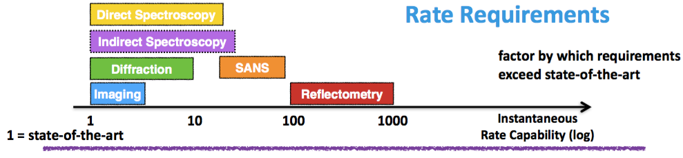
Data rate challenge
The detector rate challenge presents the same challenge to DMSC
Average data rate ~8GB / minute / instrument on disk

Slide 11
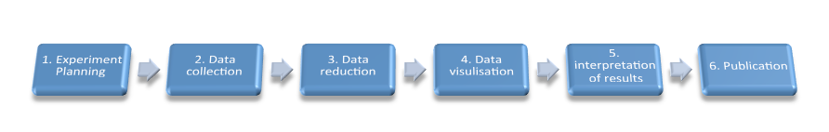
Research pipelines
Data pipelines
Pre Beamtime
Beamtime
Post Beamtime
Data collection needs to be Flexible
Experiment
Planning
Data
Collection
Data
Reduction
Data
Visualisation
Analysis & Simulation
Interpretation
Data reduction needs to be Fast
Proposal
Analysis and interpretation are a barrier to publication
Virtual experiment aided planning
Live data view
Data driven collection
DAQ should be data driven
Common data backplane
Simplified remote access
Common experiment and simulation data
Notes:
this is our workflow
often high through put beamlines if data is not analysed at the end of the experiment it will not get published

Slide 12
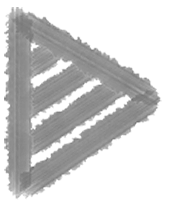
Horizontal vs vertical scope
Centralised scientific computing
Maximise common features
Easier to maintain
Ensure quality
Standard approach across facilities
Instrument specific
Data analysis
Data reduction
Instrument control
LOKI
Skadi
CSpec
TREX
BiFrost
MIRECLES
Vespa
DREAM
HIEMDAL
NMX
MAGIC
FRIEA
ESTIA
ODIN
BEER
Data analysis
Data reduction
SANS
Direct geometry
Indirect geometry
Diffraction Powder
Diffraction XTAL
Reflectometry
Imaging
Engineering
Live data reduction Framework and visualisation
Experiment control Framework
DAQ
Detector readout
12￼
User office
Compute & storage

Slide 13
DMSC priorities for instruments
  Quality
  Data acquisition, detector readout & data management Operation of interim cluster
  Experiment control
  Data reduction & data correction
  Data analysis for early scientific success

Slide 14
Current and Planned in-kind
Data streaming - STFC active
Data reduction and experiment control STFC active
Experiment control PSI active
Data curation PSI active
Imaging data treatment PSI agreed at PSI
Reflectometry / QENS / Engineering diffraction data treatment FZJ agreed by FZJ

Slide 15
Software development
Collaborate on projects
Engage with the community
Project Governance
Don’t reinvent
Use the right tools
Be open

Slide 16
What is already decided
Event mode collection
Controls architecture
Mantid for reduction and visualisation
NICOS2 core experiment control
SASView
Several in-kind packages

Slide 17
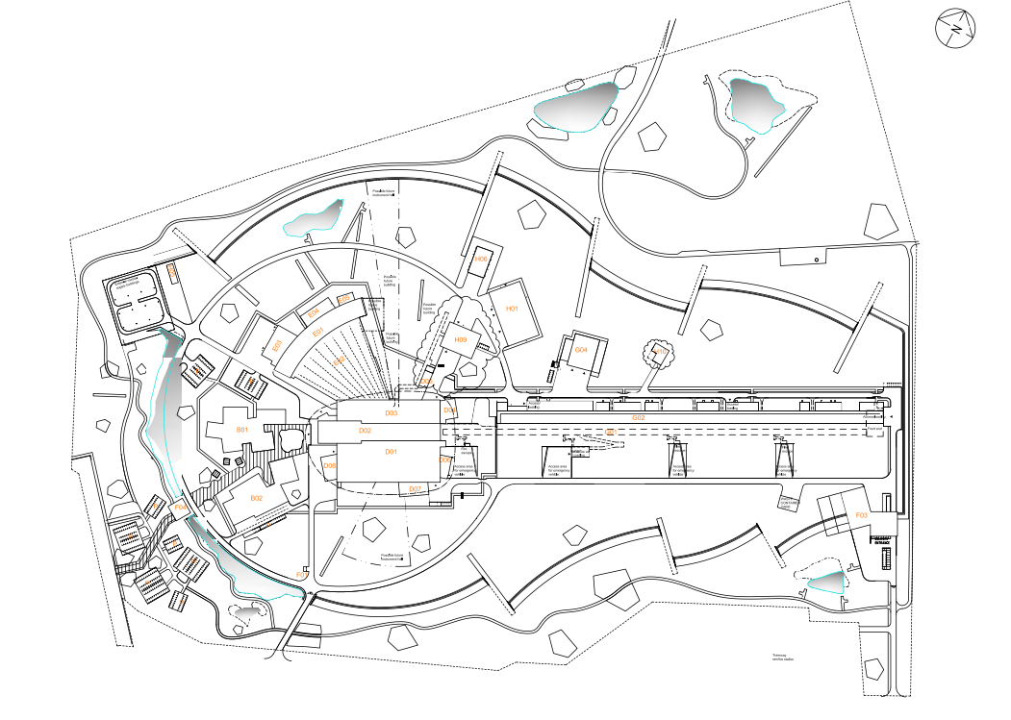

Infrastructure
Global fibre route
Focus on network capacity
  Dual redundant link from instrument to server room
  Instrument on virtual LAN that includes server room infrastructure
Minimise hardware deployed on instrument
ICS DMSC Comms rooms
H01 server room
Shared comms room ICS & DMSC
Detector read out hardware instrument / H01
Experiment control server in H01
Online data reduction in H01
Online analysis in H01
archival storage in CPH
Systems can failover between locations
Offline reduction analysis and modelling in Copenhagen

Slide 18
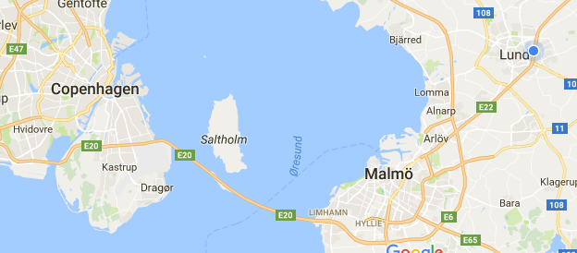

Centralised scientific computing
Visiting
Scientists
Remote
Scientists
SUNET

Slide 19
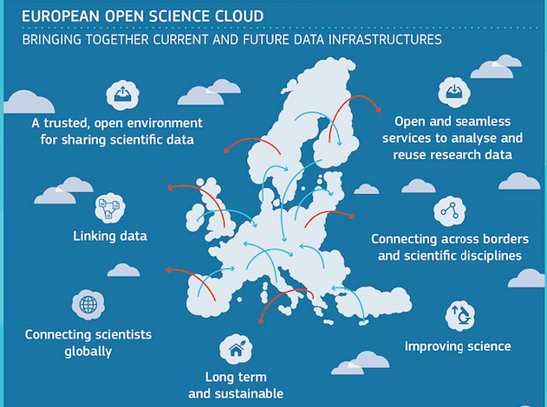
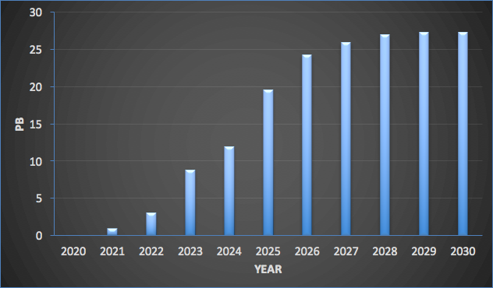
Hardware infrastructure
Focus on user experience
Maintain and upgrade interim cluster
European Open Science cloud pilot
DevOps infrastructure
Storage estimate for initial ops
Parallel file system in Lund
Parallel file system in Cph
Cluster based architecture for reduction / analysis
Virtual machine architecture for user interface
Construction phase delivers initial storage.
Compute capacity ramps to 6000 cores by 2025

Slide 20

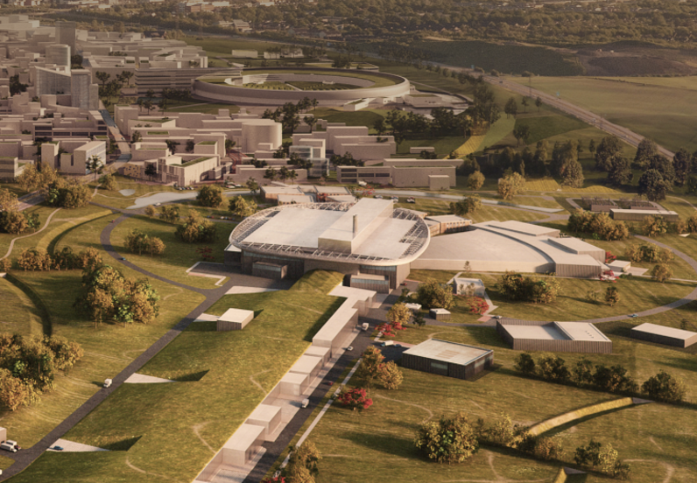
User office software
Collaboration with
Objective : A single user portal for P&N in Lund

Slide 21
DAQ progress
Detector read out & file writer Brightness
Streaming STFC in-kind
Data curation PSI in-kind
Software solution for detector readout works
Data streaming solution has required performance
Solution is actively tested at ISIS

Slide 22
ESS data pipeline
DMSC Hardware
Detector Backend
Event Formation Unit
MRF
10 GB/s fibre
NeXus File Common storage
Detector Backend
Event Formation Unit
Instrument Hardware
Data Aggregation (Kafka)
Chopper
MRF
EPICS
EPICS /Accel Bridge
Motion/SE
Live Feedback
Experiment control layer
BrightnESS is funded by the European Union’s Horizon 2020 research and innovation programme under grant agreement No. 676548

Slide 23

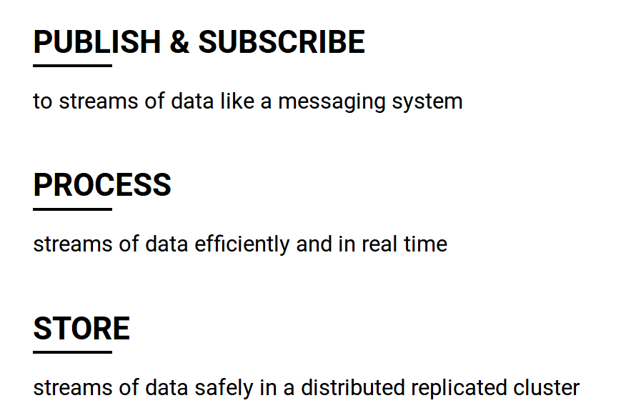







Slide 24
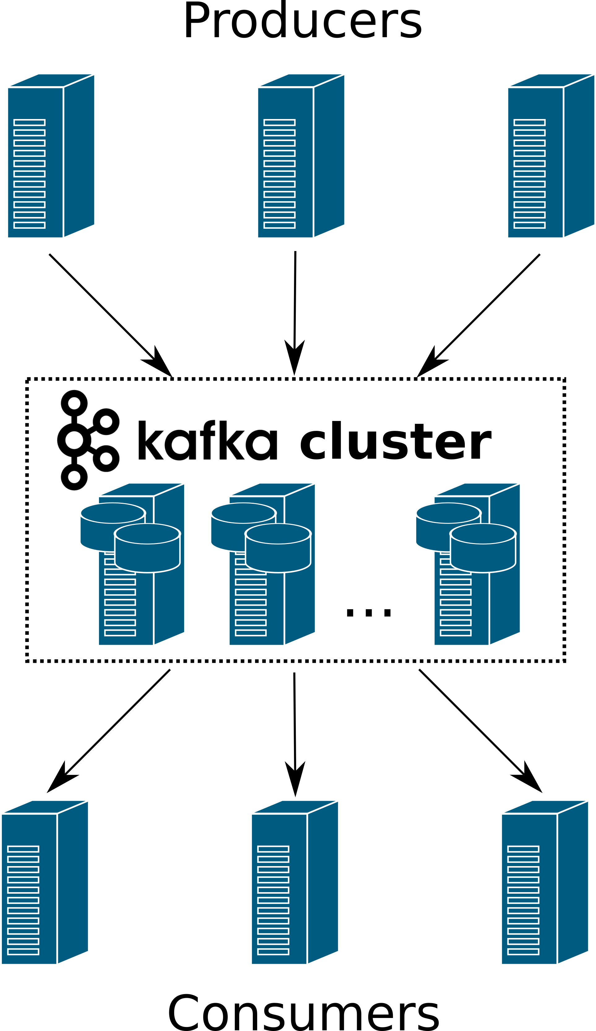
Kafka for DAQ
Detectors
Aggregator
File writer
Live & auto reduction

Slide 25
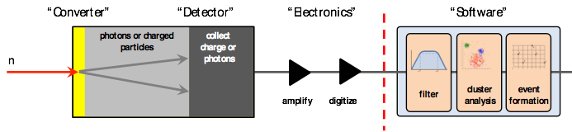
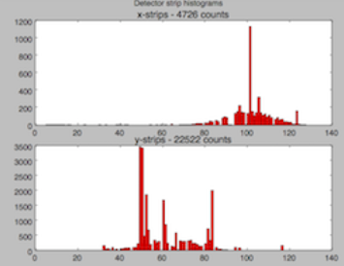
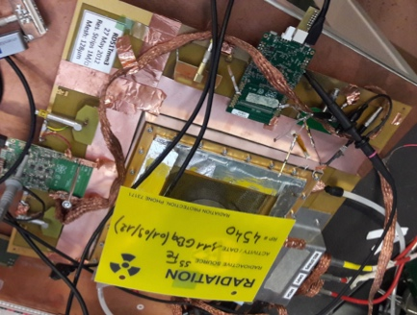
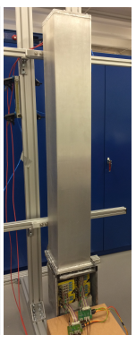
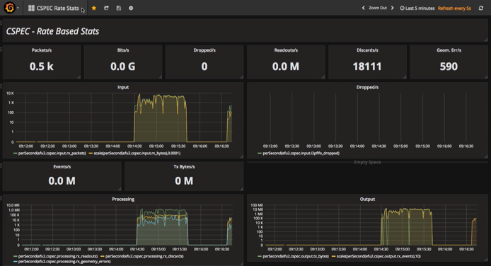
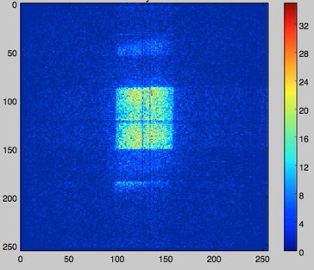
Detector readout
Event formation stage.
Collaboration with ESS detector group
Scaleable for rate
Configurable for detector performance & gamma rejection
Detector community very interested in this development

Slide 26

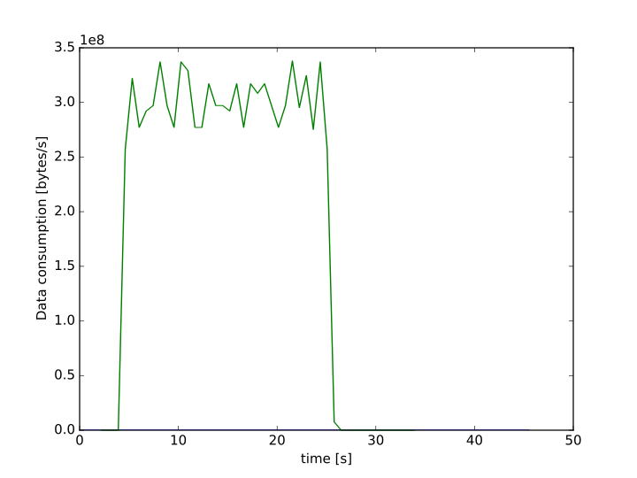
Streaming proof of concept
Streaming a NeXus file through Kafka to Mantid
Scaleable performance
~3x10⁷ events/s

Slide 27
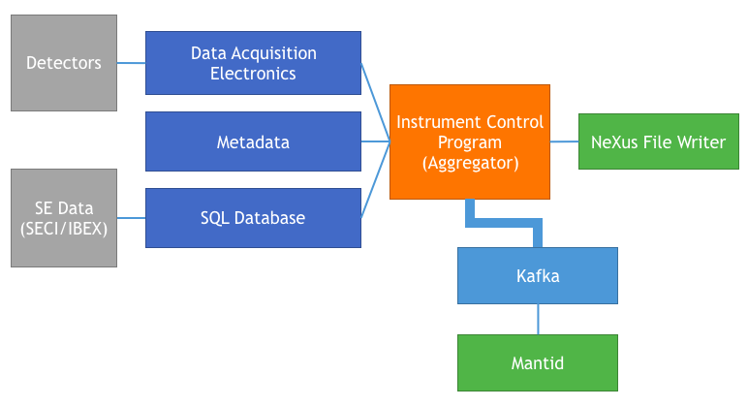

Streaming in a live environment
Production Mantid integration
Integration with Experiment control layer
End to end test on test beam line

Slide 28

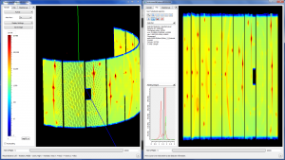
The Mantid Project
Neutron specific data treatment framework
Standardised beyond data format
Event data capable
Live view
Complete instrument geometry
nD data visualisation
Data and software curation
App based UI
Python interace
Jupyter notebook
MPL graphing
28￼

Slide 29
Mantid Performance requirements
Requirements -
  live data reduction for an event rate of > 10^7
  Filter good events from bad events
  Capability for handling of complex geometries

Slide 30
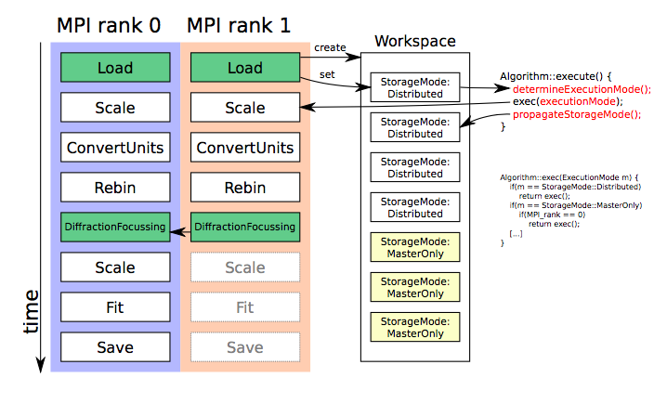
Towards live data reduction.
Mantid has
  Geometry
  Data types
  algorithms
Create a common MPI implementation
Introduce type safety

Slide 31
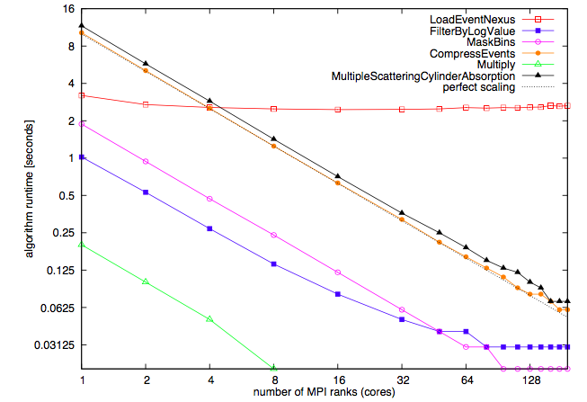
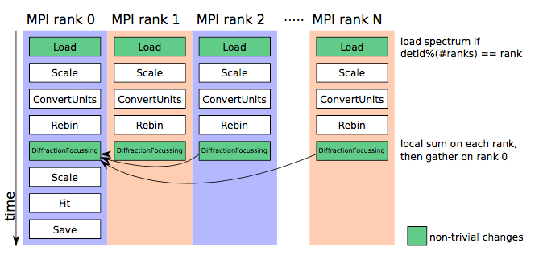
Initial MPI tests
MPI more effective than threads.
A number of ways to achieve load balance
We balance on spectra

Slide 32
Instrument 2.0
Instrument stores geometry and meta data.
r,t,p spectrum ID map, isMasked…
Complex detector geometries
Requires high performance
MPI compliance
PixID #
Spectrum #

Slide 33
Instrument 2.0 refactor
Reengineered parameter map implementation
  For current & future use cases
  MPI uses in particular
  Scanning instruments
Cached info layers
  Detector
  Spectra
  Mask
Cleaner interface for developers

Slide 34
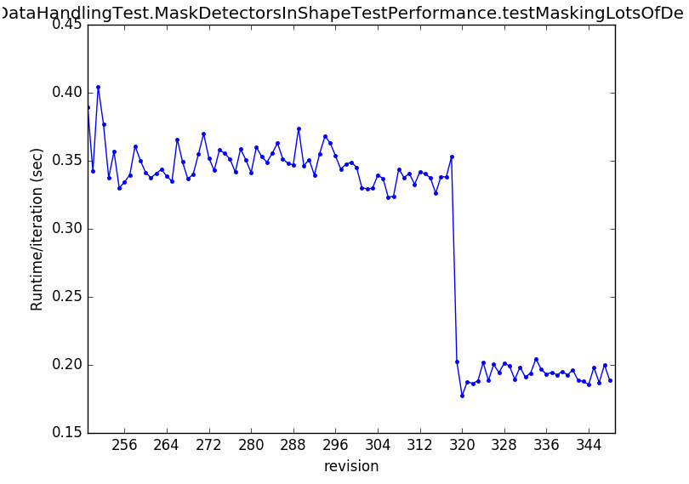
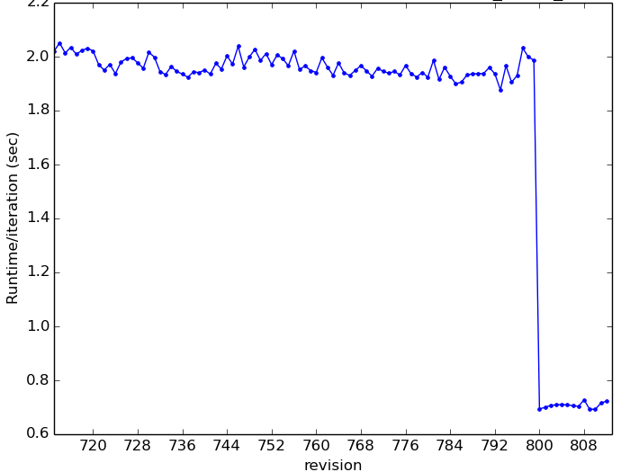
  Results
Highlights the cost of refactoring
Significant improvements across Mantid
ILL can load interlaced scans from D2B into Matrix
Direct geometry workflow x2 faster
Perf test for Mask Dets
Perf test for Convert Units

Slide 35
Experiment control progress
Data chain is well described
All scope is covered by DMSC / ICS / NT / SAD
Experiment control project
  DMSC + ISIS in-kind + PSI in-kind
  ICS + SAD
  Steering committee for all stakeholders
  Instruments represented by Andrew Jackson
PDD ESS0102794
Base framework will be NICOS2
Deployed on V20 TBL

Slide 36
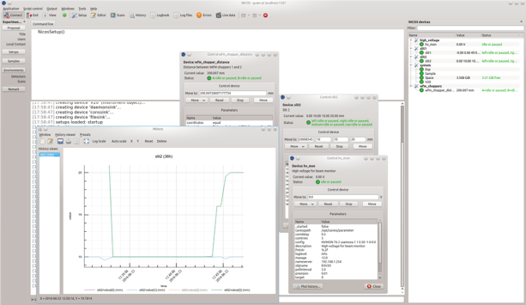

Experiment control - NICOS II
High level interface for users/scientists
Written entirely in Python
Communicates with hardware via EPICS/Channel Access and other protocols
Developed for FRM II
Deployed at V20 test beam line by ESS

Slide 37
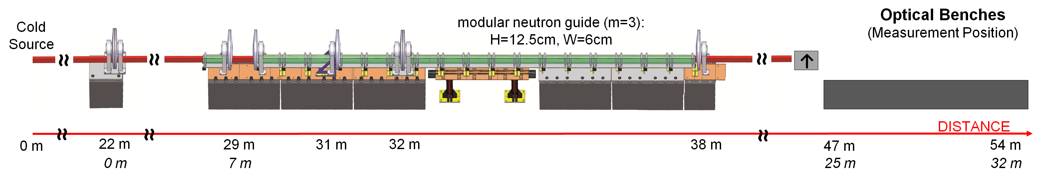
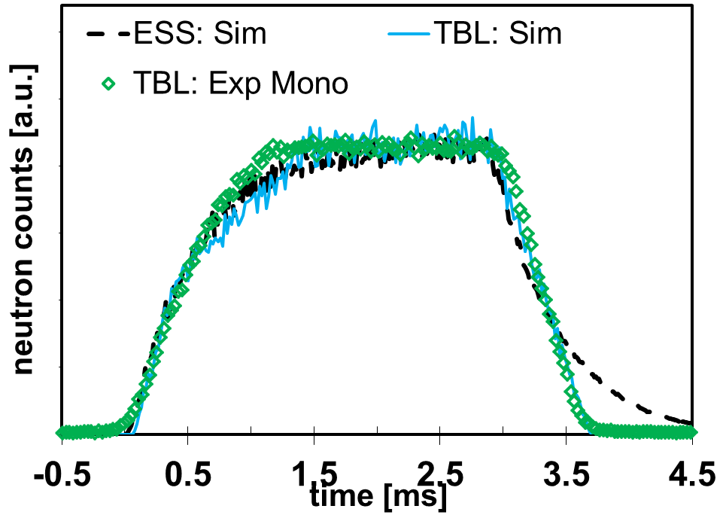
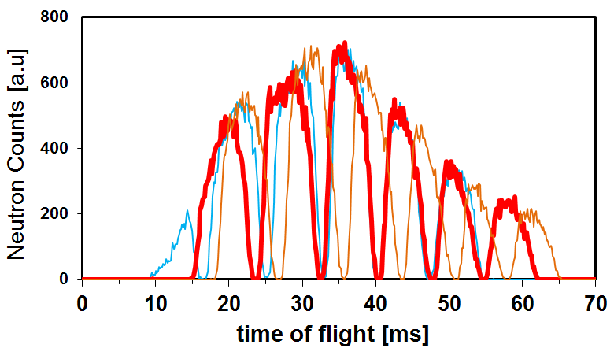

V20 Test beam line
Source
Chopper
WFM
Chopper
WB
Chopper
FOL
Chopper
FOL
Chopper
Experiment control integration
WFT data reduction tests
User experiments with Nicos
Integration with ICS EEE systems
ESS timing system deployment
End to end DAQ test deployment
Deploy onto ESS test beam line

Slide 38
Next steps
Production MPI design
    Matrix workspace
    MD workspace
Integration of DAQ into ECP
User experience
  How will users interact with the DAQ reduction and analysis systems at ESS

Slide 39
ESS Test Beam line
First onsite integration of DAQ and experiment control.

Slide 40
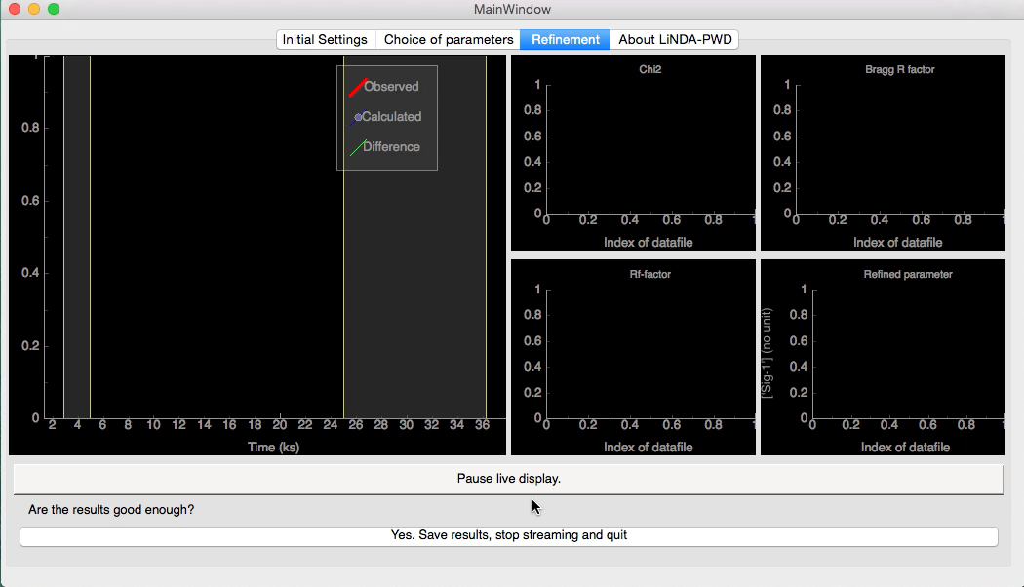
Community driven data analysis
Sustainable analysis software.
Community engagement & governance
Active research.
In-kind and collaboration mix
VR grant with Chalmers for new ways to model S(q,w) from MD simulation
VR Grant with LU for computational analysis of molecular self assembly
Collaboration with Chalmers for computational modelling of diffraction data to extract chemical order parameters

Slide 41
SINE2020 WP10: Data treatment software
Each facility takes control of one technique specific analysis software:
Technique | Facility | Software (PM)
Imaging | PSI | MuhRec/KipTool (23)
QENS | ILL | Mantid (12)
Reflectometry | MLZ | BornAgain (36)
SANS | ESS | SasView (42)
Guidelines & Standards | ISIS | N/A (based on Mantid project experience)
+ activities on simulations, muons and Mantid for continuum sources
Ranked most important WP by Head of Facilities among those proposed for SINE2020:
“of highest interest/priority for the future of the neutron community, must be taken forward in a common project.”
Notes:
Double check numbers

Slide 42
Instrument software delivery projects
Tie specific DMSC deliverables to instrument schedule
1 instrument 1 project
  Capture all DMSC related deliverables
  DAQ, Control, Reduction, Analysis, data management
  Generate milestones for delivery
Define essential ‘must have’ requirements
Define completion
6m update meetings
No funding for unwanted development

Slide 43
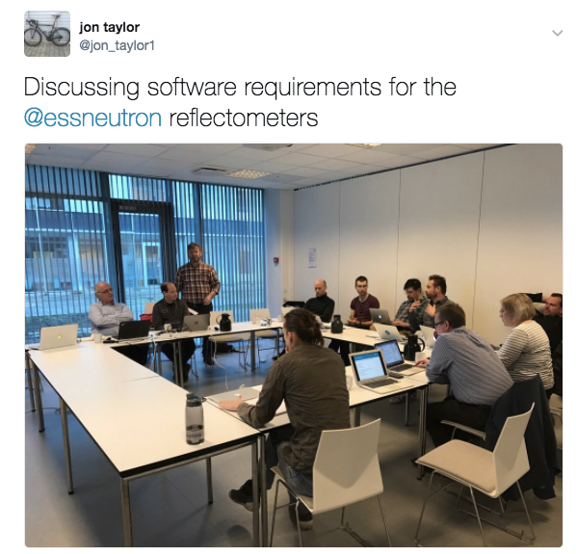
Instrument software projects
Charge:
Outline & agree the core requirements* for instrument control
Outline & agree the core requirements for data reduction
Outline & agree the core requirements for data analysis
Provide a realistic time line into full operations of diffraction instruments for DMSC.
*core requirements are provided within the DMSC budget for construction,
more with operations funding beginning in 2019.
DSMC / STAP and Instrument teams
Reflectometry 21st March
Diffraction April 7th
Imaging 26th-27th April
Spectroscopy 15-16th May
SANS 1st - 2nd June

Slide 44
Key discussion points
Key message promote science delivery
Framework for reflectometry analysis development
Community gap for single crystal diffraction with PN
Bragg edge diffraction software for imaging
Data management and acquisition for imaging
Simple user experience focus on science domain
Rietveld for Inelastic scattering

Slide 45
Software requirements for buildout
Software requirements are not the same in all phases
Software development needs integration with instrument schedule
Process drives our strategy for transition to operations and early science
Installation
Cold
commissioning
Hot
commissioning
Operation
2020
2021
2022
DMSC
construction phase
DMSC
operation phase

Slide 46
Instrument software strategy
Digest and act on software meetings
  Group commonalities
  Focus on science & community
Define milestones for instrument software delivery

Slide 47
Project delivery milestones
Detector readout & DAQ chain ready for testing (with source)
Detector readout & DAQ chain ready for testing / commissioning with neutrons
Detector readout & DAQ ready for user programme
Controls & Controls functionality required for cold commissioning
Controls & Controls functionality for hot commissioning
Experiment Control functionality for user programme
Data reduction / visualisation for commissioning (source) or hot commissioning
Data reduction functionality ready for early science
Data reduction functionality ready for user programme
Data analysis functionality ready for early science
Data analysis functionality ready for user programme
Compute requirements for cold —> hot commissioning
Storage requirements for commissioning H & C
Storage requirements for user programme.
Remote access functionality for early science & user programme

Slide 48
Moving into operations
Cover deferred scope efficiently 2019-2023
Provide support and on call
  Common ops shared with ICS / IT in Lund
Staff recruitment to cover ESS Lund
Operations staff profile benchmarked against existing facilities
Total cost shown inc power & office (covered by Admin)
 | 2020 | 2021 | 2022 | 2023 | 2024 | 2025 | 2026
Data centre ops | 775 | 765 | 1445 | 3081 | 625 | 648 | 152
Total non labour k euro | 2375 | 2087 | 2860 | 4564 | 2098 | 2363 | 2087
Total labour k euro | 4369 | 4941 | 5400 | 5616 | 5616 | 5832 | 6156
Total k euro | 6743 | 7028 | 8260 | 10180 | 7714 | 8195 | 8243

Slide 49
Delivering science Maximising impact
Delivering instrument software projects
Commissioning systems & training users
Understanding the source
Developing features
Data centre operations
Data management
User support
  Data reduction & analysis
  Simulation & modelling

Slide 50
DMSC structure in operations
DMSC
Data Systems
& Technologies
12FTE
Experiment control
Data curation
12FTE
Data reduction and data analysis
7FTE +7FTE
Scientific modelling
and simulation
4FTE
Project admin
(Petra Aulin)
3FTE
User office support
4FTE
Storage and compute
Data centre operations Lund
Data centre operation CPH
Inter site connection & network
Software Deployment
Security
Readout DAQ and Control
Data management
Data curation
Data reduction & visualisation support and development
Data analysis support & development
Support and integration of MD and a-priori simulation tools
Project support
Budget & schedule
Meeting organisation
Development, support and maintenance of user office solution
User database
proposal system
Visit system
sample tracking
Construction - Build capacity and capability to support a user programme
Operations - Deliver a supported user programme
FTE numbers shown for 2022

Slide 51
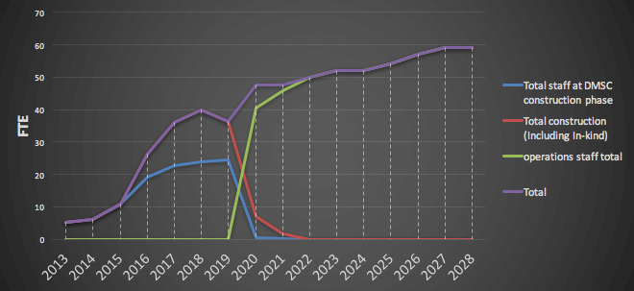
DMSC staff profile - Construction to operations
Steady state operations level benchmarked against ISIS, DLS, SNS, ESRF, ILL
Operations staff mix
  In-kind off & on site
Staff in Cph & Lund Data scientists 0.5FTE per instrument

Slide 52
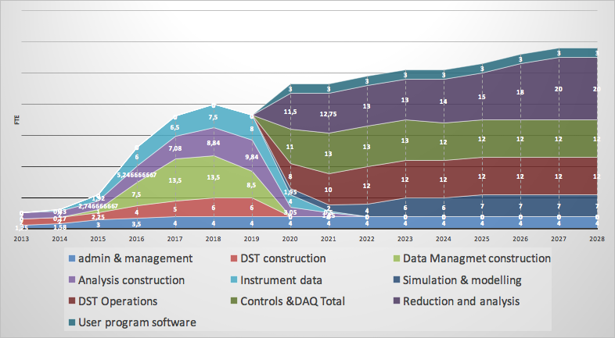
Staff profile by group

Slide 53
DMSC summary - Focus on science delivery
A lot of progress is being made
Instrument team integration
Define DMSC strategy and priorities
  2017 - 2020 EOC
  2017 - 2023 science delivery

Slide 54
Thank you
Questions

