Slide 1
NSS Project update
Shane Kennedy
NSS Project Leader
www.europeanspallationsource.se
17 May 2017

Slide 2
Topics
Update on In Kind participation
Project Budget and Schedule
Update on Neutron Bunker project
The ESS-Test Beamline
Standardization activities

Slide 3
Contributions to Neutron Instruments
Country Summary (for 15 instruments)
Partner Country | Commitment to Instruments (M€) | % of Instrument budget
Czech Republic | 7.5 | 3.8%
Denmark | 7.3 | 3.7%
France | 28.6 | 14.3%
Germany | 53.9 | 27.0%
Hungary | 4.7 | 2.4%
Italy * | 16.2 | 8.1%
Norway | 10.3 | 5.1%
Spain | 13.2 | 6.6%
Switzerland | 27.0 | 13.5%
United Kingdom * | 24.7 | 12.4%
ESS-Lund | 5.5 | 2.8%
Unassigned | 0.7 | 0.4%
total | 199.6 | 100%
Unassigned
IK = 193.8 M€
IK contributions = 97 % of instrument budget
* Split of IT & UK contributions for FREIA & VESPA to be determined
May 2017
Notes:
Main unassigned scope = 0.7 M€ => NMX

Slide 4
NSS other In-Kind Contributions
Country Summary
Main IK items outside of Instrument delivery
Experiment control systems (PSI)* 0.75 M€
BandGEM detectors (CNR) 0.5 M€
Data reduction & streaming (STFC) 2.9 M€
Detector readout system (STFC) 3.0 M€
User Laboratories (STFC) 1.0 M€
Data Curation (PSI) 0.65 M€
Other contributions 3.7 M€
(DK, EE, FR, HU, NO, etc…)
Total value 16.3 M€
> 11 M€ approved by IKRC, the rest is in preparation
May 2017
Notes:
Pie-chart to the right needs to be updated

Slide 5
NSS total In-Kind Contributions
Country Summary
Assigned value for instruments = 193.8 M€
“ of other contributions = 16.3 M€
Total In-Kind Value assigned = 210.1 M€
May2017

Slide 6
NSS budget status & forward projection
NSS Project Budget Item | Budget (M€)
Neutron Beam Instruments (NBI) | 200.0
Instrument Technologies | 49.1
Science Support Systems | 24.9
Data Management & Software Centre | 20.1
Neutron Bunker (including floor) | 18.0
NSS Integration/management | 11.2
Instrument Concepts | 6.0
Science Directorate Management | 5.1
Polarization Analysis System ² | 4.0
ESS - Test Beamline¹ | 0.8
Orphan/emerging scope: | 2.41
Total contingency | 20.3
NBI Contingency | 11.06
non-NBI Contingency (fixed at 10%) | 9.23
Total NSS Budget (BAC) | 361.9
Estimated cost at completion (EAC) | 370.2
NSS Project is 15.4 % complete
Projected IK value is 219.9 M€
Contingency split
as % of cost to complete (c2c):
10 % for non-NBI, 5.7 % for NBI
EAC – BAC = 8.3 M€ (3 % of c2c)
¹Test Beamline; excludes BrightnESS (1 M€)
²PA systems, bottom up costing - Q4 2017

Slide 7
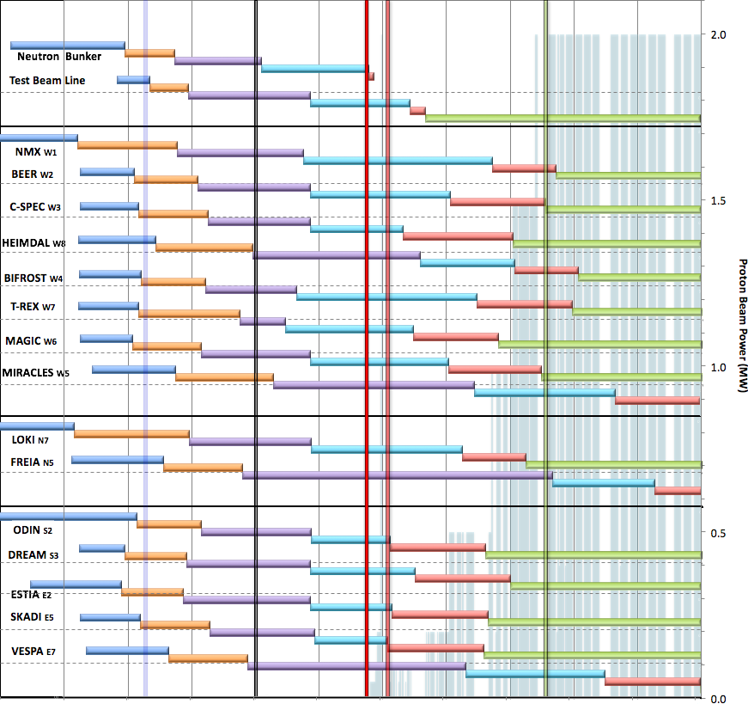

Internal* Neutron Beam Instrument Schedule
Draft for Discussion V3.2, 9th May 2017
Current date
First access to NSS areas
Beam on Target
Hot Commission
instruments
Start User Program
* still under discussion with ESS-ERIC Council
NOTES:
Assumes 2MW maximum power until end 2025
Phases aligned with TG2 reviews on 1st 9 NBIs
TG4 (Installation & Integration) not yet aligned with on-site resource plan
West sector
North sector
East and South sectors
Preliminary Design
Detailed Design
Manufacturing & Procurement
Installation & Integration
Hot Commissioning/Early science
Operation
2016 2017 2018 2019 2020 2021 2022 2023 2024 2025
Installation for most instruments begins in Q2/2019 with in-monolith optics
Access to other “instrument construction areas” will be later

Slide 8
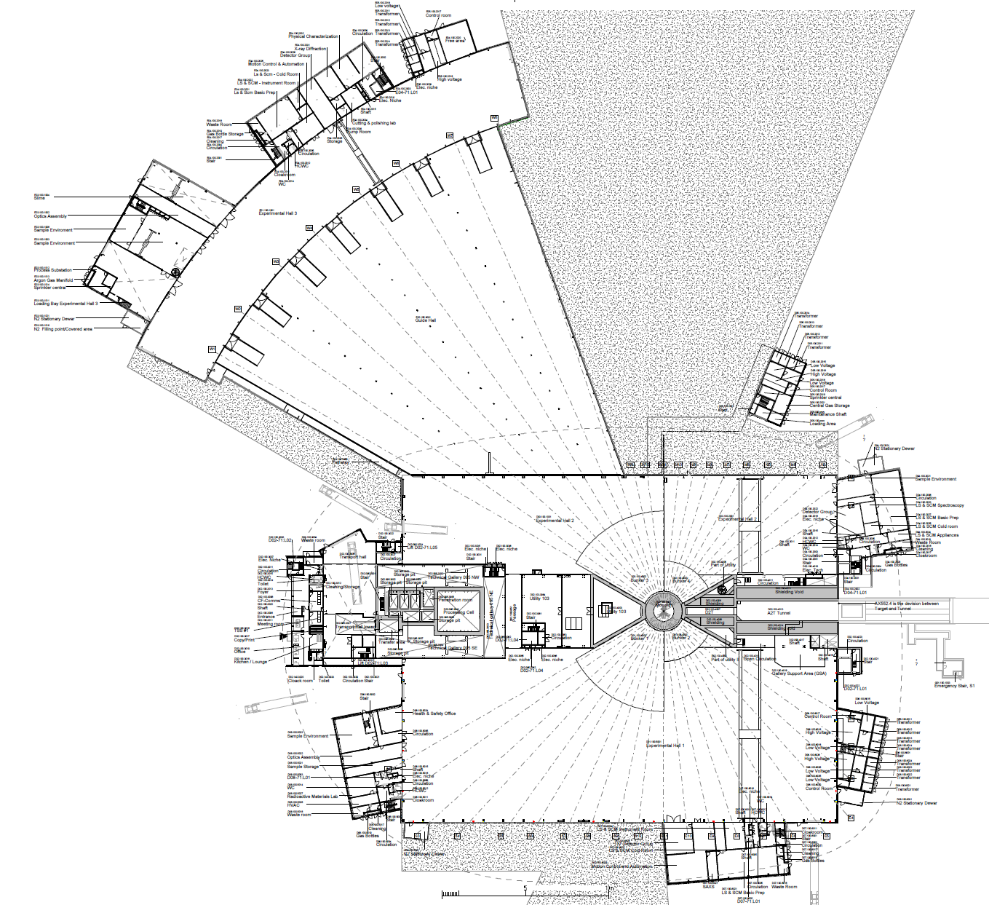
2019/2020: NSS Proposed Access Dates (Excludes Full Access Dates)
1
D08 RML Lab – Early Access 10-Jan-19 (Level 1b MS)
E05
2a
E01 – Full Access 27-Apr-19 (Level 1 MS)
E04
2b
E02 Area 1 – Partial Access 27-Apr-19 (Level 1 MS)
3
D03 Bunker – * Early Access 03-Jun-19 (Level 1 MS)
E01
2a
4
D01 Bunker – * Early Access 14-Aug-19 (Level 1 MS)
E03
2b
5
E02 Area 2 – Partial Access 15-Oct-19 (Level 1b MS)
6
D03 Main Hall – Partial Access 01-Nov-19 (Level 1b MS)
E02
7
D01 Main Hall Ph 1 – Partial Access 06-Jan-20 (Level 1b MS)
Exact Location of Final De-Lineation Point TBC
5
8
D01 Main Hall Ph 2 – Partial Access 02-Mar-20 (Level 1b MS)
D05
D04
Additional Area Made Available for Storage of Blocks (D03) for NSS: 01-Sep-19
6
3
D03 Cranes Operational: 13-Aug-19
Early bldg access dates;
Monolith (D02) 7 Feb ’19
North (D03) 1 Nov ‘19
East (D01-E) 6 Jan ’20
South (D01-S) 2 Mar ‘20
West (4 areas)
  Guides (D03-W) 1 Nov ‘19
  Guides (E02-2) 15 Oct ’19
  Guides (E02-1) 27 Apr ‘19
  Caves (E01) “
4
D06
D08
8
Additional Area Made Available for Storage of Blocks (D01) for NSS: 01-Oct-19
1
7
D01 Cranes Operational: 28-Oct-19
Area Under Review for Possibilities of Early Access for NSS
D07

Slide 9
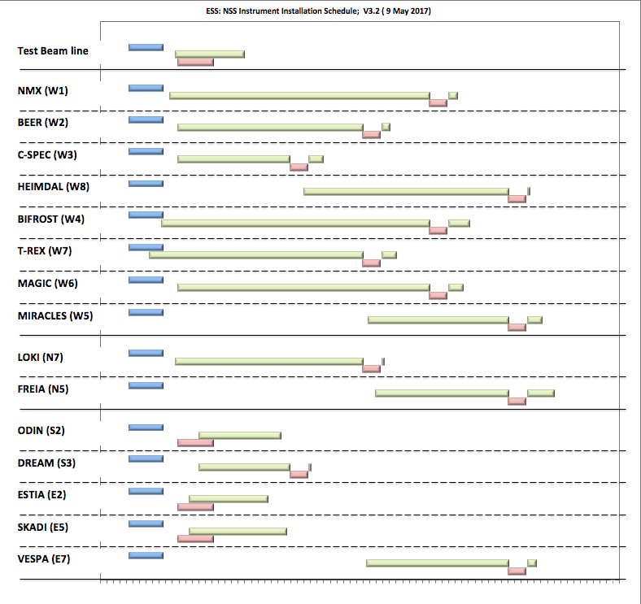
Internal* NBI Installation Schedule
Draft for Discussion (from V3.2, 9th May 2017)
* BOT still under discussion with ESS-ERIC Council
Beam on Target
Hot Commission
instruments
Start User Program
NOTES:
Plan aligned with access dates to D & E buildings
TG4 (Installation & Integration) according to on-site resource plan – not yet aligned with NBI schedules
West sector
North sector
East and South sectors
In monolith
In bunker
Out of bunker
2019 2020 2021 2022 2023 2024 2025

Slide 10
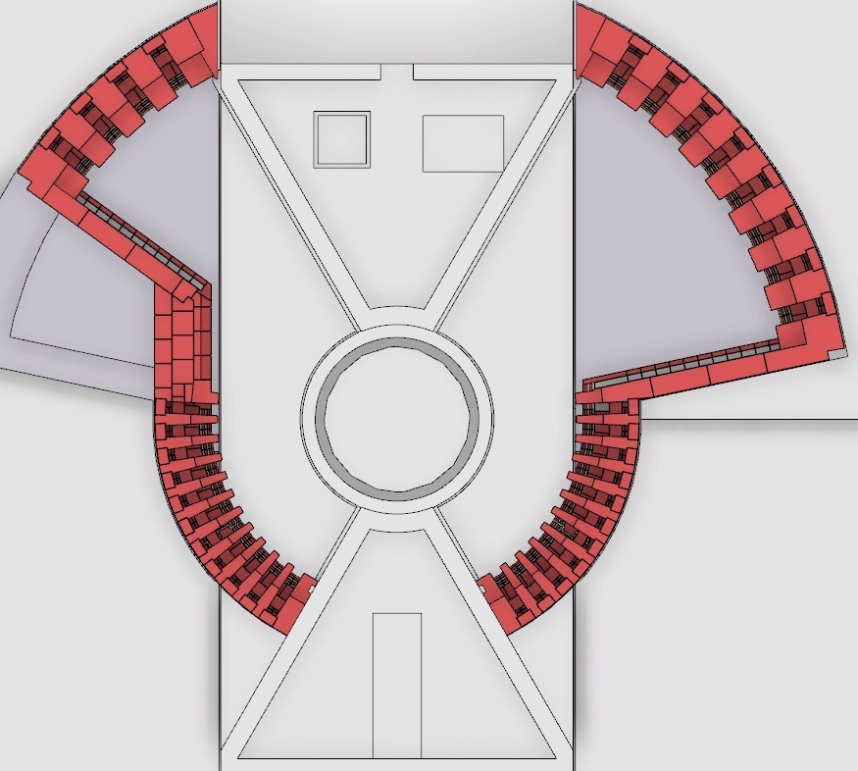
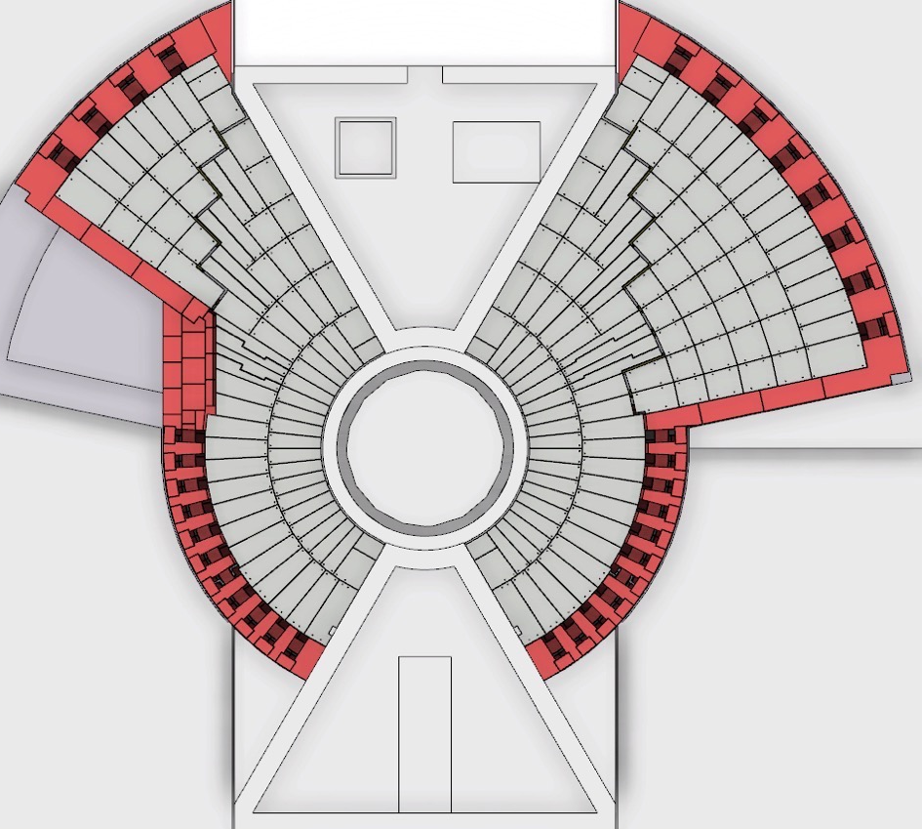
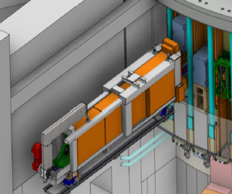
Preparing for BOT and first BOI:
In bunker activities
NMX
First installations in bunker:
(Feb – Sept 2019)
Neutron Beam Optics in monolith & light shutters
ODIN
BEER
DREAM
C-SPEC
BIFROST
MIRACLES
MAGIC
T-REX
HEIMDAL
S2
W1
S3
W2
W8
Next installations in bunker:
(from Nov 2019 – May 2020)
Bunker Optics for first 4 – 8 Neutron Beam Instruments
W11
Test Beamline
E5
N7
E3
N5
E2
LoKI
VESPA
FREIA
Bunker roof completed:
(from Jun – Aug 2020)
Bunker Optics for first 4 – 8 Neutron Beam Instruments
SKADI
ESTIA

Slide 11
ESS Proton Production Schedule from NSS Project schedule V3.1:
DRAFT FOR DISCUSSION
Start User program: Aug. 2023 (Level 0 MS)
Production 200 days/yr @ 2 MW
BOI#6, #7 & #8
BOI#4 & #5
Commission
Accel/Target
BOI#1
(L1-MS)
BOI#2 & #3
Beam on Target (L1-MS)

Slide 12
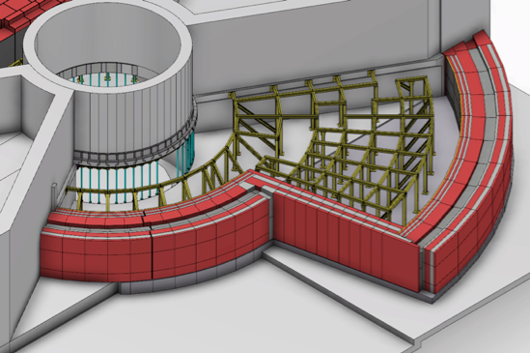
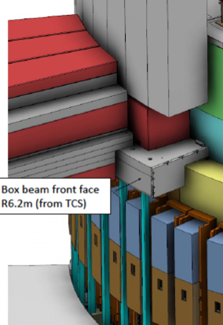
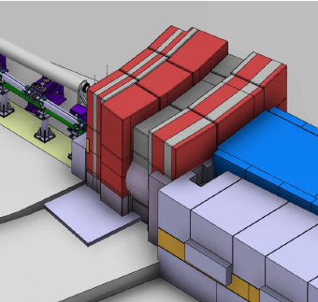
The neutron guide bunker: key milestones
Project start (Manager: Sara G-N) - June 2015
Initial costing (14.6 M€) - Aug 2015
Neutronics calculations 1st report - April 2016
Full time manager (Zvonko Lazic) - June 2016
Revised costing (18.0 M€) - Sep 2016
Bunker concept design review - 4-5 Oct 2016
Preliminary Design Review - 15-16 Dec 2016
Internal Design/Cost Review - 26-27 June 2017
Critical Design Review - Sept 2017
Start Manufacturing (Contract) - Jan 2018
First delivery to site (R6 frame) - Oct 2018
Start Installation - Feb 2019
Installation Complete (ready for BOT) - Oct 2020
Bunker design & installation is self managed by NSS.
Bunker manufacturing could be self managed or turn-key (In-Kind involvement is still possible)
SKADI & ESTIA
Notes:
Procurement through CF-Skanska or Nuvia appears most attractive

Slide 13
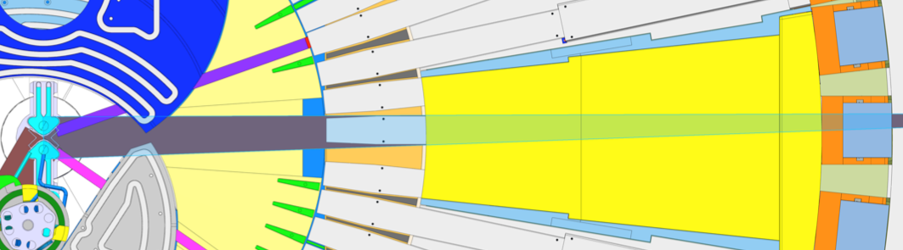
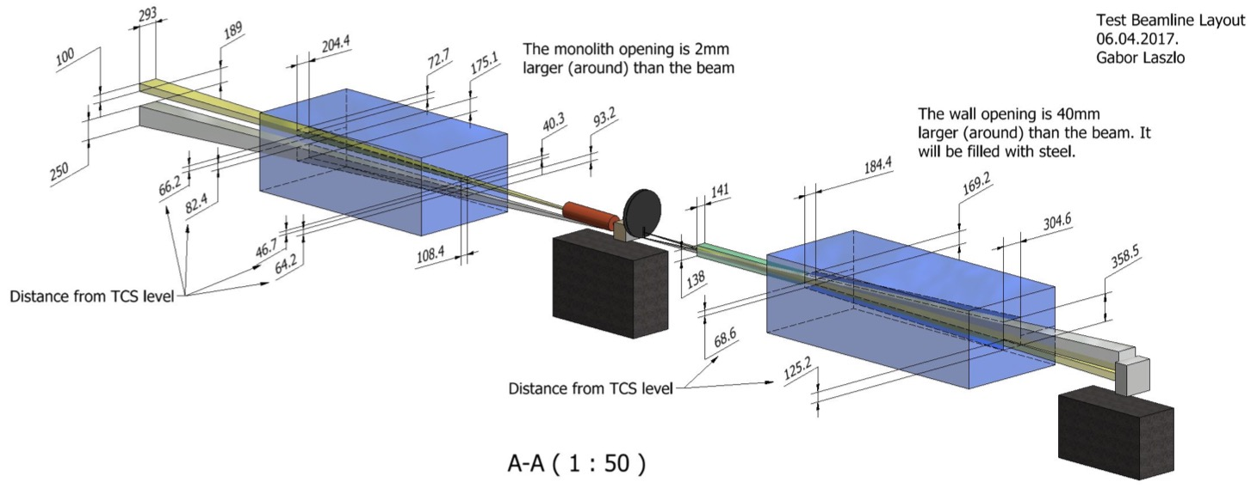
ESS Test Beam Line: Concept
W11 - trajectory
90° to moderator plane, no occlusions
Full view of moderator
L ~ 17 metres, Magnification ~ 1

Slide 14
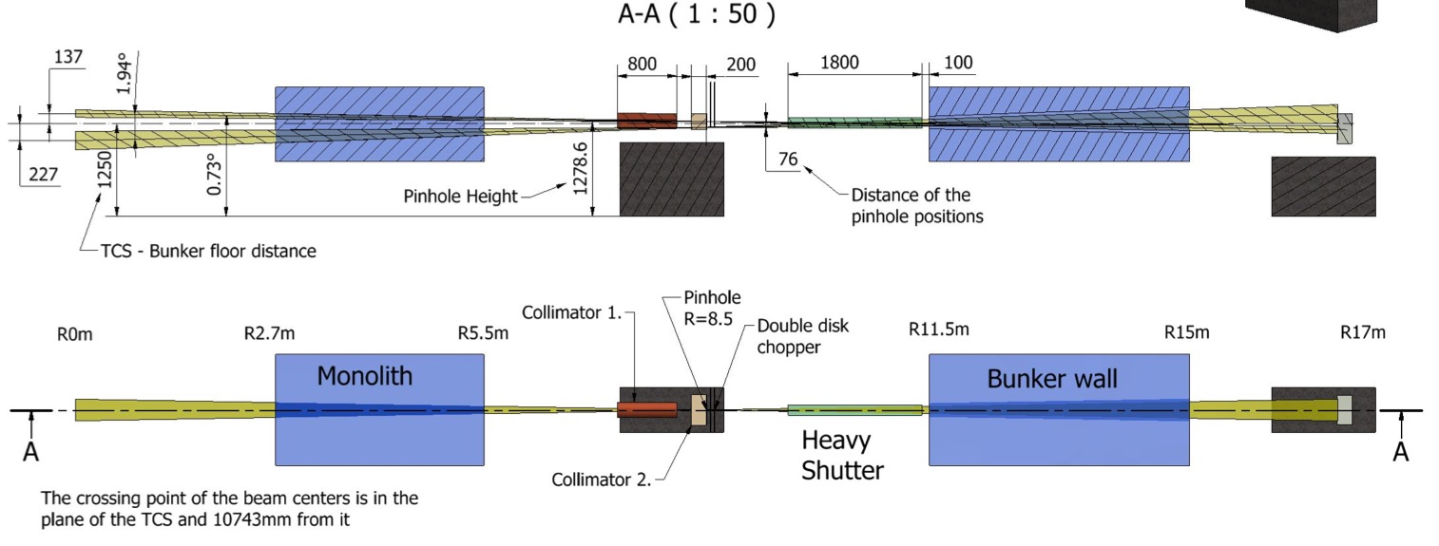
ESS Test Beam Line: Preliminary Design
(by Gabor Laszlo)
Upper schematic: ESS-TBL Elevation view
Lower schematic: ESS-TBL Plan view
ESS Project scope only includes the Upper moderator,
so ESS-TBL project scope is only for upper moderator,
(with provision for upgrade to see both moderators)

Slide 15
In-Bunker components:
Chopper, apertures & attenuators.
BrightnESS contribution (Wigner Institute)
Double disc chopper: Ø = 500 mm, with 5° & 70 mm deep openings, maximum speed is 2000 RPM.
One disc has two openings at 180°, the other disc has three openings at 90°. Depending on speed and synchronization, this allows single or double beam opening each period.

Slide 16
In-Bunker components:
Heavy Shutter & optical bench
BrightnESS contribution (Wigner Institute)
Heavy shutter will become the prototype for all NSS project heavy shutters

Slide 17
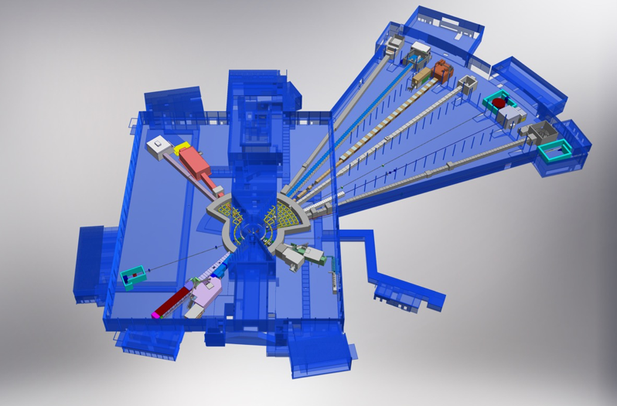
Neutron Beam Line shielding: standard solutions
Heavier beamline shielding for straight beamlines & curved beamlines before line-of-sight
NMX
BEER
C-SPEC
BIFROST
MIRACLES
MAGIC
ODIN
T-REX
DREAM
HEIMDAL
Lighter beamline shielding for curved beamlines after line-of-sight
LoKI
VESPA
FREIA
SKADI
ESTIA
ESS Instrument Layout (December 2016)

Slide 18
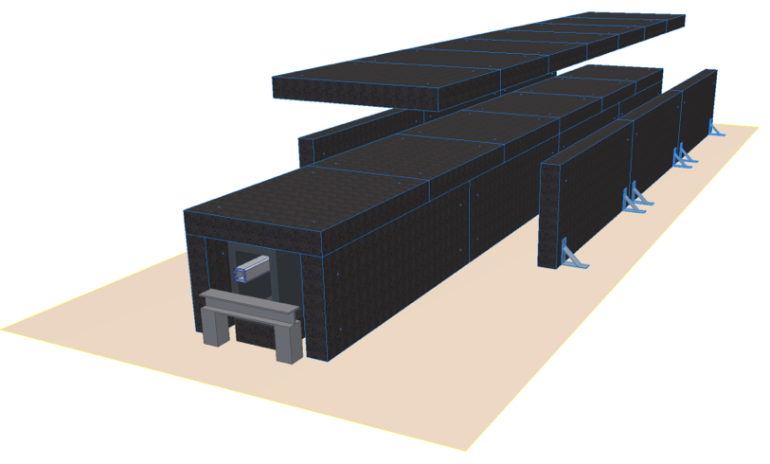
Concept 1: low manufacturing cost
(steel-concrete composite)
Manufacturing Cost: 1
Installation Cost/time: 1
Decommissioning cost: 1
Modularity: 2 level of thickness is easily achievable.
Two types:
    (50-75cm or 60-90cm)
Maintenance of components inside: top access by removing three pieces
Average weight of a
component: 3.9t
No seismic requirement in the ‘E ‘buildings: only Conventional safety!
Concept development by Gabor Laszlo

Slide 19
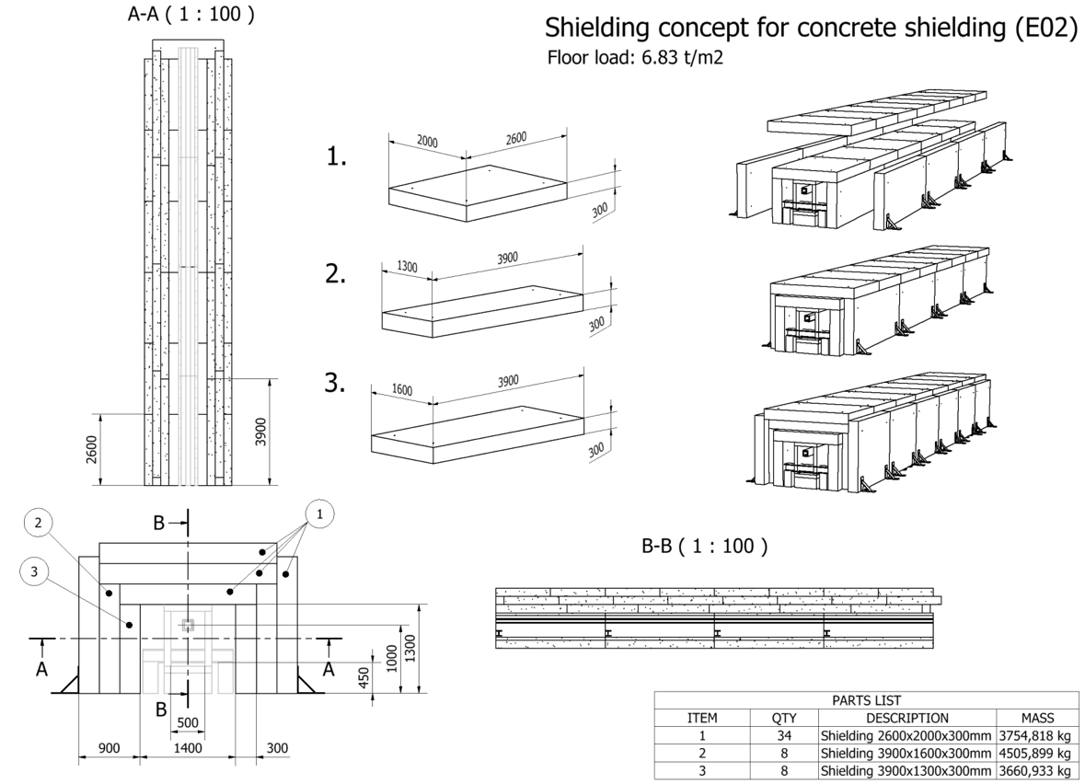
Concept for E02 (West sector)

Slide 20
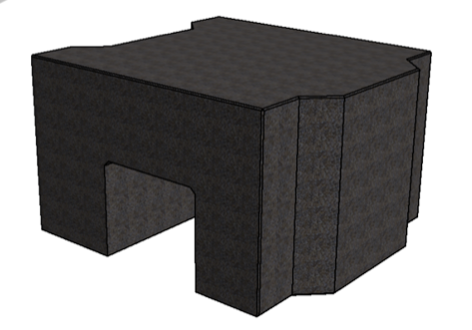
Plinth Concept for D01 - D03:
Height = 1.3 m

Slide 21
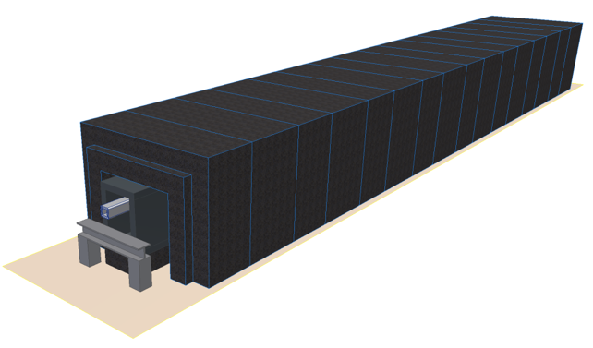
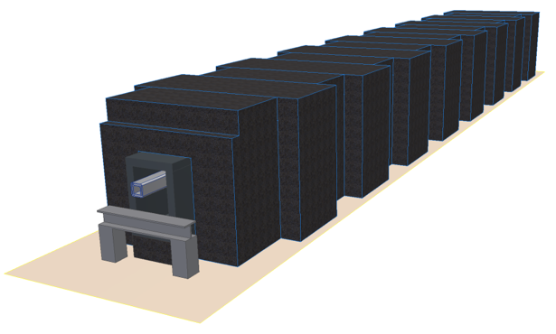
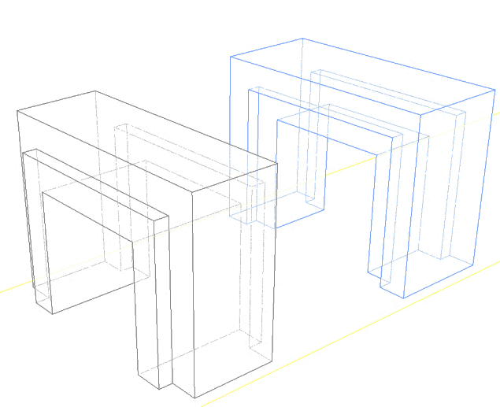
Concept 2: Easy access for maintenance
Manufacturing Cost: 1.6
Installation Cost/time: 0.7
Decommissioning cost: 1.8
Modularity: Not modular
Maintenance of components inside : full access by removing two pieces
Average weight of a
component: 7.4t
Weight:
0.1 t/m less
Male - Female

Slide 22
Other NSS standardization activities
Motion Control & Automation:
  Development packages with German In-Kind for electrical distribution, servo motors, robotics etc.,
Choppers:
  Framework agreements for “spindle supply”
  Chopper control & high speed chopper development packages with German In-Kind
  Tzero chopper development with HU
Detectors:
  Detector Prototypes (e.g. BANDGEM with Italian In-Kind)
  Detector Readout system with UK In-Kind
DMSC:
  Experiment control systems with Swiss In-Kind
  Data Curation with Swiss In-Kind
  Data Reduction & Streaming with UK In-Kind
Instrument components & Project Management:
  Heavy shutters with Hungarian In-Kind (through Test Beam Line project)
  (in-monolith) Neutron Beam Optical Assembly design and delivery (includes guide manufacturing)
  Project planning & reporting (integration with ESS PM system)
Many initiatives in Sample Environment Equipment (to be presented by Arno)

Slide 23
NSS Summary
The NSS project now has clear definition of scope, budget and schedule.
The neutron instrument project are gaining momentum (6 in Phase 2 & 9 in phase 1 – of which 5 have had TG2 reviews with favourable reports)
TG3 process is defined and planning for first reviews is underway.
The project integration team is approaching full strength.
The bunker project is well into detailed design, with CDR in Sept 2017.
The ESS-Test Beamline is moving quickly with PDR in May 2017.
NSS Installation plan is developing rapidly.
NSS is planning for first beam on instruments in Feb 2021
and start of user program in Aug 2023 (with 8 Instruments).
Notes:
SHANE COMPLETE

