Slide 1
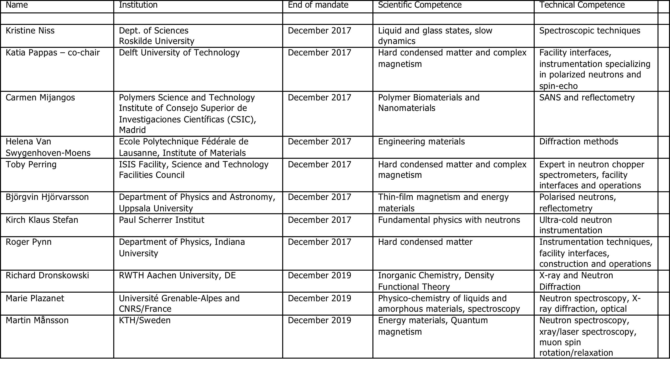
SAC members

Slide 2
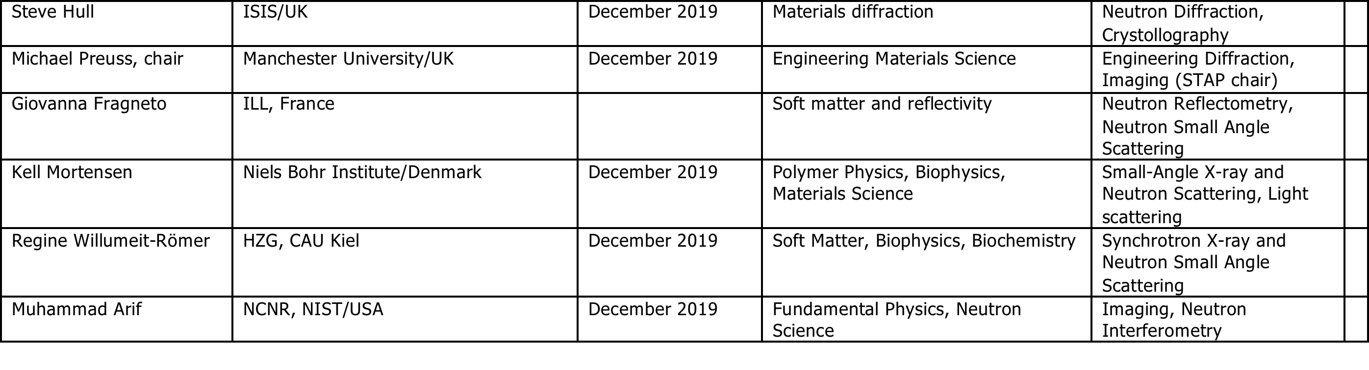
SAC members

Slide 3
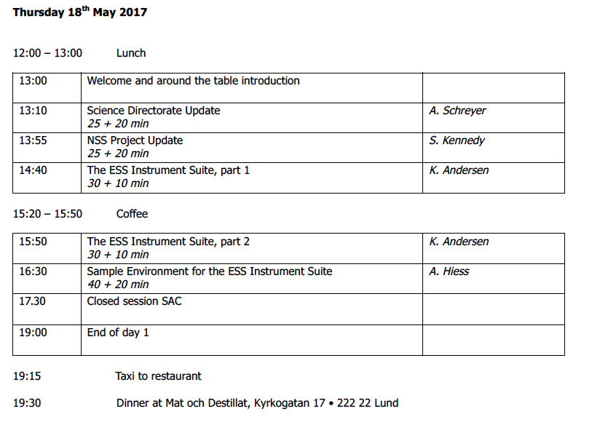
Agenda

Slide 4
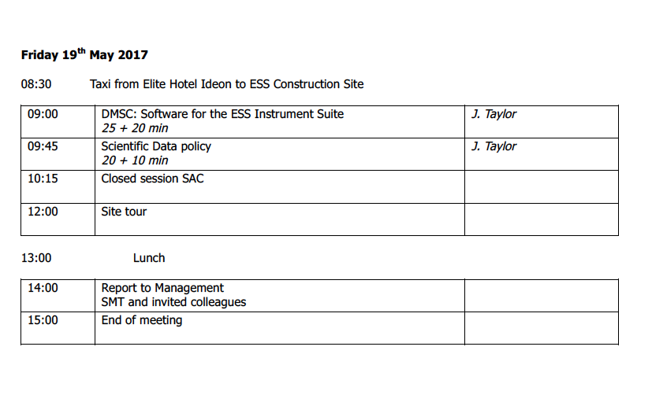
Agenda

Slide 5
Science Directorate Update
Andreas Schreyer
Director for Science
European Spallation Source
www.europeanspallationsource.se
18./19.5.2017

Slide 6
Neutron facilities – reactors and particle driven
10²⁰
Reactor Sources
Spallation Sources
J-PARC
ESS
HFIR
ILL
LANSCE
ISIS
CSNS
10¹⁵
MTR
HIFAR
MARIA
ORPHEE
IPNS
SALAM
HANARO
SNS
NRX
HFBR
NIST
ZING-P’
Dhruva
CARR
PIK
NRU
SAFARI-1
JRR-3
ETERR-2
FRM-II
OPAL
LVR
RSG
SINQ
IBR-II
HOR
JEEP II
KENS
X-10
WNR
Effective thermal neutron flux n/cm²-s
ZING-P
10¹⁰
CP-2
CP-1
10⁵
Berkeley 37-inch cyclotron
Particle driven pulsed
350 mCi Ra-Be source
Particle driven steady state
Pulsed reactor
Fission reactors
1
Chadwick
1930
1940
1950
1960
1970
1980
1990
2000
2010
2020
2030
Year
(Updated from Neutron Scattering, K. Skold and D. L. Price, eds., Academic Press, 1986)
Notes:
CP-1 Chicago USA
CP-2 Chicago USA
X-10: Oak Ridge, USA
NRX: Chalk River, USA
MTR: Idaho, USA
LVR: Rez, Czech Republic
HIFAR: Sydney Australia
NRU: Chalk River, USA
HOR Delft Netherlands
SAFARI-1 Pretoria South Africa
HFBR: Brookhaven, USA
HFIR: ORNL, Oak Ridge, USA
NIST: National Inst. for Stds and Tech. Gaithersburg, USA
ILL: Grenoble, France
JEEP II Kjeller Norway
MARIA Swierk Poland
ORPHEE LLB Saclay France
Dhruva: Mumbai, India
RSG: serpong, Indonesia
SINQ: PSI, Switzerland
JRR-3: Tokai, Japan
ES-Salam Algiers Algeria
HANARO: Daejon KAERI, South Chorea
ETERR-2 Cairo Egypt
FRM-II: Munich, Germany
OPAL: Sydney, Australia
CARR: Beijing China
PIK: Gatchina, Russia
ZING-P Argonne USA
WNR Los Alamos USA
KENS Tsukuba Japan
IPNS Argonne USA
IBR-II Dubna Russia
LANSCE Los Alamos USA
ISIS Oxfordshire UK
SNS Oak Ridge USA
JPARC Tokai Japan
CSNS Beijing China
ESS Lund Sweden
More reactor sources exist across the world….

Slide 7
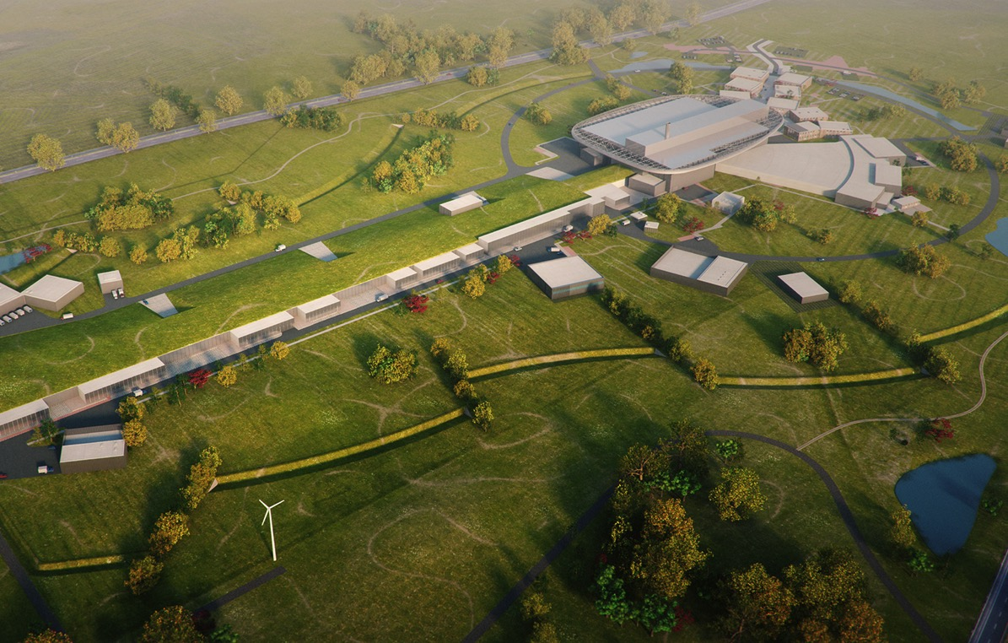

Journey to deliver the world’s leading facility for research using neutrons
2025
ESS Construction Phase Complete
2014
Construction Starts on Green Field Site
2023
ESS Starts
User Program
2009
Decision to Site ESS in Lund
2019/2020
Machine Ready for
1st Beam on Target
2012
ESS Design Update Phase Complete
2003
European Design of ESS Completed

Slide 8
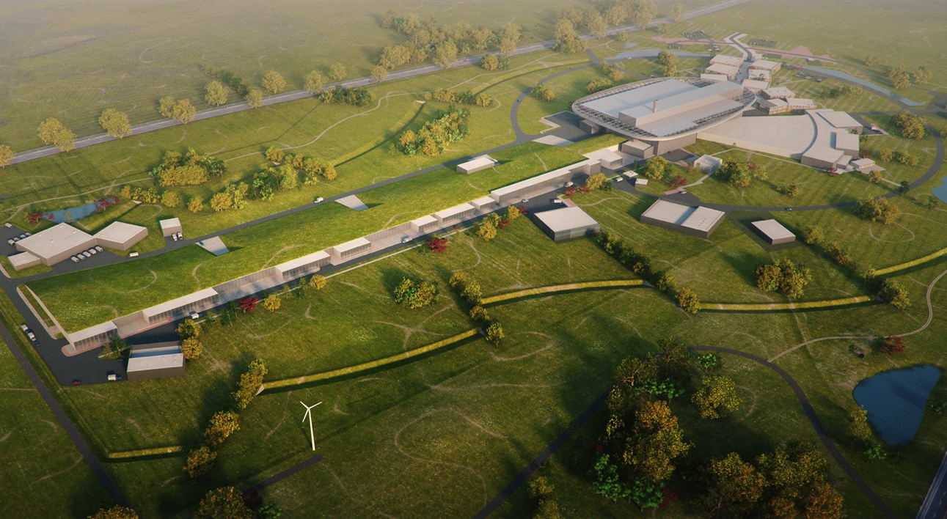
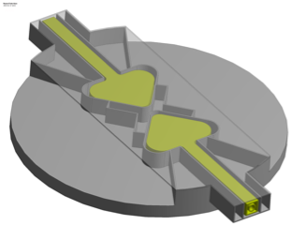
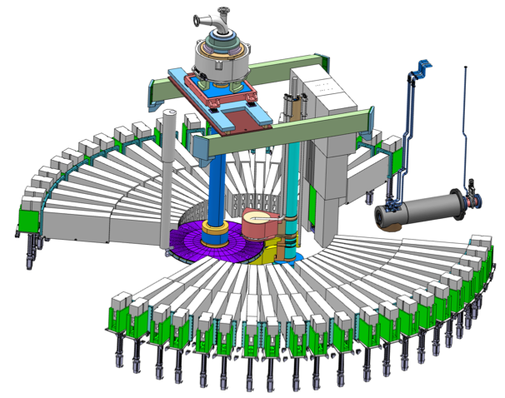
The European Spallation Source
Flat moderator delivering smaller and brighter neutron beams
High Power Accelerator means more neutrons
High brightness and tuneable resolution makes new measurements possible
An Innovative Target Station that can host >30 instruments

Slide 9
Long-pulse performance
15
x10¹³
ESS 5 MW
2015 design
λ = 5 Å
Possibilities of pulse shaping
10
Brightness (n/cm²/s/sr/Å)
ESS 5 MW
2013 design (TDR)
5
JPARC
0.3-1 MW
SNS
1-2 MW
ESS 1 MW (2021)
2015 design
ISIS TS1
128 kW
ISIS TS2
32 kW
ILL 57 MW
0
time (ms)
1
2
3
4

Slide 10
Two strategies for neutron instrumentation at ESS
Intensity
Use as much as possible of the whole pulse:
Good for low wavelength resolution instruments.
SANS, Reflectometry, single crystal diffraction.
Estimated gains 10-100 times than currently available.
0
1
2
3
4
time (ms)
Cut the long pulse into smaller pulses:
Good for higher wavelength resolution instruments
Diffraction, cold/thermal spectrometers.
Long Instruments (80-100 m)
Estimated gains 10-30 times than currently available.
Thermal gains lower.
0
1
2
3
4
time (ms)

Slide 11
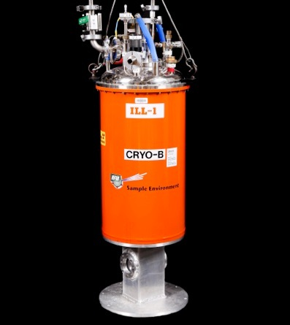
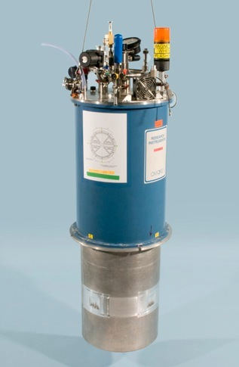
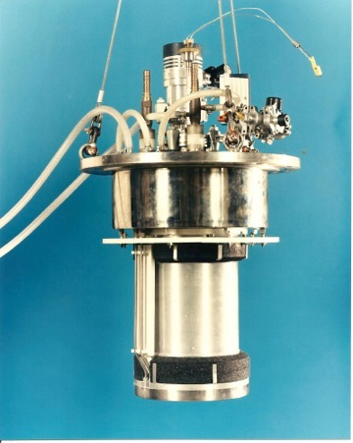


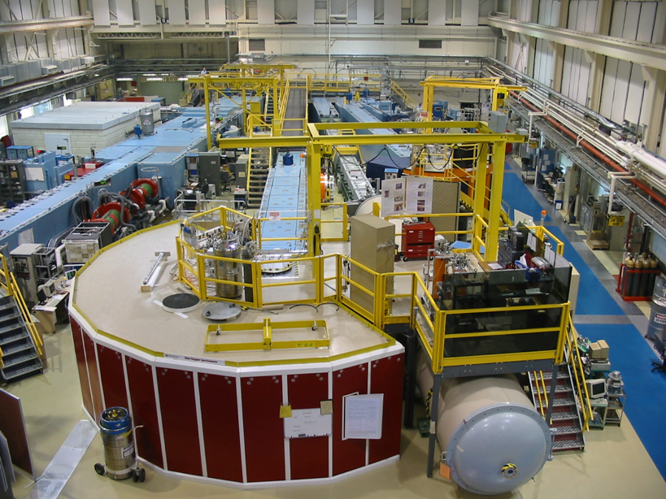
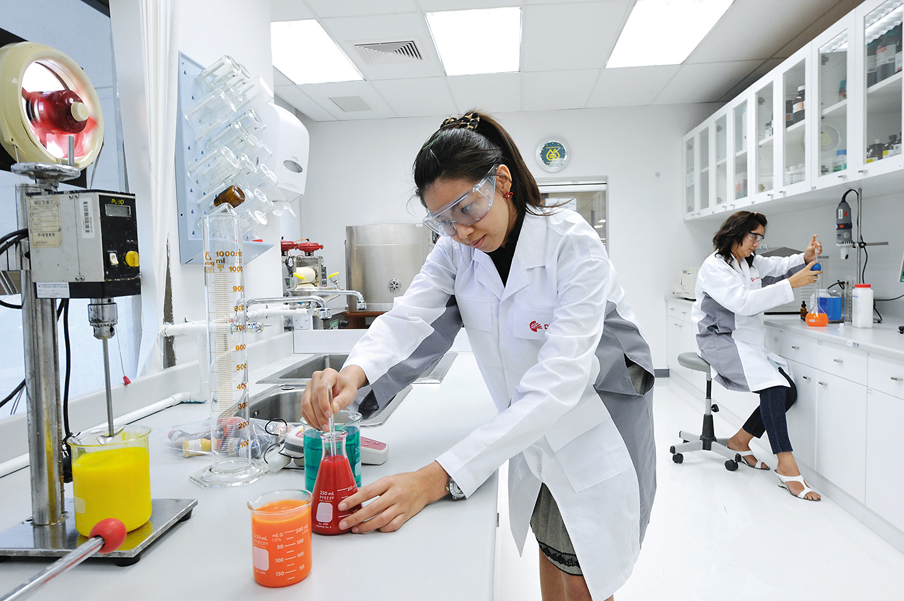
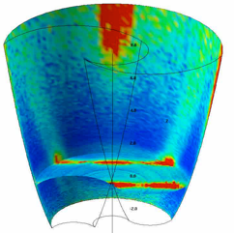
ESS Project Scope on Instruments
(Neutron Scattering Systems, NSS)
NSS Scope: 22 public instruments by 2028 together with a technical and scientific support infrastructure that enables scientific excellence and high quality scientific user service.
Science
(Publications)
Sample Environment
Ideas
(Proposals)
Science Support
Laboratories
22 Instruments
Analysis and Visualisation Software

Slide 12
Cost baseline – 1 843 M€ (2013 pricing)
(M€) Project | Original Baseline (2013 prices) | Original Baseline (cash budget indexed) | Current Baseline (includes changes)
Conventional Facilities | 438.9 | 458.1 | 458.0
Accelerator Systems | 510.2 | 518.0 | 513.1
Target Systems | 155.3 | 158.7 | 162.0
Integrated Control Systems | 73.0 | 75.1 | 79.6
Technical Management Services | 31.0 | 32.4 | 39.5
Neutron Scattering Systems | 350.0 | 361.9 | 361.9
Project Support & Administration | 126.5 | 132 | 138.9
Contingency | 158.5 | 176.5 | 159.6
Total | 1 843.3 | 1 912.6 | 1 912.6
Host Countries’ CF Scope | 93.0 | 100.5 | 115.9
Total including Host CF | 1 936.3 | 2 013.1 | 2 028.5
NSS budget ringfenced, others are not

Slide 13
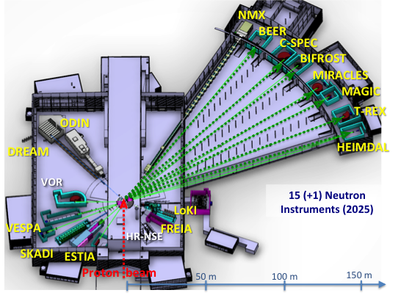
Priorities for 2016 concerning instruments
Scope setting for 13 further instruments
Realign NSS budget
Developed a realistic schedule for all instruments ensuring early science success in line with available in-kind resources and partner capabilities
Decided which instruments
are to be operational first
Decided how to
fund instruments plus
everything else required for
early science success within
budget a limited budget
Council decision Dec. 2016
Operations budget

Slide 14
2016-17 | May | Jun | Jul | Aug | Sep | Oct | Nov | Dec | Jan | Feb | Mar | Apr
LOKI
SKADI
ESTIA
FREIA
NMX
MAGIC
HEIMDAL
DREAM
BEER
ODIN
CSPEC
BIFROST
MIRACLES
T-REX
VESPA
10/5
20
29
10
14-15/6
20
29
17
22-23/6
19
31
31
8
14
17/6
14
7
5
24
12-13/9
7
3
12
Scope setting concluded
24
21
28
8
27
IKON11
ICB
SAC
COUNCIL
IKON12
STAP
scope-setting
TG2

Slide 15
The NSS Project Instruments
All are funded to be world leading in 2023
Council.07.14.a
Instrument Class | Instrument | Costbook (M€) | Upgrade (M€) | Performance target at Cost book value (@ 2MW)
Large Scale Structures | LOKI (Broad band SANS) | 12.19 | 3.0 | 5 x D22 & 20 x SANS2D
 | SKADI (General Purpose SANS) (+SONDE funds) | 11.50 | 3.0 | 4 x D22
 | ESTIA (Focusing Reflectometer) | 11.80 | 4.6 | Conventional mode: ~ 100 x D17 High intensity mode: 1cm² samples = seconds
 | FREIA (Liquids Reflectometer) | 13.20 | 5.0 | 30 x FIGARO, INTER
Diffraction | DREAM (Bispectral powder diffractometer) | 13.66 | 5.1 | > 10 x POWGEN or WISH
 | HEIMDAL (Hybrid diffractometer) | 13.55 | 3.7 | ~ 50 x GEM, ~ 8 x new POLARIS
 | MAGIC (magnetism single crystal diffractometer) | 13.10 | 1.9 | Cold: > 100 x worlds best, Thermal: 1mm³ crystals = 10 min
 | NMX (Macromolecular crystallography) | 11.67 | 2.5 | > 10 x LADI & Biodiff
Engineering & Industrial | BEER (Engineering diffractometer) | 14.99 | 9.3 | world leading in strain scanning, unique flexibility
 | ODIN (multi-purpose imaging) | 11.60 | 5.8 | world leading for high resolution, > 10 x best for TOF methods
Spectroscopy | BIFROST (extreme environment spectrometer) | 13.45 | 2.4 | > 10 x THALES & MACS
 | C-SPEC (cold chopper spectrometer) | 16.50 | 2.4 | 2 - 6 x IN5
 | T-REX (bispectral chopper spectrometer) | 16.85 | 3.1 | 3 x 4-SEASONS, 3 x IN5
 | VESPA (vibrational spectroscopy) | 12.00 | 2.9 | 10 x VISION (ΔE = 130 meV)
 | MIRACLES (backscattering spectrometer) | 13.53 | 1.7 | 2 x BASIS and DNA
Total cost book value |  | 199.59 | 56.4

Slide 16
The NSS Project Instruments
All are funded to be world leading in 2023
Council.07.14.a
Instrument Class | Instrument | Costbook (M€) | Upgrade (M€) | Performance target at Cost book value (@ 2MW)
Large Scale Structures | LOKI (Broad band SANS) | 12.19 | 3.0 | 5 x D22 & 20 x SANS2D
 | SKADI (General Purpose SANS) (+SONDE funds) | 11.50 | 3.0 | 4 x D22
 | ESTIA (Focusing Reflectometer) | 11.80 | 4.6 | Conventional mode: ~ 100 x D17 High intensity mode: 1cm² samples = seconds
 | FREIA (Liquids Reflectometer) | 13.20 | 5.0 | 30 x FIGARO, INTER
Diffraction | DREAM (Bispectral powder diffractometer) | 13.66 | 5.1 | > 10 x POWGEN or WISH
 | HEIMDAL (Hybrid diffractometer) | 13.55 | 3.7 | ~ 50 x GEM, ~ 8 x new POLARIS
 | MAGIC (magnetism single crystal diffractometer) | 13.10 | 1.9 | Cold: > 100 x worlds best, Thermal: 1mm³ crystals = 10 min
 | NMX (Macromolecular crystallography) | 11.67 | 2.5 | > 10 x LADI & Biodiff
Engineering & Industrial | BEER (Engineering diffractometer) | 14.99 | 9.3 | world leading in strain scanning, unique flexibility
 | ODIN (multi-purpose imaging) | 11.60 | 5.8 | world leading for high resolution, > 10 x best for TOF methods
Spectroscopy | BIFROST (extreme environment spectrometer) | 13.45 | 2.4 | > 10 x THALES & MACS
 | C-SPEC (cold chopper spectrometer) | 16.50 | 2.4 | 2 - 6 x IN5
 | T-REX (bispectral chopper spectrometer) | 16.85 | 3.1 | 3 x 4-SEASONS, 3 x IN5
 | VESPA (vibrational spectroscopy) | 12.00 | 2.9 | 10 x VISION (ΔE = 130 meV)
 | MIRACLES (backscattering spectrometer) | 13.53 | 1.7 | 2 x BASIS and DNA
Total cost book value |  | 199.59 | 56.4
Upgrades add another factor 2-3
Uprades to be funded from operations

Slide 17
Planned order of commencement of operation of first 8 instruments (August 2023)
Council.07.14.a
2nd Annual Review Recommendation (0.5)
Prioritisation of instruments within budget must ensure that the first tranche of instruments (8) is ready to deliver world-class science at the start of user operations (2023)
Matching early success in delivery of scientific outputs with the capacity of Lead In-Kind partners to deliver on schedule (ISIS, PSI, FZJ, LLB, HZG/NPI, TUM/PSI, TUM/LLB & DTU lead consortium).
Instrument Class | Sub-class | Candidates
Large Scale Structures | Small Angle Scattering | LOKI (ISIS), SKADI (FZJ)
 | Reflectometry | ESTIA (PSI), FREIA (ISIS)
Diffraction | Powder Diffraction | DREAM (FZJ), HEIMDAL (ÅU)
 | Single crystal diffraction | MAGIC (LLB), NMX (ESS)
Engineering | Strain scanning | BEER (HZG/NPI)
 | Imaging and tomography | ODIN (TUM/PSI)
Spectroscopy | Direct Geometry | C-SPEC (TUM), T-REX (FZJ)
 | Indirect Geometry | BIFROST (DTU), MIRACLES (Bilbao), VESPA (CNR)
Instruments in bold type to be operational by Aug 2023
Italic:
backups in case of delays
Potentially even more then 8 by 2023

Slide 18
Council resolution
Council.07.14.b
Council:
approves the construction of the 15 instruments listed in table 1 from the ESS construction budget
takes note that all 15 instruments will make use of the upper high brilliance moderator providing new options for the future use of the lower moderator position, and asks the management to provide a risk analysis at the next council meeting
takes note of the plan for the first eight instruments (listed in table 4, 14a)) selected for user operation in 2023 as part of a strategy to ensure early science success (also see item 14 a)

Slide 19
Council resolution
Council.07.14.c
Council approves the revision of the Procedure for Decisions on Construction of Instruments by waiving the second step of the instrument approval procedure, allowing instruments to move into phase 2 as fast as possible.

Slide 20
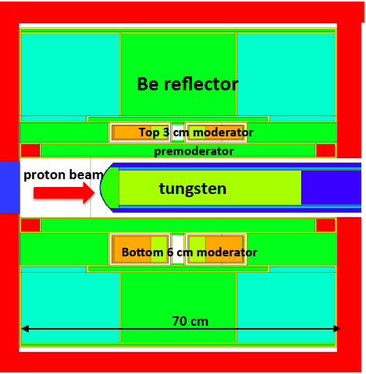
Moderator risk analysis
Conclusions
The increases in risk associated with moving from a two-moderator to a one-moderator scenario are small
  Probability x Impact ≤ 3 in all cases
There is a decrease in risk by operating only one moderator
The net result is a decrease in overall risk, resulting from the reduced complexity
Full report, see Indico page
Very positive feedback from Council

Slide 21
Neutron Instruments: Review schedule
2016-17 | Oct | Nov | Dec | Jan | Feb | Mar | Apr | May | Jun | Jul | Aug | Sep
LOKI (P2)
SKADI
ESTIA
FREIA
NMX (P2)
MAGIC
HEIMDAL
DREAM
BEER
ODIN
C-SPEC
BIFROST
MIRACLES
T-REX
VESPA
28
10
29
17
10.10
22
19
31
31
13
P2 Design review
scope-setting
TG2
14
14
7
5
24
7
3
12
24
21
24.10
28
8
27
17.10
IKON11
ICB
SAC
COUNCIL
COUNCIL
IKON12
ICB
SAC
COUNCIL

Slide 22
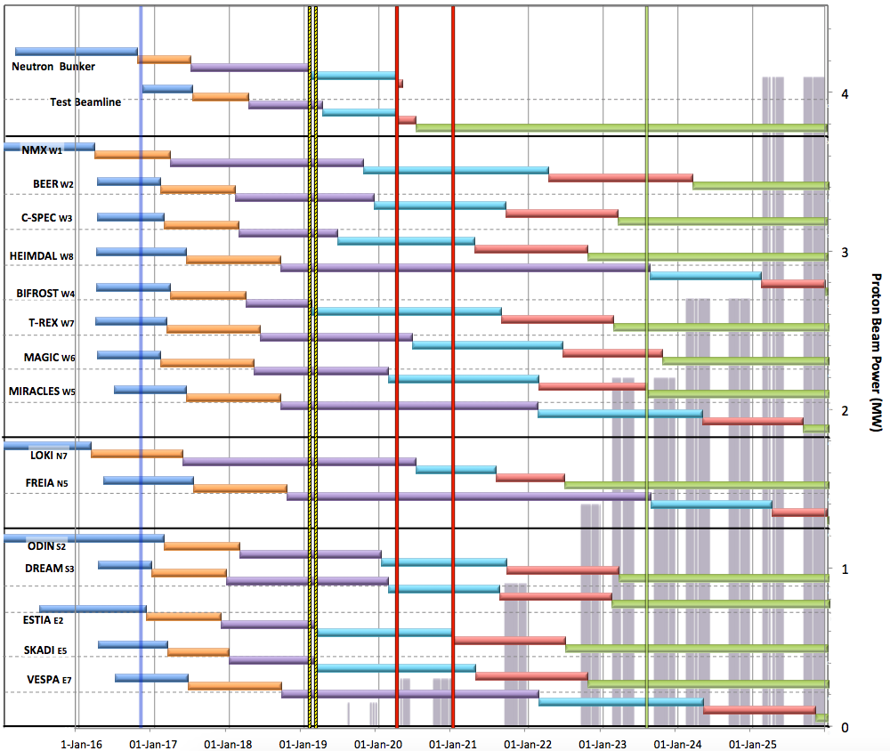

Neutron Beam Instrument Draft Schedule
V2.0, 2nd November 2016
Council.07.14.a
Beam on Target / 1st spectrum
Start Hot Commission
User instruments
Current date
Access D03
Access D01
Start User Program
Commissioning of test beam – to demonstrate performance and inform instrument projects
Notes;
Access & B.O..T dates yet to be confirmed
Instrument dates from scope setting
HC start;
  E ≥ 200 MeV
  P ≥ 200 kW
  January 2021
West sector
North sector
Preliminary Design
Detailed Design
Manufacturing & Procurement
Installation & Integration
Hot Commissioning and early science
Operation
East and South sectors
2016 2017 2018 2019 2020 2021 2022 2023 2024 2025

Slide 23
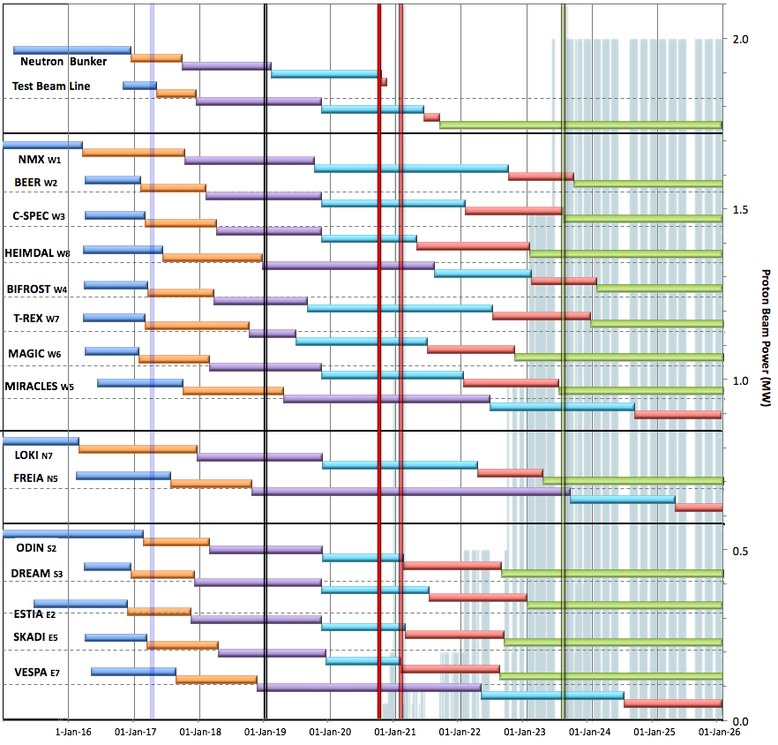
Internal* Neutron Beam Instrument Schedule
Draft for Discussion V3.2, 9th May 2017
Current date
First access to NSS areas
Beam on Target
Hot Commission
instruments
Start User Program
* still under discussion with ESS-ERIC Council
NOTES:
Assumes 2MW maximum power until end 2025
Phases aligned with TG2 reviews on 1st 9 NBIs
TG4 (Installation & Integration) not yet aligned with on-site resource plan
West sector
North sector
East and South sectors
Preliminary Design
Detailed Design
Manufacturing & Procurement
Installation & Integration
Hot Commissioning/Early science
Operation
2016 2017 2018 2019 2020 2021 2022 2023 2024 2025
Installation for most instruments begins in Q2/2019 with in-monolith optics
Access to other “instrument construction areas” will be later

Slide 24
Long-pulse performance
15
x10¹³
ESS 5 MW
2015 design
λ = 5 Å
Possibilities of pulse shaping
10
Brightness (n/cm²/s/sr/Å)
ESS 5 MW
2013 design (TDR)
5
JPARC
0.3-1 MW
ESS 2 MW
2015 design
SNS
1-2 MW
ISIS TS1
128 kW
ISIS TS2
32 kW
ILL 57 MW
0
time (ms)
1
2
3
4

Slide 25
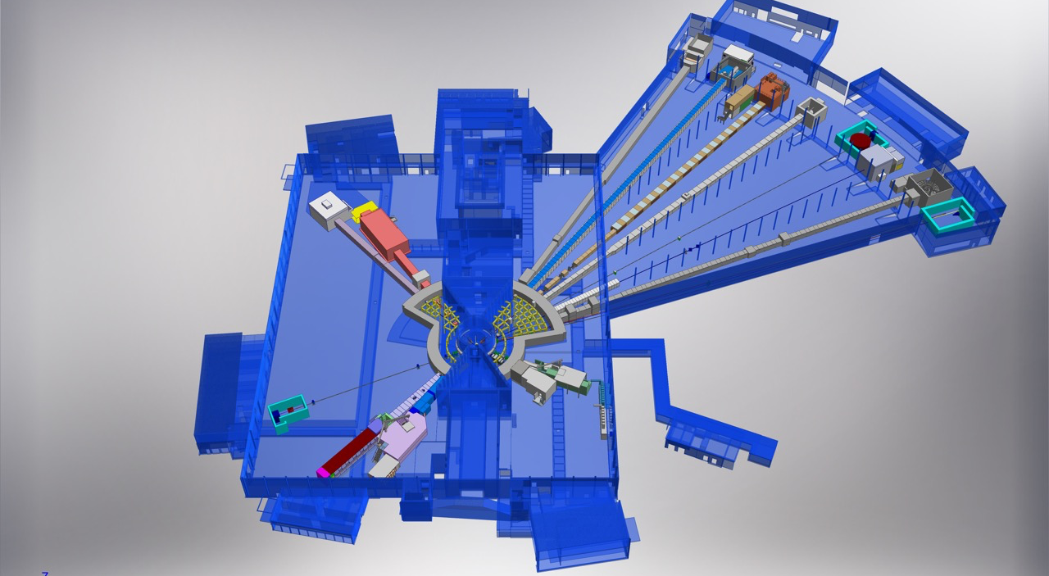
ESS Neutron Instruments 1-15 and Support Infrastructure
E03
Hall 1
D07 1 × Life Science,
1 × Cold room
D08 1 × Chemistry,
1 x Radioactive Mat. L.
NMX
BEER
C-SPEC
D08
BIFROST
E04
MIRACLES
MAGIC
T-REX
Value Engineering:
Defer D07 to initial ops
(only by 18 months)
not build upper floors
of D08, D04, E04
ODIN
DREAM
HEIMDAL
Hall3
E03 1 × Engineering
E04 1 × Life Science,
1 × Cold room
1 × Instrument room
1 × Chemistry,
1 × Characterization
LoKI
VESPA
D07
FREIA
SKADI
50 m
ESTIA
Hall 2
D04 1 × Life Science,
1 × Cold room
2 × Instrument room
D04
100 m
150 m

Slide 26
Construction and Operations cost
Previous Proposal: Initial Ops 854 MEUR
Construction Budget: Instruments 1-15
Initial Operation Budget (2019-2025):
instruments 16-22, scope upgrades for
instruments 1-8
Steady State
Operation
(reviewed Oct ‘16)

Slide 27
Construction and Operations cost
New Proposal (2017): Initial Ops 1.117 MEUR
Construction Budget: Instruments 1-15
Initial Operation Budget (2019-2025):
instruments 16-22, scope upgrades for
instruments 1-8 reviewed May 2017
Steady State
Operation
(reviewed Oct ‘16)

Slide 28
Initial Operations
Bottom Up Estimate for the years 2019-25 is 1117M€
Commissions ESS and operates it for science
Restores all the deferred scope (5MW in accelerator, etc.)
Starts instruments 16-22
Begins enhancements to instruments 1-15
… and does not include any contingency

Slide 29
How does 1117M€ compare to earlier estimates?
810 M€₂₀₁₃ in the ESS ERIC statutes dates from 2013 (partially updated 2015)
= 854.5 M€ with escalation
+ 91 M€ of deferred scope
+ roughly 10% underestimate to be expected based on findings of steady state operations review last Autumn
→ total of about 1.1 B€ would be expected

Slide 30
Deferrals from Project to Operations Implemented to Ensure Project Success
Deferrals selected during recently conducted “Value Engineering” exercise to manage within project funding constraints
Selections made based on straightforward implementation during Initial Operations --- consistent with schedule/funding plan and no or minimal extra cost

Slide 31
Budget 2015
Budget 2017
O
TMS 26500 50100
Target 55833 76600
Accelerator 181295 257549
Facility Management 111624 168383
Administration 56903 133888
ES&H QA 37500 79305
NSS 268872 273103

Slide 32
Budget 2015
Budget 2017
O
TMS 26500 50100
Target 55833 76600
Accelerator 181295 257549
Facility Management 111624 168383
NSS is the only part of the organisation,
which does not show a strong cost increase
Administration 56903 133888
ES&H QA 37500 79305
NSS 268872 273103

Slide 33
Draft report of the review commitee
ESS’s bottom up estimate of the budget needed for Initial Operations of 1117 M euros is strongly endorsed by the Initial Operations Review Committee. In supporting this, the Committee notes the cost increases coming from restoring deferred construction scope and from a more detailed and mature cost estimate for this phase of the project including: costs for operational spares, costs associated with being on a green-field site and costs due to overheads of the very substantial In-Kind Contributions. Confidence in the budget estimate comes from extensive benchmarking against scientific facilities around the world.

Slide 34
Draft report of the review commitee
Nevertheless, with the majority of the technical scope remaining to be realised, there is considerable financial risk in completing the project. This may be mitigated by provision of additional funds as contingency, on top of the proposed Initial Operation Budget or by identifying scope contingency. This should not be allowed to compromise ESS’s ability to deliver world-class science or the ultimate capability of the facility to operate at 5MW.

Slide 35
Draft report of the review commitee
In addition to whatever budget contingency can be obtained, maintaining discretional pre-planned scope contingency is highly recommended. This could be generated by defining a clear set of priorities for the initial operations phase, focused on producing world-class science at the earliest opportunity in an efficient way. For example, a reasonable set of priorities, regardless of the funding profile, would be:
establish reliable running and begin science programme with 15 instruments
establish operation at 2MW
start to build next 7 instruments
upgrade (“build-out”) first 15 instruments (e.g. add detectors etc.)
increase accelerator power from 2 to 5 MW

Slide 36
Draft report of the review commitee
In addition to whatever budget contingency can be obtained, maintaining discretional pre-planned scope contingency is highly recommended. This could be generated by defining a clear set of priorities for the initial operations phase, focused on producing world-class science at the earliest opportunity in an efficient way. For example, a reasonable set of priorities, regardless of the funding profile, would be:
establish reliable running and begin science programme with 15 instruments
establish operation at 2MW
start to build next 7 instruments
upgrade (“build-out”) first 15 instruments (e.g. add detectors etc.)
increase accelerator power from 2 to 5 MW
To be discussed at upcoming Council meeting
Council may ask for descoped budget proposal
Long term cost sharing during operations still to be agreed

Slide 37
Tentative Instrument Ramp-up
based on Instrument Construction Working Schedule V3.1, 25/4/2017
Instrument | 2014 | 2015 | 2016 | 2017 | 2018 | 2019 | 2020 | 2021 | 2022 | 2023 | 2024 | 2025 | 2026 | 2027 | 2028 | 2029 | 2030
LOKI
ODIN
NMX
ESTIA
CSPEC
DREAM
SKADI
BEER
BIFROST
MAGIC
T-REX
VESPA
MIRACLES
HEIMDAL
FREIA
Instrument 16
Instrument 17
Instrument 18
Instrument 19
Instrument 20
Instrument 21
Instrument 22
5MW
8 instruments in user programme
4MW
3MW
2MW
1
1MW
2
Construction Project
Hot Commissioning
50 75 100%
User Programme

Slide 38
Tentative Instrument Ramp-up
based on Instrument Construction Working Schedule V3.1, 25/4/2017
Instrument | 2014 | 2015 | 2016 | 2017 | 2018 | 2019 | 2020 | 2021 | 2022 | 2023 | 2024 | 2025 | 2026 | 2027 | 2028 | 2029 | 2030
LOKI
ODIN
NMX
ESTIA
CSPEC
DREAM
SKADI
BEER
BIFROST
MAGIC
T-REX
VESPA
MIRACLES
HEIMDAL
FREIA
Instrument 16
Instrument 17
Instrument 18
Instrument 19
Instrument 20
Instrument 21
Instrument 22
5MW
8 instruments in user programme
4MW
Agreement from Council for planning of
instrument build-out would be needed soon
3MW
2MW
1
1MW
2
Construction Project
Hot Commissioning
50 75 100%
User Programme

Slide 39
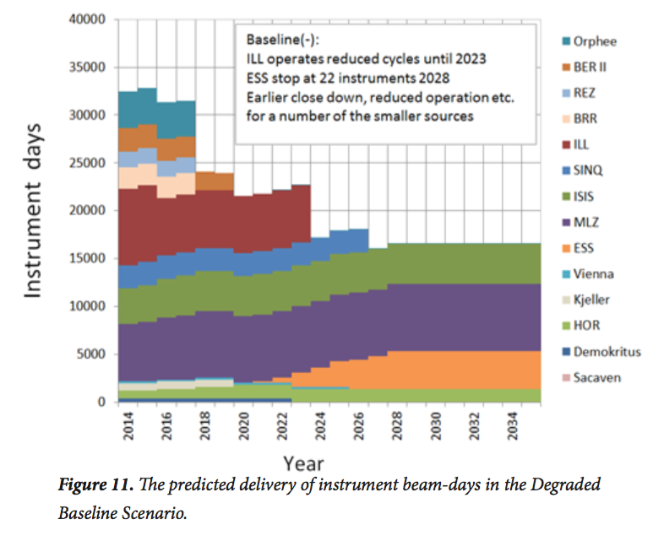
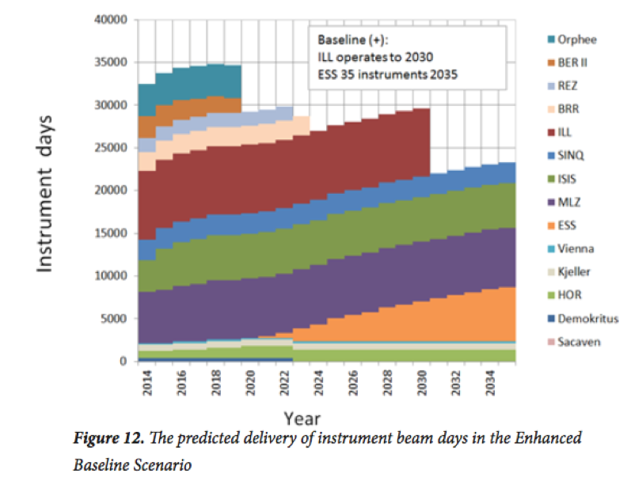
FUTURE SCENARIOS OUTLINED IN
THE 2016 ESFRI REPORT
Pessimistic scenario: ILL operates at reduced output until 2023, ESS with 22 instruments beyond 2028. Earlier closer and/reduced operations for a number of medium power sources
Optimistic scenario: ILL operates until 2030, ESS with 35 instruments beyond 2035.

Slide 40
FUTURE SCENARIOS OUTLINED IN
THE 2016 ESFRI REPORT
ESS needs to build up its research capacity
as soon as at all possible
Pessimistic scenario: ILL operates at reduced output until 2023, ESS with 22 instruments beyond 2028. Earlier closer and/reduced operations for a number of medium power sources
Optimistic scenario: ILL operates until 2030, ESS with 35 instruments beyond 2035.

Slide 41
Summary
Council support for 15 instruments and moderator change
Nine Tollgate2 meetings held. Four Instruments passed
Essential to maintain schedule
Value Engineering: minimizing impact.
Initial operations review held

Slide 42
Charge
Initial operations, Priorities
Progress on Instruments
Schedule , 2 MW
Sample environment
DMSC
Scientific Data Policy

