Slide 1









Status of
Sample Environment
Arno Hiess
Scientific Activities Division
www.europeanspallationsource.se
Notes:
ADD AN OUTLINE REFERING TO SAC / STAP TOPICS.

Slide 2
Recommendations from Annual Review 2015
NSS 4.2: Clarify within the budget of each instrument what is provided by whom: (…) Ensure (…) compliance with ESS standards.
NSS 4.6: Develop an operations plan to ensure efficient and effective delivery of science by the start of user operations. A crucial element of this will be to ensure that sufficient, staff with the right skills are in place well in advance of this date.
NSS 4.7: Develop a plan to address current staffing gaps in key areas, particularly in (…) support for scientific operations. Formally incorporate safety considerations early in instrument design via a rigorous hazards analysis.
OTHER additional recommendations from SAC and STAP.

Slide 3
Recommendations from Annual Review 2016
Need for coherent, project-wide, integrated approach to establish a safety culture.
De-scope instruments and scientific support w/o affecting initial scientific capabilities.
Clarify scope ownership including standards documents.
Refine operational plan to deliver science early on:
  Ensuring sufficient staff with right skills
  Including funds to procure sample environments and to complete instruments.

Slide 4
Charge: to provide an overall critique of the sample environment considerations in the current project plan –
Recommendations STAP (April 2016) – comments April 2017 1/2
Is the programme balanced across different user communities? – take a more organic view across the programme. Conditions still too unknown to judge this. The scope of the SSS construction work package is now well defined to cater for the first 8 instruments . We keep agile in adjusting to the needs for instruments #9-#15 and beyond.
Pool vs instrument-specific – which when? – A list should be set up indicating whether equipment is from the pool or from instruments, to ensure that any gaps are intentional. Instrument teams must communicate with the SE team. Who has ownership of the decision on who provides which equipment needs to be established. Based on input from instrument teams and considering the scope setting we have compiled a sample environment reference suite: https://1drv.ms/x/s!AuCQb_HPf3b9g8g2HHqvybpQKix-Lg .
Match with construction schedule? – The potential achievements at the beginning of operation need to be realistically considered given constraints. We have defined deliverables matching the instrument construction schedule.
Meets needs of instruments? – concentrate on the first eight instruments to start with. The budget has considerably been increased to match the needs of the first 8 instr.

Slide 5
Charge: to provide an overall critique of the sample environment considerations in the current project plan –
Recommendations STAP (April 2016) – comments April 2017 2/2
Methodological requirements? - the team clearly recognise need to train with equipment and to get it set up and integrated. The plans proposed are clear, but there are serious manpower concerns, in all areas. First technical resources are now recruited, shall be trained and form integrated team early on.
Instrumental challenges and novelty – the working environment is severely constrained financially. Work on novel techniques should focus on ESS-specific issues (e.g. small samples, high flux). Setting up the SE from scratch is already very challenging. Focus on developmental activities required at the start e.g. relevant for safety and operability.
Money should be released now. Technicians should start now, and then borrow from other facilities. Could leverage additional support from other facilities. Team is enthusiastic and motivated and can achieve with right support. We have started recruitment and have used equipment available for training.
Will suggest that a separate pot be established for big-ticket potential scientific highlights. The construction planning is quite detailed. Operational budget keeps major capital investment (1M€ per year) well separated from operational tasks.

Slide 6
SAC comments and recommendations
June and Nov 2016
‘early integration of sample environment … will be vitally important.’
Formulate mission statement and path to success.
Clear charge to STAP is required.
Define scope for sample environment suite matching instr. needs.
Integration plan is beyond urgent.
Link milestones to overall construction schedule.
Identify ESS challenges and develop R&D strategy.
Ensure interconnectivity and smooth work flow on a practical level.
Interface with instrument teams and user community.

Slide 7
SAC comments and recommendations
Nov 2016
The SAC would like to reiterate that the early integration of sample environment and new data reduction and simulation software will be vitally important for all of the approved instruments to be constructed at the ESS and it is imperative that steps be taken to ensure these aspects of the project are addressed immediately.
With respect to sample environment, the SAC remains concerned as to the integration and implementation of SE into the current instrument suite. It is important that SE be developed in context of the scope of the approved instruments. From the information presented to the SAC, some of the specific SE for each instrument has been identified as well as the need for universal connectivity across the instrumentation at the ESS, which is a good first step. However, the need for a clear integration plan for SE is beyond-urgent at this stage, and as yet remains unclear. From the last meeting the SAC requested that the SE division work with its STAP to develop a clear mission statement and a clear path to success of how the SE team will work with individual instruments as well as with the broader scientific user community in order to identify and achieve its current goals.
While the current activities of the ESS SE group may be on track to provide the necessary equipment in a timely manner, it has not, thus far, been possible for the SAC to judge this. The SAC requests this information be presented at the next SAC meeting as a matter of top priority.

Slide 8
Charge to the STAP – April 2017
Does sample environment reference suite meet the ESS needs ?
Are the R&D activities sufficient to match future scientific needs ?
Advice on usability, reliability, maintainability, safety, security.
Are requirements, performance and resources / cost estimates ok ?
Is plan sufficiently detailed, time-lines realistic, responsibilities ok ?
Are standardization efforts towards instruments adequate ?
Are integration efforts towards ICS and DMSC adequate ?
Are the infrastructure and workshop provisions adequate ?
Is staff ramp-up matching the needs; is steady state scenario ok ?

Slide 9
Feedback STAP – April 2017
Very happy and impressed with progress at Utgard, capable for use up to 2020.
Interaction with instrument teams massively improved - need to maintain this after Tollgate 2; definitely meet with engineers!
Instruments have Day 1 experiments; check what SE is needed for that, and prioritise that, identifying who owns each item.
Safety and security – liaise with ESS head of safety to identify advisor familiar with local regulations for engineering, chemical, laser safety issues (external or internal).
Integration plan – ICS/DMSC looks good, with instruments, standard equipment should be the norm unless strong scientific reasons.

Slide 10
Feedback STAP – April 2017
Shielding equipment to reduce background – who owns on a case by case basis?
Scientific needs – engineering user community. Ask Imaging and Engineering STAP to meet to go through requirements.
R&D – insufficient staff to focus in-house on new projects, but collaborations to be welcomed and going well.

Slide 11
Feedback STAP – April 2017
Workshops and labs – stocking and running.
Firm up dates for procurement.
Staff ramp up - the plan to move to 3 technicians by end of 2017 is good.
Develop clear short-term timetable (e.g. quarterly milestones) and steps to achieve aims. Our suggestion – focus on Day 1; identify a common project to work on together from repair to operation in mock-cave (e.g. auto Orange cryostat); broaden skills-base (e.g. training in CAD, machining, …)

Slide 12
Outline – Based on STAP and SAC advice
Mission and Vision : Defining a Path to Success
Sample Environment Suite : Meet Instrument and User Needs
Ensuring Interconnectivity : Interactions supporting Instr. Construction
Developmental Activities : Addressing the ESS Challenges
Moving to (Initial) Operation : Enabling Early Science Success

Slide 13
Outline – Based on STAP and SAC advice
Mission and Vision : Defining a Path to Success
STAP established and ensures that project is aligned with clearly formulated mission / vision
Sample Environment Suite : Meet Instrument and User Needs
Reference suite matching scientific need and construction schedule of first 8 instruments
Ensuring Interconnectivity : Interactions supporting Instr. Construction
Structured interactions with instruments teams in place; integrations projects progressing well
Developmental Activities : Addressing the ESS Challenges
Several R&D projects addressing future challenges on-going with partners
Moving to (Initial) Operation : Enabling Early Science Success
Deliverables, milestones, staff ramp up and budget for initial and steady state operation in place; focus on early science success.

Slide 14
Vision for Science Support Systems
Provide a coherent scientific service and collaborative environment that makes NEUTRONS more accessible, powerful and efficient to USERS from diverse SCIENTIFIC FIELDS and to harness the full scientific potential of the ESS facility.
Neutrons
User
Science
idea
proposal,
sample, labs
experiment,
sample env.
data,
modeling
publication

Slide 15

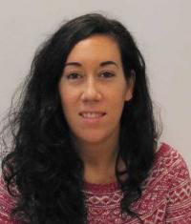

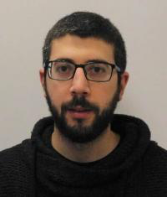
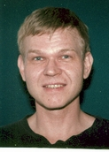
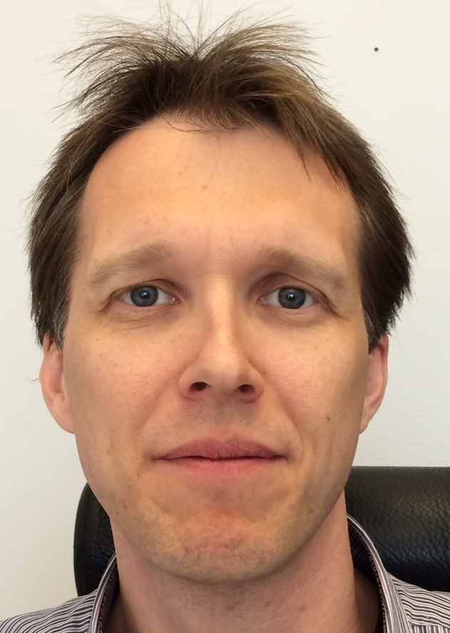



Mission: Delivering Sample Environment as part of Science Support Systems
Science Support Systems
Scientific Coord.
User Office
Temperature
Field
High Pressure
Mech. Proc.
Fluids incl. gases,
vapor, compl. fl.
Deuteration
Crystallization
Sample handling
general labs
Sample Environ.
Syst. Integration
Science Support Systems:
  sample environment
  scientific labs
  user office
SAMPLE ENVIRONMENT
Notes:
Present experience: fragemtnation, only partly supporting all topics …
New approach …mainaining balance; bringing it colse to the user

Slide 16
Mission: Delivering Sample Environment as part of Science Support Systems
Science Support Systems
Scientific Coord.
User Office
Temperature
Field
High Pressure
Mech. Proc.
Fluids incl. gases,
vapor, compl. fl.
Deuteration
Crystallization
Sample handling
general labs
Sample Environ.
Syst. Integration
Science Support Systems:
  sample environment
  scientific labs
  user office
for first 8 instruments
as part of increased (+5M€)
NSS construction budget
SAMPLE ENVIRONMENT
Notes:
Present experience: fragemtnation, only partly supporting all topics …
New approach …mainaining balance; bringing it colse to the user

Slide 17
Sample Environment – current tasks and resources
Science Support Systems
Scientific Coord.
User Office
Temperature
Field
High Pressure
Mech. Proc.
Fluids incl. gases,
vapor, compl. fl.
Deuteration
Crystallization
Sample handling
general labs
Sample Environ.
Syst. Integration
Interact with Instrument Teams
Set-up Infrastructure / Workshops
Advance Instrument Integration Project: standards on supplies, kinematic mounts, controls
Procure SE Equipment, manage IK collaborations
Manage Helium Cycle; synergy ACC, MAX IV, SVS
Execute R&D projects on ESS challenges
Develop Control Systems incl. Sample Environ. Communication Protocol SECoP (SINE2020 grant)
Train for user programme
TOTAL: 3.5 FTE in NSS plus 1.0 FTE by SINE2020 plus 2.0 FTE interns / trainees
SAMPLE ENVIRONMENT

Slide 18





Towards an integrated ESS:
Science Support Systems in Operations
Equipment
Availability
Safety, Robustness, Reliability, Ease-of-use
Maintenance, Workflow, Cost, Schedule
  Maximal range
  Multiple parameters
  Precision, accuracy
  Stability, control speed
  Total range sweep
  Return to ‘off’
Equipment
Change-over
Parameters
Mobility
Modularity
Rapidity
Reproducibility
Work flow
Sample Change
Positioning precision
Reliability, speediness
Labs
  Prepare and characterize
  Align, condition, mount
  Register, tag, store, ship, dispose
Sample Environment Suite = Pool equipment + Instrument Specific Devices
Laboratory Suite = General User Labs + Instrument Labs and Prep. Areas

Slide 19
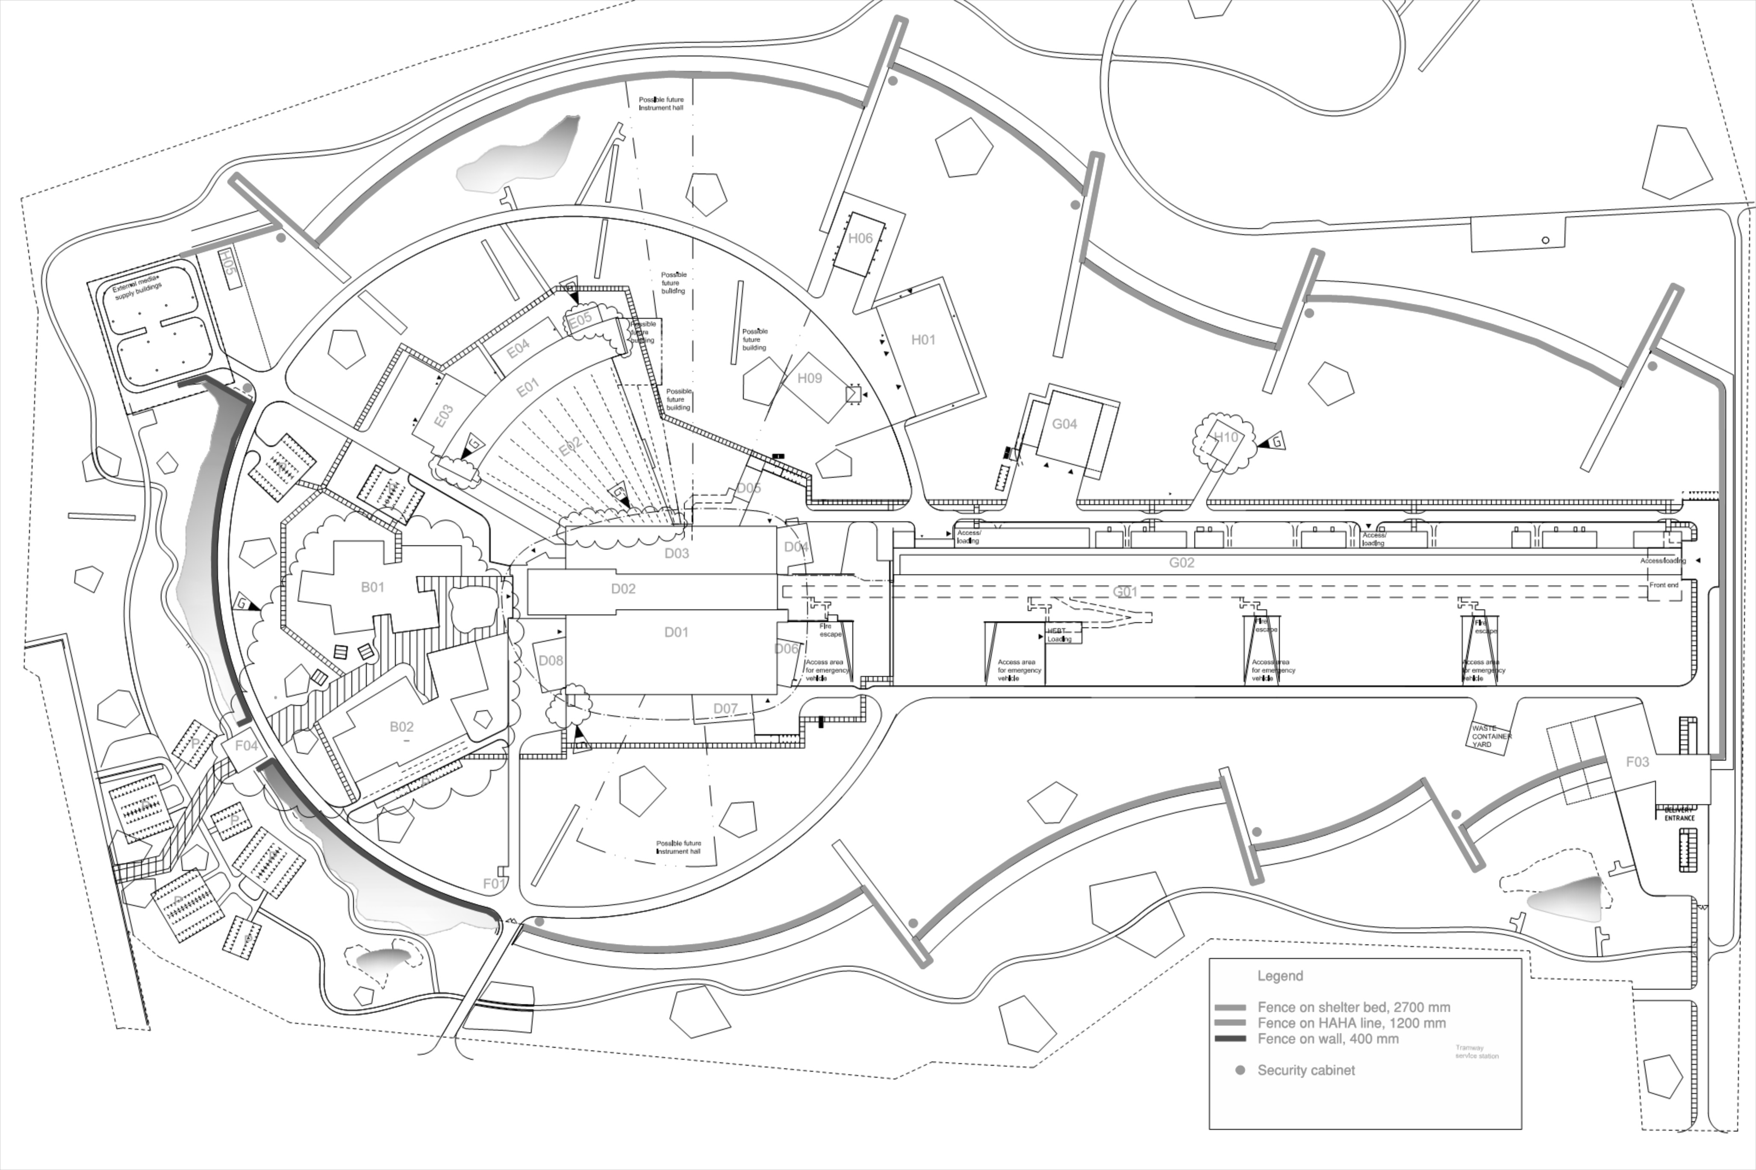
User Laboratories and Sample Environment Workshops at Exp. Halls

Slide 20
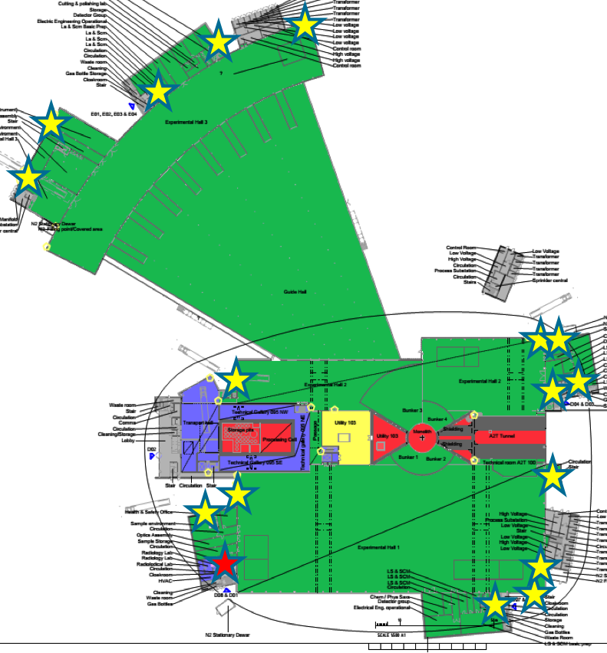
Zoning and Safety Functions
Experimental halls, workshops and labs are single supervised zone (portal monitor , access ctrl.) containing several controlled zones, e.g.
  Radioactive Materials Lab.
  sample area in experimental cave
  beamlines
Experimental
Cave -
Closed
Shutter
sample
beamline

Slide 21
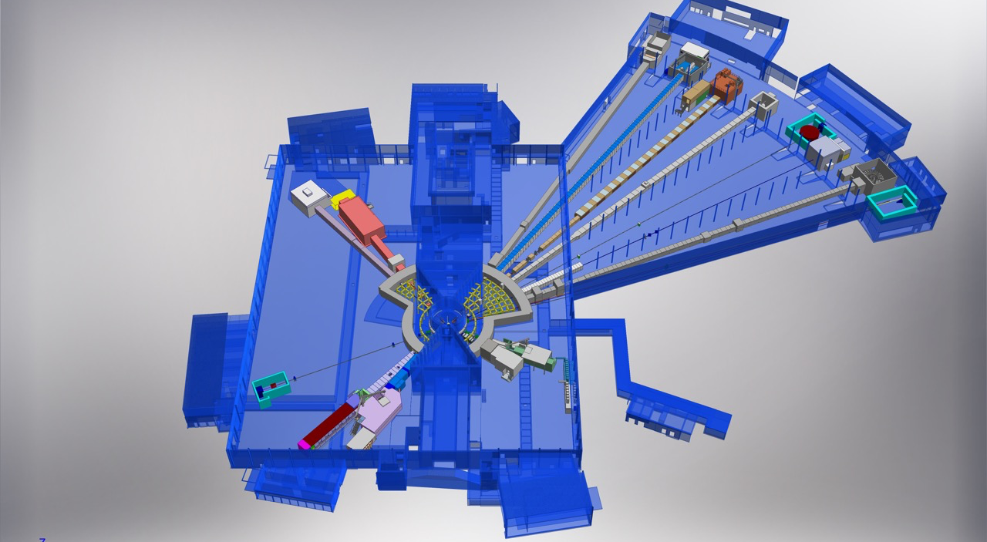
ESS Neutron Instruments #1 - #15 and support infrastructure incl. SE workshops
E03
Hall 1
D07 1 × Life Science,
1 × Cold room
D08 1 × Chemistry
1 x Radioactive Mat. L.
1 x Sample Env. Work.
NMX
BEER
C-SPEC
D08
BIFROST
E04
MIRACLES
MAGIC
T-REX
ODIN
HEIMDAL
DREAM
Hall3
E03 1 × Engineering
1 x Sample Env. Work.
E04 1 × Life Science,
1 × Cold room
1 × Instrument room
1 × Chemistry,
1 × Characterization
LoKI
VESPA
D07
FREIA
SKADI
50 m
ESTIA
Hall 2
D04 1 × Life Science,
1 × Cold room
1 x Sample Env. Work.
D04
100 m
150 m

Slide 22
ESS Neutron Instruments #1 - #15 and support infrastructure incl. SE workshops
E03
Hall 1
D07 1 × Life Science,
1 × Cold room
D08 1 × Chemistry
1 x Radioactive Mat. L.
1 x Sample Env. Work.
NMX
BEER
C-SPEC
D08
BIFROST
E04
MIRACLES
MAGIC
T-REX
ODIN
HEIMDAL
DREAM
Hall3
E03 1 × Engineering
1 x Sample Env. Work.
E04 1 × Life Science,
1 × Cold room
1 × Instrument room
1 × Chemistry,
1 × Characterization
LoKI
VESPA
D07
FREIA
Value Engineering:
Defer D07 to initial ops,
not build upper floors
of D08, D04, E04
SKADI
50 m
ESTIA
Hall 2
D04 1 × Life Science,
1 × Cold room
1 x Sample Env. Work.
D04
100 m
150 m

Slide 23
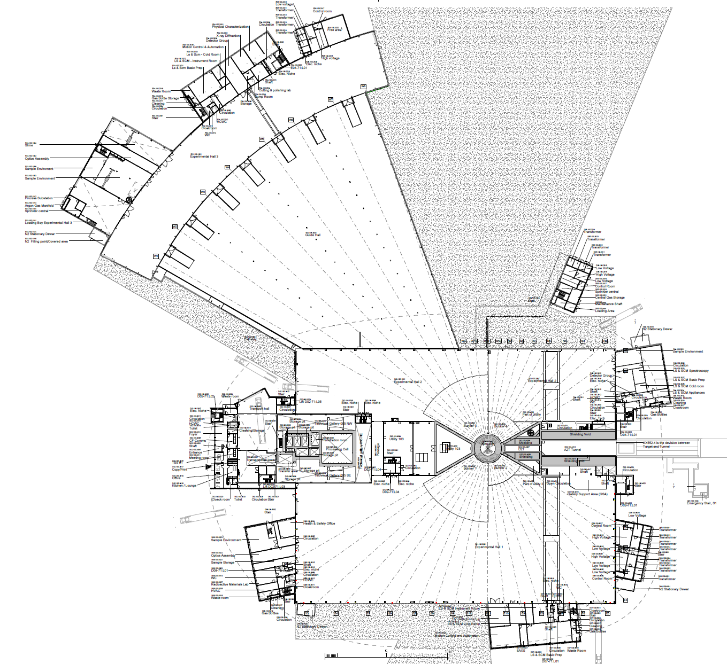
2019/2020: NSS Proposed Access Dates
E05
1
D08 RML Lab – Early Access 10-Jan-19 (Level 1b MS)
May 2019
2a
E01 – Full Access 27-Apr-19 (Level 1 MS)
E04
2b
E02 Area 1 – Partial Access 27-Apr-19 (Level 1 MS)
May 2019
3
D03 Bunker – * Early Access 03-Jun-19 (Level 1 MS)
E01
2a
4
D01 Bunker – * Early Access 14-Aug-19 (Level 1 MS)
E03
5
E02 Area 2 – Partial Access 15-Oct-19 (Level 1b MS)
2b
6
D03 Main Hall – Partial Access 01-Nov-19 (Level 1b MS)
E02
7
D01 Main Hall Ph 1 – Partial Access 06-Jan-20 (Level 1b MS)
5
8
D01 Main Hall Ph 2 – Partial Access 02-Mar-20 (Level 1b MS)
D05
D04
6
Aug. 2019
3
D08
4
D06
1
8
Early acess: Jan 2019
Complete: Dec. 2019
7
Dec. 2019
D07

Slide 24
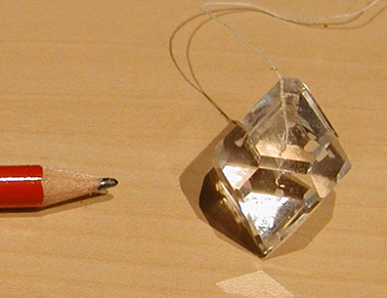
Sample & User Laboratories -
Deuteration & Crystallisation
 | Ready | Start
DEMAX equipment | 18 Q4 | started
SULF lab fitting | 19 Q4 | started
SULF glove boxes | 19 Q4 | started
SULF radioactive material lab | 19 Q4 | 17 Q2

Slide 25
Sample & User Laboratories -
Deuteration & Crystallisation
 | Ready | Start | In-kind partner
DEMAX equipment | 18 Q4 | started | started (NO)
SULF lab fitting | 19 Q4 | started | started (UK)
SULF glove boxes | 19 Q4 | started | started (EE)
SULF radioactive material lab | 19 Q4 | 17 Q2 | not identified

Slide 26
Sample & User Laboratories -
Deuteration & Crystallisation
 | Ready | Start | In-kind partner
DEMAX equipment | 18 Q4 | started | started (NO)
SULF lab fitting | 19 Q4 | started | started (UK)
SULF glove boxes | 19 Q4 | started | started (EE)
SULF radioactive material lab | 19 Q4 | 17 Q2 | not identified
Legend
Level | Start | In-kind partner | Start x IK
0 | started | Started / in-house
1 | > 12 m | ‘agreed’ / MoU
2 | > 6 m | discussed
3 | now | not identified
 |  |  | 0
 |  |  | 1 - 2
 |  |  | 3
 |  |  | 4 +

Slide 27
Sample & User Laboratories -
Deuteration & Crystallisation
 | Ready | Start | In-kind partner
DEMAX equipment | 18 Q4 | started | started (NO) | 0 x 0
SULF lab fitting | 19 Q4 | started | started (UK) | 0 x 0
SULF glove boxes | 19 Q4 | started | started (EE) | 0 x 0
SULF radioactive material lab | 19 Q4 | 17 Q2 | not identified | 3 x 3
Legend
Level | Start | In-kind partner | Start x IK
0 | started | Started / in-house
1 | > 12 m | ‘agreed’ / MoU
2 | > 6 m | discussed
3 | now | not identified
 |  |  | 0
 |  |  | 1 - 2
 |  |  | 3
 |  |  | 4 +

Slide 28
Sample & User Laboratories -
Deuteration & Crystallisation
 | Ready | Start | In-kind partner
DEMAX equipment | 18 Q4 | started | started (NO) | 0 x 0
SULF lab fitting | 19 Q4 | started | started (UK) | 0 x 0
SULF glove boxes | 19 Q4 | started | started (EE) | 0 x 0
SULF radioactive material lab | 19 Q4 | 17 Q2 | in-house | 3 x 0
Legend
Level | Start | In-kind partner | Start x IK
0 | started | Started / in-house
1 | > 12 m | ‘agreed’ / MoU
2 | > 6 m | discussed
3 | now | not identified
 |  |  | 0
 |  |  | 1 - 2
 |  |  | 3
 |  |  | 4 +

Slide 29
Towards an integrated ESS:
Science Support Systems and Instruments
Equipment
Availability
Equipment
Change-over
Parameters
Sample Change
Labs
Instrument interaction 1 FTE (equivalent to 6 PM per instrument until hot commissioning)

Slide 30
Sample Environment Needs –
Initial guess & instrument responses
 | Needed
 | Possible
 | not applicable
 |  | BEER | BIFR | CSPC | DREA | ESTIA | FREIA | HEIM | NSE | LoKI | MAGi | MIRA | NMX | ODIN | SKADI | T-REX | VESP | VOR
Temp. & Field | Horizontal cryomag 11T |  | n | n | y |  | n |  | n | n | y | n |  | y | y | n | n | n
 | Vertical cryomag 9T | n | y | y |  | y | n |  | n | n | y | y |  | y | n | y | n | y
 | Electromag | y | n | n |  | y |  | y | n | y |  | n |  | y | y | n | y | n
 | Pulsed Tube Refrigerator | y |  | y | y | y | n | y | y |  | y | y | y | y | y | y | y | y
 | Orange CryoFurnace | y | y | y | y | y | n | y | y |  | y |  |  | y | y | y | y | y
 | Dilution |  | y | y | y |  | n |  |  | n | y |  |  |  | y | y | y | y
 | HT Furnace | y | y | y | y | y | n | y | y |  | y |  | y | y | y | y | y | y
 | IR Furnace | y | y |  | y |  | n |  |  | n | y |  | y |  | y | y | y | y
 | He3 Sorption stick |  | y | y | y |  | n |  |  | n | y |  |  |  | y | y | y | y
 | 6kV HV supply | n |  |  |  | y | y |  | y | y | y | y |  |  | y
 | Pulsed magnet | n | y | y |  |  | n | n | n | n | y |  | n |  |  | y | n | y
Pressure... | DAC |  | n | n | y | n | n | y | n | y | y |  | y |  | y | n | y
 | Paris-Edin. |  | y | y | y | n | n | y | n |  | y | n | n |  | n | y | y
 | Clamp cells <3GPa |  | y | y | y | n | n | y | n |  | y |  | n |  | n | y | y
 | Gas cells < 1GPa |  | y | y | y | n | n | y | y |  | y |  | n |  | n | y | y
 | stress/strain rig (generic) | y | n | n | n | n | n | n | n | y | n | n | n | y | y | n | n | n
 | Raman system |  | n | y | y |  |  | y | n | y | y |  | y | y | y | n | y
 | Gleeble | y | n | n | n | n | n | n | n | n | n | n | n | n | n | n | n | n
 | Portable laser heating assembly | y | n | n | y | n | y | y | n | n | n | n | n | n | n | n |  | n
Fluids, Gases … | Humidity chamber |  |  | y | n | y | y | y | y | y | n | y | y |  | y
 | Stopped flow | n | n | n | n | y | y |  | y | y | n | n | n | n | y | n | n | n
 | Pump probe | n | n | y | n |  |  |  | y | y | n | y |  |  | y | y | y | n
 | In-situ light scattering |  |  | y |  | y | y |  | y | y | n |  |  |  | y |  | y
 | Shear cells | n | n | n | n | y | y | n | y | y | n |  | y |  | y | n | n | n
 | Gas processing | y | y | y | y | y | y | y | y | y | y | y | y | y | y | y | y | y
 | Rheometer | n | n | n | n |  |  |  | y | y | n | n |  |  | y | n | n | n
 | Julabo-type circulating chiller/heater |  | y |  |  | y | y |  | y | y | n | y |  |  | y
 | Liquid surface troughs | n | n | n | n | y | y | n | n | n | n | n | n | n | n | n | n | n
 | in-situ gas adsorption meas. |  | n |  | n |  |  | y | y | y | n | y | y | y | y | n | y
 | in-situ thermal analysis meas. |  | n |  | n |  |  | y | y | y | n | y | y | y | y | n | y
 | injection systems, syringe pump |  | n |  | n | y | y |  | y | y | n | y | y |  | y
 | SANS magazine 5*10 | n | n | n | n | n | n | n | n | y | n | n | n | n | y | n | n | n
 | SANS magazine 5*10 indi T-ctrl | n | n | n | n | n | n | n | n | y | n | n | n | n | y | n | n | n

Slide 31
Sample Environment Reference Suite
https://1drv.ms/x/s!AuCQb_HPf3b9g8g2HHqvybpQKix-Lg
Sample Environment Reference Suite based on instrument needs. Timelines determined by instrument construction schedule and lead time.
NSS construction budget covers needs of first 8 instruments #1-#8. Additional budget provision for instruments #9-#15 in initial operation.
Most Sample Env. Equipment is within SSS budget but some instrument specific equipment remains part of instrument construction.
Execution responsible involves expert team from partners incl. universities.
Budget leverage: refurbished equipment; collaborative projects; grants.

Slide 32
Sample Environment Reference Suite

Slide 33
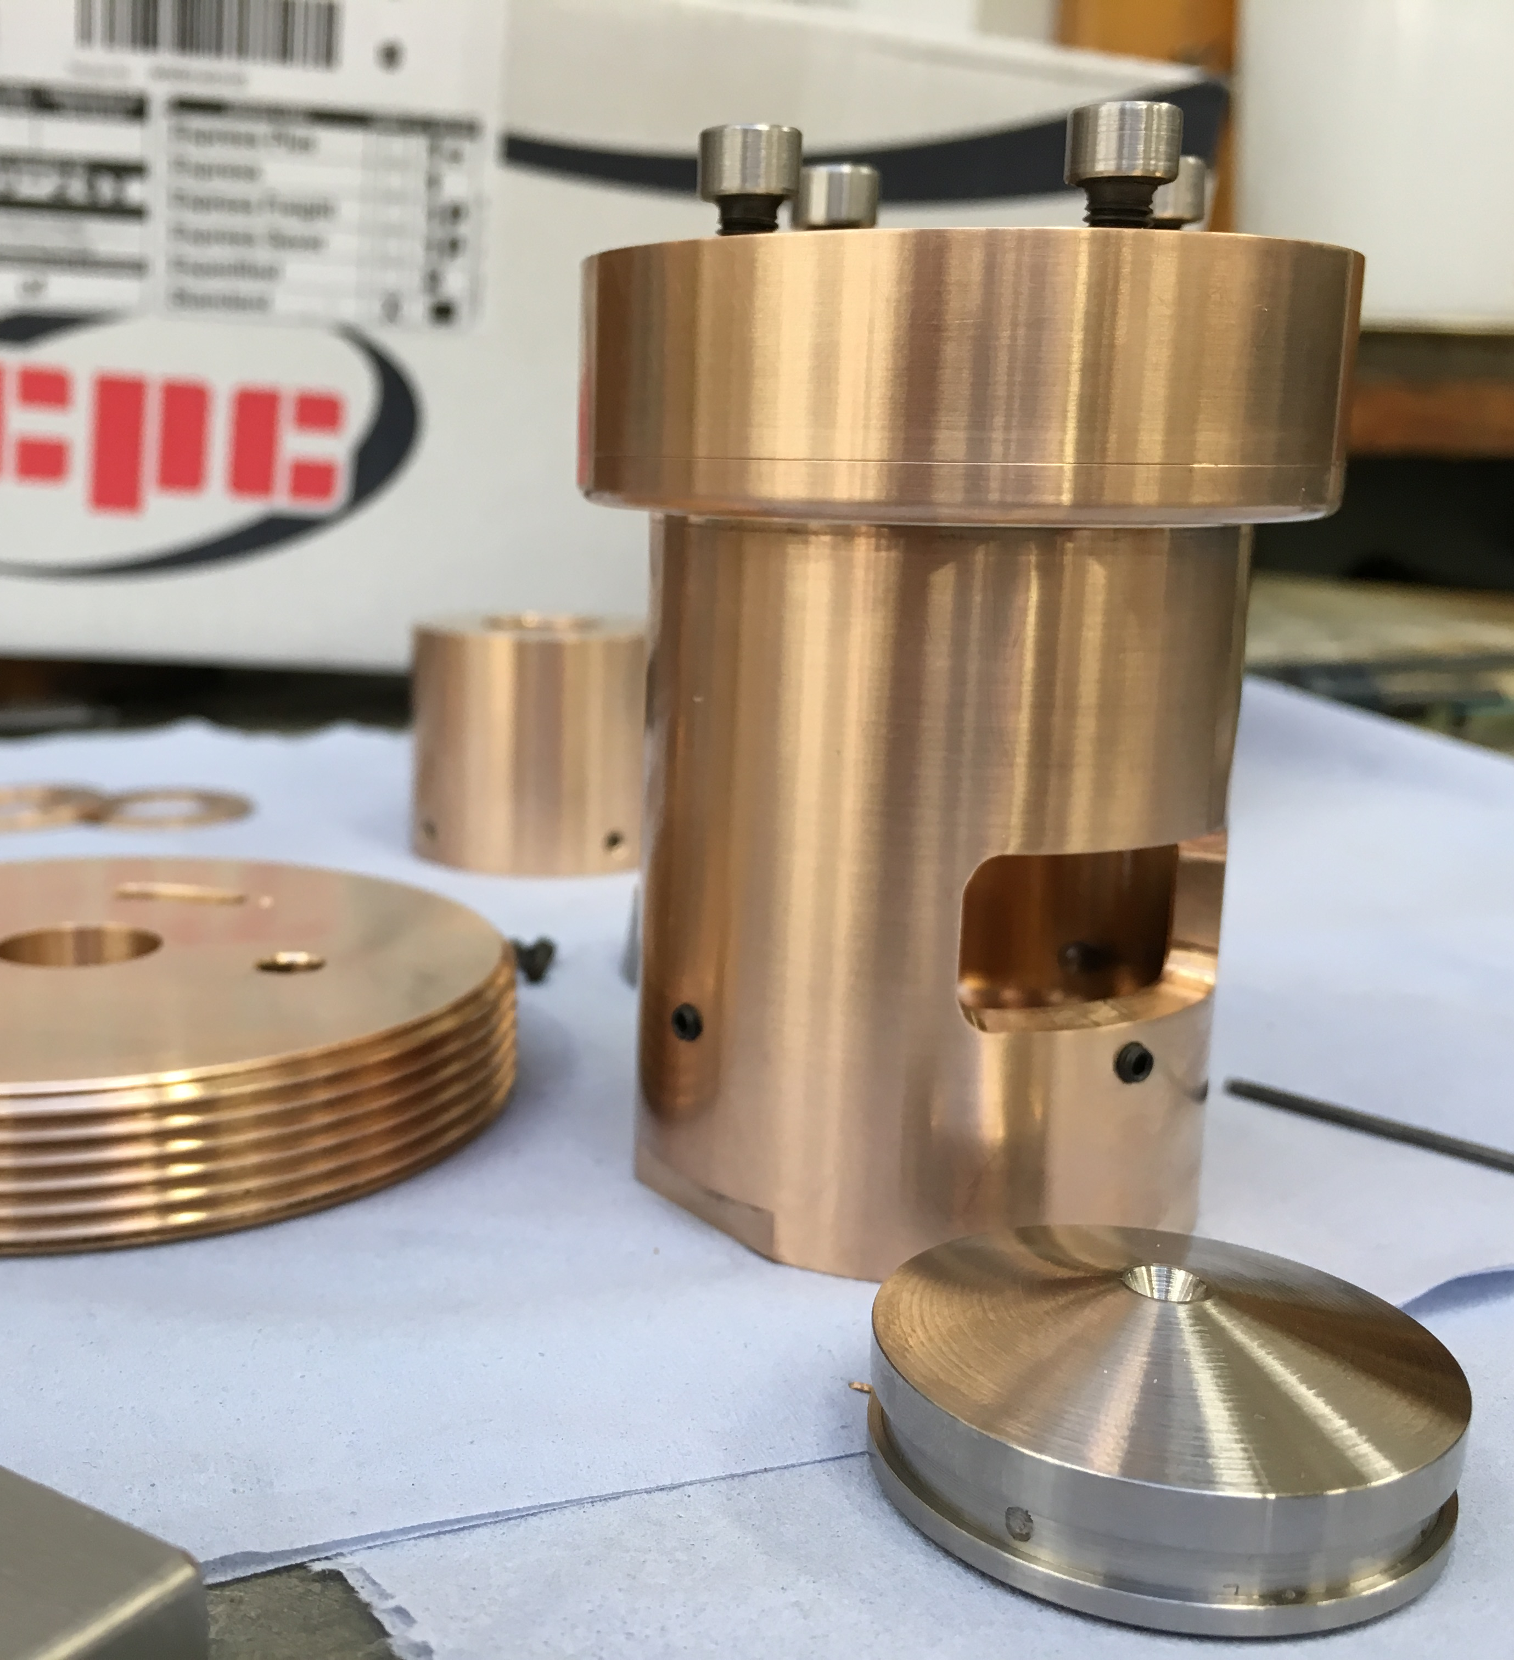
Pressure and Mechanical Processing – Suite for 8 by 2023 incl. infrastructure
 | # | Needed for … out of first 8 Instruments
Diamond Anvil Cells (DAC) – system | 1 | Dream, Loki, Magic
Paris-Edinburgh Cells – system | 1 | Bifrost, C-Spec, Dream, Magic
Clamp cells < 3GPa – system | 1 | Bifrost, C-Spec, Dream, Magic
Gas cells < 1GPa – system | 1 | Bifrost, C-Spec, Dream, Magic
stress/strain rig (generic) | 1 | Beer, Loki, [Odin]
Raman system | 1 | C-Spec, Dream, Loki, Magic
Portable laser heating | 1 | Dream, Loki, Magic
Corrosive gas manifold | 1 | Bifrost, C-Spec, Dream, Magic
Cryostats | 1 | Bifrost, C-Spec, Dream, Magic
Stress strain rig (high load) | 1 | Beer
Dilatation | 1 | Beer
Welding | 1 | Beer

Slide 34
Pressure and Mechanical Processing – Suite for 8 by 2023 incl. infrastructure
 | # | Cost k€ | Ready | Start
Diamond Anvil Cells (DAC) – system | 1 | 150 | 21 Q1 | started
Paris-Edinburgh Cells – system | 1 | 245 | 21 Q1 | 17 Q3
Clamp cells < 3GPa – system | 1 | 55 | 21 Q2 | 19 Q1
Gas cells < 1GPa – system | 1 | 50 | 21 Q2 | 19 Q1
stress/strain rig (generic) | 1 | 50 | 23 Q1 | 21 Q1
Raman system | 1 | 50 | 22 Q3 | 19 Q3
Portable laser heating | 1 | 100 | 23 Q1 | 21 Q1
Corrosive gas manifold | 1 | 15 | 23 Q4 | 21 Q4
Cryostats | 1 | 220 | 23 Q1 | 21 Q1
Stress strain rig (high load) | 1 | 300 | 21 Q1 | 18 Q3
Dilatation | 1 | 400 | 22 Q1 | 19 Q3
Welding | 1 | 200 | -- | --
PREMP general workshop / lab equip | IN | 330 |  | 18 Q1
bunker | IN | 295 |  | 18 Q1
DAC Gas loading | IN | 145 |  | 18 Q3
PREMP DAC workshop / lab equipment | IN | 140 |  | started

Slide 35
Pressure and Mechanical Processing – Suite for 8 by 2023 incl. infrastructure
 | # | Cost k€ | Ready | Start | In-kind partner
Diamond Anvil Cells (DAC) – system | 1 | 150 | 21 Q1 | started | collaboration
Paris-Edinburgh Cells – system | 1 | 245 | 21 Q1 | 17 Q3 | discussed (FR)
Clamp cells < 3GPa – system | 1 | 55 | 21 Q2 | 19 Q1 | discussed (FR)
Gas cells < 1GPa – system | 1 | 50 | 21 Q2 | 19 Q1 | discussed (FR)
stress/strain rig (generic) | 1 | 50 | 23 Q1 | 21 Q1 | not identified
Raman system | 1 | 50 | 22 Q3 | 19 Q3 | not identified
Portable laser heating | 1 | 100 | 23 Q1 | 21 Q1 | not identified
Corrosive gas manifold | 1 | 15 | 23 Q4 | 21 Q4 | not identified
Cryostats | 1 | 220 | 23 Q1 | 21 Q1 | discussed (FR)
Stress strain rig (high load) | 1 | 300 | 21 Q1 | 18 Q3 | ‘agreed’ (DE CZ)
Dilatation | 1 | 400 | 22 Q1 | 19 Q3 | ‘agreed’ (DE)
Welding | 1 | 200 | -- | -- | EXTERN
PREMP general workshop / lab equip | IN | 330 |  | 18 Q1 | discussed (FR)
bunker | IN | 295 |  | 18 Q1 | discussed (FR)
DAC Gas loading | IN | 145 |  | 18 Q3 | discussed (FR)
PREMP DAC workshop / lab equipment | IN | 140 |  | started | collaboration

Slide 36
Pressure and Mechanical Processing – Suite for 8 by 2023 incl. infrastructure
 | # | Cost k€ | Ready | Start | In-kind partner
Diamond Anvil Cells (DAC) – system | 1 | 150 | 21 Q1 | started | collaboration | 0 x 0
Paris-Edinburgh Cells – system | 1 | 245 | 21 Q1 | 17 Q3 | discussed (FR) | 3 x 2
Clamp cells < 3GPa – system | 1 | 55 | 21 Q2 | 19 Q1 | discussed (FR) | 1 x 2
Gas cells < 1GPa – system | 1 | 50 | 21 Q2 | 19 Q1 | discussed (FR) | 1 x 2
stress/strain rig (generic) | 1 | 50 | 23 Q1 | 21 Q1 | not identified | 1 x 3
Raman system | 1 | 50 | 22 Q3 | 19 Q3 | not identified | 1 x 3
Portable laser heating | 1 | 100 | 23 Q1 | 21 Q1 | not identified | 1 x 3
Corrosive gas manifold | 1 | 15 | 23 Q4 | 21 Q4 | not identified | 1 x 3
Cryostats | 1 | 220 | 23 Q1 | 21 Q1 | discussed (FR) | 1 x 2
Stress strain rig (high load) | 1 | 300 | 21 Q1 | 18 Q3 | ‘agreed’ (DE CZ) | 1 x 1
Dilatation | 1 | 400 | 22 Q1 | 19 Q3 | ‘agreed’ (DE) | 1 x 1
Welding | 1 | 200 | -- | -- | EXTERN
PREMP general workshop / lab equip | IN | 330 |  | 18 Q1 | discussed (FR) | 2 x 2
bunker | IN | 295 |  | 18 Q1 | discussed (FR) | 2 x 2
DAC Gas loading | IN | 145 |  | 18 Q3 | discussed (FR) | 1 x 2
PREMP DAC workshop / lab equipment | IN | 140 |  | started | collaboration | 0 x 0

Slide 37
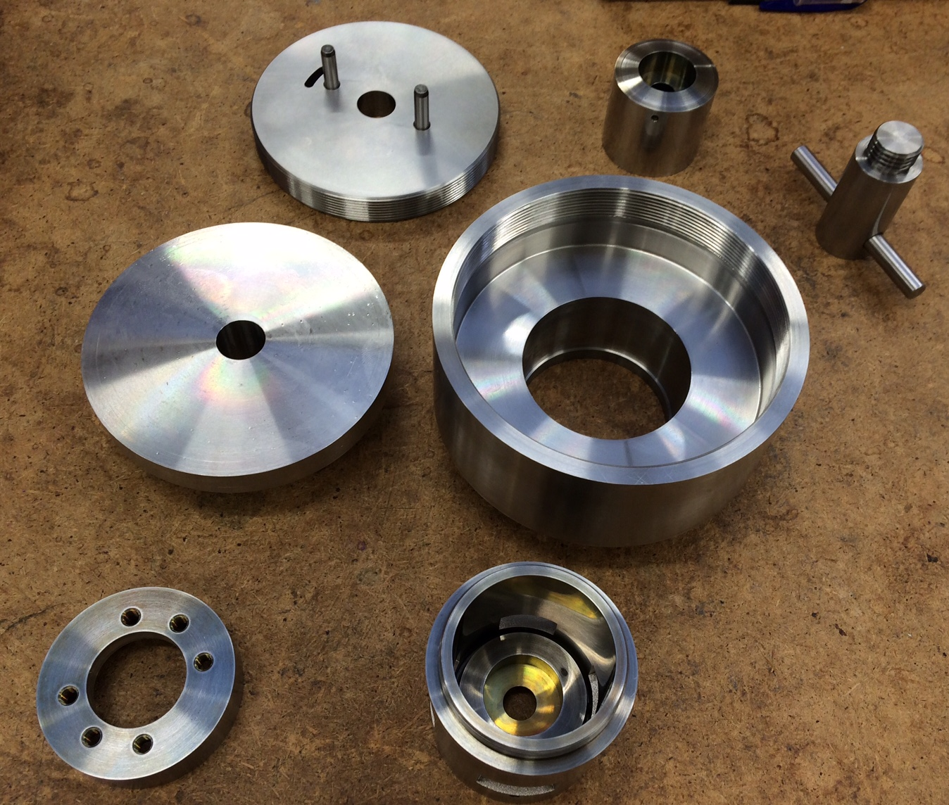
Pressure and Mechanical
Processing – Suite for 15 by 2025+
 | # | Needed for … out of #9-#15 Instruments
Diamond Anvil Cells | 2 | Vespa, Heimdal, NMX
Paris-Edinburgh Cells | 2 | T-Rex, Vespa, Heimdal
Clamp cells < 3GPa | 4 | T-Rex, Miracles, Vespa, Heimdal
Gas cells < 1GPa | 4 | T-Rex, Miracles, Vespa, Heimdal
stress/strain rig (generic) | 1
Raman system | 2 | Vespa (different system)
Portable laser heating | 1 | Freia
Corrosive gas manifold | 1
Stress strain rig (high load) | 1
Dilatation | 1
Welding | 1
Gleeble mech. proc. | 1 | Beer (investigate external funding)

Slide 38
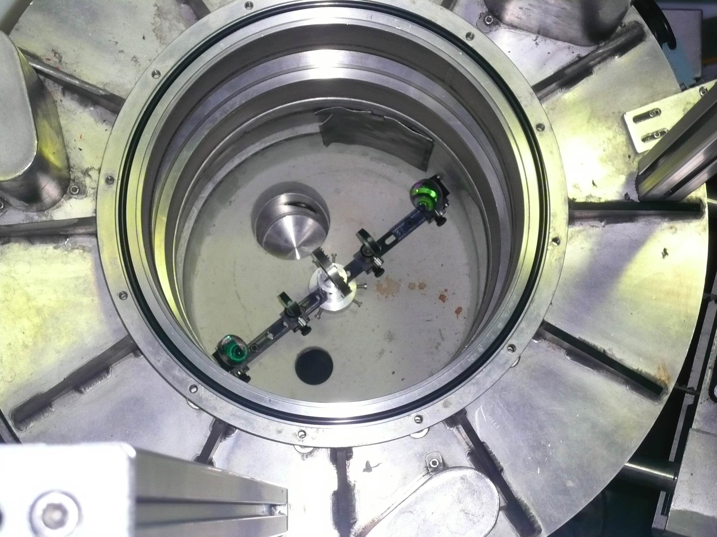
Fluids incl. gases, vapor, comp. fluids Suite for 8 by 2023 incl. infrastructure
 | # | Needed for … out of first 8 Instruments
Humidity chamber (different geom.) | 2 | C-Spec, Estia, Loki
Stopped flow systems | 1 | Estia, Loki
injection system, syringe pump | 2 | Estia, Loki
HPLC pump, 4 channel, switch | 2 | Estia, Loki
Pump probe laser system incl. heating | 1 | C-Spec
Shear cells (couette, plate plate) | 2 | Loki
Gas processing systems | 2 | C-Spec, Dream
Rheometer in-situ | 1 | Loki
Julabo-type chiller/heater | 4 | Estia, Loki
Thermolising Gas blower | 1 | Loki
SANS magazine incl. T-ctrl | 2 | Loki
Sample changer incl alignment | 1 | Estia
Rotating sample holder | 1 | Loki
Solid Liquid & Liquid liquid cells | 1 | Estia
Bio furnace 8 positions | 1 | C-Spec
Potentiostat | 1 | Estia

Slide 39
Fluids incl. gases, vapor, comp. fluids Suite for 8 by 2023 incl. infrastructure
 | # | Cost k€ | Ready | Start | In-kind partner
Humidity chamber (different geom.) | 2 | 200 | 21 Q1 | 18 Q1 | discussed DE/EE
Stopped flow systems | 1 | 100 | 21 Q1 | 18 Q1 | discussed DE/EE
injection system, syringe pump | 2 | 80 | 21 Q1 | started | in-house
HPLC pump, 4 channel, switch | 2 | 100 | 21 Q1 | 19 Q1 | LOKI, ESTIA
Pump probe laser system incl. heating | 1 | 200 | 19 Q2 | started | started (EE)
Shear cells (couette, plate plate) | 2 | 40 | 21 Q3 | 19 Q3 | in-house
Gas processing systems | 2 | 200 | 20 Q1 | started | started (EE)
Rheometer in-situ | 1 | 250 | 20 Q4 | 17 Q3 | discussed (DE)
Julabo-type chiller/heater | 4 | 25 | 21 Q1 | started | started (DK)
Thermolising Gas blower | 1 | 150 | 23 Q4 | 21 Q1 | in-house
SANS magazine incl. T-ctrl | 2 | 50 | 17 Q4 | started | started (DK)
Sample changer incl alignment | 1 | 30 | 21 Q2 | 19 Q1 | ESTIA
Rotating sample holder | 1 | 30 | 21 Q3 | started | LOKI
Solid Liquid & Liquid liquid cells | 1 | 60 | -- | 17 Q3 | ESTIA
Bio furnace 8 positions | 1 | 125 | 21 Q1 | 19 Q1 | CSPEC
Potentiostat | 1 | tbc |  | tbc | ESTIA

Slide 40
Fluids incl. gases, vapor, comp. fluids Suite for 8 by 2023 incl. infrastructure
 | # | Cost k€ | Ready | Start | In-kind partner
Humidity chamber (different geom.) | 2 | 200 | 21 Q1 | 18 Q1 | discussed DE/EE | 2 x 2
Stopped flow systems | 1 | 100 | 21 Q1 | 18 Q1 | discussed DE/EE | 2 x 2
injection system, syringe pump | 2 | 80 | 21 Q1 | started | in-house | 0 x 0
HPLC pump, 4 channel, switch | 2 | 100 | 21 Q1 | 19 Q1 | LOKI, ESTIA | 1 x 1
Pump probe laser system incl. heating | 1 | 200 | 19 Q2 | started | started (EE) | 0 x 0
Shear cells (couette, plate plate) | 2 | 40 | 21 Q3 | 19 Q3 | in-house | 1 x 0
Gas processing systems | 2 | 200 | 20 Q1 | started | started (EE) | 0 x 0
Rheometer in-situ | 1 | 250 | 20 Q4 | 17 Q3 | discussed (DE) | 3 x 2
Julabo-type chiller/heater | 4 | 25 | 21 Q1 | started | started (DK) | 0 x 0
Thermolising Gas blower | 1 | 150 | 23 Q4 | 21 Q1 | in-house | 1 x 0
SANS magazine incl. T-ctrl | 2 | 50 | 17 Q4 | started | started (DK) | 0 x 0
Sample changer incl alignment | 1 | 30 | 21 Q2 | 19 Q1 | ESTIA | 1 x 1
Rotating sample holder | 1 | 30 | 21 Q3 | started | LOKI | 1 x 1
Solid Liquid & Liquid liquid cells | 1 | 60 | -- | 17 Q3 | ESTIA | 3 x 1
Bio furnace 8 positions | 1 | 125 | 21 Q1 | 19 Q1 | CSPEC | 1 x 1
Potentiostat | 1 | tbc |  | tbc | ESTIA

Slide 41
Fluids incl. Gases, Vapor, Complex Fluids – Suite for 15 by 2025+
 | # | Needed for … out of #9-#15 Instruments
Humidity chamber (SANS, REF, SPEC) | 3 | Skadi, Miracles, T-Rex, Heimdal
Stopped flow systems | 1 | Skadi, Freia
injection system, syringe pump | 4 | Freia
HPLC pump, 4 channel, switch | 4 | Freia
Pump probe laser system | 1 | Miracles, T-Rex
Shear cells (couette, plate plate) | 2 | Skadi
Gas processing | 3 | Miracles, T-Rex, Vespa
Rheometer in-situ | 2 | Skadi, Freia
Julabo-type chiller/heater | 8 | Freia, Skadi
Gas blower | 1 | Skadi
SANS magazine incl. T-ctrl | 3 | Skadi
Sample changer incl alignment (laser) | 3 | Freia, Vespa
Rotating sample holder | 1
Potentiostat | 1
Troughs (Langmour, air-liquid) | 2 | Freia
Solid Liquid & Liquid liquid cells | 1
Bio furnace 8 positions | 1
Reaction cells | 1 | Miracles (investigate external funding)
In-situ light scattering | 1 | Miracles, Vespa (investigate ext. funding)
In-situ gas absorption | 1 | Miracles, Vespa, Heimdal, NMX (ext. fund.)
Kerr effect add-on | 1 | Estia (investigate external funding)

Slide 42
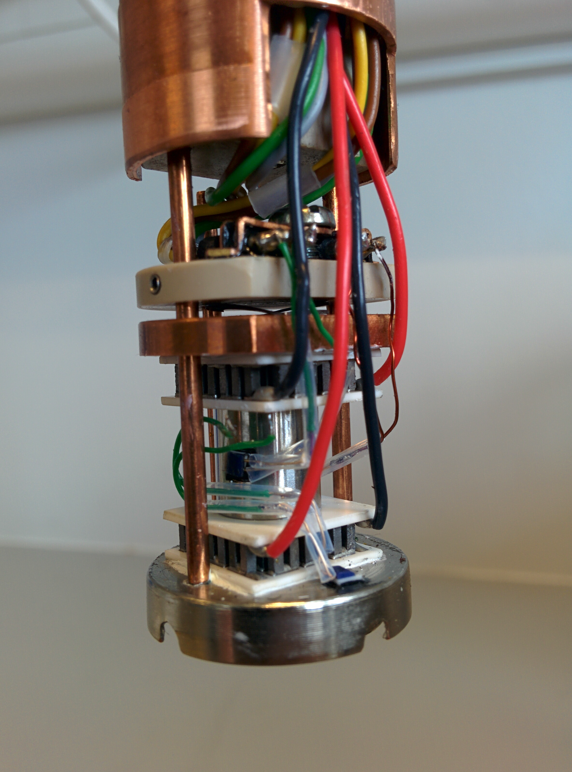
Temperature and Fields – suite for 8 by 2023 incl. infrastructure
 | # | Needed for … out of first 8 Instruments
Vertical cryomagnet 10T | 1 | Magic, C-Spec, Dream
Vertical cryomagnet 15T (HZB) | 1 | Bifrost, Dream
Warm bore cryomagnet 2x 2.5T, 1x 5T | 3 | Estia, Magic, Dream, C-Spec, Loki, [Odin], [Beer]
Horizontal cryomagnet 11T | 1 | Estia, Magic, Dream
Cryostat incl PTR, wet, flow, cryostream | 4 | Estia, Magic, Dream, C-Spec, Loki, Beer, [Odin]
CryoFurnace (4K – 500K) incl. changer | 3 | Dream, C-Spec, Bifrost, Loki, Beer, [Odin]
Dilution | 2 | Magic, C-Spec, Bifrost
High Temperature Vacuum Furnace | 2 | Magic, Dream, C-Spec, Bifrost, [Odin]
Infrared Furnace | 1 | C-Spec, Magic, Beer, Bifrost, Dream, [Odin]
Sorption stick | 1 | Magic, Dream, C-Spec, Bifrost
6kV HV supply | 2 | Magic, C-Spec, Estia, [Odin]
Peltier subcryostat, in-situ AC suscept. | 1 | additional in-situ possibility

Slide 43
Temperature and Fields – suite for 8 by 2023 incl. infrastructure
 | # | Cost k€ | Ready | Start | In-kind partner
Vertical cryomagnet 10T | 1 | 1000 | 20 Q4 | 17 Q4 | ‘agreed’ (FR)
Vertical cryomagnet 15T (HZB) | 1 | (1000) | 21 Q1 | 17 Q4 | re-used (DE)
Warm bore cryomagnet 2x 2.5T, 1x 5T | 3 | 1000 | 22 Q1 | 19 Q1 | not identified
Horizontal cryomagnet 11T | 1 | 500 | 22 Q1 | 19 Q1 | not identified
Cryostat incl PTR, wet, flow, cryostream | 4 | 350 | 21 Q1 | 19 Q2 | not identified
CryoFurnace (4K – 500K) incl. changer | 3 | 500 | 21 Q1 | 18 Q4 | MAGIC, DREAM, CSPEC
Dilution | 2 | 500 | 21 Q1 | 18 Q3 | not identified
High Temperature Vacuum Furnace | 2 | 80 | 21 Q1 | 19 Q1 | not identified
Infrared Furnace | 1 | 50 | 21 Q2 | 19 Q2 | discussed (DE)
Sorption stick | 1 | 150 | 21 Q1 | 18 Q4 | discussed (DE)
6kV HV supply | 2 | 50 | 21 Q2 | 20 Q3 | in-house
Peltier subcryostat, in-situ AC suscept. | 1 | 125 | -- | started | started (DK)
LHe vessels / Helium management | IN | 200 | 21 Q1 | 18 Q1 | not identified

Slide 44
Temperature and Fields – suite for 8 by 2023 incl. infrastructure
 | # | Cost k€ | Ready | Start | In-kind partner
Vertical cryomagnet 10T | 1 | 1000 | 20 Q4 | 17 Q4 | ‘agreed’ (FR) | 3 x 1
Vertical cryomagnet 15T (HZB) | 1 | (1000) | 21 Q1 | 17 Q4 | re-used (DE) | 3 x 2
Warm bore cryomagnet 2x 2.5T, 1x 5T | 3 | 1000 | 22 Q1 | 19 Q1 | Not identified - CH | 1 x 3
Horizontal cryomagnet 11T | 1 | 500 | 22 Q1 | 19 Q1 | not identified | 1 x 3
Cryostat incl PTR, wet, flow, cryostream | 4 | 350 | 21 Q1 | 19 Q2 | not identified | 1 x 3
CryoFurnace (4K – 500K) incl. changer | 3 | 500 | 21 Q1 | 18 Q4 | MAGIC, DREAM, CSPEC | 1 x 1
Dilution | 2 | 500 | 21 Q1 | 18 Q3 | not identified | 1 x 3
High Temperature Vacuum Furnace | 2 | 80 | 21 Q1 | 19 Q1 | not identified | 1 x 3
Infrared Furnace | 1 | 50 | 21 Q2 | 19 Q2 | discussed (DE) | 1 x 2
Sorption stick | 1 | 150 | 21 Q1 | 18 Q4 | discussed (DE) | 1 x 2
6kV HV supply | 2 | 50 | 21 Q2 | 20 Q3 | in-house | 1 x 1
Peltier subcryostat, in-situ AC suscept. | 1 | 125 | -- | started | started (DK) | 0 x 0
LHe vessels / Helium management | IN | 200 | 21 Q1 | 18 Q1 | not identified | 2 x 3

Slide 45
Temperature and Fields – envisaged suite for 15 by 2025+
 | # | Needed for … out of #9-#15 Instruments
Horizontal cryomagnet 11T | 1 | Skadi
Vertical cryomagnet 10T, 15T | 2 | T-Rex, Miracles
Warm bore electro- / cryomagnet | 2 | Miracles, Vespa, Heimdal, Freia
3D Helmholtz magnet / cryomagnet | 2 | Skadi
Cryostat incl PTR, OC, flow, cryostream | 8 | Miracles, Vespa, Heimdal, NMX
CryoFurnace (4K – 500K) incl. changer | 5 | Heimdal, Miracles
Dilution | 3 | Miracles, Vespa
High Temperature Vacuum Furnace | 4 | Miracles, Vespa, Heimdal,, Freia
Infrared Furnace | 2 | Miracles, Vespa,
Sorption stick | 3 | T-Rex, Miracles, Vespa
6kV HV supply | 3 | Skadi, Miracles, Vespa, Freia
Peltier subcryostat, in-situ AC susceptiblity | 1
Pulsed magnet and other specific magnets | 2 | Loki, Magic, Bifrost (investigate leverage / external)

Slide 46
Temperature and Fields –
Towards a unified magnet suite
Priorities
Warm bore, ‘lowish’ fields (2-5T) very popular – allows a lot of flexibility in geometry, low background, independent cryogenic or other inserts.
Angular access and low background more important than highest fields - except for BIFROST.
Heavy demand for ‘MAGiC 10T’ large aperture vertical field cryomagnet.
Horizontal field geometry not strongly demanded – except for SANS, and DREAM after detector upgrade.

Slide 47
Strategy for higher fields
There is a science case for >20T fields, but demand is not extreme.
There are ongoing developments in HTSC coils (Tallahassee, FASUM) that promise results on ~5 year timescale. Cost is significant ($10-15M), but much less than resistive/SC hybrid. Result will be compact enough to fit on existing instruments and should provide >30T
Pulsed fields ongoing option with well-known tradeoffs.
ESS magnet strategy: Stick to current SC tech. for now with view to HTSC when mature. Pulsed fields also planned, though not first priority.

Slide 48
Magnet meeting outcome
Priority | SYSTEM | DETAIL | UNIT COST (k€) | INSTRUMENTS | READY BY
=1 | 2.5T Warm bore cryomagnet | Similar to MLZ TOFTOF | 335 | ESTIA +EVERYONE | 22/Q1
=1 | Vertical 10T cryomagnet | large opening, assymetric | 1000 | MAGIC CSPEC DREAM TREX HEIMDAL | 20/Q4
=1 | Vertical 15T cryomagnet | split coil | (1000) | BIFROST DREAM HEIMDAL | 21/Q1
2 | 5T warm bore cryomagnet | Cryo-free | 300-400 | ALL (-MIRACLES)
3 | 2.5T warm bore small footprint | No bottom access | 250 | ALL incl MIRACLES
4 | Horizontal 11T cryomagnet | SANS MA11+ | 500 | SKADI ESTIA MAGIC DREAM HEIMDAL | 22
5 | Medium field cryo | Assym. large opening |  | MAGIC CSPEC DREAM TREX HEIMDAL
6 | 1T electromagnet |  | 50 | LOKI ESTIA SKADI FREIA | 21/Q1
7 | Horizontal medium field large opening |  |  | BIFROST DREAM HEIMDAL | 23
 | Pulsed field |  |  | MAGIC DREAM HEIMDAL | 24

Slide 49
Thinned Al on beam out

Slide 50
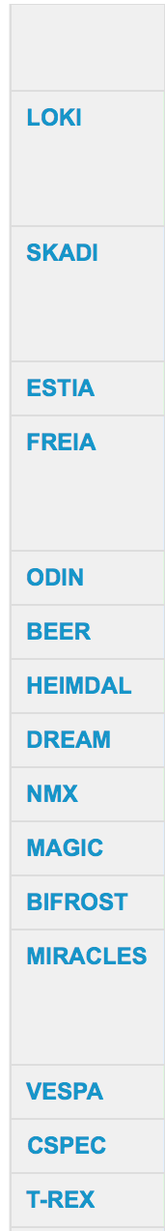
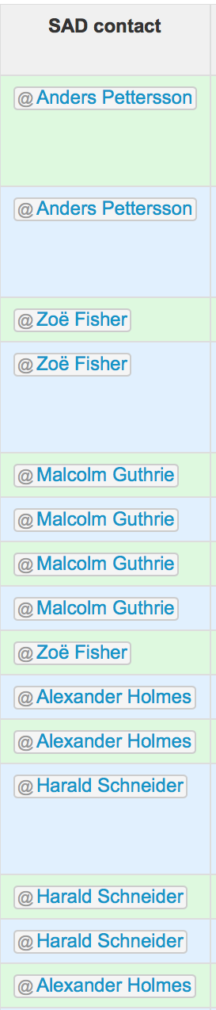
Interaction with Instrument Teams:
Sample Environment Equipment
SE Suite based on instrument needs. Timelines determined by construction schedule and lead time.
NSS construction budget covers first 8 instruments. Budget provision for instr. #9-#15 in initial operation.
Most SE Equipment within SSS budget but some remains part of instrument construction.
Execution responsible involves (potentially) expert team from partners incl. universities.
Regular topical workshops involving instr. scientists to ensure adjustments: magnet workshop …
50

Slide 51
Towards an integrated ESS:
Science Support Systems and Instruments
Equipment
Availability
Equipment
Change-over
Parameters
Sample Change
Labs
Instrument interaction 1 FTE (equivalent to 6 PM per instrument until hot commissioning)

Slide 52


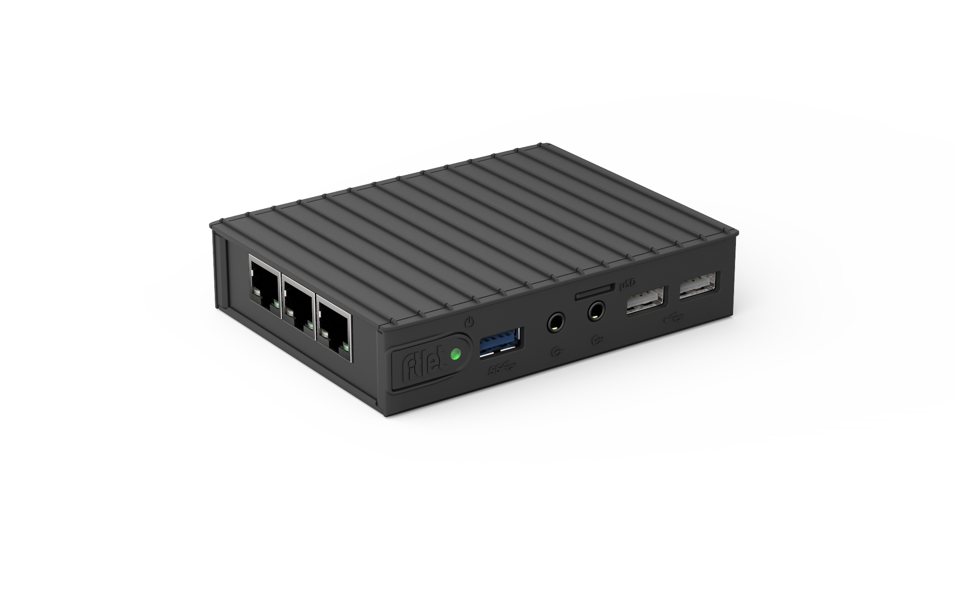
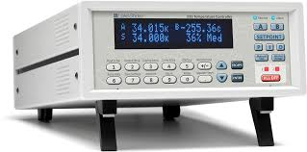
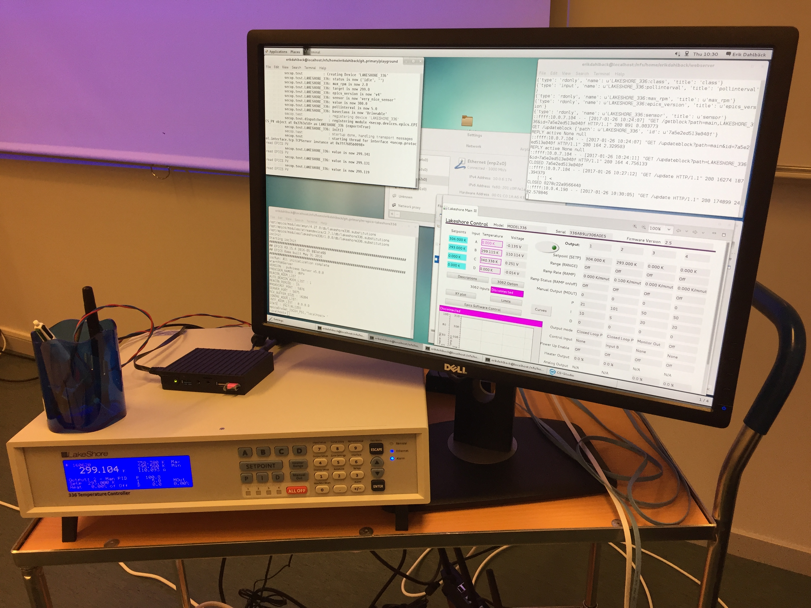

Towards an integrated ESS:
Sample Environment Communication Protocol
Currently different languages: facilities, users, manufacturers
Standardised protocol to reduce integration effort
Aim for adaptation by manufacturers
Integration completed prior to arrival
Demonstration of a SECoP implementation Jan 2017
Compatible ESS EPICS Instrument Integration Project
Full integration first SEE hardware -> UI on-going
Scientist
Experiment control system
EPICS
SECoP
SECoP
SE equipment logic
SE equipment hardware
EU H2020
No 654000

Slide 53
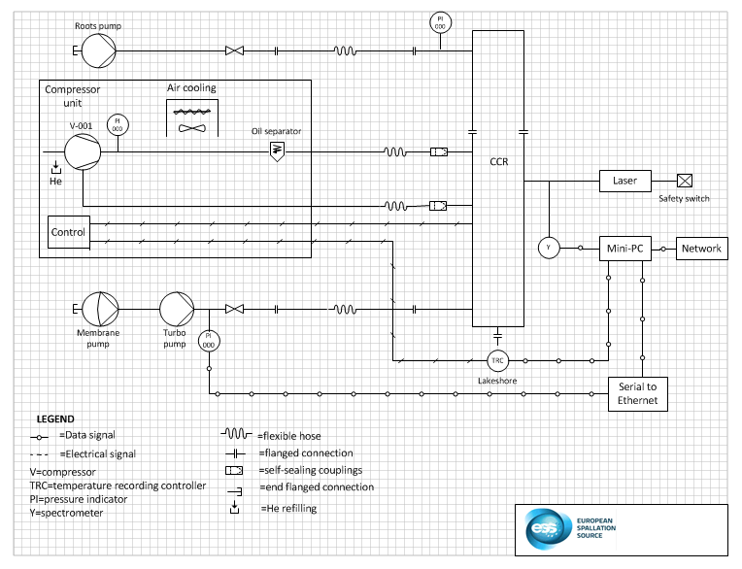
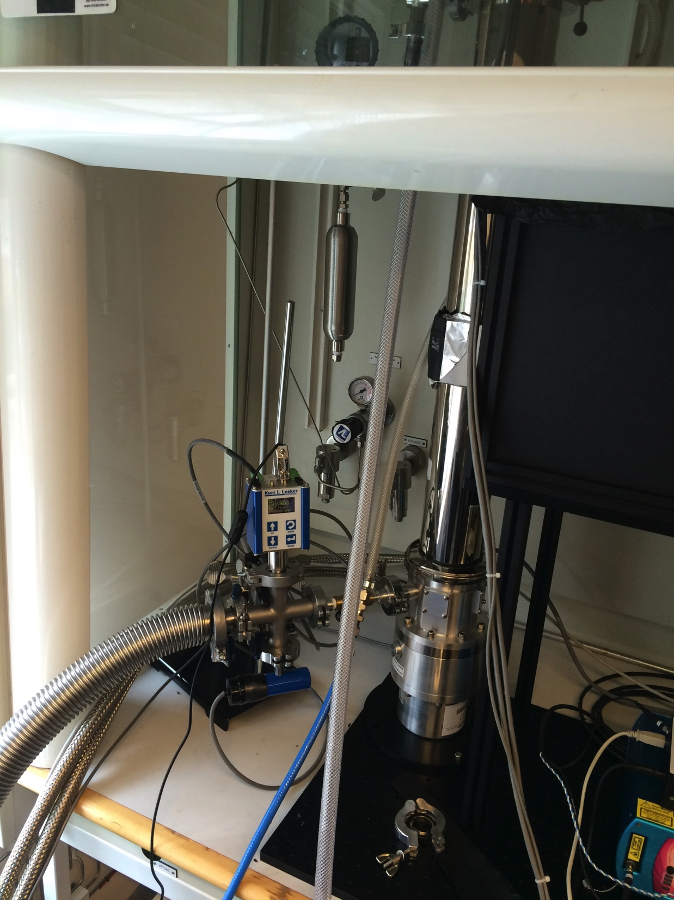
SEE Integration projects status
Temperature controller done.
CCR setup done.
JULABO heater/cooler circulator done.
EtherCAT control system evaluated
Cryostat automation project envisaged
Prototype on robotic sample changer for low mass sample sticks completed.
Re-scoped the robotics project. To modular / mobile system to
  ease sample change inside existing equipment and
  to facilitate single crystal orientation
Closed Cycle Refrigerator Setup

Slide 54
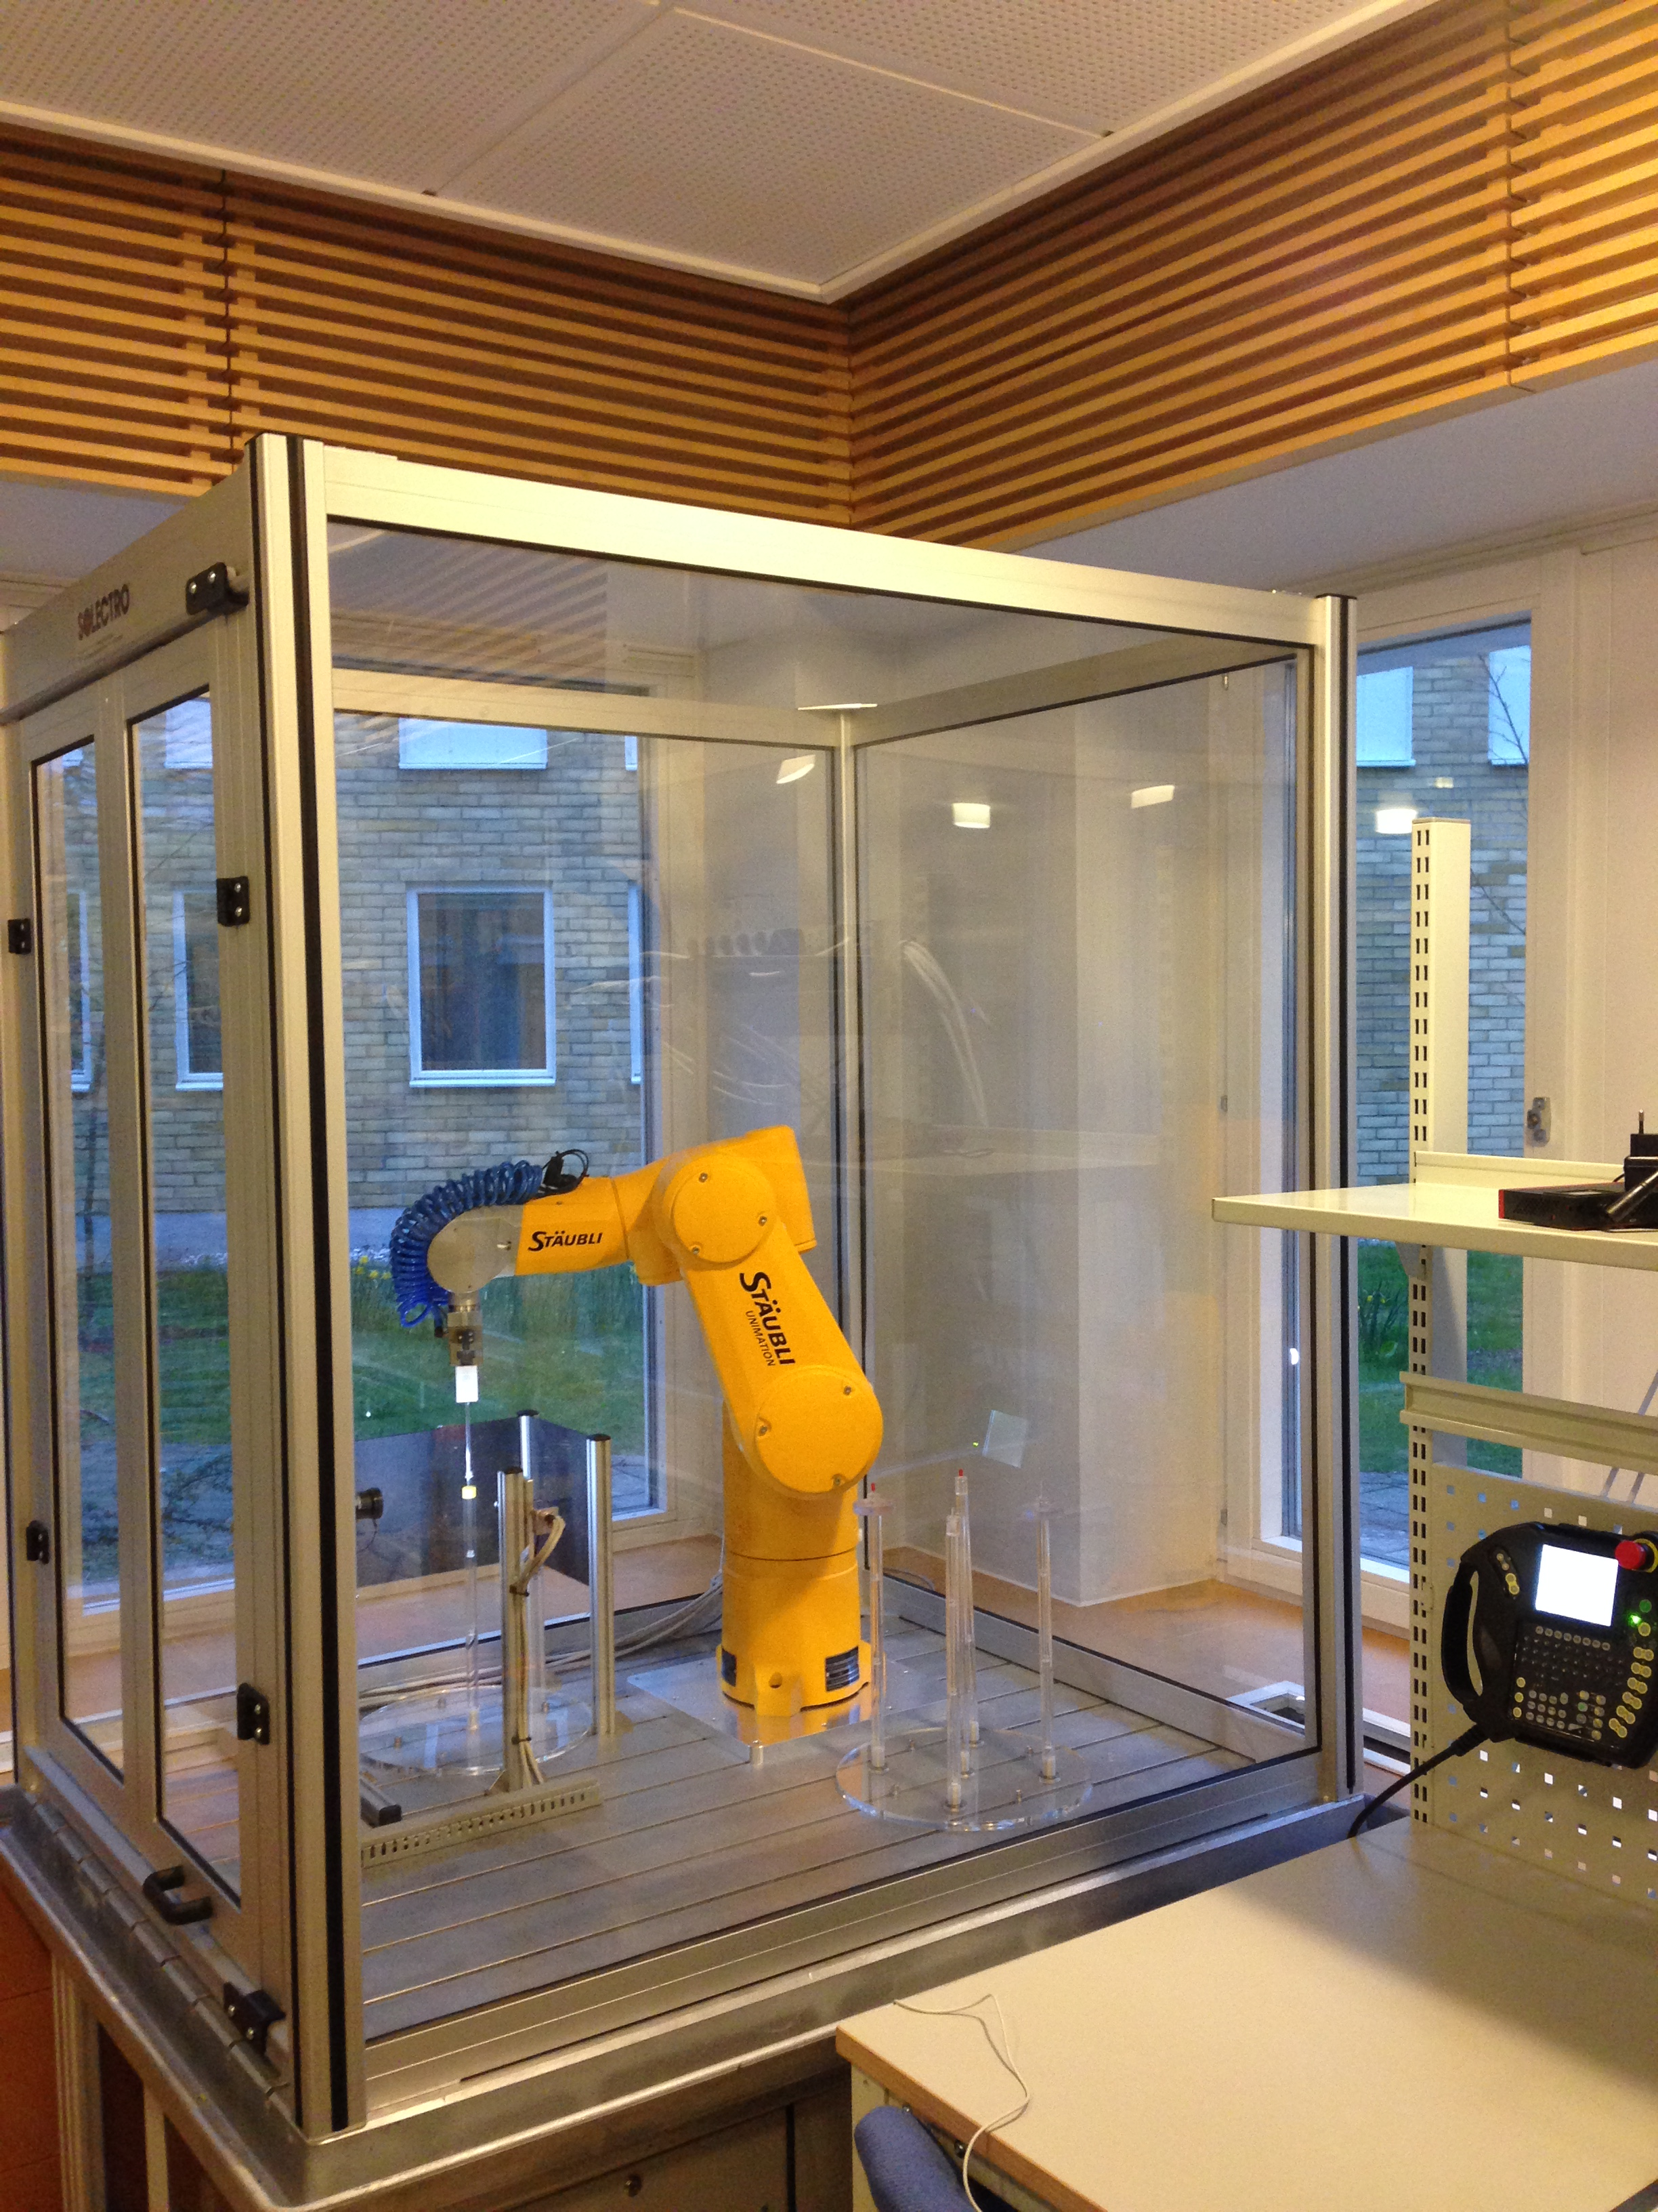
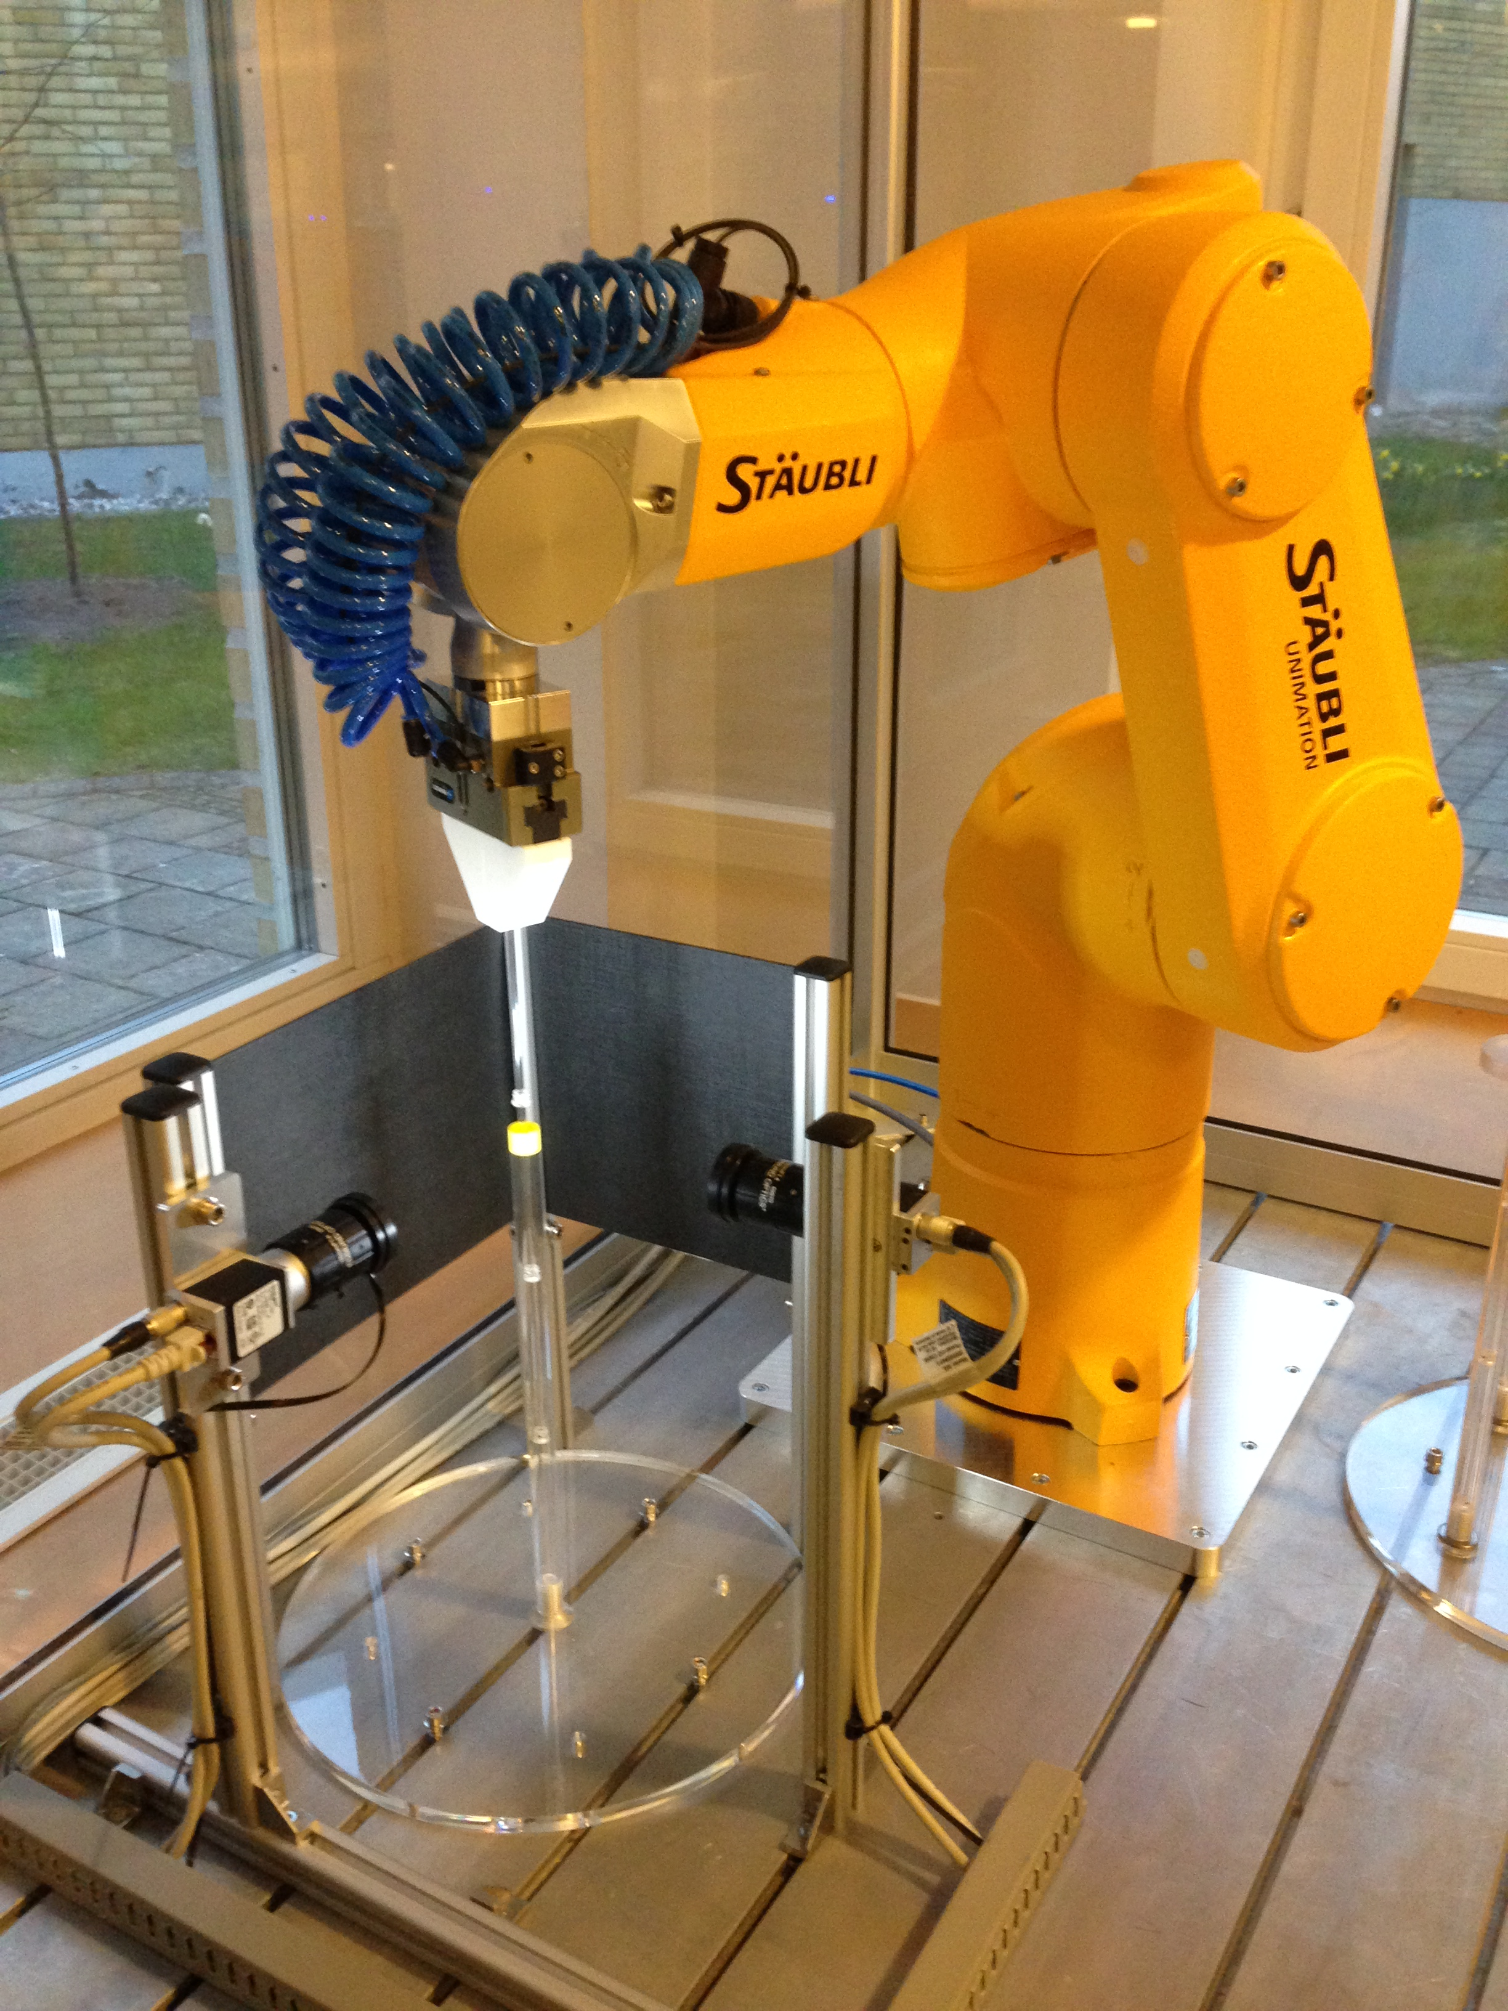
Robot project
Robot Cell with Access Door and Safety Lock
3D-printed Gripper Fingers
Image Background
2 Cameras,
Lenses and Ring-Lights
Sample Magazine
Robot Hand Control Panel
Cryostat Model

Slide 55
SEE Mechatronics and
Software Integration
 | # | Ready | Start | In-kind partner
MESI Integration Support | 1 | 21 Q1 | 18 Q1 | discussed (CH) | 2 x 2
MESI workshop | IN | 20 Q1 | 19 Q1 | Not-identified | 1 x 3

Slide 56
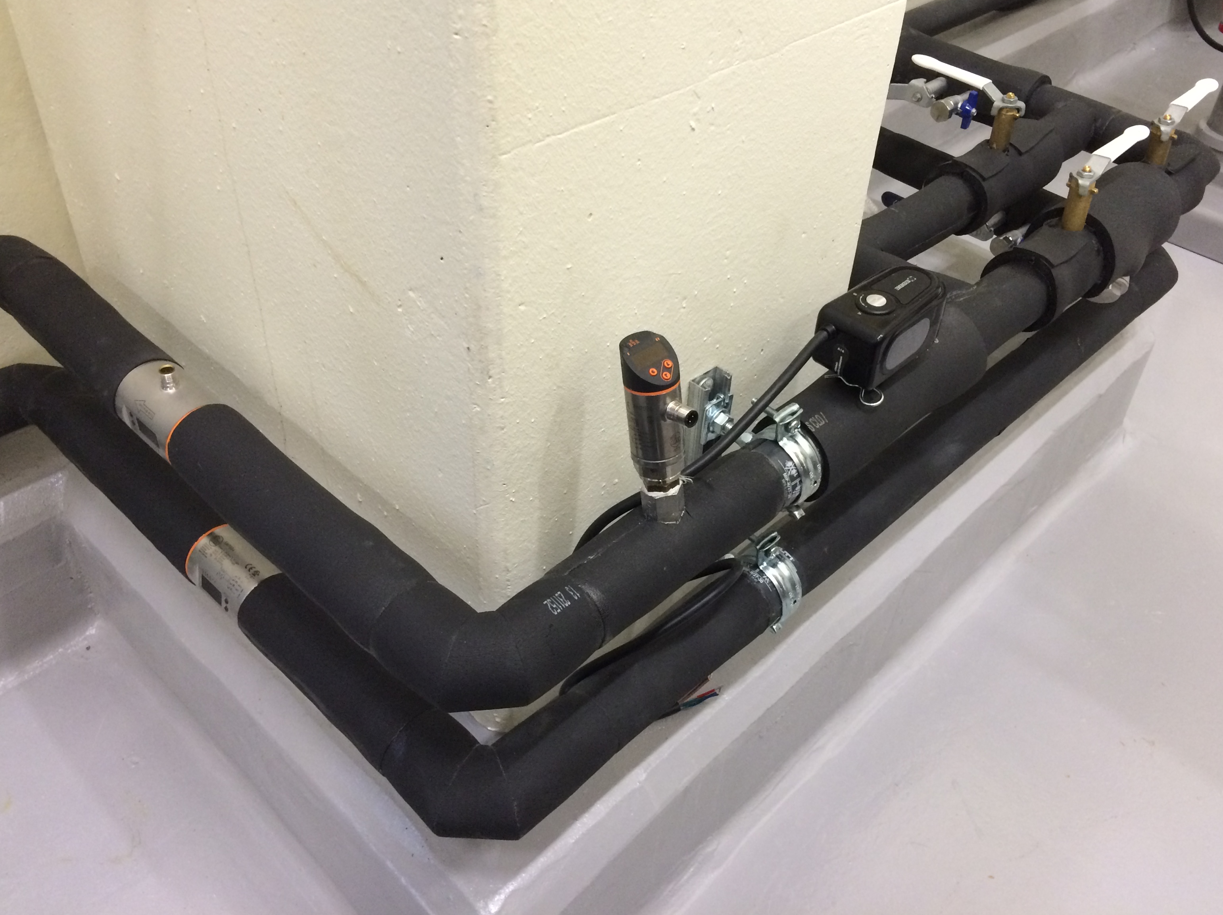
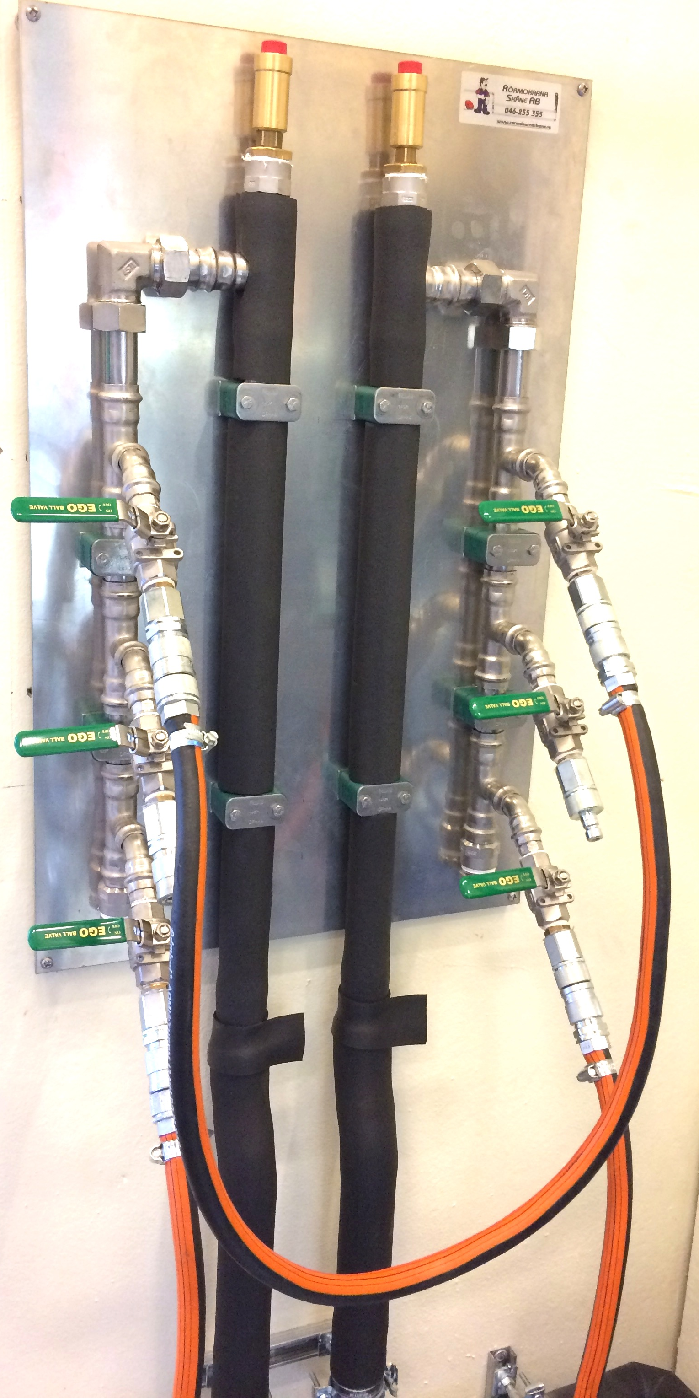
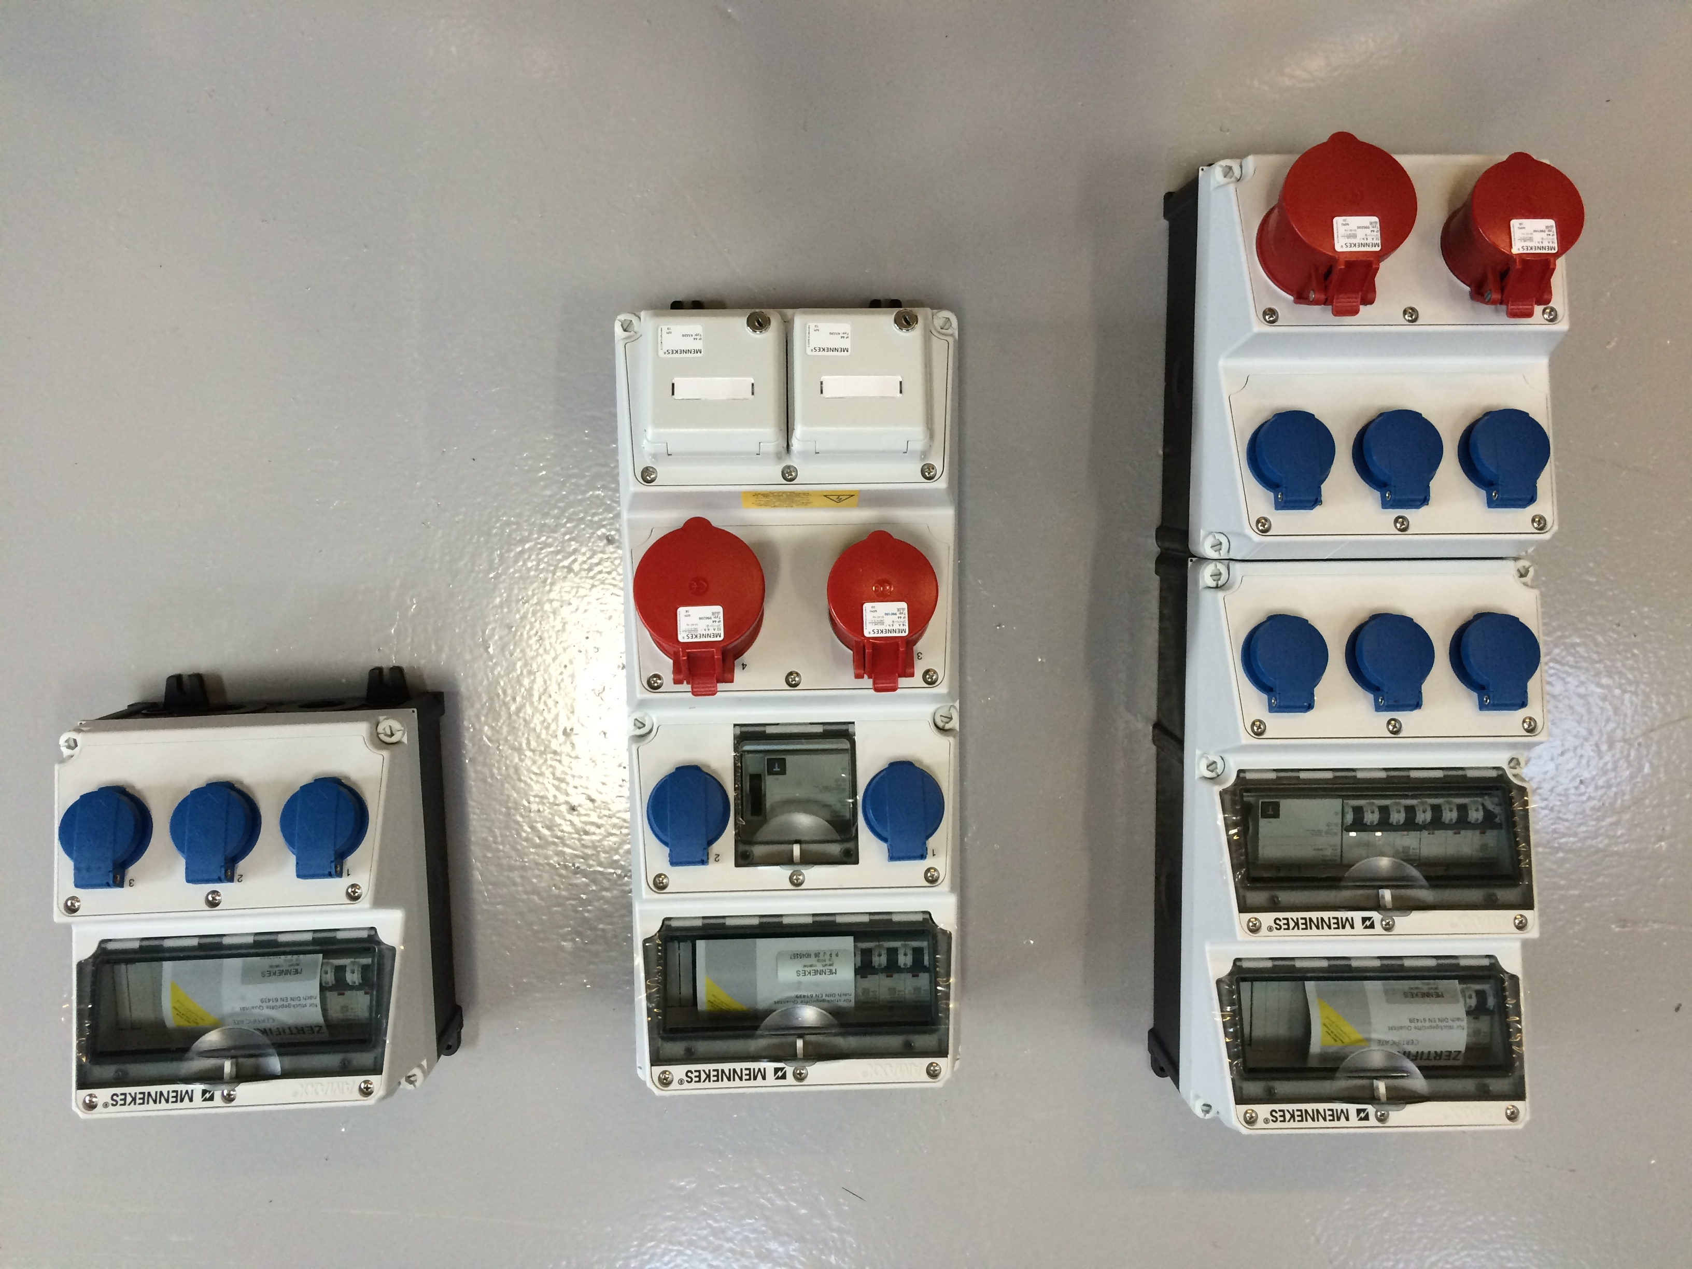
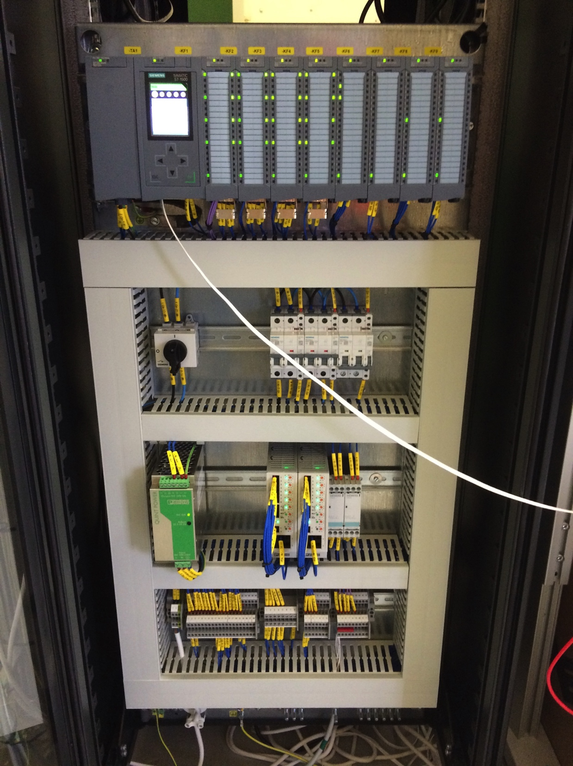
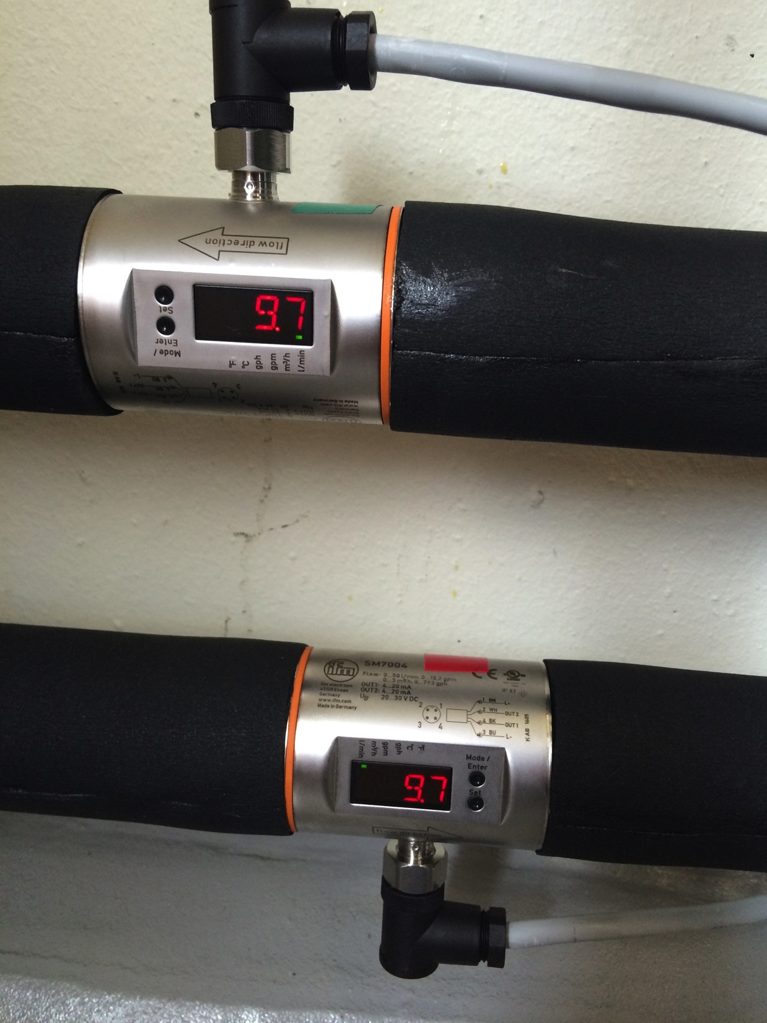
Towards an integrated ESS:
Sample Environment Supplies
Cooling water:
Prototype incl I/O flow meter, T-sensor, p-sensor, outlets, de-airing, filter, shut-off
Power:
Prototype panle and power monitoring currently tested.
Gases:
3 Gases + compressed air with indiv. Valves / regulators under development.
Helium Management:
Liquid helium provided in dewars by on-site liquefier
Recovery system to liquefier joint MAX IV
PLC:
PLC panel delivered; EPICS integration started
Meter readings, flow check logic, automatic leak detection and shut off

Slide 57
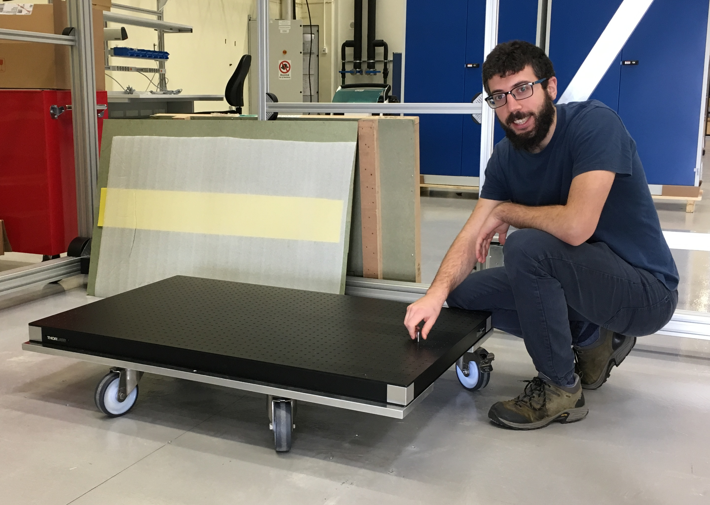
Towards an integrated ESS:
Mechanical Interfaces
Kinematic mount (B. Perez):
Allows repeatable positioning
Define Universal Coordinate System
Transfer between multiple instruments
Multiple pre-aligned SEE rapidly inserted
Instrument areas for sample environment:
Ensure sufficient space for operation, preparation and logistics.
Sample
Pos.
mount
mount
base
base
OFFLINE
ONLINE
Utgård mounting/alignment
prototype

Slide 58
Interaction with Instrument Teams:
Interconnectivity & Standards
Standards on mech. interfaces, supplies, controls, safety ensuring interconnectivity and smooth work flow
Prototyping on-site infrastructure well advanced as part of ESS Instrument Integration Project.
Specific 1:1 meetings on engineering topics
Active Participation in instrument project meetings incl. TG preparation (SSS-specific TG2 checklist)
Active participation in monthly instrument meetings
Workshops involving instrument engineers envisaged on common engineering challenges .
58

Slide 59
Towards an integrated ESS:
Science Support Systems and Instruments
Equipment
Availability
Equipment
Change-over
Parameters
Sample Change
Labs
Instrument interaction 1 FTE (equivalent to 6 PM per instrument until hot commissioning)

Slide 60
Developmental Activities
Challenge | Activity | Partner
Extreme cond / high pressure | Diamond Anvil Cells 50 GPa Low-T Hi-p cells kinematic mounts & tracker | ISIS / U Edinburgh collaboration
Multiple parameters / in-situ | Laser system Pump Probe In-situ Rheometer In-situ AC susceptibility Modular set-up f. In-situ DLS, GISANS humidity cell, SANS cell for foams | U Tartu (IK completed) FZJ (potentially) In-house incl. ILL collaboration FlexiProb (Verbundforschung)
Fast / remote sample change | Robotic changer for cryostat | MCA with U Chemnitz (completed)
High precision T control | Peltier sub-cryostat | RUC (IK started)
Efficient parameter control | Peltier differential changer SE Communication Protocol SECoP | RUC (IK started) SINE2020 (EU-H2020 started)
60

Slide 61
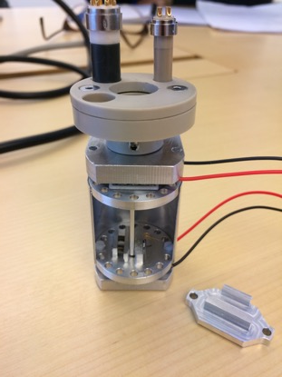
Peltier-based high-speed and high-precision T-controlled Sample Platforms
Motivation
Faster temperature change for T > 100 K
Better temperature stability
Independent T control for several samples
Deliverables
Prototype for feasibility tests
Insert for orange-type cryostats
Muliple SANS cuvette changer
First Results
mK stability proven
Feasibility down to 100K shown.
Feasibility for cost optimised
T control.
IK Partner: B Jakobsen, K Niss et al, RUC

Slide 62
Linear Sample Changer with Individual Temperature control
Principle sketch of the device
Magazine 5 positions, up to 10 pos. possible
Different sizes of quartz /sapphire cuvettes
Dedicated for SANS applications
Each position with individual controlled T performed by Peltier elements
Temperature range 5˚C – 120˚C Base plate thermalized by circulator
In “dry” atmosphere: temperatures down to – 20˚C
Cuvette holder w. Peltier elements
Thermalised base plate
Cuvette holder
IK Partner: B Jakobson, C Niss, RUC

Slide 63
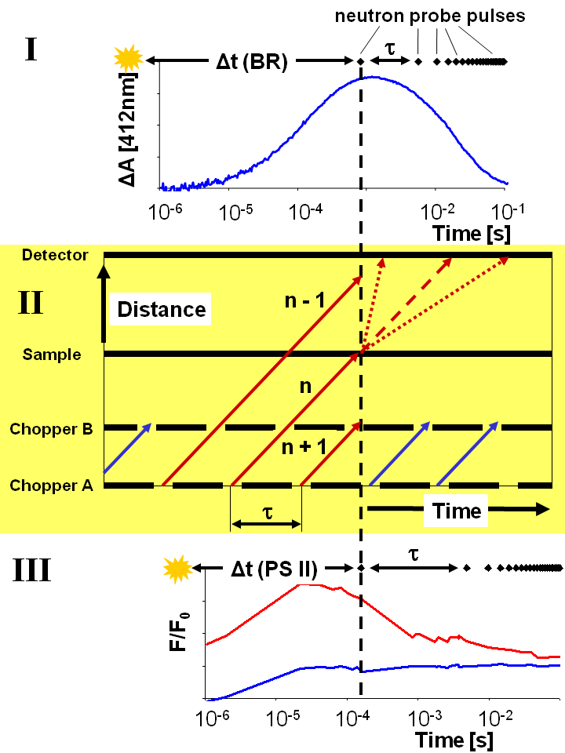
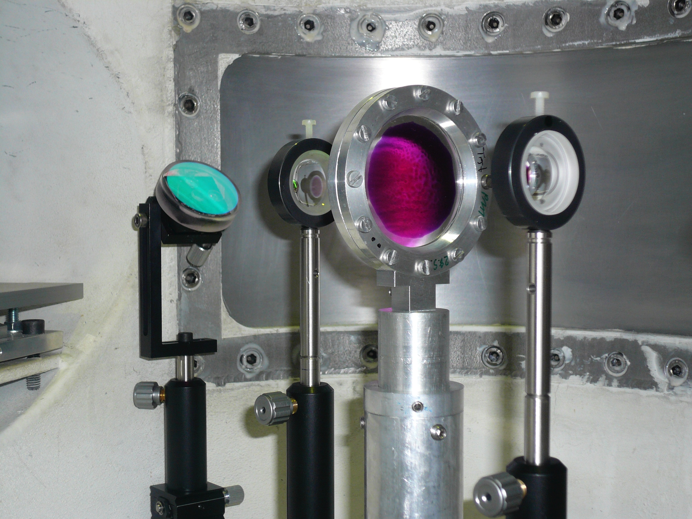
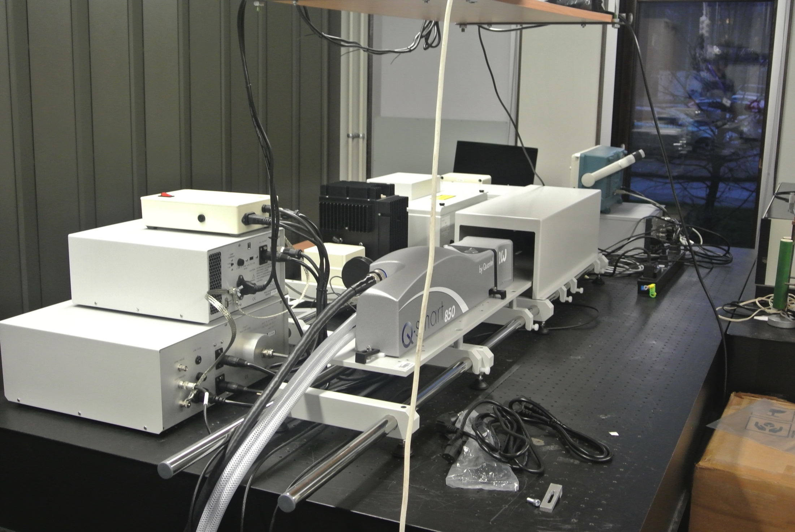
Laser-Neutron Pump-Probe Technique
Principle
Example of setup at IN5/ILL
Successful in kind contribution from University Tartu by J. Pieper
Final acceptance test Nov 2015
Biophysics, photosynthesis
First experiments at ILL IN5
Experiments planned at MLZ TOFTOF and HZB NEAT
Actual setup in University of Tartu
IK Partner: J Pieper et al., U Tartu

Slide 64
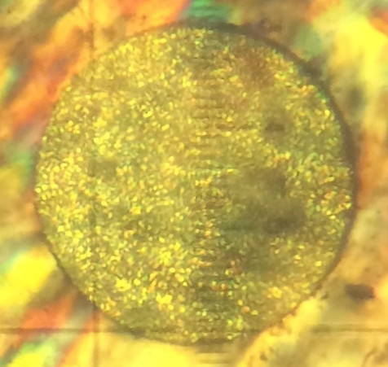
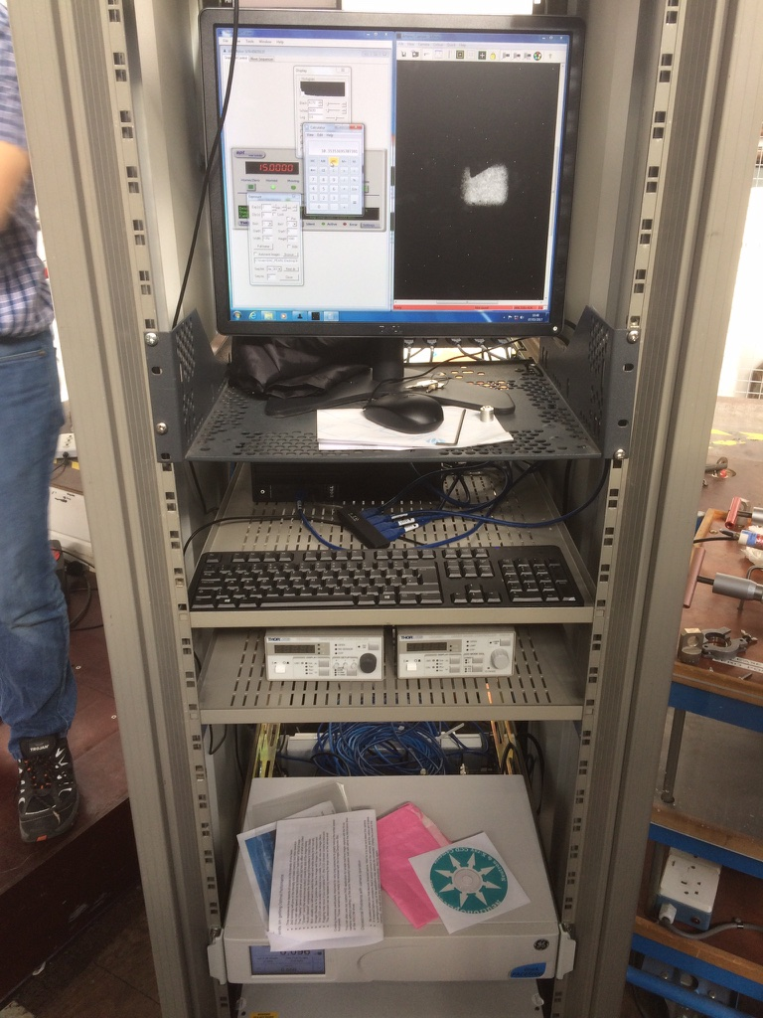
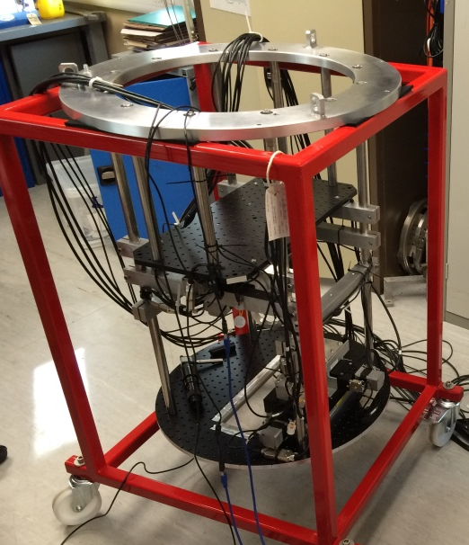
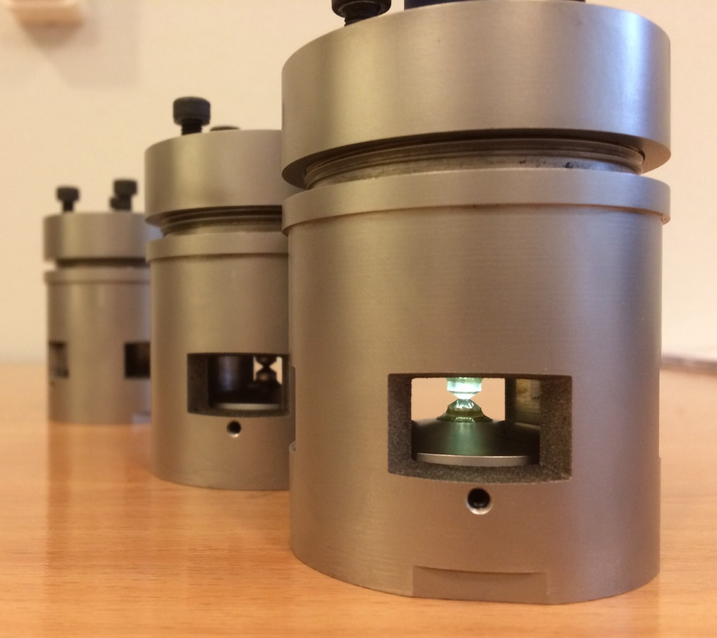
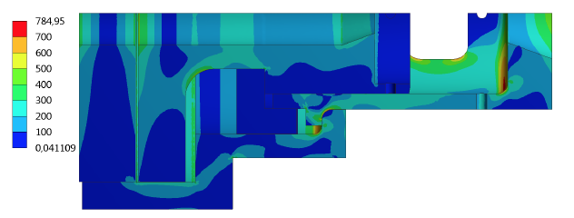
ESS – ISIS– U Edinburgh - SNS
Collaboration on Diamond Anvil Cells
Enabling Higher Pressures for Neutron Scattering
DACs common at synchrotrons … but not so much for neutrons (yet)
Though optically transparent, relatively low masses, low diff bckgrd
DACs of larger volume already successfully used on SNAP.
Collaborative project for DACs on PEARL establishing European test bed
Solid
Methane @
5 Gpa
(0.7 mm
diameter)
(Left) ISIS control rack: motors, pressure control, spectrometer, neutron camera. (right) DAC station
DAC optimisation
By finite element
M. Edung (LU)
DAC cells: SNS/ESS design, mfg by U. of Edinburgh

Slide 65
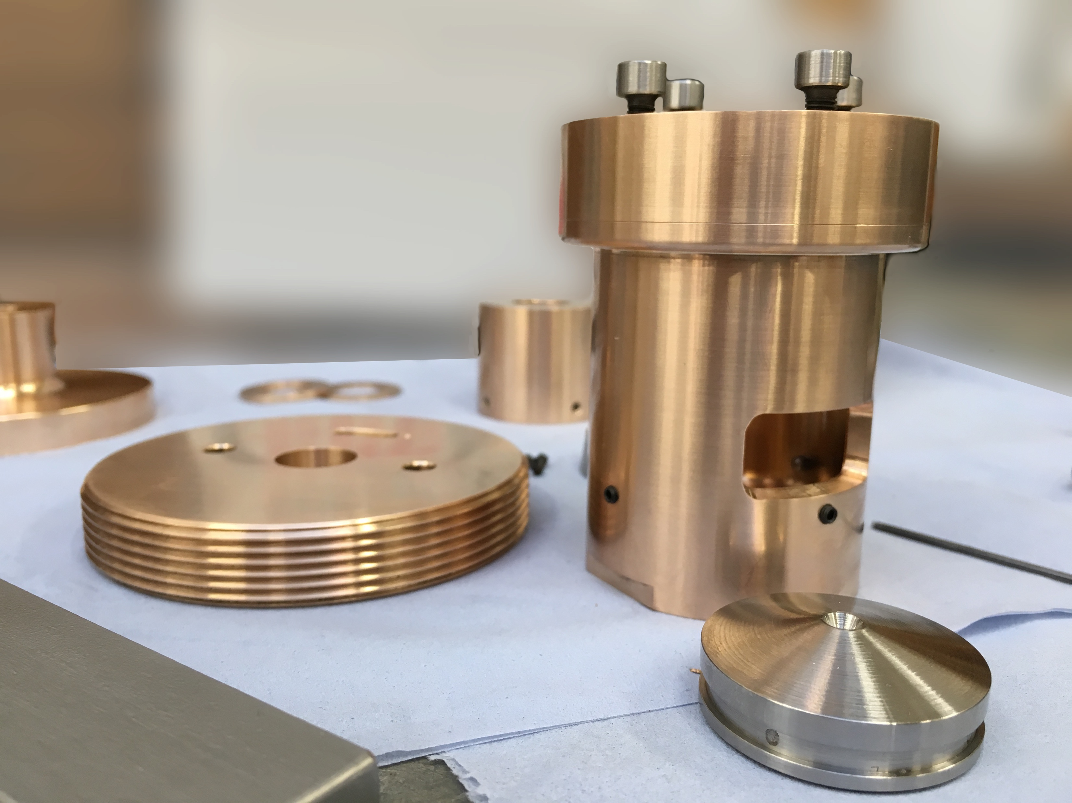
ESS – ISIS– U Edinburgh - SNS
Collaboration on Diamond Anvil Cells
Cell fabricated in Edinburgh
Visiting SNS May 9-16 will conduct cooling/pressure testing

Slide 66
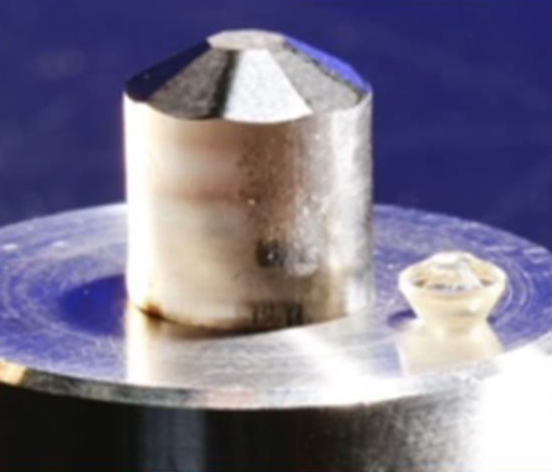
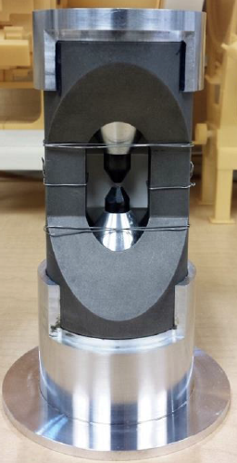
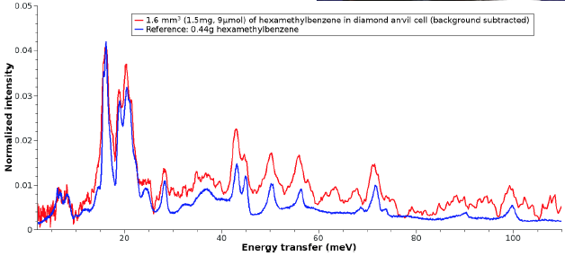
Other collaboration with SNS
INS on VISION spectrometer
(Collaboration with B Haberl, R Boehler, L Daemon, T Ramirez-costa)
In situ measurement of ice VII/VIII at 10 GPa (1 day beamtime)

Slide 67
Other collaboration with SNS
Megabar testing
Variant of VISION cell for diffraction
6mm diameter conical diamonds
1.5mm culets

Slide 68

Science Support – towards Operation

Slide 69
Science Support Systems – budget
SSS TOTAL ’13 -’23 20.5 M€ SSS spent ’13 - ’15 3.9 M€ | Available ’16 - ’19
Management; Inst. Interaction | 1830 k€
Scientific Coordination | 1190 k€
 | Available ‘16 – MS | IK % | Coordination Interaction | Labs and Equipment | MS complete move OPS
Sample and User Labs | 2081 k€ | 70 | 385 k€ | 1696 k€ | 12 / 2019
Deuteration & crystallisation incl. bench fee + chem. deut. | 885 k€ | 55 | 115 k€ | 770 k€ | 12 / 2018
 | Available ’16 – ’23 | IK % | Coordination Interaction | Workshops | Equipment Projects
Mechatronics & Software | 1857 k€ | 37 | 908 k€ | 557 k€ | 392 k€
Fluids incl. Gases Liquids … | 2306 k€ | 55 | 903 k€ | 231 k€ | 1172 k€
Pressure & Mech. Process | 2939 k€ | 64 | 783 k€ | 1122 k€ | 1034 k€
Temperature & Fields | 3570k€ | 62 | 980 k€ | 895 k€ | 1695 k€
69
Notes:
Disolve this slide or use as summary; link to SAC comments
Needs to specifc what it want from the pool and what they build for their instrument.
Instrumet team takes team during construction (and potentially in operation)

Slide 70
Science Support Systems – budget increased Nov 2016
SSS TOTAL ’13 -’23 25.1 M€ SSS spent ’13 - ’15 3.9 M€ | Available ’16 - ’19
Management; Inst. Interaction | 1830 k€
Scientific Coordination | 1190 k€
 | Available ‘16 – MS | IK % | Coordination Interaction | Labs and Equipment | MS complete move OPS
Sample and User Labs | 2081 k€ | 70 | 385 k€ | 1696 k€ | 12 / 2019
Deuteration & crystallisation incl. bench fee + chem. deut. | 885 k€ | 55 | 115 k€ | 770 k€ | 12 / 2018
 | Available ’16 – ’23 | IK % | Coordination Interaction | Workshops | Equipment Projects
Mechatronics & Software | 1857 k€ | 35 | 908 k€ | 557 k€ | 392 k€
Fluids incl. Gases Liquids … (revised + 200 k€) | 2506 k€ | 60 | 903 k€ | 231 k€ | 1372 k€
Pressure & Mech. Process (revised + 800 k€) | 3739 k€ | 70 | 783 k€ | 1122 k€ | 1834 k€
Temperature & Fields (revised + 3600 k€) | 7170 k€ | 80 | 980 k€ | 895 k€ | 5295 k€
70
Notes:
Disolve this slide or use as summary; link to SAC comments
Needs to specifc what it want from the pool and what they build for their instrument.
Instrumet team takes team during construction (and potentially in operation)

Slide 71
Key Milestones
Milestone | Date | Description
Platform for deuteration and crystallisation activities ready | End 2018 (operational activity) | essential support of deuterated materials preparation; usable to support hot comm.
Radioactive Materials Lab ready | End 2019 (ready beam on target) | RML lab needed for activated samples and equipment.
First laboratories and sample environ. workshops in exp. hall | End 2019 (ready beam on target) | Labs and workshops as needed and defined in Sample Management Procedure.
First sample environment equipment | End 2021 (first instrum. start hot commissioning) | SEE needed for demonstrating instrument performance.
Initial suite of laboratories and sample environment workshops | Mid 2023 (start user program) | Labs and workshops as needed for emerging user program on first 8 instruments.
Initial suite of sample environment equipment | Mid 2023 (start user program) | SEE needed for conditions needed for emerging user program on first 8 instr.

Slide 72
Science Support – towards (initial) operation
With instruments moving into Hot Commissioning from 2021, Scientific Activities Division will:
be managing the (early) user program incl. proposals, scheduling, sample management, user visits, experimental report and also keep publication records.
operate chemistry and life science labs incl. lab consumables and equipment maintenance
provide deuteration expertise and support.
install and jointly operate with instrument team sample environment equipment during experiment, and support users in sample conditioning / mounting.
maintain the then existing and also extend the sample environment suite and the support laboratories to cater for instruments #9-#15 entering hot commissioning and user programme (*).
(*) The NSS construction budget covers the sample environment suite and support laboratories for the first 8 instruments only and further functionality has been deferred to initial operation in-line with the instrument construction schedule.
Notes:
Present experience: fragementation, only partly supporting all topics …
New approach …maintaining balance; bringing it close to the user

Slide 73
Science Support – towards (initial) operation
With instruments moving into Hot Commissioning from 2021, Scientific Activities Division will:
be managing the (early) user program
operate chemistry and life science labs
provide deuteration expertise and support
install and jointly operate with instrument team sample environment equipment
Maintain then existing and extend sample environment suite and support laboratories to cater for instruments #9-#15.
Notes:
Present experience: fragementation, only partly supporting all topics …
New approach …maintaining balance; bringing it close to the user

Slide 74
Science Support – towards (initial) operation
SE Platforms: Staff Ramp-Up
h.c. users
h.c. users
Notes:
Present experience: fragementation, only partly supporting all topics …
New approach …maintaining balance; bringing it close to the user

Slide 75
Science Support – in steady state operation
Staff FTE | Annual budget k€ / year
2.0 . | 1512 incl. major capital projects, on-call support
7.0 | 1225
6.0 | 762
6.5 | 1295
5.0 | 895
5.0 | 875
3.5 | 535
6.0 . . | 2737 incl. user reimbursement and PhD programme
Science Support Systems
Scientific Coord.
User Office
Temperature
Field
High Pressure
Mech. Proc.
Fluids incl. gases,
vapor, compl. fl.
Deuteration
Crystallization
Sample handling
general labs
Sample Env.
Syst. Integration
Share of SAD Tasks in OPS | Beam ON | Beam OFF
user prg, instr + exp support | 60 | 20
maintenance repair, calibr. | 10 | 50
development projects | 20 | 20
Coordination, IK, procuremnt | 10 | 10
SAMPLE ENV. 20.4.3
4 Divisions within Science:
SAD operating Science Support Systems
Instruments: Experiment support incl. ‘hall coordinators’ (24/7)
Technologies incl. Projects
DMSC
Notes:
Present experience: fragementation, only partly supporting all topics …
New approach …maintaining balance; bringing it close to the user

Slide 76
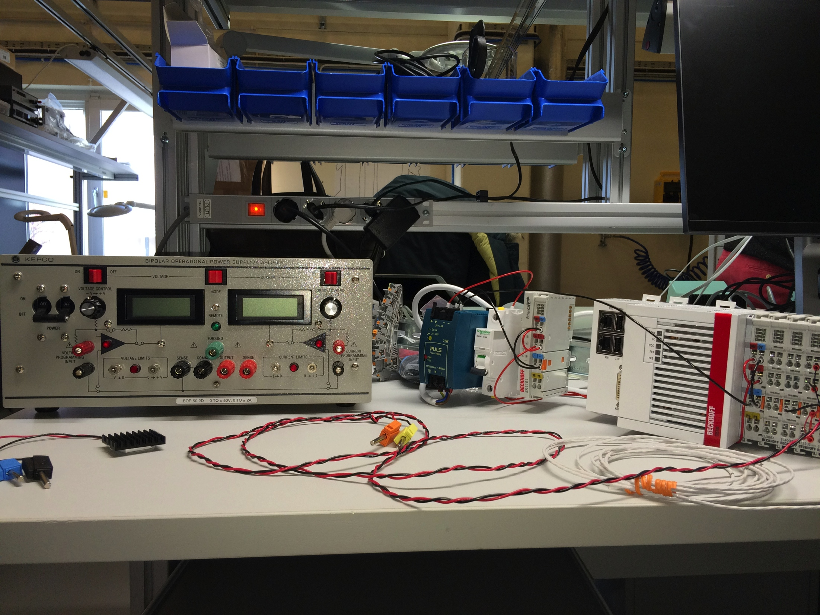
Investment in Sample Environment and Laboratory Equipment
 | Revised NSS / SSS equipment scope | 5y OPS ’19-’23 minor / major | Steady State minor / major inv.
Major strategic investment |  | 4250 k€ | 1000 k€ / y
Mechatronic & Software Integration | 392 k€ | 175 k€ | 100 k€ / y
Fluids incl. Gases Liquids … | 1372 k€ | 75 k€ | 150 k€ / y
Pressure & Mechanical Processing | 1834 k€ | 75 k€ | 150 k€ / y
Temperature & Fields | 5295 k€ | 100 k€ | 260 k€ / y
Sample and User Labs | 1696 k€ | 150 k€ | 80 k€ / y
Deuteration & Crystallisation | 770 k€ | 560 k€ | 170 k€ / y
Pre-operation 5y OPS 2019 – 2023 and steady state:
major strategic investment for science support systems managed by division.
maintenance and minor tactical investment managed by individual platforms.
76

Slide 77

SSS 20.4.3 – Sample Environment
Scope, Requirements and Function - 1
Definition and Context:
Ability to perform experiments with multiple / combined parameters incl. user supplied:
  low and high temperatures, electric and magnetic fields
  high pressures and mechanical constraints
  stabilized temperature, controlled humidity, gas loading, stopped liquid flow, excited states, conditioned fluids and free surfaces
Rapid and reproducible equipment change-over, cost efficient maintenance, reliability
Smooth integration on instrument and instrument control
Development of new equipment for specific geometries and parameter range
Agile science support for changing scientific communities and challenges
5/18/17
Sample Environment Scope Arno Hiess, November 2016 ESS Operations Cost Review
Notes:
Present experience: fragemtnation, only partly supporting all topics …
New approach …mainaining balance; bringing it colse to the user

Slide 78
SSS 20.4.3 – Sample Environment
Scope, Requirements and Function - 2
Scope, Requirements and Function:
Install and jointly operate - with instr. team - pool equipment during experiment
Support user in sample conditioning / mounting incl. machining of small adapters
Provide integration, controls and communication infrastructure on instruments
Maintain and repair pool and instrument specific (*) equipment incl. related infrastructure
Maintain sample environment workshops;
Adapt in-situ/operando cells, provide consumables / spare parts, validate calibrations
Set-up control systems of new pool, instr. specific and user supplied equipment
Develop new sample environment equipment
Organize liquid helium cycle incl. monitoring consumption
5/18/17
Sample Environment Scope Arno Hiess, November 2016 ESS Operations Cost Review
Notes:
Present experience: fragemtnation, only partly supporting all topics …
New approach …mainaining balance; bringing it colse to the user

Slide 79
SSS 20.4.3 – Sample Environment
Scope, Requirements and Function - 3
Scope Exclusions, Interfaces and Responsibilities:
Operation of instrument specific equipment and sample changes. [NID]
Craning equipment [NID]
Maintenance of some instrument specific equipment (* as agreed) [NID]
Technical writing and draftsmanship [ADMIN]
Major mechanical work [WORKSHOP]
Helium purification and liquefaction [CRYOGENICS]
Helium vessel logistics [LOGISTICS]
Vacuum pump maintenance [VACUUM]
Networks infrastructure, EPICS operation / configuration, PSS Integration [ICS]
Integration with instrument experiment control system [DMSC]
General motion control and robotics at ambient conditions [MCA]
5/18/17
Sample Environment Scope Arno Hiess, November 2016 ESS Operations Cost Review
Notes:
Present experience: fragemtnation, only partly supporting all topics …
New approach …mainaining balance; bringing it colse to the user

Slide 80
SSS 20.4.3.3 – Temperatures and Fields
Labor Resources, Costs, Comparison
Cost and Resources: 1295 k€ /y
Minor capital investment for equipment renewal and developmental activities included.
Operations includes liquid helium costs
Benchmarking, Strategy, Experience:
WBS | Personnel | Operations k€/y | Labor k€/y | Minor Cptl k€/y | Total Cost k€/y
20.4.3.3 | 2.5 FTE engineers 4 FTE technicians | 420 | 615 | 260 | 1295
ESS | ILL | ESRF | ISIS | SNS / HFIR
6.5 FTE | 9 FTE | on beam line only | 7 FTE not incl. furnaces | about 10 FTE combined
5/18/17
TEFI Resources and Cost Arno Hiess, November 2016 ESS Operations Cost Review
80
Notes:
Present experience: fragemtnation, only partly supporting all topics …
New approach …mainaining balance; bringing it colse to the user

Slide 81
SSS 20.4.3.2 – Pressure and mech. processing Labor Resources, Costs, Comparison
Cost and Resources: 895 k€ / y
Minor capital investment for equipment renewal and developmental activities included
Operations includes cell renewal / anvil costs
Benchmarking, Strategy, Experience:
Others: APS - HPCAT synchrotron beam line (11 FTE) dedicated for high pressure experiments
WBS | Personnel | Operations k€/y | Labor k€/y | Minor Cptl k€/y | Total Cost k€/y
20.4.3.2 | 1 FTE scientist 1 FTE engineer 3 FTE technicians | 270 | 475 | 150 | 895
ESS | ILL | ESRF | ISIS | SNS / HFIR
5 FTE | 3 FTE w/o mech. processing & DAC | on beam line only | 5 FTE incl. furnaces | 5.5 FTE high p team
5/18/17
PREMP Resources and Cost Arno Hiess, November 2016 ESS Operations Cost Review
81
Notes:
Present experience: fragemtnation, only partly supporting all topics …
New approach …mainaining balance; bringing it colse to the user

Slide 82
SSS 20.4.3.1 – Fluids incl. gases, liquids, vapor … Labor Resources, Costs, Comparison
Cost and Resources: 875 k€ /y
Minor capital investment for equipment renewal and developmental activities included
Benchmarking, Strategy, Experience:
WBS | Personnel | Operations k€/y | Labor k€/y | Minor Cptl k€/y | Total Cost k€/y
20.4.3.1 | 2 FTE engineers 3 FTE technicians | 250 | 475 | 150 | 875
ESS | ILL | ESRF | ISIS | SNS / HFIR
5 FTE | about 3 FTE as part of LSS group | on beam line only | 5 FTE | about 5 FTE combined
5/18/17
FLUCO Resources and Cost Arno Hiess, November 2016 ESS Operations Cost Review
82
Notes:
Present experience: fragemtnation, only partly supporting all topics …
New approach …mainaining balance; bringing it colse to the user

Slide 83
SSS 20.4.3.4 – Mechatronics and SE Systems Integration – Labor Resources, Costs, Comparison
Cost and Resources: 535 k€ / y
Minor capital investment for equipment renewal and developmental activities included
Benchmarking, Strategy, Experience:
Others: PSI (1FTE) dedicated for sample environment integration.
WBS | Personnel | Operations k€/y | Labor k€/y | Minor Cptl k€/y | Total Cost k€/y
20.4.3.4 | 1.5 FTE engineers 2 FTE technicians | 100 | 335 | 100 | 535
ESS | ILL | ESRF | ISIS | SNS / HFIR
3.5 FTE | 2 FTE in SANE plus ctrl. integrat. |  | 6 FTE
5/18/17
SESI Resources and Cost Arno Hiess, November 2016 ESS Operations Cost Review
83
Notes:
Present experience: fragemtnation, only partly supporting all topics …
New approach …mainaining balance; bringing it colse to the user

Slide 84
SSS 20.4.2 – Laboratories
SSS 20.4.3 – Sample Environment
WBS | Personnel | Operations k€/y | Labor k€/y | Minor Cptl k€/y | Total Cost k€/y
20.4.2.1 SULF | 2 FTE scientists 4 FTE technicians | 120 | 562 | 80 | 762
20.4.2.2 DEMAX | 4 FTE scientists 3 FTE technicians | 364 | 691 | 170 | 1225
20.4.2 | 13 FTE labs | 484 | 1253 | 250 | 1987
WBS | Personnel | Operations k€/y | Labor k€/y | Minor Cptl k€/y | Total Cost k€/y
20.4.3.1 FLUCO | 2 FTE engineers 3 FTE technicians | 250 | 475 | 150 | 875
20.4.3.2 PREMP | 2 FTE scient / eng 3 FTE technicians | 270 | 475 | 150 | 895
20.4.3.3 TEFI | 2.5 FTE engineers 4 FTE technicians | 420 | 615 | 260 | 1295
20.4.3.4 MESI | 1.5 FTE engineers 2 FTE technicians | 100 | 335 | 100 | 535
20.4.3 | 20 FTE sample env | 1040 | 1900 | 660 | 3600
5/18/17
SSS Summary Arno Hiess, November 2016 ESS Operations Cost Review
84
Notes:
Present experience: fragemtnation, only partly supporting all topics …
New approach …mainaining balance; bringing it colse to the user

Slide 85
SSS 20.4.0 – Management and project admin. Scope, Requirements and Function
Requirements and Functions:
Provide a coherent scientific service and collaborative scientific environment that makes NEUTRONS more accessible, powerful and efficient to USERS from diverse SCIENTIFIC FIELDS and to harness the full scientific potential of the ESS facility.
Scope, Features and Quality Objectives:
Line management of Scientific Activities Division
Project management for Science Support Systems
Administrative support, general infrastructure-related functions
On-call support for sample environment
Gather instrument needs and feasibility
Interactions with internal and external stakeholders
Investment in sample environment systems and laboratory equipment; 5% renewal on 20M€
Scope Exclusions, Interfaces and Responsibilities:
Administrative grant management and SAD-internal grant coordination [ADMIN]
5/18/17
Management Scope Arno Hiess, November 2016 ESS Operations Cost Review
85
Notes:
Present experience: fragemtnation, only partly supporting all topics …
New approach …mainaining balance; bringing it colse to the user

Slide 86
SSS 20.4.0 – Management and project admin. Labor Resources, Costs, Comparison
Cost and Resources: 1512 k€ / y
Major capital investment avoids fragmentation and ensures scientific balance.
Remain agile depending on the scientific needs.
Benchmarking, Strategy, Experience:
ILL major investment obtained outside running budget e.g. endurance programme NESSE ( ~600k€ per year) and external (co-) funding (˜500 k€ per year).
WBS | Personnel | Operations k€/y | Labor k€/y | Major Cptl k€/y | Total Cost k€/y
20.4.0 | 1 FTE head 1 FTE assistant | 085 on call 175 ops | 252 | 1000 5% re-new 20M€ | 1512
5/18/17
Management Resources and Cost Arno Hiess, November 2016 ESS Operations Cost Review
86
Notes:
Present experience: fragemtnation, only partly supporting all topics …
New approach …mainaining balance; bringing it colse to the user

Slide 87
SSS 20.4.2.2 – Deuteration and Crystallization
Scope, Requirements and Function
Requirements and Functions:
Ability to prepare deuterated samples and macromolecular crystals for neutron experiments
Scope, Features and Quality Objectives:
Operate support environment for chemical / biological deuteration + macromol. xtal growth
Provide local expertise and scale-up facilities to support ˜10% required deuterated material
Organise access similar to and conditional on neutron beam time
Enable users to make bio-materials and protein crystals
Ensure user service and collaborative development for chemical deuteration
Bench fee to LU by cost-efficient co-location with LU and MAX IV
Scope Exclusions, Interfaces and Responsibilities:
Shipping / receiving [LOGISTICS]
Safety review, sample check, waste management [ESH]
Inventory management [SULF]
Funding for collaborative research type projects and work-as-service [GRANTS, FEES]
5/18/17
DEMAX Scope Arno Hiess, November 2016 ESS Operations Cost Review
87

Slide 88
SSS 20.4.2.2 – Deuteration and Crystallization Labor Resources, Costs, Comparison
Cost and Resources: 1225 k€ / y
1 FTE scientist, 1 FTE technician for biological deuteration
1 FTE scientist, 1 FTE technician for macromolecular crystallisation.
2 FTE scientist, 1 FTE technician for chemical deuteration
Minor capital investment for equipment renewal and developmental activities included.
Synergies by co-hosting DEMAX facilities with Lund University and MAX IV included.
Benchmarking, Strategy, Experience:
WBS | Personnel | Operations k€/y | Labor k€/y | Minor Cptl k€/y | Total Cost k€/y
20.4.2.2 | 4 FTE scientists 3 FTE technicians | 364 bench fee deut. products | 691 | 170 | 1225
ESS | ILL | ESRF | ISIS | SNS / HFIR
7 FTE | 6 FTE PSB w. ESRF BioDeut & Xtal | 4 FTE PSB w. ILL BioDeut & Xtal | 4 FTE Chemical Deuteration
5/18/17
DEMAX Resources and Cost Arno Hiess, November 2016 ESS Operations Cost Review
88

Slide 89
SSS 20.4.2.1 – User Labs, Sample Management Scope, Requirements and Function
Requirements and Functions:
Ability to (safely) ship, register, tag, store and dispose (activated) samples.
Ability to (safely) characterise, condition, mount, orient and align samples.
Scope, Features and Quality Objectives:
Operate chemistry and life science labs incl. lab consumables and equipment maintenance.
Commissioning and Integration of new laboratory equipment.
Sample handling and scientific / chemical input to sample management procedure.
Scope Exclusions, Interfaces and Responsibilities:
Administration for sample management procedure [ESH]
Radiation safety check of samples and supervised zones / portal monitors [ESH]
Maintenance safety equipment, electrical and mechanical safety [ESH]
Maintenance instrument labs [NID]
Receiving and shipping [LOGISTICS]
Annual inventory (chemical, property); general industrial hygiene (surveys) [FACILITY]
5/18/17
SULF Scope Arno Hiess, November 2016 ESS Operations Cost Review
89
Notes:
Present experience: fragemtnation, only partly supporting all topics …
New approach …mainaining balance; bringing it colse to the user

Slide 90
SSS 20.4.2.1 – User Labs, Sample Management Labor Resources, Costs, Comparison
Cost and Resources: 762 k€ / y
2 FTE scientific engineers (1x chemistry, 1x life-science)
4 FTE technicians; one technician per lab. building (E03+E04, D04, D07, D08)
each specialized (2x chemistry, 1x life science, 1x radiochemistry)
Minor capital investment for equipment renewal and developmental activities included
Benchmarking, Strategy, Experience:
* ISIS 2 FTE lab managers (1x chemistry, 1x life science)
6 FTE technicians (1x materials, 1x life science, 3x chemistry, 1x specialist radiology)
WBS | Personnel | Operations k€/y | Labor k€/y | Minor Cptl k€/y | Total Cost k€/y
20.4.2.1 | 2 FTE scientists 4 FTE technicians | 120 | 562 | 80 | 762
ESS | ILL | ESRF | ISIS | SNS / HFIR
6 FTE | 4 FTE PSCM ESRF w/o management samples by ESH | 3 FTE PSCM ILL w/o management samples | 8 FTE *
5/18/17
SULF Resources and Cost Arno Hiess, November 2016 ESS Operations Cost Review
90
Notes:
Present experience: fragemtnation, only partly supporting all topics …
New approach …mainaining balance; bringing it colse to the user

Slide 91
User Programme and Sample Management
Average Experiment Duration: 3 days
Users: ~60 non-local, ~30 local, ~30 long term
User Office interfaces with ESH on user training, dosimetry, access to supervised areas.
Travel / accommodation reimbursement up to 2 non-local users per experiment; duration + 1day.
 | Reference facility ILL | ESS
guesthouse | 30 € | 70 €
lunch / dinner | 15 € | 20 €
travel (split over duration + 1d) | 25 € (150 € over 6 days) | 60 € (240 € over 4 days)
non-local users on experiment | 1.5 x | 1.8 x
TOTAL per day | 100 €/day | 270 €/day
91

Slide 92
SSS 20.4.1 – Scientific Coordination & User Office – Scope, Requirements and Function
Requirements and Functions:
Enable user access based on scientific merit and others incl. industrial access
Ensure community interaction and ‘industry as user’ support
Provide training activities and collaborative industry actions.
Internal and collaborative scientific activities; support young researchers
Scope, Features and Quality Objectives:
User program incl. proposals, feasibility, scheduling, user visits, reporting
Scheduling minimizing losses; high availability
User meetings, science symposia, training activities
Organizing access for and outreach to industry; industry specific access with other hubs
Science Focus Teams: scientific seminars and events; PhD program
Scope Exclusions, Interfaces and Responsibilities:
SCUO software maintenance [DMSC]
External relations incl. ILO network, legal support, site access [ADMIN]
User safety training [ESH]
Individual and collaborative scientific projects [NID]
5/18/17
SCUO Scope Arno Hiess, November 2016 ESS Operations Cost Review
92
Notes:
Proposal selection criteria ALL
Propriretary, feasibility and on-success ISIS, SINE
Pre-competitive method developments NSOFT
Requirements and Functions:
User access based on scientific excellence and others criteria (innovation, proprietary).
Encourage internal and collaborative scientific activities.
Enhance neutron usage by young researchers.
Community interaction incl. user meetings and science symposia.
Scope, Features and Quality Objectives:
Manage user programme incl. proposals, feasibility, scheduling, user visits, reporting.
Coordinate industrial access and training activities with RI incl. MAX IV and others.
Participate in scheduling and minimizing beam time losses ensuring high availability.
Coordinate internal scientific exchange: science focus teams, scientific seminars and events.
Coordinate training activities & PhD programme.
Advise on outreach activities, scientific priorities, innovation and societal impact.
Scope Exclusions, Interfaces and Responsibilities:
SCUO software maintenance [DMSC]
general external relations + legal support incl. ILO network [ADMIN]
user safety training [ESH]
site access incl. travel, accommodation, security, work ability [WELCOME]
Individual and collaborative scientific projects [NID]
Support for general scientific conferences and national neutron associations. [EXTERNAL]

Slide 93
SSS 20.4.1 – Scientific Coordination and User Office – Labor, Resources, Costs, Comparison
Cost and Resources: 2737 €
1 FTE scientist, 2 FTE assistants user office
2 FTE scientists, 1 FTE assistant industry access, community interaction, SFTs, PhD program incl. training activities, collaborative industry actions.
Financial compensation for scientists doing SFT coordination; synergies w. MAX IV included.
User reimbursement (270€ per day for average duration + 1 day) for travel and accommodation.
Benchmarking, Strategy, Experience:
ILL: college secretary (SFT coordination) by instrument scientists using bonus system.
MAX IV: well integrated approach between ‘industry as user’ team, user office and comm.
WBS | Personnel | Operations k€/y | Labor k€/y | Minor Cptl k€/y | Total Cost k€/y
20.4.2.2 | 3 FTE scientists 3 FTE assistants | 0380 scuo ops 1267 usr remb 0550 PhD prg | 540 | 0 | 2737
ESS | ILL | ESRF | ISIS | SNS / HFIR
6 FTE Sc. Coord. and User Office | 4.5 FTE User Office | 4 FTE User Office |  | 7 FTE User Service
5/18/17
SCUO Resources and Cost Arno Hiess, November 2016 ESS Operations Cost Review
93
Notes:
2FTE Scientists with different profiles

Slide 94
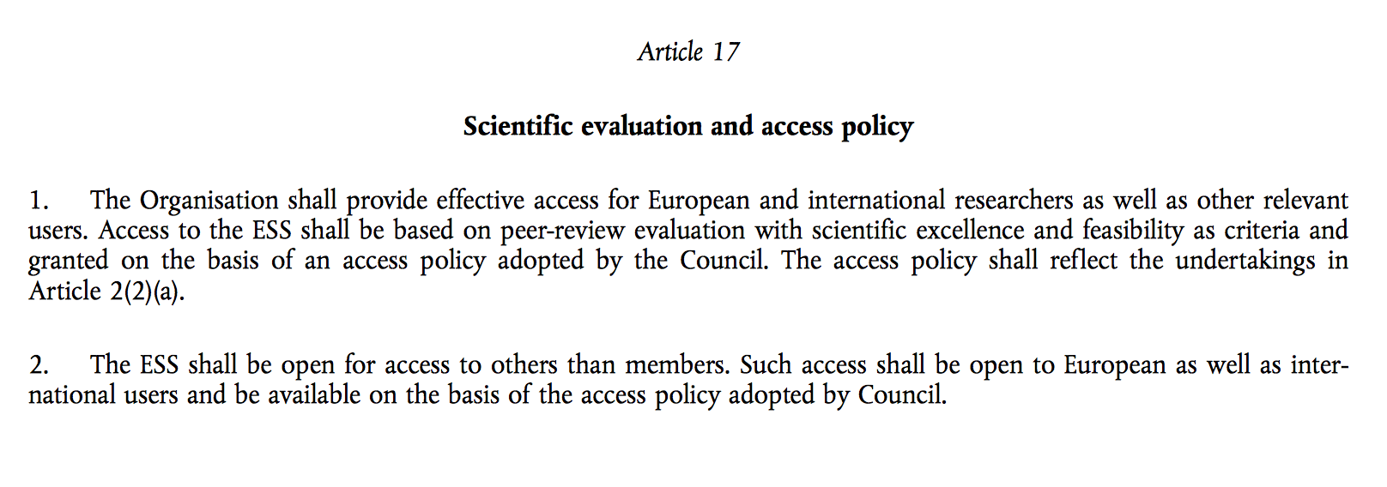
SSS 20.4.1 – Scientific Coordination and User Office – Labor, Resources, Costs, Comparison
5/18/17
SCUO ERIC access policy Arno Hiess, November 2016 ESS Operations Cost Review
94

Slide 95
ESS Staff Numbers
ESS | resource | number
Local contacts | instrument scientists | 44
Local contacts | data scientists (DMSC ESS.20.5) | 11
Local contacts | group leaders | 4
Instrument support staff | instrument support staff | 22
Sample environment staff | sample environment staff (SAD ESS.20.4.3) | 20
Technical support staff | labs (SAD ESS.20.4.2) | 13
Technical support staff | detectors (ESS.20.3.1) | 16
Technical support staff | optics, shielding, polarisation (ESS.20.3.3) | 12
Technical support staff | motion control (ESS.20.3.4) | 8
Technical support staff | choppers (ESS.20.3.2) | 10
Technical support staff | hall coordinators | 6
Technical support staff | software & theory (control, acquisition, reduction) | 40

Slide 96
ESS Staff Numbers
ESS | resource | number
Local contacts | instrument scientists | 44
Local contacts | data scientists (DMSC ESS.20.5.4) | 11
Local contacts | group leaders | 4
Instrument support staff | instrument support staff | 22
Sample environment staff | sample environment staff (SAD ESS.20.4.3) | 20
Technical support staff | labs (SAD ESS.20.4.2) | 13
Technical support staff | detectors (ITP ESS.20.3.1) | 16
Technical support staff | optics, shielding, polarisation (ITP ESS.20.3.3) | 12
Technical support staff | motion control (ITP ESS.20.3.4) | 8
Technical support staff | choppers (ITP ESS.20.3.2) | 10
Technical support staff | hall coordinators | 6
Technical support staff | software & theory (control, acquisition, reduction) (DMSC ESS.20.5) | 40

Slide 97
Comparison with Other Facilities
 | ESSª | ILL^{b} | ESRF^{c} | ISIS^{d} | SNS^{e}
Instruments (incl. CRGs/3) | 22 | 31 | 35.6 | 30 | 18.3
Beam days for user programme | 3520 | 3899 | 4404 | 2678 | 2525
per instrument | 160 | 126 | 124 | 89 | 138
Number of operational days | 200 | 158 | 225 | 130 | 184
Number of experiments | 1173 | 785 | 1358 | 766 | 681
Average Experiment Length [days] | 3.0 | 5.0 | 3.2 | 3.5 | 3.7
ª | ESS Technical Design Report | ^{d} | ISIS Annual Review 2014-15 www.isis.stfc.ac.uk
^{b} | ILL Annual Report 2015 | ^{e} | Review of Neutron Sciences Directorate, ORNL, 2015 neutrons.ornl.gov/sns
^{c} | ESRF Highlights 2015 |  | italics = extrapolated numbers

Slide 98
Comparison with Other Facilities
 | ESSª | ILL^{b} | ESRF^{c} | ISIS^{d} | SNS^{e}
Instruments (incl. CRGs/3) | 22 | 31 | 35.6 | 30 | 18.3
Beam days for user programme | 3520 | 3899 | 4404 | 2678 | 2525
per instrument | 160 | 126 | 124 | 89 | 138
Number of operational days | 200 | 158 | 225 | 130 | 184
Number of experiments | 1173 | 785 | 1358 | 766 | 681
Average Experiment Length [days] | 3.0 | 5.0 | 3.2 | 3.5 | 3.7
Local Contacts / Instrument | 2.7 | 2.2 | 3.4 | 2.2 | 2.6
Instrument Support Staff / Instr. | 1.0 | 1.0 | 1.6 |  | 0.9
Sample Environment Staff / Instr. | 0.9 | 0.5 |  | 0.6 | 0.9
Other Tech. Support / Instrument | 4.9 | 3.6 | 4.1 | 3.0 | 6.5

Slide 99
Comparison with Other Facilities
 | ESSª | ILL^{b} | ESRF^{c} | ISIS^{d} | SNS^{e}
Instruments (incl. CRGs/3) | 22 | 31 | 35.6 | 30 | 18.3
Beam days for user programme | 3520 | 3899 | 4404 | 2678 | 2525
per instrument | 160 | 126 | 124 | 89 | 138
Number of operational days | 200 | 158 | 225 | 130 | 184
Number of experiments | 1173 | 785 | 1358 | 766 | 681
Average Experiment Length [days] | 3.0 | 5.0 | 3.2 | 3.5 | 3.7
Local Contacts / Instrument | 2.7 | 2.2 | 3.4 | 2.2 | 2.6
Instrument Support Staff / Instr. | 1.0 | 1.0 | 1.6 |  | 0.9
Sample Environment Staff / Instr. | 0.9 | 0.5 |  | 0.6 | 0.9
Other Tech. Support / Instrument | 4.9 | 3.6 | 4.1 | 3.0 | 6.5

Slide 100
Comparison with Other Facilities
 | ESSª | ILL^{b} | ESRF^{c} | ISIS^{d} | SNS^{e}
Instruments (incl. CRGs/3) | 22 | 31 | 35.6 | 30 | 18.3
Beam days for user programme | 3520 | 3899 | 4404 | 2678 | 2525
per instrument | 160 | 126 | 124 | 89 | 138
Number of operational days | 200 | 158 | 225 | 130 | 184
Number of experiments | 1173 | 785 | 1358 | 766 | 681
Average Experiment Length [days] | 3.0 | 5.0 | 3.2 | 3.5 | 3.7
Local Contacts / Instrument | 2.7 | 2.2 | 3.4 | 2.2 | 2.6
Instrument Support Staff / Instr. | 1.0 | 1.0 | 1.6 |  | 0.9
Sample Environment Staff / Instr. | 0.9 | 0.5 |  | 0.6 | 0.9
Other Tech. Support / Instrument | 4.9 | 3.6 | 4.1 | 3.0 | 6.5
Total Staff / Instrument | 9.5 | 7.2 | 9.0 | 5.9 | 10.8
Total Staff / Experiment | 0.18 | 0.28 | 0.24 | 0.23 | 0.29

Slide 101
Comparison with Other Facilities: Recurrent Costs
 | ESS | ILL | ESRF | ISIS | SNS
Instruments (incl. CRGs/3) | 22 | 31 | 35.6 | 30 | 18.3
Out of hours support (k€) | 752 | 500 | 650
per instrument (k€) | 34 | 16 | 18
“group budget” per instrument (k€) | 42 | 43 |  | 43
Division-level budget (k€) | 60
Instrument-specific spares (k€) | 3,960
Emergency spares & consumables (k€) | 90

Slide 102
Accomplishments 2016
Next Steps in 2017
Core team helps instr. teams through TG2; covers ESS interfaces and in-kind.
Initial sample environment suite defined; developmental activities on-going. MV labs and Utgard Workshop set-up for integration and testing.
Reference docs on mech. interfaces, supplies, controls, safety available; Equipment currently designed / built incl. prototyping on-site infrastructure
CF and ESH interface on zoning of exp. hall & labs for smooth operation.
Several IK projects started, collaboration agreement in place, work plans for all (potential) in-kind contributions written but agreements to be finalized.
Revise IK work plans, engage with partners, start execution / commissioning.
Recruit technical resources to ensure timely training.
Complete R&D projects in Sample Environment platforms.
Transition lab platforms SULF and DEMAX into operation.
102

Slide 103
Summary
Mission and Vision : Defining a Path to Success
STAP established and ensures that project is aligned with clearly formulated mission / vision
Sample Environment Suite : Meet Instrument and User Needs
Reference suite matching scientific need and construction schedule of first 8 instruments
Ensuring Interconnectivity : Interactions supporting Instr. Construction
Structured interactions with instruments teams in place; integrations projects progressing well
Developmental Activities : Addressing the ESS Challenges
Several R&D projects addressing future challenges on-going with partners
Moving to (Initial) Operation : Enabling Early Science Success
Deliverables, milestones, staff ramp up and budget for initial and steady state operation in place; focus on early science success.

