Slide 1
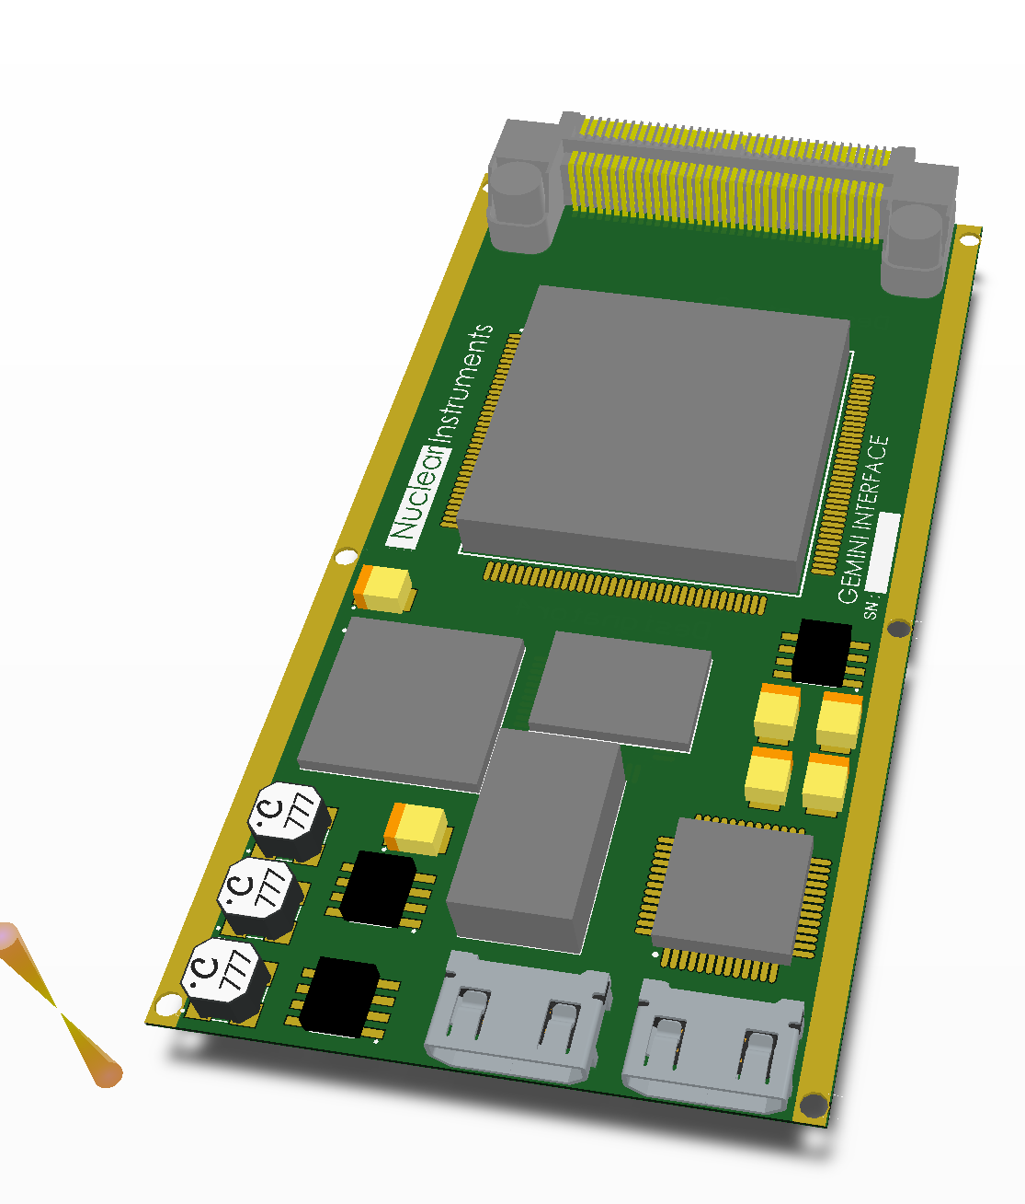

Slide 2
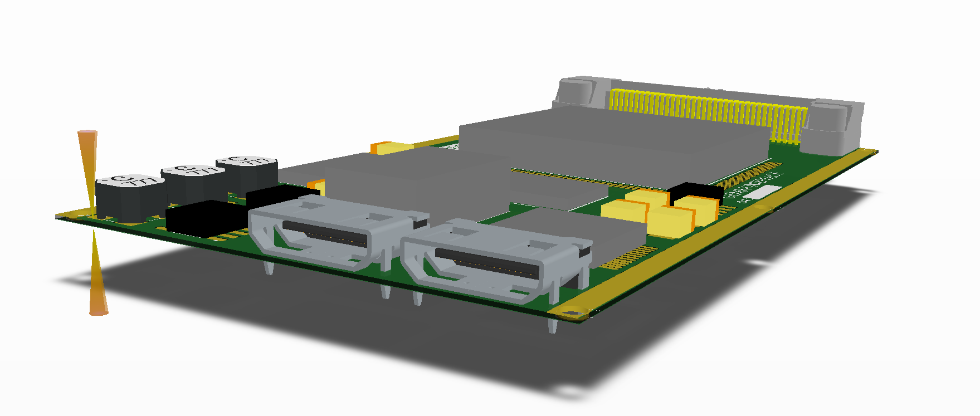

Slide 3
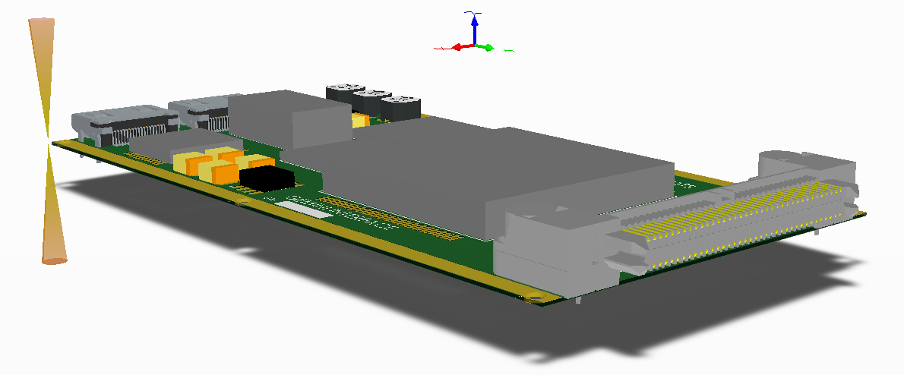

Slide 4
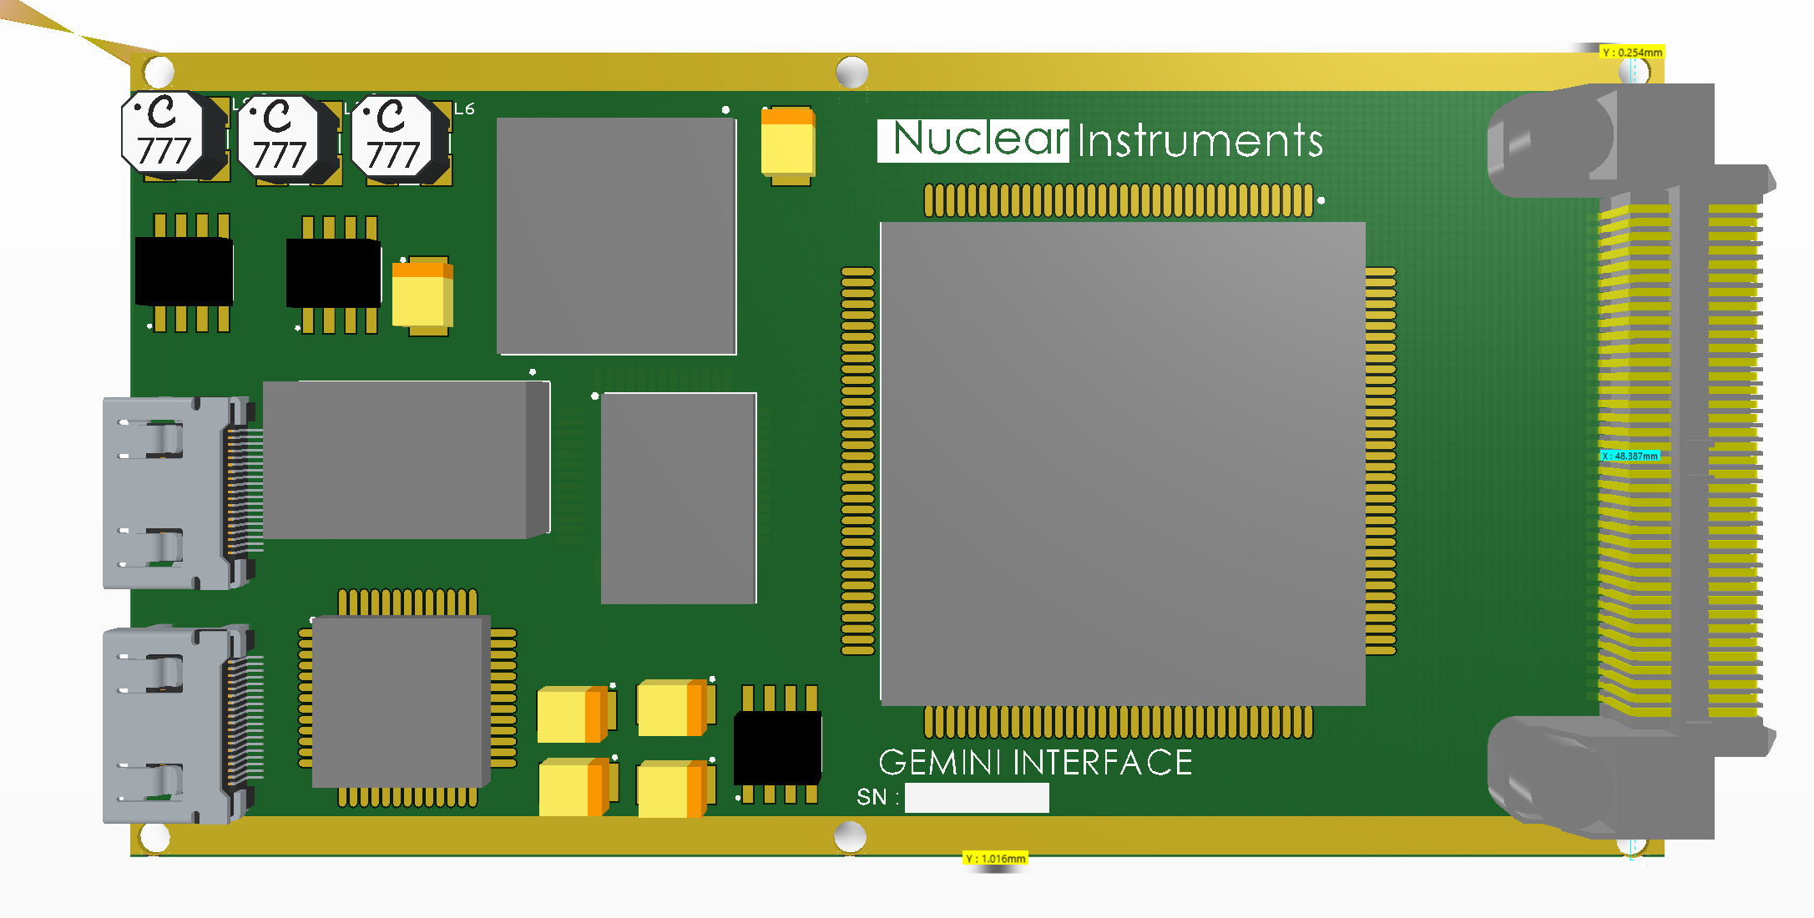
48mm
8mm

Slide 5
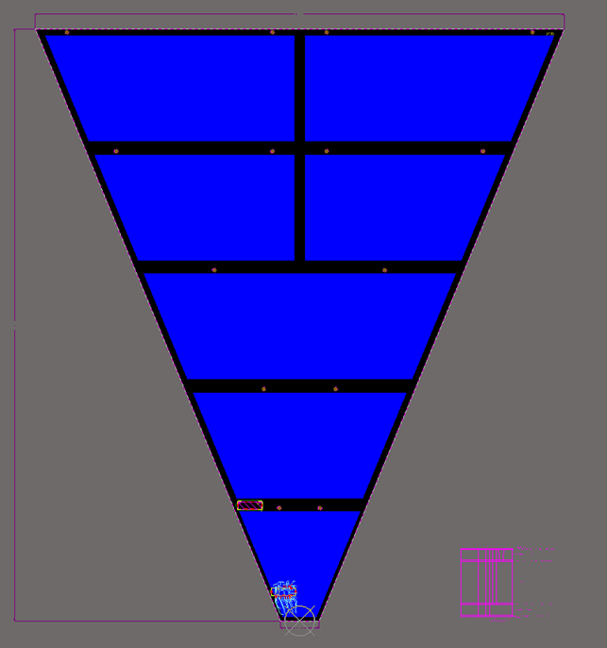
32 channels board
29 devices per Slice of the detector (261 total)
Small FPGA with ethenet connectivity on shared cable
Integrated 1 Gbps switch for deisy chain connection
Power supply, connectivity and syncronization on the same cable.
Possibility to distribute the number of board in daisy chain to optimize the bandwidth in function on the particle density

Slide 6
Deisy Chain
E
T
H
E
R
N
E
T
F
I
B
E
R
fiber

