Slide 1
GEMINI
summary

Slide 2
Main features
16 channels
Programmable threshold
  I2C
  9-bit
Both manual and automatic calibration
  I2C
  5 bit
LVDS output
Analog output

Slide 3
Biasing
Vdd 2 V
Input common mode 1V
Analog output biased at 1 V (optimized for 1 Mohm load)

Slide 4
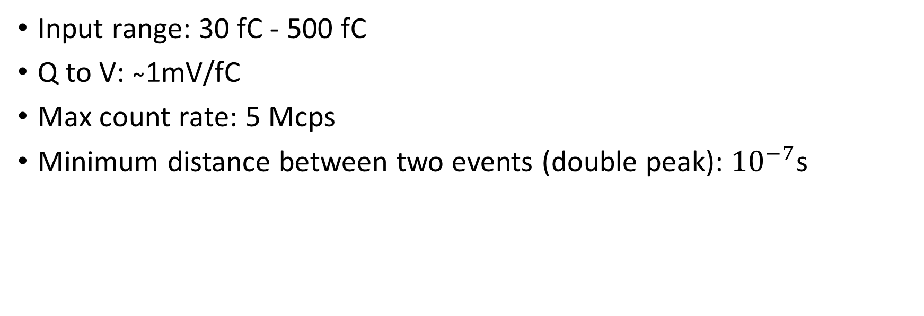
Performance
(from preliminary measurements)
Input range: 30 fC - 500 fC
Q to V: ̴1mV/fC
Max count rate: 5 Mcps
Minimum distance between two events (double peak): ${10}^{−7}$s

Slide 5
ASIC Block Diagram

Slide 6
Nominal power consumption
Without LVDS: 2.7mW/ch
With LVDS Driver: 10.7mW/ch

Slide 7
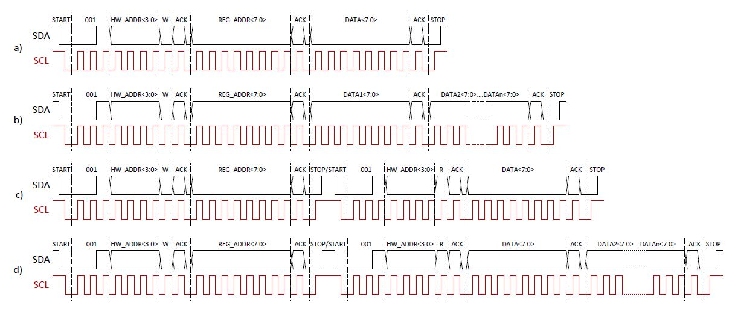
I2C communication

Slide 8
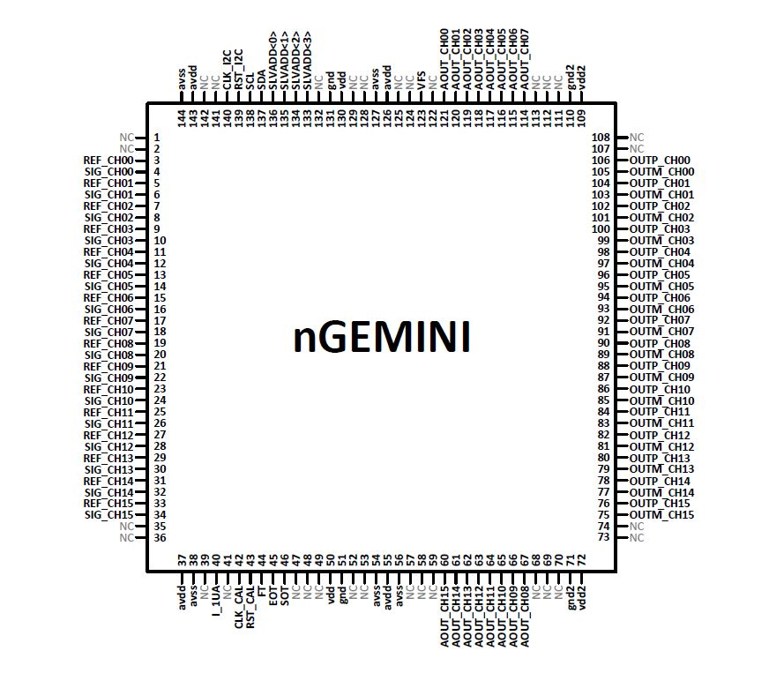
ASIC pinout

Slide 9
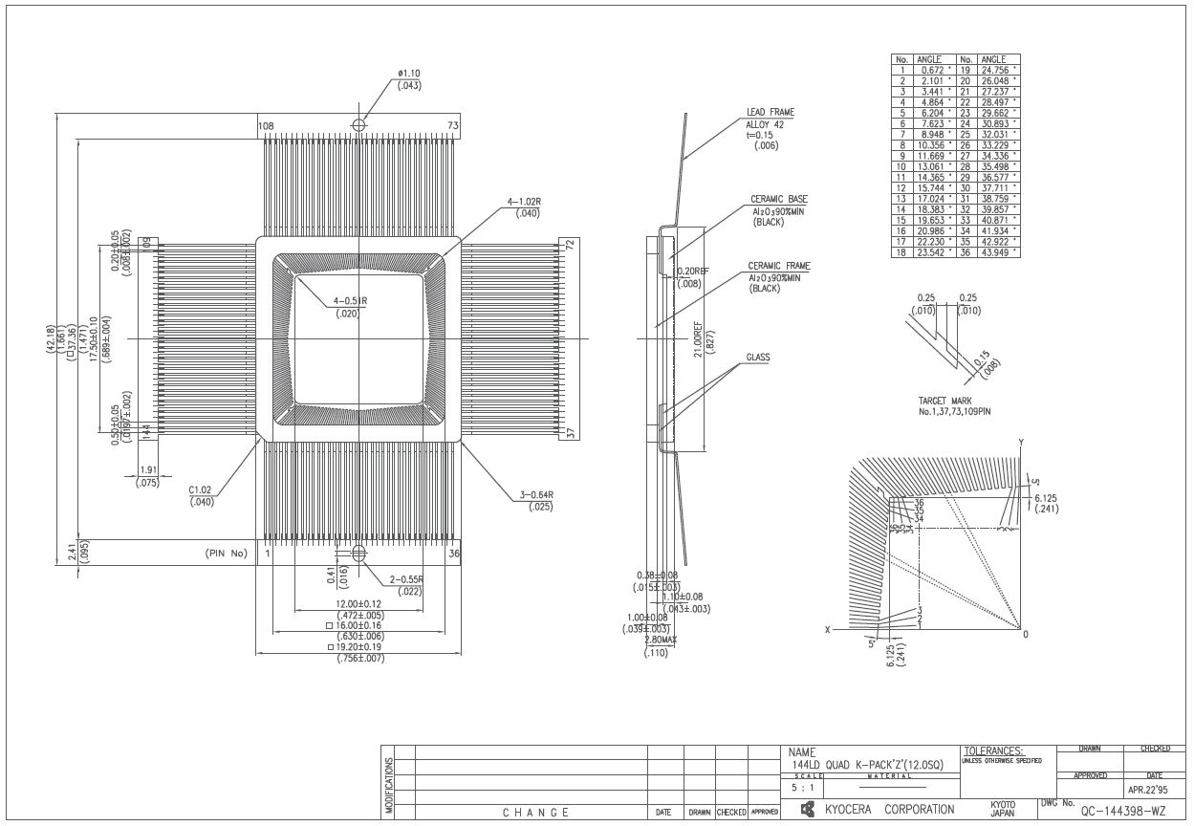
Package

