Slide 1
Event Formation Unit: EF Pipeline, Interfaces, DAQ, Monitor
Morten Jagd Cristensen
www.europeanspallationsource.se
17-09-14
Notes:
Welcome
Last Jamboree was Nov 2016
Number of participants up!
Revisit workshop summaries from last meeting!

Slide 2
System data flow
instruments
detectors
event formation
aggregator
nexus writer
storage
inst1_det1
inst1_det2
...
instN_detM
Notes:
Explain data path - mention that beyond the 'live' data lies Mantid, scientists and Nobel prizes
Mention the control path for setting up experiment parameters but that those should be irrelevant for the EFU
Still undefined whether the event formation units should be dynamically reconfigurable and to what extent
Important: this presentation is only concerned with the detectors/event formation part

Slide 3
Detector to EFU
readout system
event formation
readout
Instr. 1 Detector 1
switch
EFU
Instr. 1 Detector 2
EFU
Instr. 2 Detector 1
EFU
Notes:
For the EFU the specific detector/readout system interconnection is unimportant
Assumption: a single detector is handled by a single EFU and that no communications between EFU’s are necessary
It is possible, but currently undefined, if there will be more than one Ethernet link between the readout system and a specific EFU

Slide 4
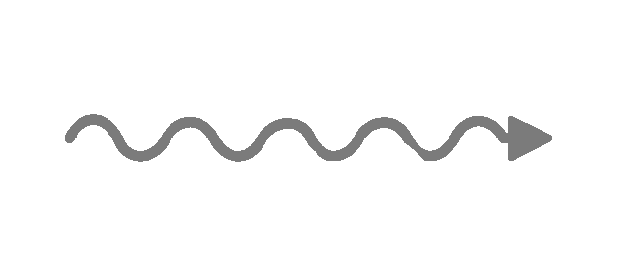
WG5 – WG6 interface
“Converter”
“Detector”
“Electronics”
“Software”
photons or charged
particles
collect
charge or photons
n
amplify
digitize
filter
cluster
analysis
event
formation
Notes:
Reminder: DG is on the left of the dotted line and that DMG is on the right
EFU Software: “Software” is synonymous with EFU in this case
Software means flexible, but it doesn’t mean we don’t have a say in defining what we
should expect to receive

Slide 5
EFU Framework
servers
broker_ip:9092
user interaction
Detector
Data
UDP
TCP
Kafka
Broker
input
processing
efu_ip:9000
output
Command
Client
TCP
efu server
TCP
Graphite
db
Grafana
Live
Metrics
efu_ip:8888
graphite_ip:2003
grafana_ip:3000
TCP
Graylog
file system
config .json
calibration
data
greylog_ip:12201
Notes:
Data path - network, pipeline, streaming
Control path - static and dynamic configuration
Reporting - Graphite, Graylog

Slide 6
Current status
Working prototype EFU
Receive from UDP, Kafka producer, live stats
Can run in multiple instances
Processing pipelines
Multigrid
cspec, cspec2 – threshold filtering, discard invalid data
Gd-GEM
gdgem - coincidence algorithm implementation 1
SoNDe
sonde – already clustered data, just convert to pixels
Multiblade (NBI, status?)
mbcaen – coincidence algorithm implementation 2
Data generators
Files: raw_binary, hdf5_apv, wireshark, mgcncsgenfile, mgcncsgenjson
Simulated: mgcncsgen
Data sources
Multigrid CNCS data
Gd-GEM APV HDF5, SRS UDP data
SoNDe IDEAS UDP data
Notes:
Collaboration with many people from both DG and DMG to reach this stage
Possible to write your own pipeline plugins with additional debug output or for testing new algorithms

Slide 7
TODO
Software maturation
robustness to certain scenarios
loss of network connectivity, unresponsive services, disk problems, ...
logging, monitoring, remote diagnostics
automated deployment
nightly integration tests for all detectors (real data)
Instrument maturation
ESS Readout protocol
Algorithms for event formation
parallelism / load distribution
EFU configuration
Detector geometry

Slide 8
EFU as DAQ
Software bundle on single workstation
Readout software (DIY)
Gd-GEM
SoNde
Multiblade?
Event Formation Unit
Software ‘hook’ to write parsed data to disk
Kafka
Data aggregation (temporary storage)
Daquiri
Detector image visualization from Kafka topics
Histograms, TOF spectra, ...
Graphite/Grafana
Visualizing EFU counters and stats
Wireshark
Raw readout data capture

Slide 9
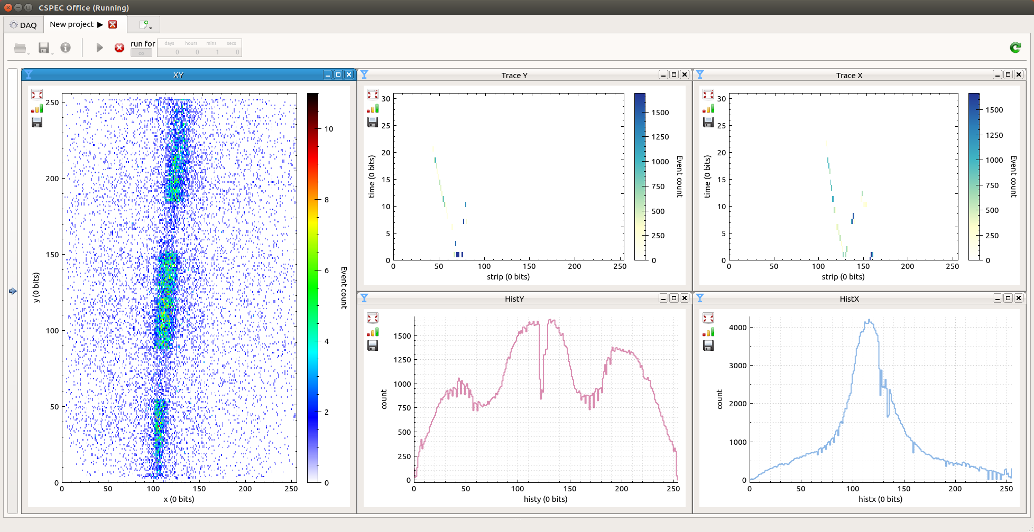
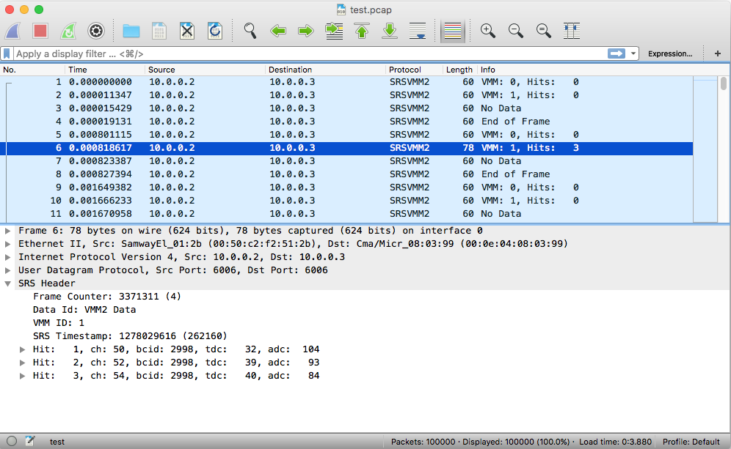
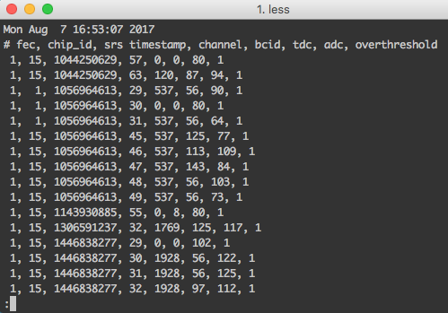
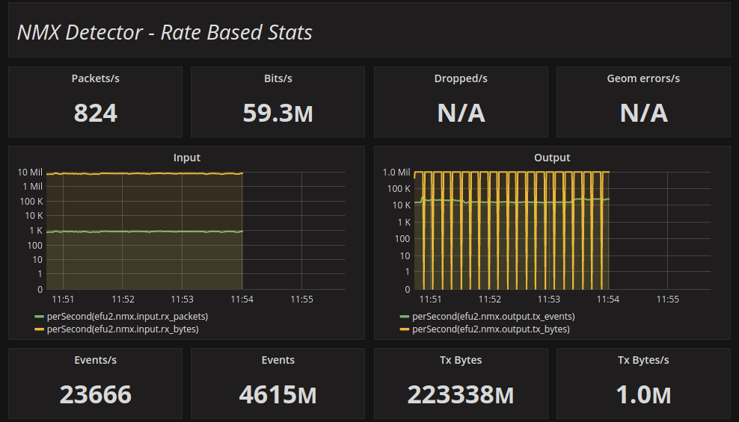
Detector data taps
Analog/Electric
Digital HW
Event Formation
Data Aggregation
EFU
Events
Gd-GEM Detector
SRS
Input
Proc.
Output
Histograms (x,y)
Particle tracks (x,y)
SoNDe Detector
IDEAS
Multigrid
ESS
Multiblade
File Storage
raw data captures
Decoded data dump
Counters & Stats
Activity dashboards
Notes:
Busy slide - sorry
Data path again
Domains
Data TAPS

Slide 10
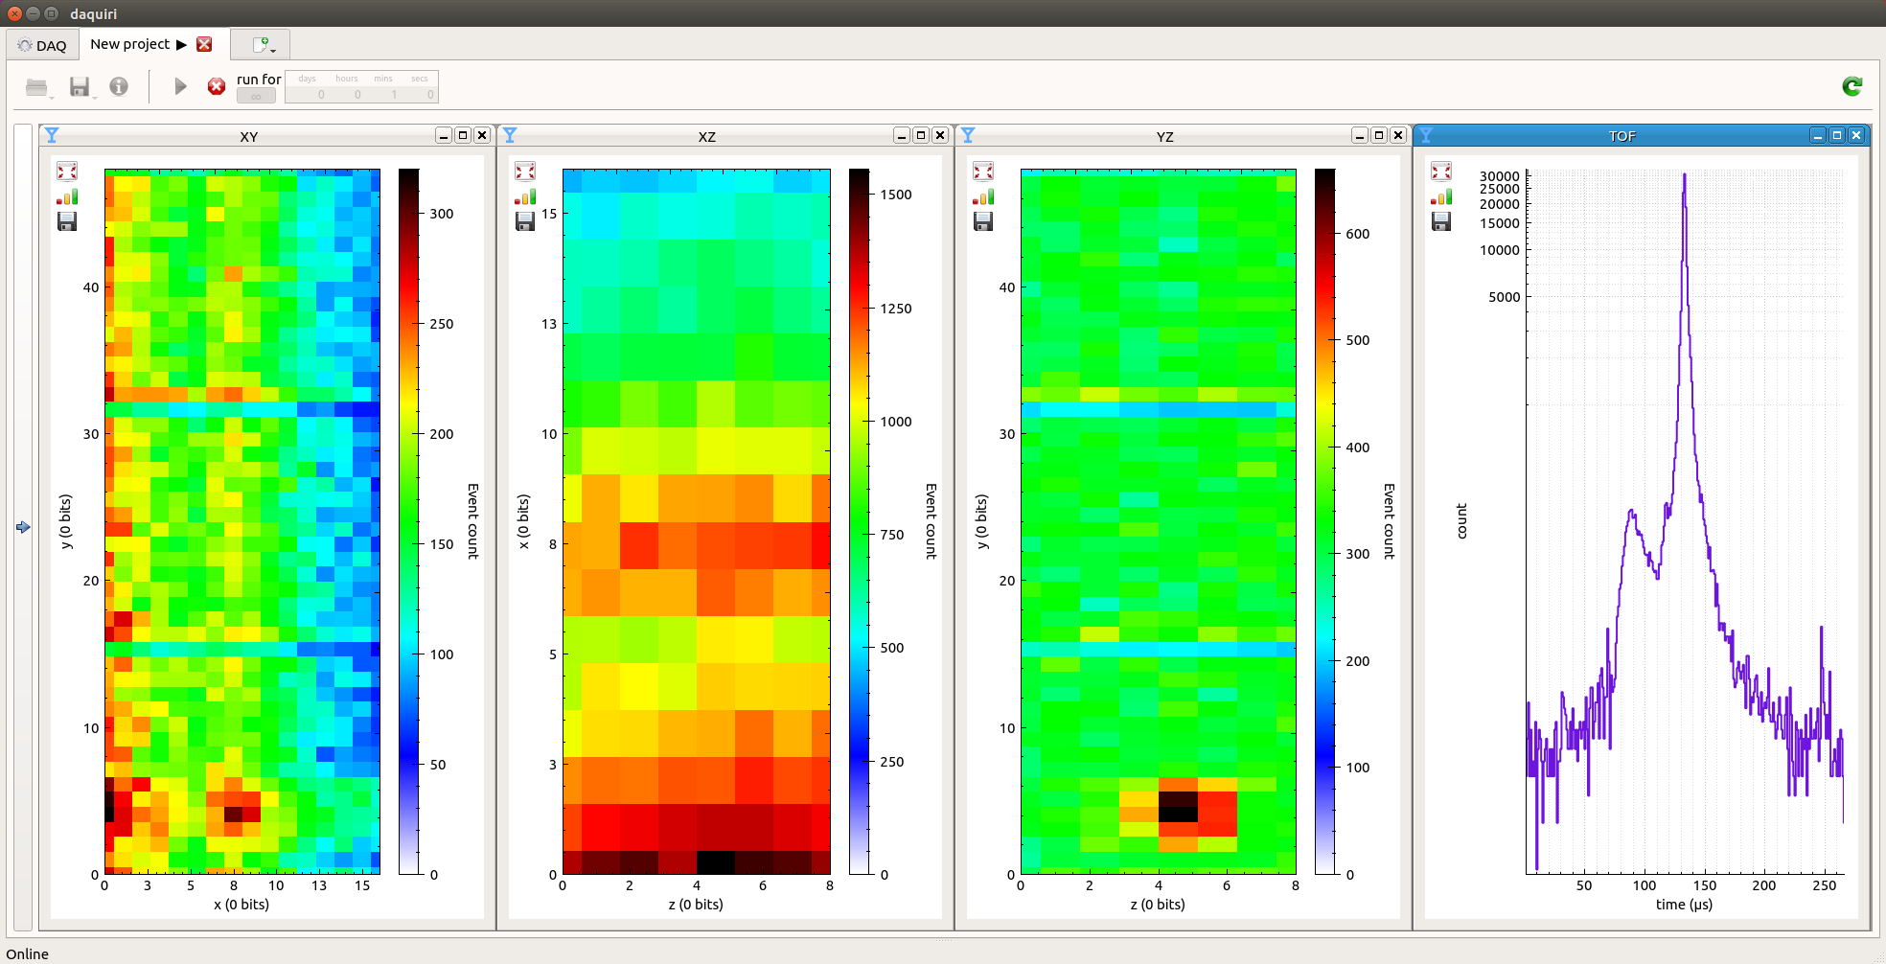
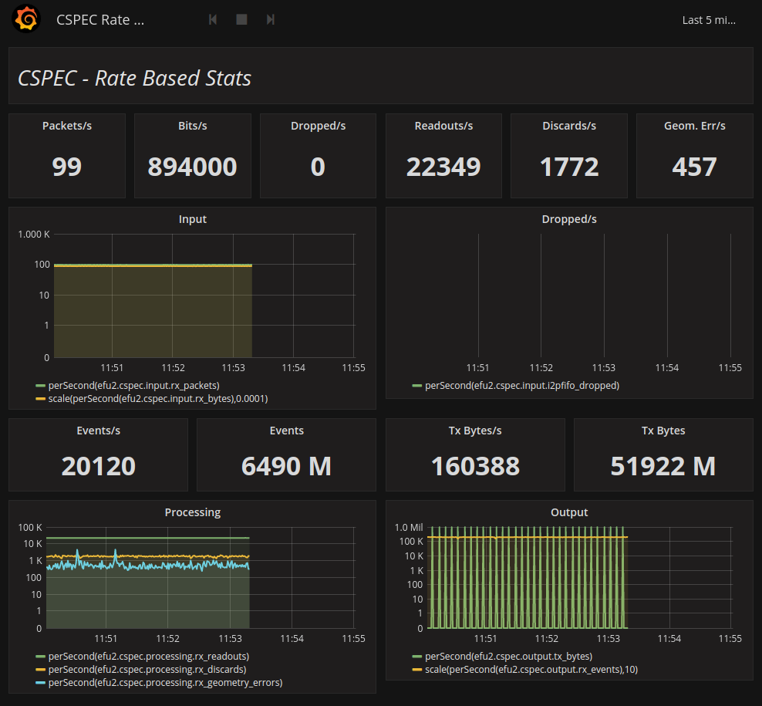
Realtime visualizations
Visualize detector images,
TOF spectra, Histograms, ...
Stay tuned for Martins demo
Low level EFU system counters for activity overview

Slide 11
Loose ends
Detectors
Logical detector geometry
Separation of data-path and control-path
need for live configuration of EFUs?
Pre-timestamp operation
suggested workarounds when t not available
Specify algorithms for event calculations
corner cases – adjacent readout configurations
Readout systems
Discuss and agree on data formats
Timestamp availability

Slide 12
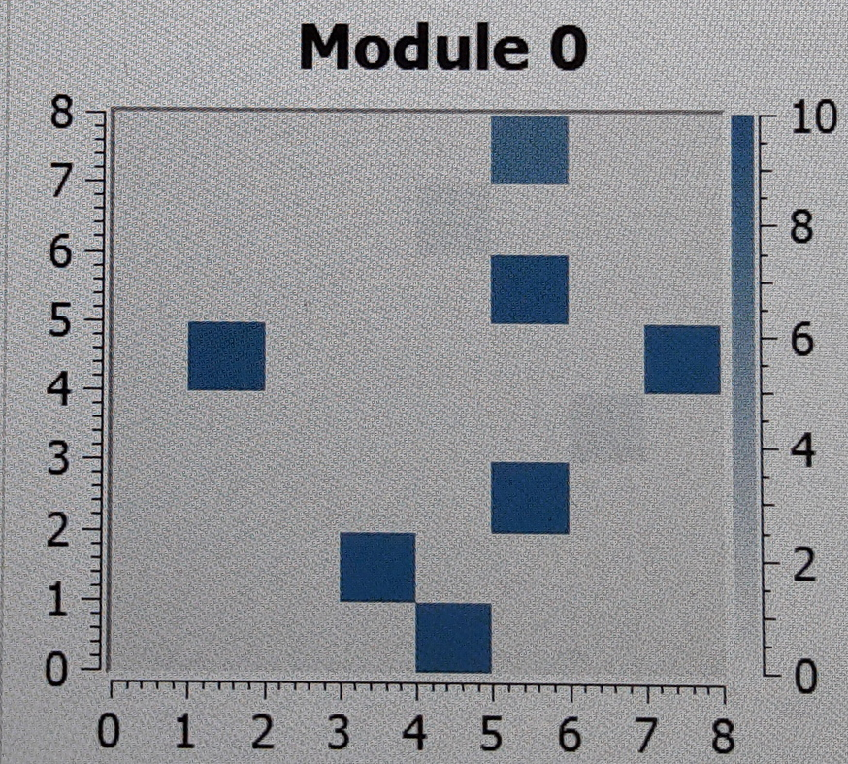
Geometry
Agree on geometry definitions
Mapping from wires, grids, blades, strips, ... to (x,y,z) coordinates
Mapping from (x,y,z) to pixel_id
Support for N prototype detectors
positions and pixel_id’s – where do we get that information?
Please think about this early
Notes:
This is about engineers and scientist being a little structured about their creations.
Documentation!

Slide 13
Single Detector Panel
Distributed calculations
Which front end boards serves which regions?
Need mechanism to distribute readout packets to different cores
VMM3
Xeon E5
CPU00
CPU01
CPU02
CPU03
CPU04
CPU05
CPU06
CPU07
CPU08
CPU09
CPU10
CPU11
Notes:
When data rates are high we need to use more cores or even more servers for a single detector panel.
Detector panels are considered independent.

Slide 14
Single Detector Panel
Distributed calculations
how to handle overlapping regions?
who duplicates the data?
VMM3
Xeon E5
CPU00
CPU01
CPU02
CPU03
CPU04
CPU05
CPU06
CPU07
CPU08
CPU09
CPU10
CPU11
Notes:
How do we handle overlapping regions?
How big are the overlaps?
Initially ignore this problem but need an estimate of what the consequences are.

Slide 15
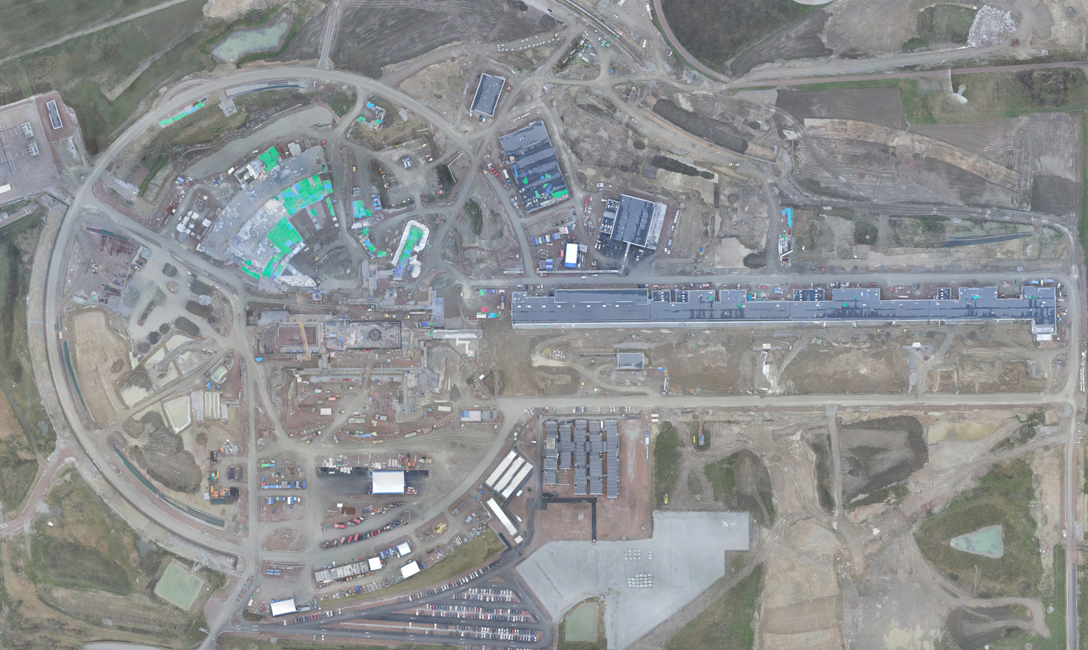
The End
Focus on system interfaces
Formalise the work on Detector/readout/EFU interfaces
This is the area with most bugs and performance problems
Bugs typically introduced early in the development process and detected late
We must avoid last minute feature/change request congestion
Interfaces are NOT a unilateral decision, internal implementations ARE
Documentation is required

