Slide 1

100 G Data Generator
Second Joint BrightnESS WP4 and WP5 Jamboree
15th September 2017
Steven Alcock (DG)

Slide 2
Simplified Readout Electronics Architecture
Front End
Front End
Front End
Front End
FPGA Master 1
FPGA Master 2
Switch
Diagnostic Server
DMSC Server 1
DMSC Server 2
Steven Alcock, Detector Group, 6th September 2017

Slide 3
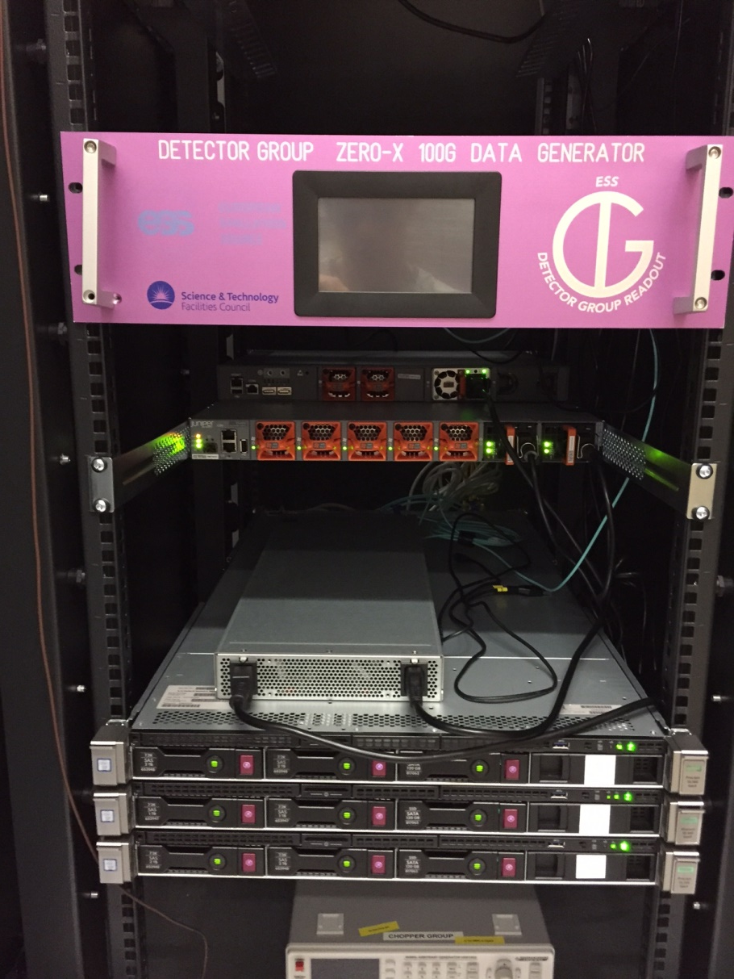
100 G Detector Readout Demonstrator
Provides the DMSC with high-rate packets
in a format representative of the final system.
Allows data packing format to be agreed ahead of final system.
Proves key interfaces ahead of final system.
Steven Alcock, Detector Group, 6th September 2017

Slide 4
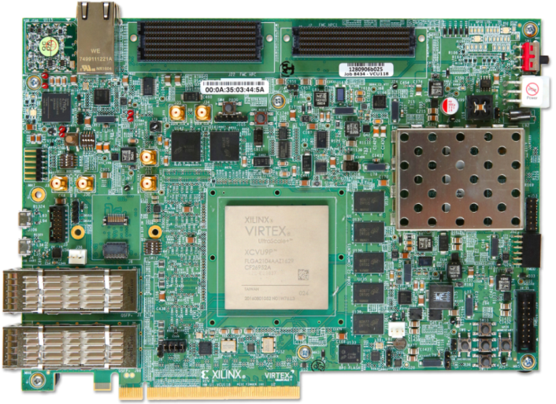
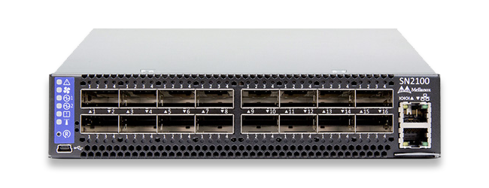
Key Features
Four packet engines are independently configurable at run-time.
Aggregate output data rate is configurable at run-time.
Aggregate number of packets is configurable at run-time.
Mellanox Switch can output data as 10/25/40/56/100 G. This means, for example, the full 100 G input could be split across 10 x 10 G outputs.
Firmware can be remotely loaded and debugged from any location with access to the ICS VPN and the appropriate FPGA programming software (for example, Daresbury) - upgrades and support should be easy.
Steven Alcock, Detector Group, 6th September 2017

Slide 5
FPGA Architecture
RAM Write FSM
Packet Config Parameters
RAM Write FSM
Packet Config Parameters
Config Source
RAM Write FSM
Packet Config Parameters
RAM Write FSM
Packet Config Parameters
512-bit Packet RAM
512-bit Packet RAM
512-bit Packet RAM
512-bit Packet RAM
RAM Read FSM
RAM Read FSM
Packet Mux
CMAC
RAM Read FSM
Data Sink
RAM Read FSM
Steven Alcock, Detector Group, 6th September 2017

Slide 6
Variable Packet Rate Design
Tx
Ti
Tx
Ti
Data rate is ratio of time spent transmitting at 100 G (Tx) to time spend idle (Ti).
Tx = {Packet Length in bits} / {100 G Transmission Rate} = L/100e9
Ti = {Number of Idle Clock Cycles} / {Processing Clock Speed} = G/322.265625e6
Therefore the new time taken to transmit one packet becomes {Tx + Ti}
The new rate becomes R = {L/(Tx + Ti)} = {L/(L/100e9 + G/322.265625e6)}
Rearranging gives G = {322.265625*(L/Re5)*(100-R)} where G is in Gbps
Steven Alcock, Detector Group, 6th September 2017

Slide 7
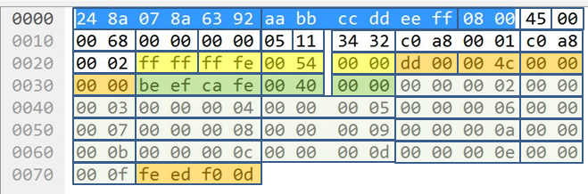
Packing Format Example 1
Ethernet Header
IP
Header
UDP
Header
Readout
Header
Data
Header
Data
Payload
Steven Alcock, Detector Group, 6th September 2017

Slide 8
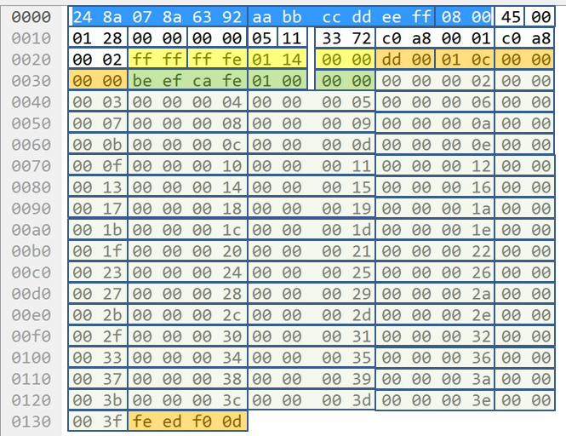
Packing Format Example 2
Ethernet Header
IP
Header
UDP
Header
Readout
Header
Data
Header
Data
Payload
Steven Alcock, Detector Group, 6th September 2017

Slide 9
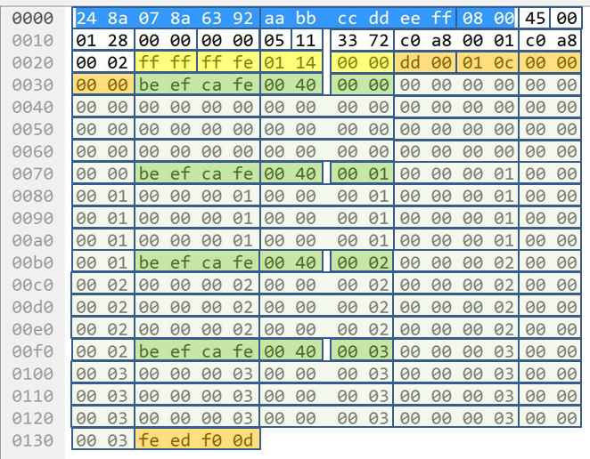
Packing Format Example 3
Ethernet Header
IP
Header
UDP
Header
Readout
Header
Data
Header 0
Data
Payload 0
Data
Header 1
Data
Payload 1
Data
Header 2
Data
Payload 2
Data
Header 3
Data
Payload 3
Steven Alcock, Detector Group, 6th September 2017

Slide 10
To Do List
Support the DMSC!
Physical layer link integrity stress testing with representative cable lengths.
Steven Alcock, Detector Group, 6th September 2017

