Slide 1
Multi-Grid
Anton Khaplanov

Slide 2


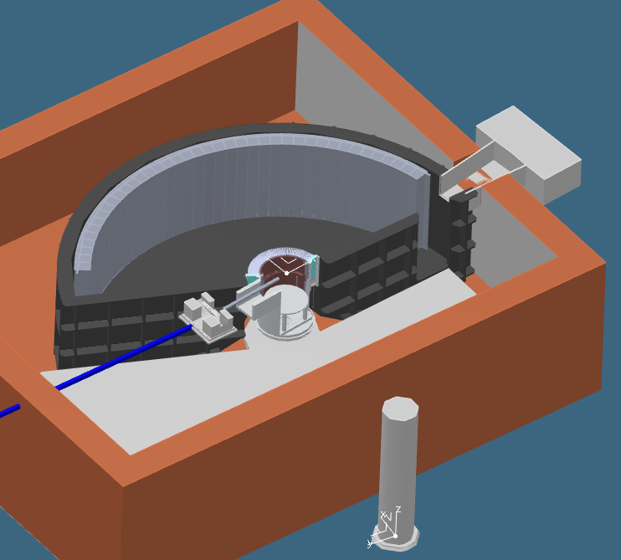
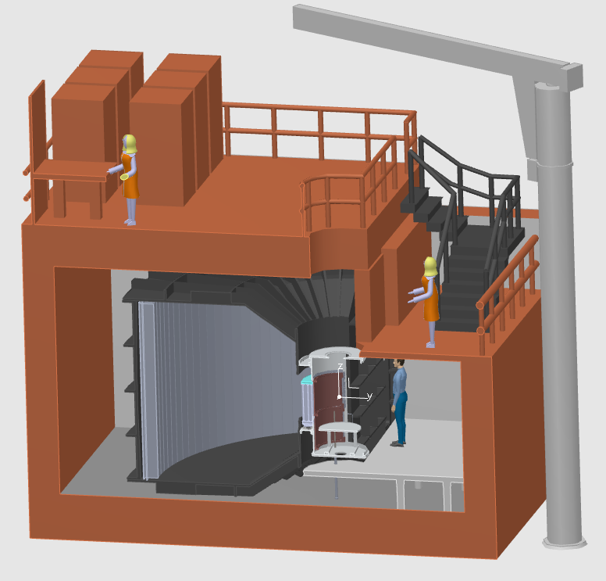
CSPEC at ESS
Cold spectrometer
0.2 meV < E_{i} < 20 meV
29m² detector
Horizontal coverage 5° to 135°
Vertical coverage -25° to 25°

Slide 3


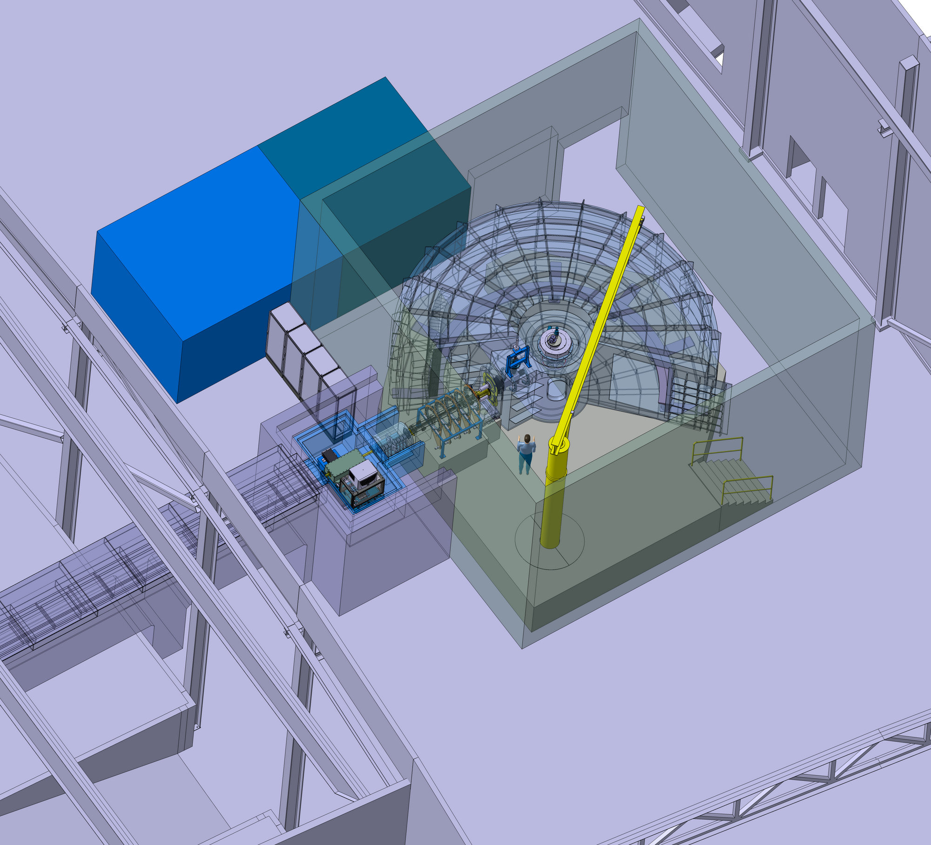
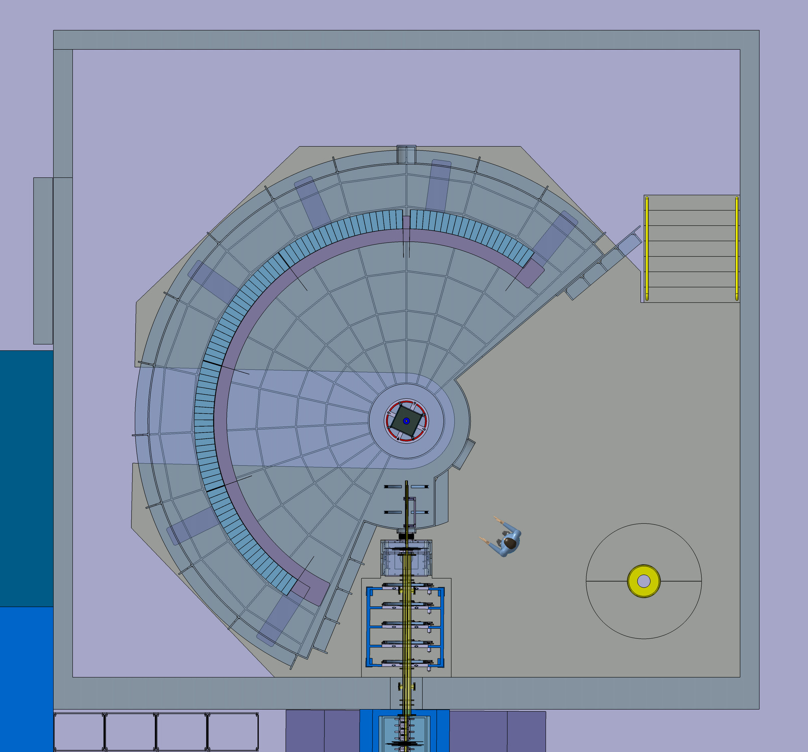
T-REX at ESS
Thermal / bispectral spectrometer
2 meV < E_{i} < 160 meV
21m² detector
Horizontal coverage -36° to -1° and 1° to 144°
Vertical coverage -25° to 15°

Slide 4
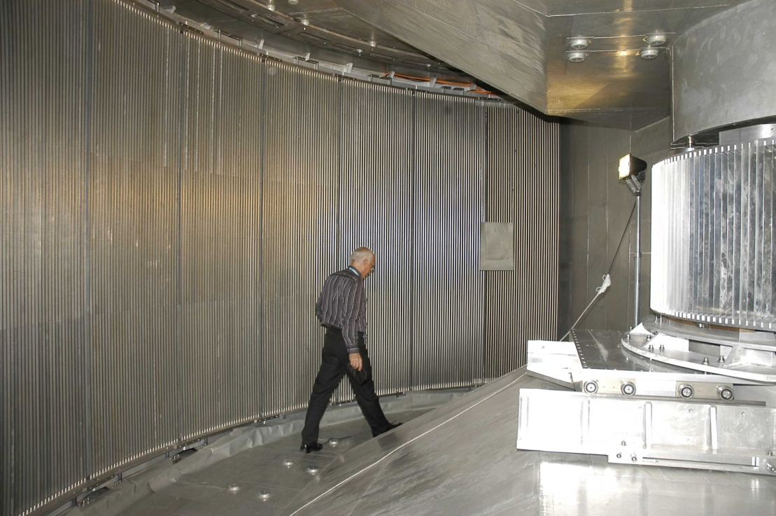
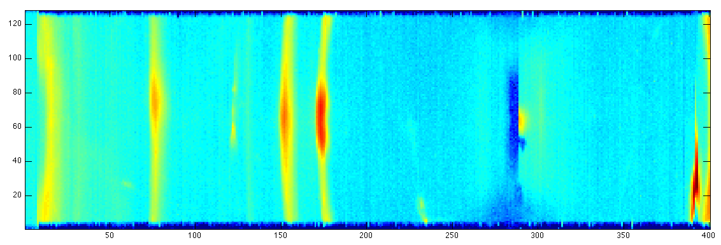
Application of Multi-Grid: Time-of-Flight Spectrometers
IN5 at ILL
Time-of-flight information
2-5 m sample to detector distance
→ Energy transfer
20-40 m² detector area
Position resolution O(1inch)
Momentum transfer
High dynamic range
Low background
Detected image
Incident beam
n E_{i}, Q_{i}
n E_{f}, Q_{f}
Detected ToF spectrum
Sample

Slide 5
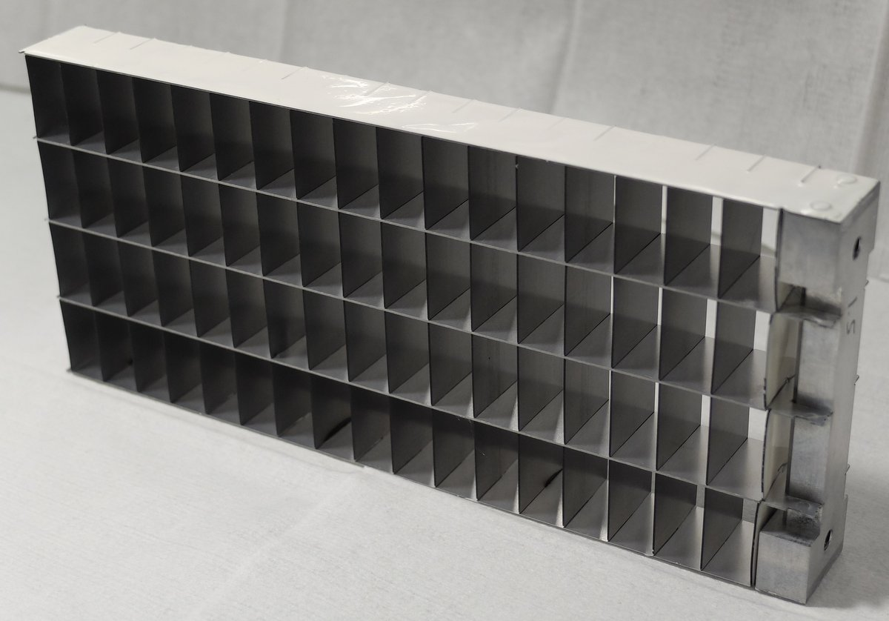


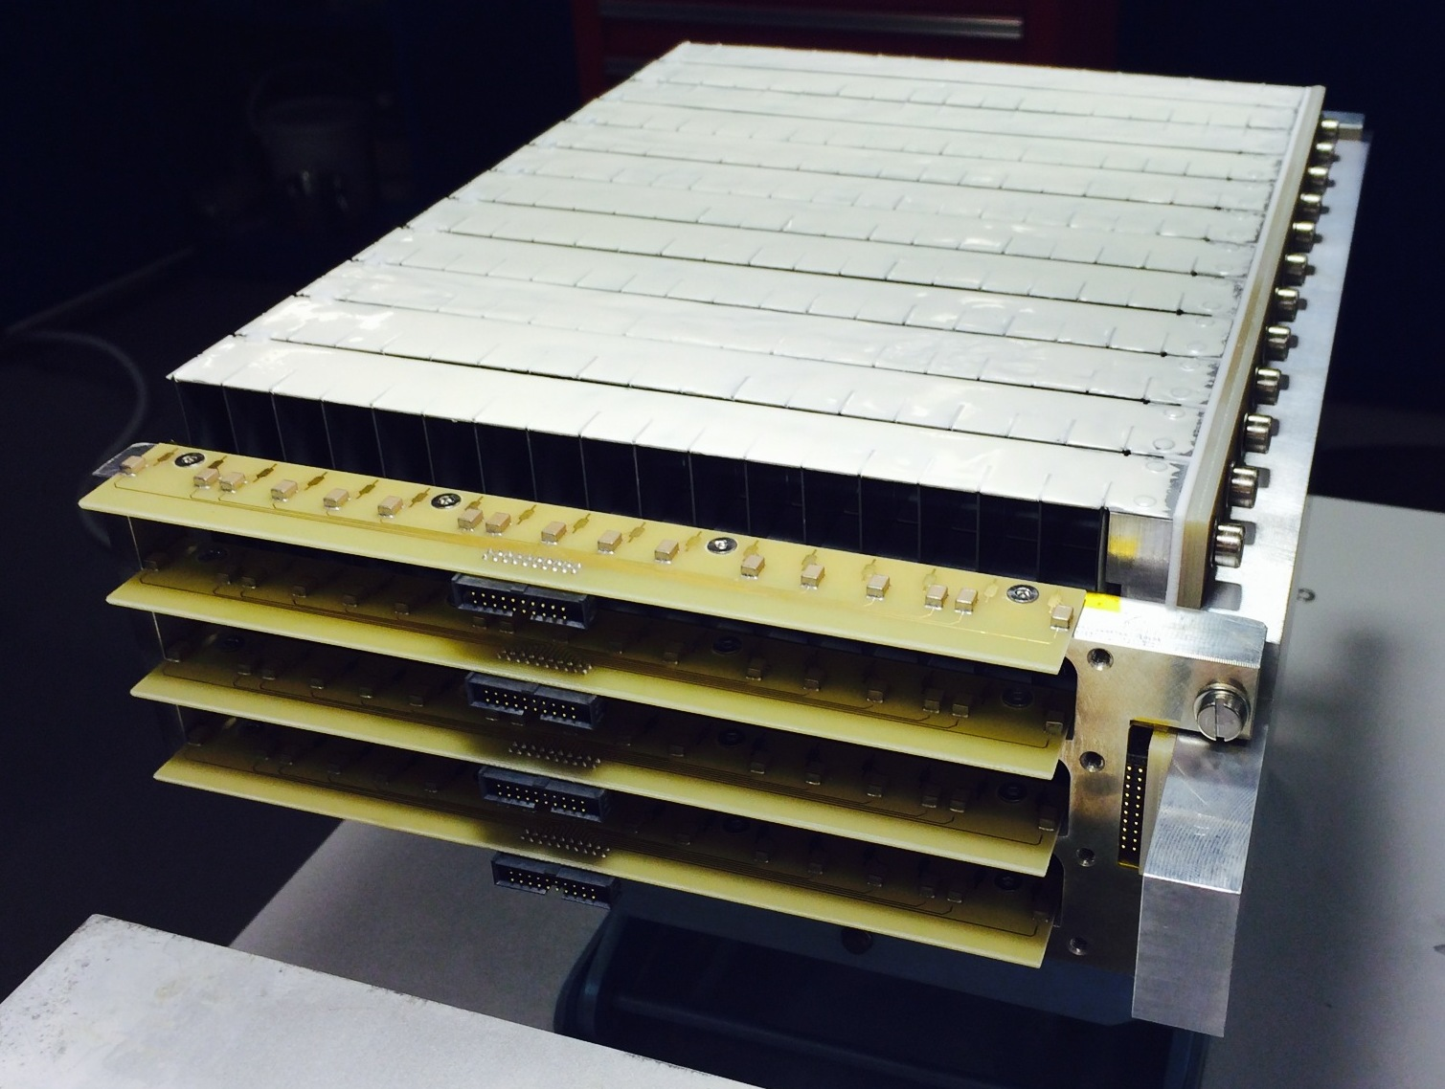

Multi-Grid: How it Works
n
n
n
Low cost for large area
Modular
High total efficiency
Many layers – lower local rate
No need for resistive readout – low gain
Introduced at ILL, jointly developed by ILL and ESS under CRISP project,
now under BrightnESS

Slide 6
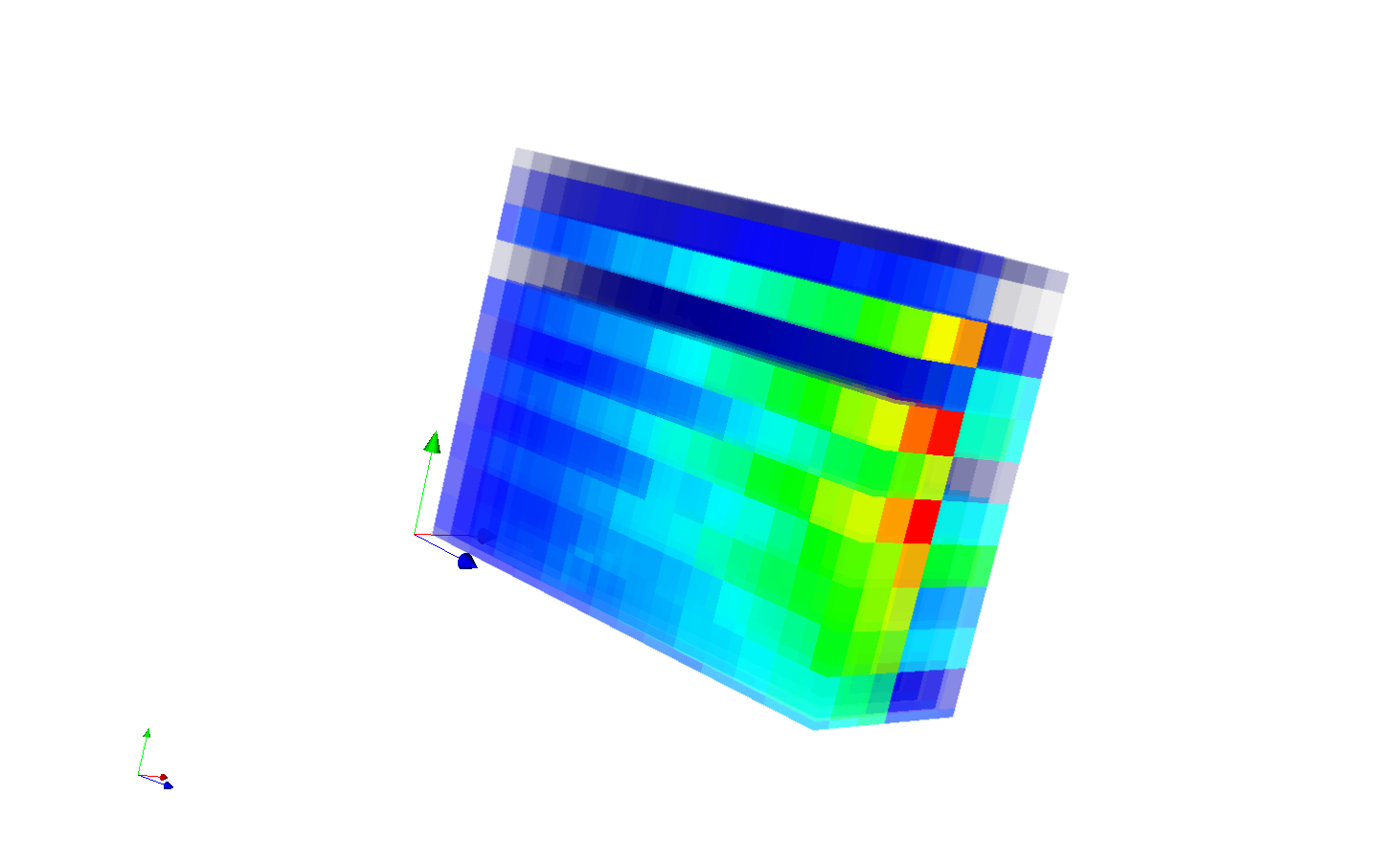
Multi-Grid Concept for Data Analysis
Voxels in 3D
List mode data: [time, x, y, z]

Slide 7
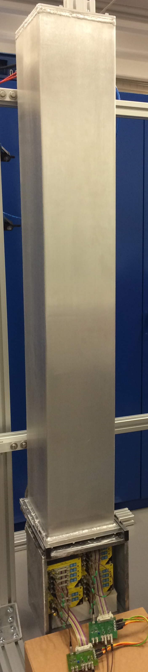
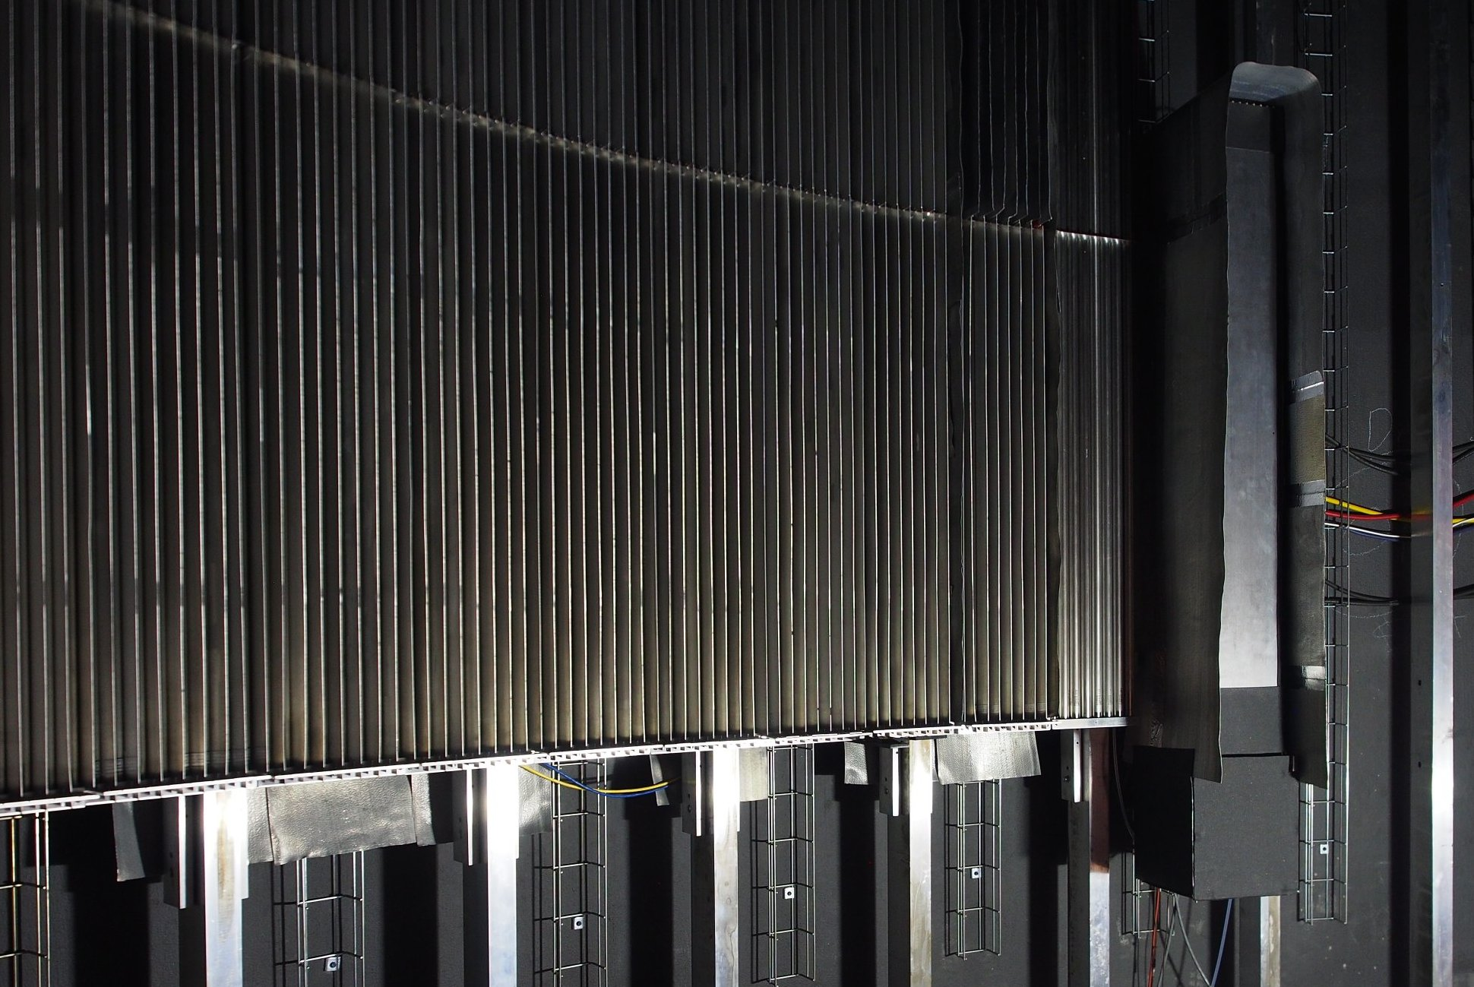

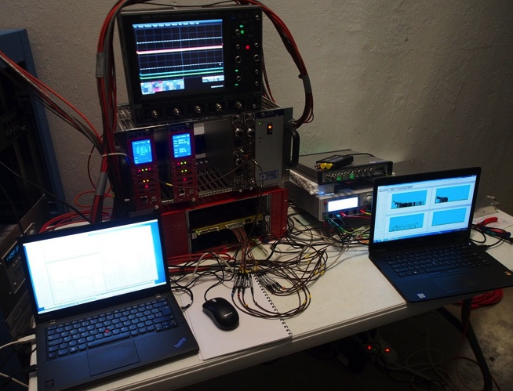
Multi-Grid installed at CNCS
Detector installed at 57° scattering angle
Inaccessible between summer and winter shutdowns
DAQ setup outside, accessible remotely
He-tubes
MG
View from sample
³He 8-packs
M-G
2m
1.1m
20cm
19cm

Slide 8
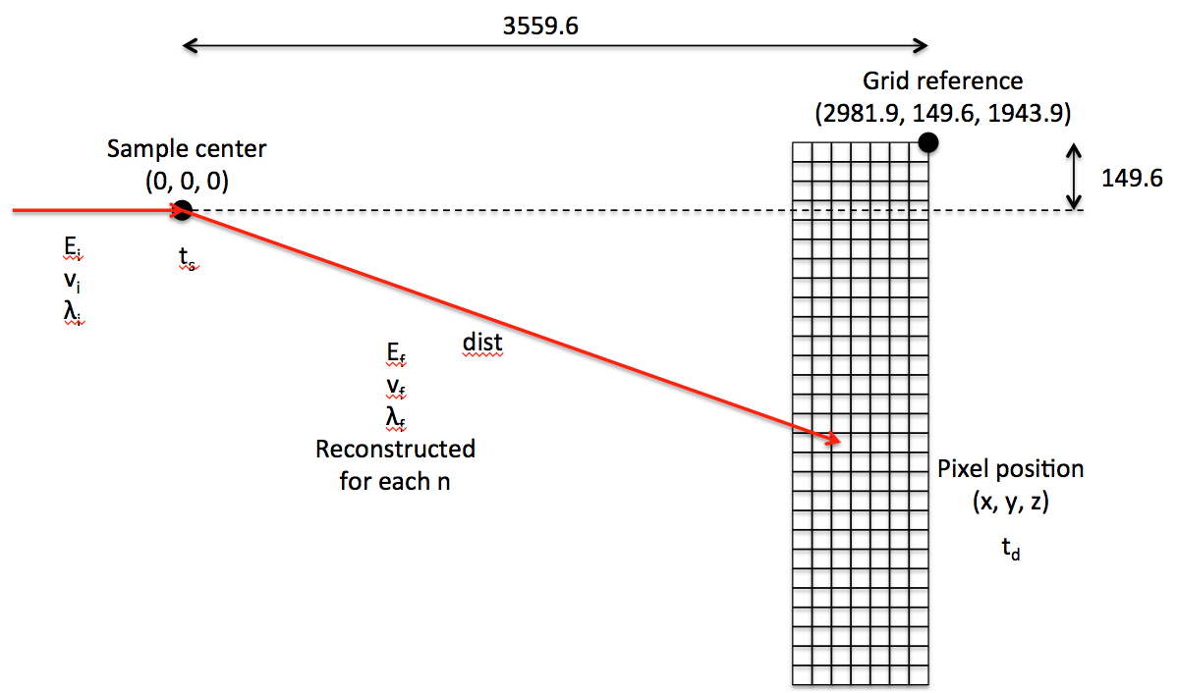
Energy Reconstruction
Energy transfer:
E_{f}-E_{i}

Slide 9
Some Results (Optional)

Slide 10
Time-of-Flight Spectrum
Prompt peak
Elastic peak
Neutron energy gain
Neutron energy loss
Time between source pulses

Slide 11
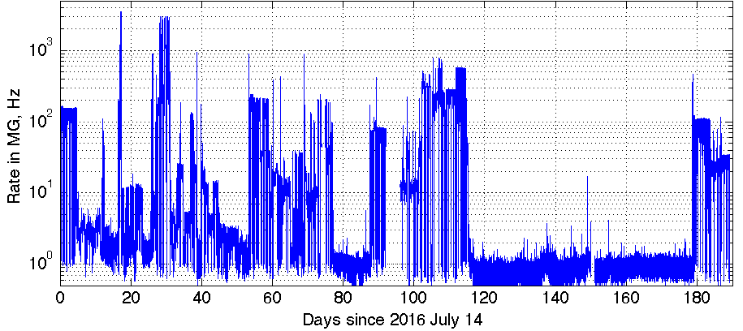
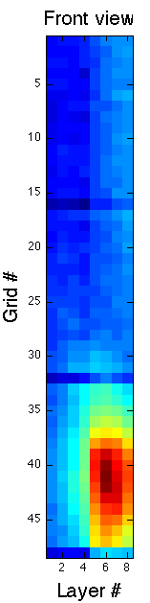
Methods Used for Tests
Vanadium
Counts over time, background
Rate and background analysis
Single crystal
High local rate
Water, Ice
Fast neutrons (fission, prompt)
Gamma background
(NaI detector)
x2 lower fast n counts in MG
Allowing to measure:
Energy resolution – efficiency, scattering – background sensitivity – saturation

Slide 12
Elastic Energy Resolution

Slide 13
Efficiency
Counts from integral of the elastic peak in dE
Efficiency measured relative to the nearest He3 tubes
Error bars: 5-8%, agrees with prediction

Slide 14
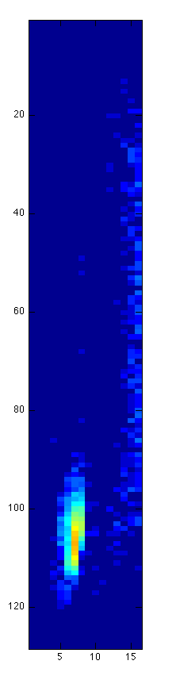
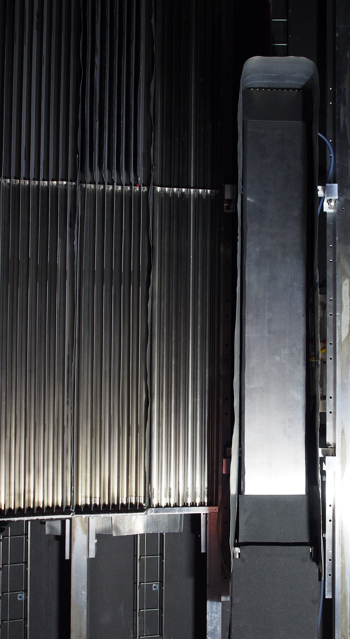
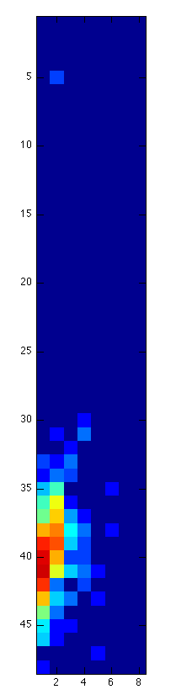
Single Crystal Reflection
He3
A single crystal reflects neutrons according to Bragg’s law:
Resulting in an intense spot seen by detector
MG
Reflected beam at E_{i} = 17.20meV
Crystal
Reflected beam at E_{i} = 13.74meV
Incident beam

Slide 15
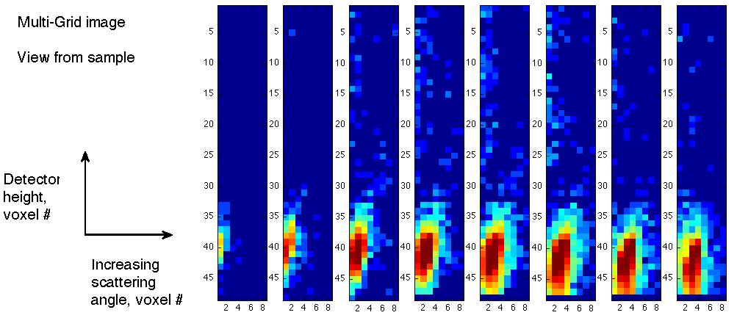
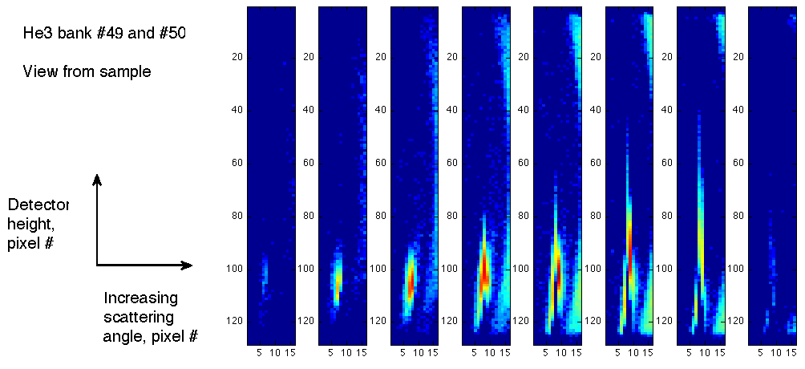
Single Crystal Reflection
Image recorded in each detector as a function of time during elastic peak
Each frame advances 30 μs
Multi-Grid
He3
No loss of position resolution or saturation observed in Multi-Grid

Slide 17
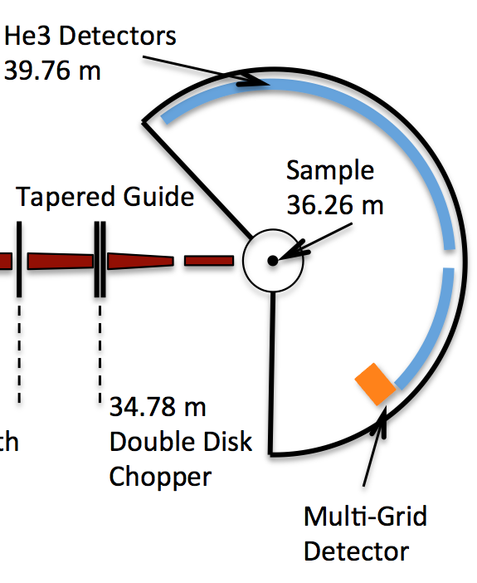
MG Relative CNCS He3 detectors

Slide 18
Q Cut Comparisons for Water Sample
Analysis by Wiebke Lohstroh

Slide 19
What is still not done for MG.CNCS data analysis
~DONE:
Automated pixel assignment
Pixel encoding gain shifts corrections
NOT DONE:
MG visualization alongside He3
dE, dQ calculation, comparison to He3 for arbitrary run
NOT DONE, but tools exist (by Morten / Edgars):
Statistical analysis over time under constant conditions
Search for “interesting” runs

Slide 20
What is coming next:
MG Thermal Instrument Test

Slide 21
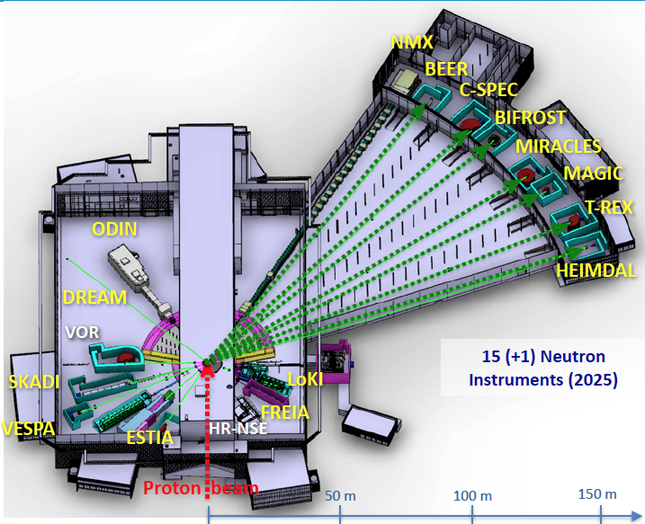
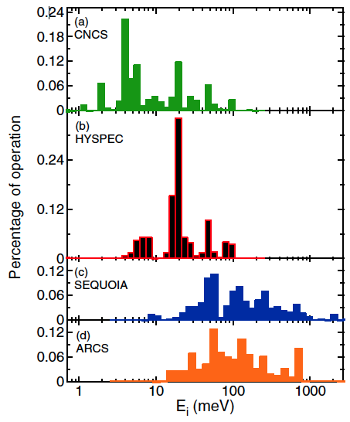
Energy Ranges for ESS Spectrometers
Energy ranges of the first ESS ToF spectrometers
 | CSPEC | T-REX
Typical initial λ, Å (meV) | 2 to 15 Å (20 to 0.36 meV) | 0.7 to 6.4 Å (160 to 2 meV)
Measurements needed for thermal range, up to 160 meV
Cold range, 0.76 to 15 meV measured
Incident energies used at CNCS
(M. Stone et al.)

Slide 22
Efficiency Optimizations
Optimized grid
n
Efficiency as a function of wavelength for MG optimized for cold vs. thermal spectrum
Tested at MG.CNCS
0.5μm
Would like to test:
1.0μm
1.5μm
Layer thicknesses in MG.CNCS (16 blades):
7 blades 0.5μm,
7 blades 1.0μm,
3 blades 1.5μm
Proposed for a thermal detector (20 blades):
4 blades 1.0μm,
10 blades 1.25μm,
6 blades 2.0μm.
Would like to test:
Cold – optimization centered on 4Å
Thermal – optimization centered on 1Å

Slide 23
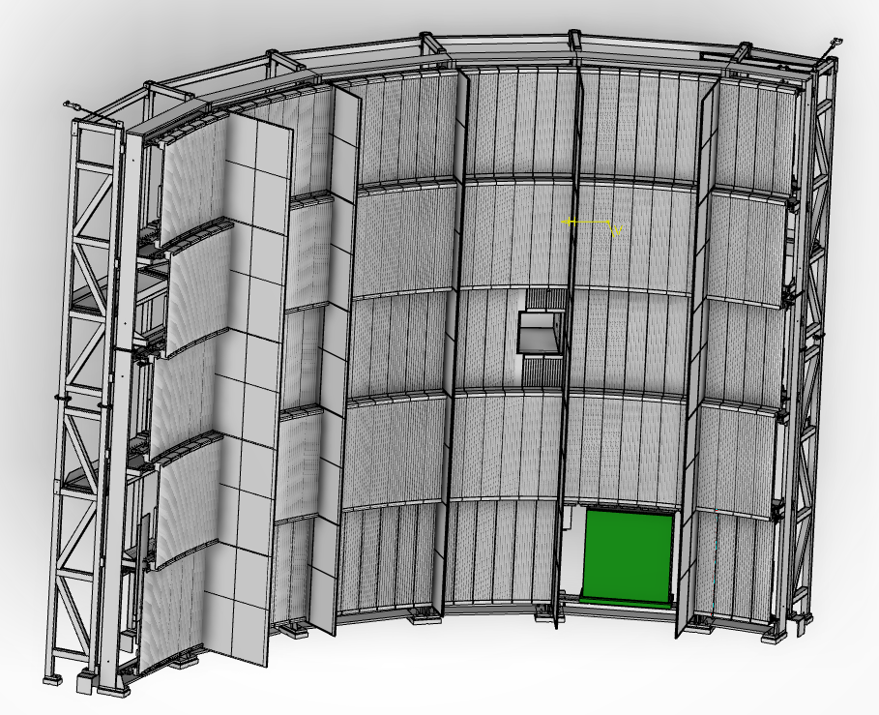
MG Test on Thermal Instrument

Slide 24
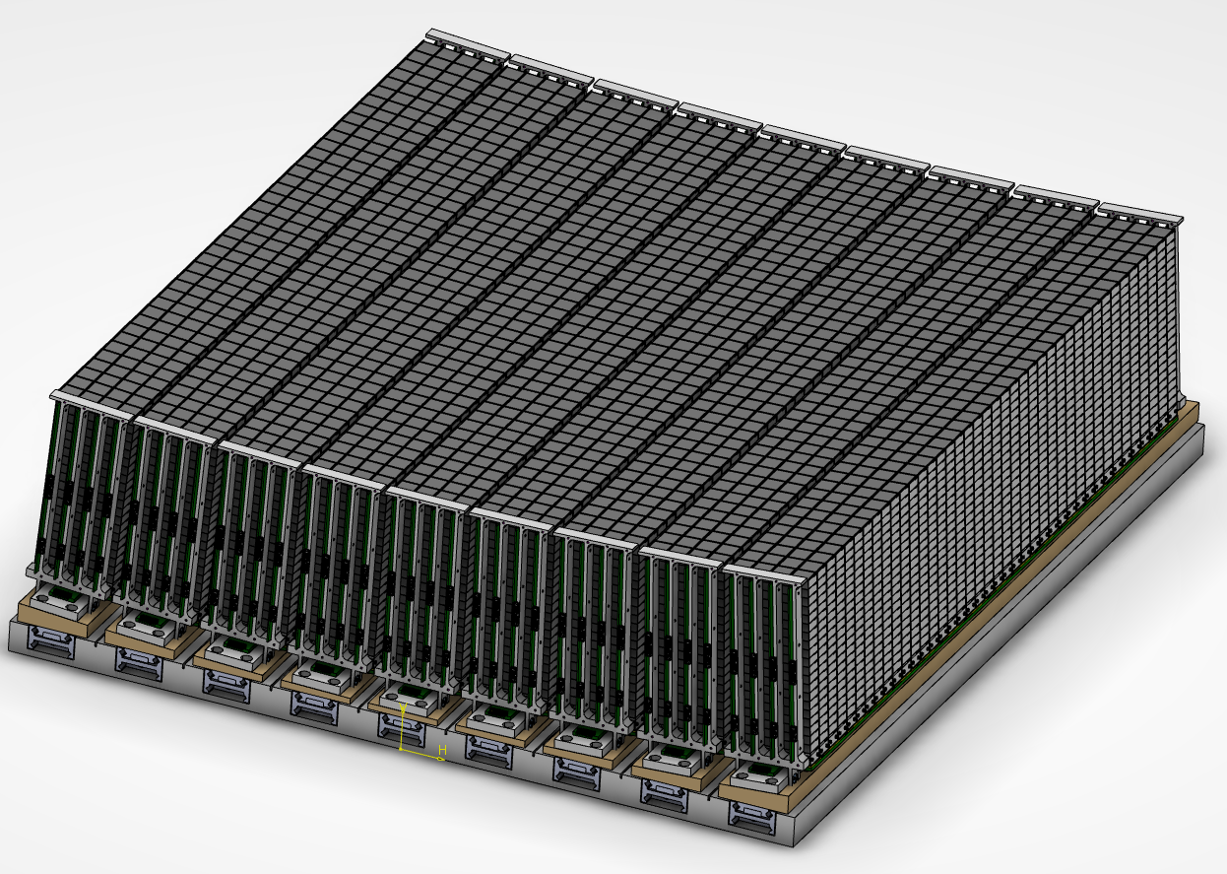
MG Test on Thermal Instrument

Slide 25
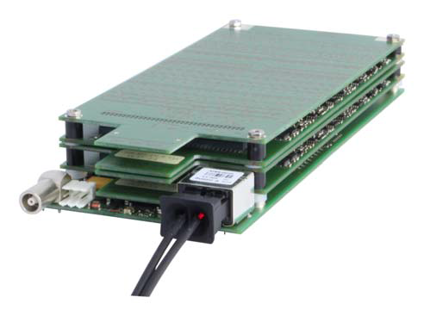
MG Test on Thermal Instrument
1 of these packs for each module
(9 modules total)
Electronics plan:
New front-end from Mesytec
No longer using analogue channel encoding
Will provide (likely):
[module #,
channel #1, amplitude #1,
channel #2, amplitude #2,
…,
time]
In each event: every channel over threshold
Some channels are grids, some are wires
Each wire + grid combination corresponds to a unique 3D coordinate

Slide 26
MG.SEQ schedule (DAQ-related)
Small-scale electronics test – by beginning of Nov 2017
event format known
sample data available
Full set of electronics available – by beginning of Feb 2018
MG.SEQ beam / source / background – March 2018 *
data from full detector available
Installation at SEQUOIA – April 2018 *
Installation coordinates available
First beam data – May 2018 and onward *
beam data
He3 data
*(fall back by ~2 month possible)

Slide 27
MG.SEQ DAQ Wishes
Continually processing incoming data
Should be possible to see:
current rate
current image (3D, 1-2D projections)
current ToF spectrum
For a certain time index range:
rate, image, ToF, dE, dQ, …
dE, dQ will require information on Ei.
Can this be obtained automatically from instrument?
>1 algorithm for reconstructing position from grid #:
first channel
highest amplitude channel
Center of Gravity, ....
Plotting side-by-side with He3 data
Can this be obtained automatically from instrument?

Slide 28
MG Test on Thermal Instrument

