Slide 1
Multi-Blade
Data acquisition and event formation
Stig Skelboe, Carsten Søgaard, Troels Blum
Niels Bohr Institute, University of Copenhagen
Second Joint BrightnESS WP4 and WP5 Jamboree, September 14, 2017

Slide 2
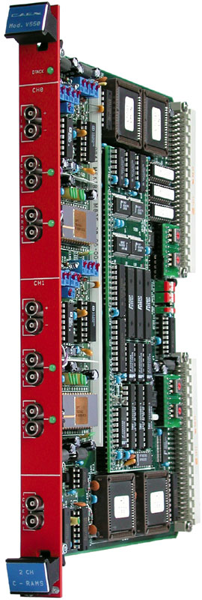
Multiblade DAQ
We are building a completely new DAQ based on CAEN hardware in collaboration with Lund University.
We will base the DAQ on the CAEN V1740D digitizer.
Running the “new” DPP-QDC firmware.
(Digital Pulse Processing for Accumulated Charge to Digital Converter)
Creating a DAQ that can communicate directly with the EFU while being versatile enough for general experiments at Lund University.

Slide 3
Detector and data acquisition
A
D
C
USB
Communication
and control processor
UDP
packets
control
Left half of figure from F. Piscitelli et al. ”The Multi-Blade Boron-10-based neutron detector for high intensity neutron reflectometry at ESS”, Jinst March 2017.

Slide 4
Multiblade DAQ workflow
Polling for data
Reading data
Decoding data
  Channel number, ADC amplitude
  Combining with global time
We could do event formation here
Network packing
  UDP
The DAQ will be multithreaded so that: <polling and data reading> is decouppled from <data processing> which again is decoupled from <network communication>

Slide 5
Multiblade DAQ main challenges
Support for the DPP-QDC firmware is not implemented in the CAEN library. So we need to implement these ourselves.
We need to support both aggregated data format for the EFU and wave-forms for debugging and further experiments.
We do not know what facilities will be available for integrating the global time into the data - containing only digitizer local time (16ns resolution).

Slide 6
Pipeline SW Architecture
Prototype Pipeline Process v2
Ethernet RingBuffer <9000> (length)
Lockless FIFO <unsigned int, length>
Event RingBuffer <12> (length)
Lockless FIFO <unsigned int, length>
pthread
pthread
pthread
input
processing
output
UDP
TCP
input thread writes data to buffers by socket receive()
processing thread reads data from RingBuffer, writes (event)data to event RingBuffer
output thread reads (event) data from RingBuffer and appends to Kafka transmit buffer. Sends when full.
No dynamic allocation of memory, no mutexes, small data structures, minimal copying.
From the presentation by M. J. Christensen, “EFU Pipeline Prototype, Architecture, Demo, Source Code”, 17-09-08

Slide 7
Event Formation Unit
C++ program based on a Matlab implementation by Francesco Piscitelli.
Structure:
Clustering
Validation
Localization

Slide 8
Clustering
The multiblade event-builder receives data-points individually.
A data-point consists of a channel number, an ADC-value and a time-stamp.
Data-points where the time differences are smaller than the specified time-window (~3us) are combined into one cluster.
In most events the cluster consists of signals from both wire channels and strip channels.
Before determining the location, the cluster is validated.

Slide 9
Validation
Clusters are considered valid if the channels carrying a signal are
adjacent when considering wire and strip channels separately.
Clusters where either wire and/or strip channels are non-adjacent are considered to be the readout of more than one neutron event and are currently being discarded.
In data where only wire or strip points can be used, multiple neutron
events can in some cases be separated if either wire or strip channels
are considered.
Multiple neutron events are rare in the beam tests so far, 70 out of 4297.

Slide 10
Localization
The interaction point of the neutron must be localized in both the wire plane and the strip plane.
Two methods are implemented into the event-builder:
  Wire/strip channel with largest ADC-value.
  Weighted average of involved wire/strip channels with ADC values as weights.
The two methods give slightly different results as shown on the next slide.

Slide 11
Max ADC pos. Weighted pos.

Slide 12
Processing speed
Processing speed tests have been performed on a Lenovo X250 with an INTEL CORE i7-5600U CPU @ 2.60GHz.
The data was loaded into memory and the actual event building timed using the Clock::now() function from the <chrono> library.
The tests show that average processing time is 2.88x10^-8 seconds per
data-point.
The data set involved 4297 thermal neutron events and the average processing time per neutron was 7.95x10^-8 seconds.

Slide 13
Conclusion
The data acquisition part is expected to be operational, but not complete, by the end of this month (September 2017).
The event formation software is complete and embeded in the EFU pipeline.
Various extensions and improvements are considered:
  Multiple neutron event formation
  Improved processing speed

