Slide 1




VESPA at the Toll Gate 2
Vibrational Excitations Spectroscopy with Pyrolytic-graphite Analyzers
“VESPA, the only spectrometer in the ESS instrument suite
focused on molecular vibrations in chemistry”
U. Bafile, S. Bellissima, M. Celli, D. Colognesi, A. de Bonis, L. del Rosso, L. Di Fresco, G. Gorini, F. Grazzi, F. Masi, R. Senesi, L. Ulivi, C. Vasi, M. Zanetti
M. Chowdhury, K. Jones, S. F. Parker
S. Ansell,
M. Hartl, C. Lopez

Slide 2
Outline of VESPA TG2 presentation
1. Con. Ops. + IOSP₁ : VESPA scientific scope,
[D. Colognesi Overview of the science case
& M. Hartl] VESPA HLSR
“competitive” vs. “full scope” after SSM
Overview of VESPA layout, PBS and P&ID
      Upgrade stages from the IOSP document
      Q&A: Con. Ops. and IOSP₁
2. Sys. Req.: VESPA HLSR in connection with the scientific scope
[D. Colognesi] Functional requirements for the high level components
& M. Hartl] Q&A: Sys. Req.
3. PSDD: Description of the preliminary design
[L. Di Fresco Interfaces with monolith, bunker and neighbours
& M. Chowdhury] Key components and areas
  Performance at P=2 MW
  Q&A: PSDD
4. WPS + IOSP₂: Risk analysis
[R. Senesi] Schedule
Q&A: WPS and IOSP₂

Slide 3
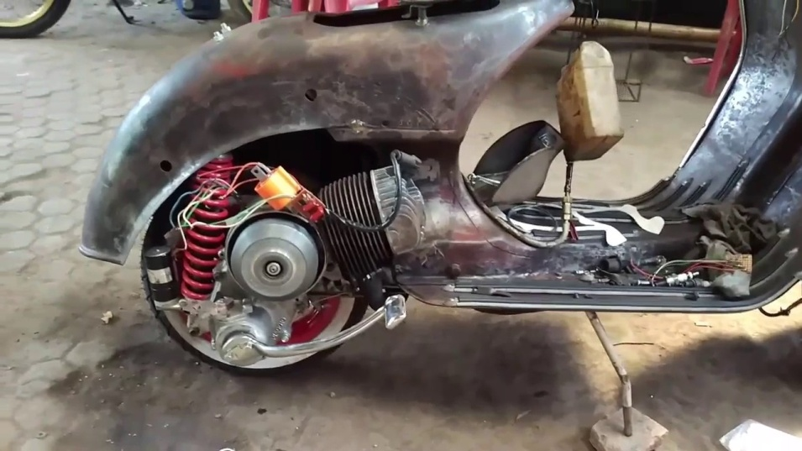
VESPA
“Concepts of Operations Descriptions”
&
“Initial Operations and Staging Plan (1)”
documents

Slide 4
VESPA: the scientific scope
Non-hydrogenous materials
High-performance polymers
Renewable Energies
Catalysis
Earth Science
General
Polymers, pharma-ceuticals
•
Hydrogen storage
Bioprotectants
•
Battery materials
Amino acids
•
Photolysis / solar cells
H, CO_{x}/NO_{x}
Applied, industrial catalysis
DFT-benchmarking
•
Molecules in confinement
Short H-bonding
•
H-spillover
Water in Minerals
•
•
•
Fracking
•
CO₂ sequestration
Waste repositories
Neutron Vibrational Spectroscopy
NVS

Slide 5

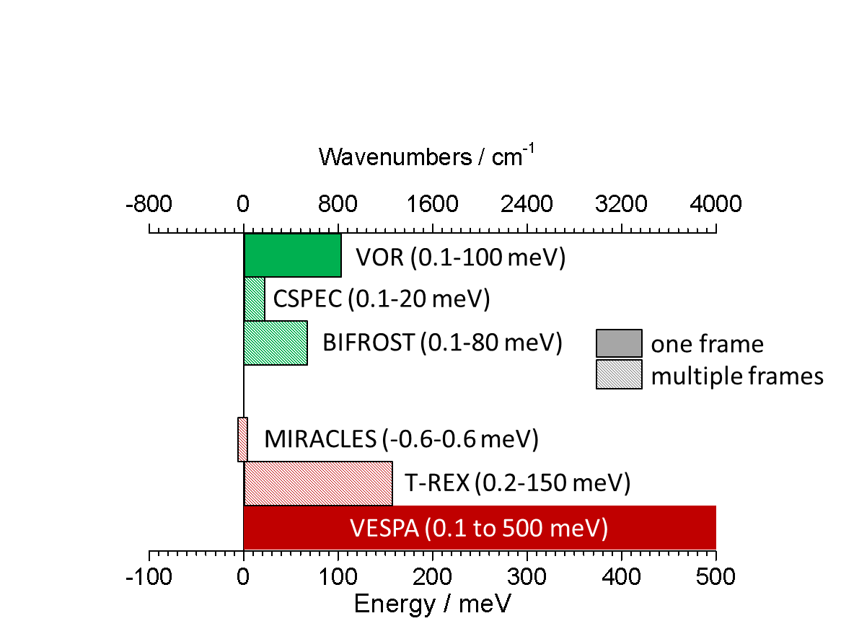
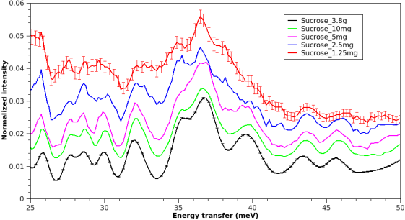
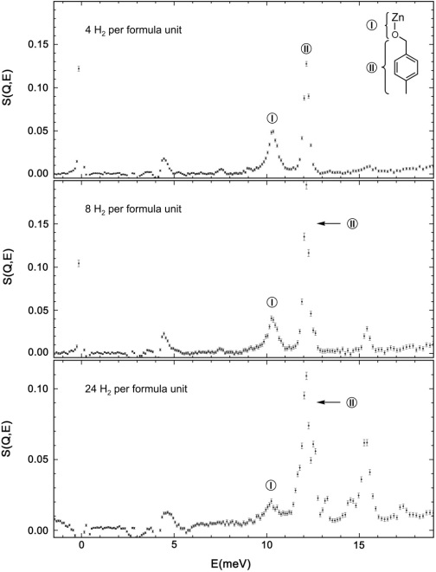
VESPA: the scientific scope
Flux on sample larger than in the current leading instruments for E<80 meV.
Wide energy transfer range: 0÷500 meV in ”one shot”.
Hydrogen storage
Sucrose: 1.25-3.8 g
0.08-240 mmol ‘H’
25 30 35 40 45 50 (meV)
H₂ in MOF-5
8H₂
C. Brown et al.
The only instrument at ESS with wide energy transfer range.
0 5 10 15 (meV)
Ideal E range for “hydrogen”:
- hydrogen storage materials /clathrates…
Neutron Vibrational Spectroscopy
NVS

Slide 6
VESPA: the scientific scope
High-performance polymers
Non-hydrogenous / battery materials
Relative resolution ΔE/E₀ constant over wide range of energies.
Trade of flux for resolution possible.
Li-electrolyte in-situ impedance meas. (batteries)
- at the resonance frequency (bottom) and above/below (top)
B. Hudson et al.
Synthetic polymers:
intermolecular interactions through hydrogen bonding
n-C₆H₁₄,
n-C₁₅H₃₂
n-C₂₅H₅₂
0 200 400 600
(cm⁻¹)
Daemen, Hartl et al.
200 400 600 800
(cm⁻¹)
resolving vibrational line-shapes in a very crowded spectral range with constant resolution (easier modelling)
Ideal conditions for observing Li⁺ movement in Li electrolytes (high intensity needed, but sometimes high resolution is better to resolve peaks…)
VESPA TG2 (Lund, 17 Oct. 2017)

Slide 7
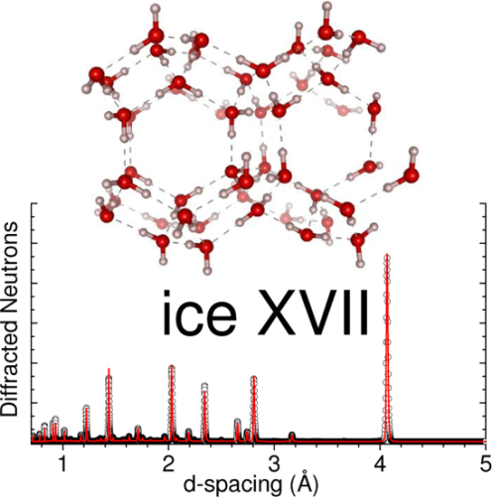
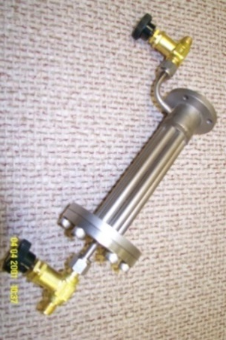
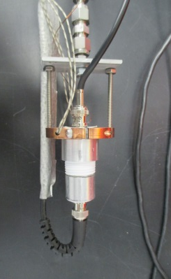
VESPA: the scientific scope
Hydrogen storage
Core sample environment (CCR and Sample Changer) from the beginning.
Standard diffraction capabilities from the beginning.
L. del Rosso et al.
The latest ice phase (2016) has been identified by CNR researchers using both IINS and neutron diffraction.
CCR
neutrons
flow cell
battery cell
Identifying phases of measured solid materials through their crystal structure. Upgrade of backscattering diffraction banks for pair-distribution-function (PDF) analysis.
With our large CCR with increased tail size/ cooling/ elect. insulation, we are set to expand with little effort/cost by:
(1) using the pool aux. equipment OR (2) fabricating new sample cells with input from University collaborators
VESPA TG2 (Lund, 17 Oct. 2017)

Slide 8
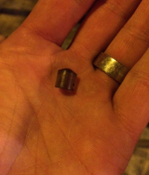
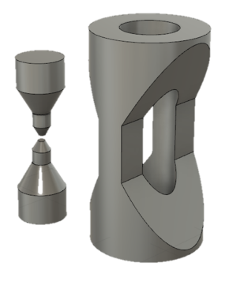
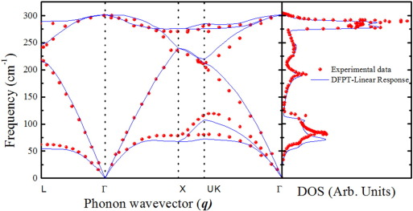
VESPA: the scientific scope
The scientific highlight experiment is focused in the spectral area of highest flux:
collaboration with B. Haberl (ORNL, USA). High-pressure (p>10 GPa) amorphous Ge; experiment currently not feasible even on VISION.
- The capability to obtain pressure-dependent vibrational data for amorphous materials could be transformative for the study and understanding of the entire class of amorphous materials.
- p=10 GPa and above is not commonly achieved for IINS!
Other challenging in-situ experiments will be proposed.
1 mm³ sample at
4 GPa
R. Boehler
VISION anvil cell
(M. Guthrie,
ESS pressure
expert is planning
similar cell usable
on VESPA)
Crystalline Ge
p-DoS at ambient
pressure
VESPA TG2 (Lund, 17 Oct. 2017)

Slide 9
VESPA: the scientific scope
Day-1 experiments are focused on the “bread and butter” in NVS:
static experiments: bio-materials, hydrogen storage materials, MOF’s, water in minerals, gas-loading, batch processing/sample changer for applied industrial catalysis;
in-situ experiments: heterogeneous catalysis (academia/industry), medium pressure geochemistry (gas cell, clamp cell etc.).
⇒ “Easy” experiments with high success rate to get high-profile publications.
DATA ANALYSIS NEEDS:
VESPA will need density functional theory and molecular modelling to publish results.
Software is available for free (Abinit, Quantum-Espresso etc.) or for cost (CASTEP, Wien 2K etc.).
Translation to “neutron scattering” intensity (Oclimax (2017)) is available for free => VESPA team is in close contact with author and users
SUPPORT from DMSC with respect to providing computer clusters, as well as challenging non-standard modelling (see Science Case), are essential!

Slide 10
VESPA: High Level Scientific Requirements
(submitted version)
VESPA shall exploit the Wavelength Frame Multiplication technique in order to cover a broad range of energy transfer 0 meV<E<500 meV in “one shot”. The full spectrum is collected in a single ESS pulse, thus making kinetic or parametric experiments feasible and easy to interpret.
VESPA shall offer an unparalleled, almost constant, relative energy resolution up to ΔE/E₀=1% for NVS over most of its energy transfer range.
VESPA shall provide an excellent neutron flux in the so called “fingerprint region” of vibrational spectroscopy (i.e. 60<E<220 meV), surpassing all the existing NVS instruments in the low energy range (up to about E≤40-60 meV).
VESPA shall be able to “trade” neutron flux for energy resolution using a flexible Pulse Shaping Chopper configuration made of only three elements.

Slide 11
5. VESPA shall make full use of the ESS long pulse via an instrument length of about 59 m and a usable neutron wavelength range from 0.4 to 4.7 Å.
6. VESPA system design, especially the sample environment area, should provide the space and flexibility necessary to host and drive future developments in the neutron spectroscopy area and combining NVS with other techniques (pressure, electrochemistry, neutron magnetic resonance and others).
7. VESPA should serve the users as well as the scientific and instrumental development program without interruptions during ESS source operation.

Slide 12
VESPA: High Level Scientific Requirements
(amended version)
VESPA shall exploit the Wavelength Frame Multiplication technique in order to cover a broad range of energy transfer 0 meV<E<500 meV in “one shot”. The full spectrum is collected in a single ESS pulse, thus making kinetic or parametric experiments feasible and easy to be interpreted.
VESPA shall offer an unparalleled, almost constant, relative energy resolution better than ΔE/E₀=1% for NVS over most of its energy transfer range (with E₀ being the incoming neutron energy).
VESPA shall provide high neutron flux on sample in the so-called “fingerprint region” of vibrational spectroscopy (i.e. 60 meV<E<220 meV); surpassing all the existing NVS instruments in the low energy range (up to about E≤80 meV). These figures have been estimated assuming the ESS full power scenario (P=5 MW).

Slide 13
VESPA shall be able to “trade” neutron flux for energy resolution using a flexible Pulse Shaping Chopper configuration made of only three elements. The switching factors between the two instrument sub-modes (i.e. Hi-res. and Low-res.) shall be about 2.5 (concerning resolution width) and about 3.8 concerning (concerning flux on sample).
VESPA shall be able to illuminate samples up to 35 mm×35 mm (which is a common and practical size for chemical applications). Beam size reduction shall be always possible making use of adjustable jaws.
VESPA shall exhibit a signal-to-background ratio (S/B) larger than that necessary to allow the detection of the spectrum from a low-temperature (T≈20 K) solid sample containing 1⋅10⁻³ moles of protons. S/B on VESPA should be comparable to those of the best NVS spectrometers in the neutron sources all over the world.
7. VESPA system design, especially the sample environment area, should provide the space and flexibility necessary to host and drive future developments in the neutron spectroscopy area and combining NVS with other techniques (pressure, electrochemistry, neutron magnetic resonance and others).

Slide 14
8. VESPA should serve the users as well as the scientific and instrumental development program without interruptions during ESS source operation.

Slide 15
VESPA HLR no. 3: flux on sample
VESPA “proposal” (2015), P=5 MW
VESPA equipped with a large elliptical guide. ESS “pancake” moderator (×1.5), power P=5 MW.

Slide 16
VESPA HLR no. 3: flux on sample
VESPA “project scope”, P=5 MW
Reduction with respect to the 2015 preliminary evaluations:
between 2 (low E₀) and 9 (high E₀).
Solid angle factor not included: 0.66/2.16 (Vision)
0.66/0.80 (Tosca)
VESPA equipped with a straight tapered guide. ESS “butterfly-1” moderator, power P=5 MW.

Slide 17
VESPA HLR no. 5: sample size
Beam-size on sample: 35 mm×35 mm → large amount of material needed.
Heterogeneous catalysis: investigated molecules converted by catalyst are in small concentration compared to the carrier material.
Photo-catalysis: the amount of “material in excited state” << “material in ground state”
Non-hydrogenous samples: scattering cross section is small compared to “H”
Beam size reduction shall be always possible making use of adjustable jaws – one set before hutch entrance and one small set close to sample area, e.g. for high-pressure DAC cells, electrochemistry (pellets) etc.;
Sample holder geometry for basic measurements:
Flat cells: 35×35 mm²;
Annular to cylindrical cans: 35 × 35 mm²
(outer dimensions).
Connection
point
lead pig

Slide 18



VESPA HLR no. 5: sample size & ACTIVATION
Conservative assumptions: sample in beam for 24 h, flux 10⁹ n/cm²/s, 1min delay (only relevant decay products considered):
Heterogeneous catalysis: Pt-doped alumina (1% Pt on Al₂O₃) m=10 g
Al-27 (n,G) → 18.91 MBq Al-28 (2.240 m) => However, it is short lived!
Electrochemistry: RbH₂PO₄ m=10g
Rb-87 (n,G) → 1.058 MBq Rb-88 (17.80 m)
=> 10s time to handle sample (on contact!!!)
Shielding on cell: Cadmium (Cd) m=25g (estimate for sheet size of sample holder)
Cd-106 (n,G) → 1.541 MBq Cd-107 (6.490 h)
            3min time to handle sample (on contact!!!)
In seal in beam (misalignment): Indium (In) m=1g
In-113 (n,G) -> 1.517 MBq In-114 (71.90 s) => However, it is short lived!
no problem for 75% of samples (C,H,N,O,Si,Al,S, mg amounts of metals)
sample stick allows for distance to sample, lead “pig” in hutch shields immediately
- experience on VISION: samples activate moderately but handling time is short

Slide 19
VESPA HLR no. 6: signal-to-noise ratio
Background consists of high-energy neutrons (99.99%), Albedo effect (10⁻⁴),cross-talk.
High-energy neutrons:
time-correlated and can be reduced by T_{zero} chopper or time gate (VISION, TOSCA)
VESPA (59m) is 2.2x longer than VISION (27m) => fast flux can be better separated by a factor of 5 (1/r²)
by designing compact cave, the neutron decay can be kept as short as possible
Albedo effect:
not time correlated, cannot be removed by chopper
shielding solutions are needed (triangular or ZOOM-like shielding)
Cross-talk:
improve cave shielding to avoid stray radiation from other beamlines (thickness given by background count rate on detector)
GOAL: see <0.01 mmol of “H”

Slide 20
VESPA HLR no. 7: sample area
Cave concept with upper experimental cave (EC):
no activation of components in upper EC => electronics, equipment can be placed nearby (cold gas loading,…)
room for temporary auxiliary equipment (gas loading, mass spec, …)
containment ventilation for gas experiments and vacuum exhaust
shielded area for sample sticks
Sample preparation area:
preparation table for preparing sample sticks and sample holders
possibility for minor sample treatment (heating, cooling, evacuating, aligning) and intermediate cold storage for samples (l-N₂ dewar)
glove box for loading air-sensitive samples
Sample cabinet for samples before and after irradiation => shielded as needed
VESPA needs in user labs (take from experience at LANSCE/SNS):
VESPA will make use of the user laboratories in D08 and D07
general synthetic chemistry capabilities (VESPA is a beamline for chemistry and related science)
Equipment wishes: BET; TG/DTA; IR/RAMAN; XRF, powder-XRD;

Slide 21
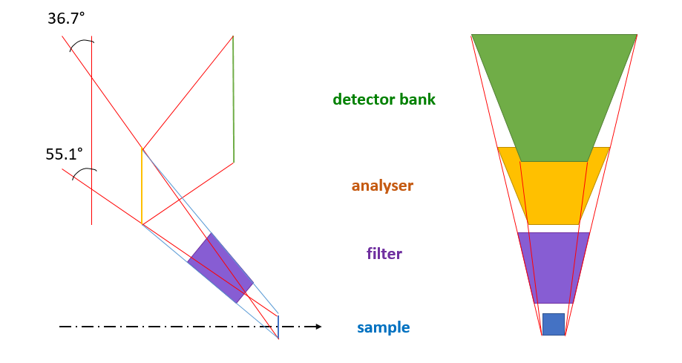
Secondary spectrometer: the new conceptual design

Slide 22
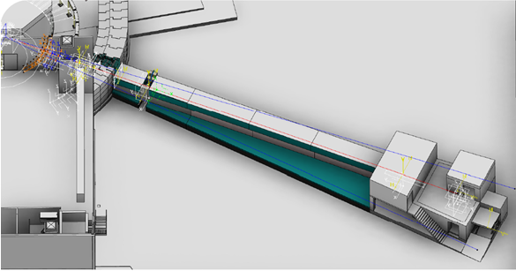
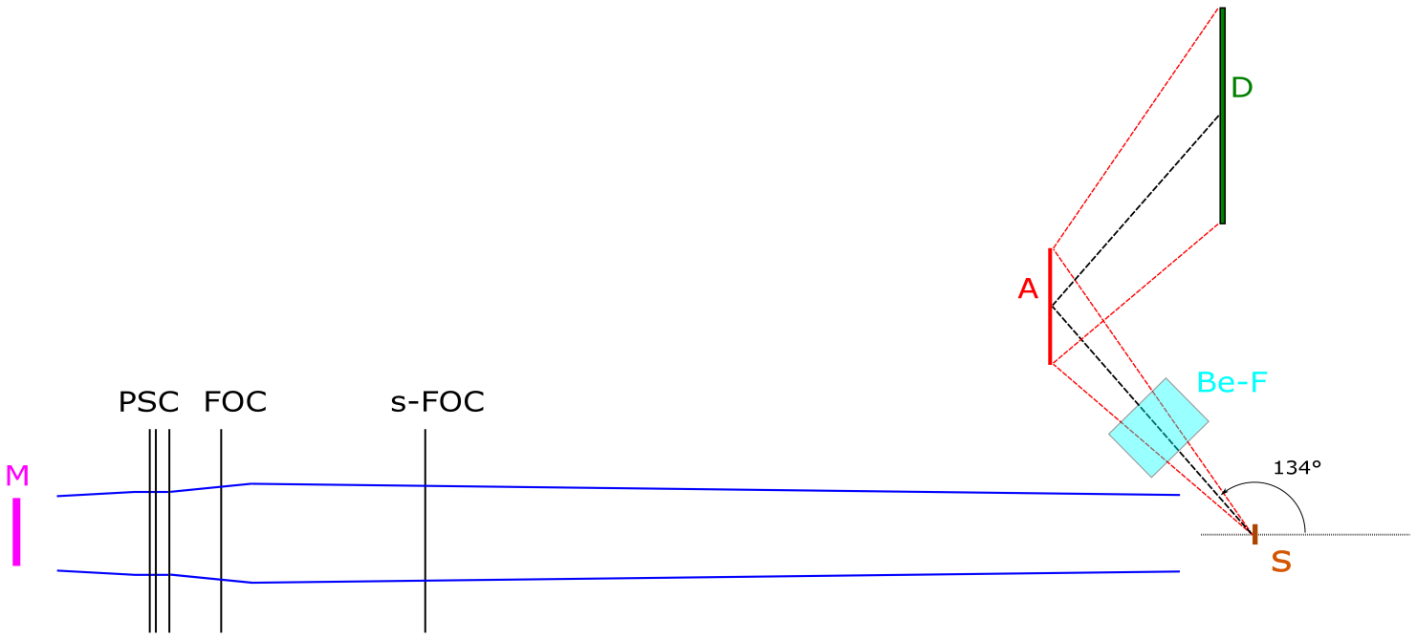
Overview of VESPA layout, PBS and P&ID
VESPA project layout
Layout of VESPA in the East sector 7
of the Experimental Hall 1.
VESPA conceptual layout: moderator (M), pulse shaping choppers (PSC), frame overlap chopper (FOC), sub-frames overlap chopper (s-FOC), sample (S), analyzers (A), beryllium filters (Be-F), and detectors (D).

Slide 23
VESPA configurations: “competitive” vs. “full
scope” after the Scope Setting Meeting
Competitive
Chopper system
(3 PSC p., FOC d., s-FOC p.)
Guide (straight tapered)
—
Basic Sample Environment
(CCR and ASC)
Backscattering inelastic bank (0.67 sr)
—
1 diffraction bank (at about 90º).
Full Scope
Chopper system
(3 PSC p., FOC d., s-FOC p.)
Guide (straight tapered)
T₀ chopper (if needed)
Advanced Sample Environment
(see ConOps & IOSP)
Backscattering inelastic bank (0.67 sr)
Forward-scattering inelastic bank (0.67 sr)
4 diffraction banks (1 in backscatt.)

Slide 24
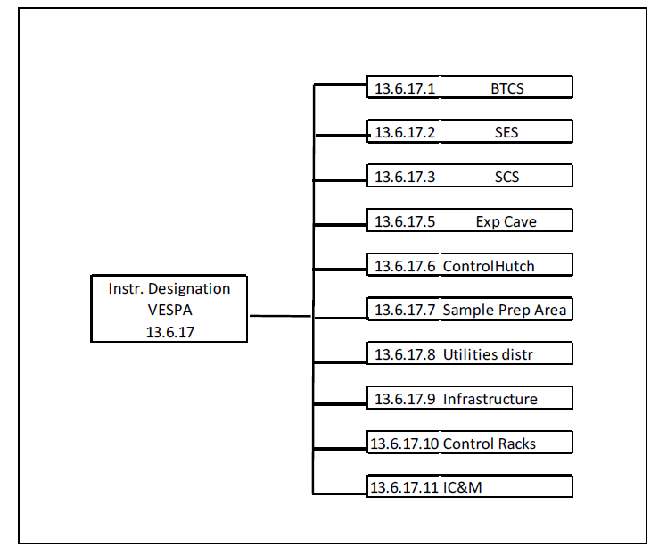
VESPA Product Breakdown Structure
ESS standard nomenclature;
10 High Level Components;
Almost 100 Low Levels Components;
Baseline structure for Sys. Req. document and budget.

Slide 25
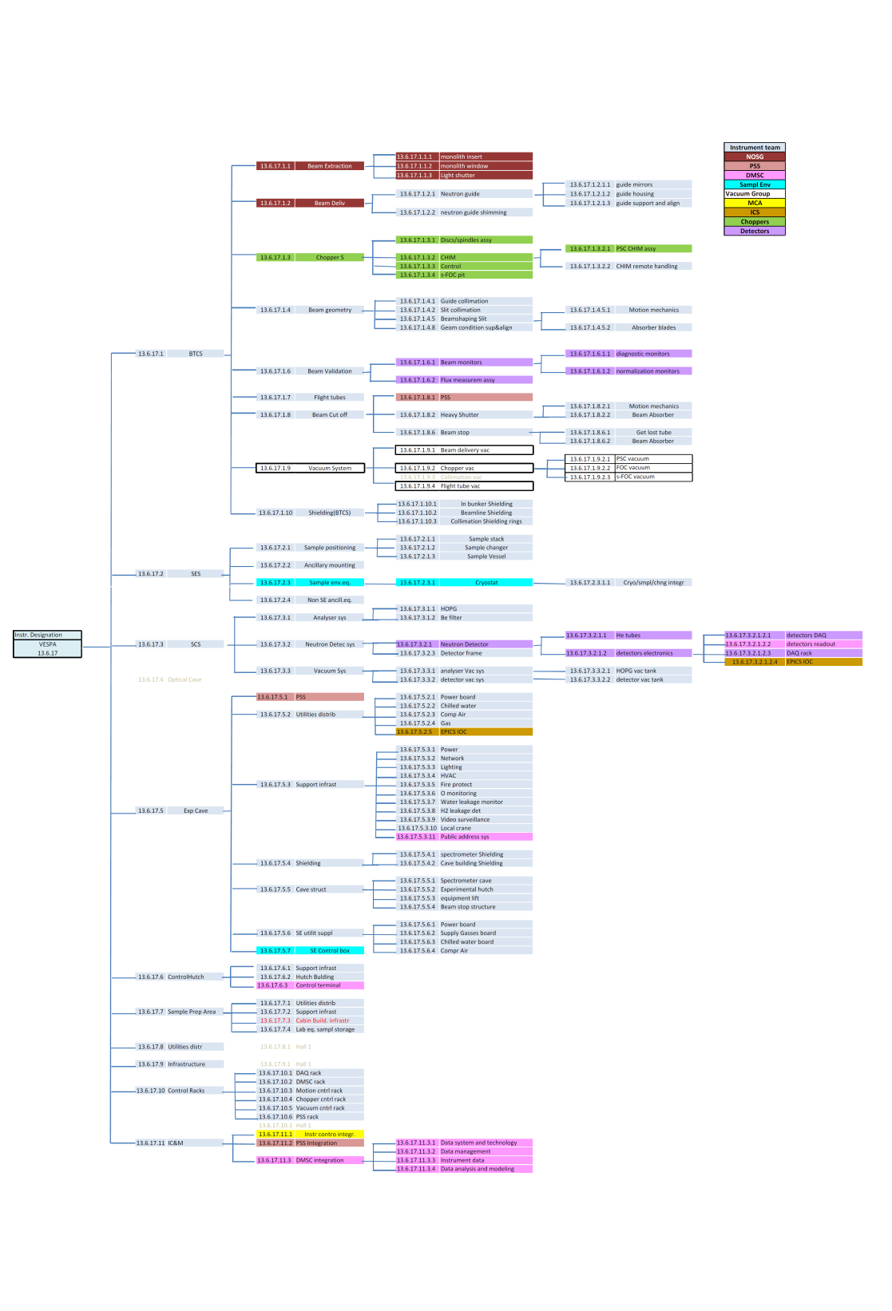
VESPA PBS – more in detail
A description of the VESPA components will be provided
in the section “Key components and areas”
A higher resolution picture is available in INDICO

Slide 26
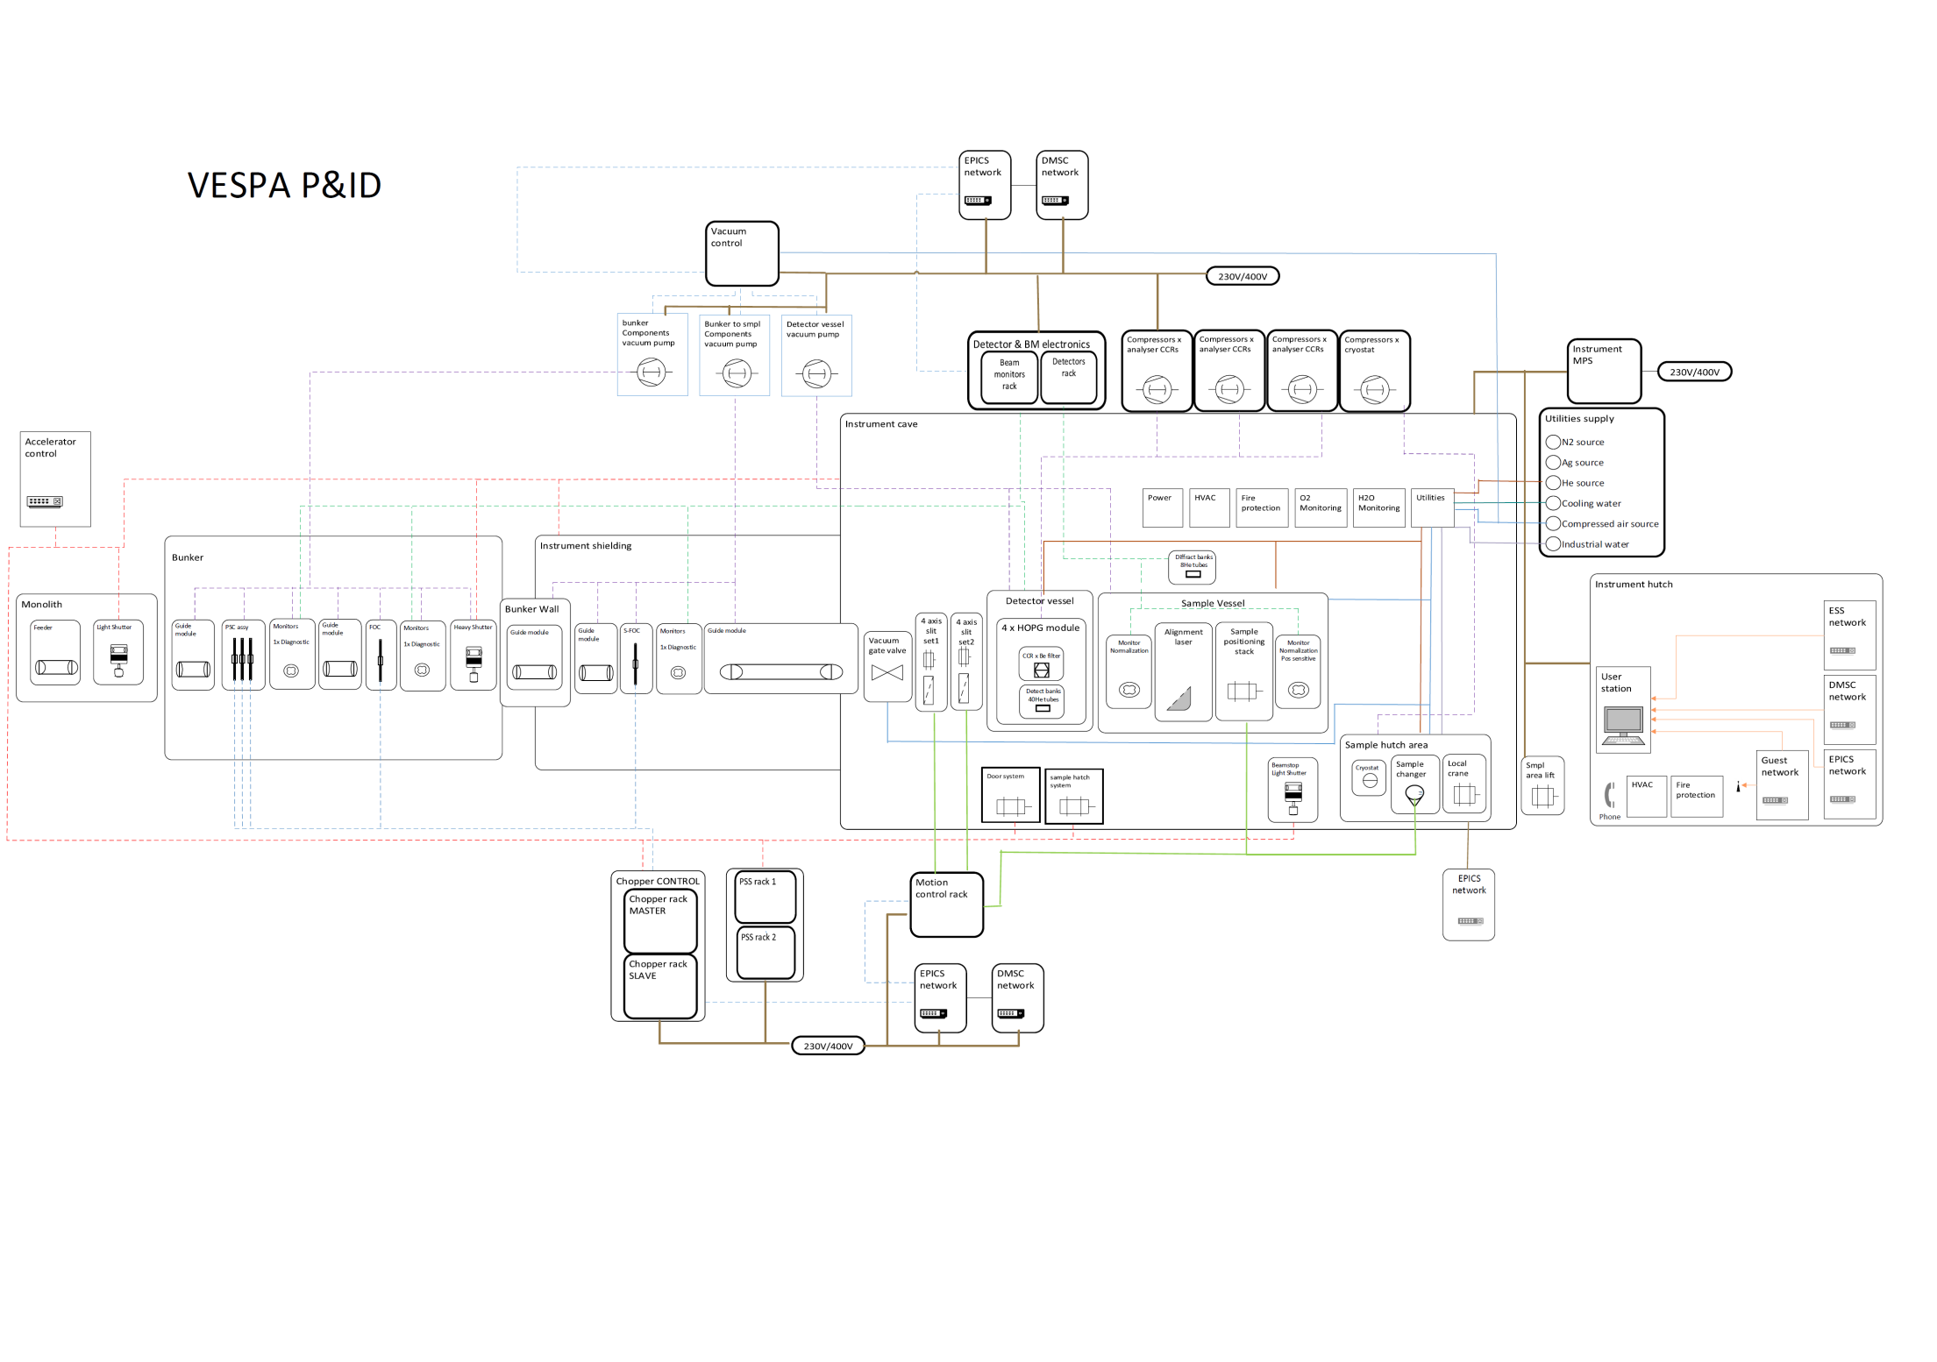
VESPA P&ID
A higher resolution picture is available in INDICO

Slide 27
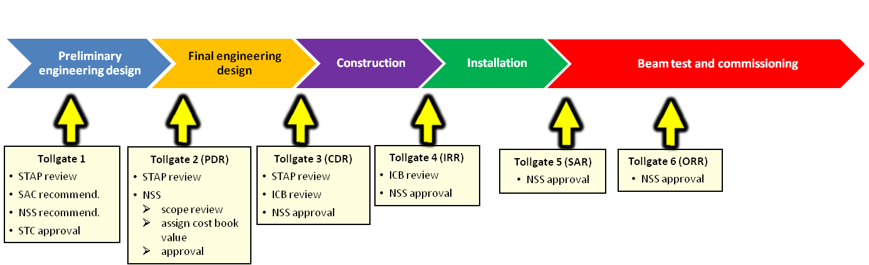
VESPA life cycle
Design |  | Construction | Staging | Initial Operations | Operations |  | Decommissioning
2016-2020 |  | 2020-2023 | 2020 (beam on target)-2023 | 2023 (handover to operations)-2025 | 2025-2065 |  | 2065-?
Preliminary engineering design | Final engineering design | Construction and installation | Beam test and commissioning |  | Operation and continuous upgrade; development period |  | Decommissioning period
 |  |  | Staging to full scope
TG1-TG2-TG3 |  | TG3-TG4 | TG4-TG5
PDR, CDR |  | IRR, SAR | ORR | Upgrade and/or modernization work

Slide 28
Upgrade stages of VESPA from the IOSP document
- upgrading to “full scope” configuration (i) -
VESPA baseline scope: a fully functional, competitive instrument within the 12 M€ cost category.
Planned upgrade: VESPA intensity will double & (S/N) will be improved, allowing for the measurements of smaller samples (i.e. in HP experiments) & quicker runs (i.e. in-situ catalysis).
Installation of the PPS chopper (a.k.a. T₀ chopper): it will improve the (S/N) by cutting γ and fast-neutron flash. VESPA: a straight instrument, noise might be significant!
Analyzer upgrade: 2 forward-scattering frames containing 2 AFDM (Be-filter, analyzer crystal & detector tubes) each.

Slide 29
- upgrading to “full scope” configuration (ii) -
Achieving the “full scope” coverage: solid angle Ω=1.3 sr.
Depending on the background level observed during the “hot commissioning”: either implementing PPS chopper (T₀), or upgrading the spectrometer first.
Elastic detectors: adding 3 diffraction banks with 24 ³He tubes covering angular ranges 75°<2θ<105° (equatorial position) & 162°<2θ<172° (backscattering).
All the infrastructure for the AFDM’s will be part of the baseline scope: upgrade to full scope will have very small impact on the instrument operations!

Slide 30

Questions about the VESPA
“Concepts of Operations Descriptions”
and
“Initial Operations and Staging Plan (I)”
documents?

Slide 31
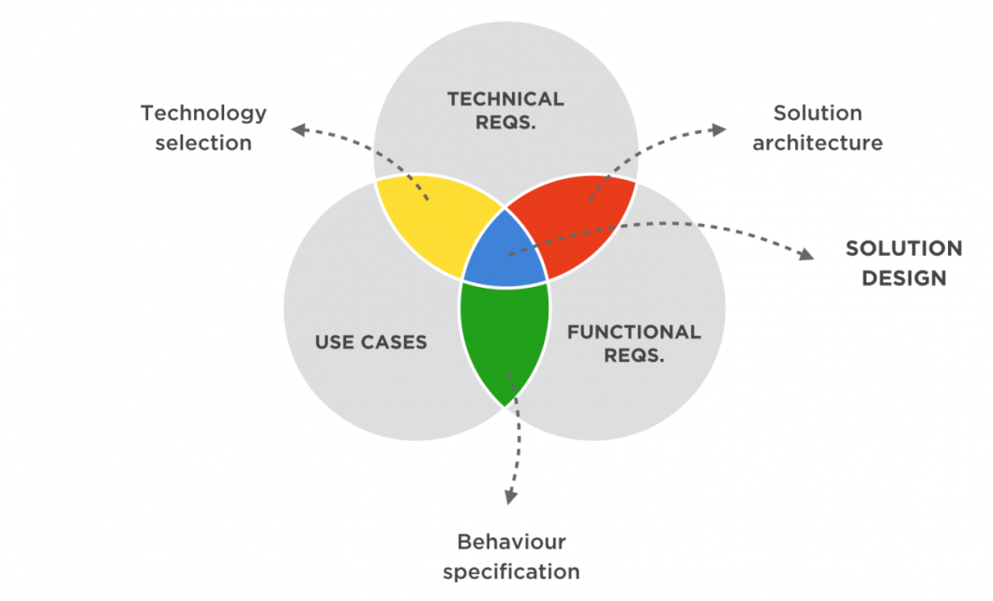
2. VESPA
“System Requirements Specification”
document

Slide 32
VESPA: High Level Scientific Requirements in connection with the scientific scope
Science-driven High Level Requirements & Design Goals
1 | NVS in “one shot” (i.e. “chemistry style”) | Energy transfer (E) range | 2 meV<E<500 meV (i.e. 0.4 Å <λ₀< 4.7 Å)
2 | NVS (especially on small or non-hydrogenous samples) | Neutron flux on sample (J) at 5 MW & Low res.; detector coverage (Ω) | J(10 meV)=2.5E7 s⁻¹cm⁻²meV⁻¹; J(100 meV)=2.2E5 s⁻¹cm⁻²meV⁻¹; Ω=0.66 sr
3 | NVS, trading flux for resolution (flexibility) | Relative energy transfer resolution (ΔE/E₀) | ΔE/E₀ ≈ 1.0% (High res.) ΔE/E₀ ≈ 2.5% (Low res.)
4 | NVS (especially on small or non-hydrogenous samples) | Signal to background ratio (S/B): final goal 0.01 mmol “H” [see later] | State of the art in NVS; always S/B>30
5 | NVS (general) | Uniform beam on sample; low divergence (Θ); adjustable beam size (L) | Better than ±10%; Θ_{h,v}<2º; L ≤35 mm

Slide 33
6 | Standard powder diffraction capabilities | d-space range; | 0.5 Å<d<3.5 Å
7 | NVS for chemical applications | Appropriate sample environment | Dedicated CCR and automatic sample changer
8 | NVS for chemical applications | Appropriate sample environment | CCR compatible with advanced sample cells (high pressure, electric field, gas flow etc.)

Slide 34
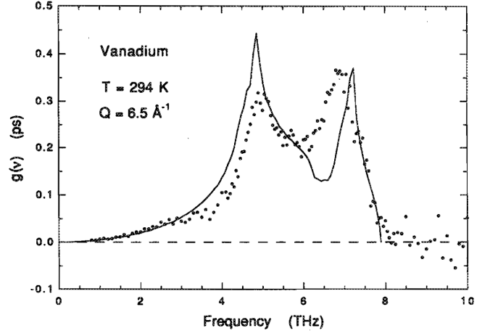
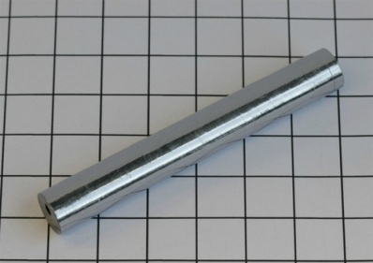
(S/B) Requirements
[not explicitly included in Sys. Req.]
In general, in a neutron vibrational spectrometer, “inelastic” (i.e. 2-500 meV) B can be divided into three main components:
  sample-independent B (si-B);
  spectrum-independent B (spi-B);
  spectrum-dependent B (spd-B).
The first, si-B, is rather trivial (empty CCR measurements etc.), while the second, spi-B, can be easily estimated using a standard, mainly elastic, sample (e.g. V slab with a 10% scattering), after correcting for the small inelastic contributions (i.e. DoPS, multiphonons, multiple scattering). For example, vanadium DoPS stretches up to 33 meV. If cold (T<<390 K) multiphonon scattering is reduced.
from Sears et al., 1995

Slide 35
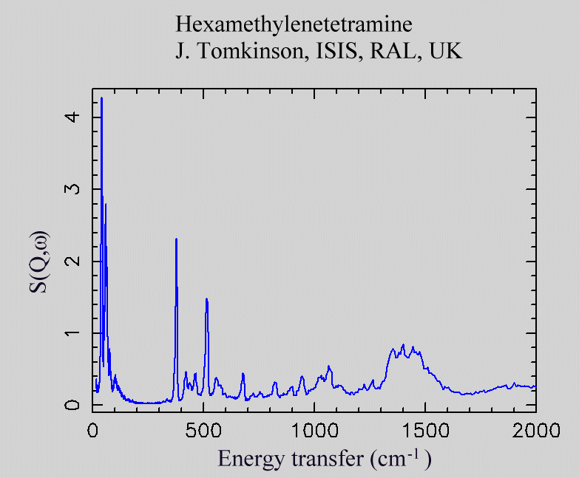
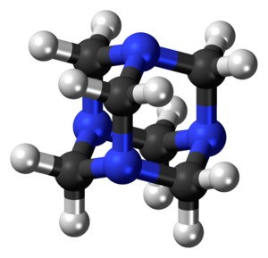
On the contrary, the last term, spd-B, is more demanding and its estimate needs a series of measurements on standard inelastic samples (e.g. HMT, C₆H₁₂N₄ at low T) of various thicknesses. After correcting for multiple scattering and self-shielding, spd-B can be finally isolated.
HMT
Presently, we have McStas simulations of HMT scattering (10% at E₀=100 meV, including single and multiple sc.) for VESPA: S, but we still do not have reliable simulations of B…
To be done via MCNP or GEANT4.

Slide 36
We are quite optimistic about the S/B magnitude since modern NVS ToF
machines (e.g. TOSCA & VISION) tend to be very “clean”:
  “On TOSCA-III with an empty CCR (so no sample in the beam), we now (i.e. with the guide installed) get about 1 count per μA h in the first 100 μs or so of the frame, and essentially zero thereafter (it is at the level of the intrinsic noise of the detectors).” (S. F. Parker, 15/9/’17)
However, an extremely conservative requirement was set for VESPA, in all conditions and in the whole spectral range 2 meV<E<500 meV:
This S/B roughly corresponds to the ratio between the scattering level of a 10% scatterer (≈4.5% inelastic) (at E₀=2×137 meV), considering 4.21 g of ZrH₂ powder, and the same sample including 10⁻³ moles of protons [Sys. Req. no. 17].
However we have the ambition to be able to detect up to 10⁻⁵ moles of protons, i.e. S/B ≈ 3000.

Slide 37
Functional requirements for the
high level VESPA components
a) Beam Transport and Conditioning System
Wavelength range (optimally transported at L₀=59.1 m from TCS): 0.4 Å-4.7 Å
Beam
Natural beam size (on sample pos.): 35×35 mm²
Natural beam divergence (h. & v., on sample pos.): <2°
Natural beam homogeneity: better than ±10%
Adjusted beam size (h. & v., on sample pos.): 35×35 mm² or less
Framing
ToF sub-frames: 8-28 ms, 29-47 ms & 48-72 ms
(non-overlapping sub-frames)
λ sub-frames: 0.4-1.7 Å, 1.7-3.1 Å & 3.1-4.7 Å
(fully overlapping sub-frames)
ToF (& λ) resolution (2 sub-mode) 0.4% (Hi-res); 1.1% (Lo-res.).
Chopper system
sub-mode switching: from remote (also possible in case in of failure).

Slide 38
Accessibility (especially FOC and s-FOC)
Beam monitoring
Diagnostic 3 points (PSC, FOC, s-FOC)
Normalization 2 points (upstream and downstream the sample)
Phase monitoring PSC
Background (already discussed).
Vacuum p<10⁻² mbar (except shutter)
Beam stop below 3 μSv/h outside the EC
Get-lost pipe inside EC

Slide 39
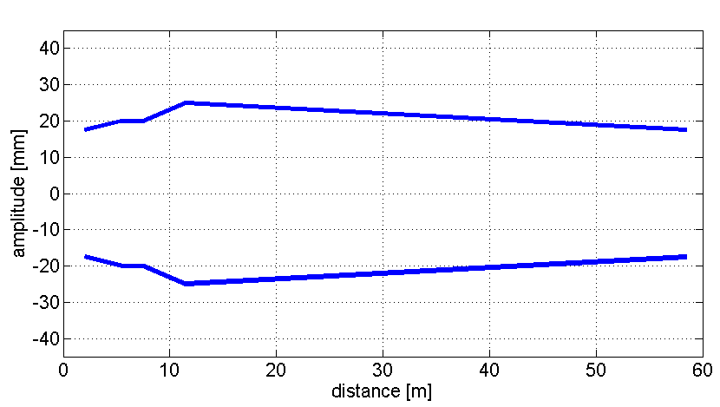
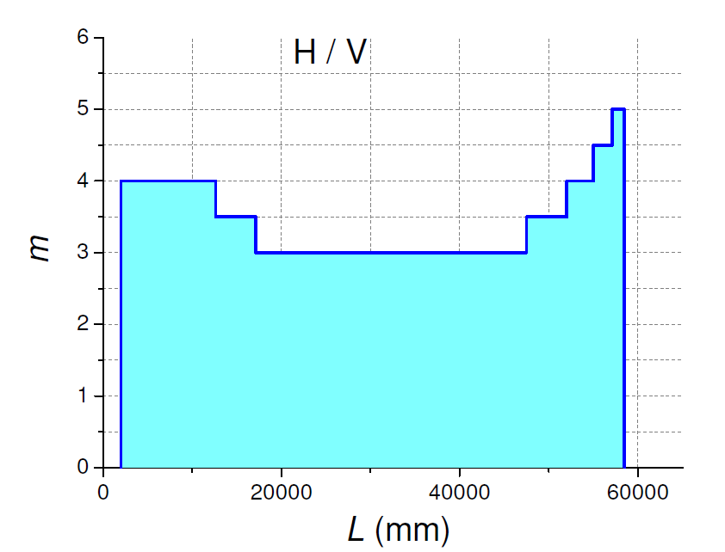
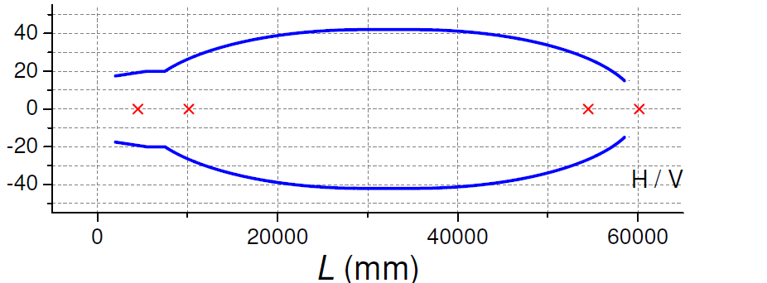
Neutron Guide [not explicitly included in Sys. Req.]
It was decided to present as the baseline a narrow straight tapered (ST) guide (all m=4, 56.5 m long, starting from 2 m after the moderator). Two elliptical solutions (E1: bi-elliptical, E2: mono-elliptical) have been investigated. E2 left as second option (more effective, but larger and so more expensive too).
ST
E1
E1 (issues T₀/heavy shutter, too large)

Slide 40
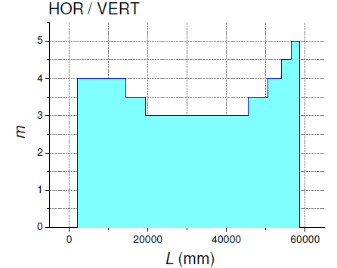
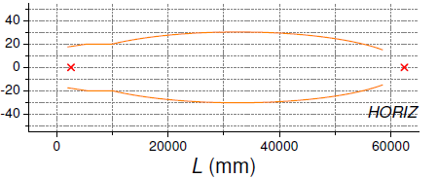
E2
E2
H / V
Flux on sample

Slide 41
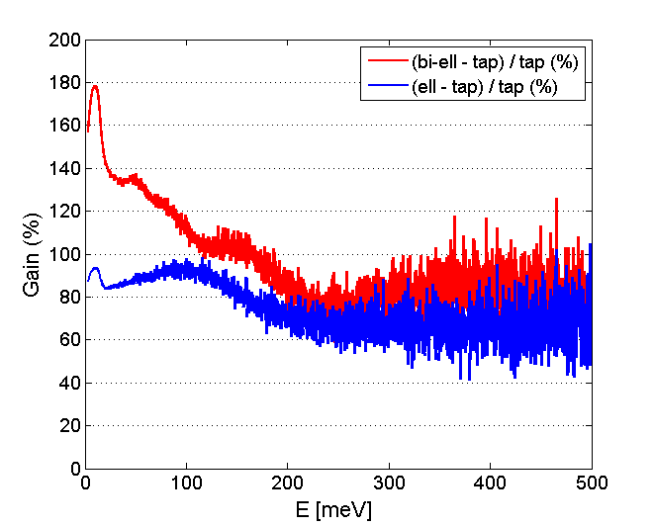
Gain elliptical vs. tapered
Fingerprint zone (60-220 meV)
(% gain factor of elliptical options over baseline)
Bi-elliptical:
90-130 % gain factor
Mono-elliptical:
70-90 % gain factor

Slide 42
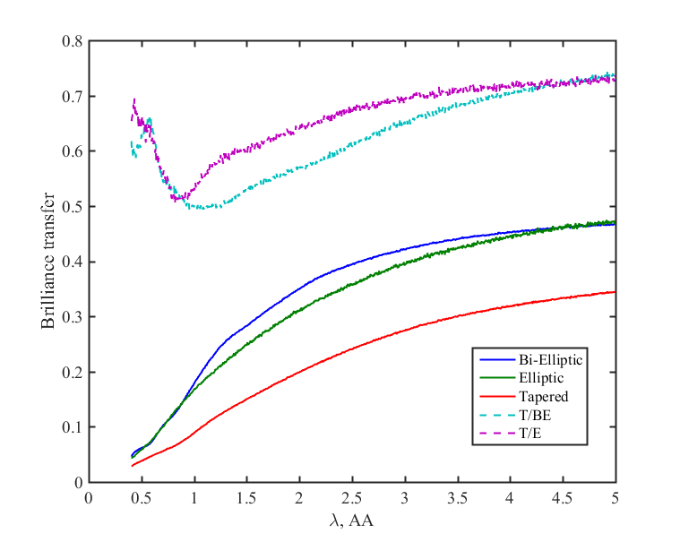
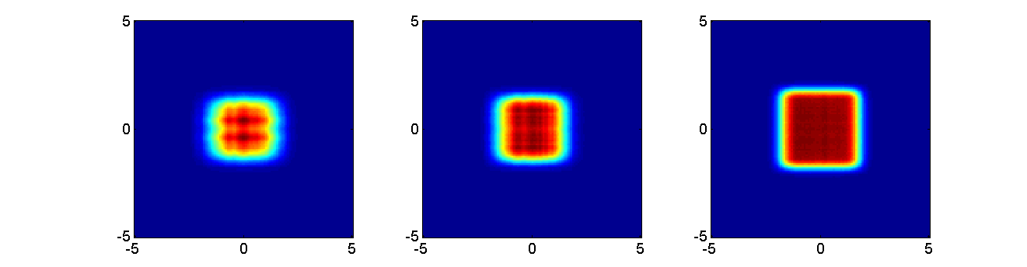
Brilliance transfer
(integration area: 30x30 mm²
divergence range: -1° to 1°)
E1: x⋅y
E2: x⋅y
ST: x⋅y
Integration domains
Beam surface: 30x30 mm²
Divergence: ±1°
35×35
30×30
30×30
Beam profile @ 59 m (baseline vs. elliptical options)

Slide 43
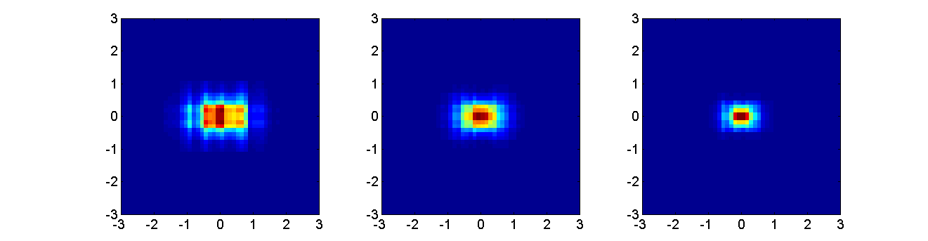
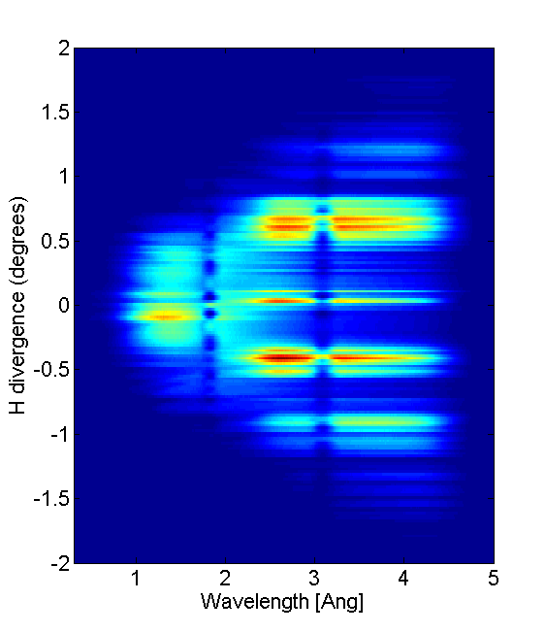
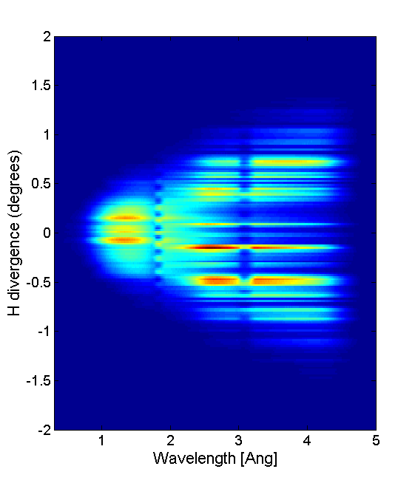
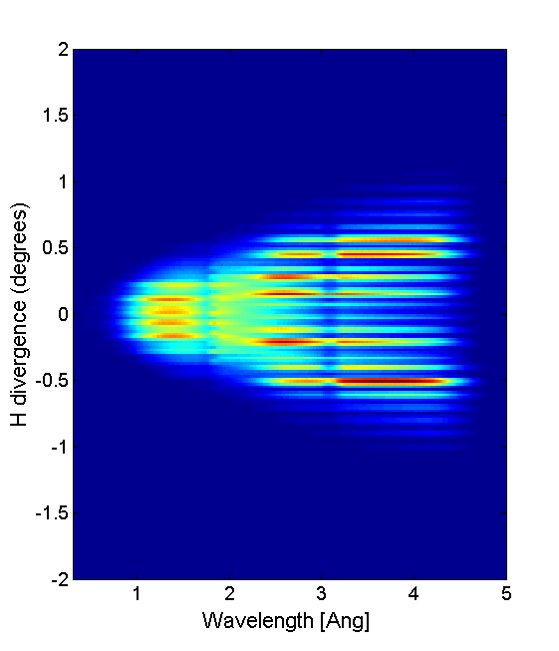
E1: δ_{h}⋅δ_{v}
E2: δ_{h}⋅δ_{v}
ST: δ_{h}⋅δ_{v}
Beam divergence @ 59 m (baseline vs. elliptical options)
E1: λ,δ_{h}
E2: λ,δ_{h}
ST: λ,δ_{h}

Slide 44
b) VESPA Sample Exposure System
Requirements
Sample: positioning accuracy (hor.) < 1 mm; (ver.) < 1 mm;
positioning precision (hor.) < 1 mm; (ver.) < 1 mm;
volume V≤500 ml;
weight M≤5 kg.
Sample Environment
equipment: diameter ∅≤1 m;
weight M≤10³ kg;
CCR, 10 K<T< 300 K;
automatic sample changer (N≥30 cells).
Sample visualization and
positioning from Control Hutch: sample “webcam”;
interface with instrument control.

Slide 45
c) VESPA Scattering Characterization System
Requirements
SPECTROSCOPIC MODE
Sample-analyzer average distance: 40.9 cm
Analyzer-detector average distance: 31.5 cm
Total solid angle: 0.66 sr (4 AFDM, 40 tubes per module)
Scattering angle range: 127.6°-144.1° (mean ≈134°)
Bragg angle range: 37.6°-54.1° (mean ≈ 44°)
Time resolution (binning): ≤5 µs
Be filters (T<77 K, cut-off λ=3.97 Å): thickness 12 cm, V_{total}=15 dm³ trans. at λ<3.6 Å ≤ 11%,
trans. at λ>4.1 Å ≥ 91%.
Analyzers: HOPG (S=1743 cm², mosaic 2°-4°)
λ₁ range 4.09-5.44 Å (mean ≈ 4.83 Å)
E₁ range 2.77-4.88 meV (mean ≈ 3.51 meV)

Slide 46
Detector Coverage: 5510 cm²
Detection Efficiency: η ≥ 80 % at λ₁=4.83 Å
Count Rate: max peak rate ≈ 2.5⋅10³ count/s/cm² (minimal req.)
max peak rate ≈ 4.0⋅10³ count/s/cm² (optimal req.)
Overall γ ray sensitivity: <10⁻⁶
Noise (no radiation on tubes): <10⁻⁴ count/s/cm²
Vacuum: p≤10⁻⁶ mbar (in order to prevent secondary scattering, probably 10⁻² is enough).
Detector capture efficiency in the 3.5 Å<λ_{f}<6.5 Å range
    A standard commercial solution
    Cylindrical ³He tubes;
    L=203.2 mm, long (i.e. 8”);
    W=7.938 mm, internal ∅ (i.e. 5/16”);
    ³He pressure (max p=20 bar): ≈ 11 bar;
    Upper limit count rate: ≈ 40-50 kHz (peak rate per tube)

Slide 47
Count Rate requirements vs. Scattering Power
Fictitious McSTAS sample: purely incoherent elastic scatterer, scattering power ~5% for 3.7 meV<E₀<5.4 meV. Low-resolution mode @ 5 MW with the straight tapered guide. Old secondary spectrometer configuration.
Backscattering (θ≈130º): 14 ideal McStas detectors (8 mm × 200 mm)
[4.00 Å<λ_{f}<4.66 Å].
Example: tube no. 17 (the most intense), λ_{f}=4.00 Å → E_{f}=5.112 meV
        Peak rate, I= 4.65×10⁴ n/s ⇒ J=2.91×10³ n/cm²/s;
            Mean rate, I= 2.78×10⁴ n/s ⇒ J=1.73×10³ n/cm²/s.
    Upper limit for ³He tube count rate: ≈ 40-50 kHz peak rate per tube.
    Just about for the elastic line, so inelastic part is surely all right!
    Why? Let us take a standard calibration sample: HMT @ T=20 K
    The maximum of the elastic line is 46.8 times larger that of the inelastic part
    (ω=5.15 meV) in a raw ToF spectrum I(θ,t) (with θ=130º & E_{f}=5 meV)!

Slide 48
NEW TESTS (13th-10-2017)!!!
Same fictitious McSample sample: purely incoherent elastic scatterer, scattering power ~5% for 3.7 meV<E₀<511.1 meV. Low-resolution mode @ 5 MW. New secondary spectrometer configuration.
Example: tube no. 6 (the most intense, θ=130º), λ_{f}=4.35 Å → E_{f}=4.3 meV, area: S=44.8 cm² (8 mm × 560 mm)
        Straight tapered g. ⇒ Peak rate, I= 3.73×10⁴ n/s ⇒ J=0.83×10³ n/cm²/s;
            Mono-elliptical g. ⇒ Peak rate, I= 5.49×10⁴ n/s ⇒ J=1.23×10³ n/cm²/s;
            Bi-elliptical g. ⇒ Peak rate, I= 7.77×10⁴ n/s ⇒ J=1.73×10³ n/cm²/s.
    Data for the elastic line, so the inelastic part will be all right!

Slide 49
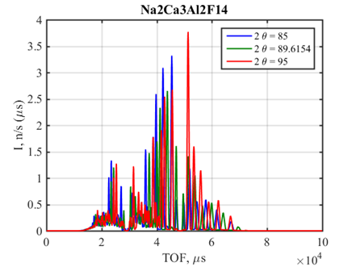
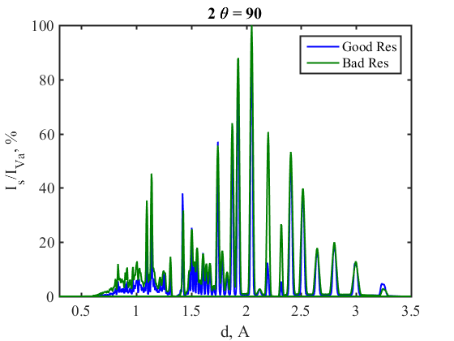
DIFFRACTION MODE
The SCS shall include 1 diffraction bank in the scattering angular range 85º-95º with 14 detector tubes ca. 10cm long, Ø 8mm (0.37 Å<d<3.36 Å at 90º, in backscattering it would be 0.26 Å<d<2.38 Å).
    The simulated sample, Na₂Ca₃Al₂F₁₄ (m=5.4 g ⇒ 0.01 moles), provided a scattering power of about 4% and a maximum peak count rate of 216 KHz (at t≈50 ms on the strongest Bragg peak, d≈2 Å), which is about 4-5 times larger than our ³He tube upper limit. Diaphragm or low-p needed.
    Na₂Ca₃Al₂F₁₄
    From ToF (μs) to d-space (Å)
    ⇒

Slide 50
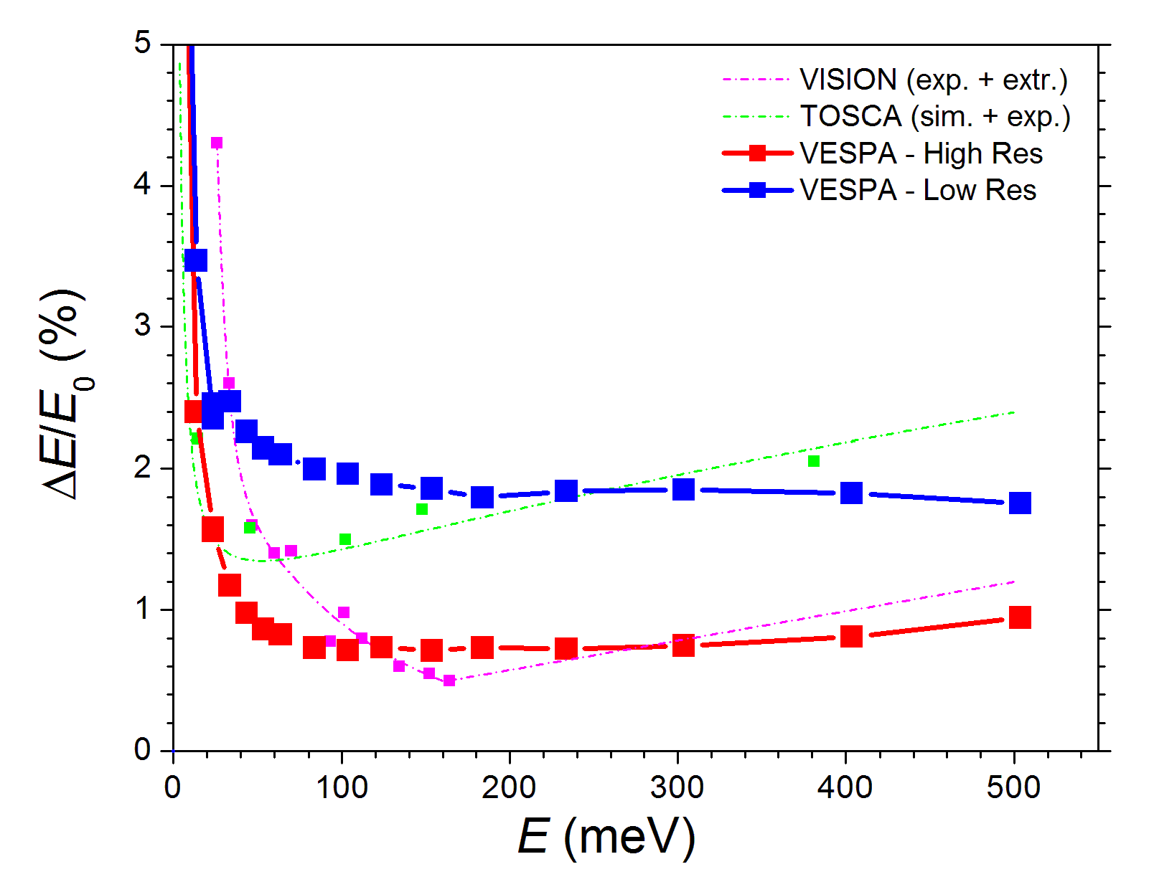
Energy transfer resolution:
a comparison with the state-of-the-art NVS
VESPA relative energy
resolution (Hi-res and Lo-res) calculated with a mosaic spread of 2 deg.: world leading up to 140 meV !

Slide 51
d) VESPA Experimental Cave, Control Hutch &
Sample Preparation Area Requirements
EC: divided in two main areas, upper EC (top-loading & SE) and lower EC (secondary spectrometer & CCR). Distinct dose levels. CCTV in both areas. Floor surface >20 m². Communicating through an opening (∅=0.9 m).
Upper part: door 1 m (w) × 2 m (t); suitable for SE devices with
∅<1.0 m and a M<1000 kg.
Lower part: beam axis between 1.2-1.6 m; removable (by crane) ceiling.
CH: monitoring the instrument, data analysis and reduction through dedicated workstations, comfortable space for 6 peoples etc.
SPA: activated and non-activated sample cabinets, sample preparation table, glove-box etc.
Plus all the other types of Requirements:
3.3 Constraint requirements (especially R.A.M.I. reqs.);
3.4 Safety requirements (especially radiation safety reqs.).

Slide 52
Questions about the VESPA
System Requirements Specification
document?

Slide 53

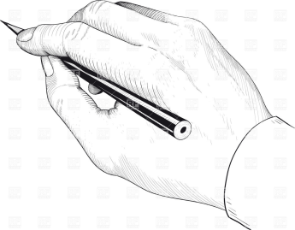
3. VESPA
“Description of the preliminary design”
documents

Slide 54
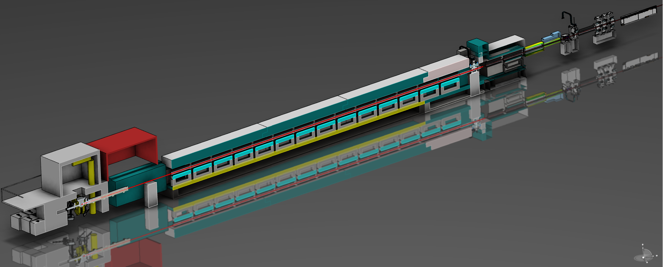
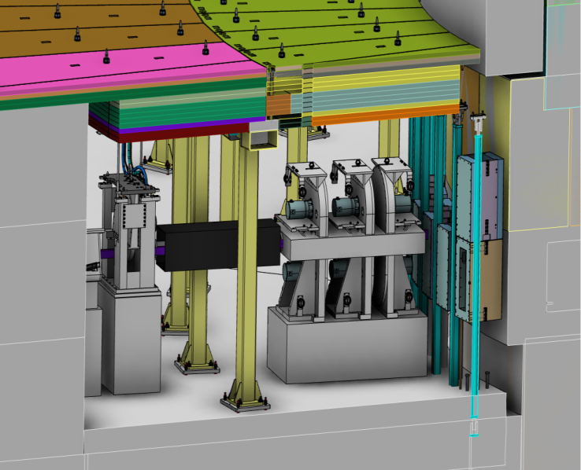
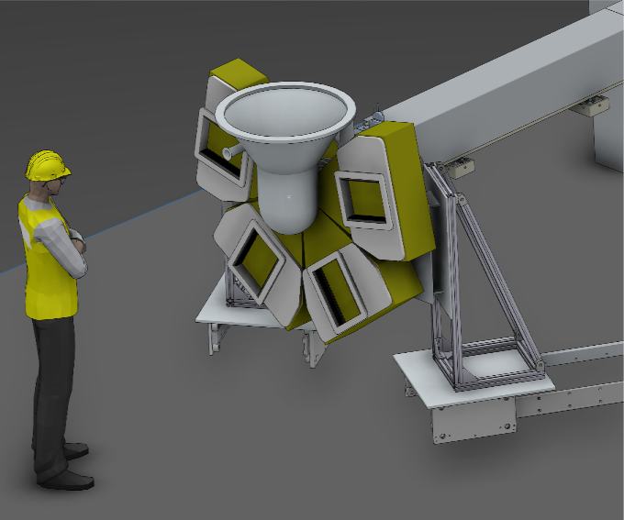
VESPA:
S-FOC @ 20 m from ISCS
A crystal-analyser inverse-geometry time-of-flight spectrometer fully devoted to Neutron Vibrational Spectroscopy (NVS)
A crystal-analyser inverse-geometry time-of-flight spectrometer fully devoted to Neutron Vibrational Spectroscopy (NVS)
Control Hutch
In-bunker Chopper system detail
Sample position: 59 m from ISCS
Bunker to cave Beamline: 40 m
Beamstop
FOC @
10m from ISCS
PSC assembly
Sample position@59 m from moderator
Analyser: 4 modules
HOPG + Be filter + CCR + He tubes
Diffraction bank:
14 x He tubes
Secondary spectrometer
Lower cave detail

Slide 55

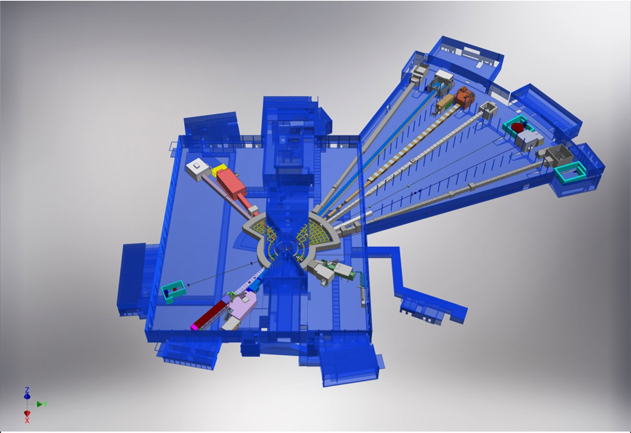











NSS Neutron Instrument
ESS Lead Partners for instrument construction
+
Nuclear Physics Institute
15 Approved Instruments
E01 (Long Hall) 8 Instruments
D01 (Short hall) 2 Instruments
D03 (Short hall) 5 instruments
NMX
BEER
+
C-SPEC
BIFROST
MIRACLES
MAGIC
ODIN
T-REX
DREAM
HEIMDAL
LoKI
VESPA
FREIA
SKADI
ESTIA
+
ESS In-Kind Partners also collaborate on technology development, sample environment, data management systems etc.
ESS Instrument Layout (December 2016)

Slide 56
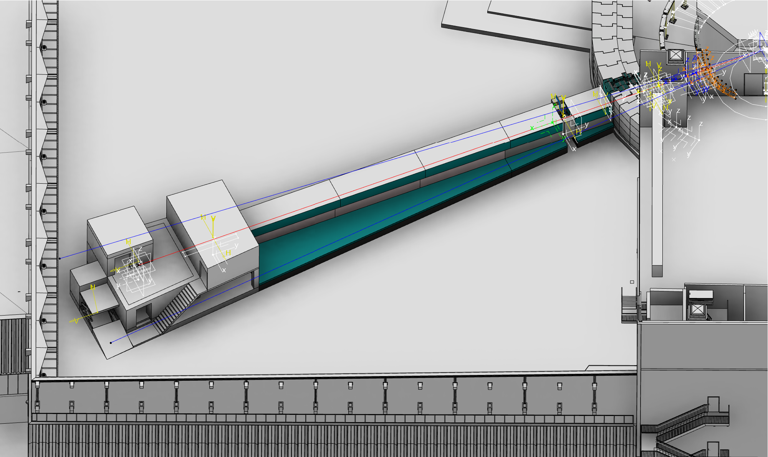
VESPA beamline overview: Hall 01, east sector Beamport E7

Slide 57
VESPA Baseline July 2017
Instrument configuration:
ISCS @ (40, -95) from TCS
Choppers
  3 x PSC double disc (@ 6.5, 6.8, 7.44 m)
  1 x FOC single disc (@10 m)
  1 x s-FOC double disc (@20 m)
Optics (BTCS)
  Tapered T2, m=4 MAX section 50x50 mm2
  Substrates: metallic (Al,Cu) 20 m, borkron 37 m
  Beam axis: 2137 mm from hall floor
  “outside vacuum” flight tubes
  2 set of jaws (@~58.5 m and ~58.8 m)
Analyser
  4 modules, backscattering, 4x0.15sr modules (TBC)
  1 module AFDM: vacuum box, 1xHOPG, 1xBe Filter, 1xCCR, ~40He tubes
Diffraction bank, ~100x200 mm2, 85-95 deg
Sample environment: cryostat, sample changer, sample stack (vertical and rotation axis)
57

Slide 58
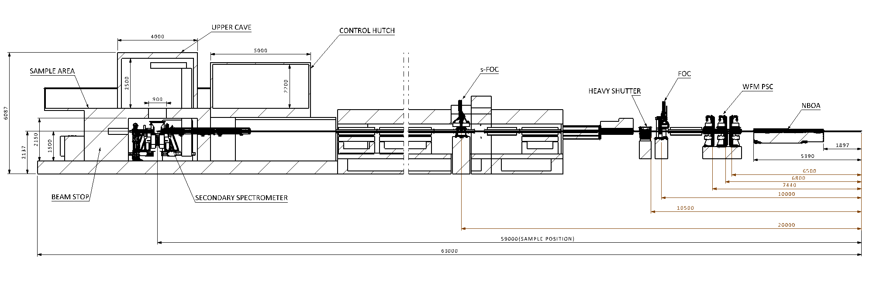
VESPA Baseline July 2017
Beam direction

Slide 59
VESPA Instrument ZONE-BREAKDOWN
3. Experimental hall
4. Neutron detection
1.
Monolith
2. Bunker
Bunker to Cave Shielding
Steel
Concrete
Cavities Backgroundshielding
Insert Vessel
Remote handl. Tools
Shims and packing
Streaming shielding
Insert Cooling system
Windows
Gamma shutter insert
Bunker shielding
Heavy shutter
Component supp struct
Remote handling tools
Detectors
Monitors
Backend electronics
Exp. Cave
Cave struct
Beamstop
Sample area
Detector vessel assy
7. Services
5.Beamline components
6. Choppers
Hutch
Racks
Electrical cabling
Mechanical services
PSS
Computing
Access
Elevator to smpl prep area
Crane
Vacuum services
Sample prep area
Blockhouse services
Logistics
Prebuild
Discs assy
CHIM
CNTRL sys
Support sys
Guide system
guides
housing
support
Cavities shield
XY slits
59

Slide 60
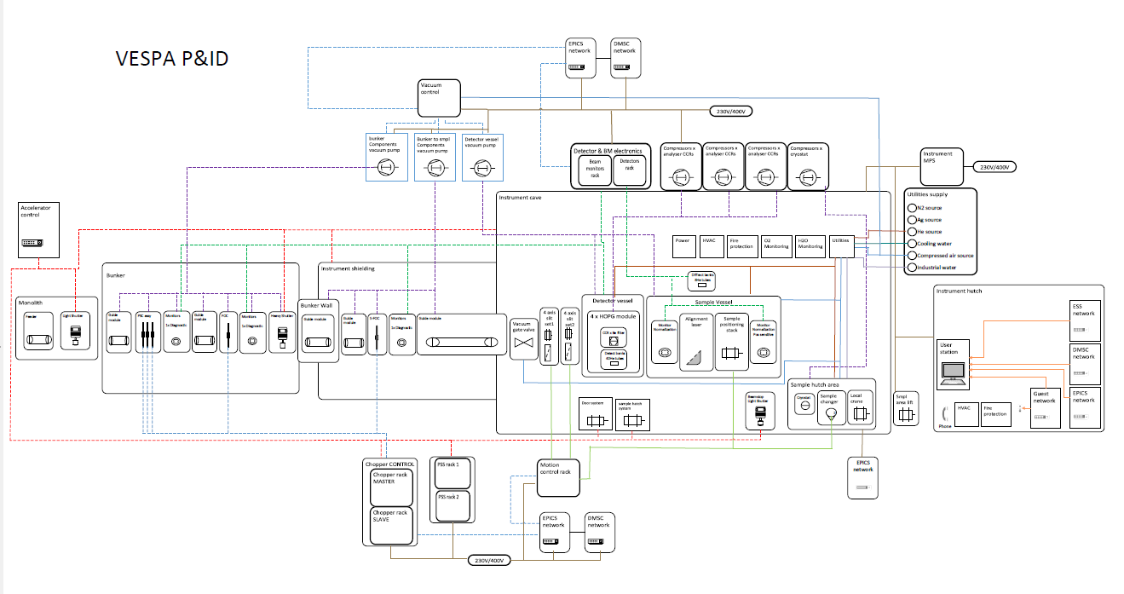
VESPA P & ID
A higher resolution picture is available in INDICO
60

Slide 61
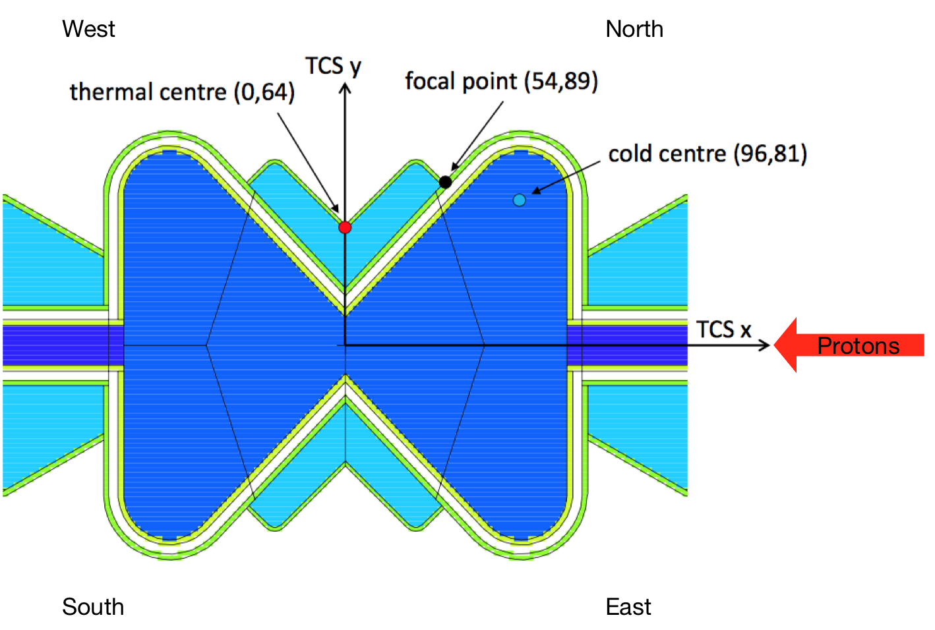
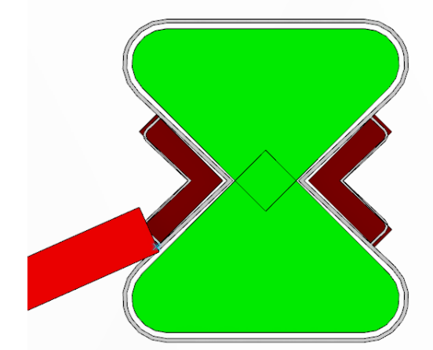
Target and moderators
Monolith insert focuses on the BPCS
VESPA Beam centre focuses on the ISCS
Bunker wall feedthrough blocks focus on the TCS
FP (54,-89)
VESPA
ISCS (40,-95)

Slide 62


VESPA Moderator to bunker wall:
NBOA, optics, chopper system, remote handling
Lorenzo Di Fresco, VESPA lead engineer
Notes:
The picture shows a sketch of the beamline located in the sector East, beamport 7 of the ESS faCILITY and a detail of the secondary spectrometer with 4 banks of HOPG anlyzer
Each bank made of an HOPG crystal, a Be filter conditioned by a CCR and a detector with He tube technology

Slide 63
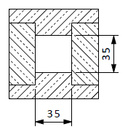
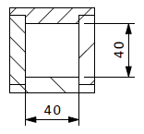
VESPA NBOA
All sides tapered
M=4
Cross section @ 1937 mm (ISCS): 35x35 mm2
Cross section @ 5392 mm (ISCS): 40x40 mm2
Cross section @ 1937 mm
Cross section @ 5392 mm

Slide 64
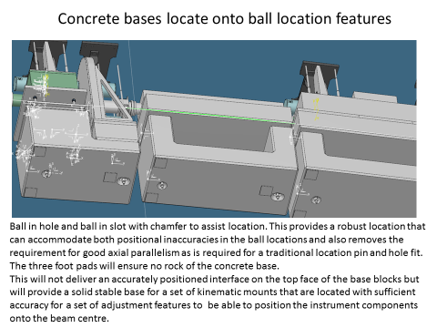


Guide system LOKI-like
VESPA Beam axis: 2137 mm from hall floor
64

Slide 65

VESPA In-Bunker components
WFM-PSC chopper assembly
WFM-PSC support frame fixed to the bunker floor baseplate
Mirrored guide section (7.8-9.7 m from ISCS)
FOC single disc assembly
Heavy shutter
Collar
6
65

Slide 66

VESPA In-Bunker components handling strategy
OPTION 1
“Guide section pivoting”
66

Slide 67

VESPA In-Bunker components handling strategy
OPTION 2
“Guide section lowering”
67

Slide 68


VESPA In-Bunker components: WFM-PSC assembly
Neutron beam

Slide 69



VESPA In-Bunker components: WFM-PSC assembly
WFM-PSC assembly
- unique block
- remote handling features
- Kinematics mounts for precision positioning
- Weight < 2000 kg
- Integrated optics section
Chopper Integration Module (CHIM):
- fixed to the bunker floor
- remote handling features
- Kinematics mounts for precision positioning

Slide 70


VESPA In-Bunker components: FOC and Heavy shutter
Heavy Shutter composition(TBC)
50% epoxy+50% B₄C /20cm/
Standard steel /40cm/
50% epoxy+50% B₄C /20cm/
Standard steel /20cm/
Tungsten/paraffin /20cm/
TOTAL thickness 1.2 m
FOC ESS pillar variant CHIM
70

Slide 71
Heavy shutter: Technical results of the requirements
The shutter has to be in the bunker wall or inside the bunker, next to the bunker wall with minimum gap
The shutter block should be made of maximum two pieces
Because of our bunker and building design, if the shutter is in the wall then it has to be a Rotary shutter with horizontal axis in beam direction.
Some kind of indicator about shutter position or radiation level is necessary (can be the PSS monitor)
The shutter control mechanism requires a veto interlock from the PSS
Shutter composition
Based on the shutter analysis from Uwe Filges the preliminary composition of the shutter block in case of MAGIC and ODIN is the following (long sector direct beam in the bunker-wall and inside the bunker):
50% epoxy+50% B₄C /20cm/
Standard steel /40cm/
50% epoxy+50% B₄C /20cm/
Standard steel /20cm/
Tungsten/paraffin (density 11.8 g/cm³) /20cm/
The radiation is 10µSv/h after the shutter. We are going to use similar composition for similar beam-lines.
According to NSS experts, the used source-term was too soft.
A different suggestion for the attenuator:
Pb/5cm/+HDPE/5cm/+B4C/5mm/+Copper/60cm/+Pb/2cm/
(The thicknesses are not supported by calculations, it is only starting point for the real analysis)
TOTAL thickness: 1.2 m
TOTAL thickness: <1 m

Slide 72



ESS – VESPA guide through bunker wall
For geometric details of the insert see “ESS-0094042.3”
Substrate: copper
Vanes: silicon 0.5mm thick
Reflectivity: m=4 on all surfaces exposed to the beam

Slide 73

ESS – VESPA guide through bunker wall
Copper substrate with close fitting steel shielding that provides vacuum containment
Support pillars
Adjustment and support

Slide 74
VESPA Bunker wall to Cave:
Beamline shielding
Lorenzo Di Fresco, VESPA lead engineer
Notes:
The picture shows a sketch of the beamline located in the sector East, beamport 7 of the ESS faCILITY and a detail of the secondary spectrometer with 4 banks of HOPG anlyzer
Each bank made of an HOPG crystal, a Be filter conditioned by a CCR and a detector with He tube technology

Slide 75



“ZOOM”-like cavities background shielding
VESPA hall components: beamline shielding concept
15 m from TCS
55 m from TCS
ZOOM cavity
Bunker wall
Cavity 1
(21-25 m TCS)
Cavity 2
(51-55 m TCS)
Cavity 3
?
Spectrometer cave
FOC
GAP 200 mm
GAP 200 mm
S-FOC
@20 m
CROSS SECTION
~15cm
~15cm
Cavity length
wall | 500
gap | 20
Steel | 50 | x 40
gap | 20
 | 2800
W disk | 50
gap | 20
wall | 500
TOTAL [m] | 3.8
?
~25cm
Cavity cost ~ 35 k€

Slide 76
VESPA hall components: beamline shielding concept
~55 m from TCS
~21 m from TCS
Bunker wall
Cave
~3.0 m
Chopper pit shielding
~2.5 m
Beamline (from 21 to 55 m)
1000 mm
Raise floor/concrete ~1137 mm
Hall floor
Table 1: Indicative shielding specifications to absorb high energy dose from spallation process, as a function of distance from the source, for a straight beamline.
Table 2: Shielding starting specifications to reduce gamma dose from supermirror neutron capture, for various supermirror m values.

Slide 77

VESPA hall components: beamline shielding concept
MCNP simulation for cave shielding:
n + γ
(no thermal neutrons from guide!)
WORST CASE SCENARIO:
-chopper open
-jaws open
-sample: steel cylinder (r= 5cm, h-10cm)
BEAMSTOP/GET-LOST-PIPE is currently being
Simulated.

Slide 78


Front end space utilization
Chopper pit
The WFM PSC assembly
Beamline optics
Beamline optics support and align sys
Raised floor
CF floor level
Beamline shielding
E7 axis
Bunker wall
E8 axis
E8 wedge

Slide 79
VESPA hall components: beamline shielding concept
2500 mm
~3200 mm
Concrete: 400 mm
Concrete: 400 mm
Steel: 500 mm
Air gap
Steel: 500 mm
CHIM
Air gap 200mm
Air gap
Ø~700 mm
2500 mm
Guide housing
Concrete 400 mm
~3000 mm
3600 mm
Steel: 500 mm
~1900 mm
~1000 mm
2137 mm
Raise floor/concrete ~1137 mm
Raise floor/concrete ~1137 mm
FOC @ 20 m - Front view
Beamline shielding - front view

Slide 80



Concept for Elevation (floor to beam= 2137 mm)
15-18.5m from TCS
19.5-25m from TCS
ESS elevation blocks concept

Slide 81




Raise floor
VESPA shielding opt 1
 | Area | length | volume | weigth
 | [m2] | [m] | [m3] | [t]
Wedge 1 |  | 3.50 | 6.70 | 33.50
ROOF | 2.17 | 3.50 | 7.58 | 37.89
WALLS | 2.46 | 3.50 | 8.59 | 42.96
footprint | 9.2
avg load | 12.43 | [t/m2]
Wedge 2 |  | 5.50 | 12.50 | 62.50
ROOF | 2.17 | 5.50 | 11.91 | 59.54
WALLS | 2.46 | 5.50 | 13.50 | 67.51
footprint | 19.2
avg load | 9.87 | [t/m2]
Wedge 3 |  | 30.00 | 35.00 | 175.00
ROOF | 2.17 | 30.00 | 64.95 | 324.75
WALLS | 2.46 | 30.00 | 73.65 | 368.25
footprint | 102
avg load | 8.51 | [t/m2]
15-18.5m from TCS
1
2
19.5-25m from TCS
3
TOTAL VOLUME: ~239 m3
Back end
25-55 m from TCS

Slide 82

“ZOOM”-like cavities
Reduce background: collars and cavities
In bunker collars
Cavity length
wall | 500
gap | 20
Steel | 50 | x 40
gap | 20
 | 2800
W disk | 50
gap | 20
wall | 500
TOTAL [m] | 3.8
Cavity cost ~ 35 k€
ZOOM cavity

Slide 83





VESPA triangular shielding option
Complex design, but low background
about 8 triangles, angle ~6° (bunker) to ~12° (hutch)
Walls: lead/steel/concrete
~ 5/10/20 cm

Slide 84
Vespa spectrometer and sample environment concepts
Lorenzo Di Fresco, VESPA lead engineer
Notes:
The picture shows a sketch of the beamline located in the sector East, beamport 7 of the ESS faCILITY and a detail of the secondary spectrometer with 4 banks of HOPG anlyzer
Each bank made of an HOPG crystal, a Be filter conditioned by a CCR and a detector with He tube technology

Slide 85

Vespa Spectrometer and Sample Environment Concept
Notes:
General view – location E7 in D01

Slide 86

Vespa spectrometer and sample environment concepts
distance: 2.76 m
Notes:
Space behind the instrument
‘Upper’ and ‘lower’ caves
Note position of control hutch over front end shielding – assuming future requirement to adjust guide

Slide 87

Vespa spectrometer and sample environment concepts
Notes:
3Deg and 6Deg sector – Where did we get this from???

Slide 88

Vespa spectrometer and sample environment concepts
Notes:
General view
Mention working in Solid Edge
Space available behind and either side of the beamstop for compressors or racks, and side of front end shielding for other racks – motion control and chopper racks
Routes into upper and lower caves for electrical and mechanical services yet to be worked out
Sample preparation area over beamstop is 3.5m x 5m

Slide 89

Vespa spectrometer and sample environment concepts
Cave wall shown 0.65m thick – just a guess, needs neutronics
Notes:
Plenty of scope to thicken walls either inside or outside

Slide 90


Vespa spectrometer and sample environment concepts
Minimum coverage of 0.66 steradians in back-scattering array
Detector array – 8mm He3 tubes
Detector array
Vacuum tank
680
Analyser
Be filter
Vacuum side of detector array
Sample point
CCR – to cool filter
Scattered neutron path
Notes:
3 different lengths – means ESS having to keep spares of 3 different lengths

Slide 91

Vespa spectrometer and sample environment concepts

Slide 92

Vespa spectrometer and sample environment concepts
Envelope for closed-cycle refrigerator
Notes:
NOTE – we are only making forward scattering bank for this phase of Vespa

Slide 93



Vespa spectrometer and sample environment concepts

Slide 94

Vespa spectrometer and sample environment concepts
jaws
Notes:
Highlight Jaws – 650 and 2000 from sample, beam monitors, diffraction banks

Slide 95




Vespa spectrometer and sample environment concepts
Notes:
Highlight maintenance of ADFM module – compare to Tosca with it’s 2 days of disassembly alone

Slide 96
VESPA: Sample environment ‘philosophy’
Cryostat is the “heart” of the SE for VESPA.
Temperature range: 5-300K ++
Large cooling power
  for large metal sample holders, e.g. pressure cells,…
  keep the cold head at ambient while heating the sample to temperatures <=600 K (battery research, geological, catalysis)
Large diameter for sample compartment (>=15 cm ?)
  More room to fit special cells (e.g. gas flowing, electrical, photo,…)
Possibility to reproducibly align sample
  motor for aligning sample stick -rotation and perpendicular to beam)
Electric insulation from rest of instrument
  experimental setup needs to be well insulated from instrument (including inductive interference), proper grounding needed

Slide 97




Sample sticks /sample cells
Conventional stick (temperature adjustable)
With gas-lines (flow of gases)
With optical probe (Raman, photochemistry)
With electrical connections (Impedance, electrolytes)
For the HP gas cell
For the DAC cell
Customization according to research interest of user community at time of commissioning

Slide 98

VESPA Sample changer (SC)
Requirements:
  Needs to work with the VESPA CCR (no change-over!)
  < 1 hr for installing it
  Should contain at least 30 samples, preferably 50 (needs to have enough space to run for a weekend: 1 hr/sample including cooling time)
  Waiting samples should be pre-cooled, preferably to 70K or lower
  Camera/scanner to scan the sample that goes into beam for tracking
TOSCA SC:
  30 Samples at 10-300K, not reloadable while running
  VISION SC:
  50 samples at 10-300K, reloadable
TOSCA SC
Best
of
both

Slide 99
VESPA Upper cave layout planning
2m
2m
Gas manifold
Sample stick rack
with lead cylinders
sample cool-down
Gas cylinders
1m
He compressor for SE (1m x 1m)
cryostat
3m
Rack for controls (1m x
0.8 m)
Vacuum pump stands
Oxygen monitor
5m

Slide 100
Questions about the VESPA
“Description of the preliminary design”
documents?

Slide 101

5. VESPA
“WBS, Project Costing and Planning”
documents

Slide 102
Introduction
Project Documents and Governance
Project Structure
Project Scope
Project schedule
Risks
Responses to TG2 reviews

Slide 103
Project structure
Vespa Project Board
ESS
CNR
INFN
ISIS
Project Sponsor
Giuseppe Gorini
Project Manager
Roberto Senesi
Integration Engineer
Clara Lopez
Vespa
Lead Engineer
Mo Chowdhury/
Lorenzo Di Fresco
Lead Scientist
Daniele Colognesi
Pan Instrument
Detectors Davide Raspino
Choppers Peter Galsworthy
Installation John Crawford/David Maxwell
Motion Control Nick Webb
Electrical Graeme Johnson
Technical Advisory board
Instrument Advisory Committees

Slide 104

Project governance: a VESPA Project Board has been appointed and started its activity on September 2017
Chair CNR-DSFTM Director (C. Spinella)
• CNR-Sentieri Rep (C. Vasi)
• CNR Sentieri Science Committee Rep (C. Andreani)
• CNR-ESS ICB rep (A. Triolo)
• CNR-DSFTM Fin. Manager &Board Sec. (A. Tajani)
VESPA Sponsor (Giuseppe Gorini)
Representatives
STFC - Sean Langridge
• ESS - Shane Kennedy
• INFN - Eugenio Nappi
• User - Fabio Bruni
Approve
- the Project Specification and monitor compliance.
- all changes to the Project Specification (above an agreed threshold level).
the Project Schedule and monitor progress.
the Cost Plan and monitor expenditure.
bids to the contingency funds controlled by Project Board.
bids for contingency funds controlled by the CNR-ESS Management
•Monitor compliance with Procurement Strategy.
•Sign off the Project on completion on behalf of CNR.
•Ensure the Project complies with NSS project management requirements (including change control)

Slide 105
Team Structure
Project Manager Roberto Senesi/K Jones
Project Office CNR/ISIS
Lead Scientist Daniele Colognesi
Lead Engineer Mo Chowdhury/L Di Fresco
Cross Functional Teams
Detectors Davide Raspino
Choppers Peter Galsworthy
Electrical Antonio De Bonis
Operations John Crawford/Dave Maxwell
CAD Nick Moloney
ESS Integration Clara Lopez
Mechanical Design Engineer Federico Masi
Design Engineer Claudio Bovo
Design Engineer ISIS
Motion Control Nick Webb
Junior Instrument Scientist M Zanetti
S Parker (ISIS)
S Bellissima
L Del Rosso
L Ulivi
U Bafile
M Celli
F Grazzi
M Hartl (ESS)

Slide 106
Team Structure
Why in collaboration with ISIS?
1) CNR-ISIS agreement on science and collaboration on design and construction of 7 instruments since 1985
2) TOSCA designed and built within the CNR-STFC agreement
3) TOSCA is the world reference vibrational spectroscopy instrument : day-by day contact with one of the world leaders
4) Possibility of testing of components with real data: pulsed neutrons up to 500 meV (backgrounds, detectors, analysers, etc..)
5) Prebuild in a dedicated facility at RAL

Slide 107
Project Costing
 | Cost Book Value (M€) | Project Estimate | Estimate to Complete
Equipment |  | 8.803 | 8.803
Travel |  | 0.195 | 0.195
Labour |  | 1.685 | 1.685
Contingency | 10% | 20% (2.136) | 20% (2.136)
Total | 12.0 | 12.819 | 12.819

Slide 108


Schedule

Slide 109
Risks to Schedule
Risk | Probability | Impact | Severity | Mitigation
Neutronic calculation effort from ESS/ISIS is not available | 2 | 5 | 10 | Look for additional effort
Infrastructure not yet ready | 2 | 4 | 8 | Don’t install until ESS are ready
ESS providing required information in line with needs of the project | 2 | 3 | 6 | Ensuring ESS have clear milestones for project in their plan
Problems found during prebuilds effect ability to hit installation slots at ESS | 2 | 3 | 6 | Ensure there is schedule contingency built into the prebuilds
Delay in delivery of components | 2 | 3 | 6 | Reorder installation of components, early start of procurement
Working in CATIA is difficult and time consuming | 4 | 3 | 12 | Work in Solid edge and convert Data
Increase of personnel costs due to longer project runtime /delays | 4 | 3 | 12 | Balance value/performance

Slide 110
Risks Schedule proposed changes
Risk 1: insert “not” after “ESS/ISIS”
Risk 2: “Don’t install” is not a mitigation, but the result of the risk eventuating this is an issue to escalate, as mitigation a ready communication to re-plan the schedule promptly can reduce the delay?
Risk 4: insert “schedule” before “contingency”
Risk 5: the impact of3 seems too low
Risk 7: why is the probability rated so high? Also “Balance value/performance” is not a mitigation, but the result of the risk eventuating agreed and propose an impact 2, we can’t find a mitigation for this
 | Risk | Probability | Impact | Severity | Mitigation
1 | Neutronic calculation effort from ESS/ISIS is not available | 2 | 5 | 10 | Look for additional effort
2 | Infrastructure not yet ready | 2 | 4 | 8 | ESS prompt communication on infrastructure works and changes
3 | ESS not providing required information in line with needs of the project | 2 | 3 | 6 | Ensuring ESS have clear milestones for project in their plan
4 | Problems found during prebuilds effect ability to hit installation slots at ESS | 2 | 3 | 6 | Ensure there is schedule contingency built into the prebuilds
5 | Delay in delivery of components | 2 | 3 | 6 | Reorder installation of components, early start of procurement
6 | Working in CATIA is difficult and time consuming | 4 | 3 | 12 | Work in Solid edge and convert Data
7 | Increase of personnel costs due to longer project runtime /delays | 4 | 2 | 8 | Balance value/performance
Notes:
We should Pull out that the Multiple chopper builds gives us a potential resource problem.

Slide 111
Risks Cost
Risk | Probability | Impact | Severity | Mitigation
Detector costs exceed budget | 2 | 4 | 8 | Reduce active area
Shielding costs exceed budget | 1 | 4 | 4 | Initial shielding requirements will be lower, use early operations budget to improve shielding
ESS not providing required information in line with needs of the project | 2 | 3 | 6 | Ensuring ESS have clear milestones for project in their plan
General cost underestimate | 2 | 4 | 8 | Balance value/performance
Final Bunker solution requires beamline design to be reworked | 2 | 4 | 8 | Close engagement with bunker project
Cost of Beryllium analysers exceeding expectation | 2 | 4 | 8 | Use existing costs allow suitable contingency
Cost of detector increases due to coverage | 2 | 4 | 8 | Reduce day one coverage

Slide 112
Risk on Cost proposed changes
Risk 1: “Reduce active area” is not a mitigation, but the result of the risk eventuating. Staging the coverage thanks to a modular design of the detectors assembly
Risk 2: the probability of 1 seems too low we think is good because we expect reduction of thickness after neutronics calc
Risk 3: insert “not” after “ESS”.
Risk 4: “Balance value/performance” is not a mitigation, but the result of the risk eventuating agreed we propose as mitigation Estimates based on similar project completed
Risk 6: I do not understand the stated mitigationsimilar to risk 4
Risk 7: I do not understand the stated risk description. Also “Reduce day one coverage” is not a mitigation, but the result of the risk eventuating Risk 7 is included in risk 1
 | Risk | Probability | Impact | Severity | Mitigation
1 | Detector costs exceed budget | 2 | 4 | 8 | Staging coverage
2 | Shielding costs exceed budget | 1 | 4 | 4 | Initial shielding requirements will be lower, use early operations budget to improve shielding
3 | ESS not providing required information in line with needs of the project | 2 | 3 | 6 | Ensuring ESS have clear milestones for project in their plan
4 | General cost underestimate | 2 | 4 | 8 | Estimates based on similar project completed
5 | Final Bunker solution requires beamline design to be reworked | 2 | 4 | 8 | Close engagement with bunker project
6 | Cost of Beryllium analysers exceeding expectation | 2 | 4 | 8 | Estimates based on OSIRIS (year ~2011)
7 | Cost of detector increases due to coverage | 2 | 4 | 8 | Staging coverage
Notes:
We should Pull out that the Multiple chopper builds gives us a potential resource problem.

Slide 113
Risks Technical
Risk | Probability | Impact | Severity | Mitigation
Chopper geometry in the bunker area is tight and designing maintainable choppers is difficult | 2 | 5 | 5 | Design work has been started and a solution looks possible early testing is required to ensure suitability
Unable to design Beamline around the floor loading | 3 ? | 5 | 15 | Initial design may be possible through spreading load but this will encroach on neighbouring instruments and effect the ability to put additional shielding if required after survey
Neutronic calculation effort from ESS/ISIS is not available | 1 | 4 | 4 | Look for additional sources from both CNR and ISIS
Chopper delivery failure due to multiple beamline builds | 3 | 5 | 15 | Staging and recruitment
Insufficient Shielding | 2 | 3 | 6 | Early Neutronics Leave space around the beamline where possible to add additional shielding
Neutron Optics not meeting specification | 1 | 3 | 3 | Improve adjustment, accept reduction in performance
Final Bunker arrangement does not deliver workable instrument solution | 2 | 5 | 10 | close engagement with bunker project
Suitable Monitor technology | 2 | 3 | 6 | Monitor efficiencies are a potential problem here but in reality and the experience on ISIS the ability to really understand this before testing on the final ESS beam is low and therefore after ISIS leave the project therefore a plan needs to be put in place for what happens in this scenario
Notes:
We should Pull out that the Multiple chopper builds gives us a potential resource problem.

Slide 114
Risks Technical proposed changes
Technical risks:
Risk 1: the impact of 5 is unreasonably high 5 is ok can happen during operation more than once every 5 year, the maintenability doesn’t affect performance but operability
Risk 2: the probability of 3 seems unreasonably high
Risk 3: insert “not” after “ESS/ISIS”
Risks 3 & 4 are not really technical risks, but mainly impact on the schedule. Agreed, but also poor neutronics calc. can affect performance
Risk 6: “Accept reduction in performance” is not a mitigation, but the result of the risk eventuating. Proposed mitigation is provide enough neutronics effort for accurate calculations on all relevant aspects
 | Risk | Probability | Impact | Severity | Mitigation
1 | Chopper geometry in the bunker area is tight and designing maintainable choppers is difficult | 5 | 2 | 4 | Design work has been started and a solution looks possible early testing is required to ensure suitability
2 | Unable to design Beamline around the floor loading | 2 | 5 | 10 | Initial design may be possible through spreading load but this will encroach on neighbouring instruments and effect the ability to put additional shielding if required after survey
3 | Neutronic calculation effort from ESS/ISIS is not available | 1 | 4 | 4 | Look for additional sources from both CNR and ISIS
5 | Insufficient Shielding | 2 | 3 | 6 | Early Neutronics Leave space around the beamline where possible to add additional shielding
6 | Neutron Optics not meeting specification | 1 | 3 | 3 | Improve adjustment, provide enough neutronics effort for accurate calculations on all relevant aspects
7 | Final Bunker arrangement does not deliver workable instrument solution | 2 | 5 | 10 | close engagement with bunker project
8 | Suitable Monitor technology | 2 | 3 | 6 | Monitor efficiencies are a potential problem here but in reality and the experience on ISIS the ability to really understand this before testing on the final ESS beam is low and therefore after ISIS leave the project therefore a plan needs to be put in place for what happens in this scenario
Notes:
We should Pull out that the Multiple chopper builds gives us a potential resource problem.

Slide 115
Schedule:Prebuild-rebuild and transfer of ownership
The planning is along the lines of the scheme adopted for LOKI, FREIA, and those adopted successfully for ISIS TS2 instruments
Estimated 1 year of rebuild time assuming full availability and free access to all parts
Contract installation to a rebuild company (as done at ISIS-TS2)- contract labour already in the budget
Assuming ESS integration engineer to be available FTE during the rebuild
Assuming adequate resources from ESS NSS core engineering support team for co-ordination of on-site assembly-installation
VESPA team available (not seconded) to follow specific aspects of rebuild:
CNR lead engineer, ISIS lead engineer, VESPA leads and junior scientists, VESPA cross functional team engineers and technicians (CNR and ISIS)
Transfer completed at TG5

Slide 116

Schedule:Early procurement
ESS-0136894_ISIS-ESS Vespa-PD-0006 Early Procurement _Vespa_V1.2
The document is intended to optimise the work flow in views of full TG3
Dates on the early procurement review table will be identified in groups of max 2-3 items at the time, to conduct mini reviews and match with procurement schedules of empowered entity (INFN for CNR/or ISIS)
Request to ESS: please provide estimates to conduct mini-reviews once documentation has been received

Slide 117
TG2 review of PM documents
Budget: the costing of 12.0 M€ includes the minimum 10% contingency recommended by ESS. The VESPA project IK partner has indicated an additional 10% contingency to total 12.8 M€
WP: assignment of deliverables and values to each partner. Will be carried out with the philosophy of maximizing CNR contribution.
Work package specification document: corrections to the text will be carried out

Slide 118
TG2 review of PM documents
Work package specification document: Section 5.1 Is the green line entitled “ESS staff, installation, prebuild, shipping” at a cost of 967 k€ part of the instrument budget: YES
Work package specification document, Technical Risks: previous slides present updates in response to the review. Relevant documents will be updated post TG2

Slide 119
TG2 review of Project Planning documents
Work package specification document, milestone plan- ESS milestones: dates suggested by reviewers will be updated
Work package specification document, progress milestones for TA: relevant documents will be updated post TG2
Work package specification document, budget- see previous reply
Work package specification document, risks- update reduction of red risks, see previous slides.

Slide 120
Questions about the VESPA
“WBS, Project Costing and Planning”
document?

Slide 121
END OF THE PRESENTATION
Thank you for your kind attention!

