Slide 1



TG2 MIRACLES
MIRACLES Team
Lead Scientist: Félix J. Villacorta (ESS-Bilbao)
Lead Engineer: Paula Luna, Iñigo Herranz (ESS-Bilbao)
Part-time scientists: Heloisa N. Bordallo (KU) and Melissa Sharp (ESS)
ESS Integration Engineer: Clara I. López (ESS)
Team: J. Aguilar, M. Magán, O. González-del Moral, M. Huerta, M. Mosconi, A. Serrano, E. Abad, F. Sordo (ESS-Bilbao)

Slide 2
Outline
Concepts of Operations
System Requirements
Preliminary System Design
Work Package Specification
Initial Operations and Staging Plan

Slide 3
Concepts of Operations

Slide 4
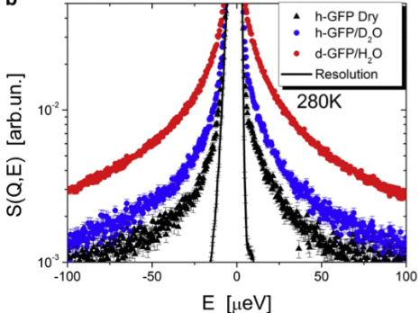
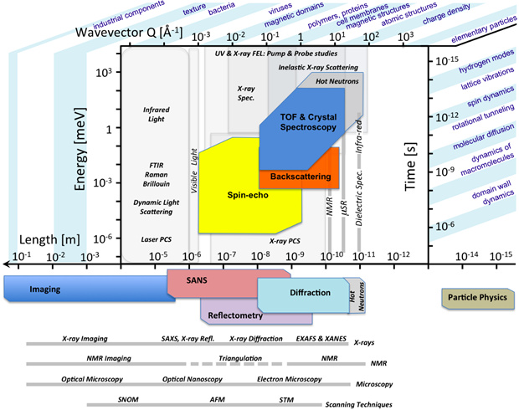
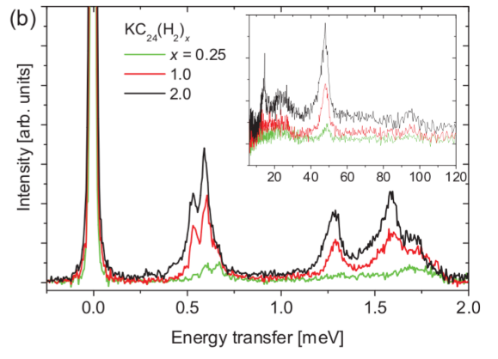
Science case: QENS, INS, Observation time

Slide 5
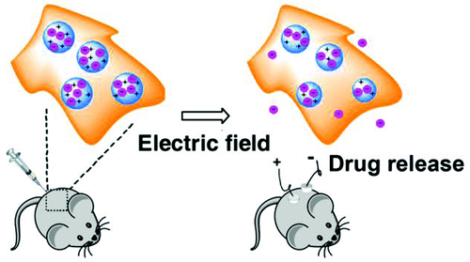
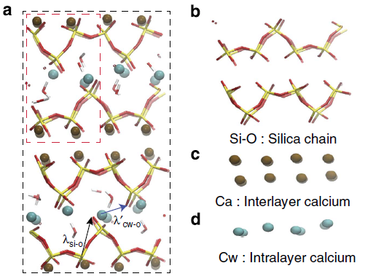
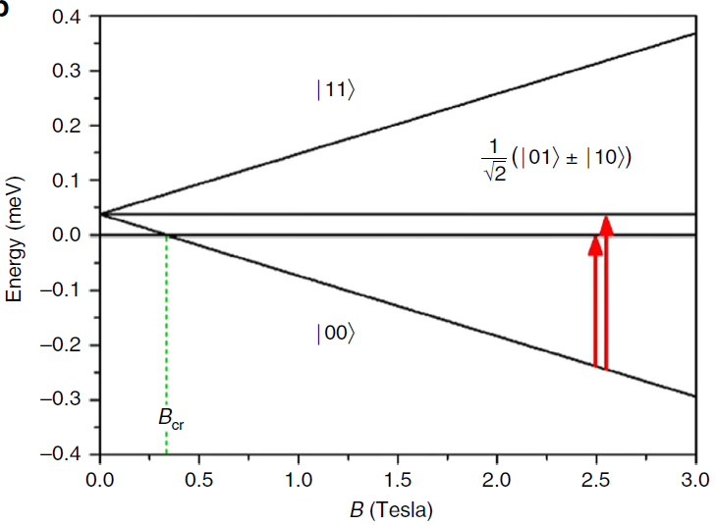
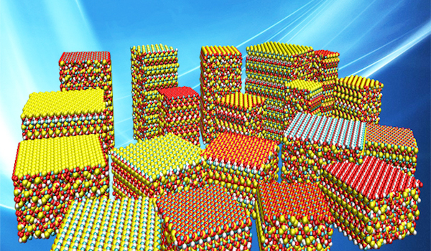
MIRACLES: Science case
Life science
Pharmaceutical science
Polymer science
Dynamics of Proteins and Water
Example: Self-diffusion of haemoglobine and water diffusion in human red blood cells
Drug Delivery
Example: drug release from electric-field responsive nanoparticles
Morphology-performance connections
Example: Polymers in organic photovoltaic devices
M. Stadler et al., Biophysical J. 95, 5449 (2008)
J. Ge et al., ACS Nano. 6, 227-233 (2012).
G. Paternó et al.,Chem. Phys.427, 142 (2013)
Energy science
21st century Magnetism
Environment science
Fuel Cells – Hydrogen Storage
Example: Hydrogen conduction in the solid state
Quantum Information Processing
Example: Molecular magnets and quantum entanglement
Greener building materials
Example: use of greener cements to reduce greenhouse gases
M. A. Haywarth et al., Adv. Mater. 18, 3304 (2006)
E. Garlatti et al., Nature Commun. 8, 14543 (2017)
J. Jacobsen et al., Sci. Reports 3, 2667 (2013)

Slide 6
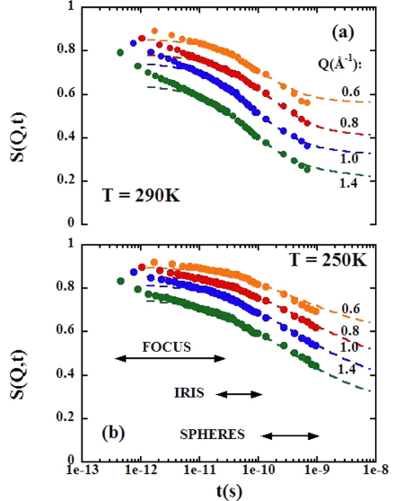
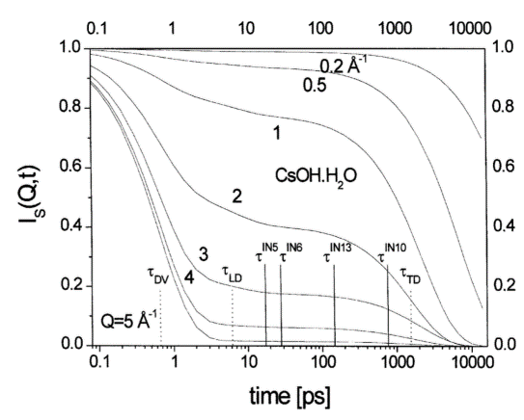
Scientific Requirements
I. Performing experiments in a wide energy transfer with variable resolution - spanning over a large observation time - covering exactly the same wave-vector range using the same instrument in a single measurement.
Notes:
Neutron spectrometers cover an energy transfer range (ℏω), related to a wave-vector range (Q) over which one can measure different excitations, with an associated energy resolution (δ(ℏω)) and wave-vector resolution (DQ). The choice of spectrometer is generally defined by how these capabilities match the excitations of interest. Therefore, to define the most suited spectrometer to be used, both the type of excitation(s) of interest (for example molecular vibrations, phonons, magnons, local diffusion and rotation, crystal field excitations) as well as the overall scale of the energetics need to be known. Often it is necessary to collect data on more than one spectrometer in order to cover the complete energy range of these excitations.
MIRACLES will change this landscape. As detailed below based on a combination of analytical calculations and Monte-Carlo simulations, the ESS backscattering instrument will provide an energy transfer range, ℏω, centered at the elastic line from -650 to + 450 meV, the largest of any backscattering spectrometer, with a variable elastic energy resolution, δ(ℏω), between 2 and 32 μeV, when using a wavelength of λ ≈ 6. 267 Å (Si(111)-reflection). The dynamic wavelength range of MIRACLES, approximately 1.6 Å, can be shifted within the interval of 2–20 Å. to allow the measurement of low-energy inelastic excitations. In addition, when selecting λ ≈ 2.08 Å (i.e., the Si(333)-reflection), δ(ℏω) can be relaxed to 300 μeV and the energy transfer range, ℏω will range from 9 meV in energy gain to -2 meV in energy loss.

Slide 7
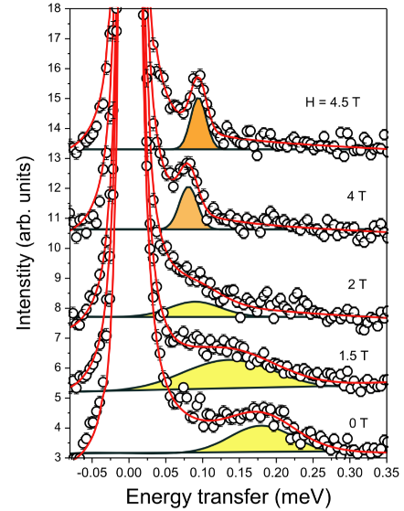
Scientific Requirements
I. Performing experiments in a wide energy transfer with variable resolution - spanning over a large observation time - covering exactly the same wave-vector range using the same instrument in a single measurement.
II. Availability of large energy spectra for inelastic scattering spectra.
Notes:
The required flux provided by the ESS in a very broad wavelength range and the ability of MIRACLES chopper cascade of selecting wavelengths between 2 and 20 Å (i.e., from -17 meV to +2 meV) are remarkable assets in the performance of MIRACLES for inelastic neutron scattering measurements. The offset of the dynamical wavelength range away from the elastic line enables inelastic neutron scattering measurements, while maintaining high inelastic resolution. This feature, important in many areas of condensed matter physics, allows distinguishing energy-resolution-limited inelastic excitations.

Slide 8
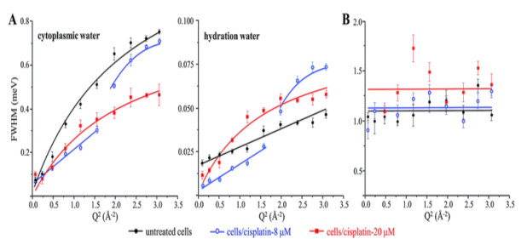
Scientific Requirements
I. Performing experiments in a wide energy transfer with variable resolution - spanning over a large observation time - covering exactly the same wave-vector range using the same instrument in a single measurement.
II. Availability of large energy spectra for inelastic scattering spectra.
III. Flux optimization by tuning the energy resolution.
Notes:
The instrument energy resolution can be relaxed to reach record values of flux for a backscattering spectrometer, for samples from 1x1 cm² to 3x3 cm², seizing the excellent brilliance of the ESS source. The instrument shall have an optimized flux on sample and flux on detectors to cover the scientific requirements in cases related to, e.g. dilute and or limited amount of samples as well as biological or metastable samples. The tuneable time structure combined with the outstanding brightness of ESS allows for tailoring MIRACLES elastic resolution providing for flexibility and uniqueness that will contribute to changing the way we perform experiments today and will open for new opportunities in neutron scattering. We expect to open unprecedented opportunities in the areas of biomolecular dynamics and medicine.

Slide 9
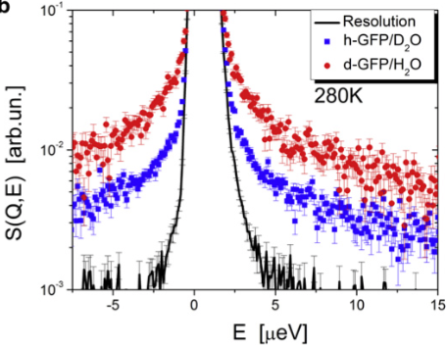
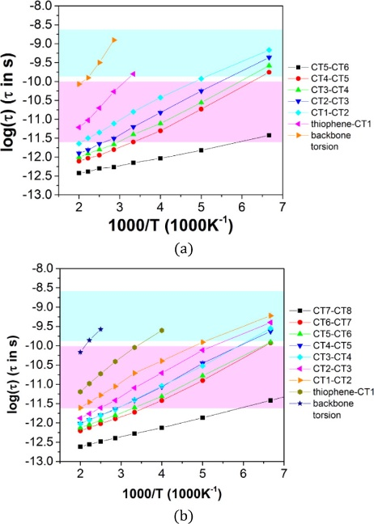
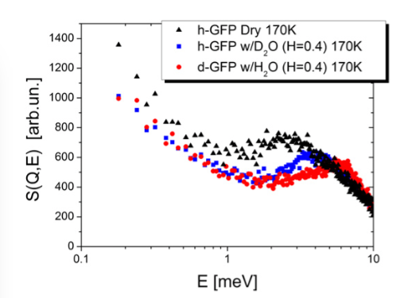
Scientific Requirements
IV. Resolution optimization for a backscattering instrument in a spallation neutron source.
Notes:
Optimized energy resolution (δ(ℏω)) of ~2 meV will be achieved by MIRACLES, at the quasielastic Si(111) regime, representing the best energy resolution in comparison with other backscattering instruments in accelerator-driven neutron sources. Moreover, the meV resolution is kept throughout the extensive incident energy range, selected with the optimized chopper cascade. If we consider the case of polymer science and the advantages of such improved resolution, we have to recall that neutron backscattering spectroscopy is a unique experimental to unambiguously access the single-particle self-correlation function in the ns time scale. Moreover the analysis of QENS data associated to molecular dynamics simulations (MD) is one of the most suitable approaches to support the use of MD generated structures. Here we show a successful example applied to the optoelectronic properties of thin films of conjugated polymers at room temperature [A. A. Y. Guilbert et al. Chemistry of Materials 27 (2015), 7652-7661].
On the other hand, extensive progress will also occur in the areas of chemical and biomolecular dynamics, as such studies often require systematic investigation of many similar molecules under slightly different conditions, requiring a large range of energy/timing resolutions for optimum study.

Slide 10
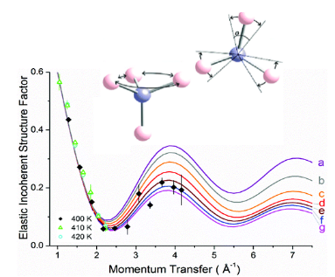
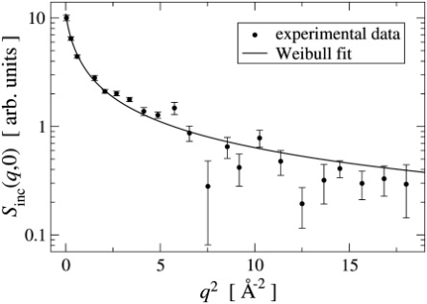
Scientific Requirements
IV. Resolution optimization for a backscattering instrument in a spallation neutron source.
V. Exploring the λ ≈ 2.08 Å mode (i.e. the Si(333) - reflection) that provides access to the thermal energy transfer range and the energy range of the inelastic scattering experiments ℏ𝜔 can reach 18 meV in energy gain spectra.
Notes:
The use of these reflection wavelengths, along with the ESS source characteristics provided by the cold moderator, render a unique combination of high energy, momentum transfers up to 6 Å⁻¹ and a variable resolution starting at 25 μeV. These features will open new possibilities for studies related to the identification of localized motions, such as dynamics of biological cells and tissues as well as proton diffusion in energy storage materials. Upgrade avenues for the continuous development of the instrument include the incorporation of Si(311), which will enable covering an intermediate resolution and momentum transfer

Slide 11
System Requirements

Slide 12
System Requirements: updated
13.6.16.R1. MIRACLES shall be optimized for high resolution QENS measurements using the Si(111) reflection (at λ ≈ 6.267 Å) with an energy resolution of δ(ℏ𝜔) ~ 2 μeV. This favours the observation of diffusion processes along with very low-lying excitations.
13.6.16.R2. MIRACLES shall allow a unique energy transfer dynamic range around the Si(111) elastic peak of ℏ𝜔 = 1020 μeV. Within every ESS frame, the definition of pulses with the chopper cascade shall allow a wavelength bandwidth of 1.5 Å.
13.6.16.R3. MIRACLES shall be capable to cover a wavelength range between 2 and 20 Å, providing the largest energy range in inelastic neutron scattering spectra (around 17 meV in both energy gain and loss sides of the spectrum, according to the elastic line selected). This is a key parameter to allow for extension of the (Q,E) range covered by the instrument well beyond the quasielastic regime.
13.6.16.R4. At the Si(111) elastic energy (E=2.08 meV) the instrument shall be able to relax the energy resolution in order to increase flux by increasing the opening time of the pulse shaping choppers, displaying an energy resolution of δ(ℏ𝜔) = 32 μeV.
13.6.16.R5. The instrument shall allow a maximum Q range of up to 2 Å⁻¹, that can be extended up to 6 Å⁻¹ in the Si(333) elastic energy range.
13.6.16.R6. MIRACLES shall be capable of a spatial Q-resolution in the range of 0.02 Å⁻¹ in forward and 0.1 Å⁻¹ in backscattering in the Si(111) QENS mode.

Slide 13
System Requirements:updated
13.6.16.R7. MIRACLES shall maximise the signal-to-background ratio, measured on a QENS experiment for a vanadium sample 10% scatterer, using a cryostat as sample environment and integrated over the detector array. A signal-to-noise ratio of ~10⁵:1 around the elastic energies is expected to be routinely achieved.
13.6.16.R8. MIRACLES shall have a versatile performance for a broad range of sample sizes, allowing the measurement of sample areas up to 3x3cm².
13.6.16.R9. MIRACLES shall have a sample chamber size around the detectors area of R=20 cm, meeting the sample environment equipment requirements of the science case described in the proposal, and minimizing the relative separation between sample and detectors and thus energy resolution contribution from the near backscattering geometry.
13.6.16.R10. MIRACLES’ design shall provide space and flexibility to host and drive future developments in the Neutron Backscattering field, as well as for upgrade avenues for the continuous development of the instrument, including full coverage of the backscattering geometry (analyser + detectors), with either Si(111) or Si(311), which will enable an intermediate resolution, energy transfer and momentum transfer.
13.6.16.R11. The instrument shall serve the user and science and instrumental development program without interruptions during source operation.
13.6.16.R12. MIRACLES shall allow a safe operation for staff, users and bystanders.

Slide 14
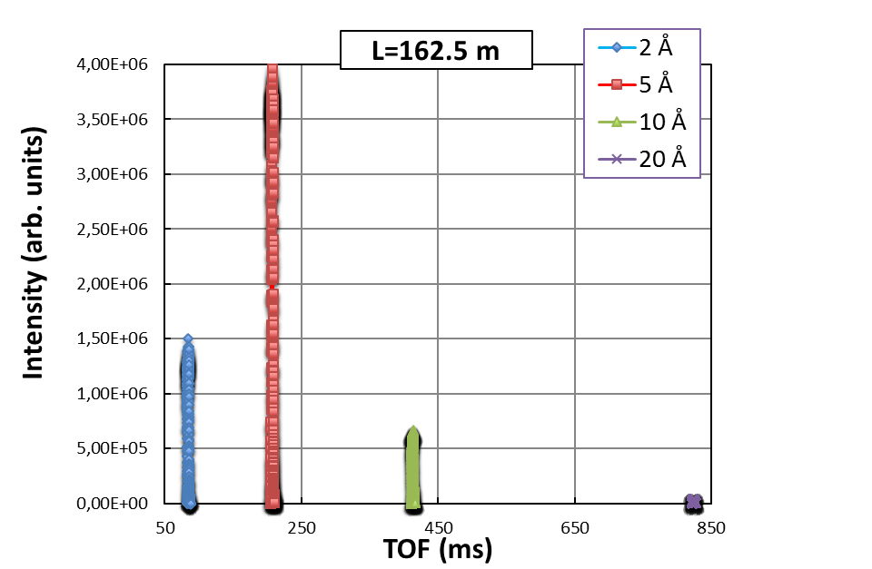
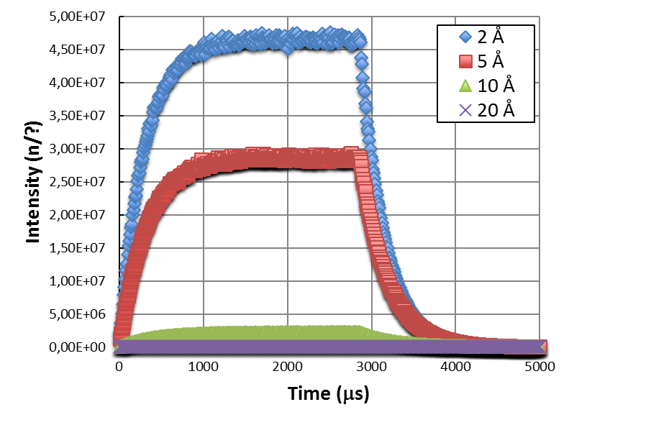
Primary Spectrometer
ToF long instrument
L=0 m
(source)
L=162,5 m
(sample)

Slide 15
Secondary Spectrometer
K. range: Q vs. ħω
(Si(333))
λ = 2,08 Å
E = 18,9 meV
(Si(311))
λ = 3,275 Å
E = 7,63 meV
(Si(111))
λ = 6,267 Å
E =2,083 meV
λ = 2 Å
E = 20.45 meV
Δλ=1.5 Å
ΔE~11 meV
Δλ=1.5 Å
ΔE~8 meV
Δλ=1.5 Å
ΔE~1 meV
λ = 20 Å
E = 0,2 meV

Slide 16
Preliminary System Design

Slide 17
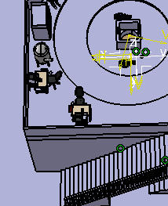
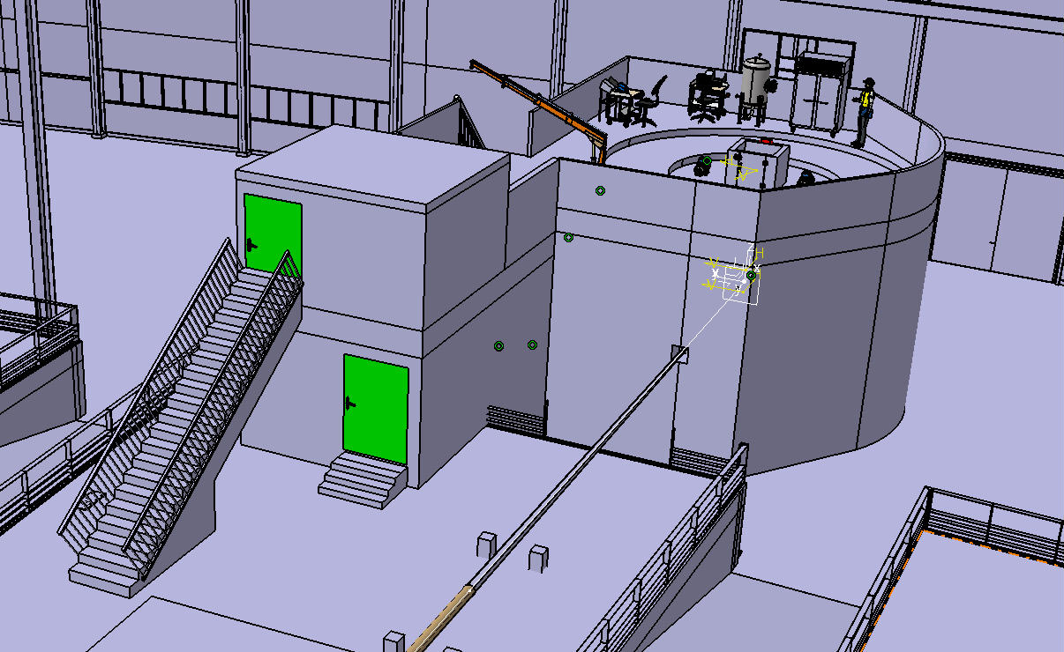
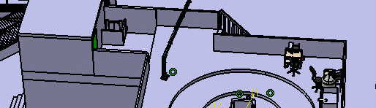
Control room/Sample Preparation Areas
Sample Preparation Areas (Experimental areas)
- Sample Mounting Area
- Next Experiment Preparation Area
- Storage Area
Sample Mounting Area
Next Experiment Preparation Area
Control Room

Slide 18
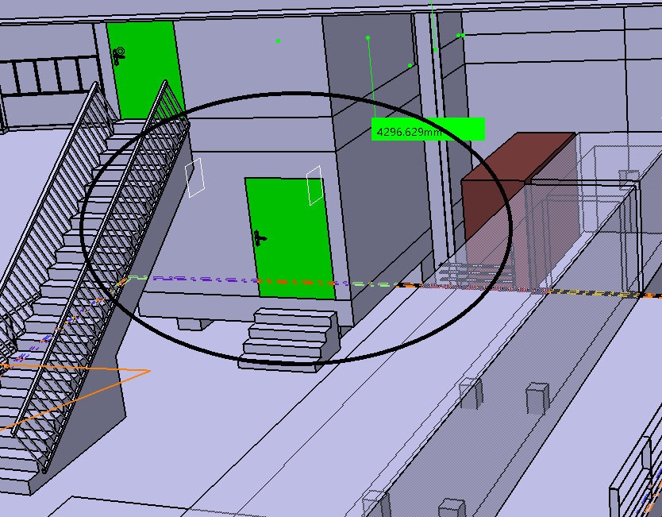
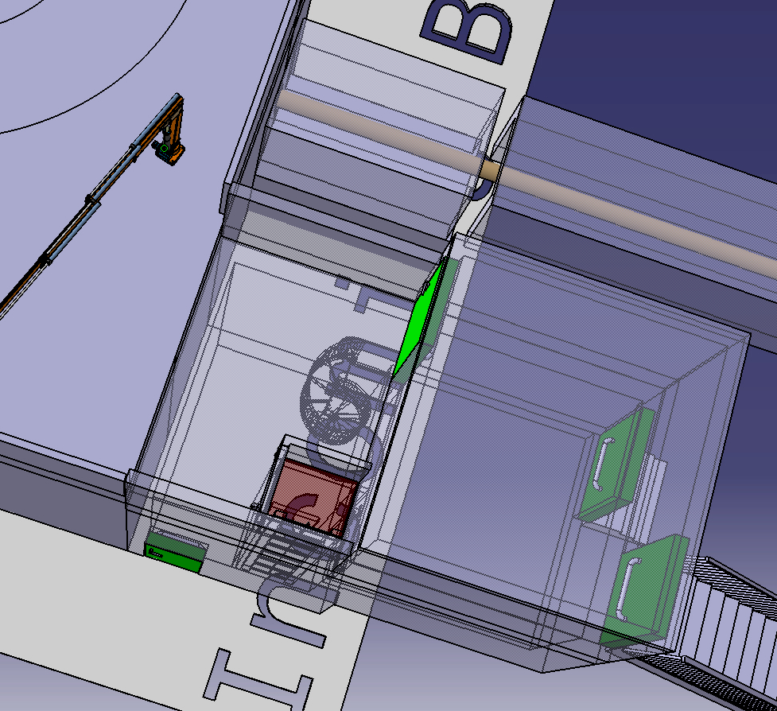
Storage area
Samples Gamma emmiters:
Al sample holder ~15 min to cool down
Na clays
Silicates (traces)
Mn-containing magnetic materials
Co60 > 5 years to cool down – bad
active samples (and active SE)
Storage Area for
non-active samples (standard storage)
Sample environment: Crane (Lift can add up safety issues)
Procedure extraction from sample area:
Samples extracted from SE/chamber will be momentarily stored

Slide 19
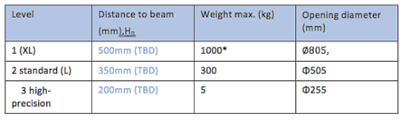
Top loading: flange
Sample Flange dimensions: (recent conv. w/ Malcom Guthrie)
Sample chamber dimensions:
- Dimensions: ∅~400 mm and L~1000-1200 mm
- Sample flange ∅~505 or 805 mm
- Flange-beam distance: ~625-650 mm
2000
1800
2000
2000
1800
2000
800
800
1200
1000
1200
650
22º
1000
650
22º
1200
1200
85
85
1000
1200
1000
1200
400
400
460
460
300
300
500
500
2500
700
2500
2900
2900

Slide 20
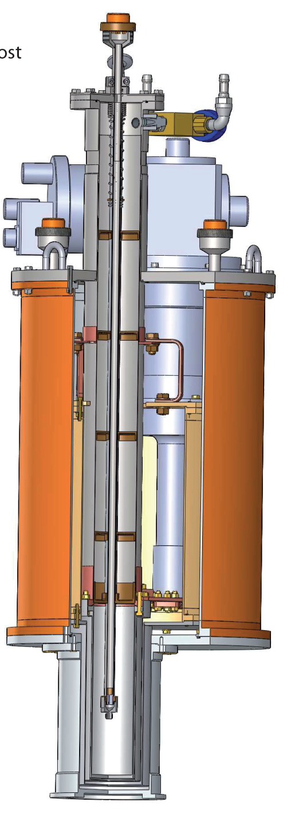
Sample environment: Project scopee
Project scope: Sample environment
- Sample stick + Motion control
- Table
- Sample holders
Operations (agreed SSM)
- Cryofurnace (3-650 K; bore ∅≈50 mm; cryostat ∅≈400 mm )
- Pool: high-T furnace (up to 1200K)
ILL Dry Cryostat
Sample holders, different geometries:
Flat- Al-alloy cans of 40mm x 40mm for powders, liquids or films, with varying thicknesses (0.1-2 mm)
Annular- Al-alloy cans 50mm tall for powders, liquids or films, with varying thicknesses (0.1-2 mm)
Annular with gas loading capabilities

Slide 21
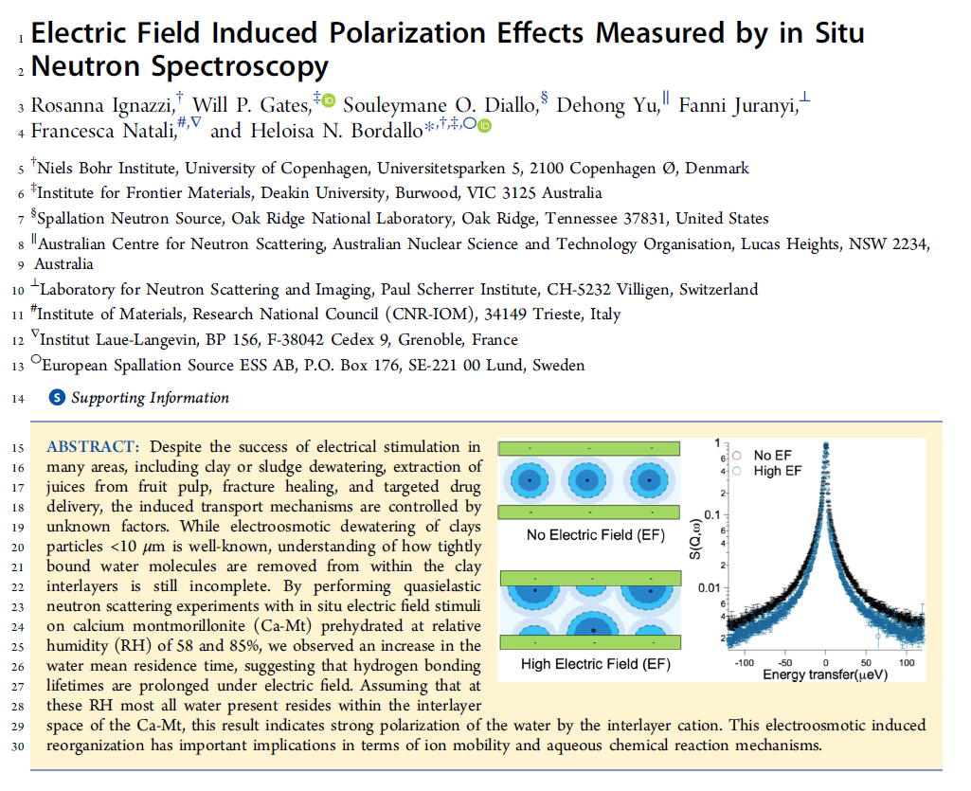
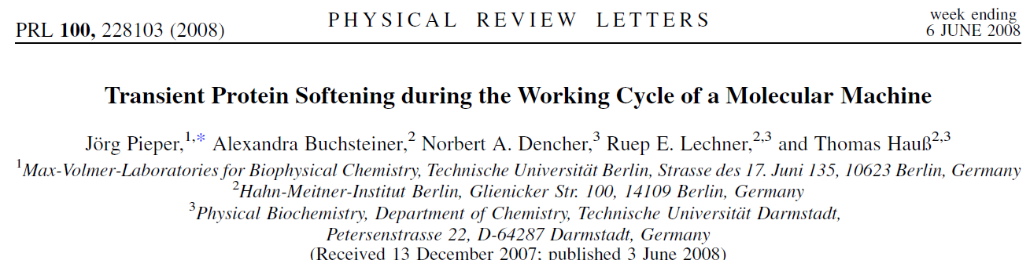
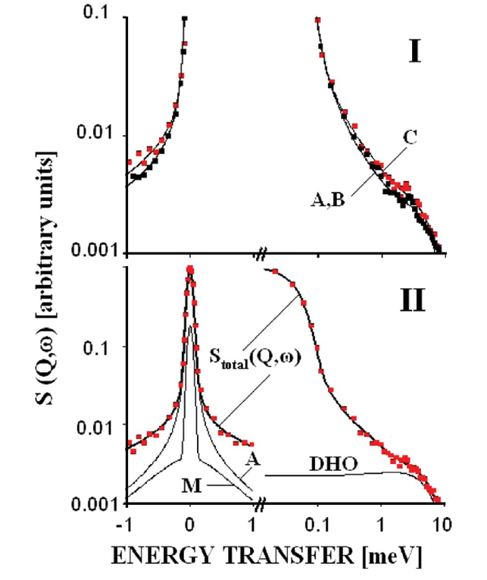
Sample environment: additional resources
Additional requirements: Automatic multiple sample changer, Dilution insert (down to 50 mK), High pressure gas cell (catalysis), In-situ gas adsorption measurements, Corrosive gas processing, In-situ Raman system,…
- Electric field polarization (IK – Italy – F. Natali)
- Pump-probe laser (IK – Estonia – J. Pieper)
- Humidity chamber (Proposal ISIS/Sweden/KU/ESS)

Slide 22
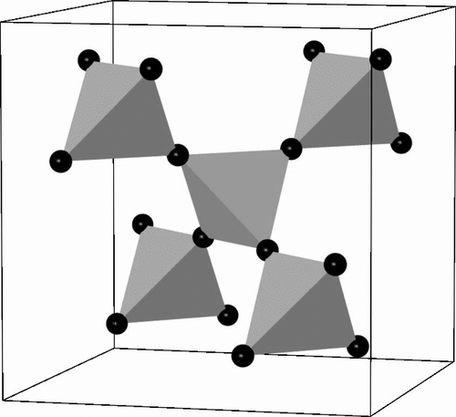
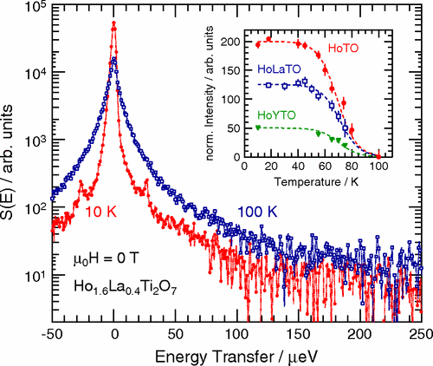
MIRACLES: science case in magnetism
Magnetism in MIRACLES science case (projected # of users: 20-25%)
Molecular magnets (high resolution)
Some of the experiments do not use magnets (only cryostat with dilution insert)
Quantum Information Processing
(quantum entanglement, B=2-3 T)
E. Garlatti et al., Nature Commun. 8, 14543 (2017)
Frustrated magnetism – Spin ice (high resolution)
Dynamic spin-ice correlations in Ho2Ti2O7
(B=3-5 T)
G. Ehlers, et al., Phys. Rev. Lett. 102, 016405 (2009)

Slide 23
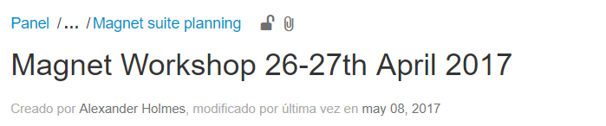
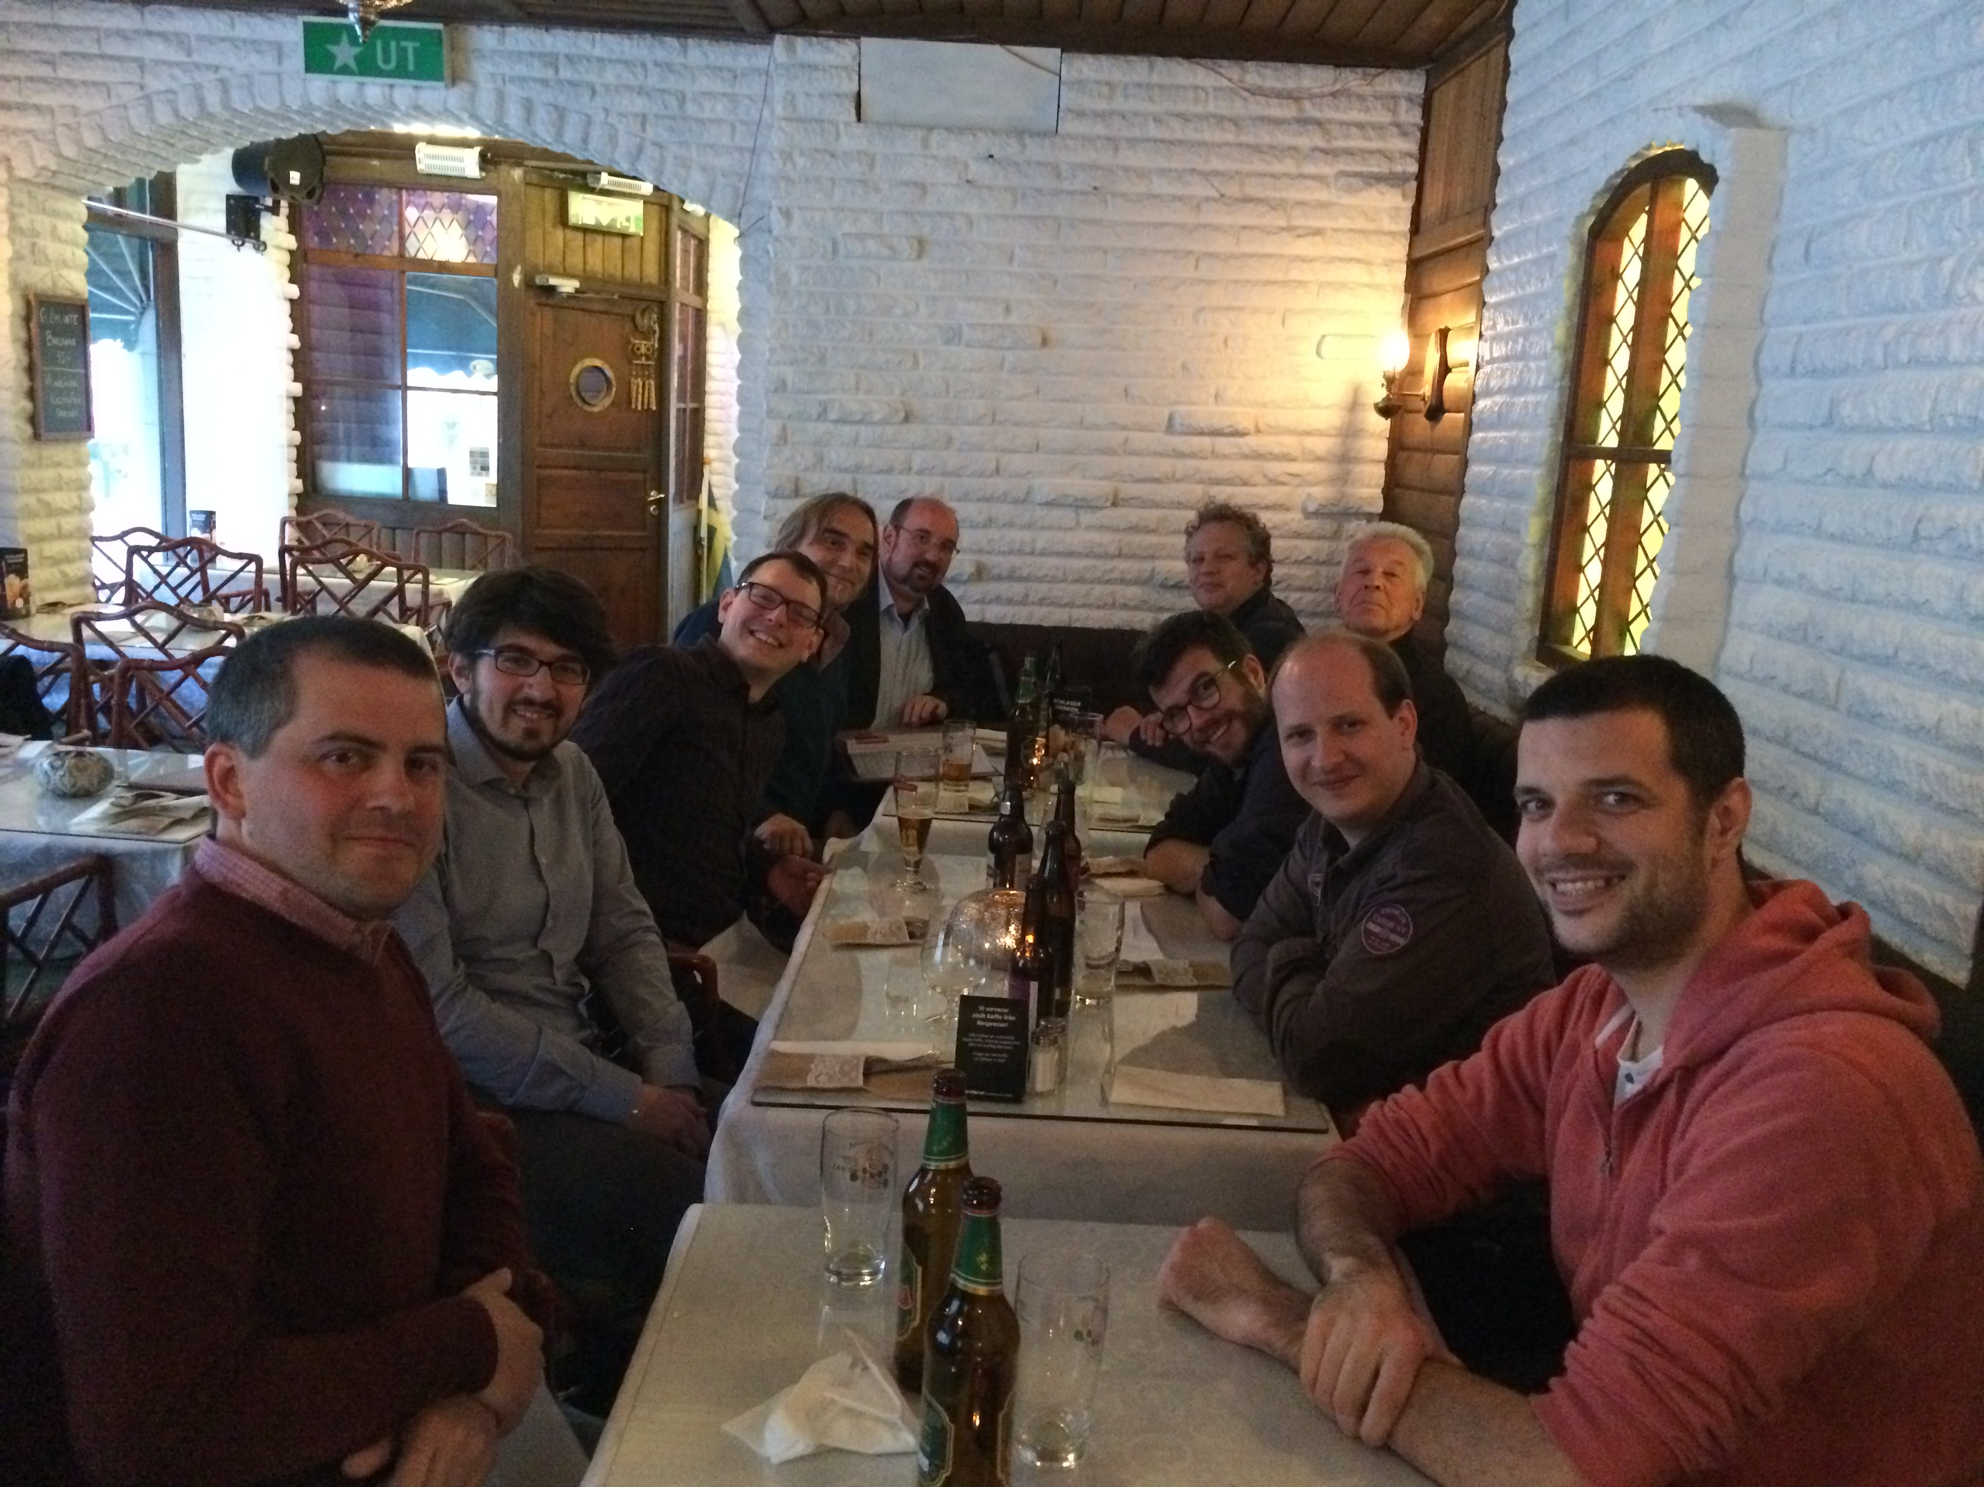
Requirements: magnet for MIRACLES
Compact SEE, Diameter : Ø <40 cm
Horizontal aperture : 150 °
Vertical aperture : ~ 22-44 °
Field : > 3 T
Temperature : 50 mK - 300 K
Strategies: dimensions, but saving MIRACLES science case

Slide 24
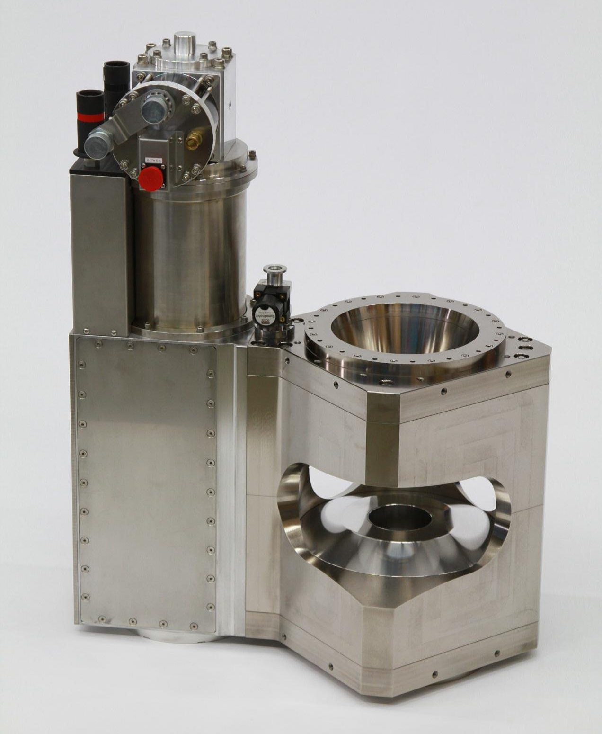
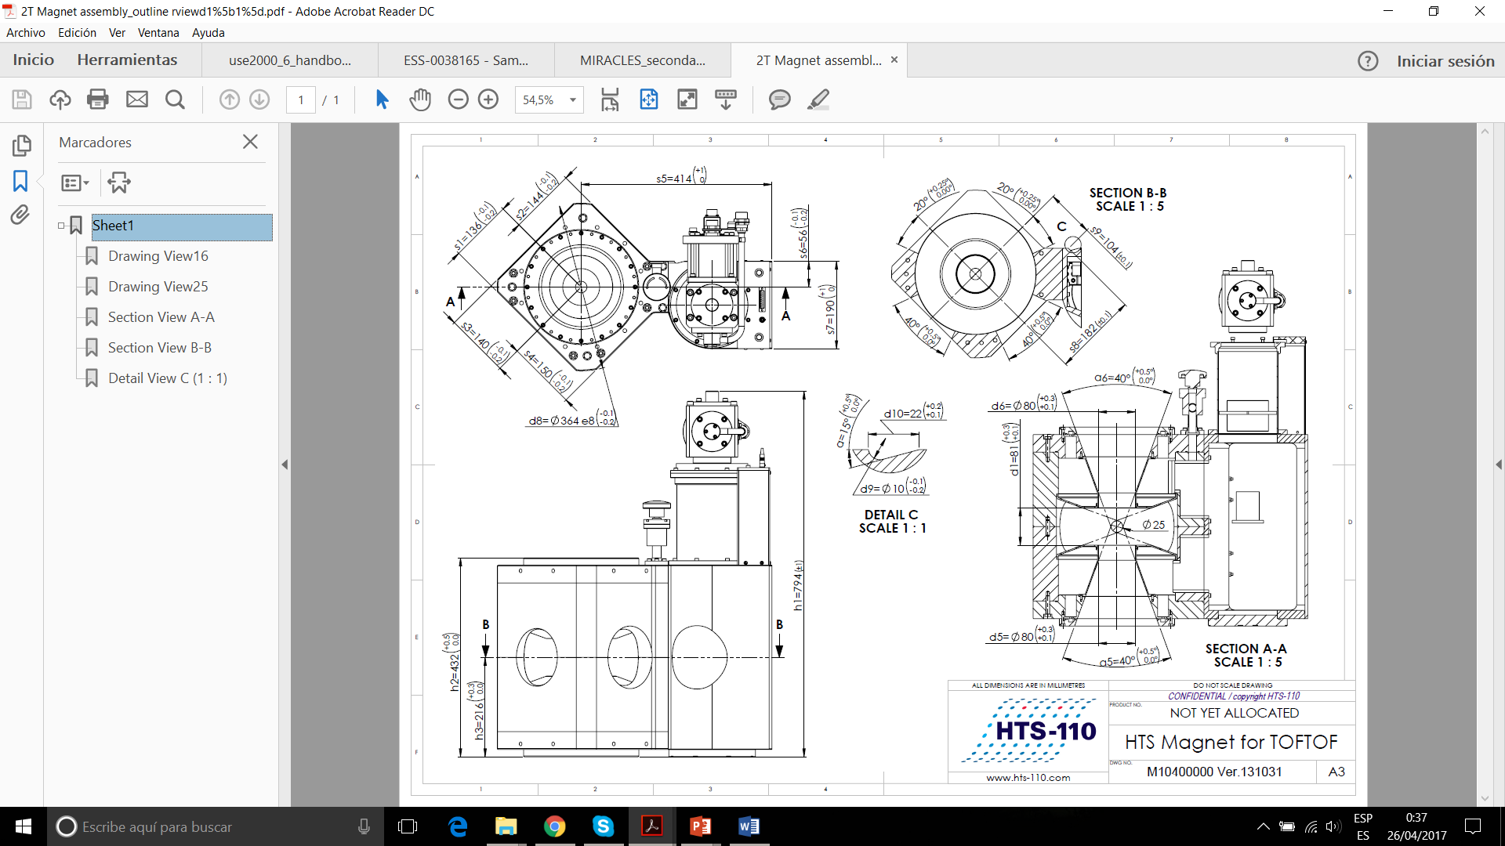
Option 1 : similar to HTS Magnet for TOFTOF (MLZ)
Modification of the position of the PTR: top flange.
Attachment of sample environment (dilution insert) possible?
Possibility of reducing the distance between magnets (vertical aperture: ±22º) will increase the field magnitude (expected, > 3 T).
Diameter (~380 mm)
380 mm

Slide 25
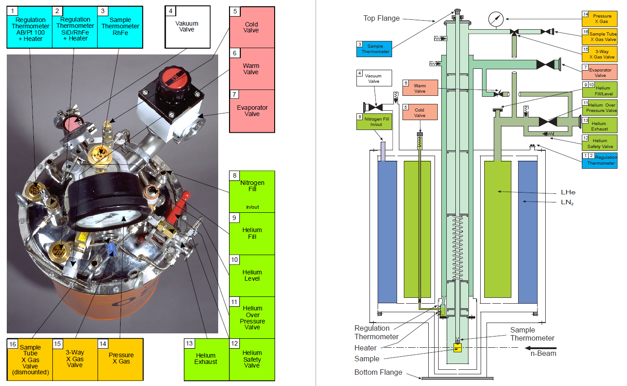
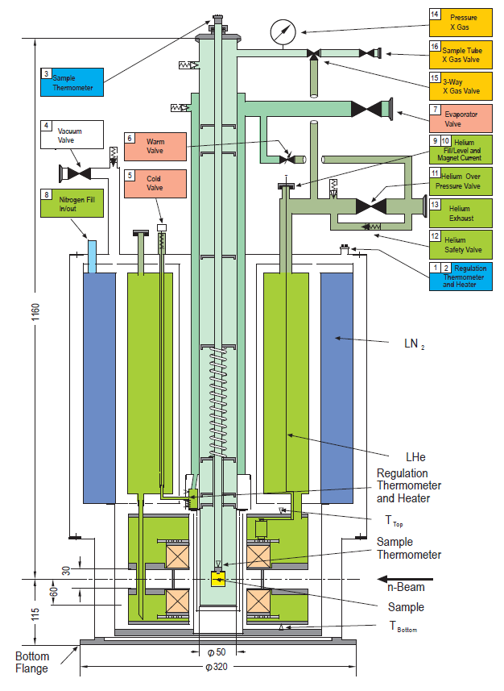
Option 2: similar to Vertical Magnet VM-3 (Berlin)
±12° could be OK
(24° vertical aperture)
Modified cryostat (field up to 5 T)
Vertical aperture (through slight modification without affecting the magnets’ distance: ±12º)
Diameter: 320 mm
320 mm

Slide 26
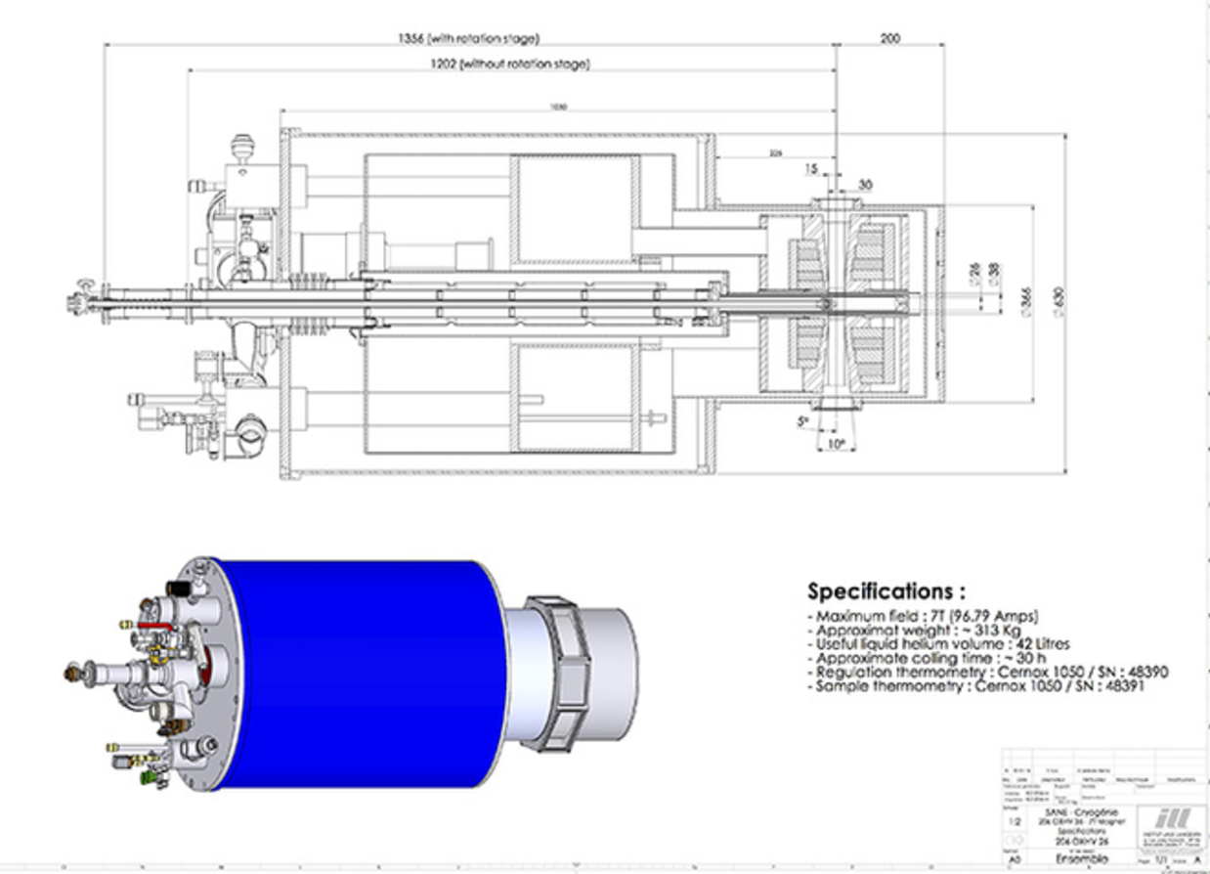
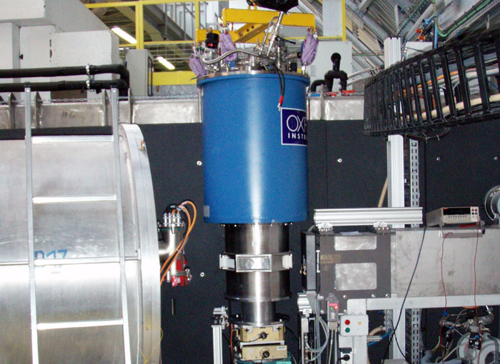
Option 3: Vertical Cryomagnet 206OXHV26 7 T (ILL)
Reduced diameter at sample and detectors position
To increase this size to ~400 mm
390 mm
Field up to 7 T
Sample equatorial size (diameter)= 390 mm
Vertical aperture =±5º
(Possibility of increasing vertical aperture to ±10º?

Slide 27
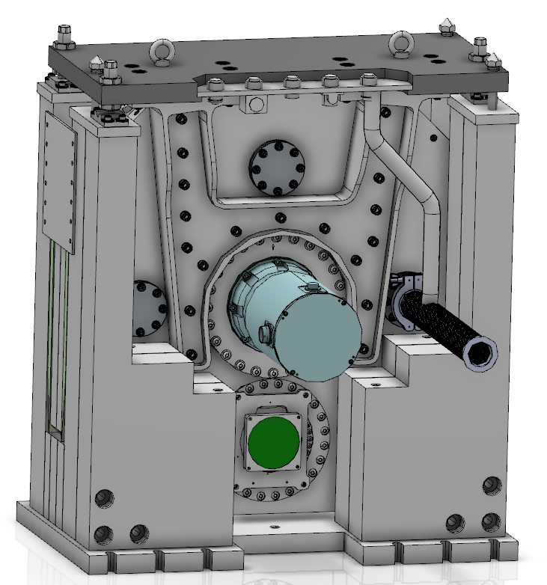
Detectors: Beam monitors
Beam monitors
- 3 BM after the Scope Setting Meeting
BM1: inside the beamline; pulse and TOF monitoring
BM2: before the sample; normalization and TOF monitoring
BM3: after the sample; sample positioning and beam shape monitoring
BM0: Another beam monitor is still needed, likely located after the PS chopper, for pulse and TOF monitoring
R=2,5m
FO2 Chopper + BM1
BM2
BM3

Slide 28
Detectors: Beam monitors
Position sensitive detector: BM3, likely BM2
³He filled or BCS (BM3)
Detector efficiency thermal neutrons: ~10⁻⁴
Time resolution: 10 μs
Dead Time: <1 μs
Window thickness: 0,5 mm & Scattering <10%
BM Mirrotron
 | MWPC BM-100X50 | 2D-MWPC | Scintillator
supplier | Mirrotron | Mirrotron | Quantum detector
Isotope used for neutron capture | ³He | ³He | ⁶Li
Gas pressure mbar | Partial pressure 6,5 | Partial pressure 0.4 | ------
Filled gas | ³He+CF₄ | ³He+CF₄ | --------
Applied voltage (V) | 1300 | Anode at -3500V Drift at 1500V | 650
Measured attenuation % | 2.5 | 7.3 | 0.4
Measured Efficiency at 2.4Å | 1.1x10⁻³ | 1.5x10⁻⁴ | 5x10⁻³
Scattering (%) | 4±0.9 | 9±1 | 0.74±0.2
Beam Monitor | Location | Dimensions | Type
BM0 | L=8 m | 8x4.5 cm2 | Flux & TOF
BM1 | L=80 m | 11x13 cm2 | Flux & TOF (diagnosis)
BM2 | L=162.2 m | 5x5 cm2 | Normalization
BM3 | L=163 m | 5x5 cm2 | PSD
(Source: F. Issa presentation to NID)

Slide 29
Spectroscopy detectors
50 tubes (above) + 50 tubes (below) the sample pos.
∅=1 cm → Angle covered 3°/tube
Sainless steel tube, length= 12 cm ;wall thicknesss= 0.25 mm
PSD, voxel 1cm×1cm×1cm
Tilted to minimize ΔTOF (φ=17°)
At θ=15°
δQ=0,05°
360º/2πR=2.5º/cm
³He detector tubes
2.5º+0,5º
D=1 cm(+~2 mm spacing)
B₄C shield
L_{SAD}^{top}
Sample chamber
L_{AD}^{top}
γ
L_{SA}^{top}
150º
φ=17°
χ=α−γ
R_{A}
y_{A}
h_{det}
l_{det}
α=22º
L_{AD}^{bottom}
R_{A}
γ
L_{SA}^{bottom}
L_{SAD}^{bottom}
R_{d}
n beam
In the no-tilt configuration, the difference between top and bottom pathways is ΔL_{SAD} ≈ 2 cm, which might correspond to a time-of-flight mismatch at λ = 6.267 Å of Δt_{SAD} ≈ 40 μs.
At θ=165°
δQ=0,008°

Slide 30
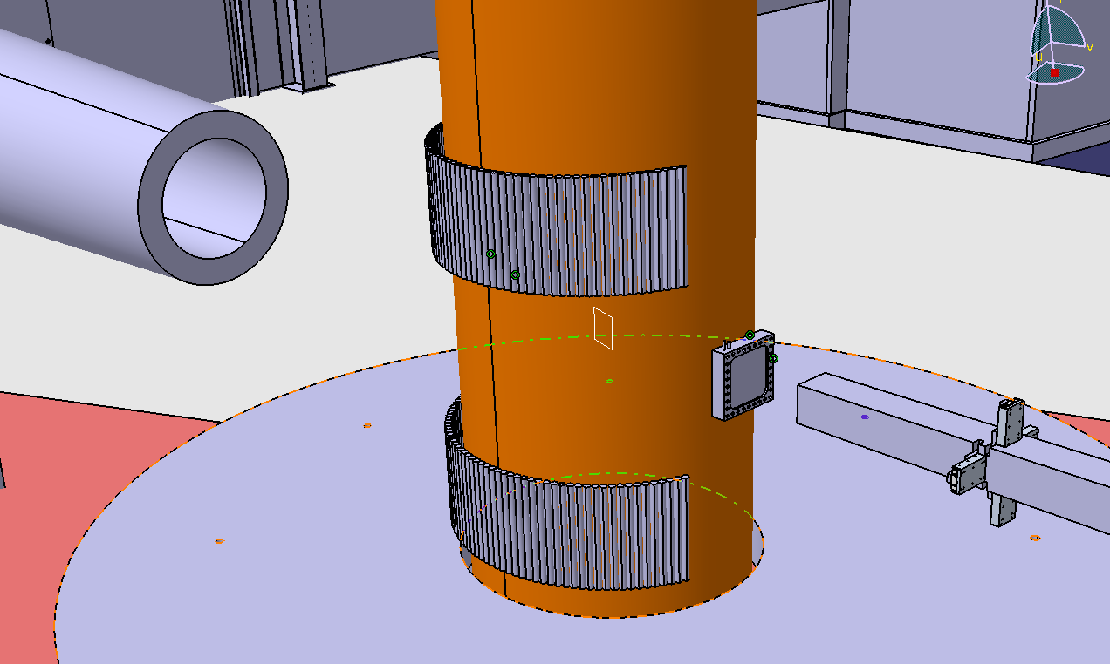
Spectroscopy detectors
³He Pressure: 8 atm.
Efficient (>50%) for λ>2 Å (i.e., for Si(333) and/or Si(311))
Gamma sensitivity at 1 MeV < 10⁻⁵
Rate capability: 13 kHz over an area 1 x 12 cm²
³He + n → ³H + p + 764 keV.
GE ³He tubes
Sample chamber
³He tubes
Get-lost tube
BM2
Guide
Table

Slide 31
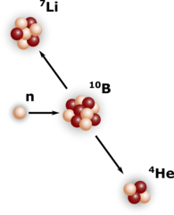
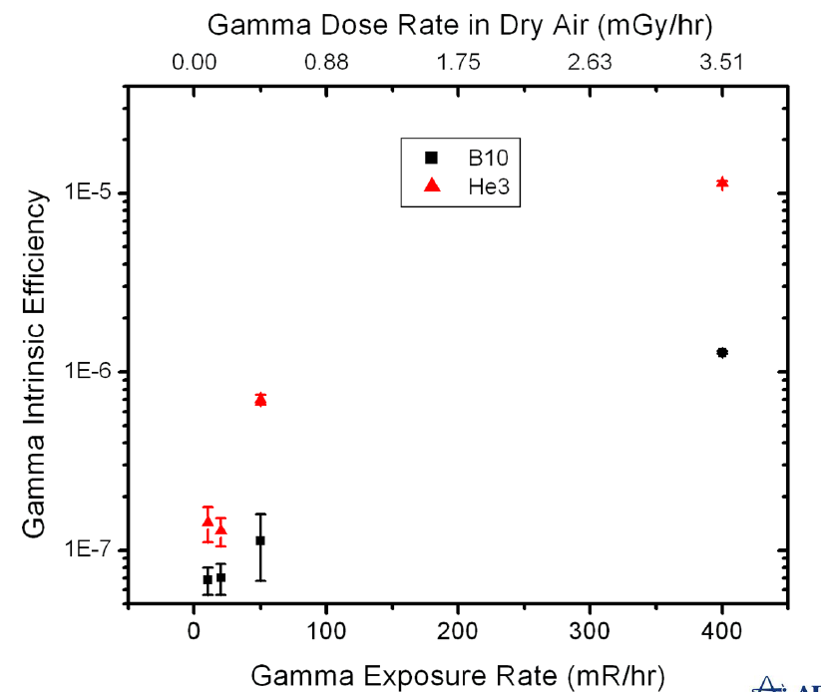
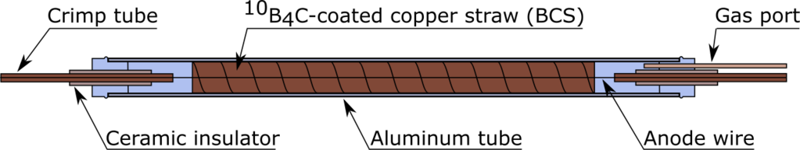
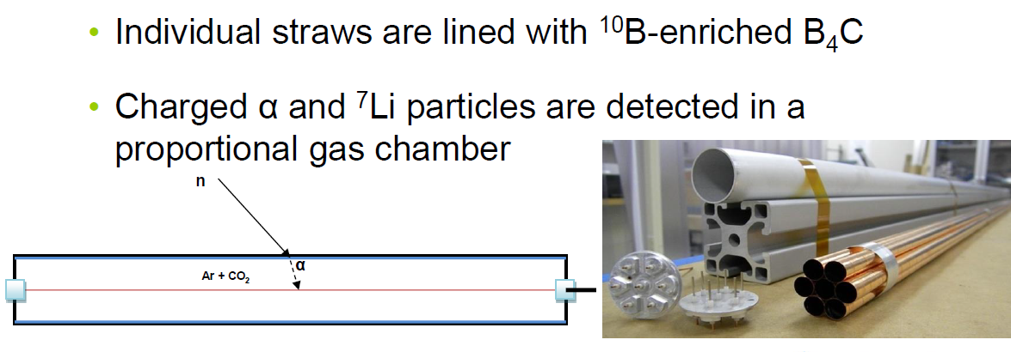
Back-up solution: boron-coated straws
Pie12, from Proportional Technologies.
∅ = 3 mm in diameter ; Length: 10 to 20 cm
PSD: 3 mm resolution in x and y
Equivalent to 10 atm ³He in sensitivity.
The amplified signal can be as narrow as 60 nsec facilitating higher rates than ³He.
n + ¹⁰B → ⁷Li*+ α + 2.3 MeV (94%)
→ ⁷Li + α + 2.8 MeV (6%)
Proportional Technologies Inc.

Slide 32
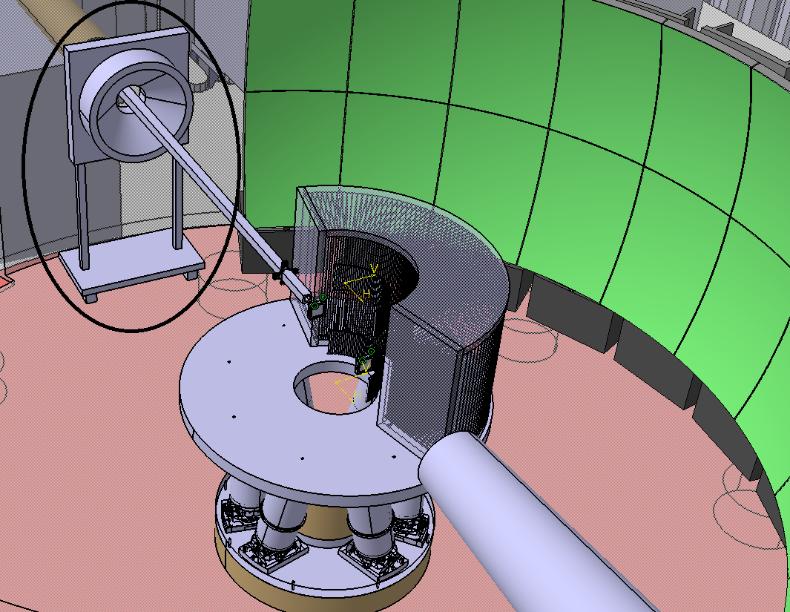
Diffraction Detector
Detector in near backscattering position: 170º
Dimension: 30 cm in height, 30 cm in width
³He or BCS proportional counter
Spatial resolution: 1 cm x 1 cm
Efficiency: > 50% at 6Å
Time resolution ~ 10 μs
Gamma sensitivity at 1 MeV < 10⁻⁵
Rate capability: ~ 68 kHz
Frame for diffractometer

Slide 33
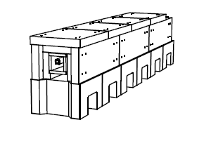
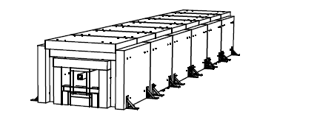
Shielding concepts beamline
Shielding concept D03 (curve):
- Steel (30 cm) / B-HDPE (15 cm) -> H_{n}~0,5 μSv/h
- B-HDPE (15 cm) / Steel (20 cm) / Concrete (60 cm) -> H_{n}~2 μSv/h
Shielding concept E02 (straight):
- B-HDPE (6 cm) / Steel (9 cm)
Concrete (~xx mm)
Steel (~50-100 mm)
Concrete (~600 mm)
B-HDPE (~50-100 mm)
Steel (~200 mm)
B-HDPE (~100 mm)
1000
2000
Elevation & shielding concepts Gabor

Slide 34
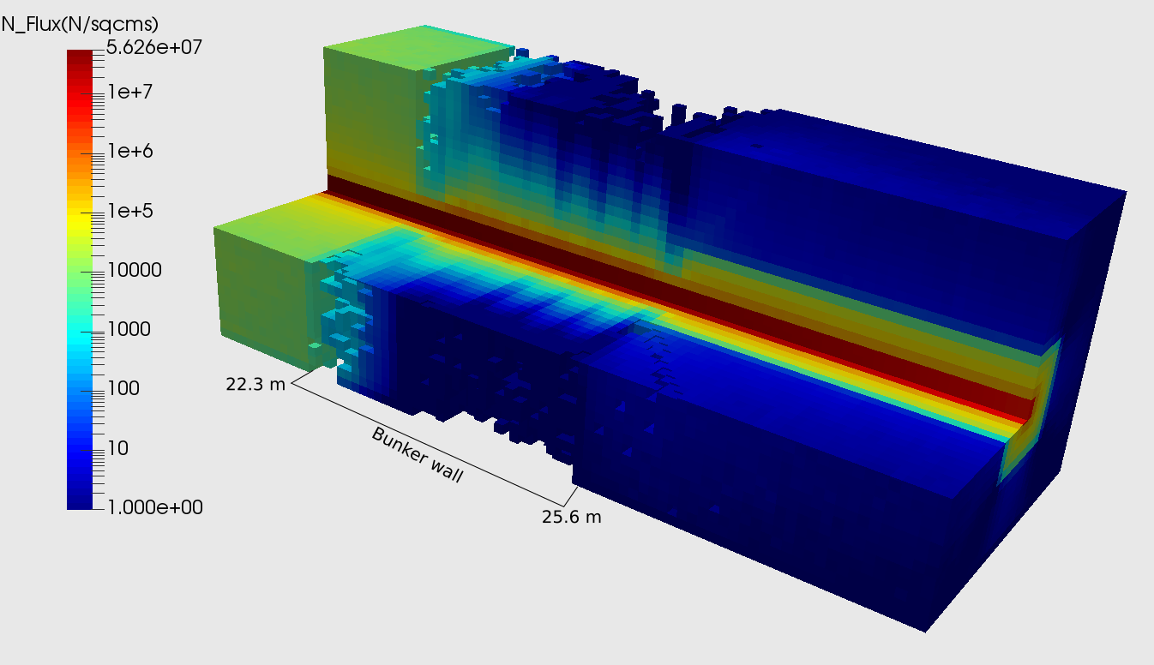
Shielding beamline (curve)
First tests:
- Curve Steel (30 cm) / B-HDPE (15 cm)

Slide 35
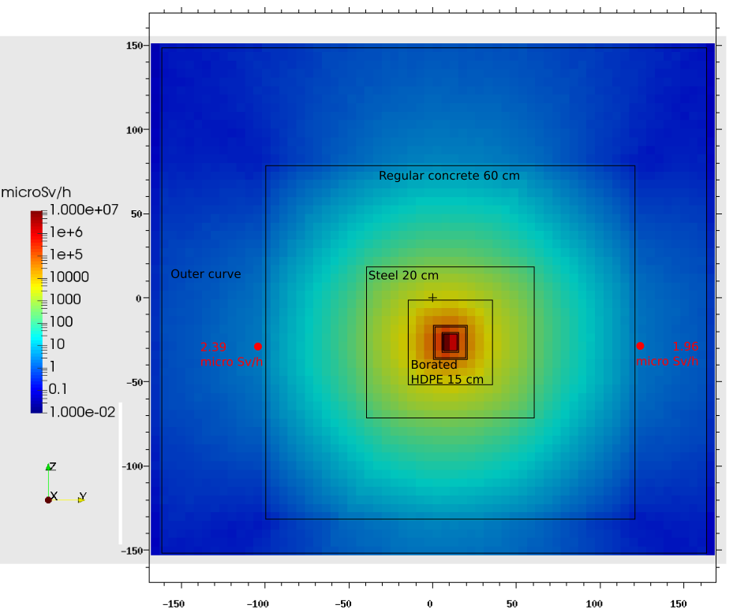
Shielding beamline (curve)
First tests:
- Curve Steel (30 cm) / B-HDPE (15 cm)
- B-HDPE (15 cm) / Steel (20 cm) / Concrete (60 cm)
L=28.3 m
2.4 μSv/h
2.0 μSv/h
Position X (m) | Neutron dose (μSv/h) | Photon dose (μSv/h) | Total dose (μSv/h)
35 | 0.014 | 6.17E-3 | 0.020
45 | 0.046 | <0.001 | 0.046
55 | 0.010 | <0.001 | 0.010

Slide 36
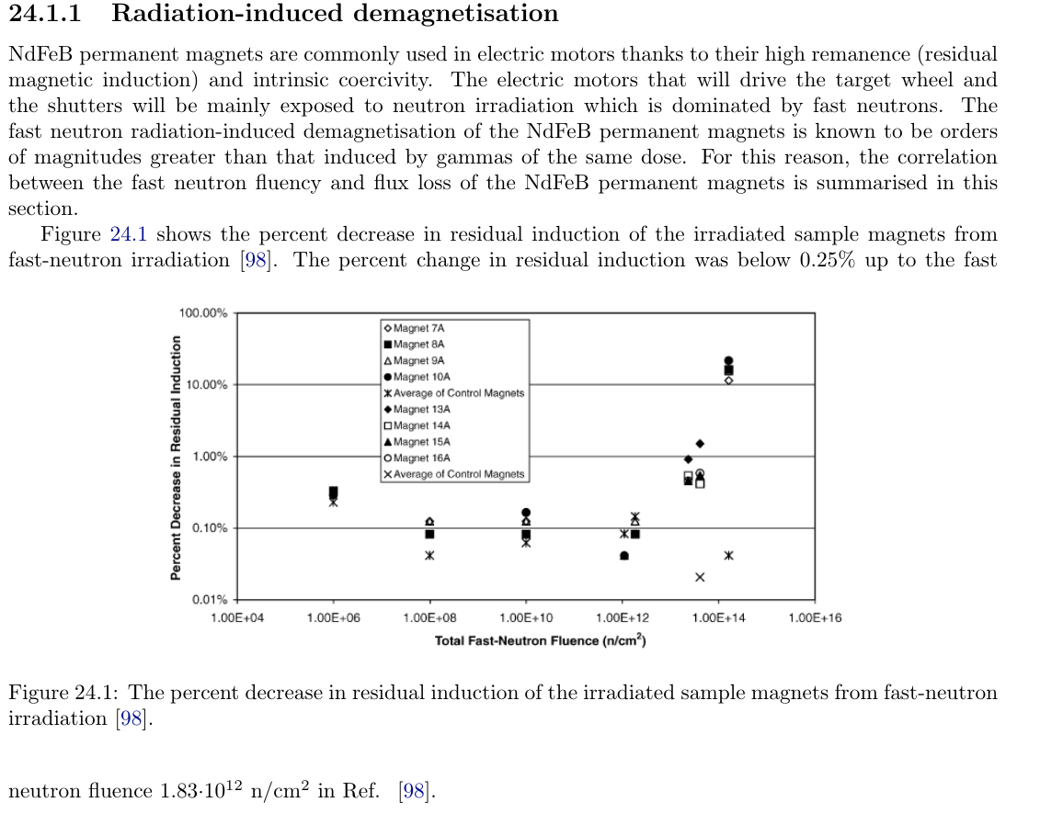

Shielding beamline (curve)
Next steps:
- Motors choppers (H~1-10 Sv/h; neutron fluence: ~10¹³ n/cm²/year)
- Neutron dose as function of the neutron energy (Lethargy?)
- Detailed design & Dose map: curve + straight guide + FO2-shutter pit assembly
- Focusing guide
ESS Materials Handbook (ESS-0028465)

Slide 37
Shielding cave
H1 scenario:
  Full beam 3·10¹⁰ photons/s of Eγ=2 MeV at sample pos.
  Cave walls: t=60 cm concrete
  Flange area: t=60 cm HD concrete
  Vessel B-concrete/B-HDPE: 5-10 cm
Source | Tally | Eq. Dose (μSv/h/part/s) | Eq. dose (μSv/h)
S1 | T1 | 5.22E-13 ± 4% | 0.02
S1 | T2 | 1.65E-11 ± 1% | 0.50
S2 | T1 | 5.55E-12 ± 2% | 0.17

Slide 38

Shielding cave
Beam stop
  Full beam hitting the beam stop
  3·10¹⁰ photons/s of Eγ=0,5 MeV at B₄C canister
  B₄C (10 cm) / lead (5 cm) / concrete (40 cm)
  Get-lost tube: Al + t=0,5 cm B-HDPE (check B₄C)
Source | Tally | Eq. Dose (mSv/h/part/s) | Eq. dose (mSv/h)
S1 | T1 | 5.22E-13 ± 4% | 0.02
S1 | T2 | 1.65E-11 ± 1% | 0.50
S2 | T1 | 5.55E-12 ± 2% | 0.17

Slide 39
Shielding cave (ongoing)
Shielding calculations are stated for H1 scenarios in their preliminary concept, but envisioned for H2 scenarios.
- Shielding sample area (flange-fence)
- Potentially H2 scenario (sheet of Cd; Eγ^{Cd} =9,4 MeV)
- Shielding background cave: use boron, Gd paint,…
- Detailed design
2600
Fence (steel+lead)
2000
1800
2000
900-1300 mm concrete (cave)
500
350
Cave (Concrete or HD-concrete)
Steel or lead
Flange (steel)
Steel, lead or HD-concrete
130-140 cm thickness concrete
Vessel (B-lined)
400

Slide 40
Work Package Specification

Slide 41
Master Schedule v3.4: updated Oct-2017
MIRACLES Project Timeline
MIRACLES Access Bunker and Out-of Bunker

Slide 42
Planning: Milestones
ID MIRACLES | External Milestones | Projected date
1 | Monolith insert delivered to ESS site | Jan-2019
2 | Monolith insert ready for installation | Mar-2019
3 | Crane & Access to E01 | May-2019
4 | Crane Access to Neutron Guide Hall E02-1 (close to E01) | May-2019
5 | Crane Access to Neutron Guide Hall E02-2 | Nov-2019
6 | Crane & Access to D03 Main Hall | Dec-2019
7 | Crane & Access to West sector D03 Bunker | Dec-2019
8 | Bunker closed | Jul-2020
9 | First Beam on Target | Oct-2020
Progress milestones MIRACLES
ID | Milestone | Projected date
13 | Guides housing & supports delivered and ready to install | Jan – 2022
14 | Analyzer delivered and ready to install | Mar – 2022
15 | Vessel and Vessel Components delivered and ready to install | May – 2022
16 | ³He Detectors and Beam Monitors delivered and ready to install | Jul – 2022
17 | Shielding delivered and ready to install | Aug – 2022
TG4 and Start of Installation & Integration (Phase 4) |  | SEP – 2022
18 | Neutron Choppers delivered and ready to install | Sep – 2022
19 | Neutron Guides delivered and ready to install | Sep – 2022
20 | E02 Guides Installed (Neutron Guide hall) | Apr – 2023
21 | FO2 Chopper / Shutter / Beam Monitor BM1 (E02 pit assembly) Installed | Apr – 2023
22 | PWD-PS Choppers Installed | Aug – 2023
23 | FO1 Chopper Installed | Aug – 2023
24 | Bunker & D03 Guides Installed | Aug – 2023
26 | Guide Shielding Installed | Oct – 2023
27 | Vacuum Vessel Installed and ready to accept components | Nov – 2023
28 | Get-lost tube and Beam Stop Installed | Nov – 2023
29 | E01 Optics: Focusing Guide installed | Nov – 2023
30 | Cave Installed and ready to accept components | Nov – 2023
31 | ³He Detectors and Table installed | Feb – 2024
32 | Other in-vessel Components (Radial Collimator, Beam Monitors,…) installed | Apr – 2024
33 | Analyzer Panels Installed & Closing Vessel & Cave Roof | Jun – 2024
34 | Cave Equipment, Control Hutch, and Support Installed | Aug – 2024
35 | PSS Installed | Sep – 2024
36 | Components integrated into EPICS | Sep – 2024
TG5 and Start of Hot Commissioning (Phase 5) |  | SEP – 2024
Progress milestones MIRACLES
ID | Milestone | Projected date
Start of Detailed Design (Phase 2) |  | NOV – 2017
1 | Monolith Insert Early Procurement | Feb – 2018
2 | Shielding Design frozen | Nov – 2018
3 | Secondary (vessel and cave) Design frozen | Dec – 2018
4 | Monolith insert delivered and ready to install | Jan – 2019
5 | Primary (guide and choppers) Design frozen | Jun – 2019
TG3 and Start of Manufacturing & Procurement (Phase 3) |  | NOV – 2019
6 | D03 Optics (Neutron guide) Procurement | Jan – 2020
7 | E02 Optics (Neutron guide) Procurement | Mar – 2020
8 | PWD-PS Choppers Procurement | Sep – 2020
9 | FO Choppers Procurement | Nov – 2020
10 | Guide Shielding Procurement | Jan – 2021
11 | Vacuum Vessel and in-vessel Components Procurements | Mar – 2021
12 | Detectors Procurement | May – 2021
Jun-Sep 2024: Priority Bunker Access MIRACLES – Backup for installation and alignment

Slide 43
Risk analysis: updated
Technical
Risk | Probability [1-5] | Effect [1-5] | Risk level | Mitigation and Responsible
Backup plan detectors to susbstitute 3He detectors (10B coated straws) do not have a sufficiently efficient performance | 2 | 4 | 8 | Identify the factors that can be modified (design, composition) to improve performance of the detectors. An action plan including tests on other spectrometers should be scheduled
 |  |  |  | Responsible: MIRACLES team
Vacuum vessel: inefficient cross-talk shielding or parasitic scattering phenomena | 3 | 2 | 6 | Verify calculations. Plan for additional work during Commissioning. Potential redesign of scattering geometry
 |  |  |  | Responsible: MIRACLES team
Infeasibility of CFRP choppers due to radiation | 1 | 5 | 5 | Replace by Aluminum choppers. However, the operation modes of the instrument might be affected because Al choppers work at a lower frequency.
 |  |  |  | Responsible: MIRACLES team
Inadequate beamline shielding | 1 | 4 | 4 | Close discussions with NOSG / NSS on requirements. Verify calculations and design. Checks during commissioning, possibly resulting in adding shielding.
 |  |  |  | Responsible: MIRACLES team
Interferences (clashes) with neighbour instruments | 2 | 2 | 4 | Close interactions and discussions with other instrument teams and NCG / NSS integration throughout the Project timeline
 |  |  |  | Responsible: MIRACLES team

Slide 44
Risk analysis: updated
Schedule
Risk | Probability | Effect | Risk level | Mitigation and Responsible
 | [1-5] | [1-5]
Extended procurement time for neutron optics components, due to high demand | 3 | 4 | 12 | Freeze parameters of detailed design early. Early procurement planned. Adjust installation plan.
 |  |  |  | Responsible: MIRACLES team
Changes and delays in ESS contributions and interfaces i.e. Bunker, facility, instrument control… | 4 | 3 | 12 | Keep updated with ESS schedules and have good and close communication with ESS teams
 |  |  |  | Responsible: MIRACLES team and ESS groups involved
Delay in choppers delivery and installation | 2 | 4 | 8 | Seek reliable providers. Early procurement. Coordinate with bunker team for installation planning.
 |  |  |  | Responsible: MIRACLES team, Bunker team and NSS Chopper group
Shortage in ³He detectors supply, resulting in needing to switch to a different detector technology | 2 | 4 | 8 | Evaluate the possibility of alternatives, like 10B lined straws to substitute the 3He tubes
 |  |  |  | Responsible: MIRACLES team
Delay in vacuum vessel: delivery | 2 | 3 | 6 | Early procurement.
 |  |  |  | Responsible: MIRACLES team
Long lead time for analyser procurement / delivery | 2 | 3 | 6 | Early procurement.
 |  |  |  | Responsible: MIRACLES team

Slide 45
Risk analysis: updated
Cost
Risk | Probability | Effect | Risk level | Mitigation and Responsible
 | [1-5] | [1-5]
Cost of shielding increases; increase in shielding requirements | 2 | 5 | 10 | Close discussions with NOSG. Modify design to meet requirements, optimising for both cost and performance.
 |  |  |  | Responsible: MIRACLES team
Cost of neutron optics significantly higher than estimated | 2 | 3 | 6 | Work closely with NOSG to optimise guides also with respect to cost
 |  |  |  | Responsible: MIRACLES team
Cost of 3He for detectors increases significantly | 2 | 3 | 6 | Work together with the NSS Detector Group to identify performance-cost parameters. Evaluate the possibility of alternatives, like ¹⁰B lined straws tp replace the ³He tubes
 |  |  |  | Responsible: MIRACLES team
Vacuum vessel cost increases | 2 | 3 | 6 | Preliminary quotes. Check a simplified design. Close discussions with suppliers.
 |  |  |  | Responsible: MIRACLES team
Increasing cost associated to general project scope creep | 2 | 3 | 6 | Follow the project schedule. Anticipate incoming events and ensure timely intervention.
 |  |  |  | Responsible: MIRACLES Team

Slide 46

PBS

Slide 47

PBS

Slide 48

PBS

Slide 49

PBS, WU & Budget
 | Phase 1 | Design | Procurement & Fabrication | Installation | Commissioning | LABOR BUDGET | NON LABOR BUDGET | Total k€
W.U.1 Shielding
Beamline Shielding | 0 | 200 | 809 | 100 | 0 | 300 | 809 | 1109
Cave shielding | 0 | 200 | 860 | 20 | 0 | 220 | 860 | 1080
Beam Stop | 0 | 0 | 100 | 0 | 0 | 0 | 100 | 100
W.U.2 Optics
Neutron Optics | 0 | 0 | 2900 | 100 | 0 | 292 | 2708 | 3000
Slit | 0 | 0 | 30 | 0 | 0 | 0 | 30 | 30
W.U.3 Choppers
Choppers | 0 | 0 | 950 | 65,56 | 19,14 | 65,56 | 969,14 | 1034,7
W.U.4 Science Support
Sample Environment | 0 | 0 | 0 | 0 | 126 | 0 | 126 | 126
W.U.5 Detectors
Detector and Beam Monitors | 0 | 0 | 633 | 76,65 | 0 | 76,65 | 633 | 709,65
W.U.6 Data Acquisition & Analysis
 | 0 | 0 | 0 | 0 | 0 | 0 | 0 | 0
W.U.7 Motion Control & Automation
Motion Control and Automation | 0 | 53,712 | 29,373 | 4,65 | 28,578 | 58,362 | 57,951 | 81,313
W.U.8 Scattering System
Analyser | 0 | 30 | 720 | 70 | 0 | 100 | 720 | 820
Radial collimator | 0 | 0 | 105 | 0 | 0 | 0 | 105 | 105
Berylium filter | 0 | 0 | 0 | 0 | 0 | 0 | 0 | 0
W.U.9 Instrument Infrastructure
Instrument Infrastructure | 0 | 0 | 717 | 0 | 0 | 0 | 717 | 600 + x
W.U.10 Vacuum
 |  |  |  |  |  | 0 | 0 | 0
W.U.11 PSS
PSS Installation (complete) |  |  |  |  |  |  |  | x
PSS Design |  |  |  |  |  |  |  | 117
Management | 479,75 | 540 | 432 | 432 | 0 | 1883,75 |  | 1883,75
Contingency | 0 | 8,37 | 157,14 | 7,47 | 2,86 | 15,84 | 160,00 | 300,71
 |  |  |  |  |  |  | Total | 13525,15
ESS-0115143

Slide 50

Work Units
“function creates the organ”
WP MIRACLES
Lead Scientist: Félix J. Villacorta
Lead Engineer: Paula Luna
Sub-WP Neutronics (Beamline – BTS)
Sub-WP Science (Cave – SES, SCS, Cave, SPA)
Sub-WP Detection and Control
WU1 Shielding
WU2 Optics
WU3 Choppers
WU4 Science SS.
WU8 Scattering Sys
WU5 Detectors
WU7 MC&A
Sub-WP Infrastructure & Installation (CH, US, I)
WU9 Instrument Infrastructure
Integration, Quality and Risk Analysis
WU6 DAQ/DMSC Interface
ICS Interface
WU10 Vacuum
WU11 PSS
Manufacturing

Slide 51

Work Units
MIRACLES
WORK UNITS
ESS Technical Groups
WU Shielding
NOSG (Shielding) – Douglas Di Julio
sWP Neutronics
WU Optics
NOSG (Optics) – Damián Martín Rodríguez
WU Choppers
NCG – Markus Olsson
WU Scattering System
Scientific Activities Division (SAD) Harald Schneider
sWP Science and Experiments
WU Science SS
Data Management and Software Centre (DMSC) – Jon Taylor
WU DAQ
WU Detectors
Detectors Group – Fatima Issa
sWP Detection and control
Motion Control & Automation (MC&A) – Federico Rojas
WU MC&A

Slide 52
Work Units
MIRACLES
WORK UNITS
ESS Support Groups
Sub-WP Infrastructure & Installation (CH, US, I)
WU Choppers
WU DAQ
ICS Interface
Integrated Control Systems (ICS)
WU Detectors
WU MC&A
Survey Alignment Metrology (SAM)
WU Optics
Conventional Facilities (CF)
WU Instrument Infrastructure
Electrical Design
Cooling and Fluid Systems,
WU Vacuum
Vacuum
WU PSS
PSS

Slide 53


WBS: ESS-Bilbao
FTE, workforce resources

Slide 54
Initial Operations & Staging Plan

Slide 55
Initial Operations
Hot Commissioning: Sept-2024 / Jan-2026
Beam validation
  Beam monitors (flux and pulse length)
  Gold foil for flux
  Vanadium sample for widths resolution function
Energy resolution
  Vanadium sample or sample at the lowest temperature
  Obtain the line shape for the elastic resolution as a function of the PWD choppers configurations.
  Obtain the contribution of the sample size to the elastic energy resolution.
Alignment of Si(111) analyzer
  Bent Si(111) crystals glued on a B4C-lined Al panel, and all panels supported by an Al frame structure
  Panels will be aligned by means of laser track inspection

Slide 56
Initial Operations
Hot Commissioning: Sept-2024 / Jan-2026
Scientific pre-results
  A vanadium sample (rod) to quantify the elastic line.
  A soft matter sample (water) with well-known evolution of the quasielastic elastic signal as a function of resolution and scattering vector.
Background
  Continuous effort for the entire period of the hot commissioning
  Impact of gamma radiation from the sample environment equipment and the beam stop
  Measurements of diverse sources of unwanted radiation: gamma rays, fast neutrons, thermal neutrons outside the selected bandwidth propagating in the scattering vessel.
Detector calibration
  Tests with a radioactive neutron source will be carried out prior to installation in a laboratory at ESS-Bilbao.
  Tests during hot commissioning will be carried out, using a vanadium sample.

Slide 57
Full coverage analyzer-detector
Priority 1. 1.3 M€.
          Strategy: Commissioning experiments with the Si(111) analyzer, to verify if the Si(333) harmonic reflection.
          [The Si(333) reflection, although intense, is quite narrow]
Satisfactory? full coverage will be carried out with Si(111) crystals.
Not satisfactory? the upgrade path will be oriented to cover the other half of the tank with Si(311) crystals.
Double counting rate, and 2 analyzers in one; considerable extension of the observation time provided by the instrument.
The final layout will be ½ coverage for E=2.08 meV and ½ coverage with E=7.63 meV.

Slide 58
Diffraction detector
Priority 2. 0,25 M€.
³He position sensitive detectors array
A conical frame around the focusing guide (ensuring a diffraction angle range around 168°-172°)
B-lined straw detectors array
Day 1 provides only one ³He tube for diffraction detection

Slide 59

Be filter
Priority 3. 0,5 M€.
To get rid of the peak harmonics at higher energies.
Significant increase of the signal-to-noise background ratios in the quasielastic region
Be filter will be retractable
OSIRIS
BASIS
Sample/Be filter/Radial collimator? Sample/Radial Collimator/Be filter?

Slide 60
Exchangeable focusing guide
Priority 4. 0,4 M€.
Exchangeable focusing guide optimized for smaller samples (~5x5 mm²).
Minimizing disruption. Exchangeable just part of the multitapered “elliptic” guide
On demand.

Slide 61


Small-angle analyzer?
~? M€.
Issues:
Count rates are low.
Background issues?
The relative wavenumber spread q/q is proportional to ϑ/ϑ so that a scattering law S(q, ω) that varies with q is more smeared the smaller ϑ is.
SPHERES
IN16

