Slide 1
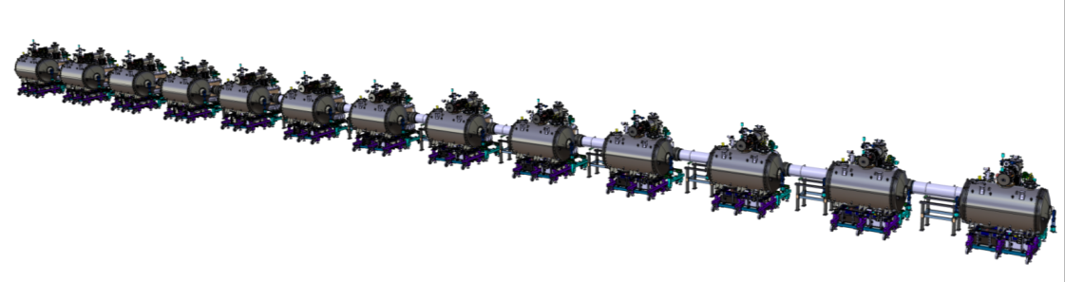
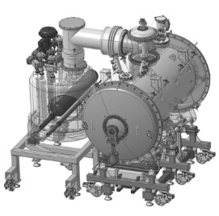
Work Unit 11.11.5.3 - AIK 11.2
CDR of the CDS-SL
Thermal analysis
April 19th 2017

Slide 2
ASSUMPTIONS
MATERIALS
  Stainless steel 304 L considered for:
    Vacuum vessels
    Pipes
    Valves bodies
    Supports of the thermal shields of the valve boxes
  Copper (RRR=10 ) considered for:
    The thermal shields of the valve boxes
    NB.: for Cu c1 (Cu OF), 100 < RRR < 200
  AL6082 considered for:
    The thermal shields of the hedares units
  G10 considered for:
    the supports of the cryogenic lines

Slide 3
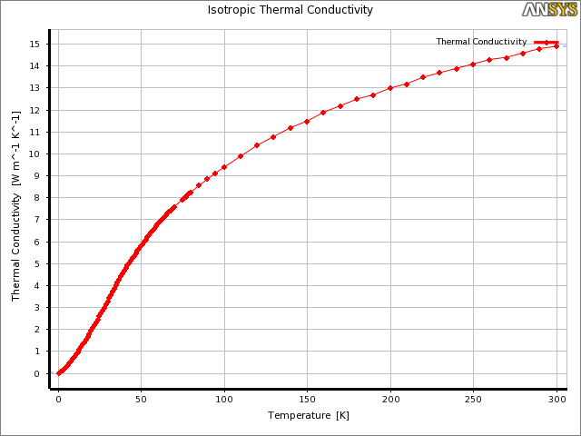
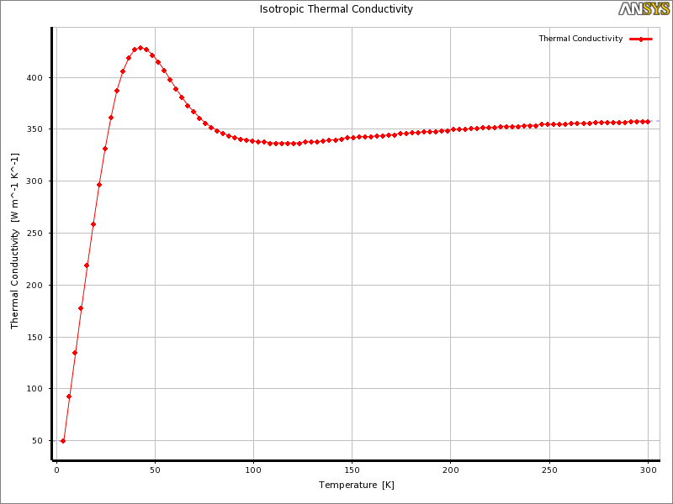
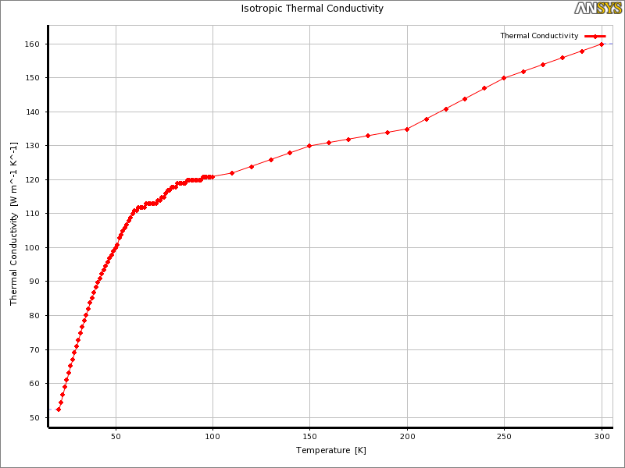
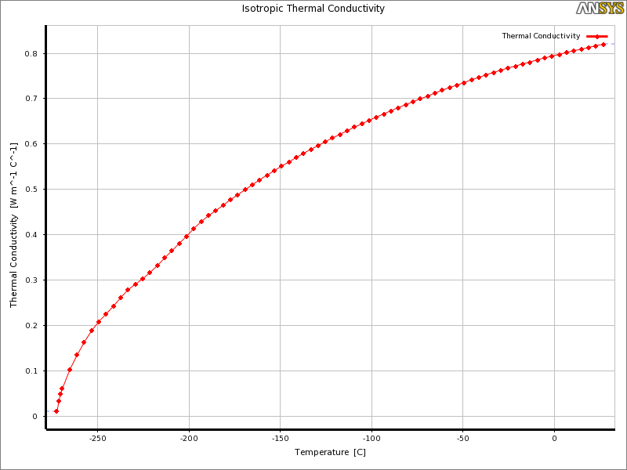
ASSUMPTIONS
MATERIALS
  Temperature dependant thermal conductivites is considered
304L
Cu_RRR=10
AL 6082
G10

Slide 4
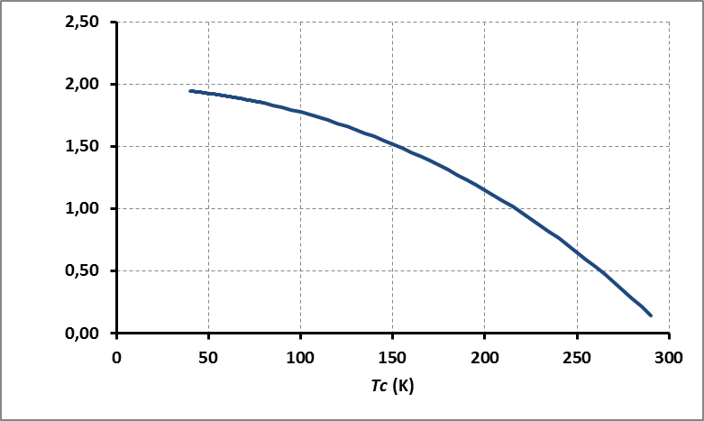

ASSUMPTIONS
Radiated heat
  Onto the TS shield (covered with 1.5 cm thick stack of 30 layers of MLI):
  Onto the cold mass (covered with 0.5 cm thick stack of 10 layers of MLI):
$$\dot{{\dot{q}}_{rad}=h^{′}\left(T_{h}−T_{c}\right)+{ε′}_{eff}\left({T_{h}}^{4}−{T_{c}}^{4}\right)}$$
⇒ 2 W/m² maximum
⇒ 0,05 W/m²

Slide 5
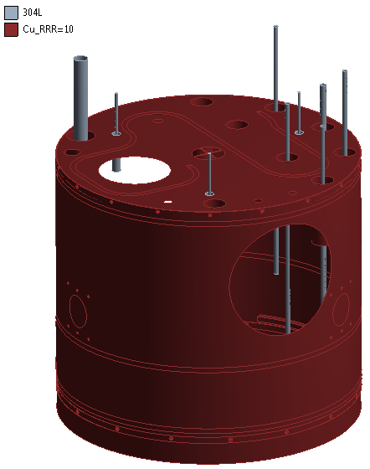
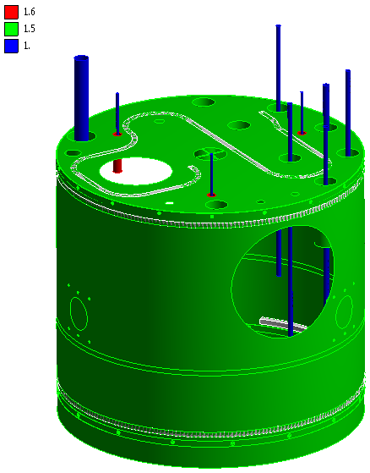
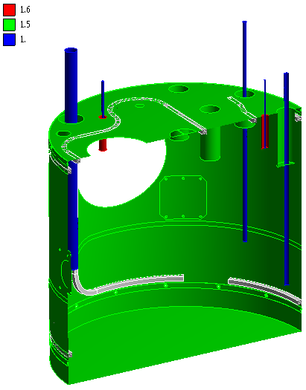
VALVE BOX
THERMAL SHIELD
  Conduction and radiation onto the thermal shield
Materials
Thicknesses of shell elements (mm)

Slide 6
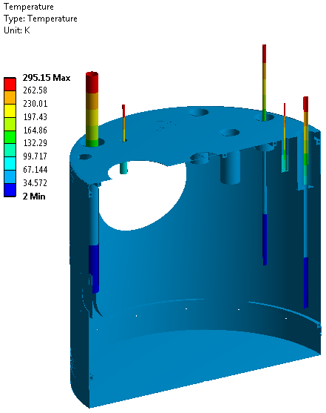
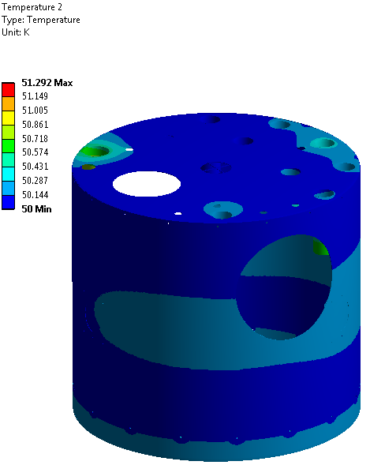
VALVE BOX
THERMAL SHIELD
  Conduction and radiation: temperature fields
⇒ 11.1 W

Slide 7
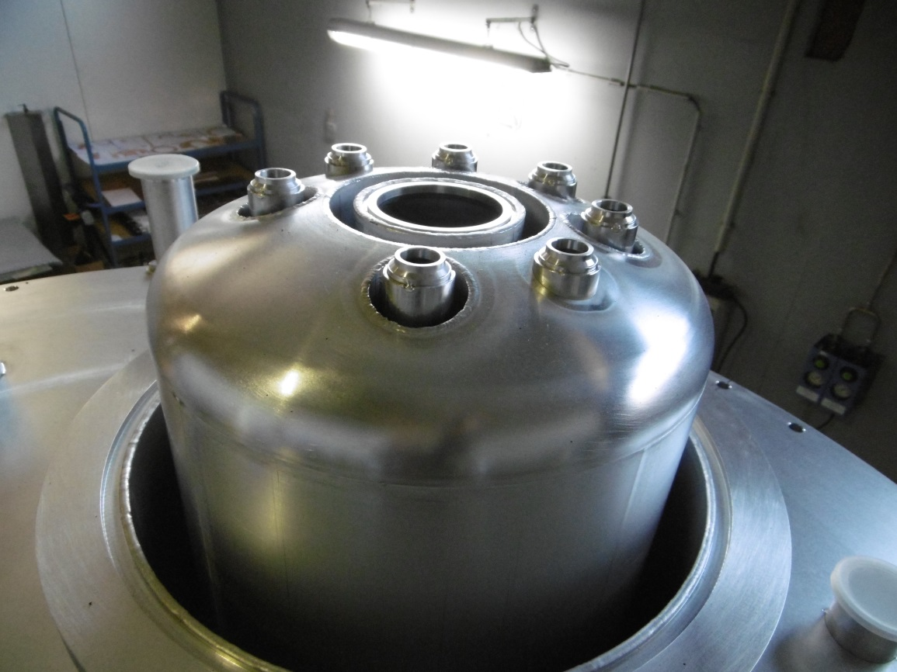
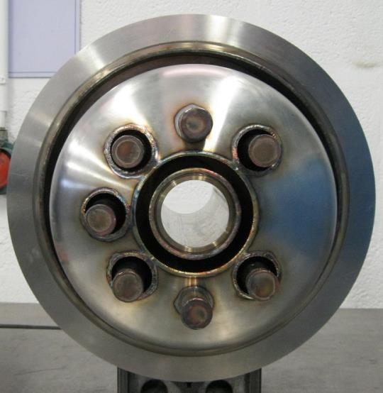
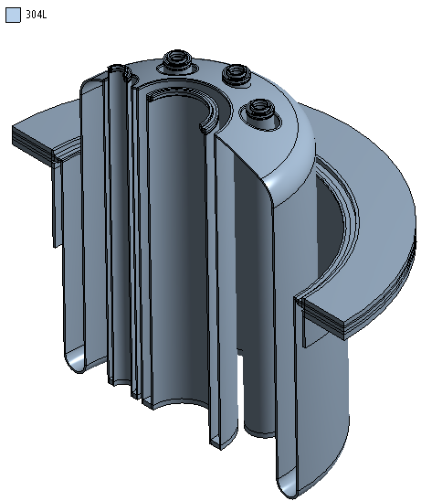
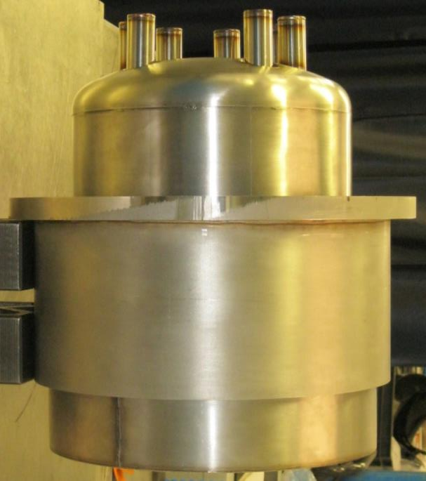
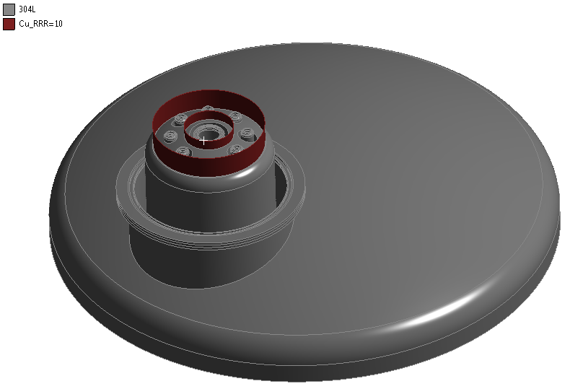
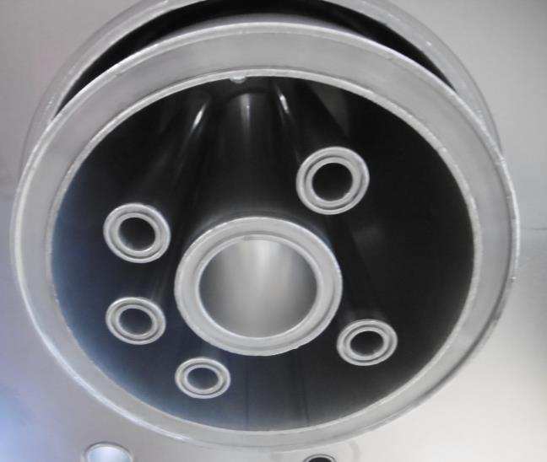
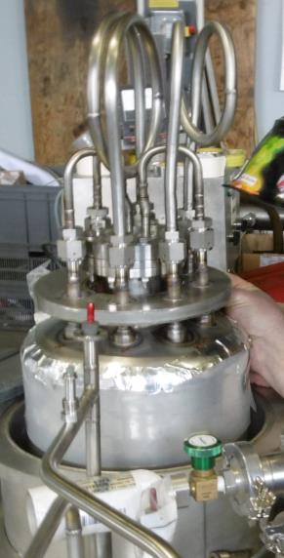
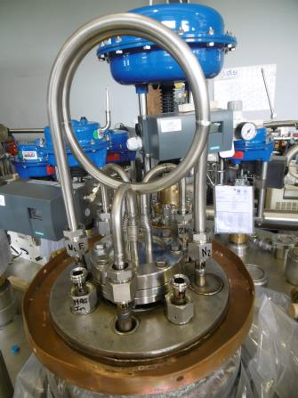
VALVE BOX
VACUUM BARIER
  Heat diffusion
Materials
Double heat intercept

Slide 8
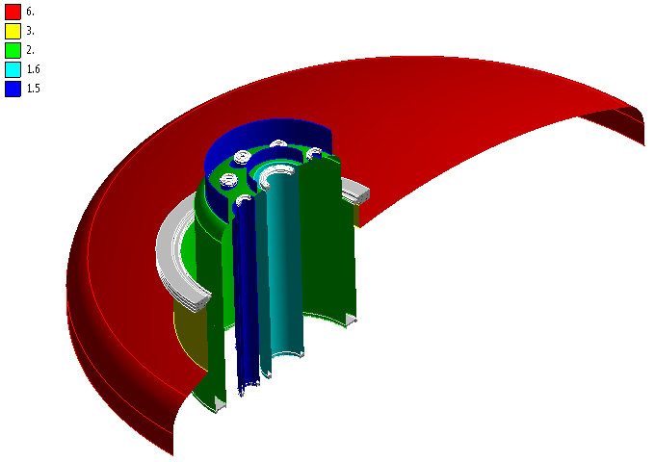
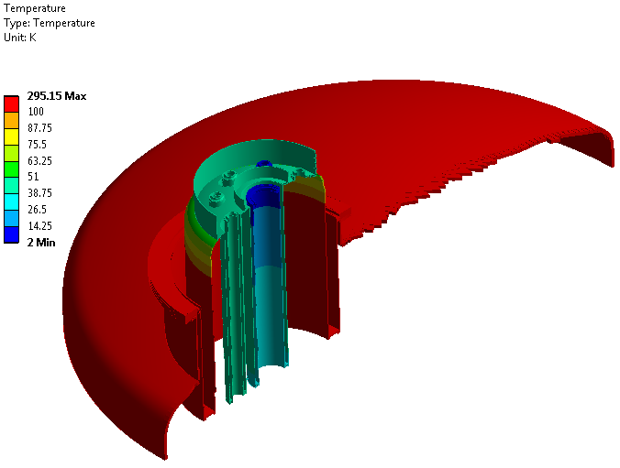
VALVE BOX
VACUUM BARIER
  Heat diffusion
Thicknesses of shell elements (mm)
Temperature
Branch line | Acronym | Temperature (K) | Heat load (W)
He supply | BC | 2.2 | 0.028
VLP | BB | 2 | 0.066
TS inlet | BE | 40 | 0.312
TS return | BF | 50 | 8.160
Power coupler supply |  | 5 | 0.028

Slide 9
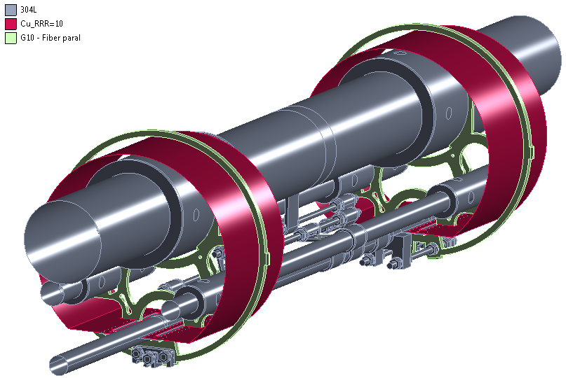
VALVE BOX
SUPPORTS OF THE MAIN CRYOLINES
  Heat diffusion and heat radiated (TS)

Slide 10
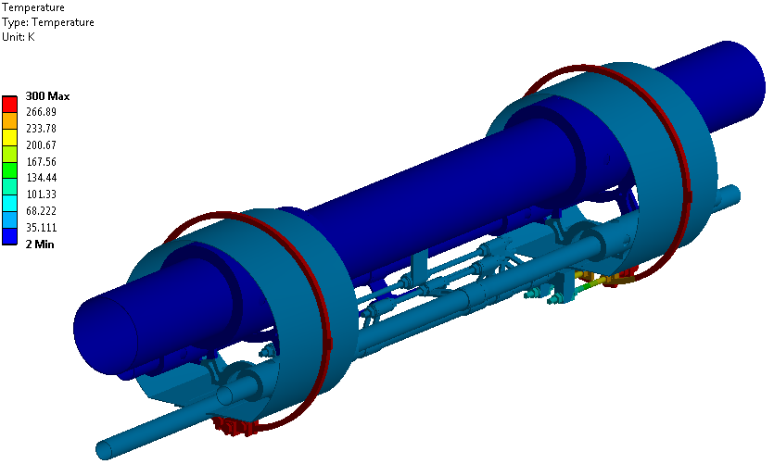
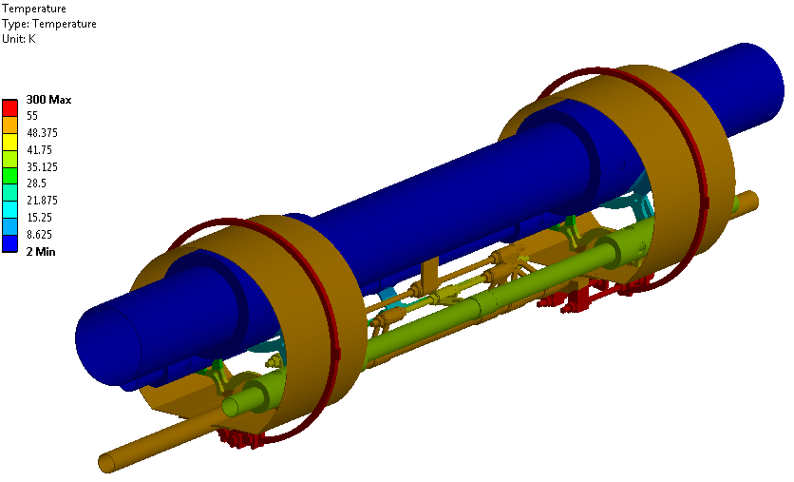
VALVE BOX
SUPPORTS OF THE MAIN CRYOLINES
  Temperature field
  Heat loads
Header line | Acronym | Temperature (K) | Heat load (W)
He supply | MC | 5.5 | 0.039
VLP | MB | 2 | 0.045
TS inlet | ME | 40 | 0.039
TS return | MF | 51 | 7.041

Slide 11
VALVE BOX
Heat loads due to the cryogenic valves
VALVE | CV01 | CV02 | CV03 | CV04 | CV06 | CV07 | CV60 | CV61 | CV63
Function | He II production | Cool-down / 4 K fill-in | Shut off valve | Shut off valve | Cool-down / warming-up | Magnetic shield cool down | Shut off valve | Shut off valve / regulation | Cool-down/ warming-up
Max. heat load at 51 K (W) | 0.4 | 0.4 | 0.4 | 0.5 | 0.4 | 0.4 | 0.3 | 0,2 | 0.3
Max. heat load at 4 K (W) | 0.1 | 0.1 | 0.15 | 0.6 | 0.15 | 0.1 | - | - | -
Max. heat load at 4 K (W) | 0.05 | 0.05 | 0.06 | 0.25 | 0.06 | 0.05 | - | - | -

Slide 12
VALVE BOX
Heat radiated onto the cold process lines
Header lines | Acronym | Outer diameter (mm) | Length (m) | Temperature (K) | Heat load (W)
He supply | MC | 42.4 | 1.792 | 5.5 | 0.012
VLP | MB | 139.7 | 1.792 | 2 | 0.039
TS supply | ME | 33.7 | 1.792 | 40 | 0.360
TS return | MF | 33.7 | 1.792 | 51 | 0.360
Branch line | Acronym | Temperature (K) | Heat load (W)
He supply (CV01 line including part of the heat exchanger and the magnetic shield cool-down line inlet) | BC | 2.2 | 0.016
VLP (CV04 line including part of the heat exchanger and the magnetic shield cool-down line outlet) | BB | 2 | 0.018
TS inlet | BE | 40 | 0.134
Power coupler supply |  | 5 | 0.003

Slide 13
VALVE BOX
Heat diffused from the vacuum vessel along the process lines (from the safety valves and/or warm valves and/or pressure sensors to the TS or cold mass)
Branch line | Acronym | Temperature (K) | Heat load (W)
TS supply side line | SE | 300 - 40 | 0.80
TS return side line 1 | SF1 | 300 - 50 | 0.10
Helium recovery side line 2 | SR2 | 300 - 50 | 0.18
Helium supply side line | SC1 | 300 - 50 | 1.14
Branch line | Acronym | Temperature (K) | Heat load (W)
Helium recovery side line 2 | SR2 | 300 - 50 | 0.19
Helium supply side line 1* | SC1 | 50 – 5 | 0.02

Slide 14
VALVE BOX
Valve box instrumentation
Sensor | Number | Wire material | AWG | Length (m) 300 K → 50 K | Length (m) 300 K → 5,5 - 2 K | Heat flux (W)
He supply | 6 | Maganin | 32 | 1 | 0.5 - 1 | 0.002
VLP | 4 | Maganin | 32 | 1 | 1 | 0.001
TS inlet | 1 | Maganin | 32 | 0.5 | - | < 0.001
TS return | 1 | Maganin | 32 | 0.5 | - | 0.003
Power coupler supply | 1 | Maganin | 32 | 0.5 | 0.5 | < 0.001

Slide 15
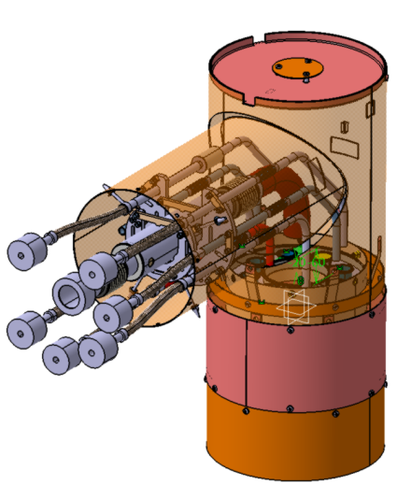
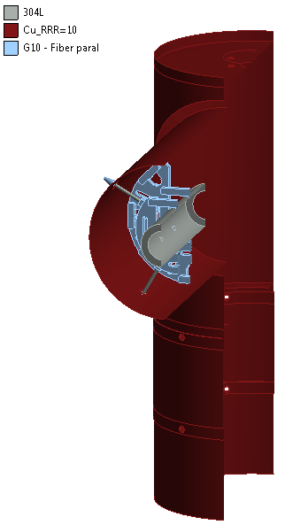
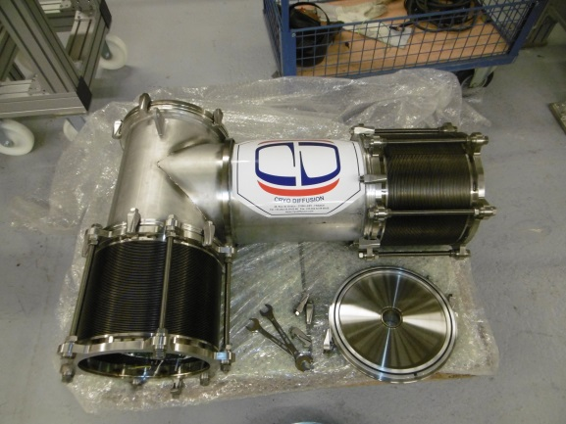
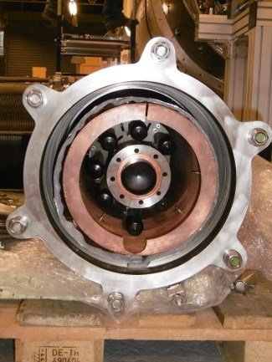
VALVE BOX
Cryogenic jumper
  Preliminary design (update of the prototype jumper)

Slide 16
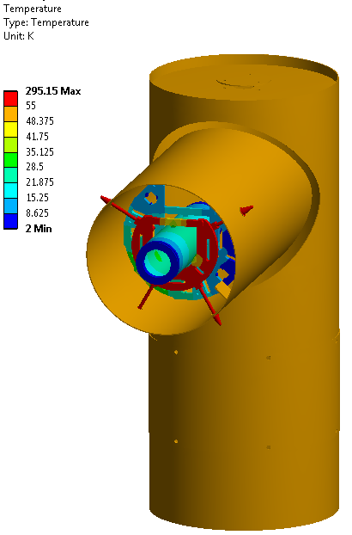
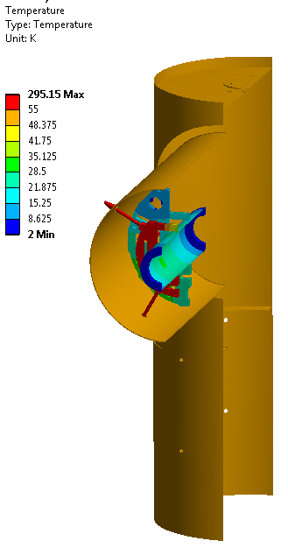
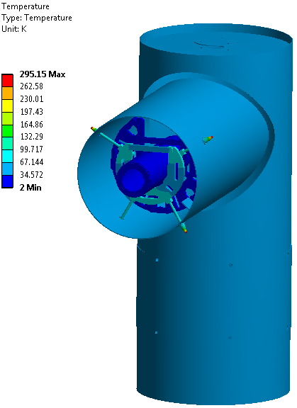
VALVE BOX
Branch line | Acronym | Temperature (K) | Heat load (W)
He supply | BC | 2.2 | 0.007
VLP | BB | 2 | 0.170
TS inlet | BE | 40 | 0.028
TS return | BF | 50 | 2.62
Power coupler supply |  | 5 | 0.013

Slide 17
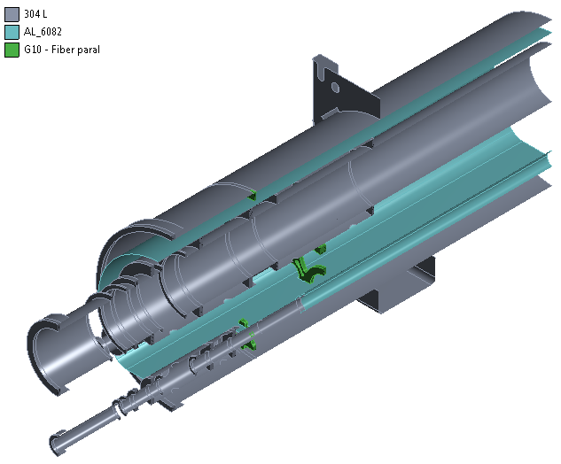
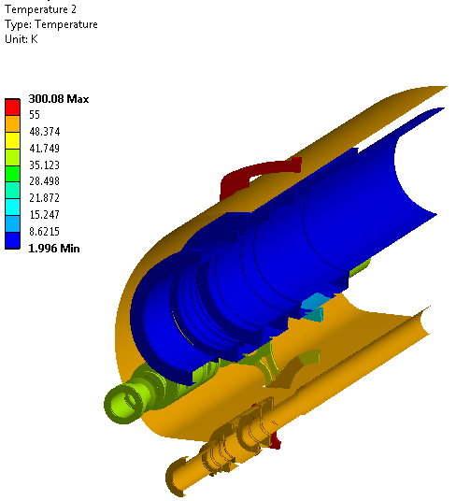
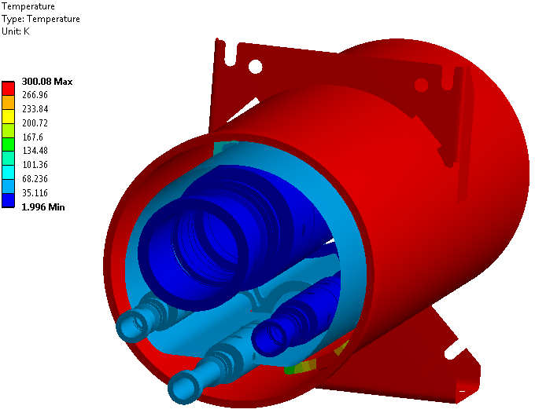
HEADERS UNIT
Heat diffusing in the supports and heat radiated
Header line | Acronym | Temperature (K) | Heat load (W)
He supply | MC | 4.5 | 0,071
VLP | MB | 2 | 0,016
TS inlet | ME | 40 | 0,052
TS return | MF | 51 | 7,178

Slide 18
VALVE BOX
TOTAL BUDGET
  Estimations
  Requirements
 | He supply | VLP | TS inlet | TS return
 | (W) | (W) | (W) | (W)
13x VB | 8.06 | 20.74 | 25.69 | 438.43
13x HU | 0.92 | 2.11 | 0.68 | 93.32
1x End Box | ? | ? | ? | ?
TOTAL | 9,0 | 22,9 | 26,4 | 531.8
Maximum allowable heat loads for the CDS of the Spoke linac section.
Helium supply line (W) | VLP line (W) | TS supply line (W) | TS return line (W)
28.6 | 68.8 | 25.2 | 606
Margin | Margin | Excess | Margin

Slide 19
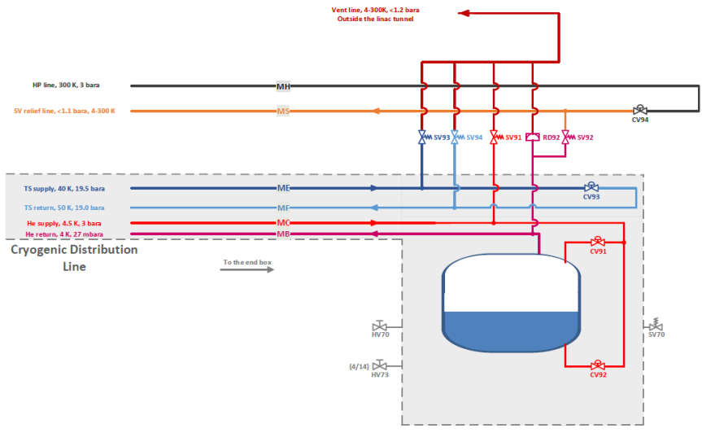
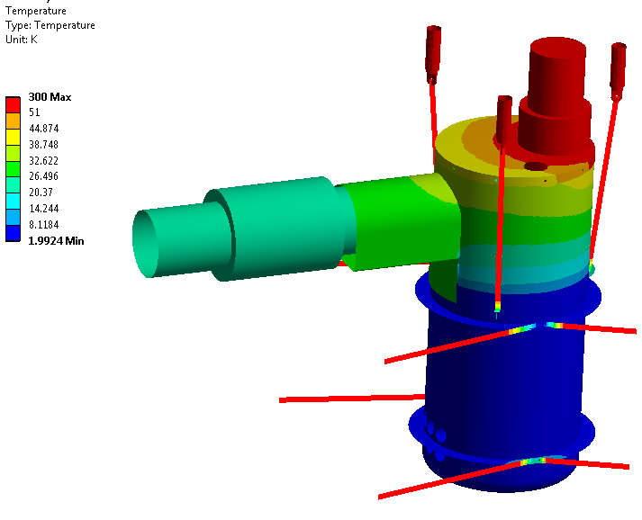
End Box
 | TS supply line (W) | TS return line (W)
Current estimation | 26.4 | 531.8
 | ? | ?
 | Excess | Margin
  1- Increase length of SE (TS supply to CV62)
  2- End Box
⇒

Slide 20
THERMOACOUSTISC OSCILLATIONS
Based on Rott’s theory
  Onset on thermoacoustic instabality defined in the space of 3 parameters:
    Thermal parameter:
    Geometric parameter:
    Acoustic parameter:
T_{c}
T_{h}

Slide 21
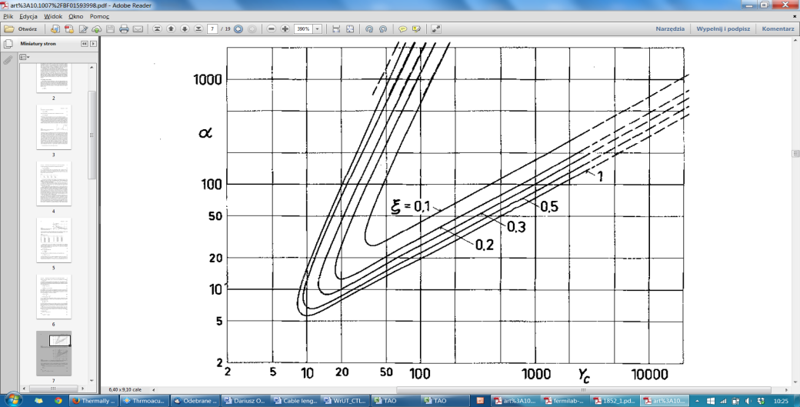
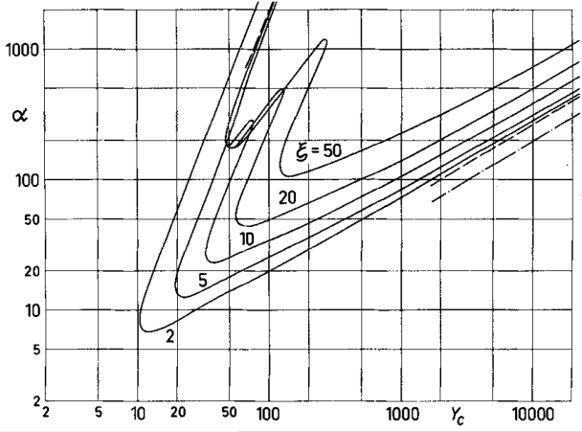
THERMOACOUSTISC OSCILLATIONS
Based on Rott’s theory
  Onset on thermoacoustic instabality defined in the space of 3 parameters:

Slide 22
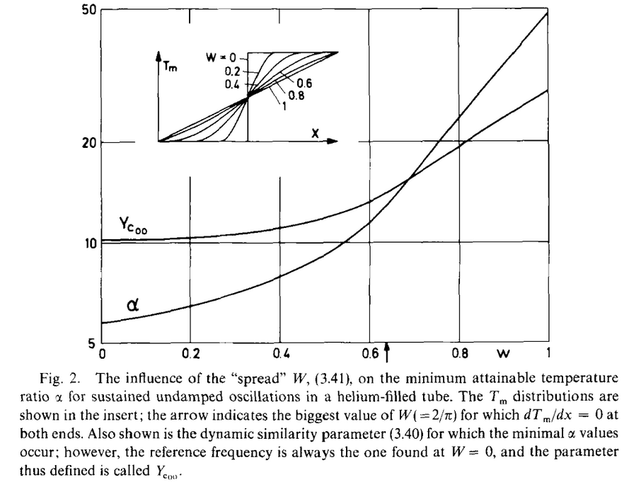
THERMOACOUSTISC OSCILLATIONS
Based on Rott’s theory
  Shape of the temperature gradient
the steeper is the temperature gradient, the more are potentially driven TAO
the assumption of step temperature profile is conservative

Slide 23
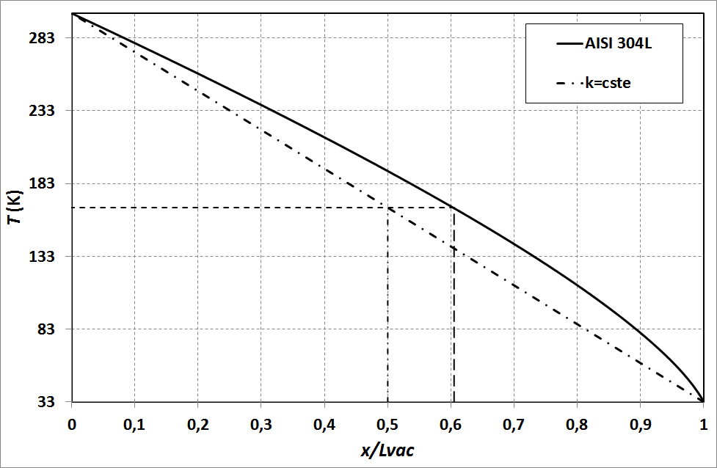
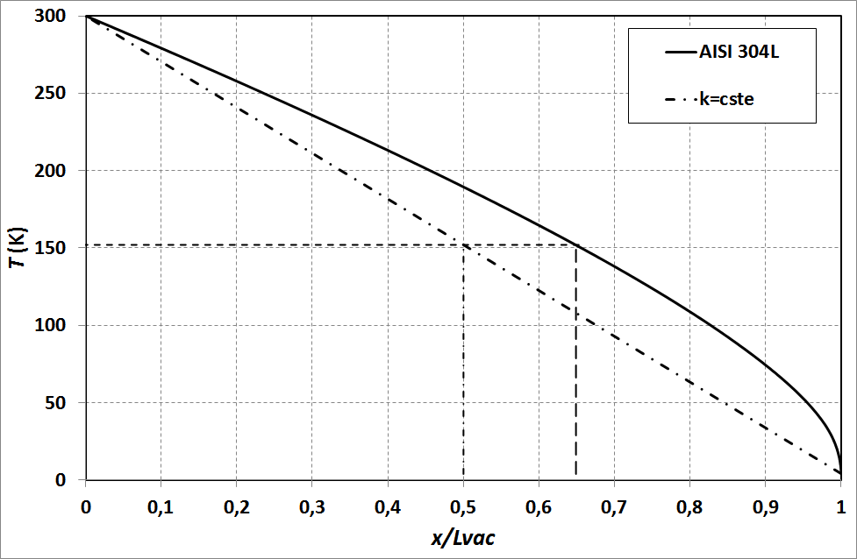
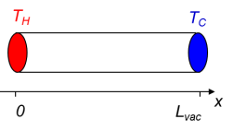
THERMOACOUSTISC OSCILLATIONS
Step-temperature profile and cold and hot lengths
T
T_{H}
T_{C}
x
0
0.35(or 0.4) L_{vac}
L-L_{room}
L
L_{vac}
L_{room}
Closed end
At room T°
Connection to the cryogenic line
(opened end)
Cold portion : l
Hot portion : L-l
T_{c}=33 K
T_{c}=2 to 5 K

Slide 24
THERMOACOUSTISC OSCILLATIONS
Results
Segment | ø_{int} | Lvac | Lroom | L | L-l | l | T_{H} | T_{C} | p | ac | vc | α | ξ | Yc | TAO
 | (mm) | (m) | (m) | (m) | (m) | (m) | (K) | (K) | bara | (m/s) | (m²/s) | (-) | (-) | (-) | (-)
SF1:TS->HV60 | 10.3 | 1.784 | 0.375 | 2.159 | 1.45 | 0.71 | 300 | 33 | 19 | 364 | 2.04E-07 | 9.09 | 2.03 | 257.70 | NO
SF1:TS->SV60 | 10.3 | 1.784 | 0.211 | 1.995 | 1.28 | 0.71 | 300 | 33 | 19 | 364 | 2.04E-07 | 9.09 | 1.79 | 257.70 | NO
SE:TS->PT60 | 10.3 | 0.225 | 0.096 | 0.321 | 0.23 | 0.09 | 300 | 33 | 19.5 | 365 | 1.99E-07 | 9.09 | 2.57 | 734.93 | NO
SE:TS->NV60 | 10.3 | 0.225 | 0.443 | 0.668 | 0.58 | 0.09 | 300 | 33 | 19.5 | 365 | 1.99E-07 | 9.09 | 6.42 | 734.93 | NO
SE:TS->HV61 | 10.3 | 0.225 | 0.474 | 0.699 | 0.61 | 0.09 | 300 | 33 | 19.5 | 365 | 1.99E-07 | 9.09 | 6.76 | 734.93 | NO
SC1:He->CV05 | 10.3 | 0.633 | 0.557 | 1.190 | 0.97 | 0.22 | 300 | 4.5 | 3 | 202 | 2.67E-08 | 66.67 | 4.37 | 951.22 | NO
SC1:He->HV01 | 10.3 | 0.633 | 0.492 | 1.125 | 0.90 | 0.22 | 300 | 4.5 | 3 | 202 | 2.67E-08 | 66.67 | 4.08 | 951.22 | NO
SC1:He->PT01 | 10.3 | 0.633 | 0.500 | 1.133 | 0.91 | 0.22 | 300 | 4.5 | 3 | 202 | 2.67E-08 | 66.67 | 4.11 | 951.22 | NO
SC1:He->SV01 | 10.3 | 0.633 | 0.481 | 1.114 | 0.89 | 0.22 | 300 | 4.5 | 3 | 202 | 2.67E-08 | 66.67 | 4.03 | 951.22 | NO
SC1:He->CV05 | 10.3 | 0.633 | 0.557 | 1.190 | 0.97 | 0.22 | 300 | 5.5 | 3 | 128 | 2.87E-08 | 54.55 | 4.37 | 730.11 | NO
SC1:He->HV01 | 10.3 | 0.633 | 0.492 | 1.125 | 0.90 | 0.22 | 300 | 5.5 | 3 | 128 | 2.87E-08 | 54.55 | 4.08 | 730.11 | NO
SC1:He->PT01 | 10.3 | 0.633 | 0.500 | 1.133 | 0.91 | 0.22 | 300 | 5.5 | 3 | 128 | 2.87E-08 | 54.55 | 4.11 | 730.11 | NO
SC1:He->SV01 | 10.3 | 0.633 | 0.481 | 1.114 | 0.89 | 0.22 | 300 | 5.5 | 3 | 128 | 2.87E-08 | 54.55 | 4.03 | 730.11 | NO
SR2:He->CV63 | 14 | 1.661 | 1.406 | 3.067 | 2.40 | 0.66 | 300 | 33 | 1.1 | 339.4 | 3.08E-06 | 9.09 | 3.62 | 90.21 | NO
SR2:He->NV01 | 14 | 1.538 | 1.406 | 2.944 | 2.41 | 0.54 | 300 | 4.5 | 1 | 108.4 | 1.06E-07 | 66.67 | 4.47 | 305.61 | NO
SR2:He->NV01 | 14 | 1.538 |  | 1.538 | 1.00 | 0.54 | 300 | 5.5 | 1 | 129 | 1.06E-07 | 54.55 | 1.86 | 333.38 | NO

Slide 25
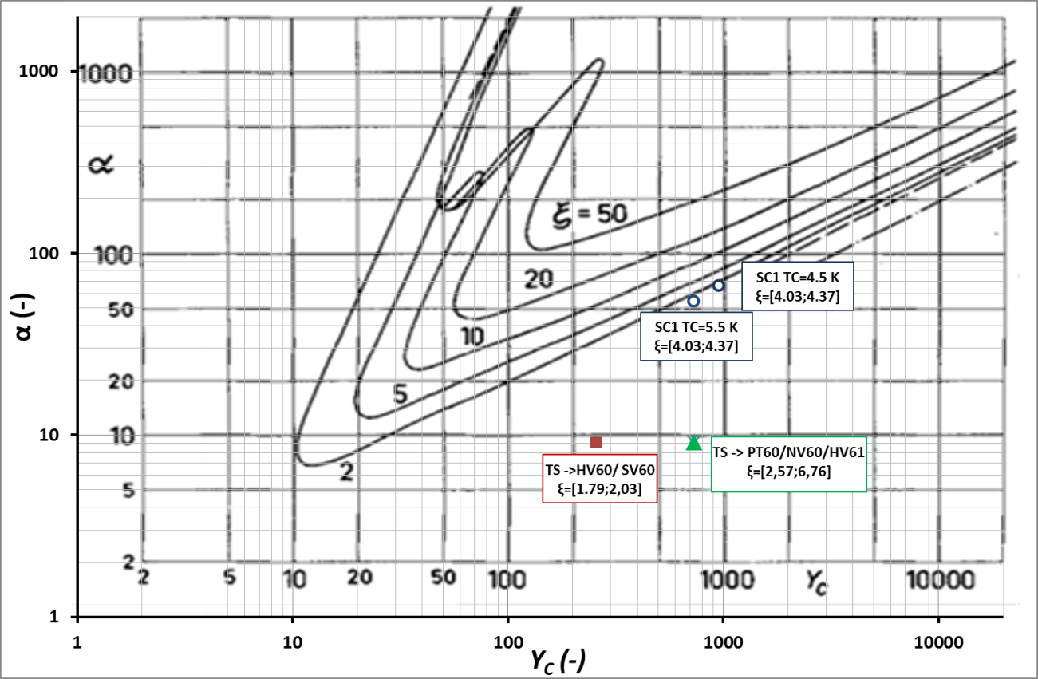
THERMOACOUSTISC OSCILLATIONS
Results

Slide 26
Thank you for your attention
CSP12
28 Novembre 2014

