Slide 1
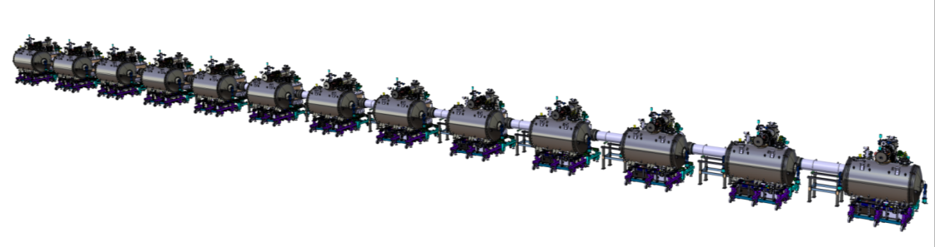
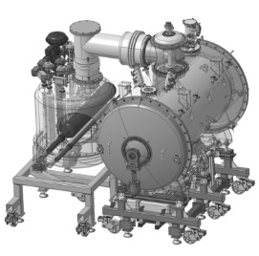
WP11: CDS-SL CDR
Cryogenics
April 19th 2017

Slide 2
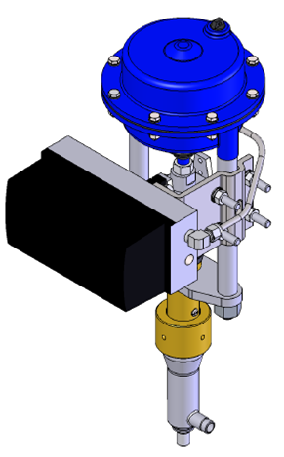
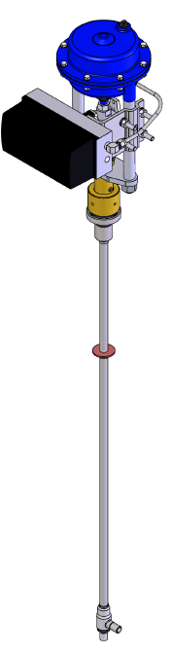
Outline
Cryogenic and warm control valves sizing
  Control valves sizing
  Valve box
    Thermal shield circuit
    Cold mass circuit
  End box
    Thermal shield circuit
    Cold mass circuit
  Control valves properties
Auxiliary lines pressure drops
Cryogenic circuits pressure drops
  Thermal shield circuit
    Valve box
    Main cold process lines
  Helium circuit
    Valve box
    Main cold process lines

Slide 3
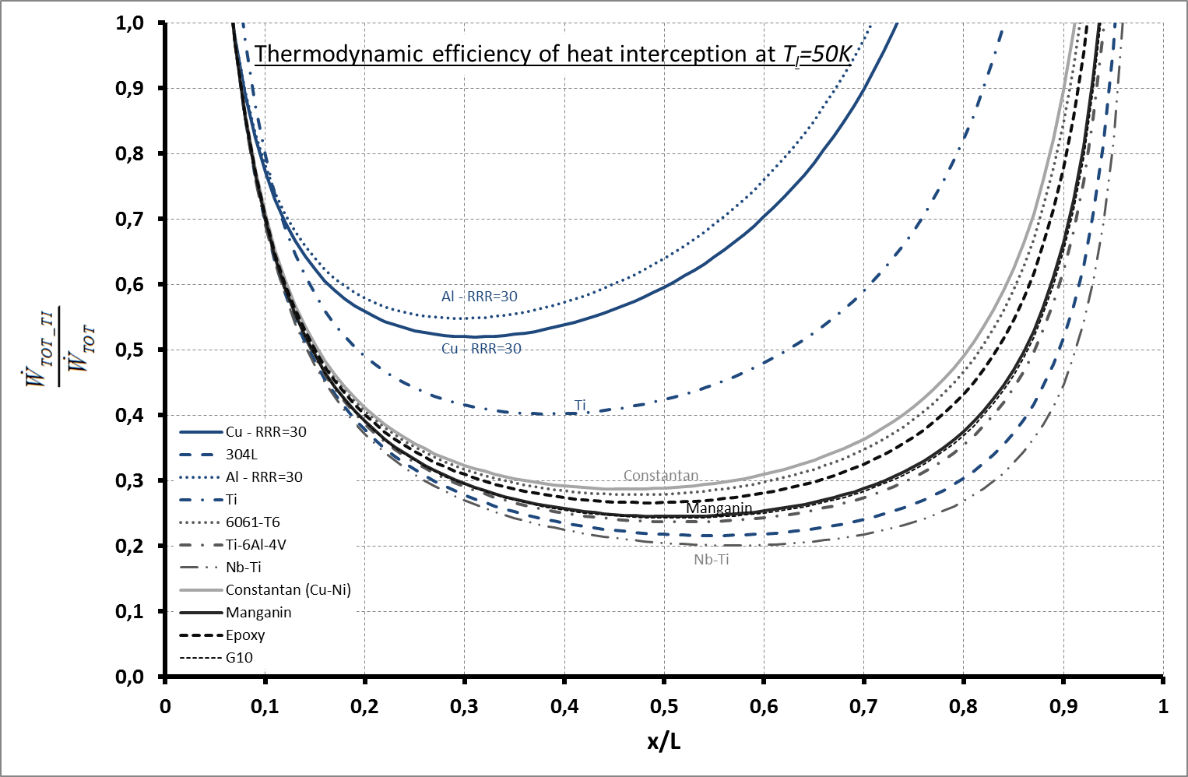
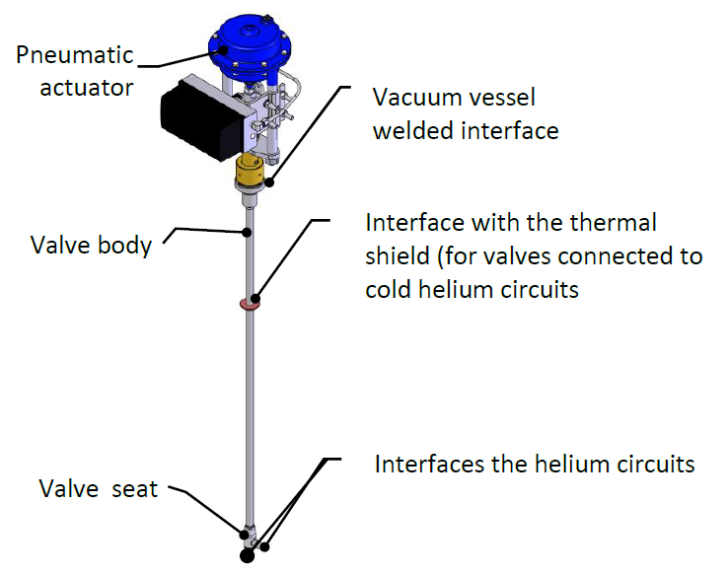
Valves sizing – Overview 1/2
Control valves
Positioner
Warm control valve
Cryogenic control valve

Slide 4
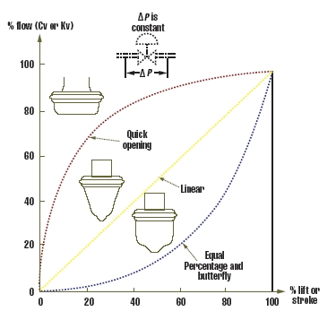
Valves sizing – Overview 2/2
Control valves
  For each valve, we calculate for flow control:
  A minimum Kv value
    Lowest mass flow rate, liquid or cold vapors
    or requirements
  A maximum Kv value
    Highest mass flow rate, liquid or warm gas
    or requirements
Then we determine the operating points
of the valve and we draw the valve curve.
High sensitivity

Slide 5
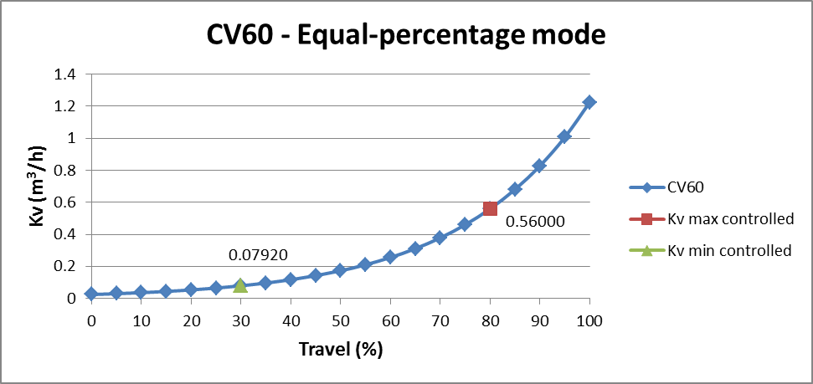
Valve box
Thermal shield circuit – CV60
Max Kv

Slide 6
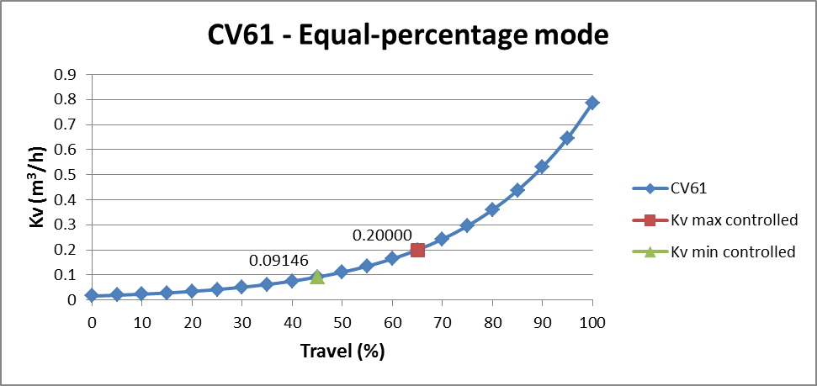
Valve box
Thermal shield circuit – CV61
Max Kv

Slide 7
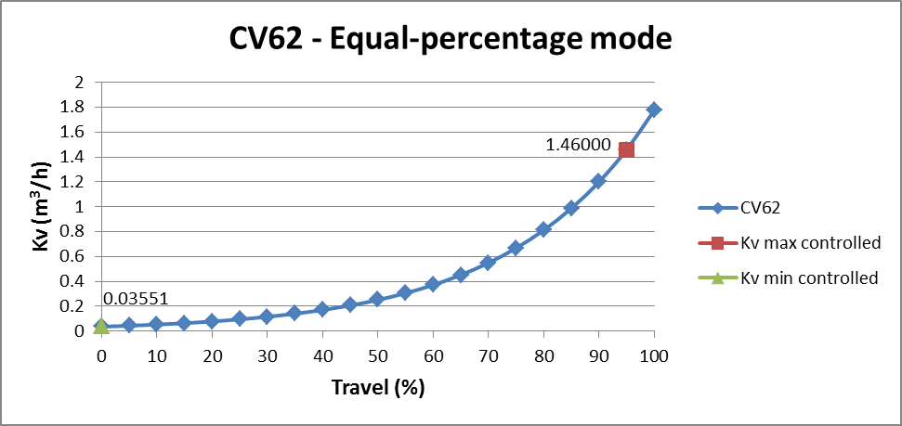
Valve box
Thermal shield circuit – CV62
Max Kv

Slide 8
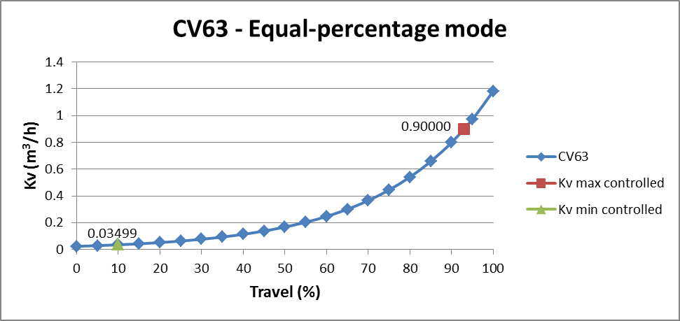
Valve box
Thermal shield circuit – CV63
Max Kv

Slide 9
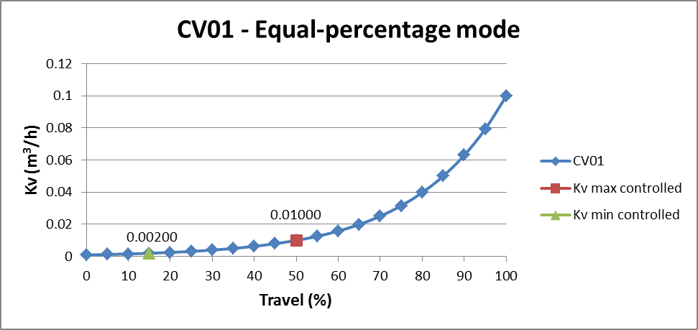
Valve box
Helium circuit – CV01
Max Kv

Slide 10
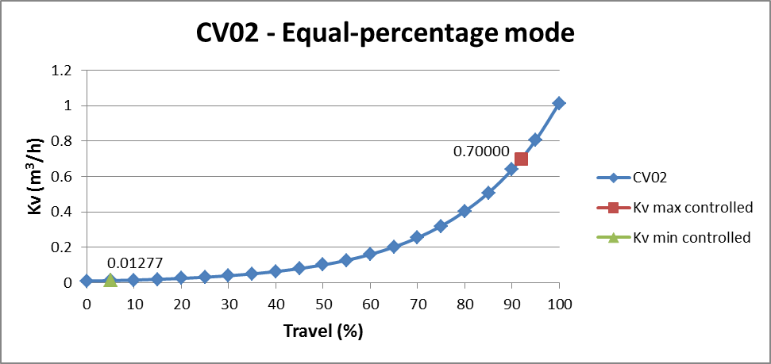
Valve box
Helium circuit – CV02
Max Kv

Slide 11
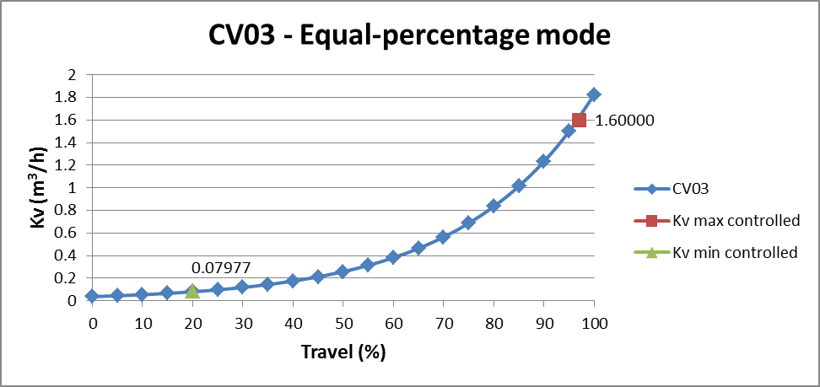
Valve box
Helium circuit – CV03
Max Kv

Slide 12
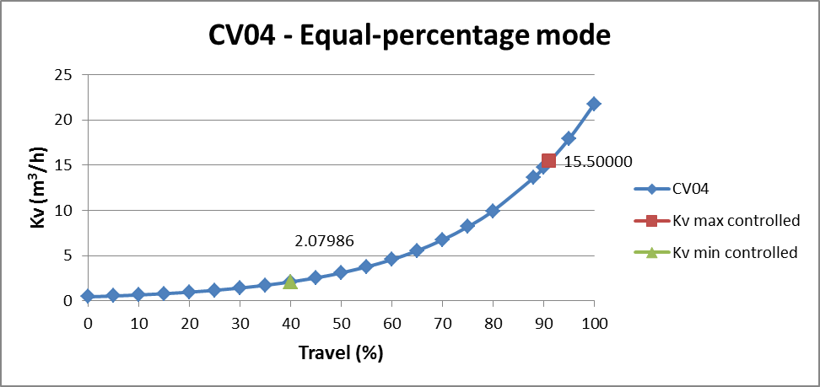
Valve box
Helium circuit – CV04
Max Kv

Slide 13
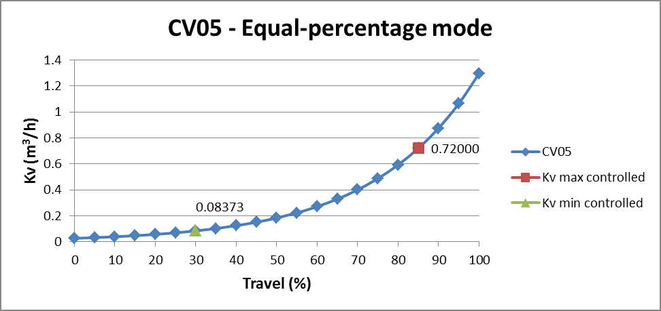
Valve box
Helium circuit – CV05
Max Kv

Slide 14
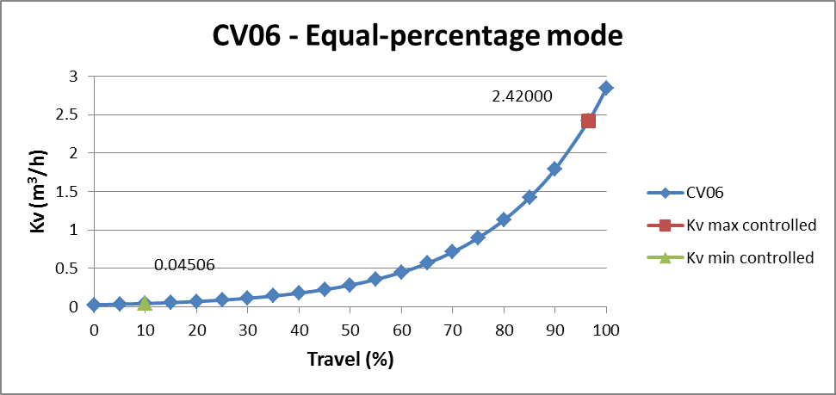
Valve box
Helium circuit – CV06
Max Kv

Slide 15
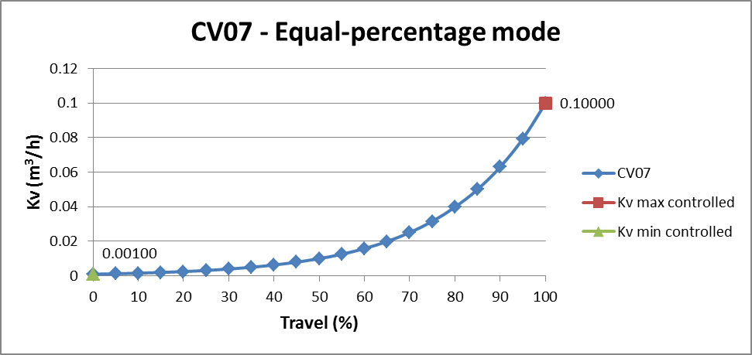
Valve box
Helium circuit – CV07
Max Kv

Slide 16
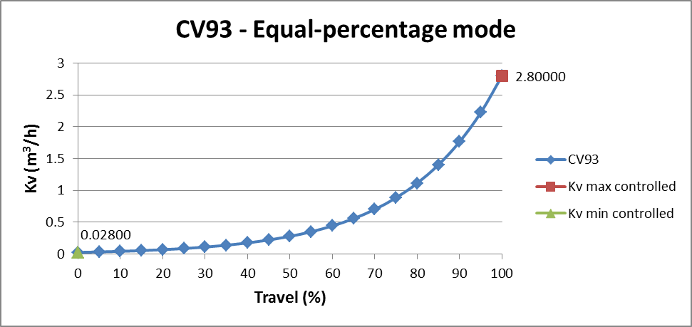
End box
Thermal shield circuit – CV93
Max Kv

Slide 17
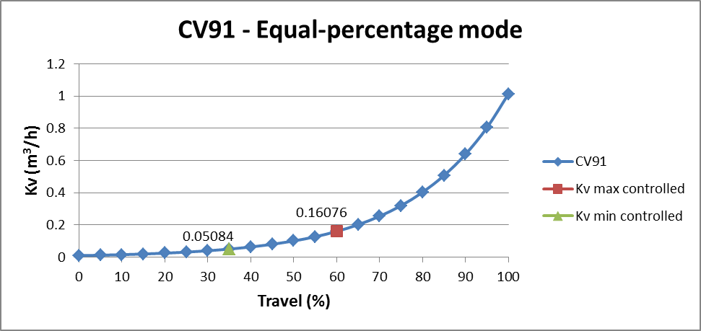
End box
Helium circuit – CV91
Max Kv

Slide 18
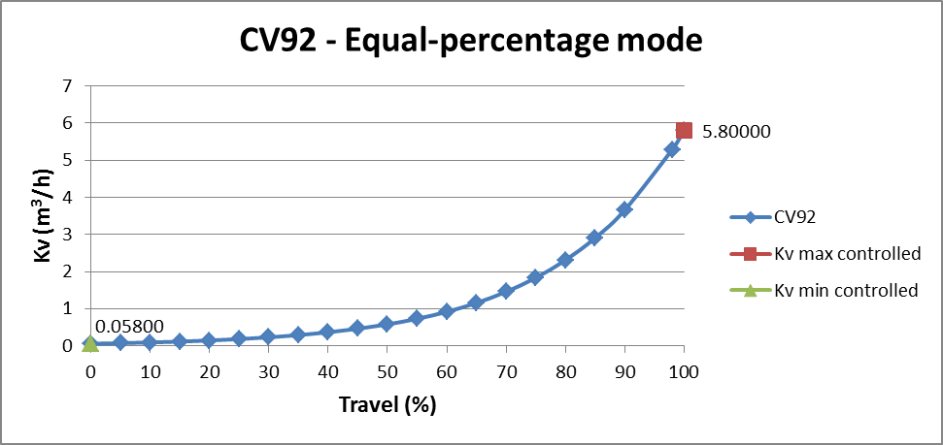
End box
Helium circuit – CV92
Max Kv

Slide 19

End box
HP line – CV94
Max Kv

Slide 20
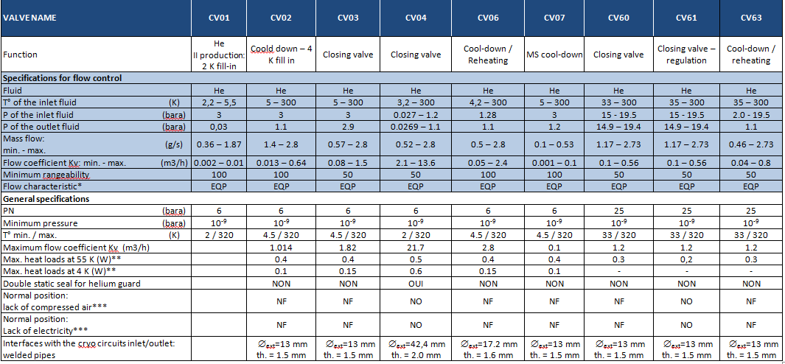
Valves sizing - Overview
Cryogenic control valves properties – Valve box

Slide 21
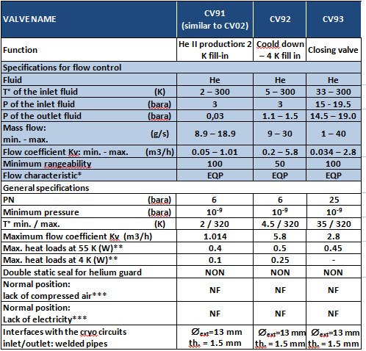
Valves sizing - Overview
Cryogenic control valves properties – End box

Slide 22
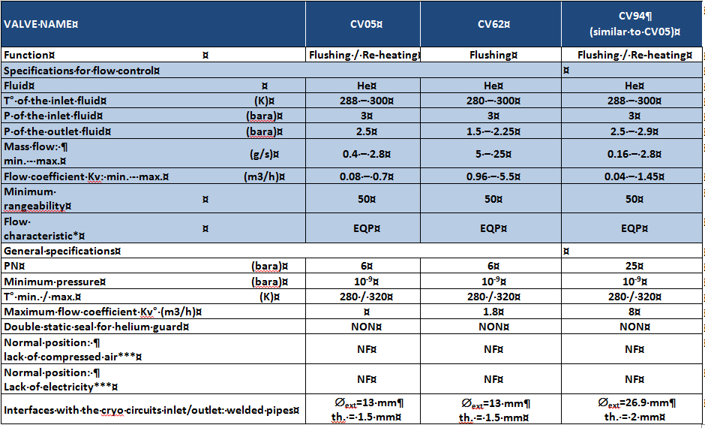
Valves sizing - Overview
Warm control valves properties – Valve box and End box

Slide 23


Pressure drops
Auxiliary pressure lines
  Regular pressure drops in a smooth pipe
Branch and side lines
  Regular pressure drops in a smooth pipe
  Singular pressure drops:
  Stream direction change
  Sudden velocity variation
Main cold process lines
  Regular pressure drops in a smooth pipe
  Singular pressure drops:
  Stream direction change
  Sudden velocity variation
  Flow divisions and junctions
Circuits are divided into several elements:
straight section, elbow, T, valves, HX…
Singular pressure drop coefficients extracted from

Slide 24
Auxiliary lines
Regular pressure drops
60m
ΔP
Thermo-physical properties of the fluid are considered constant along the line
Requirements

Slide 25
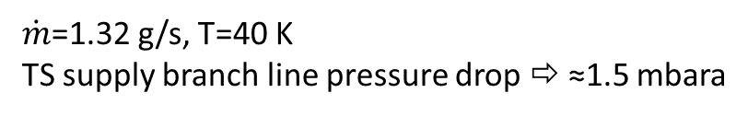
Thermal shield
VB - Thermal shield circuit – TS supply branch line (BE)
ΔP
$\dot{m}$=1.32 g/s, T=40 K
TS supply branch line pressure drop ⇨ ≈1.5 mbara

Slide 26
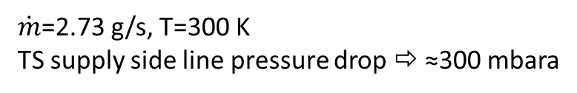
Thermal shield
Thermal shield circuit – TS supply side line (SE+BE)
ΔP
$\dot{m}$=2.73 g/s, T=300 K
TS supply side line pressure drop ⇨ ≈300 mbara

Slide 27
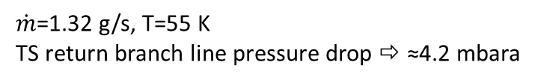
Thermal shield
Thermal shield circuit – TS return branch line (BF)
ΔP
$\dot{m}$=1.32 g/s, T=55 K
TS return branch line pressure drop ⇨ ≈4.2 mbara

Slide 28
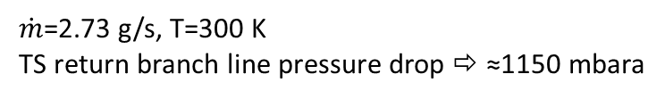
Thermal shield
Thermal shield circuit – TS return side line (BF+SF2)
ΔP
$\dot{m}$=2.73 g/s, T=300 K
TS return branch line pressure drop ⇨ ≈1150 mbara

Slide 29

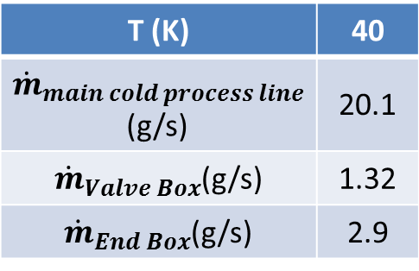



Thermal shield
Main cold process lines
CDS-EL / CDS-SL interface
ΔP
T (K) | 40
${\dot{m}}_{main cold process line}$(g/s) | 20.1
${\dot{m}}_{Valve Box}$(g/s) | 1.32
${\dot{m}}_{End Box}$(g/s) | 2.9
$${\dot{m}}_{main cold process line}=13×{\dot{m}}_{Valve Box}+{\dot{m}}_{End Box}$$
End box
$${\dot{m}}_{EB}$$
$${\dot{m}}_{VB}$$
$${\dot{m}}_{VB}$$
$${\dot{m}}_{VB}$$
VB13
VB02
VB01
ΔP
$${\dot{m}}_{main cold process line}=13×{\dot{m}}_{Valve Box}+{\dot{m}}_{End Box}$$
End box
$${\dot{m}}_{EB}$$
$${\dot{m}}_{VB}$$
$${\dot{m}}_{VB}$$
$${\dot{m}}_{VB}$$
VB13
VB02
VB01
CDS-EL / CDS-SL interface

Slide 30
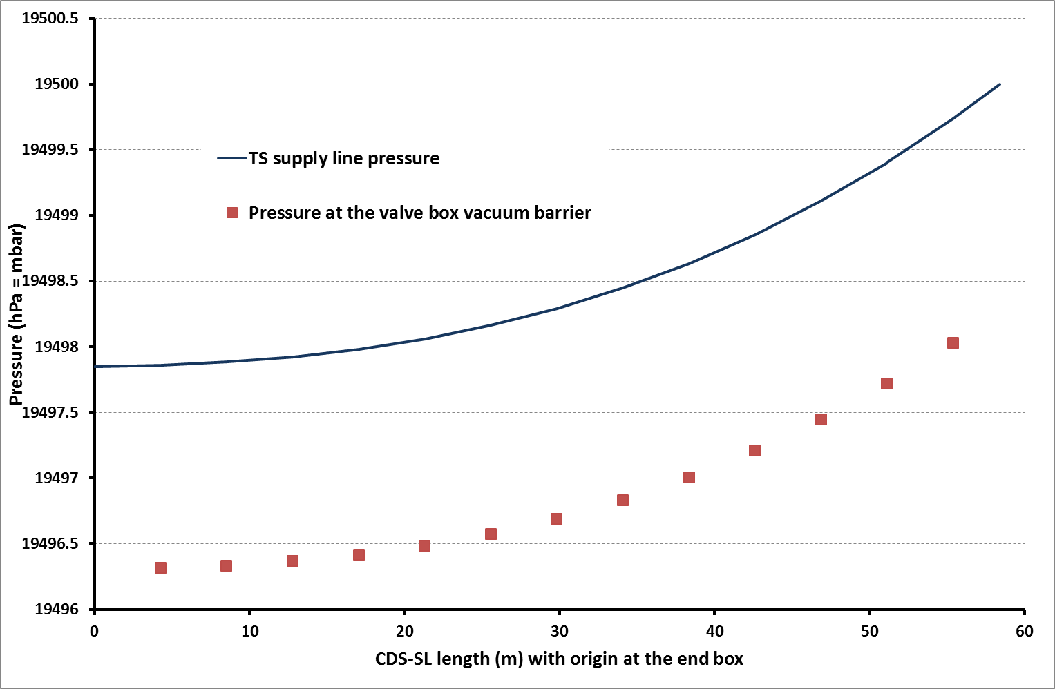
Thermal shield
Main TS supply line
⇨≈2.2mbara

Slide 31
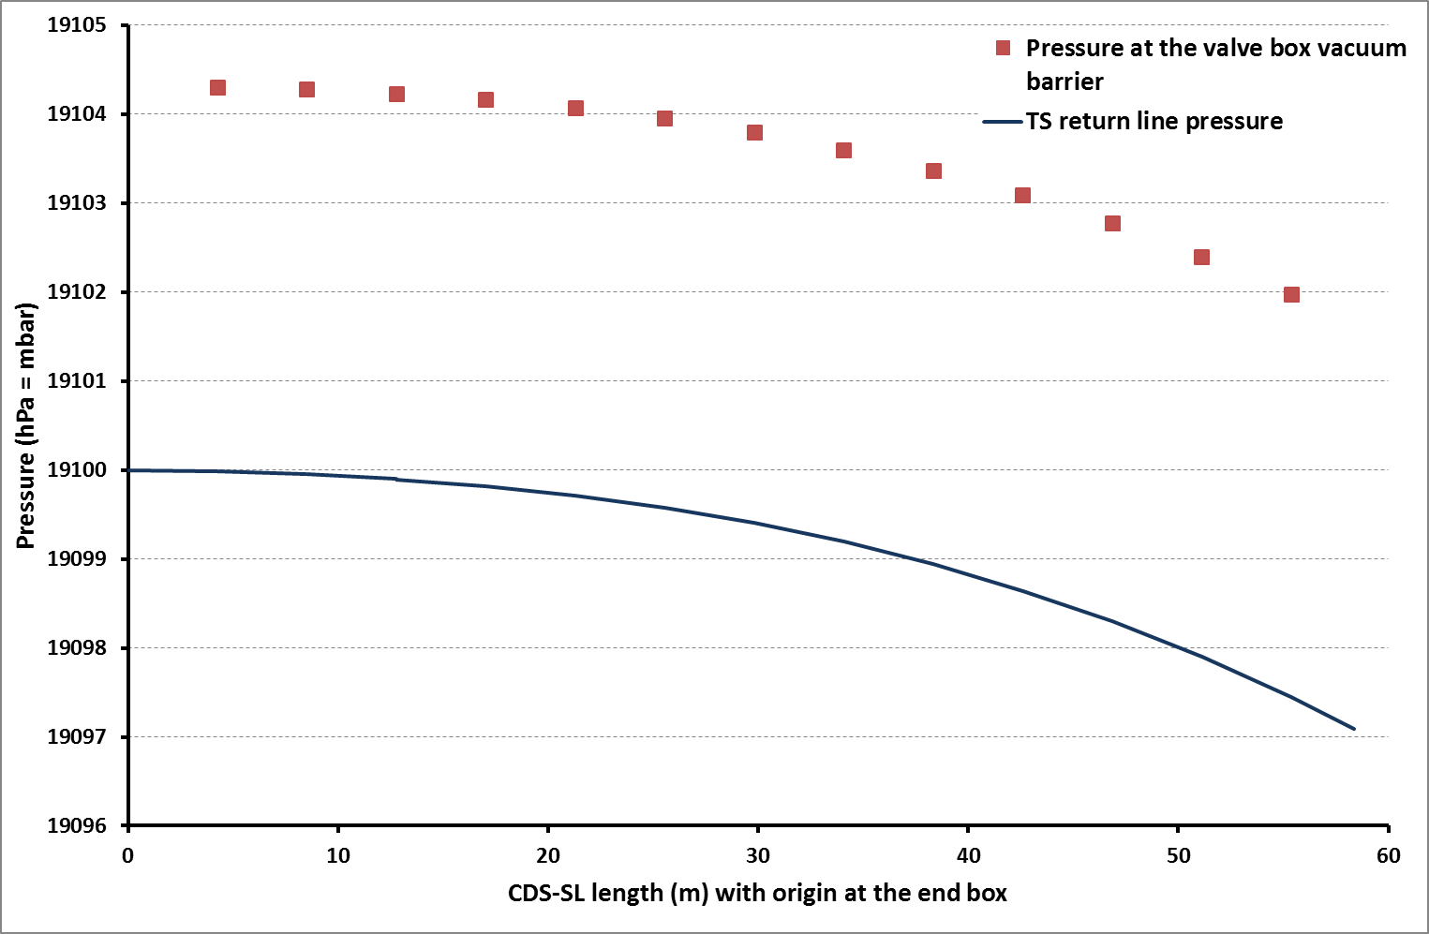
Thermal shield
Main TS return line
⇨≈3mbara

Slide 32
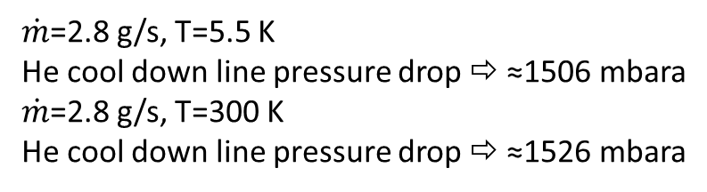
He circuit
VB – Helium circuit – He cool down line (BC)
ΔP
$\dot{m}$=2.8 g/s, T=5.5 K
He cool down line pressure drop ⇨ ≈1506 mbara
$\dot{m}$=2.8 g/s, T=300 K
He cool down line pressure drop ⇨ ≈1526 mbara

Slide 33
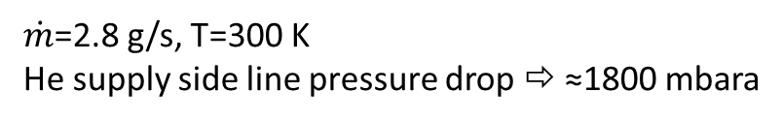
He circuit
VB – Helium circuit – He supply side line (SC1+BC)
ΔP
$\dot{m}$=2.8 g/s, T=300 K
He supply side line pressure drop ⇨ ≈1800 mbara

Slide 34
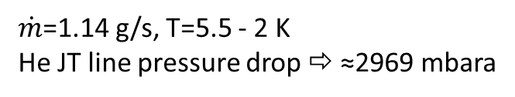
He circuit
VB – Helium circuit – He JT line
ΔP
$\dot{m}$=1.14 g/s, T=5.5 - 2 K
He JT line pressure drop ⇨ ≈2969 mbara

Slide 35
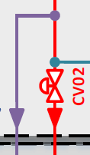
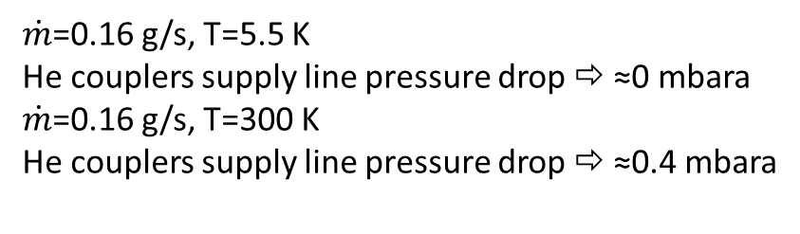
He circuit
VB – Helium circuit – He couplers supply line
ΔP
$\dot{m}$=0.16 g/s, T=5.5 K
He couplers supply line pressure drop ⇨ ≈0 mbara
$\dot{m}$=0.16 g/s, T=300 K
He couplers supply line pressure drop ⇨ ≈0.4 mbara

Slide 36
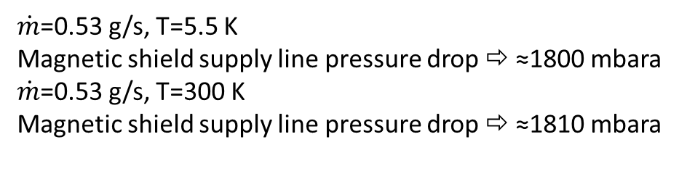
He circuit
VB – Helium circuit – Magnetic shield supply line
$\dot{m}$=0.53 g/s, T=5.5 K
Magnetic shield supply line pressure drop ⇨ ≈1800 mbara
$\dot{m}$=0.53 g/s, T=300 K
Magnetic shield supply line pressure drop ⇨ ≈1810 mbara
ΔP

Slide 37
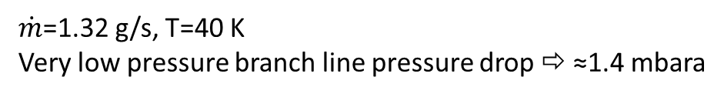
He circuit
VB – Helium circuit – Very low pressure branch line (BB)
ΔP
$\dot{m}$=1.32 g/s, T=40 K
Very low pressure branch line pressure drop ⇨ ≈1.4 mbara

Slide 38
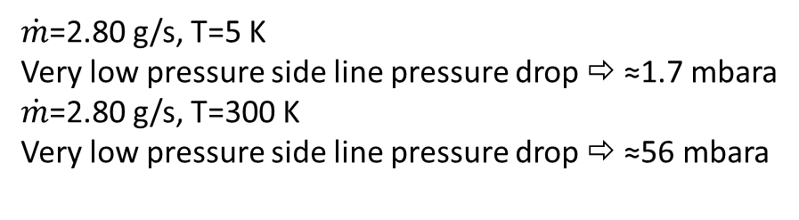
He circuit
VB – Helium circuit – Very low pressure side line (BB+SB)
ΔP
$\dot{m}$=2.80 g/s, T=5 K
Very low pressure side line pressure drop ⇨ ≈1.7 mbara
$\dot{m}$=2.80 g/s, T=300 K
Very low pressure side line pressure drop ⇨ ≈56 mbara

Slide 39
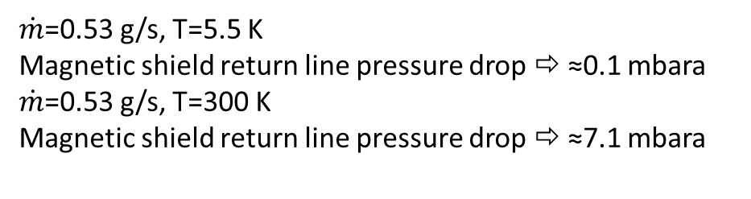
He circuit
VB – Helium circuit – Magnetic shield return line
ΔP
$\dot{m}$=0.53 g/s, T=5.5 K
Magnetic shield return line pressure drop ⇨ ≈0.1 mbara
$\dot{m}$=0.53 g/s, T=300 K
Magnetic shield return line pressure drop ⇨ ≈7.1 mbara

Slide 40
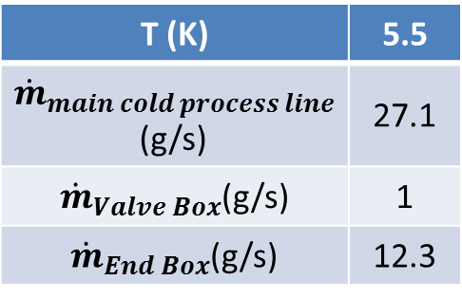
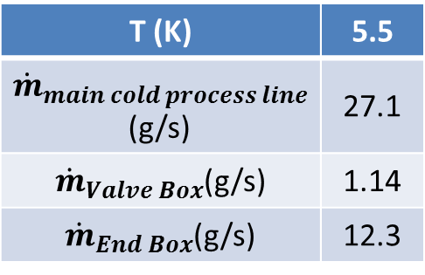
He circuit
Main cold process lines
CDS-EL / CDS-SL interface
ΔP
T (K) | 5.5
${\dot{m}}_{main cold process line}$(g/s) | 27.1
${\dot{m}}_{Valve Box}$(g/s) | 1.14
${\dot{m}}_{End Box}$(g/s) | 12.3
$${\dot{m}}_{main cold process line}=13×{\dot{m}}_{Valve Box}+{\dot{m}}_{End Box}$$
End box
$${\dot{m}}_{EB}$$
$${\dot{m}}_{VB}$$
$${\dot{m}}_{VB}$$
$${\dot{m}}_{VB}$$
VB13
VB02
VB01
T (K) | 5.5
${\dot{m}}_{main cold process line}$(g/s) | 27.1
${\dot{m}}_{Valve Box}$(g/s) | 1
${\dot{m}}_{End Box}$(g/s) | 12.3
ΔP
$${\dot{m}}_{main cold process line}=13×{\dot{m}}_{Valve Box}+{\dot{m}}_{End Box}$$
End box
$${\dot{m}}_{EB}$$
$${\dot{m}}_{VB}$$
$${\dot{m}}_{VB}$$
$${\dot{m}}_{VB}$$
VB13
VB02
VB01
CDS-EL / CDS-SL interface

Slide 41
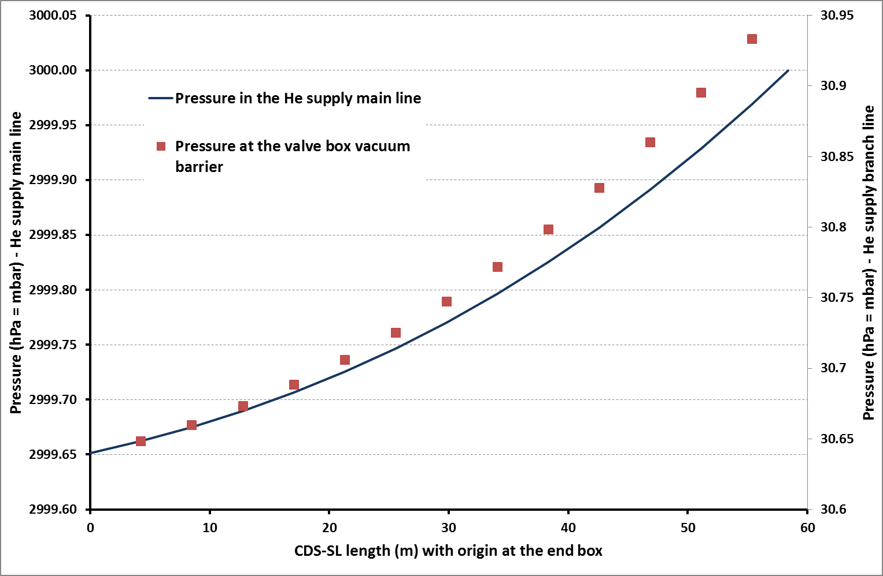
He circuit
Main He supply line
⇨≈0.35mbara

Slide 42
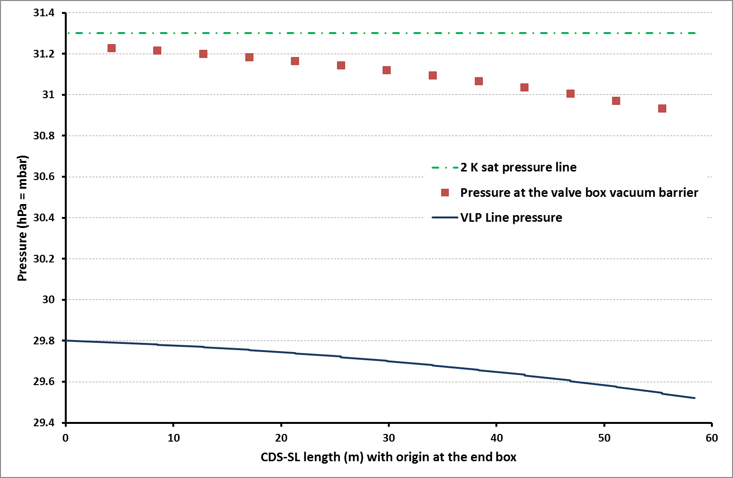
He circuit
VLP return line
⇨≈0.3mbara

Slide 43
Pressure drops
Results

Slide 44
Thank you for your attention
CSP12
28 Novembre 2014

