Slide 1
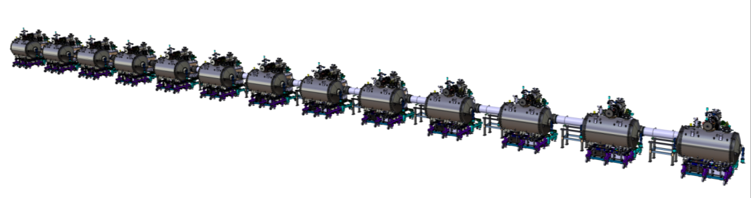
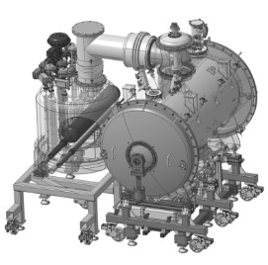
WP11: CDS-SL CDR
Instrumentation and safety devices
April 19th 2017

Slide 2
Instrumentation - Overview
The CDS-SL valve box
TS circuit
Pressure sensor
Temperature sensors (x2)
Cryogenic control valve (x3)
Warm control valve
Cold mass circuit
Pressure sensor
Temperature sensors (x11)
Cryogenic control valve (x6)
Warm control valve

Slide 3
Instrumentation - Overview
The CDS-SL end box
Ts circuit
Pressure sensors (x2)
Temperature sensors (x4)
Cryogenic control valve (x3)
Auxiliary lines
Pressure sensor
Warm control valve
Cold mass circuit
Pressure sensors (x2)
Temperature sensors (x16)
Level sensors (X2)
Cryogenic control valve (x2)
Electrical heaters (x6)
Insulating vacuum
Vacuum gauges (x2)

Slide 4
Instrumentation - Summary
Sensors
Actuators

Slide 5
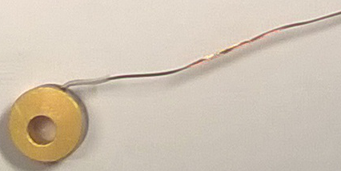
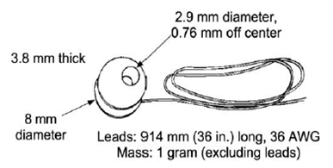
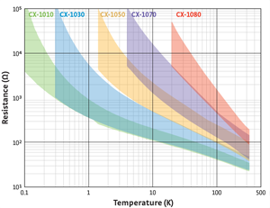
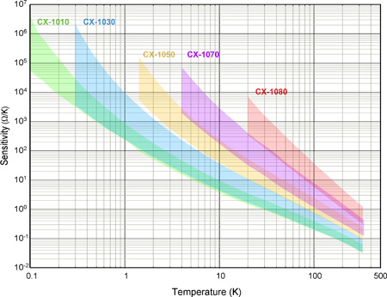
Temperature sensors 1/2
Gold plated copper bobin
Temperatures below 30K
Cernox™ 1050 - Lakeshore Cryotronics
Thermo-resistive sensor (Zirconium-oxynitride)
≈75Ω@300K; ≈10kΩ@2K
Good sensivity at cryogenic temperatures
4 wires
CU package – Teflon free model
Stycast 2850FT + Catalyst 9 ⇨OK for ESS?
(cf. WP5 CDR)
Brass screw M2.5
Temperature sensor
Cernox CX1050CU package
Face with the series number
Surfaces which are greased by use of ApiezonTM type L or M? (1 MGy)
Copper support for temperature sensor
Calibration @ IPNO

Slide 6
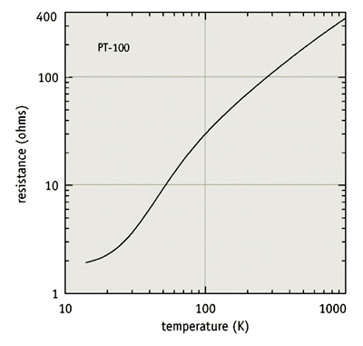
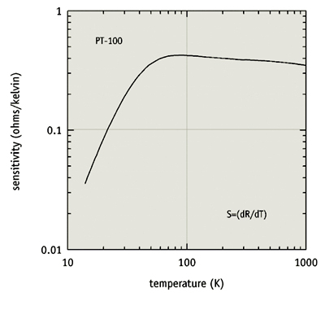

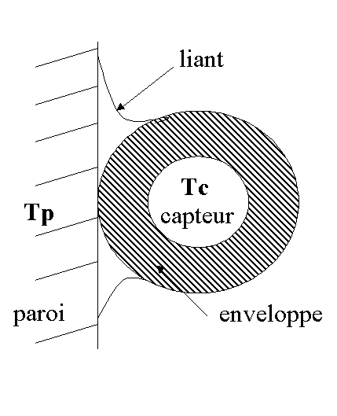
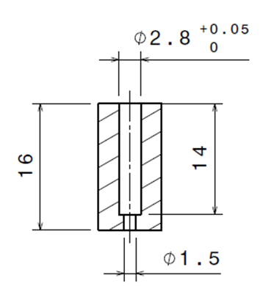
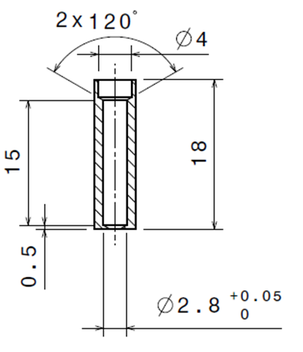
Temperature sensors 2/2
Temperatures above 30K and electric heaters
PT100 class A
≈108Ω@300K; ≈9.4 Ω @50K
Sensivity of about 0.4 Ω/°C [50K;300K]
Temperature sensor
PT100
Ø=2.8mm
L=15mm
From Lakeshore Cryotronics documentation
Ts
Surface which are greased with ApiezonTM type L or M? (1 MGy)
Braze
Rth
Tw
Ts
Tc
Canister
Rth
Tw

Slide 7
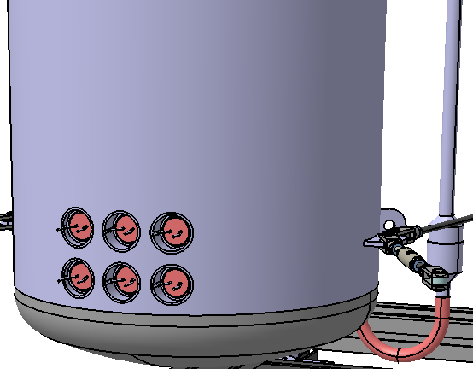
Electrical heaters
Heating cartridges
Derived from a standard model (Vulcanic)
Geometry | Diameter (mm) | 25.4⁺⁰_{-0.2}
 | Overall length (mm) | 150⁺⁰_{-1% or-5mm}
 | Heating length (mm) | 120
Heat transfer | Thermal load (W/cm²) | 1
Electricity | Supply voltage (V) | 48
 | Power (W) | 100
Leads | AXON (provided by IPNO)
Temperature is monitored by means of two PT100 including redundancies

Slide 8
Thermal anchoring
Valve box
End box
Thermal shield case
Sensor
Multi channels
feedthroughs
Thermal anchoring
Cold mass case
Multi channels
feedthroughs
Sensor
Sensor thermal anchoring
TS thermal anchoring
Thermal shield case
Sensor
Multi channels
feedthroughs
Thermal anchoring
Cold mass case
Multi channels
feedthroughs
Sensor
Sensor thermal anchoring
Electrical heater
Multi channels
feedthroughs

Slide 9
Electrical connection
Internal instrumentation
Part1:
Sensor or actuator cable
(~0,75 - 1 m)
Part 2: Cables prolongations
(~2 m)
Part3: Feedthroughs internal
Cables (~0,30 m)
Sensor or actuator
connectors
connectors
Multi channels
feedthrough
EH: twisted pair
TT: two twisted pairs both twisted together
Four wires cable (copper)
Four channel electrical connector x2
This approach allows for :
Easy replacement of a component (sensor, prolongation, feedthrough)
An independent mounting of each part of the temperature sensor cabling
For reliability:
Electrical tests at room temperature (electrical continuity and insulation and sensor and cable resistance measurement)
Five thermal cycling with liquid nitrogen (cool-down shock and warm up)
Electrical tests again at room temperature

Slide 10
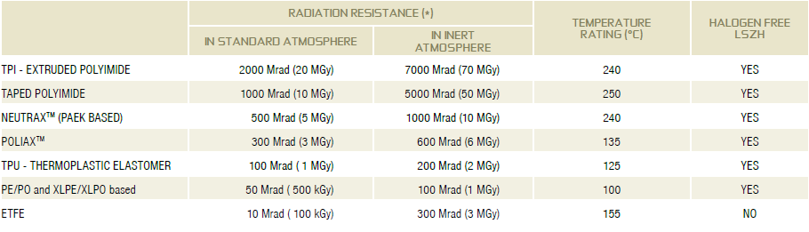
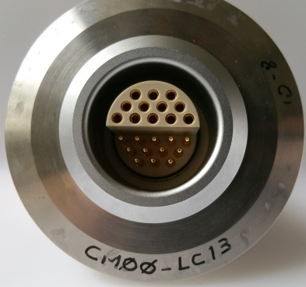
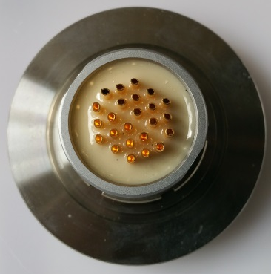
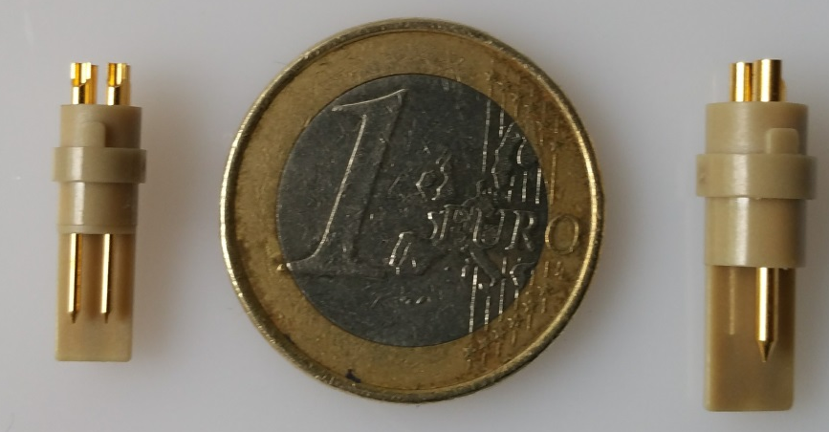
Electrical connection 2/2
Internal cables
  Insulating material
  Conductor material
Multi-channels feedthrough and internal connectors
Radiation resistance > 5,0.10⁴ Gy
TT (from vacuum vessel to TS) – Manganin, Phosphor/brass, Copper – AWG TBD (supplier)
EH – Copper – AWG TBD (supplier)
From AXON radiation resistant cables for scientific and nuclear applications documentation
Example of a multi-channels feedthrough (LEMO HGP.5S.324.CLAP(E)) mounted on a KF DN50 flange.
Thermometer internal connector (LEMO FGG.0S.304.ZLAT) (left)
Electrical heater internal connector (LEMO FGG.1S.302.ZLAT) (right)

Slide 11
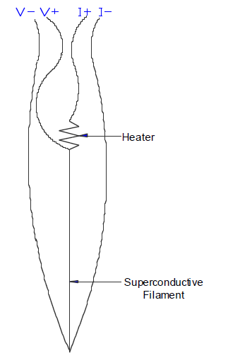
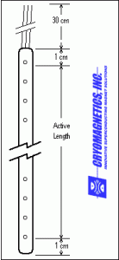

Liquid helium level sensors
Superconducting level gauge
Electrical connections
Multi channels
feedthrough
Vacuum vessel wall
Heater
Two twisted pairs both twisted together
End box insulating vacuum
Superconductive
Nb-Ti filament
Supply current 70mA
≈4.55 Ohm/cm (normal state)
Expected active length : 60cm
End box phase separator

Slide 12
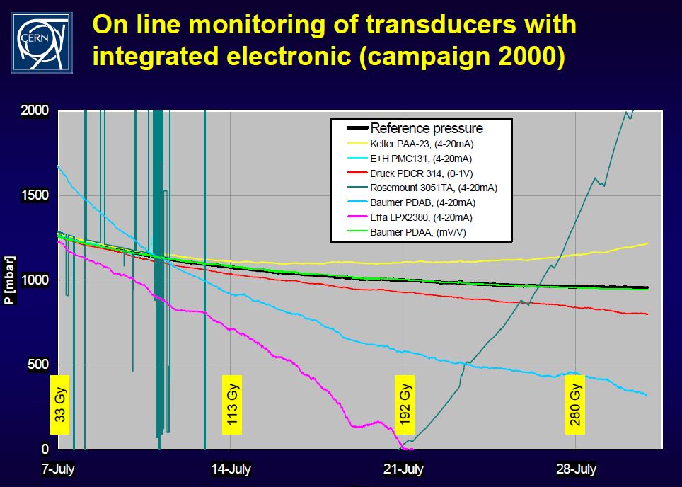
Pressure sensors 1/3
Requirements
  Radiation dose: 5,0.10⁴Gy ⇨remote electronic sensor
  Tightness of the cryogenic circuits ⇨fully welded construction
Technical solution
Manufacturers and models
  Baumer PDAS (used and qualified at CERN)
  HBM P3
  Honeywell TJE and STJE (suggested by ESS)
Measurement range
  Thermal shield circuit: 0-25 bara
  Cold mass circuit and SV relief line: 0-6 bara
  Measurement principle based on strain gauges
Max measure P > MAWP
⇨ allows for pressure monitoring if a critical event occurs

Slide 13
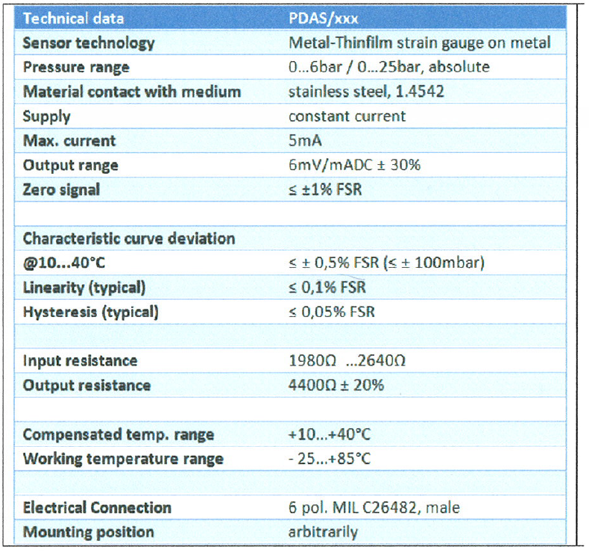
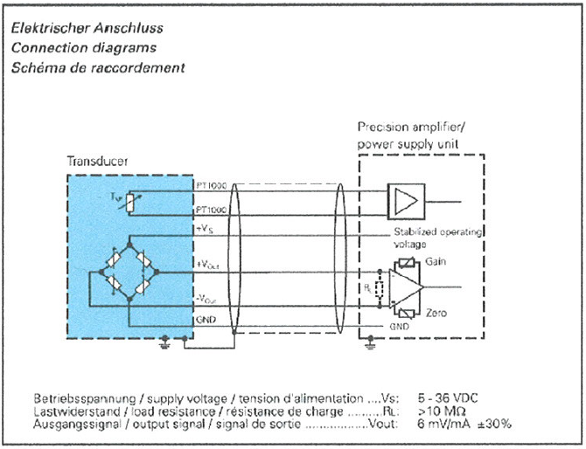
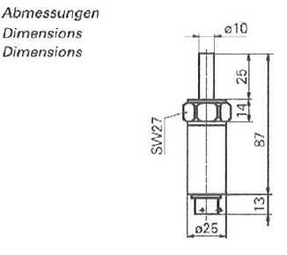
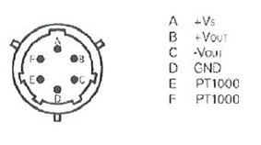
Pressure sensors 2/3
Main characteristics

Slide 14
Pressure sensors 3/3
Cost estimation (IPNO (WP4+WP11) + CEA (WP5) need)
  « PDAS sensors are no longer manufactured »
  After discussions with Baumer ⇨Special manufacture for ≈ 100 units is possible…
  …but expensive

Slide 15
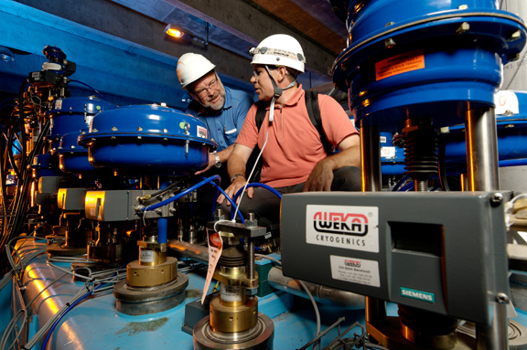
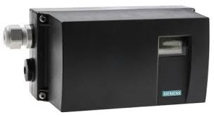
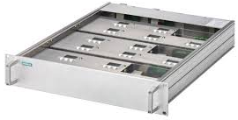
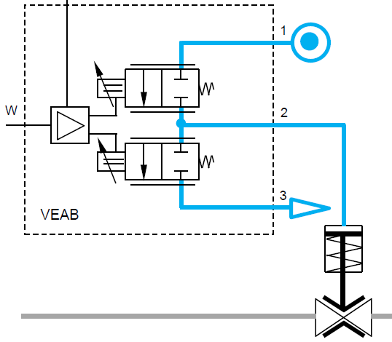
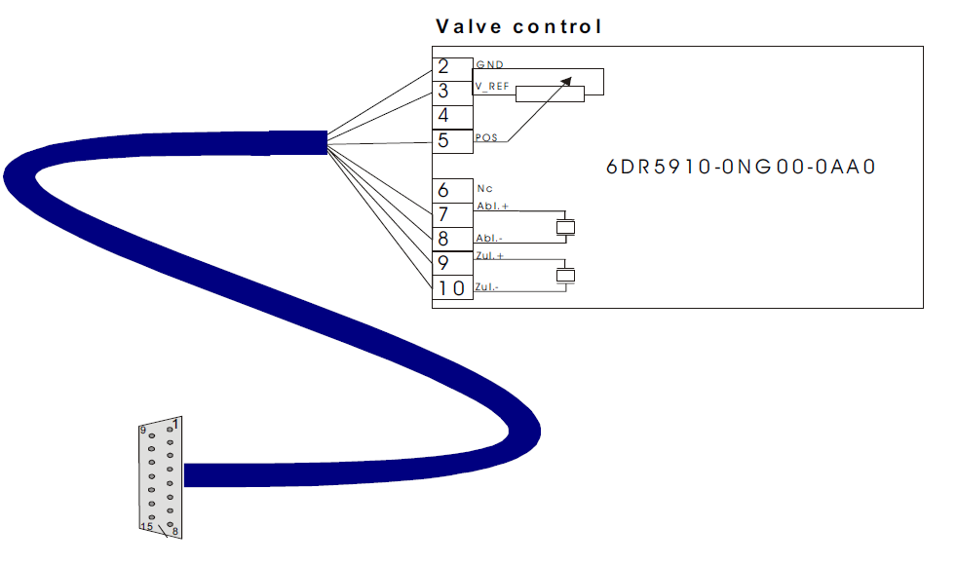
Control valves positioner
Radiation compliant solution : SIEMENS SIPART PS2
  Positioner for pneumatic control valves with remote electronics
  ⇨Industrial solution available on the market
Qualified at CERN
Drawer: 5, 10, 15 valves
On top of each valve
Positioner hosts :
Position sensor
Piezoresistive valves (x2)
WPXX: Cryogenic C&C
WP11: CDS-SL
Drawer hosts:
Electronics of the control loops for 5, 10 or 15 valves
Communication module (Profibus PA)
Position sensor
(potentiometer)
Compressed air supply
Outlet piezoresistive control valve
Inlet piezoresistive control valve
To the atmosphere

Slide 16
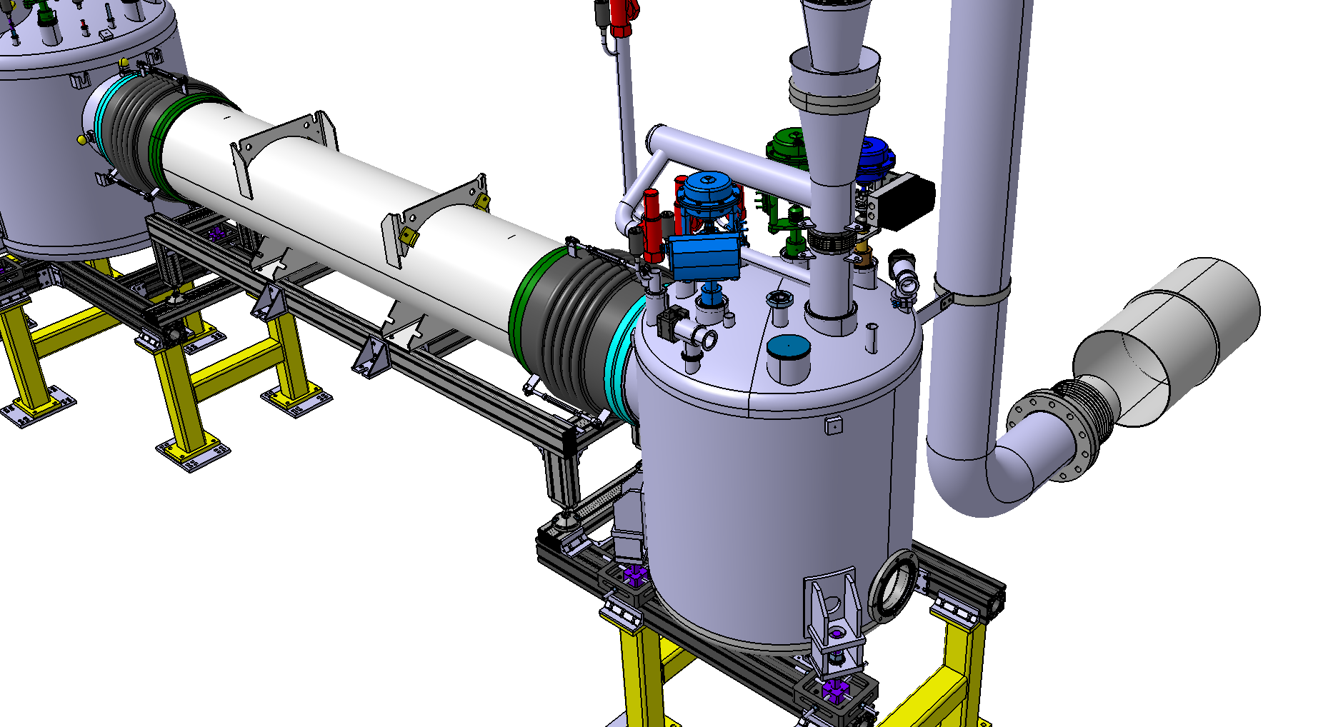
Vacuum components 1/2
The vacuum instrumentation port (x1)
  On the top of the vacuum vessel of the End Box of the CDS-SL
  KF DN40 (ISO 2861) made in stainless steel
  Equipped with a manual vacuum valve
  One primary (Pirani) and one secondary
  (Cold cathode) gauge
EB control port
EB instrumentation port

Slide 17
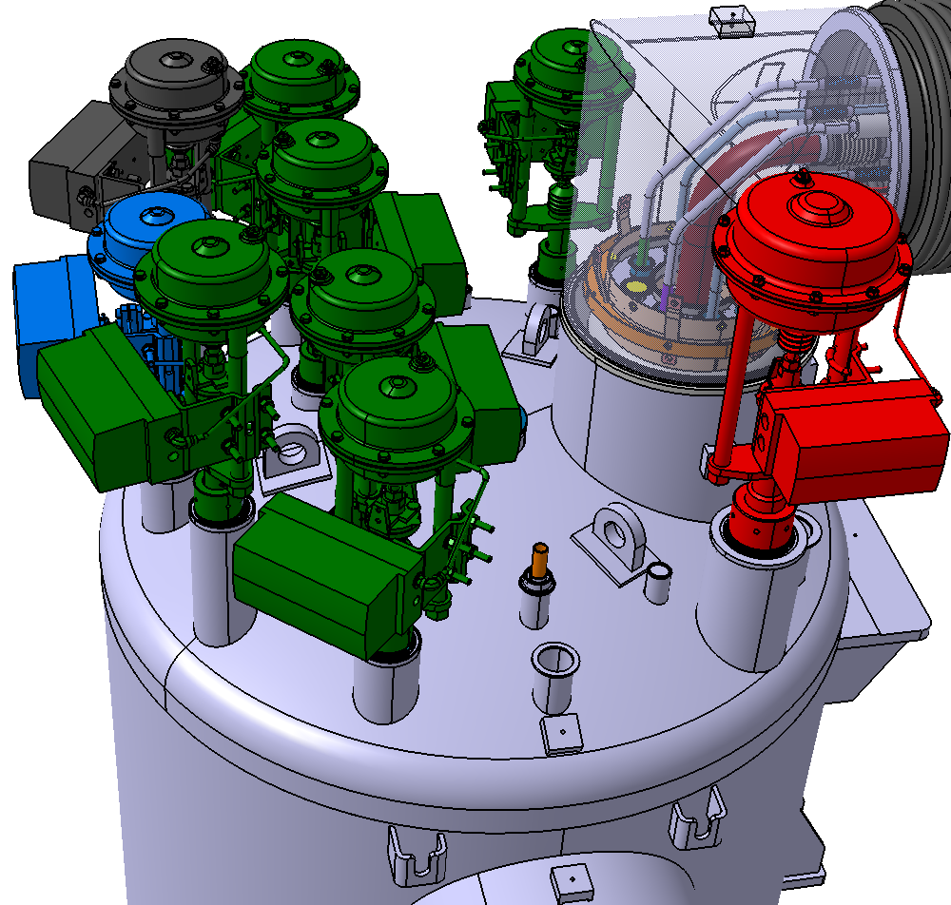
Vacuum components 2/2
The vacuum control ports (x14)
  On the top of the vacuum vessel of each VB and the EB
  KF DN40 (ISO 2861) made in stainless steel
  At least 4 ports equipped with a manual vacuum valve
  Other ports equipped with KF DN40 (ISO 2861) blank-off flange and tightened with an EPDM o-ring and a collar
VB control port

Slide 18
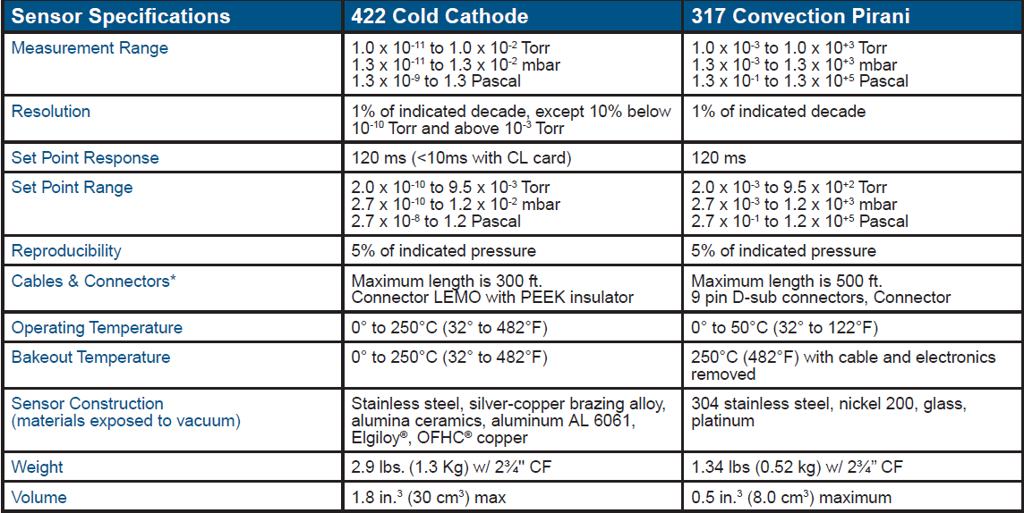
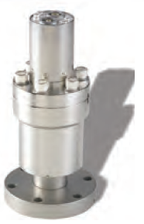
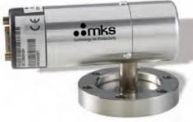
Vacuum gauges
UHV Vacuum gauges for Accelerator Physics from MKS (suggested by ESS)
Mechanical interface : CF40
⇨CF to KF adaptors needed

Slide 19
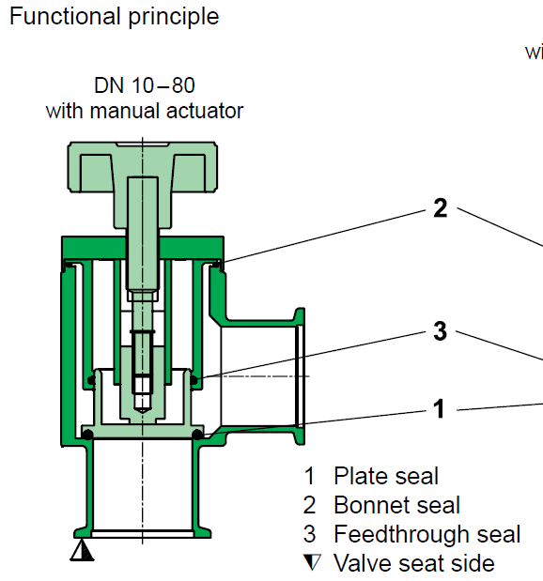

Vacuum valves
Angle or in-line manual vacuum valves main properties (TBC)
⇨Sealing material: EPDM

Slide 20
Safety devices - Overview
The CDS-SL end box
TS circuit
Main supply line (SV93)
Main return line (SV94)
He circuit
Main supply line (SV91)
Main very low pressure line (SV92, RD92)

Slide 21
Safety devices - Overview
The CDS-SL valve box
TS circuit
Branch return line (SV60)
He circuit
Branch supply line (SV01)

Slide 22
Safety devices - Summary
List of the CDS-SL safety devices
Safety device | Location | Device type | Supplier | Supplier description | Set pressure | Req min. d0 | Size and d0 | PN | Maximum opening hysteresis or uncertainty | MAWP
 |  |  |  |  | (barg) | (mm) | (mm)
SV91 | He Supply (End Box) | Safety valve, spring-loaded | LESER (TBC) | 4414.467x xx | 4 -> 3.75 | 35 | DN50 - d0=46 PCTFE | 40 | +/- 10% TBC | 5
RD92 | VLP (End Box) | Reverse Buckling Rupture Disk (welded) | Witzenmann (TBC) | BDRI.XX100.4,5 (TBC) | 3.7 -> 4.5 | 45 | 45 < d0 < 100 | - | +/- 5% | 5
SV92 | VLP (End Box) | Safety valve, spring-loaded | LESER (TBC) | 4594.217x xx | 3 -> 3.8 | 14 | DN20 do=13 PCTFE | 40 | +/- 10% TBC | 5
SV93 | TS supply (End Box) | Safety valve, spring-loaded | LESER (TBC) | 4594.217x xx | 21 | 9 | DN20 do=13 PCTFE | 40 | +/- 10% TBC | 24
SV94 | TS return (End Box) | Safety valve, spring-loaded | LESER (TBC) | TBD4414.464x xx | 21 | 20 | DN25 do=23 PCTFE | 40 | +/- 10% TBC | 24
SV01 | He branch supply (Valve Boxes) | Safety valve, spring-loaded | Herose (TBC) | 06850 (TBC) | 3,75 | 6 | 10 | 6 | +/- 10% | 5
SV60 | TS branch return (Valve Boxes) | Safety valve, spring-loaded | Herose Circle Seal (TBC) | 06850 (TBC) | 21 | 6 | 10 | 25 | +/- 10% | 24
ESS change
WUST/ESS sizing
Not critical: small quantity of fluid in a pipe + small surfaces

Slide 23
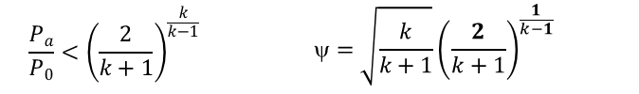

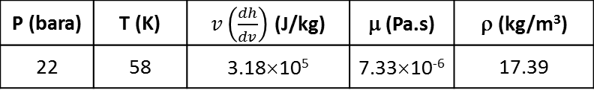
Safety devices – Branch lines
Thermal shield safety valve sizing SV60:
  Considered worst scenario: loss of insulation vacuum
    air leak into the vacuum vessel of the CM (∅ = 50 mm)
    air fully condensates onto the CM thermal shield surface covered with 30 MLI
    considered heat power density : 1.5 kW/m² [Lehmann, 1978]
    for 1 (CM + jumper) thermal shield (~11 m²): 19.5 kW
  Helium properties considered (supercritical helium):
  ISO 21013:
    Mass flow rate:
    Sonic flow considered as
    Min. relief cross section:
P (bara) | T (K) | $v\left(\frac{dh}{dv}\right)$ (J/kg) | μ (Pa.s) | ρ (kg/m³)
22 | 58 | 3.18×10⁵ | 7.33×10⁻⁶ | 17.39
$$\dot{m}={\dot{Q}}/{v\left(\frac{dh}{dv}\right)}$$
$$\frac{P_{a}}{P_{0}}<{\left(\frac{2}{k+1}\right)}^{\frac{k}{k−1}}$$ | $$=\sqrt{\frac{k}{k+1}}{\left(\frac{2}{k+1}\right)}^{\frac{1}{k−1}}$$
Req. d0 ≤ 6 mm
Po (bar) | Pa (bar) | ρV (kg/m3) | Surf. écran (m²) | Heat load density (W/cm²) | Heat load (kW) | Mass flow (kg/s) | k hélium | Crit, Pressure ratio | Pa/P0 | Ψ | A (mm2) | α | Dmin (mm)
22 | 1,1 | 17,39 | 11 | 1500 | 16 500 | 0,05 | 1,67 | 0,487 | 0,050 | 0,51 | 18 | 0,73 | 4,79

Slide 24
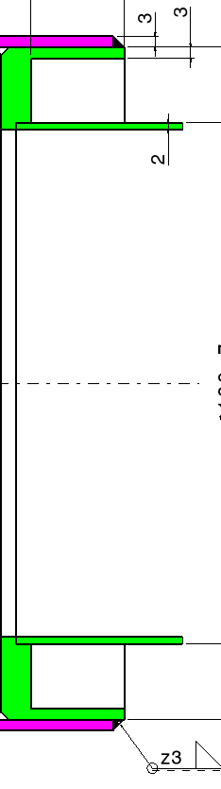
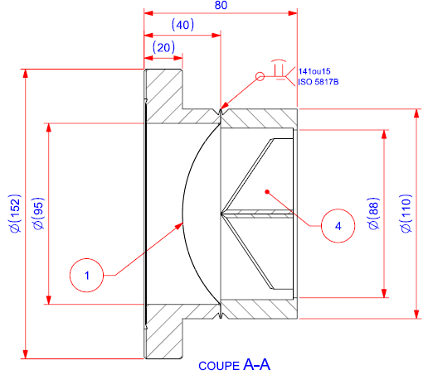
Safety devices – Branch lines
Burst disk:
  For the prototypes (WP4 and WP5 + test Spoke valve box):
    CF flange
    Possibility to have a welded interface (Witzenmann)
    To be updated (also depends on the interface with the vent line)
Safety valves:
  Interface to be confirmed but:
    LESER: thread + external weld possible
    HEROSE: welded pipe possible
  with lever arm for control actions if welded

Slide 25
Safety devices
Pressure scale:
  Presented during the safety review at Lund (2016/06/09th)
  Same principle but here updated
Absolute pressure
(bara)
Gauge pressure
(barg)
25.25
24,25: maximum pressure for a 100% opening of the relief valve
(1,1x 22.0 ∼ 0.55 bar)
PS = MAWP = 24
∼ 22,0 (1.05 x Pset)
Relief pressure
(SF relief line)
∈ [1 atm ; 1.1 bar]
Opening area of the relief valves
21.0: set pressure of the safety valve (Pset ± 5%)
∼ 20.0 (0.95 x Pset)
19.5
Pressure operation in the temperature range 35-55 K
19
18.0: minimum pressure to allow the closing of the relief valve (0.9 x 20.5 ∼ 18,0 bar)
Max. operating pressure
⇒ ongoing: checking the tolerances of the safety valves with the suppliers: +/- 10% (total) TBC

Slide 26
Thank you for your attention
CSP12
28 Novembre 2014

Slide 27
Electrical connection
Internal cables
  Insulating material
Radiation resistance > 5,0.10⁴ Gy
From AXON radiation resistant cables for scientific and nuclear applications documentation

Slide 28
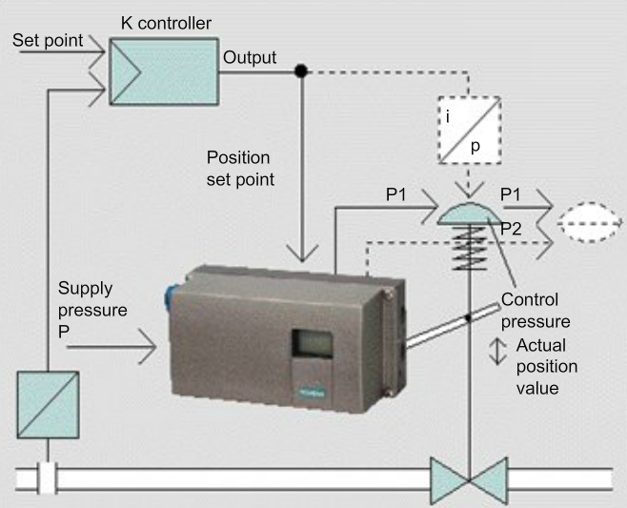
Control valves positioner 1/2
Radiation compliant solution : SIEMENS SIPART PS2
  ⇨Industrial solution available on the market

Slide 29
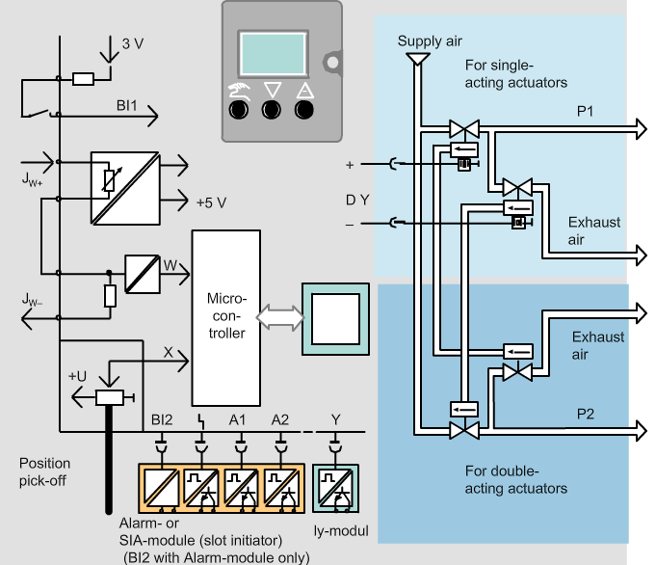
Control valves positioner 2/2
Radiation compliant solution : SIEMENS SIPART PS2
  ⇨Industrial solution available on the market

Slide 30
Instrumentation - Overview
Thermal shield circuit and auxiliary lines
  Valve box
  End box
TS circuit
Pressure sensor
Temperature sensors (x2)
Cryogenic control valve (x3)
Warm control valve
Ts circuit
Pressure sensors (x2)
Temperature sensors (x4)
Cryogenic control valve (x3)
Auxiliary lines
Pressure sensor
Warm control valve

Slide 31
Instrumentation - Overview
He circuit and insulating vacuum
  Valve box
  End box
Cold mass circuit
Pressure sensor
Temperature sensors (x11)
Cryogenic control valve (x6)
Warm control valve
Cold mass circuit
Pressure sensors (x2)
Temperature sensors (x16)
Level sensors (X2)
Cryogenic control valve (x2)
Electrical heaters (x6)
Insulating vacuum
Vacuum gauges (x2)

