Slide 1
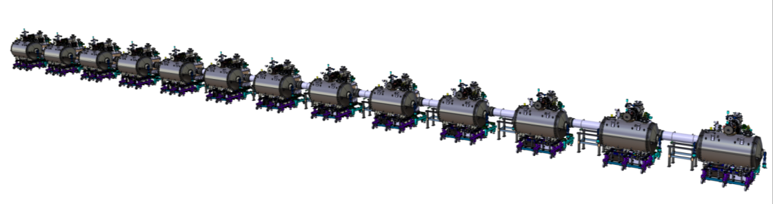
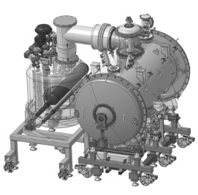
Work Unit 11.11.5.3 - AIK 11.2
CDR of the CDS-SL
Mechanical analyses of the valve box
April 19th 2017

Slide 2
Design framework
European Pressure Equipment Directive (PED)
    EN 13445: Unfired pressure vessels
    EN13480: Metallic industrial piping
    EN 13458: Cryogenic vessels – Static vacuum insulated vessels ⇒ End Box
    gives rules for:
    Design
    Materials
    Manufacturing
    Installation
    Tests
    Maintenance
AFS 2005:2

Slide 3
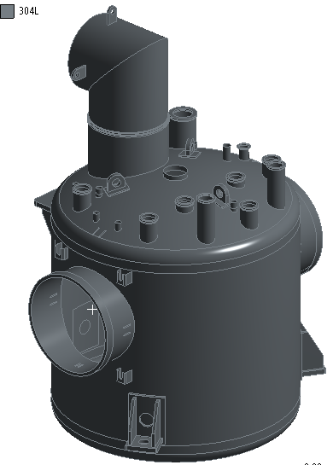
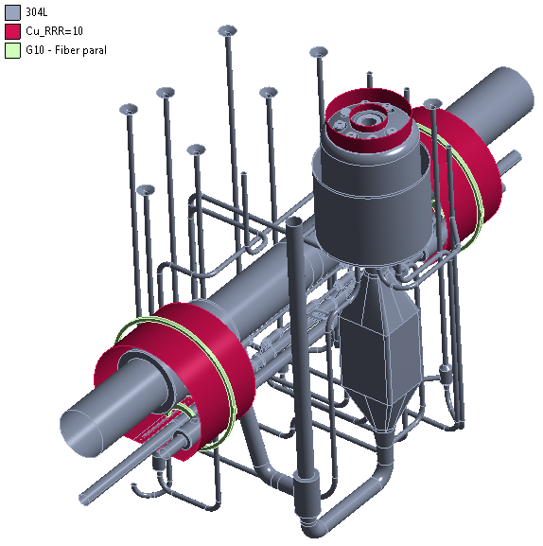
Material 1/3
Model
AISI 304L (1.4306 / X2CrNi19-11)
E = 190 000 Mpa
= 0.305
ρ = 7 900 kg/m³

Slide 4
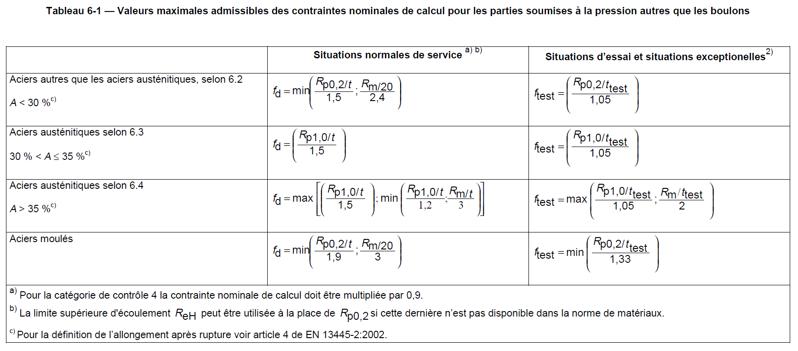
Material 2/3
Pressure Equipment Directive 2014/68/EU
  EN 10028-7
    Proof strength: R_{p1,0} = 240 Mpa @ room T° (= pressure test T°)
    Tensile strength: R_{m} ≥ 500 Mpa @ room T° (= pressure test T°)
    Elongation after fracture: A ≥ 45 %
  EN 13445-3 (p25)
⇒ f_{d 304L} = 166 MPa
⇒ f_{test 304L} ≥ 250 MPa

Slide 5
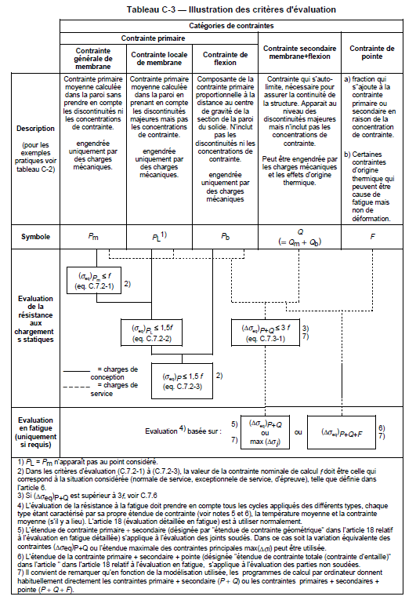
Material 1/3
Pressure Equipment Directive 2014/68/EU
  EN13445-3
p565
⇒ for normal pressure operation (i.e. for MAWP = Ps):
for the membrane stresses
(=neutral fibre of the shell elements):
  - for areas away from the shape discontinuities:
  f = f_{d} (cf. §2.2 for f_{d}) ➔ s_{max} membrane < 166 MPa
  - for areas near shape discontinuities:
  f = f_{d} x 1.5 ➔ s_{max} membrane < 249 MPa
for the bending stresses: f = f_{d} x 1.5
➔ s_{max} bending < 249 MPa

Slide 6
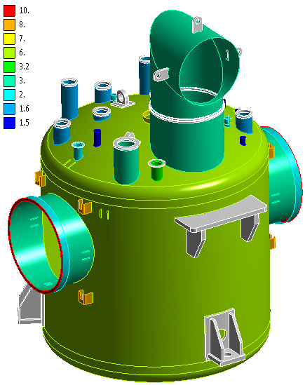
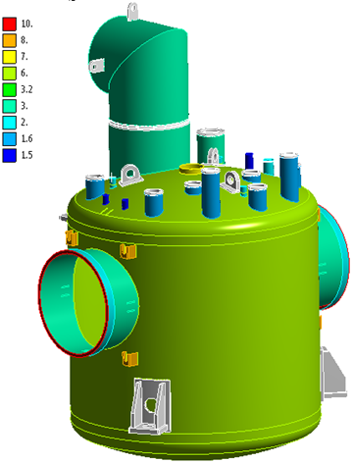
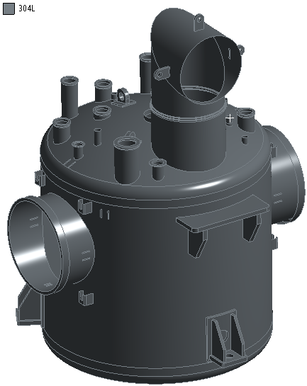
VALVE BOX
Vaccum vessel
  Static analysis
  Thicknesses of shell elements

Slide 7
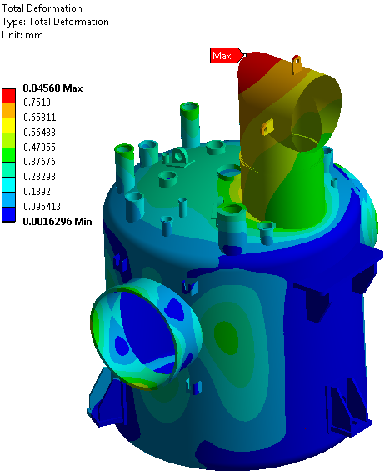
VALVE BOX
Vaccum vessel
  Static analysis
    Considered:
      gravity,
      the weights of non-modelled components such as the piping, valves and thermal shield;
      the forces due to the thermal shrinkage which are transmitted onto the vacuum vessel;
      and the pressure loads (external pressure.
⇒ magnitude displacement of the vacuum vessel: 0.9 mm at the jumper location

Slide 8
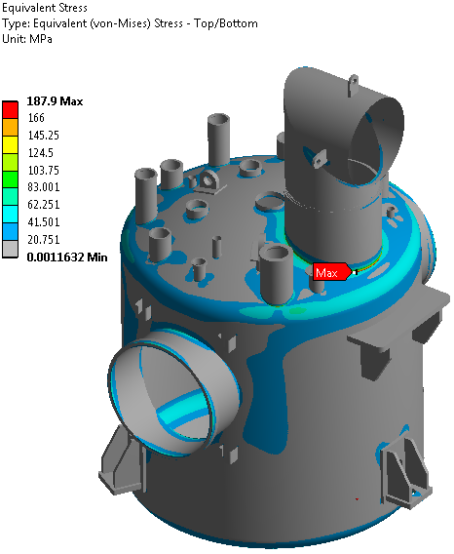
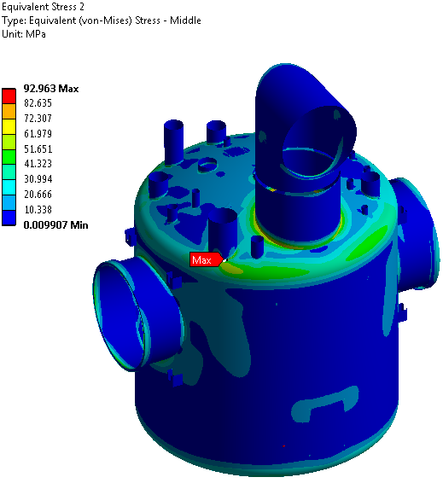
VALVE BOX
Vaccum vessel
  Static analysis: valve box standing on its 3 support pods
    Considered:
      gravity,
      the weights of non-modelled components such as the piping, valves and thermal shield;
      the forces due to the thermal shrinkage which are transmitted onto the vacuum vessel;
      and the pressure loads.
Left: total (membrane + bending) stress
⇒ σ_{max} ≤188 Mpa (at a geometric discontinuity)
Right: bending stress on shell elements
⇒ σ_{max} ≤188 Mpa

Slide 9
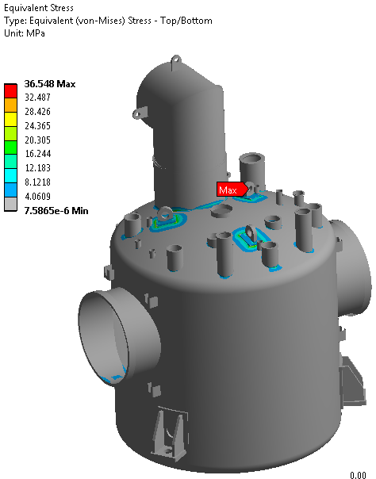
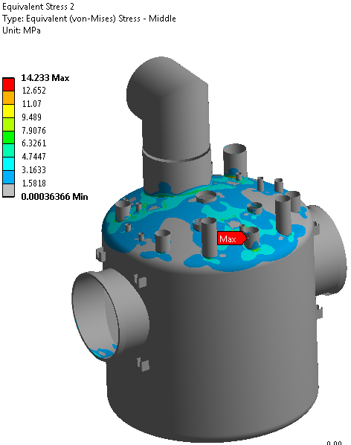
VALVE BOX
Vaccum vessel
  Static analysis: valve box lifted by use of its 3 eye rings
    What is considered:
      gravity,
      the weights of non-modelled components such as the piping, valves and thermal shield;
      the forces due to the thermal shrinkage which are transmitted onto the vacuum vessel;
      and the pressure loads.
Left: total (membrane + bending) stress
⇒ σ_{max} ≤37 Mpa
Right: bending stress on shell elements
⇒ σ_{max} ≤14 Mpa

Slide 10
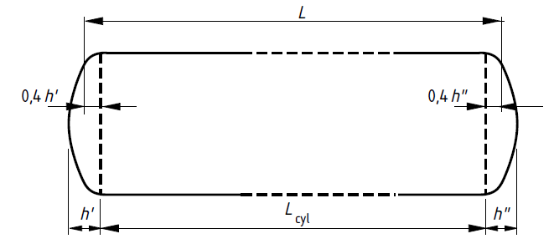
VALVE BOX
Buckling analysis of the vacuum vessel
  Evaluation of the critical external pressure by use of EN13445
1000
e_{a}
=960
Thickness e_{a} = 6 mm

Slide 11
VALVE BOX
Buckling analysis of the vacuum vessel
  Circumferential stress Py (EN 13445: equation 8.5.3-15)
  Theoretical elastic instability pressure (EN 13445: equation 8.5.2-5)
  Calcluating the ratio Pm/Py and detrmining Pr/Py
  Maximum external pressure
= 2.41 MPa
σ_{e}: Yield strength
e_{a}: Thickness
R: Mean radius of the cylinder
σ_{e} = 200 MPa
e_{a} = 6 mm
R = 497 mm
γ = 0
G = 0
= 1.38 MPa
E = 190000 MPa
e_{a} = 6 mm
ε = 0.0006 with:
L/2R = 0.96 & 2R / e_{a} = 165
R = 497 mm
Pm / Py = 0,57
Pr / Py = 0.56 ➔ Pr = 1.35 MPa
P_{max} < Pr / S
S = safety factor = 1.5
P_{max} < 0.9 Mpa = 9 bar (external pressure)
with e_{a} = 6 mm, sufficient margin is expected

Slide 12
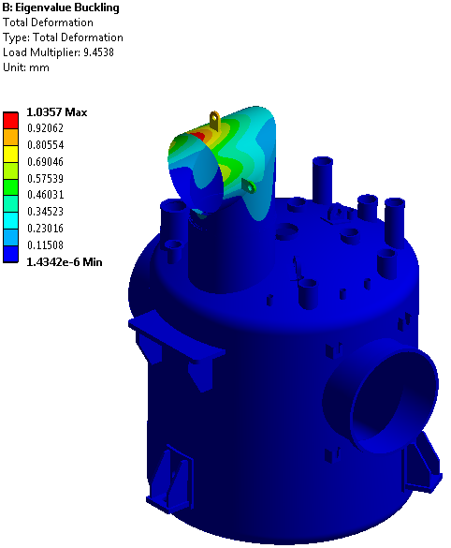
VALVE BOX
Buckling analysis of the vacuum vessel
  Comparison with a FEM analysis
    Only pressure loads are considered
The critical pressure is evaluated to be 9.4 bar
⇒ comparison is satisfactory

Slide 13
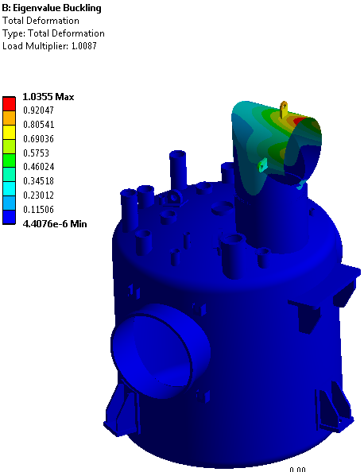
VALVE BOX
Buckling analysis of the vacuum vessel
  Considering all loads: pressure but also gravity (and forces, cf. previous static analysis)
The critical pressure is evaluated to be 5.2 bar
⇒ sufficient margin is expected

Slide 14
VALVE BOX
Static analysis of the internal pipes
    What is considered:
      gravity,
      the connections with the vacuum vessel;
      the pressure loads,
      the contacts between elements such as the supports ⇒ frictionless contacts
Rx = 0 imposed at the ends of the 4 main cryolines
⇒ assess the reaction moments (torsional moment to be transmitted to the bellows of the Headers Unit)
x-axis

Slide 15
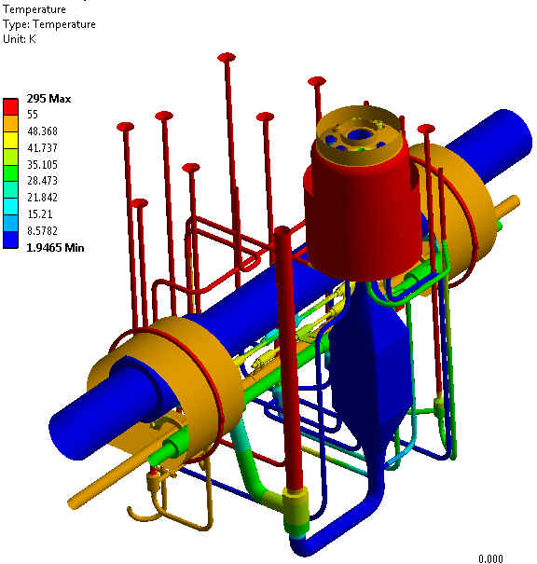
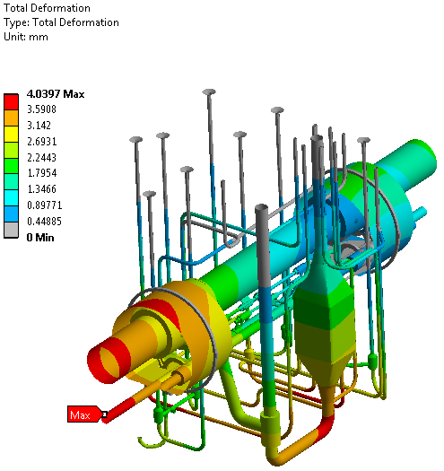
VALVE BOX
Static analysis of the internal pipes
    Results:
Temperature field (T > 55 K in red)
Total deformation
⇒ δ_{max} ≈ 4 mm (essentially in the X axis direction)

Slide 16
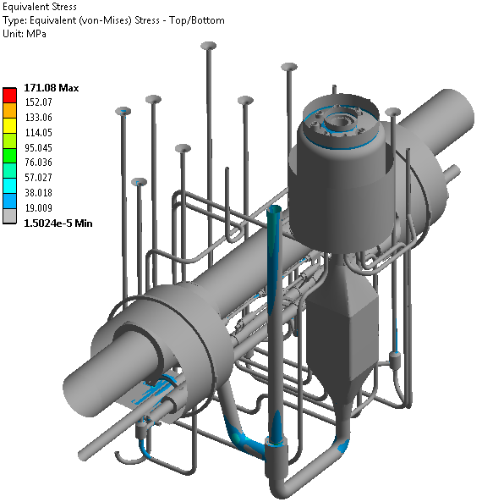
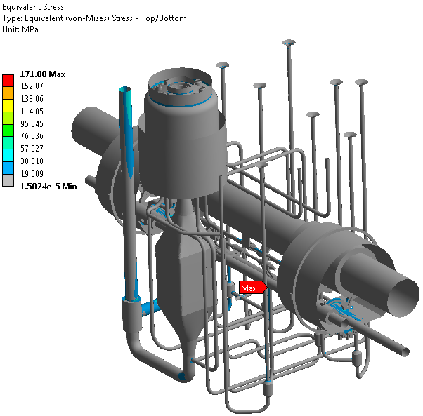
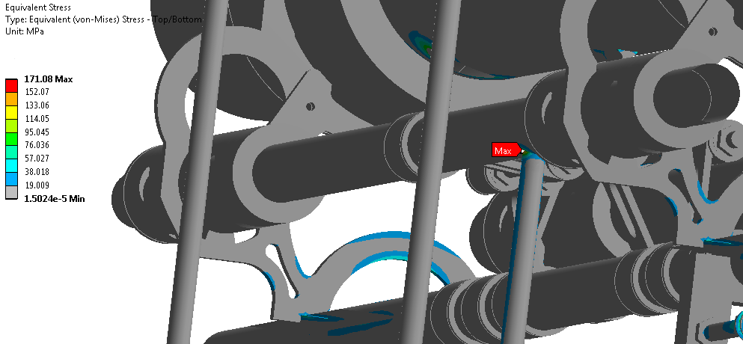
VALVE BOX
Static analysis of the internal pipes
    Results:
Left: total (membrane + bending) stress
⇒ σ_{max} ≤172 Mpa (in a discontinuity area)

Slide 17
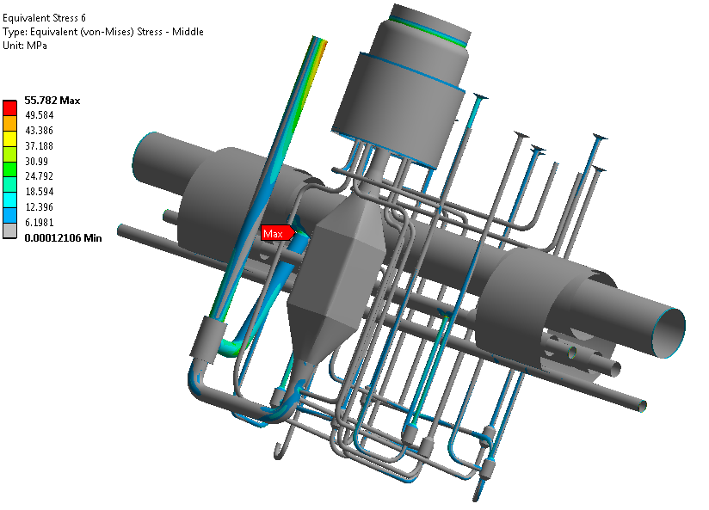
VALVE BOX
Static analysis of the internal pipes
    Results:
Bending stress on shell elements only
⇒ σ_{max} ≤56 Mpa
⇒ Maximum moment:
13.1 N.m estimated at the extremity of the VLP
⇒ compatible with torsional moment accepted by bellows

Slide 18
CONCLUSION
Valve box mechanical analysis
  Static analyses of the vacuum vessel and internal piping were performed:
    Maximum stress comply with EN13445
    Maximum moments are compatible with the use of bellows
  Buckling analysis:
    The critical buckling pressure was evaluated
    ⇒ 5,2 bar is estimated taking into account all (possible) static loads
    ⇒ we consider that this is a sufficient margin
Next steps
  Transport
    Modal analysis has to be performed
    ⇒ evaluation of the eigen modes
    Static analysis with different acceleration (magnitude and directions)
    ⇒ evaluation of the stress
    ⇒ design of the transportation (and handling) tooling

Slide 19
Thank you for your attention
CSP12
28 Novembre 2014

