Slide 1
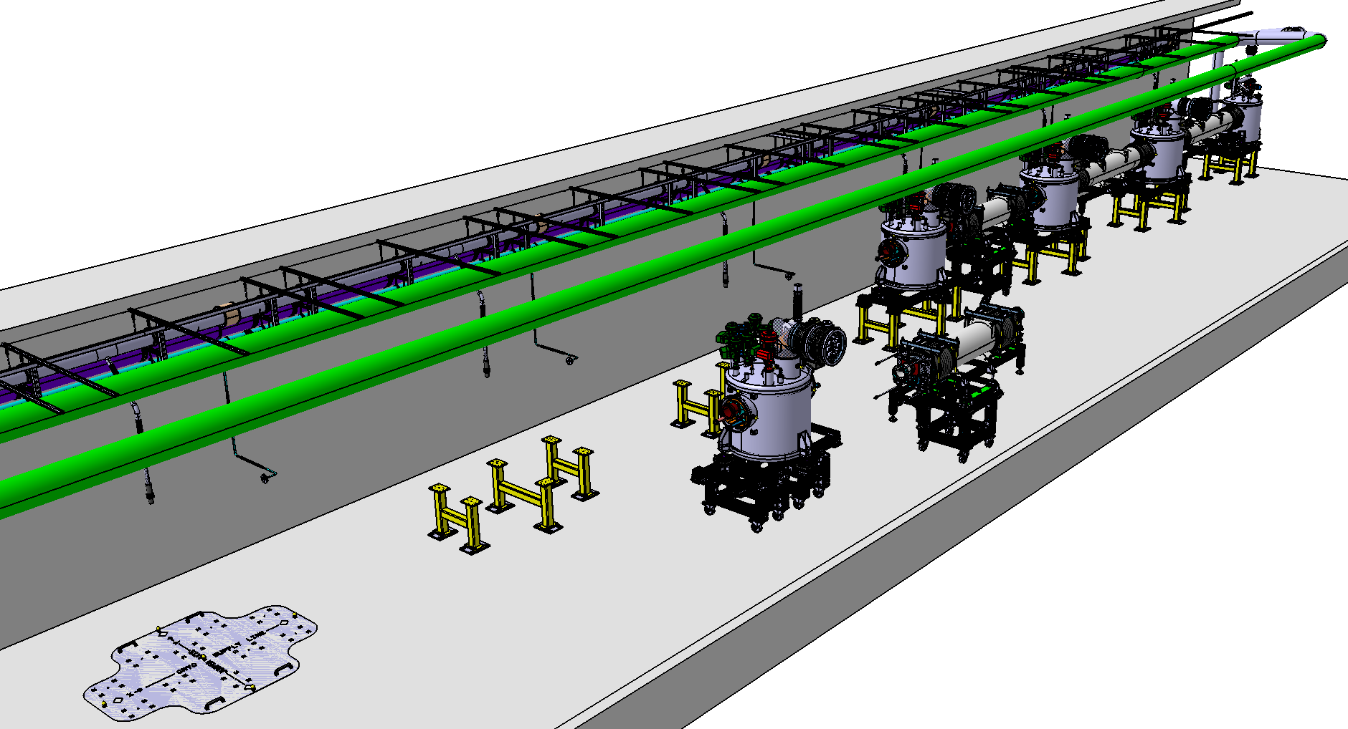
Work Unit 11.11.5.3 - AIK 11.2
CDR of the CDS-SL
Mechanics
April 19th 2017

Slide 2
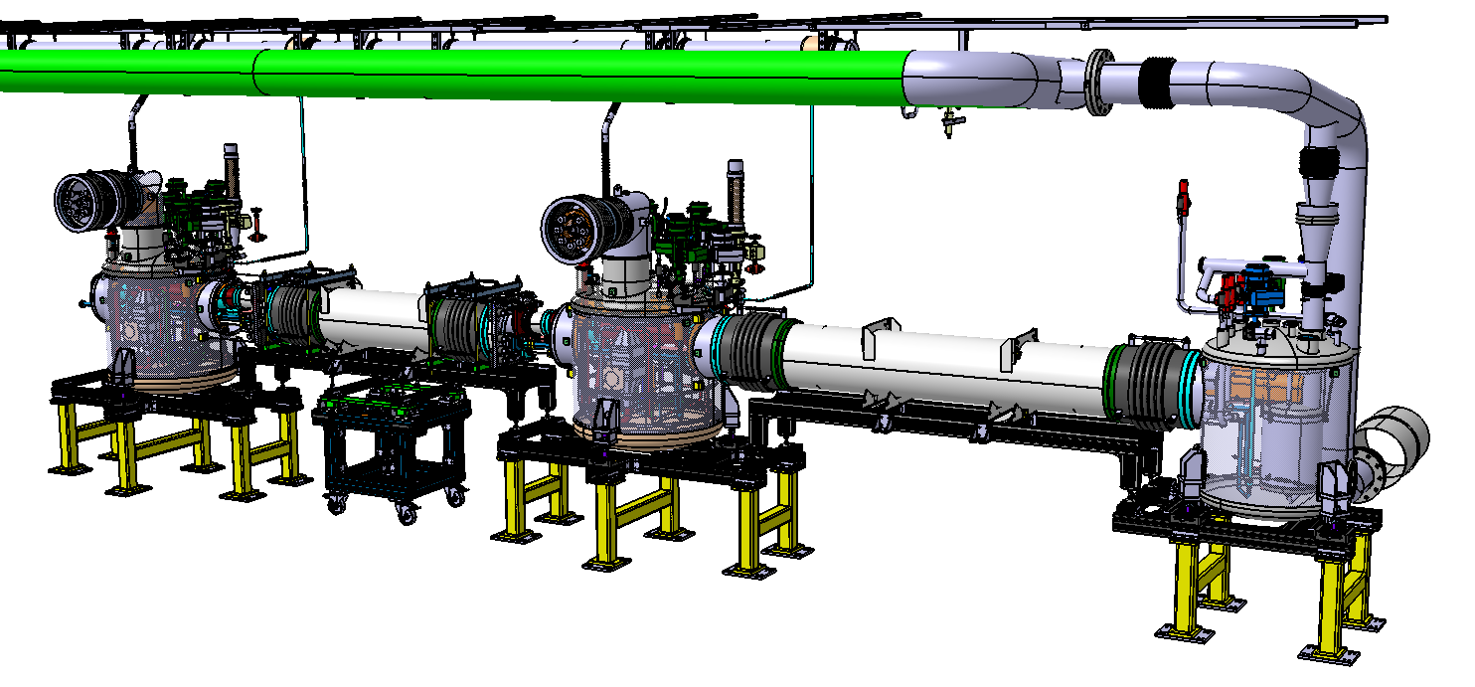
CDS-SL
Summary
Under progress
Valve box
Headers unit
Part one : the valve box
  Mechanical design
  Manufacturing process
Part two : the headers units

Slide 3
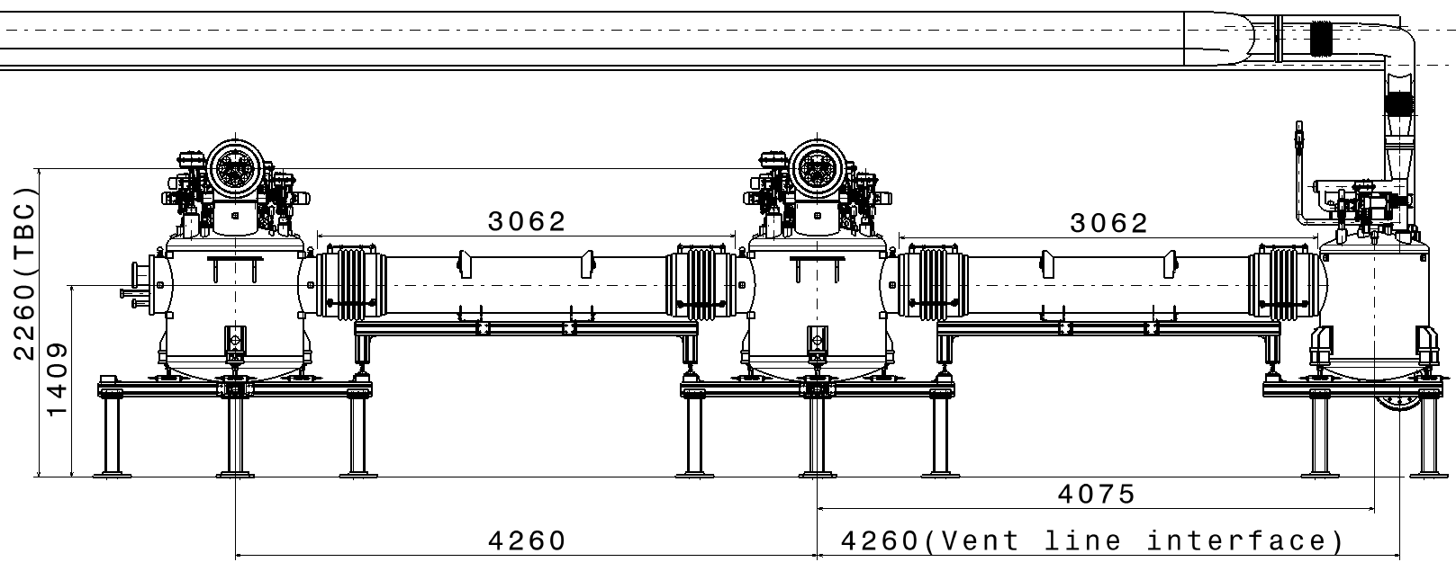
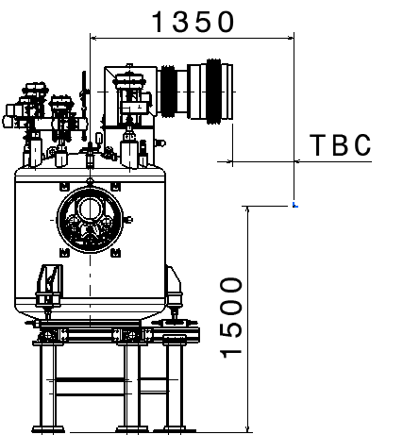
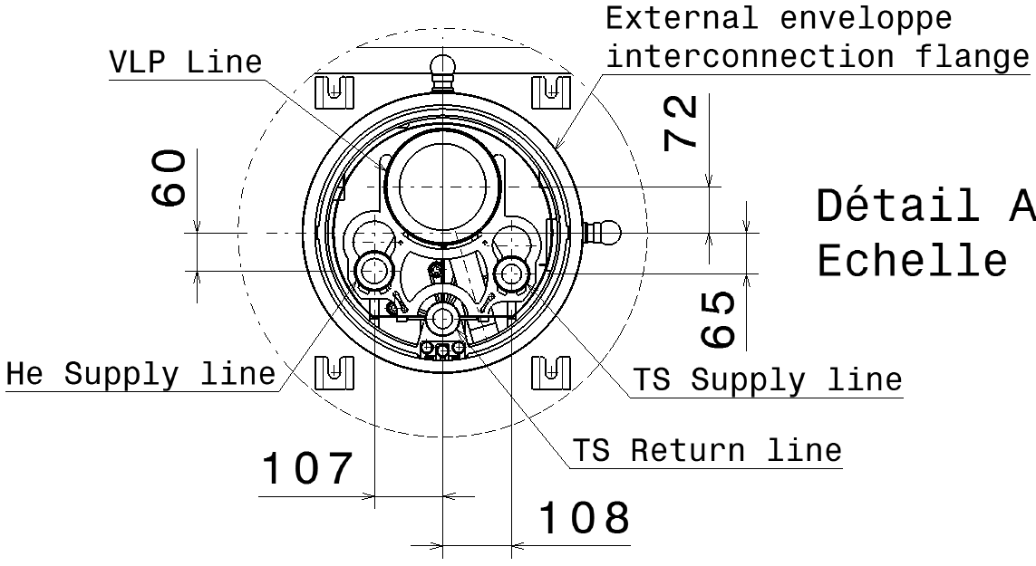
CDS-SL
Main dimensions
  13 Identical headers units
  TBC : to be confirmed
  linked to WP4 design
  (under progress)

Slide 4
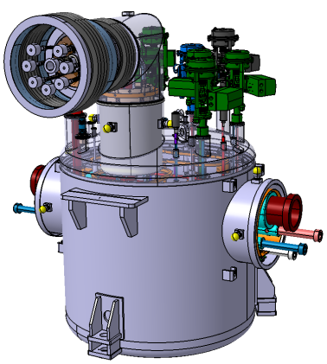
Valve box
Part one : Design and manufacturing process
of the Valve box

Slide 5
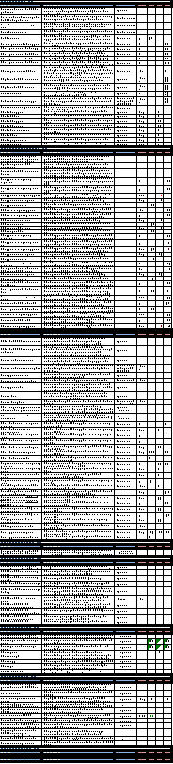
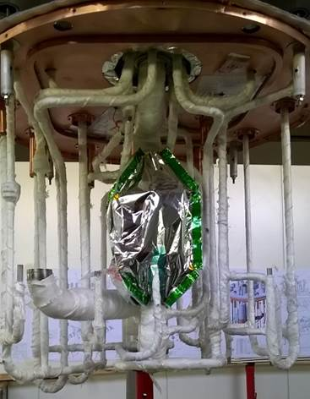
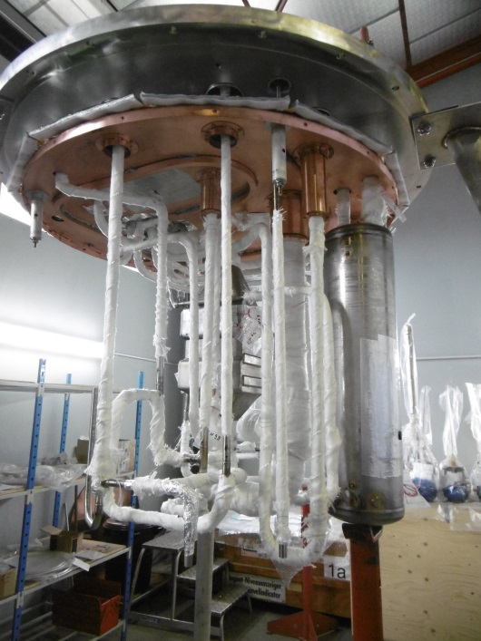
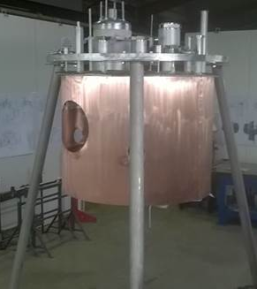
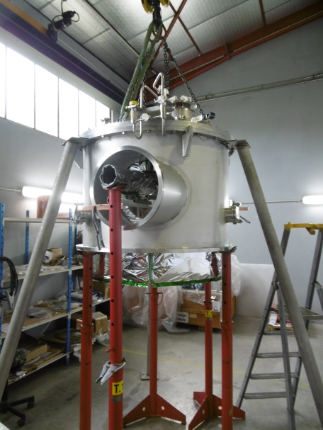
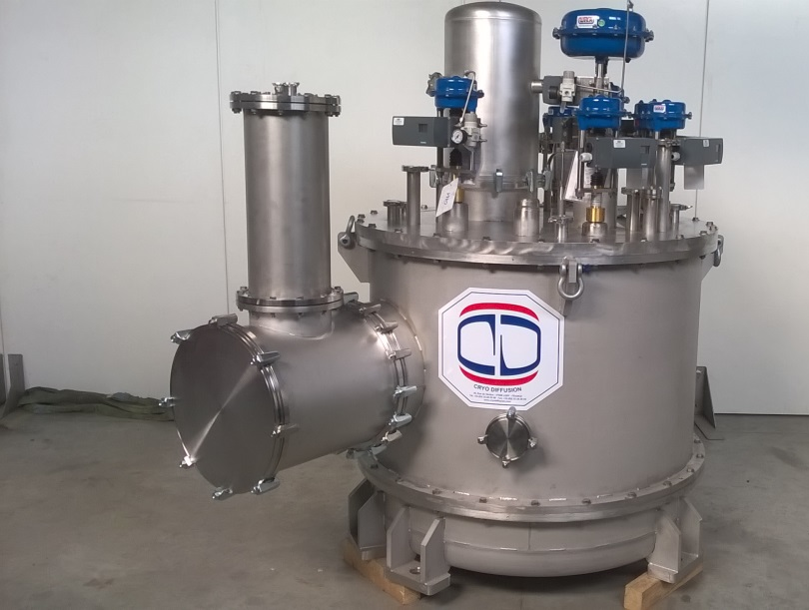
Valve box
Design of the Valve box
Based on :
ESS requirements
Feedback of the valve box
prototype manufacturing

Slide 6
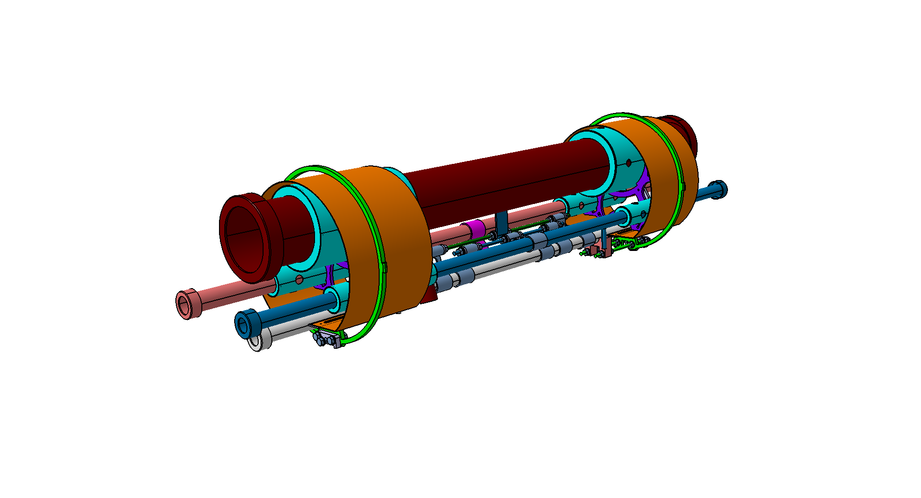
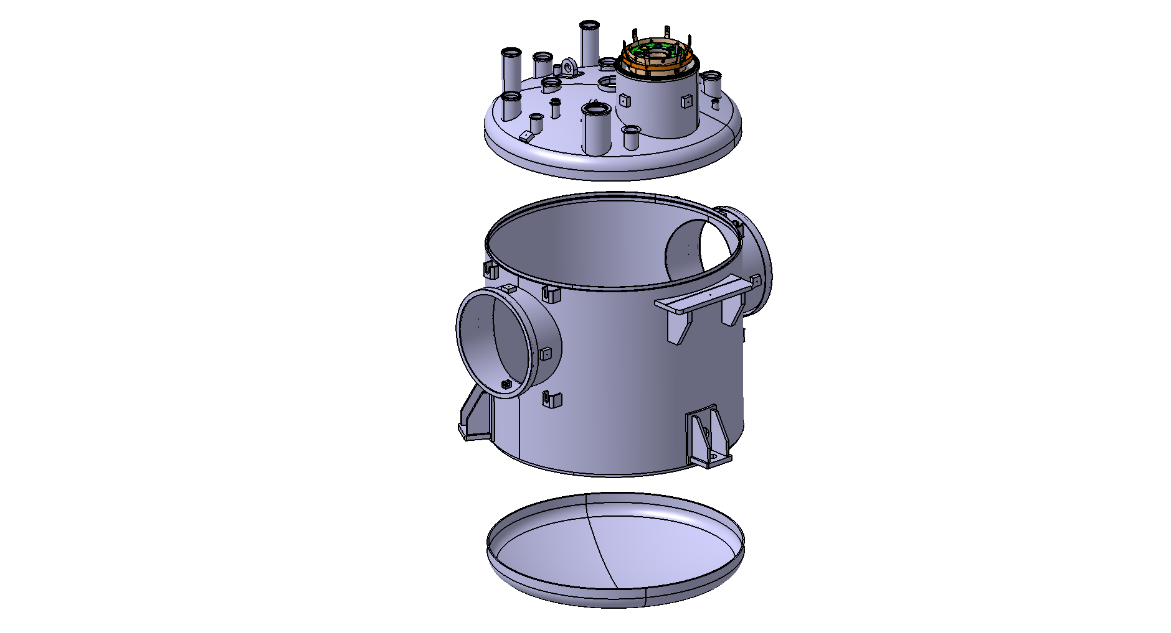
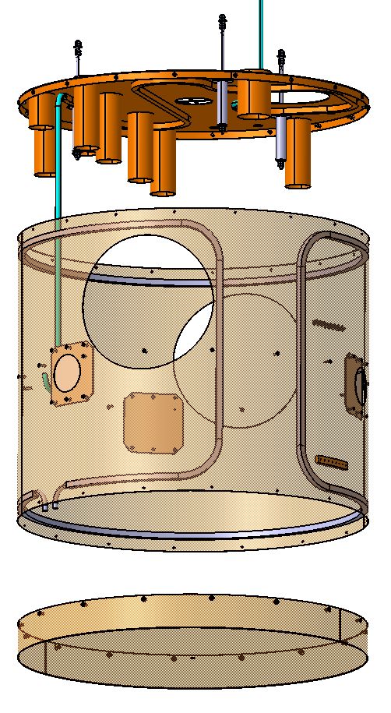
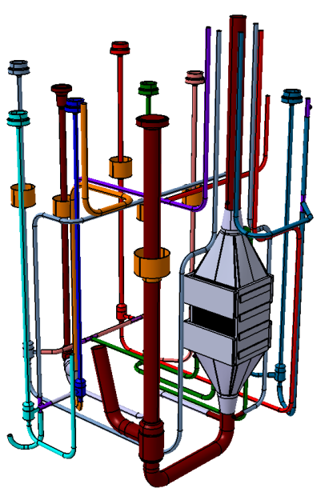
Valve box
Valve box main components without jumper (under progress)
Vacuum Vessel
(Ø1000-SS-260kg)
Thermal shield
(Cu-75kg)
CDL (SS+Cu+G10 – 45kg)
heat exchanger (SS-30kg)
Valve bodies and
Pipes (SS-25kg)
Estimated total weight
with jumper and
valves actuators: 550kg

Slide 7
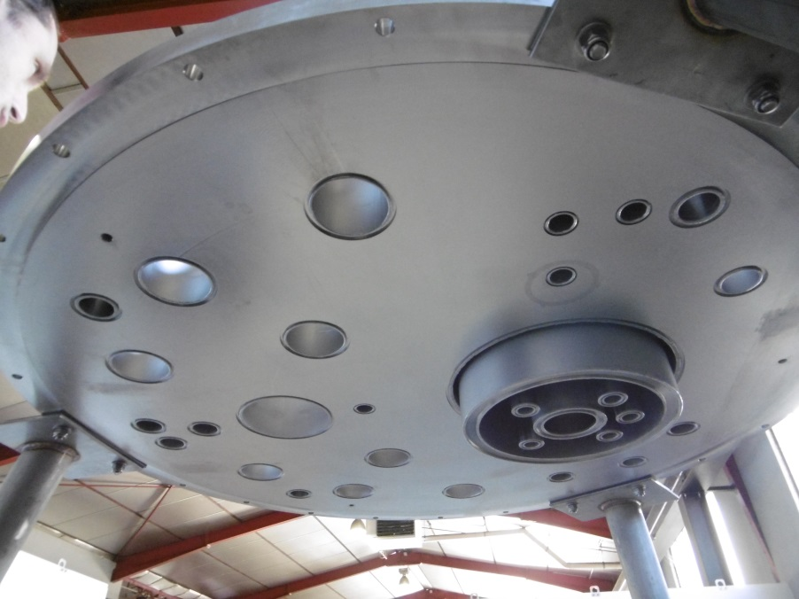
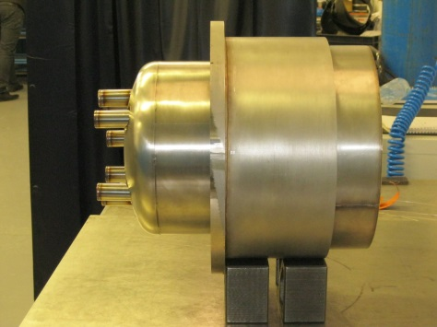
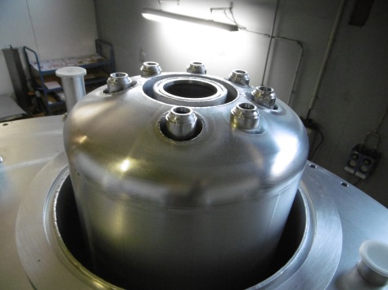
Valve box
Valve box assembly process
Prototype: top flat cover (120kg)
The Vacuum vessel top cover is
the most important component
Series: dish end version (55kg)
No fondamental changes for the
vacuum barrier
Vacuum barrier

Slide 8
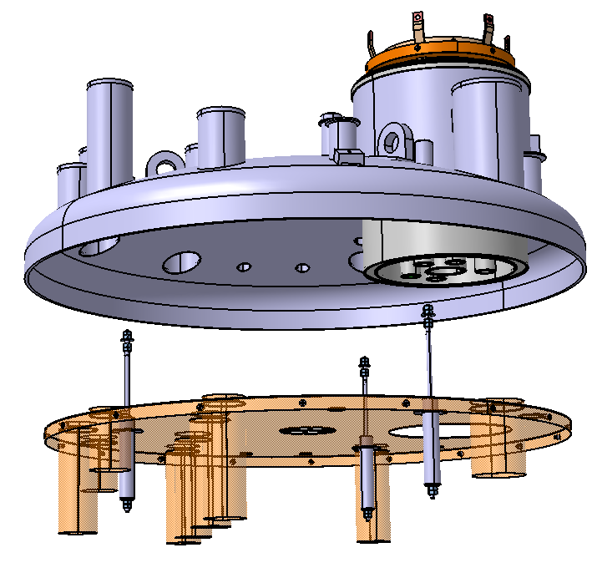
Valve box
Valve box assembly process – STEP 1
Vacuum vessel Top cover
30 layers of MLI
Thermal shield top plate
3 tie rods for adjusting and clamping (SS pipe)

Slide 9
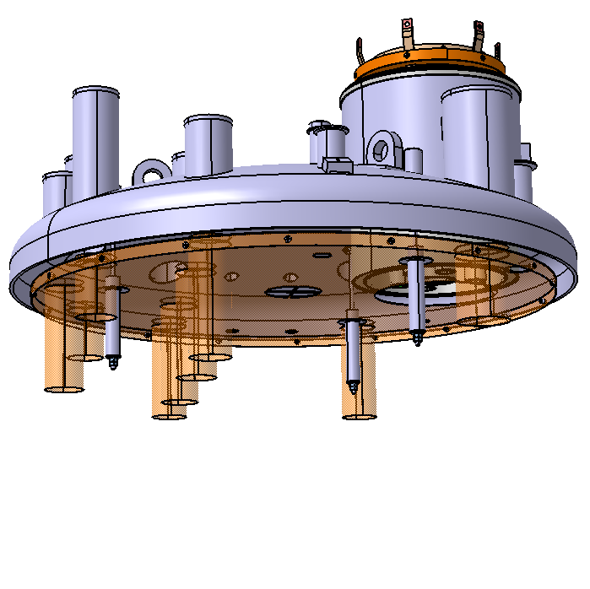
Valve box
Valve box assembly process – STEP 1
Top cover equipped

Slide 10
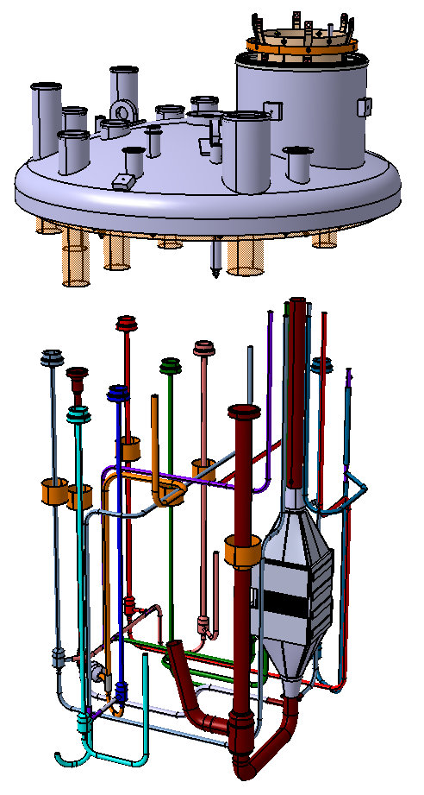
Valve box
Valve box assembly process – STEP 2
Top cover equipped
Insertion
Lines already welded
and leak tested
Cryo-valves bodies
No bellows
within the valve box
Heat exchanger
Internal pipes

Slide 11
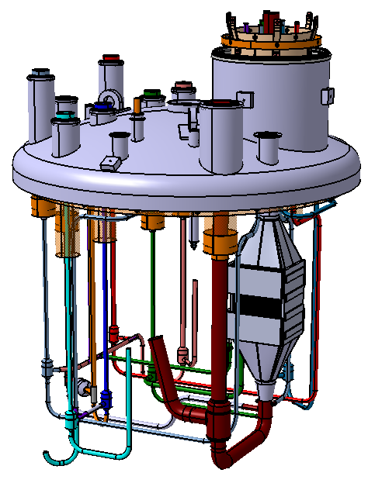
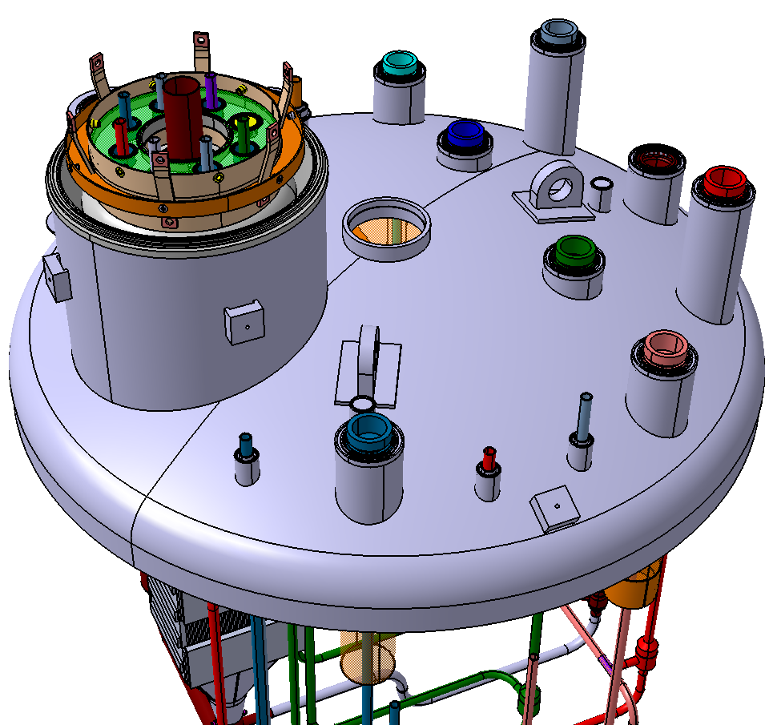
Valve box
Valve box assembly process – STEP 2
Welding of
valve bodies and pipe interfaces

Slide 12
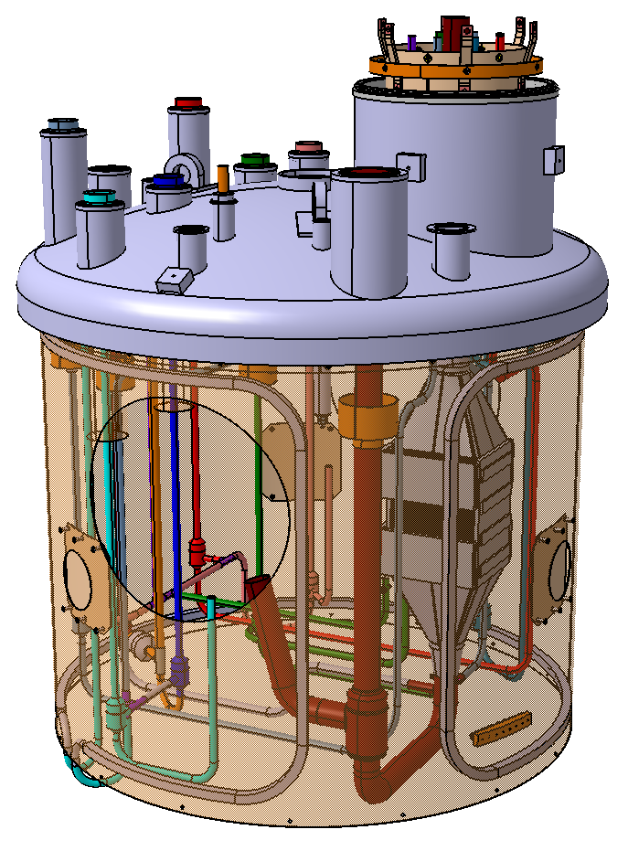
Valve box
Valve box assembly process – STEP 3
Assembly of the thermal shied
30 layers of MLI

Slide 13
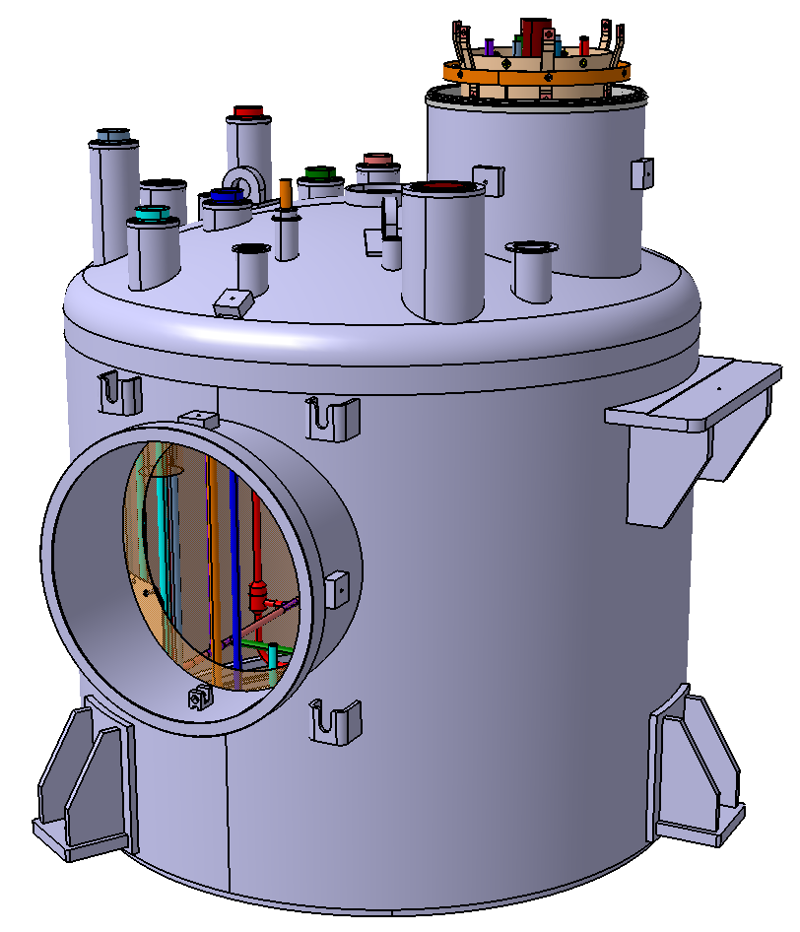
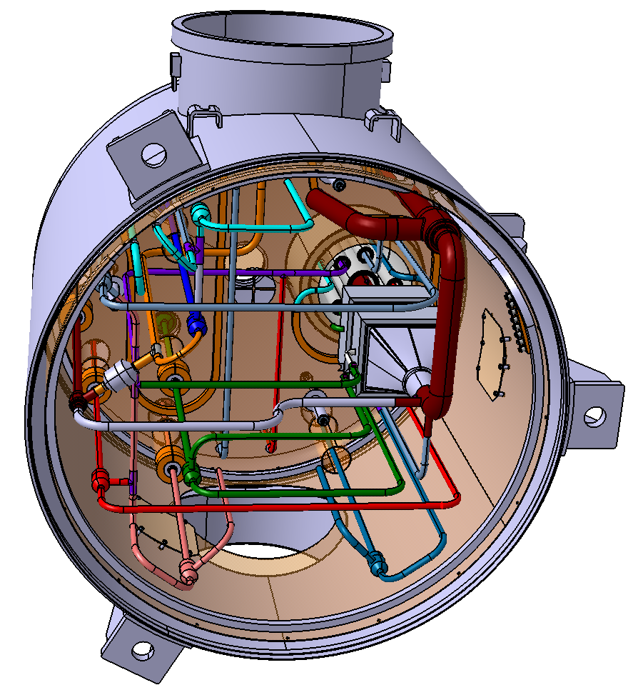
Valve box
Valve box assembly process – STEP 3
Assembly of the thermal shield
30 layers of MLI
Vacuum vessel body (welding)
Bottom view

Slide 14
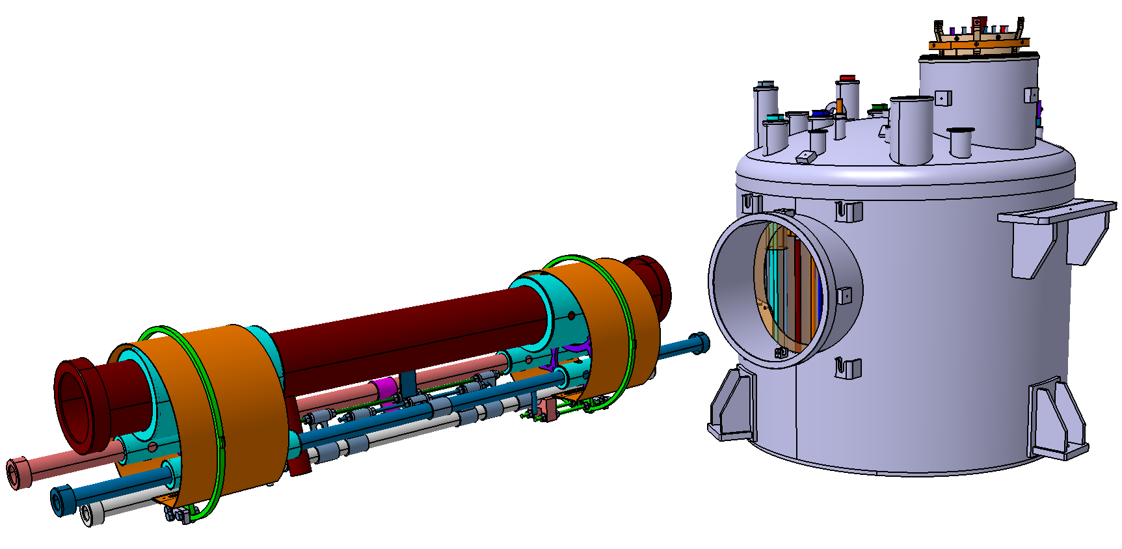
Valve box
Valve box assembly process – STEP 4
Insertion of the CDL
(main cryolines or headers)

Slide 15
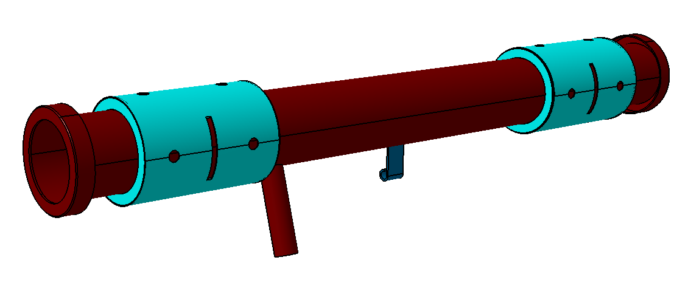
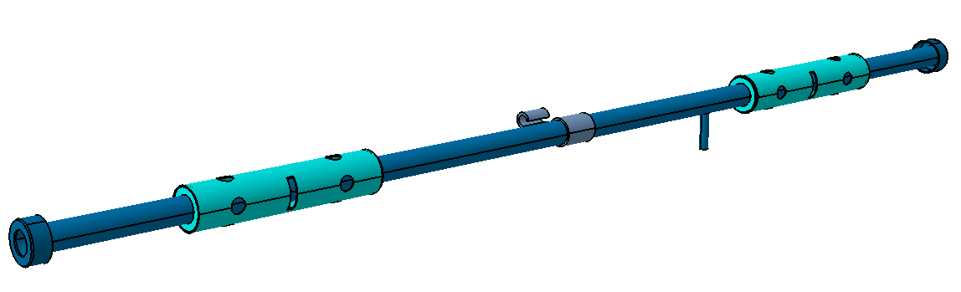
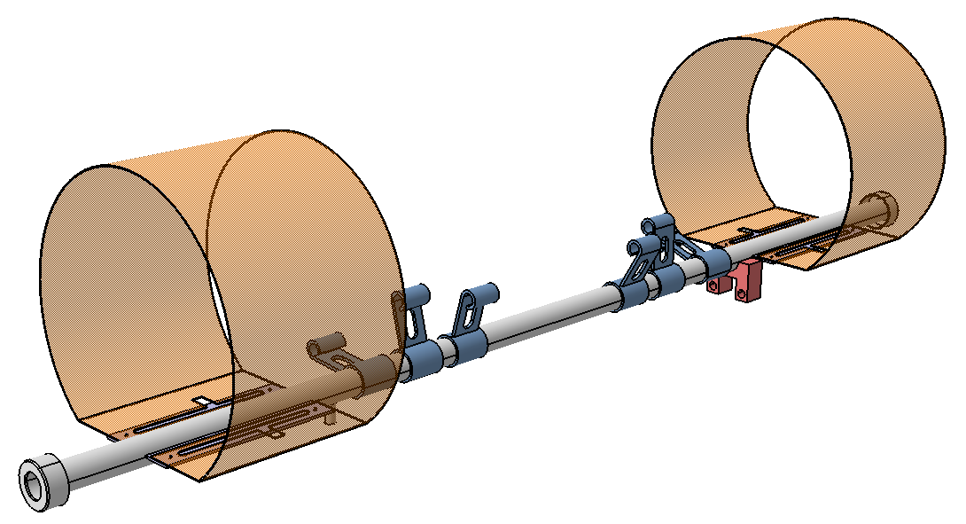
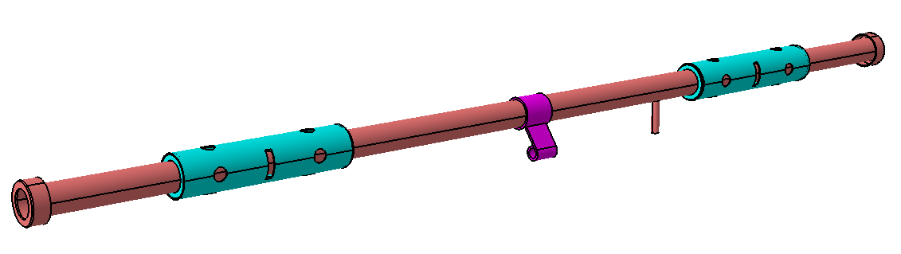
CDL
CDL Main components
Spacers
(G10 or G11)
VLP line
TS Supply line
He Supply line
Always no bellows
TS Return line

Slide 16
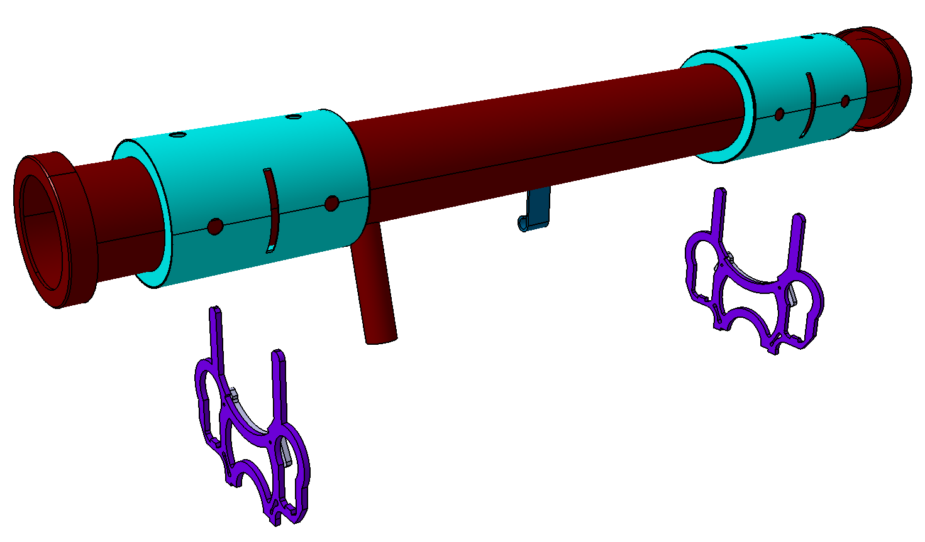
CDL
CDL assembly process – step 1
VLP line
VLP with inner spacers
Inner Spacers
(G10 or G11)

Slide 17
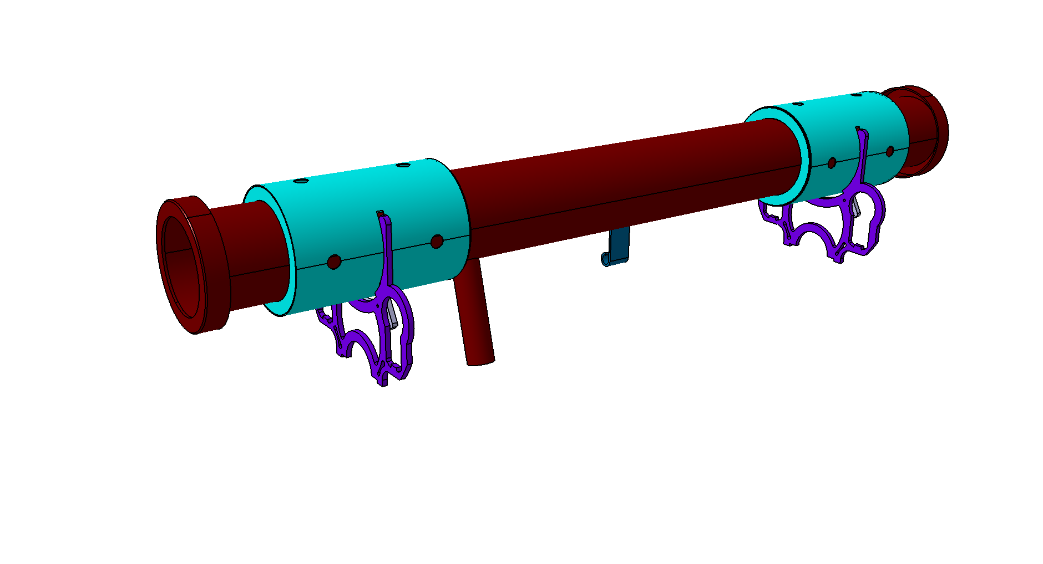
CDL
CDL assembly process – step 1
VLP with inner spacers

Slide 18
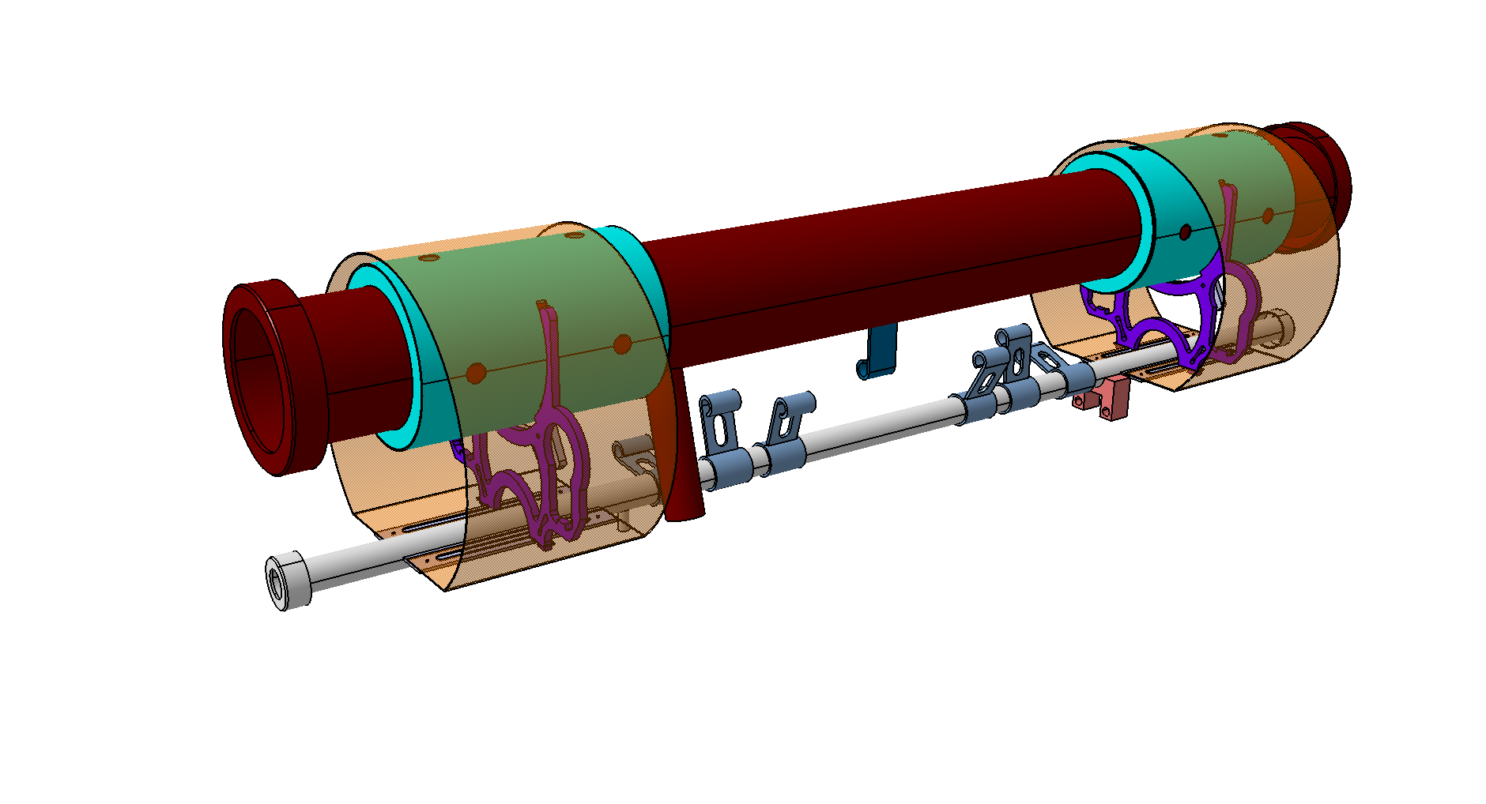
CDL
CDL assembly process – step 2
TS Return line
Fixation clips (not welded)
Thermal shield and TS return line placed around the VLP

Slide 19

CDL
CDL assembly process – step 2
VLP Fixed point
SS threaded rod
TS Return line
Welding of fixation clips
Assembly of the SS threaded rod

Slide 20
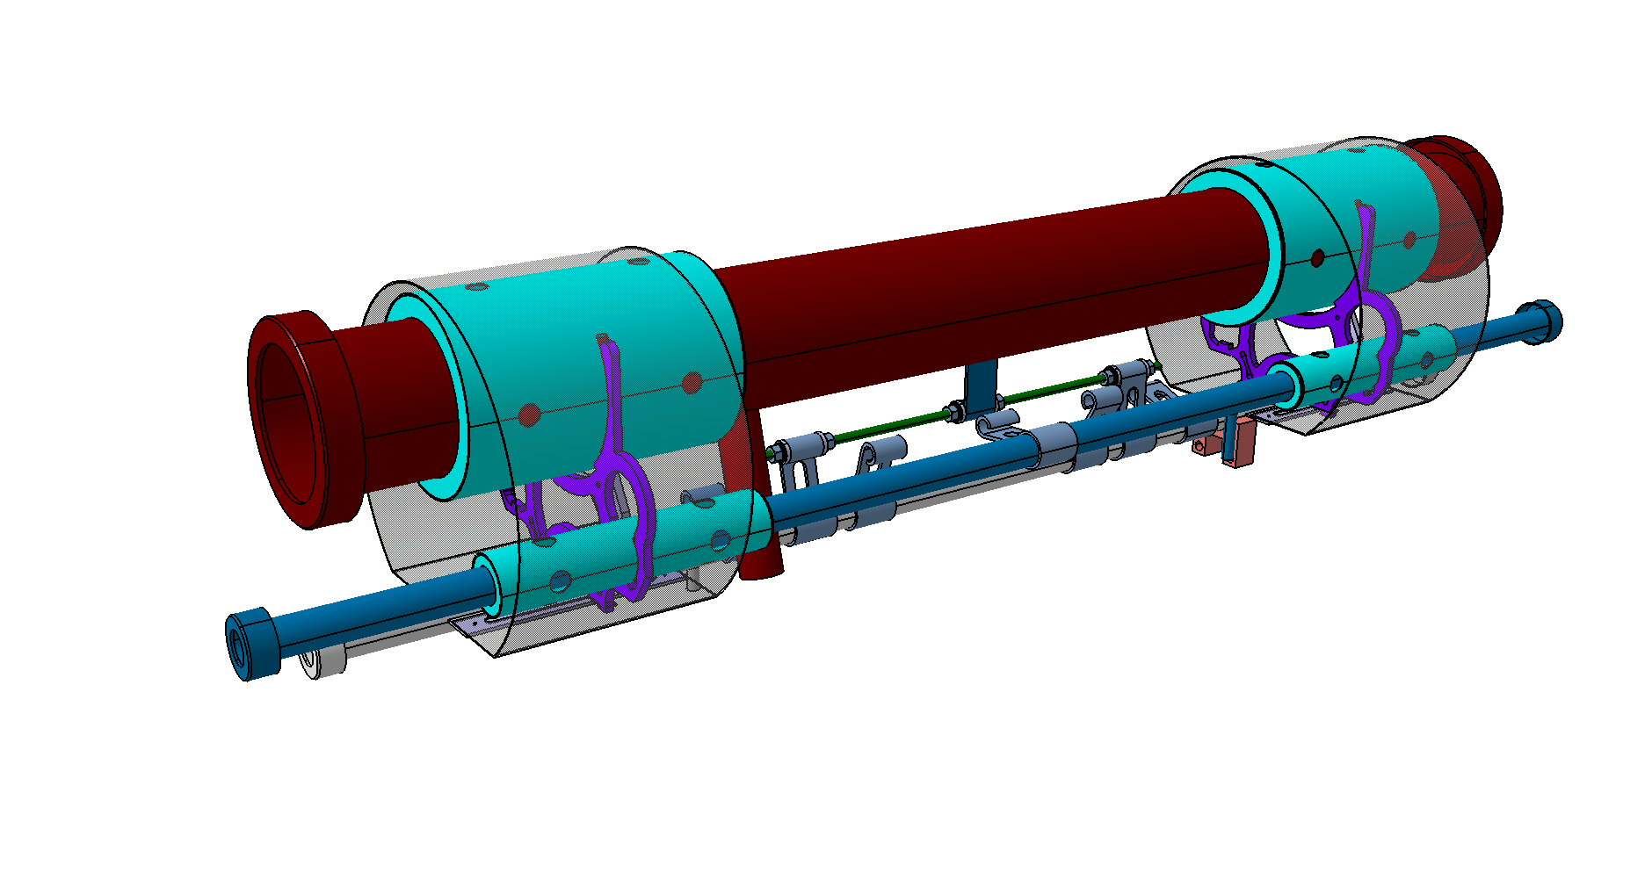
CDL
CDL assembly process – step 3
Insertion of the TS supply line

Slide 21
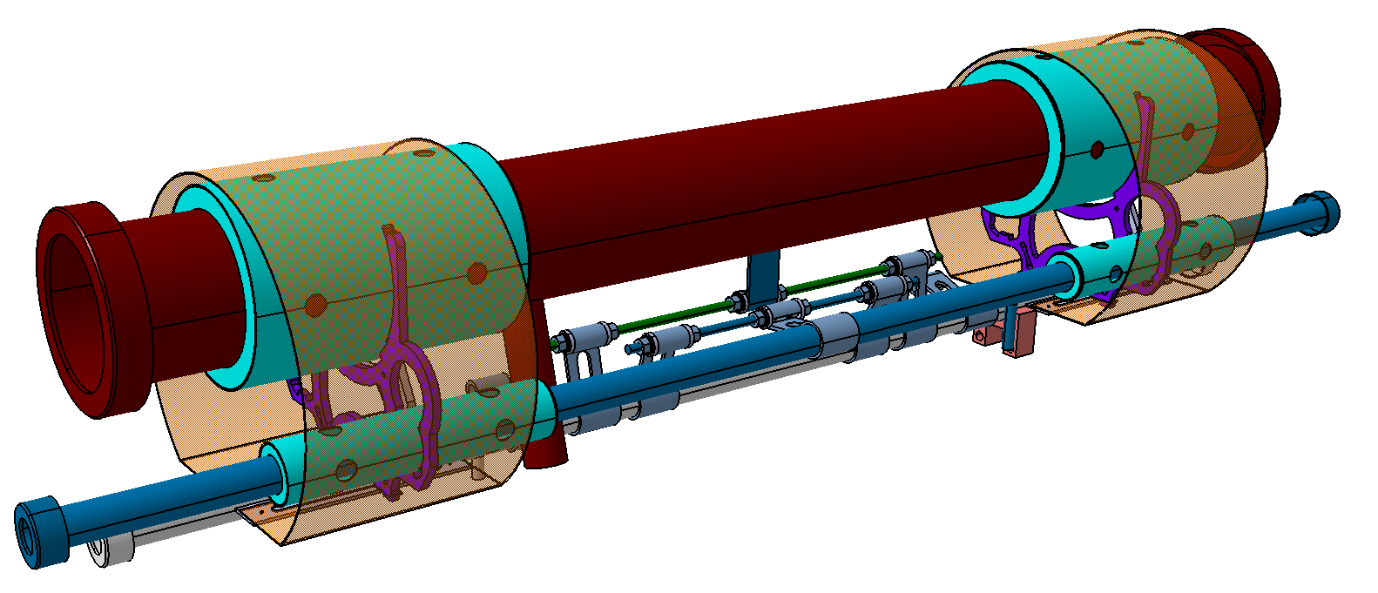
CDL
CDL assembly process – step 3
Thermal shield supply line fixed point
SS threaded rod
Welding of fixation clip
Insertion of the TS supply line

Slide 22
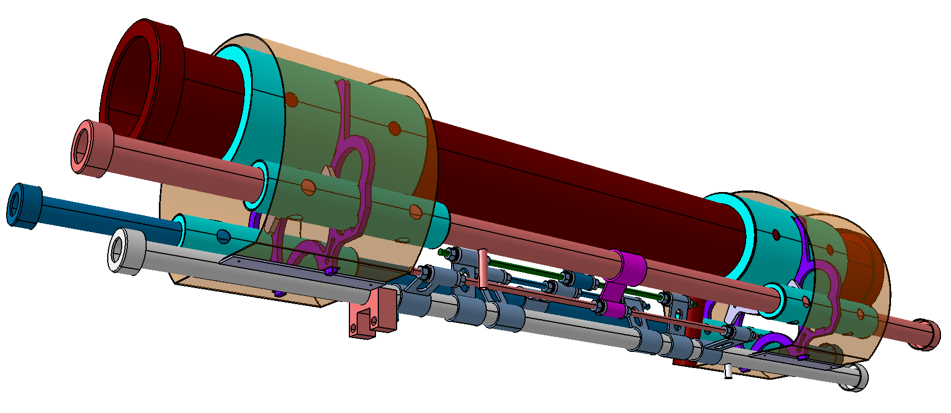
CDL
CDL assembly process – step 4
SS threaded rod
He supply line fixed point
Insertion of the He supply line
Welding of fixation clip

Slide 23
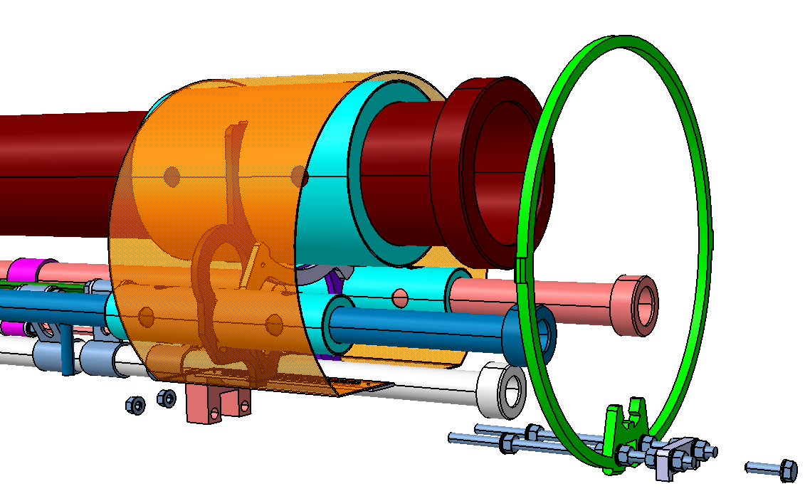
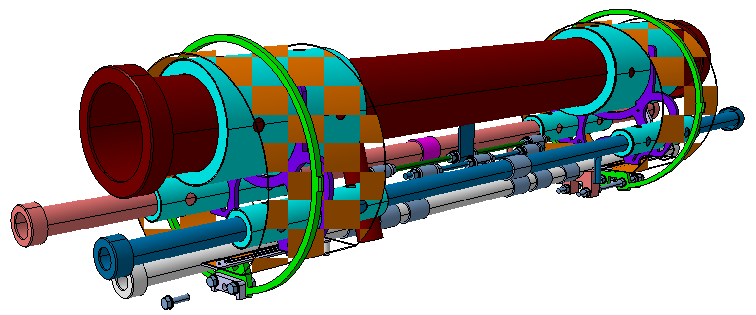
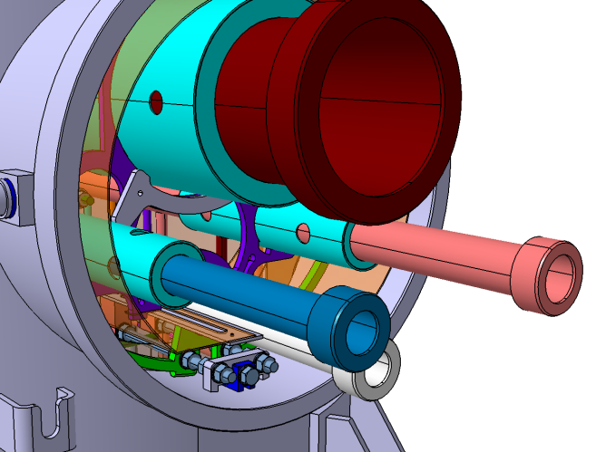
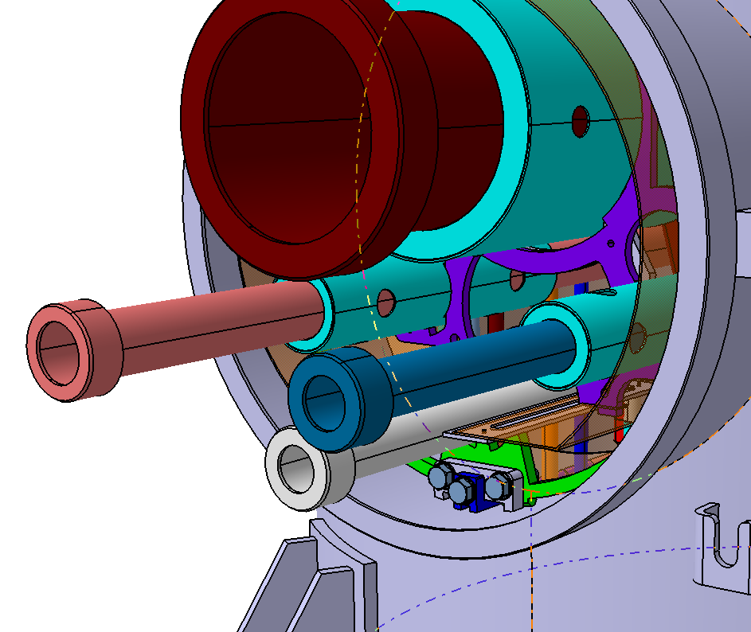
CDL
CDL assembly process – step 5
Assembly of the spacers
Fixed spacer functions:
- centring the cryolines
- fixed displacement along the x axis
Sliding spacer function:
- centring the cryolines

Slide 24
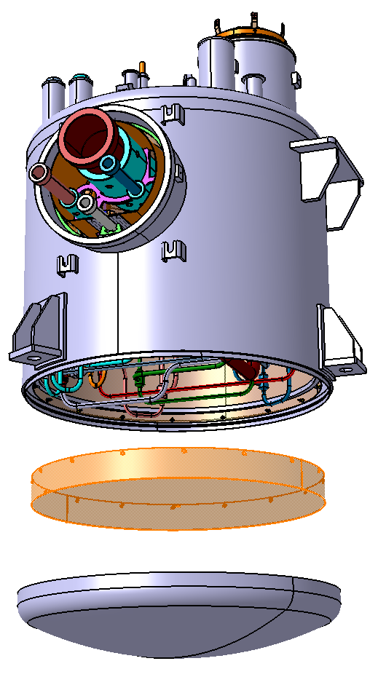
Valve box
Valve box assembly process – STEP 5
Leak test validation !
Assembly of the thermal shield bottom cover
30 layers of MLI
Closing of the vacuum vessel with
the bottom dish end (welding)

Slide 25
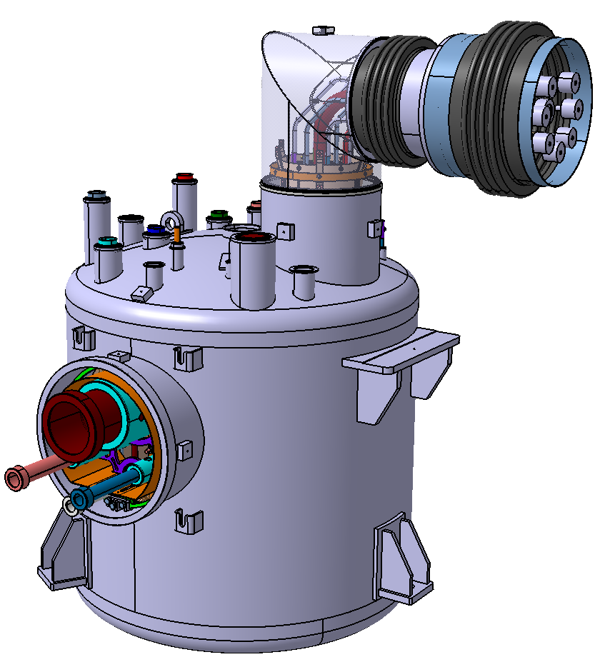
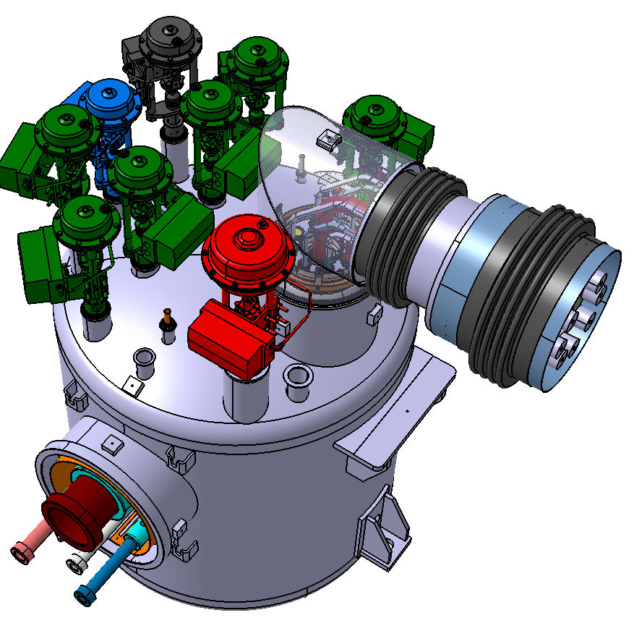
Valve box
Valve box assembly process – STEP 6
Assembly of the jumper, valves actuators…
Under progress

Slide 26
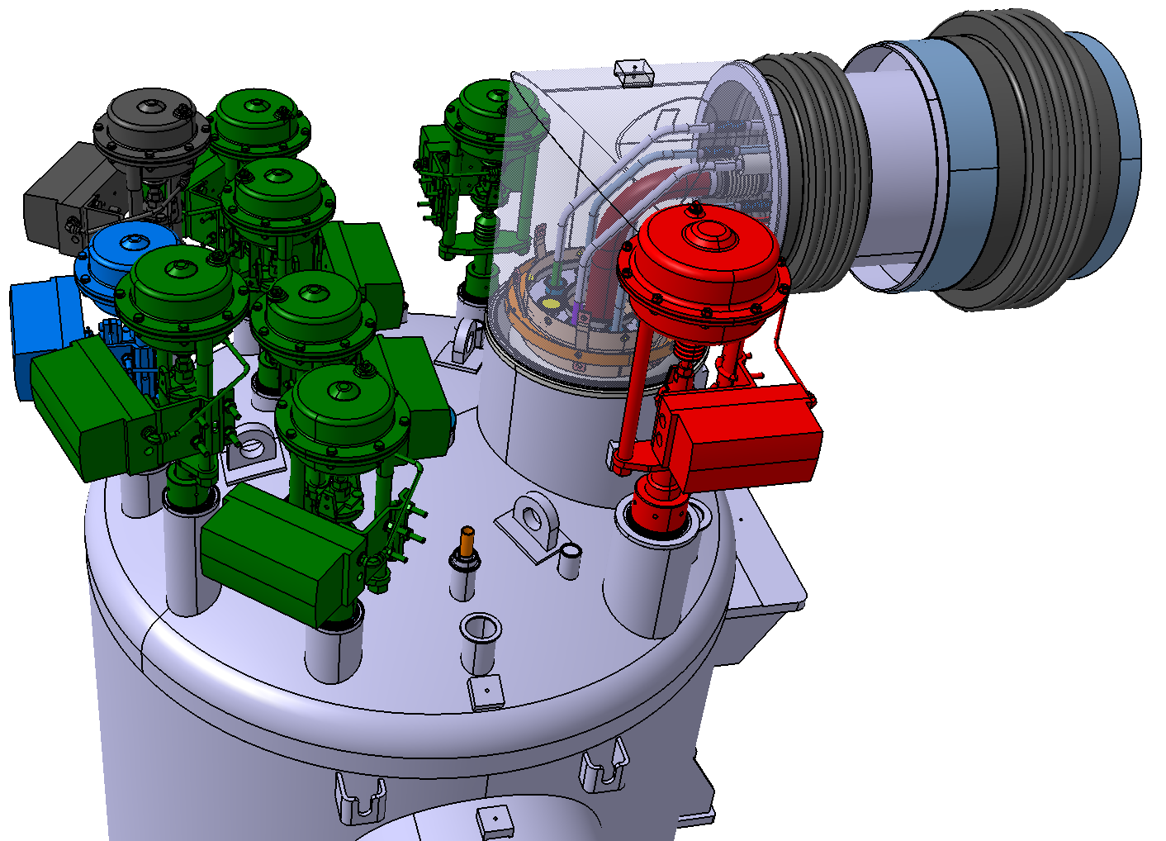
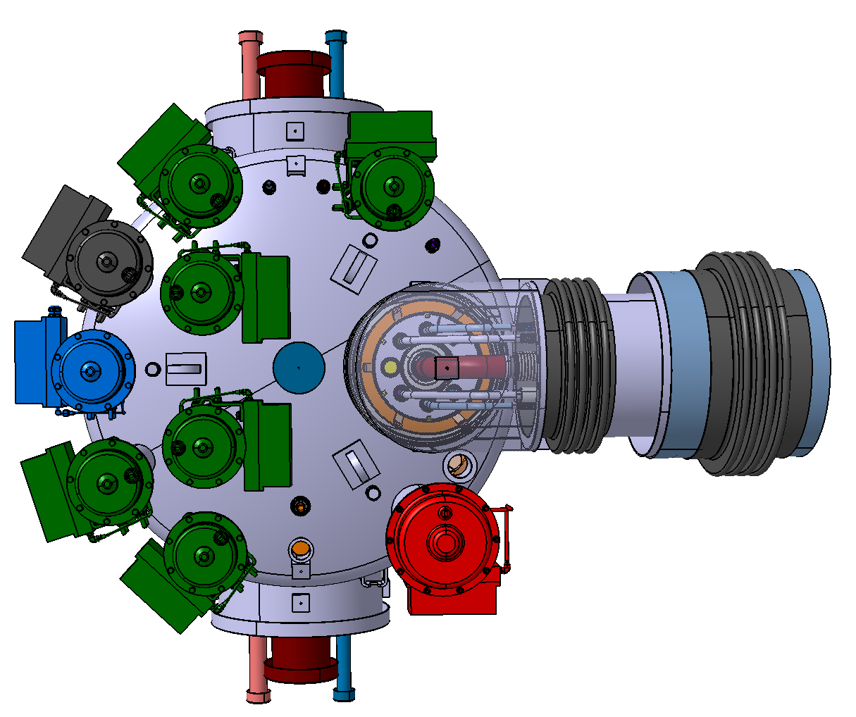
Valve box
Handling
3 lifting eyes at 120°
No risk of collision

Slide 27
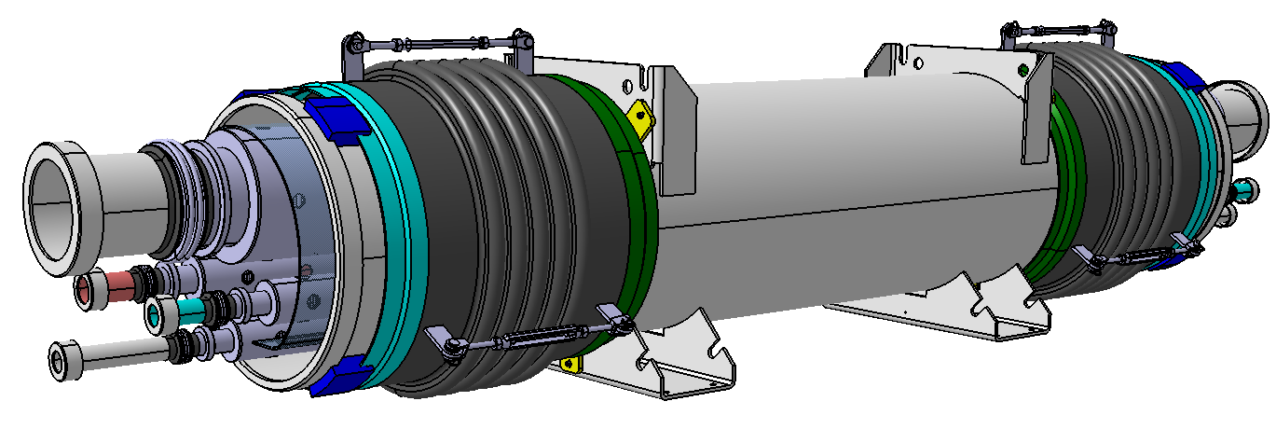
Headers unit
Part two : Design and manufacturing
of the headers units
Based on the Valve box CDL design principle

Slide 28
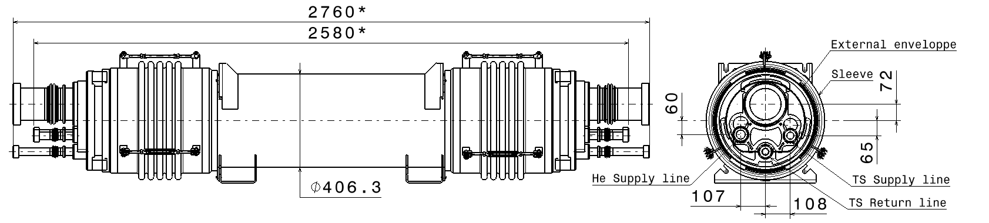
Headers unit
Overview
Sleeve
External envelope
Total weight : 280kg
VPL line
He Supply line
TS Supply line
TS Return line
* theoretical dimensions
Main dimensions

Slide 29
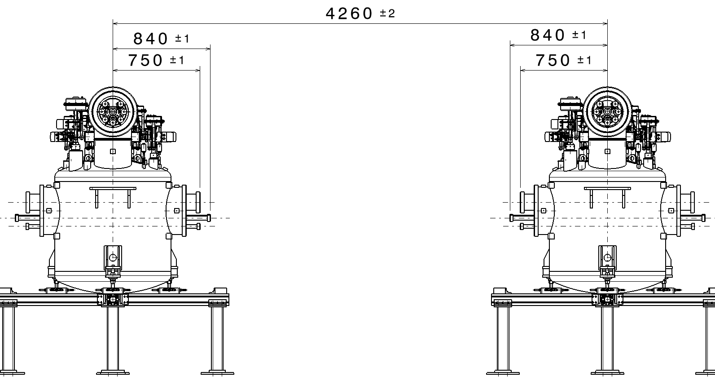
Headers unit
Detail of the Design: length of cryolines, bellows
Misalignment and mechanical defect:
±6mm and ±5° (X,Y,Z axis)
Gap for installation (10mm)
Thermal contraction (-13mm)
Bellows are needed
→ effective stroke : ± 22mm
Goal: free position at cold T°

Slide 30

Headers unit
Detail of the Design: cryoline
The four cryolines have the same functionality
symmetry
Guide against buckling
1x guided bellows: n (depending on diameter) corrugations to compensate
the thermal contraction, manufacturing and positioning defects (X axis)
1x bellows: 2 corrugations for angular defects compensation

Slide 31

Headers unit
Overview of the croylines assembly
Inner spacer
Spacer between TS
and external envelope
VLP line
The four cryolines are linked by the inner spacers
TS Supply line
Support function:
- centring inside the external envelope
( - free displacement along the X axis)
He Supply line
TS Return line (included the shield sheet)

Slide 32


Headers unit
Detail of the Design
External envelope
Cryolines : free displacement
along the X axis
2 Removable sleeves:
- Standard expension joint
- 3 tensioners
- Protection blocks

Slide 33

Headers unit
Detail of the design: support frame
support frame
Aluminium standard profiles
Total weight : 50kg
Storage, transport and support

Slide 34
Thank you for your attention
Special thanks to
Syvain Brault (chief designer)
Paxti Duthil (mechanical, thermal… calculations)
CSP12
28 Novembre 2014

