Slide 1
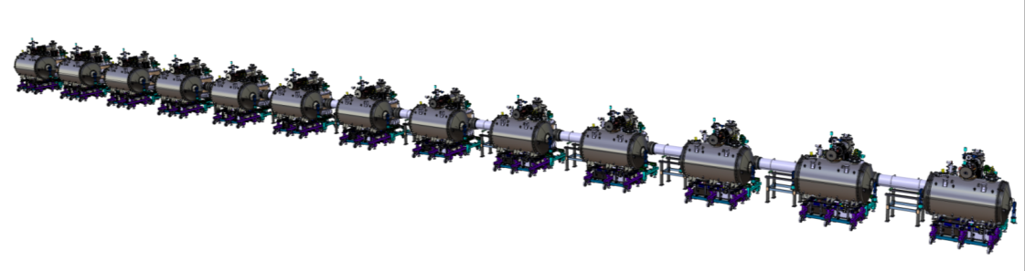
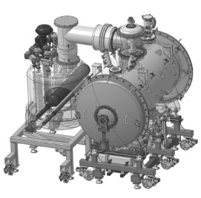
Work Unit 11.11.5.3 - AIK 11.2
CDR of the CDS-SL
Quality
April 19th 2017
ATRIUM - 183666

Slide 2
CONTENTS
QUALITY ASSURANCE
Documentation naming : CAD and project documents
Documentation storage : CAD and project documents
Documentation transfert to ESS
QUALITY CONTROL
PBS
Components identification
  Configuration management
WBS
  Life cycles
  Traceability
Non conformity management

Slide 3
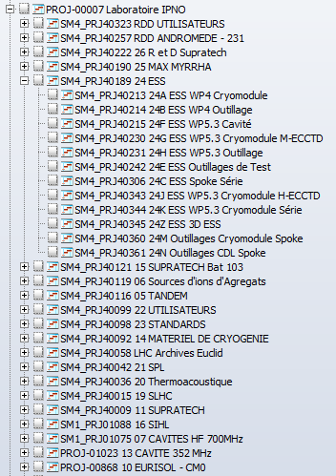

Documentation naming
CAD Documents
  3D and drawings identification
IPNO Design Office project number
Component
number
Detail
number
IPNO Design Office project numbers
used for ESS IK collaboration

Slide 4
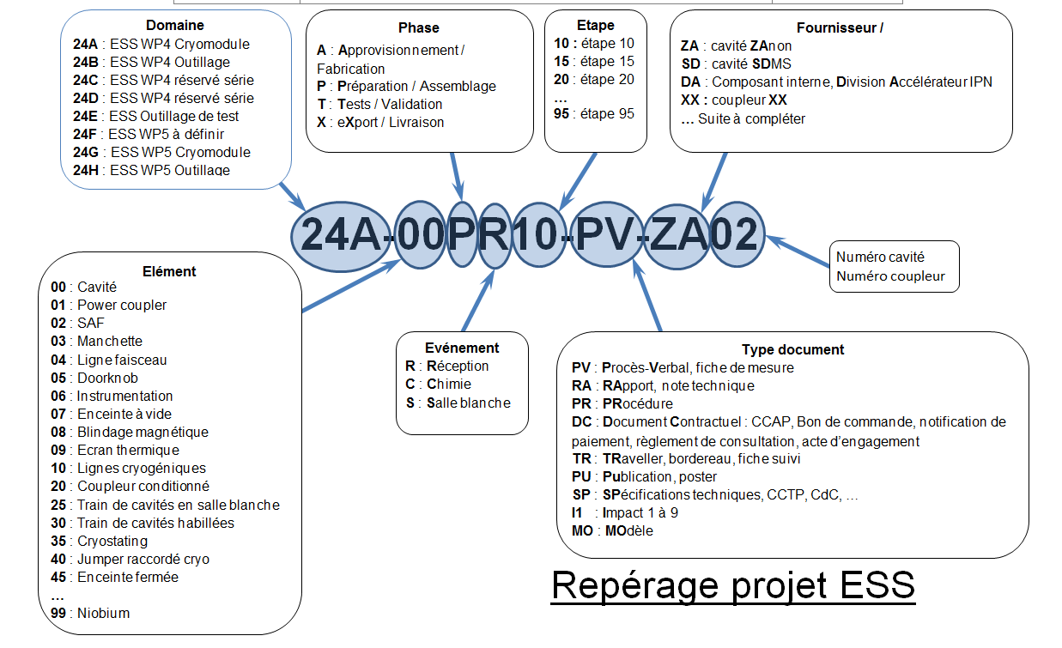
Documentation naming
Project Documents
  Used at the beginning of the project, ESS WP4 prototyping based on CAD identification
PQP §V

Slide 5
Documentation naming
Project Documents
  Changes now being discussed to simplify naming
➔ taking into account the experience feedback
➔ based on the Product Breakdown Structure
Domain
ESS-SPK or ESS-WP4 : ESS WP4 Serie Spoke Cryomodule
ESS-CDS or ESS-WP11 : ESS WP 11 CDS-SL ….
Component
CAV : Cavity
CRM or CM: Cryomodule
COU : Power coupler
CTS : Cold Tunning System (SAF) …
Cavity number
Coupler number
00 : generic
Title of the element / document
(ESS-)SPK-CAVxx-PRO(-PR10)-
Chemical procedure
Under discussion
Type document
PRO : Procedure
REQ : Requirement
TRP : Verification, test report
TRA : Traveller
FAT : Factory Acceptance Test
REV : Review report
NCR : Non conformity
CFG : assembly configuration
BOM : engineering bill of material
…
Evénement
R : Réception
C : Chimie ..
Etape
10 : étape 10
15 : étape 15
20 : étape 20
Phase
A : Approvisionnement / Fabrication
P : Préparation / Assemblage
T : Tests / Validation
X : eXport / Livraison
PQP §V

Slide 6
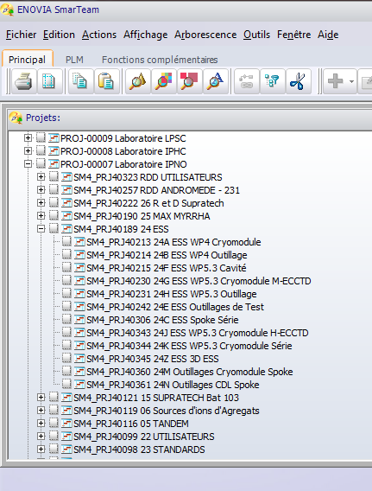
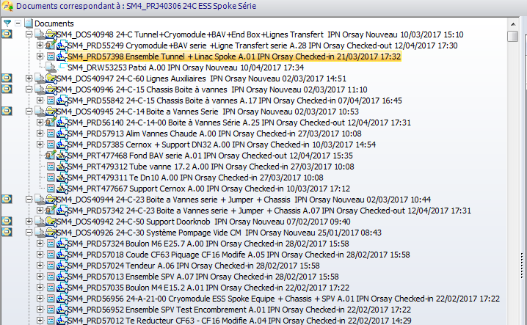
Documents storage
CAD Documents
  3D and drawings
  SMARTEAM, based on CATIA V5 R collaborative tool, is proposed by the IN2P3
  Used to share and storage the CAD documents

Slide 7
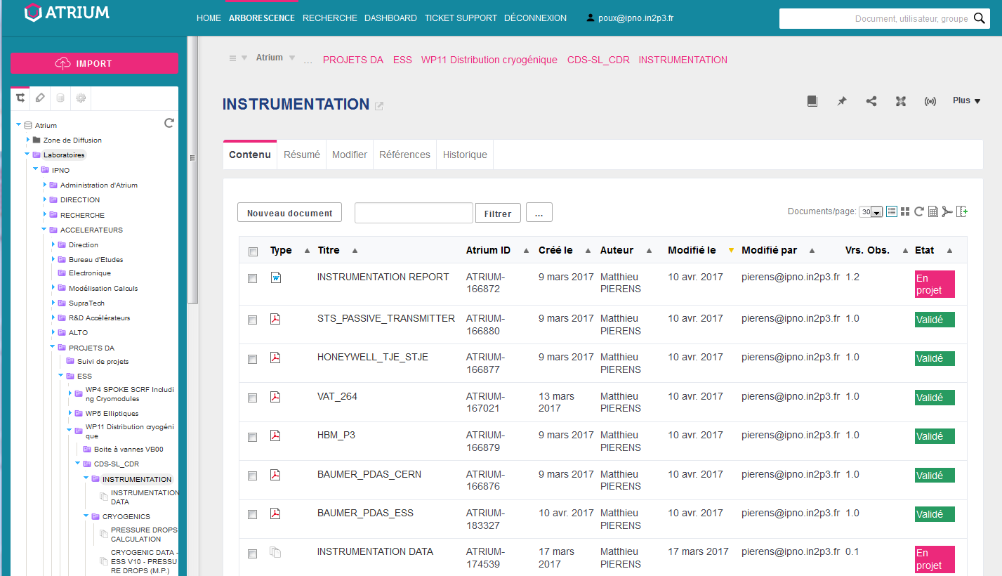

Documents storage
Project Documents
  Electronic Data Management Systeme : ATRIUM, collaborative tool proposed by the IN2P3 ➔ Used to share and storage the documents of the project:
  management
design and manufacturing drawings
project documents of the companies
assembly and test documents
PQP §VI

Slide 8
Documents transfer to ESS
From ATRIUM to CHESS
Transfer to ESS
EDMS partners documentation ATRIUM
Transfer to workstation areas
ESS – Partner areas
Documents and datas for use
ESS – Workstation areas
Transfer to partner areas
ESS - DROPBOX CHESS
PBS structure
Transfer will be up-loaded in a semi-automatical way using naming convention (ESS/partners) based on PBS structure
More discussions and tests to be done
PQP §VI

Slide 9
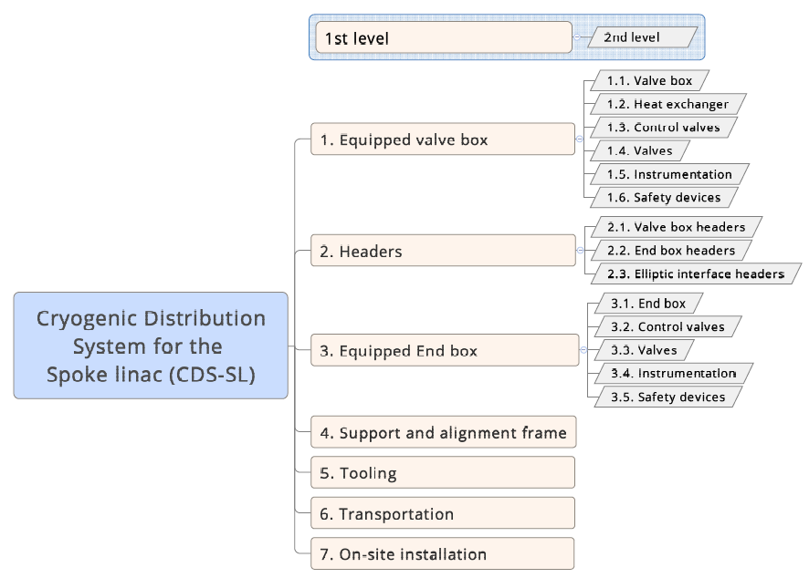
PBS
The Product Breakdown Structure
  => Deconstruction of the product
  To identify components according to the naming convention
  To identify the reference component drawing
  To identify the delivered components
  To classify the documents
PQP §XXIII.2

Slide 10
PBS - Components naming
Similar to Documents naming
  Improvements in discussion
➔ to take into account the experience feedback
➔ based on the Product Breakdown Structure
Domain
ESS-SPK or ESS-WP4 : ESS WP4 Series Spoke cryomodule
ESS-CDS or ESS-WP11 : ESS WP 11 CDS-SL ….
Element *
CAV : Cavity
CRM or CM: Cryomodule
COU : Power coupler
CTS : Cold Tunning System (SAF) …
Cavity or coupleur number
00 : reference number
Or serial supplier number
Under discussion
(ESS-)SPK-CAVxx..
*Element in relation with ESS naming convention

Slide 11
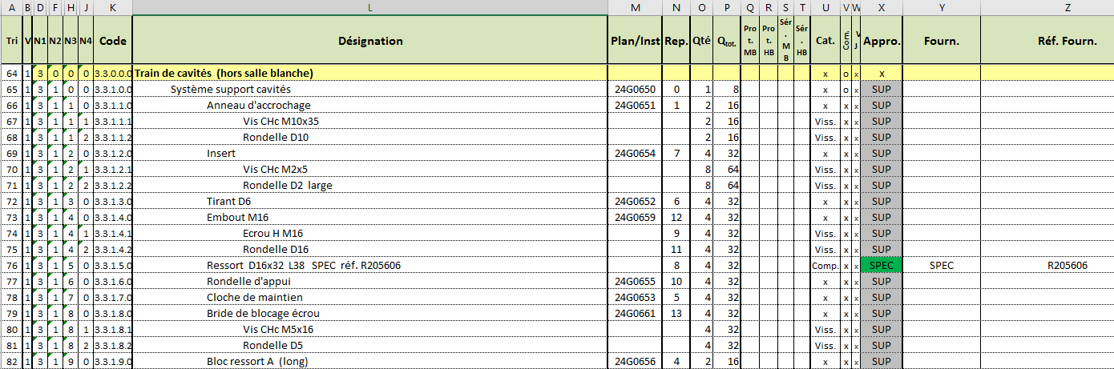
PBS – Configuration management
To identify all the product configuration information
Will be similar to the one used by G. Olivier for ESS-WP5
PQP §XIII

Slide 12
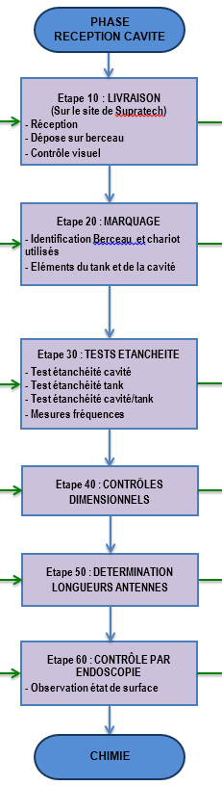
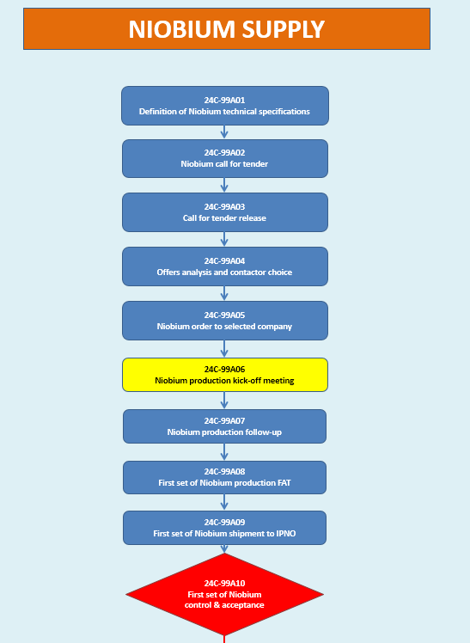
Work Breakdown Structure
Elaborated from all components life cycles
  For WP4: defined by all the team: managers and the assembling and testing team
To be release
Example of a life cycle
for cavity prototype
PQP §XII

Slide 13
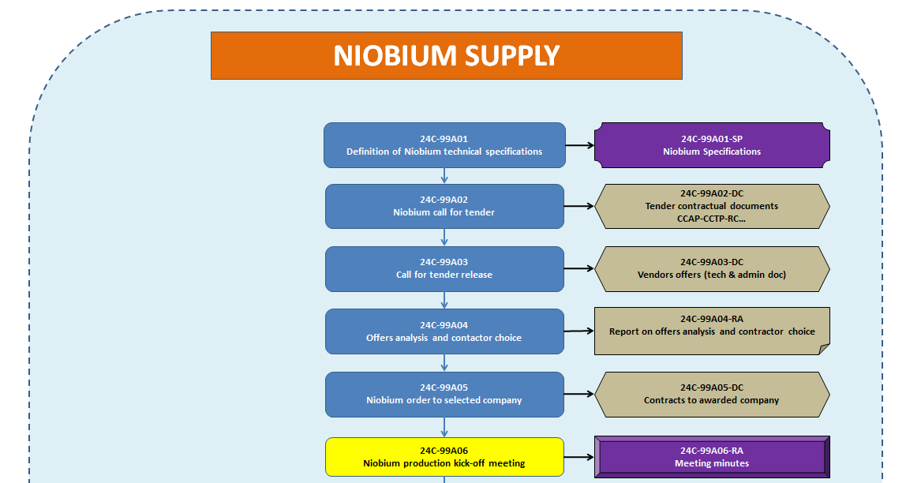
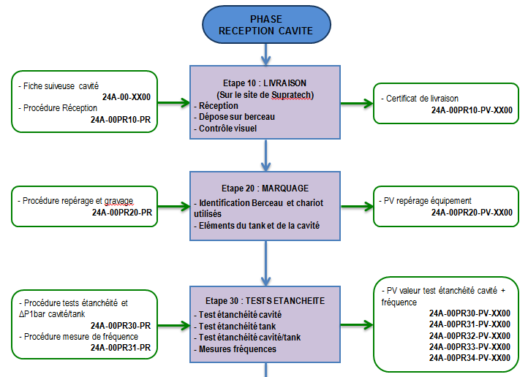
Traceability
Life cycles are the basis of the traceability documentation
  Defines all the needed input and output documents
To be released
Documents
PQP §XIII

Slide 14
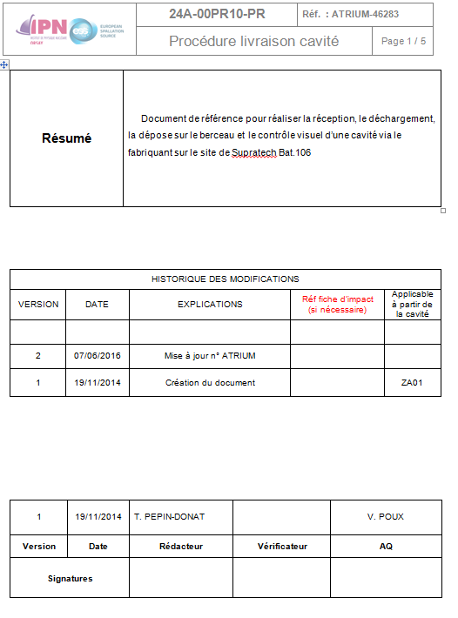
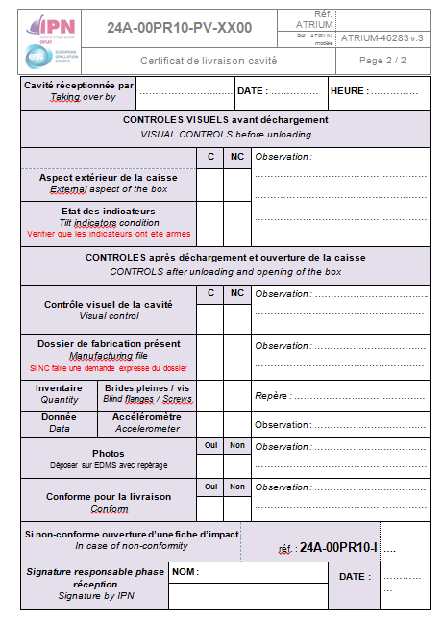
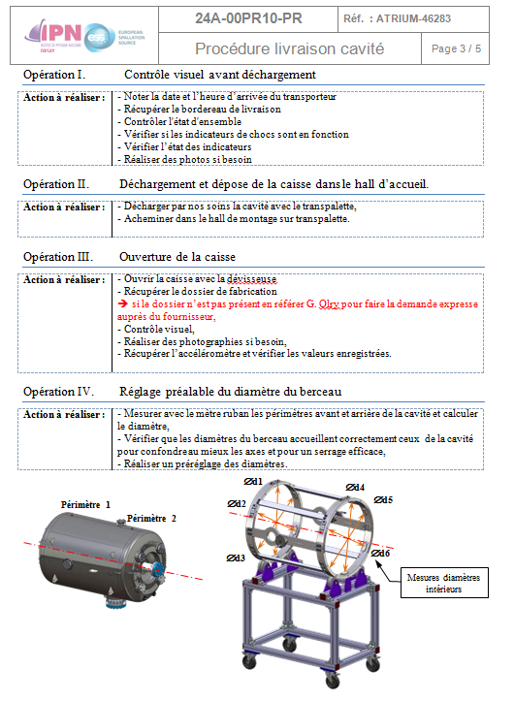
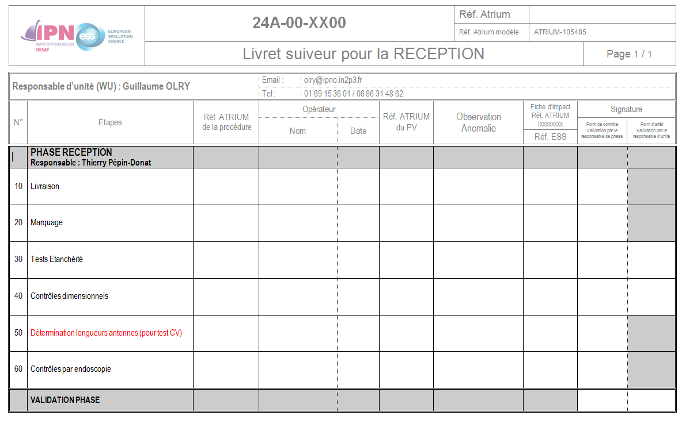
Traceability
Life cycles are the base of the traceability documents
  Defines all the needed input and output documents
Example of a procedure
for cavity prototype
Example of a acceptance record
for cavity prototype
Traveller booklet for the acceptance
of a cavity prototype
PQP §XIII

Slide 15
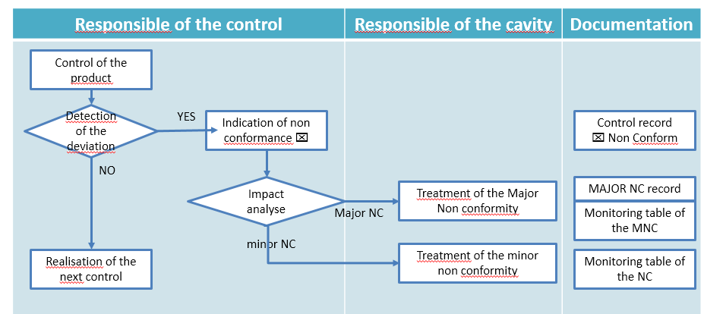
Non conformance management
Non conformance process
PQP §XIV

Slide 16
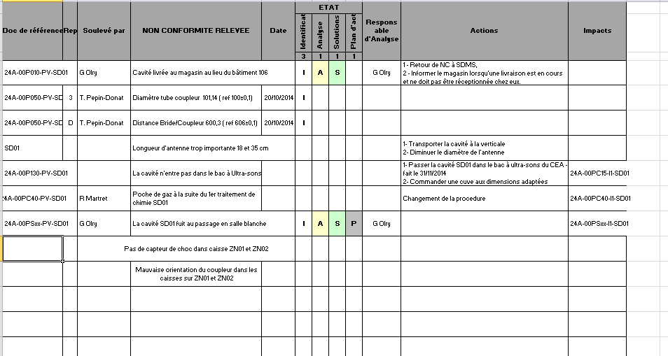
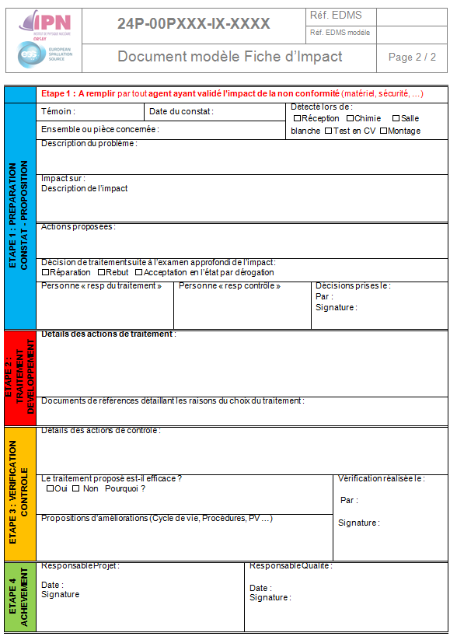
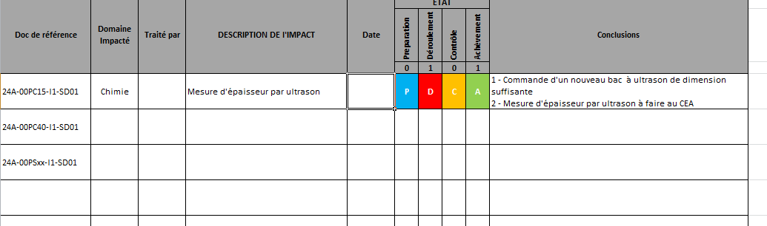
ESS MACHINE
Non conformity
Monitoring table of all the NC
Major NC
Monitoring table of Major NC
Traveller of Major NC

Slide 17
Thank you for your attention
Special thanks to
?
CSP12
28 Novembre 2014

